Slide 1
SOCIAL HISTORY OF JAPANESE POPULAR CULTURE
THE CULTURE OF MEIJI
(1868-1912)

Slide 2
BASIC CHRONOLOGY
1868: The Meiji Restoration
1873: "civilization and enlightenment" (bunmei kaika)
1876: Samurais are prohibited from wearing swords
1877: The “last samurai” revolt of Saigō Takamori
1877: Tokyo University opens in Hongō
1889: New Constitution is drafted
1990: New Diet opens in Nagatachō
1894: Beginning of The Sino-Japanese War
1905: Beginning of The Russo-Japanese War
1910: Colonialization of Korea

Slide 3
GENERAL BACKGROUND: SOCIETY
The age of modern imperialism and building of Empire
Returning to the Emperor system, but triggering modernisation campaigns
Implementing the policy of “rich country and strong military” (fukoku kyōhei)
Adapting British parliamentary system, Prussian military, and German constitution (Ōkuma Shigenobu, Itō Hirobumi)
Embracing the West (Fukuzawa Yukichi and bunmei kaika) versus expelling the barbarians (Tokutomi Sohō and sonnō jōi)
Samuraization of society (samurais enter the Tokyo University, later moving to high civil service jobs)

Slide 4
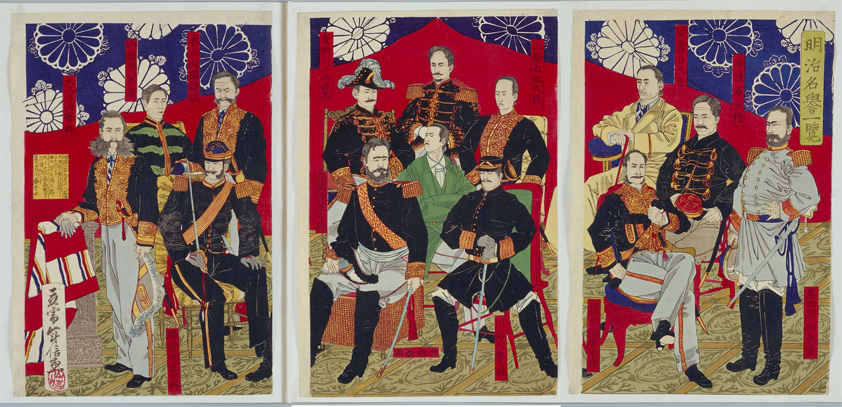
National assembly (genrōin) in early Meiji (1875)

Slide 5
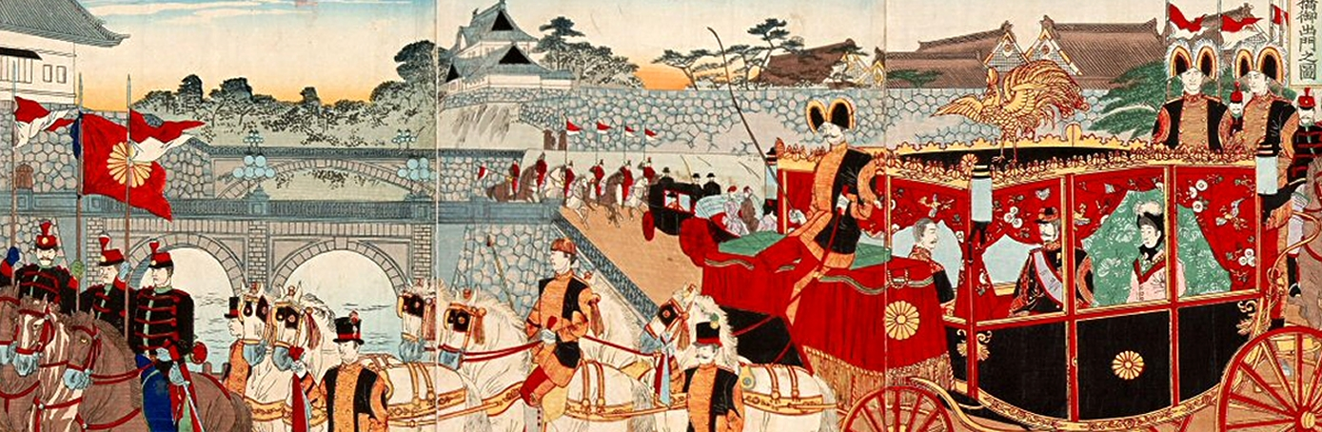
Meiji Japan: re-modelling the capital

Slide 6
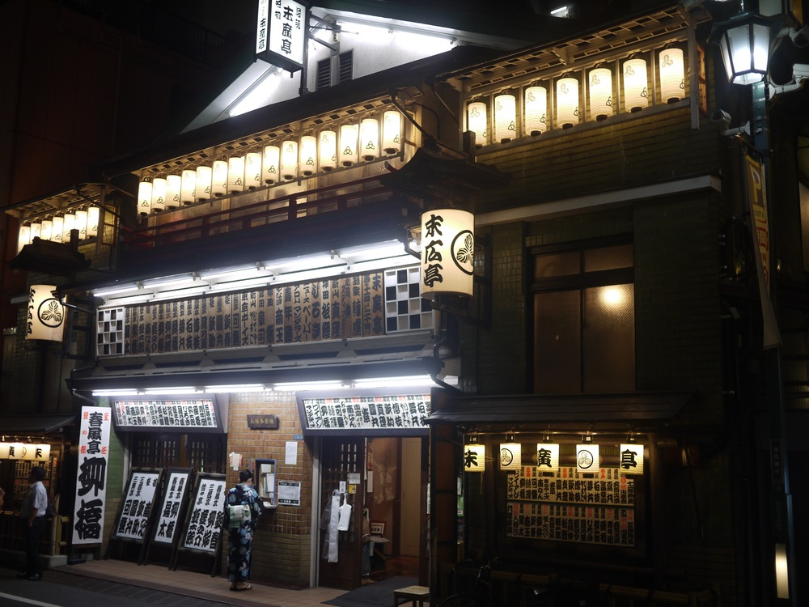
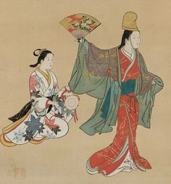
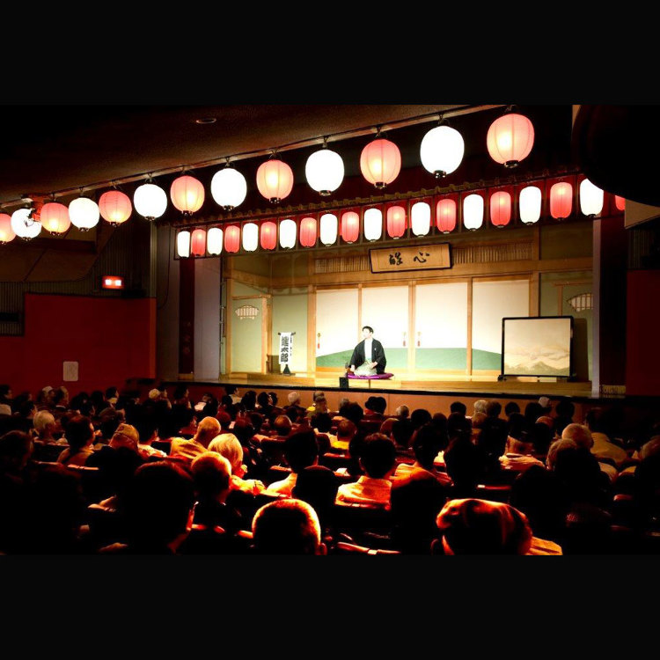
GENERAL BACKGROUND: POPULAR CULTURE
Best elements of Edo culture were now deemed outdated/vulgar, but some old media survived
  yose (variety halls) and misemono (open-air street shows­)
  Woodblock prints (ukiyoe, colored nishikie) as essential visual records
  rakugo (comic story telling) and manzai (comedialogues)

Slide 7
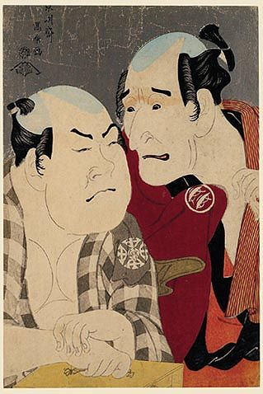
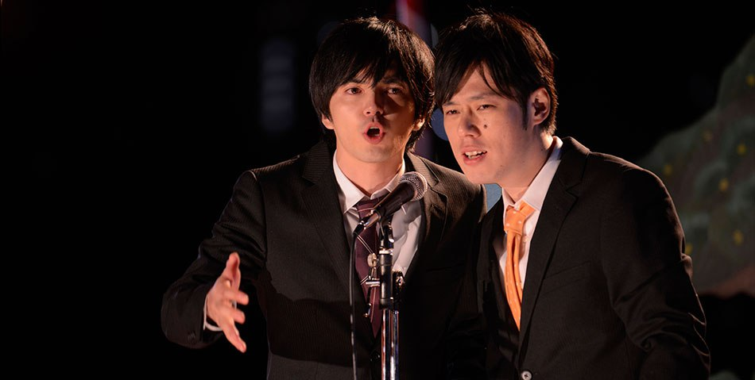
Manzai

Slide 8
COMMERCIALIZATION OF CULTURE
Some old media converged with the new ones (newspapers, cartoons, magazines)
Traditional arts were (com)modified with the entry of foreign and Japanese capital
Active participation of the masses was lost, commercial side of the arts developed
Creating modern citizenry, fostering national integration, censoring popular culture
The commercialized popular culture simultaneously gaining on political significance

Slide 9
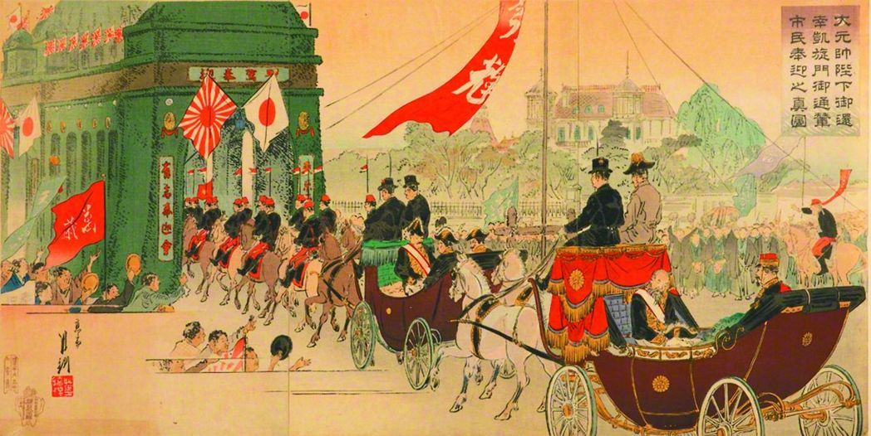
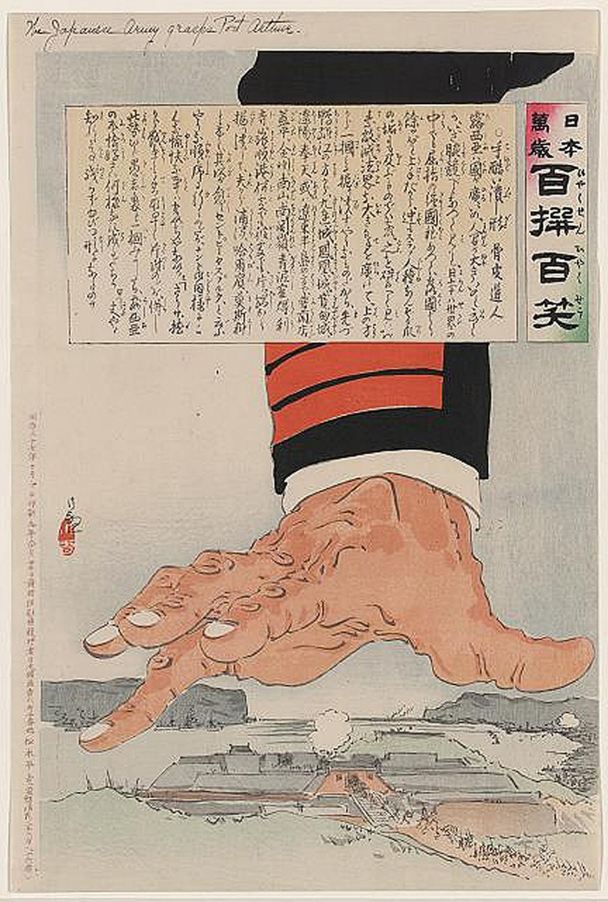
Popular media as propaganda tool (1894-5, 1904-5)

Slide 10
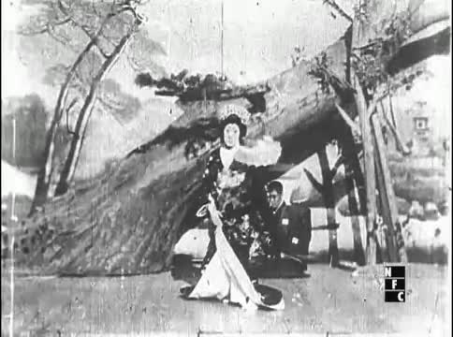
FILM & MUSIC
first Japanese film: a scene from kabuki play Momijigari (1899)

Slide 11
FILM & MUSIC
Film
  1903: first permanent movie house (“Electric Theater”) built in Akasaka
  1904-1905: first Japanese “blockbusters” during the Russo-Japanese War
  1910s-1920s: film companies Nikkatsu and Shōchiku established
Music
  More pragmatic than artistic
  Western music essential to the ceremonial style of governance
  “national music” (kokugaku) inculcates morality and nationalist sentiments

Slide 12
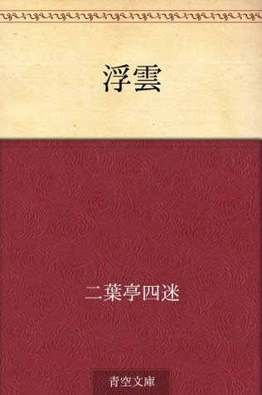
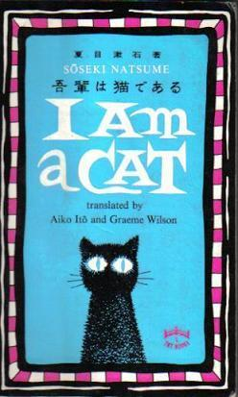
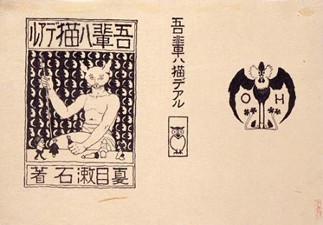
NATIONAL LITERATURE
1887: Futabatei Shimei: “Drifting cloud” (Ukigumo)
  first modern Japanese novel
  psychological exploration of characters, the role of anomie (cf. Durkheim)
1900: Japan's publishing industry undergoes an unprecedented boom
1900s: wave of translation of European literature (Nietzsche popular)
1905: Natsume Sōseki: “I am a cat” (Wagahai wa neko de aru)
  becomes very popular
  domestic cat reflecting the modernized Meiji society in “ich-form” (shisōsetsu)
1906-10 Japanese naturalism becomes national literacy movement
Others: Shimazaki Tōson, Mori Ōgai, Akutagawa Ryūnosuke

Slide 13
SOCIAL HISTORY OF JAPANESE POPULAR CULTURE
THE CULTURE OF TAISHŌ
(1912-1926)

Slide 14
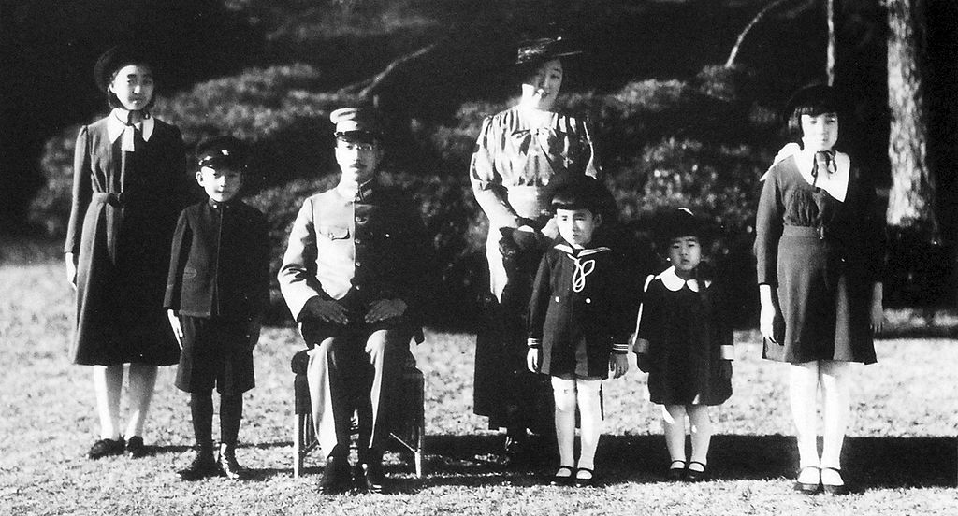
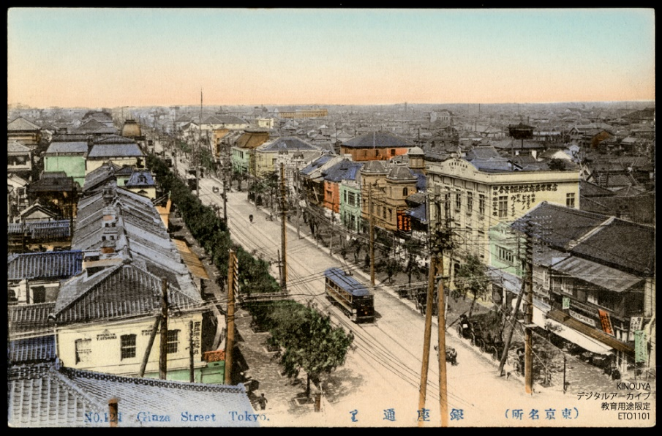
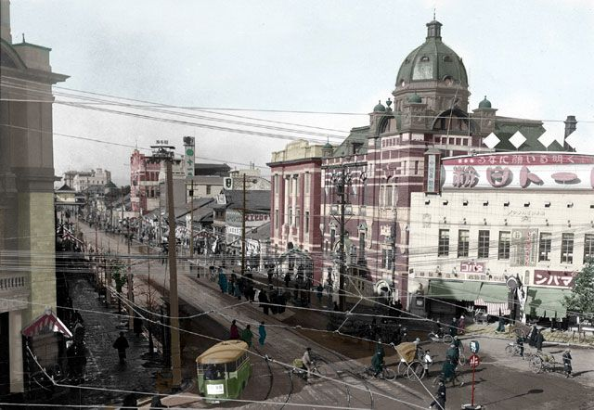
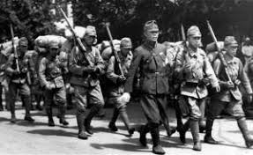
GENERAL BACKGROUND: SOCIETY
1912: the new emperor Taishō, 1914: entry of Japan into WW I.
Facilitating transition from agricultural society to an industrial one
Implementing imperialism (teikokushugi) and national policy (kokusaku)
Paternalism toward Korea, contempt for China, emulation of the West
Emergence of individualism, consumerism and internationalism

Slide 15
GENERAL BACKGROUND: CULTURE
Cultural imperialism: exporting culture and language to colonies and peripheries
The rise and massification of the Japanese media during wartime
Japanese “pure literature” (junbungaku)
  Contemplating contemporary social issues
  Reflecting incompleteness of Japanese modernity (e.g. Sōseki’s Sanshirō)
  Vague insecurity about the future (Akutagawa’s bonyari shita fuan)
1920s: the rise of new pop-cultural forms
  Cosmopolitan culture of “Modern Girl” (moga) and “Modern Boy” (mobo)
  Performance of “puppet theater” (kamishibai) and “female revue” (Takarazuka)
  Provocative and perverted world of “erotic grotesque nonsense” (ero guro nansensu)

Slide 16
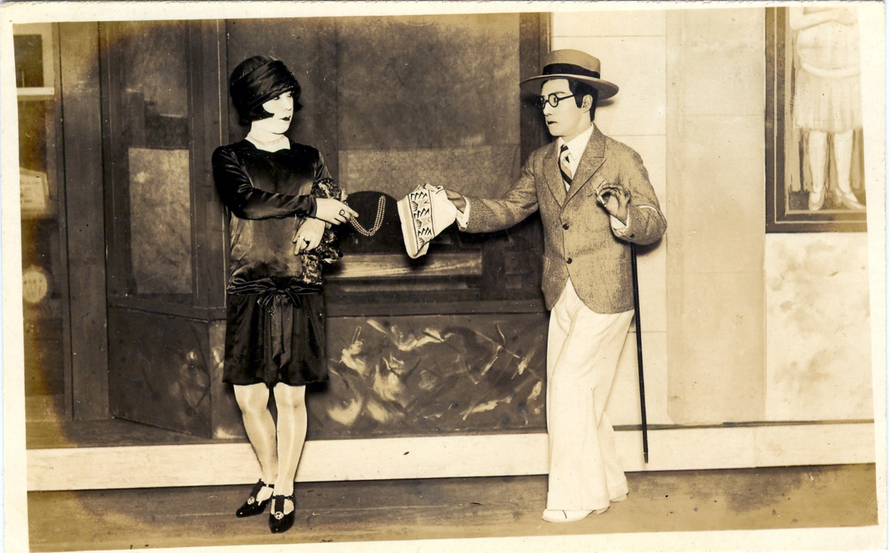
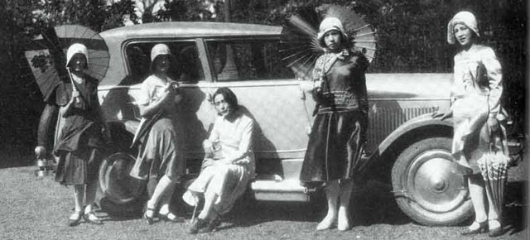
Moga and Mobo
  1920s–1930s: time of radical social change especially for young women
  Secretaries and accountants created a new cosmopolitan “culture of taste”
  Dating/Chaplin/baseball/jazz/café/Ginza/cigarettes/magazines/celeb gossip
  Loanwords from English, French, German; fashion from New York, London, Paris
  Commuting to new commercial ballrooms (selling dance tickets to “modern boys”)
  Moga/mobo as self-awakened, emancipated youth, or self-involved, citified brats? [cf. hipsters]

Slide 17
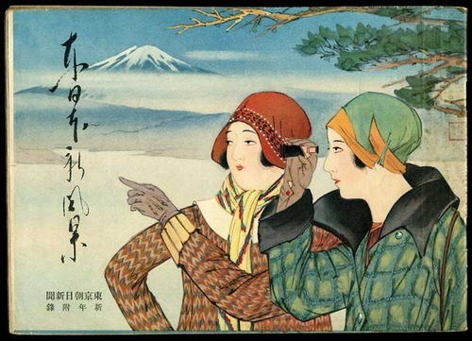
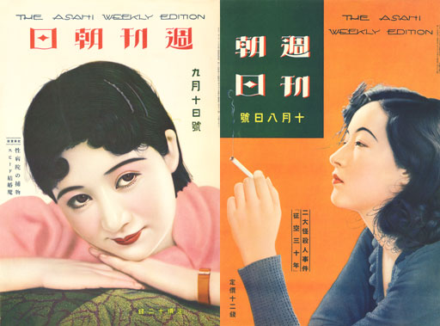
Moga in popular media

Slide 18
Ten Commandments of Moga taken from “Ladies’ World magazine” (Fujin Sekai, 1929)
1. Strength is the enemy of conventional femininity
2. Conspicuous consumption of Western food and drink
3. Devotion to jazz records, dancing, smoking
4. Knowledge of the types of Western liquor
5. Willingness to flirt to get those liquors for free
6. Devotion to fashion and cinema from Paris and Hollywood
7. Interest in dance halls and interactions with modern boys
8. Strolling the street of Ginza every Saturday and Sunday night
9. Pawning things to get one to buy new clothes for each season
10. Offering lips to any man who is useful, but keeping one’s chastity

Slide 19
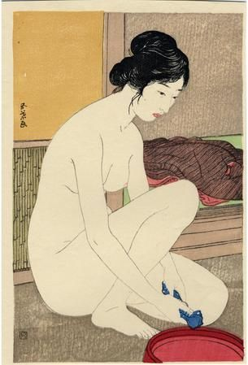
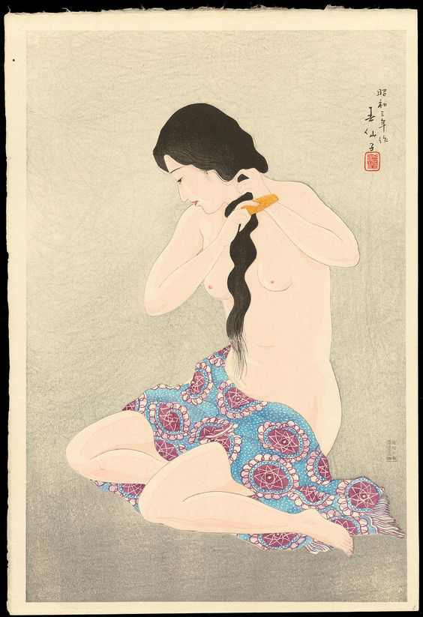
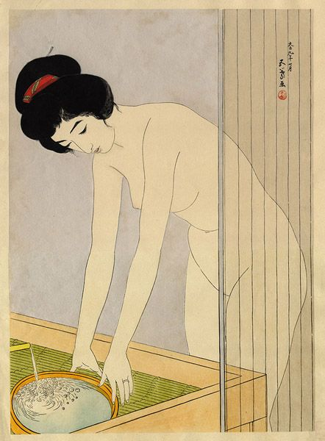
Hanga paintings: cultivated nudity and subtle eroticism
(e.g. Hashiguchi Goyō, Natori Shunsen)

Slide 20
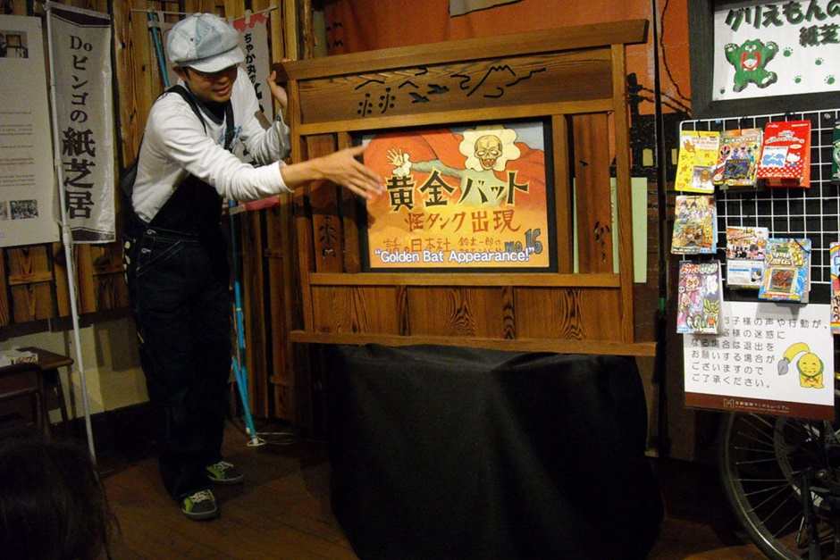
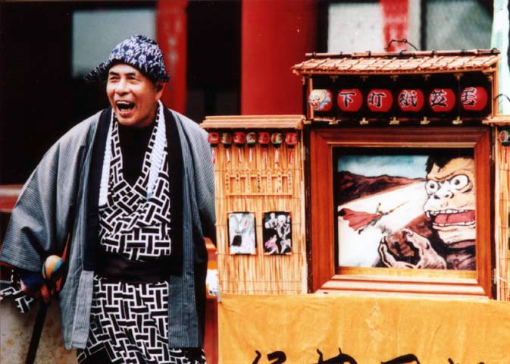
NEW CULTURAL FORM:
KAMISHIBAI
“paper theater” (kamishibai) popular in Japan since late 1920s (existing until the early 1970s)
Form of street theater for labouring classes, typical of naïve simplicity and countryside mentality
The direct ancestor of today’s manga and anime (performing latest instalments of a serial narrative)
Kamishibai produced the space of machikado (street corner), but it was also used for wartime propaganda

Slide 21
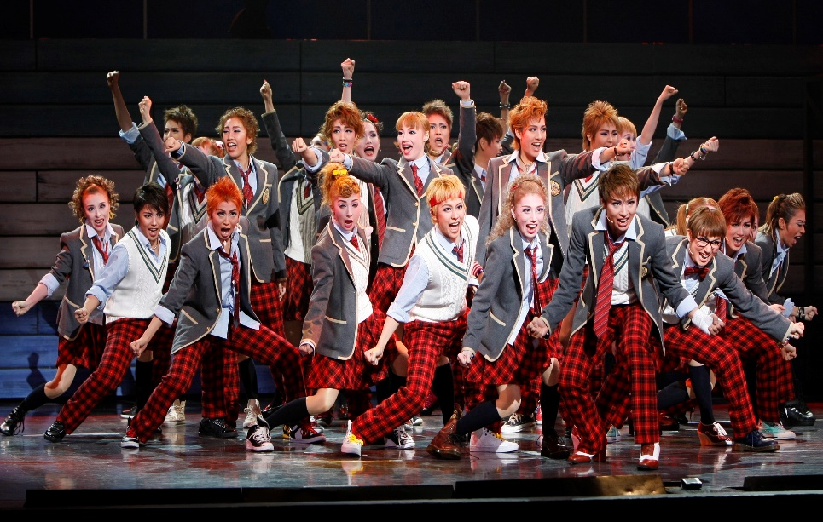
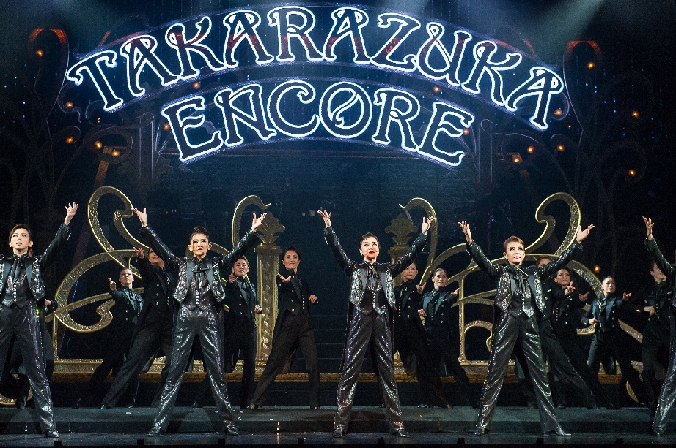
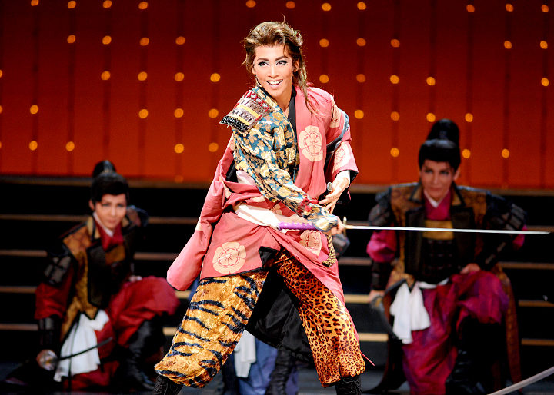
NEW CULTURAL FORM:
TAKARAZUKA
established in 1914 near Takarazuka station
significant site of Japanese musical modernity
Cross-dressing, cross-gender, all-female performers

Slide 22
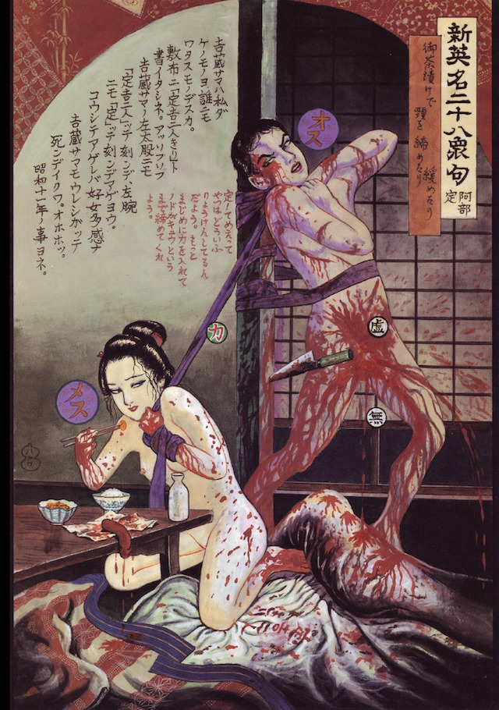
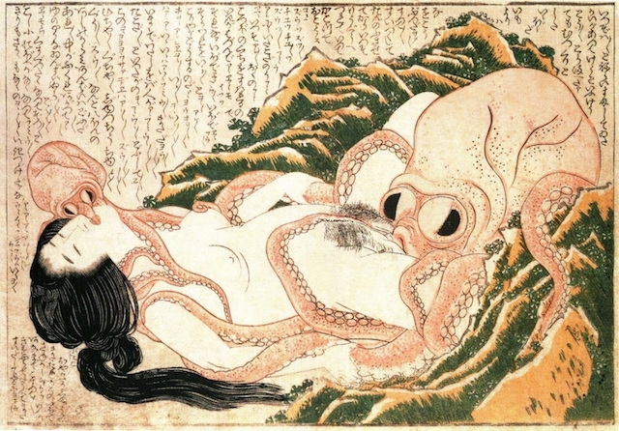
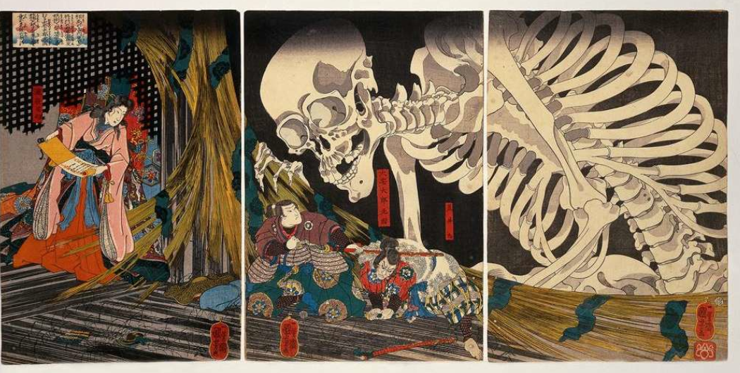
NEW CULTURAL FORM:
ERO GURO NANSENSU
Imaginary cultural world of the “erotic, grotesque, nonsense” (from 1920s to 1930s)
Motivated by the upheavals of politics and society during turbulent times
Content: decadence, rebellion, hedonism, irrationality, “primitivism”
Roots in late ukiyoe (Tsukioka Yoshitoshi, Utagawa Kuniyoshi, Hokusai)
Ero Guro came to be “symbolized” by the Abe Sada Incident (1936)

Slide 23
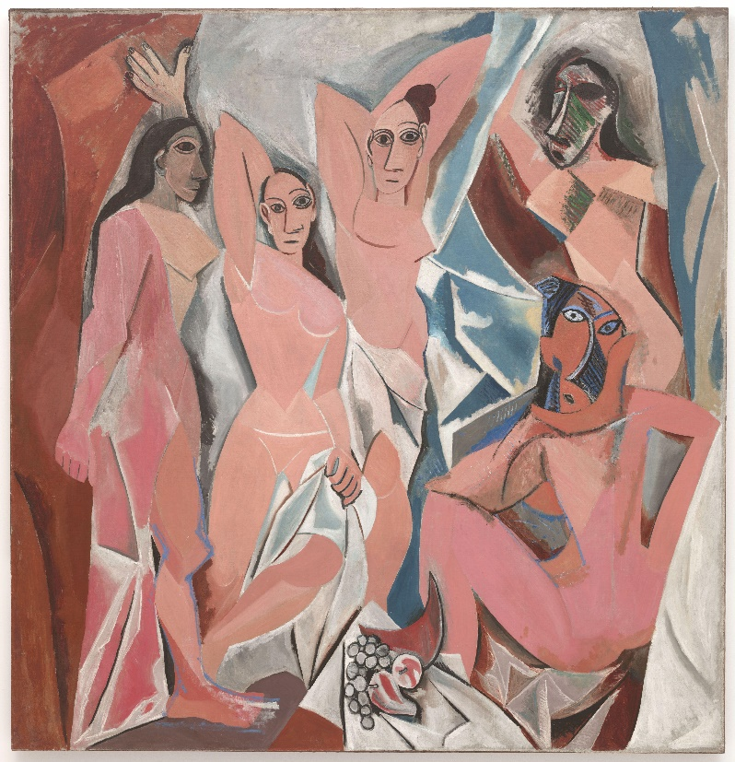
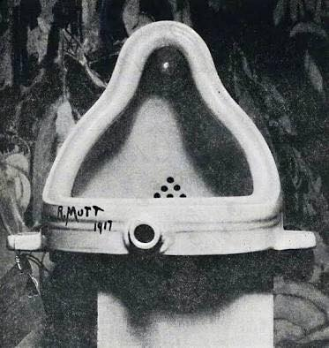
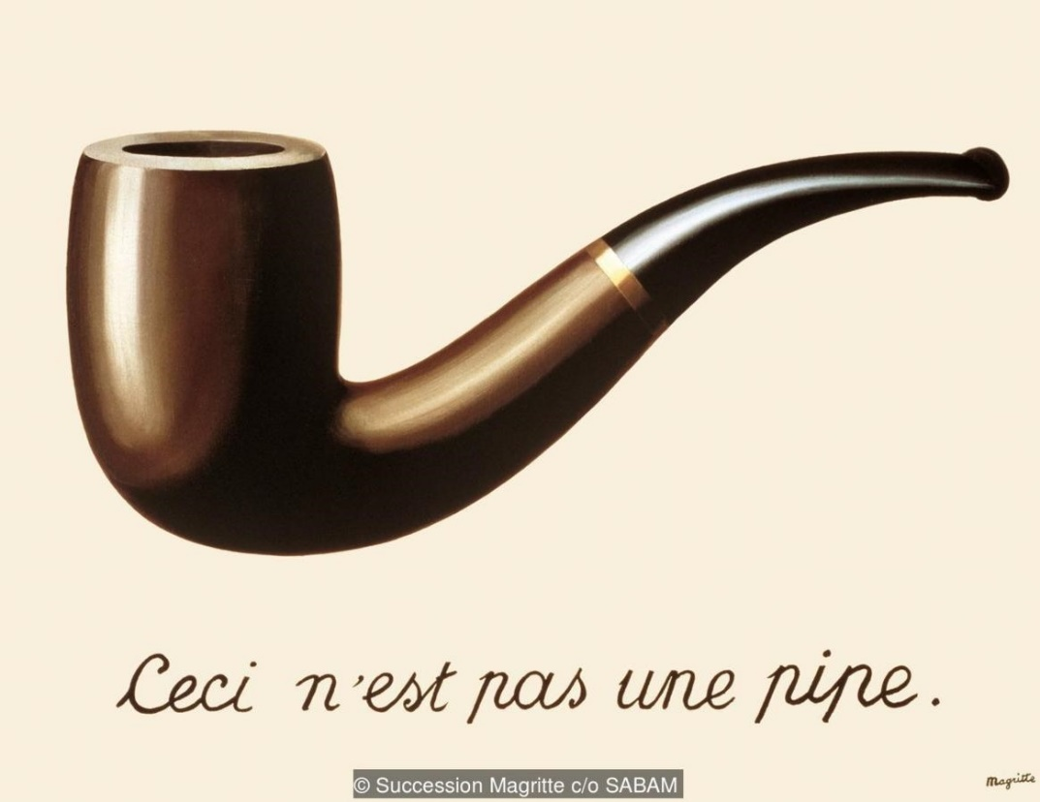
(MEANWHILE IN EUROPE)
P. Picasso’s Ladies from Avignon (1907) M. Duchamp’s “Fountain” (1917) R. Magritte’s “This is Not a Pipe” (1928)

Slide 24
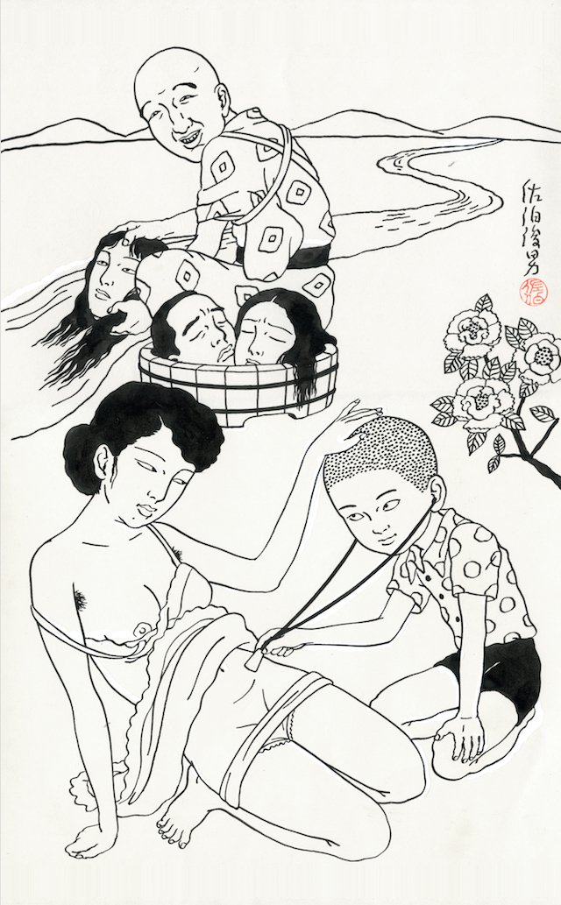
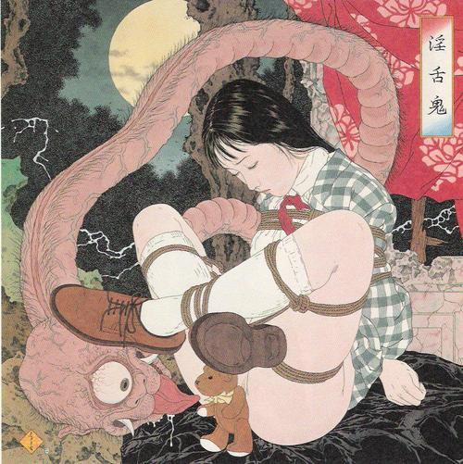
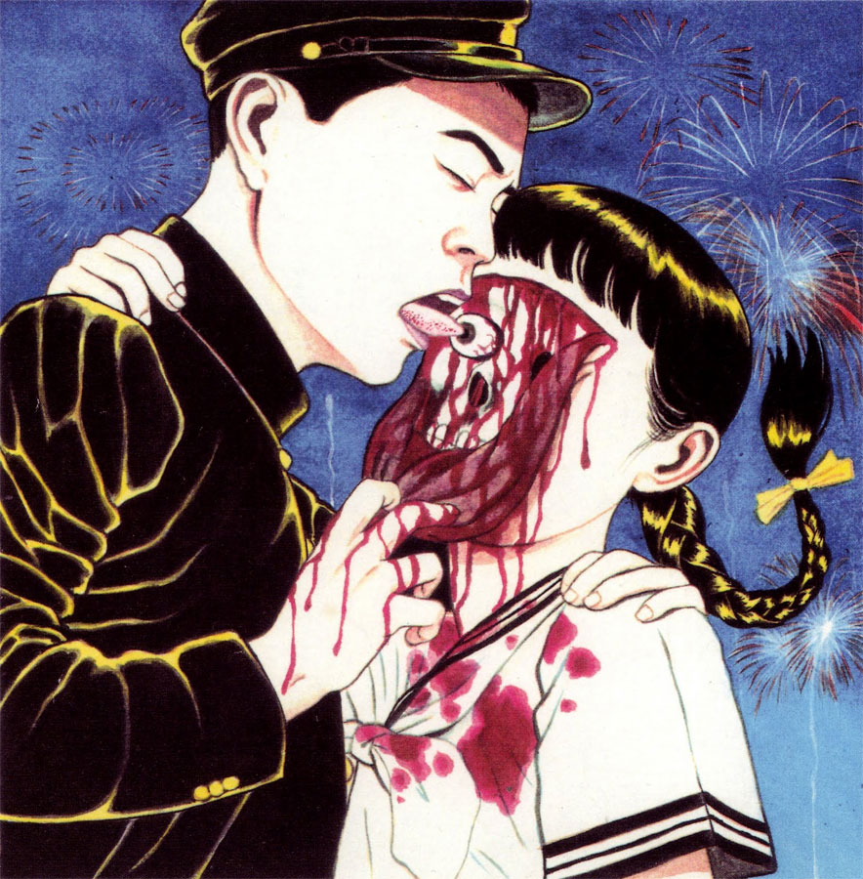
LATE ERO GURO MOVEMENT: female exploitation and twisted sexuality (ijō seiai)
(e.g. Suehiro Maruo)

Slide 25
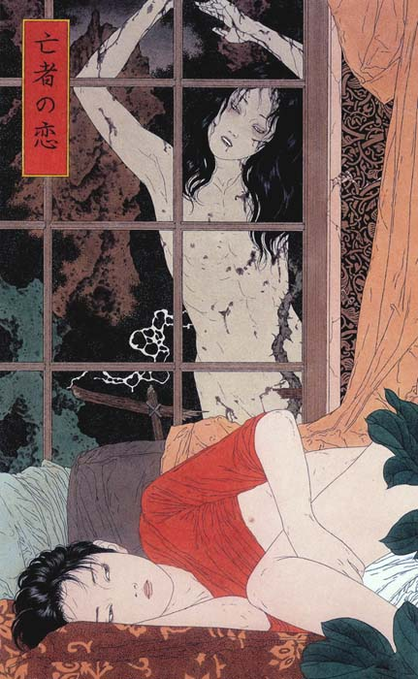
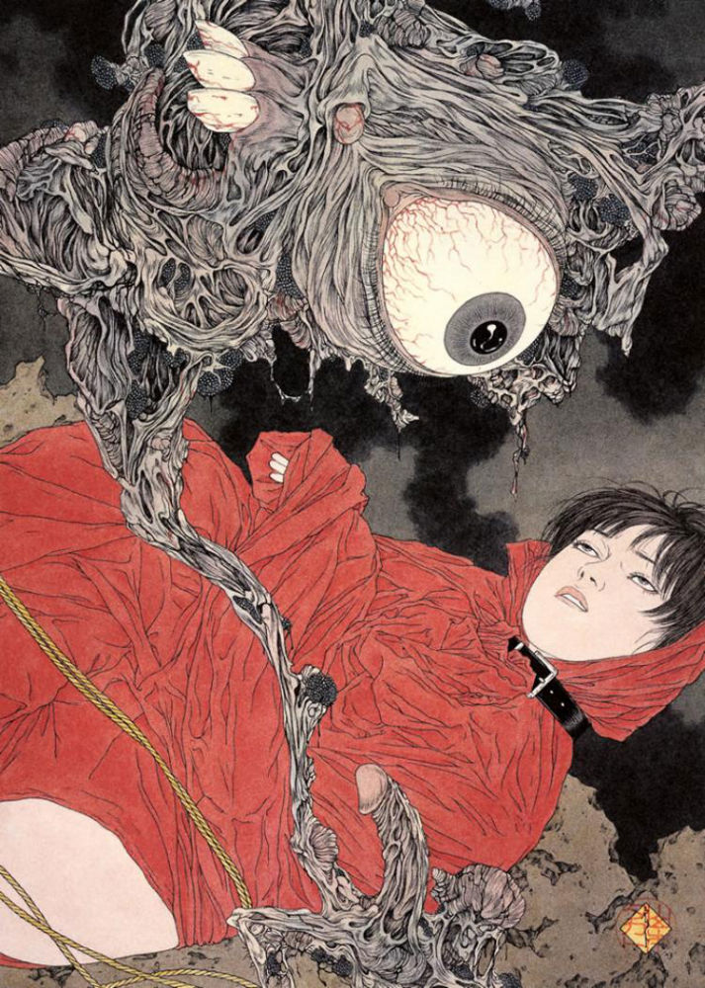
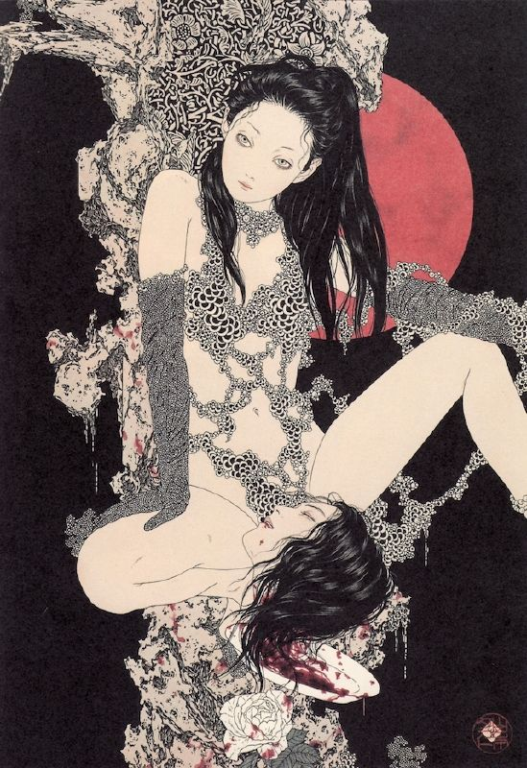
LATE ERO GURO MOVEMENT: dark female fantasies
(e.g. Takato Yamamoto)

Slide 26
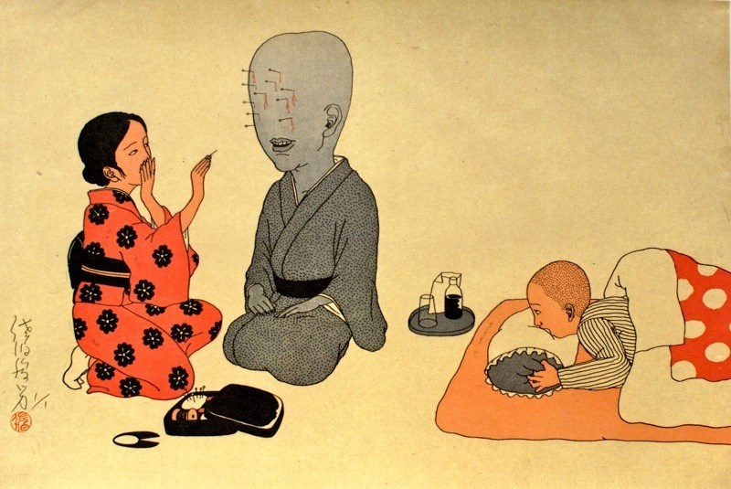
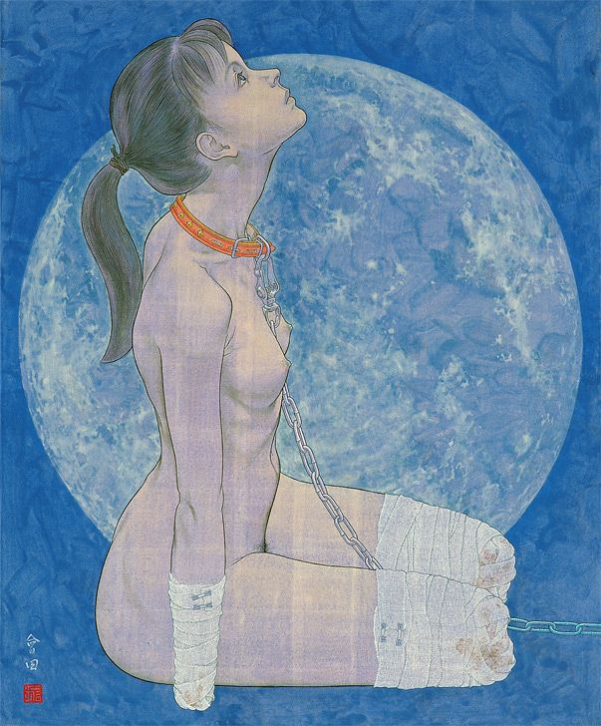
ERO GURO TODAY
(e.g. Saseki Toshio, Aida Makoto, Sono Shion)

