Slide 1

tán tiān qì
谈天气
Talking about the Weather
LI XIN YU

Slide 2
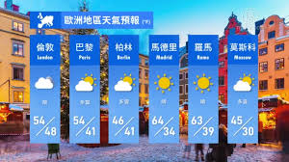
tiān qì
天气
weather

Slide 3
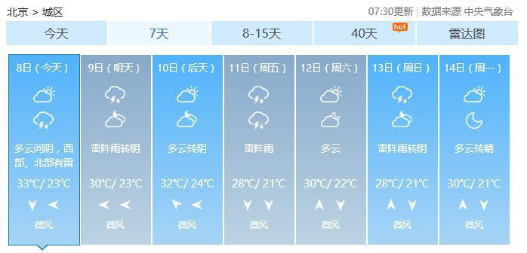
yù bào
预报
to forecast

Slide 4
tiān qì yù bào
天气预报
weather forecast

Slide 5

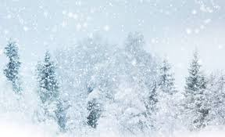
xià xuě
下雪
to snow

Slide 6

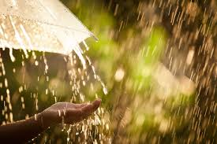
xià yǔ
下雨
to rain

Slide 7

qíng
晴
sunny

Slide 8

duō yún
多云
partly cloudy

Slide 9

yīn
阴
cloudy day

Slide 10
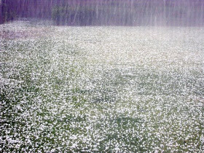
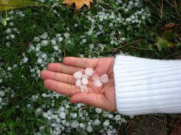
bīng báo
冰雹
hail

Slide 11
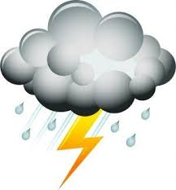
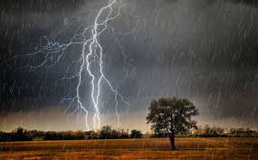
léi zhèn yǔ
雷阵雨
Thunder shower

Slide 12
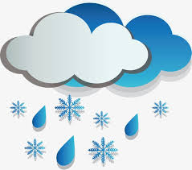
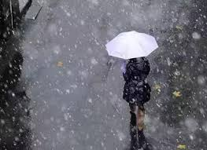
yǔ jiā xuě
雨夹雪
Sleet

Slide 13

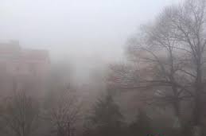
wù
雾
fog,mist

Slide 14
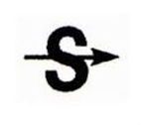
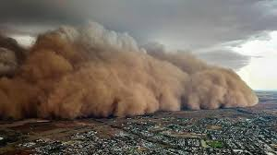
shā chén bào
沙尘暴
Sand storm

Slide 15

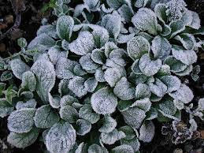
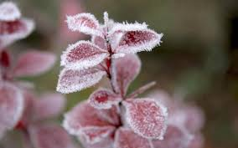
shuāng dòng
霜冻
Frost

Slide 16
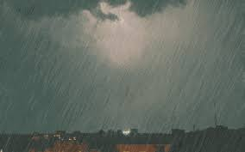
bào yǔ
暴雨
rainstorm

Slide 17
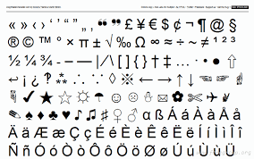
fú hào
符号
symbol

Slide 18
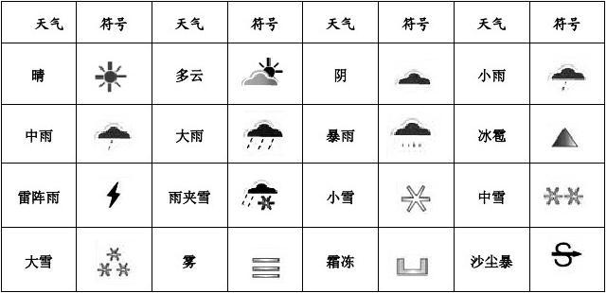

Slide 20
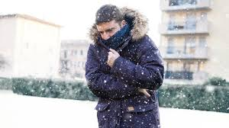
lěng
冷
cold

Slide 21
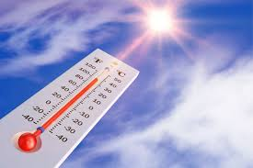
rè
热
hot

Slide 22

nuǎn huo
暖和
warm

Slide 23
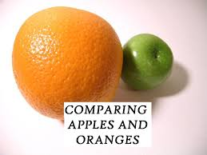
bǐ
比
(comparison marker);
to compare

Slide 24
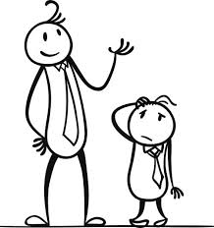
1.Comparative Sentences with 比(bǐ)
Specific comparison of two entities is usually expressed with the basic pattern
A+比(bǐ)+B+Adj
1.李友比她大姐高。
lǐ yǒu bǐ tā dà jiě gāo.
Li You is taller than her oldest sister.
李友
李友的大姐

Slide 25
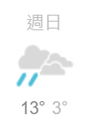


1.Comparative Sentences with 比(bǐ)
Specific comparison of two entities is usually expressed with the basic pattern
A+比(bǐ)+B+Adj
2.今天比昨天冷。
jīn tiān bǐ zuó tiān lěng.
Today is colder than yesterday.

Slide 26
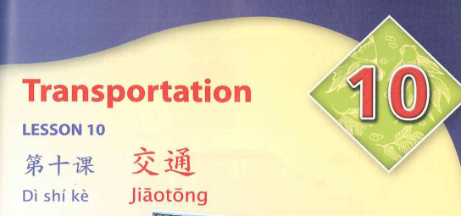
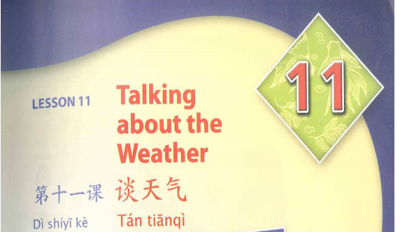
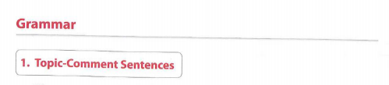
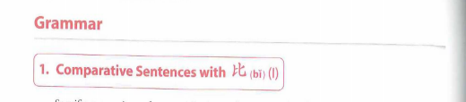
1.Comparative Sentences with 比(bǐ)
Specific comparison of two entities is usually expressed with the basic pattern
A+比(bǐ)+B+Adj
3.第十课的语法比第九课的语法容易。
dì shí kè de yǔ fǎ bǐ dì jiǔ kè de yǔ fǎ róng yì.
Lesson Ten`s grammar is easier than Lesson Nine`s grammar.
easy
diffcult

Slide 27
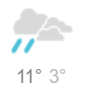
1.Comparative Sentences with 比(bǐ)
Specific comparison of two entities is usually expressed with the basic pattern
A+比(bǐ)+B+Adj+一点儿/得多/多了(yì diǎnr /de duō /duō le )
4.今天比昨天冷一点。
jīn tiān bǐ zuó tiān lěng yì diǎn.
Today is a bit colder than yesterday.
今天比昨天一点儿冷。（X）
jīn tiān bǐ zuó tiān yì diǎnr lěng.

Slide 28

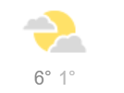
1.Comparative Sentences with 比(bǐ)
Specific comparison of two entities is usually expressed with the basic pattern
A+比(bǐ)+B+Adj+一点儿/得多/多了(yì diǎnr /de duō /duō le )
5.明天会比今天冷得多。
míng tiān huì bǐ jīn tiān lěng de duō.
Tomorrow will be much colder than today.

Slide 29
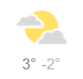
1.Comparative Sentences with 比(bǐ)
Specific comparison of two entities is usually expressed with the basic pattern
A+比(bǐ)+B+Adj+一点儿/得多/多了(yì diǎn ér /de duō /duō le )
6.纽约比这儿冷多了/冷得多。
niǔ yuē bǐ zhèr lěng duō le /lěng de duō.
New York is much colder than here.
布尔诺
Brno
纽约
New York

Slide 30
1.Comparative Sentences with 比(bǐ)
Specific comparison of two entities is usually expressed with the basic pattern
A+比(bǐ)+B+Adj+一点儿/得多/多了(yì diǎn ér /de duō /duō le )
6.纽约比这儿冷多了/冷得多。
niǔ yuē bǐ zhèr lěng duō le /lěng de duō.
New York is much colder than here.
Note that the modifying expression must be placed after the adjective, not before it.
纽约比这儿很冷。(X)
niǔ yuē bǐ zhèr hěn lěng.
“Much colder“ is 冷得多(lěng de duō) or 冷多了(lěng duō le), not 很冷(hěn lěng, very cold).

Slide 31
1.Comparative Sentences with 比(bǐ)
by adding the adverb 更(gèng) or the adverb 还(hái) in front of the adjective.
A+比(bǐ)+B+更/还(gèng /hái)+Adj
7.昨天冷，今天比昨天更冷/今天比昨天还冷。
zuó tiān lěng , jīn tiān bǐ zuó tiān gèng lěng /jīn tiān bǐ zuó tiān hái lěng.
Yesterday was cold. Today is even colder than yesterday.

Slide 32
1.Comparative Sentences with 比(bǐ)
跟(gēn) and 和(hé) can be used in another type of comparative sentence;
A跟/和B(不) 一样+Adj(A gēn/hé B (bù) yí yàng+Adj
However, unlike a comparative sentence with 比(bǐ), a comparative sentence with 跟(gēn) or 和(hé) only indicates whether two things or persons exhibit the same degree of an attribute, without specifying which of the two exhibits it to a greater or lesser degree.
Compare (8a) with (8b) and (8c) with (8d).

Slide 33
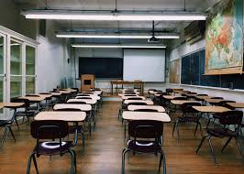
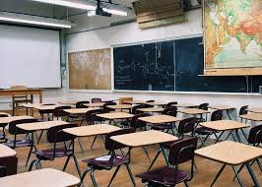
1.Comparative Sentences with 比(bǐ)
跟(gēn) and 和(hé) can be used in another type of comparative sentence;
A跟/和B(不) 一样+Adj(A gēn/hé B (bù) yí yàng+Adj
8. a 这个教室和那个教室一样大。
zhè ge jiào shì hé nà ge jiào shì yí yàng dà.
This classroom and that classroom are the same size.
40M²
40M²

Slide 34

1.Comparative Sentences with 比(bǐ)
跟(gēn) and 和(hé) can be used in another type of comparative sentence;
A跟/和B(不) 一样+Adj(A gēn/hé B (bù) yí yàng+Adj
8. b 这个教室跟那个教室不一样大。
zhè ge jiào shì gēn nà ge jiào shì bù yí yàng dà.
This classroom and that classroom are not the same size.
c 这个教室比那个教室大。
zhè ge jiào shì bǐ nà ge jiào shì dà.
This classroom is larger than that classroom.
d 这个教室比那个教室大得多。
zhè ge jiào shì bǐ nà ge jiào shì dà de duō.
This classroom is much larger than that classroom.
40M²
30M²

Slide 35
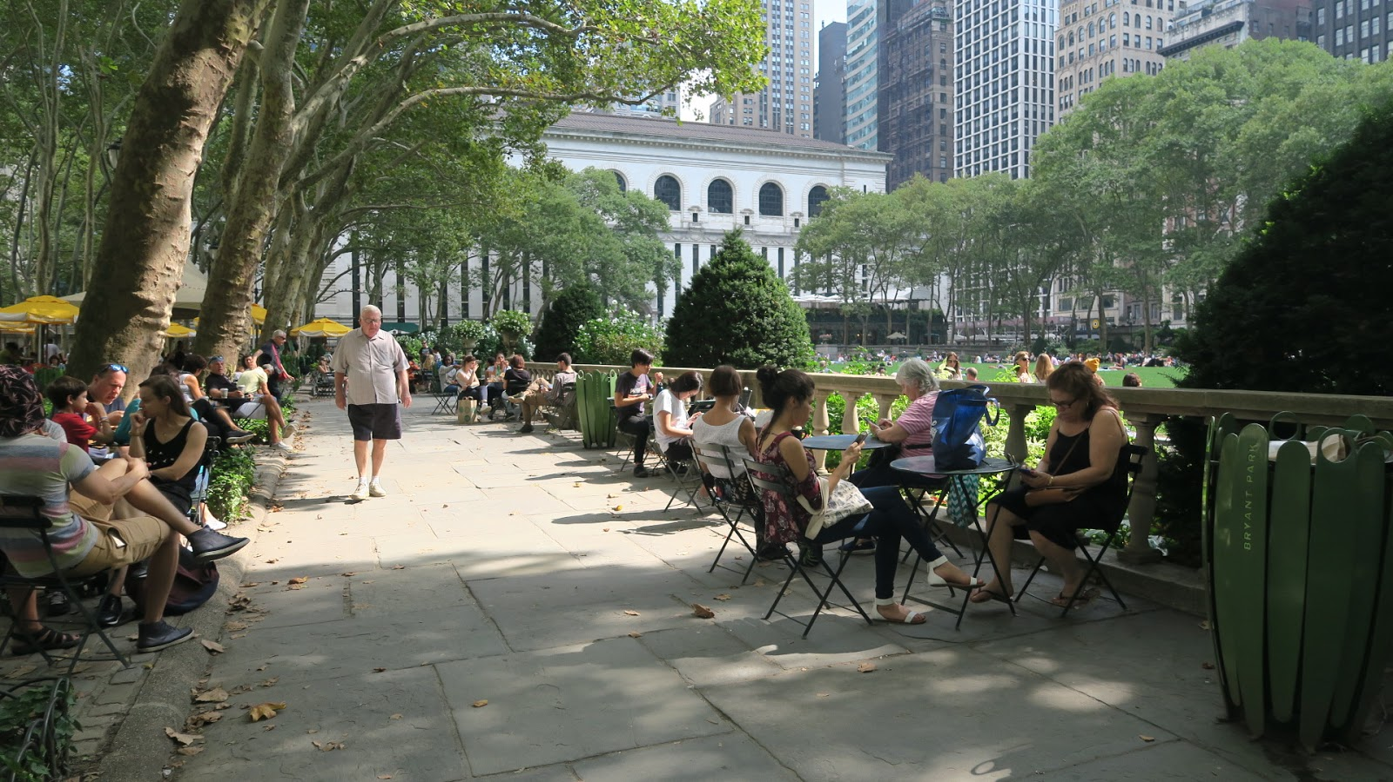
gōng yuán
公园
park

Slide 36
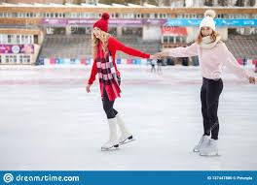
huá bīng
滑冰
to ice skate

Slide 37
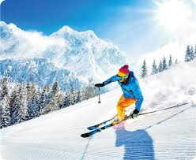
huá xuě
滑雪
to ski

Slide 38

gāng cái
刚才
just now
a moment ago

Slide 39

wǎng shang
网上
on the internet

Slide 40

yuē
约
to make an appointment

Slide 41

huì
会
will

Slide 42
3.The Modal Verb 会(huì ,will)(II)
会(huì) indicates an anticipated event or action.
1. 白老师现在不在办公室，可是他明天会在。
bái lǎo shī xiàn zài bú zài bàn gōng shì , kě shì tā míng tiān huì zài.
Teacher Bai is not in the office now, but he will be tomorrow.
2. A：你明年做什么？
nǐ míng nián zuò shén me ？
What will you do next year?
B：我明年会去英国学英文。
wǒ míng nián huì qù yīng guó xué yīng wén.
I`ll go to Britain to learn English next year.

Slide 43
3.The Modal Verb 会(huì ,will)(II)
会(huì) indicates an anticipated event or action.
3. 他说他晚上会给你发短信。
tā shuō tā wǎn shang huì gěi nǐ fā duǎn xìn.
He said he will send you a text message this evening.

Slide 44
3.The Modal Verb 会(huì ,will)(II)
The nagative form of 会(huì) is 不会(bú huì)
4. 小王觉得不舒服，今天不会来滑冰了。
xiǎo wáng jué de bù shū fu ，jīn tiān bú huì lái huá bīng le.
Little Wang is not feeling well, He won`t come ice skating today after all.
5. 她这几天特别忙，晚上不会去听音乐会。
tā zhè jǐ tiān tè bié máng ，wǎn shang bú huì qù tīng yīn yuè huì.
She is very busy these days, She won`t be going to the concert tonight.
6. 天气预报说这个周末不会下雪。
tiān qì yù bào shuō zhè ge zhōu mò bú huì xià xuě.
The weather forecast says that it won`t snow this weekend.

Slide 45

gèng
更
even more

Slide 46
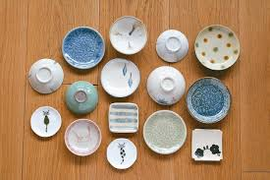
dié
碟
dise;
small plate;
dish,saucer

Slide 47

碟(dié) means a small plate or something that resembles a small plate. It is now often used to refer to DVDs. The phrase 看碟(kàn dié) thus means to watch a movie or TV series on DVD.

Slide 48
bàn
办
to handle
to do

Slide 49
不但(bú dàn)..., 而且(ér qiě)...(not only..., but also...)
In a sentence with the 不但(bú dàn)..., 而且(ér qiě)...(not only..., but also...) structure, the conjunction 而且(ér qiě) in the second clause is generally required , while the conjunction 不但(bú dàn) in the first clause is optional.
明天天气比今天更好，不但不会下雪，而且会暖和一点儿。
míng tiān tiān qì bǐ jīn tiān gèng hǎo , bú dàn bú huì xià xuě , ér qiě huì nuǎn huo yì diǎnr.
Tomorrow`s weather will be even better than today. Not only will it not snow , it`ll be a bit warmer , too.

Slide 50
2.The Particle 了(le) (III): 了 as a Sentence-Final Partice
When 了(le) occurs at the end of a sentence, it usually indicates a change of status or the realization of a new situation.
1. 下雪了。
xià xuě le.
It`s snowing now.
2. 妹妹累了。
mèi mei lèi le.
My sister has become tired.

Slide 51
2.The Particle 了(le) (III): 了 as a Sentence-Final Partice
When 了(le) occurs at the end of a sentence, it usually indicates a change of status or the realization of a new situation.
3. 我昨天没有空儿，今天有空儿了。
wǒ zuó tiān méi yǒu kōngr ，jīn tiān yǒu kōngr le.
I didn`t have time yesterday, but I do today.
4. 你看，公共汽车来了。
nǐ kàn ，gōng gòng qì chē lái le.
Look, the bus is here.

Slide 52
2.The Particle 了(le) (III): 了 as a Sentence-Final Partice
When used in this sense, 了(le) can still be used at the end of a sentence even if the sentence is in the negative.
5. 我没有钱了，不买了。
wǒ méi yǒu qián le , bù mǎi le.
I don`t have any money [left]. I won`t buy it anymore.
Remember that to negate 有(yǒu, to have), one uses 没(méi), not 不(bù).

Slide 53
4. Adj +(一) 点儿((yì ) diǎnr )
The expression (一) 点儿((yì) diǎnr) can be placed after an adjective to indicate slight qualification. 一(yī) is optional.
1. 前几天我很不高兴，昨天考试考得很好，我高兴点儿了。
qián jǐ tiān wǒ hěn bù gāo xìng ，zuó tiān kǎo shì kǎo de hěn hǎo , wǒ
gāo xìng diǎnr le.
I was very unhappy a few days ago. I did very well on the exam yesterday.
2.我妹妹比我姐姐高一点儿。
wǒ mèi mei bǐ wǒ jiě jie gāo yì diǎnr.
My younger sister is a bit taller than my older sister.
我妹妹比我姐姐一点儿高（X）
wǒ mèi mei bǐ wǒ jiě jie yì diǎnr gāo .

Slide 54
4. Adj +(一) 点儿((yì ) diǎnr )
The expression (一) 点儿((yì) diǎnr) can be placed after an adjective to indicate slight qualification. 一(yī) is optional.
3.你得快点儿，看电影要晚了。
nǐ děi kuài diǎnr ，kàn diàn yǐng yào wǎn le.
You`d better pick up the pace a bit , or you`ll be late for the movie.

Slide 55
4. Adj +(一) 点儿((yì ) diǎnr )
The expression (一) 点儿((yì) diǎnr) can be placed after an adjective to indicate slight qualification. 一(yī) is optional.
4. 今天比昨天冷点儿。
jīn tiān bǐ zuó tiān lěng diǎnr.
Today is a bit colder than yesterday.
今天比昨天一点冷。（X）
jīn tiān bǐ zuó tiān yì diǎnr lěng.
5. 老师，请您说话说得慢一点儿。
lǎo shī , qǐng nín shuō huà shuō de màn yì diǎnr.
Teacher, would you please speak a little hit more slowly?
老师，请您说话说得一点儿慢。（X）
lǎo shī , qǐng nín shuō huà shuō de màn yì diǎnr.

Slide 56
language practice

