Slide 1
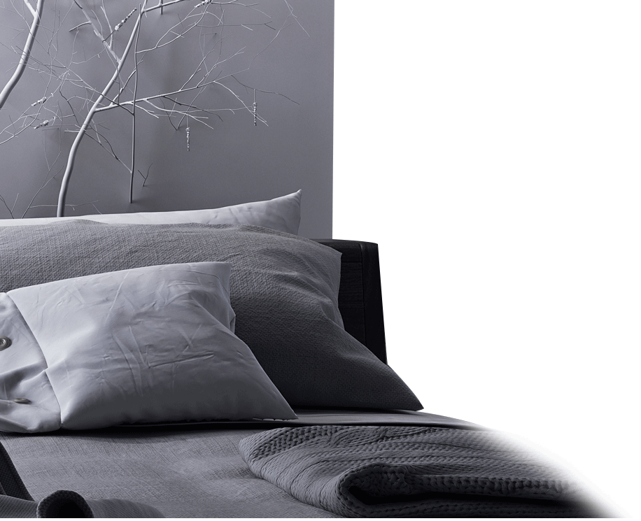
DESIGN
zū fáng zi
租房子
Renting an Apartment
LI Xin Yu

Slide 2
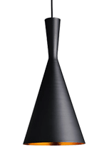
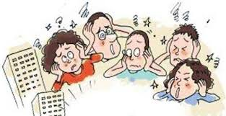
chǎo
吵
王朋觉得宿舍太吵，睡不好觉。
wáng péng jué de sù shè tài chǎo, shuì bu hǎo jiào.
Wang Peng thinks that the dorm is too noisy, and he can`t sleep well.
to quarrel; noisy

Slide 3
房间太小，连电脑都放不下。
fáng jiān tài xiǎo, lián diàn nǎo dōu fàng bu xià
The room is too small to fit even the computer.
我连你是谁都不知道。
wǒ lián nǐ shì shéi dōu bù zhī dào
I don't even know who you are.
lián
连
even

Slide 4
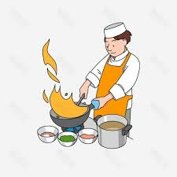
zuò fàn
做饭
to cook; to prepare a meal
小白不会做饭。
xiǎo bái bú huì zuò fàn.
Little bai can't cook.

Slide 5

bào zhǐ
报纸
newspaper

Slide 6
guǎng gào
刚才他在报纸上看到了一个广告。
gāng cái tā zài bào zhǐ shang kàn dào le yí ge guǎng gào.
He saw an advertisement in the newspaper just now.
广告
advertisement

Slide 7
fù jìn
附近
学校附近有一个公园。
xué xiào fù jìn yǒu yí ge gōng yuán.
There is a park near the school.
vicinity; neighborhood; nearby area

Slide 8
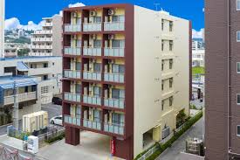
gōng yù
公寓
apartment

Slide 9
tào
王朋觉得这套公寓很适合他。
Wáng péng jué de zhè tào gōng yù hěn shì hé tā.
Wang Peng thinks this apartment is suitable for him.
我有三套衣服。
Wǒ yǒu sān tào yī fu.
I have three sets of clothes.
套
(measure word for suite or set)

Slide 10

chū zū
出租
to rent out
学校附近有一套公寓出租。
xué xiào fù jìn yǒu yí tào gōng yù chū zū.
There is an apartment for rent near the school

Slide 11
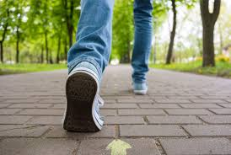
zǒu lù
走路
to walk
离学校很近，走路只要五分钟。
lí xué xiào hěn jìn, zǒu lù zhǐ yào wǔ fēn zhōng.
It's very close to the school and only a five-minute walk.

Slide 12
他做饭很快，只要10分钟。
tā zuò fàn hěn kuài, zhǐ yào shí fēn zhōng.
He cooks quickly, as long as 10 minutes.
他迟到了20分钟。
tā chí dào le èr shí fēn zhōng.
He was late for 20 minutes
fēn zhōng
分钟
minute

Slide 13
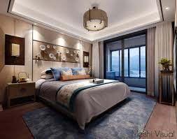
wò shì
卧室
bedroom

Slide 14
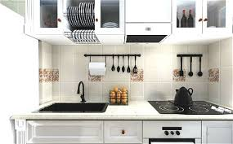
chú fáng
厨房
kitchen

Slide 15
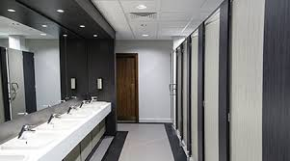
wèi shēng jiān
卫生间
bathroom;restroom;
toilet

Slide 16
Taiwan
洗澡间(xǐ zǎo jiān) : bathroom (with a toilet and shower or bathtub)
化妆室(huà zhuāng shì) : restroom
In mainland China.
卫生间(wèi shēng jiān) : restroom
浴室(yù shì), bathroom for bathing(usually without a toilet)
厕所(cè suǒ), public restroom with no bathing facilities
洗手间(xǐ shǒu jiān), restroom or bathroom
Occasionally, some Chinese speakers refer to the restroom euphemistically as 一号(yī hào), literally, number one.

Slide 17
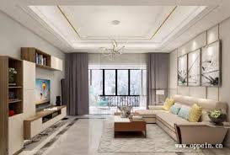
kè tīng
客厅
living room

Slide 18
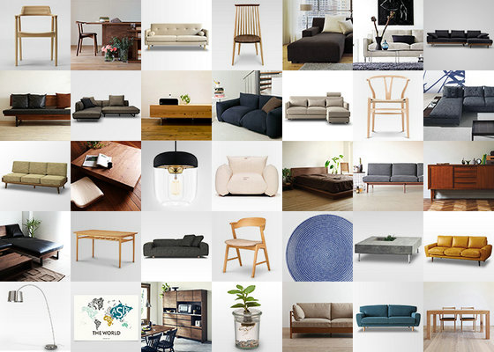
jiā jù
家具
furniture
公寓有一个卧室，一个厨房，一个卫生间，一个客厅，还带家具。
gōng yù yǒu yí ge wò shì, yí gè chú fáng, yí gè wèi shēng jiān, yí gè kè tīng, hái dài jiā jù.
The apartment includes a bedroom, a kitchen, a bathroom, and a living room, and it is furnished.

Slide 19
这个工作可能很适合他。
zhè ge gōng zuò kě néng hěn shì hé tā.
This job may be suitable for him.
他可能已经死了。
tā kě néng yǐ jīng sǐ le.
He may be dead.
kě néng
可能
maybe; possible

Slide 20
1. Verb+了+Number+Measure Word+Noun+了
On its own, the sentence usually implies that the action has been
continuing for some time and is expected to last into the future
王朋在学校的宿舍住了两个学期了。
Wáng péng zài xué xiào de sù shè zhù le liǎng ge xué qī le.
Wang Peng has been living on campus for two semesters up to this moment

Slide 21
1. Verb+了+Number+Measure Word+Noun+了
On its own, the sentence usually implies that the action has been
continuing for some time and is expected to last into the future
1. A: 你开出租汽车开了几年了？
nǐ kāi chū zū qì chē kāi le jǐ nián le？
How many years have you been driving a cab ?
B: 一年半了。
yì nián bàn le.
Fot a year and a half now.

Slide 22
1. Verb+了+Number+Measure Word+Noun+了
On its own, the sentence usually implies that the action has been
continuing for some time and is expected to last into the future
2.弟弟写电子邮件写了半个钟头了，不知道还要写多长时间。
dì di xiě diàn zǐ yóu jiàn xiě le bàn ge zhōng tóu le, bù zhī dào hái yào xiě duō cháng shí jiān.
My younger brother has been writing e-mails for half an hour. Who knows how much longer he will be.

Slide 23
1. Verb+了+Number+Measure Word+Noun+了
The following two sentences are different in meaning:
3. 他病了三天了。
tā bìng le sān tiān le.
He has been sick for three days.
[The illness has continued for three days and he currently remains sick.]
4. 他病了三天。
tā bìng le sān tiān.
He was sick for three days.
[He recovered from the illness on the fourth day.]

Slide 24
1. Verb+了+Number+Measure Word+Noun+了
If, however, a clause in this pattern is followed by another clause, it may suggest that the action may come to an end.
5. 我打扫房子打扫了一上午了，想休息一下。
wǒ dǎ sǎo fáng zi dǎ sǎo le yí shàng wǔ le, xiǎng xiū xi yí xià.
I`ve been cleaning the house all morning. I`d like to take a break.

Slide 25
1. Verb+了+Number+Measure Word+Noun+了
This structure is not limited to temporal expressions. It can also be used to indicate quantity:
6. 衣服我已经买了三件了，够了。
yī fu wǒ yǐ jīng mǎi le sān jiàn le, gòu le.
I have already bought three pieces of clothing. That`s plenty.
7. 这封信我已经看了两遍了，不想再看了。
zhè fēng xìn wǒ yǐ jīng kàn le liǎng biàn le, bù xiǎng zài kàn le.
I`ve read this letter twice already and don`t want to read it again.

Slide 26
2. 连...都/也(lián ...dōu /yě)
连(lián) is an intensifier which is always used in conjunction with 都/也(dōu /yě).
1. 我姐姐的孩子很聪明，连日本话都会说。
wǒ jiě jie de hái zi hěn cōng ming, lián rì běn huà dōu huì shuō.
My sister`s child is really smart. She can even speak Japanese.
What follows 连(lián) usually represents an extreme case: the biggest or smallest, the best or worst, the most difficult or easiest, etc. (1), for instance, implies that Japanese is very difficult. If a child can speak such a difficult language as Japanese, then the child must be very intelligent.

Slide 27
2. 连...都/也(lián ...dōu /yě)
连(lián) is an intensifier which is always used in conjunction with 都/也(dōu /yě).
2.我弟弟学中文学了一年了，可是连“天”字都不会写。
wǒ dì di xué zhōng wén xué le yì nián le, kě shì lián “tiān” zì dōu bú
huì xiě.
My younger brother has been studying Chinese for a year now, but
can`t even write the character 天.
Similarly, 天(tiān) is considered one of the easiest Chinese characters. If the younger brother in (2) does not know how to write 天(tiān), it goes without saying that he can`t write other more difficult characters

Slide 28
2. 连...都/也(lián ...dōu /yě)
连(lián) is an intensifier which is always used in conjunction with 都/也(dōu /yě).
3. 你怎么连药都忘了吃？
nǐ zěn me lián yào dōu wàng le chī ?
How could you forget even to take your medicine ?
4. 昨天学的生词我连一个也不记得了。
zuó tiān xué de shēng cí wǒ lián yí ge yě bú jì de le.
I can`t recall even a single word we learned yesterday.

Slide 29
3. Potential complements with Verb + 不下 (bu xià)
The V+不下(bu xià) structure suggests that a location or container in question does not have the capacity to hold something.
1. 这个客厅大是大，不过坐不下二十个人。
zhè ge kè tīng dà shì dà, bú guò zuò bu xià èr shí ge rén.
This living room is pretty spacious, but still not large enough to seat
twenty people.

Slide 30
3. Potential complements with Verb + 不下 (bu xià)
The V+不下(bu xià) structure suggests that a location or container in question does not have the capacity to hold something.
2. 这张纸写不下八百个字。
zhè zhāng zhǐ xiě bu xià bā bǎi ge zì.
This piece of paper isn`t big enough to write 800 characters on.
3. 这个冰箱放不下两个西瓜。
zhè ge bīng xiāng fàng bu xià liǎng ge xī gua.
This refrigerator won`t fit two watermelons.

Slide 31
4. 多(duō) indicating an Approximate Number
多(duō) can be placed after a number to indicate an approximate number. The combination indicates not an exact number but a general numeric range, e.g., 十多个(duō)means more than ten but fewer than twenty; it could be eleven, twelve, thirteen, etc.
十多个： 10<十多个<20 but 十一多个（X）
二十多个: 20<二十多个<30 二十二多个 (X)

Slide 32
4. 多(duō) indicating an Approximate Number
If the concept represented by the noun is not divisible into smaller units, and the number is ten or a multiple of ten, 多(duō) precedes the measure word.
二十多个人 三十多个学生
èr shí duō ge rén sān shí duō ge xué sheng
more than twenty people more than thirty students
一百多张纸 Number+多+Measure word+Object
yì bǎi duō zhāng zhǐ
over one hundred sheets pf paper

Slide 33
4. 多(duō) indicating an Approximate Number
If the concept represented by the noun can be divided into smaller units, (一块钱=十毛，一星期=七天), there are two possibilities.
If the number is not ten or a multiple of ten, 多(duō) should be used after the measure word. Number+Measure word+多+Object
七块多钱
qī kuài duō qián
more than seven dollars but less than eight.
一个多星期
yí ge duō xīng qī
more than one week but less than two

Slide 34
4. 多(duō) indicating an Approximate Number
If the concept represented by the noun can be divided into smaller units, (一块钱=十毛，一星期=七天), there are two possibilities.
If the number is ten or a multiple of ten, 多(duō) can be used either before the measure word, but these two options represent different numeric ranges.
十多块钱 10块钱<十多块钱<20块钱
shí duō kuài qián
more than ten dollars but less than twenty.
十块多钱 10块钱<十块多钱<11块钱
shí kuài duō qián
more than ten dollars but less than eleven.

Slide 35
4. 多(duō) indicating an Approximate Number
EXAMPLE: 10<X<20 钱 十多块钱
1. 20<X<30 钱
2. 4<X<5 钱
3. 10<X<11 年
4. 90<X<100 年
5. 60<X<70 苹果
6. 80<X<90 天
7. 40<X<50 衣服
20多块钱
4块多钱
10年多
90多年
60多个苹果
80多天
40多件衣服

Slide 36
4. 多(duō) indicating an Approximate Number
1. 这支笔一块多钱。
zhè zhī bǐ yí kuài duō qián.
This pen is over one dollar
The price is more than one dollar but less than two.
2. 我们班有二十多个学生。
wǒ men bān yǒu èr shí duō ge xué sheng.
There are over twenty students in our class.
There are more than twenty students but fewer than thirty.

Slide 37
4. 多(duō) indicating an Approximate Number
3. 妹妹感冒十多天了。
mèi mei gǎn mào shí duō tiān le.
My younger sister has had a cold for more than ten days.
The number of days is between ten and twenty.
4. 他昨天买了四十多个梨
tā zuó tiān mǎi le sì shí duō ge lí.
He bought over forty pears yesterday.
The number is between forty and fifty.

Slide 38

4. 多(duō) indicating an Approximate Number
5. 他昨天买礼物花了一百多块钱。
tā zuó tiān mǎi lǐ wù huā le yì bǎi duō kuài qián.
He bought over one hundred dollars` worth of gifts yesterday.
He spent more than one hundred dollars but less than two hundred.
100<礼物的价格（lǐ wù de jià gé;The price of the gift）<200

Slide 39
4. 多(duō) indicating an Approximate Number
6. A: 这双黑鞋十多块钱。10<鞋的价格(xié de jià gé; The price of shoes) <20
zhè shuāng hēi xié shí duō kuài qián.
This pair of black shoes is over ten dollars.
The price is more than ten dollars but less than twenty.
B: 这双咖啡色的鞋十块多钱。10<鞋的价格(xié de jià gé; The price of shoes)<11
zhè shuāng kā fēi sè de xié shí kuài duō qián.
This pair of brown shoes is over ten dollars.
The price is more than ten dollars but less than eleven.

Slide 40
4. 多(duō) indicating an Approximate Number
7. A: 这家饭馆儿的师傅和服务员认识十年多了。
zhè jiā fàn guǎnr de shī fu hé fú wù yuán rèn shi shí nián duō le.
The chef and the waiter in this restaurant have known each other
for ten years and some months.
The length of time is longer than ten years but shorter than eleven.
B: 我以为他们认识十多年了
wǒ yǐ wéi tā men rèn shi shí duō nián le.
The length of time is between ten and twenty years.

Slide 41
yì fáng yì tīng
一房一厅
one bedroom and one living room

Slide 42
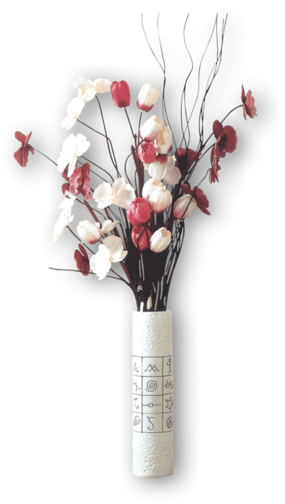
Instead of 一房一厅(yì fáng yì tīng), one can also say 一室一厅(yí shì yì tīng). Both expressions refer to an apartment with one bedroom and one living room. By the same token, one may refer to a two-bedroom apartment with a living room as 两房一厅(liǎng fáng yì tīng) or 两室一厅(liǎng shì yì tīng).

Slide 43

gān jìng
干净
这件衣服很干净。
zhè jiàn yī fu hěn gān jìng.
This dress is very clean.
这间房间非常干净。
zhè jiān fáng jiān fēi cháng gān jìng.
This room is very clean.
clean

Slide 44
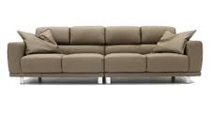
shā fā
沙发
sofa

Slide 45
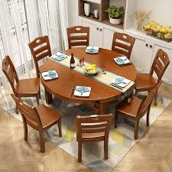
fàn zhuō
饭桌
dining table

Slide 46
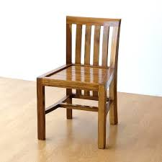
yǐ zi
椅子
chair

Slide 47
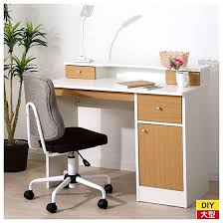
shū zhuō
书桌
desk

Slide 48
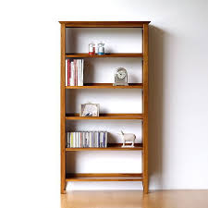
shū jià
书架
bookcase; bookshelf

Slide 49


ān jìng
安静
这里很安静。
zhè lǐ hěn ān jìng.
Here is very quiet.
请安静。
qǐng ān jìng.
Please be quiet.
quiet

Slide 50
你们那里安静不安静？
nǐ men nà li ān jìng bù ān jìng?
Is it quiet over there?
你们那里有狗吗？
nǐ men nà li yǒu gǒu ma?
Do you have dogs there?
nà li
那里
there

Slide 51
每个月房租多少钱？
měi ge yuè fáng zū duō shǎo qián?
How much is the monthly rent?
这间房子的房租很贵。
zhè jiān fáng zi de fáng zū hěn guì.
The rent for this house is very expensive.
fáng zū
房租
rent

Slide 52
yuán
A: 这条裤子多少钱？
zhè tiáo kù zi duō shǎo qián?
How much are these pants?
B: 八百五十元。
bā bǎi wǔ shí yuán.
Eight hundred and fifty yuan.
元
(measure word for the basic Chinese monetary unit) ; yuan

Slide 53
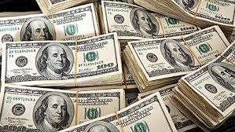
měi yuán
美元
U.S. currency

Slide 54
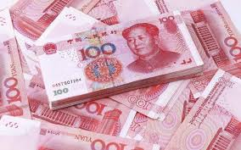
wèi shēng jiān
人民币
renminbi (RMB, Chinese currency)

Slide 55
chà bu duō
差不多
almost; nearly; similar

Slide 56
八百五十美元，人民币差不多是六千多块。
bā bǎi wǔ shí měi yuán, rén mín bì chà bu duō shì liù qiān duō kuài.
Eight hundred and fifty dollars, the renminbi is almost more than six thousand yuan
李友和白英爱差不多高。
Lǐ yǒuhé bái yīng ài chàbùduō gāo.
Li You and Bai Yingai are about the same height

Slide 57
你不用付水电费。
nǐ bú yòng fù shuǐ diàn fèi.
You don't have to pay for the utilities.
我每个月要付700块的电话费。
wǒ měi ge yuè yào fù qī bǎi kuài de diàn huà fèi.
I have to pay 700 for the phone per month..
fèi
费
fee; expenses

Slide 58
yā jīn
入住时需要先交押金。
rù zhù shí xū yào xiān jiāo yā jīn.
A deposit is required when checking in.
这是你的押金。
zhè shì nǐ de yā jīn.
This is your deposit.
押金
security deposit

Slide 59
A: 要不要付押金？
yào bú yào fù yā jīn?
Do I have to pay a deposit ?
B: 要多付一个月的房租当押金。
yào duō fù yí ge yuè de fáng zū dāng yā jīn.
An extra month`s rent as a security deposit.
dāng
当
to serve as; to be

Slide 60
你搬出去的时候，我会把押金还给你。
nǐ bān chū qu de shí hou, wǒ huì bǎ yā jīn huán gěi nǐ.
I will return the deposit to you when you move out
你把那支笔还给我。
nǐ bǎ nà zhī bǐ huán gěi wǒ.
You return me that pen.
huán
还
to return (something)

Slide 61
lìng wài
这间公寓要多付一个月的房租当押金，另外，还不准养宠物。
zhè jiān gōng yù yào duō fù yí ge yuè de fáng zū dāng yā jīn, lìng wài, hái bù zhǔn yǎng chǒng wù.
This apartment requires an extra month's rent as a deposit. In addition, pets are not allowed.
另外
furthermore; in addition

Slide 62
zhǔn
上课的时候，不准睡觉。
shàng kè de shí hòu, bù zhǔn shuì jiào.
During class, sleeping is not allowed.
考试的时候，不准作弊。
kǎo shì de shí hòu, bù zhǔn zuò bì.
During the exam, cheating is not allowed.
准
to allow; to be allowed

Slide 63
我家养了一只猫、两只狗。
wǒ jiā yǎng le yì zhī māo, liǎng zhī gǒu.
My family has a cat and two dogs.
我爸爸很喜欢养花。
wǒ bà ba hěn xǐ huān yǎng huā.
My dad likes to grow flowers.
yǎng
养
to raise

Slide 64
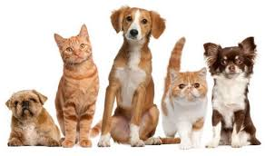
chǒng wù
宠物
pet
我对养宠物没有兴趣。
wǒ duì yǎng chǒng wù méi yǒu xìng qù.
I`m not interested in keeping pets.

Slide 65
我对养宠物很有兴趣。
wǒ duì yǎng chǒng wù hěn yǒu xìng qù.
I am very interested in keeping pets.
我对做饭很有兴趣。
wǒ duì zuò fàn hěn yǒu xìng qù.
I am very interested in cooking.
xìng qù
兴趣
interest

Slide 66
One should not mix up 有兴趣(yǒu xìng qù) with 有意思(yǒu yì si).
有兴趣(yǒu xìng qù) is a verb that pertains to a person who is interested (in something),
有意思(yǒu yì si) is an adjective describing someone or something that is interesting.

Slide 67
5. Question Pronouns with 都/也(dōu /yě)
A question pronoun can appear in sentences other than questions. When a question pronoun is used in a statement with 都/也(dōu /yě) appearing after it, it simply means “all” or “none” in the sense of being all-inclusive or all-exclusive.
1. A: 你想喝点儿什么饮料？
nǐ xiǎng hē diǎnr shén me yǐn liào?
What beverage would you like to drink?
B: 谢谢，我不渴，什么都不想喝。
xiè xie, wǒ bù kě, shén me dōu bù xiǎng hē.
No, thanks. I am not thirsty. I don`t feel like drinking anything.

Slide 68
5. Question Pronouns with 都/也(dōu /yě)
A question pronoun can appear in sentences other than questions. When a question pronoun is used in a statement with 都/也(dōu /yě) appearing after it, it simply means “all” or “none” in the sense of being all-inclusive or all-exclusive.
2. 这些公寓我哪套都不租。
zhè xiē gōng yù wǒ nǎ tào dōu bù zū.
I am not renting any of these apartments.
3. 中国我什么地方都没去过。
zhōng guó wǒ shén me dì fang dōu méi qù guo.
I haven`t been to any place in China.

Slide 69
5. Question Pronouns with 都/也(dōu /yě)
A question pronoun can appear in sentences other than questions. When a question pronoun is used in a statement with 都/也(dōu /yě) appearing after it, it simply means “all” or “none” in the sense of being all-inclusive or all-exclusive.
4. 我什么宠物都不养。养宠物太麻烦了！
wǒ shén me chǒng wù dōu bù yǎng. yǎng chǒng wù tài má fan le！
I don`t keep any pets. Keeping pets is too much trouble!
5. 在这个城市，哪儿也吃不到糖醋鱼。
zài zhè ge chéng shì, nǎr yě chī bu dào táng cù yú.
You can`t find sweet and sour fish anywhere in this city.

Slide 70
5. Question Pronouns with 都/也(dōu /yě)
A question pronoun can appear in sentences other than questions. When a question pronoun is used in a statement with 都/也(dōu /yě) appearing after it, it simply means “all” or “none” in the sense of being all-inclusive or all-exclusive.
6. A: 在舞会上你认识了谁？
zài wǔ huì shang nǐ rèn shi le shéi ?
Who did you get to know at the dance party ?
B: 我谁都没认识。
wǒ shéi dōu méi rèn shi.
I didn`t get to know anybody.

Slide 71
5. Question Pronouns with 都/也(dōu /yě)
7. 你明天几点跟我见面都行。
nǐ míng tiān jǐ diǎn gēn wǒ jiàn miàn dōu xíng.
You can meet with me any time tomorrow.
8. 这些药我哪种都试过，对我的过敏都没有用。
zhè xiē yào wǒ nǎ zhǒng dōu shì guo, duì wǒ de guò mǐn dōu méi
yǒu yòng.
I have tried all these medicines; none of them is effective for my
allergies

