Slide 1

第十二课 中国的变化
老师：郑学懿

Slide 2





姑父
姑妈
爸爸
妈妈
舅舅
舅妈
我
表哥

Slide 3

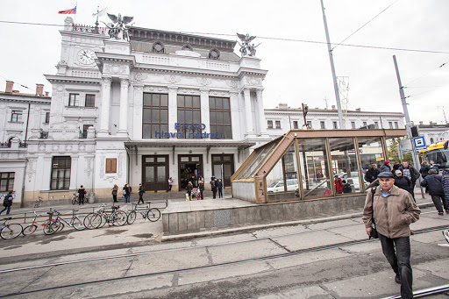
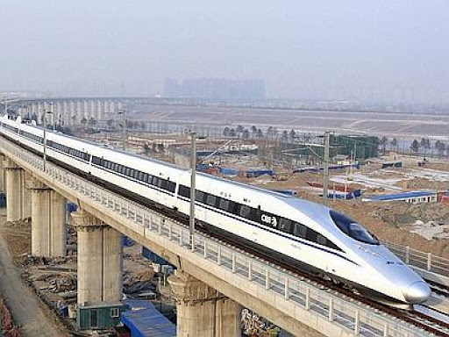
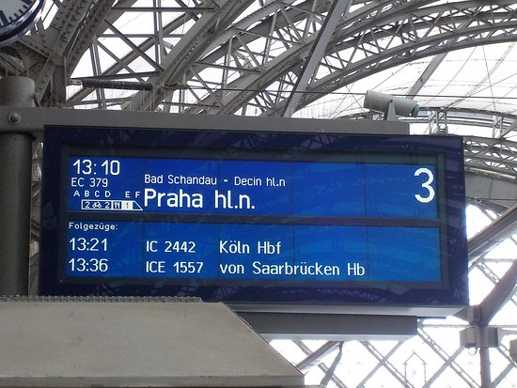
骑
自行车
qí
中央
zhōngyāng
火车站
高速火(列)车
platform
gāosù
liè
高铁
月台
tiě

Slide 4
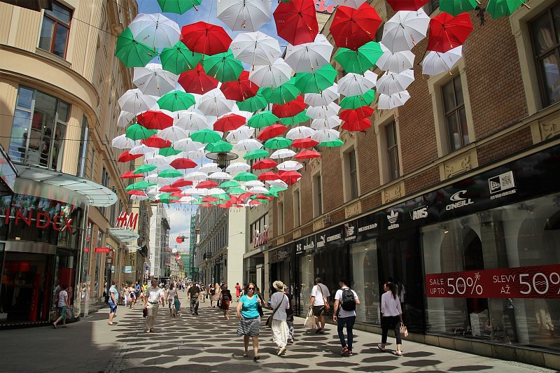

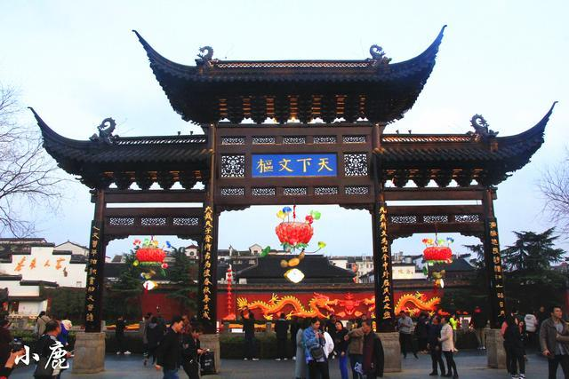
ulice
architectures
街
建筑
南京夫子庙
I like Chinese architectures, for example Chinese temples.
我喜欢中国的建筑，
比如说中国的寺庙。
寺庙
sìmiào

Slide 5



Measure word of buildings and mountains
Nowadays there are too many foreigners live in China.
现今有太多老外住在中国。
座
老外
游客
有景点的地方就会有________。

Slide 6

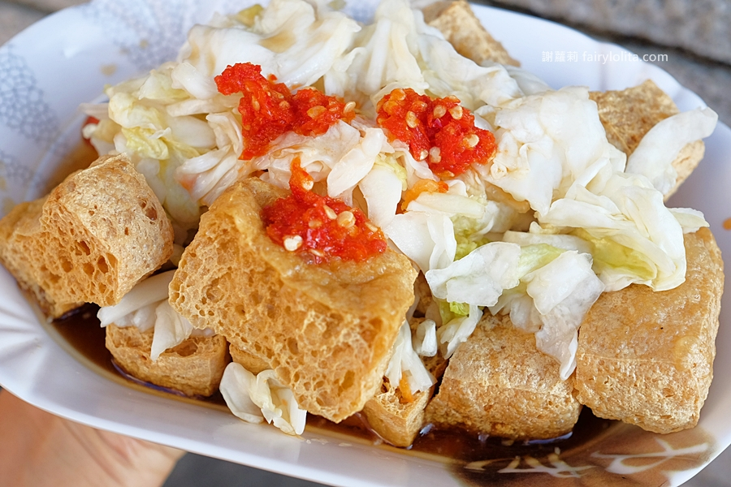
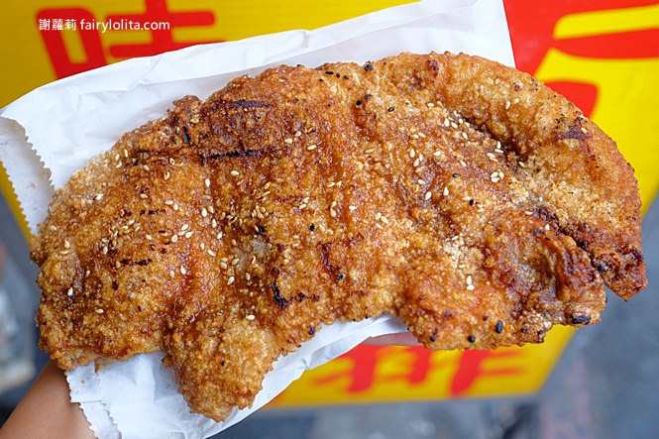
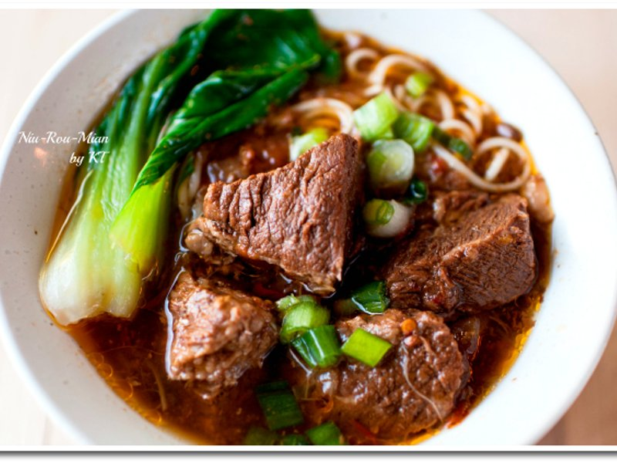
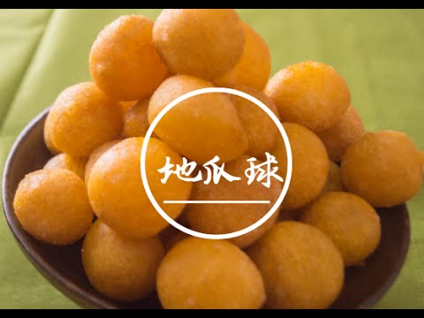

小吃
快餐
The people think of food as important as heaven
A famous saying from a Han dynasty
民以食为天

Slide 7
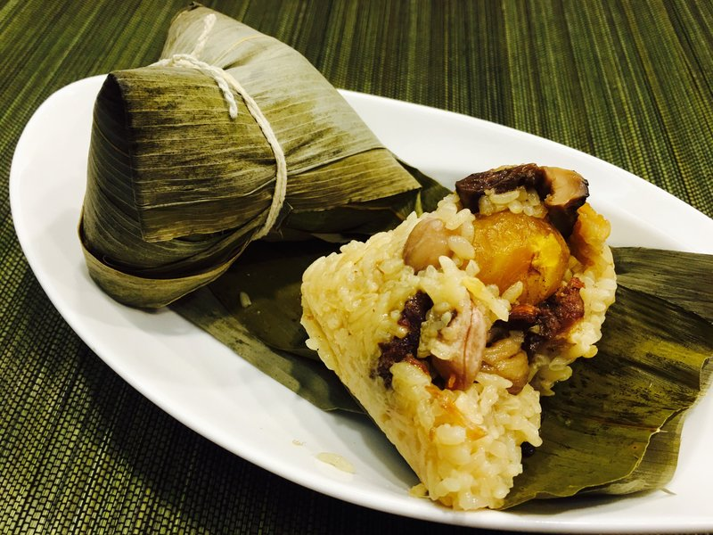
From past till present
从来
从来 is an adverb. It’s often followed by a word of negation such as 不 or 没
A：你吃过粽子吗？
B：我从来没吃过粽子。

Slide 8
From past till present
从来
从来 is an adverb. It’s often followed by a word of negation such as 不 or 没
I’ve never rode bikes.
我从来没骑过自行车。

Slide 9
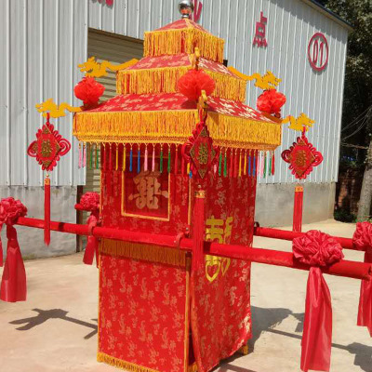
From past till present
从来
从来 is an adverb. It’s often followed by a word of negation such as 不 or 没
轿子
jiàozi
我从来没看过中国传统的轿子。

Slide 10
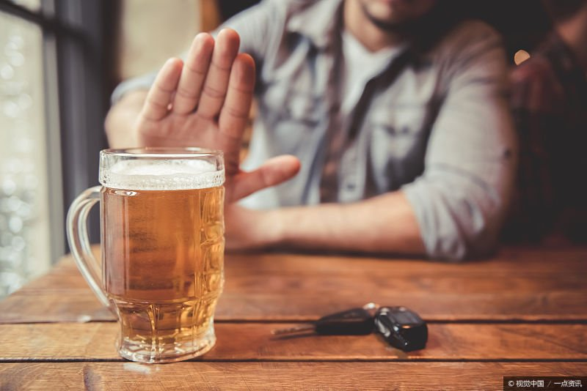
From past till present
从来
从来 is an adverb. It’s often followed by a word of negation such as 不 or 没
Ａ：你喝啤酒吗？/你喝不喝啤酒？
B：我从来不喝啤酒。

Slide 11

From past till present
从来
从来 is an adverb. It’s often followed by a word of negation such as 不 or 没
A：你买衣服在乎衣服的牌子吗？
B：我买衣服从来不在乎衣服的牌子。

Slide 12
From past till present
从来
从来 is an adverb. It’s often followed by a word of negation such as 不 or 没
造句

Slide 13
Adverb竟(然)
Formal Chinese
It suggests that something is unexpected from the speaker’s point of view

Slide 14
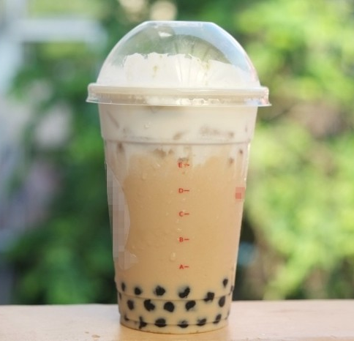

Adverb竟(然)
It suggests that something is unexpected from the speaker’s point of view
住在台湾三年
我从来没喝过珍珠奶茶。
你住在台湾三年，竟(然)没喝过珍珠奶茶。

Slide 15

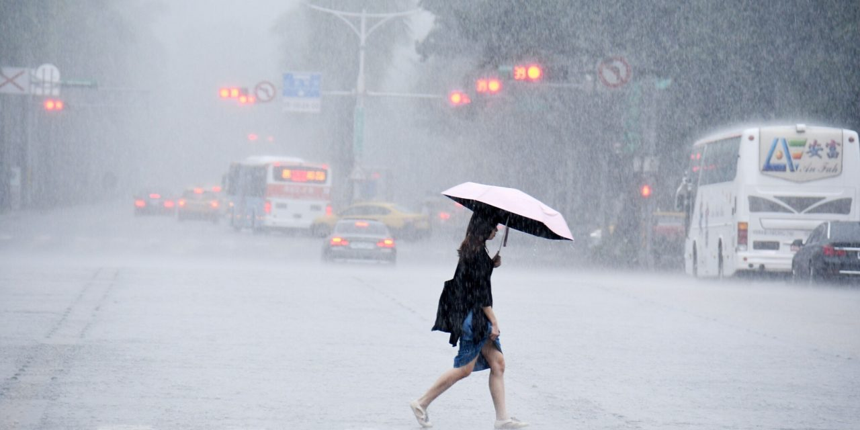
Adverb竟(然)
It suggests that something is unexpected from the speaker’s point of view
早上天气非常好
下午
早上天气非常好，下午竟(然)下雨了。

Slide 16

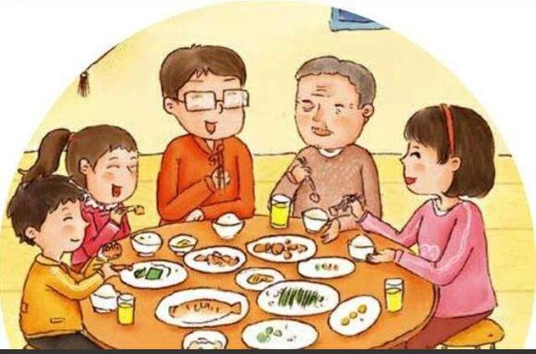

Adverb竟(然)
It suggests that something is unexpected from the speaker’s point of view
春节的时候我没回家。
春节的时候，他竟(然)没回家。

Slide 17

Adverb竟(然)
It suggests that something is unexpected from the speaker’s point of view
今天是张天明母亲的生日，没想到他….
什么！今天是我妈的生日？
今天是张天明母亲的生日，没想到他竟然忘得一干二净。

Slide 18
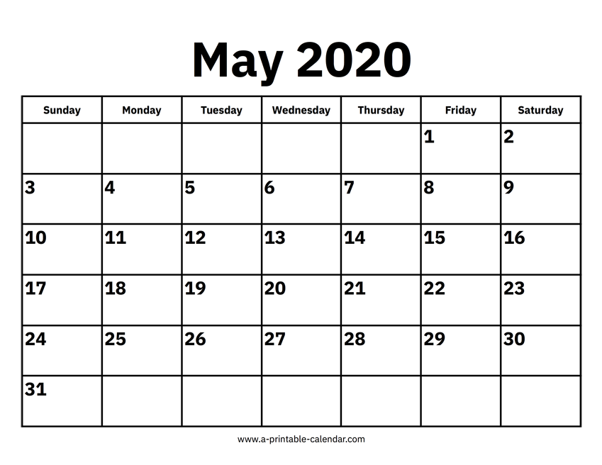
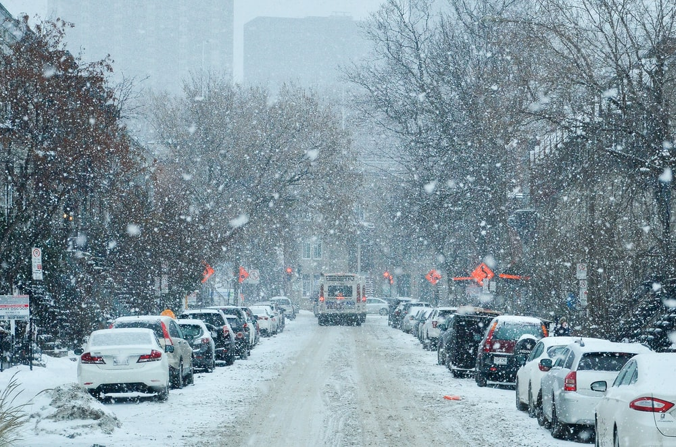
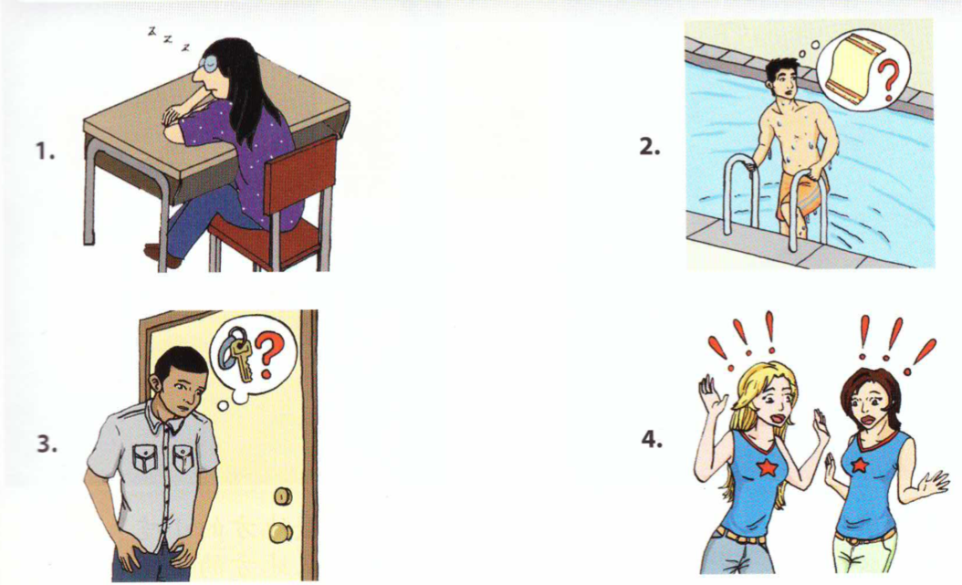
Adverb竟(然)

Slide 19
1. 五月竟然下雪了！
2. 她竟然睡着了。
3. 他竟然忘了他的毛巾。
4. 他竟然没带钥匙。
5. 她竟然跟她的朋友穿一样的衣服。

Slide 20
Adverb竟(然)
It suggests that something is unexpected from the speaker’s point of view
造句

Slide 21
看来
“It seems” “it appears”
Introduces a conclusion or opinions based on a previously stated fact or previously described situation

Slide 22

看来
“It seems” “it appears”
Introduces a conclusion or opinions based on a previously stated fact or previously described situation
张天明一整天没和丽莎说话，看来….
张天明一整天没和丽莎说话，看来他们闹别扭了。

Slide 23
看来
“It seems” “it appears”
Introduces a conclusion or opinions based on a previously stated fact or previously described situation
他没喝桌上的啤酒
他没喝桌上的啤酒，看来他不喜欢喝啤酒。

Slide 24
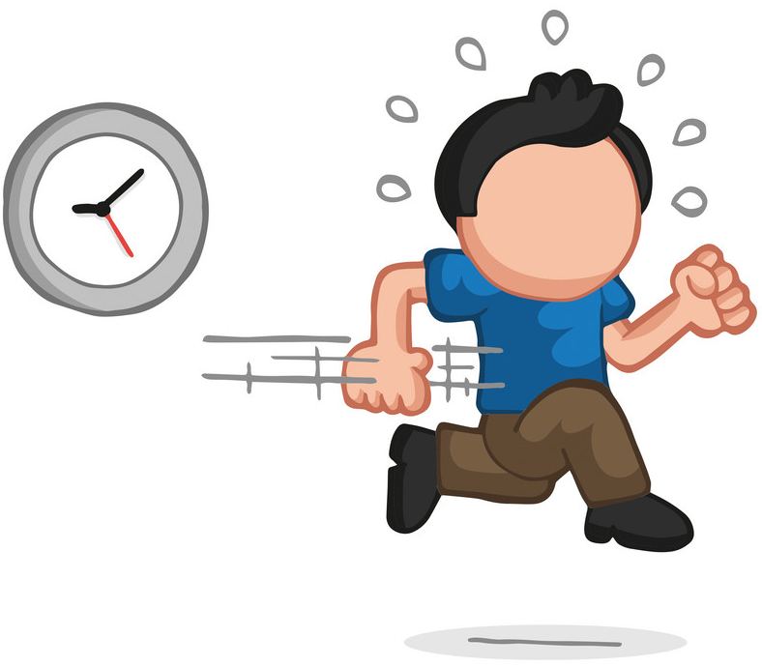
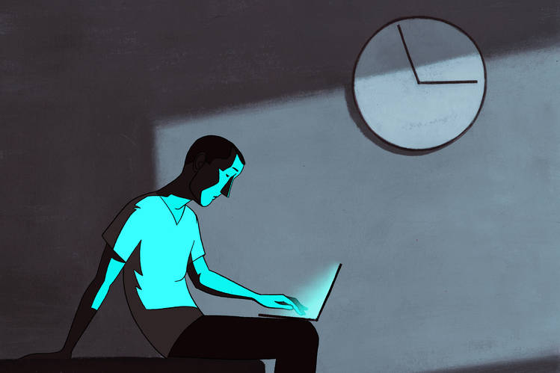
看来
“It seems” “it appears”
Introduces a conclusion or opinions based on a previously stated fact or previously described situation
他今天又迟到了
他今天又迟到了，看来他昨天很晚才睡。

Slide 25
看来
“It seems” “it appears”
Introduces a conclusion or opinions based on a previously stated fact or previously described situation
造句

Slide 26

To build
盖

Slide 27
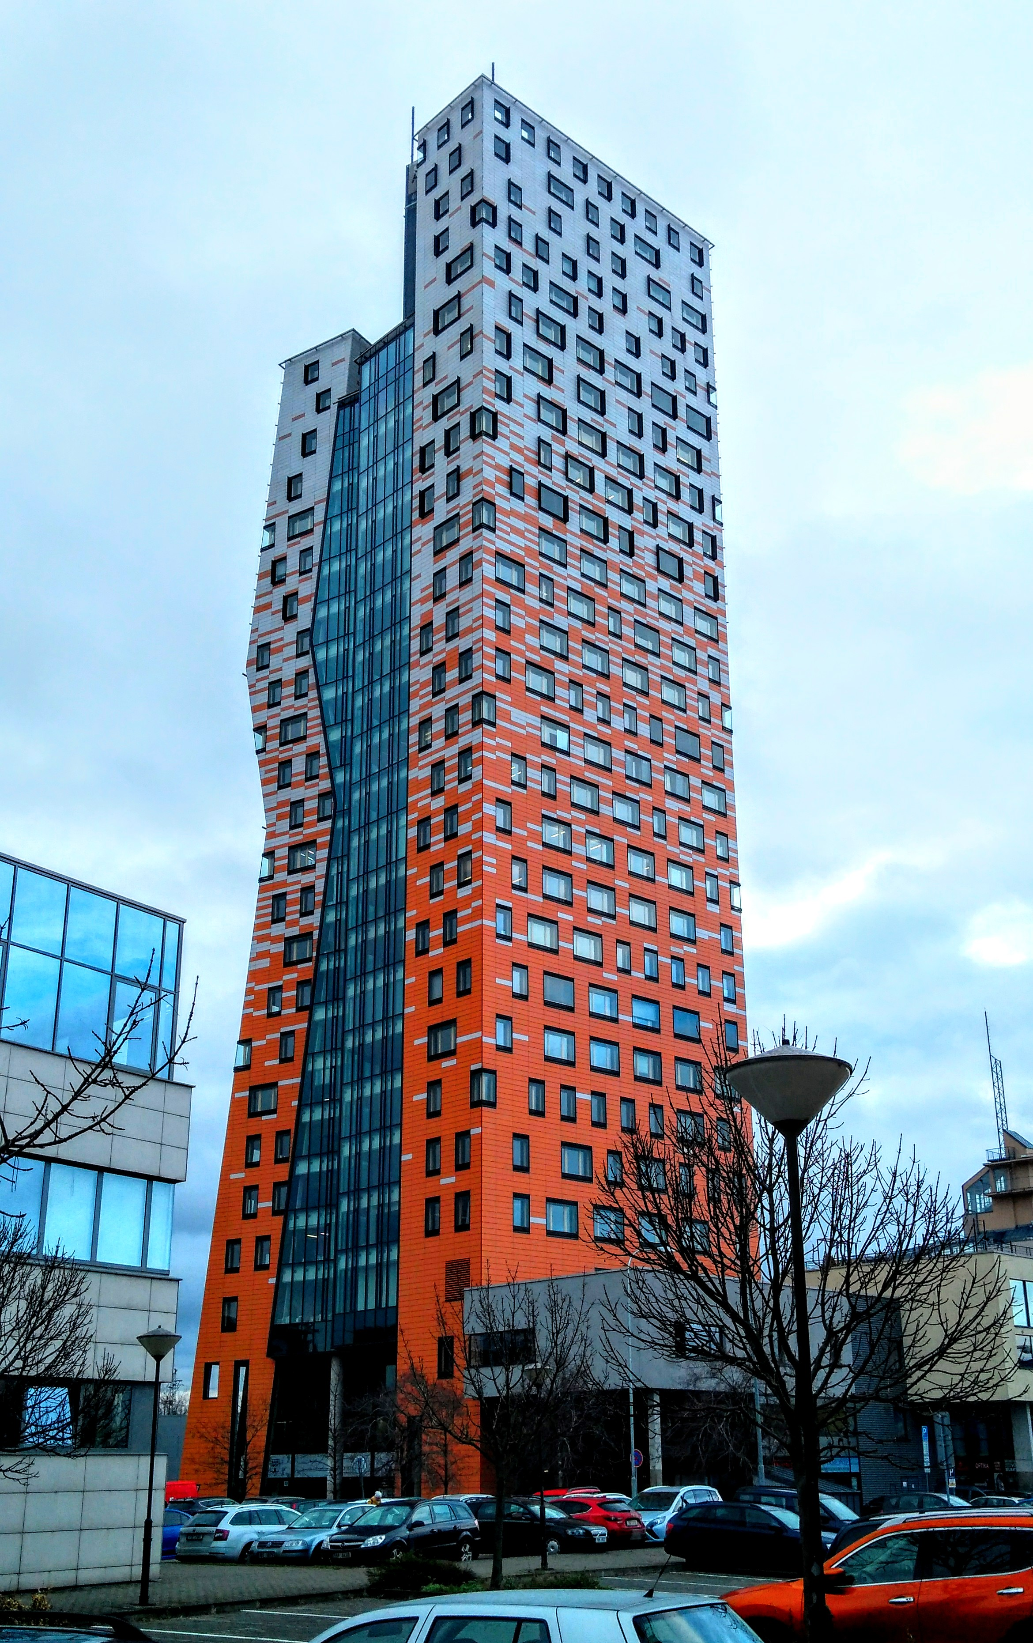
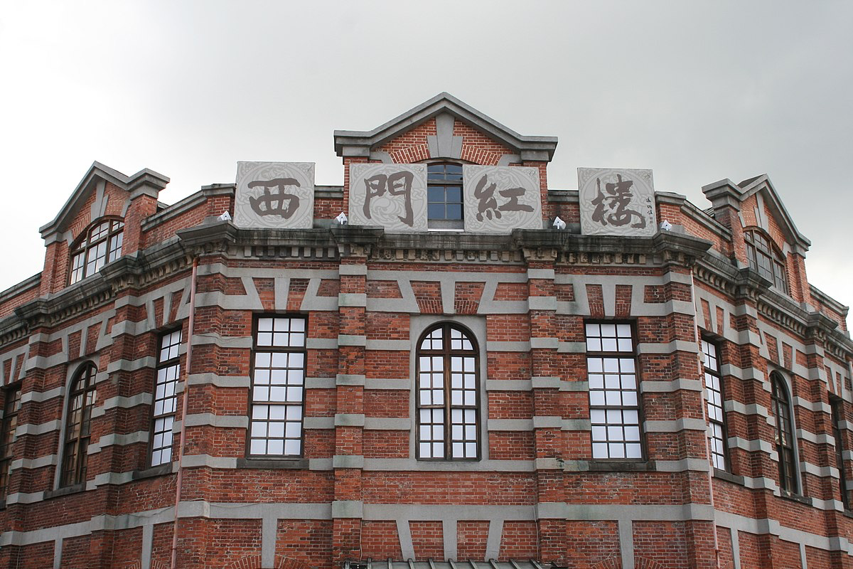
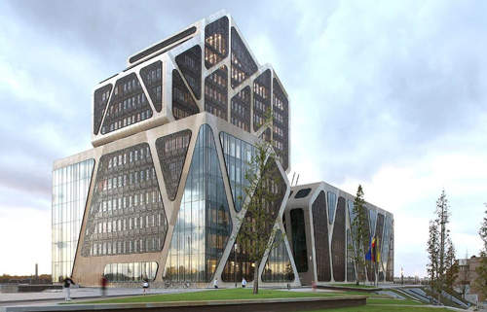
Tall building
There are many tall buildings in Taipei.
台北有很多高楼大厦。
Recent years there are a lot of change in Czech.
近年来捷克有很多(大)的变化。
近年来捷克变化很大。
N
高楼
大厦
V
change
变化

Slide 28


以前27克朗就能买到一杯珍珠奶茶，现在至少要42克朗才能买到一杯珍珠奶茶。
27克朗
42克朗
以前
现在
说一说捷克的变化

Slide 29
To change；become
变
My city has changed a lot.
我的城市变了很多。
End
末
Final exam
Final bus; train
期末考
末班车

Slide 30

Not have enough time
to do something; too late to do something
来不及+V
I don’t have enough time to finished my homework.
我来不及写完功课(作业)。
I was too late to catch the last bus.
我来不及坐到(上)末班车。

Slide 31

always (spoken Chinese)
always (formal way)
总
总是
My dad always say Czech beer is the best.
我爸爸总(是)说捷克的啤酒是最好的。
To be familiar with
I’m familiar with her.
我跟他很熟。
Here is my familiar place.
(熟)悉
这里是我熟悉的地方。

Slide 32
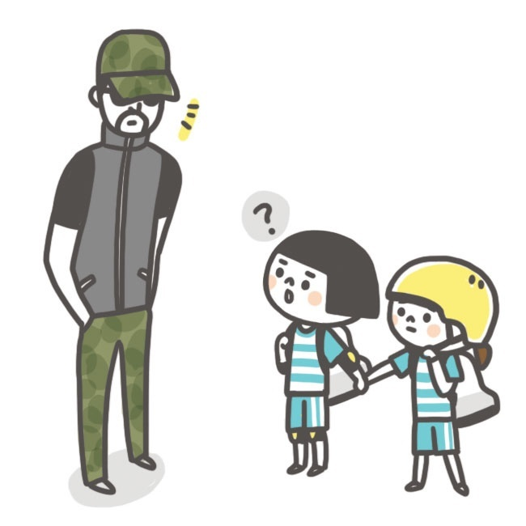

unfamiliar
陌生人
最熟悉的陌生人。
陌生
对面

Slide 33
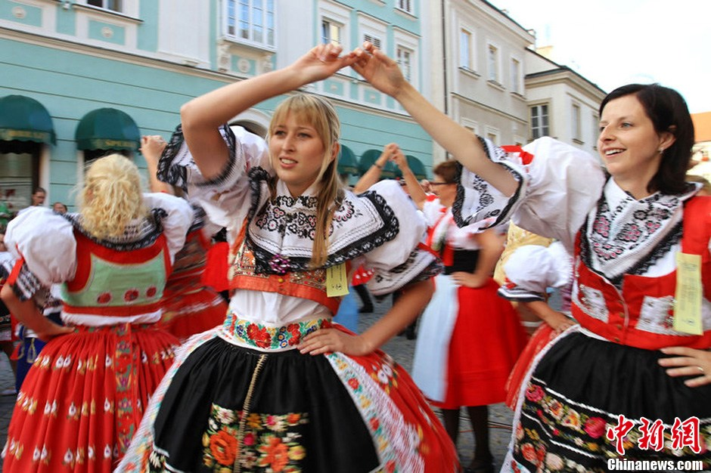
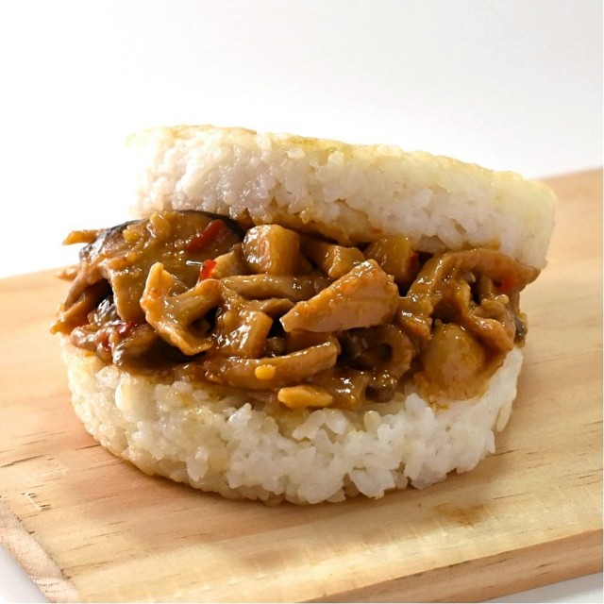
clothing
To meld into
融入
服装
characteristic
特色

Slide 34

Indeed
的确
的确is an adverb meaning “completely true” used to confirm a previous statement or fact
S/Topic+的确+something you have confirmed
A：在捷克吃不到月饼，对吧？
Topic
B：在捷克的确吃不到月饼。

Slide 35
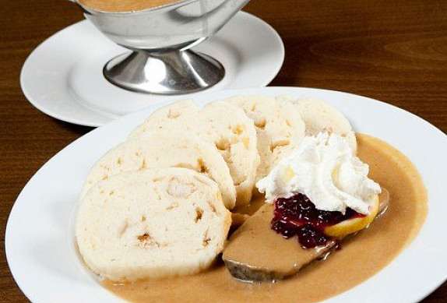
Indeed
的确
的确is an adverb meaning “completely true” used to confirm a previous statement or fact
S/Topic+的确+something you have confirmed
A：捷克的Svičková很好吃!
B：捷克的Svičková的确很好吃。

Slide 36

Indeed
的确
的确is an adverb meaning “completely true” used to confirm a previous statement or fact
S/Topic+的确+something you have confirmed
A：她真的跟你道歉了吗？
对不起，我错了。
B：她的确跟我道歉了。

Slide 37
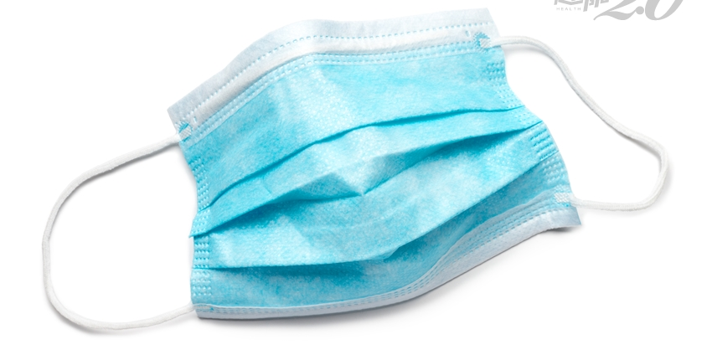
Indeed
的确
的确is an adverb meaning “completely true” used to confirm a previous statement or fact
S/Topic+的确+something you have confirmed
A：在捷克真的买不到口罩了吗？
口罩
kǒuzhào
B：在捷克的确买不到口罩了。

Slide 38
Indeed
的确
的确is an adverb meaning “completely true” used to confirm a previous statement or fact
S/Topic+的确+something you have confirmed
造句

Slide 39


As much as possible; do one utmost
尽可能
冠状病毒越来越严重，我们尽可能…
COVID-19
冠状病毒
guànzhuàng bìngdú
冠状病毒越来越严重，我们尽可能待在家里。

Slide 40

As much as possible; do one utmost
尽可能
快餐对身体不好，我们尽可能
少吃吧！
快餐对身体不好，我们尽可能少吃。

Slide 41


As much as possible; do one utmost
尽可能
上中文课的时候，我们尽可能…
上中文课的时候，我们尽可能说中文。

Slide 42

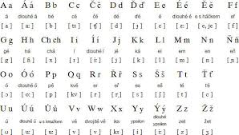
As much as possible; do one utmost
尽可能
如果你想在捷克生活，(你)尽可能…
如果你想在捷克生活，(你)尽可能学一些捷克语。

Slide 43
尽可能
As much as possible; do one utmost
造句

Slide 44
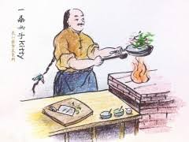
以A为B
“regard or treat A as B”
Written Chinese
食以安为先

Slide 45


以A为B
“regard or treat A as B”
Written Chinese
这是我家
把
当作
这位老师以校为家。

Slide 46

以A为B
“regard or treat A as B”
Written Chinese
我姐姐以帮助别人为自己最大的快乐。

Slide 47

Entirely; completely
Adverb
完全
＋Potential Complements
这里太暗了！
我完全看不到。
Àn

Slide 48

Entirely; completely
Adverb
完全
＋Potential Complements
WHAT???
他住在中国三年了
他住在中国三年了，可是他完全听不懂中文。

Slide 49

Entirely; completely
Adverb
完全
完全？
＋不/没+V
这个语法你知道怎么用吗？
这个语法我完全不知道怎么用。

Slide 50

Entirely; completely
Adverb
完全
＋不/没+V
考试的前一天没看书
考试的前一天他完全没看书。

Slide 51
Entirely; completely
完全
Adverb
造句

Slide 52
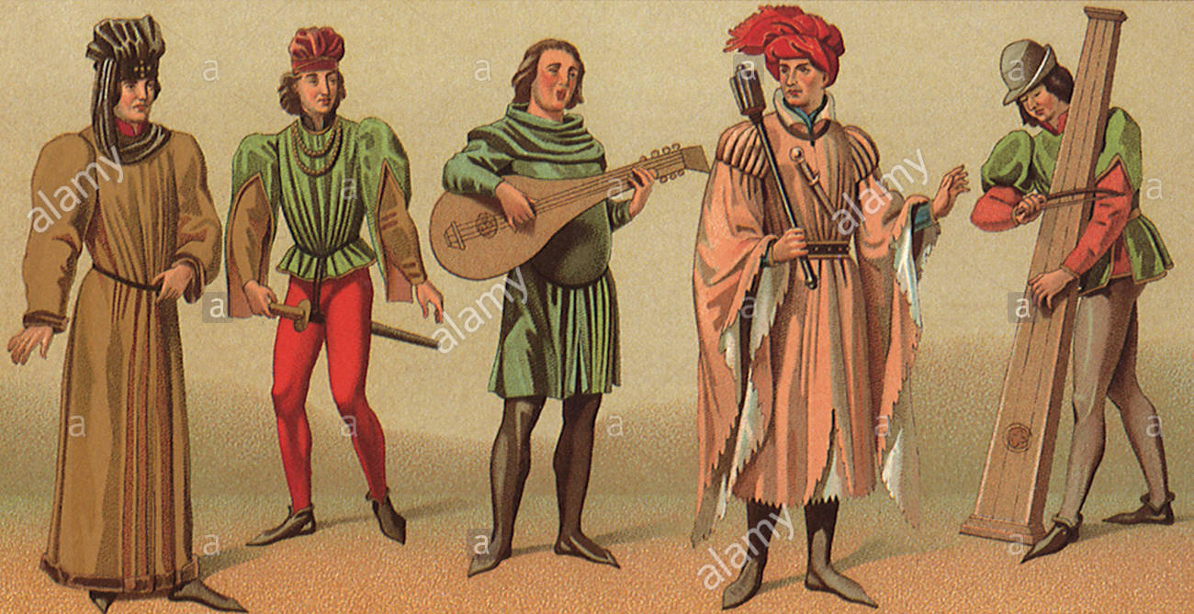
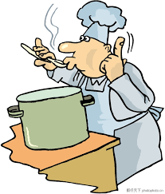
To keep; to remain as before
common folk
保留
老百姓
平民老百姓
尝尝看
尝一尝
尝
尝起来
这碗汤尝起来很咸。

Slide 53


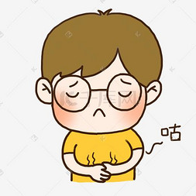

sound; voice
foot steps
声音
脚步
我的肚子咕噜咕噜叫。
难过
咕噜

Slide 54
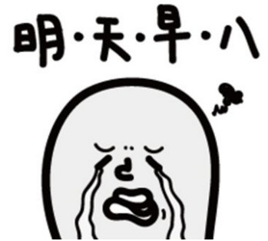
要不是
If it were not for; but for
要不是+something has occurred+ something won’t happen
(如果没有…)
要不是上早上八点的课，我不必这么早起。

Slide 55


要不是
If it were not for; but for
要不是+something has occurred+ something won’t happen
(如果没有…)
要不是天气不好，我今天肯定去打球。

Slide 56
要不是
If it were not for; but for
要不是+something has occurred+ something won’t happen
(如果没有…)
要不是昨天晚上太晚睡，我今天根本不会迟到。

Slide 57

要不是
If it were not for; but for
要不是+something has occurred+ something won’t happen
(如果没有…)
要不是(我)来捷克，我根本不会认识你们。

Slide 58
If it were not for; but for
要不是
(如果没有…)
要不是+something has occurred+ something won’t happen

Slide 59
particle 过
One usage of 过 is as a complement indicating completion
你去过南京夫子庙了吗？
你去过南京夫子庙吗？
我去过南京夫子庙。
我(从来)没去过南京夫子庙。
我去过南京夫子庙了。

Slide 60
particle 过
One usage of 过 is as a complement indicating completion
这个语法你学过了吗？
I think you did that
这个语法你学过吗？
I’m not sure
这个语法我学过了。
这个语法我学过。

Slide 61
particle 过
One usage of 过 is as a complement indicating completion
台湾的小吃你吃过吗？

Slide 62
particle 过
猜一猜
他做过什么事？

Slide 63
Adverb 可(是)continued
The adverb可(是)can mean “indeed”,”very true” in a conversation to affirm or emphasize a fact. This usage typically occurs in spoken Chinese
Especially in Chinese soap opera

Slide 64

Adverb 可(是)continued
The adverb可(是)can mean “indeed”,”very true” in a conversation to affirm or emphasize a fact.
A：你不是说他们分手了吗？
B：我可没说他们分手了。

Slide 65

Adverb 可(是)continued
The adverb可(是)can mean “indeed”,”very true” in a conversation to affirm or emphasize a fact.
布尔诺
对不起，你买不到口罩了。
现在在布尔诺你可买不到口罩。

Slide 66

Adverb 可(是)continued
The adverb可(是)can mean “indeed”,”very true” in a conversation to affirm or emphasize a fact.
在捷克你可看不到熊猫。

Slide 67

Adverb 可(是)continued
The adverb可(是)can mean “indeed”,”very true” in a conversation to affirm or emphasize a fact.
那个景点太远，走路可走不到。

Slide 68
End of sentence particle 啊
A. At the end of an exclamatory sentence
你看！今天雨下得多大啊！
你尝！这个蛋糕多好吃啊！
她的汉字写得多好啊！
这台手机多贵啊！

Slide 69
End of sentence particle 啊
B. At the end of a declarative sentence to explain or remind
别忘了你的钥匙啊！
我们就是你的家人和朋友啊！
今天你吃的食物就是Svičková啊！
明天没有中文课啊！

Slide 70
End of sentence particle 啊
C. At the end of question
谁啊？
中午吃什么啊？
昨天你几点睡啊？

Slide 71
End of sentence particle 啊
D. 啊can tone down an imperative sentence
这些菜别吃完啊！
小心点儿啊！
别急啊！慢慢来。

