Slide 1
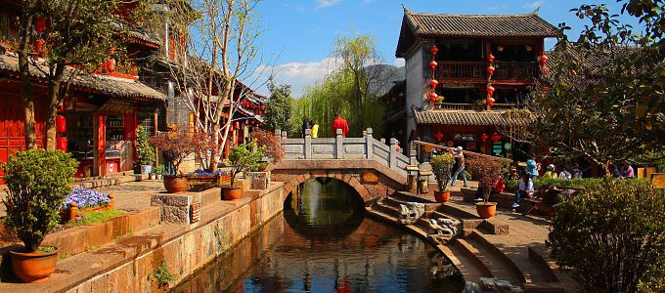
第十三课 旅游
老师：郑学懿

Slide 2


self-assisted travel
自由行
旅行团

Slide 3


To participate
To sign up; to register
报名
参加
你想要自由行还是参加旅行团？为什么？

Slide 4
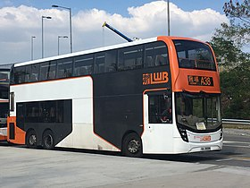
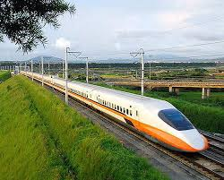

transportation
To including; to consist of
包括
交通
Fee of tour group including transportation and ticket
门票
包括交通和门票。
旅行团费____________________

Slide 5
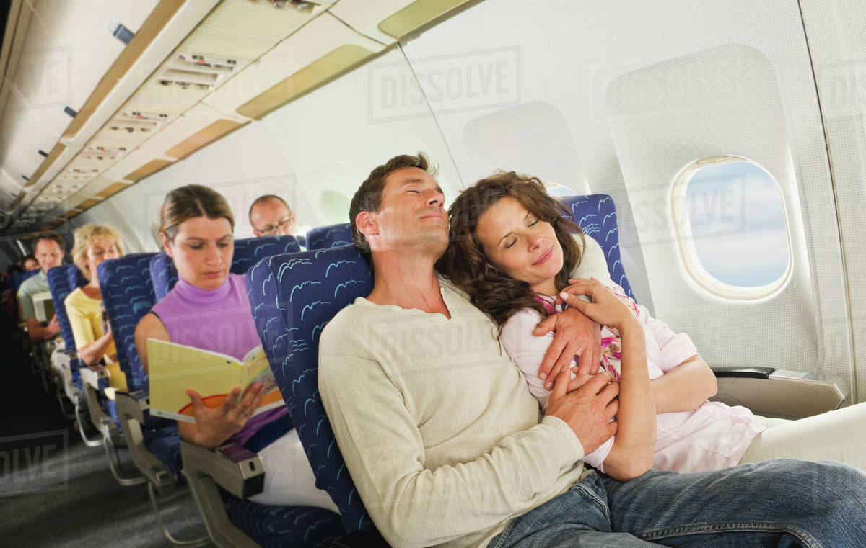
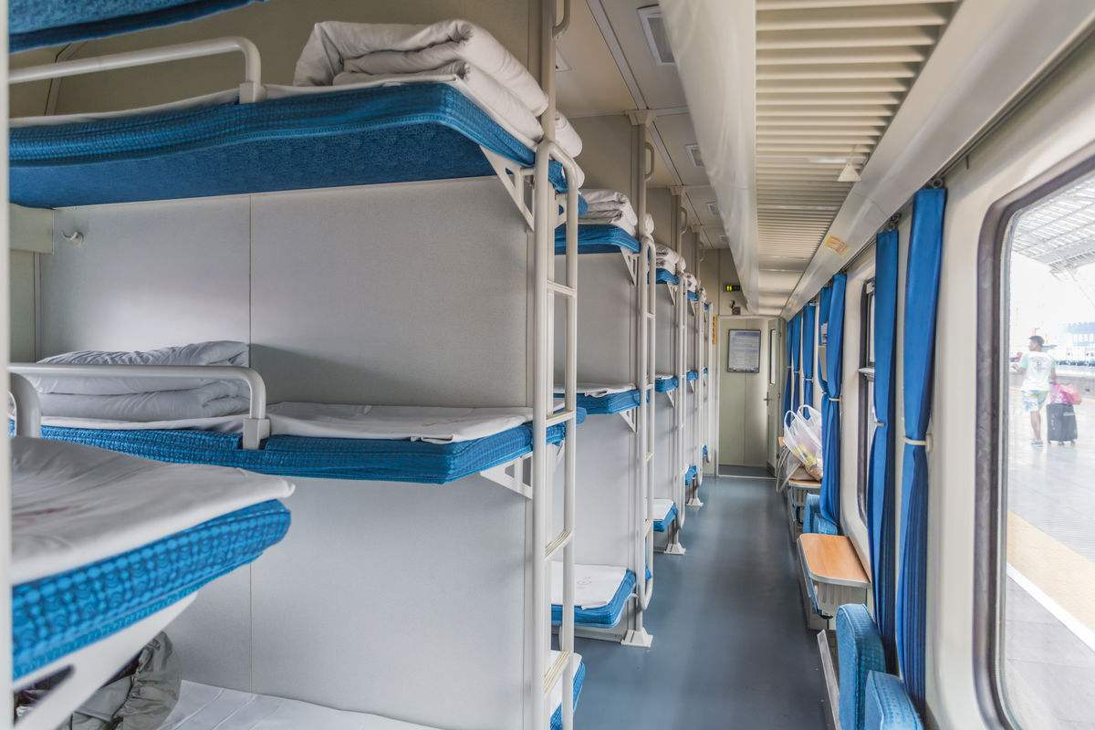
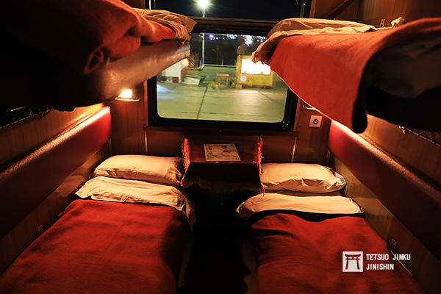
passenger
All passenger please pay attention.
各位旅客请注意。
旅客
枕头
硬铺
软铺
卧铺

Slide 6
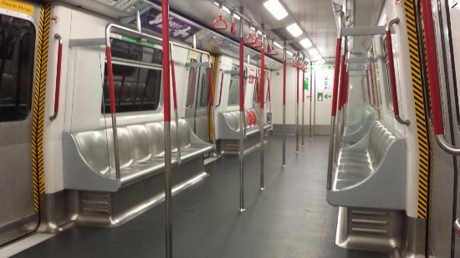

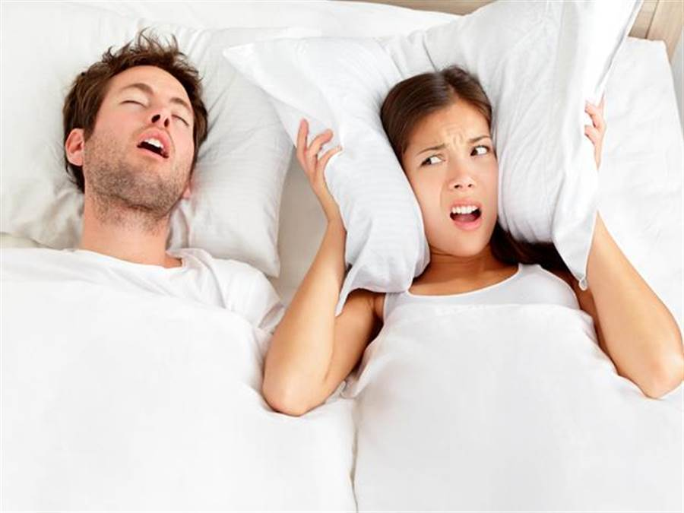
soft
railway carriage
软
车厢
呼噜呼噜...
打呼噜

Slide 7
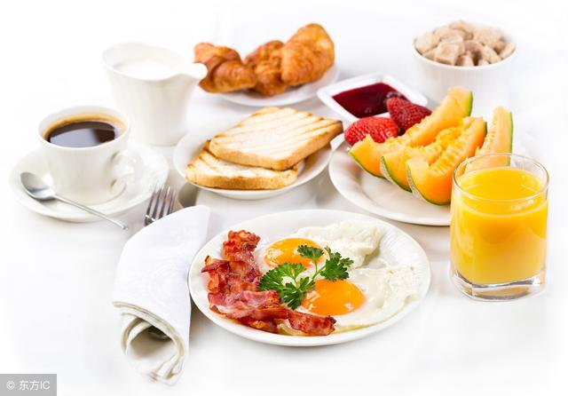
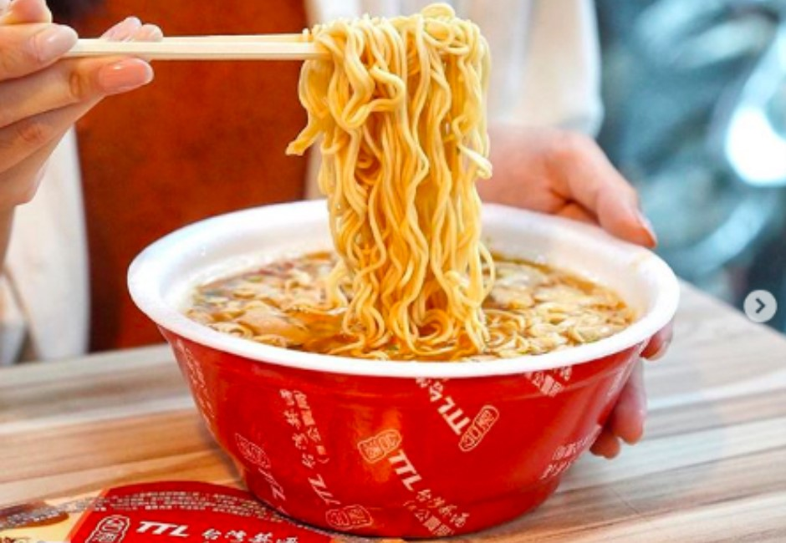
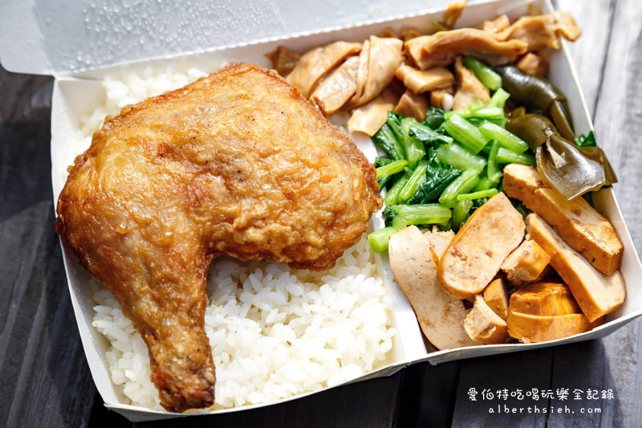
This breakfast looks nice
Measure word of meal
顿
这顿早饭看起来很不错。
(餐)
盒饭
便当
泡面
方便面

Slide 8

Impression
印象
1. 有/没有印象
degree of adverb
2. A对B的印象很好/不好/很深/不错
3. B给A留下很好/不好/很深的印象

Slide 9
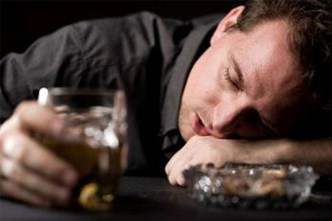
Impression
印象
1. 有/没有印象
昨天他说的话你还有印象吗？
昨天他说的话我没有印象了，因为我喝醉了。

Slide 10
Impression
印象
1. 有/没有印象
以前学过的语法你还有印象吗？
语法
V得出来
以前学过的语法我还有印象。

Slide 11

Impression
印象
2. A对B的印象(很好/不好/很深/不错)
A：第一次见面的时候你对我的印象怎么样？
B：我对你的第一印象很好。
B：我对你的第一印象就是你很善良、很聪明。

Slide 12
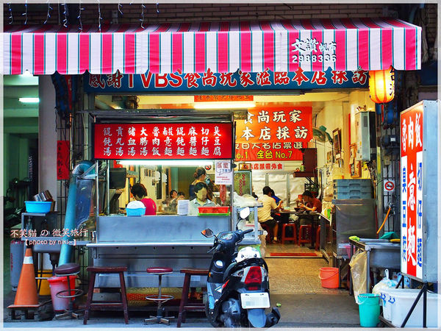
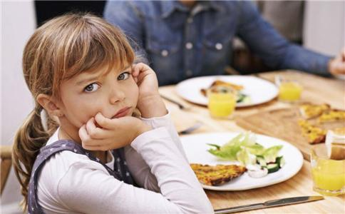
Impression
印象
1. A对B的印象(很好/不好/很深/不错)
她对那家饭馆儿的印象怎么样？
菜很咸，很难吃。
她对那家饭馆儿的印象不好，它的菜很咸、很难吃。

Slide 13
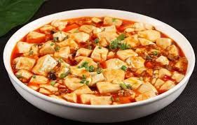
Impression
印象
3. B给A留下(很好/不好/很深的)印象
A：哪道中国菜给你留下最深的印象？
B：麻婆豆腐给我留下最深的印象。

Slide 14

Impression
adj.
印象
2. B给A留下(很好/不好/很深的)印象
哪个国家给你留下友好的印象?
捷克给我留下友好的印象。

Slide 15
adj.
Impression
印象
2. A对B的印象(很好/不好/很深/不错)
3. B给A留下(很好/不好/很深的/adj.)印象
造句

Slide 16
before; prior to
之前
之前 means “before such a time.” If the time is specified, the preposition 在 can be used. When used alone at the beginning of sentences, 之前 means “beforehand” or “previously”
以前
之前
现在
A little bit like 以前, but for native speaker 之前 is “not longer before”

Slide 17

before; prior to
之前
“before such a time.”
(在)…之前
A：你有没有吃过中国菜？
我吃过中国菜
B：来中国(之)前，我吃过中国菜。

Slide 18

before; prior to
之前
“before such a time.”
(在)…之前
A：(在)旅游之前，我们需要做什么？
B：(在)旅游之前，我们需要查好资料。

Slide 19


before; prior to
之前
“before such a time.”
(在)…之前
(在)吃饭之前，你会做什么？
(在)吃饭之前，我会洗手。

Slide 20

before; prior to
之前
When 之前 used alone at the beginning of sentences or after a subject, it means “beforehand” or “previously”
之前我学过画画儿。
我之前学过画画儿。

Slide 21

before; prior to
之前
When 之前 used alone at the beginning of sentences or after a subject, it means “beforehand” or “previously”
Someone told me this thing before
之前有人告诉我这件事。
有人之前告诉我这件事。
x
之前没人告诉我这件事。
没人之前告诉我这件事。

Slide 22
before; prior to
之前
之前 means “before such a time.” If the time is specified, the preposition 在 can be used. When used alone at the beginning of sentences, 之前 means “beforehand” or “previously”
造句

Slide 23
Have no choice but
只好
Sold out
盒饭卖完了，我们只好吃方便面。

Slide 24
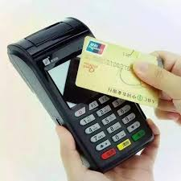
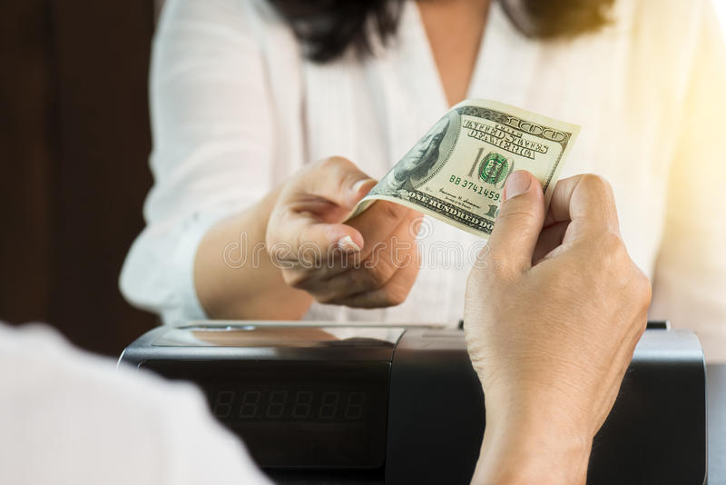
Have no choice but
只好
Ｘ
Ｏ
这家饭馆儿不能刷卡，只好付现(金)。

Slide 25
Have no choice but
只好
她的男朋友在她旁边打呼噜，她只好去别的房间睡觉。

Slide 26
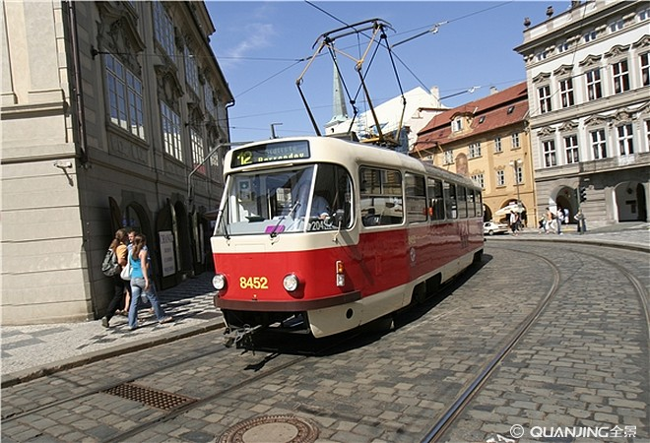
Have no choice but
只好
电车坏了
电车坏了，我们只好走路去学校。

Slide 27
Have no choice but
只好
造句

Slide 28
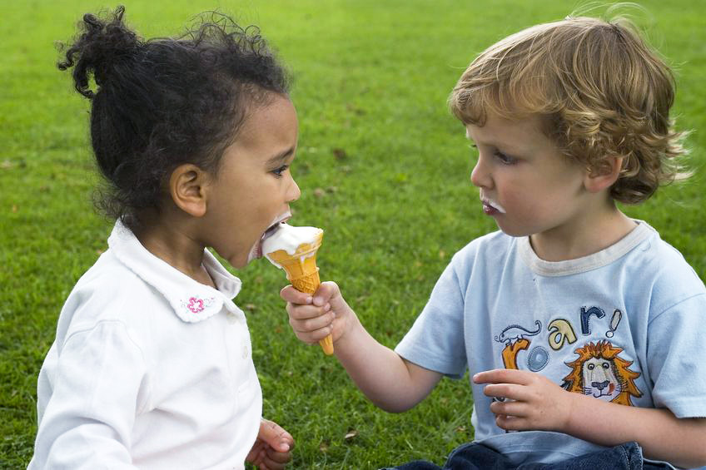
To leave behind
Deep
深
留(下)
哪个国家或地方给你留下最深的印象？
To share
To share your traveling experience
分享一下你的旅游经验。
分享

Slide 29

分享
To share joy, happiness, benefit, or something pleasant or positive
usage:跟/和 someone 分享
丽莎跟天明要结婚了，他们跟大家分享喜悦。
xǐyuè

Slide 30

分享
To share joy, happiness, benefit, or something pleasant or positive
usage:跟/和 someone 分享
如果你中乐透，你想跟谁分享你的快乐？
lètòu
win lottery

Slide 31




To set out; to depart (for travel)
出发
拥抱
To tease; to play with
她说笑话逗我开心。
To make
逗

Slide 32
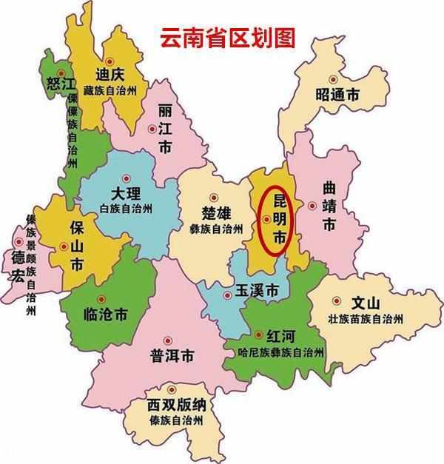
humorous
幽默
provincial capital
昆明市是云南省的省会
省会

Slide 33

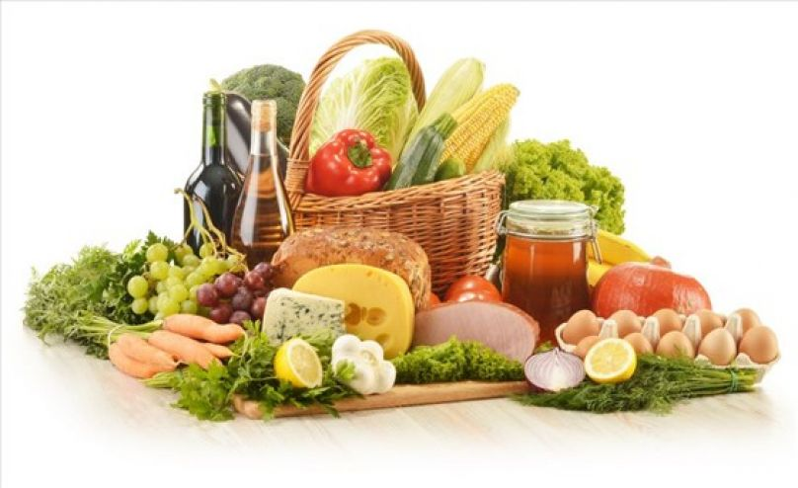
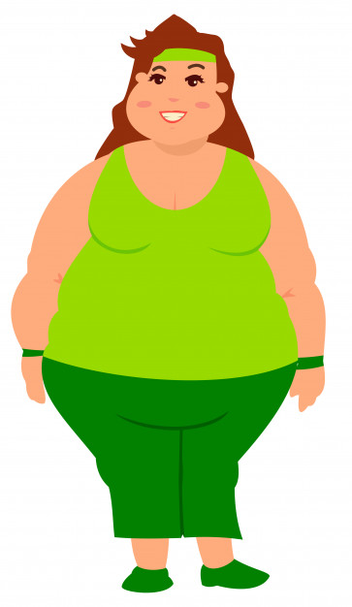
diet; food and drink
饮食
习惯
Do I need to change my diet?
每个国家的饮食习惯不一样。
我需要改变我的饮食吗？

Slide 34
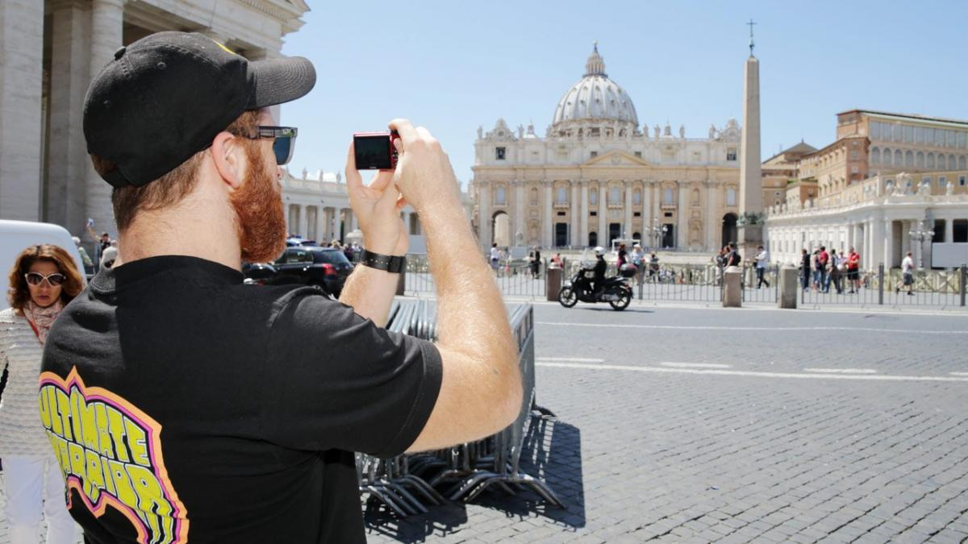

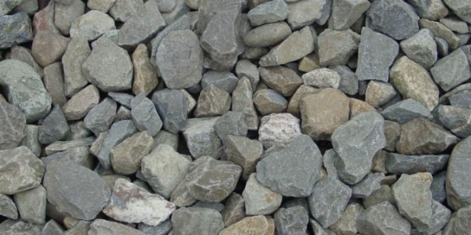
custom
To go sightseeing
风俗
游览
树林
石头

Slide 35
1
2
separately; to part from each other
分别
1
+ action verb
The adverb 分别 is usually used before action verbs
separately

Slide 36



separately
(adv.)
分别
+ action verb
我给朋友们分别打了电话。

Slide 37

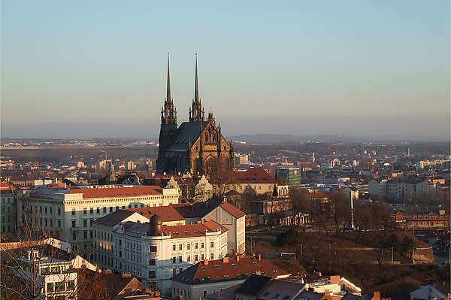
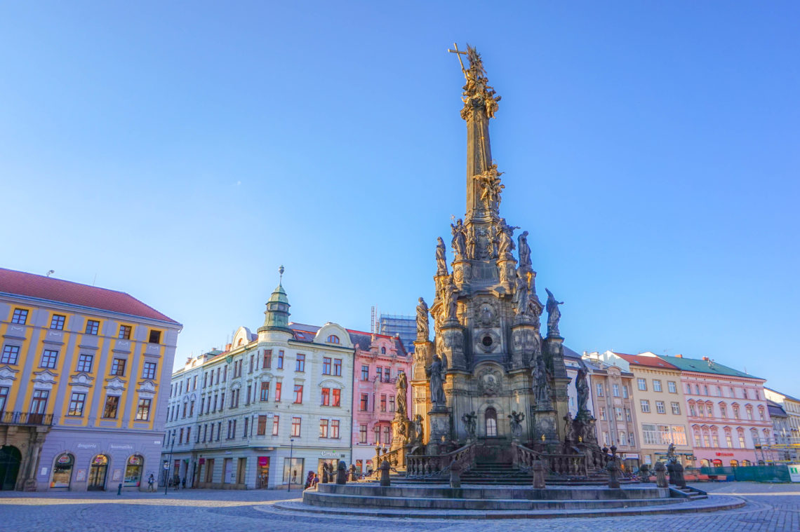
separately
(adv.)
分别
+ action verb
A：你去了捷克哪里？
B：我去了三个地方，
分别是布尔诺、布拉格和Olomouc。

Slide 38
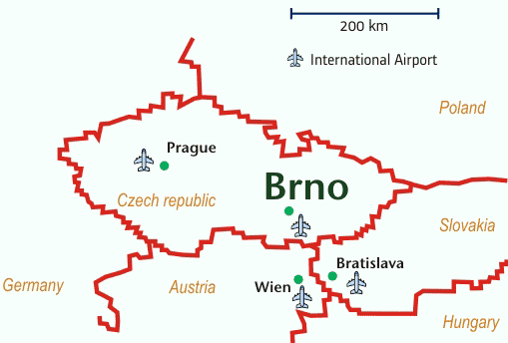
separately
(adv.)
分别
+ action verb
They go separately on Friday.
他们星期五分别出发
他们星期五分别从布拉格和布拉提斯拉发出发。

Slide 39
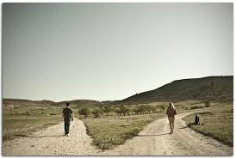
“To separate”; “to part from each other”
(V.)
分别
2
毕业后，我就和同学们分别了。

Slide 40
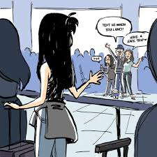

“To separate”; “to part from each other”
分别
2
After she separated with her family, she call her family everyday.
她和家人分别以后天天给家人打电话。

Slide 41
separately; to part from each other
分别
+ action verb
The adverb 分别 is usually used before action verbs
separately
造句

Slide 42


讲
My mom tell me a story.
故事
我妈妈跟我讲一个故事。
讲
+
电话
事情

Slide 43

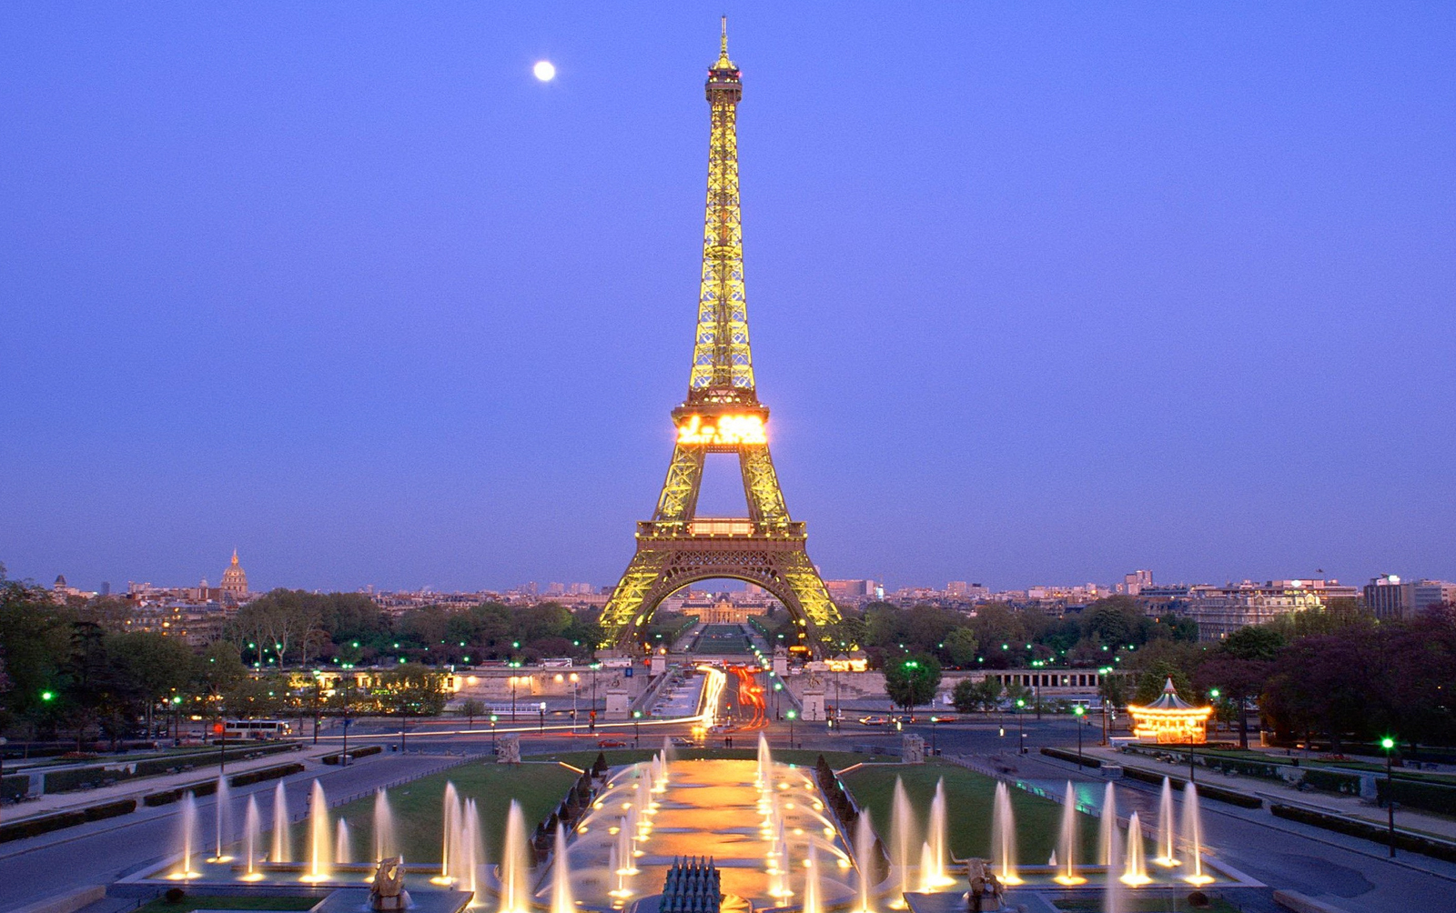

塔
埃菲尔铁塔
Ài fēi ěr tiě tǎ
纪念品
1889年盖好的
1891年盖好的
ancient; old
哪个塔比较古老？
佩特任瞭望塔
pèi tè rèn liàowàng tǎ

Slide 44
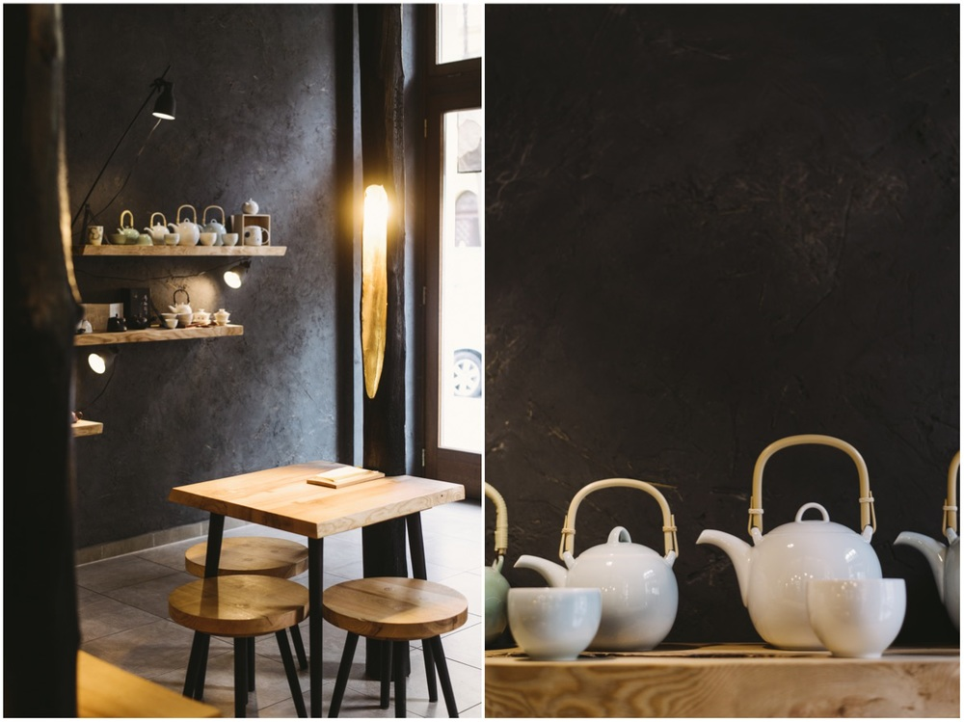
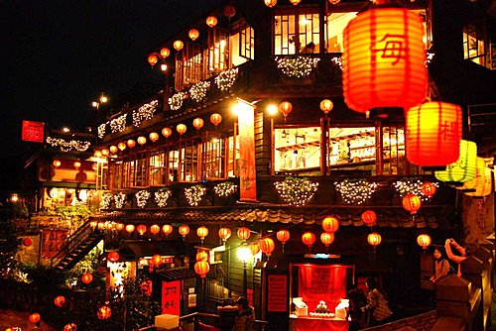
tea house
茶馆
灯笼🏮

Slide 45
1
To come and go
2
connection
来往
1
There are many people to come and go in the train station.
车站里来往的人很多。
/车站里来来往往的人很多。
2
After we broke up, we don’t have any connection.
我们分手后没有任何的来往。

Slide 46

Landlord
房东

Slide 47

语法

Slide 48
by all means; absolutely must
千万
Means “to make certain” It occurs in imperative sentences to advise or to urge.

Slide 49
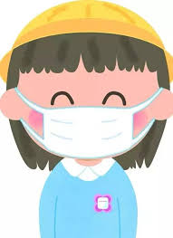
by all means; absolutely must
千万
Usage: 千万+要/别+your advice or urge
现在出门千万……
Don’t forget your mask
现在出门千万别忘了戴口罩。
dài
zhào

Slide 50
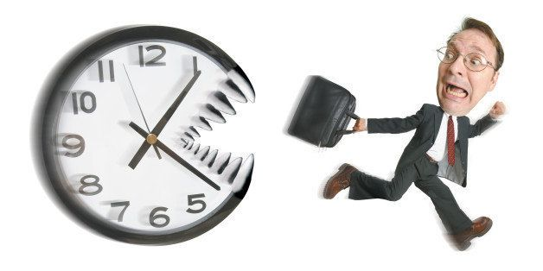
by all means; absolutely must
千万
Usage: 千万+要/别+your advice or urge
明天考期末考，你千万……
明天考期末考，你千万别迟到了。

Slide 51

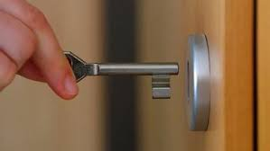
by all means; absolutely must
千万
Usage: 千万+要/别+your advice or urge
出门的时候千万要记得……
锁门
suǒ mén
出门的时候千万要记得带钥匙。

Slide 52

by all means; absolutely must
千万
Usage: 千万+要/别+your advice or urge
去旅游千万要记得….
?
去旅游千万要记得买纪念品。

Slide 53

by all means; absolutely must
千万
Usage: 千万+要/别+your advice or urge
去旅游千万别….
？
护照
hùzhào
去旅游千万别忘了带护照。

Slide 54
by all means; absolutely must
千万
Means “to make certain” It occurs in imperative sentences to advise or to urge.
造句

Slide 55
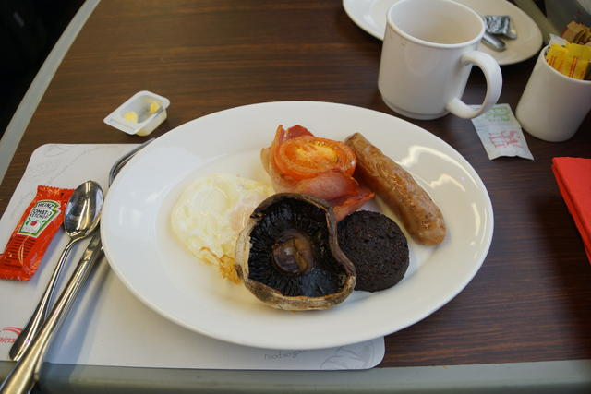
You Mustn’t Do It!
Based on each of the scenarios below, advise your friend against doing something by using 千万别。
火车上的东西又贵又不新鲜，
千万别在火车上买东西吃。

Slide 56
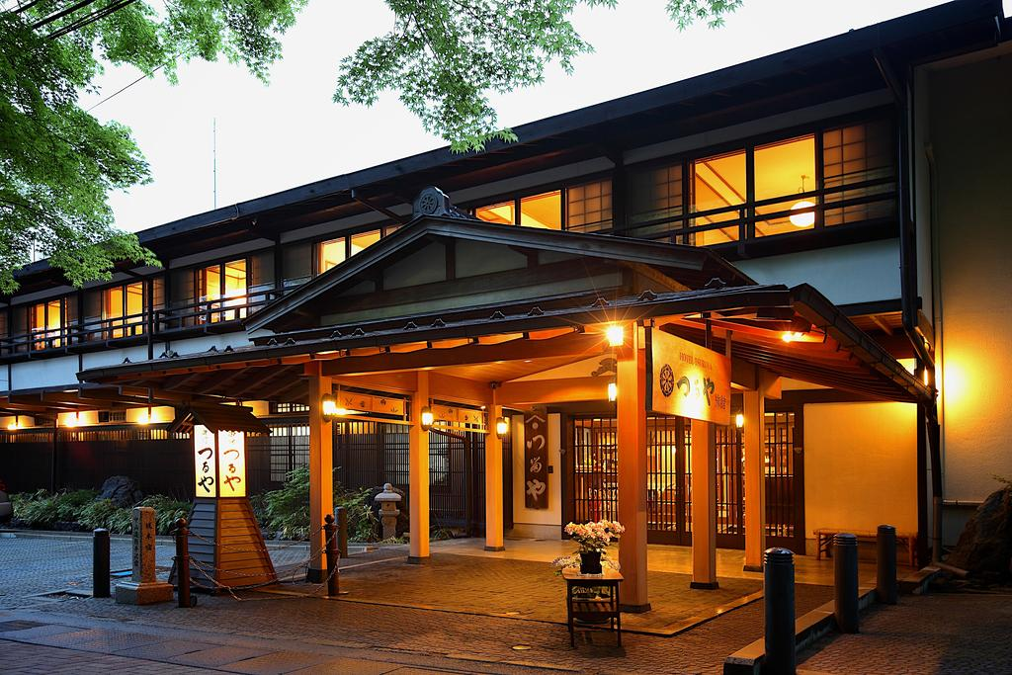

那个家庭旅馆又不干净，又不能上网，
千万别住那个家庭旅馆。
八月的时候三十五度
云南南部八月非常热，
八月的时候千万别去。

Slide 57
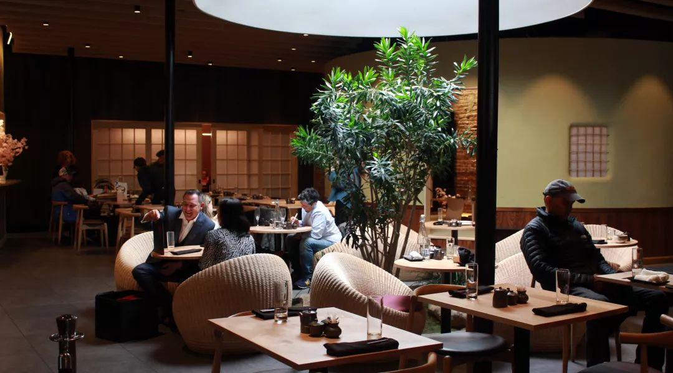
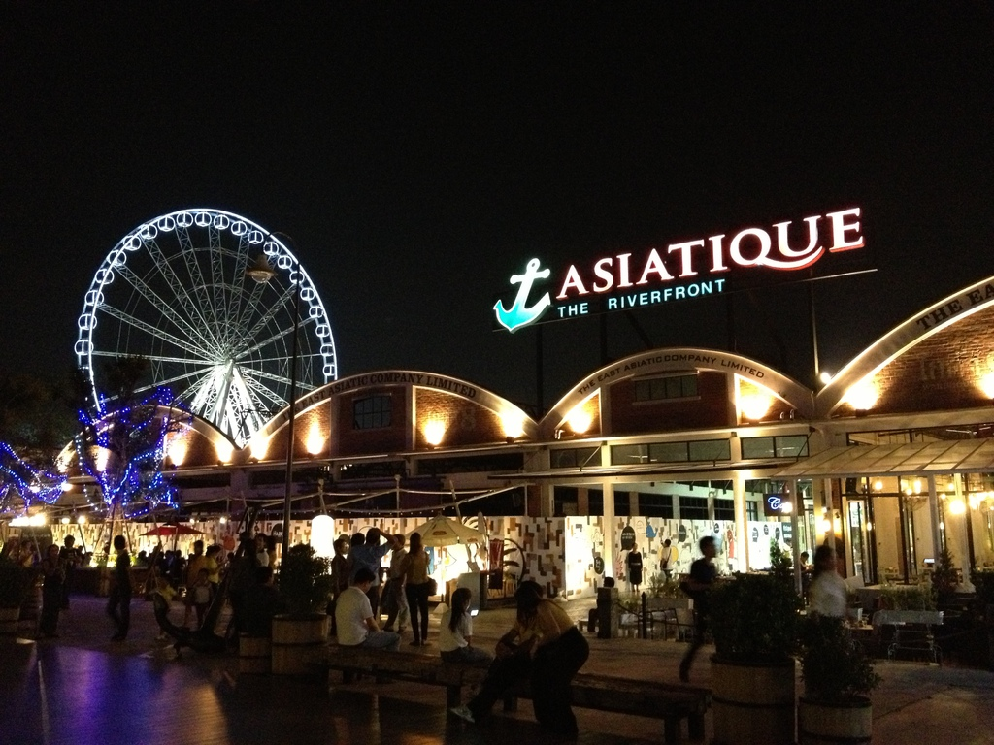
对面茶馆卖的茶贵极了，
千万别买他的茶。
河边那个景点这几天人太多，挤死了，
千万别去那个景点。

Slide 58
Adverbs
亲眼，亲自，亲耳，亲手，亲身
👀
👂
👋
亲is short for 亲自(oneself). 亲手、亲眼 and 亲耳 suggest firsthand experiences, whereas 亲身 and 亲自 convey personal attention and special care because the person considers it important to do so.

Slide 59
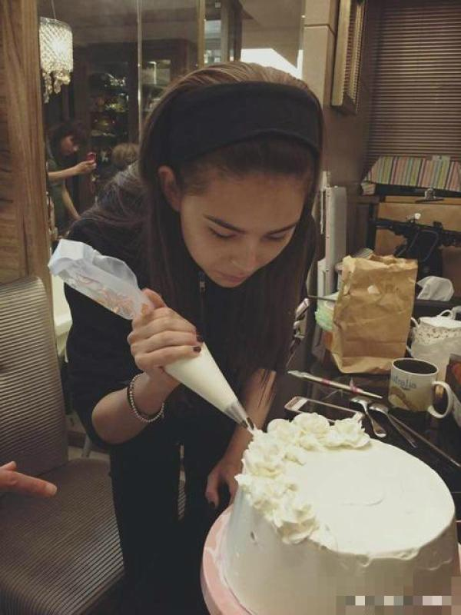
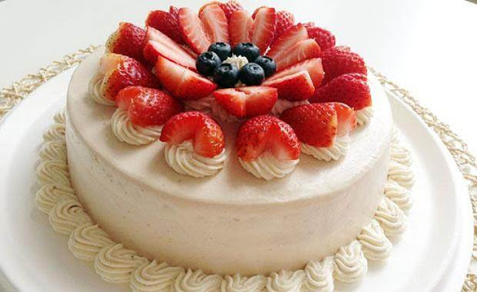
Adverbs
亲手
suggest firsthand experiences
这个蛋糕是她亲手做的。

Slide 60
Adverbs
亲眼
suggest firsthand experiences
他终于亲眼看到埃菲尔铁塔了！

Slide 61

Adverbs
亲耳
suggest firsthand experiences
Did you hear she say she break up with her boyfriend by yourself?
我跟我男友吹了。
你是亲耳听见她说她和她男友吹了吗？

Slide 62
Adverbs
亲口
suggest firsthand experiences
Yes, she told me by herself.
我跟我男友吹了。
对，是她亲口告诉我的。

Slide 63
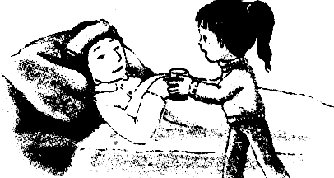
Adverbs
亲自
convey personal attention and special care because the person considers it important to do so.
我妈妈生病了，我得亲自去看她。

Slide 64
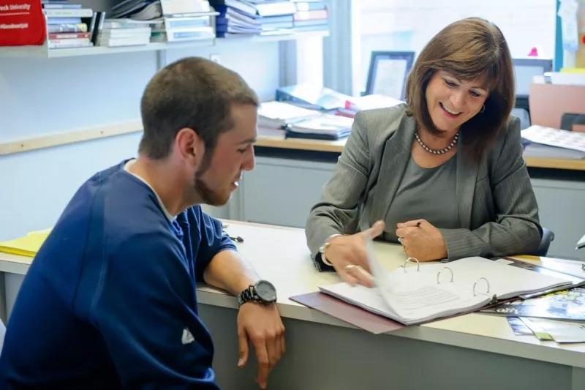
Adverbs
亲自
convey personal attention and special care because the person considers it important to do so.
你的指导教授有事找你，请你亲自去找她。

Slide 65
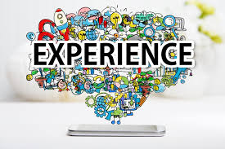
Adverbs
亲身
convey personal attention and special care because the person considers it important to do so.
亲身+own experience
这些是我的亲身经历。
jīnglì

Slide 66
Adverbs
亲眼，亲自，亲耳，亲手，亲身
👀
👂
👋
suggest firsthand experiences
convey personal attention and special care because the person considers it important to do so.
造句

Slide 67
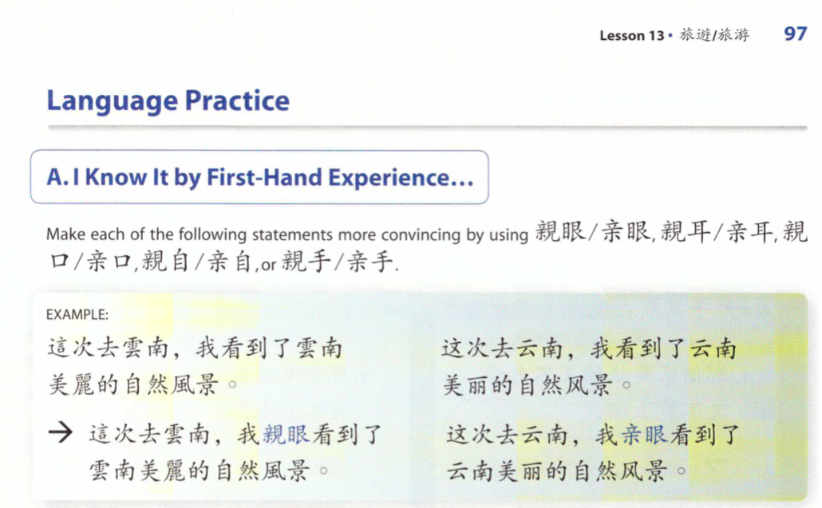

Slide 68
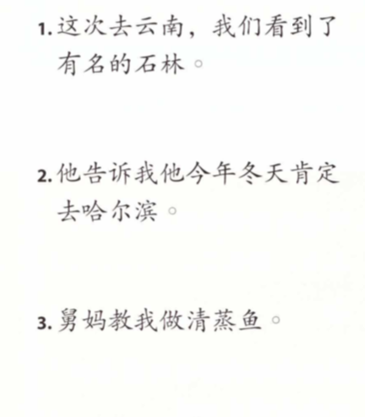
亲眼/亲自/亲口
这次去云南，我们亲眼看到了有名的石林。
他亲口告诉我他今年冬天肯定去哈尔滨。
舅妈亲自教我做清蒸鱼。

Slide 69
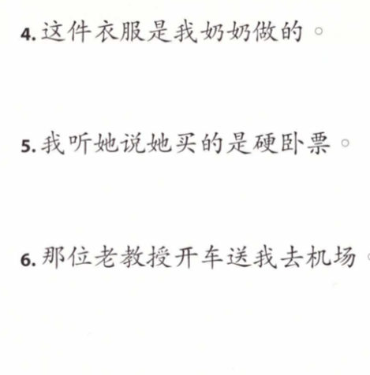
亲耳/亲自/亲手
这件衣服是我奶奶亲手做的。
我亲耳听她说她买的是硬卧票。
那位老教授亲自开车送我去机场。

Slide 70
1
However; but (conjunction)
2
only; no more than (adv.)
(It can be modified by “只”)
不过
1
这里的夏天非常热，不过冬天舒服的很。

Slide 71
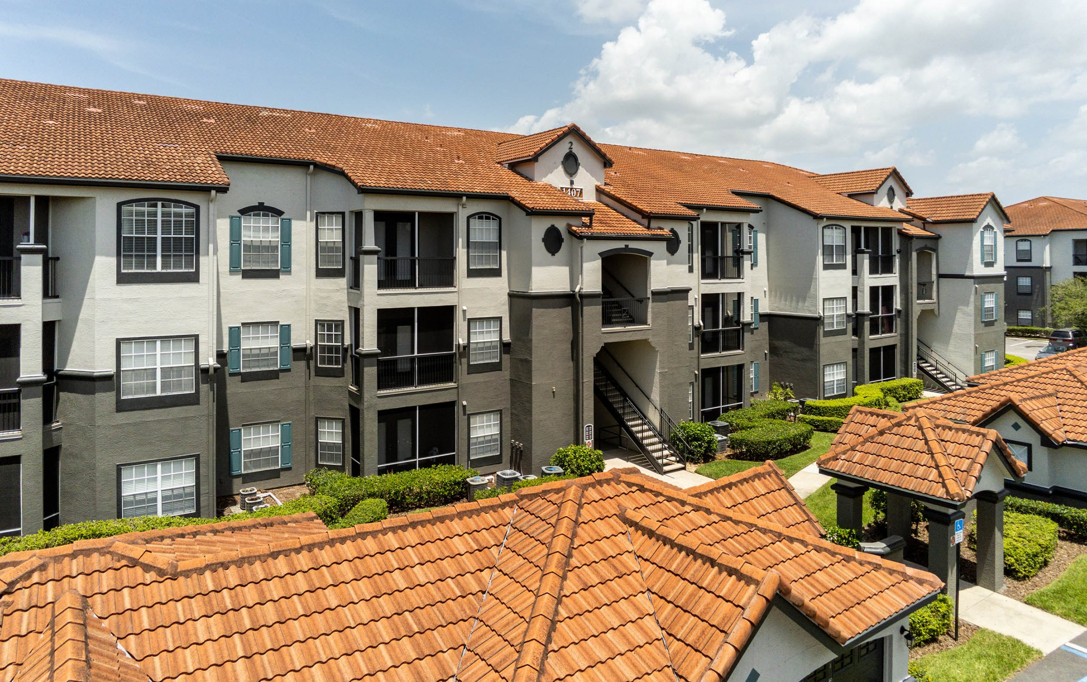
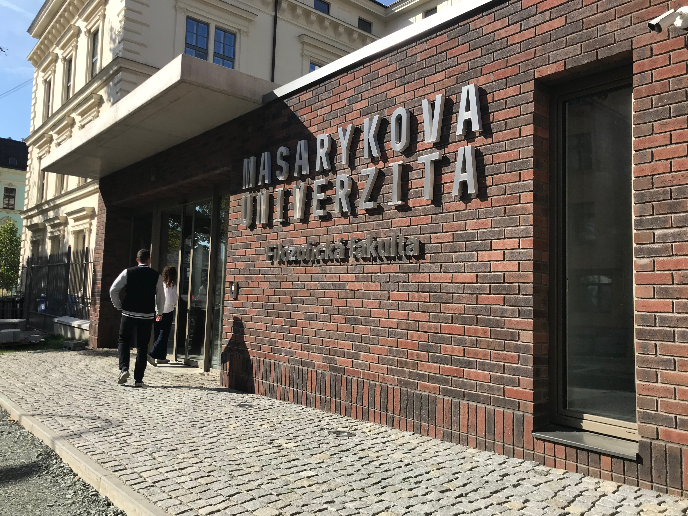
不过
2
only; no more than (adv.)
🚶‍♀️
五分钟
我的宿舍离学校很近，走路不过五分钟。

Slide 72

不过
2
only; no more than (adv.)
🚶‍♀️
三分钟
从学校走到albert不过三分钟。

Slide 73


不过
2
only; no more than (adv.)
only(只是)
lightly
我不过轻轻地打你，你怎么就生气了。

Slide 74
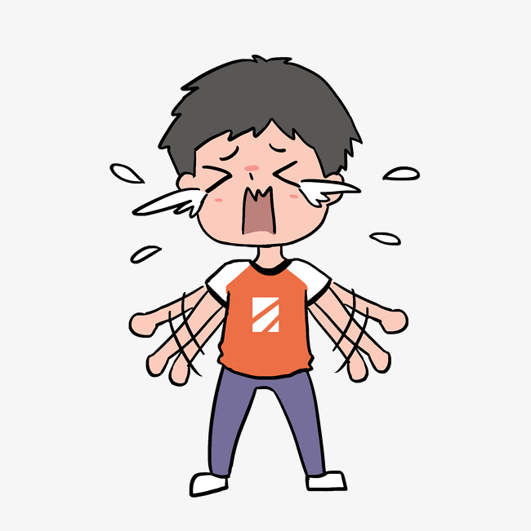

不过
2
only; no more than (adv.)
他
only(只是)
他不过开你玩笑，你怎么就哭了。

Slide 75
2
only; no more than (adv.)
(It can be modified by “只”)
不过
造句

