Slide 1
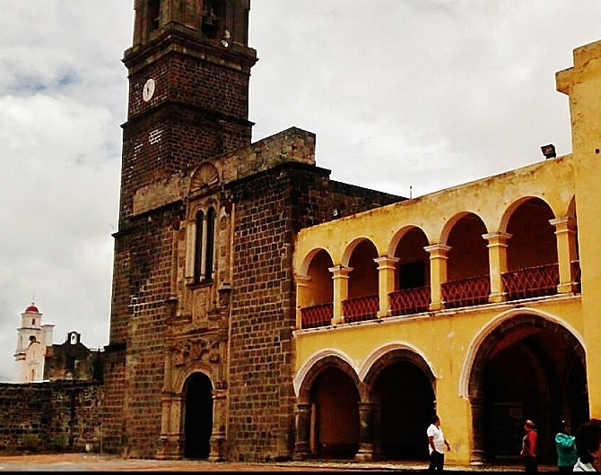
The End of Medieval Monasticism?: Protestant suppressions, Catholic reforms, monasticism in the New World (c. 1520-1600 AD)

Slide 2
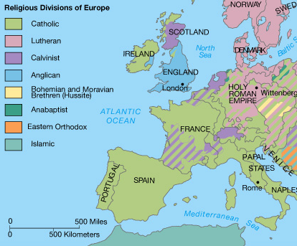
Catholic and Protestant Europe
By the mid-16th century, the Latin West had been hit by a wave after wave of religious division sparked by what is known, in totality, as the Protestant Reformation
If the late fourteenth and early fifteenth centuries had seen disunity in obedience to rival popes, the obedience to any pope at all was now questioned or disavowed across much of Europe.
In addition, doctrines that the Catholic Church dismissed as heretical not only survived but flourished under the protection of lay rulers in many regions.

Slide 3
Non-Catholic Christianity in the Latin West
Those who disavowed papal supremacy and challenged Catholic theological norms were themselves divided into multiple sects with different regional coverages and different beliefs.
Hussites – a “Pre-Protestant” group that followed the teachings of the Czech cleric Jan Hus, executed in 1415 at the Council of Constance. Divided into Utraquist and Taborite factions, the former of which, after multiple wars, is able to claim stable acceptance in the region until the 17th century despite key divergences from Catholicism. Key beliefs: among the moderates - Eucharist in both kinds for the laity; freedom to preach beyond the priesthood; “poor Church”; among the more radical party – complete break from Church hierarchy, iconoclasm, rejection of transubstantiation.
Lutherans – the followers of Martin Luther (see Lecture 9). Their influence spread rapidly across Northern Europe from the 1520s. Key beliefs: Good works play no role in salvation; God’s grace and man’s acceptance of grace through faith are the only factors. Rejected all sacraments except baptism and the Eucharist (but consubstantiation rather than transubstantiation). Priesthood freed from Rome and the demand of celibacy
Calvinists – followers of John Calvin (from Geneva), also influenced by Huldrych Zwingli (from Zurich): they enjoyed success in Switzerland, Southern France, the Low Countries. Much in common with Lutheran beliefs but in some ways more radical – key belief is “pre-destination”: the idea that those who will be saved and go to heaven are pre-ordained by God.
Anabaptists – Influenced by other Protestant Reforms but considered more radical: centred around the belief that the sacrament baptism was only valid if made freely (in the style of Jesus with John the Baptist)
Anglicans – the Protestantism of the “Church of England” following Henry VIII’s break with Rome after his failure to secure a divorce from his wife, Catherine of Aragon. Alongside the moderate Hussites, the least theologically radical. Some Lutheran influence – e.g. the doctrine of transubstantiation was dropped in favour of consubstantiation, priests could marry.
Common threads: amid this diversity there were some common features, above all the focus on the Bible, Christ and apostolic example as the ultimate source of religious authority rather than a hierarchy of clerics centred on Rome, whose apparent corruption by power and wealth was attacked: all allowed more status for lay religious involvement in some way as a result.

Slide 4
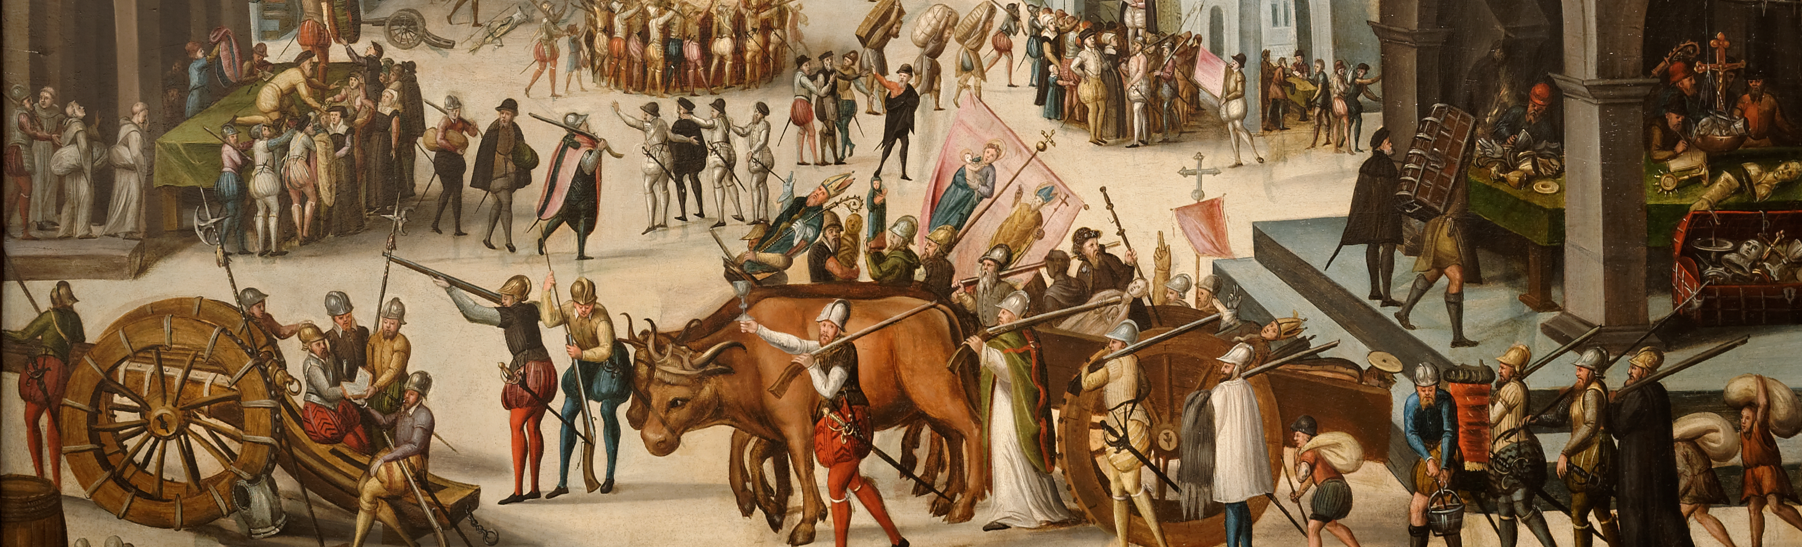
Protestantism and monasticism
Another common feature among emergent Protestant Churches were a very negative attitude towards monasticism.
This was acted out in a number of different ways, e.g.
Encouraging monks and nuns to flee their monasteries, to give up their vows, to marry etc. This was a key feature of the Lutheran Reformation, in part because Luther himself fled a monastic life and married: he encouraged others to do the same.
Attacking monastic institutions and their members violently. Such attacks were perhaps particularly prominent with more radical forms (e.g. Calvinism) and where Protestants faced the most determined Catholic opposition: e.g. Southern France, the Spanish Netherlands. The Taborite Hussites – the most radical sect of this “pre-Protestant” group – arguably began this trend.
Dissolving monasteries. This occurred when a Protestant lay ruler stepped in and claimed monastic lands and property for himself. The most famous example is the English “dissolution of the monasteries”, which took place between 1536 and 1539 under the command of Henry VIII.

Slide 5
Protestant outlooks on monasticism
What did Protestants object to about monasticism?
Their attacks came from several directions (different Protestants emphasised some more than others), e.g.
Denial of the idea/necessity of a vowed spiritual elite.
  Luther thought that the Catholic Church had abandoned its professed belief in the centrality of God’s grace to salvation in part through its promotion of vowed religious life and placing the most regulated, effortful forms of religious expression at the pinnacle. In his view, all men were treated by God only in accordance with their faith, rather than their works and types of actions – and anyone could be strong in faith! A less institutional attitude to religion more broadly weighed against monastic institutions [see G.W. Bernard in bibliography on England]
Attacks on monastic “depravity” and “hypocrisy”.
  Paralleled more general Protestant attacks on clerical morals and hypocrisy – e.g. the selling of spiritual services and being too wealthy – but the charge of hypocrisy could be levelled particularly strongly at monks due to their vowed status and the greater expectation that they would give up worldly things
Concern that the property of monasteries might be better used for other social purposes
  This dovetailed well with the naturally acquisitive nature of expanding and expansionist royal governments. Protestant calls for monastic properties to be used to support other educative and social institutions and works could easily be used to justify a royal government seizing this property.
But note the medieval heritage:
Only the first could be regarded as a particularly Protestant idea – and even this had a medieval roots: it was arguably underpinned by the late medieval progress of lay pious ambitions.
Criticisms of depravity and hypocrisy were commonplace in the late Middle Ages, especially due to the influence of hard-line (e.g. Observant) monastic reformers. [See Lecture 9]
Rulers had introduced “mortmain” laws in the late Middle Ages in order to place a barrier against too much land falling into the hands of the Church and especially monasteries with lots of privileges and exemptions – hard to tax! Donors had to pay a “fine” to the government for the privilege of giving such institutions. The concern of late medieval patrons to secure ongoing explicit services for their donations also arguably promoted a more conditional attitude to monastic property (i.e. what happens if the service stops, or the donor or their family decides they no longer need it) [This is the argument of Benjamin Thompson]

Slide 6
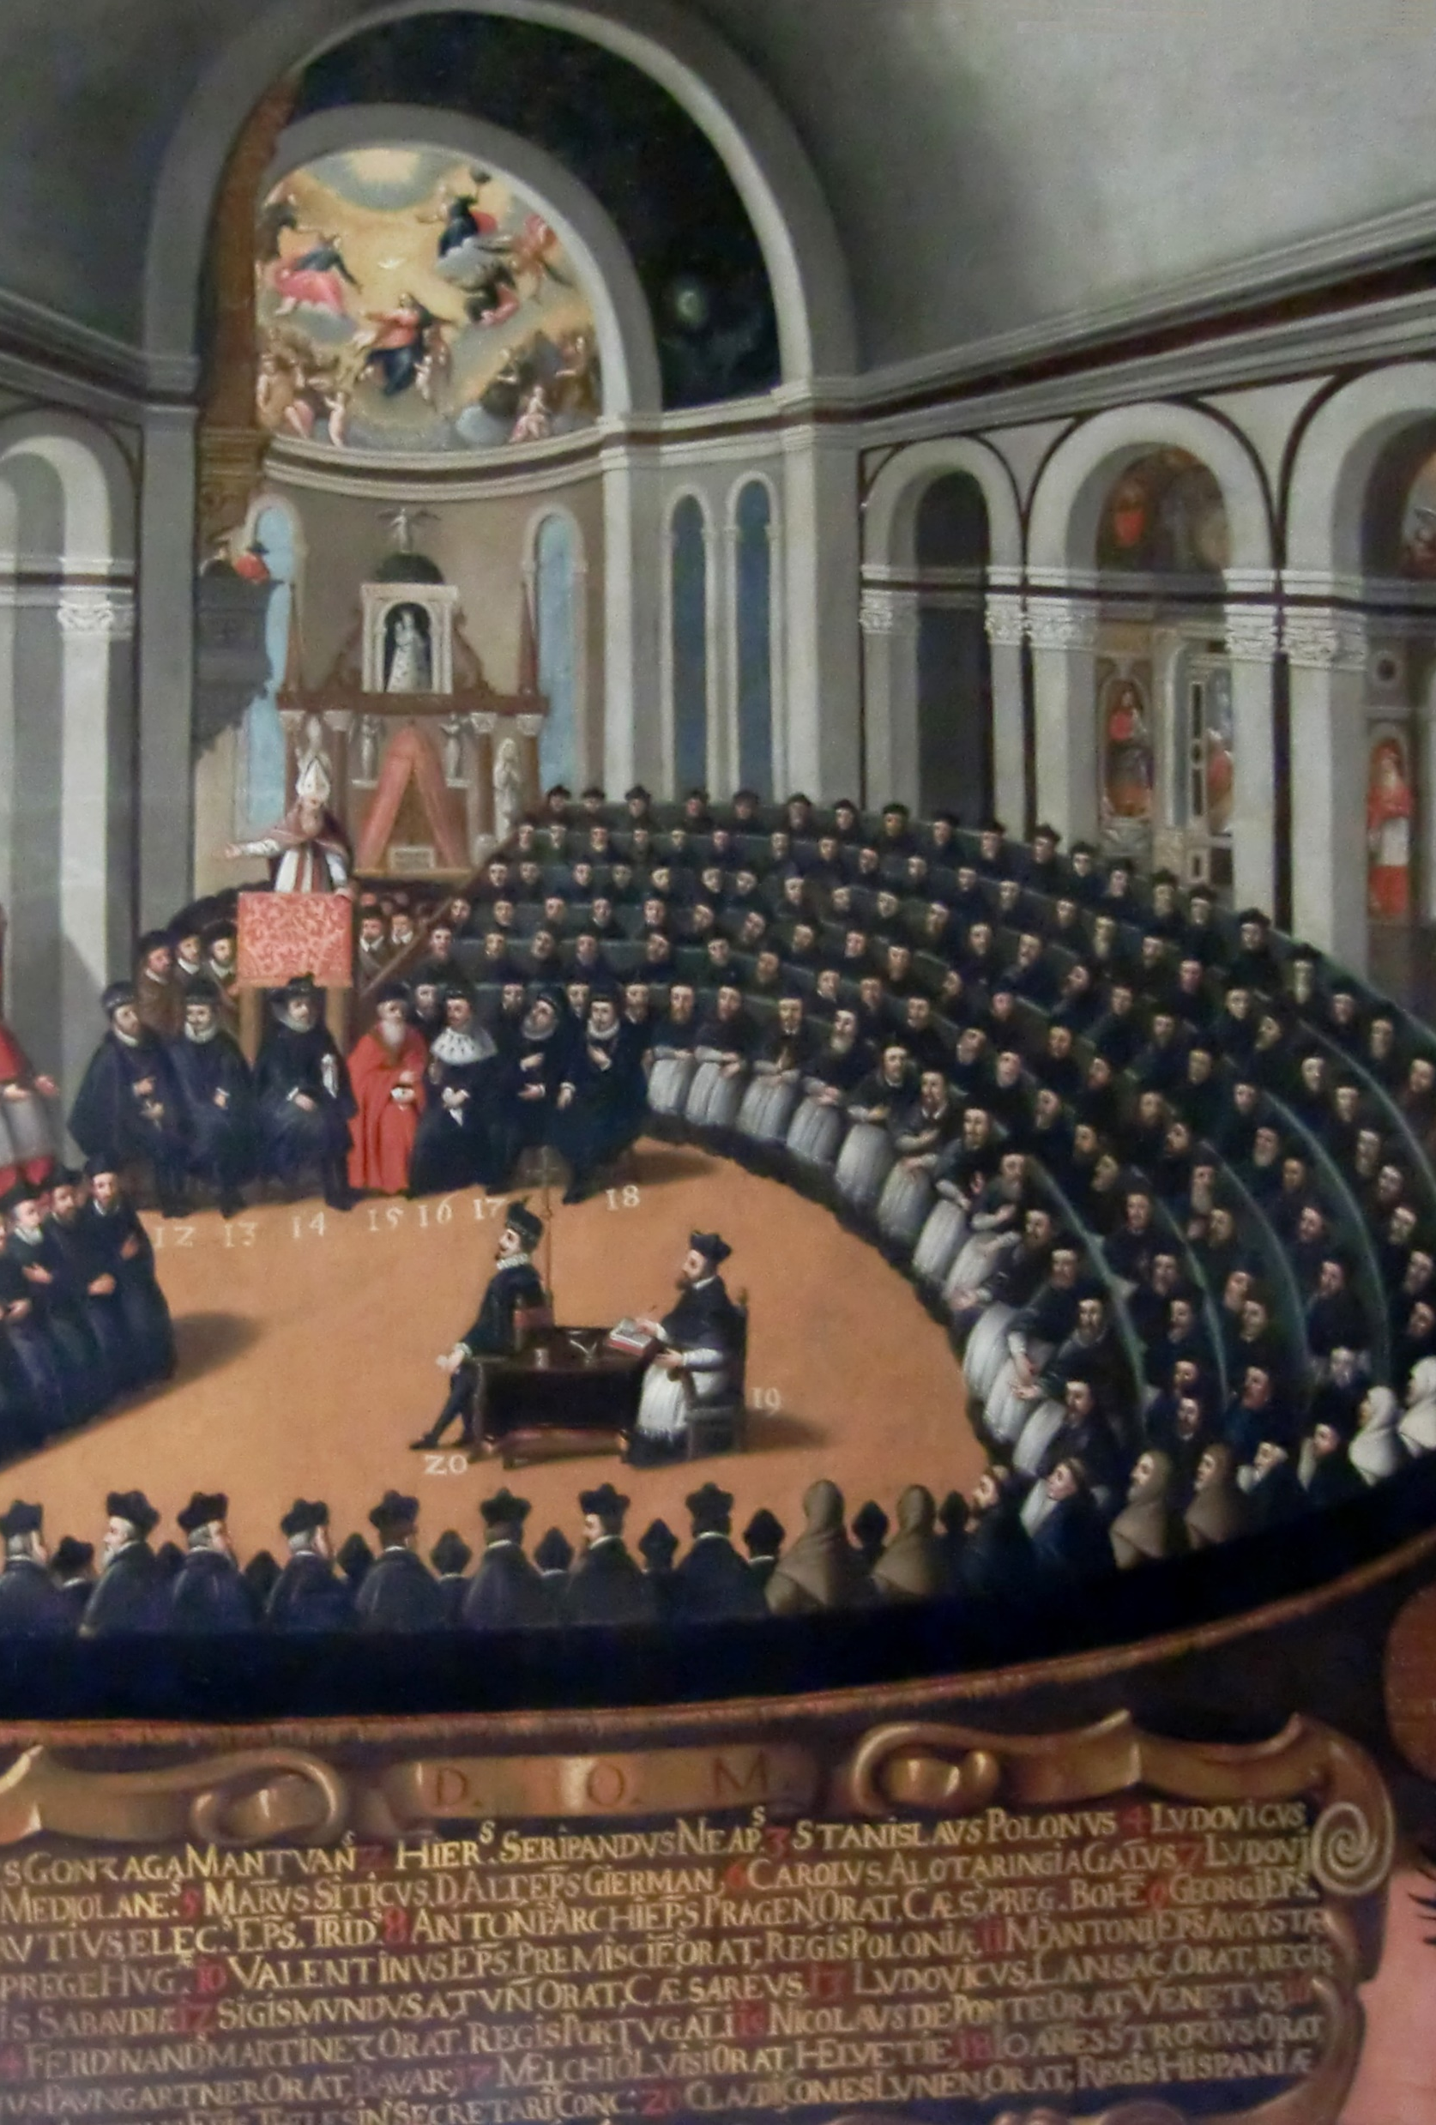
Catholic Reformation
With Protestantism growing, the Catholic church responds in the mid-16th century.
Over the course of nearly 20 years at a general Council of Trent (1545-1563), a formal position was laid out
On the one side, it was defensive of many aspects of medieval Christianity, especially in terms of theology and the necessity of Church sacraments and institutions, including monasticism
On the other side, it sought a reform of discipline: this was designed in part to undercut Protestant attacks of clerical immorality and strengthen the laity’s respect for Church institutions, including monastic houses

Slide 7
Continued attachment to monasticism
The efforts of the Council of Trent should not be seen simply as a high-handed effort of Church authorities to maintain control over an increasingly chaotic situation. The continuing relationship between monasticism and Catholic society reflected their emphases
At the ground level, many non-Protestants appear similarly unaffected in their respect for monastic life in many forms and defensive about change. [See Hoyle in Bibliography]
Founding families and later benefactors often retained a strong belief in the investment in their salvation they have made by supporting monasteries.
Monastic charity to the poor and educative work was quite important to many of the less visible in society: if Protestants often believed they could better fill this gap by redirecting monastic funds, many who received charitable help or simple education from monks were naturally concerned by the attacks
The Pilgrimage of Grace (1536) – a revolt in the North of England – had complex social roots, but did respond to genuine popular concerns about the closure of monasteries by Henry VIII. [see the view of R.W. Hoyle in the bibliography]

Slide 8
Continuance of late medieval monastic reform
In many ways, both Protestant attacks on Church corruption and abuses and the Counter-Reformation’s focus on reform of discipline mirrored the direction of late medieval monastic activism since the late 14th century.
While late medieval monastic activism (e.g. Observant reform) – with its emphasis on detailed practice and obedience to written law - was quite opposite to the theological spirit of the Protestant Reformation (e.g salvation by God’s grace and by faith alone), it remained a powerful and influential force – just as it had been on Luther in his early life! [see Roest, “The Observance and the Confrontation with Early Protestantism” in bibliography]
Late medieval reforms continued to grow in influence:
  Rigorous enclosed monks and nuns (which enjoyed a particular burst of popularity in the late Middle Ages) continued to receive support, just as it had in the late Middle Ages. The Minim order (technically Mendicant but its male order was more enclosed than most other friars) also grew even more rapidly at the end of the 16th and into the 17th century than it had in the late 15th and early 16th centuries. By 1623, they have 623 convents across Europe, up from c. 30 in 1507, at the death of their founder.
  Observant Mendicants (e.g. Franciscans, Dominicans, Augustinians, Carmelites) were already beginning to gain significant momentum in the later 15th century, especially as public preachers, but become still more important and influential with the impact of the Reformation: they were well placed to react to Protestant preaching to the laity with their own, rigorous Catholic message
Interestingly, it is precisely such monastic groups that the Protestant reformers attack the hardest, despite the fact that they shared some of their idealism about the primitive church and stand against the corruption
There is also a not insignificant flow of people between late medieval monastic reformist groups and the Protestants, despite their theological outlooks being very different, mirroring Luther’s own change of allegiance: In their shared promise of a purer religion, both Protestantism and Observant-style monasticism both fundamentally represented appealing paths to the most religiously engaged.

Slide 9
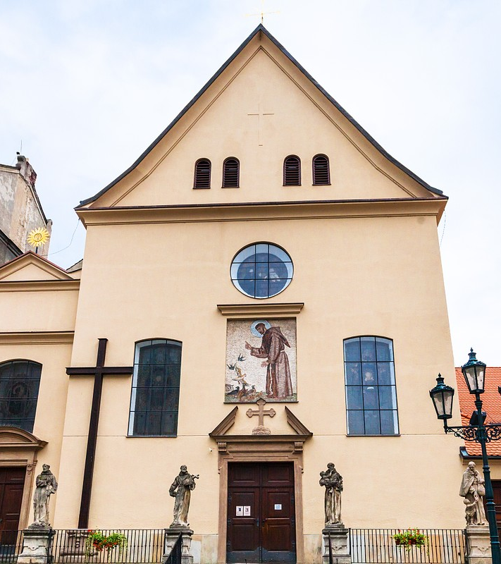
New hardline reforms
In line with the continued relevance of hard-line, Observant-style monasticism, we see the rise of some new groups that seek to go even further down this path.
The Capuchin Franciscans, a reform founded by the Italian Observant Franciscan Matteo da Bascio (1495-1552) in 1525, sought to go beyond the rigours of the Observant Franciscans, reinjecting some of the eremitic idealism (although their houses were soon also founded in cities) that had been present in the life of Saint Francis.
The Franciscan Recollects were influenced by Observant Franciscan energies of Peter of Alcantara (1499-1562) and emphasised that friars must reserve time to withdraw more completely from the world within an enclosure, as well as teach and preach.
Discalced Carmelites: following similar aspirations, Theresa of Avila (1515-1583) began a rigorous reform of female Carmelites – again re-stressing some of the order’s early eremitic style – that soon spread to the male friars. Their name means “without shoes” in Latin, since they were to either go barefoot or in sandals. Discalced Augustinian Friars also follow a similar path in the late sixteenth century
Overall one can perhaps see a tendency in these groups in these groups to combine Mendicant outreach to the laity – of renewed urgency amid Protestant growth – with the even more rigorous dividing lines from the world that were pushed by the harsh but urban-centred enclosed groups that flourished from the fourteenth and early fifteenth centuries (e.g. the Carthusians, the French Celestines).

Slide 10
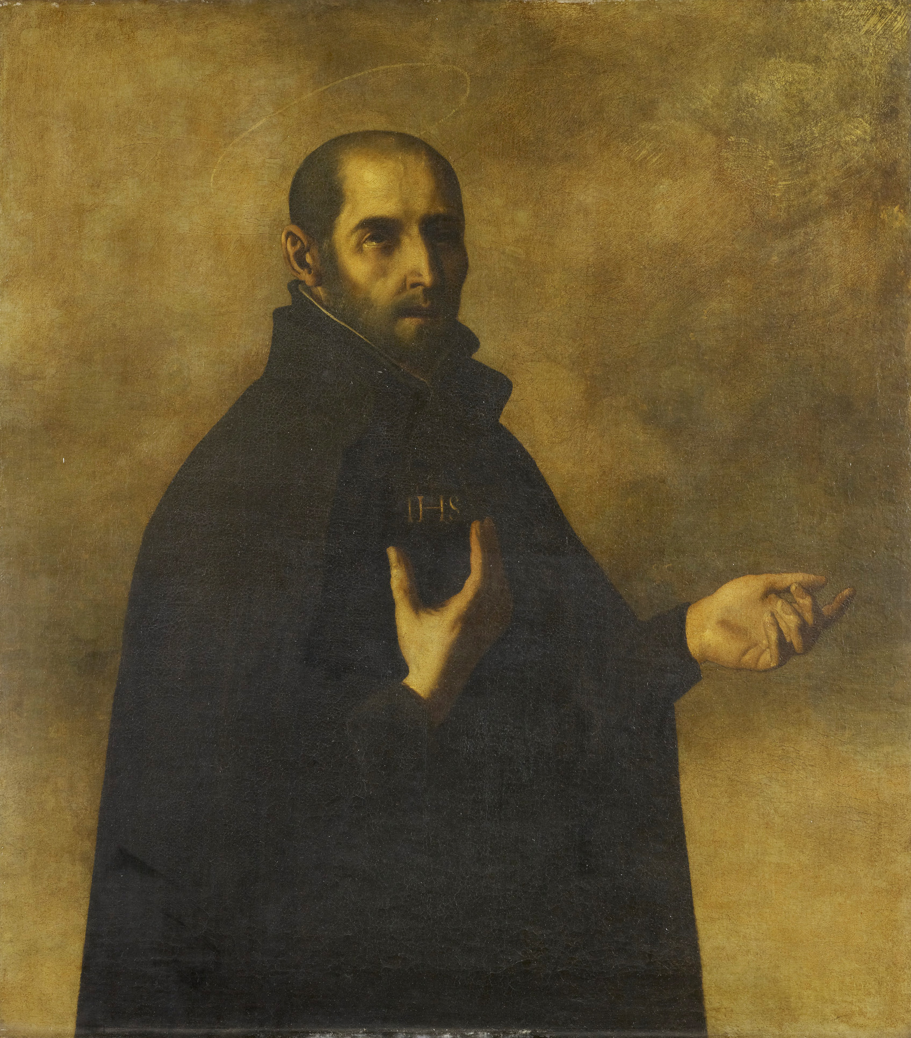
“Clerics Regular” and other priestly orders
Monastic energies and idealism also influenced a new type of religious order – that of the “Clerics Regular”: essentially, priests who took up a Rule and vows.
The Theatines, founded in 1524 by several Italian priests. While they did not live in communities or follow a shared liturgy, they took Mendicant-style monastic vows of poverty, chastity and obedience, and aimed to live a stricter life while running houses of prayer and hospitals
The Jesuits (the Society of Jesus) – the most famous order of regular clerics – had similar roots in a band of Spanish priests under the direction of Ignatius of Loyola (1491-1556). Only the more senior members took vows after a significant probation period. The order emphasises learning, teaching and preaching.
In addition, later in the 16th century, societies of the clerics emerge under a Rule where monastic-style vows never occurred: e.g.
The Oratorians, founded in the late 16th century (formalized in 1575) by the Italian priest, Filippo Neri (1515-1595)

Slide 11
The mission of priestly orders
These groups were different from earlier monastic expressions in a number of ways
Much less emphasis on “common life” of a community in order to focus solely on public ministry
Members often do not live together in houses; some have less emphasis on taking vows or put these aside altogether.
To later historians, they have often appeared more flexible, more individualistic, and even more “modern” by these virtues.
BUT, it is important to note that they speak as much to the relevance of monastic tradition as to its alteration:
Like canons regular, they stemmed from idea of bringing ordained clerics, usually priests, together in greater conformity.
Their emphasis on mobility, learning, teaching and preaching was prefigured by the Mendicant orders.
Like Observant reforms across orders of all types, they also possessed quite a lot of legislation and were often very strict in terms of self-denial. [see Roest, “The Observance and the Confrontation with Early Protestantism” in bibliography]
They can thus also be seen as a new attempt to “monasticize” the clergy, as much as a loosening of monasticism.

Slide 12
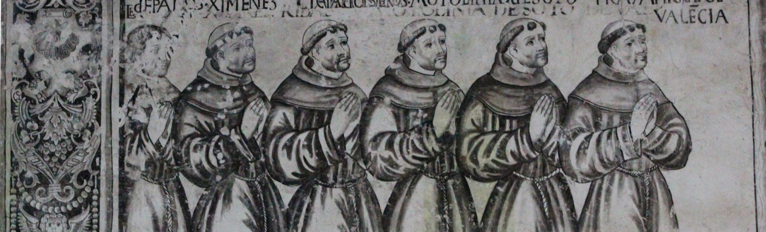
Monasticism in the New World
Christopher Columbus’s landing in the Caribbean in 1492 was followed a wave of further expeditions to the Americas in the early 16th century. Meanwhile, exploration also pushed further East, into the Indian Ocean and South East Asia.
The most rapid early colonisers were the Catholic Spanish (in the West) and the Portuguese (in the East): and with them, they brought the Church and its institutions, including religious orders
Just as monks had played a role in converting pagans in the early Middle Ages, members of religions orders saw converting natives in these uncharted regions as a not only a religious duty but also an ascetic challenge.
Franciscans – especially Observant Franciscans – as well as Dominicans and Augustinian friars are the first wave. The Jesuits joined in the later 16th century.

Slide 13
Conversion from Europe to the Americas
Those who travelled to the New World brought their attitudes from the old.
Spanish and Portuguese Mendicants brought with them their experience of lay preaching in Europe, and more specifically, of conversion of Jews and Muslims in territories reconquered from the Muslims.
Observants (above all Observant Franciscans) also led the way
They looked upon new territories full of unconverted natives as an opportunity to instil the ‘purer’, stricter faith that they preferred even for the laity (i.e., the idea of starting afresh)
Their rigour and professionalism helps to make them more systematic in their efforts: they prepare many lay teaching books, develop ways to learn and teach in the languages.
Their approach naturally enhanced their demands on lay converts, in terms of both belief and morals.
Harsh punishments – whippings and beatings – were frequently enforced on new converts when they failed to live up to high standards, especially those of the Observants.
Some even became concerned by “heresy” among the Indians in holding on to elements of their former faith. The Observant Franciscan bishop of Mexico, Juan de Zumárraga (1468-1548) organised the first trials of “relapsed” Indians, which resulted in some being burnt at the stake.
Such approaches built on the experience of the Spanish Inquisition of the fifteenth century that had targetted Jewish and Muslim converts suspected of “relapsing”. Notably, the Spanish Inquisition had also been instigated by an Observant Dominican: Tomás de Torquemada (1420-1498). Notably, however, this approach is curtailed by the Spanish authorities who are concerned about popular revolts – Zumárraga is reprimanded for his actions, and later inquisitorial efforts focus more on settlers.

Slide 14
The impact of missionary experience
The reality of meeting new cultures, however, did lead to more complex approaches.
Some, under the influence of Observant thought – even secular bishops like Vasco de Quiroga (1470/78 - 1565) – continued to seek to impose idealistic, and very monastic images of monastic order on Native Americans:
  Vasco, having read Thomas More’s Utopia – a text highly influenced by monastic thought – argued for organising the natives in “congregations” with clear lines of obedience
Others – even those from committed Observant backgrounds – began to see their subjects as unconvertable to this sort of discipline
Pessimistically, some come to see them as “children” or “savages” who could never come close to their own standards. While this represented a very negative outlook on the natives, this could also lead to a greater flexibility in approach, more focussed on simple Christian teaching.
This experience also influenced the approach of Mendicants and Regular Clerics in Europe too. Seeing Europe torn apart by Protestants, they begin to believe that the faith was very weak in the common people.
Rather than primarily preaching moral rigour – as the Observant Franciscans such as Bernardino of Siena (1380-1444) and Giovanni da Capistrano (1386-1456) had previously done – they begin to focus more on gaining assent and adherence to principal matters of faith. [See Roest, “From Reconquista to Mission in the Early Modern World” in bibliography]

Slide 15
Summary: an end without an end
In this lecture we have seen powerful and lasting societal rejections of monasticism
  In some parts of Europe, like England, it is essentially wiped out.
But we have also seen it in health and growth
  As some came to reject ascetic separation from the world as unnecessary and hypocritical, many others reaffirmed their support, especially for rigorous examples that were in close proximity and/or close interaction with them.
Religious orders and ascetic life lived under vow were thus far from irrelevant – even its attackers found it important enough to attack! – but, rather, divisive.
  While they were either offensive or irrelevant to the increasingly lay-centred religious ambitions of Protestants, to others – including a no less religiously engaged Catholic laity – they were reaffirmed as an essential support to religious aspirations.
Both exploration and the circumstances of the Reformation, moreover, also breathed new life into the monastic missionary and educative roles
  The Mendicants and the Regular Clerics in particular would be on the frontline in attempting to convert the New World, and “reconvert” the Old. A monasticism lived beyond the monastery again comes to the fore to meet these new needs.
  Elements of flexibility that had not been fashionable in the initial Observant expansion returned in the name of pastoral leadership and care.

Slide 16
Sources – Manifesto of the Taborite Captains (1430)
Manifesto of the Taborite Captains (1430)
The leaders of the Taborite Hussite sect – famed for their particularly hard-line and violent attitude towards monasteries and iconoclasm in comparison to milder Hussites – wrote and distributed this document in order to gather support and ward off potential attackers
The text enjoyed a surprisingly wide distribution not only in Bohemia and Moravia, but in Germany as well.
The following section defends their attacks – often violent – on monasteries: their virulent stance prefigured the kind of determined opposition that monasticism would later face from Protestants in the 16th century.

Slide 17
Sources – Manifesto of the Taborite Captains (1430)
And also they say that we destroy divine service, that we destroy monasteries, by expelling monks and nuns. We used to believe them to be saints, and that they fulfilled a great service to God. But afterwards we rightly thought and considered their lives and works: then we knew them to be saintly hypocrites and false in their humility, teaching on high, and selling indulgences and masses for the dead […] And their prayers and masses for the dead on account of their gifts are nothing other than hypocrisy and heresy. Thus, when we contradict them and destroy their monasteries, we do not destroy divine service but rather the service of the devil and the schools of heretics. And when you come to know them, just as we now know them, thus you will set about destroying them too, just as we have. Since Christ, our Lord, did not institute any order: thus it is right that they are destroyed sooner or later.

Slide 18
Sources – Act for the dissolution of the lesser monasteries (1536).
Act for the dissolution of the lesser monasteries (1536)
A royal act that dissolved smaller English monasteries (those with less than 12 members) and gave their property to the King.
It followed in the wake of Henry VIII’s divorce, and the Act of Supremacy (1534) – where he declared himself ultimate head of the English Church (rather than the pope), and to which all monastic abbots, abbesses, priors, prioresses etc. were pressured to accept
It preceded the dissolution of all other monasteries in 1539: a simple act that merely stated that the abbots of all the remaining monasteries consented to the transfer of monastic property and estates to the crown.

Slide 19
Sources – Act for the dissolution of the lesser monasteries (1536).
Manifest sin, vicious, carnal and abominable living is daily used and committed among the little and small abbeys, priories, and other religious houses of monks, canons, and nuns, where the congregation of such religious persons is under the number of twelve persons. The governors of such religious houses and their convents spoil, destroy, consume, and utterly waste as much their churches, monasteries, priories, principal houses, farms, granges, lands, tenements, and hereditary tenements as the ornaments of their churches and their goods and possessions, to the high displeasure of Almighty God, slander of good religion, and to the great infamy of the King's Highness and the realm. And although many continual visitations [of the monasteries] have occurred within the last 200 years or more to honestly and charitably reform such wasteful, carnal, and abominable living, nevertheless little or no amendment has been made. Rather, their vicious style shamelessly expands and grows, by a cursed way of life that is deeply rooted and infested, so that a great multitude of the religious persons in such small houses would prefer to roam around in apostasy rather than conform themselves to the observance of good religion. Thus, such small houses should be utterly suppressed, and the religious persons within them committed to great and honourable monasteries of religion in this realm, where they can be compelled to live religiously for the reformation of their lives, since there is no other way to reform them.

Slide 20
Sources – Letter to Henry VIII of England (1536), by Thomas Starkey
Thomas Starkey
Thomas was Henry VIII’s chaplain and a firm ally of the king’s actions against the monasteries
An Oxford educated humanist scholar, he was regarded as a moderate reformer: was employed as an intermediary between royal circles and Catholic holdouts
Letter to Henry VIII of England (1536)
The following letter – written around the time of the dissolution of the lesser monasteries – set out a moderate (but ultimately Protestant) reform position to the King, as well as a defence of his recent policies.
Like many medieval letters, they were not intended to be purely “personal”, but rather to be read by others, who might also be informed by them.

Slide 21
Sources – Letter to Henry VIII of England (1536), by Thomas Starkey
There are many who plainly judge this act for the suppression of certain abbeys both to be against charity and unjust to those who are dead, because their founders and other departed souls would seem to be defrauded of the benefit of prayer and [spiritual] almsgiving that are done there for their relief. […]
But although it is so that prayer and almsgiving is of great comfort for those who have departed, and though God delights much in the direction of our charitable minds [towards this], to convert too many possessions to this end and purpose, and to appoint too many person to this role and duty cannot be done without great detriment and hurt to the Christian commonwealth … and although it is a good and very religious thing to pray for those departed from this [worldly] misery, we cannot give all our possessions so that idle men are nourished with continual prayer.

Slide 22
Sources – Statement concerning the massacre of the Franciscan Observants at Nimes (1675, concerning 1569)
Statement concerning the massacre of the Franciscan Observants at Nimes (1675)
An interesting document that was draw up at the house of Franciscan Recollects in Nimes in 1675, but referring to events over 100 years earlier, drawing on second hand accounts of eye-witness testimony
The background of the text is not entirely clear: but it appears that the Recollects are keen to record proofs of sanctity for a group of Franciscan Observants who had previously occupied their monastery prior to being brutally massacred by Protestants in 1569.
They may have been hoping to canonise the men (i.e. have them declared saints by the papacy) in order to gain devoted support for their house and church.

Slide 23
Sources – Statement concerning the massacre of the Franciscan Observants at Nimes (1675, concerning 1569)
“We Louise de Fons […] and Gabrielle de Fons […], sisters, testify before God and in all truth […] that we clearly recall having heard from our father […] Jacques de Fons […] son of Jean de Fons, royal counsellor […] and from Louise d’Andron […] his wife and our grandmother, that in the year 1569, in the month of November, during the tumultuous entrance into Nimes of Monsieur Calvierre, lord of Saint-Cosme, and the rest of the heretic army, and the horrible massacre of the Catholics, of those of religious orders, and of priests that followed, eight religious men of the strict observance of Saint Francis in Nimes took refuge in the house of Monsieur [Jean] de Fons. […] Monsieur [Jean] de Fons and his wife, from a sentiment of tenderness and of Christian piety, and also in view of the friendship that their family had always had with the [Observant] convent – now occupied by the Recollect fathers –, hid the 8 religious in a remote part of their house so that they would not be massacred by the heretics […] These religious men […] despite considering the irreparable loss they would face – the palm of martyrdom would be unavoidable – if they showed themselves in public in order to support their Catholic faith, generously resolved to leave this house of Monsieur de Fons to go, as they did, to encourage by their words and examples the rest of the poor Catholics in support of their faith. Thus, it followed that the said religious men […] having been found and taken by the seditious heretics […] were put to death, receiving the palm of martyrdom.”

Slide 24
Sources: History of the Indian Church (1573-1597), by Geronimo de Mendieta (1525-1604)
Geronimo de Mendieta (1525–1604)
Joined the “Observant” arm of the Franciscan order in 1545 in Bilbao, Spain
In 1554, he went to New Spain (modern day Mexico) to pursue missionary work among the Native Americans (the Spanish referred to them as “Indians”). In the process, he learnt the local Nahuatl language.
History of the Indian Church (1573-1597)
A noted writer, Geronimo was commissioned in 1573 by his order to write a history of the Franciscan missionary work in the region. This Historia eclesiástica Indiana, written in Spanish, was completed in 1597.

Slide 25
Sources: History of the Indian Church (1573-1597), by Geronimo de Mendieta (1525-1604)
This land was a transplanted hell, seeing how its people would yell at night, some invoking the devil, others in a drunken stupor, and still others singing and dancing. They had kettledrums, trumpets, horns and large conches, especially at the feasts of their demons. It is incredible how much wine they consumed at the drinking orgies which they held very often and how much one poured into his body. It was very pitiful to see men, created after the image of God, becoming worse than brute animals.
[…]
[Those venerable old friars], getting rid of their persons' seriousness, started to play straw and little stones with them [native children] during the recreation time. The friars always had paper and ink in their hands, and on hearing a word they wrote it down, indicating the circumstances in which it was said. In the afternoon the friars used to meet to interchange their writings and, the best they could, adapted the Nahuatl words to the Spanish terms that they considered most appropriate. And it used to happen that what one day they had understood the following day they would find out not to be so. [After some time] some of the grown-up children, as they saw the friars' desire to learn the language, not only corrected their mistakes, but also asked them many questions that were a source of happiness [for the friars].

Slide 26
Select Bibliography
G. W. Bernard, “The Dissolution of the Monasteries.” History, 96.4 (2011), pp. 390–409.
www.jstor.org/stable/24429244
R. W. Hoyle, “The Origins of the Dissolution of the Monasteries.” The Historical Journal 38 (1995), pp. 275–305.
www.jstor.org/stable/2639985
B. Roest “The Observance and the Confrontation with Early Protestantism” and “From Reconquista to Mission in the Early Modern World” in J. Mixson and B. Roest (eds.), A Companion to Observant Reform in the Late Middle Ages and Beyond (Leiden, 2015) – articles uploaded to MS Teams fileshare

