Slide 1
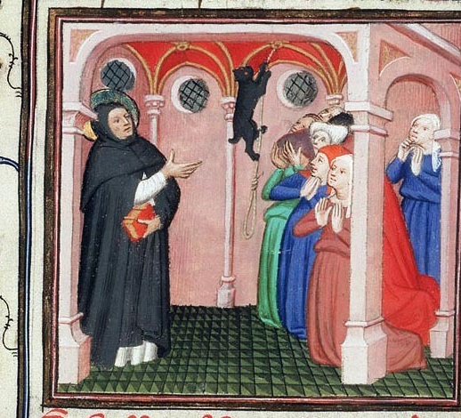
Poverty and Mobility: new religious movements (c. 1200-1300 AD)

Slide 2
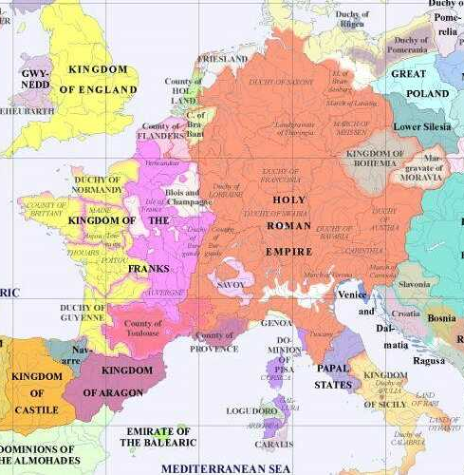
Europe c. 1200-1300
By 1200, the map of Europe was a complex one:
A number of polities that had grown up in the wake of the collapse of the Carolingian empire – by this stage, they were increasingly mature and ambitious!
The most powerful kings increasingly sought to establish fuller control over core and neighbouring territories, limiting the authority of other dukes and princes within them, and establishing clearer borders. The roots of “countries”, in the modern sense, are becoming a little easier to see.
In the region of modern-day France, the Kings of the Franks (who increasingly styled themselves “Kings of France”) began a struggle with the Angevin/English kings; the latter had full sovereignty in England, but also held and effectively ruled many territories in France that were technically subordinate to the French King.
The Empire, meanwhile, was becoming an increasingly German polity. Increasingly independent and ambitious local states in northern Italy – Venice and Genoa especially – as well as the Papacy begin to roll back the power of the German Emperors in the Italian peninsula.
The aspiration to have a ‘universal’ authority still existed in the Latin West, however, despite the decline of the Empire. The post-Gregorian reform papacy had much success in subjugating the clergy throughout Western/Central Europe to its overall authority. This greater control in religious matters ran across borders and effectively gave the papacy significant political influence across the West. They also claimed the right to collect taxes from ecclesiastical properties regardless of which polity they were located in.
These ever-rising papal ambitions resulted in some significant clashes with kings (e.g. Philip IV of France vs Boniface VIII), especially at the end of the 13th century.
Western and Central Europe, 1200 AD

Slide 3
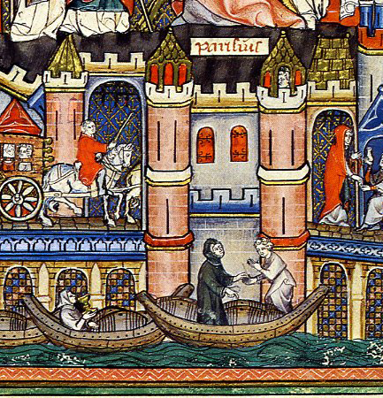
Evolving societies and economies
Since the fall of the Western Roman Empire (476 AD), medieval economies had evolved in significant ways.
The Roman Empire – with its culture of urban elites and its sponsorship of long distance trade – had depended heavily on a network of towns and cities both as centres of authority and to make money.
The fall of the Roman empire and the rise of new tribal polities (e.g. Franks, Anglo-Saxons) made towns and cities less important: the new rulers and powerholders often preferred to cement their authority and grow their wealth in the countryside. The building of church institutions – which sought to reach all people, wherever they were - also enhanced the administration of rural areas.
The result was a greater colonization and economic exploitation of the countryside from the 4/5th centuries onward. Monasteries played an important role in this. Usually situated away from towns and cities, they helped to develop rural economies in order to provide monks and nuns with sustenance. The Cistercians – with their direct farming of areas that had previously seen little agricultural activity – arguably took this a step further.
As these agricultural economies move further and further beyond providing just for subsistence of the people living on the land, economic possibilities for wealth creation expanded. In the course of the 12th century and 13th centuries, industries (e.g. clothmaking), longer distance trade and banking became increasingly important – and towns and cities grew as centres of these activities.

Slide 4
Social change and religious change
As medieval societies and economies evolved, the context of religious culture is also effected.
The development of trade and exchange gradually helped to raise levels of literacy, semi-literacy and education and encouraged people to live more dynamic lives involving more social connections. This helps to create a new curiosity about religion: people seek to interact with it directly in new ways.
The growth of “profit economies” (as opposed to “subsistence economies”) centred on production, trade, and towns, interacted with Christianity to create a new discussion over wealth and poverty [see Lester K. Little, Religious Poverty and the Profit Economy in Medieval Europe (Cornell University Press, 1978)]. How would a world where the possibilities for money-making expanded be squared with the message of Christ – who said that “it is easier for a camel to go through the eye of a needle than for someone who is rich to enter the kingdom of God.” [Matthew 19:24]?
If the religious life of the countryside and the landed nobility in particular had long-standing rural monasteries at its heart, the growing cities and towns – which included potential patrons of increasing wealth and status – arguably also began to represent a ‘gap in the market’ for new religious movements and institutions.

Slide 5
New religious movements
Against the background of these changes, new religious movements began to emerge from the twelfth century, peaking in the early thirteenth century [see Grundmann in Bibliography].
These movements tended to emphasise strong ascetic practices, but with a particular emphasis on voluntary poverty, modelled on the community of Christ and the apostles (“apostolic poverty”).
This poverty often went further than the traditional monastic renunciation of personal property (with it all owned by the monastery): being really and truly “poor” in appearance and every manner of life mattered.
The practitioners of this sort of life do not isolate themselves from society but remain in unusually close interaction with it.
While many took influence from harsh eremitic asceticism and spent times in hermitages (like slightly earlier monastic reformers), they remained mobile and were often found ministering and preaching to men and women of every variety.
Their public preaching emphasised not only the virtues of poverty but also “affective piety” (originally developed by 11th/12th century monks): this piety was founded on God’s love for all, and the bonds of divine love between fellow Christians. This helped to justify their lack of enclosure within monasteries, and made their preaching to lay audiences quite inclusive, even for those who did not wish to fully imitate the asceticism of the preachers.
This combination of poverty and mobility proved particularly popular in towns and cities, even if its earliest practitioners were often quite inspired by eremitic life.
This success can be related to the “profit economy” of towns and cities. But it should not only – or even primarily – be seen as an adversarial response of poor townspeople, as Marxist historians tended to emphasise. Early converts to new religious movements rarely appear poor, and their early supporters were often rich nobles and merchants. Lester K. Little suggests that the support of such people for the “poor followers of Christ” helped them to justify their own world of increasing wealth and status.
The ability to move around and preach to people of every variety responded to the increased religious curiosity that was found in busy urban environments.

Slide 6
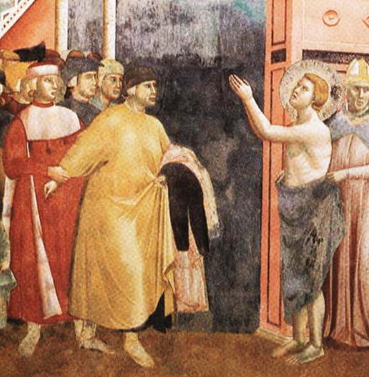
Saint Francis of Assisi
What kind of people followed this new type of religious life?
Francis of Assisi (i.e. St Francis, 1181/2-1226) is the most famous example. His background is indicative of the new economic and social possibilities of this period.
Son of a prosperous Italian silk merchant and a French noble mother, born in the Italian town of Assisi.
Lived a prosperous life in his youth, enjoying fine clothes and developing an interest in poetry.
Became increasingly disillusioned with this life of wealth between 1202 and 1205. After a short period of military service, he goes on pilgrimage, visiting Rome and praying with the poor.
At a rural chapel outside Assisi dedicated to Saint Peter Damian (see lecture 3), he saw a vision of Jesus, who tells him to repair the chapel
Sold some of his father’s cloth to pay for the repairs, but the priest would not accept it. He hides from his father but is eventually punished severely by him for his action.
Francesco renounced his vengeful father and his inheritance, even returning his clothes to him (see image)
Saint Francis returning his clothes to his father: fresco from Assisi, c. 1300

Slide 7
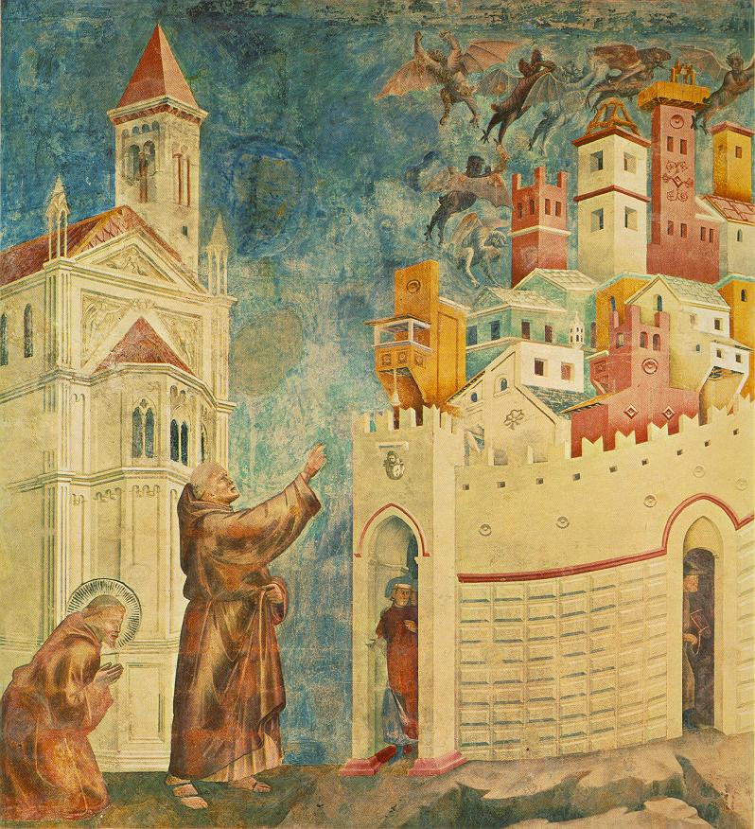
Saint Francis of Assisi and his followers
His initial response to this moment of “conversion” to a more religious life appears strongly influenced by the Italian semi-eremitic movements of the previous centuries (e.g. Romuald, Peter Damian).
He and his early followers retire to the Umbrian countryside to live a life of extreme poverty, forming their first communities there
But, they remain in touch with society at every level, not only in the countryside but in the towns too.
They not only preach to the peasants in the countryside, but beg for donations in the towns to repair chapels and churches.
He and some of his followers exorcise some demons from the town of Arezzo on a trip there: Francis preaches in the town square afterwards (see picture).
Despite their emphasis on ascetic emphasis on attaining greater purity through voluntary poverty, the Franciscans in other ways show a level of positivity about spiritual fabric of the “world” that was uncommon for earlier monks: Francis sees God in every part of His creation: everything from rocks and animals to the ugliest parts of towns!
These followers would soon come to be known as the “fratres minores” in Latin, or “friars minor” in English – meaning the “lesser brothers” – a reference to their simple lives of poverty and humility.
Saint Francis and Brother Sylvester (his follower) removing demons from Arezzo: fresco from Assisi, c. 1300

Slide 8
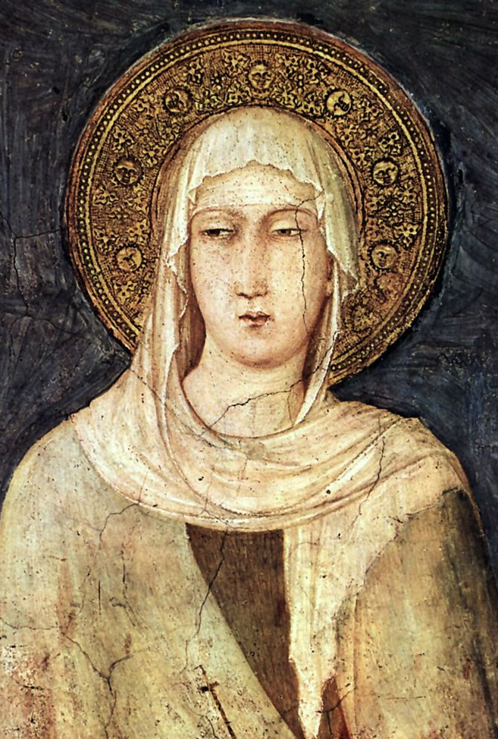
Saint Clare of Assisi and Female Followers
The early circle of Saint Francis was quite attractive to women
One of his early followers was Clare of Assisi (d. 1253), the eldest daughter of a major noble family.
Heard Francis preaching in 1211 in Assisi and decided to take up a more religious life, against the wishes of her parents.
Francis helps find her a place to stay in a Benedictine nunnery.
She does not profess as a Benedictine, however, and instead, with her sister, begins living in a small hermitage adjoined to the chapel of Saint Peter Damian, which Francis has repaired.
Other women join her there, living a life inspired by Francis’s commitment to poverty, but in a more enclosed environment than his male followers, reflecting the traditionally greater demands for religious women to stay out of contact with the outside world.
The style of Saint Clare – inspired by Francis but committing to an enclosed way of life – was perhaps not followed by all female followers of Francis, however.
Jacques de Vitry (d. 1240), a French canon regular who showed a supportive interest in religious women, suggested in 1216 that both male and female followers of Francis often roamed freely.
Popes Gregory IX and Innocent IV criticised certain “sorores minores” (“minor sisters”) who were apparently roaming freely in Umbria, much like the male friars, as late as 1241 and 1257!

Slide 9
The Franciscans - a challenging movement
The followers of Saint Francis represented a significant challenge for the established church
Their insistence on “apostolic poverty” could be seen as a critique of the richness of some parts of the Church, even if Francis claimed total loyalty and obedience to the papacy.
In comparison to bishops with fine robes and cathedrals, and traditional monasteries that drew money from large estates, Francis insisted that all his followers should live from day-to-day donations from those they ministered to (not even having communal property).
Ironically, this apparent poverty – and thus apparent holiness – also meant that they were successful in getting many donations that might otherwise have gone to existing institutions!
Their mobility also represented a challenge
They interfered with normal ecclesiastical hierarchies, by offering preaching and even the sacraments (e.g. confession) outside of the usual bishop/parish priest structures.
The idea that religious women might roam freely was particularly challenging.

Slide 10
The Order of Saint Francis
Rather than trying to crush the movement of Francis, however, the papacy offered support in return for compromises.
Pope Innocent III – at the Fourth Lateran Council of 1215 – and his successor Honorius III decided to allow these followers; in return they accepted a more institutional form, under a rule written by Francis of Assisi and revised twice. They formed a centralised congregation led by a general chapter and a Minister General.
Male followers – the “friars”, called the “First Order of Saint Francis” - are required to profess vows of poverty, chastity and obedience. These vows were somewhat different from those of the Benedictines (Obedience, Stability – i.e. living in the same monastery for life, and “conversion of behaviour”, which included the ideals of chastity and renunciation of personal property), playing more emphasis on behaviour – particularly poverty – and less on consistency in location.
Franciscan friars thus became similar to more traditional monks; but, unlike them, friars could move relatively freely outside the houses in which they lived, interacting with and preaching to the public.
At first their houses technically did not have even communal property, but this was something of a fiction: houses had an appointed papal guardian who administered property for them and gave the friars what they needed.
The female followers were also accepted, provided that they followed the rule written by Clare of Assisi (heavily inspired by Francis’s rule), which also included a firm commitment to enclosure: they effectively became quite similar to traditional nuns. The “Order of Saint Clare” came to be known as the “Second Order of Saint Francis”.
Since the early movement also had many married followers and those who otherwise did not wish to fully commit to a “monastic” style of life, an arm of the new institutional order was founded to accommodate them: the “Third Order of Saint Francis”. These followers made no formal vows beyond agreeing to follow a much simpler rule (also written by Francis) that asked them to wear simple clothes, to fast more than normal, and to meet together for liturgical celebrations.
The Order of Saint Francis became an overnight success. Even within Francis’s own lifetime (he died in 1226), there were Franciscan communities spread across multiple regions (Italy, France, Germany, England, Spain, Portugal etc.): by the end of the 14th century there were hundreds of houses across the Latin West.

Slide 11
Other Mendicant Orders
The Franciscans were not the only movement of this sort to receive papal approval around this time. Other new orders emphasised a similar combination of strong commitment to ascetic practices (above all poverty) and mobility beyond the walls of their communities, but had different origins and somewhat different emphases.
Alongside the Franciscans, they are known as mendicant orders: from the Latin verb “mendicare” (to beg), since their earliest communities were often dependent on ad-hoc support from people of every background who heard them preach.
The Augustinian Hermits / Friars
Not to be confused with Augustinian Canons Regular (but often are, even by historians!): their origin lay in men who became travelling hermit preachers in Italy.
In 1215, at the Fourth Lateran Council, Innocent III organised many of them into an order, following the Rule of Saint Augustine; despite their eremitic origin, their combination of tough ascetic practices (including strong commitment to poverty) and public preaching would make them popular in the towns. Their houses would soon be found across Europe
The Dominicans
Evolved from the circle of the Spanish priest Dominic de Guzman (1170-1221), who had been educated in the Cathedral schools of Palencia as a theologian. Became an Augustinian Canon Regular who preached publicly in Northern Spain and Southern France
Travelling to Toulouse in Southern France in 1215 to attempt to convert Cathar heretics (see later slide), he established a small community that would devote itself to stronger ascetic life (especially poverty) and to the most effective preaching: they trained very hard to become effective public speakers.
His followers were approved as the “Order of Preachers” - known more commonly as the “Friars Preachers” or the “Dominicans” - in 1216 by Honorius: they would continue to to follow the Rule of Saint Augustine but added their own additional constitutions.
Like the Franciscans, the new order soon came to possess “second” (enclosed nuns) and “third” (lay followers) orders, ruled by a General Chapter. They possessed hundreds of houses by 1300, mostly in towns and cities.
The Carmelites
Began as a group of hermit monks established at Mount Carmel (modern day Israel) during the Crusades in the late 12th century. They followed a Rule written for them by the Latin Patriarch of Jerusalem – Saint Albert Avogadro – which essentially described the life of a semi-eremitic community. Pope Honorius III approves of the Rule in 1226.
With the instability of the crusader states in the Near East, they attempted to establish communities in Europe, initially in rural locations. By the late thirteenth century, however, their commitment to poverty and interest in preaching began to find its niche in and near towns, similar to other mendicant orders: they adapt their Rule to fit these new circumstances. They came to possess c. 150 houses by 1300.

Slide 12
Mendicant orders and the papacy
By co-opting new religious movements in this way, the papacy gained in a few ways:
The new mendicant orders were directly subject to the pope (rather than the bishops): the popes hoped their ministry and preaching would extend their power and influence in quite a direct manner.
By creating official communities of new religious men and women more devoted to poverty and with greater mobility, it also hoped to thwart other new religious movements that might be less loyal and less controllable, or influenced by unorthodox theological doctrines that the Church did not support (i.e. “heresies”).
Having allowed these new orders, they attempted to put a stop to further new additions: the legislation of the Fourth Lateran Council in 1215 and the Council of Lyon in 1274 sought to put an end to the creation of new monastic “rules” and orders.
While new religious movements and congregations would continue to emerge, the papacy would work to push them to conform more closely to the basic patterns of life of existing orders, or face censure.

Slide 13
Heretics and Mendicants
There were indeed some new movements that arose within the Church at around the same time as the mendicant orders that the Church could not or would not accommodate.
The Cathars:
Influenced by “dualist” theology (see lecture 1), with some positing the existence of equal good (spiritual) and bad (physical) forces/Gods in the universe; these ideas may have been spread from the East (there were still some dualist sects there, e.g. the Bogomils) via Medierranean trade roots. Catharism becomes particularly prominent in Southern France and parts of Italy.
While some beliefs were clearly very unorthodox, there was a connection to the wider religious atmosphere. Cathar believers congregated around so-called “perfects” who lived a strongly ascetic life, renouncing almost everything, including property, to cleanse themselves of the wicked physical world. They would perform cleansing rituals on others at death (the so-called consolamentum).
The Waldensians:
The followers of Peter Waldo (d. c. 1205) a travelling merchant from Lyon. Inspired by the ideal of “apostolic poverty”, he gave away his possessions and preached this message to others who become known as “the poor men of Lyon”.
Possessed strong similarities with the early Franciscans in some ways; and they were far less extreme than Catharism in theological terms.
Nevertheless, they were much more critical of the established Church than Saint Francis; supported the idea that all believers could preach and that the Bible should be translated from Latin into common vernacular languages. The Waldensians were declared heretical in 1215 at the Fourth Lateran Council, where the Franciscans and Augustinian Hermits were formally approved.
Of the orthodox mendicant groups, the Dominicans had a particular role in preserving “orthodoxy”
Dominic had reached fame by his preaching mission to Toulouse, where he debated Cathars, and sought to convince their followers through his public preaching and strong, but more orthodox, commitment to voluntary Christian poverty.
If the initial effort was to attract people back to obedience, the emphasis would shift to prosecution and punishment. The Dominicans played a leading role papal inquisition efforts against heretics – resulting in harsh punishments and even executions – for centuries to come.

Slide 14
Mendicants under suspicion
The boundaries between heretical movements and orthodox ones, however, were far from clear.
The so-called Spiritual Franciscan faction took up more extreme criticisms of the Church and even their own order from the late 13th century into the early 14th century.
Men like Peter John Olivi (d. 1298) and Angelo da Clareno (d. 1337) criticised the Church for not renouncing property more forcefully and even their own order for using property in a way that they saw as a breach of their vow of poverty.
The papacy reacted strongly against these criticisms – since they paint the Church as corrupted by greed – and seeks to stamp out their followers.
Pope John XXII (reigns from 1316 to 1334) firmly condemns them in 1317. He also forces the wider Franciscan order to accept that their convents do own property just like other monastic houses and that Franciscan poverty was simply a strong commitment to the renunciation of personal property, as with other monks - an attempt to stop this difference from inspiring Franciscan zealots.
Meanwhile, mainstream Franciscans and other mendicants would also receive significant criticism from secular Churchmen (bishops and parish priests) and other monastic orders for the way they operated.
People sometimes looked to mendicants and chose to ignore their parish priests. New, exciting orders also meant existing monastic institutions might receive less patronage – or feel like they were, at very least.
If the criticisms were partly about power and money within the Church, they also struck a chord with lay audiences too. Mendicants – and especially the Franciscans – often looked hypocritical. The way they gained financial support could look rather unscrupulous and unfitting with poverty: e.g. chasing people with deceased relatives to give money to the Franciscans for funerals.
The lack of enclosure for male mendicants also meant misbehaviour was public – breaches of chastity, drunkenness become frequently commented upon by satirical literature (e.g. the 14th century English poetry of Chaucer, Langland and Gower)

Slide 15
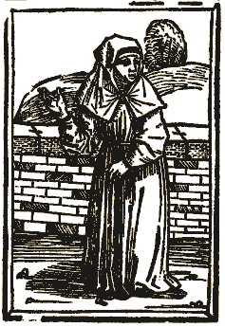
Semi-monastic movements and the boundaries of orthodoxy
The new religious movements that flourished in the 13th century were thus often controversial, even if they weren’t always declared heretical.
Other groups endured a precarious existence at the boundaries of orthodoxy
Groups like the Humiliati (in Italy and Southern France) and the Beghards and Beguines (in Northern France, the Low Countries, and Germany) were characterised by a semi-monastic appearance.
Their members usually co-operated with the church, but they were often unwilling to take formal monastic vows. Such men and women – who wanted to live a life of greater religious perfection but were not easily placed within formal institutions – represented a particular quandary for the papacy and the bishops.
All these groups were broadly tolerated, but also occasionally persecuted: inquisitors were often concerned by the potential for “heresy” among them.
Alongside the growth of mendicant third orders, the survival of such precarious groups – which flourished in the most urbanized regions – suggest the increasing desire of people (often from good backgrounds) in these areas to seek a greater involvement in religious life.
A 15th century drawing of a Beguine

Slide 16
Female experiences
Women’s involvement in these new religious movements was both prominent and controversial. Mendicant orders were able to turn many female followers into enclosed nuns. Others, however, were not so easily contained. [See Andrenna in bibliography]
Often such independently minded women find both followers and controversy through very emotional displays of religious fervour and visionary experiences..
Clare of Rimini – a widowed Franciscan tertiary (i.e. a member of the third order) from a noble background who became famed for extravagant displays of masochistic asceticism. She was eventually pushed to join the Franciscan “Second Order” (i.e. the order of Saint Clare) and become an enclosed nun.
Angela of Foligno – a Franciscan tertiary from a wealthy urban background who became famed for visions; familiar with the Spiritual Franciscans. Founded a house for religious women that refused enclosure (with the aim of the religious women treating the sick).
Mary of Oignies (d. 1213) – from a noble background; married against her parents’ wishes at the age of 14, and goes to live in the town of Nivelles with her husband. Convinced him to take a vow of chastity with her. She takes up ever more extreme ascetic practices (wearing a tight rope around her stomach, sleeping on planks) and has visceral experiences when taking communion, believing she could taste Christ in it.
Hadewijch – a 13th century woman from Brabant; little known about her, but probably an urban Beguine: writes about her mystical visions in poetic form
The experiences of such semi-monastic women (or even essentially lay women) as we know them are shaped by male priestly and limiting expectations:
Such women find their voice through emotional/physical/visionary (more than intellectual) experience of God: these arguably build on traditional female monastic images of spiritual (virgin) marriage to Christ. Marguerite Porete (d. 1310), a possible Beguine who wrote a book about her more intellectual mystical experiences called the “Mirror of Simple Souls” was burnt for heresy.
Nevertheless, the fact that these religious women forged paths outside of the traditional confines and enclosure of traditional women’s monasticism, and without the Church fully stopping them, does represent a shift.

Slide 17
Monasticism exploded or a monastic explosion?
In the 13th century, religious life could no longer be contained within traditional forms as societies and economies evolved. We have seen:
A desire to push further with voluntary poverty than traditional monastic orders
A desire to live out monastic values – ascetic life, affective piety – outside of monasteries as well as within them.
The Church struggling to contain these energies within new types of monastic communities and new mendicant orders.
One can look at this as a great challenge to the status of monastic life within wider society.
But one can also look at is as evidence of its successful influence on society, and adaptability: the Mendicant orders founded in this period remain powerful religious forces in the Catholic world to this day!
Moreover, these changes did not necessarily spell the end of relevance of enclosed monks and nuns, even if they had found new competitors:
The society of the medieval West evolved gradually; the vast majority of people still lived in the countryside, and still engaged in simple agricultural activities. More traditional forms of monasticism continued to hold pride of place in many areas that were not changing so rapidly
Even within urban society, the Mendicant friars were not without criticisms that stemmed from the apparent hypocrisy caused by the weakening of clear dividing lines with society. There was room, as we will see, for more strictly enclosed forms of monasticism to find further relevance within this environment.

Slide 18
Sources – First Life of Saint Francis, by Thomas of Celano (1228-9)
Thomas of Celano (1185-1260)
From a noble family in central Italy; Thomas received a good education, probably from the Benedictine monastery school at Celano.
He joined the new Franciscan order in 1215.
Well known for the quality of his writing, and especially his poetic style. He would write three works devoted to the life and miracles of saint Francis at the request of papal and Franciscan authorities.
First Life of Saint Francis
Thomas knew Saint Francis well towards the end of his life (Francis died in 1226) and thus has had heard many things directly from him and other early disciples.
His first account of Francis’s life was written at the request of Pope Gregory IX, around the time that Francis was declared a saint.
Like all “vitae” (saint’s lives), it is meant to describe the virtues of the saint and the miracles they brought about, in order to prove their sanctity.
An extremely popular Latin text in both mendicant and traditional monastic libraries.

Slide 19
Sources – First Life of Saint Francis, by Thomas of Celano (1228-9)
Once, because he was ill, he ate a little bit of chicken. When his physical strength returned, he entered the city of Assisi. When he reached the city gate, he commanded the brother who was with him to tie a cord around his neck and drag him through the whole city as if he were a thief, loudly crying out: ‘Look! See this glutton who grew fat on the flesh of chickens that he ate without your knowledge.’ Many people ran to see this grand spectacle and, groaning and weeping, they said: ‘Woe to us! We are wretches and our life is steeped in blood! With excess and drunkenness we feed out hearts and bodies to overflowing!’ They were touched in their hearts (Acts 2: 37) and were moved to a better way of life by such an example.
[…]
Whenever he found an abundance of flowers, he used to preach to them and invite them to praise the Lord, just as if they were endowed with reason. Fields and vineyards, rocks and woods, and all the beauties of the field, flowing springs and blooming gardens, earth and fire, air and wind: all these he urged to the love of God and to willing service

Slide 20
Sources – First Life of Saint Francis, by Thomas of Celano (1228-9)
There was in that place a certain man named John, of good reputation and even better life, whom the blessed Francis particularly loved. Noble and honourable in his own land, he had rejected the nobility of the flesh and pursued that of the soul. Around fifteen days before the birthday of Christ [i.e. Christmas], Francis sent for this man, as he often did, and said to him, "If you wish to celebrate the approaching feast of the Lord at Greccio, hurry and do what I tell you. I want to do something that will recall the memory of that child who was born in Bethlehem, to see with bodily eyes the inconveniences of his infancy, how he lay in the manger, and how the ox and ass stood by." Upon hearing this, the good and faithful man hurried to prepare all that the holy man had requested.
The day of joy drew near, the time of exultation approached. The brothers were called from their various places. With glad hearts, the men and women of that place prepared, according to their means, candles and torches to light up that night which has illuminated all the days and years with its glittering star. Finally the holy man of God arrived and, finding everything prepared, saw it and rejoiced.
The manger was ready, the hay was arranged, the ox and ass were led in. Simplicity was honoured there, poverty was exalted, humility was commended and a new Bethlehem, as it were, was made in Greccio. Night was illuminated like the day, delighting both men and beasts. The people came and joyfully celebrated the new mystery. The forest resounded with voices and the rocks responded to their rejoicing. The brothers sang, discharging their debt of praise to the Lord, and the whole night echoed with jubilation. The holy man of God stood before the manger, filled with sighs, consumed by devotion and overflowing with a marvellous joy. The solemnities of the mass were performed over the manger and the priest experienced a new consolation.
The holy man of God wore a deacon's vestments, for he was indeed a deacon, and he sang the holy gospel with a sonorous voice. And his voice, a sweet voice, a vehement voice, a clear voice, a sonorous voice, invited all to the highest rewards. Then he preached sweetly to the people standing about, telling them about the birth of the poor king and the little city of Bethlehem. Often, too, when he wished to mention Jesus Christ, burning with love he called him "the child of Bethlehem." And speaking the word "Bethlehem" or "Jesus," he licked his lips with his tongue, seeming to taste the sweetness of these words.
The gifts of the Almighty were multiplied here and a marvellous vision was seen by a certain virtuous man. For he saw a little child lying lifeless in the manger, and he saw the holy man of God approach and wake the child as if from a deep sleep. Nor was this an unfitting vision, for in the hearts of many the child Jesus really had been forgotten, but now, by His grace and through His servant Francis, He had been brought back to life and lived within their hearts through loving recollection. Finally the celebration ended and each returned joyfully home.

Slide 21
Sources - Life of Saint Anthony of Padua, anonymous author (c. 1232-1249)
An anonymous Latin biography of a famous Franciscan preacher, Anthony of Padua (1195-1231), written between c. 1232-1249. Widely copied and read, especially among the Franciscans.
“Anthony” was actually from Lisbon, Portugal, even if he became famous in Italy.
Born Fernando Martins de Bulhões to a wealthy Portuguese noble family.
He began his monastic life as an Augustinian Canon Regular, and received a strong education at their house at Coimbra, Portugal.
When some Franciscans travelled to Coimbra in c. 1214 and set up a small hermitage just outside the city, he gets dispensation to leave the Canons Regular and join the Franciscans. Takes the name Anthony in honour of the Egyptian monk “Anthony the Great”.
He to go to Africa to preach the Gospel to Muslims there but ended up in Italy, where he meets Saint Francis in the early 1220s.
Francis, although somewhat suspicious of people being too educated (due to the danger of arrogance), was apparently impressed by Anthony’s combination of learning and humility, and put him in charge of the friars’ studies.
Anthony became particularly noted for the quality of his preaching. While the Dominicans were regarded as the most advanced preachers of their age, the Franciscans were not far behind, and Anthony was the most famous of their early preachers.
He attracted large crowds wherever he went, and appears to have been particularly popular in many Italian towns and cities.

Slide 22
Sources - Life of Saint Anthony of Padua, anonymous author (c. 1232-1249)
Gathering in an impressive crowd, the people came from everywhere to listen to him, like the land that thirsts for rain. [Anthony] established daily stations through the churches of the city. And as soon the churches could not contain the growing throngs of men and women who had come to listen to him, he retired to the vast meadows [outside the city]. They came from the cities, castles, and villages surrounding Padua in an almost innumerable crowd. There were both men and women there, all united in the greatest devotion, thirsting for the word of life, hanging on his words for their salvation with a steadfast hope. Rising in the middle of the night – everyone wanted to get there first – they went out enthusiastically, in torchlight, to the place where he was going to preach. You would have seen knights and noble ladies rushing out into the darkness, warming exhausted limbs in soft blankets, who then, without any difficulty by all reports, spent a good part of the day wide-awake before the preacher. The old were there, the young hurried along: they were men and women of every age and condition. Casting off their ornaments and jewellery, each took on, if I may say so, the habit of religion. Even the venerable Bishop of Padua, along with his clergy, was a devoted follower of the preaching of Anthony, the servant of God: moved in his soul to become a model for his flock, through his humble example he showed the people that they should listen. Each and every one of them sought to grasp his words; they did this so avidly that, despite the size of the gathering, amounting to thirty thousand men according to some accounts, there were no loud voices nor murmuring to be heard. Rather, in continuous silence, they were as if one man, the ears of their body and those of their heart held in suspense: all looked to the orator.

Slide 23
Sources – Vox Clamantis (“The Voice of One Crying Out), by John Gower (c.1377-1381)
John Gower (c. 1330-1408)
From a middling family that held some land in the south-east of England.
Seems to have spent much of his life in and around London and may have been a lawyer
Became a noted poet, writing in Latin, French, and also English.
Received royal commissions for much of his work (from Richard II and Henry IV)
Vox Clamantis
A poetic “dream-vision”, describing the state of English society at the time of writing.
Most famous for its contemporary description of the Peasant’s Revolt of 1381.
But also contained discussions of many other social topics – including the role and place of various religious orders.
A popular text in English court and church circles in the late 14th and 15th centuries: tens of manuscripts; would be printed in the late 15th century by the first English printer, William Caxton.

Slide 24
Sources – Vox Clamantis (“The Voice of One Crying Out), by John Gower (c.1377-1381)
The friar wanders about outside and explores inside, and no place or affair is a mystery to him. Sometimes he is a medical doctor, sometimes a religious confessor, sometimes a mediator in disputes: he gives orders both high and low and at every turn. Thus the friar arrogantly runs around everywhere as if he were the spirit of the Lord. But he only comes to the bed when the husband is away.
[…]
The friars maintain that they are disciples of Christ and that they are pursuing all of their duties after His example […] I would say these men are not disciples but rather “gods”: since both life and death bring money to them

Slide 25
Sources – Book of Visions, by Hadewijch (c. 1240s)
Hadewijch (lived early to mid 13th century)
Very little is known about her life. She was from Brabant (modern-day Netherlands), it appears, since her works were written in Brabantine Dutch.
Her writings suggest she received some education in Latin, due to the references she is able to make (e.g. Saint Augustine), and French, since her writings appear influenced by the French romantic poetry that flourished at aristocratic courts.
She appears to have lived as a beguine with some other women for some time, to judge by her letters. These also suggest she may have been forced to leave this environment and take up a wandering existence.
She is an example of a new breed of semi-monastic women/pious laywomen who could not be easily contained within more traditional (i.e. enclosed) female monastic institutions or even within the new mendicant orders.
Book of Visions (c. 1240s)
This text describes Hadewijch’s religious visions in great detail. She talks to Christ directly in these at times, often in very romantic language, full of emotion.
Not widely copied or read at the time but they are thought to have had some influence on other Dutch Christian mystics, including men, e.g. the Augustinian canon John of Ruusbroec

Slide 26
Sources – Book of Visions, by Hadewijch (c. 1240)
On a certain Pentecost Sunday, I had a vision at dawn. The psalms were being sung in the church, and I was present. My heart and my veins and all my limbs trembled and quivered with eager desire and, as often occurred with me, such madness and fear took over my mind that it seemed to me that I could not fully please my Beloved [i.e. Christ] and that my Beloved would not fulfil my desire […] On that day my mind was filled so fearfully and so painfully by desirous love that each of my limbs threatened to break, and all of my veins were in pain. The longing I felt cannot be expressed by any language of any person I know; and everything I could say about it would be unheard-of to all those who have never come to understand Love as something to work for with desire, and whom Love had never come to possess. I can say this about it: I desired to enjoy my Beloved fully and to understand and taste Him fully. I desired that His humanity should to the fullest extent be united in enjoyment of my humanity, and that my humanity would be strong enough to enter into perfection, until I could content Him, who is perfection itself, in purity and unity.

Slide 27
Bibliography
Beyond the general reading, the following are very useful and easily available:
H. Grundmann, Religious Movements in the Middle Ages (trans. Steven Rowan), University of Notre Dame Press, 1995. www.jstor.org/stable/j.ctvpj7dp4. (esp. chapters 1 and 2).
C. Andenna, “Female Religious Life in the Twelfth and Thirteenth Centuries”, in A. I. Beach & I. Cochelin (eds.), The Cambridge History of Medieval Monasticism in the Latin West (Cambridge University Press, 2020), 1039–1056. https://www.cambridge.org/core/books/cambridge-history-of-medieval-monasticism-in-the-latin-west/female-religious-life-in-the-twelfth-and-thirteenth-centuries/D2EEC524F0BC199A6D5ACCD0810DD737
Lester K. Little, Religious Poverty and the Profit Economy in Medieval Europe (Cornell University Press, 1978). Not available online but worth reading if you can find it. If the British Library reopens sometime I will try to photocopy some chapters…

