Slide 1
Received Pronunciation vs
Upper Received Pronunciation
RP & URP (PRP)
Presentation based mainly on PronunciationStudio.com¹

Slide 2
Defining RP & URP (PRP)
Neither RP nor URP are regional or geographically distinguishable.
Indicative of social class or educational institutions.
RP: Conservative & Contemporary (Traditional vs Modern, Collins &Mees²) (Historical)
  HMQ (URP) & Emma Watson³ (RP)
  Freddie Mercury⁴ (RP)

Slide 3
Differences RP & URP
SEGMENTALS ASPECTS
CONSONANTS pronounced more clearly, but no real difference
  HMQ pronouncing her ”r” (very)⁵

Slide 4
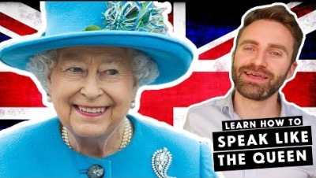

Slide 5

VOWELS
      FRONT VOWELS tendency towards /e/
        /æ/ as in MAN – towards the /e/ in MEN
        /əʊ/ as in GO nearer the front – towards the /e/ position
        /i/ as in REALLY / more open towards the /e/ position
      BACK VOWELS tendency towards /a/
        /aʊ/ as in HOW near the back in the /ɑ/ position
        /ʌ/ in FUN further open and back, towards the /ɑ/ position
          Defining sound for RP (ESDE)
        /ɜː/ in BIRD more open and back, towards /ɑː/ more like BARRED
        /uː/ sound in YOU is made with the tongue further back (but HMQ fronting it, ESDE)

Slide 6
VOWELS
    TRIPHTONGS: Smoothing
        /aɪə/ in WIRE, RIOT² and /aʊə/ in HOUR, POWER are realised as one long /ɑː/ sound

Slide 7
SUPRASEGMENTAL ASPECTS
Tone. Intonation - rising, falling. Stress. Pitch. Length. Word accent.
URP
  high falling patterns
  creaky voice towards ends of sentences (E.W.⁶)
RP
    Uptalk⁷
    Endings (segmental) interfering with (suprasegmental) as in ‘happy’ realized by Emma or HMQ? (ZJ)⁸

Slide 8
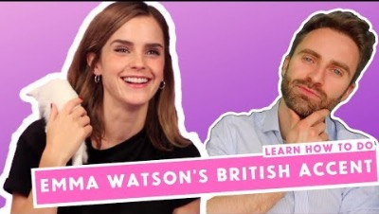

Slide 10
Complaints & Weaknesses, Strengths
Unfair! - Emma Watson (modern) Americanized /t/, mixture of RP and URP.
Plenty of resources, not contradictory, but possibly inconsistent.
Strengths
    Possible to learn (Freddie Mercury, Elisa Doolittle⁹ - historical)
Highly recommend the www.PronunciationStudio.com free package

Slide 11
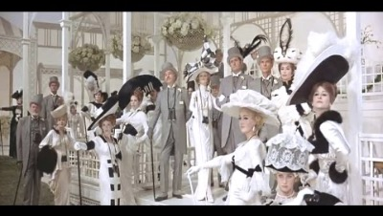

Slide 12
Resources
https://pronunciationstudio.com/upper-received-pronunciation/
Tomkova, K. Materials in AJL52066
https://youtu.be/xrWXsoXuuKs?t=66
https://youtu.be/g0qShxkuS7Q?t=760
https://youtu.be/DPZkrRpJ4Zc?t=463
https://youtu.be/xrWXsoXuuKs?t=282
EatSleepDream English YT. https://youtu.be/xrWXsoXuuKs?t=173
EatSleepDream English YT. https://youtu.be/xrWXsoXuuKs?t=396
Doolitle, E. in My Fair Lady. https://youtu.be/P_5RyXYhdP8?t=67

