Slide 1
English Autonomously
Marcela Sekanina Vavřinová
Martina Šindelářová Skupeňová
Eva Rudolfová
Lenka Zouhar Ludvíková
Notes:
Technické hlášení
Small talk
Představení (improvizovaný rozhovor vedoucí k „priorities“)

Slide 2
ENGLISH AUTONOMOUSLY checking understanding
Finish the sentence:
Autonomous learning is …
In English, I am really good/bad at …
When learning, I feel …
When learning, I would like to …
When learning, I need …
In EA, I can …
Counselling is …
Modules are …
With EA materials, I did ….
Notes:
examples???

Slide 3

ENGLISH AUTONOMOUSLY plan for today
CONTRACT
COUNSELLINGS
LOG
READINESS
Notes:
examples???

Slide 4
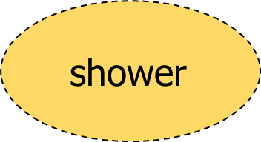

ENGLISH AUTONOMOUSLY plan for today
BOOKING
study buddy
1st counselling
module
module
Notes:
Fotka nějakého dobrého kontraktu pro inspiraci…? MŠS, poté erasure
examples???

Slide 5
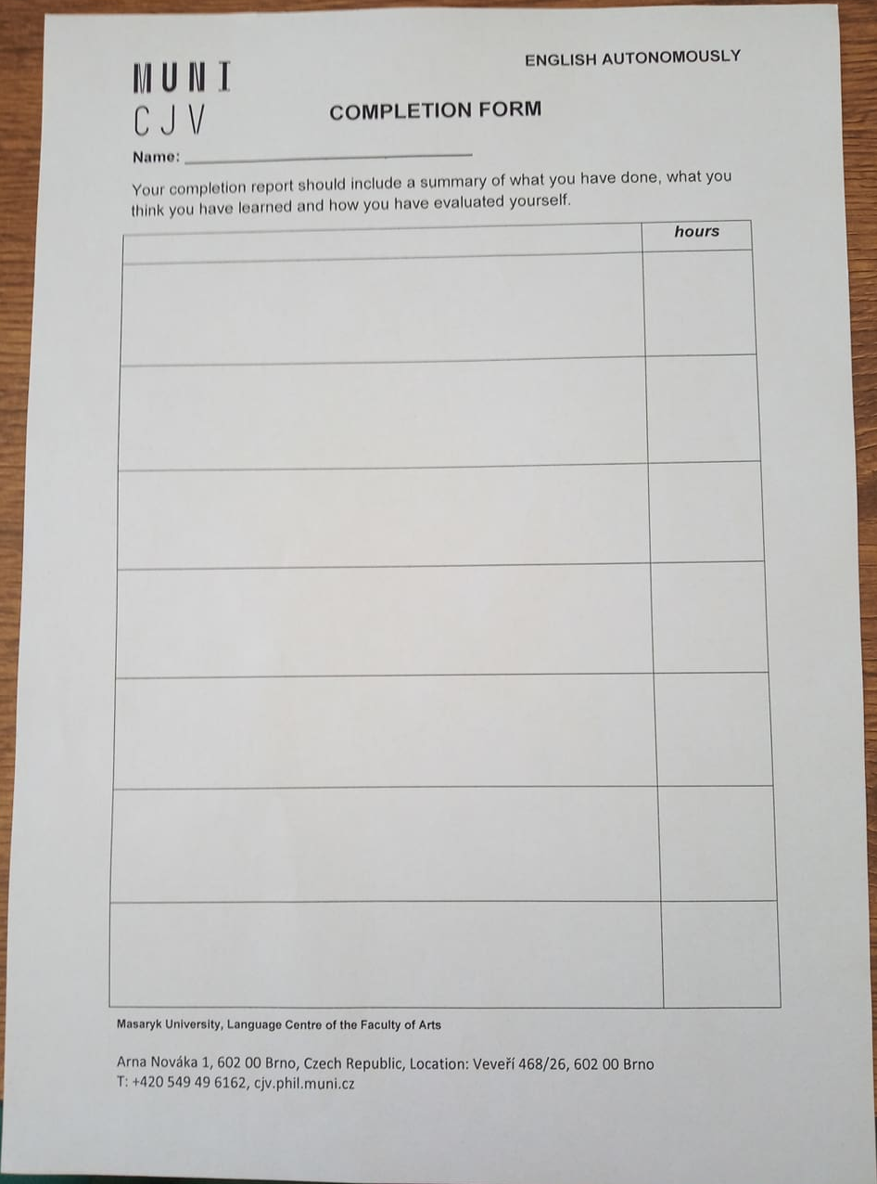
ENGLISH AUTONOMOUSLY contract/ plan/ agreement
Notes:
Připomenout DIY!!!!!!
contact hours – 4,5 with modules plus home preparation – how much?
Odkazy na videopozvánky?

Slide 6
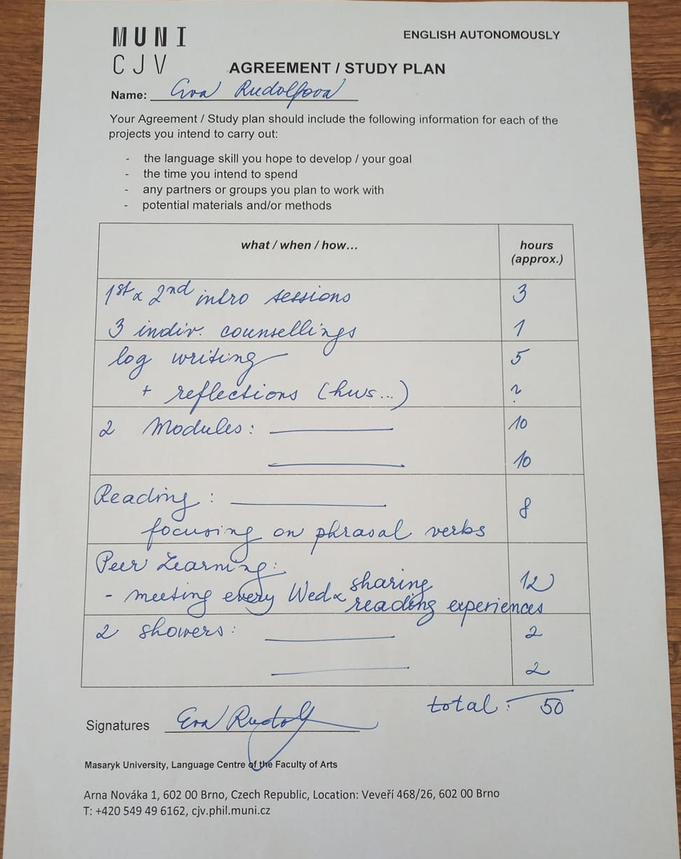
ENGLISH AUTONOMOUSLY contract/ plan/ agreement
Notes:
Struktura kurzu!!!
contact hours – 4,5 with modules plus home preparation – how much?
Odkazy na videopozvánky?

Slide 7
ENGLISH AUTONOMOUSLY metacognition for autonomous learning
planning
monitoring
evaluating
Notes:
MAI – všichni snad mají…

Slide 8
ENGLISH AUTONOMOUSLY counselling sessions
planning
monitoring
evaluating

Slide 9

ENGLISH AUTONOMOUSLY counseling session 1 - planning
Image from https://kimblechartingsolutions.com/2017/06gold-bulls-wantnedd-support-hold/

Slide 10
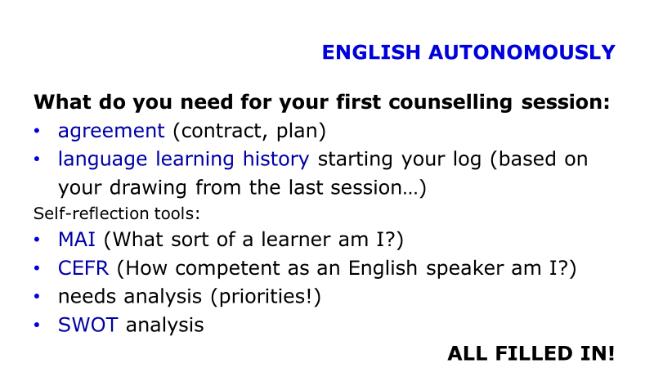
ENGLISH AUTONOMOUSLY getting ready for 1st counselling
TASK:
In pairs talk about your preparation for the 1st counselling session:
What do I want and need to achieve?
Do I know what to bring?
Do I know what to do with each paper and why?
Do I have a plan?

Slide 11

ENGLISH AUTONOMOUSLY counseling session 2 - monitoring
Image from Unsplash.com

Slide 12

ENGLISH AUTONOMOUSLY counseling session 3 - evaluating
Image from Unsplash.com

Slide 13






ENGLISH AUTONOMOUSLY learning diary/ log/ reflective writing
Images from Unsplash.com
Notes:
examples???

Slide 14



ENGLISH AUTONOMOUSLY reflective writing
a guide by University of Hull
a very brief guide by Vancouver Community College

Slide 15
ENGLISH AUTONOMOUSLY log writing
Focus: English learning
Activity: regular
Writing style: use I/we/me
structure your writing (before/during/after; event/learning/what/how/why/next time)

Slide 16
ENGLISH AUTONOMOUSLY log writing
Questions:
What have I learned?
What do I know now that I did not know?
What were my strenghts and weaknesses during the experience? What were the challenges and how did I handle them?
What was useful?
What would I do better next time?
What have I learnt from this?

Slide 17
ENGLISH AUTONOMOUSLY log writing
Form: online log, video log, audio log, hand-written log, portfolio, book...
language learning history (LLH) to start with

Slide 18
ENGLISH AUTONOMOUSLY learning by doing – writing a reflection
Try to reflect on your recent learning experience.

Slide 19
ENGLISH AUTONOMOUSLY log writing
Questions:
What have I learned?
What do I know now that I did not know?
What were my strenghts and weaknesses during the experience? What were the challenges and how did I handle them?
What was useful?
What would I do better next time?
What have I learnt from this?

Slide 20
ENGLISH AUTONOMOUSLY
What do you need for your first counselling session:
agreement (contract, plan)
language learning history starting your log (based on your discusssion from the last session…)
Self-reflection tools:
MAI (What sort of a learner am I?)
CEFR (How competent as an English speaker am I?)
needs analysis (priorities!)
SWOT analysis
ALL FILLED IN!

Slide 21
ENGLISH AUTONOMOUSLY
FAIR
BOOKING
1st counselling
module
module
.
Notes:
Fotka nějakého dobrého kontraktu pro inspiraci…? MŠS, poté erasure
examples???

Slide 22
ENGLISH AUTONOMOUSLY
Thank you for the second session:)

Slide 23
ENGLISH AUTONOMOUSLY bibliography
Holec, Henri: Autonomy and Foreign Language Learning. Oxford, 1981.
Little, David: Learner autonomy 1: definitions, issues and problems. Dublin, 1991.
Karlsson, Leena, Kjisik, Felicity & Nordlund, Joan: From Here To Autonomy. Helsinki, 1997.
Schraw, Gregory and Dennison, Ryne Sperling: Assessing metacognitive awareness. In: Contemporary Educational Psychology, 19, 460-475.

