Slide 1
Art History as a ‘Science’
Observation and the Role of ‘Theory’

Slide 2
‘The visitor must learn some physics before he can see what the physicist sees. Only then will the context throw into relief those features of the objects which the physicist sees.
[ … ]
This obtains in all seeing. Attention is rarely directed to the space between the leaves of a tree, save when a Keats [poem] brings it to our attention
[ … ]
There is a sense, then, in which observation is a theory-laden undertaking. Observation of x is shaped by prior knowledge of x.’
Norman Hanson, Patterns of Discovery (1958) in Stuart Brown, ed., Conceptions of Inquiry (London, 1981) pp. 267-9

Slide 3
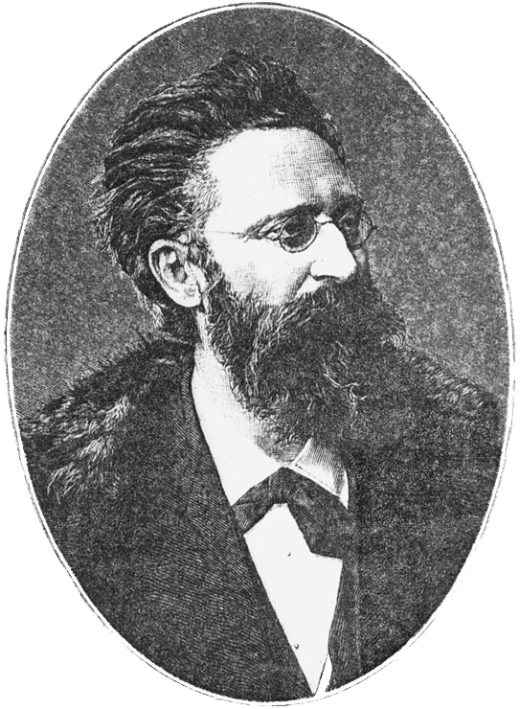
‘[Art history] has nothing whatsoever to do with deduction or speculation: what it publishes are not aesthetic judgments, but historical facts which might then serve as a subject for inductive research. The benchmarks of the history of art are as little of an aesthetic nature as political history serves as the subject for moral judgments [ … ] the question whether a painting is beautiful or not is actually not in any way justifiable in the history of art, and the question for instance of whether Raphael or Michelangelo, Rembrandt or Rubens achieved greater perfection is an art historical absurdity. I can imagine the best history of art in which the word ‘beautiful’ does not at all occur. Art historical judgments are limited to the conditions under which a work of art was created, as these are discovered through research and autopsy.
Moriz Thausing
‘The Place of Art History as an Academic Discipline [Wissenschaft]’ (1873)
Moriz Thausing (1838-1884)

Slide 4
The aestheticizing approach has been a great disadvantage for the reputation of a discipline which has only recently been successfully inaugurate ... It created the impression that history of art represented a sort of intellectual sofa – a sort of snack which carries with it the threat of indigestion - and not a hearty intellectual fare, a field fraught with difficulties and satisfaction like any other scholarly endeavor. For these reasons, the history of art has been unnecessarily often associated with aesthetics, and we are here all the more admonished to clarify the distinguishing characteristics more strongly than the common elements.
Moriz Thausing
‘The Place of Art History as an Academic Discipline [Wissenschaft]’ (1873)

Slide 5
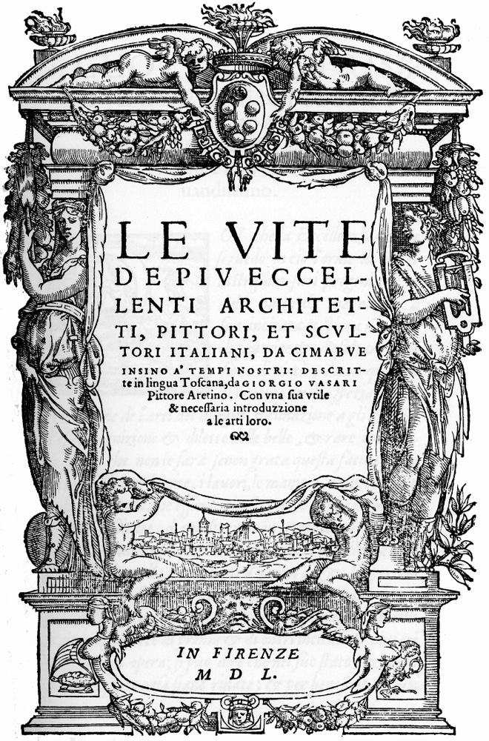
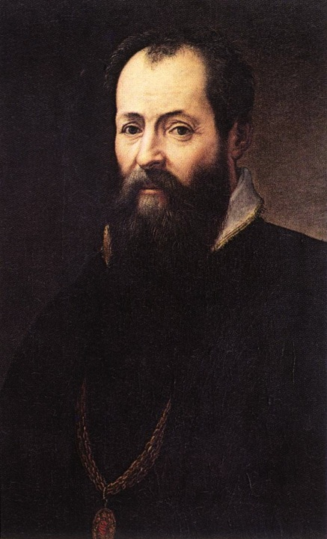
R: Giorgio Vasari – Self Portrait (1566-68)
L: Giorgio Vasari – Frontispiece of The Lives of the Most Excellent Architects, Painters and Sculptors (Florence, 1550)
Notes:
5

Slide 6
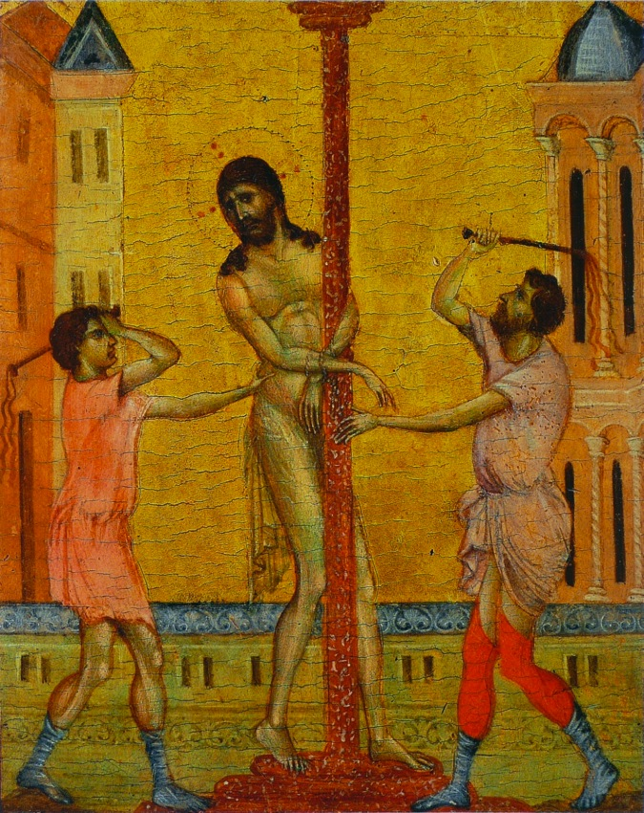
Furthermore …
‘I have endeavoured not only to record what the artists have done but also to distinguish between the good, the better and the best, and to note with some care the methods, manners, styles and behaviour and ideas of the painters and sculptors. I have tried as well as I know how to help people who cannot find out for themselves to understand the sources and origins of various styles, and the reasons for the improvement or decline of the arts at various times and among different people.’
Vasari, Lives of the Artists, Preface to Part 2, p. 84.
Cimabue – Flagellation of Christ (1280s) (Frick Collection, New York)
Notes:
6

Slide 7
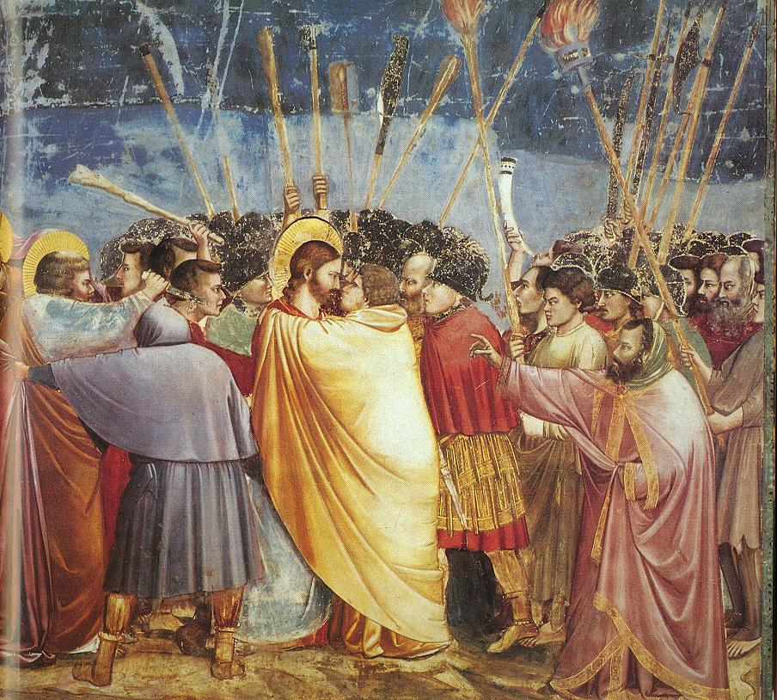
‘Although Giotto’s fame obscured his … Cimabue was, as it were, the first cause of the renewal of the art of painting. Giotto, although he was his pupil … aspired even higher. It was Giotto who opened the door of truth to those who have subsequently brought the art of painting to the greatness and perfection it can claim in our own century.’
Vasari, Lives of the Artists, ‘Cimabue,’ p. 55.
Giotto – Kiss of Judas (1305) Arena Chapel, Padua.
Notes:
7

Slide 8
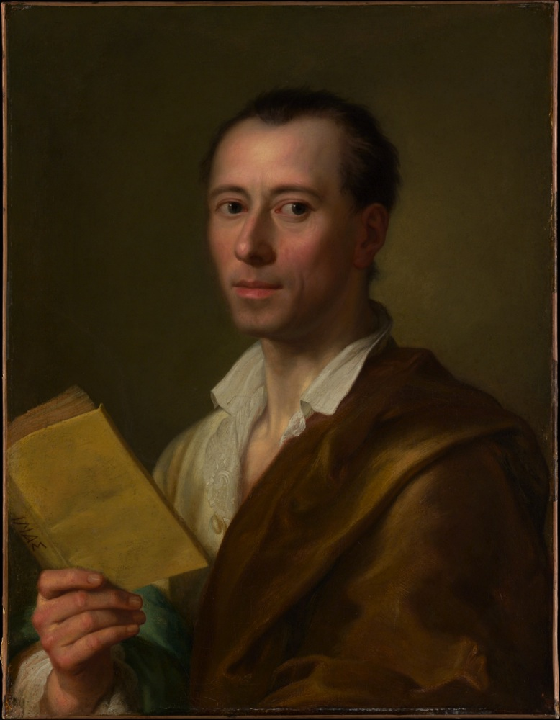
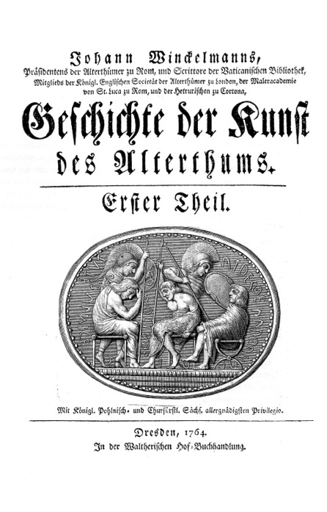
Winckelmann – History of the Art of Antiquity (Dresden, 1764)
Anton Raphael Mengs - Johann Winckelmann (after 1755)
Notes:
8

Slide 9
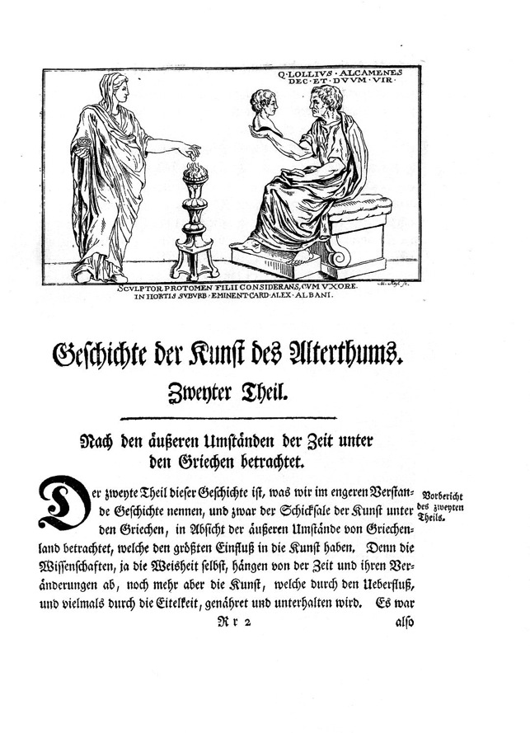
‘The history of the art of antiquity that I have endeavoured to write is no mere narrative of the chronology and alterations of art …. The history of art should inform us about the origin, growth, change and fall of art, together with the various styles of peoples, periods and artists ….’
Winckelmann, History of the Art of Antiquity (Los Angeles, 2006) p. 71
Notes:
9

Slide 10
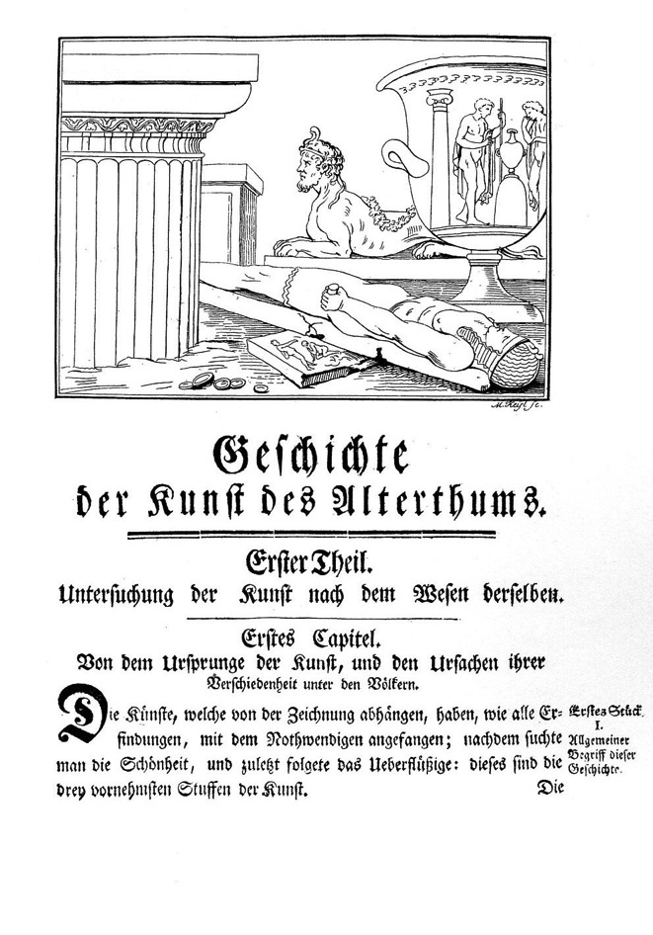
‘Just as visible and understandable as the influence of climate on appearance is, secondly, its influence on ways of thinking, to which external circumstances also contribute … The way of thinking of Eastern and southern peoples, as well as that of the Greeks, is evident in their works of art. Among the former peoples, figurative expressions are as warm and fiery as the climate in which they live, and the flight of their thoughts often takes them well beyond the bounds of possibility …
By contrast, the Greeks, who lived in a moderate climate … Their imagination was not exaggerated as with the Eastern and southern peoples …’
Winckelmann, History of the Art of Antiquity (Los Angeles, 2006) p. 121.
Notes:
10

Slide 11
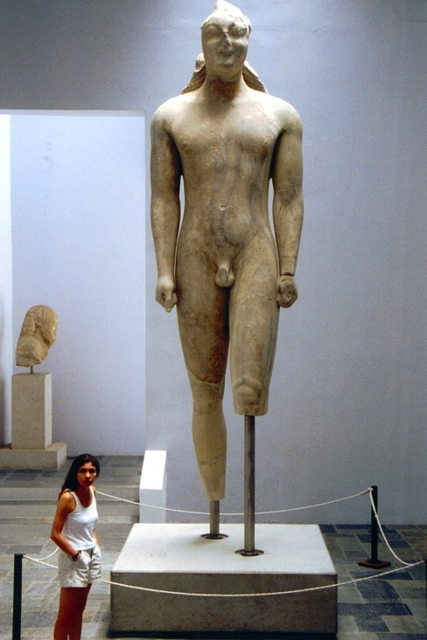
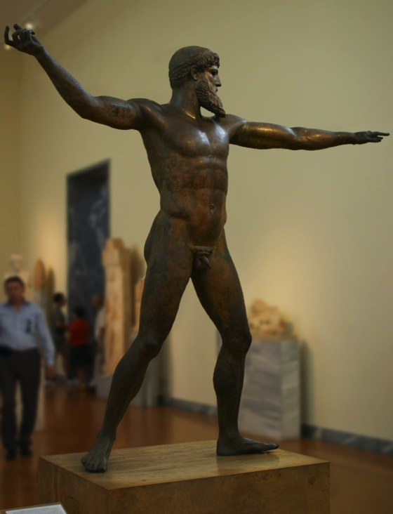
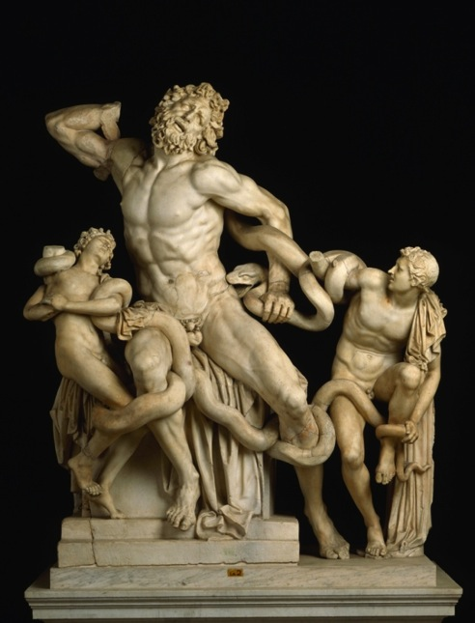
Archaic
Classical … and Hellenistic
Notes:
11

Slide 12
The Idea of Positive Science
‘ … just like the physical sciences, research [into culture] culminate in the establishment of constant relations between facts; the discovery of these dependencies in the physical sciences has given men the ability to anticipate and modify events in nature; an analogous discovery in the moral sciences must be able to provide men with the means to anticipate and modify to a certain degree historical facts.’
‘The entire secret of our practical progress, 300 years, is encapsulated here: we have separated out and defined pairs of facts, such that whenever the first appears, the second one never fails to follow …’
Hyppolite Taine, Essais de Critique et de l’Histoire (Paris, 1858) p. xxiv and xxvv

Slide 13
The Idea of Positive Science (2)
‘The key ideas are as follows: (1) An emphasis upon verification (or some variant such as falsification): Significant propositions are those whose truth or falsehood can be settled in some way. (2) Pro-observation: What we can see, feel, touch, and the like, provides the best content or foundation for all the rest of our non-mathematical knowledge. ‘
Ian Hacking, ‘Positivism’ from Hacking, Representing and Intervening (Cambridge, 2012) p. 41

Slide 14
The Historical Critical Method
Origins in the interpretation and criticism of biblical and classical texts:
Barthold Georg Niebuhr (1776-1821) - Roman History (Berlin, 1811-1832)
David Strauss (1806-75) – The Life of Jesus, critically Analysed (Tübingen, 1835-36)
Leopold Ranke (1795-1886) – German History in the Age of the Reformation (Berlin, 1839-47)
Based on systematic and critical reading of historical source texts
Guided by belief in objectivity and idea of presenting history ‘as it really was’ (Ranke)

Slide 15
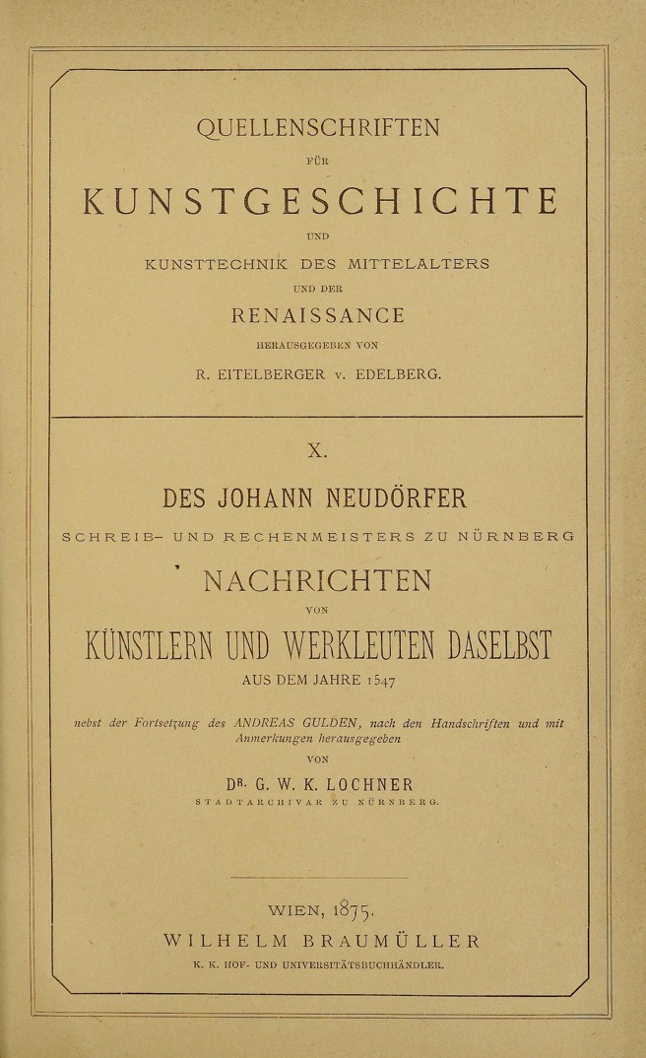
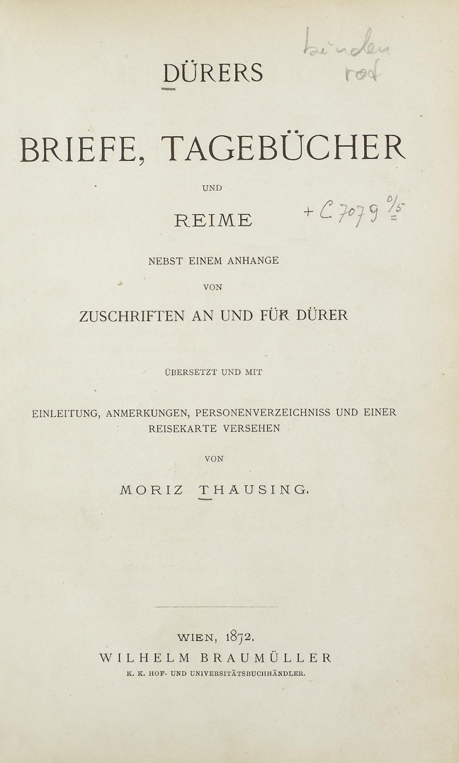
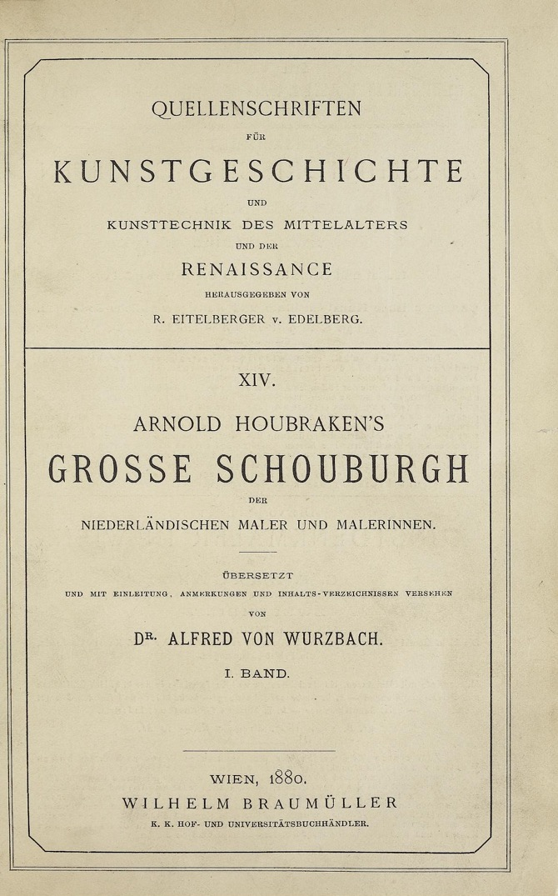

Slide 16
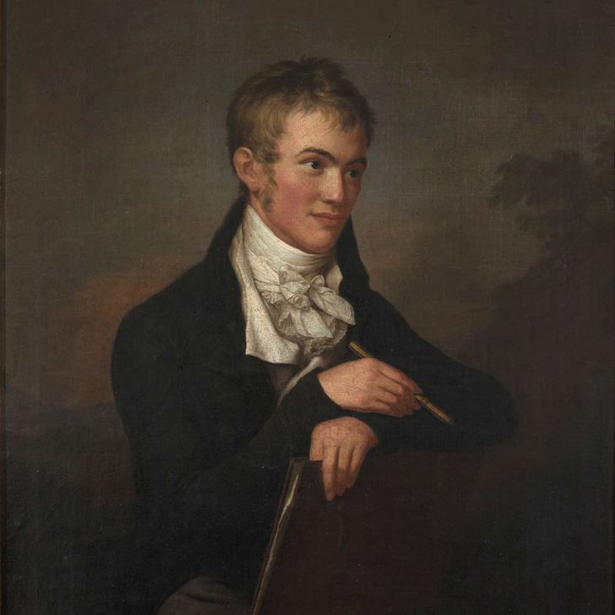
Carl Friedrich von Rumohr (1785-1843)
Author of Italienische Forschungen (Italian Enquiries) (Berlin, 1827)
Pioneer of the ‘Philological Method’ borrowed from historians at the Humboldt University, Berlin
Friedrich Gröger
Portrait of Carl Friedrich von Rumohr (1802)

Slide 17
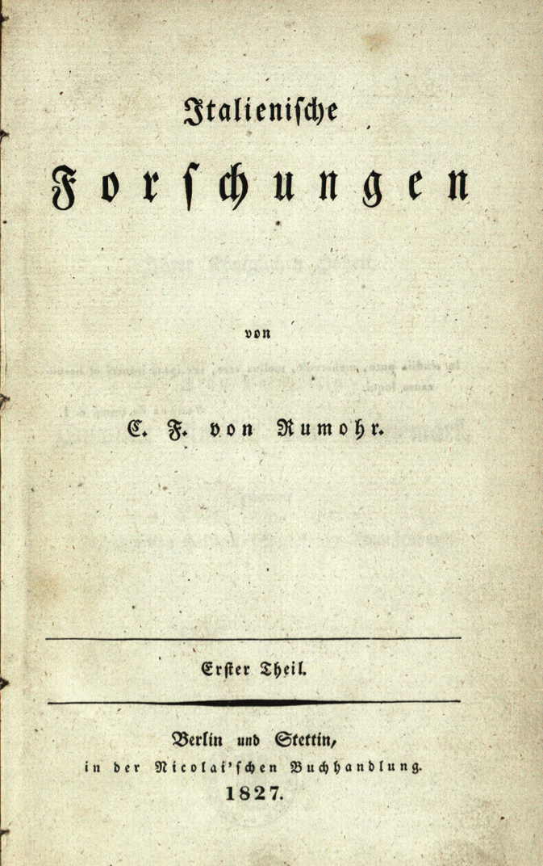
‘The reader should not expect any literary accomplishment … when establishing individual facts that provided a point of support in obscure periods, I found it necessary to present them in an intricate manner and their connections extensively, since any benefit that I can bring to others with my work rests on the reliability of the details, I can assure, have been fully weighed up, examined and inspected in every way.’
Rumohr, Italienische Forschungen, Vol. I, p. ix.

Slide 18
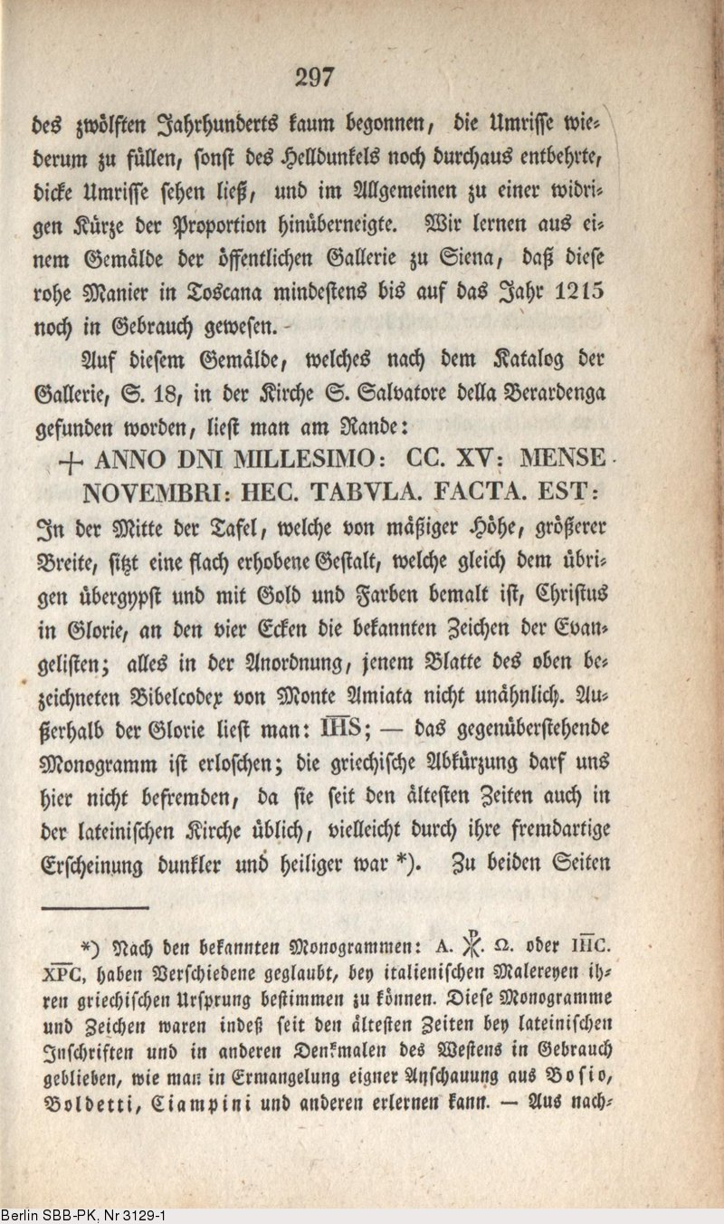
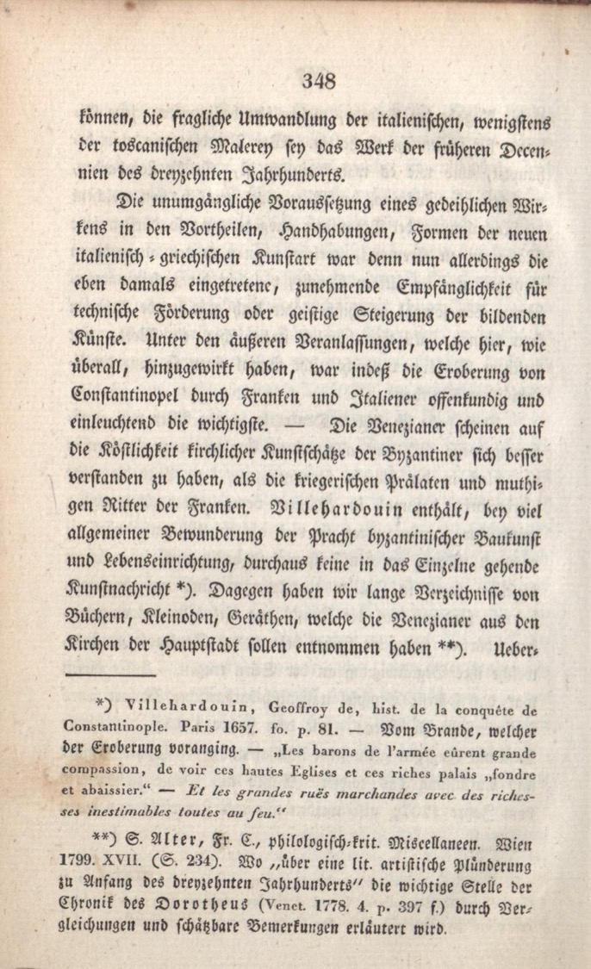

Slide 19
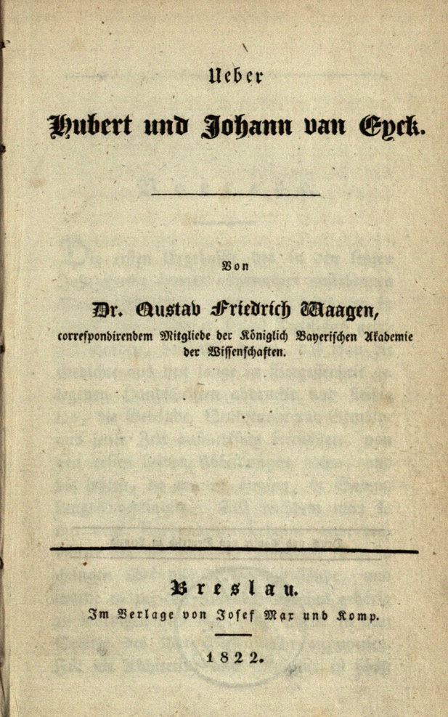
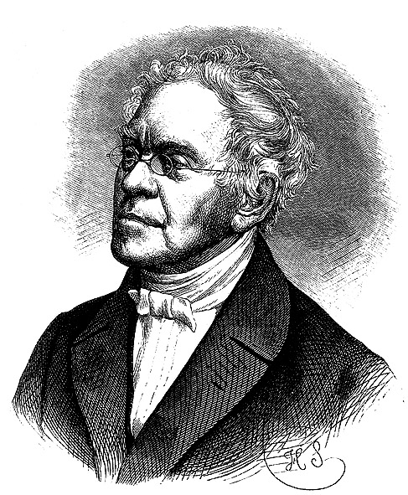
Gustav Friedrich Waagen (1794-1868)
Director of the Art Gallery, Berlin
Author of Über Hubert und Johann van Eyck (Breslau, 1822)
First catalogue raisonnée
Like Rumohr – use of historical sources and critical analysis of their reliability

Slide 20
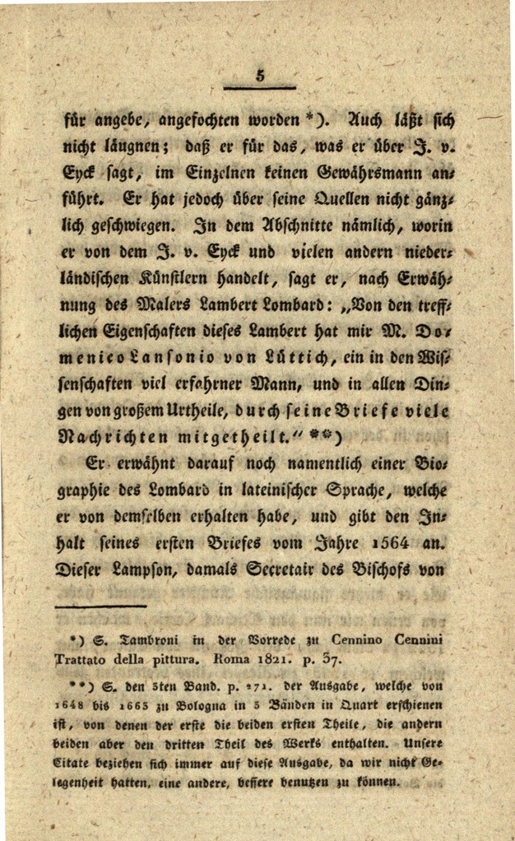
‘The information preserved for us by Vasari about Johann van Eyck, especially about his invention of oil painting and its dissemination across Italy, has been contradicted in many ways, and moreover its credibility has been challenged due to his claim that he has no source. It cannot be denied, he provides no guarantor for what he says about van Eyck. And yet he is not entirely silent about his sources. In the paragraph where he deals with van Eyck and many other Netherlandish painters, he says, when discussing the painter Lambert Lombard: “Domenico Lansonio of Liège, a highly learned man with fine judgement in all matters,
told me many things about the excellent qualities of this Lambert in his letters”.’
Waagen, Über Hubert und Johann van Eyck, pp. 4-5

Slide 21
Positivism and its problems

Slide 22
Examples of Art Historical Positivism
Research into who painted / sculpted / engraved / installed what, where and when (questions of provenance, attribution etc.)
Research into the life history of artworks (who owned them, how much they were sold for etc.)
Catalogues raisonnées
Topographical Studies
Iconological dictionaries

Slide 23
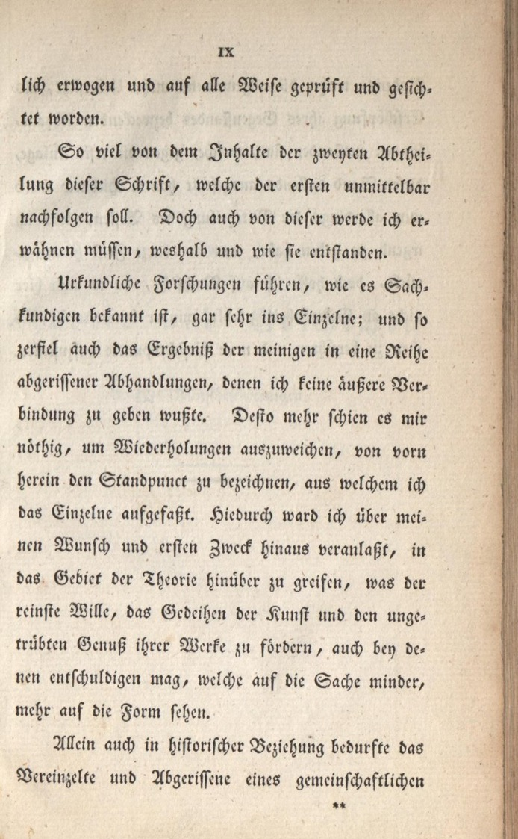
‘Research into sources leads, as every expert knows, to the singular item; hence the results of my research disintegrated into a series of ragged treatises, for which I could provide no external coherence. In order to avoid repetition of this, it therefore seemed all the more necessary to determine the point of view from which I was grasping the individual objects. I was thereby prompted, against my wishes and initial purpose, to reach into the domain of theory …’
Rumohr – Italienische Forschungen, p. ix

Slide 24
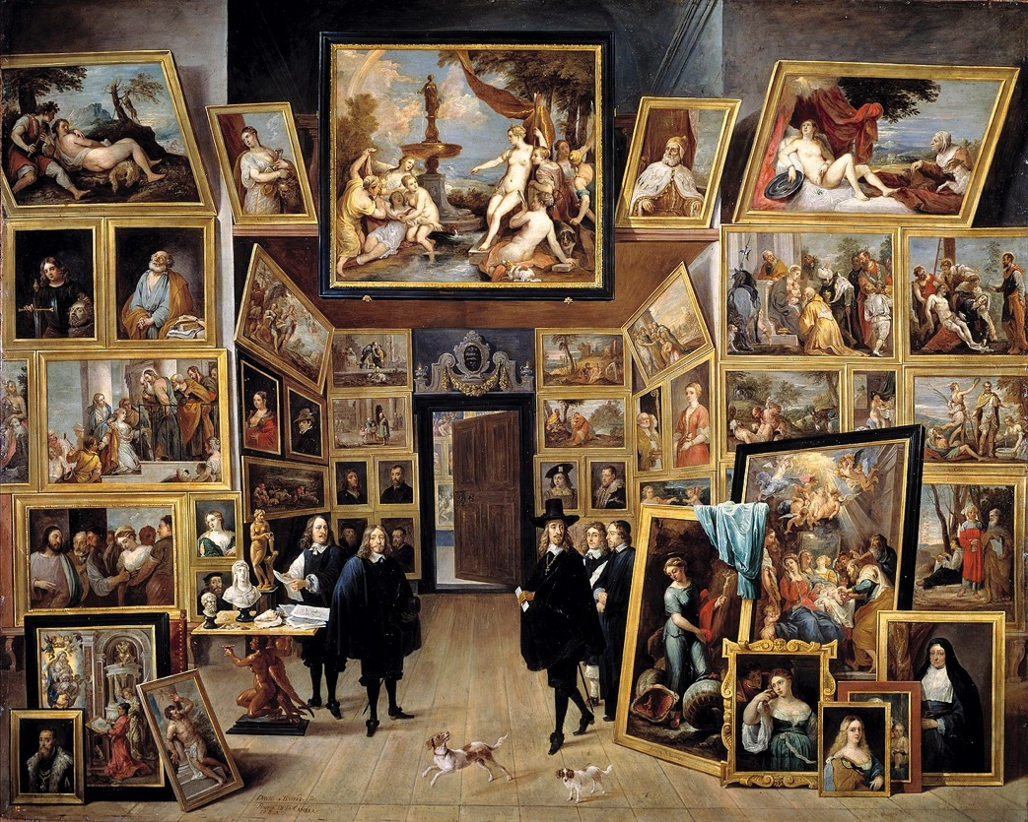
‘The hundreds of pictures in a gallery … Art History places them in a context they do not possess in themselves, and for which they were not painted, and from which there arises a sequence, a continuity, under the influence of which the painters of these pictures stood without being aware of it.’
Gustav Droysen, Historik. Enzyklopädie und Methodologie der Geschichte (1858) (Munich, 1958) p. 35
David Teniers the Younger
Archduke Leopold in his Art Gallery in Brussels (1647-51)

Slide 25
‘ … if historians are to contribute distinctive knowledge, annals of events have to be ordered according to some principle. The alternative … amounts to nothing more than a “planless conglomeration of human actions.” But what might serve as an ordering principle? This question in turn raises other questions. Does history have meaning? Shape? Pattern? Direction? Stages?’
John Hall, Cultures of Inquiry (Cambridge, 1999) p. 35.

Slide 26
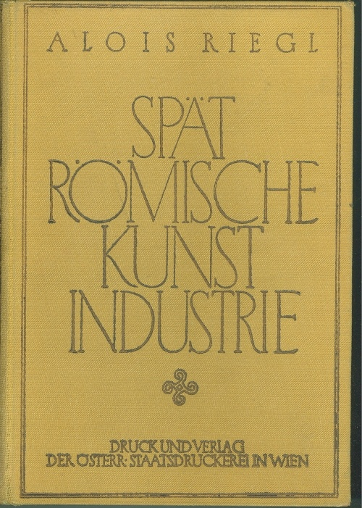
Alois Riegl
Late Roman Art Industry (1901)
‘Scientific’ Art History here means grounding it in:
The psychology of Johann Friedrich Herbart (1776-1841)
The aesthetic theory of Robert Zimmermann (1824-1898)
Sought to understand the visual style of late Roman art as expression of late Roman ‘Kunstwollen’ (formal artistic impulse)
Based on theory of history of perception:
Nahsicht (proximate vision, with an emphasis on tactile engagement with the external world)
Normalsicht (a combination of tactile and visual engagement)
Fernsicht (a distanced vision, based purely on visual engagement)

Slide 27
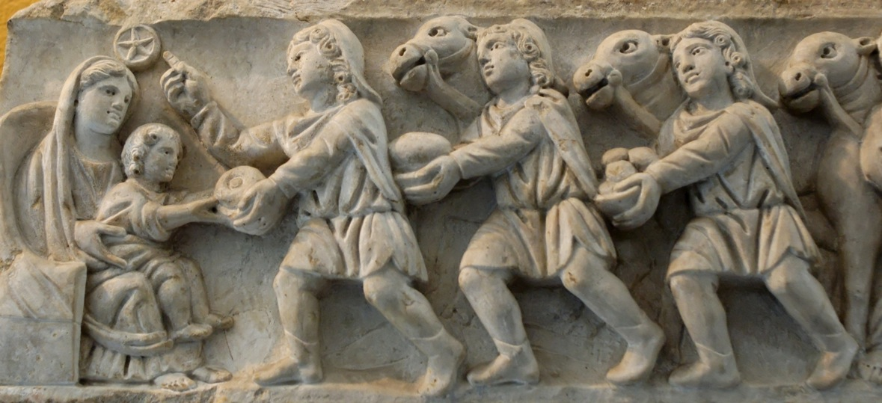
‘… from the viewpoint of modern taste it seems absolutely impossible that there should ever have been a positive Kunstwollen directed towards ugliness and non-animation, as we seem to see it in late Roman art. But everything depends on our understanding that the aim of the fine arts is not completely exhausted with what we call beauty … but that Kunstwollen may be directed towards the perception of other forms of objects ... one must first demonstrate the existence of laws specific to late Roman art.’
Riegl, Late Roman Art Industry (Vienna, 1901) p. 6
Notes:
27

Slide 28
Alois Riegl
Late Roman Art Industry (1901)
Key focus of analysis:
1. figure / ground relation
2. relation between figures and space
His argument =
the history of perception is reflected in the changing relationship between these in art, and
can also explain the specific aesthetic qualities [‘style’] of classical art (especially late Roman art)

Slide 29
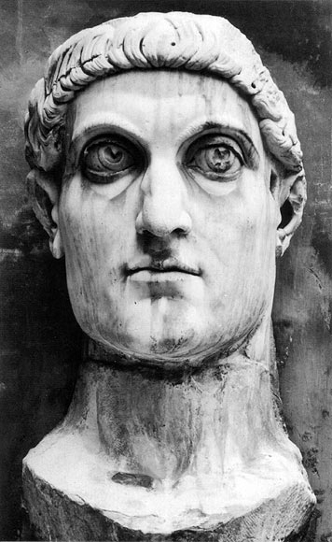
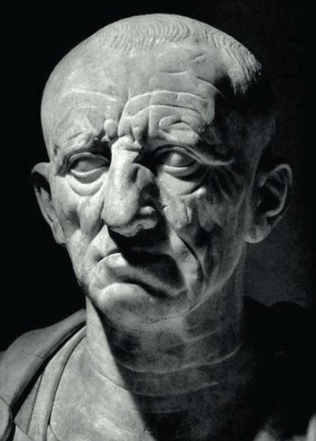
L: Bust of Constantine the Great (4th Century CE)
R: Bust of Cato the Elder (1st century BCE

Slide 30
‘ … the ultimate aim of the visual art of the whole of antiquity was the representation of external things in their clear material individuality, and thereby in contrast to the accidental appearance of things in nature, to avoid and minimize anything that might cloud or weaken this direct convincing impression of material separateness.’
Riegl, Spätrömische Kunstindustrie p. 17
‘The art of antiquity … had deliberately to deny and suppress the existence of space, for it was detrimental to the clear appearance of absolutely isolated individuality of external objects in the work of art.’
Riegl, Spätrömische Kunstindustrie p. 18

Slide 31
‘In ancient Egyptian art there is … just planar composition, while it evidently deliberately avoided spatial composition … Relief figures are kept flat, so that a minimum of shadow is visible; they must therefore be enjoyed by being viewed close up [Nahsicht] because the further one moves away from them, the blunter and flatter the surface will necessarily appear to be …’
Riegl, Spätrömische Kunstindustrie p. 52
‘Two phenomena accompanied the decisive transition to an optical perception of things … First, the viewer is placed at a distance, whereby the tactile material existence of things withdraws in favour of their mere chromatic appearance … we call this distancing “viewing from afar” [Fernsicht] in contrast to
“viewing from close up” [Nahsicht] … Second, there is a heightened appeal to the experience, the consciousness of the viewer.’
Riegl, Spätrömische Kunstindustrie p. 64

Slide 32
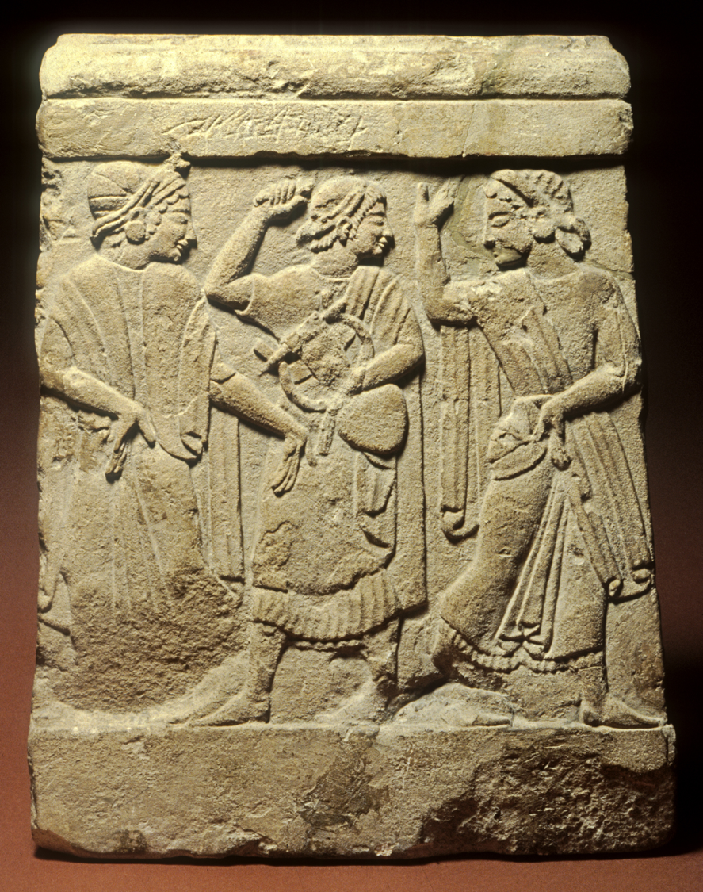
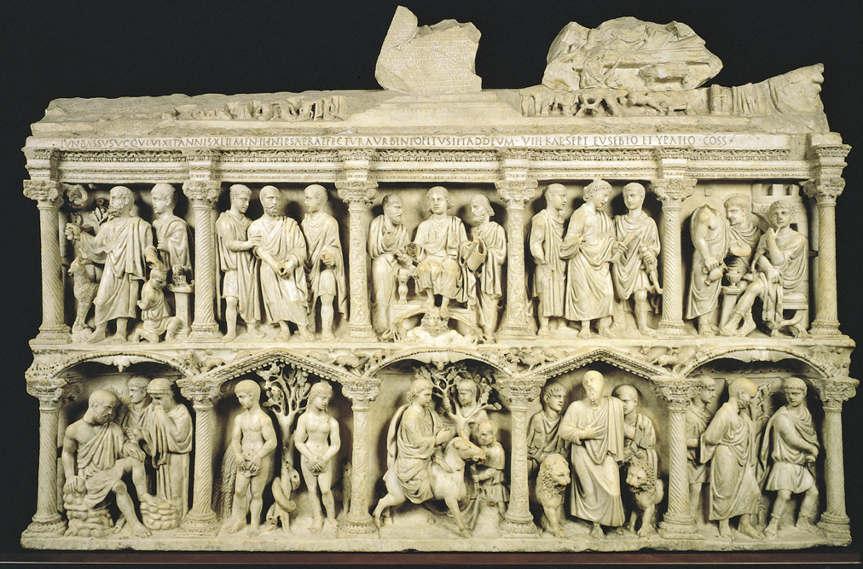
L: Etruscan relief (ca. 7th century BCE)
R: Sarcophagus of Junius Bassus (359 CE)

Slide 33
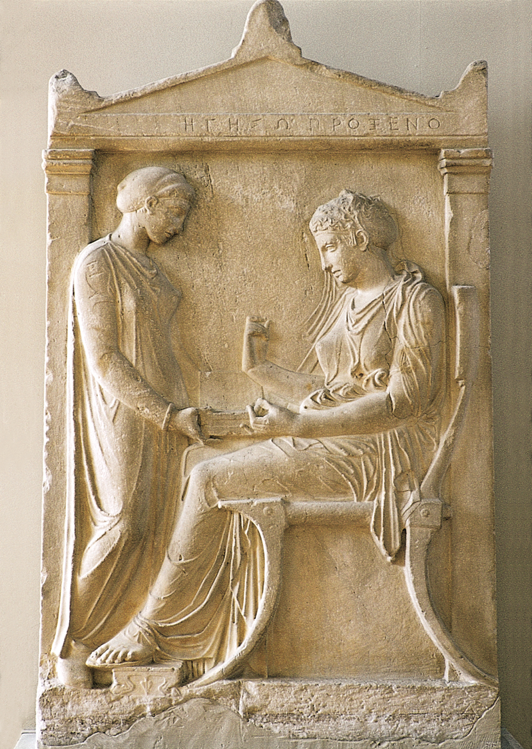
'Normalsicht’
Hegiso Relief (ca. 400 BCE)

Slide 34
The problem of ‘objectivity’

Slide 35
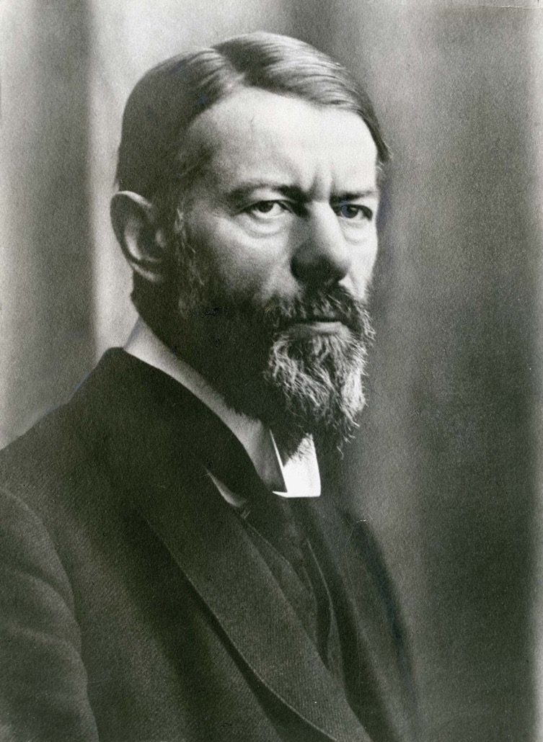
Max Weber (1864-1920)
‘Objectivity in Social Science and Social Policy’
‘The quality of an event as a “social-economic” event is not something which it possesses “objectively.” It is rather conditioned by the orientation of our cognitive interest, as it arises from the specific cultural significance which we attribute to the particular event in a given case.’
‘There is no absolutely "objective" scientific analysis of culture. ... All knowledge of cultural reality ... is always knowledge from particular points of view. ... An “objective” analysis of cultural events, which proceeds according to the thesis that the ideal of science is the reduction of empirical reality to “laws,” is meaningless [because] the knowledge of social laws is not knowledge of social reality but is rather one of the various aids used by our minds for attaining this end.’
On the Methodology of Social Sciences (Glencoe, 1949) p. 64 and 80.

Slide 36
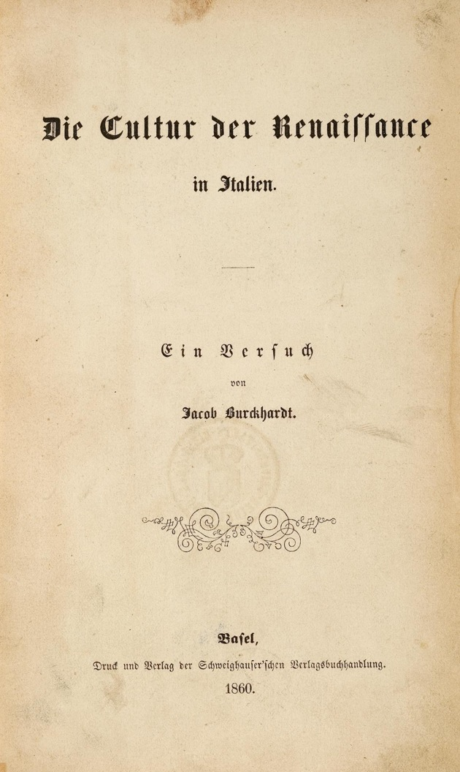
‘The topics of socio-historical inquiry are not pre-formed things in the world itself. Instead, inquiry draws aspects of the world into focus through concepts like “industrialisation”, “social movement”, “coup d’état” and “citizenship” … we are best served by assuming that these organizing rubrics are not only historically saturated but also mediated by a welter of meaningful interests that shape inquiry.’
John Hall, Cultures of Inquiry (Cambridge, 1999) p. 33

Slide 37
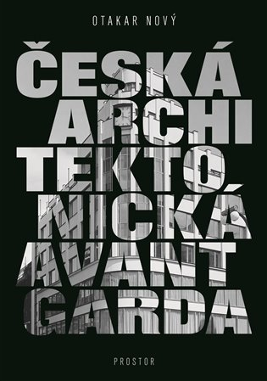

Slide 38
‘Knowledge is not produced by passively perceiving individuals, but by interacting social groups engaged in particular activities. And it is evaluated communally and not by isolated individual judgement. Its generation … must be accounted for by reference to the social and cultural context in which it arises. Its maintenance is not just a matter of how it relates to reality, but also of how it relates to the objectives and interests a society possess by virtue of its historical development.’
Barry Barnes, ‘Conceptions of Knowledge’ in C. Harrison, ed., Modernism, Criticism, Realism (London, 1984) p. 104

Slide 39
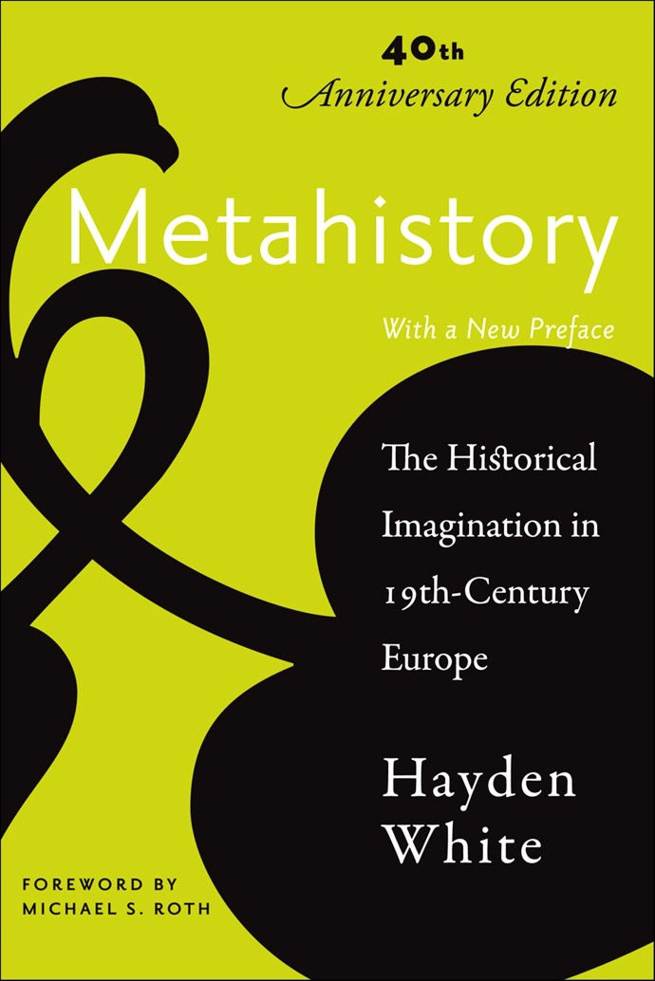
Hayden White (1928 - 2018) - history as a kind of writing that maps historical events onto narrative structures (‘emplotment’) according to literary genres such as:
Tragedy
Romance
Comedy
Satire
White, Hayden, Metahistory. The Historical Imagination in Nineteenth-century Europe (Baltimore, 1973).

Slide 40
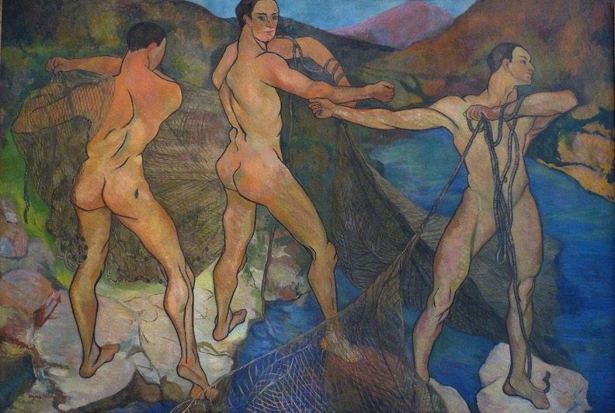
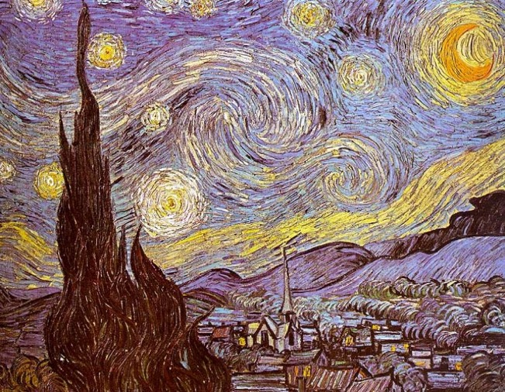
Consider the tradition of artists’ biographies, which involves constructing a narrative about the artist’s life, using emplotment according to a particular literary genre. Thus, Artemisia Gentileschi is heroic, Suzanne Valadon is romantic, van Gogh is tragic ….

Slide 41
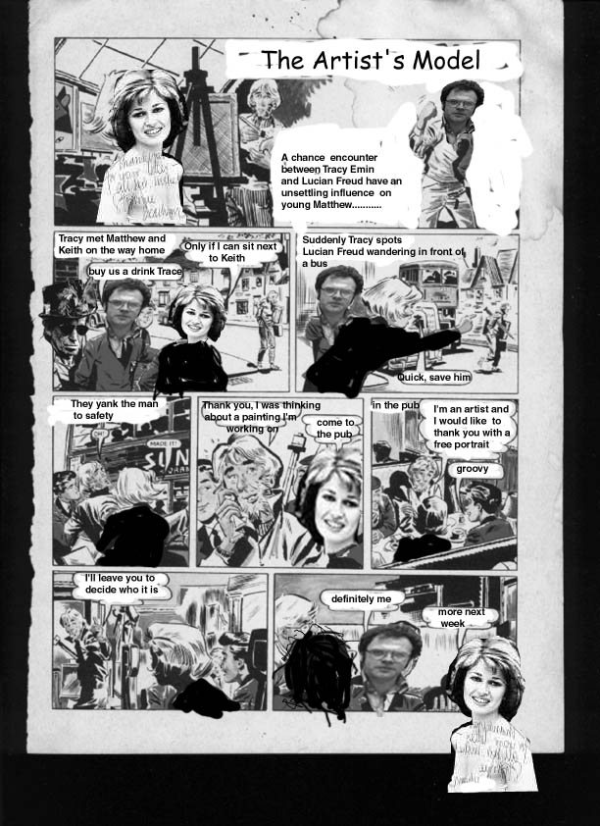
…. Tracy Emin is satirical

Slide 42
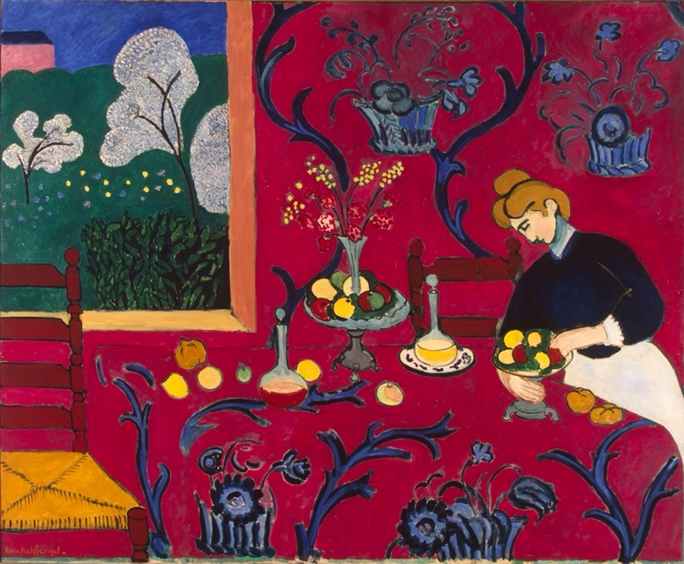
Indecidability – the Case of Modernism
For Clement Greenberg the rise of modern painting was dominated by the quest for artistic autonomy in the face of popular culture (‘kitsch’).
The logic of modernism was driven by an emphasis on the physicality of painting, resulting in a flattening of the pictorial space and, eventually, abstraction.
Greenberg, Clement (1939). ‘Avant-Garde and Kitsch,’ in Partisan Review Vol. VI No. 5, pp. 34-39.

Slide 43
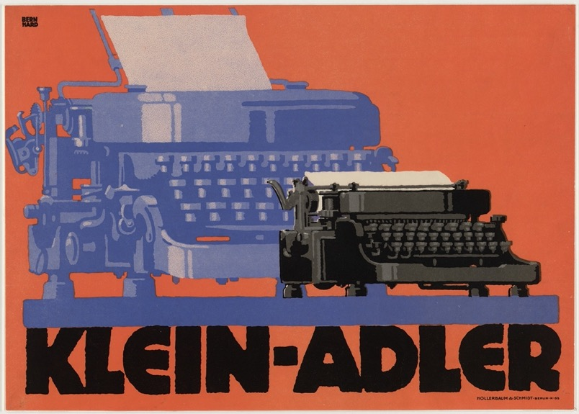
For Thomas Crow the flatness of modernist art was a positive engagement with popular culture, and in particular, with the flat surfaces of advertising posters.
Thomas Crow, ‘Modernism and Mass Culture in the Visual Arts’ (1985)

Slide 44
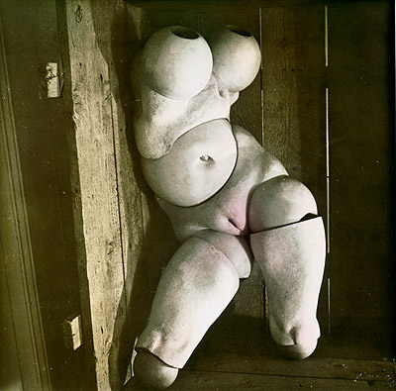
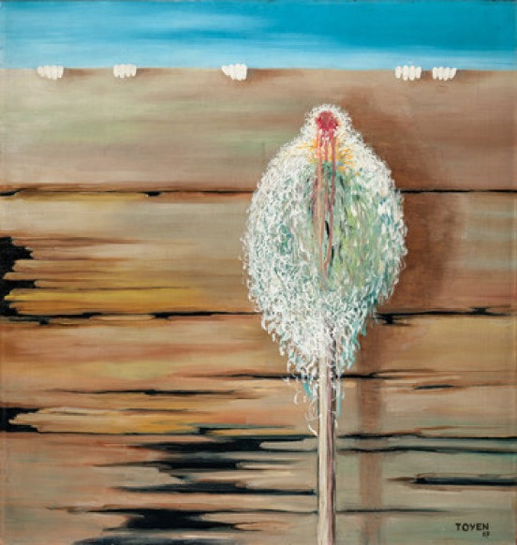
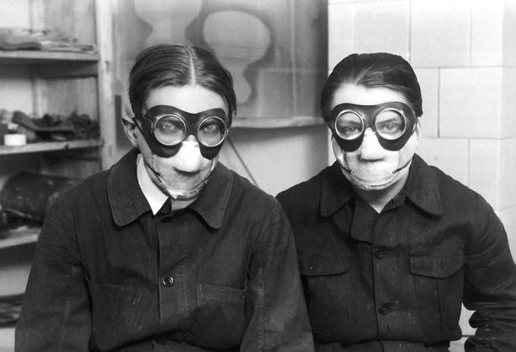
For Rosalind Krauss modernity resulted in a crisis of subjective identity, as a result of which modernism was concerned with interrogation of identity. Consequently, for Krauss, it is surrealism, rather than abstraction, that is of key importance.
Krauss, Rosalind (1985). Amour Fou. Photography and Surrealism. Cambridge, MA, MIT Press.

