Slide 1
The commerce of auteurism
Episode 3
Notes:
We have started with two foundational topics them: cultural discourses of creativity, and media industries. In this session we’ll bring them together through a subject you have probably had at least some knowledge of: authorship in film (and television, to a lesser extent – that’s mostly next session.) This is a subject that’s been a mainstay of the discipline since the 60s, so you’ll probably recognize some of the ideas we deal with today. We’ll be taking them apart and seeing where they come from and what they’ve done.
The auteur: who knows what that is?

Slide 2
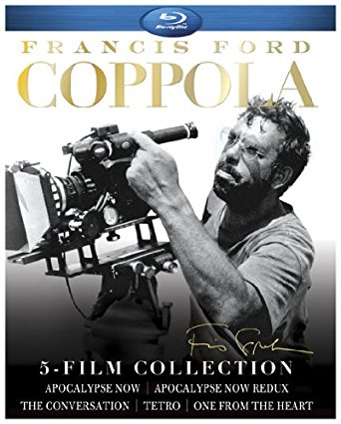
The Auteurist Discourse
Auteur = director
Has a large, ideally absolute degree of creative control
Control is thematic and stylistic
Endangered by the interference of non-creative agents
Weakened studio control leads to creative expression and experimentation
Films created by an auteur are works of art
Notes:
The auteur, a primer.
This reminds us of discourses we know, but by now we also know it doesn’t reflect industrial realities or even understandings. So where does this idea come from and how has it been integrated into the history of cinema (and spread from it to other media)?

Slide 3
Auteurist metaphors
"Filmmaking is a collaborative art, yet the auteur is forever alone, in solitude [...The director, as captain, sailing the vessel across the sea, forever fixes his gaze on the endless nights."
– Patrick Tam
Notes:
Quote and images in this slide a good start. Film and TV by very nature collaborative: When looking at behind the scenes practices of coming up with and putting together ideas, Caldwell notes acknowledged importance of collaboration, credit sharing, mentorship, and even idea theft. But even as Caldwell observes these creative practices, and industrial understanding that this is the normal and proper course of creation (remember – right/not right, normal/not normal?) he also observes outward-facing dedication to totally different story: one that casts a singular creator (film director, TV showrunner) as central heroic leader figure. Tam’s metaphors (visually manifested) are great. Solitude, enterprise, courage, sacrifice and suffering (another common metaphor is “soldier”.)
We can read those metaphors in the images here as well. Notably all very masculine! Top right corner is studio era director Dorothy Arzner, who was at the time (‘27-’43) the only working female director in Hollywood – note how she’s dressed, styled, and staged.

Slide 4
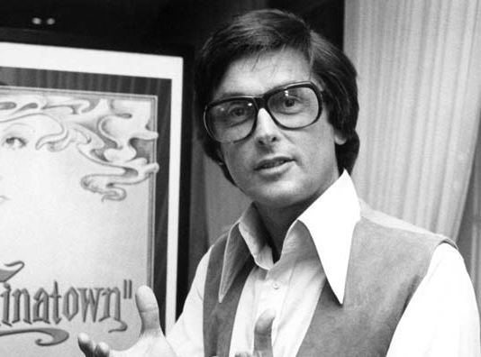
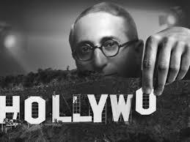
From studio production to package deals
In classical Hollywood, directors are employed by the studios on contracts: a steady stream of content for studio-owned exhibitors.
From the 1950s, the studios’ role is mainly financers and distributors of smaller number of film “packages” that include script, star, producer, and director.
Notes:
For all this seems common sense, actually dates to 1960s. Let’s time travel to early Hollywood and see how industrial conditions and structures shape ideas, identities, and myths.
Up until 1950 or so, what we call the studio era. Powerful producers identified with studios – see in example Robert Evans of Paramount and Louis B. Mayer of MGM – and directors as contract-bound line workers alongside others. Vertical integration, Fordist mode of production churning out content for own exhibitors.
Roots of the auteur in Paramount Decree of 1948, and transition to package deal system of production.

Slide 5
Work modes and relations in package deals:
Directors no longer studio employees: greater independence, but greater insecurity.
Directors (and other creative workers) must prove themselves to studios over and over with successful films.
More room for ideas from outside the majors: new executive players bring in new creative players.
New models of compensation: percentage of box office take, or other rights to content create opportunities for high earnings.
Importance of bankable talent in the package: directors must sell themselves to studios, studios must sell directors to audiences.
Notes:
Prelude to developments mentioned last session – importance of individual identities/reputations in Hollywood – and we will get back to acceleration of this in final session when we look at expanding logic of branded self.

Slide 6
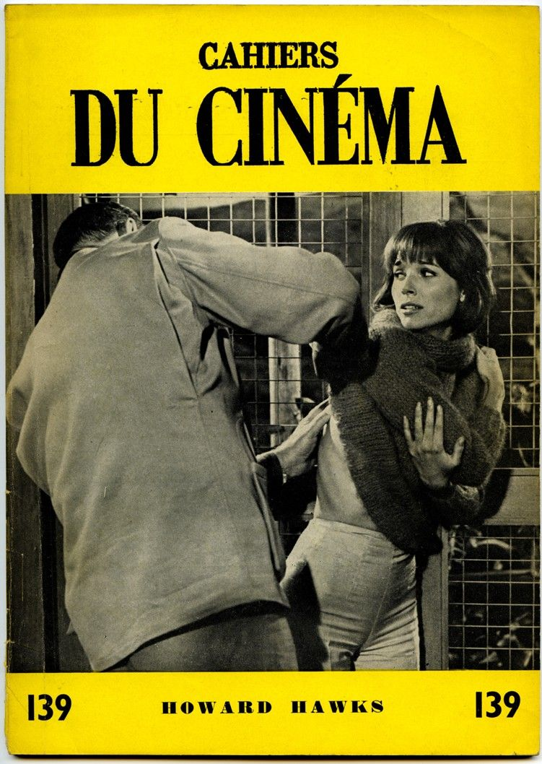
The Emergence of Auteurism
Auteurism as ideology
Auteur theory, emerging in discussions in French journal Cahiers du Cinéma in the 1950s, is brought to the U.S. mainly through the writings of Andrew Sarris (“Notes on the Auteur Theory”, 1962), orienting a generation of film school alumni directors towards the French “Masters”.

Slide 7
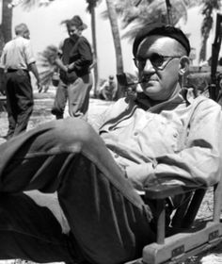
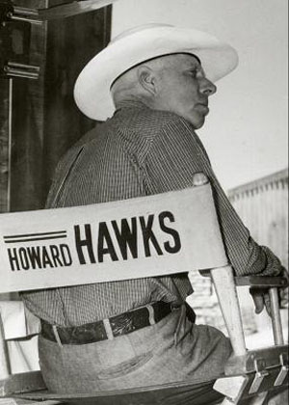
The Emergence of Auteurism
Classical Hollywood auteurs
French auteur theory also “rediscover” auteur directors in studio era Hollywood, just as their films are newly available through art cinemas and television. They are understood as heroic figures who were able to realise personal creative visions despite working within the Hollywood system.

Slide 8
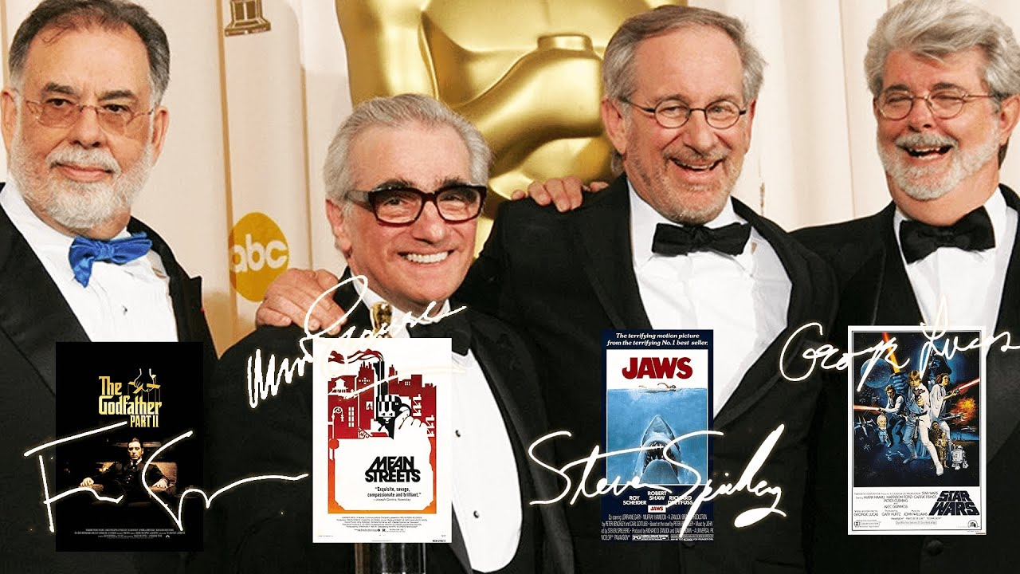
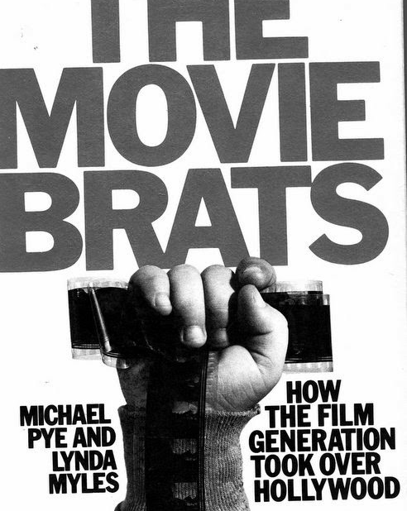
The “Hollywood Renaissance” (aka the New Hollywood, American New Wave)
Notes:
60s perceived as period of exceptional creativity and creative freedom and experimentation in Hollywood.
“Renaissance” – a term with specific, strong associations
At the heart of this is the director-as-auteur – the legitimator of cinema as art
“Movie brats” and Renaissance Masters

Slide 9
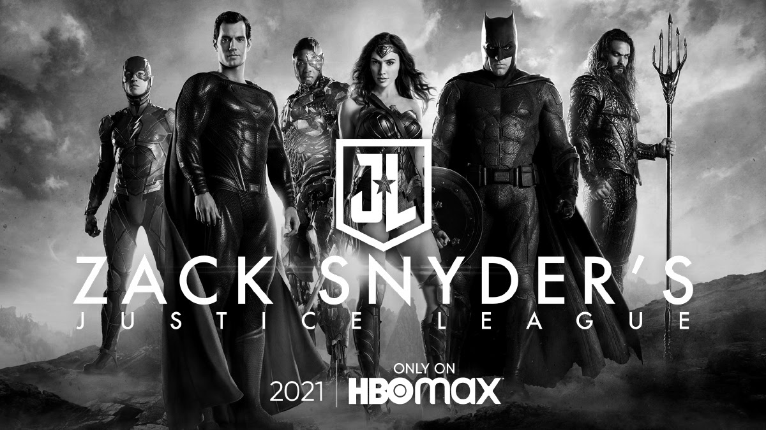
“The Commerce of Auteurism”
“The name of a director, and varying degrees of auteurist association, can be a considerable asset to the studios. The creation of such an identity is also a benefit to the individual filmmaker. The ultimate achievement for the New Hollywood commercial auteur is to become a distinct brand-identity, marketable on that basis. Stylistic traits and departures from classical conventions are encouraged, up to a point, as a way for the director to leave a distinctive mark or sign of authorship. […] the commerce of auteurism is a phenomenon in which the director rematerialized in the eighties and nineties as an agent of a commercial performance of the business of being an auteur.”
Geoff King, New Hollywood Cinema (I.B.Tauris, 2002) p114-115
Notes:
Sees the auteur as something not innate to the film, but as a purposeful construction that is used to imbue the film with value and prestige, with cultural clout and meaning.
Switches us from Romantic authorship to Foucault’s author function: authors as means to categorise, organize, and evaluate texts (to talk about them, and produce them as we are talking – a discursive function.)
But deliberate, industry-led.

Slide 10
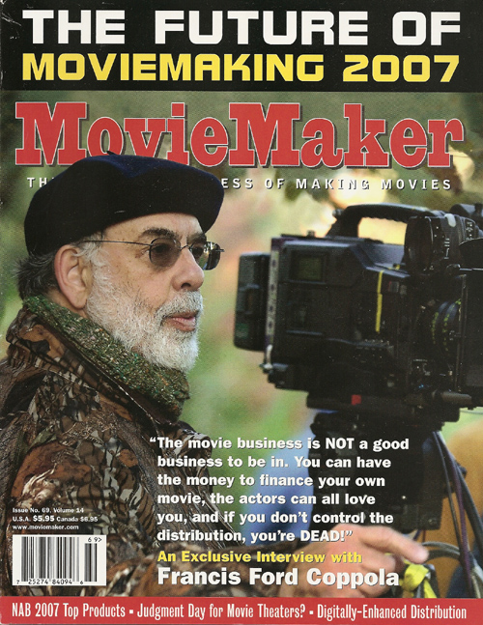
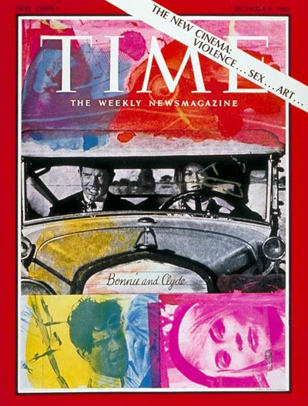
Auteurism as performance
The auteur figure is created through conscious evocation of the discourse; through publicity, press materials, interviews.
Auteurism as legitimation
By affirming filmmaking as capable of expressing a personal vision, auteurism provided cinema with cultural legitimacy as a form of art.
Notes:
Another stakeholder is critics (as per Bourdieu) – who gets to define, discover, and claim to understand and interpret the genius auteur - academics, curators of all sorts. This is an entire “art world”.
But for now I’d like to stay with the industry. I want to build on last session and think about how industrial actors “produce” auteurs. Because this runs counter to the “common sense” of the theory as well as a keys tenet of the ideology – that the auteur is present within the cinematic text and may be found there through analysis of that text. This is still where film criticism, and a great deal of film scholarship, locates the auteur, something you can find in most film reviews. But I contend – following Corrigan – that you can find the auteur even before you’ve seen the film or read any reviews: that the audience is primed to look for the auteur, and be informed of their significance and qualities, in a whole other range of paratexts.

Slide 11
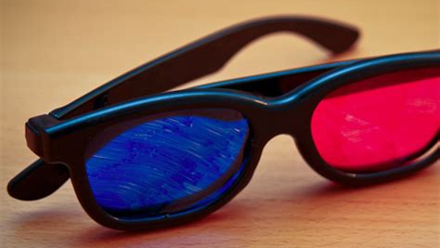
Understanding media promotion: Paratexts
We watch nothing in a vacuum
Additional texts that surround a media product:
Shape our expectations
Create our framework for understanding
Expand the story, the world, and the experience
Create and add value
Notes:
Gray refers to “promotional” and “in media res” paratexts. In his model, this covers everything from trailers and posters, to merchandise and toys, to social media conversations and fanwork. Though he argues they can have the same effects, it is important to differentiate industrial and fan paratexts from the perspective of analysis.
Paratexts today have become increasingly common and important due to new technologies and screens: rise of VHS has turned film and TV into ownable products, the DVD has created a space for more content, and of course the internet brought about effectively endless space. Media industries have had to consider how to create, disseminate, monetize – tied to implications for labour that we’ll get to in session 5.
Though that’s our focus today, this isn’t only a lens for authorship! We’ll finish today on an exercise that draws on the reading to look at paratexts more broadly.

Slide 12
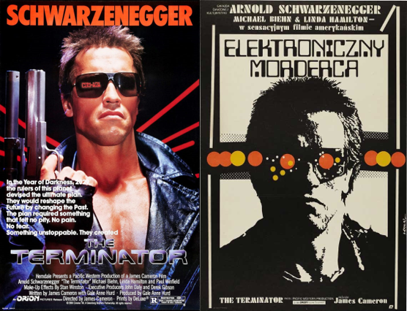
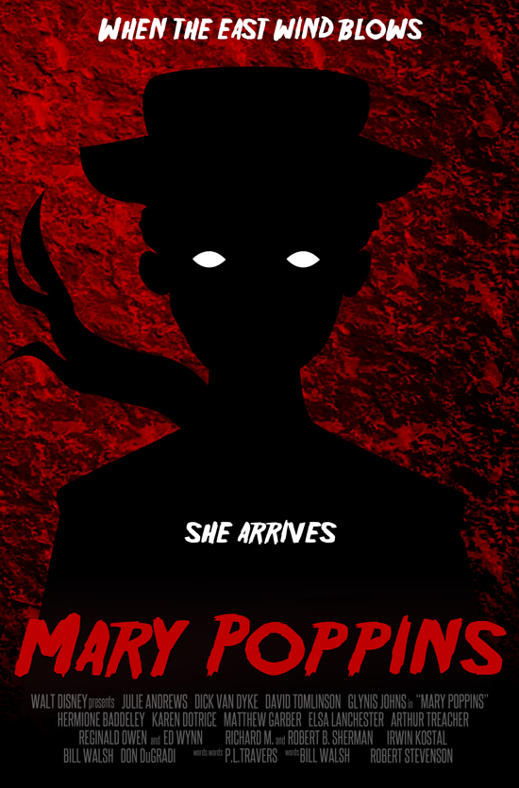
Notes:
Good way to understand the power of promotional paratexts is to look at different film posters and the kind of experiences they prime the audience for.

Slide 13
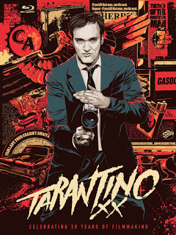
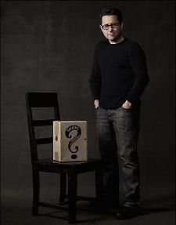
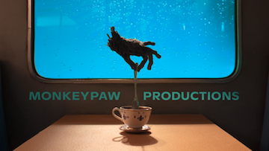
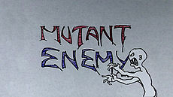
Notes:
Let’s quickly think: Where are author figures visible in film promotion? How do we see them add value to a film? How are they used to make the audience want to see that film?
Authors as paratexts, as noted usefully recalls Foucault’s idea of the “author function”: authorship as a discursive function for talking about, sorting, understanding, and evaluating texts. But paratexts also create authors.
How do paratexts create authors: by emphasizing some themes or characteristics over others, by creating the author’s identity for us to then identify in their work. In the profound complexity of a text, paratexts guide us on what to look for and what to find meaningful.
We can “read” the directors’ authorial signature here: Tarantino’s jagged pop violence, Abrams’ mystery box, Jordan Peele’s stylish polished weird horror vs Joss Whedon’s funky nerdy cult horror. Without watching a single film by these directors, we can learn what they’re about, so that when we do watch the films we are primed to read the signatures in them.

Slide 14
Exercise: Analysing paratexts
In your groups, select a famous film or film series. Find a special edition DVD or Blu-ray release, and analyse it as a paratext.
Look at the box and cover design; the back blurb; any inserts or other physical materials included; the special features; try to see if you can find the menu or intro video online and look at their designs.
What do those elements tell you about the film? How do they frame it? What viewing experience do they invite? How do they add value?
Notes:
The reading for this session included Jonathan Gray’s analysis of the LOTR special edition DVD collection. This shows us an example of example of value creation and framing through paratexts. Some themes Gray identifies:
The establishment of authorship: the roles of Tolkien, Peter Jackson, and others in creating the “vision” for the films – a faithful adaptation of a culturally significant work of art.
The production of the film itself as a mythic quest, and the cast and crew as a real-life fellowship.
A sense of filmmaking as “magic” and a heroic pursuit – appropriate for the heroic fantasy film.
The explorable breadth and physicality of the world of Middle-earth: a world that you, as a viewer, can explore, both literally in New Zealand and in the digital space of the DVD.
Let’s do an exercise where we try Gray’s method on some new objects.

