Slide 1
Production culture(s) and industry studies
Episode 2
Notes:
As said in introduction, we are building an idea in this course. In this session laying down a second foundational element, which is understanding film and television production as industries.
This is a relatively new and unusual way to think about media: still frequently stumps my students at Nottingham. Discipline spent a long time with focus on text and, from another direction , audiences. Art/commerce binary discourages us from thinking not just about business of film and TV, but even more broadly about ways in which industrial systems and structures affect the way media is made and thus its contents. Hollywood as dream factory not so keen on the “factory” part: problems of demythologization/demystification/deromantization of the creation of art.
But industry studies profoundly important because reflect reality, expose power structures, turn attention to labour. Hollywood is a real place in which real people live and make a living. Thus scholars like David Hesmondhalgh, Miranda Banks, Amanda Lotz, Timothy Havens – to namedrop just a few we won’t be discussing more at length - study industry from varied perspective: structural, financial, historical, sociological/ethnographic. Businesses, life and work worlds, and indeed systems of symbolic creation.
We will be thinking of two aspects: one that will focus on today is on characteristics that shape media industries as work worlds. In next sessions, will be discussing structural conditions that shaped place and meaning of authorship.
A lot of the things I will say today will recur in greater detail in further sessions. I am laying groundwork so you’ll see how the patterns all fit together.

Slide 2
What are the Media Industries?
Symbolic works – texts that generate and circulate meaning
Creative inputs – the generation of new ideas, concepts, and texts
Public goods – can be consumed without reducing availability
Experience goods – characteristics difficult to observe in advance
High risk; unpredictability; artificial scarcity; managed creativity
Notes:
What makes the media industries different from other industries like cars, fast food, banking? Let’s understand some of the basic characteristics of the industrial production of media.

Slide 3
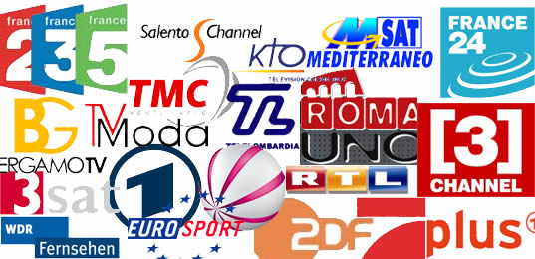
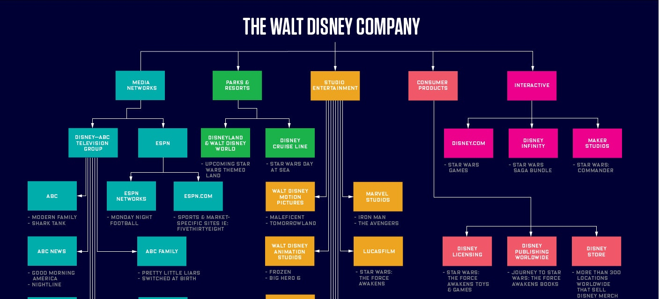
The Media Industries Today
A crowded, fragmented market:
A huge variety of screens, platforms, and channels offering near-incomprehensible amounts of content: a focus on attracting differentiated audiences.
Horizontal and vertical integration:
Massive conglomerates own businesses in multiple industry sectors and up and down the supply chain
Notes:
Film and TV industries today look vastly different to their inception in number of key ways, all of which shape what work is like for everyone, but particularly for creative people within them.
Satellite channels available in EU – but this is a very small list compared to what’s available to all of us daily even under COVID.
Structure of Disney as a conglomerate – Disney will come up a lot – great example of both horizontal and vertical integration.

Slide 4
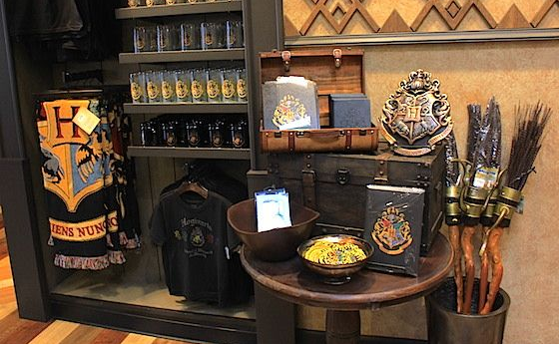
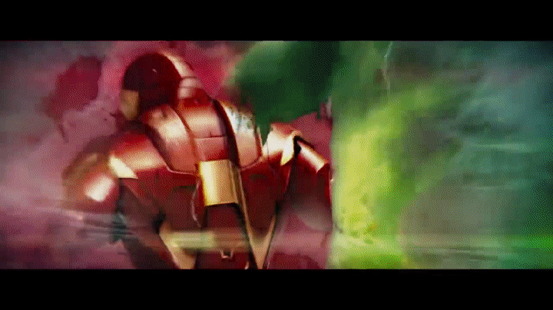
The Media Industries Today
The IP economy:
Product of the film and TV industries are no longer just movies or series, but product ranges linked by intellectual property.
Branding:
Companies creating distinct identities and creating relationships between products and consumers that extend beyond material properties
Notes:
David Maisel, famously: “We’re in the Iron Man business right now.” Absolutely crucial to understanding how media is created today.
Brands are incredibly useful in a crowded landscape characterized by many spaces to fill and audiences that struggle to navigate choices.
We will get back to all of these topics throughout the next sessions.

Slide 5
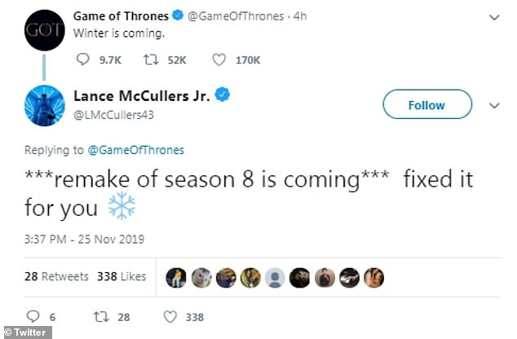

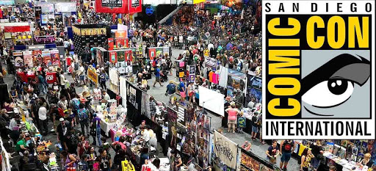
The Media Industries Today
Visible audiences, visible work:
Digital technologies enable – and thus demand – new forms of interaction with connected and participant media audiences.
Notes:
All of these factors together have changed the way media is made and the way money is made off media, and thus the work, lives, and identities of media creators.
All of them have contributed to the increased importance and value of professional reputations; the need for promotional hooks and devices; demand for ways to manage relationships with audiences; and new ways for the industry to tell its own story to itself and its consumers.

Slide 6
Work in the Media Industries
https://uniofnottm.padlet.org/ajzlh1/pebp96fr2m7fc7b0
Creative, offer flexibility and “freedom”
Rewarding, self-expressive and self-actualising
Culturally celebrated, inspirational
BUT ALSO:
Precarious, hyperflexible, hypercompetitive
Project-, network-, and reputation-based
Hierarchical and structured (above/below the line)
Notes:
We’ll get to that last bit in a moment. Let’s talk for now about media work today.
The characteristics and structural conditions of the media industries create in turn certain characteristics of work in those industries. Something I’m certain a lot of you have given thought to (or might have experience with!) Let’s have a quick Padlet exercise to get some crowdsourced impressions. Why do you want to work in the creative industries, and what worries do you have about such work?
We can differentiate here between the conditions of media work, and the experience of it: and this brings us back to the ideas of discourses and narratives that we started with last session. Importantly this isn’t just about difference between reality and perception, but how the people doing this work understand what they do and why, what is important or not, valuable or not, normal or not, or right or not. The industry tells itself stories about itself all the time, and circulates these stories to its audience – such as yourselves.
This takes us to John Thornton Caldwell and his idea of industrial reflexivity.

Slide 7
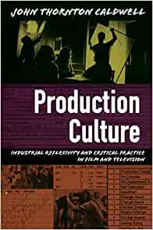
Caldwell: Industrial reflexivity
“Film and television, in other words, do not simply produce mass or popular culture […] but rather film/tv production communities themselves are cultural expressions and entities involving all of the symbolic processes and collective practices that other cultures use: to gain and reinforce identity, to forge consensus and order, to perpetuate themselves and their interests, and to interpret the media as audience members.”
Caldwell, John T. (2008). “Introduction: Industrial reflexivity and common sense”, p. 8
Notes:
Everything we’ve done up until now, in both sessions, was “theorize” – discuss ideas about how media works; why some things work better than others; consider how decisions are made; identify values and what is considered valuable; contemplate meaning and ways of understanding. We tend to think of this as the job of academics.
Caldwell proposes we stop thinking of media theory and practical media work as separate things, and instead recognize that media workers “theorize” all the time, thinking about and explaining the logic behind decisions and practices, thus creating consensus and norms.
Key to Caldwell’s intervention is study of the media industry as a culture: book is the result of a 10-year ethnography including observation, interviews, and study of artifacts. Sociological approach that can be traced back to Hortense Powdermaker in 1950 who studied Hollywood as an anthropologist (Hollywood, the Dream Factory). Challenging methodology as industry often reluctant to cooperate and hostile to academic “outsiders”. Caldwell’s approach allowed him to observe for example the negotiation around multiple writers on a film script, who gets credit, conflicts around idea theft – processes and interactions that rarely make it to the public eye, but that inform practitioners’ ideas of how things are done.
However, as Caldwell, points out, the industry is busily disseminating its own theories to an audience hungry for insight about how the sausage is made: and those rarely align with its own internal understandings.

Slide 8
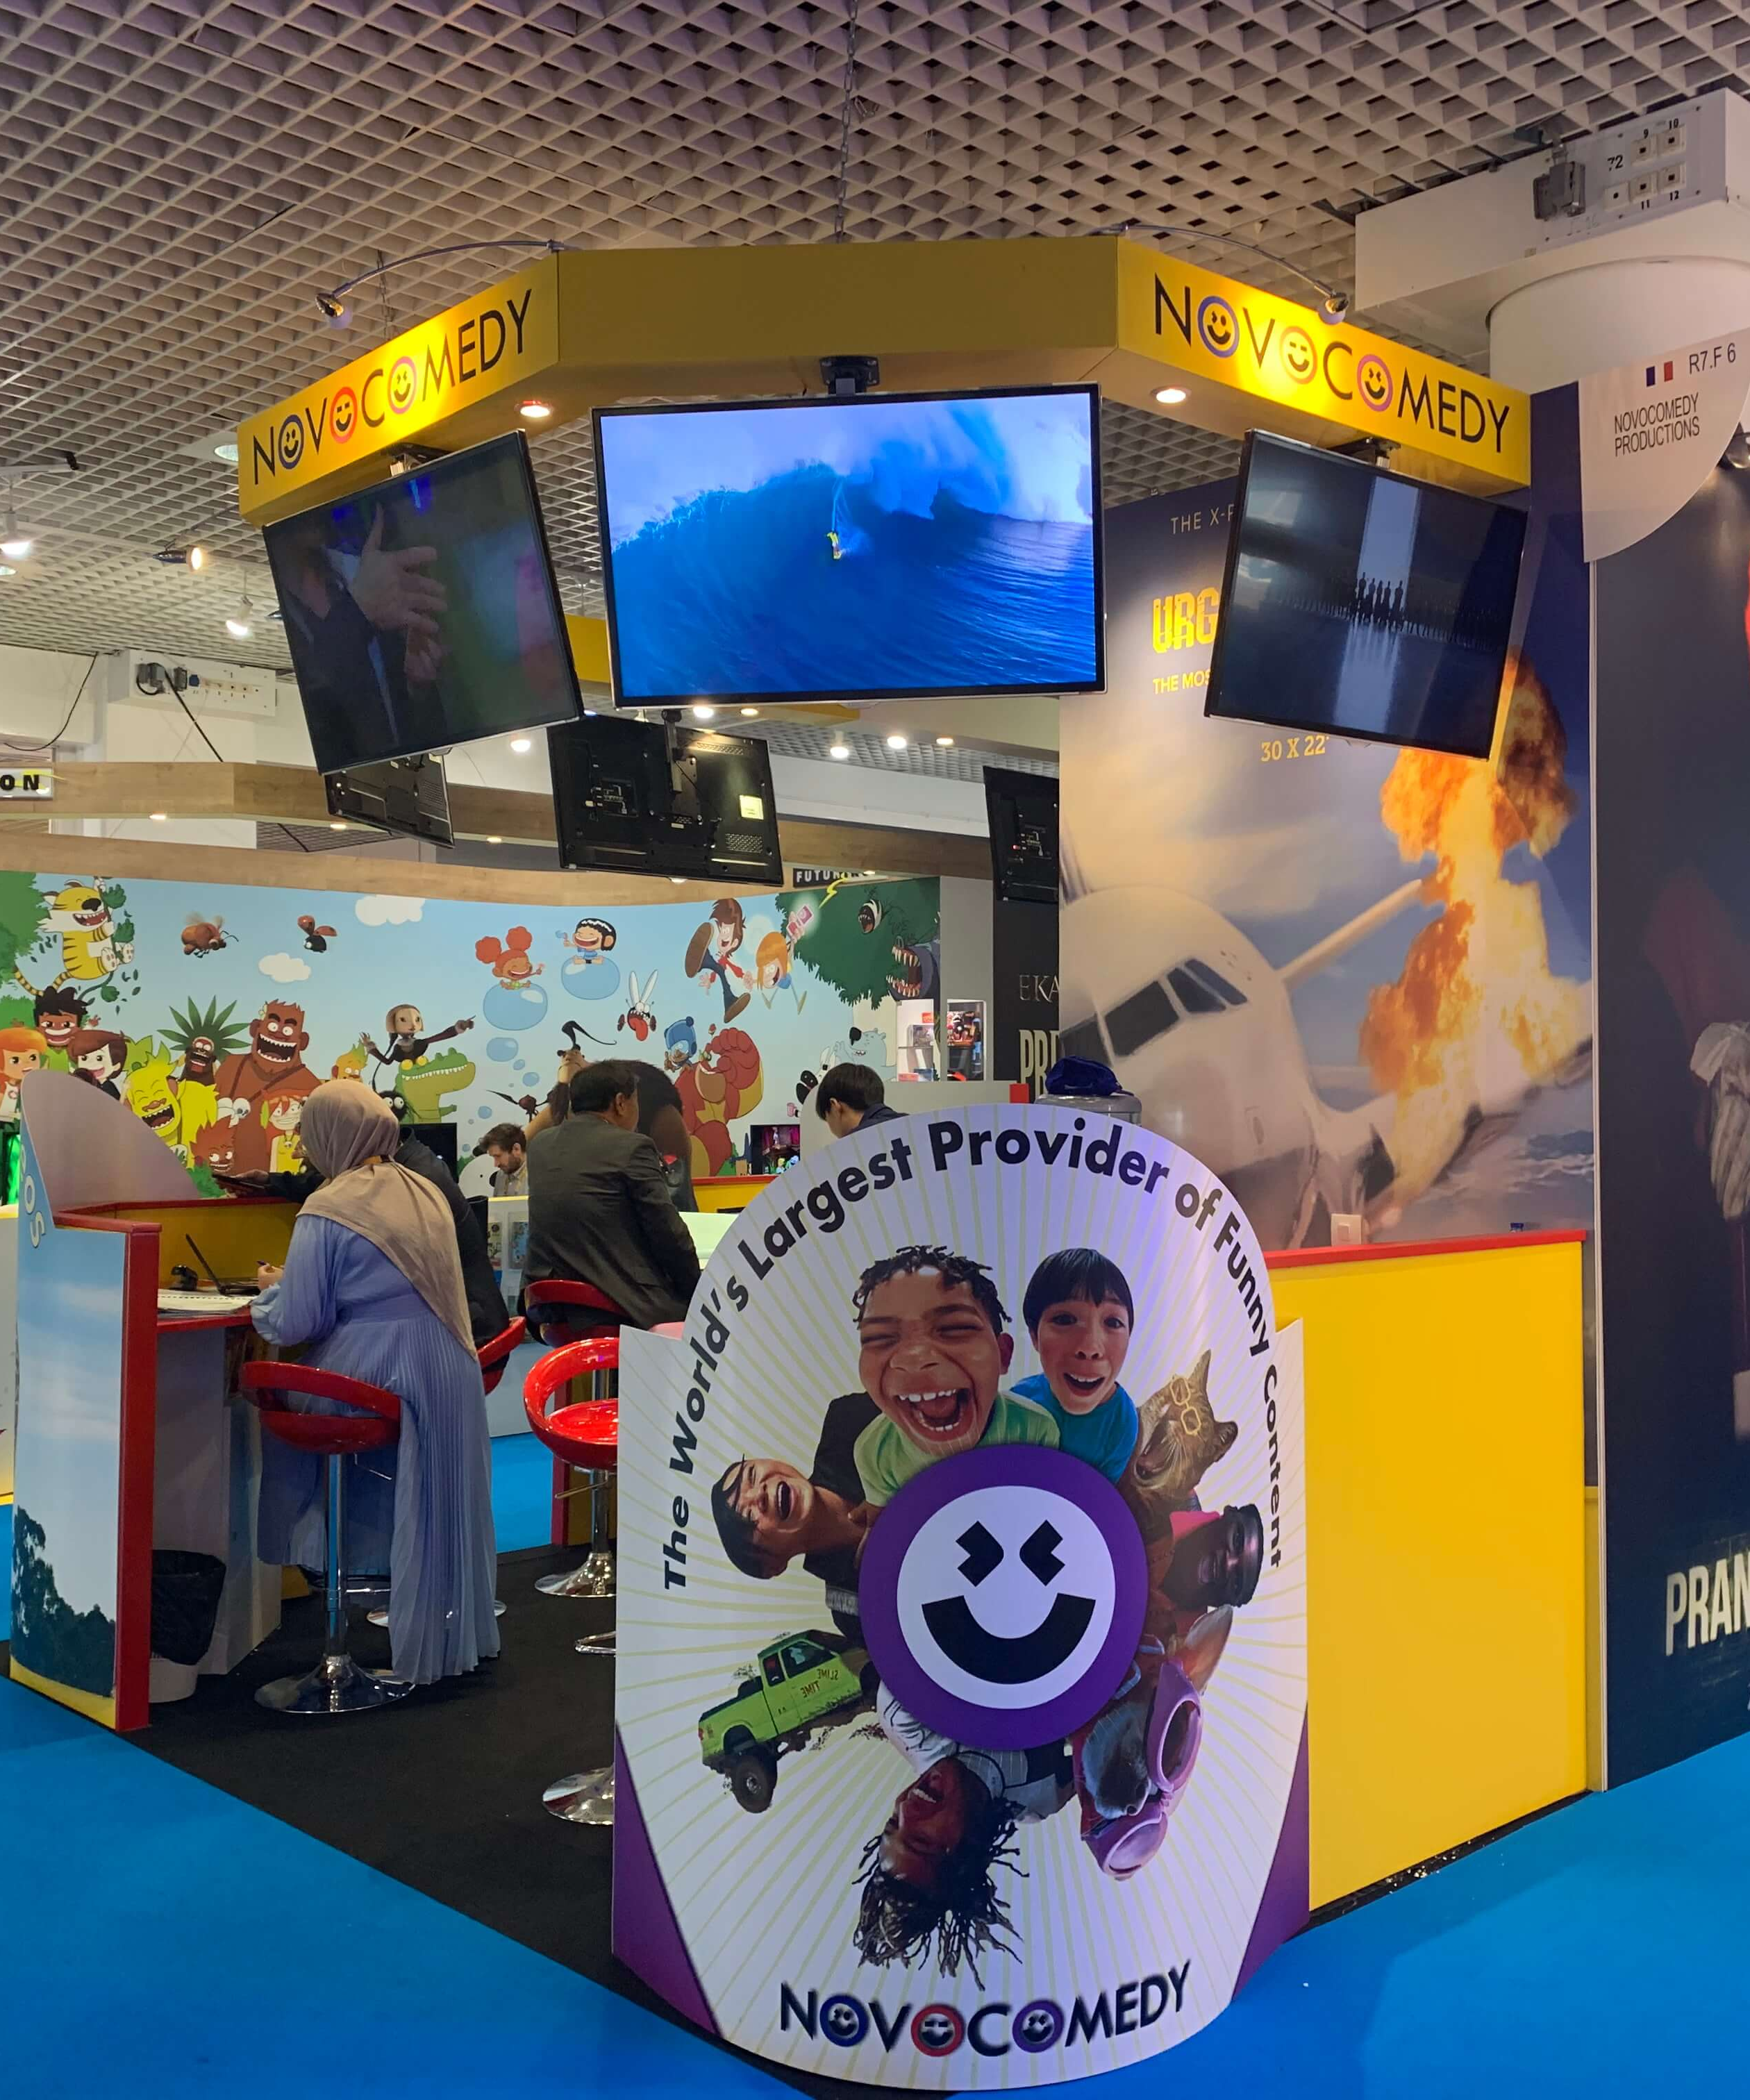
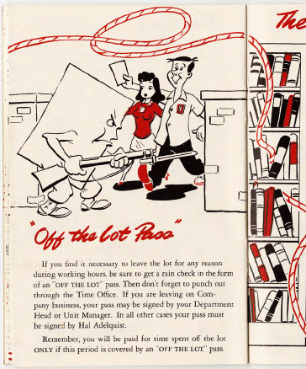
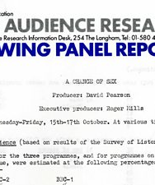
Deep texts of industry
Notes:
Caldwell’s methodology points us at the “deep texts of industry”. Some of his project focused on conversations with practitioners and on industry press, but he warns of prevalence and natural habits of spin and PR. Thus points to the potential of things like internal reports and memos; training manuals and demos; contracts; the “deep texts” of industry that aren’t for external consumption, and show the industry talking to itself. For example in the chapter you’ve read, NBC is sharing its theory of audience needs and televisual flow with its affiliates, while also building its identity and brand. Johnson and Grainge in researching promotional industries looked at trade shows and conventions, office spaces, brochures as sites of intra-industrial meaning making.
Here’s a few examples: a delightful-slash-alarming page from a Disney: The Ropes 1943 booklet for employees; a page from the BBC Audience Research Viewing Panel Report, 1979, on inclusion of LGBTQ+ themes in content; a booth from the mipTV 2020 festival. Language, visual design, spatial design, as well as of course the content, all sites for fruitful research. (LOOK FOR EXAMPLE IN CALDWELL OR GRAINGE/JOHNSON?)

Slide 9
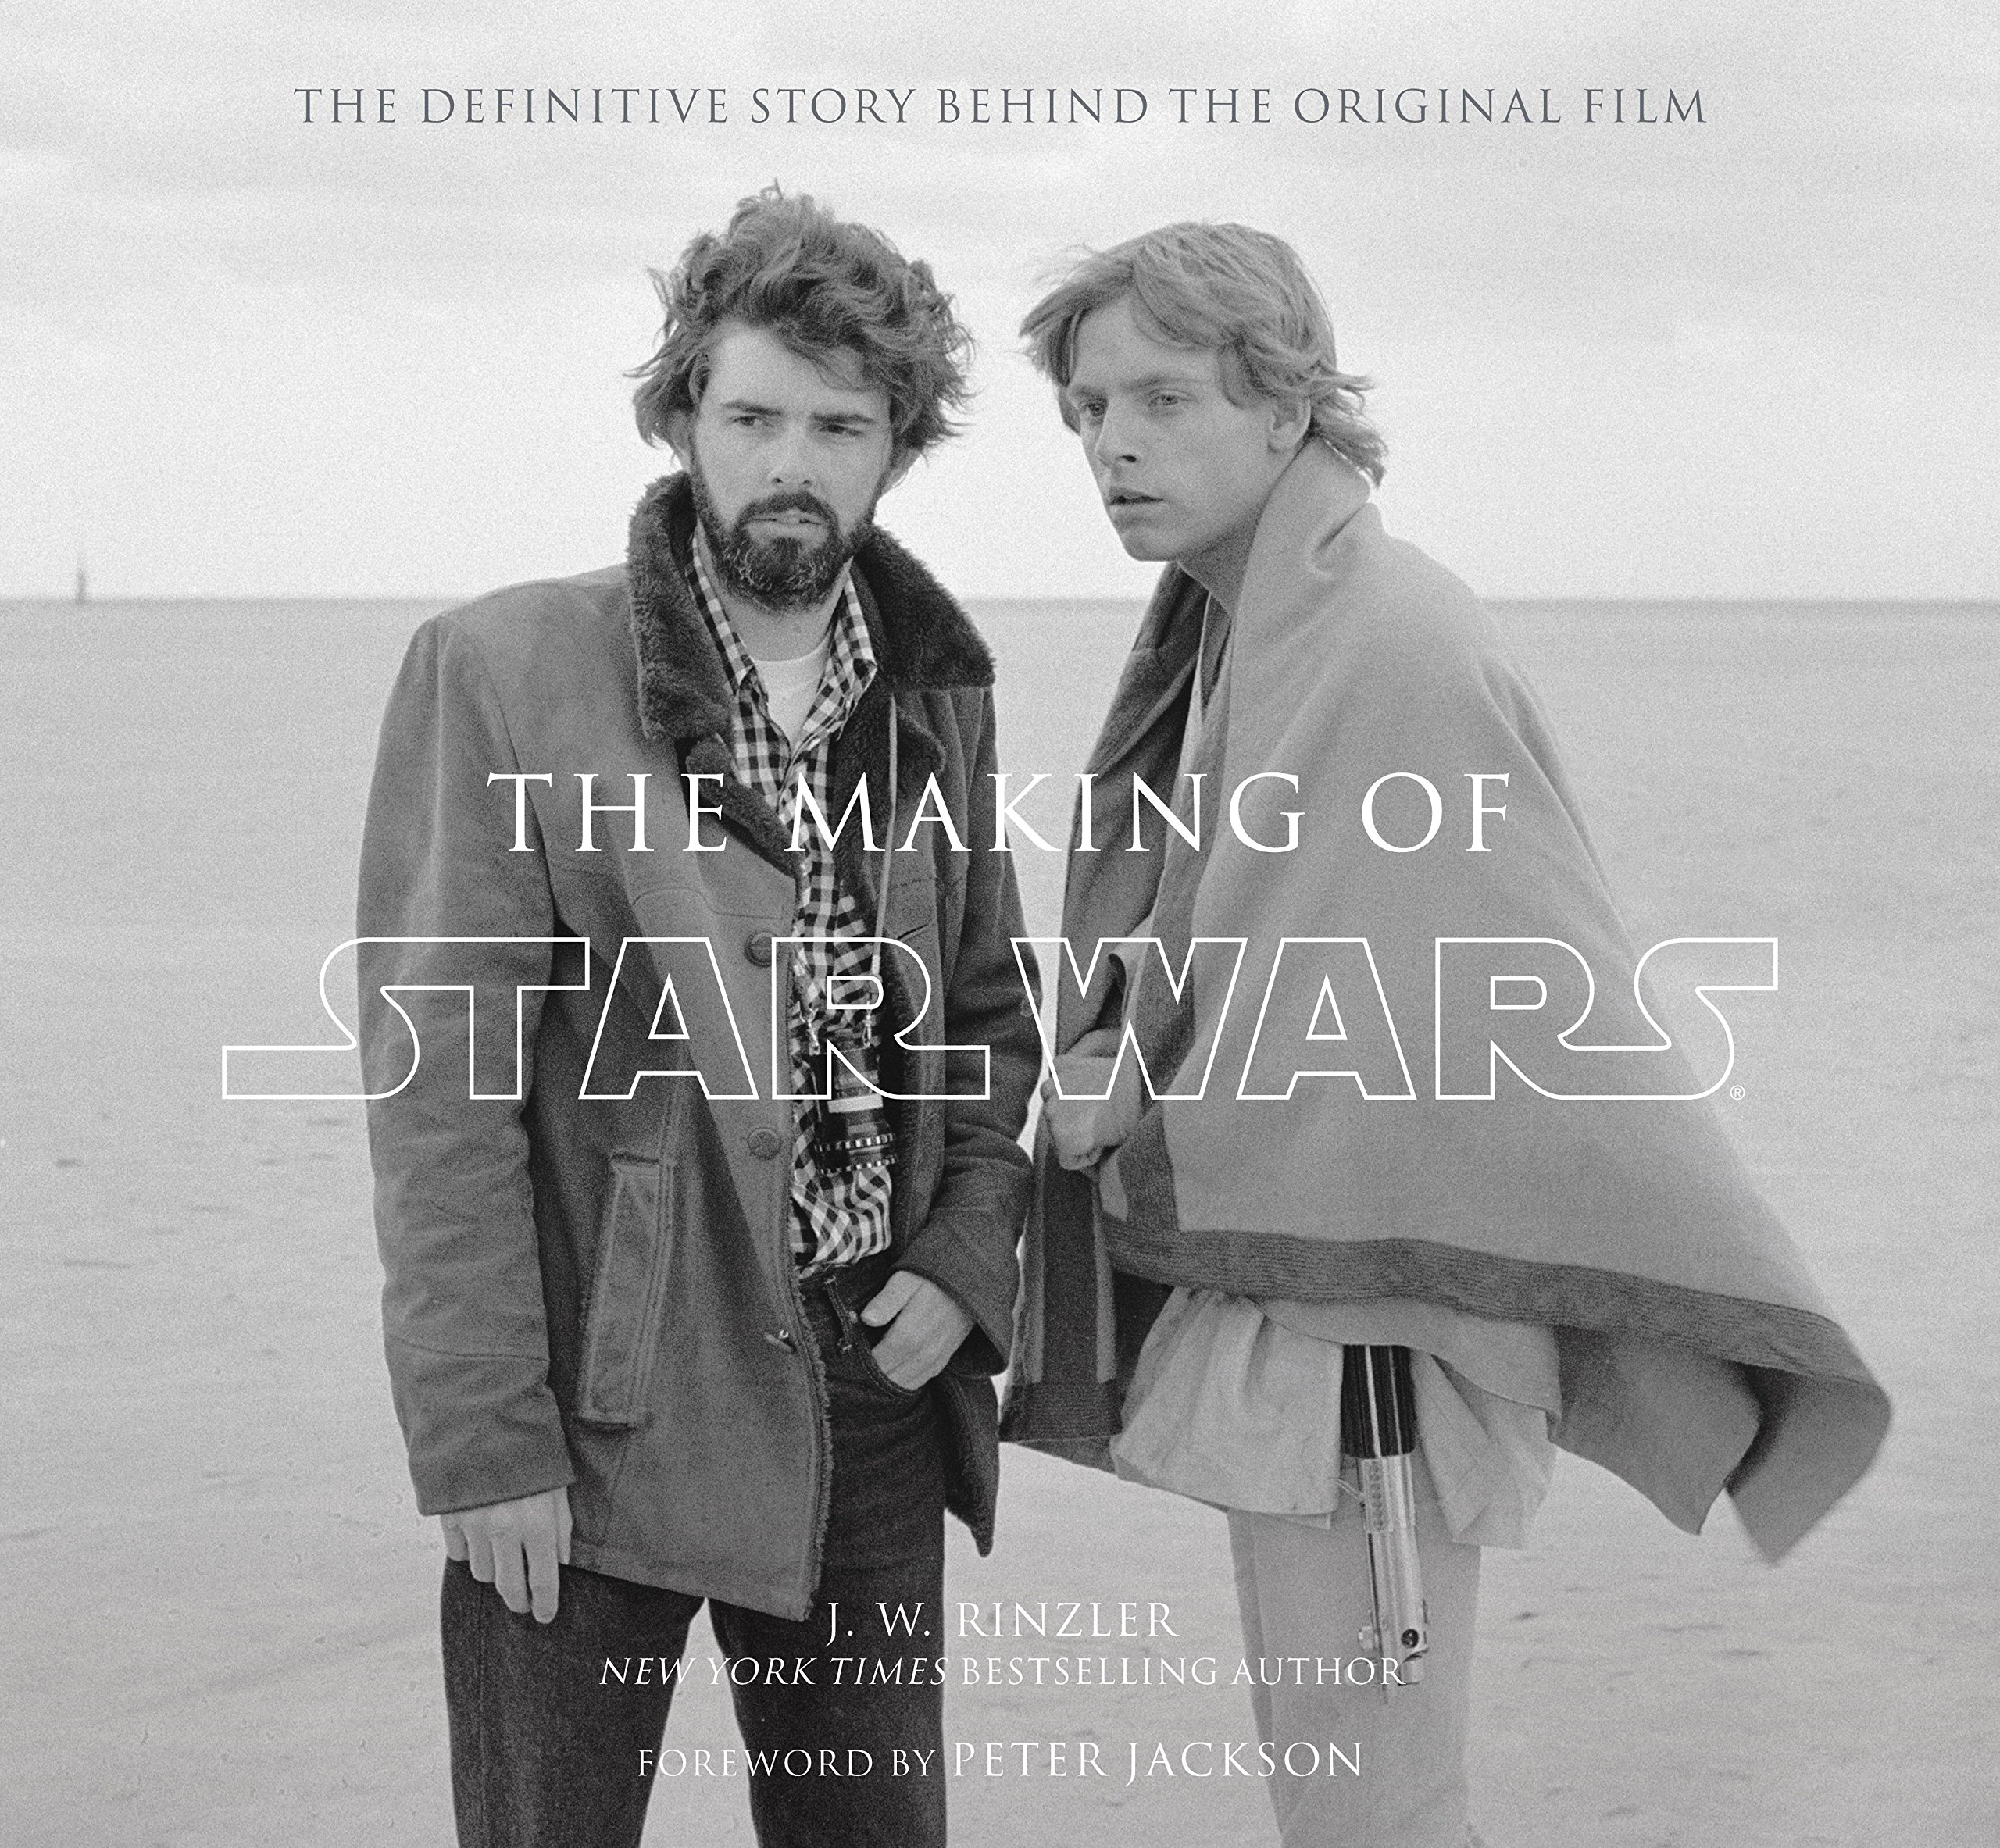

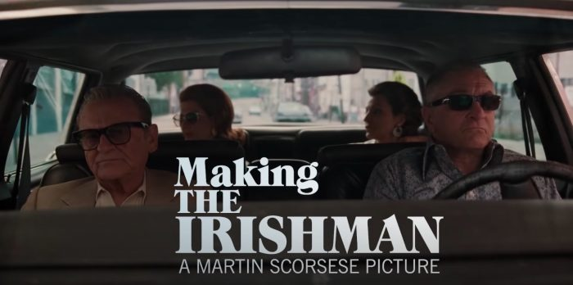
“Film and television today reflect obsessively back upon themselves and invest considerable energy in over-producing and distributing this industrial self-analysis to the public. Once considered secondary or backstory phenomena, industry self-analysis and self-representation now serve as primary on-screen entertainment forms across a vast multimedia landscape.”
Caldwell, Production Cultures, P1
https://www.youtube.com/watch?v=cF8gd6UICx4
Notes:
But the industry is “porous”. While some deep texts hidden, and strong degree of press dependence and repetition of official sources, audiences increasingly savvy and expecting disclosure and communication.
Interest in knowing and engaging with creators turns roles that used to be hidden behind the scenes (for example the TV writer/producer) into parts of the promotional apparatus
This is also a result of increasing will to brand and Hollywood in constant marketing campaign; need to fill spaces and opportunities for extra content for extra value, see emergence of the DVD; rise of social media; increased importance of audience loyalty, fan communities, and parasocial relationship.
Thus the industry also produces huge amounts of content about the industries themselves, ranging from films about making film and shows about making TV (30 Rock, Extras) to fantastical metaphors for storytelling and fandom (Supernatural).
Exercise: Where do you get your media news? How much do you feel you know about the film and TV industry, and what about the people around you who aren’t media students?

Slide 10
Industrial narratives:
Marvel’s “cinematic destiny”
“Trade stories ask us to consider how production personnel are themselves audiences of a kind for whom deep texts, as paratexts, offer branded meaning and identity to the media firms in relation to which they labor.”
Derek Johnson looked at the trade stories around Marvel Studios’ entrance to Hollywood. He found a number of key narrative tropes:
Legitimizing managerial control by film industry outsiders: “The Marvel Way”
Offering reassurances to the established Hollywood order
Playing up the value of fandom and fan expertise
Emphasizing communal bonds with contracted labor
The language of destiny and inevitability
Derek Johnson, “Cinematic Destiny: Marvel Studios and the Trade Stories of Industrial Convergence” Cinema Journal, Volume 52, Number 1, Fall 2012, pp. 1-24
Notes:
In the next session, we will start thinking of how these same practices of sense-making apply to authorship, and also expand our exploration beyond industrial texts and into the promotional sites that primarily face the audience.

Slide 11
Industrial narratives:
Marvel’s “cinematic destiny”
In your groups, look at some of the articles Johnson used in his analysis: can you find the tropes he refers to? Where do you see them?
Borys Kit, “The Avenger,” Hollywood Reporter, July 21, 2009
David Ward, “Sega Plays Marvel Video Game,” Hollywood Reporter, May 2, 2008
Paul Bond, “Arad Jumps Marvel Ship for New Film,” Hollywood Reporter, June 1, 2006,
Borys Kit, “Marvel’s Universal Approach Makes It a World Apart from DC,” Hollywood Reporter, May 13, 2008
Scott Bowles, “The Search for Fanboy,” USA Today, July 25, 2007.
Matthew Garrahan, “From a Comic Fan to a Marvel Movie Maker,” Financial Times, May 1, 2008
Scott Bowles, “Re-Hulk’d,” USA Today, June 6, 2008
Lauren Schuker, “Studios’ Latest Stunt: Less Risk, Less Reward,” August 7, 2006
Devin Leonard, “Calling All Superheroes,” Fortune, May 2007
Notes:
In the next session, we will start thinking of how these same practices of sense-making apply to authorship, and also expand our exploration beyond industrial texts and into the promotional sites that primarily face the audience.

