Slide 1
The evolution of television: authorship and art
Episode 4
Notes:
Our discussion in last session focused on film, and was defined both by historical structural considerations of the film industry, and by the cultural context of films as “art”. The question of what medium “counts” as art is a complicated one: as we’ve noted, cultural status and the recognition of author figures were inextricably linked for film. Television meanwhile had a very different journey to this status, and a very different relationship with authorship, stemming again from industrial conditions – structural, financial, and as we’ll see, technological. So today is the story of US television through the lens of authorship and cultural status.

Slide 2
U.S Network Oligopoly: mid-1950s to mid-1980s
Limited broadcasting spectrum
Free to air – advertising-based
Three network oligopoly – 90% of market share
“Least objectionable programming”
Notes:
This is going to sound prehistoric, but once upon a time there were only three TV channels, and they were all for free
.

Slide 3
I invite each of you to sit down in front of your own television set when your station goes on the air and stay there, for a day, without a book, without a magazine, without a newspaper, without a profit and loss sheet or a rating book to distract you. Keep your eyes glued to that set until the station signs off. I can assure you that what you will observe is a vast wasteland.
You will see a procession of game shows, formula comedies about totally unbelievable families, blood and thunder, mayhem, violence, sadism, murder, western bad men, western good men, private eyes, gangsters, more violence, and cartoons. And endlessly, commercials — many screaming, cajoling, and offending. And most of all, boredom.
Newton N. Minow, "Television and the Public Interest", address to the National Association of Broadcasters, Washington, D.C., May 9, 1961.
Requiem for a Heavyweight by Rod Serling, presented last night on Playhouse 90, was a play of overwhelming force and tenderness. It was an artistic triumph that featured a performance of indescribable poignancy by Jack Palance in the part of the inarticulate has-been of the prize ring.
Jack Gould, “Rod Serling’s Drama Scores a Knockout”, The New York Times, 12 October 1956.
Notes:
Hence, while cinema could be art, TV suffered from extremely low cultural status.
This isn’t a set in stone fact of the medium. Early early TV, when it was recorded live, was perceived as “broadcast theatre” and enjoyed the clout of this association with a respectable art form. Corporations sponsored shows to show that they were patronizing the arts. But by the 60s, recorded TV was the absolute massest of media. It was in every home, and its place in the home associated it with the domestic and feminine, exacerbated by its reliance on advertisers of consumer goods.
Note the distinction here between forms of value judgement. There is little question that 60s TV was bad: deliberately creatively limited and lazy due to its economic structures. But its low cultural status extended much beyond that.

Slide 4
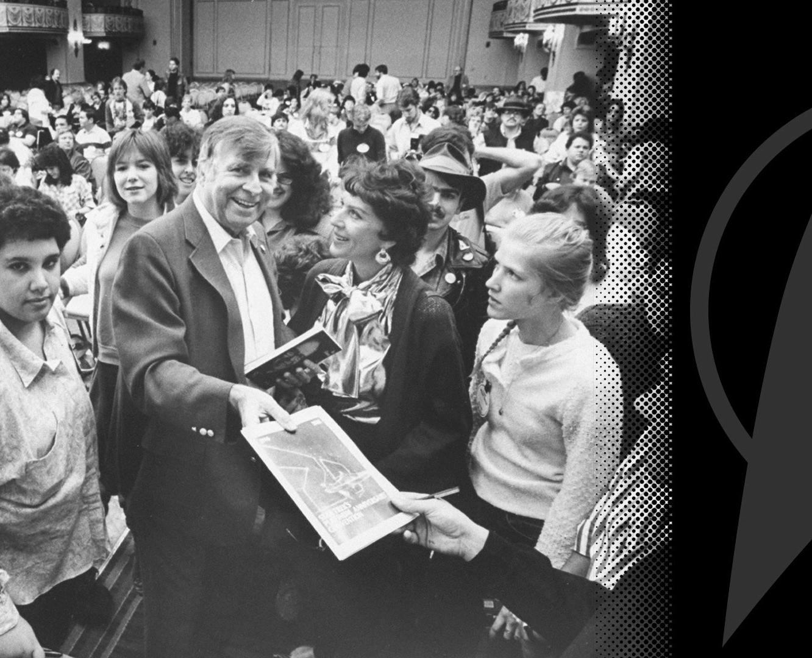
Rod Serling and Gene Roddenberry: standing out from the “boob tube”
Notes:
Loss of author figures was a part of that. Writers of early, live-recorded screenplays were recognized as serious artists. Rod Serling’s script for “Requiem for a Heavyweight”, 1956, won a Peabody Award.
However in the 60s, on top of everything else, recorded TV ran into a problem – a problem that was cinema’s fault, actually. Its screens were tiny, and its visual qualities poor. There wasn’t much directing happening on it. And as the director was being recognized as an auteur in cinema, this was not a possibly for television: thus a powerful dichotomy between “silver screen” and “boob tube”.
A couple of writer-producers stood out from among the general invisibility of TV creators at the time, and are worth noting for the model they created: Rod Serling and Gene Roddenberry. Roddenberry especially is noteworthy for the tropes he employed in establishing his image: visionary, against the network, close association with fans. He was TV’s first “cult author”.

Slide 5
The television industry changes: 1970s/1980s
Developments in market research:
As new technologies for audience measurement emerge, advertisers become more aware of which demographics buy their products
Notes:
Then, in the 1970s, things started to change, though not necessarily for the reasons you might think.
We can essentially trace the change to factors that changed TV’s ability to differentiate and target its audience(s), and the economic impetus that followed.
So, step one: market research and targeted advertising.

Slide 6
The television industry changes: 1970s/1980s
Rise of cable and satellite channels:
No longer free to air: possible to limit access and demand pay.
New channels are funded through subscription or subscription and advertising.
A targeted audience, “narrowcasting”, filling a specific niche in the market.
Importance of distinction and channel brands.
Notes:
Followed by step 2: new technologies, new channels, new financial models.
Birth of narrowcasting.
Subscription-based cable TV is not only free of the restrictions posed by advertisers, but also has to justify to consumers the price of subscription. It is based on appealing to an upmarket, educated, sophisticated audience.
For broadcast TV, not only is the oligopoly challenged to upscale by the pressures of new competition, but there is now impetus to create distinct shows for distinguishing audiences.

Slide 7
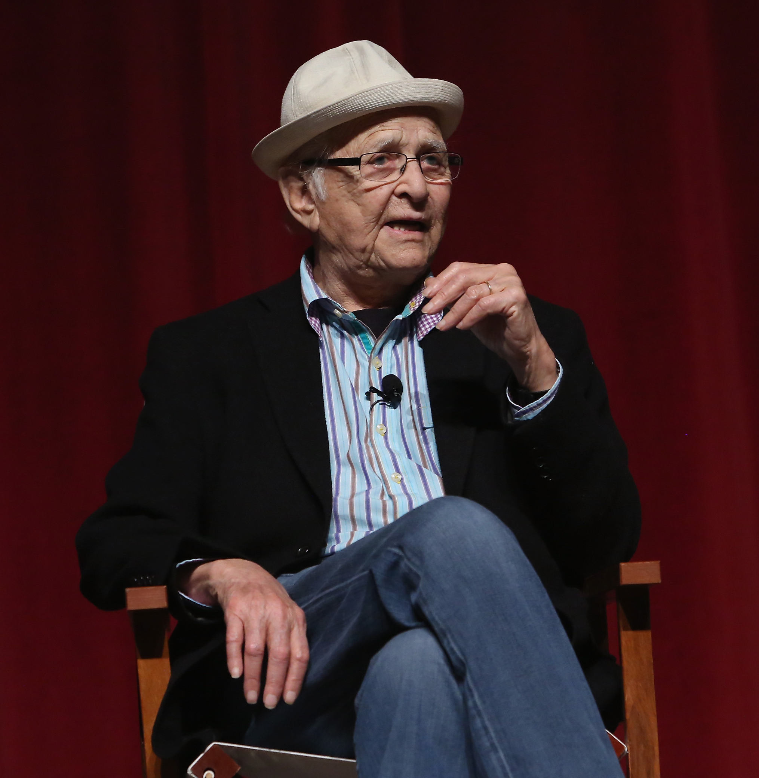
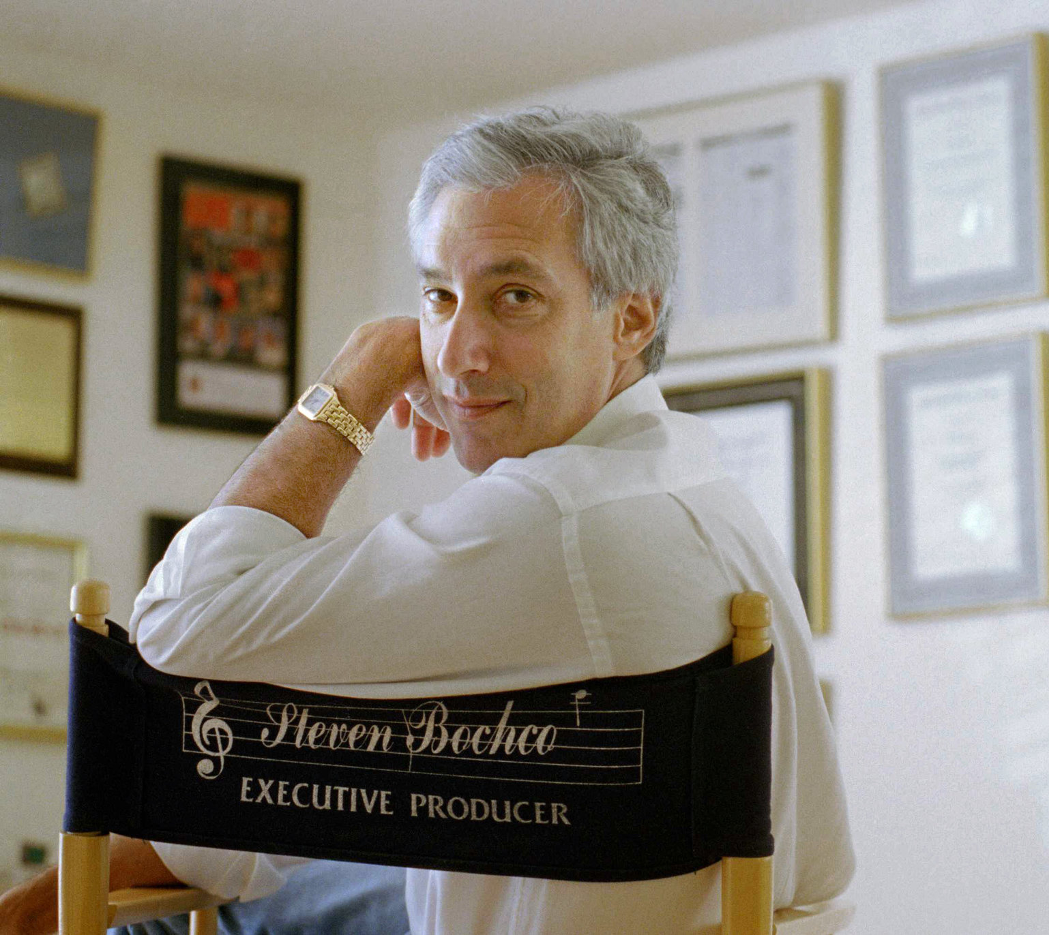
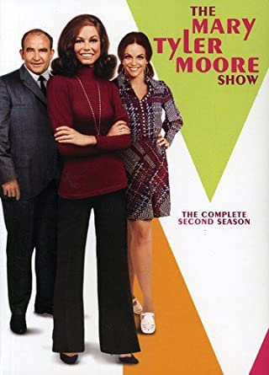
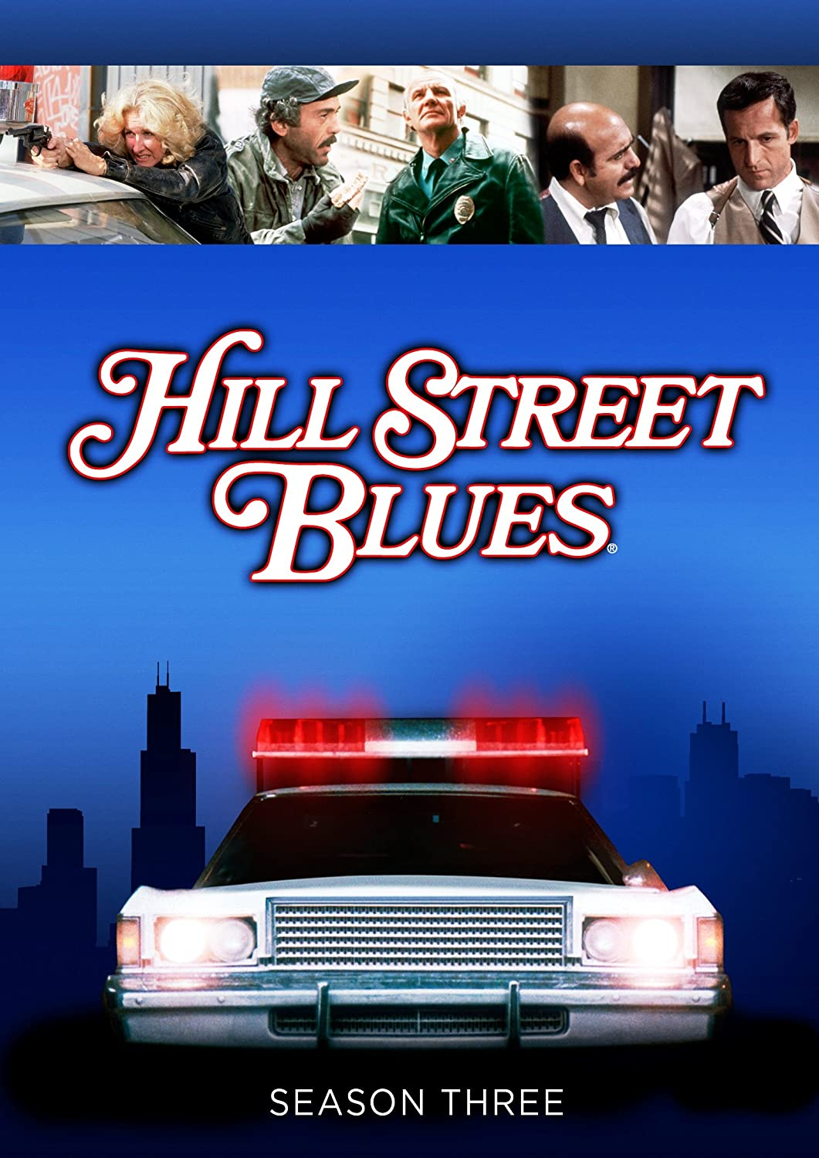
Notes:
We see shades of this in the late 70s with the critically acclaimed comedies of producer Norman Lear starting with MTM, and in the drama genre soon after with shows like Hill Street Blues. These start to be critically acclaimed especially for their portrayal of social issues.

Slide 8
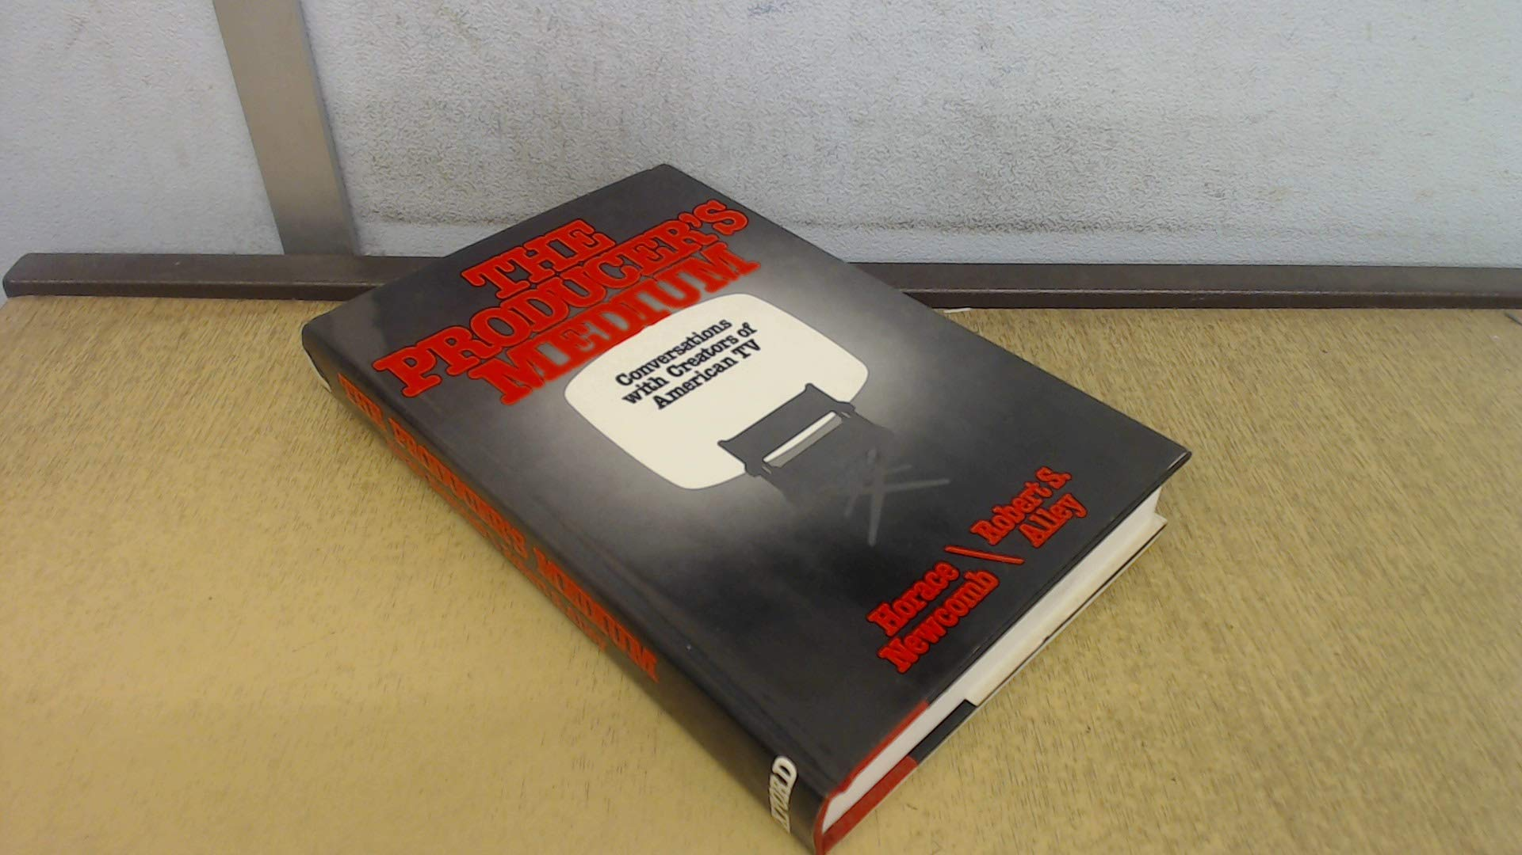
The Producer’s Medium: Writer-producers and choric creativity
Newcomb and Alley are especially interested in producers “who create in the ‘bardic’ center of our shared culture” versus those who use the medium for individual expression (Newcomb and Alley 1983, 34). Newcomb terms the latter mode “lyric” television, which is “rooted in subjective response” to the culture and operates in a voice that is “personal rather than social” (Newcomb and Alley 1983, 37). Newcomb and Alley are more interested, conversely, in television’s “choric” function, its capacity to explore “the central regions of the American mind,” and “the shared systems of meaning and symbol that form our cultural life” (Newcomb and Alley 1983, 43)
Alisa Perren and Thomas Schatz, “Theorizing Television’s Writer–Producer: Re-viewing The Producer’s Medium”, Television & New Media, 2015, Vol. 16(1) 86–93
Notes:
Academia catches on. In 1983, the idea of authorship in television is rediscovered in classic book The Producer’s Medium. Scholars Newcombe and Alley discard the director and find the author (if not yet auteur!) of television in another figure – the writer-producer.
They interview some figures whom they recognize as having creative control over their shows. As we’ll see, this is a really early precursor for the idea of the showrunner.
Call the creativity of the writer-producer choric: expressing not the inner obsessions of the self (as with the auteur director), but the concerns and feelings of broader culture. Interesting distinction showing how parameters of the medium inflect some ideas about creativity and creative process.

Slide 9
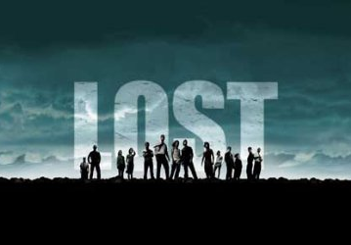
“Cult” and “Quality” television
Target an upscale, usually young/educated, intensely loyal and engaged audience
Rich and complex storyworlds
Sophisticated, witty and self-referential writing
High production values; striking, visually distinctive cinematography
Opportunities for fan participation and creativity
Complicated plots require close attention and spark discussion
Notes:
In late 80s to 90s, with arrival of youth-oriented Fox network and increased emergence of original series content on cable channel, we see some (but not all!) forms of television evolve through appeal to new targeted audiences, that increasingly enjoy higher cultural status. Shows labelled as cult and quality television (amorphous, sometimes overlapping definitions; really value judgements) are celebrated for complex plots, rich storyworlds, distinct visual styles and cinematography (thanks to evolution of TV screens!), witty self-referential writing, and strong appeal to fan and loyal audiences.
They also feature increasingly visible writer-producers as authors, built on the tropes of creative vision, struggle to realize this vision, and engagement with the fans (reminds you of anyone?)

Slide 10
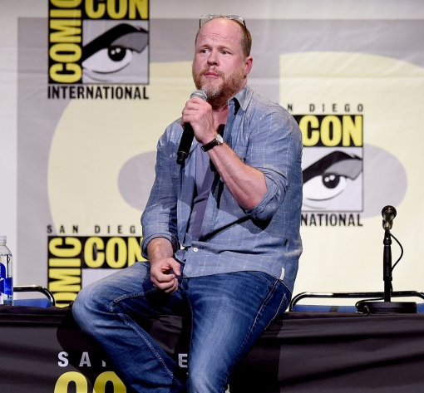
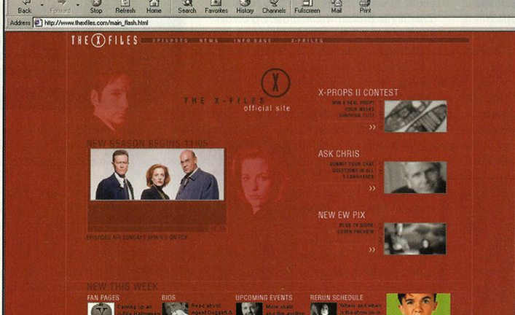
Notes:
Two notable examples here: Chris Carter and Joss Whedon. Early adopters of online technology, closely engaged with fandom to degree of weaponizing it, and associated with elevation of telefantasy with Emmy nominations. Also strongly associated with Fox network and its bid for distinction in late 1990s.

Slide 11
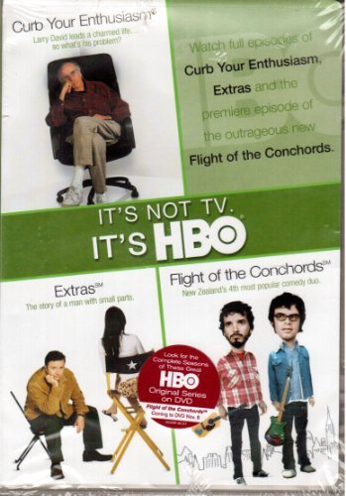
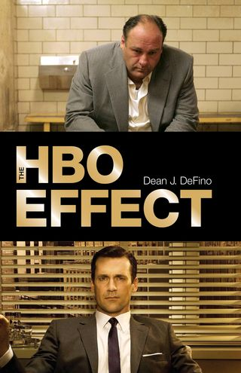
“It’s Not TV”: HBO and the legitimation of television
”I don’t give a fuck—I hate television.”
David Chase, creator, The Sopranos
https://www.youtube.com/watch?v=Jxv0vZXfu4A
Notes:
Circa the turn of the millennium, a key moment: HBO begin branding itself as “Not TV”.
Importantly, this isn’t about a change in behind the scenes practices. As we’ve seen, the work of the showrunner as such was recognized by Newcombe and Alley in the writer-producer all the way back in 1983.
What has changed is the narrative of TV authorship. The showrunner as a publicly recognized and promotionally useful author, part of whose job is to be a public face for the show.
This is about the showrunner as changing TV’s cultural status – at least for some kinds of television!

Slide 12
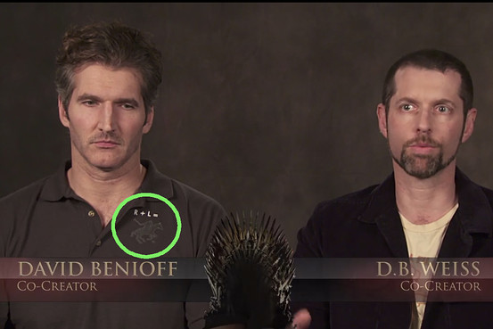
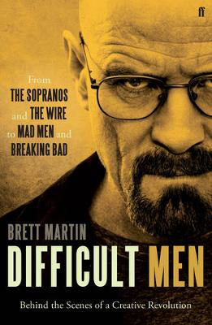
The showrunner as auteur: Genius comes to television
https://www.youtube.com/watch?v=aYWRgqRcSO4
Notes:
Today understanding of showrunner as TV auteur, “golden age” and “prestige” narratives .
Case study: Cultural perception of TV and the showrunner as auteur, circa Difficult Men (2012)
See how “difficult men” evokes narratives we’ve criticised in the first session?
Regardless of truth behind such narratives, this has real implications for the kind of skills and work required from showrunners and TV writers.
Calls for different skills: combination of creative and management skills, ability to run a writers’ room is very different from being a writer, understanding of all aspects of production, also to be able to navigate between show and network, create a unified tone and brand, and this applies not only to show you have created yourself: today many shows have showrunners for hire.
Showrunner is the face of a television show: this also means promotional work opposite the audience, something mostly unheard of until very recently. Social media, conventions, press interviews, variety of paratexts including podcasts, after-show specials. All of these are labour, and they are labour again requiring a skillset. Insert quote on Ryan Murphy here.
This is not a showrunner only problem, but something that all television writers are having to contend with to a degree as the work of television writing is considerably less anonymous. A degree of online presence and availability from the entire creative team is common and expected. This turns social media literacy into an important skill in the industry.
Notably, none of this changes the essential nature of writing work as work for hire. Even the most celebrated showrunner does not own their work.

Slide 13
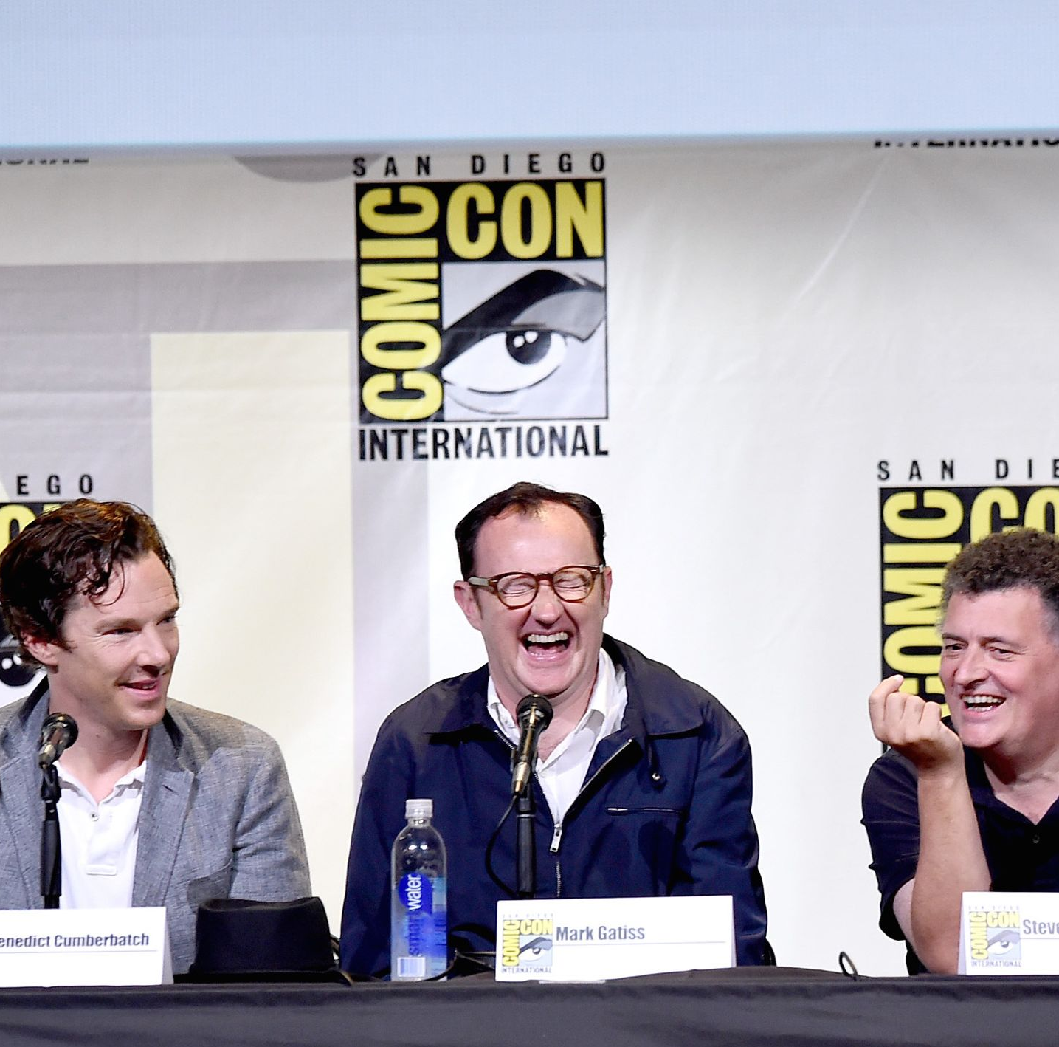
Exercise: The showrunner goes international
The US brand name showrunner model has affected and been emulated by television writer-producers in other countries: for example, Steven Moffat and Mark Gatiss (BBC Sherlock).
Who is the “author” of Czech television?
Do you know the names of television writers? Producers? Directors?
Are they ever featured in television promotion? Look for promotional paratexts: trailers, interviews, social media accounts.
Do you believe the showrunner model is suitable for Czech television?
Notes:
Is this a good exercise or do I want to get them to analyse 50 Power Showrunners lists for tropes: What are the language and narrative tropes used to describe the showrunner as auteur? Think of key terms (“genius”), metaphors (“captain”), what is told about their biographical details or their ways of working.

