Slide 1
Creativity: a cultural history
Episode 1
Notes:
This is basically my book in expanded course form.
At its centre is an exploration of ideas around concept of authorship and creativity, and how they are constructed and communicated by the film and TV (media) industries, both within themselves and to us the audience.
Using this subject to open doors onto and explore an array of other topics: cultural theory of art, film and especially television history, media industry studies, media promotion and branding, contemporary creators.
So you will learn varied things, all tying back into one overall topic. Some ideas will recur as we study them from different angles.
You may be familiar with some of the ideas I present, in which case consider them a reiteration. I’m working up from the basics so that we don’t miss any important building blocks.
Bear with me as I pull a very long ribbon from a hat. I will wrap everything up neatly in Session 6.
Importantly: this course is not about authorship theory. We will not be asking whether authors exist as an ontological fact, or what it means if they do or don’t. We are concerned purely with discourse. What is discourse? In a moment
First. some technicalities:
Length and structure of sessions
Workgroups and how they work
Expectations for participation, readings and questions
Let’s go!

Slide 2
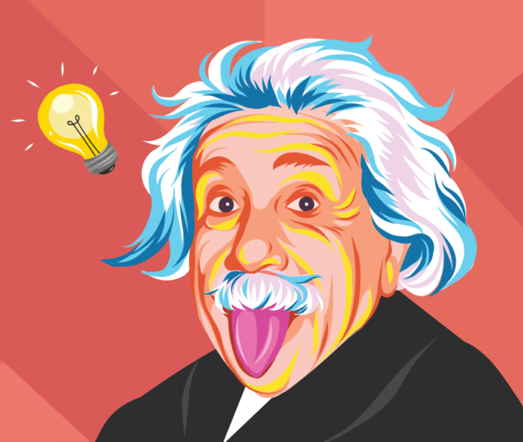
Exercise: defining genius
What do you think about when you think about creativity? What about genius?
Find a quote, image, graphic, or anything else that reflects your associations.
Post them on the padlet at: https://uniofnottm.padlet.org/ajzlh1/yd4sh6lbb213u451

Slide 3
Discourse and Myth
Cats are mean
Ways of thinking -> talking -> acting.
Common-sensical, taken for granted
Systems and knowledge and meaning
Socially constructed
Situated in historical and cultural context
Enforce power relations
Women talk more than men
Anyone can succeed if they work hard
Kings are chosen by God
Homosexuality is not a mental illness
Notes:
This exercise reveals our ways of thinking about genius and creativity. Common ideas, associations, things we take for granted, concepts that are tied together in our minds, terms we use to define and describe. We can call them tropes, cliches, myths. I choose to call them discourses.
The idea of the discourse comes to us from Foucault, who points us to the ways in which how we speak reflects what we understand as common sense: and common sense holds up power. Discourses are language’s way of representing reality (knowledge) which exist in the socio-cultural content of a particular moment. “Discursive formations” institutionalize ways of thinking/talking/acting about a particular topic: we may call them “regimes of truth”.
For example, Foucault discusses the shift in the discursive formation of sexuality: historically different ways of understanding and attributing meaning to sexual acts. “Sodomy” as a broad category of sexual isolated actions (bestiality, oral sex, any sexual act that could not lead to reproduction) within the legal and religious sphere; redefined in modernity into “sodomy = homosexuality” as an identity, a truth about a person’s essential self, which now also belongs within the fields first of medical knowledge and now of subjectivity and the politics of human rights. The action of same-sex intercourse are the same – the meaning is different. This becomes common sense knowledge, and it affects action and behaviour: like medical practice, law, policy, and self-understanding.
Myth naturalises.

Slide 4
The idea of the creative genius as we have it today is newer than we think.
In fact, the idea of creativity is newer than we think.
“A poet is an airy thing, winged and holy, and he is not able to make poetry until he becomes inspired and goes out of his mind and his intellect is no longer in him.” ― Plato, Ion
Notes:
One of the most interesting things about discourses is the way they become commonsensical and a-historical. But in fact we’ve got a pretty clear sense of how this particular one came about, and how it emerges from a fairly specific historical moment.
We can say that exceptional creative or artistic expression or ability has always been recognized, but that its source, where it resides and how it comes about, have been placed differently. The first understanding we have of creativity is that its origin is not in the individual mind but in divine inspiration.
Plato, honored forefather of Western aesthetics, tells us (through Socrates) that inspiration (note the word!) comes from a god speaking through the poet. From his description of the poet as “not able to make poetry until he becomes inspired and goes out of his mind”, we have a consistent thread in Western thought linking creativity and artistic expression with madness – one which solidly survives today, though with a different twist as we’ll see. But from Plato we get the legacy of some ideas about how creativity works. What it’s like to create great art: that you can’t rush or force inspiration; and also ideas about who the artist is: different from ordinary mortals.
The idea of expression as not so much self-expression as channeling something else was a historically persistent one. In medieval times, the question of who wrote a particular text certainly mattered, but only in the sense of making sure they were a proper vessel to convey truth. The auctor, according to Andrew Bennett (2005) was conceived (as the root of the word author still suggests) as a reliable authority, one that could be appealed to, a source sanctioning moral and political power: but not as a creator, only as a transmitter of information or fiction. Though we call the artists of the Renaissance “Masters” (this will come in as important later on!) we need only take a brief look at their works to see that originality of ideas was not something that was expected or valued from them.
As Bourdieu notes in the chapter you’ve read for this session, pre-modern art existed within other realms: the religious and political. So we can see the link between the social and economic conditions of the production of art, and the way this production is understood.

Slide 5
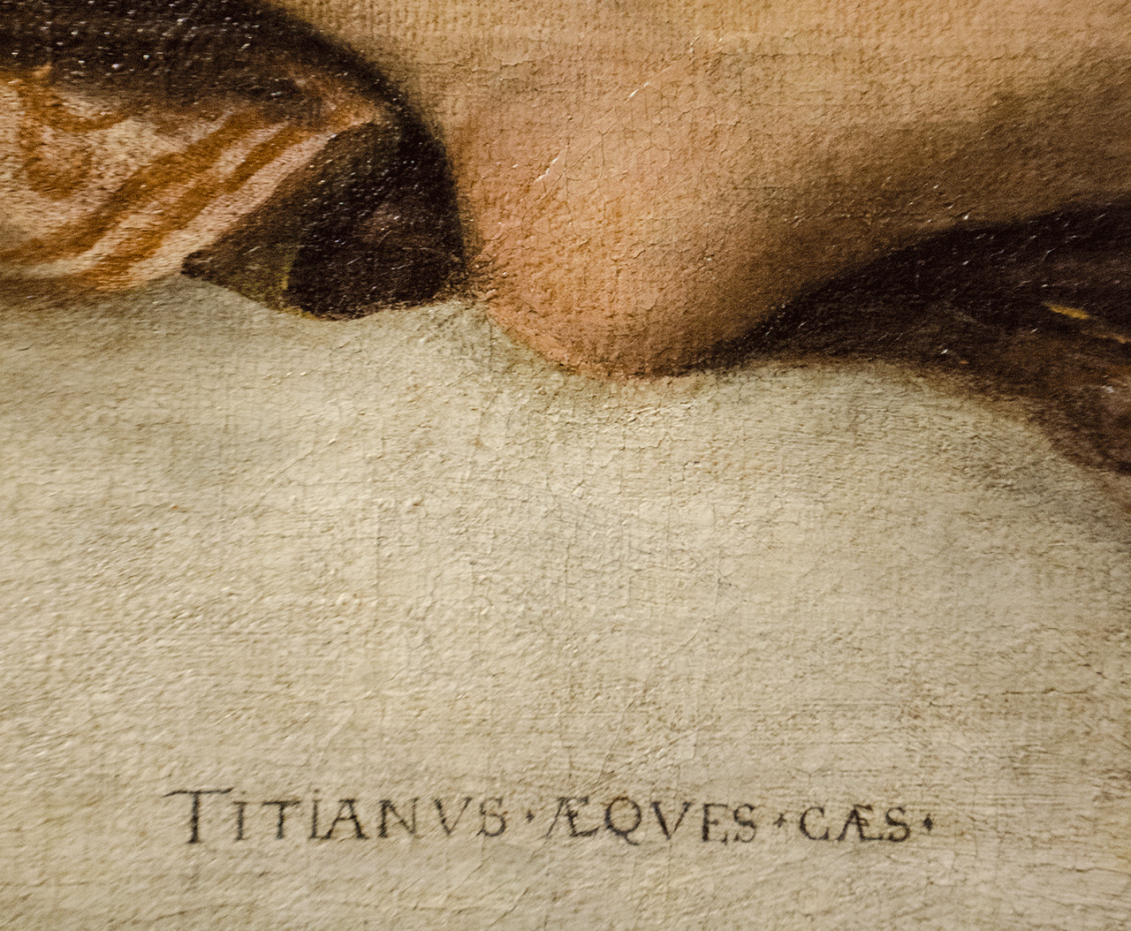
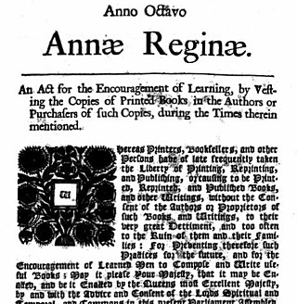
The birth of copyright law
1710: the Statute of Anne
It now becomes possible to own ideas.
Originality
A single originator
Subsumption in the signature
Notes:
Everything changes with the introduction of print, or rather with what Walter Benjamin calls “mechanical reproduction”.
Of course this isn’t an abrupt change (nothing in culture ever is.) We already see some significance attributed to having a name attached to an artwork in the Renaissance, see Titian’s signature here. I’m fond of Titian because while this may be his signature, it may not be his painting – workshop system due to the great value of owning “a Titian”.
The possibility to mechanically reproduce written works opened enormous market possibilities. Here begins the possibility of the world of art becoming its own “world”, as per Bourdieu, thanks (among other things) to possibility of detachment from structures of patronship and shift to market. However, it also rendered the signature of the artist’s hand useless. Mechanical reproduction creates the need for artificial scarcity. And here we come to copyright law.
Born in 1710 with the Statute of Anne – that’s Queen Anne pf Britain – copyright law meant that for the first time it became possible for people to own ideas. It enshrined in law the concept of a new idea that could be attached to one originator. The singularity is important: rise of the individual, and leads now to legal subsumption of creative work under the signature. Originality is also important: idea can only be copyrighted and thus only valuable if new.
Mechanical reproduction strips the aura from the work (Benjamin): the author comes in there as well. If the original work used to bear the physical print of the embodied artist’s hand, the signature now stands for the soul of that individual artist within the work: a confirmation of that artist’s ongoing presence, and thus a replacement for the aura.

Slide 6
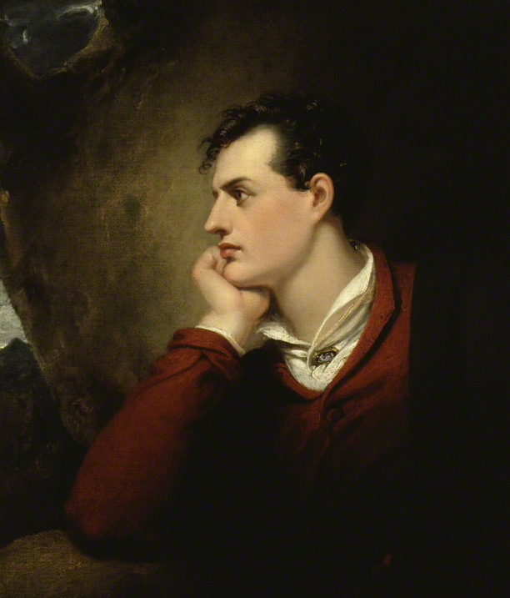
Industrialisation and Romanticism The economic world reversed
Notes:
Industrialization and standardization challenge the very idea behind copyright law: the singularity and significance of the individual artist. This is at the same time ideology of Romanticism emphasizes resistance to rationalism, return to mysticism of the artist.
Romantic thinkers – represented here by their Platontic ideal, Lord Byron – pointed to something irreplaceable in the individual artist, that sets them apart and aloft from the market and the masses that are now gaining access to their art.
They rediscover the mystical genius an reposition it a rooted in the unique, individual self. As Jane Gaines writes, ‘the Romantic view of art as transcendent and the artist as a superior human being evolved as a means of rescuing the artist’s work from the hostile public.’ Writing for the market reduces the artist to just another provider of commodities among many: but art as the result of self-expression, self-expression as a hallowed activity, offers “spiritual compensation for the ignominy of writing for pay”.
This modern artist, says Bourdieu, “invents himself in suffering”: key to his myth is being outside society, unappreciated, uncompensated, and misunderstood. This was certainly up Byron’s alley, who was all about the removal of the artist from societal norms (and from the domestic sphere – we’ll get back to this!)

Slide 7
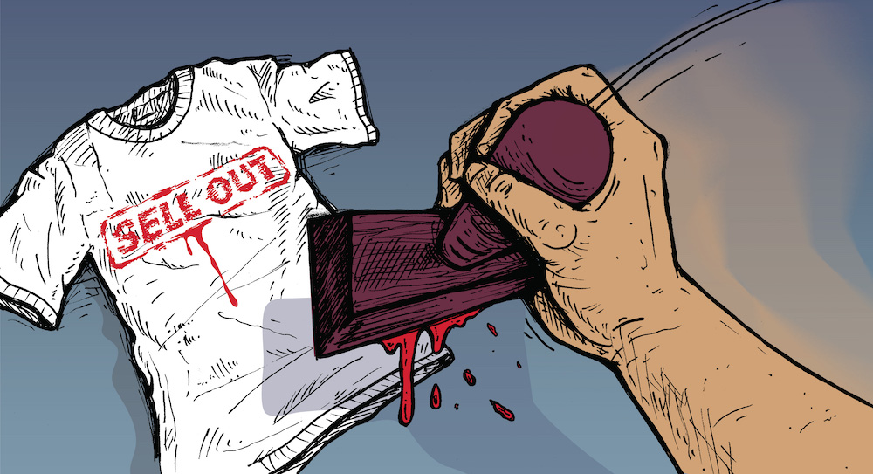
Art vs. Commerce
The binary of “selling out”:
Sold out “of something” – financial success
But also: sold out “to the man”
(Sold out “outside the proper audience”)
Notes:
Bourdieu thus identifies in the art world an “economic world reversed”: one in which the artistic value of the work stands in direct opposite to its market value. Yet another element so strong it’s written right into our language use (at least in English!) The artistic and the commercial are a binary – good and bad, light and dark. And here again distinction – we put a lot of stock into the innate superiority of the unpopular and unrecognized (“before it was cool”).
This will accompany us throughout the course.

Slide 8
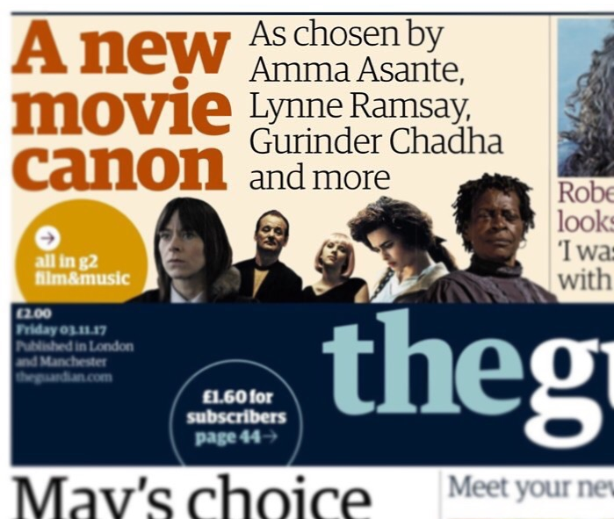
The world of art: Who legitimizes?
There is social prestige and power (cultural capital) in recognizing “true” art and artists.
The canon is negotiated through multiple agents and institutions in the art world: artists, producers, critics, exhibitors – and academics.
Notes:
From the rather complex chapter you’ve read for today I want to pull out two ideas: consecration/legitimation and the art world.
Essentially, as much is for Bourdieu, all about distinction: whether something is considered “art” or not (perhaps “craft”, perhaps “entertainment”, perhaps “garbage”!) “This is art” as a classification and a value judgement, which detaches the object from the secular, vulgar world of the market, the everyday, the domestic (the religious, the political) and elevates it to a kind of purity. This is cultural legitimation.
As importantly, Bourdieu points out that this isn’t something that’s innate or something that just happens – it is something that is done through a range of activities by people within the field, artists, critics, academics, members of institutions etc. He makes a valuable comparison (which Foucault later picks up) to the canonization of religious figures and texts, and indeed we speak of a literary and cinematic “canon”. Bourdieu notes that there is cultural capital (for our immediate needs, we might more simply call it prestige) in being recognized as being able to identify “true” art and discover “real” artists: also notes the negotiations and struggles inherent in this.
We are doing this negotiation right now!

Slide 9
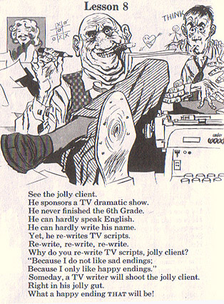
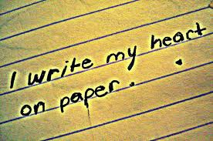
Cultural discourses of creativity
Individual: The authentic artwork is the product of a singular genius
Independent: Free of interference by outsiders
Not motivated by profit but by the desire for self-expression
Extraordinary: The purview of unique individuals working under unique conditions
This has real implications for the legal and social dimensions of cultural labour
Notes:
So – how do we understand artistic creativity today? And why is this important?
It’s important because it is how people understand themselves, their work, their relationships to their creations and to other people; it’s important because it is the foundation upon which we build the mechanisms according to which we run our society, such as our laws.

Slide 10
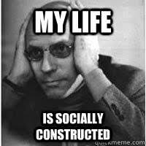
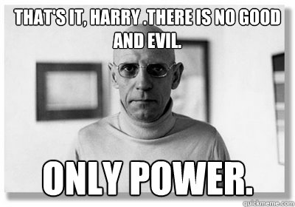
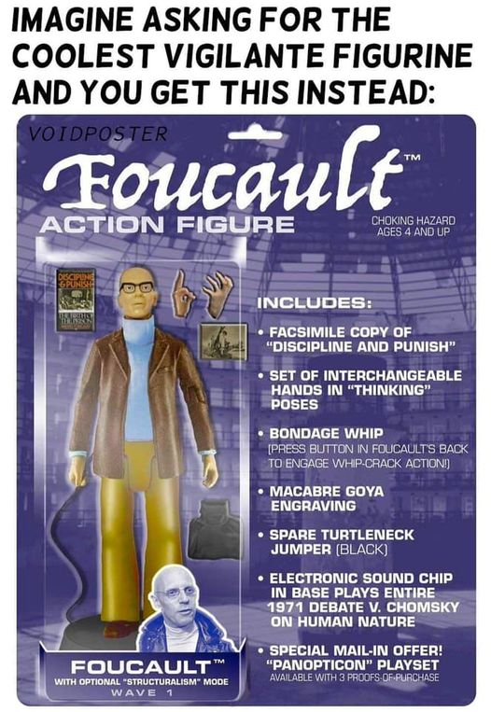
The uses of authorship
Foucault: The author function
Removed from the author as an embodied individual
Used separately from a proper name
Used to discuss texts and relationships between texts
Used to group, categorise and find coherence within texts and groups of texts
Acts within a legal system: “objects of appropriation”
“These aspect of an individual, which we designate as an author […] are projections […] of our way of handling texts: in the comparisons we make, the traits we extract as pertinent, the continuities we assign, or the exclusions we practice.”
Notes:
Lest you come to the same unpopular conclusion as me, which is that authorship is all a scam and originality is a lie, Foucault calls attention to the fact that authorship is actually useful when we think of it as a discursive function: i.e. a way of talking about texts.

Slide 11
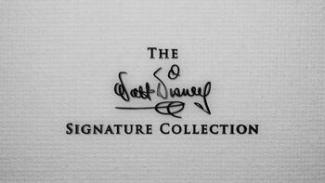
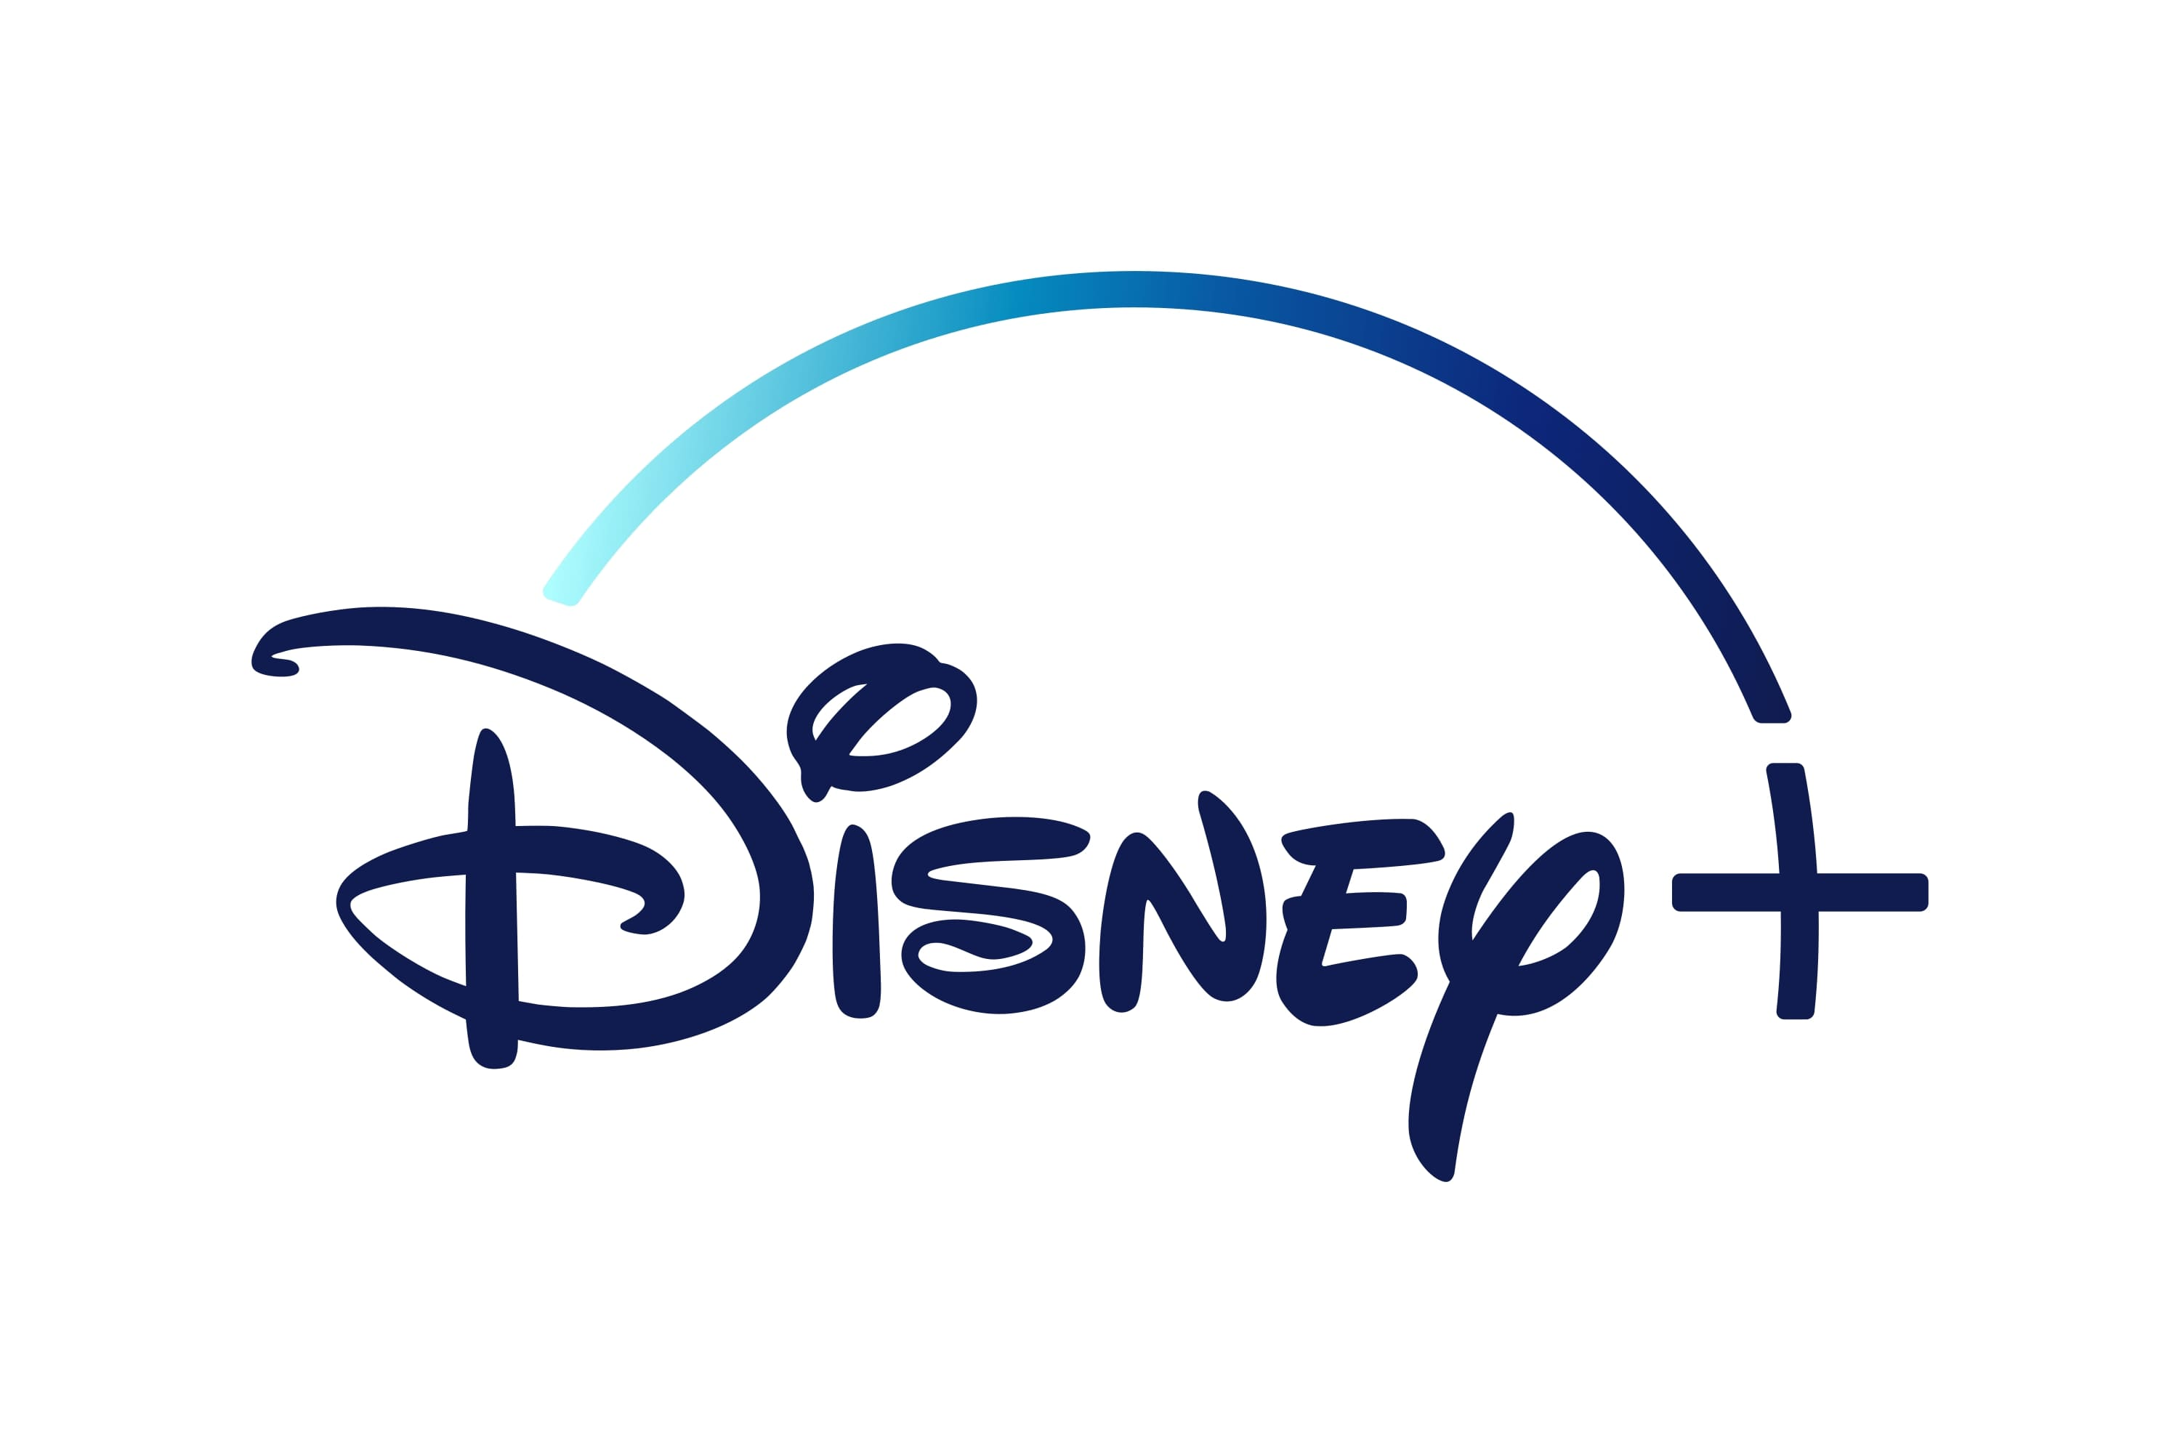
Authorship and branding
“Both the aesthetic of the signature and the aesthetic of the brand are ideologies: they are regimes of marketing and authorization which draw in rather similar ways on an imaginary of the unique person or of personality. […] The dual economies of value that underpin all cultural production may exist in tension, and their disjunction is the rationale for the privileged status of ‘high’ art in its self-understanding as a disinterested culture unaffected by market pressure. But the historical logic of the brand was always already implicit in the aesthetics of the signature.”
John Frow, “Signature and Brand,” in High-Pop: Making Culture into Public Entertainment, ed. Jim Collins (Malden, Mass: Blackwell, 2002), p71-72.
Notes:
And here’s where it gets interesting, because an author’s name isn’t the only thing in our culture which works this way: as a sign binding together a set of not-necessarily-similar artifacts, which signifies a set of associations and attracts value. And the other thing is set very firmly in the realm of commerce. That other thing is the brand.
John Frow notes the similarity between signatures and brand. Creative originality versus managed standardization constitutes two opposite poles of the binary in question. However, they are both rooted in the same logic that creates the system of value generation through control of the dissemination of information.
We will be returning to branding as an important concept later on, so let’s explain it quickly:
Goodwill
Relationships with consumers
Coherent identity
Set of associations/values
Integration into consumer life/identity construction
Controlled innovation

Slide 12
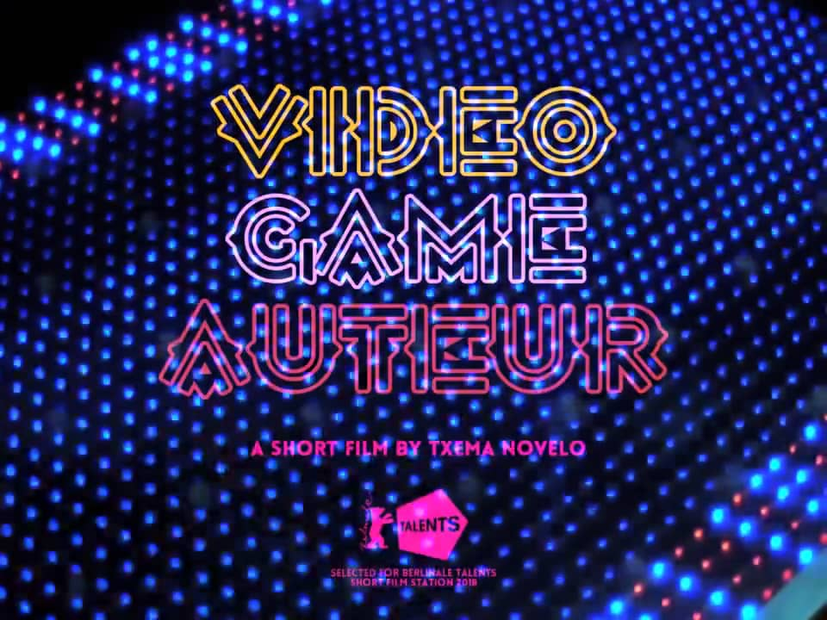
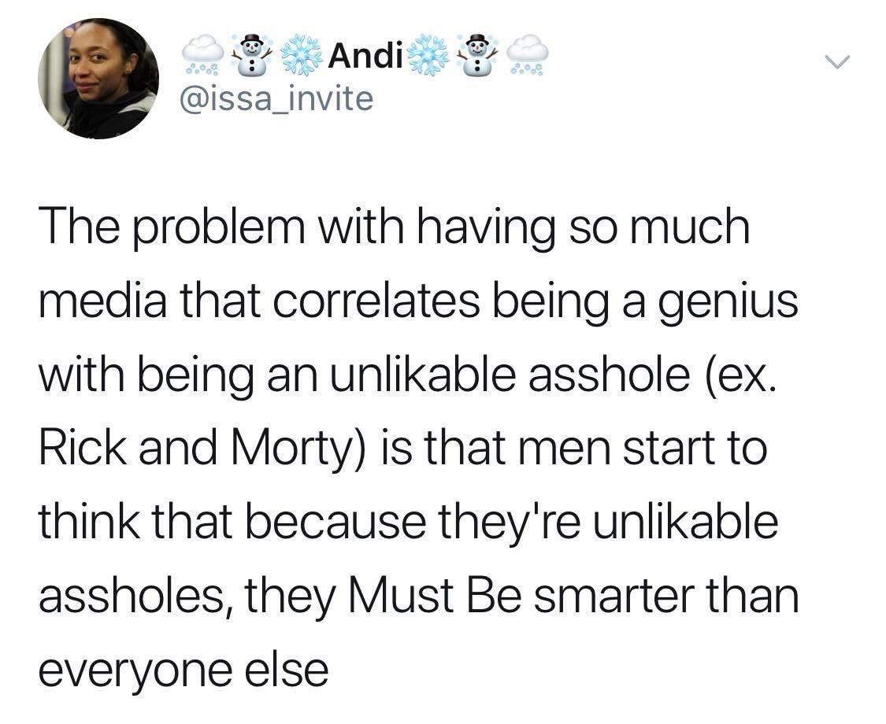
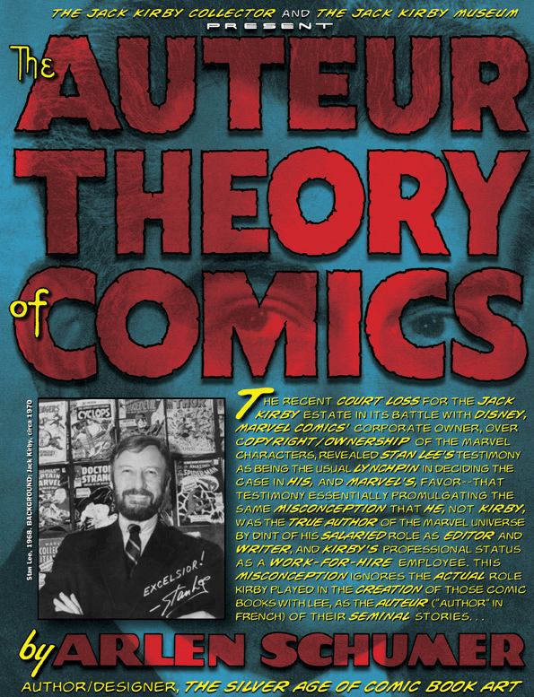
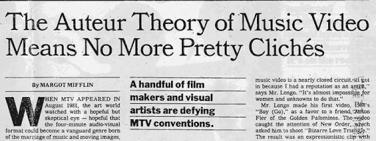
The author today?
An enduring myth: a cornerstone of culture
Present in ever more spaces: television, video games, digital media
But subject to criticism:
The fetishization of genius in neoliberalism
The gendered genius: excuse for abuse?

Slide 13
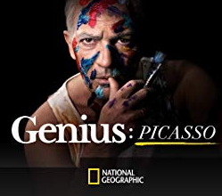
Discussion: Deconstructing the Artistic Genius?
“Do we really expect our artists to be paragons? Because if we do, we are not just going to be very disappointed, we are going to be stuck with a lot of mediocre art.” - Neil McCormick
"In the same way we think about where our fruit comes from or where our potatoes come from, you need to be asking where your entertainment is coming from. Who’s making it? How many asses were grabbed in the name of making this movie or getting this show out or putting this record out?" - Wesley Morris
Where do you encounter the discourse of artistic genius in everyday life?
What are its benefits and disadvantages? What does it mean for us as a culture?
Do we need new models for creativity?
https://www.youtube.com/watch?v=fFw_4L09ANw

