Slide 1
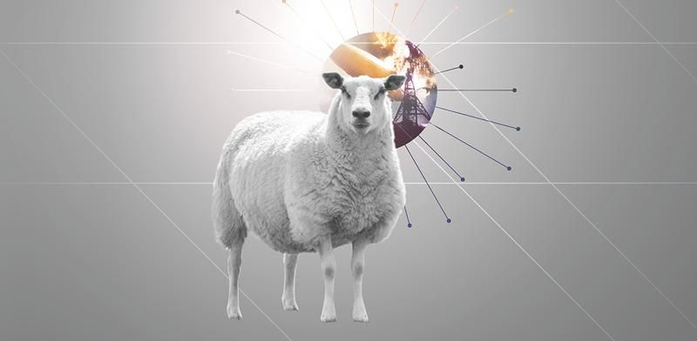
Videoart

Slide 2
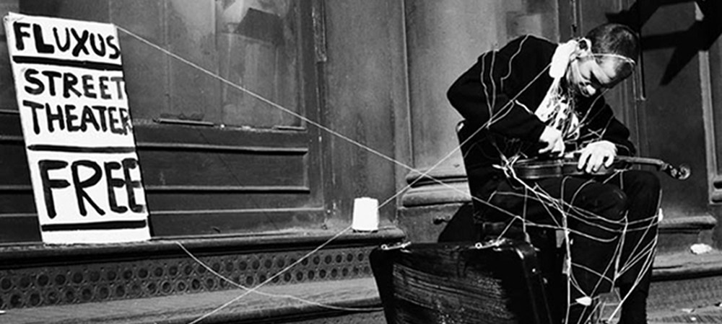
Fluxus
“the immense stupidity, sadness and lack of meaning that is our wound in life.”
George Brecht

Slide 3
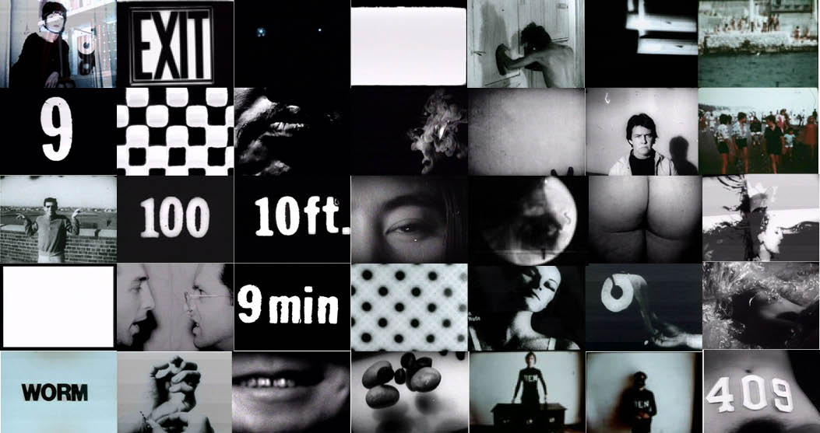
Fluxfilm Anthology
George Maciunas

Slide 4
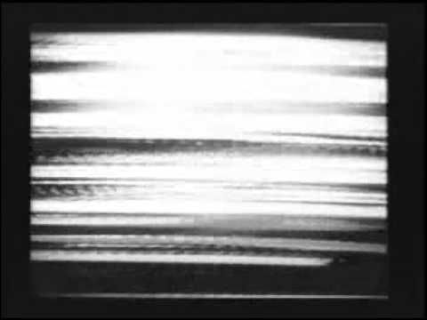
Wolf Vostell – Sun in your head (1963)
Vostell 60 - Rückblick 92 (1992) - https://vimeo.com/146009115
8:00

Slide 5
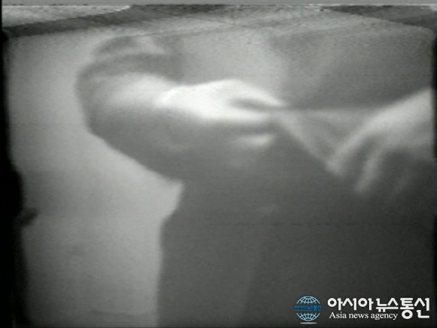
Button Happening - Nam June Paik (1965)

Slide 6
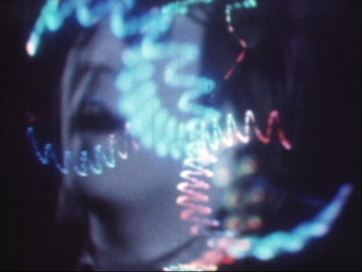
Video-Film Concert - Nam June Paik a Jud Yalkut (1965-1972)

Slide 7
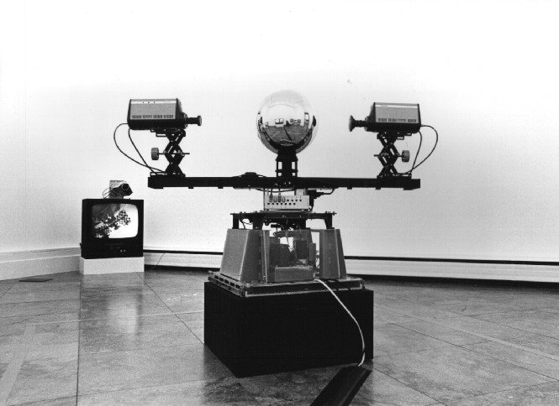
Steina Vasulka – Allvision (1976)
Alien perception - Vision Machine 10
https://vimeo.com/143680456

Slide 8
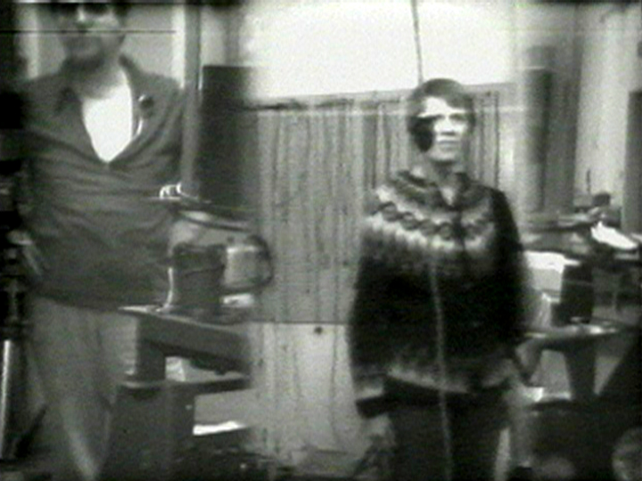
Steina Vasulka - Switch! Monitor! Drift! (1976)

Slide 9
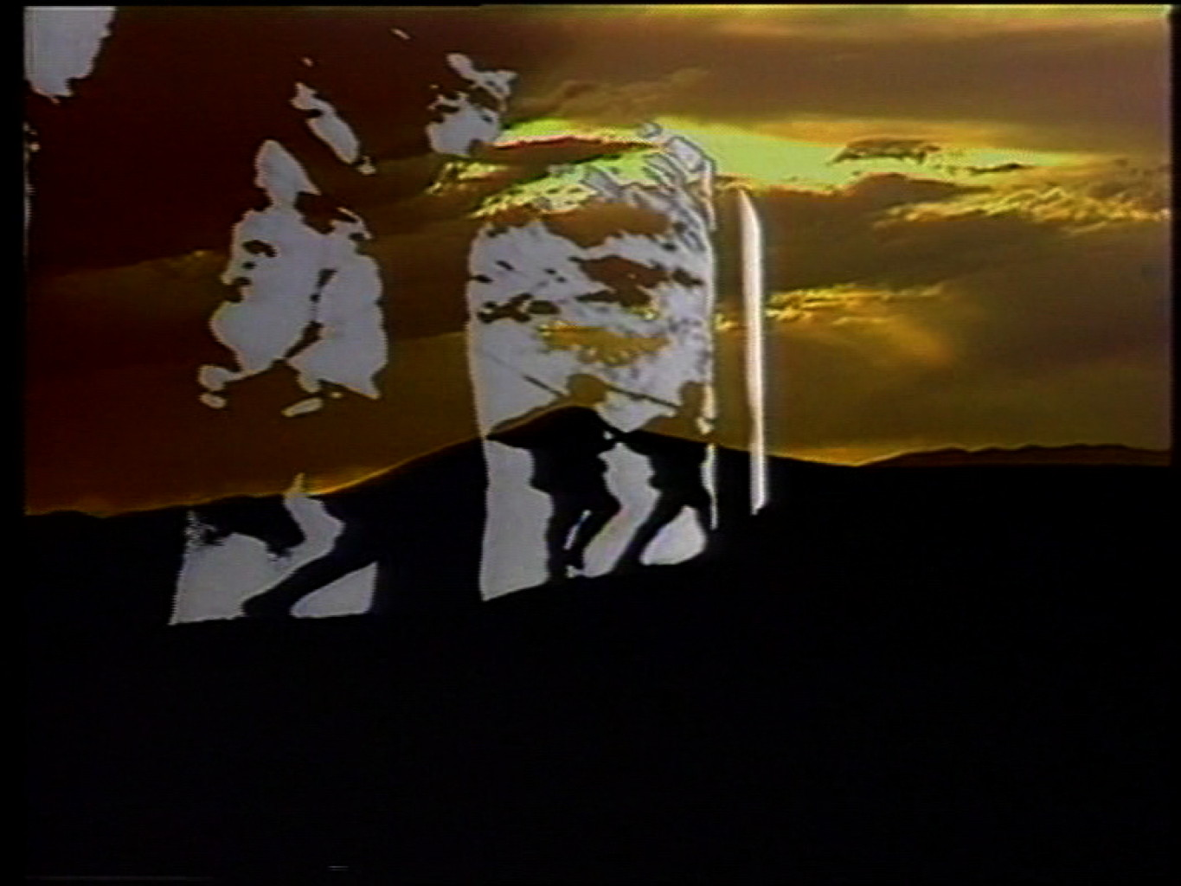
Art of Memory – Woody Vasulka (1987)
Art of Memory - http://www.vasulka.org/Videomasters/pages_stills/index_6.html
Binary Lives - Peter Kirby – 24:00 https://www.youtube.com/watch?v=uYyR6EWbPC0

Slide 10
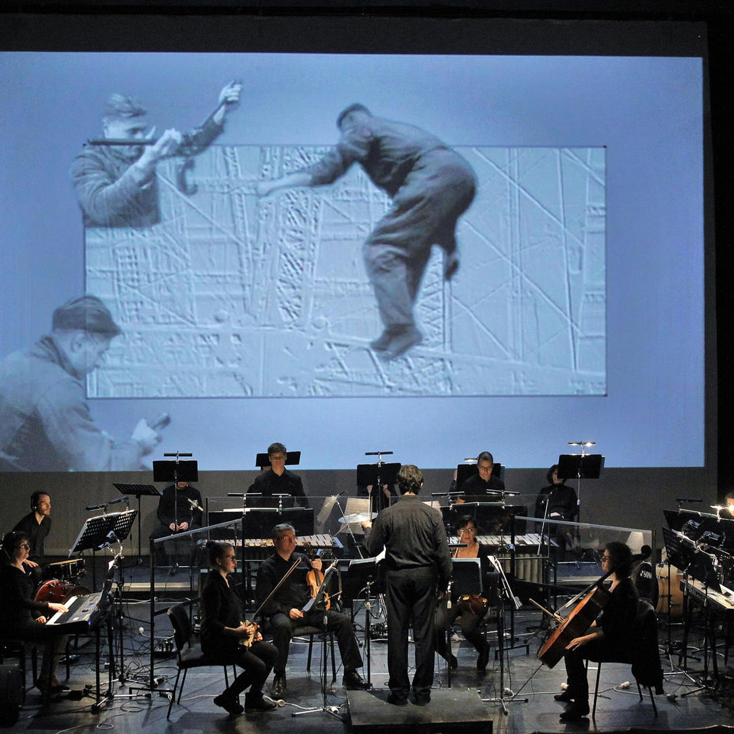
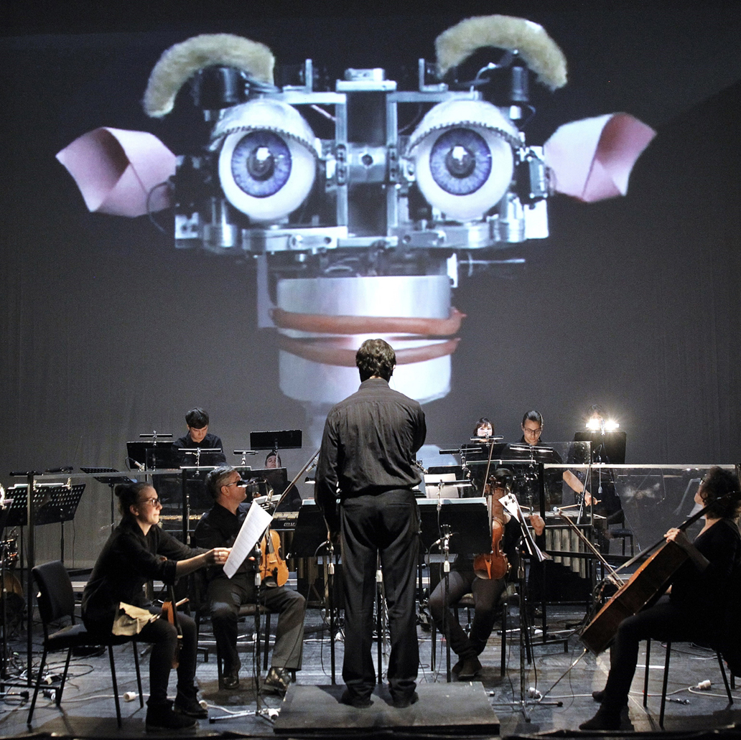
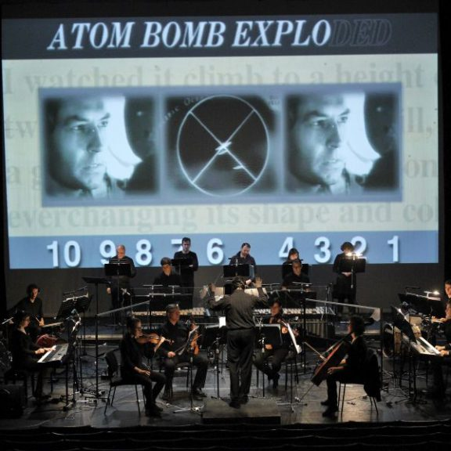
Steve Reich / Beryl Korot: Three Tales (2003)
https://www.youtube.com/watch?v=ff11eik33xI
https://www.facebook.com/earways/videos/three-tales-act-ii-bikini-steve-reich-beryl-korot/643483452500176/
https://www.youtube.com/watch?v=D4cWhkHnW34
Viva video, video viva - https://www.youtube.com/watch?v=r6OAyhfGbAQ

