Slide 1
Cantonese II
Week 1

Slide 2
What to expect in Cantonese II?
Interact more in Cantonese
More practice
Comparison of Cantonese and Mandarin

Slide 3
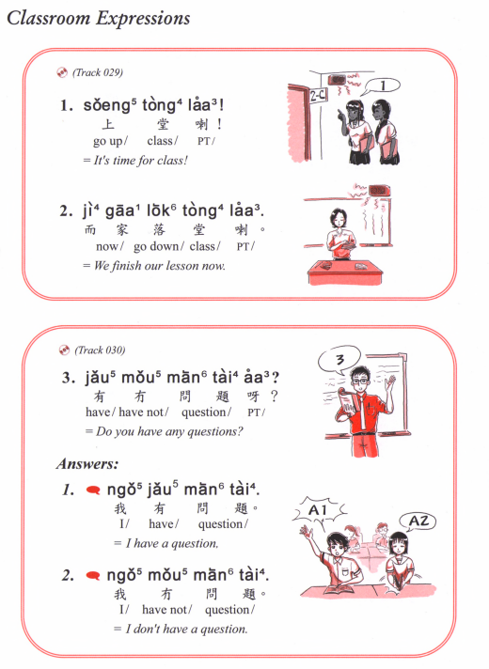

Slide 4
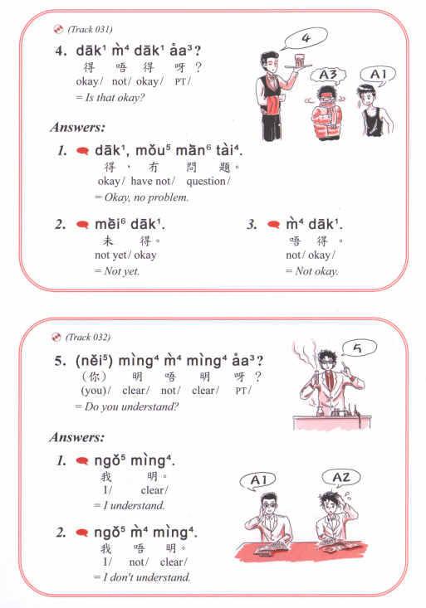
Dak1 mei6 aa3?
得未呀？
Is it ready yet?

Slide 5
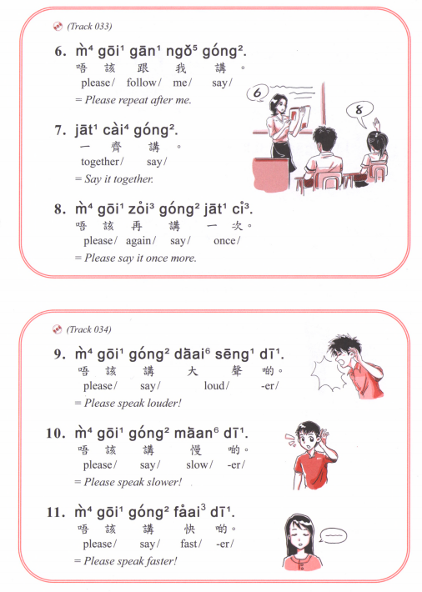

Slide 6
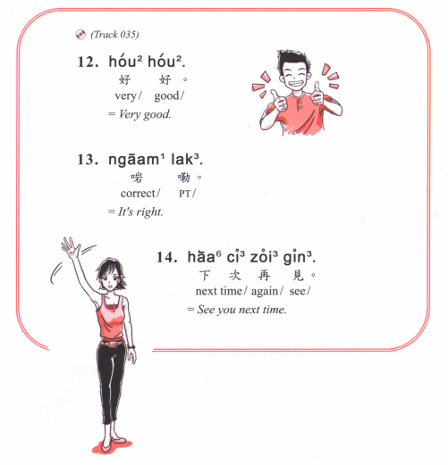

Slide 7
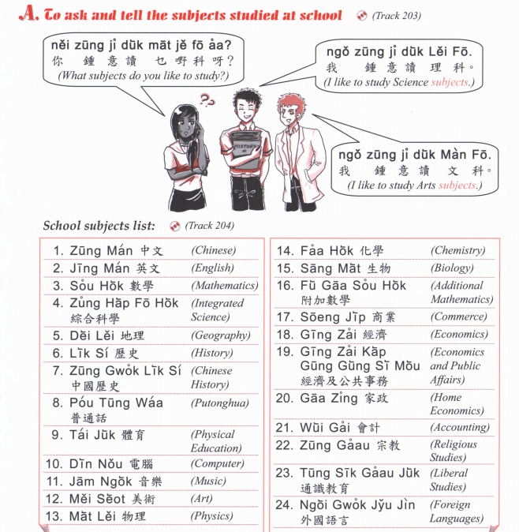

Slide 8
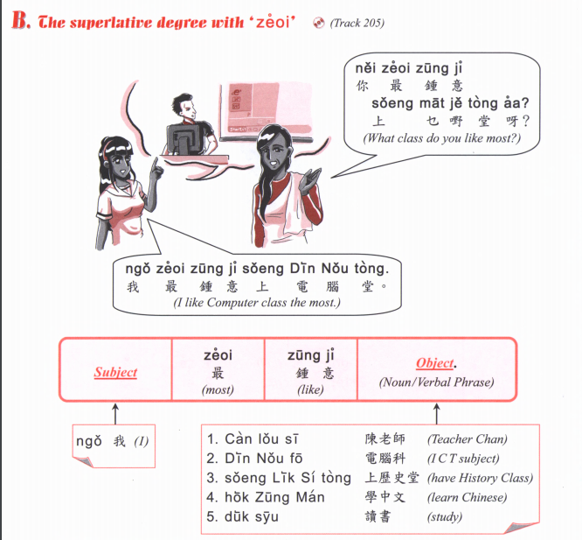

Slide 9
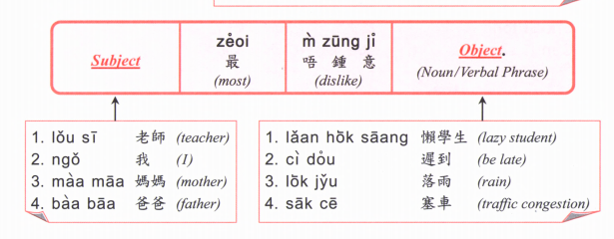

Slide 10
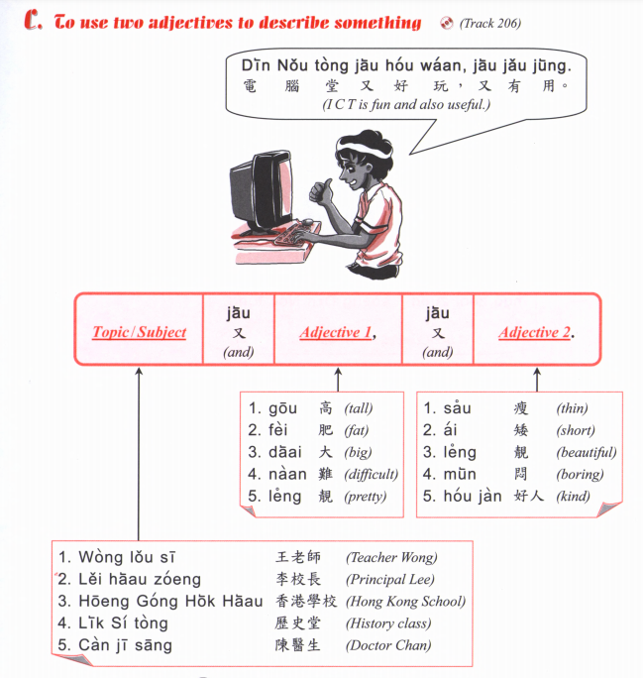

Slide 11
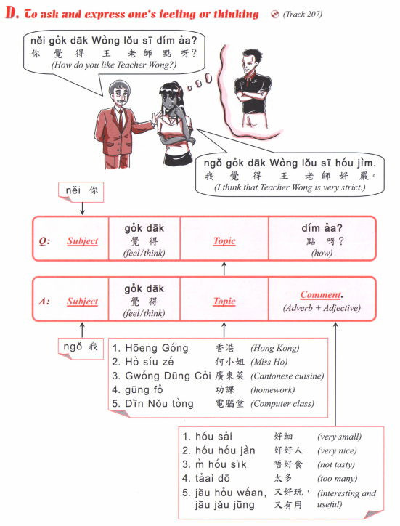

Slide 12
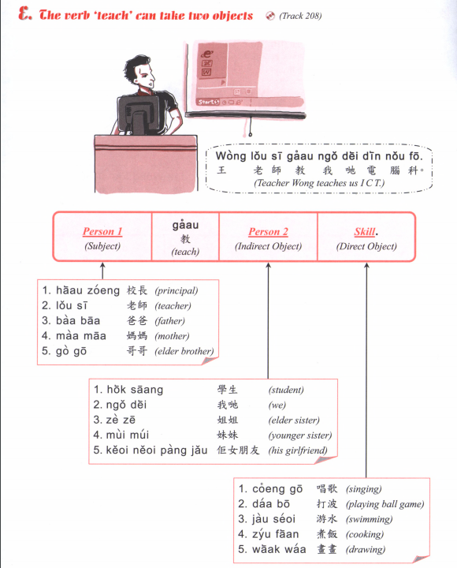

Slide 13
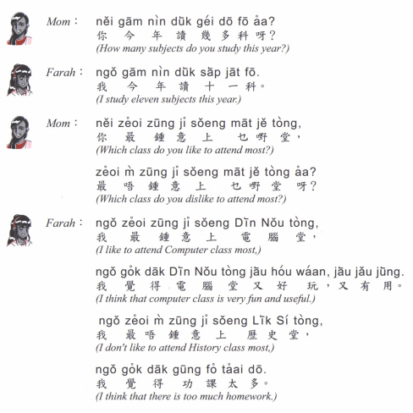

Slide 14
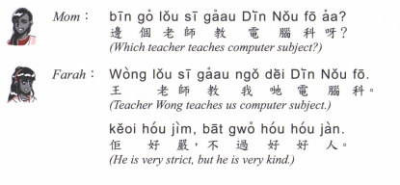

Slide 15
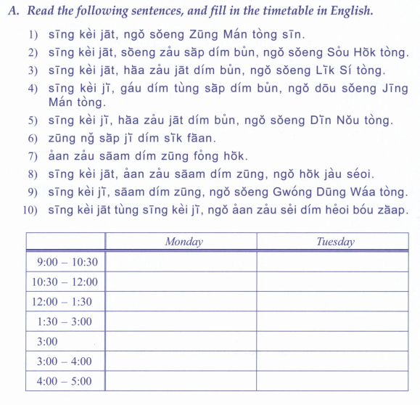

Slide 16
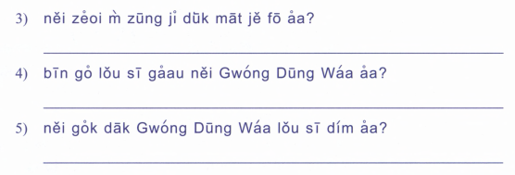

Slide 17
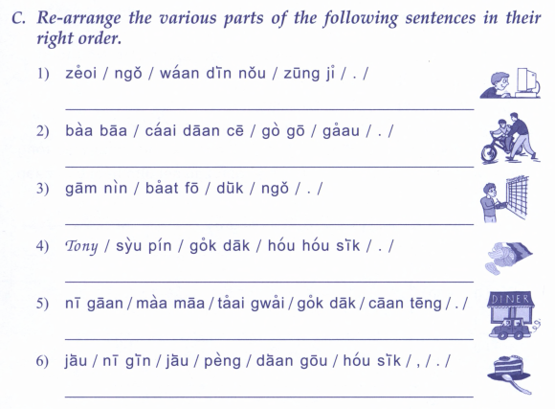

Slide 18
鍾意 | To like | zung1 ji3 | m4 zung1 ji3
識 | To know (a skill, a person | sik1 | m4 sik1
知 | To know (information, news) | zi1 | m4 zi1
明白 /明 | To understand | ming5 baak6 / ming5 | M4 ming5 baak6 / M4 ming5
去 | To go | heoi3 | m4 heoi3
有 | To have | jau5 | Mou5 (冇)
要 | To want (object) / have to (do something) | jiu3 | M4 jiu3 (for object)/ M4 sai2 (for action)
想 | To want (to do something) | soeng2 | M4 soeng2
講 | To speak | gong2 | M4 gong2
做 | To do | zou6 | M4 zou6
覺得 | To think (feeling/opinion) | Gok3 dak1 | M4 gok3 dak1
溫習 | To revise | Wan1 zaap6 | M4 wan1 zaap6

Slide 19
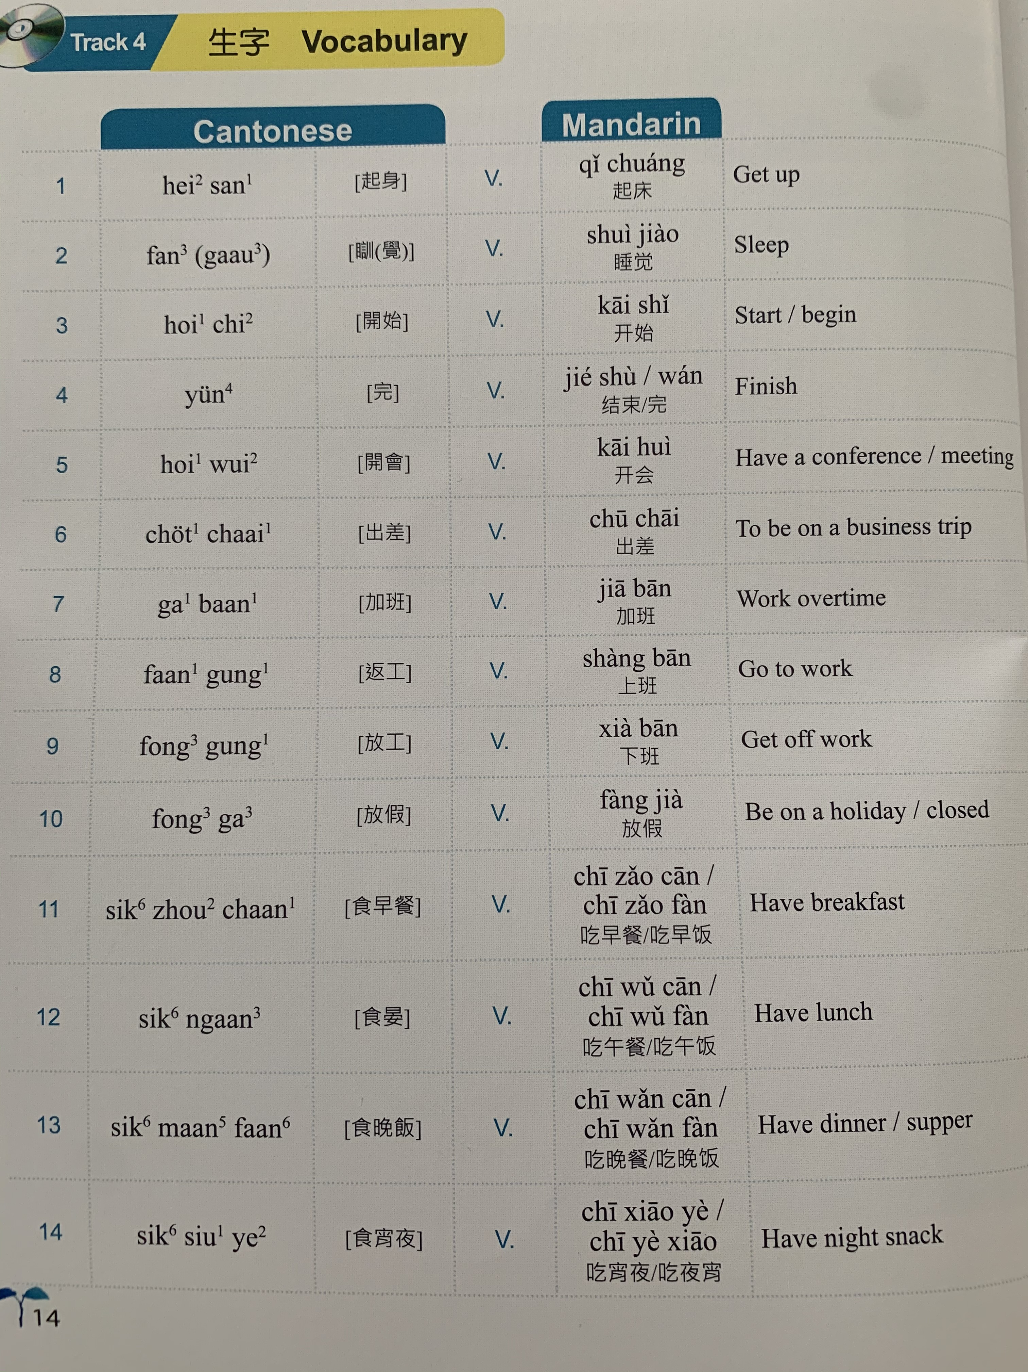

Slide 20
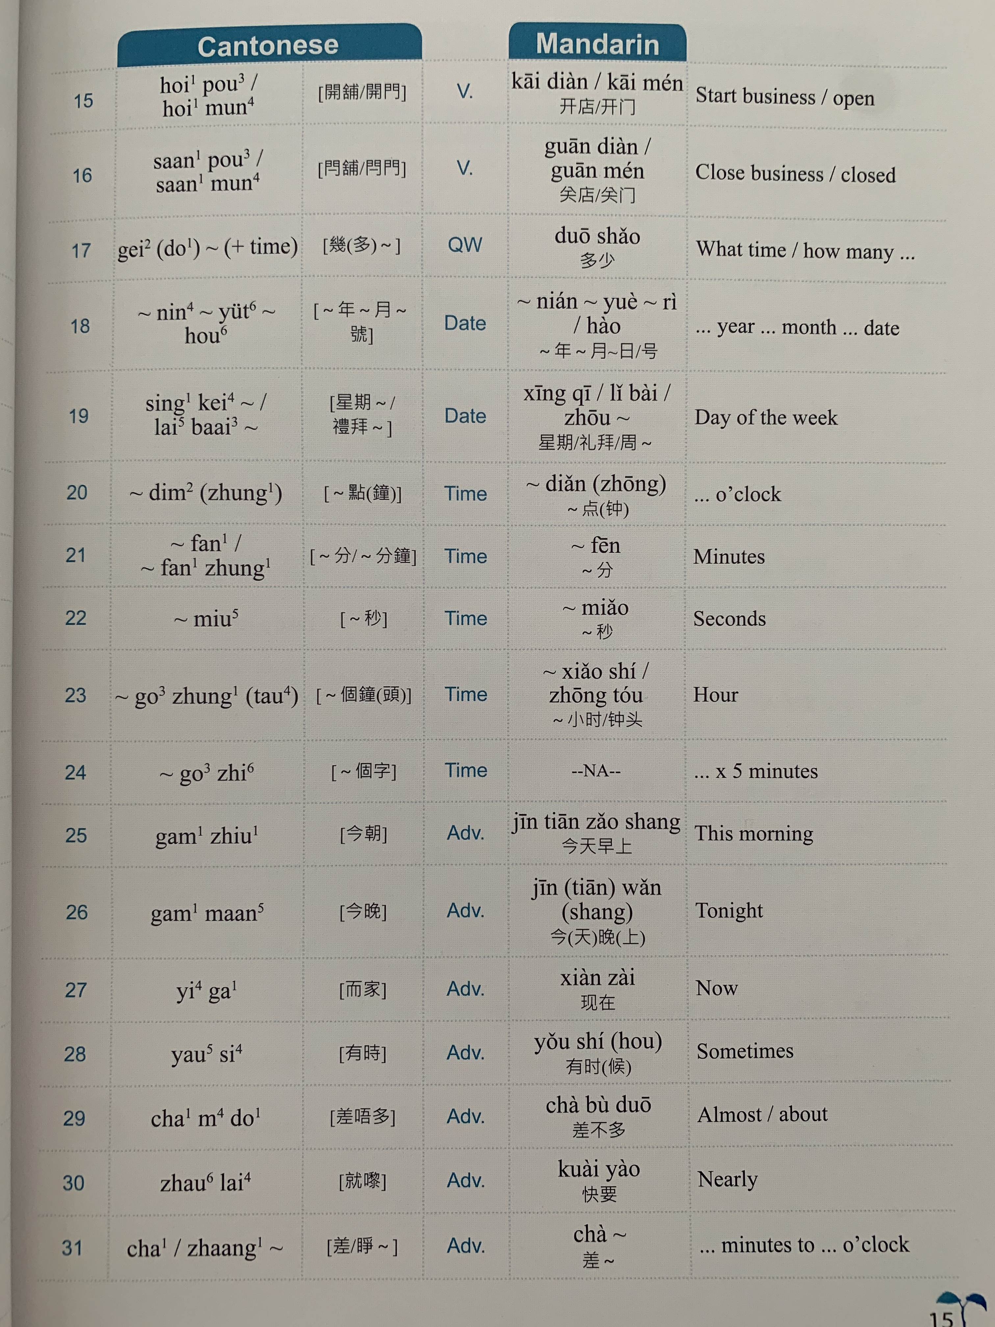

Slide 21
