Slide 1
Cantonese II
Week 10

Slide 2
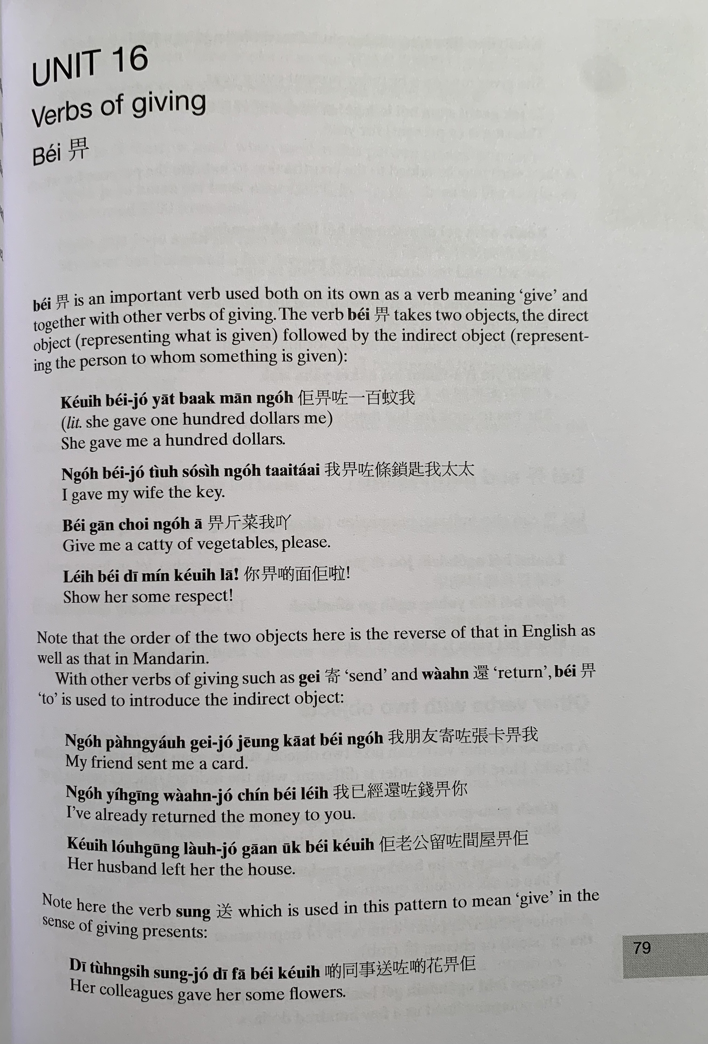
bei2
給
keoi5 bei2 zo2 jat1 baak3 man1 ngo5
ngo5 bei2 zo2 tiu4 so2 si4 ngo5 taai3 taai2
bei2 gan1 coi3 ngo5 aa1
nei5 bei2 di1 min2 keoi5 laa1

Slide 3
gei3
bei2
waan4
ngo5 pang4 jau5 gei3 zo2 zoeng1 kaat1 bei2 ngo5
ngo5 ji5 ging1 waan4 zo2 cin2 bei2 nei5
keoi5 lou5 gung1 lau4 zo2 gaan1 uk1 bei2 keoi5
sung3
di1 tung4 si6 sung3 zo2 di1 faa1 bei2 keoi5

Slide 4
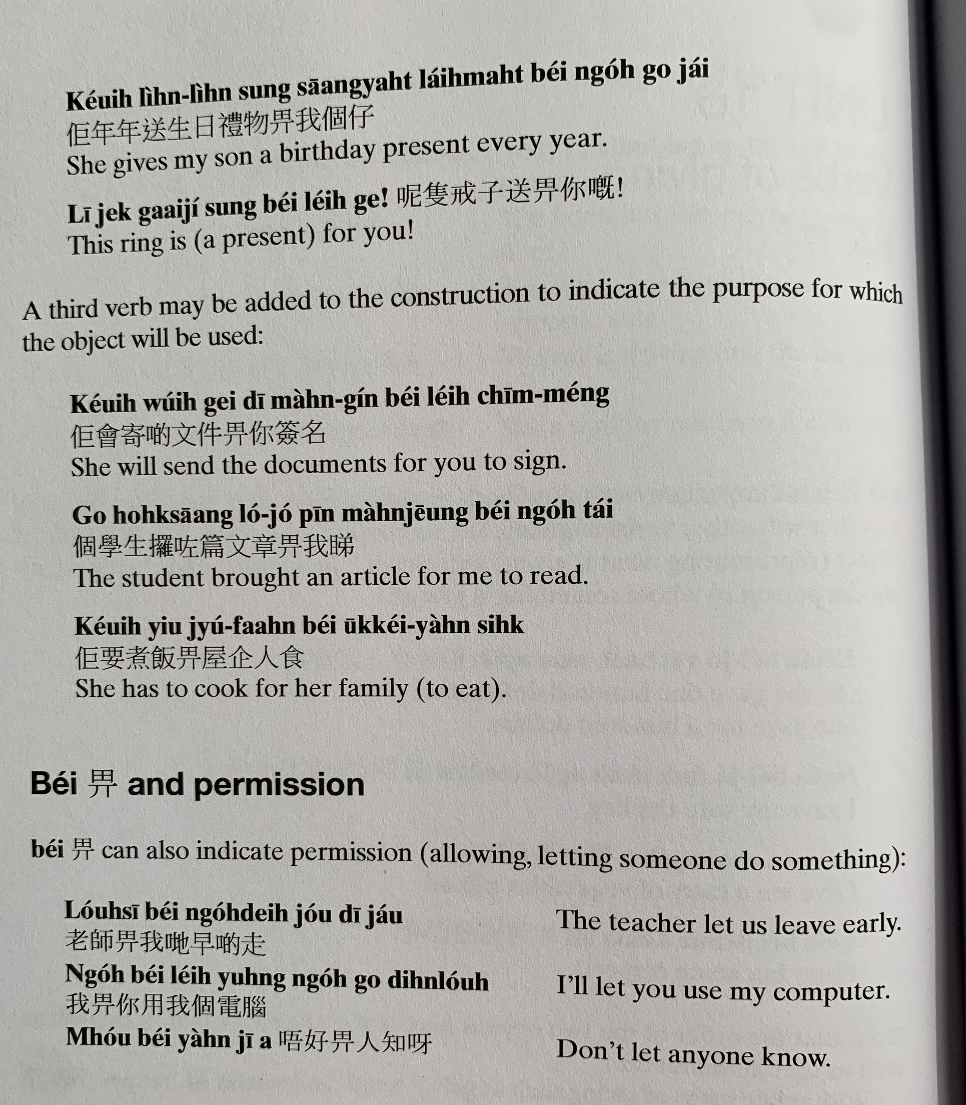
keoi5 nin4 nin4 sung3 saang1 jat6 lai5 mat6 bei2 ngo5 go3 zai2
ni1 zek3 gaai3 zi2 sung3 bei2 nei5 ge3
keoi5 wui5 gei3 di1 man4 gin2 bei2 nei5 cim1 meng2
go3 hok6 saang1 lo2 zo2 pin1 man4 zoeng1 bei2 ngo5 tai2
keoi5 jiu3 zyu2 faan6 bei2 uk1 kei5 jan4 sik6

Slide 5
lou5 si1 bei2 ngo5 dei6 zou2 di1 zau2
ngo5 bei2 nei5 jung6 ngo5 bou6 din6 nou5
m4 hou2 bei2 jan4 zi1 aa3

Slide 6
Translate the following into Cantonese
I have to pay (money)
You need to return some books.
I want to give a present (lai5 mat6 禮物) to my mom.
I gave my book to my friend to read.
I have to submit（gaau1交） homework （gung1 fo3功課）to the teacher
The teacher gave a lot of homework to us.
I will return some documents （man4 gin2 文件）to you
Grandma always gives presents to me
It is not allowed to eat (sik6 je5 食嘢） in the library （ tou4 syu1 gun2圖書館）
Kids are not allowed to drink alcohol （ jam2 zau2 飲酒）.

Slide 7
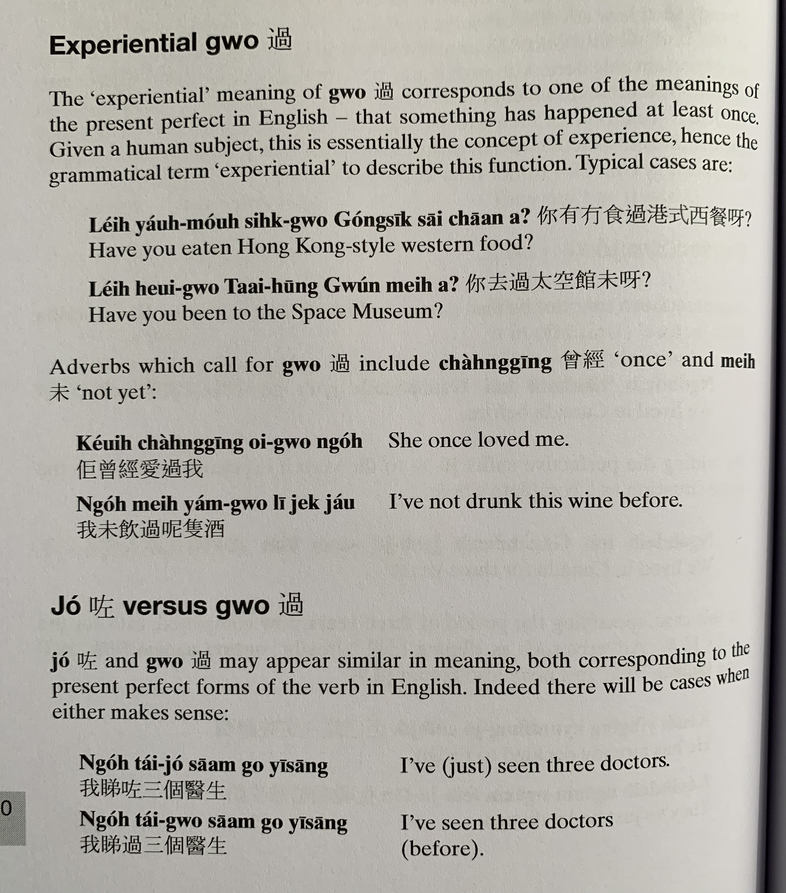
nei5 jau5 mou4 sik6 gwo3 gong2 sik1 sai1 caan1 aa3?
nei5 heoi3 gwo3 taai3 hung1 gun2 mei6 aa3?
cang4 ging1
mei6
keoi5 cang4 ging1 oi3 gwo3 ngo5
ngo5 mei6 jam2 gwo3 ni1 zek3 zau2

Slide 8
zo2
gwo3
ngo5 tai2 zo2 saam1 go3 ji1 sang1
ngo5 tai2 gwo3 saam1 go3 ji1 sang1

Slide 9
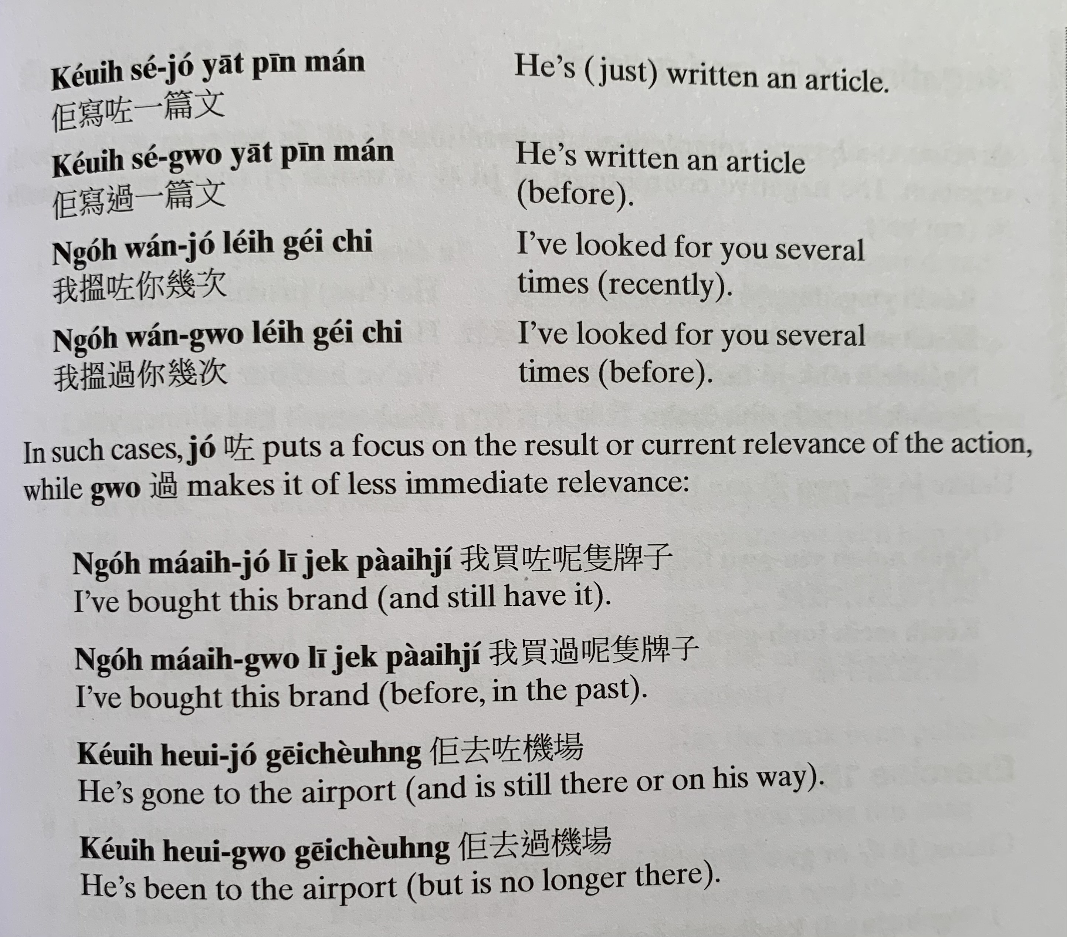
keoi5 se2 zo2 jat1 pin1 man4
keoi5 se2 gwo3 jat1 pin1 man4
ngo5 wan2 zo2 nei5 gei2 ci3
ngo5 wan2 gwo3 nei5 gei2 ci3
ngo5 maai5 zo2 ni1 zek3 paai4 zi2
ngo5 maai5 gwo3 ni1 zek3 paai4 zi2
keoi5 heoi3 zo2 gei1 coeng4
keoi5 heoi3 gwo3 gei1 coeng4

Slide 10
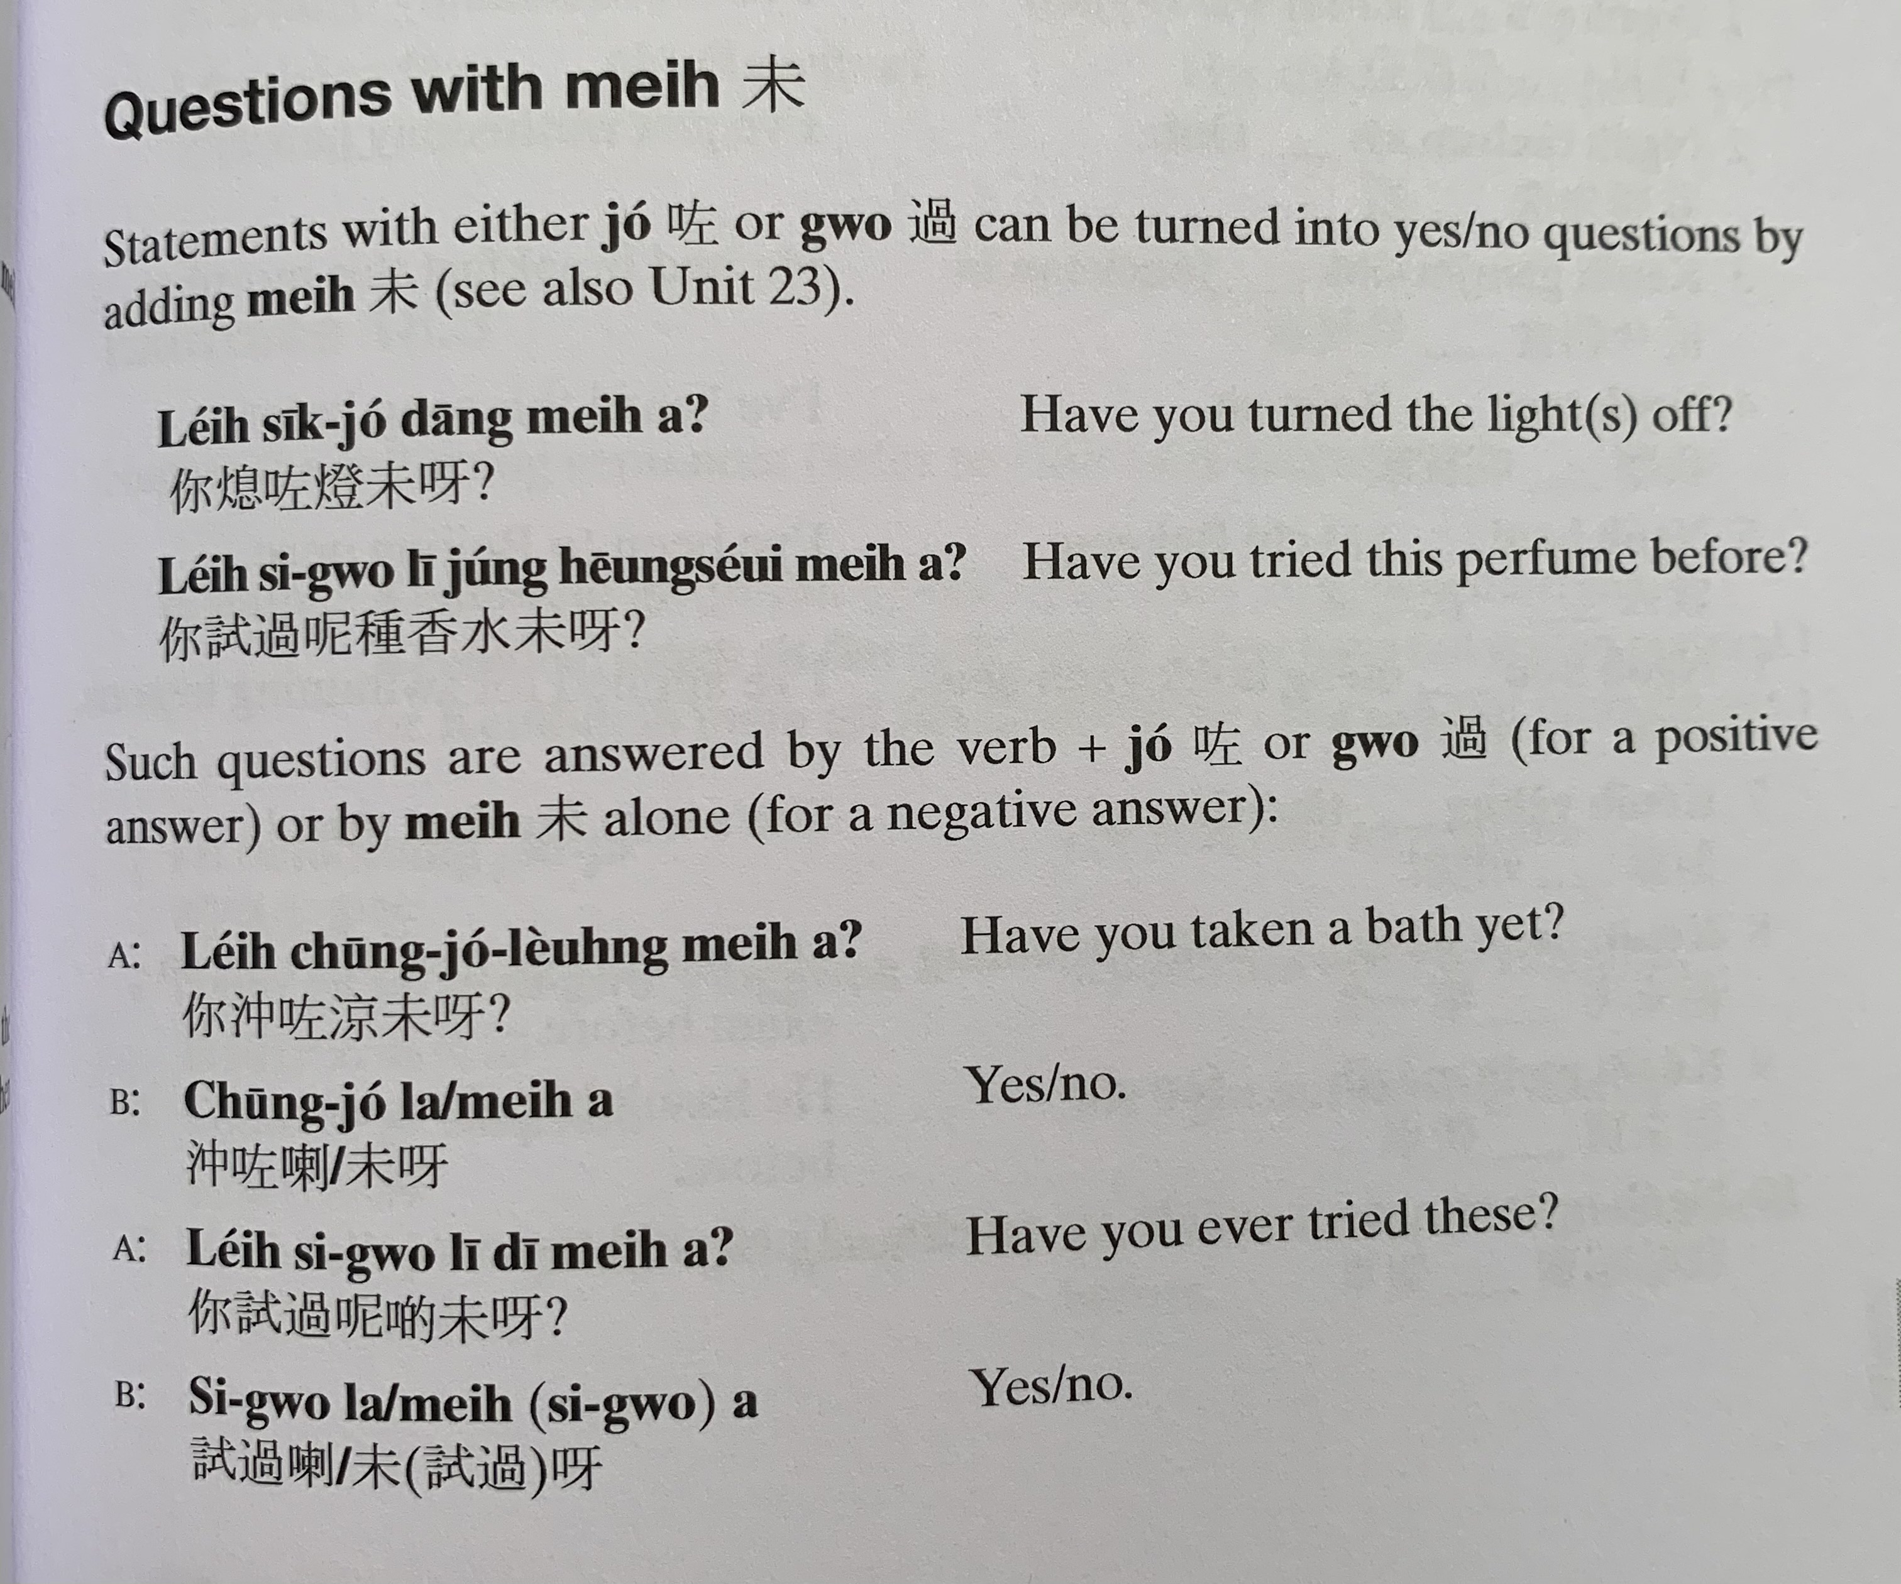
mei6
nei5 sik1 zo2 dang1 mei6 aa3
nei5 si3 gwo3 ni1 zung2 hoeng1 seoi2 mei6 aa3
nei5 cung1 zo2 loeng4 mei6 aa3
cung1 zo2 laa3/ mei6 aa3
nei5 si3 gwo3 ni1 di1 mei6 aa3
si3 gwo3 laa3/ mei6 aa3

Slide 11
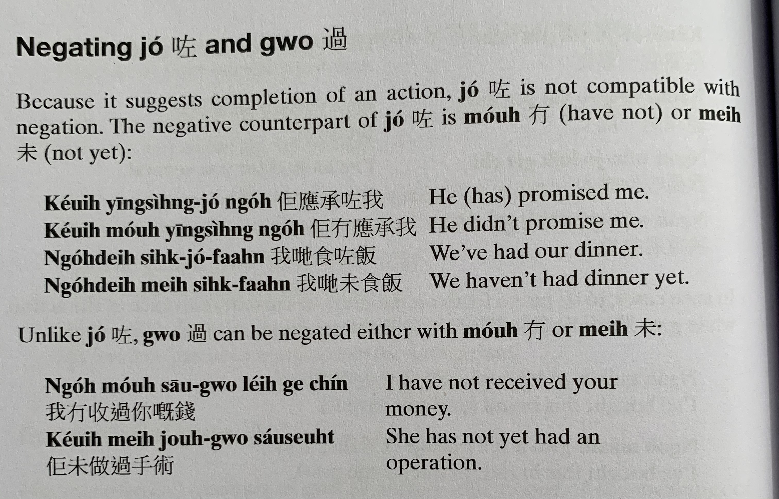
zo2
zo2
zo2
mou4
keoi5 jing1 sing4 zo2 ngo5
keoi5 mou4 jing1 sing4 ngo5
ngo5 dei6 sik6 zo2 faan6
ngo5 dei6 mei6 sik6 faan6
ngo5 mou4 sau1 gwo3 nei5 gei3 cin2
keoi5 mei6 zou6 gwo3 sau2 seot6

Slide 12
Translate the following into Cantonese using zo2, gwo3, mei6 or mou5.
I’ve met (gin3 見） his family （ uk1 kei5 jan4 屋企人 ）before
I’ve just washed my hair （sai2 tau4 洗頭）。
He had breakfast （zou2 caan1 早餐） this morning (ziu1 朝）
I’ve heard （teng1 聽） this song （sau2 go1 首歌） before
I’ve been to Hong Kong once
She’s won the first prize
He hasn’t bought （maai5 買） a new car （san1 ce1 新車）before
I just sold (賣）the car
I haven’t gone to the school (but you will)
I didn’t go to the school
I haven’t been to Thailand before
12. My father just went to Brno

Slide 13
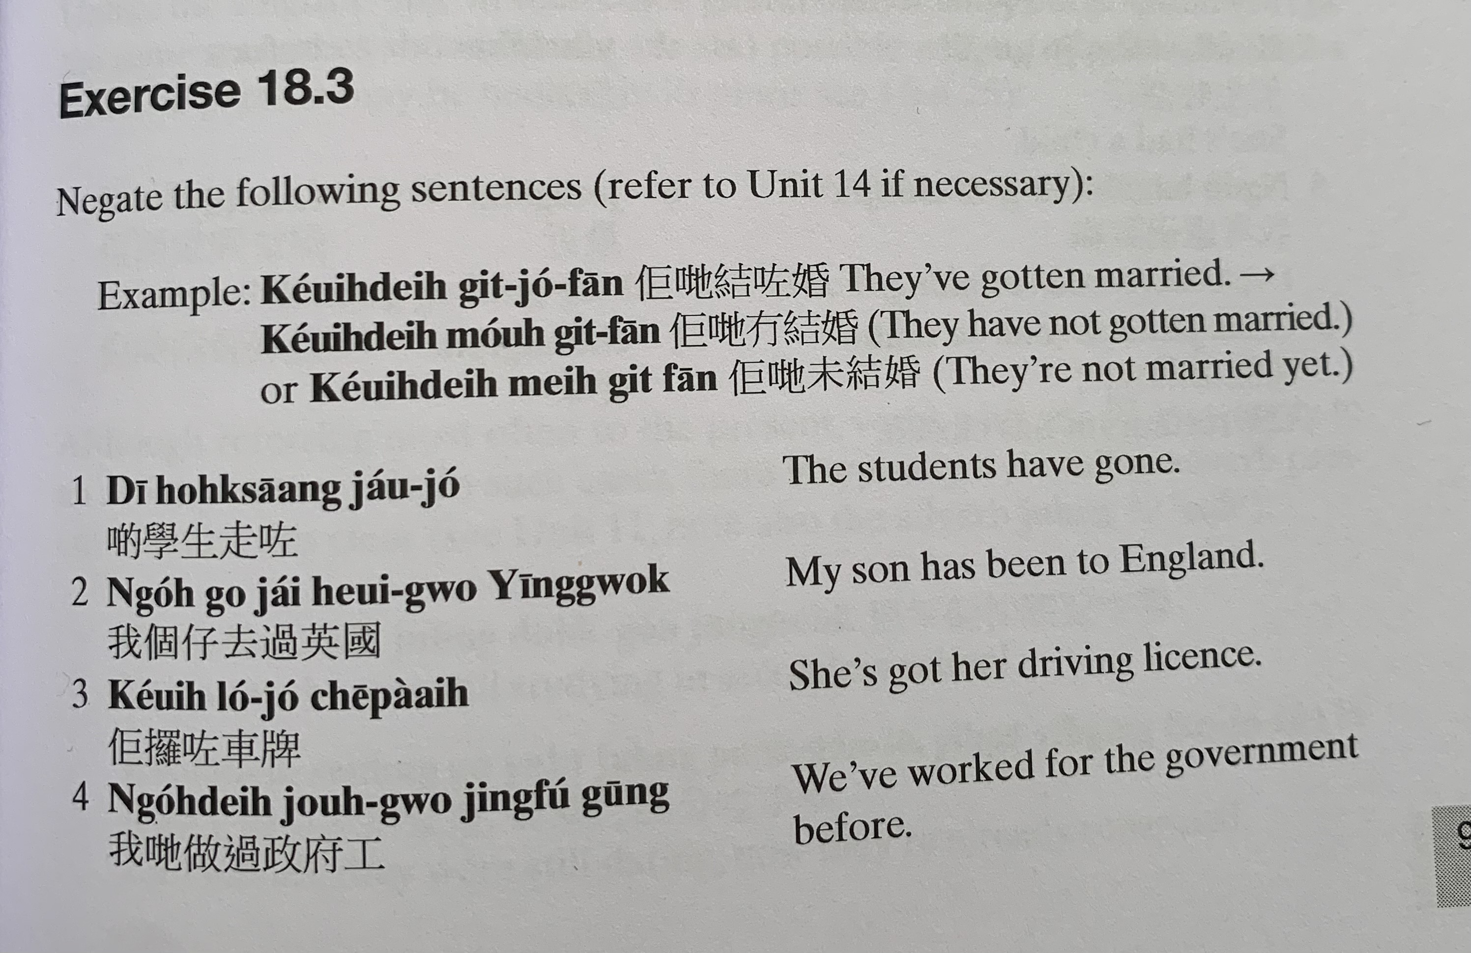
keoi5 dei6 git3 zo2 fan1
keoi5 dei6 mou4 git3 fan1
keoi5 dei6 mei6 git3 fan1
di1 hok6 saang1 zau2 zo2
ngo5 go3 zai2 heoi3 gwo3 jing1 gwok3
keoi5 lo2 zo2 ce1 paai4
ngo5 dei6 zou6 gwo3 zing3 fu2 gung1

Slide 14
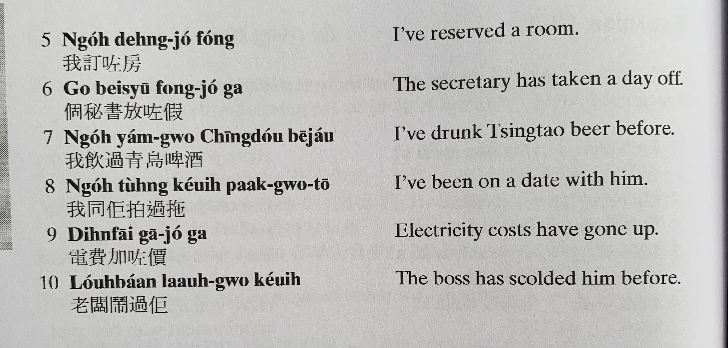
ngo5 deng6 zo2 fong2
go3 bei3 syu1 fong3 zo2 gaa3
ngo5 jam2 gwo3 cing1 dou2 be1 zau2
ngo5 tung4 keoi5 paak3 gwo3 to1
din6 fai3 gaa1 zo2 gaa3
lou5 baan2 naau6 gwo3 keoi5

Slide 15
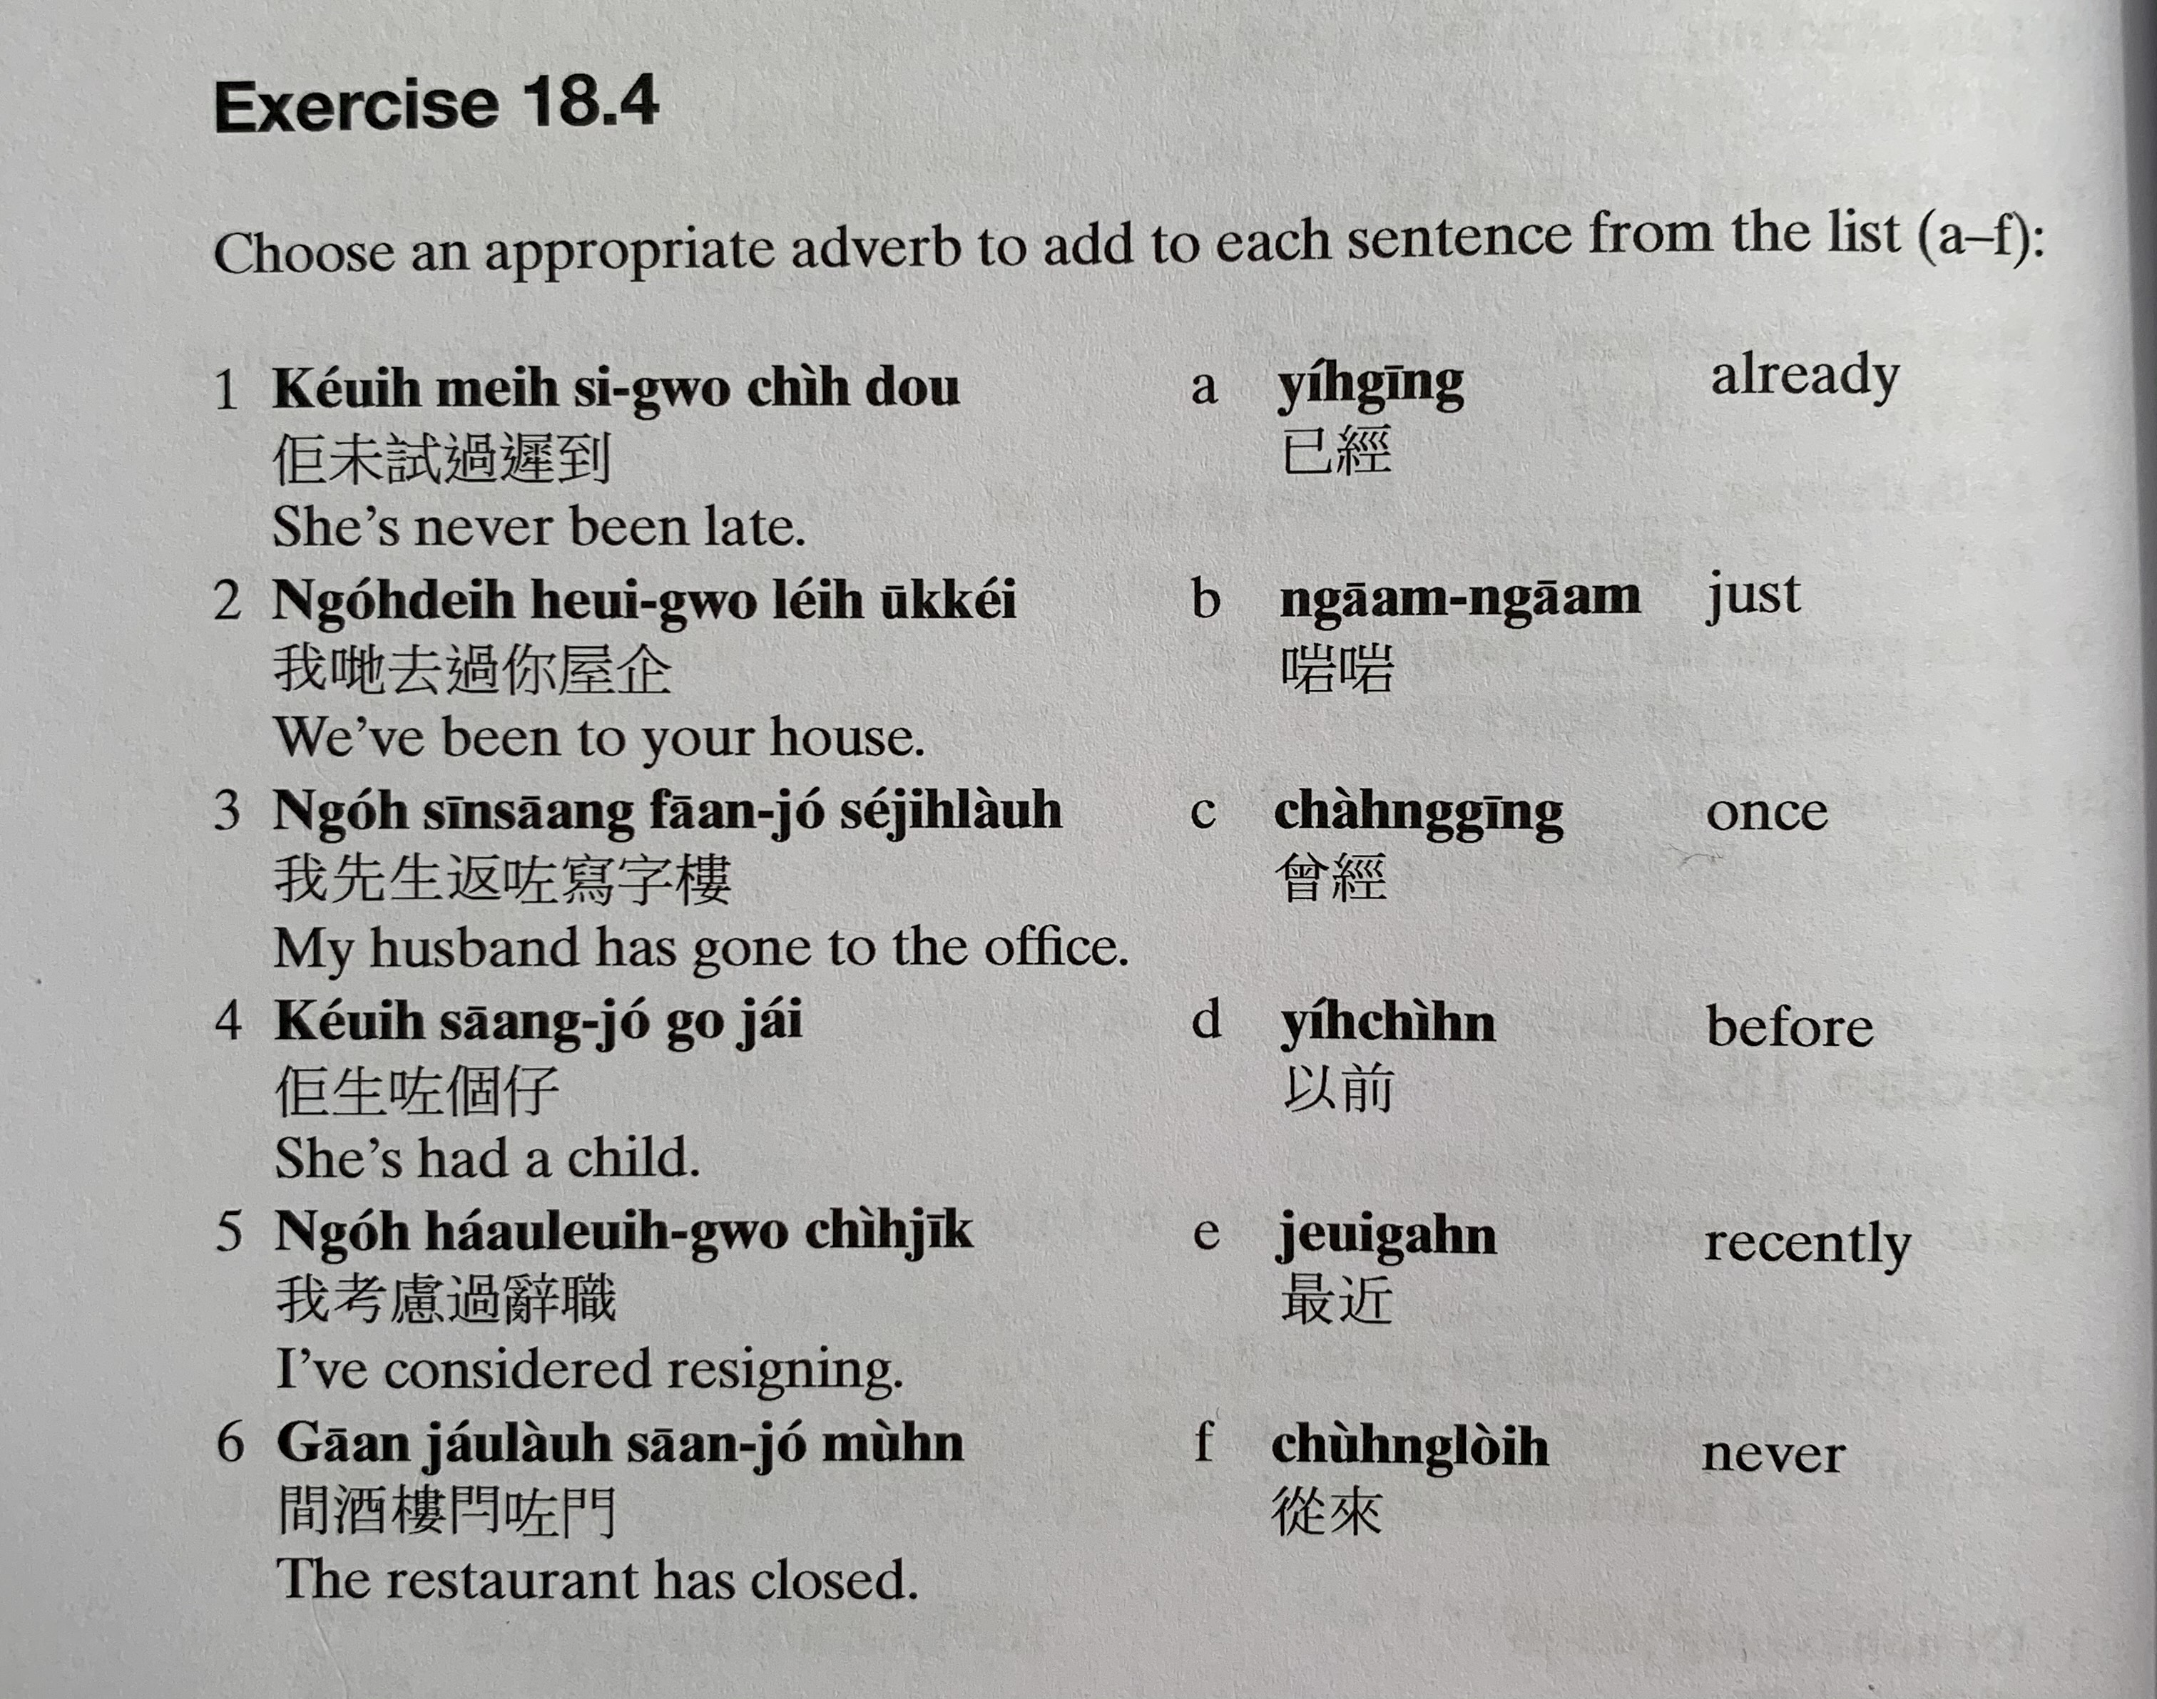
keoi5 mei6 si3 gwo3 ci4 dou3
ji5 ging1
ngo5 dei6 heoi3 gwo3 nei5 uk1 kei2
ngaam1 ngaam1
ngo5 sin1 saang1 faan1 zo2 se2 zi6 lau4
cang4 ging1
keoi5 saang1 zo2 go3 zai2
ji5 cin4
ngo5 haau2 leoi6 gwo3 ci4 zik1
zeoi3 gan6
gaan1 zau2 lau4 saan1 zo2 mun4
cung4 loi4

Slide 16
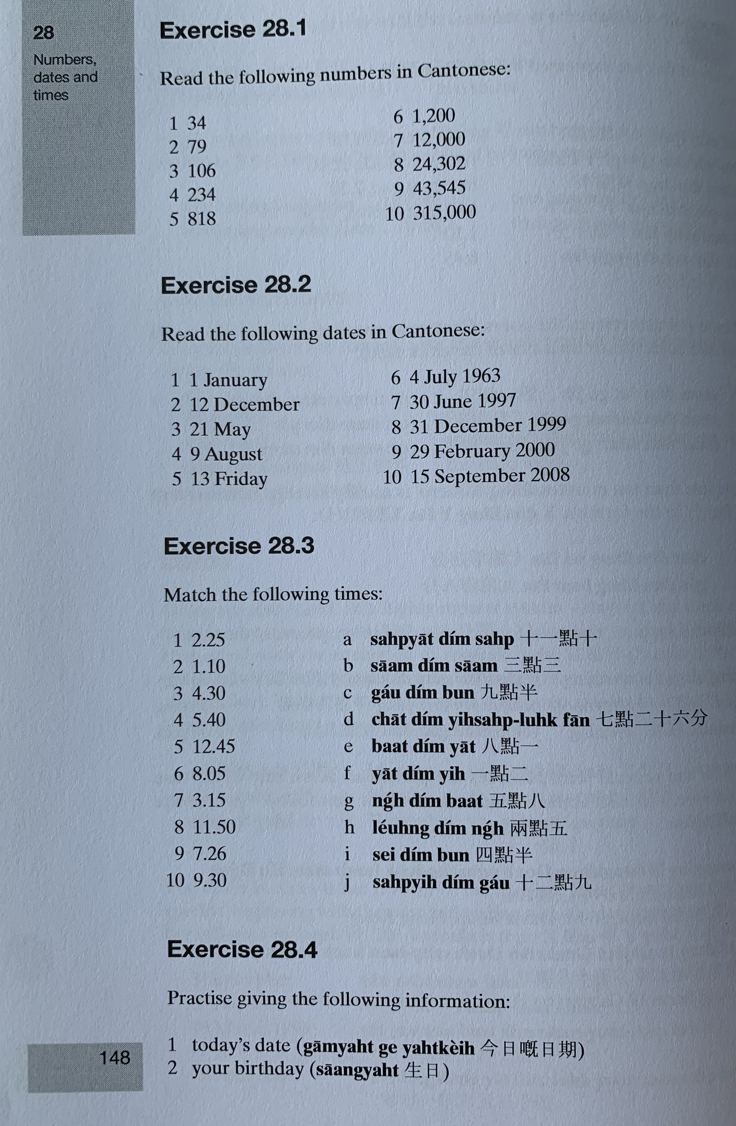

Slide 17
gam1 jat6 gei3 jat6 kei4
saang1 jat6
ceot1 saang1 jat6 kei4
din6 waa2 hou6 maa5 電話號碼

Slide 18
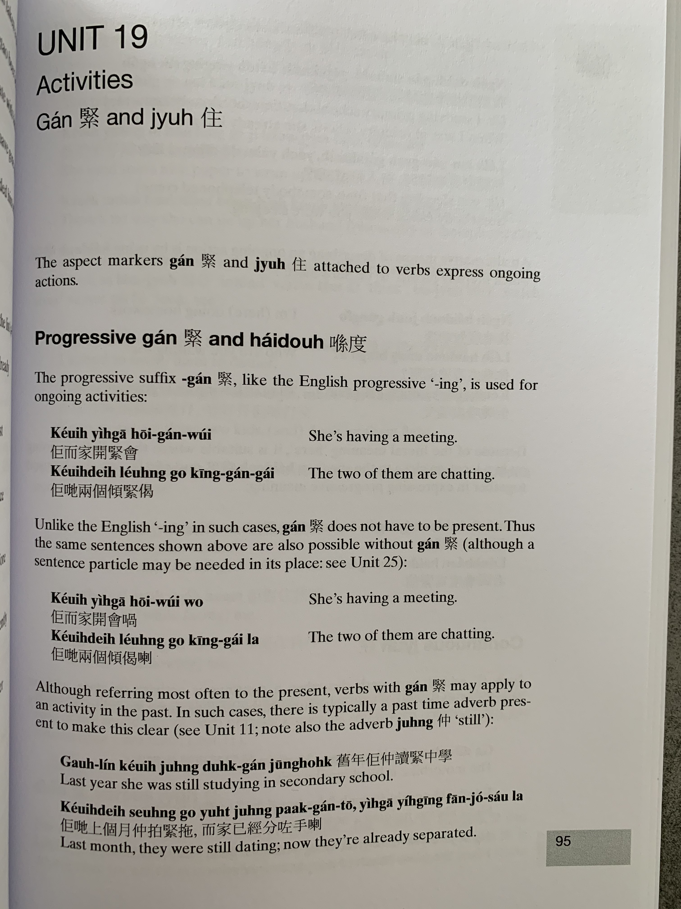
gan2
zyu6
hai2 dou6
keoi5 ji4 gaa1 hoi1 gan2 wui2
keoi5 dei6 loeng5 go3 king1 gan2 gai2

Slide 19
zung6
gau6 nin2 keoi5 zung6 duk6 gan2 zung1 hok6
keoi5 dei6 soeng6 go3 jyut6 zung6 paak3 gan2 to1, ji4 gaa1 ji5 ging1 fan1 zo2 sau2 laa3

Slide 20
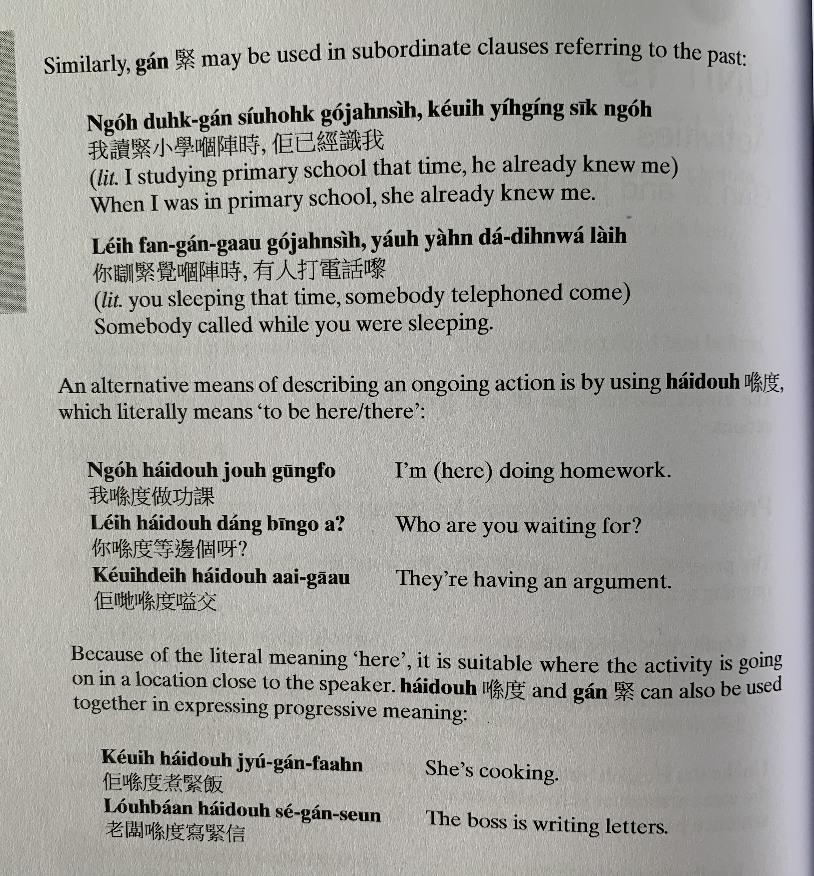
gan2
ngo5 duk6 gan2 siu2 hok6 go2 zan6 si4, keoi5 ji5 ging1 sik1 ngo5
nei5 fan3 gan2 gaau3 go2 zan6 si4, jau5 jan4 daa2 din6 waa2 lai4
hai2 dou6
ngo5 hai2 dou6 zou6 gung1 fo3
nei5 hai2 dou6 dang2 bin1 go3 aa3?
keoi5 dei6 hai2 dou6 aai3 gaau1

Slide 21
keoi5 hai2 dou6 zyu2 gan2 faan6
lou5 baan2 hai2 dou6 se2 gan2 seon3

Slide 22
zyu6
Mandarin: zhe 著
gaa3 din6 daan1 ce1 zo2 zyu6 go3 ceot1 hau2
keoi5 sing4 jat6 zaa1 zyu6 fan6 bou3 zi2
ngo5 jat6 jat6 deoi3 zyu6 tung4 jat1 baan1 jan4

Slide 23
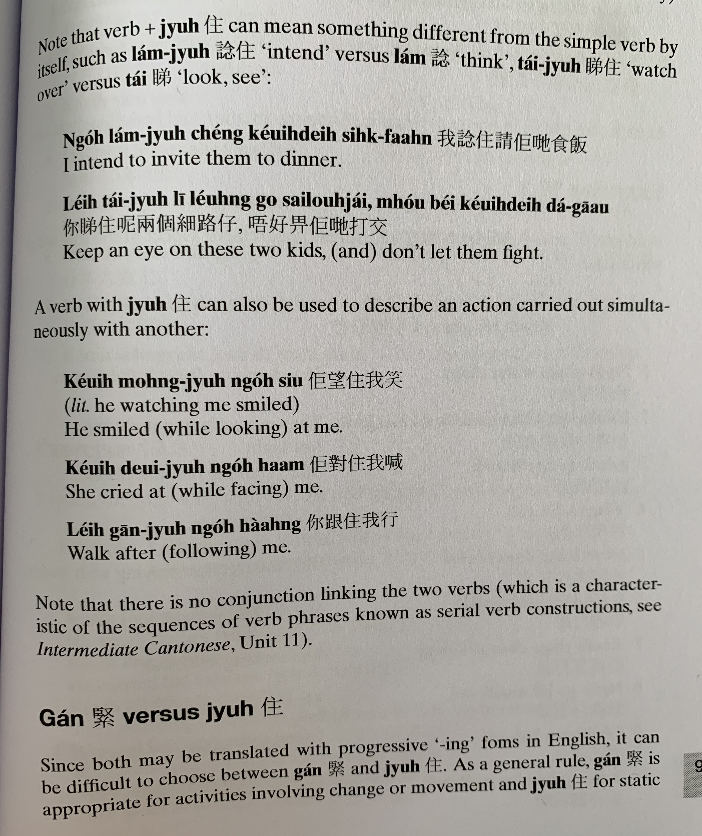
nam2 zyu6
nam2
tai2 zyu6
ngo5 nam2 zyu6 ceng2 keoi5 dei6 sik6 faan6
nei5 tai2 zyu6 ni1 loeng5 go3 sai3 lou6 zai2, m4 hou2 bei2 keoi5 dei6 daa2 gaau1
zyu6
keoi5 mong6 zyu6 ngo5 siu3
keoi5 deoi3 zyu6 ngo5 haam3
nei5 gan1 zyu6 ngo5 haang4

Slide 24
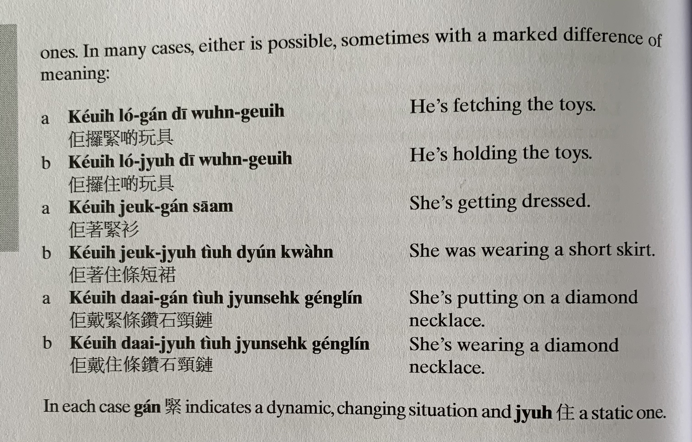
keoi5 lo2 gan2 di1 wun6 geoi6
keoi5 lo2 zyu6 di1 wun6 geoi6
keoi5 zoek3 gan2 saam1
keoi5 zoek3 zyu6 tiu4 dyun2 kwan4
keoi5 daai3 gan2 tiu4 zyun3 sek6 geng2 lin2
keoi5 daai3 zyu6 tiu4 zyun3 sek6 geng2 lin2

Slide 25
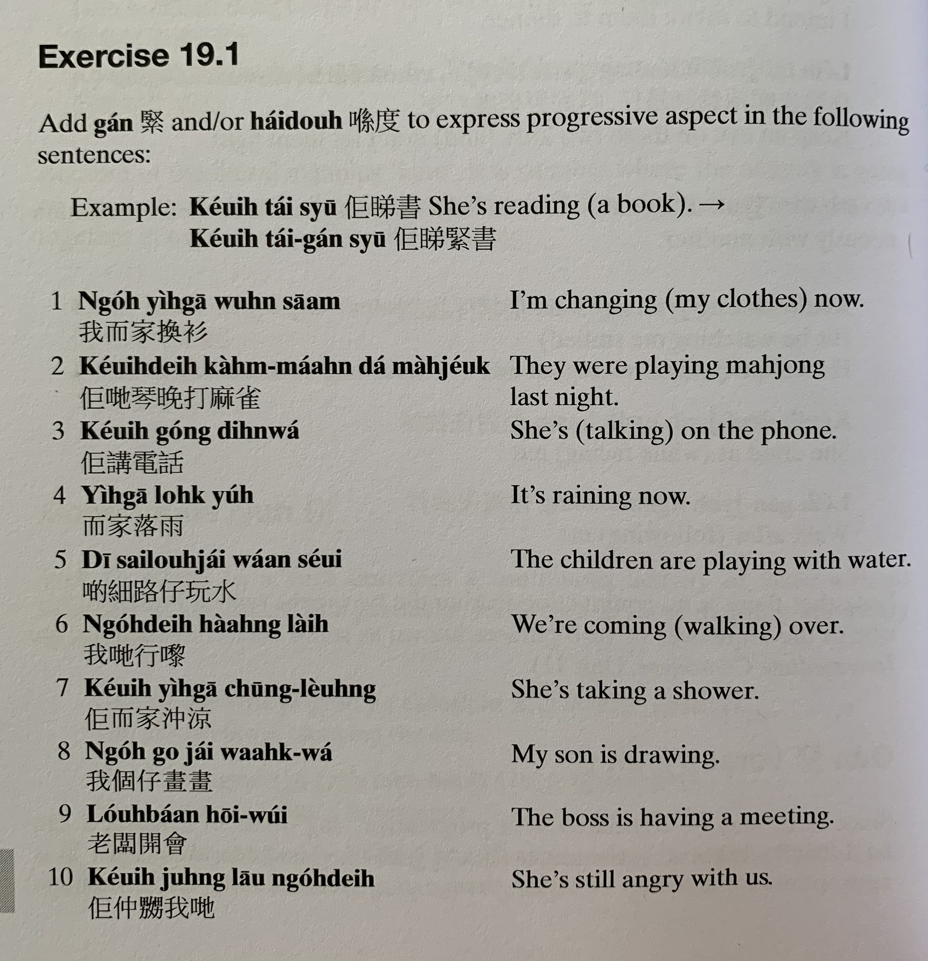
keoi5 tai2 syu1
ngo5 ji4 gaa1 wun6 saam1
keoi5 dei6 kam4 maan5 daa2 maa4 zoek2
keoi5 gong2 din6 waa2
ji4 gaa1 lok6 jyu5
di1 sai3 lou6 zai2 waan2 seoi2
ngo5 dei6 haang4 lai4
keoi5 ji4 gaa1 cung1 loeng4
ngo5 go3 zai2 waak6 waa2
lou5 baan2 hoi1 wui2
keoi5 zung6 nau1 gan2 ngo5 dei6

Slide 26
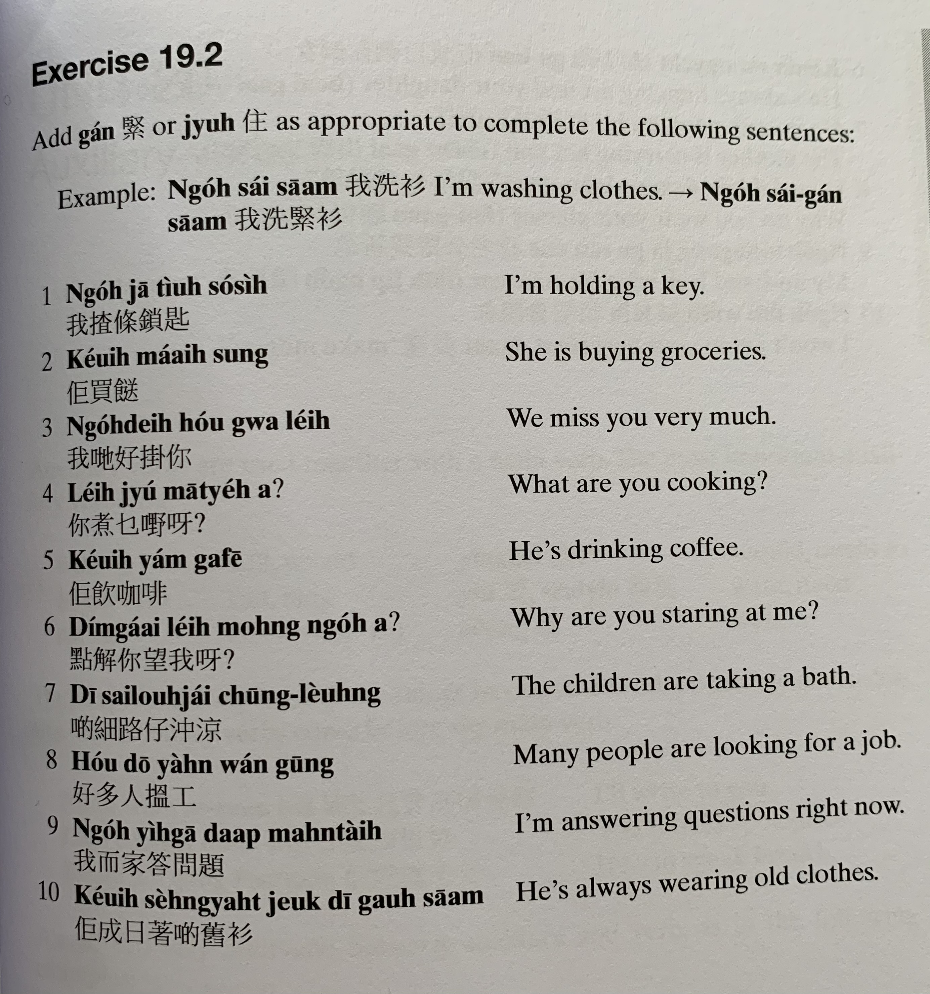
ngo5 sai2 saam1
keoi5 maai5 sung3
ngo5 dei6 hou2 gwaa3 nei5
nei5 zyu2 mat1 je5 aa3?
keoi5 jam2 gaa3 fe1
dim2 gaai2 nei5 mong6 ngo5 aa3?
di1 sai3 lou6 zai2 cung1 loeng4
hou2 do1 jan4 wan2 gung1
ngo5 ji4 gaa1 daap3 man6 tai4
keoi5 sing4 jat6 zoek3 zyu6 di1 gau6 saam1

Slide 27
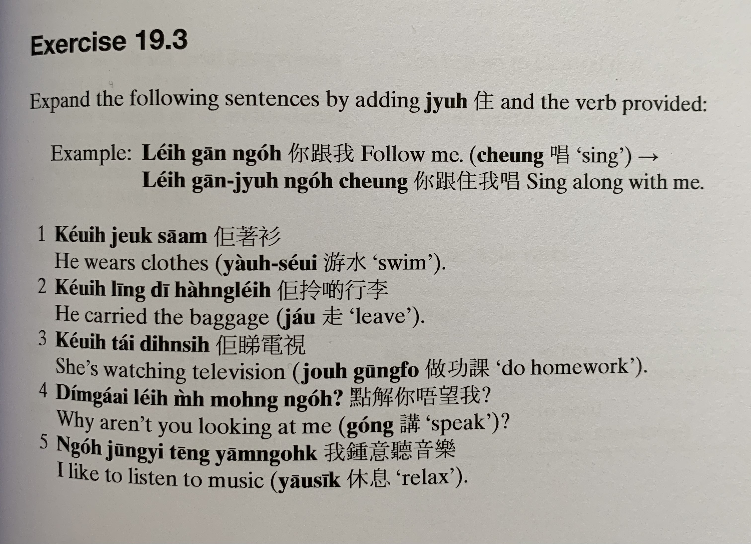
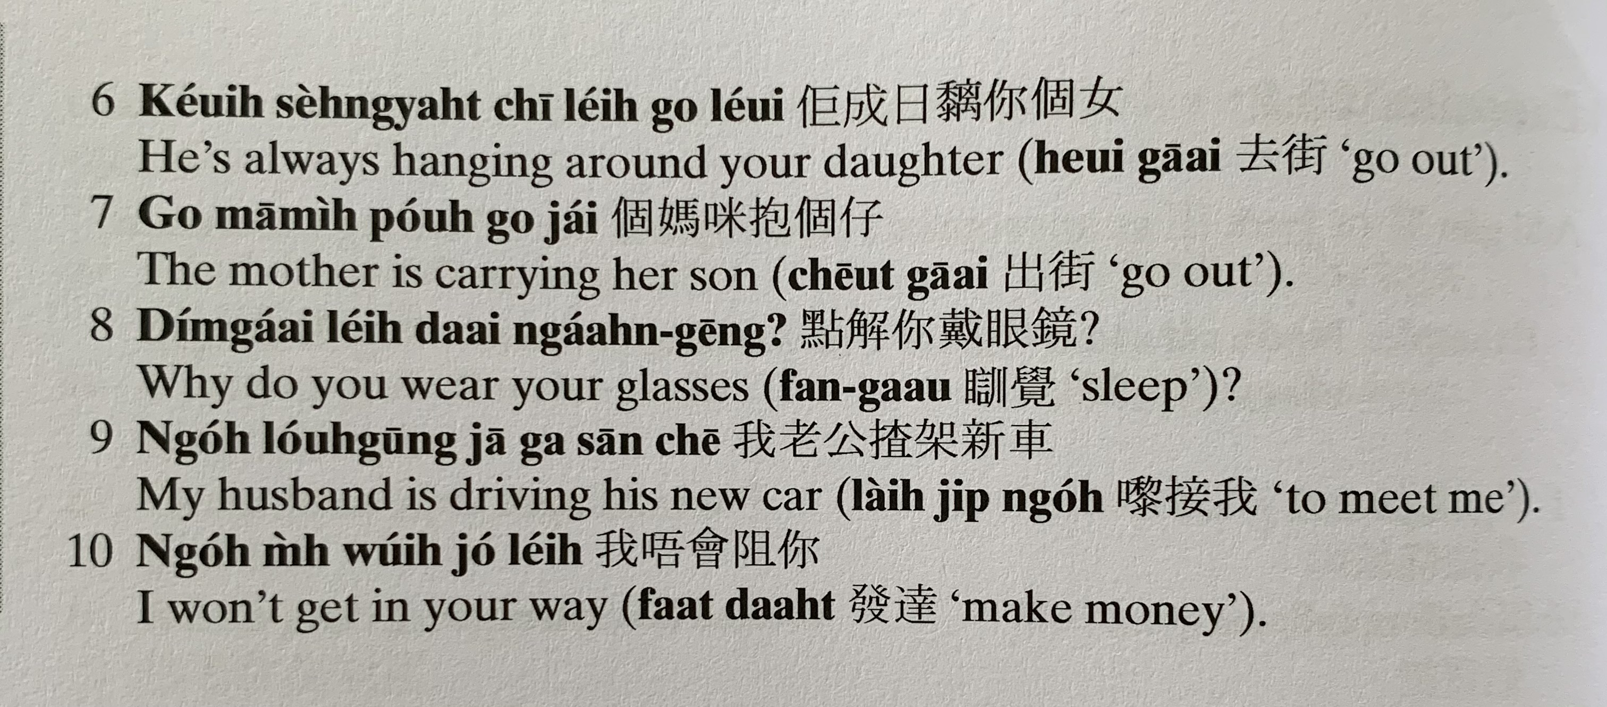

Slide 28
邊個 | Who | Bin1 go6
咩 / 乜嘢 | what | Me1 / Mat1 je5
邊度 | Where | Bin1 dou6
點解 | Why | Dim2 gaai2
幾時 | When | Gei2 si4
點（樣） | How | Dim2 （yoeng2）
幾多 | How many/ much | Gei2 do1

