Slide 1
Cantonese II
Week 13

Slide 2
嚟嘅 lai4 ge3 / 嚟㗎 lai4 gaa3 = lai2 de 來的 （Mandarin）
ni1 go3 hai6 ngo5 baa4 baa1 lai4 ge3
呢個係我爸爸嚟嘅
This is my father
keoi5 m4 hai6 mei5 gwok3 jan4, keoi5 hai6 jing1 gwok3 jan4 lai4 gaa3
佢唔係美國人，佢係英國人嚟㗎
He is not American, he is British

Slide 3
Daa2 syun3 打算
What do you plan to have for dinner?
What do you plan to do in the weekend?

Slide 4
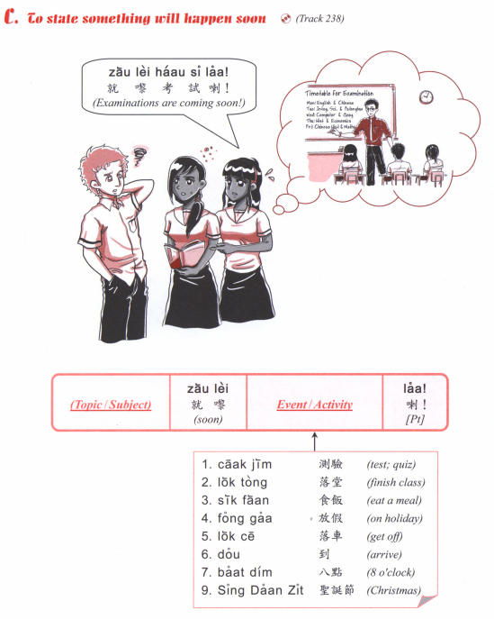
食咗飯
食緊飯
就黎食飯
會食飯

Slide 5
I will have exam soon.
I will have vacation soon. (fong3 gaa3)
3. What is he doing?
He is reading. (tai2 syu1)
4. What are you doing?
I am going to the university. (daai6 hok6)
5. What are you eating?
I am eating noodles. (min6)
6. What will you do this weekend?
I will go to the park. (gung1 jyun2)
7. What book did you read?
I read XXX.
8. How long have you been learning Mandarin?
I have been learning for X years.
9. Have you done your homework?
I am doing it!

Slide 6
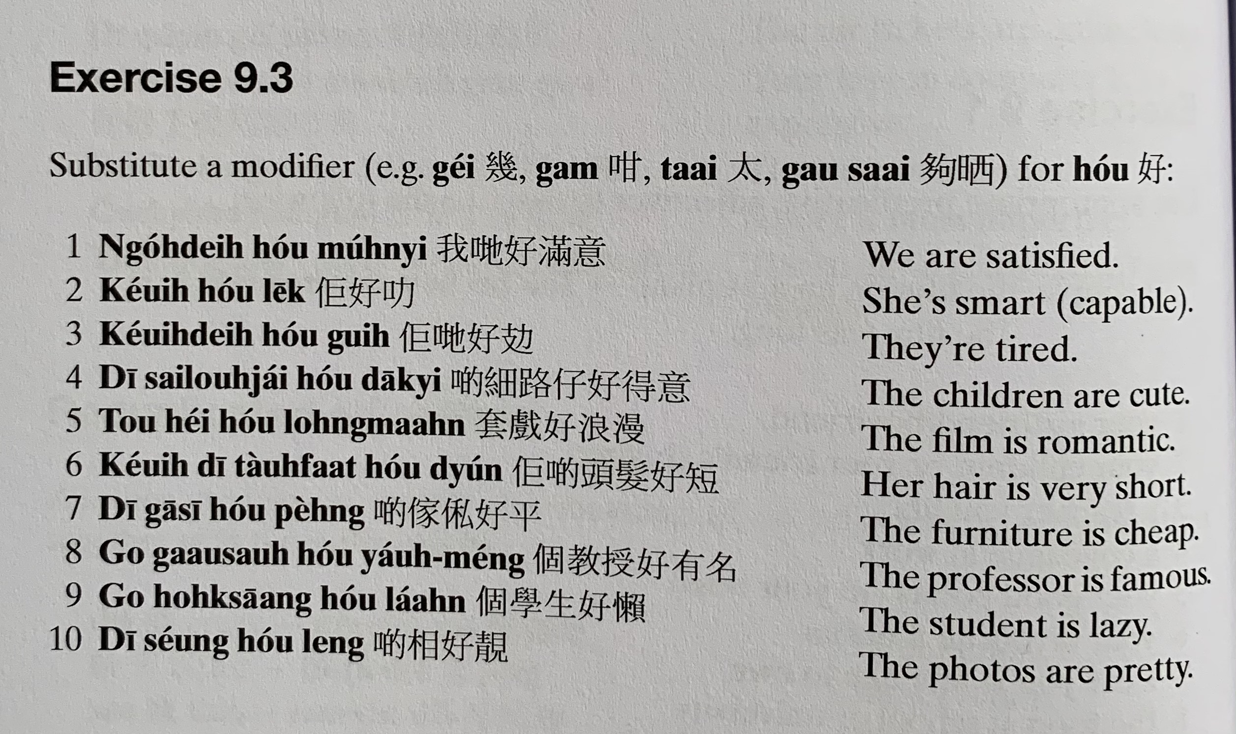
gaa1 si1 peng4
mun5 zuk1
lek1
Gui6 攰
dak1 ji3
套戲 tou3 hei3
long6 maan6
tau4 faat3…dyun2
gaa1 si1家俬 peng4
gaau3 sau6…ceot1 meng2
laan5
soeng2... leng3

Slide 7
Translate the following into Cantonese using adverbs.
1. I was in Prague 【bou3 laai1 gaak3】 (yesterday)
2. She arrived at the university (just now)
3. I have met him (before)
4. They won the first prize (last time)
5. We were still small 【sai3 go3 細個】 (then)
6. I used to be a nurse 【wu6 si6 護士】 (originally)
7. We will contact 【lyun4 lok3 聯絡】you (next time)
8. He got angry 【nau1 嬲】 (immediately)
9. I will treat you a meal 【ceng2 sik6 faan6 請吃飯】(in the future)
10. We used to live in America 【mei5 gwok3】 (before)
11. My father arrived home (just now)
12. I liked swimming (then)

Slide 8
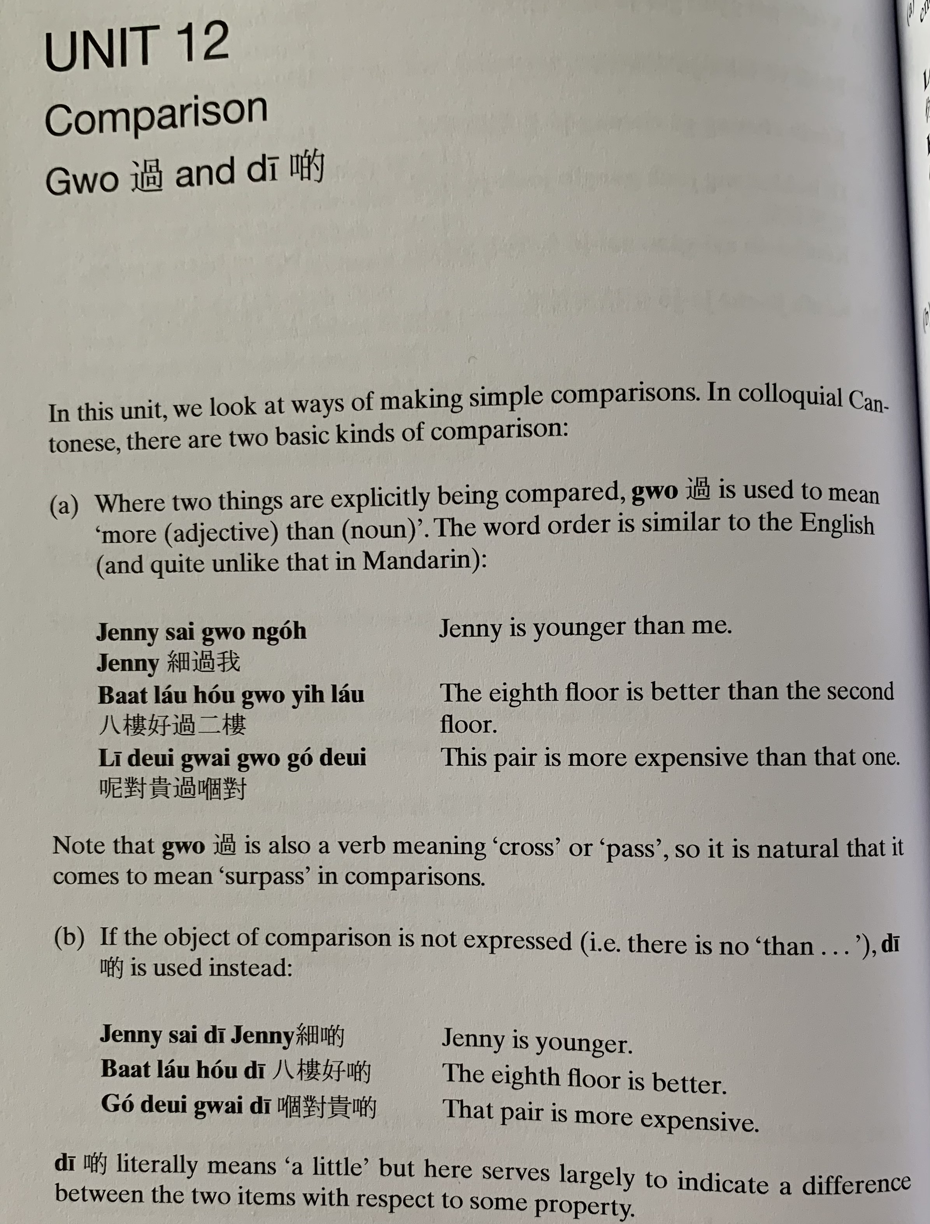
Gwo3
sai3 gwo3 ngo5
baat3 lau2 hou2 gwo3 ji6 lau2
ni1 deoi3 gwai3 gwo3 go2 deoi3
Jenny sai3 di1
baat3 lau2 hou2 di1
go2 deoi3 gwai3 di1

Slide 9
Translate the following into Cantonese
It’s warmer today
2. She is happier now
3. My friend is older than me
4. She is much taller than before
5. It’s slower this time
6. This restaurant is cheaper than that one
7. Cycling is better than walking
8. Your idea is better

Slide 10
Translate the following into Cantonese
1. It’s warmer today (nyun5 暖）
gam1 jat6 nyun5 di1 今日暖啲
2. She is happier now
keoi5 ji4 gaa1 hoi1 sam1 di1 佢而家開心啲
3. My friend is older than me
ngo5 pang4 jau5 daai6 gwo3 ngo5 我朋友大過我
4. She is much taller than before
keoi5 gou1 gwo3 ji5 cin4 hou2 do1 佢高過以前好多
5. It’s slower this time
gam1 ci3 maan6 di1 今次慢啲
6. This restaurant is cheaper than that one
ni1 gaan1 caan1 teng1 peng4 gwo3 go2 gaan2 呢間餐廳平過嗰間
7. Cycling is better than walking （haang4 lou6 行路）
caai2 daan1 ce1 hou2 gwo3 haang4 lou6 踩單車好過行路
8. Your idea is better (zyu2 ji3 主意）
nei5 ge3 zyu2 ji3 hou2 di1 你嘅主意好啲

Slide 11
Bei2
Translate the following into Cantonese
I have to pay (money)
I have to submit homework to the teacher
It is not allowed to eat in the library
Kids are not allowed to drink alcohol

Slide 12
Bei2
Translate the following into Cantonese
I have to pay (money)
You need to return some books.
I want to give a present (lai5 mat6 禮物) to my mom.
I gave my book to my friend to read.
I have to submit（gaau1交） homework （gung1 fo3功課）to the teacher
The teacher gave a lot of homework to us.
I will return some documents （man4 gin2 文件）to you
Grandma always gives presents to me
It is not allowed to eat (sik6 je5 食嘢） in the library （ tou4 syu1 gun2圖書館）
Kids are not allowed to drink alcohol （ jam2 zau2 飲酒）.

Slide 13
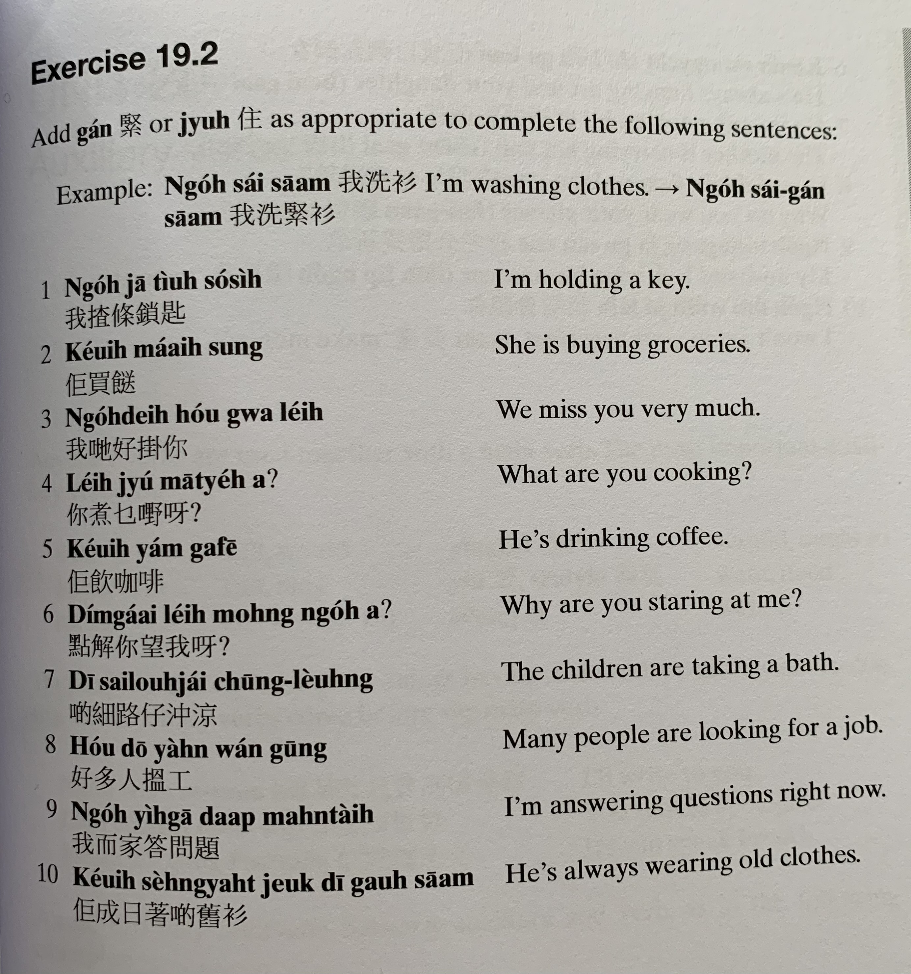
ngo5 sai2 saam1
keoi5 zaa1 tiu4 so2 si4
keoi5 maai5 sung3
ngo5 dei6 hou2 gwaa3 nei5
nei5 zyu2 mat1 je5 aa3?
keoi5 jam2 gaa3 fe1
dim2 gaai2 nei5 mong6 ngo5 aa3?
di1 sai3 lou6 zai2 cung1 loeng4
hou2 do1 jan4 wan2 gung1
ngo5 ji4 gaa1 daap3 man6 tai4
keoi5 sing4 jat6 zoek3 di1 gau6 saam1

Slide 14
Translate the following into Cantonese using zo2, gwo3, mei6 or mou5.
I’ve met his family before
He had breakfast this morning
I’ve heard this song before
He hasn’t bought a new car before
5. I haven’t gone to the school (but you will)

Slide 15
Translate the following into Cantonese using zo2, gwo3, mei6 or mou5.
I’ve met (gin3 見） his family （ uk1 kei5 jan4 屋企人 ）before
I’ve just washed my hair （sai2 tau4 洗頭）。
He had breakfast （zou2 caan1 早餐） this morning (ziu1 朝）
I’ve heard （teng1 聽） this song （sau2 go1 首歌） before
I’ve been to Hong Kong once
She’s won the first prize
He hasn’t bought （maai5 買） a new car （san1 ce1 新車）before
I just sold (賣）the car
I haven’t gone to the school (but you will)
I didn’t go to the school
I haven’t been to Thailand before
12. My father just went to Brno

Slide 16
Passive Voice
Translate the following into Cantonese and also in passive voice.
1. Someone ate my bread （min6 baau1 麵包）
2. Someone borrowed my money （ze3 cin2 借錢）
3. My father broke （zing2 waai6 整壞） the computer （bou6 din6 nou5 部電腦）
4. I washed （sai2 洗） the clothes （saam1 衫）
5. He has broken (daa2 laan6打爛) the glass (zek6隻 bui1 杯）
6. Someone open the box (soeng1 箱）
7. Someone stole （ tau1 偷）her wallet （ ngan4 baau1 銀包）
8. Someone scammed （ aak1呃） his money

Slide 17
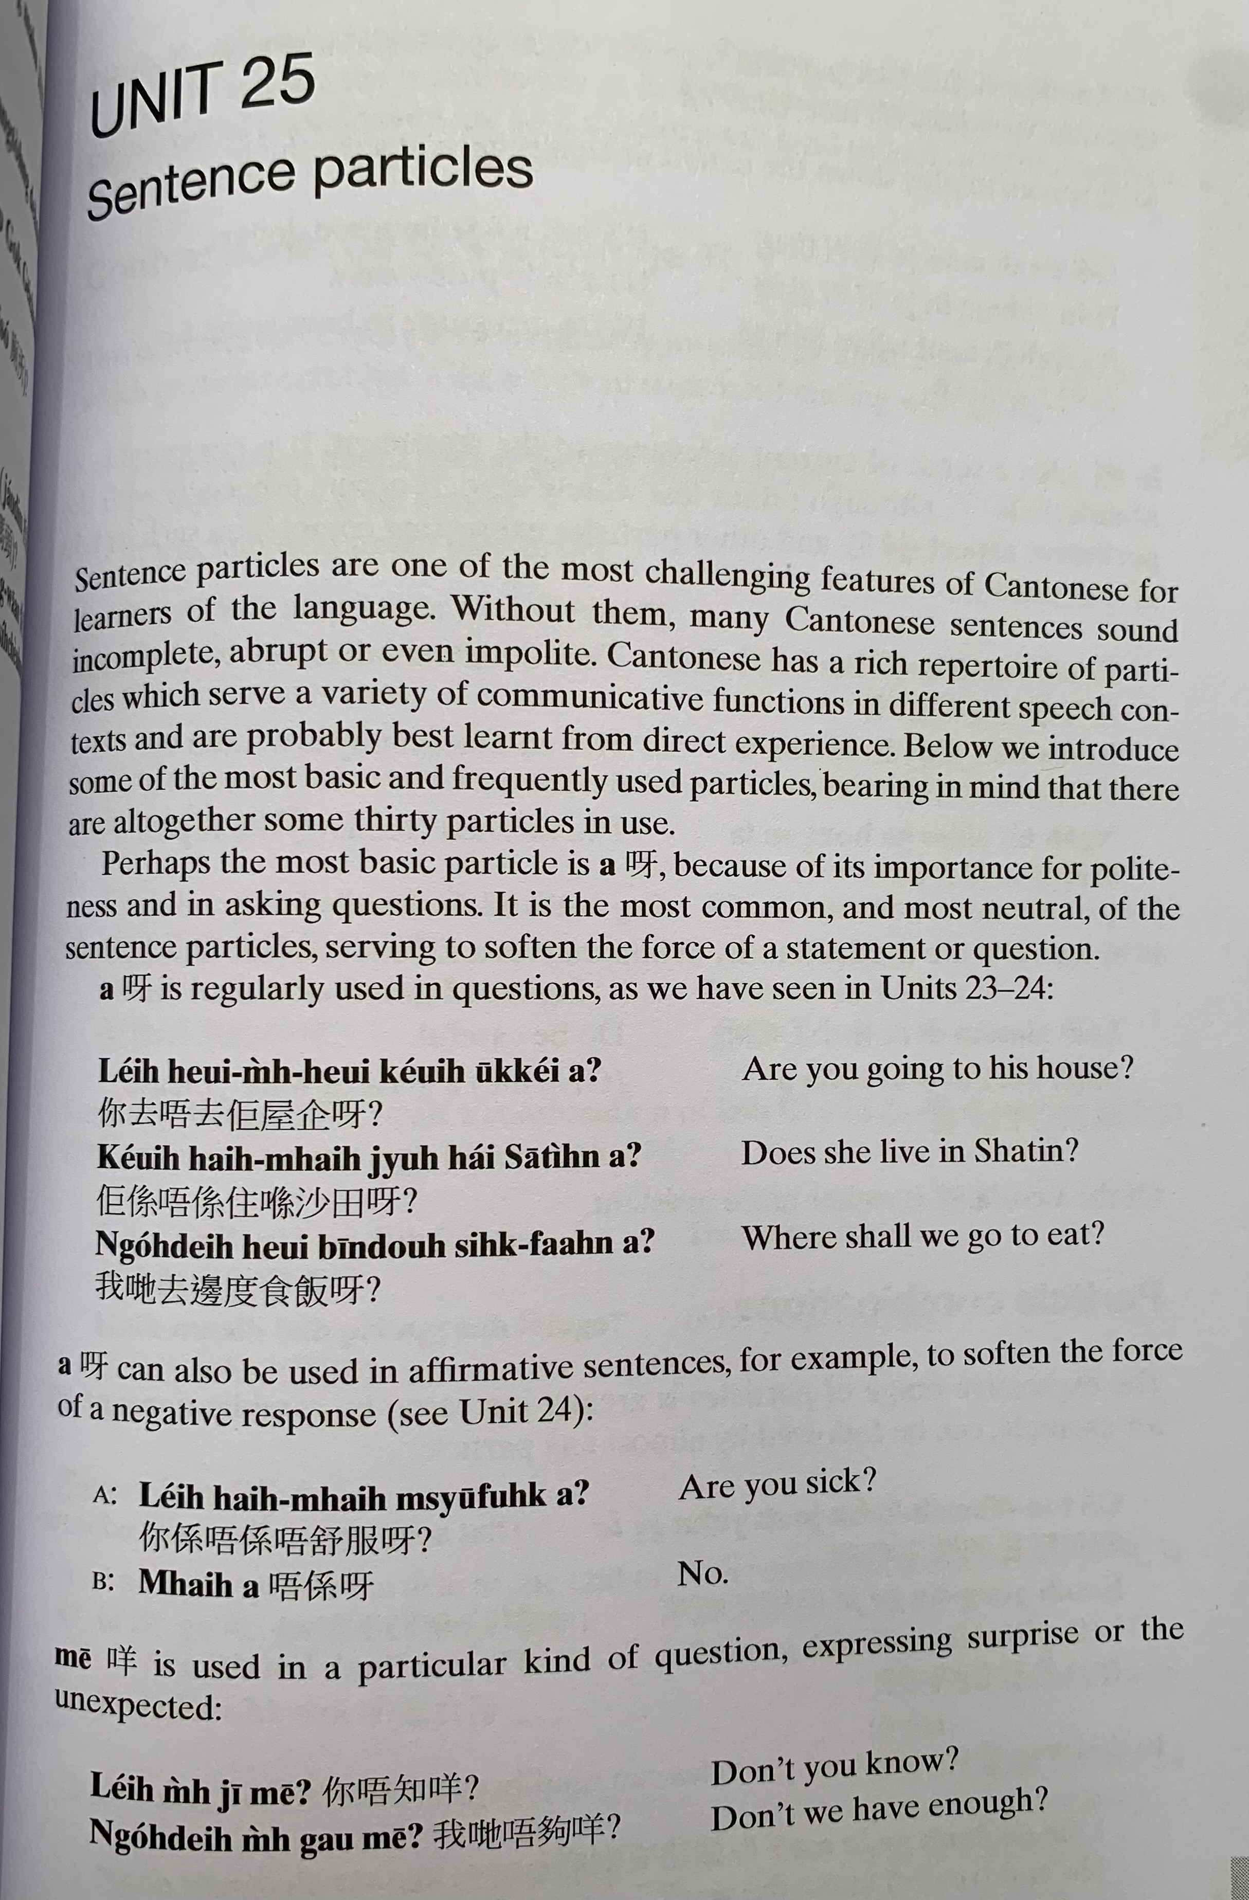
aa3
aa3
nei5 heoi3 m4 heoi3 keoi5 uk1 kei2 aa3 ?
keoi5 hai6 m4 hai6 zyu6 hai2 saa1 tin4 aa3 ?
ngo5 dei6 heoi3 bin1 dou6 sik6 faan6 aa3 ?
aa3
nei5 hai6 m4 hai6 m4 syu1 fuk6 aa3？
m4 hai6 aa3

Slide 18
me1
nei5 m4 zi1 me1 ?
ngo5 dei6 m4 gau3 me1?

Slide 19
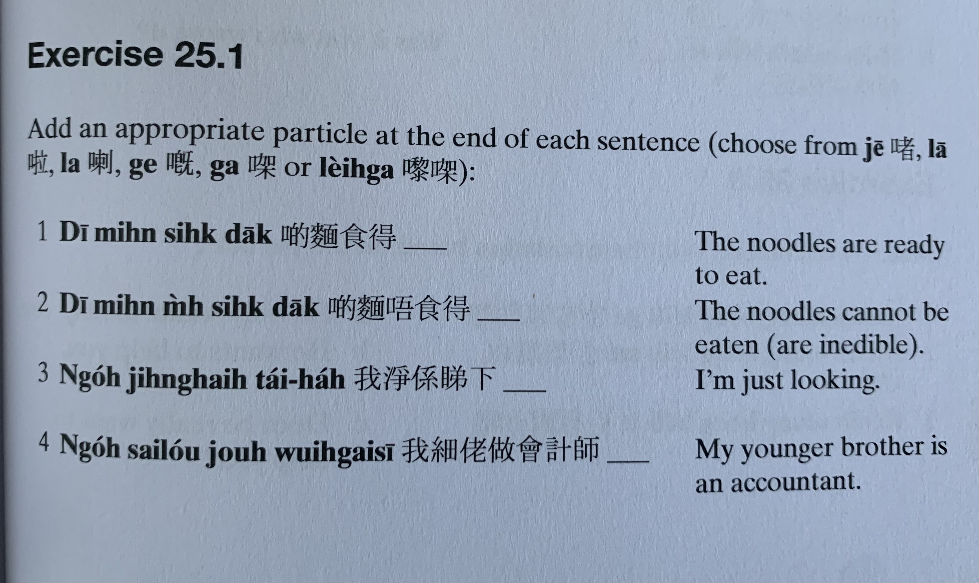
ze1
laa1
ge3
gaa3
lai4 gaa3
laa3
di1 min6 sik6 dak1
di1 min6 m4 sik6 dak1
ngo5 zing6 hai6 tai2 haa5
ngo5 sai3 lou2 zou6 wui6 gai3 si1

Slide 20
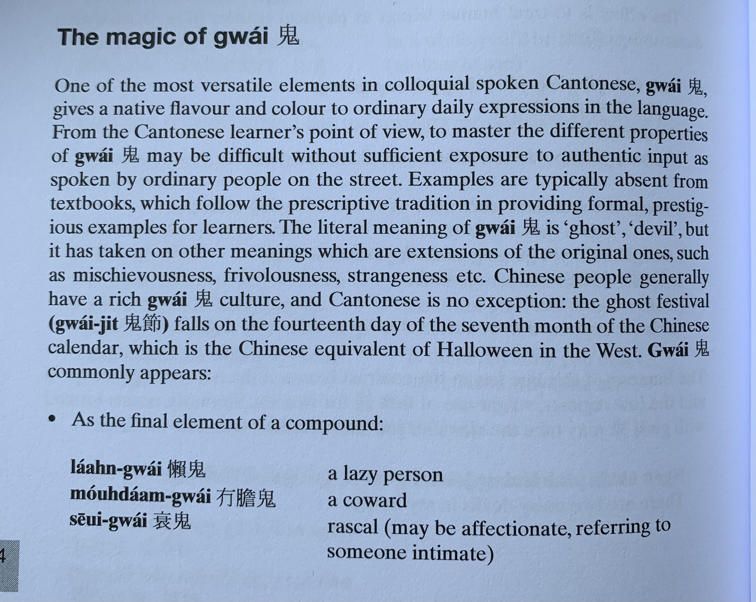
gwai2
laan5 gwai2
mou5 daam2 gwai2
seoi1 gwai2
zau2 gwai2 酒鬼

Slide 21
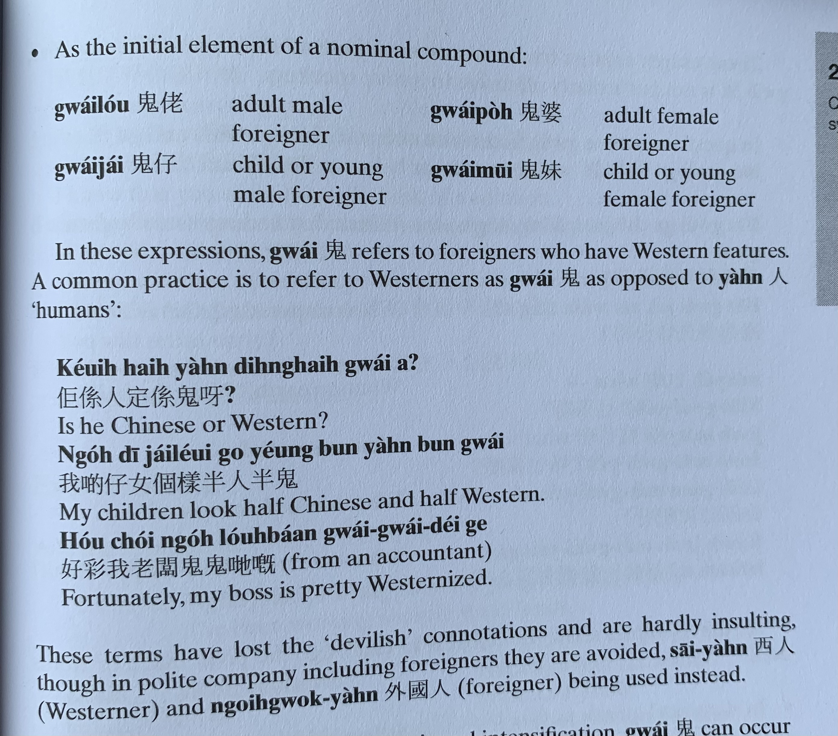
gwai2 lou2
gwai2 po4
gwai2 zai2
gwai2 mui1
keoi5 hai6 jan4 ding6 hai6 gwai2 aa3 ?
ngo5 di1 zai2 neoi2 go3 joeng2 bun3 jan4 bun3 gwai2
hou2 coi2 ngo5 lou5 baan2 gwai2 gwai2 dei2 ge3
sai1 jan4
ngoi6 gwok3 jan4

Slide 22
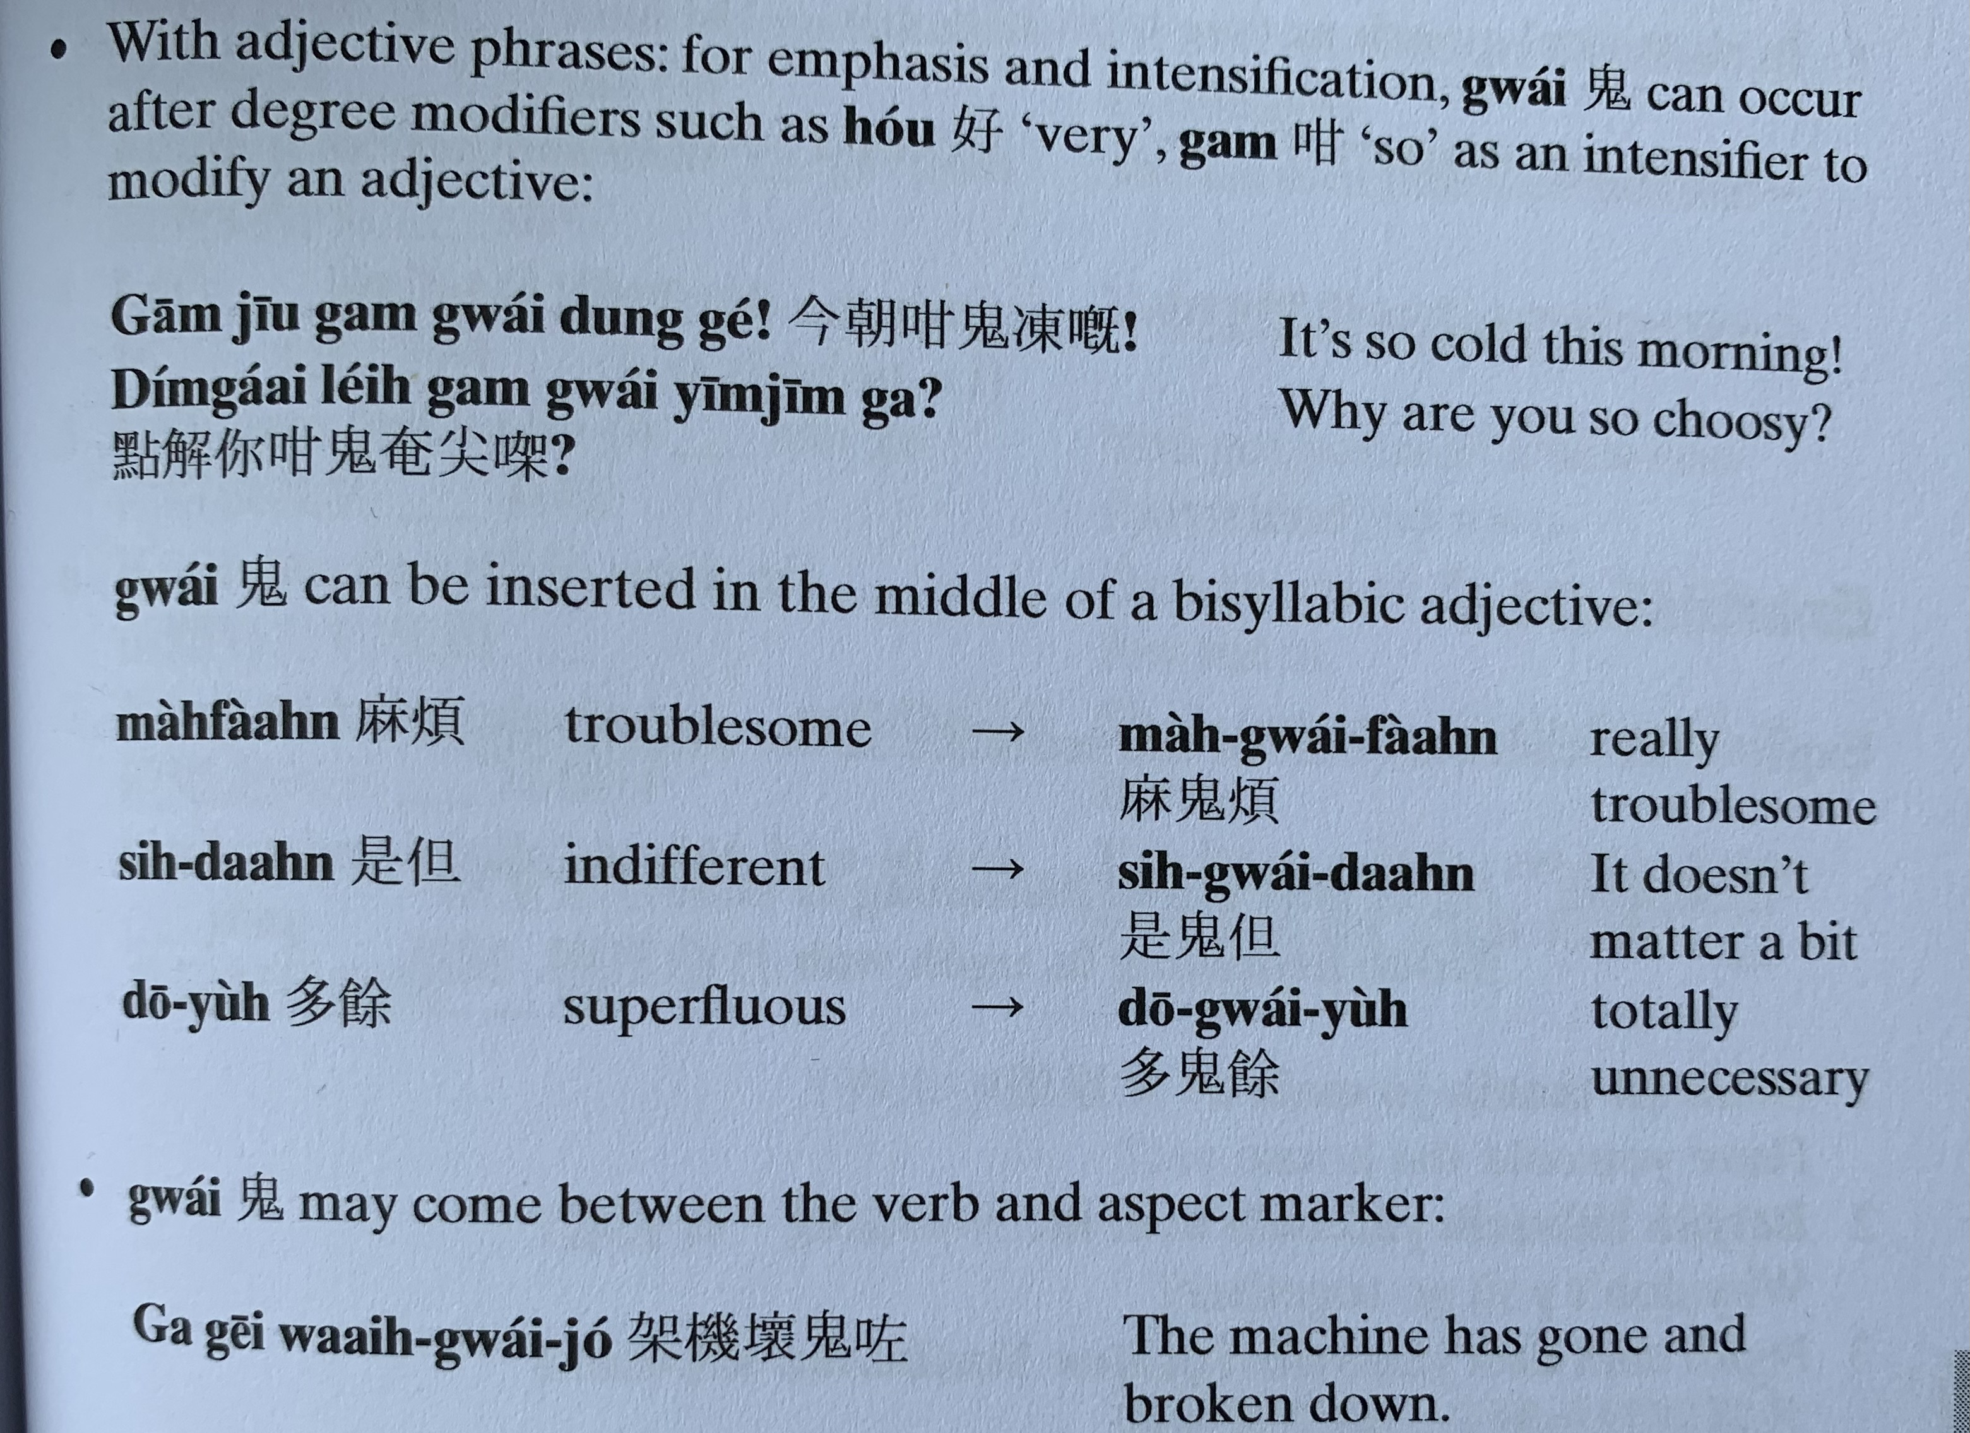
hou2
gam3
gam1 ziu1 gam3 gwai2 dung3 ge3 !
dim2 gaai2 nei5 gam3 gwai2 yim1 zim1 gaa3?
maa4 faan4
si6 daan6
do1 jyu4
gaa3 gei1 waai6 gwai2 zo2

Slide 23
bin1
go3
bin1 gwai2 go3
bin1 gwai2 gaa3 ce1 zong6 faa1 ngo5 gaa3 ce1 aa3?
gwai2 zi1 me1?
gwai2 bong1 keoi5 aa3

Slide 24
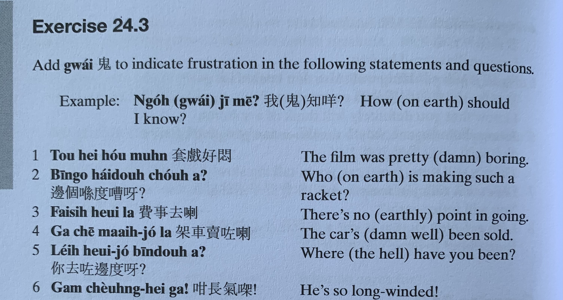
ngo5 gwai2 zi1 me1 ?
tou3 hei3 hou2 mun6
bin1 go3 hai2 dou6 cou4 aa3?
fai3 si6 heoi3 laa3
gaa3 ce1 maai6 zo2 laa3
nei5 heoi3 zo2 bin1 dou6 aa3?
gam3 coeng4 hei3 gaa3!

Slide 25
邊個 | Who | Bin1 go6
咩 / 乜嘢 | what | Me1 / Mat1 je5
邊度 | Where | Bin1 dou6
點解 | Why | Dim2 gaai2
幾時 | When | Gei2 si4
點（樣） | How | Dim2 （yoeng2）
幾多 | How many/ much | Gei2 do1

