Slide 1
Cantonese II
Week 3

Slide 2
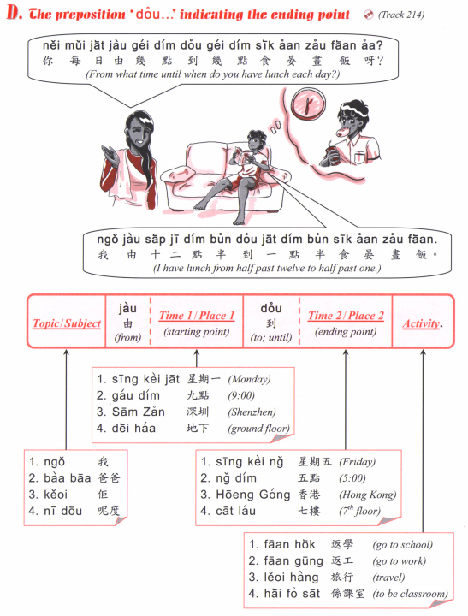

Slide 3
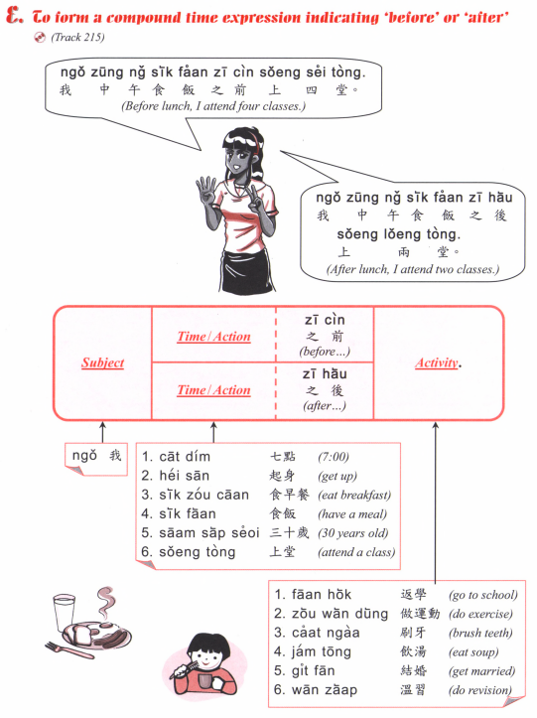

Slide 4
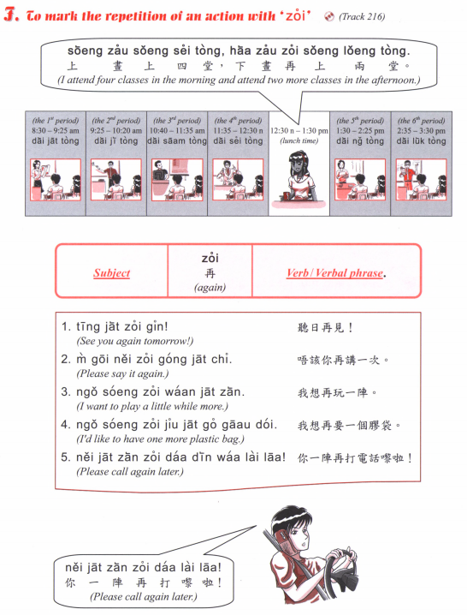

Slide 5
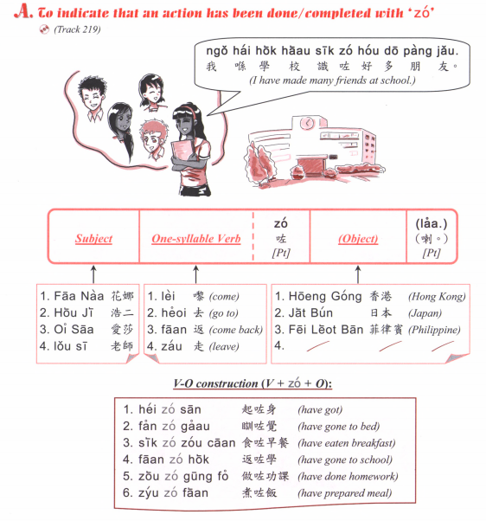
Sik6 zo2 faan6 mei6 aa3?
食咗飯未呀？
Have you eaten?
Sik6 zo2 laa3
食咗喇
Or
Mei6 aa3
未呀

Slide 6
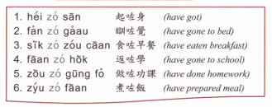
Question: [Verb] zo2 [object] mei6 aa3?
Answer: [Subject] [verb] zo2 [object] laa3.
OR [subject] mei6 [verb] aa3.

Slide 7
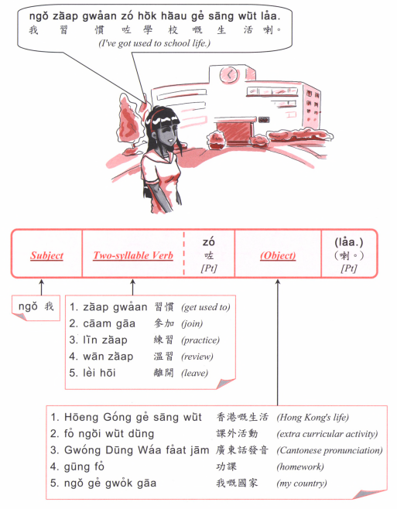
Question: [Verb] zo2 [object] mei6 aa3?
Answer: [Subject] [verb] zo2 [object] laa3.
OR [subject] mei6 [verb] aa3.

Slide 8
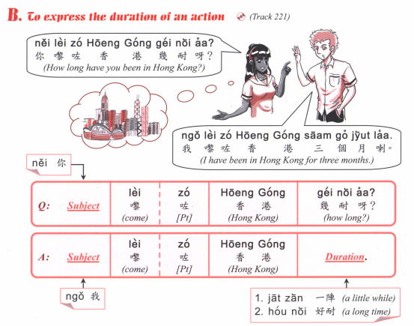

Slide 9
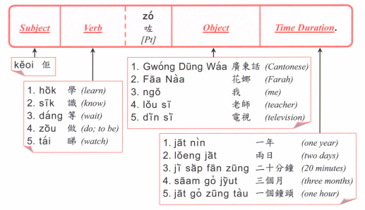

Slide 10
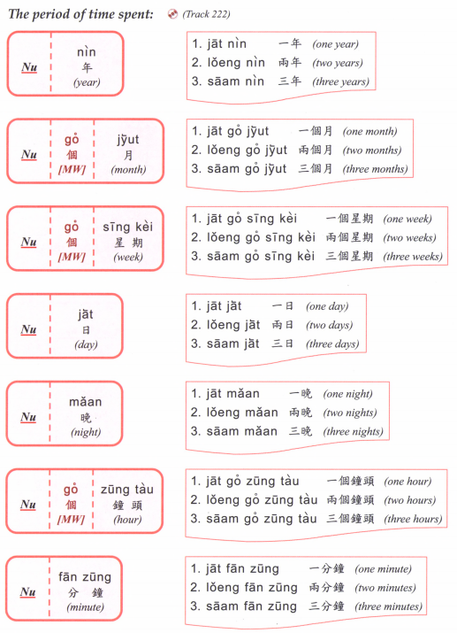

Slide 11
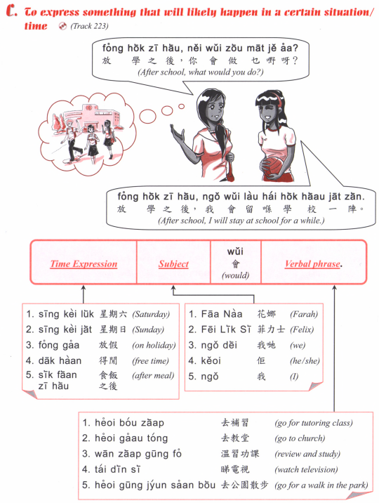

Slide 12
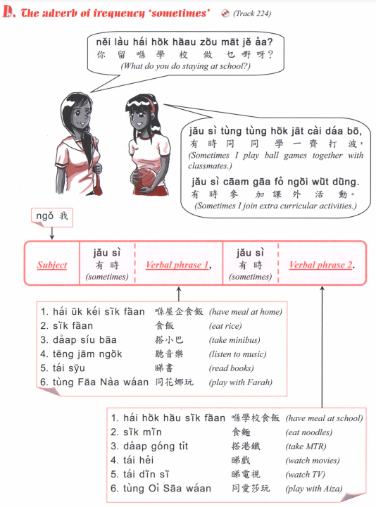

Slide 13
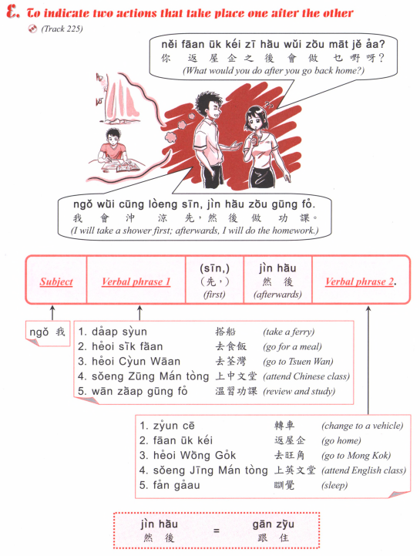

Slide 14
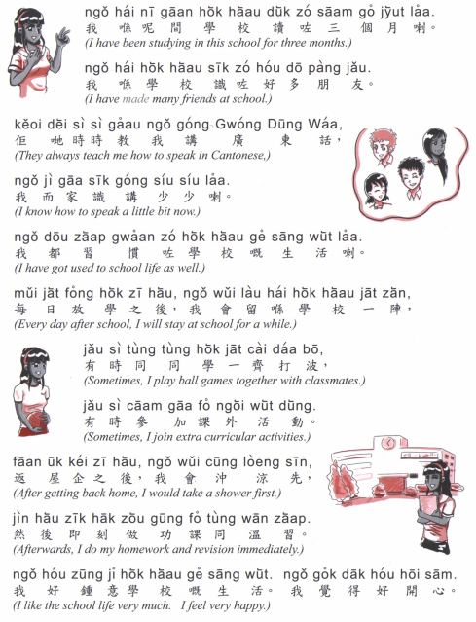

Slide 15
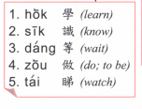
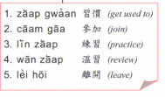

Slide 16
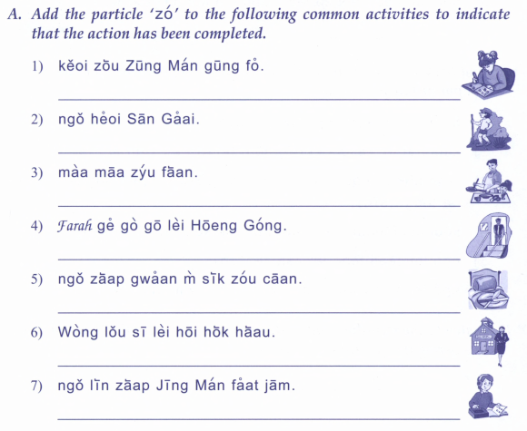
佢做中文功課
我去新界
喇
啦
媽媽煮飯
Farah既哥哥黎香港
我習慣唔食早餐
黃老師離開學校
我練習英文發音

Slide 17
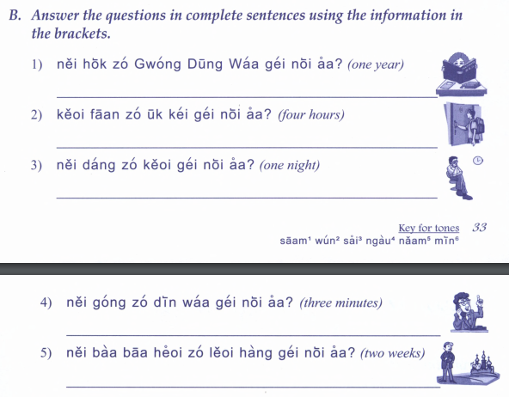
你學咗廣東話幾耐呀？
佢返咗屋企幾耐呀？
你等咗佢幾耐呀？
你講咗電話幾耐呀？
你爸爸去咗旅行幾耐呀？

Slide 18
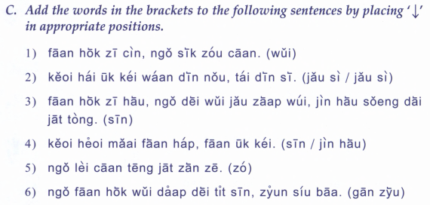
返學之前，我食早餐。
佢喺屋企玩電腦，睇電視
返學之後，我地有集會，然後上第一堂
佢去買飯盒，返屋企。
我黎餐廳一陣啫。
我返學會搭地鐵先，轉小巴

Slide 19
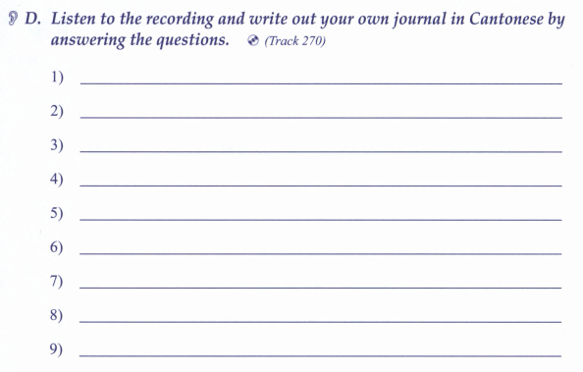

Slide 20
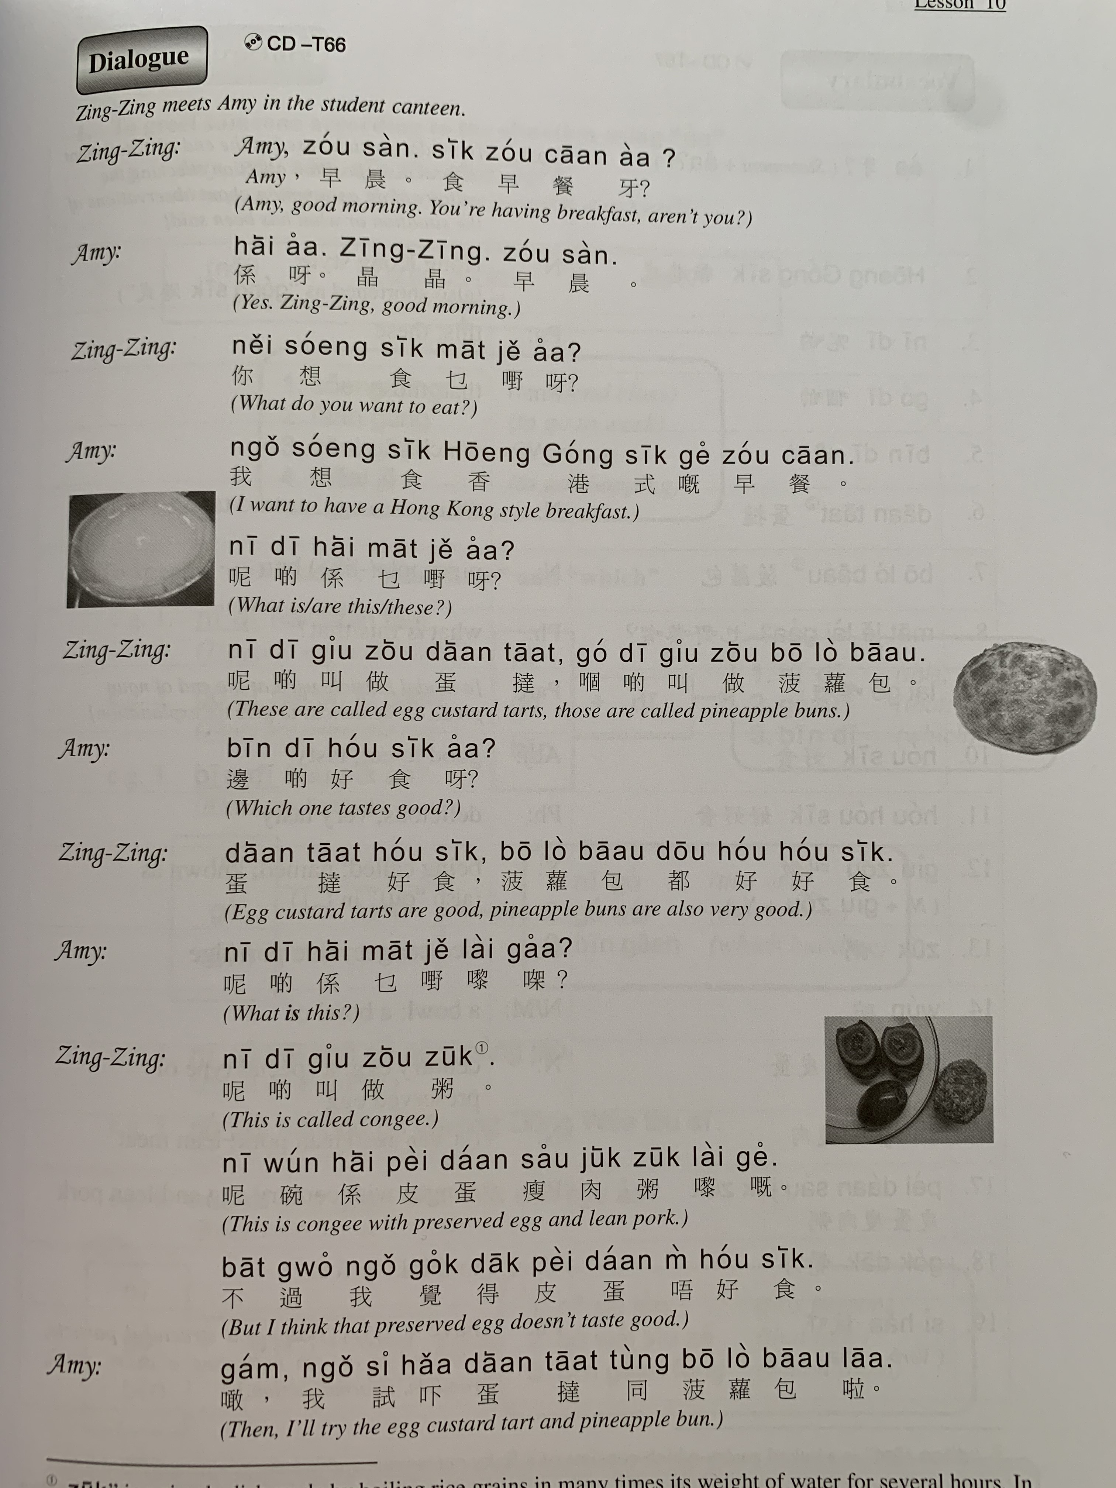

Slide 21
Particle | Jyutping | Usage | Example
呀 | aa3 | Used in neutral questions. Also used to soften the tone of affirmative statements so they don't sound as abrupt. | Nei5 heoi3 bin1aa3? 你去邊呀? Where are you going? Ngo5 faan1 uk1 kei2 aa3. 我返屋企呀 I'm going home.
嘅 | ge3 | Used in assertions where something is emphasized (usually 係 hai6 is in front of what is being emphasized). Pronouncing it as ge2 adds a sense of puzzlement about the situation. This is equivalent to the Mandarin/written Chinese 的 dik1. | Ngo5 hai6 gam1 jat6 faan1 uk1 kei2 ge3. 我係今日返屋企嘅 I'm going home today. (the "today" is emphasized)
㗎 | gaa3 | Contraction of the combination 嘅呀 ge3 aa3. Can be used in question and answer. | 你係幾時返來㗎? When are you coming back? (the "when" is emphasized) Use for defending your argument or emphasis. Stronger than嘅ge3. Hai6 ngo5 gaa3! 係我架! It’s mine!
啦 | laa1 | Used in requests and imperatives. This is one particle where leaving it out could make the sentence sound rude. This is equivalent to the Mandarin/written Chinese sentence final 吧 baa6. | Bei2 ngo5 laa1 畀我啦 Give it to me [please].
啫 | ze1 | Can be used to mean "only" or "that's all," or used to play down the significance of the situation. | Keoi5 faan1 yat1 yat6 ze1 佢返一日啫 He's only coming back for one day.

Slide 22
keoi5 faan1 zo2 uk1 kei2 佢返咗屋企 ("He went home")
佢返咗屋企 aa3 呀 – (informing the listener) “He went home!” 佢返咗屋企 laa3 喇 – (informing the listener) “He already went home!” 佢返咗屋企 wo3 喎 – “Oh… He already went home though.” 佢返咗屋企 gwaa3 啩 – (with uncertainty) “He went home, I guess” 佢返咗屋企 me1 咩? – “Oh, he went home?” 佢返咗屋企 lo1 囉 – (with emphasis) “He went home already.” 佢返咗屋企 laa3 maa3 啦嘛 – “He went home already! (so he can’t be here right now)”

