Slide 1
Cantonese II
Week 5

Slide 2
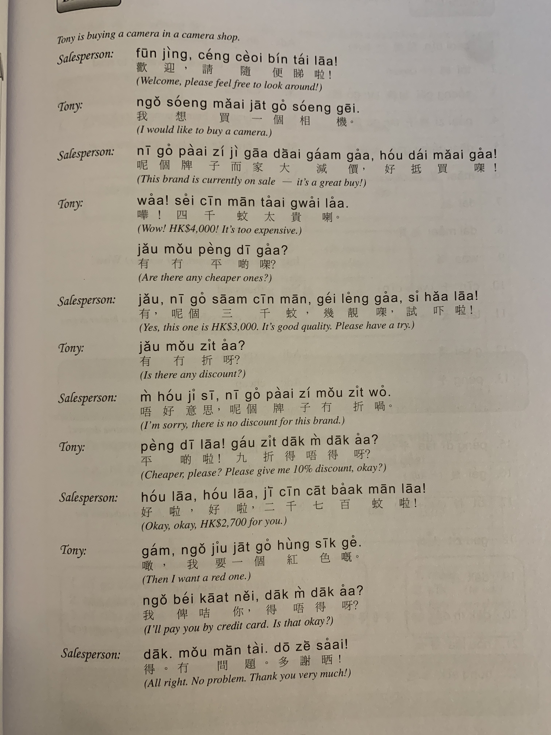
單車 daan1 ce1
踩 caai2 (verb)

Slide 3
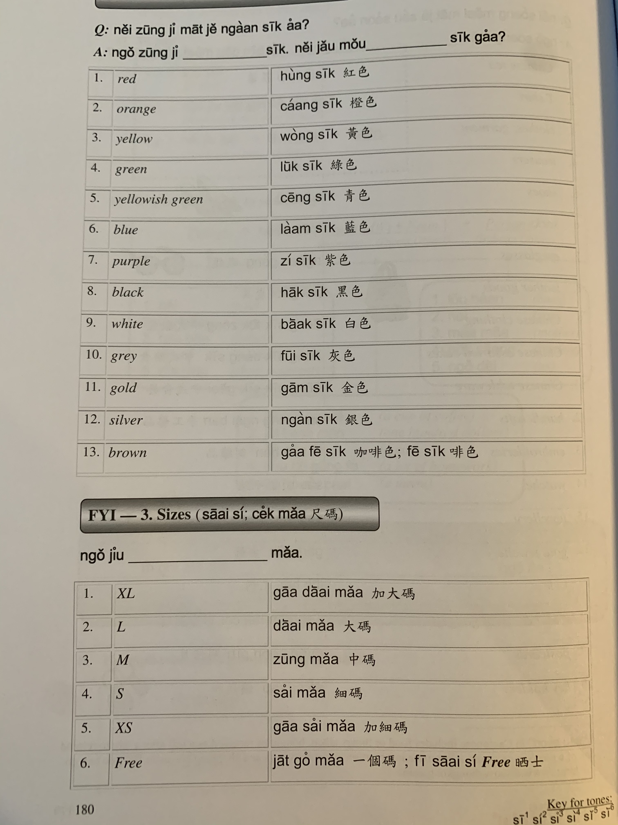

Slide 4
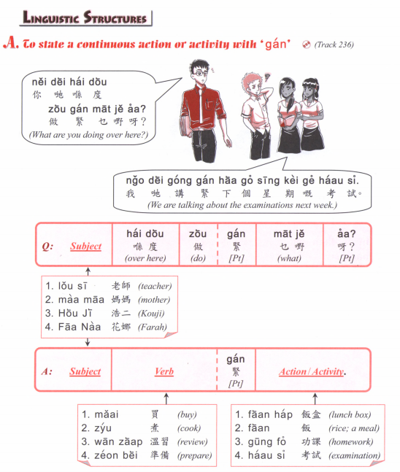

Slide 5
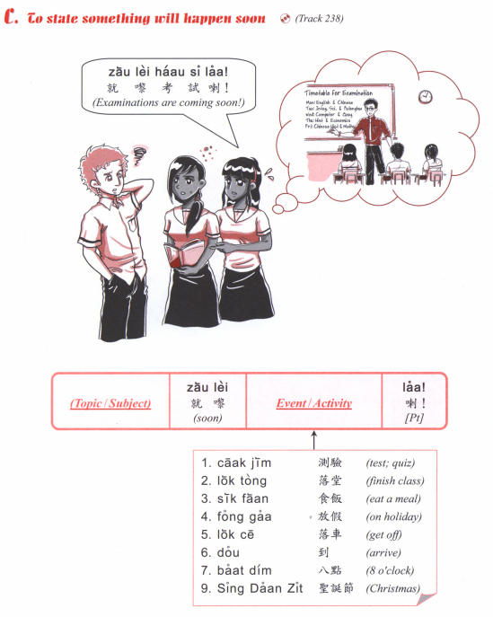
食咗飯
食緊飯
就黎食飯
會食飯

Slide 6
I will have exam soon.
I will have vacation soon. (fong3 gaa3)
3. What is he doing?
He is reading. (tai2 syu1)
4. What are you doing?
I am going to the university. (daai6 hok6)
5. What are you eating?
I am eating noodles. (min6)
6. What will you do this weekend?
I will go to the park. (gung1 jyun2)
7. What book did you read?
I read XXX.
8. How long have you been learning Mandarin?
I have been learning for X years.
9. Have you done your homework?
I am doing it!
10. What will you do in Easter? (fuk6 wut6 zit3)

Slide 7
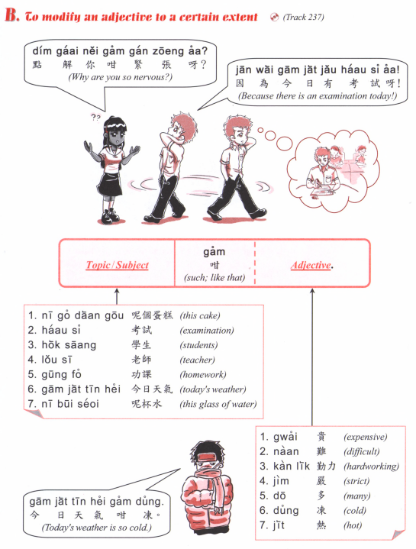

Slide 8
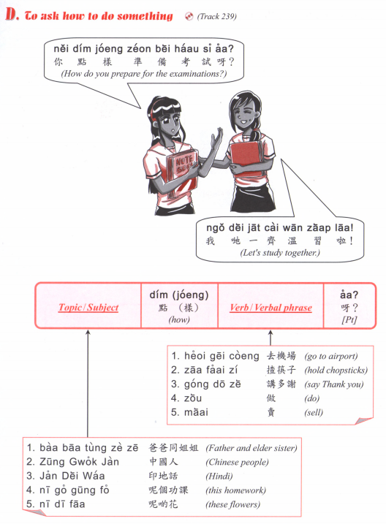

Slide 9
邊個 | Who | Bin1 go6
咩 / 乜嘢 | what | Me1 / Mat1 je5
邊度 | Where | Bin1 dou6
點解 | Why | Dim2 gaai2
幾時 | When | Gei2 si4
點（樣） | How | Dim2 （yoeng2）
幾多 | How many/ much | Gei2 do1

Slide 10
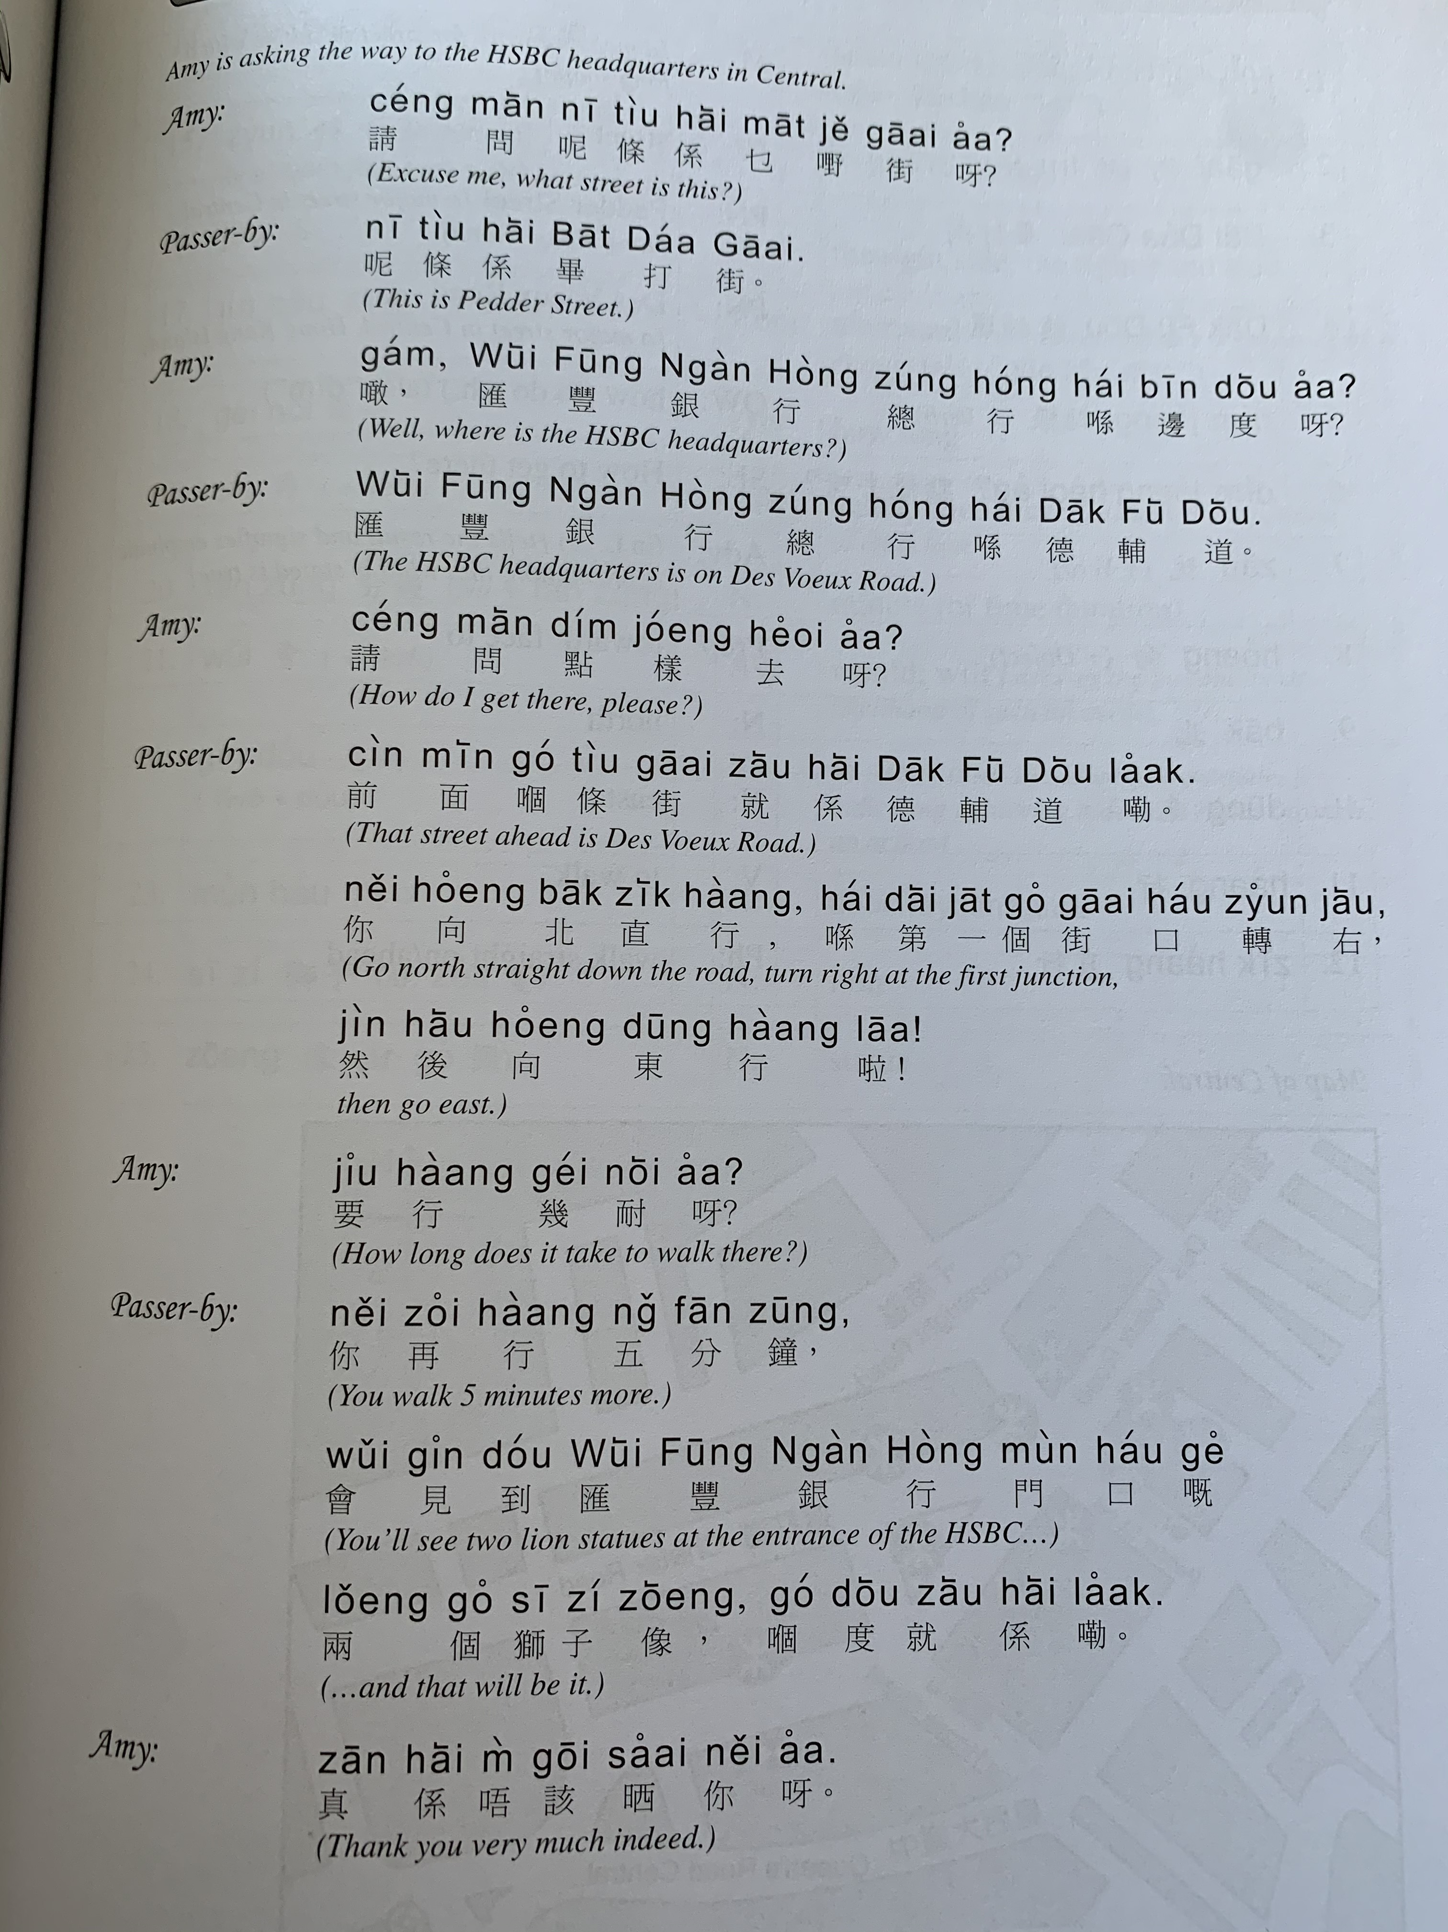

Slide 11
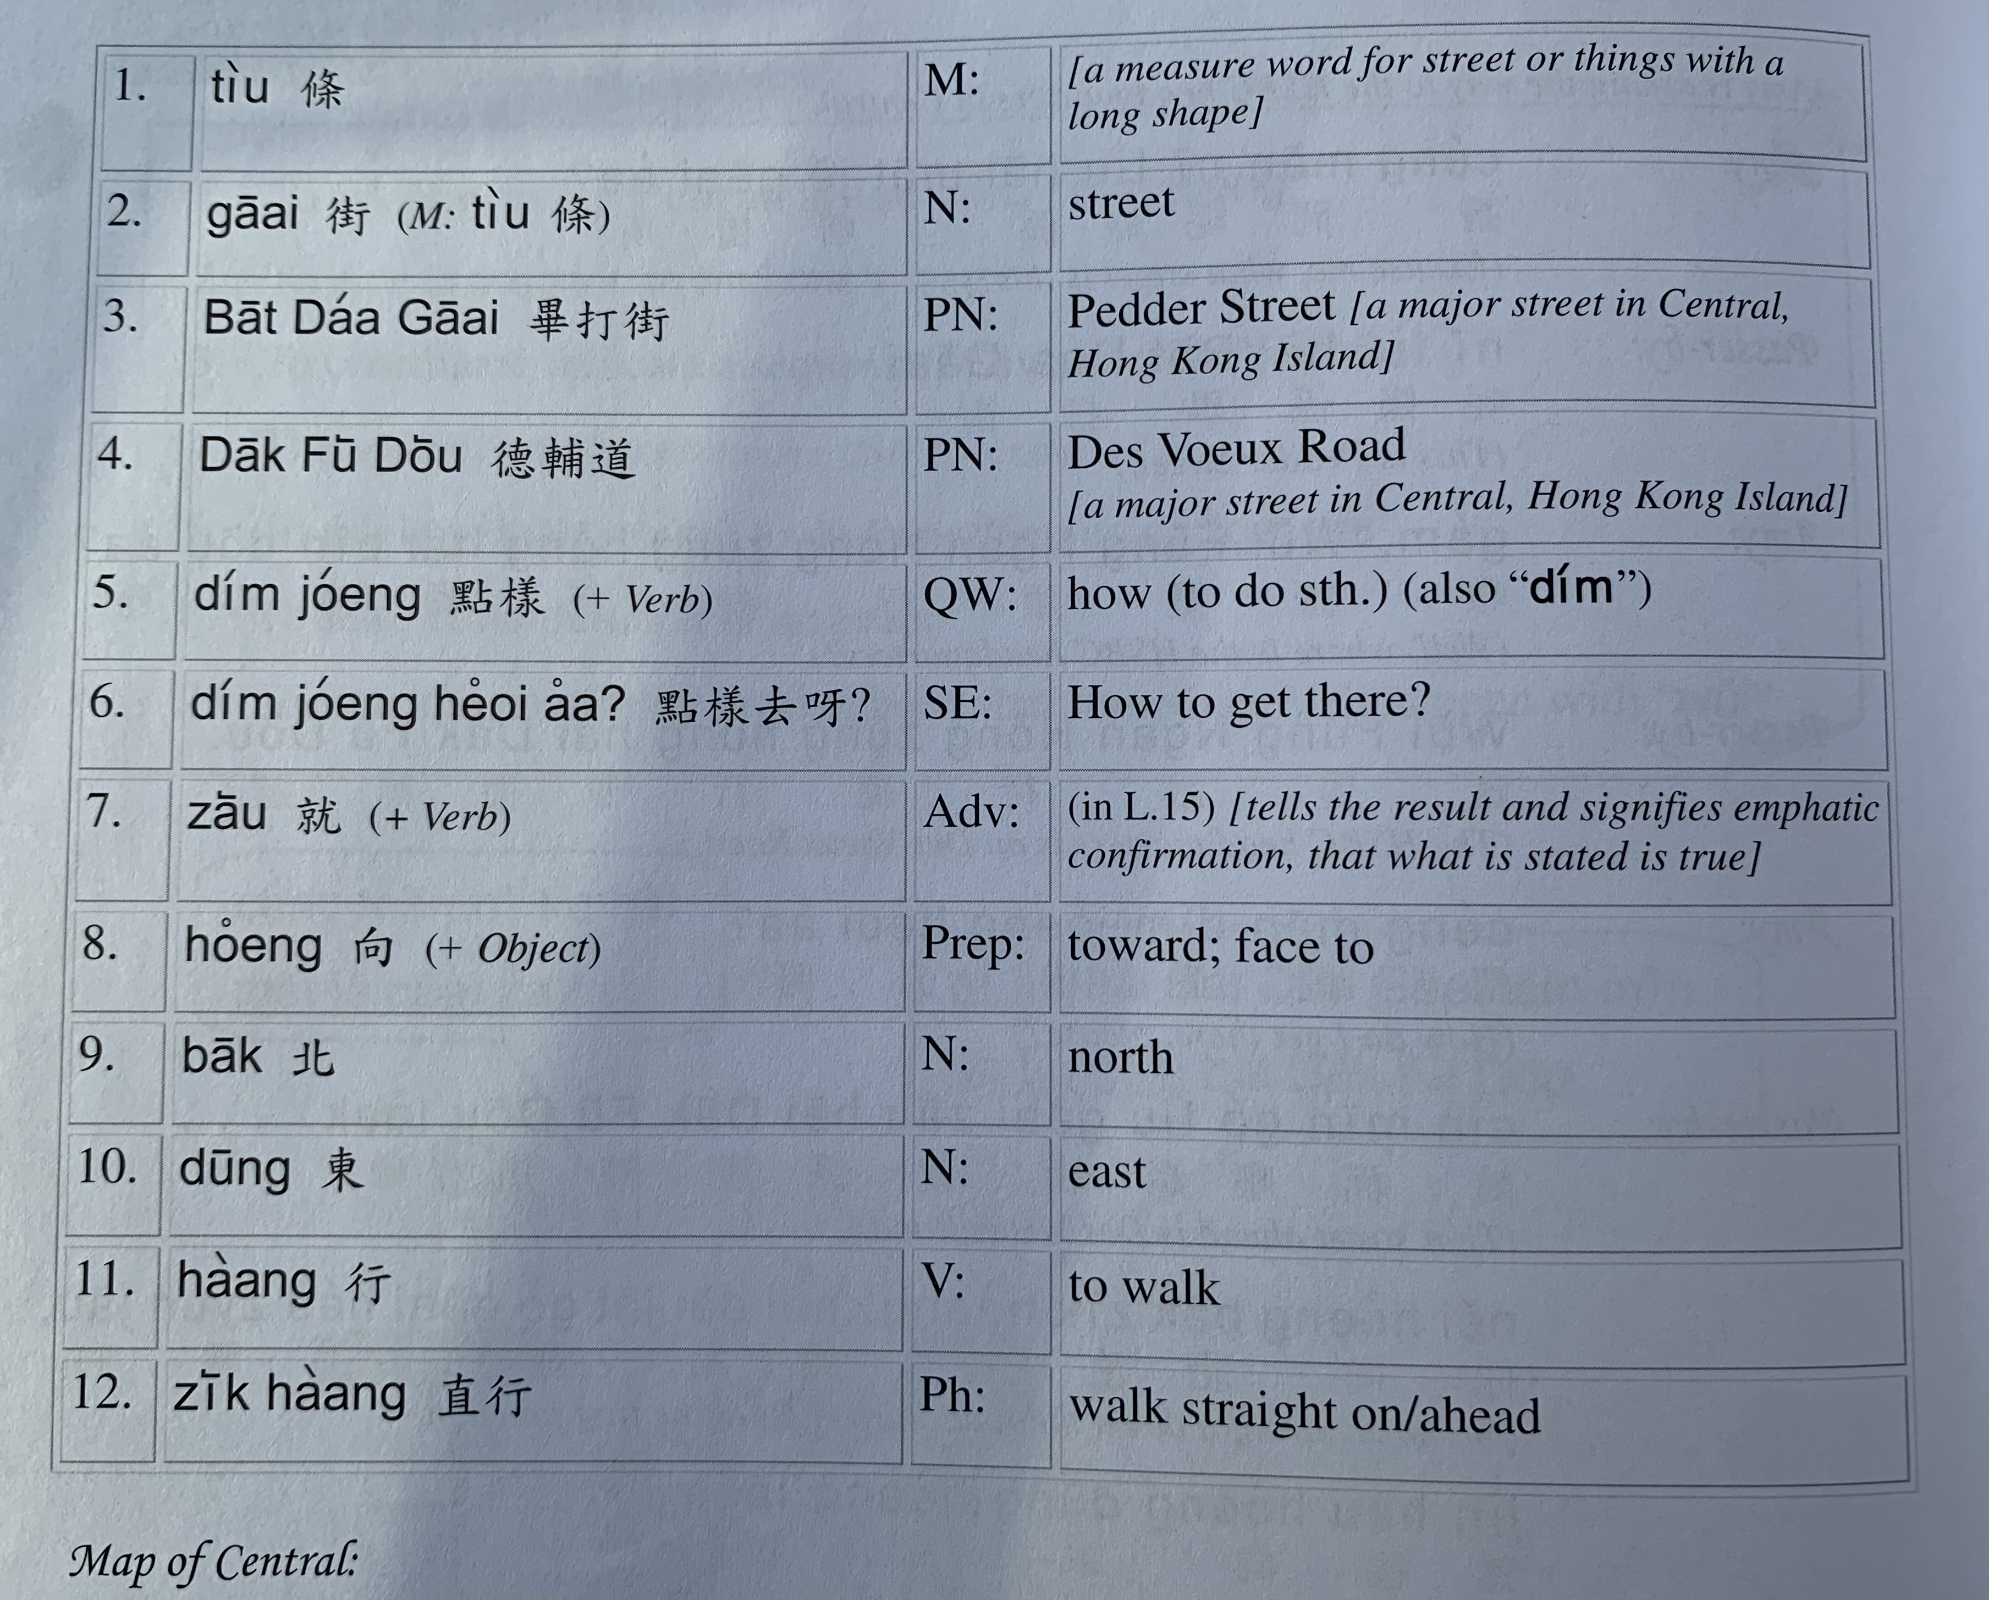

Slide 12
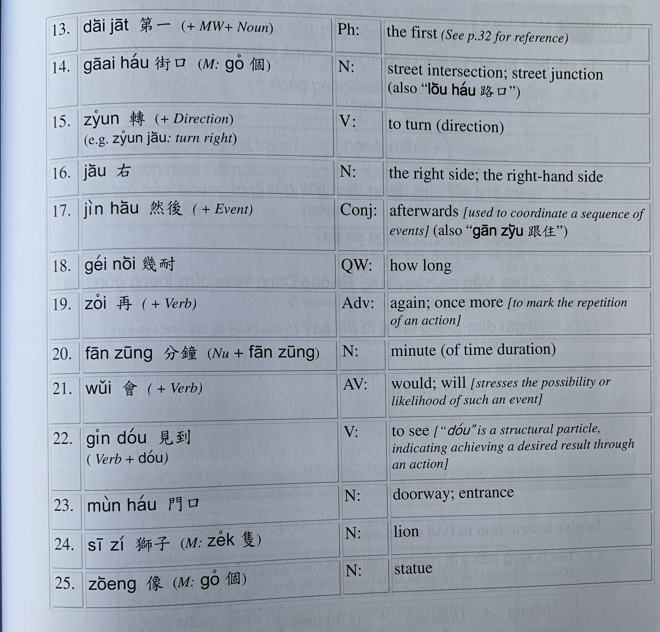

Slide 14
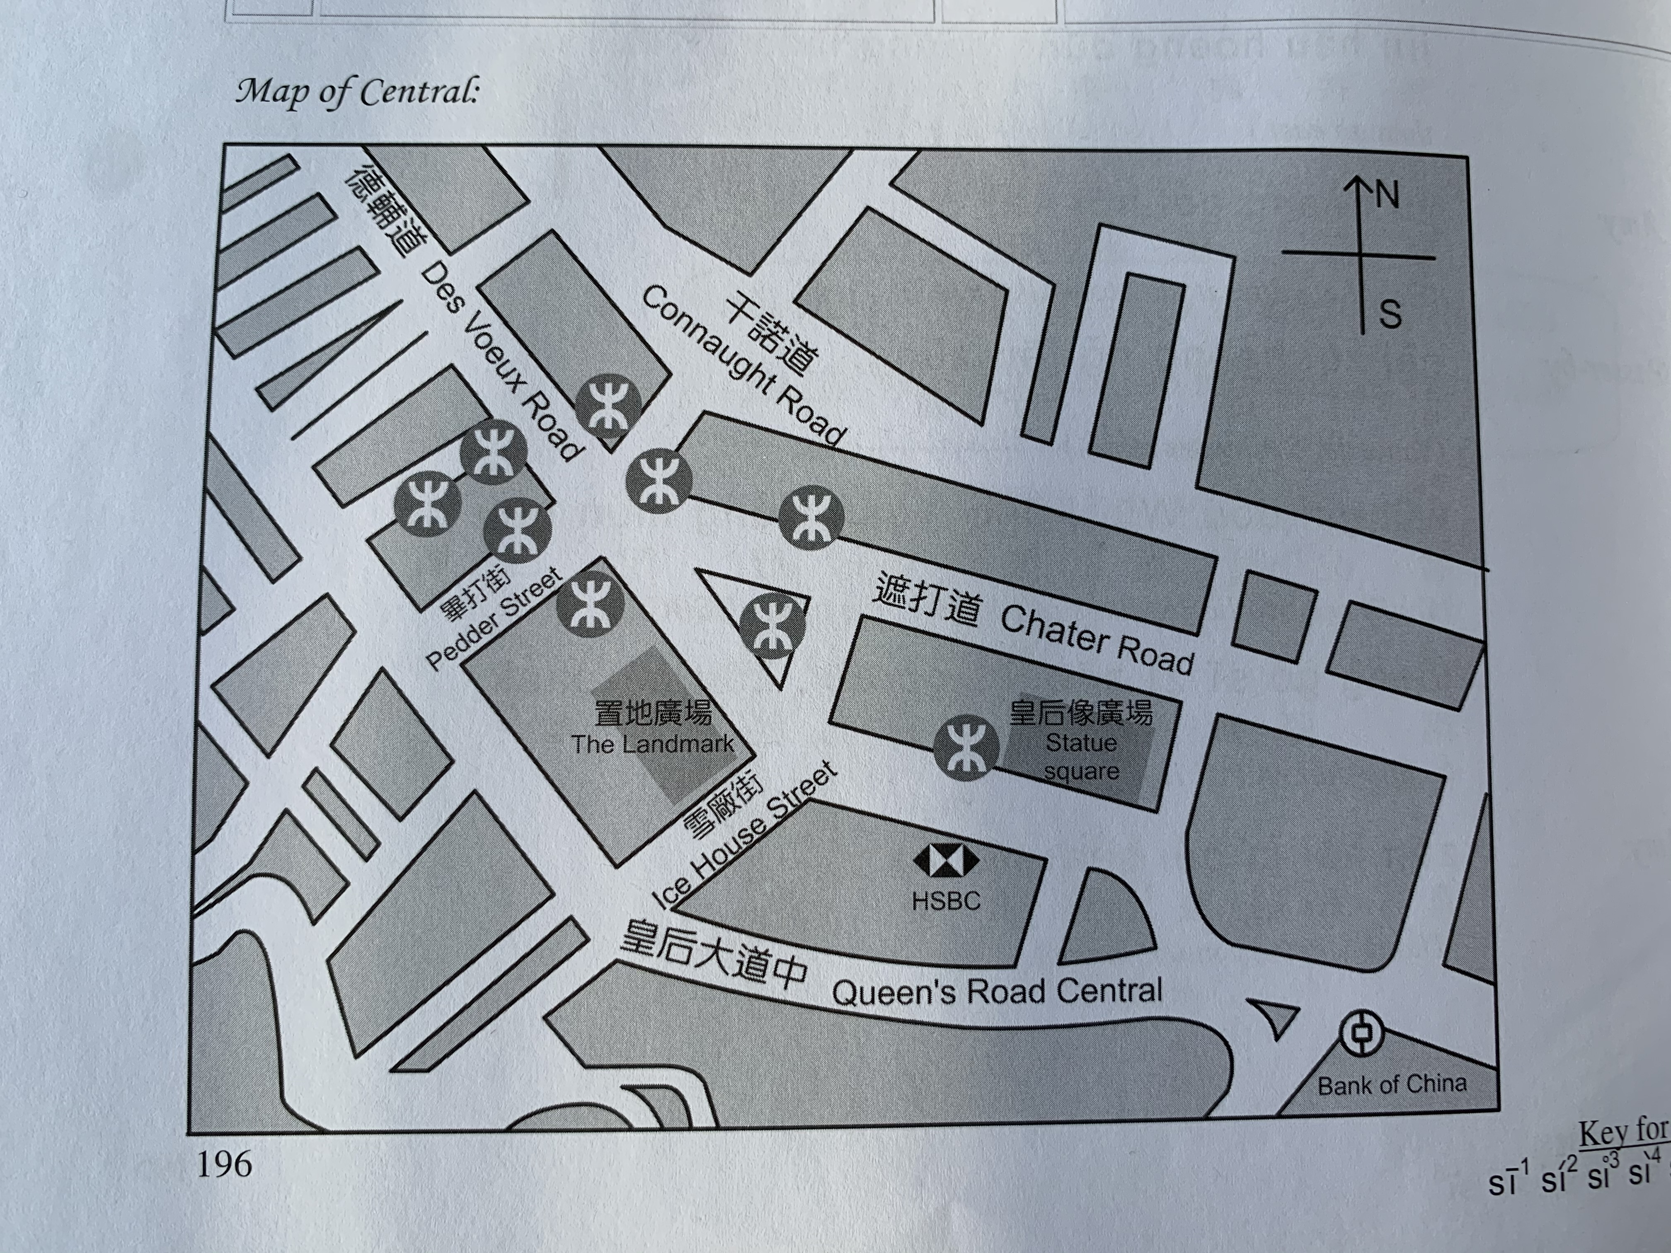
A
D
C
B

Slide 15
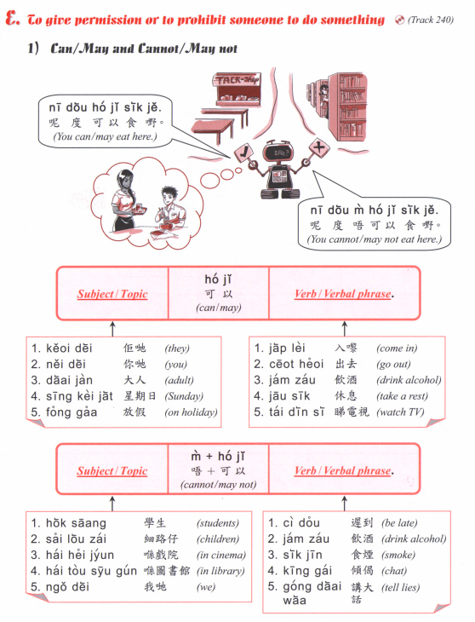

Slide 16
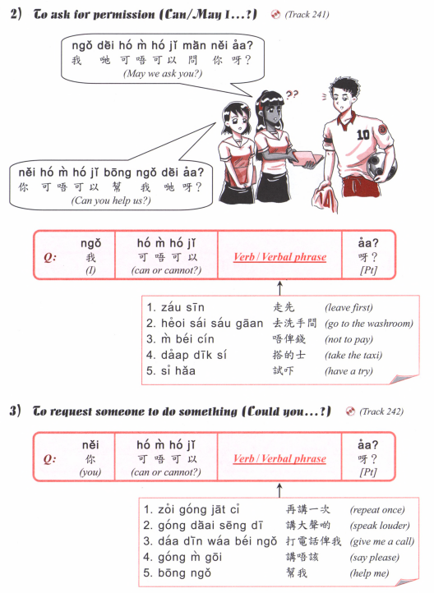

Slide 17
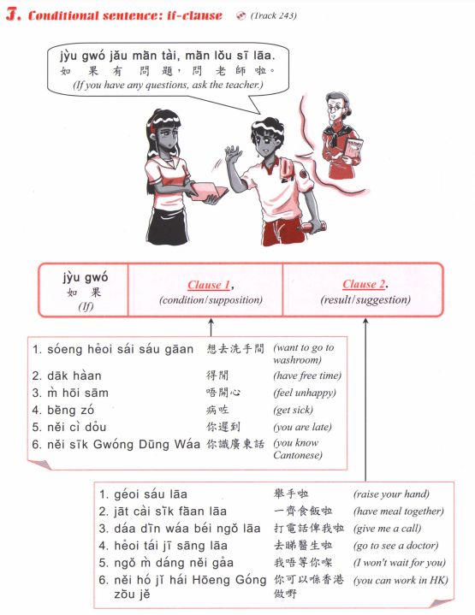

Slide 18
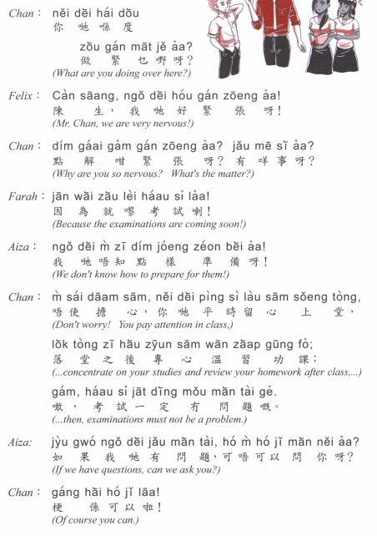

Slide 19
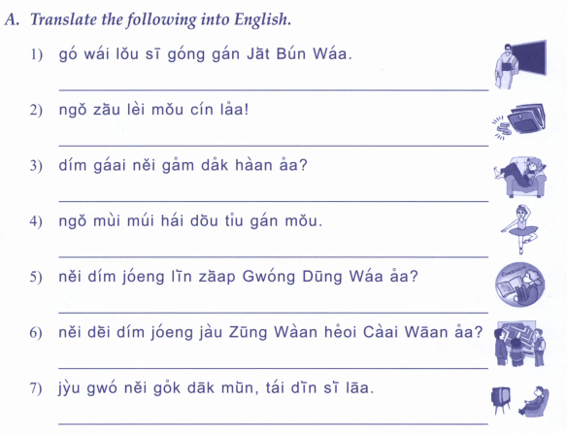
嗰位老師講緊日本話
我就黎無錢喇
點解你咁得閒呀？
我妹妹喺度跳緊舞
你點樣練習廣東話呀？
你地點樣由中環去柴灣呀？
如果你覺得悶，睇電視啦。

Slide 20
佢哋喺度打緊波
因為佢好攰，所以喺度訓覺。
呢對鞋靚，我想買呀！
因為我生日，所以我開心。
你地無問題，落堂喇。
佢哋返屋企喇。

Slide 21
