Slide 1
Cantonese II
Week 8

Slide 2
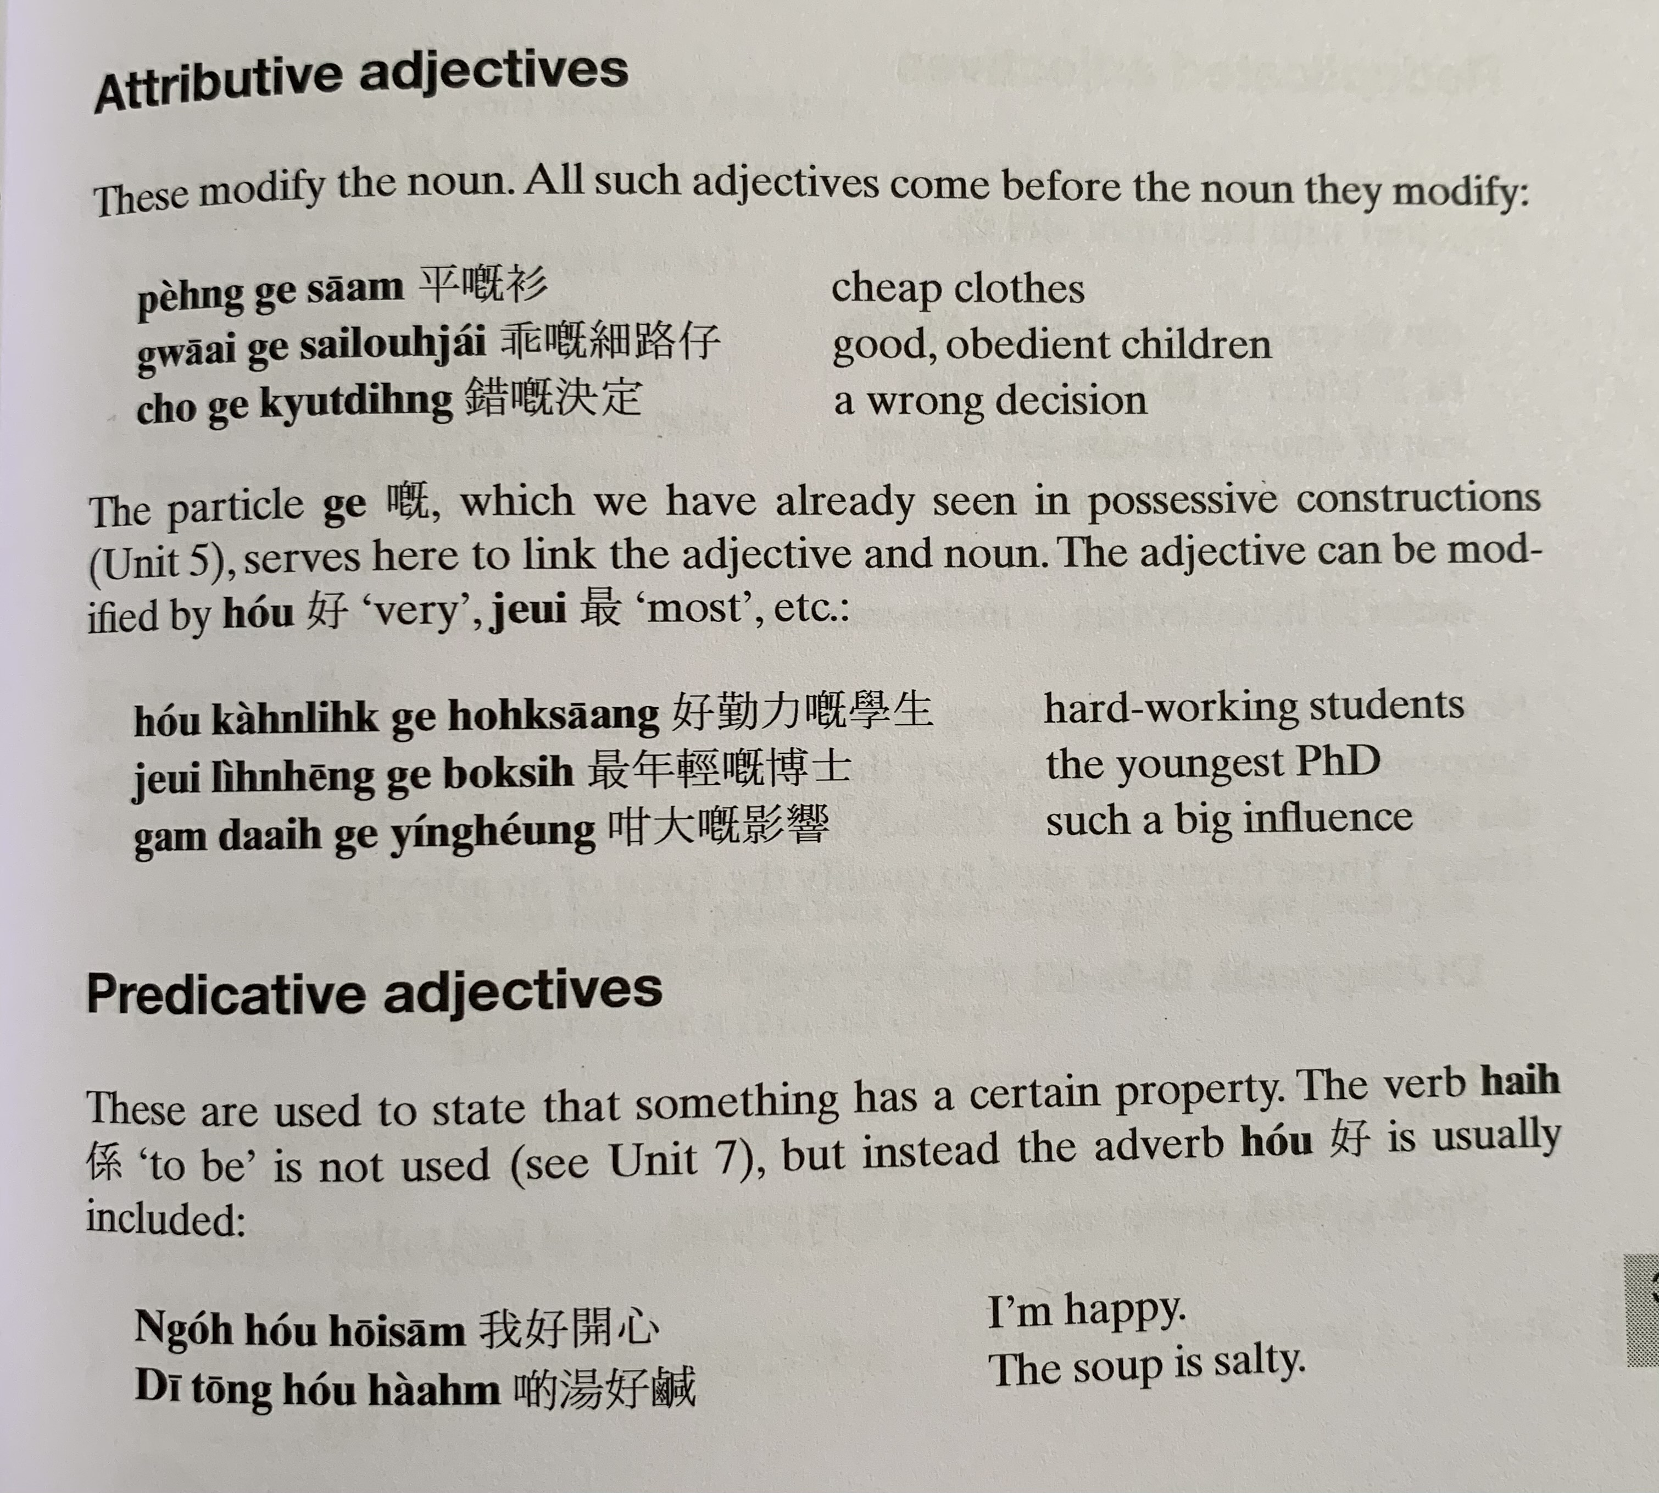
peng4
gwaai1 ge3 sai3 lou6 zai2
co3 ge3 kyut3 ding6
hou2 kan4 lik6 ge3 hok6 saang1
zeoi3 nin4 hing1 ge3 bok3 si6
gam3 daai6 ge3 jing2 hoeng2
hai6
ngo5 hou2 hoi1 sam1
di1 tong1 hou2 haam4

Slide 3
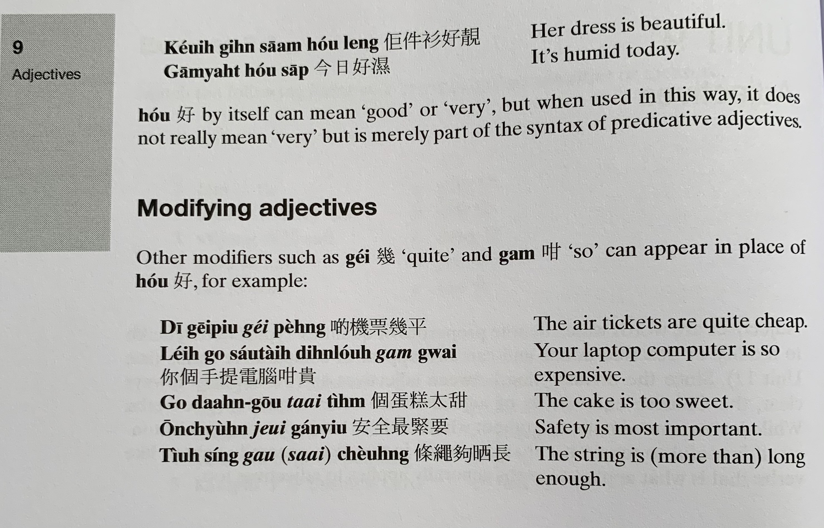
keoi5 gin6 saam1 hou2 leng3
gam1 jat6 hou2 sap1
di1 gei1 piu3 gei2 peng4
nei5 go3 sau2 tai4 din6 nou5 gam3 gwai3
go3 daan6 gou1 taai3 tim4
on1 cyun4 zeoi3 gan2 jiu3
tiu3 sing2 gau3 saai3 coeng4

Slide 4
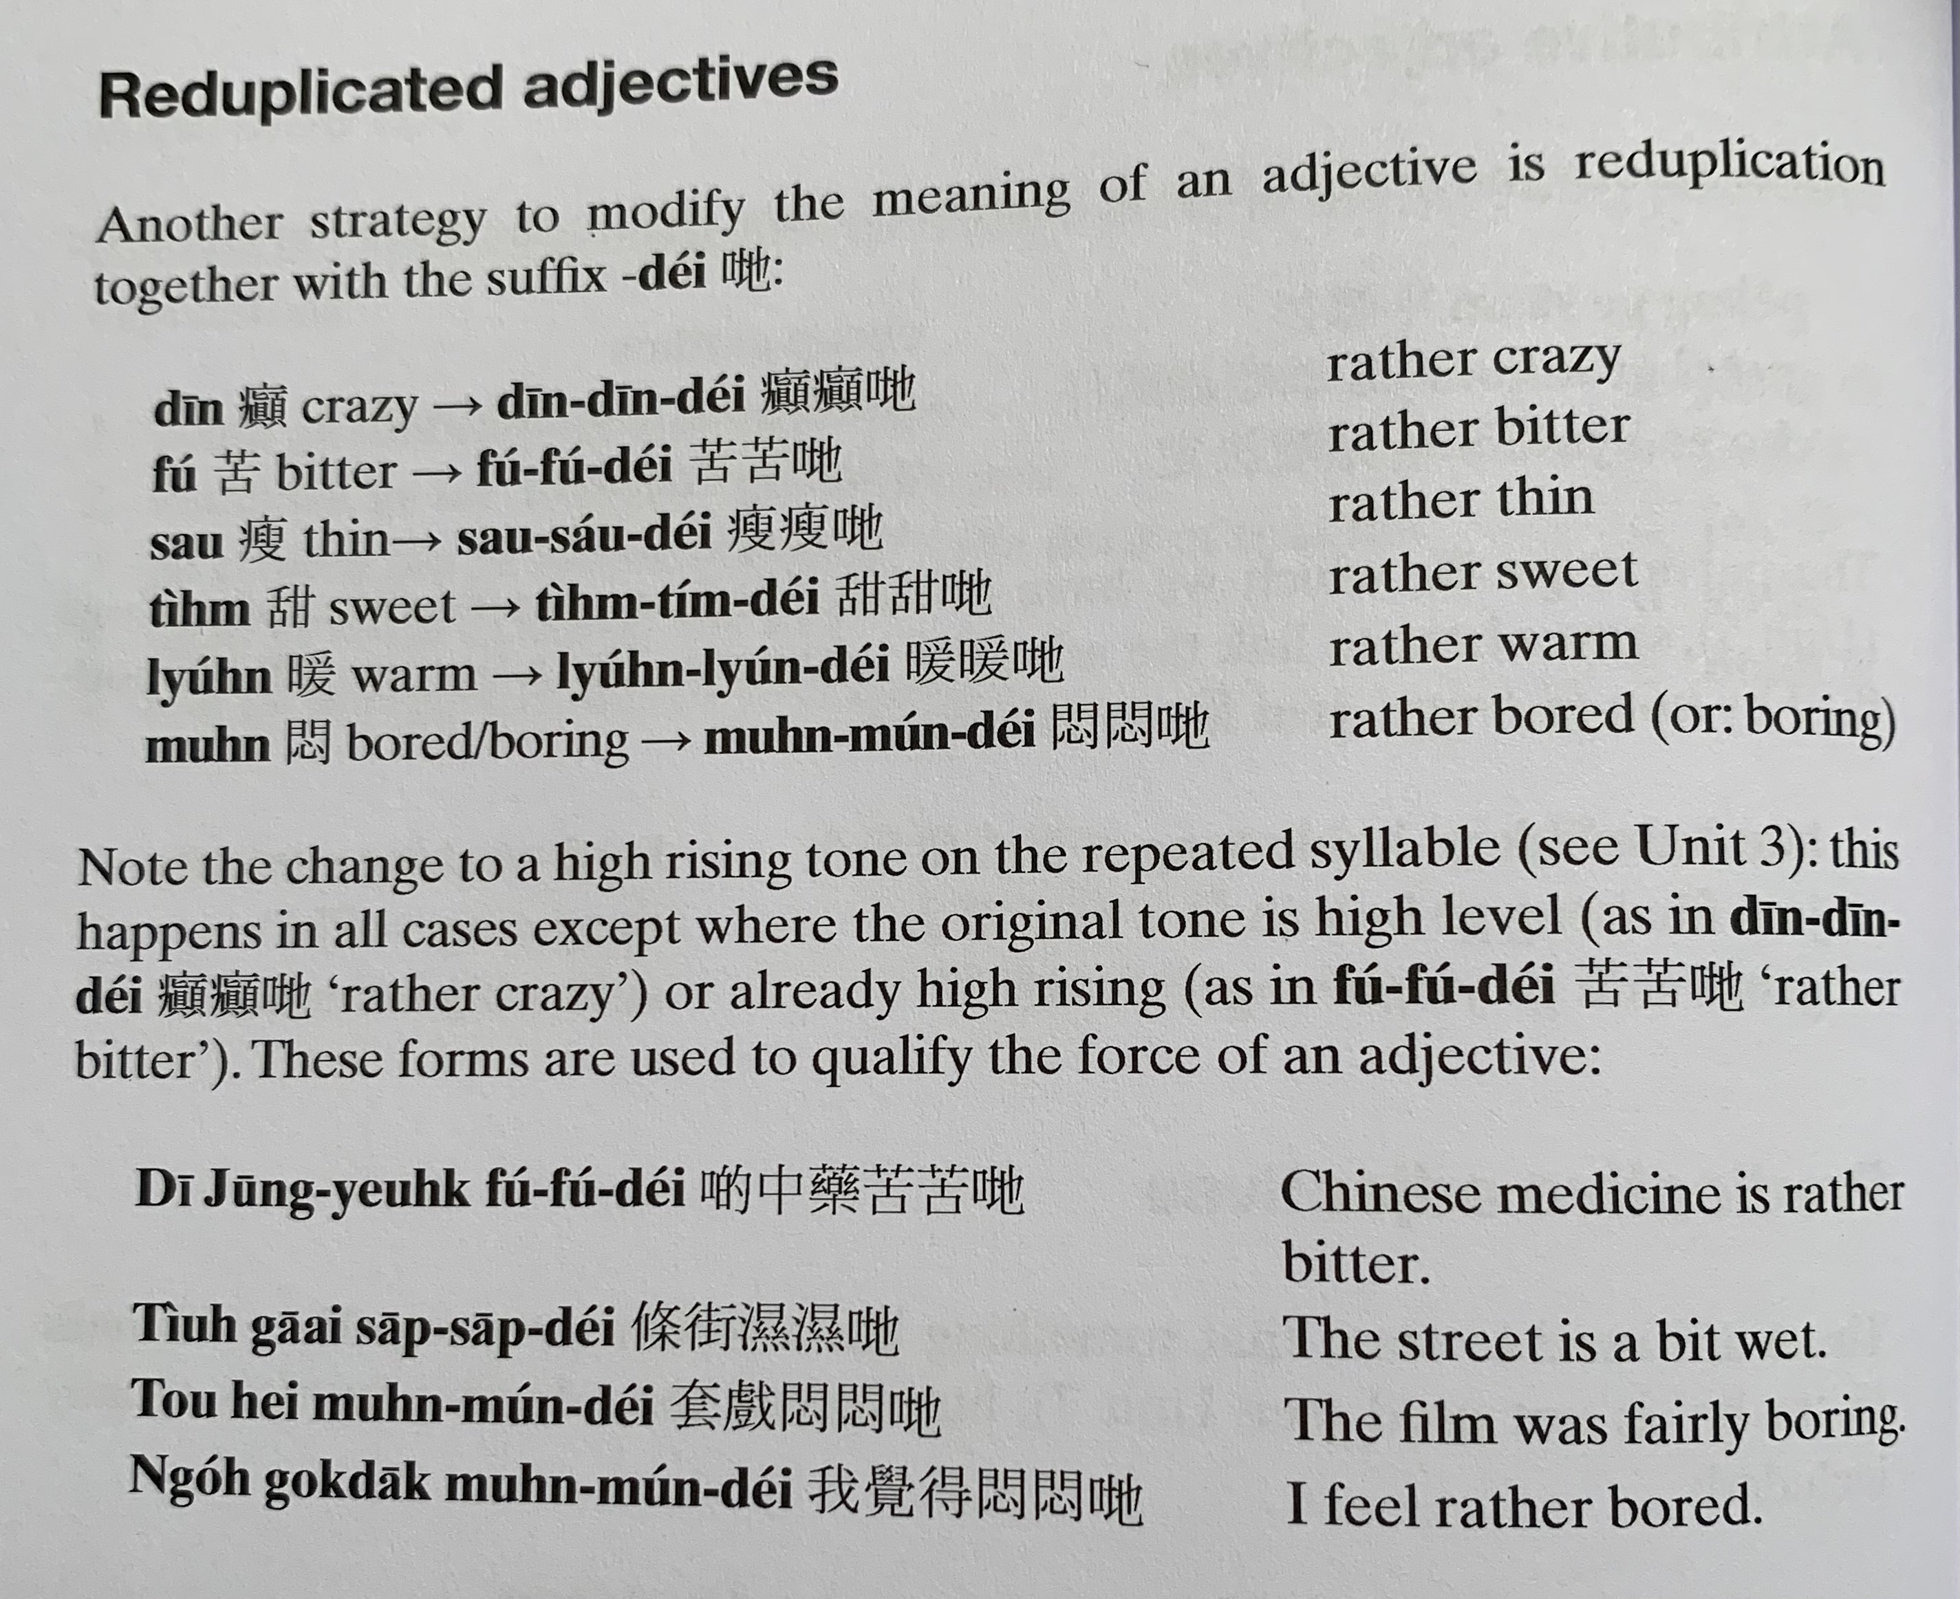
tim4
Tim4 tim2 dei2
nyun5
Nyun5 nyun5 dei2
mun6
Mun6 mun2 dei2
di1 zung1 joek6 fu2 fu2 dei2
tiu4 gaai1 sap1 sap1 dei2
tou3 hei3 mun6 mun2 dei2
ngo5 gok3 dak1 mun6 mun2 dei2

Slide 5
ngo5 go4 go1 hai2 jat1 gaan1 hou2 jau5 meng2 ge3 gung1 si1 zou6 je5
keoi5 uk1 kei2 jau5 go3
haak3 teng1
deoi3 min6 jau5 gaan1
caan1 teng1
ngo5 zeoi3 gan6 tai2 zo2

Slide 6
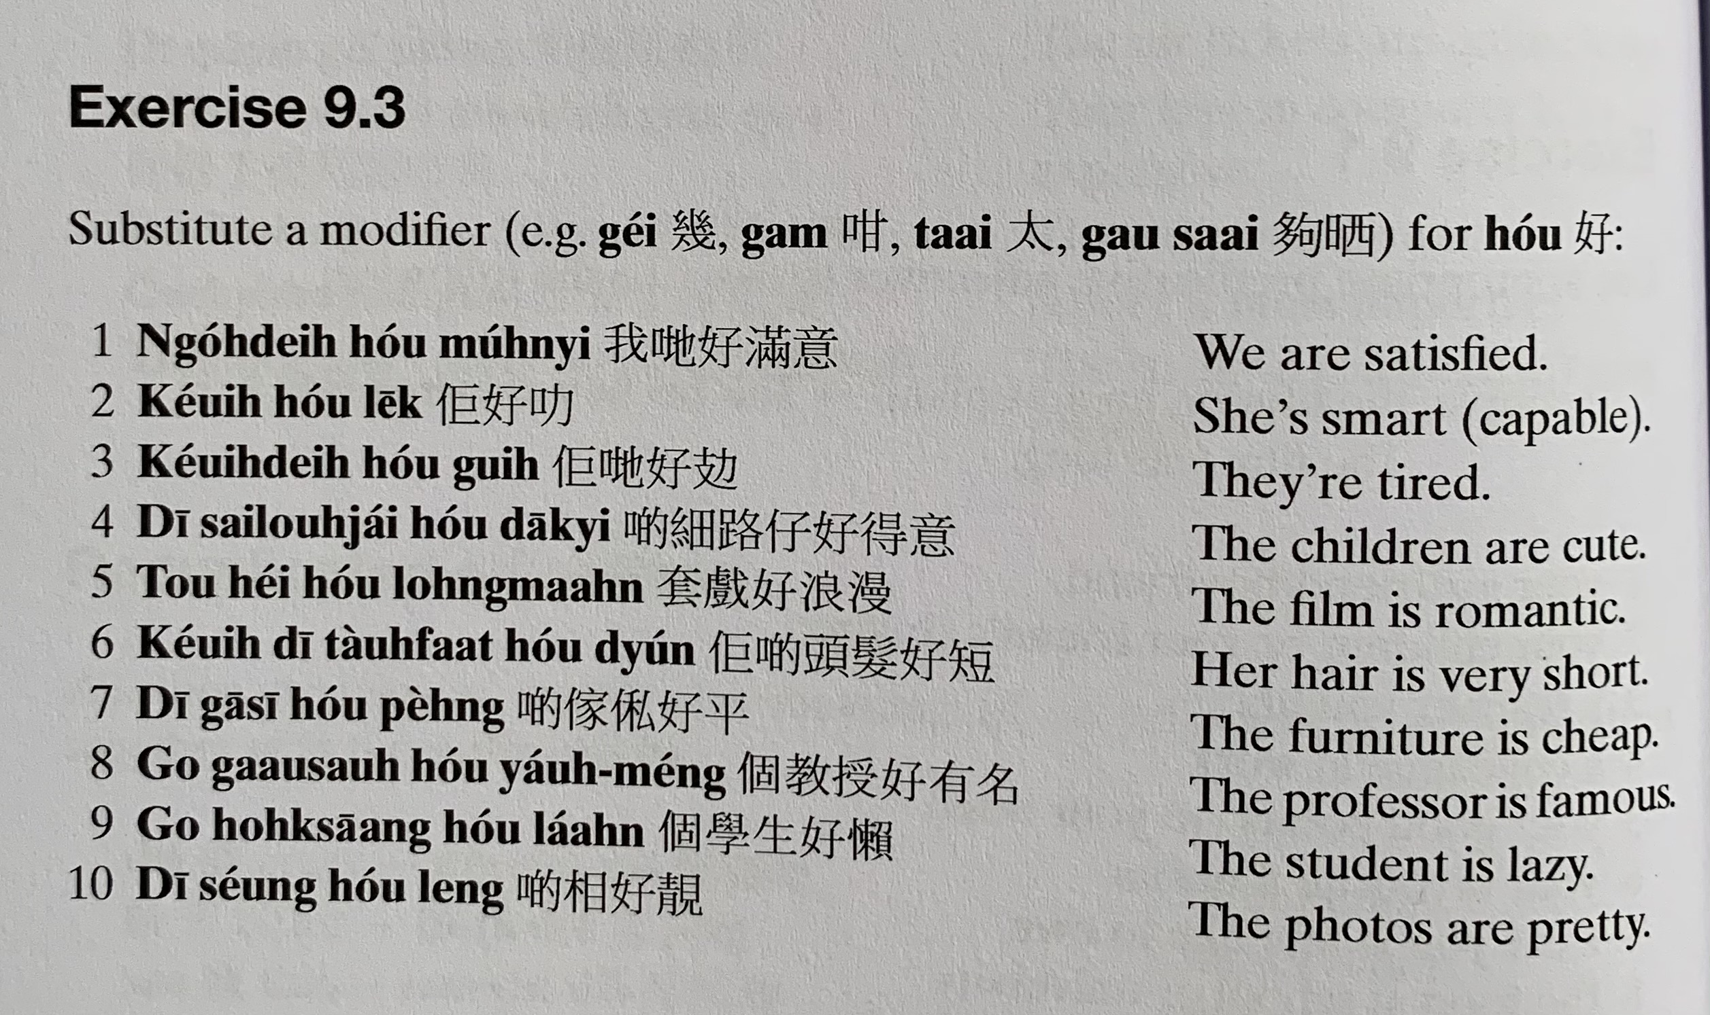
gaa1 si1 peng4
mun5 zuk1
lek1
Gui6 攰
dak1 ji3
套戲 tou3 hei3
long6 maan6
tau4 faat3…dyun2
gaa1 si1家俬 peng4
gaau3 sau6…ceot1 meng2
laan5
soeng2... leng3

Slide 7
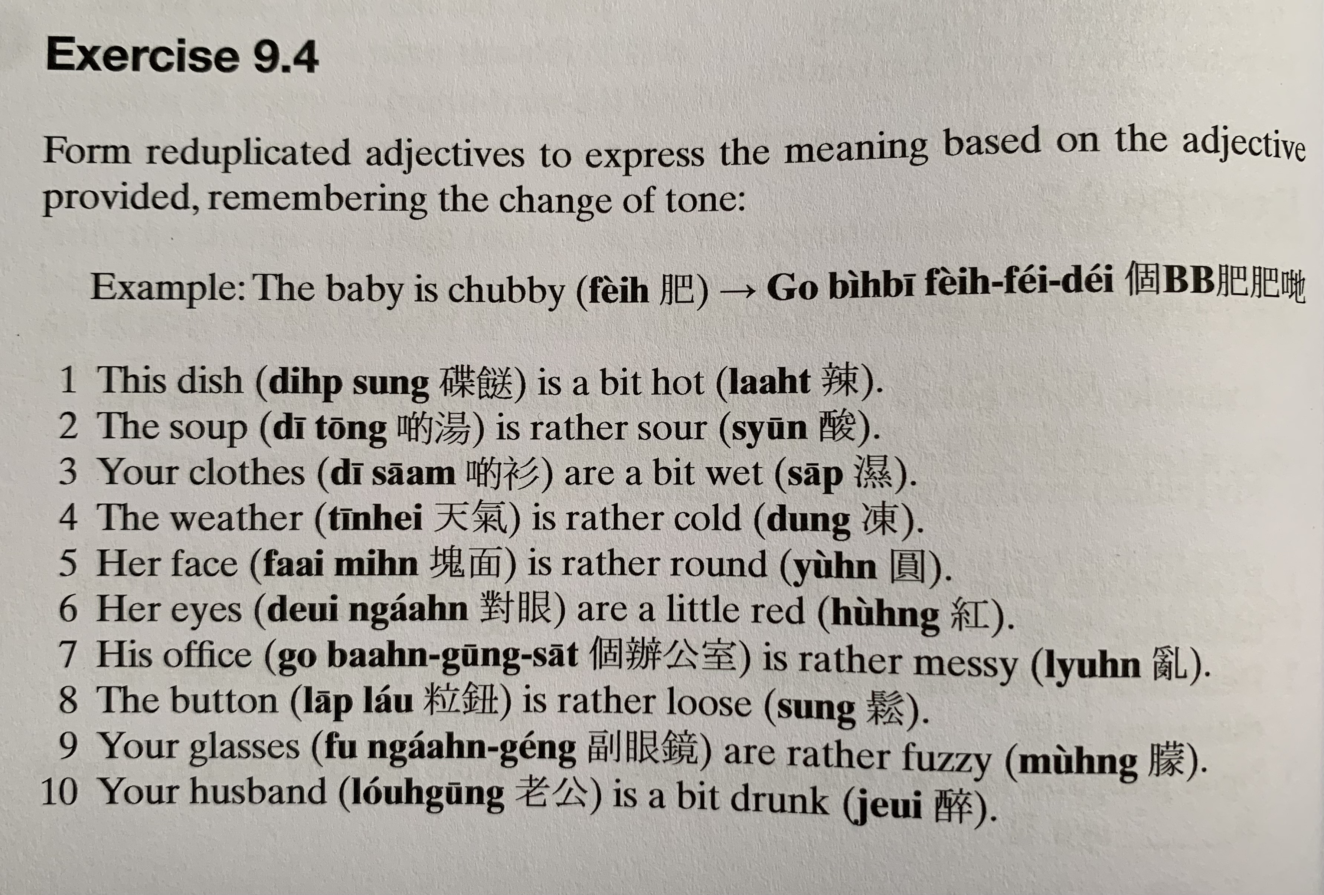
dip6 sung1
laat6
tong1
syun1
saam1
tin1 hei3
dung3
faai3 min6
jyun4
deoi3 ngaan5
hung4
baan6 gung1 sat1
lyun6
lap1 lau2
sung1
fu3 ngaan5 geng2
mung4
lou5 gung1
zeoi3

Slide 8
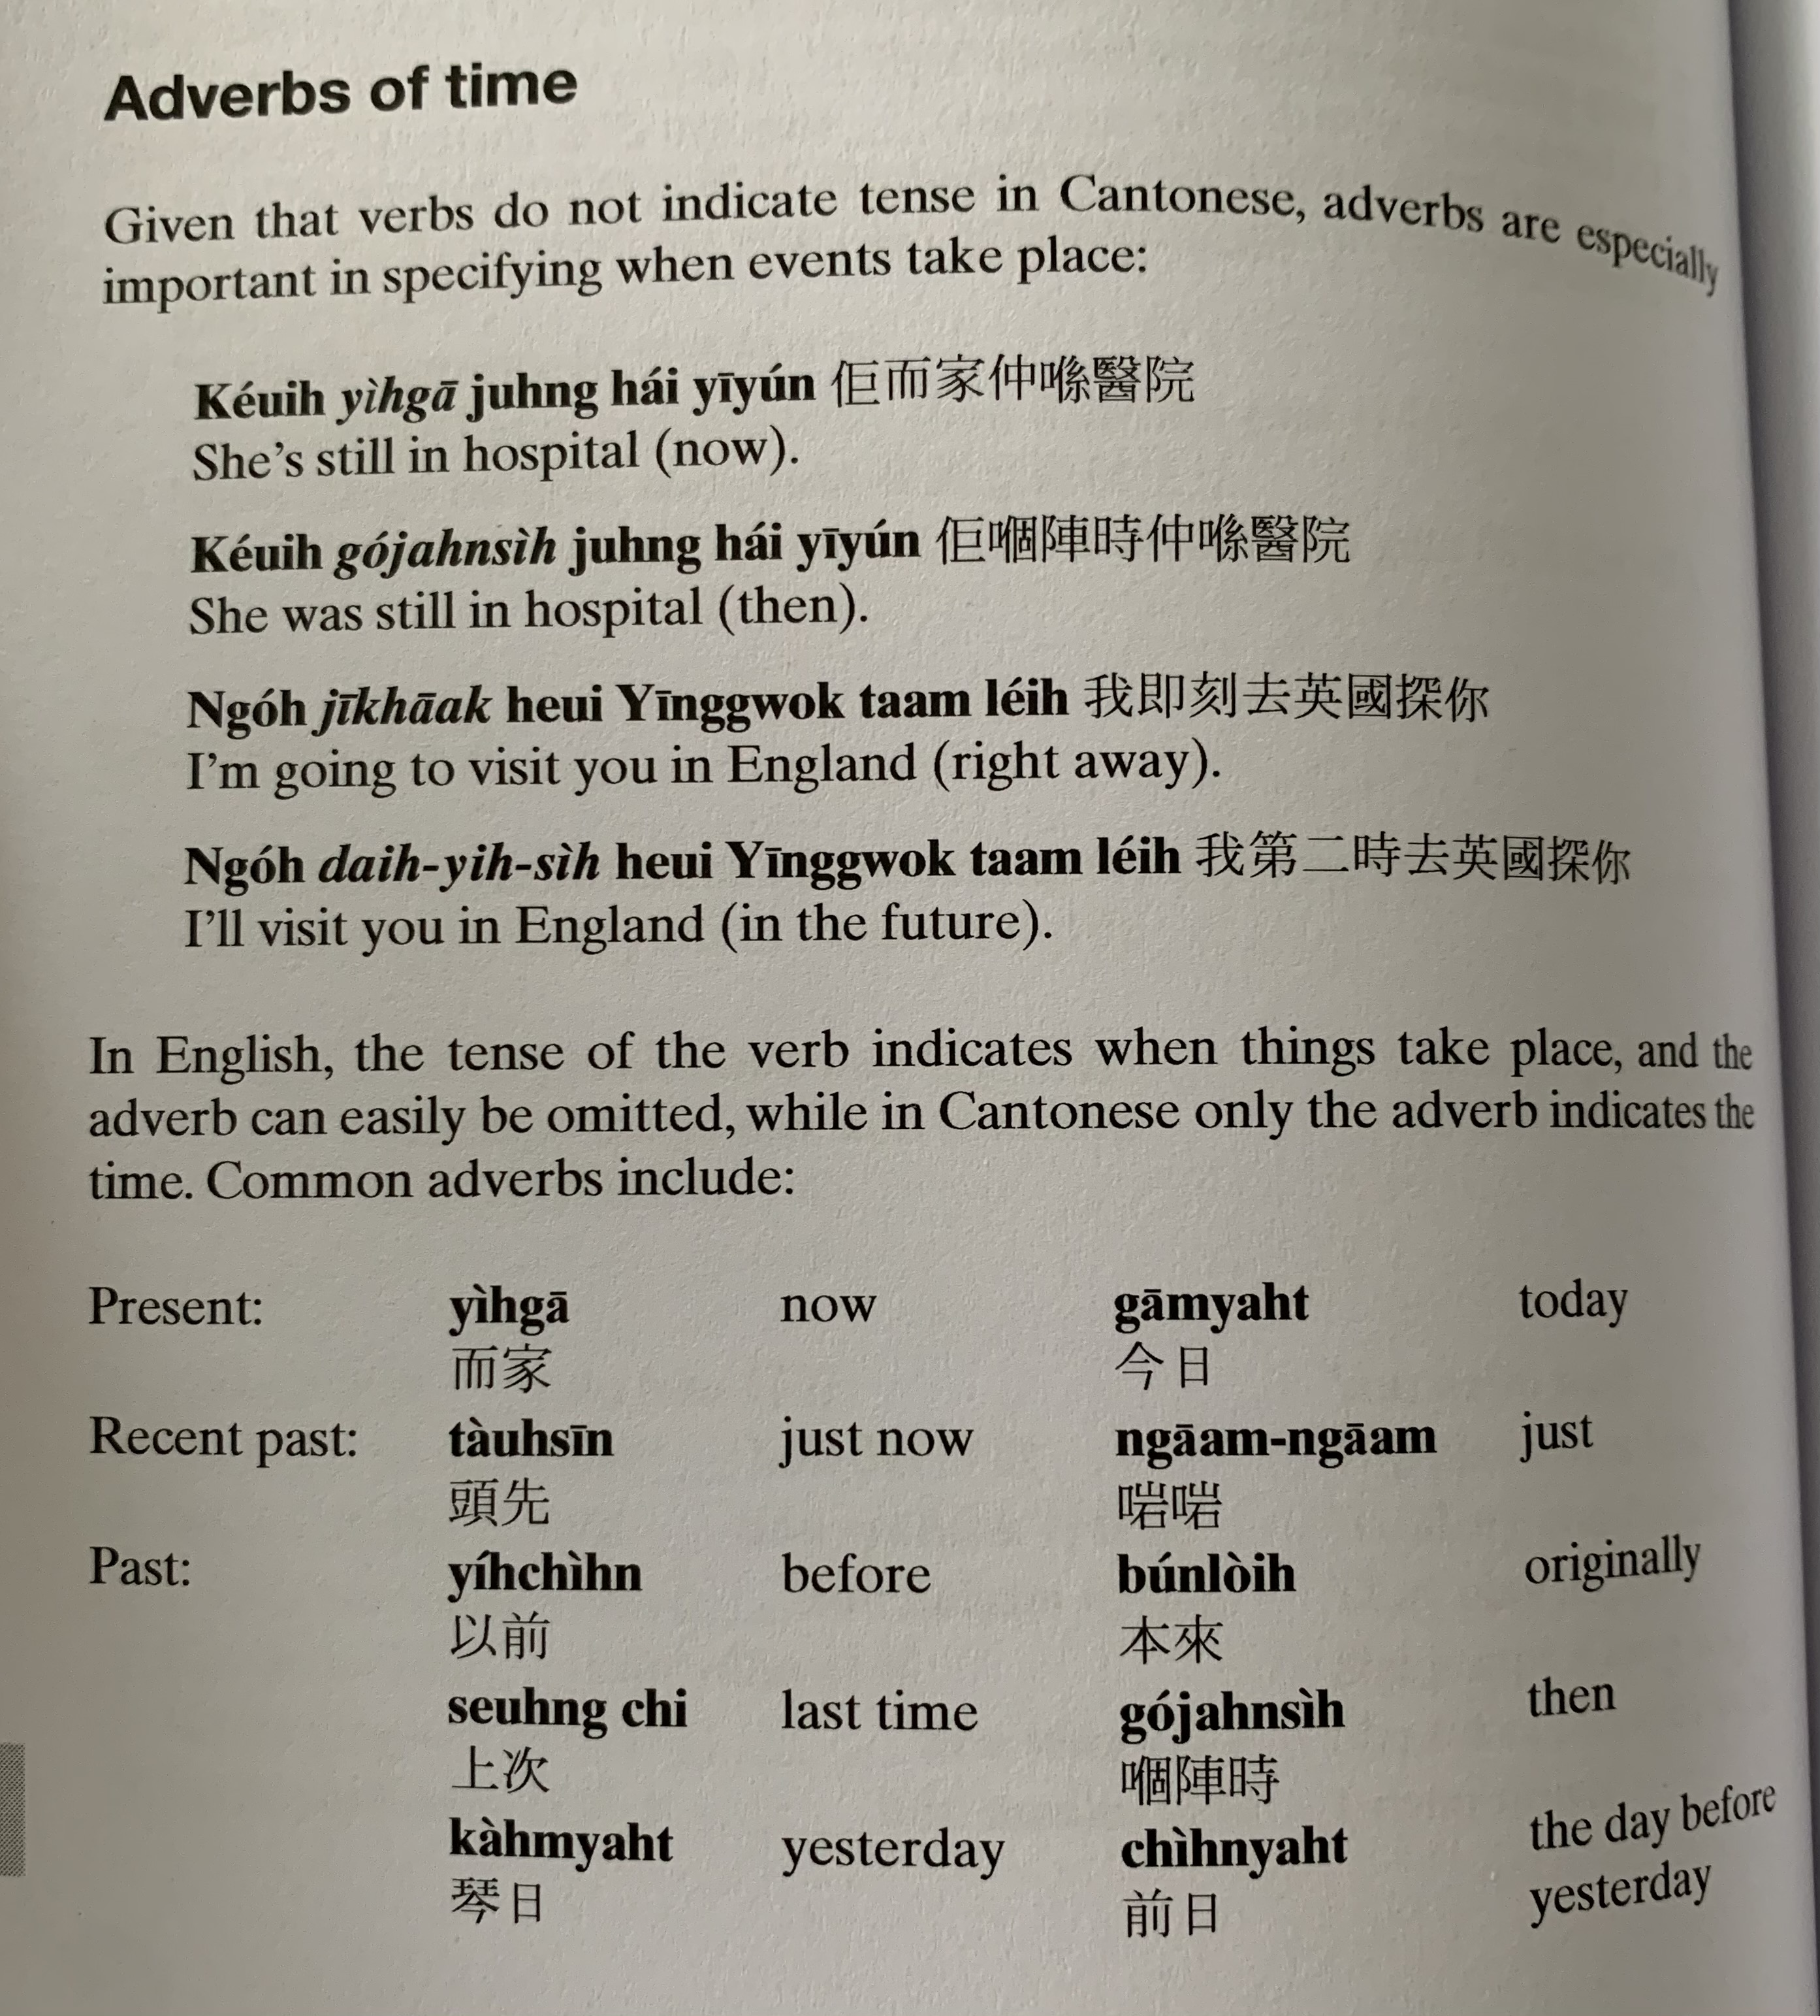
keoi5 ji4 gaa1 zung6 hai2 ji1 jyun2
keoi5 go2 zan6 si4 zung6 hai2 ji1 jyun2
ngo5 zik1 hak1 heoi3 jing1 gwok3 taam3 nei5
ngo5 dai6 ji6 si4 heoi3 jing1 gwok3 taam3 nei5
ji4 gaa1
gam1 jat6
tau4 sin1
ji5 cin4
bun2 loi4
soeng6 ci3
go2 zan6 si4
Kam4/cam4 jat6
cin4 jat6

Slide 9
zik1 hak1
dai6 （ji6） si4
haa6 ci3
dou3 si4
ting1 jat6
hau6 jat6
ngo5 dei6 ji4 gaa1 ceot1 heoi3
keoi5 ngaam1 ngaam1 zau2 zo2
bun2 loi4 ngo5 soeng2 duk6 ji1 fo1
tau4 sin1 keoi5 m4 gei3 dak1 daai3 so2 si4

Slide 10
Sing4/ seng4 jat6
jat1 ci3
do1 sou3
jau5 （zan6） si4
jat1 si4 si4
ping4 si4
tung1 soeng4
mui5
mui5 ci3
mui5 jat6
mui5 nin4
mui5 ziu1
mui5 maan5

Slide 11
Translate the following into Cantonese using the adverbs we just learnt.
1. I was in Prague 【bou3 laai1 gaak3】 (yesterday)
ngo5 cam4 jat6 hai2 bou3 laai1 gaak3 我尋日喺布拉格
2. She arrived at the university (just now)
Keoi5 ngaam1 ngaam1 dou3 zo2 daai6 hok6 佢啱啱到咗大學
3. I have met him (before)
ngo5 zi1 cin4/ ji5 cin4 gin3 gwo3 keoi5 我之前/以前見過佢
4. They won the first prize (last time)
keoi5 dei6 soeng6 ci3 jeng4 zo2 dai6 jat1 ming4 佢哋上次贏咗第一名
5. We were still small 【sai3 go3 細個】 (then)
ngo5 dei6 go2 zan6 zung6 sai3 go3 我地嗰陣仲細個
6. I used to be a nurse 【wu6 si6 護士】 (originally)
ngo5 bun2 loi4 hai6 go3 wu6 si6 我本來係個護士
7. We will contact 【lyun4 lok3 聯絡】you (next time)
ngo5 dei6 haa2 ci3 wui5 lyun4 lok3 nei5 我地下次會聯絡你
8. He got angry 【nau1 嬲】 (immediately)
keoi5 zik1 hak1 nau1 zo2 佢即刻嬲咗
9. I will treat you a meal 【ceng2 sik6 faan6 請吃飯】(in the future)
ngo5 dai6 si4 ceng2 nei5 sik6 faan6 我第時請你食飯
10. We used to live in America 【mei5 gwok3】 (before)
ngo5 ji5 cin4 zyu6 hai2 mei5 gwok3 我以前住喺美國
11. I planned to go to Taiwan (originally)
ngo5 bun2 loi4 daa2 syun3 heoi3 toi4 waan1 我本來打算去台灣
12. I will go to Hong Kong (next time)
ngo5 haa6 ci3 wui5 heoi3 hoeng1 gong2 我下次會去香港
13. My father arrived home (just now)
ngo5 baa4 baa1 ngaam1 ngaam1 faan1 zo2 uk1 kei2 我爸爸啱啱返咗屋企
14. I liked swimming (then)
ngo5 go2 zan6 zung1 ji3 jau4 seoi2 我嗰陣鍾意游水

Slide 12
Jau4 seoi2
游水
swimming
Zou6 gym
做gym
Go to the gym
Gin6 san1
健身
Go to the gym
Zyu2 je5 sik6
煮嘢食
Cooking
Haang4 saan1
行山
Hiking
Caai2 daan1 ce1
踩單車
Cycling
Teng1 jam1 ngok6
聽音樂
Listen to music
Ask: How often do you _____ ?
Answer with with frequency we just learnt
sing4 jat6
jat1 ci3
do1 sou3
jau5 （zan6） si4
jat1 si4 si4
ping4 si4
tung1 soeng4
mui5
mui5 ci3
mui5 jat6
mui5 nin4
mui5 ziu1
mui5 maan5

Slide 13
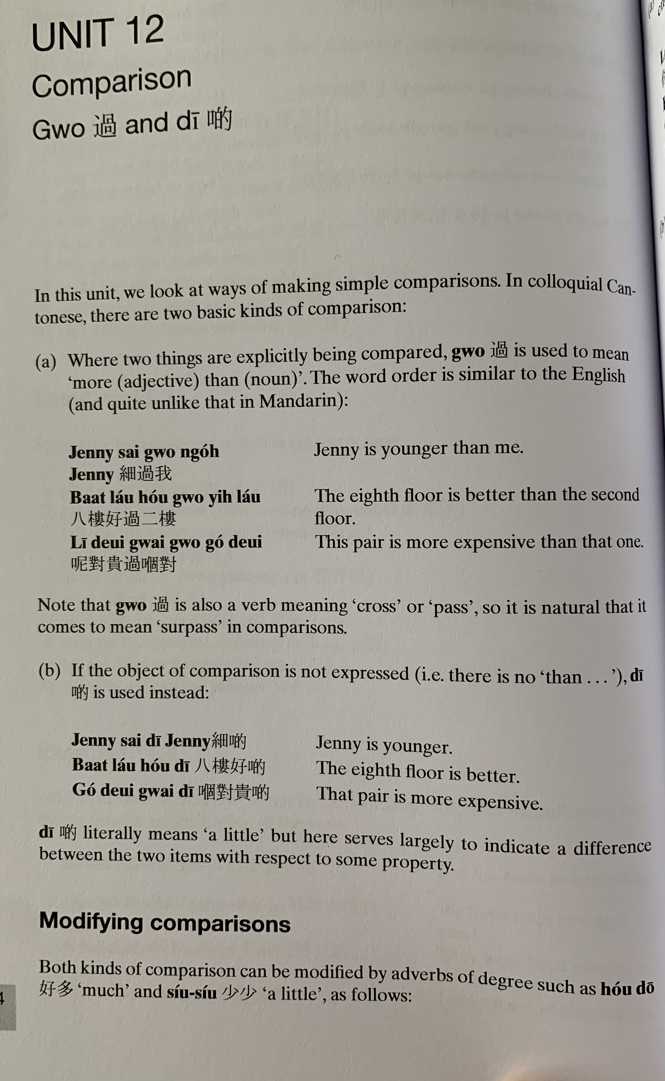
Gwo3
sai3 gwo3 ngo5
baat3 lau2 hou2 gwo3 ji6 lau2
ni1 deoi3 gwai3 gwo3 go2 deoi3
Jenny sai3 di1
baat3 lau2 hou2 di1
go2 deoi3 gwai3 di1

Slide 14
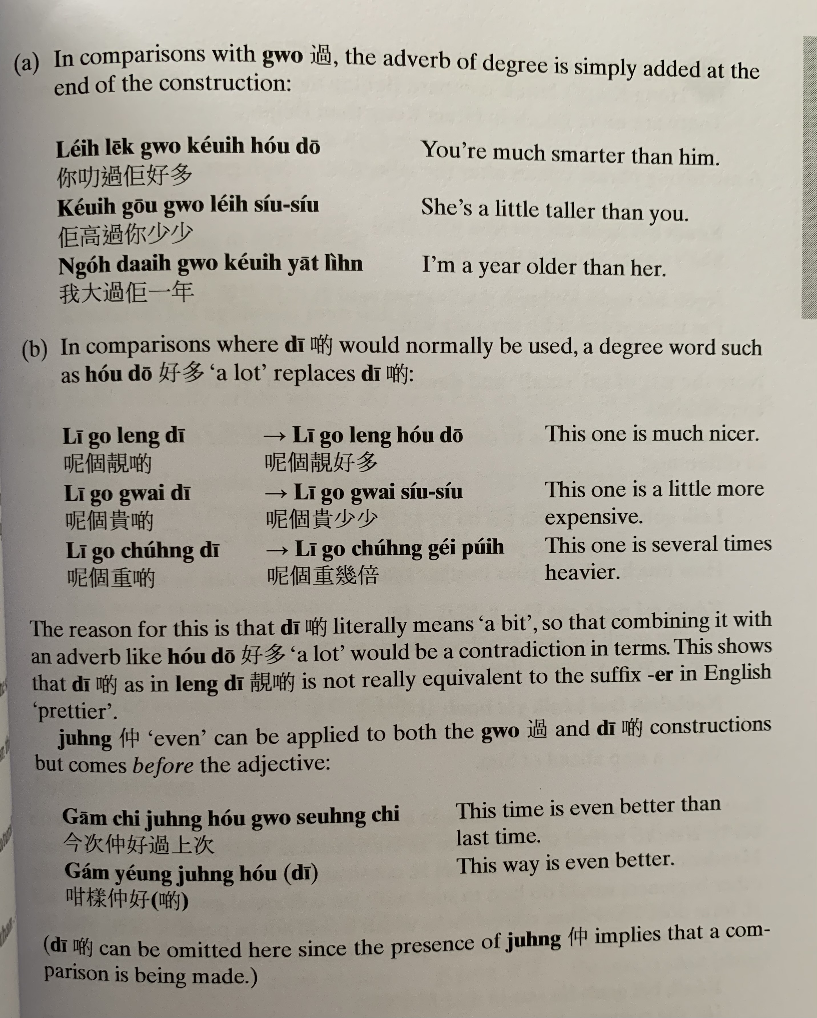
nei5 lek1 gwo3 keoi5 hou2 do1
keoi5 gou1 gwo3 nei5 siu2 siu2
ngo5 daai6 gwo3 keoi5 jat1 nin4
ni1 go3 cung5 di1
ni1 go3 cung5 gei2 pui5

Slide 15
zung6
gam1 ci3 zung6 hou2 gwo3 soeng6 ci3
gam2 joeng2 zung6 hou2 di1

Slide 16
Translate the following into Cantonese
1. It’s warmer today (nyun5 暖）
gam1 jat6 nyun5 di1 今日暖啲
2. She is happier now
keoi5 ji4 gaa1 hoi1 sam1 di1 佢而家開心啲
3. My friend is older than me
ngo5 pang4 jau5 daai6 gwo3 ngo5 我朋友大過我
4. She is much taller than before
keoi5 gou1 gwo3 ji5 cin4 hou2 do1 佢高過以前好多
5. It’s slower this time
gam1 ci3 maan6 di1 今次慢啲
6. This restaurant is cheaper than that one
ni1 gaan1 caan1 teng1 peng4 gwo3 go2 gaan2 呢間餐廳平過嗰間
7. Cycling is better than walking （haang4 lou6 行路）
caai2 daan1 ce1 hou2 gwo3 haang4 lou6 踩單車好過行路
8. Your idea is better (zyu2 ji3 主意）
nei5 ge3 zyu2 ji3 hou2 di1 你嘅主意好啲

Slide 17
Make the following comparisons more explicit using the adverb given in brackets:
This year is (much) colder [dung3凍] than last year
It’s (much) warmer [nyun5 暖] today
Your hair is (a little) shorter [dyun2短] now
Hong Kong is (several times) more expensive than here
I’m (even) more tired [gui6 攰 ] than she is
Eating rice is (even) cheaper than eating noodles
She is (5cm lei4 mai5厘米) taller than me
My elder brother is (20 pounds bong6磅) heavier than me

Slide 18
Tell us:
What you planned to do last year but couldn’t do.
What activities do you like to do? How often you do them?
Compare yourself with your family member/ friend

Slide 19
邊個 | Who | Bin1 go6
咩 / 乜嘢 | what | Me1 / Mat1 je5
邊度 | Where | Bin1 dou6
點解 | Why | Dim2 gaai2
幾時 | When | Gei2 si4
點（樣） | How | Dim2 （yoeng2）
幾多 | How many/ much | Gei2 do1

