Slide 1
Cantonese II
Week 9

Slide 2
Tell us:
What you planned to do last year (gau6 nin2) but couldn’t do.
羅馬尼亞 lo4 maa5 nei4 aa3
本來想去音樂會 bun2 loi4 soeng2 heoi3 jam1 ngok6 wui2
What activities do you like to do? How often you do them?
每日
差唔多 caa1 m4 do1
Compare yourself with your family member/ friend

Slide 3
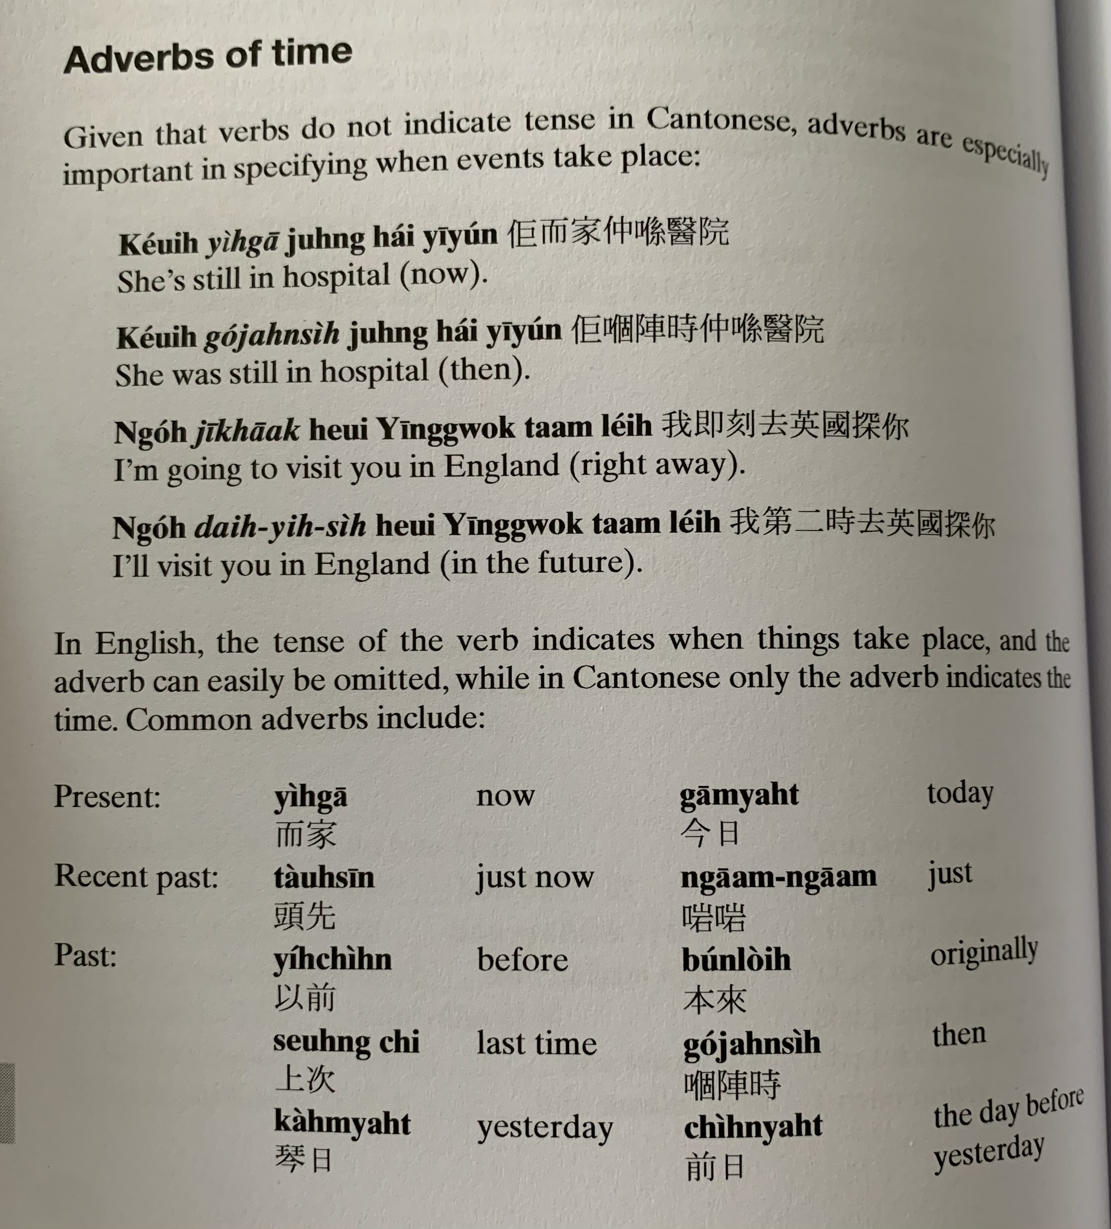
keoi5 ji4 gaa1 zung6 hai2 ji1 jyun2
keoi5 go2 zan6 si4 zung6 hai2 ji1 jyun2
ngo5 zik1 hak1 heoi3 jing1 gwok3 taam3 nei5
ngo5 dai6 ji6 si4 heoi3 jing1 gwok3 taam3 nei5
ji4 gaa1
gam1 jat6
tau4 sin1
ji5 cin4
bun2 loi4
soeng6 ci3
go2 zan6 si4
Kam4/cam4 jat6
cin4 jat6

Slide 4
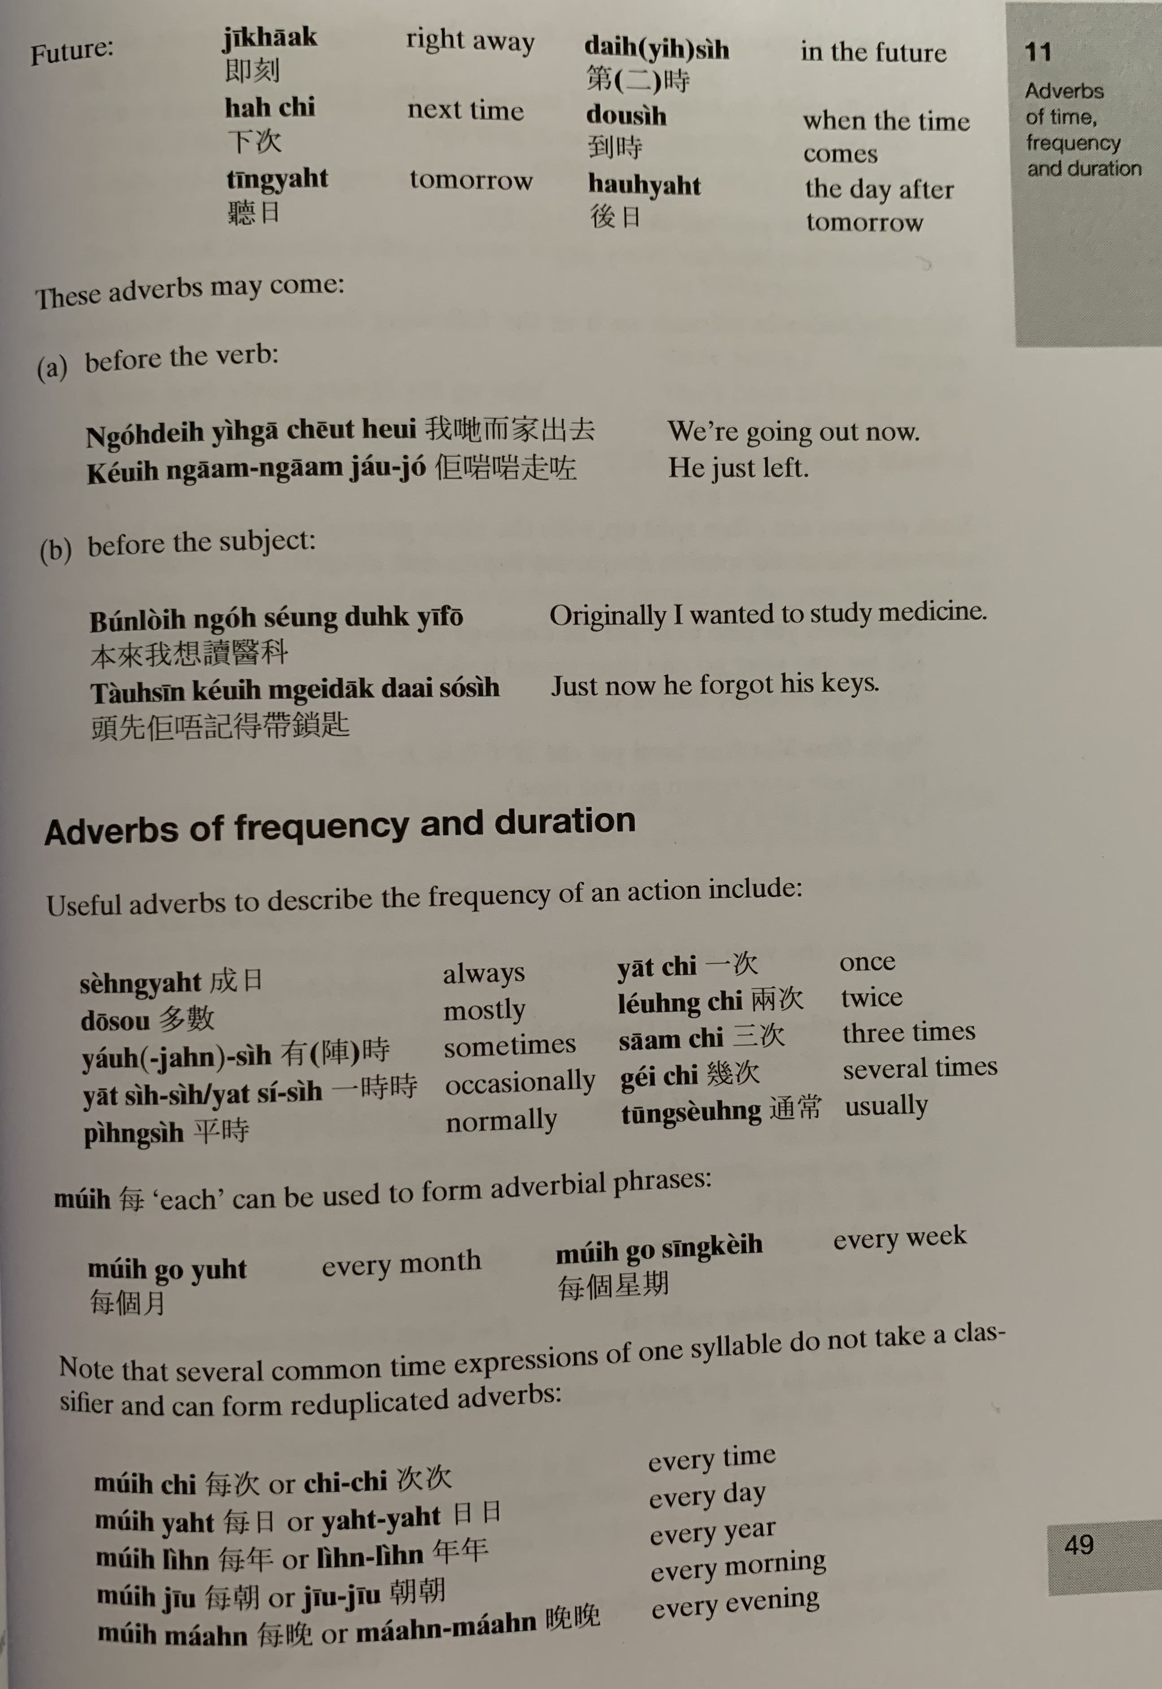
zik1 hak1
dai6 （ji6） si4
haa6 ci3
dou3 si4
ting1 jat6
hau6 jat6
ngo5 dei6 ji4 gaa1 ceot1 heoi3
keoi5 ngaam1 ngaam1 zau2 zo2
bun2 loi4 ngo5 soeng2 duk6 ji1 fo1
tau4 sin1 keoi5 m4 gei3 dak1 daai3 so2 si4

Slide 5
Sing4/ seng4 jat6
jat1 ci3
do1 sou3
jau5 （zan6） si4
jat1 si4 si4
ping4 si4
tung1 soeng4
mui5
mui5 ci3
mui5 jat6
mui5 nin4
mui5 ziu1
mui5 maan5

Slide 6
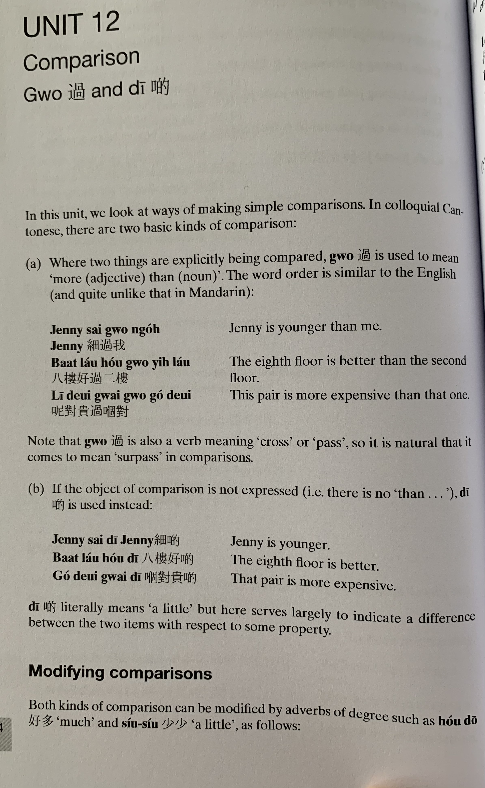
Gwo3
sai3 gwo3 ngo5
baat3 lau2 hou2 gwo3 ji6 lau2
ni1 deoi3 gwai3 gwo3 go2 deoi3
Jenny sai3 di1
baat3 lau2 hou2 di1
go2 deoi3 gwai3 di1

Slide 7
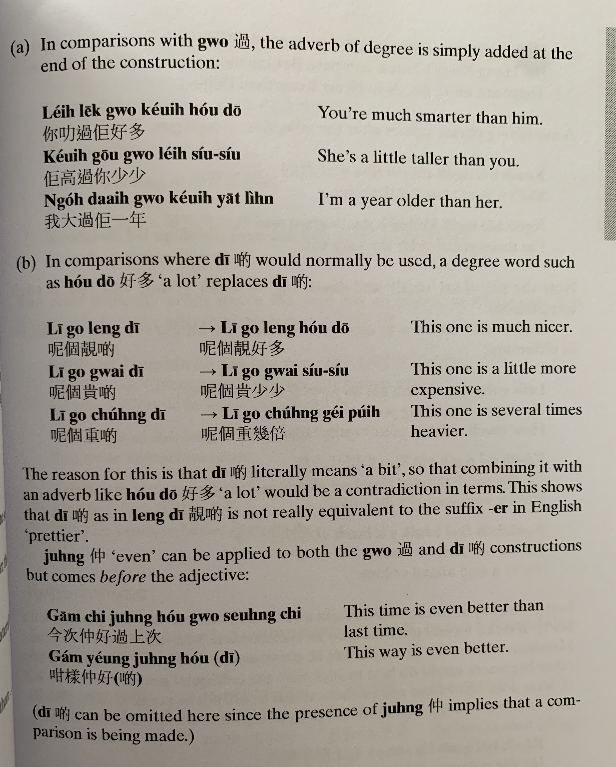
nei5 lek1 gwo3 keoi5 hou2 do1
keoi5 gou1 gwo3 nei5 siu2 siu2
ngo5 daai6 gwo3 keoi5 jat1 nin4
ni1 go3 cung5 di1
ni1 go3 cung5 gei2 pui5

Slide 8
zung6
gam1 ci3 zung6 hou2 gwo3 soeng6 ci3
gam2 joeng2 zung6 hou2 di1

Slide 9
Make the following comparisons more explicit using the adverb given in brackets:
This year is (much) colder [dung3凍] than last year
It’s (much) warmer [nyun5 暖] today
Your hair is (a little) shorter [dyun2短] now
Hong Kong is (several times) more expensive than here
I’m (even) more tired [gui6 攰 ] than she is
Eating rice is (even) cheaper than eating noodles
She is (5cm lei4 mai5厘米) taller than me
My elder brother is (20 pounds bong6磅) heavier than me

Slide 10
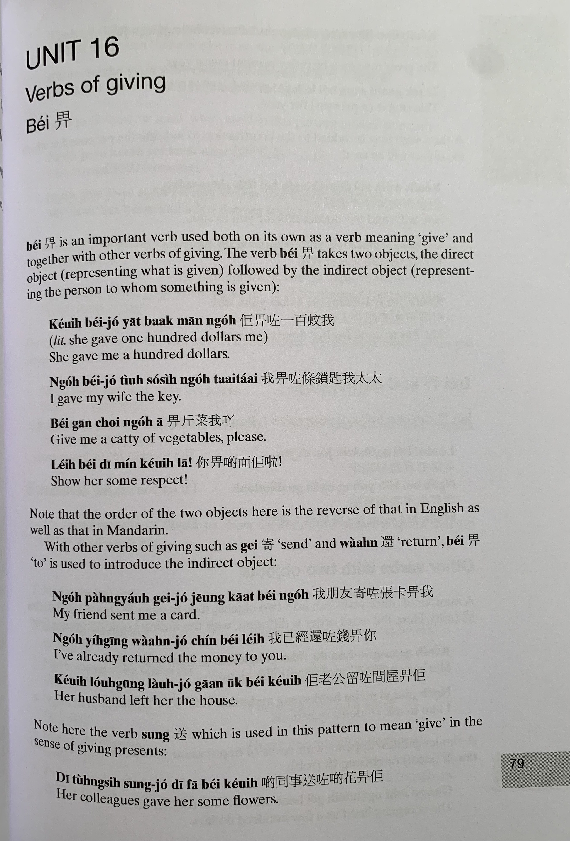
bei2
給
keoi5 bei2 zo2 jat1 baak3 man1 ngo5
ngo5 bei2 zo2 tiu4 so2 si4 ngo5 taai3 taai2
bei2 gan1 coi3 ngo5 aa1
nei5 bei2 di1 min2 keoi5 laa1

Slide 11
gei3
bei2
waan4
ngo5 pang4 jau5 gei3 zo2 zoeng1 kaat1 bei2 ngo5
ngo5 ji5 ging1 waan4 zo2 cin2 bei2 nei5
keoi5 lou5 gung1 lau4 zo2 gaan1 uk1 bei2 keoi5
sung3
di1 tung4 si6 sung3 zo2 di1 faa1 bei2 keoi5

Slide 12
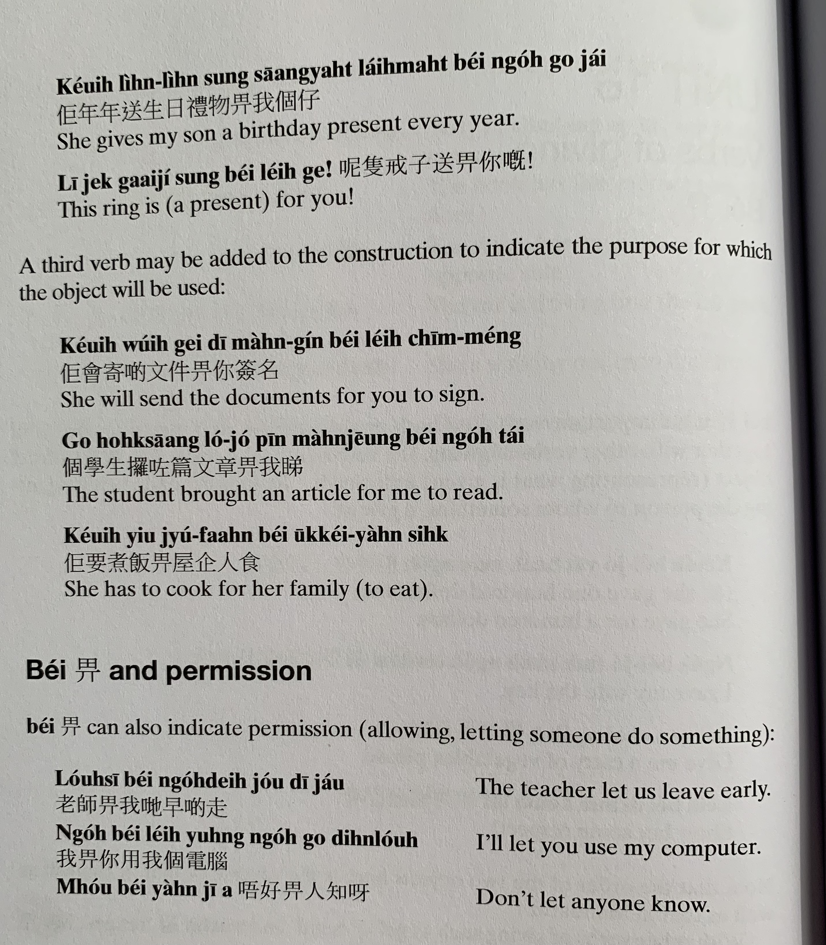
keoi5 nin4 nin4 sung3 saang1 jat6 lai5 mat6 bei2 ngo5 go3 zai2
ni1 zek3 gaai3 zi2 sung3 bei2 nei5 ge3
keoi5 wui5 gei3 di1 man4 gin2 bei2 nei5 cim1 meng2
go3 hok6 saang1 lo2 zo2 pin1 man4 zoeng1 bei2 ngo5 tai2
keoi5 jiu3 zyu2 faan6 bei2 uk1 kei5 jan4 sik6

Slide 13
lou5 si1 bei2 ngo5 dei6 zou2 di1 zau2
ngo5 bei2 nei5 jung6 ngo5 bou6 din6 nou5
m4 hou2 bei2 jan4 zi1 aa3

Slide 14
Translate the following into Cantonese
I have to pay (money)
You need to return some books.
I want to give a present (lai5 mat6 禮物) to my mom.
I gave my book to my friend to read.
I have to submit（gaau1交） homework （gung1 fo3功課）to the teacher
The teacher gave a lot of homework to us.
I will return some documents （man4 gin2 文件）to you
Grandma always gives presents to me
It is not allowed to eat (sik6 je5 食嘢） in the library （ tou4 syu1 gun2圖書館）
Kids are not allowed to drink alcohol （ jam2 zau2 飲酒）.

Slide 15
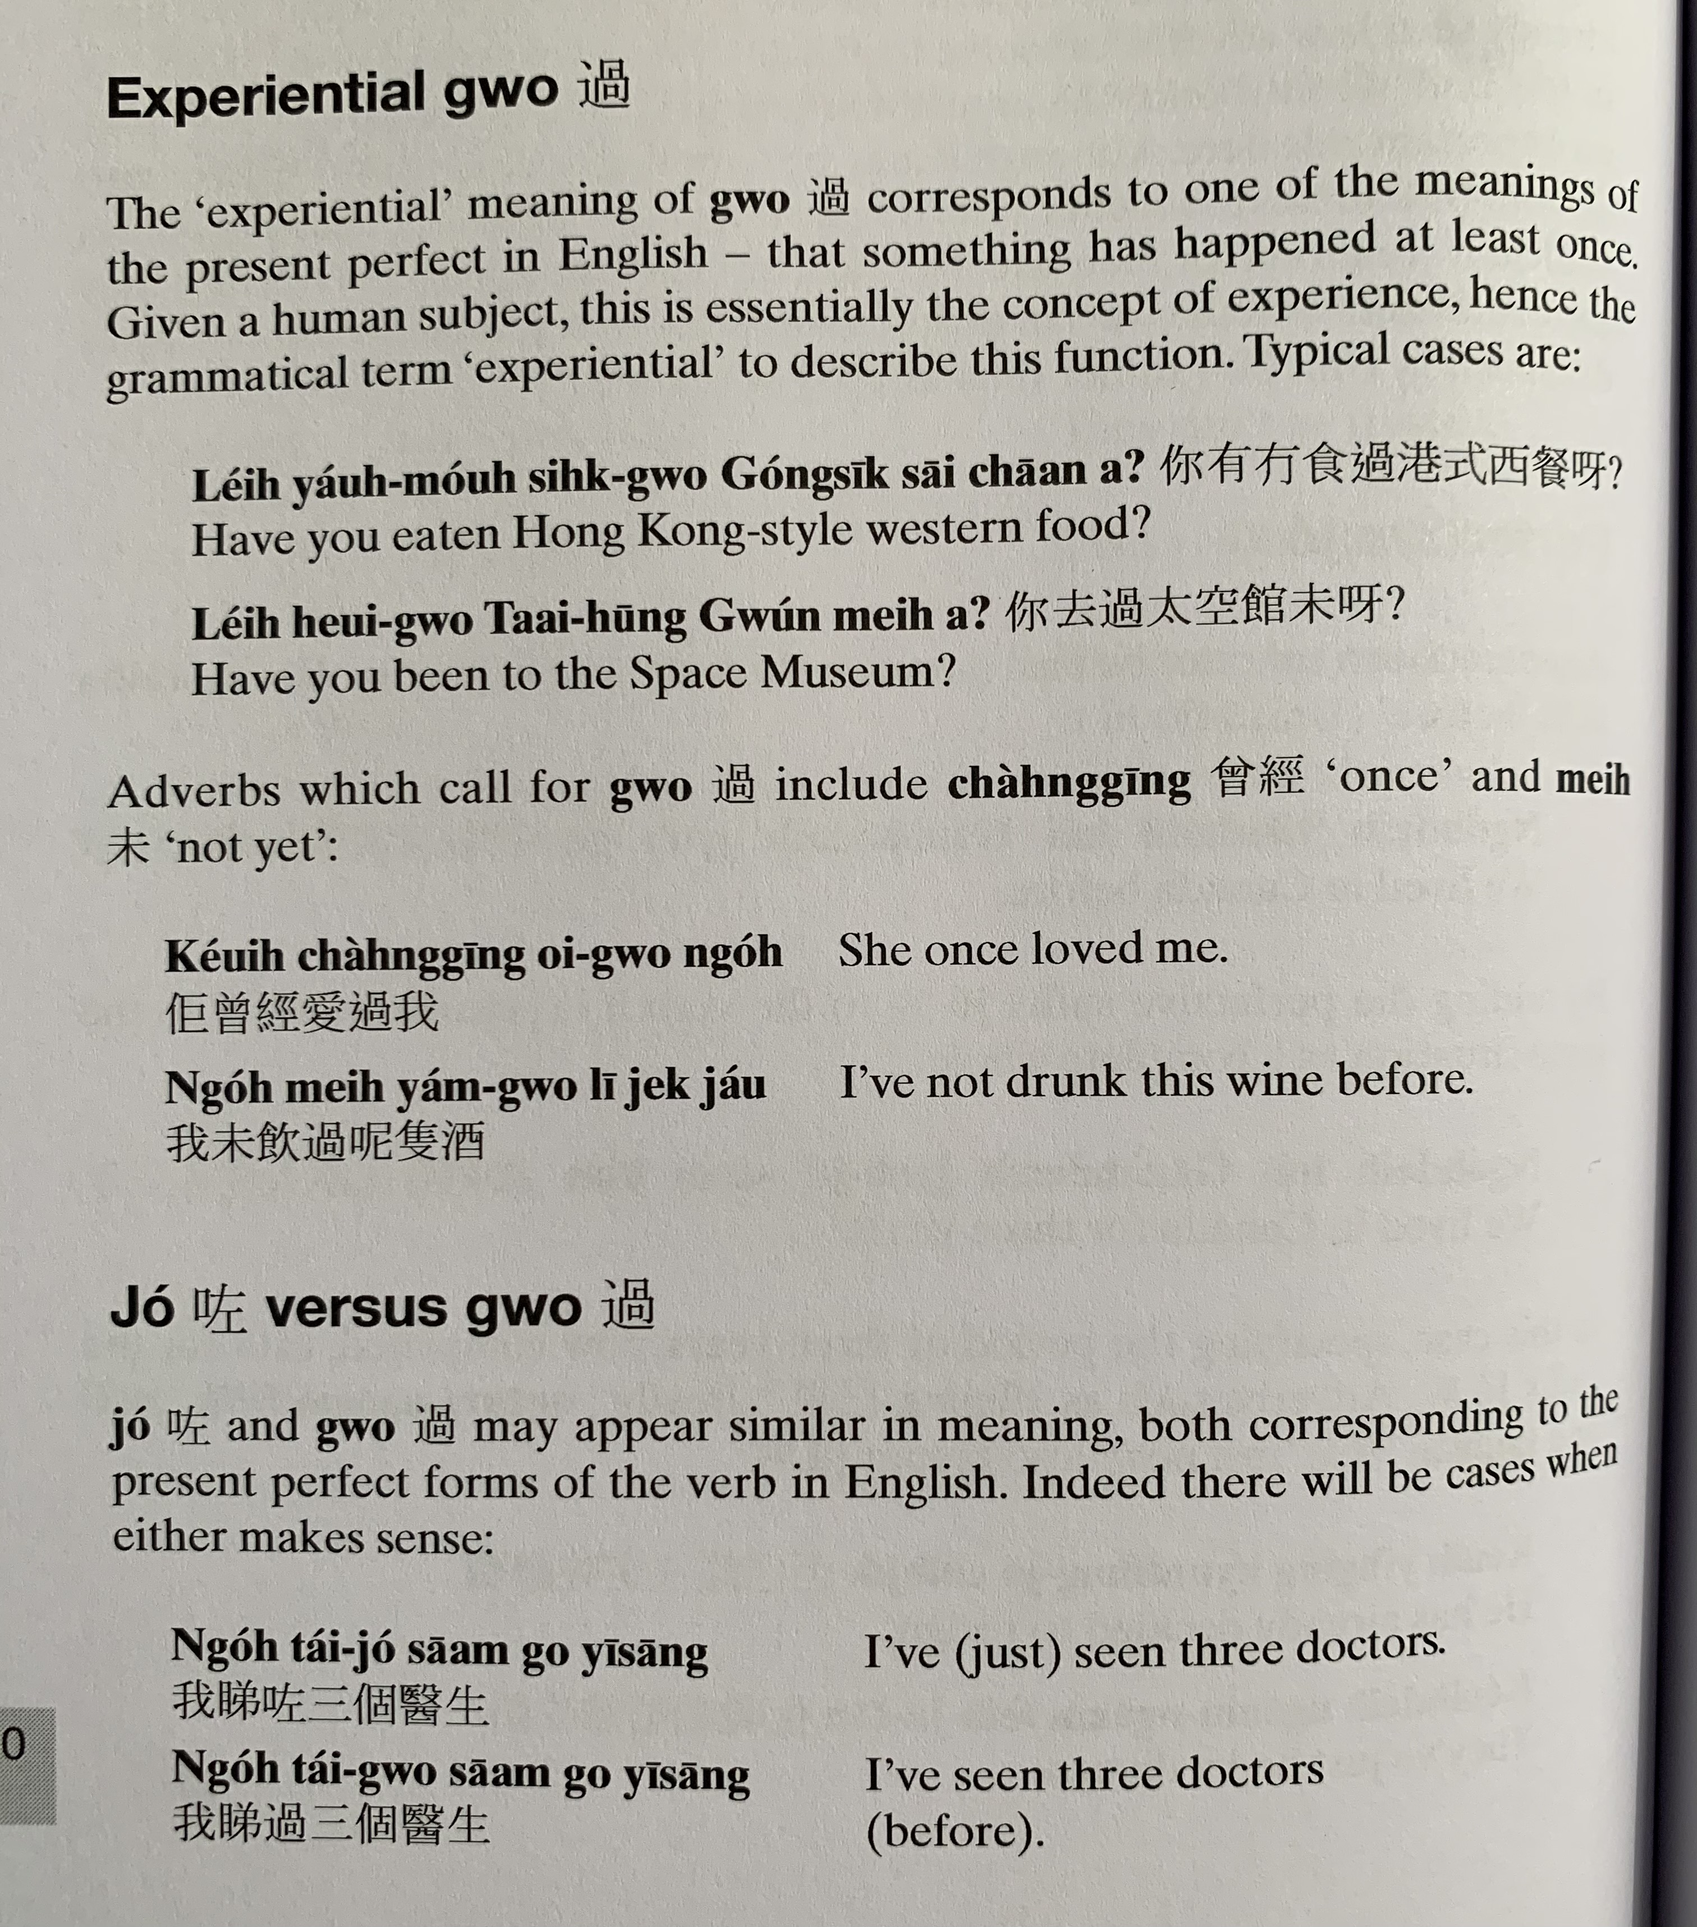
nei5 jau5 mou4 sik6 gwo3 gong2 sik1 sai1 caan1 aa3?
nei5 heoi3 gwo3 taai3 hung1 gun2 mei6 aa3?
cang4 ging1
mei6
keoi5 cang4 ging1 oi3 gwo3 ngo5
ngo5 mei6 jam2 gwo3 ni1 zek3 zau2

Slide 16
zo2
gwo3
ngo5 tai2 zo2 saam1 go3 ji1 sang1
ngo5 tai2 gwo3 saam1 go3 ji1 sang1

Slide 17
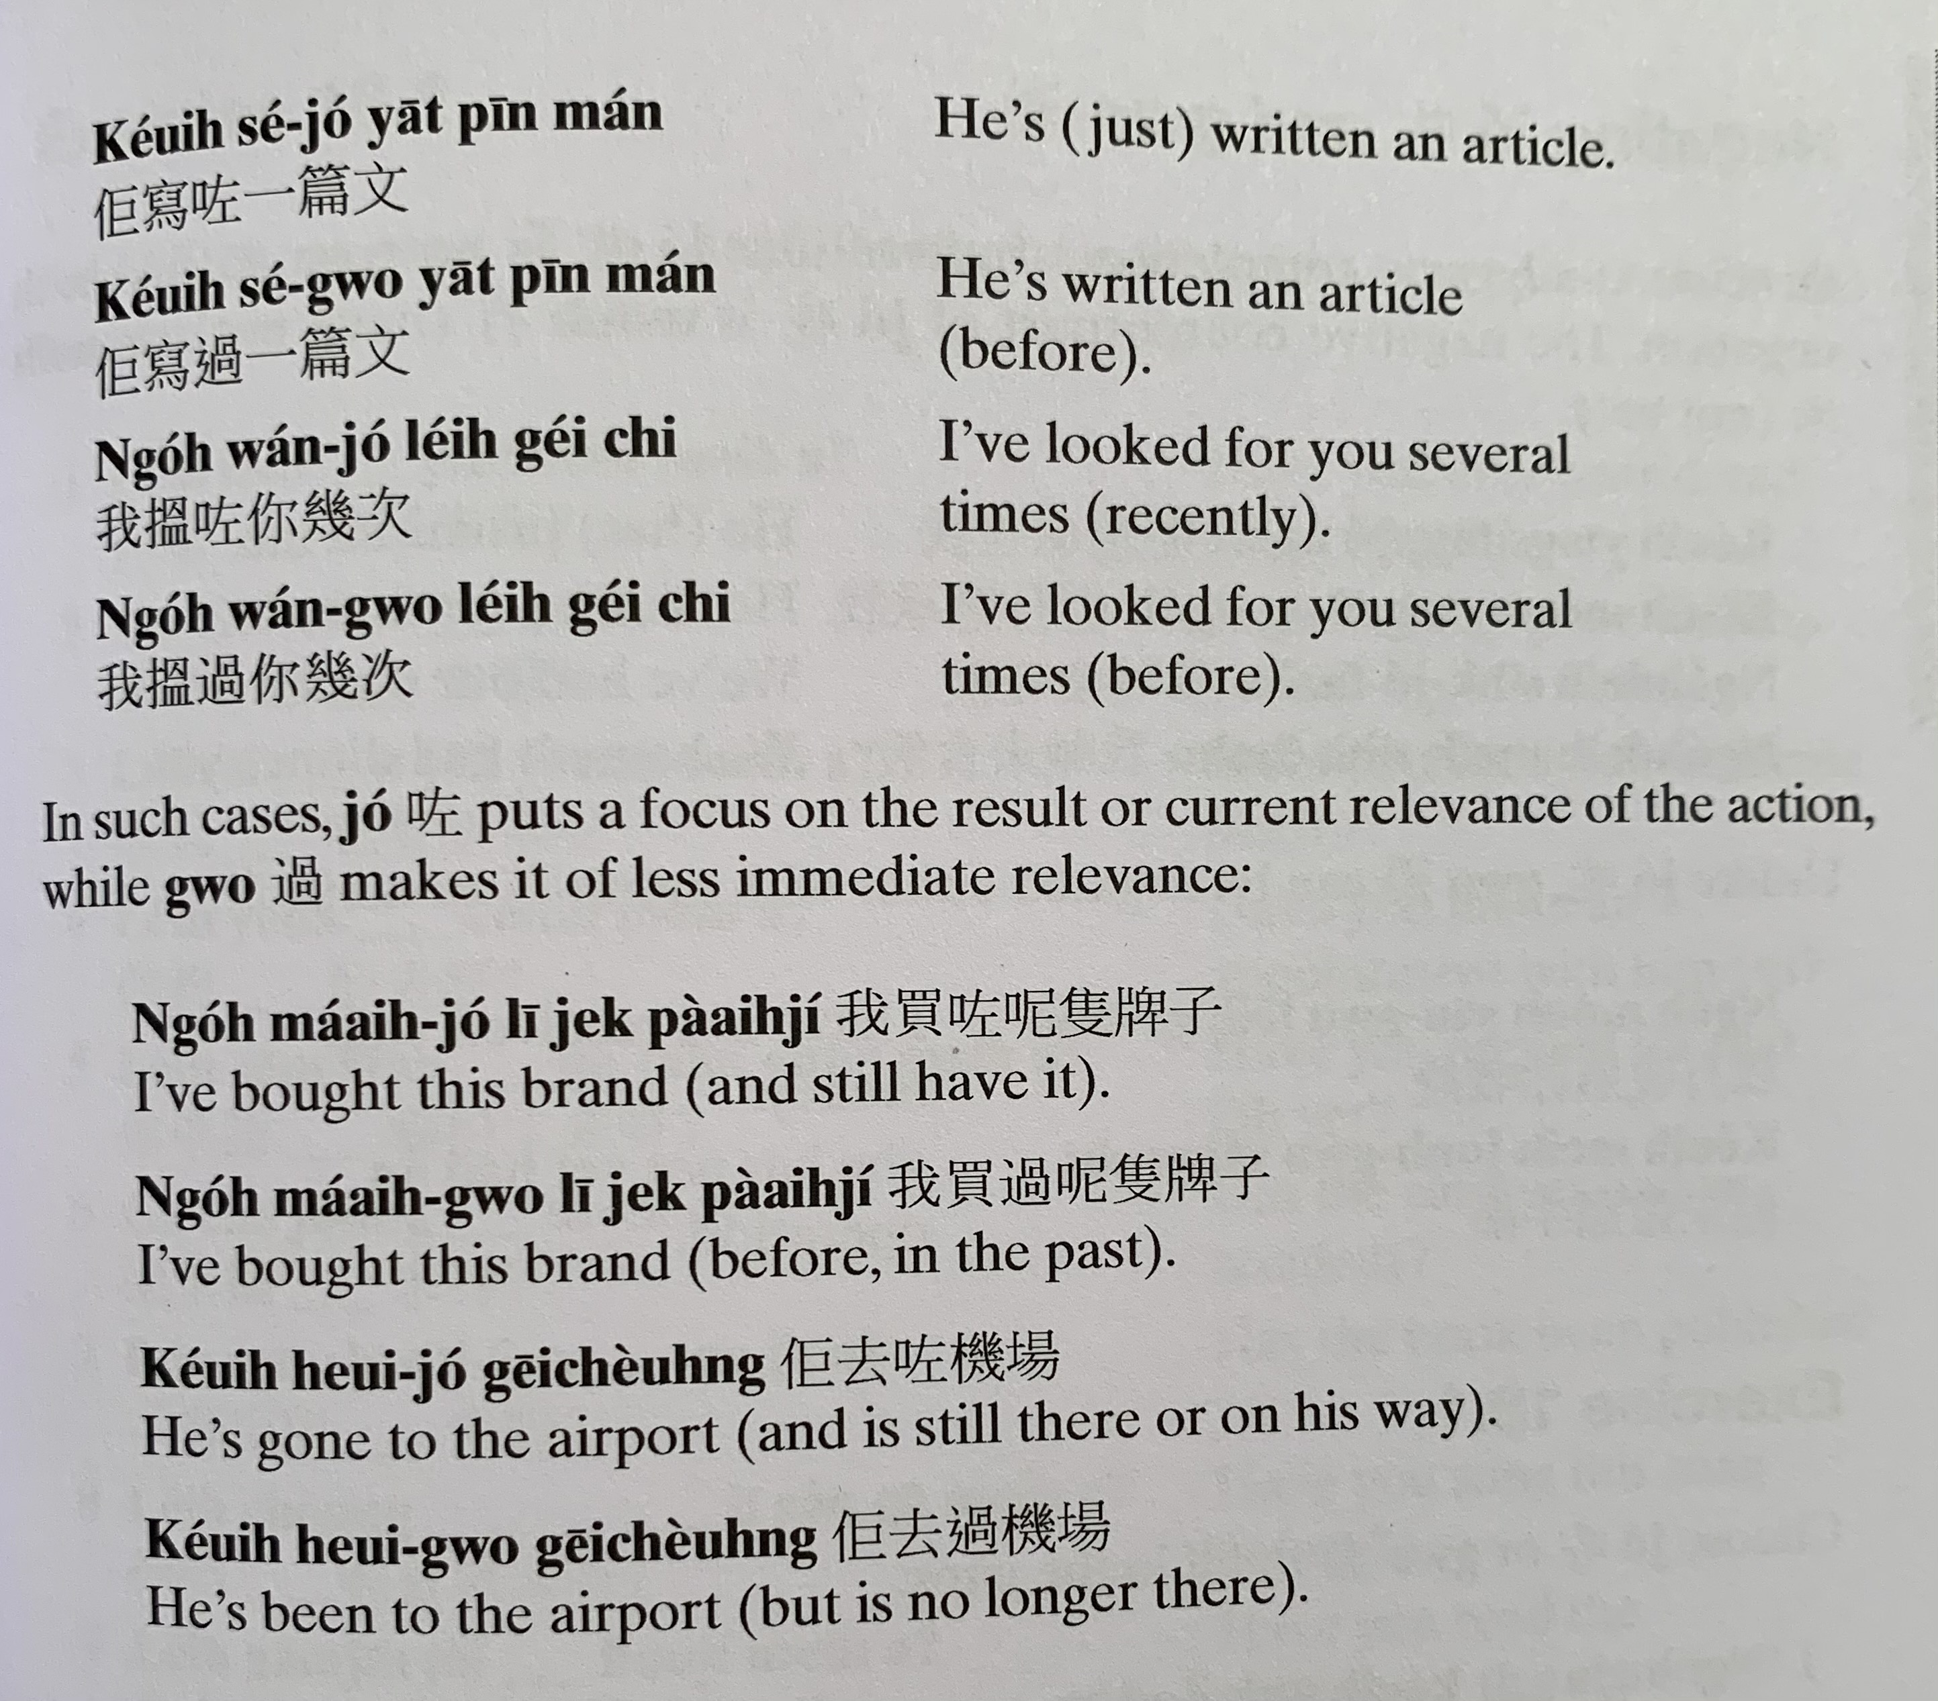
keoi5 se2 zo2 jat1 pin1 man4
keoi5 se2 gwo3 jat1 pin1 man4
ngo5 wan2 zo2 nei5 gei2 ci3
ngo5 wan2 gwo3 nei5 gei2 ci3
ngo5 maai5 zo2 ni1 zek3 paai4 zi2
ngo5 maai5 gwo3 ni1 zek3 paai4 zi2
keoi5 heoi3 zo2 gei1 coeng4
keoi5 heoi3 gwo3 gei1 coeng4

Slide 18
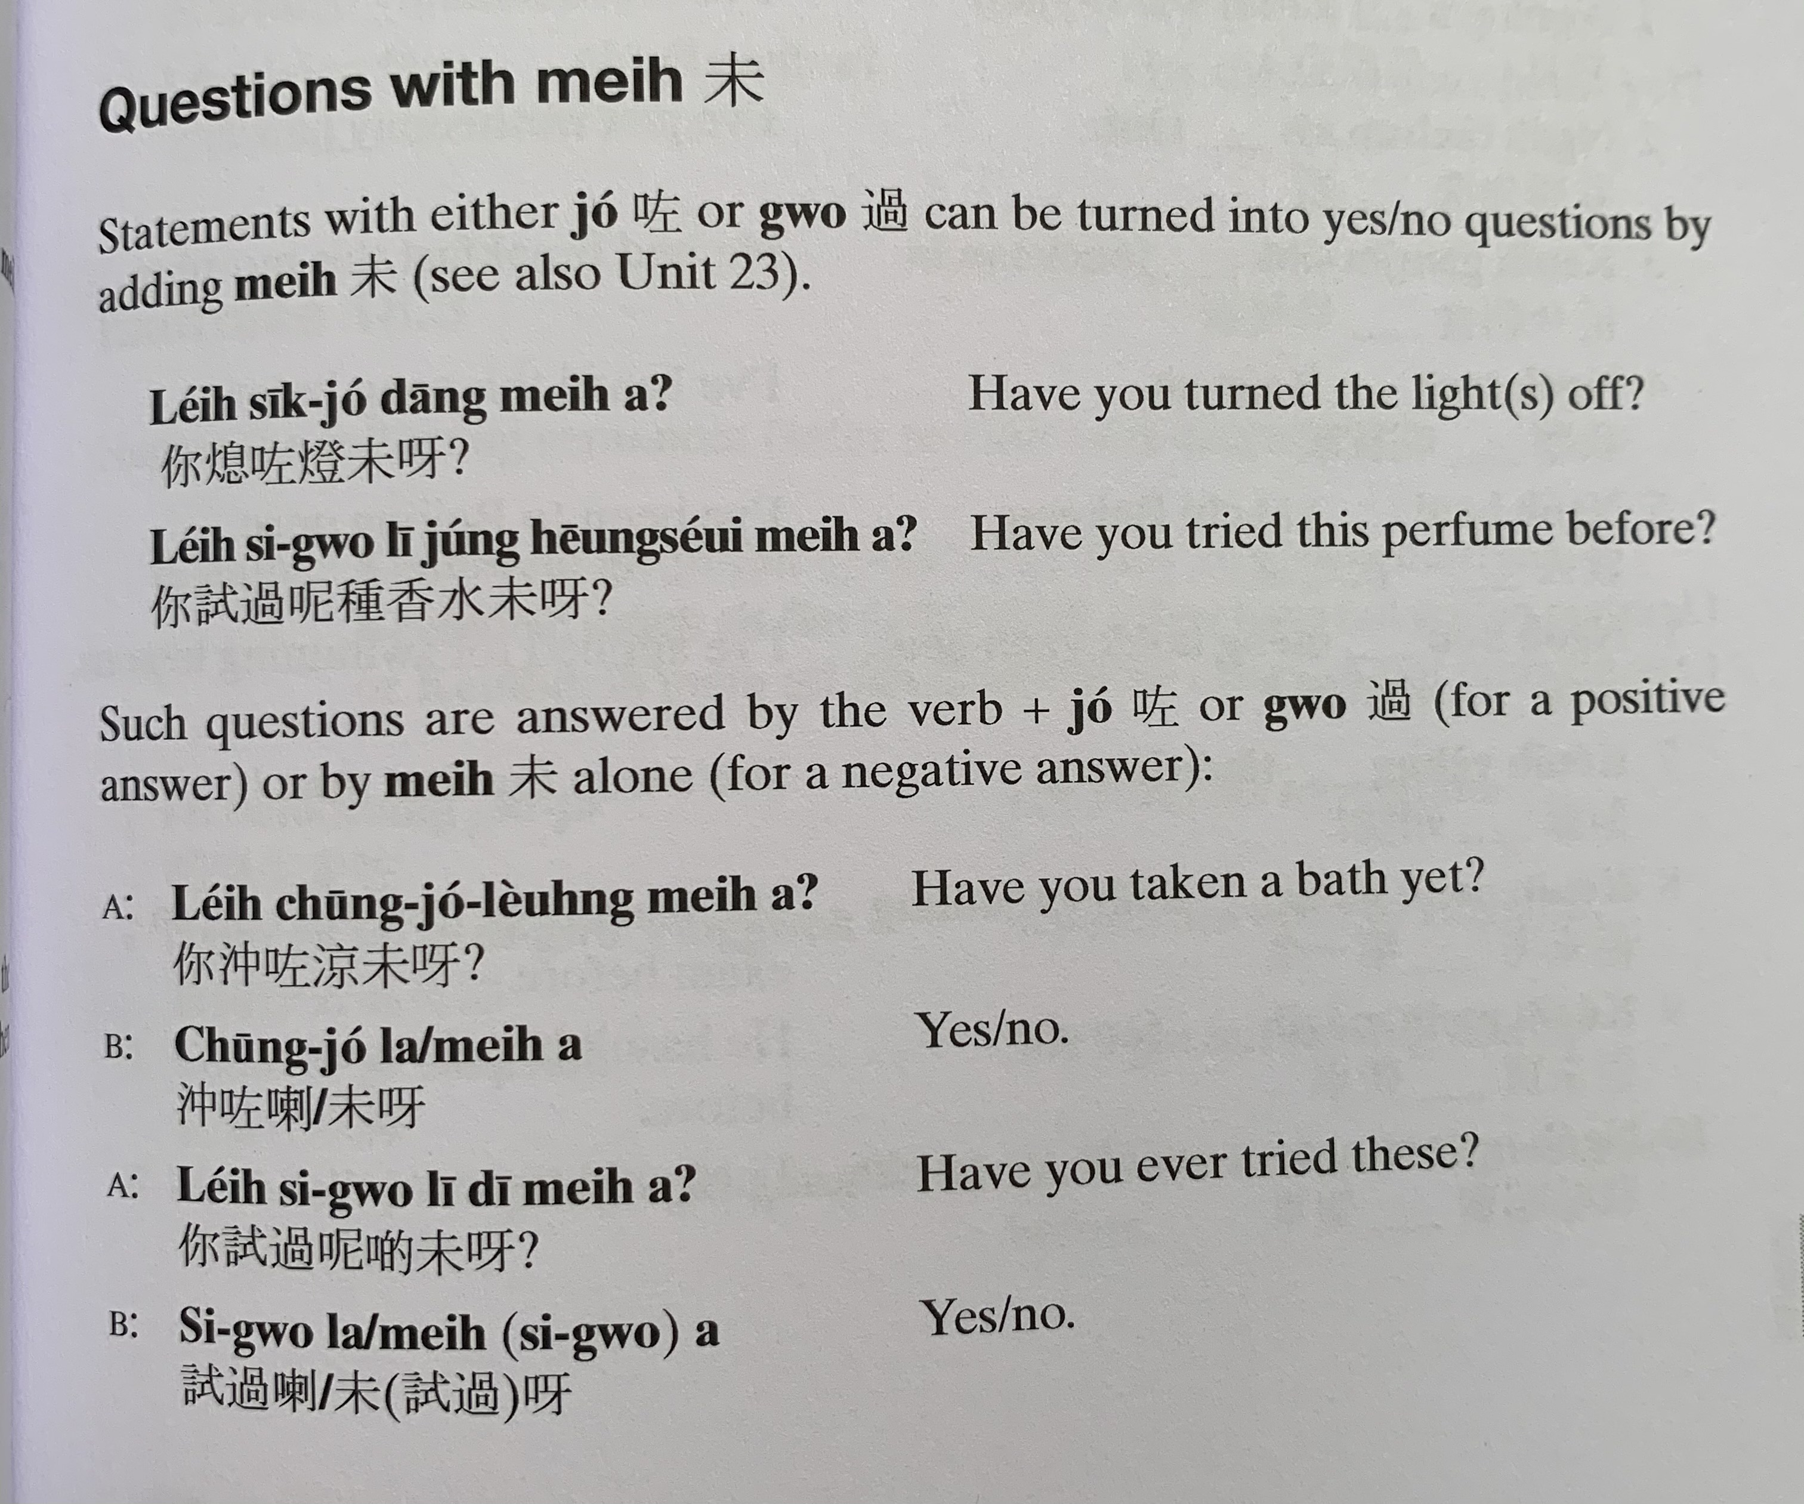
nei5 sik1 zo2 dang1 mei6 aa3
nei5 si3 gwo3 ni1 zung2 hoeng1 seoi2 mei6 aa3
nei5 cung1 zo2 loeng4 mei6 aa3
cung1 zo2 laa3/ mei6 aa3
nei5 si3 gwo3 ni1 di1 mei6 aa3
si3 gwo3 laa3/ mei6 aa3

Slide 19
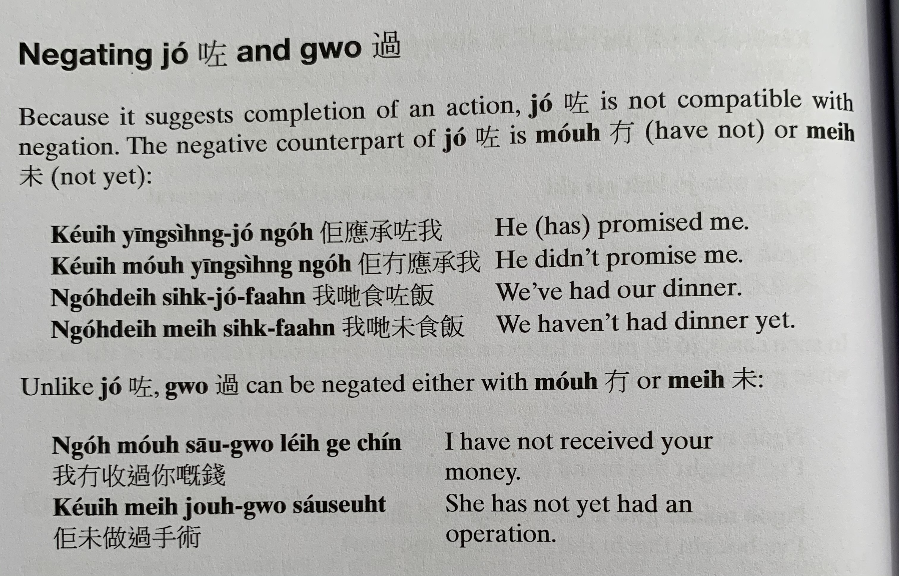
zo2
zo2
zo2
mou4
keoi5 jing1 sing4 zo2 ngo5
keoi5 mou4 jing1 sing4 ngo5
ngo5 dei6 sik6 zo2 faan6
ngo5 dei6 mei6 sik6 faan6
ngo5 mou4 sau1 gwo3 nei5 gei3 cin2
keoi5 mei6 zou6 gwo3 sau2 seot6

Slide 20
Translate the following into Cantonese using zo2 or gwo3.
I’ve met (gin3 見） his family （ uk1 kei5 jan4 屋企人 ）before
I’ve just washed my hair （sai2 tau4 洗頭）。
He had breakfast （zou2 caan1 早餐） this morning (ziu1 朝）
I’ve heard （teng1 聽） this song （sau2 go1 首歌） before
I’ve been to Hong Kong once
She’s won the first prize
He hasn’t bought （maai5 買） a new car （san1 ce1 新車）before
I just sold (賣）the car

Slide 21
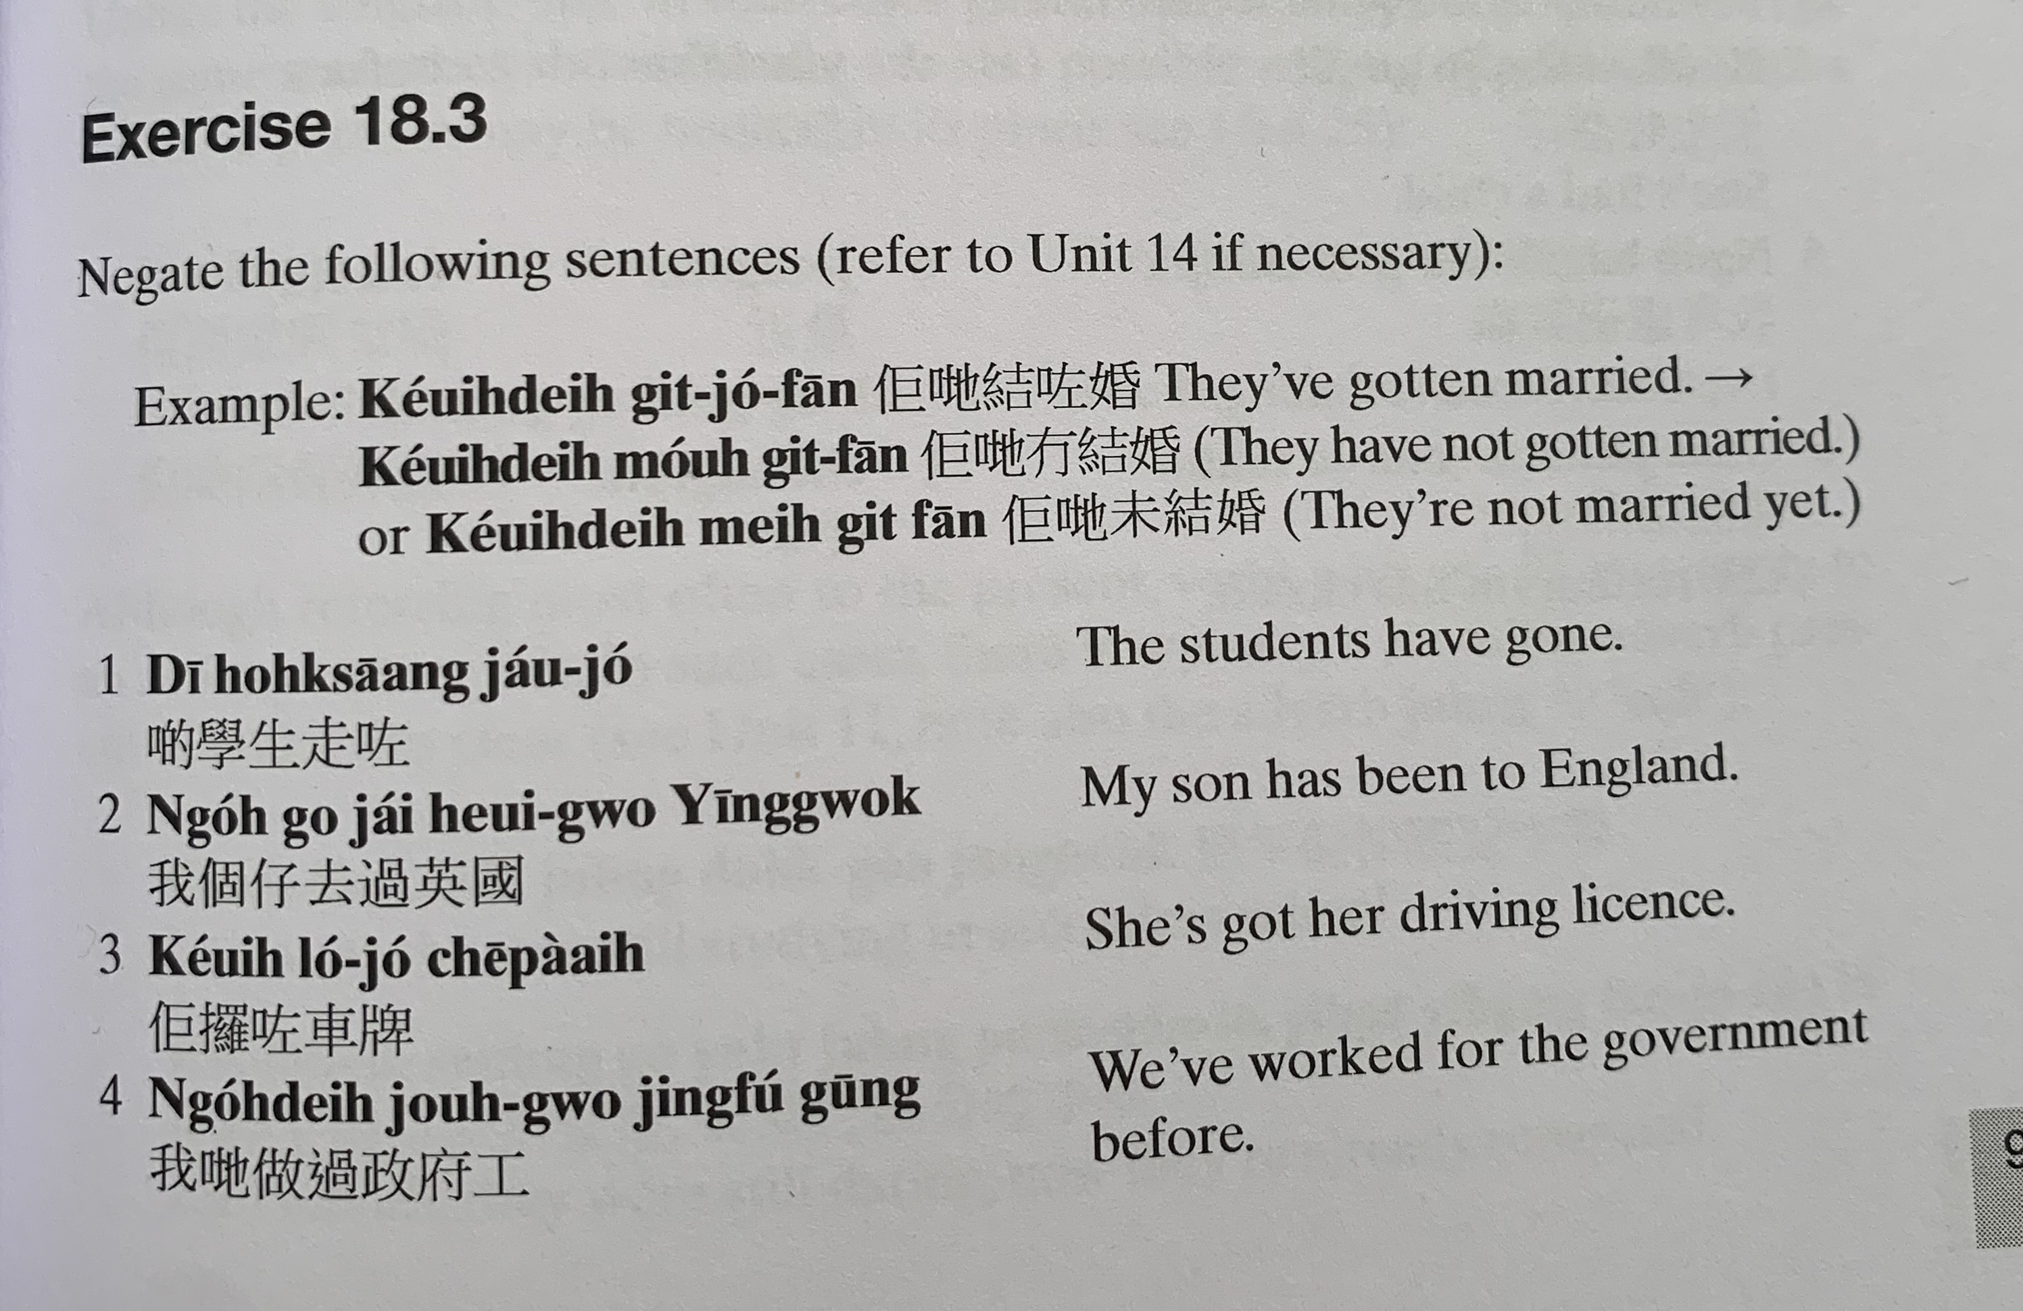
keoi5 dei6 git3 zo2 fan1
keoi5 dei6 mou4 git3 fan1
keoi5 dei6 mei6 git3 fan1
di1 hok6 saang1 zau2 zo2
ngo5 go3 zai2 heoi3 gwo3 jing1 gwok3
keoi5 lo2 zo2 ce1 paai4
ngo5 dei6 zou6 gwo3 zing3 fu2 gung1

Slide 22
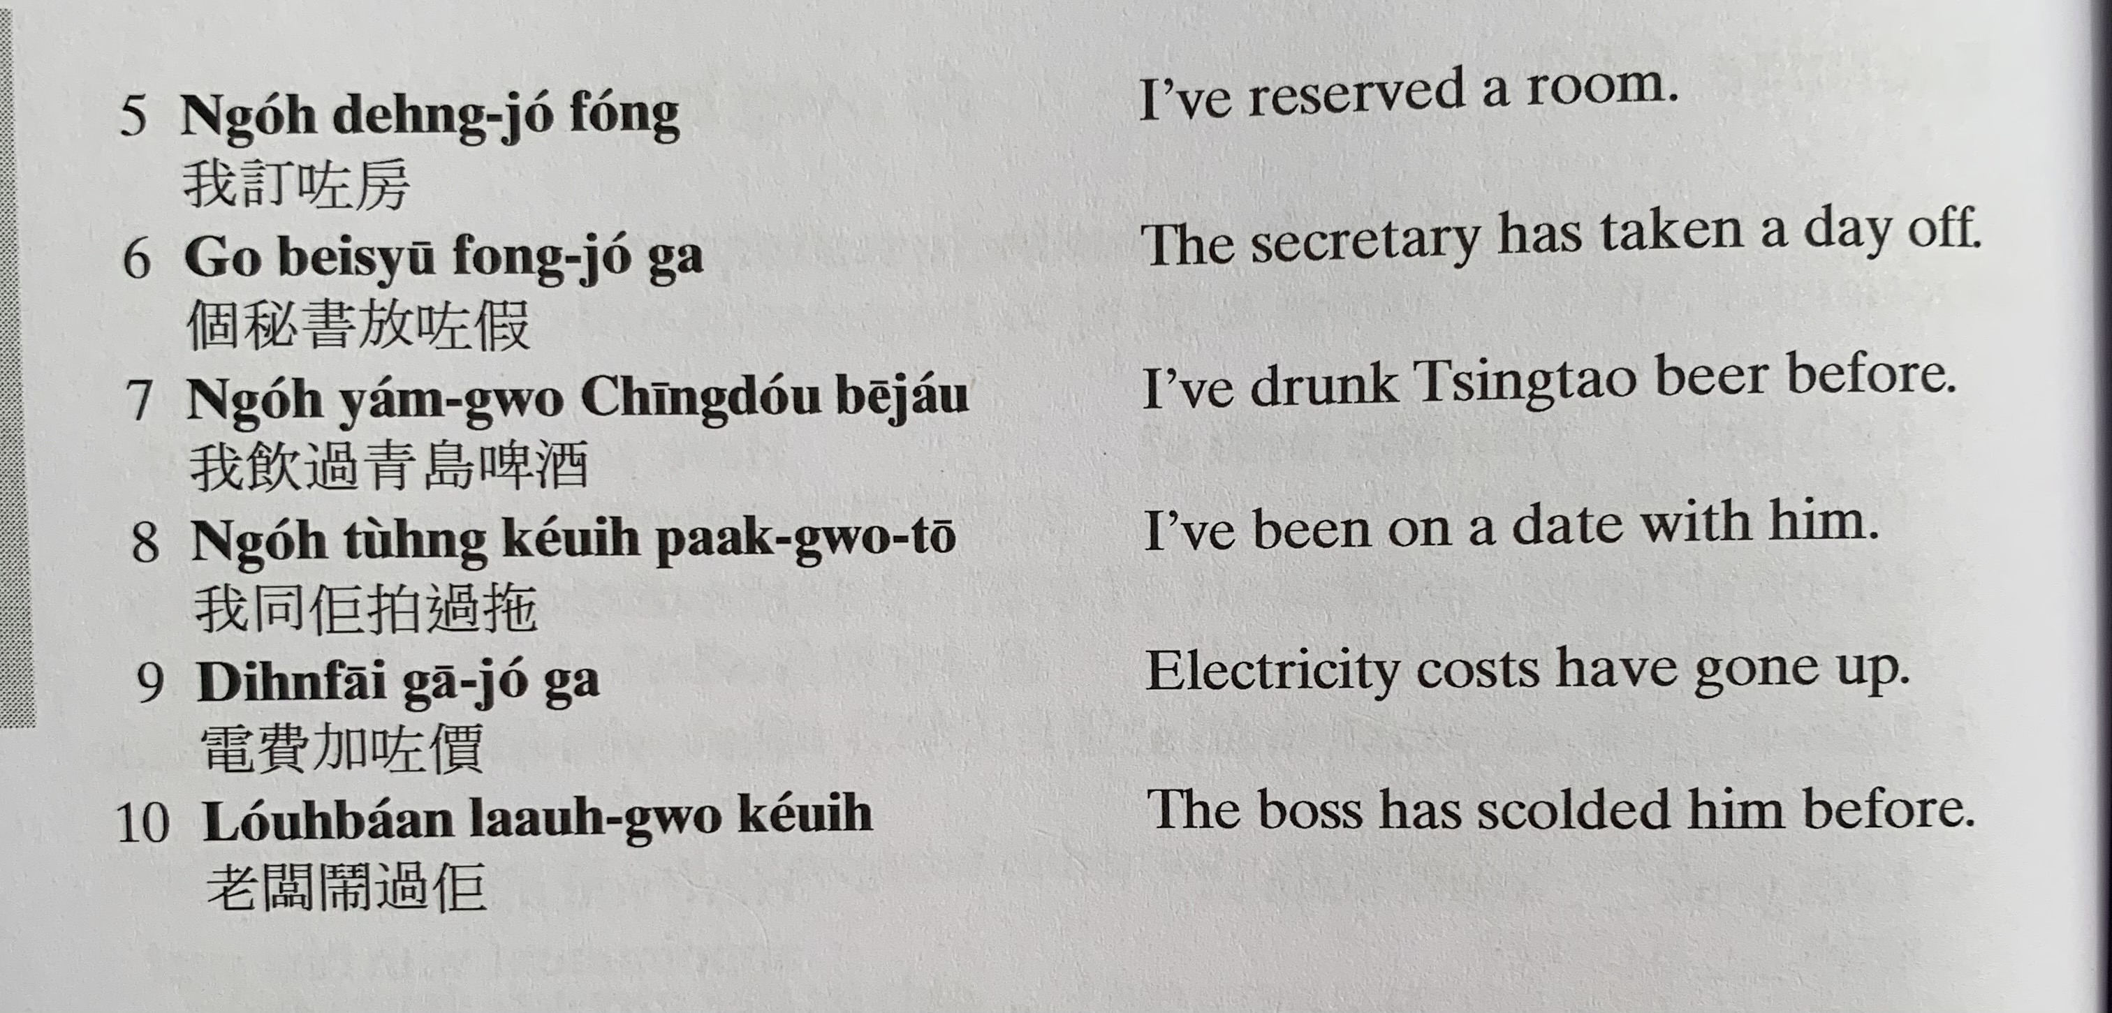
ngo5 deng6 zo2 fong2
go3 bei3 syu1 fong3 zo2 gaa3
ngo5 jam2 gwo3 cing1 dou2 be1 zau2
ngo5 tung4 keoi5 paak3 gwo3 to1
din6 fai3 gaa1 zo2 gaa3
lou5 baan2 naau6 gwo3 keoi5

Slide 23
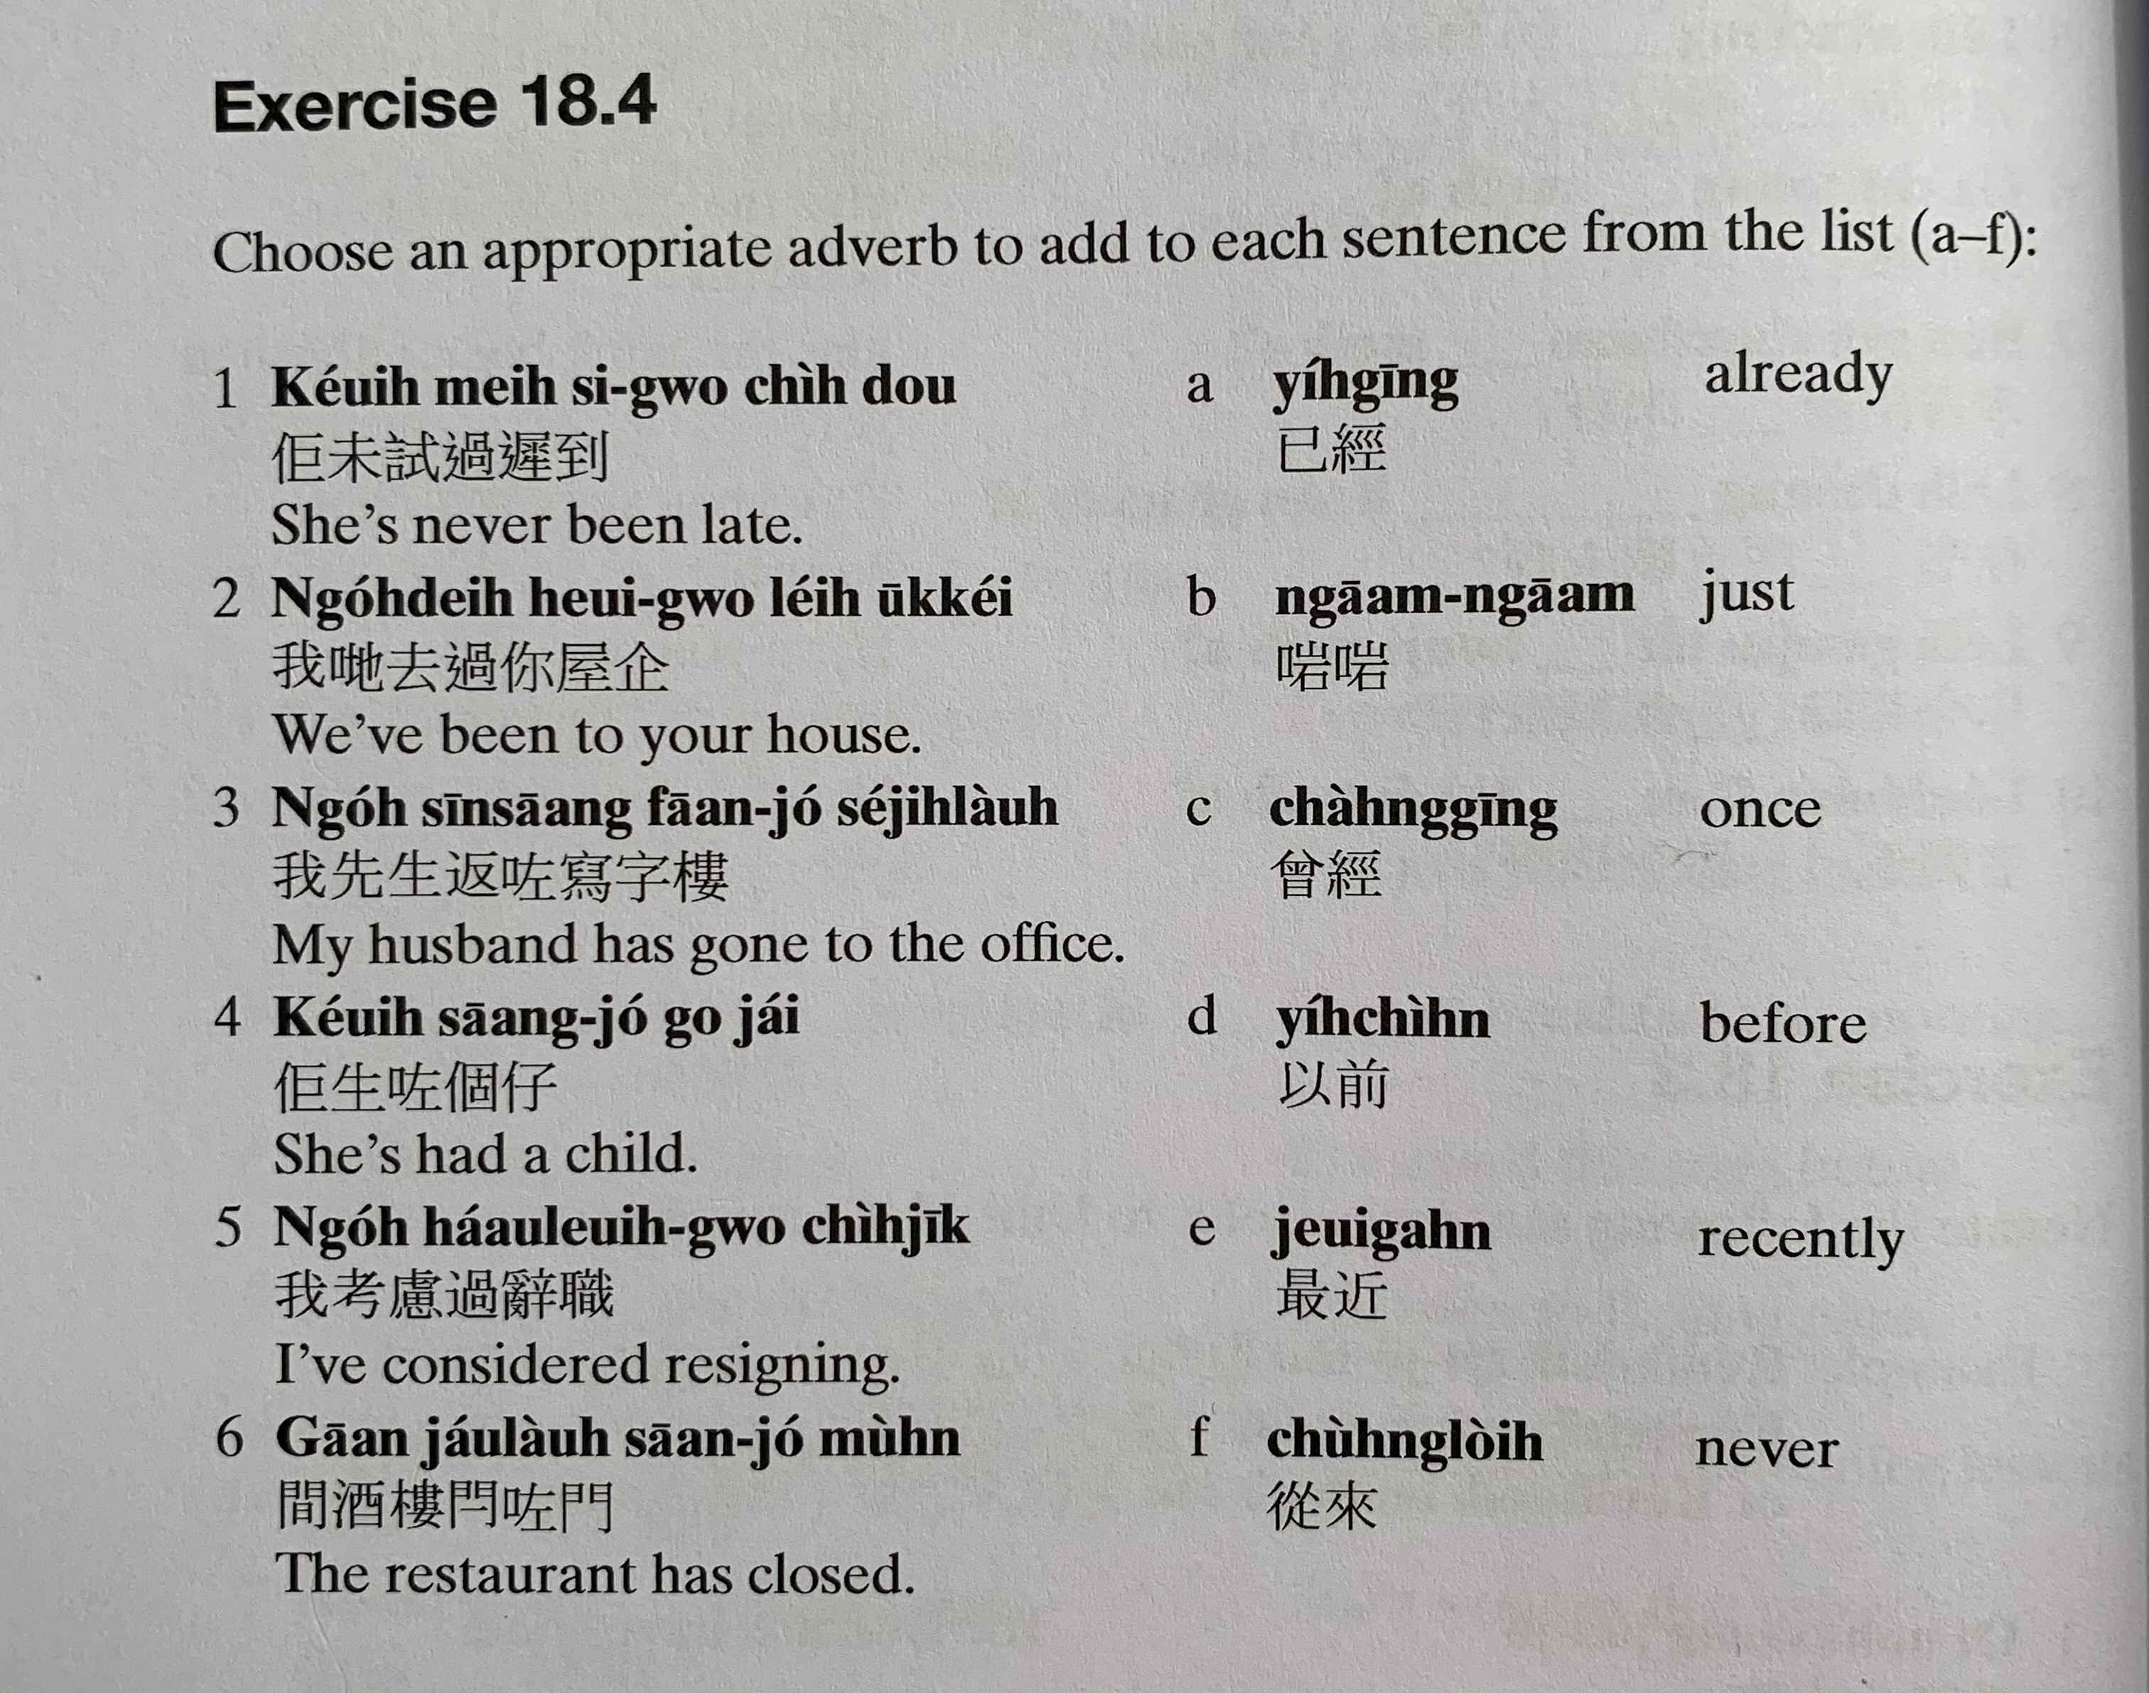
keoi5 mei6 si3 gwo3 ci4 dou3
ji5 ging1
ngo5 dei6 heoi3 gwo3 nei5 uk1 kei2
ngaam1 ngaam1
ngo5 sin1 saang1 faan1 zo2 se2 zi6 lau4
cang4 ging1
keoi5 saang1 zo2 go3 zai2
ji5 cin4
ngo5 haau2 leoi6 gwo3 ci4 zik1
zeoi3 gan6
gaan1 zau2 lau4 saan1 zo2 mun4
cung4 loi4

Slide 24
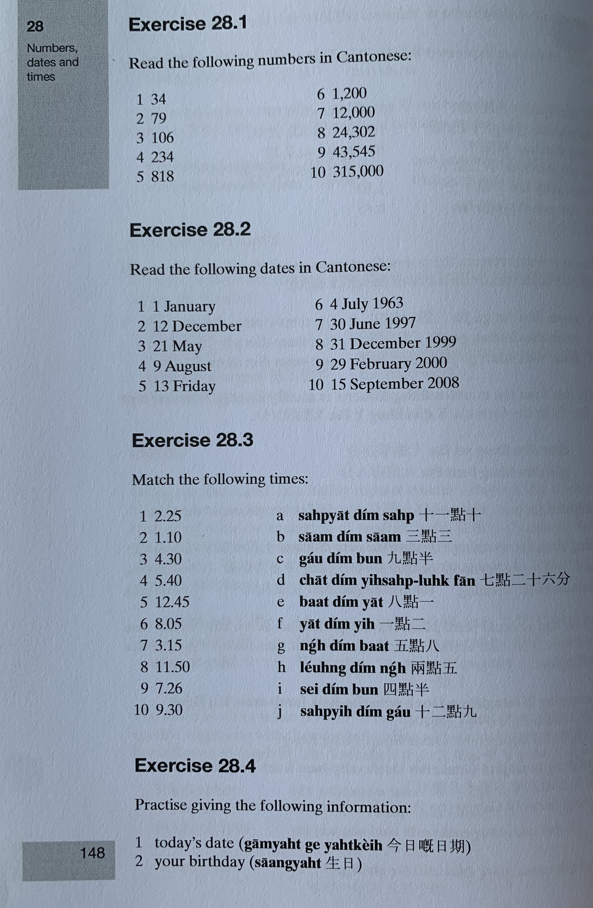

Slide 25
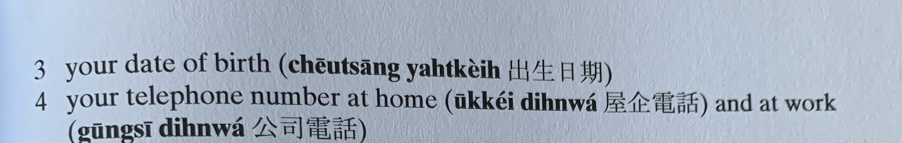
gam1 jat6 gei3 jat6 kei4
saang1 jat6
ceot1 saang1 jat6 kei4
uk1 kei2 din6 waa2

Slide 26
邊個 | Who | Bin1 go6
咩 / 乜嘢 | what | Me1 / Mat1 je5
邊度 | Where | Bin1 dou6
點解 | Why | Dim2 gaai2
幾時 | When | Gei2 si4
點（樣） | How | Dim2 （yoeng2）
幾多 | How many/ much | Gei2 do1

