Slide 1
Audiovisual Metaphors in Moving Images
Seminars, 31. March-1. April 2022
Brno, Masaryk University
Prof. Dr. Kathrin Fahlenbrach
Institute for Media & Communication
University of Hamburg

Slide 2
1. Part: Image Schemata and Primary Metaphors in Moving Images
10-11:30 am

Slide 3
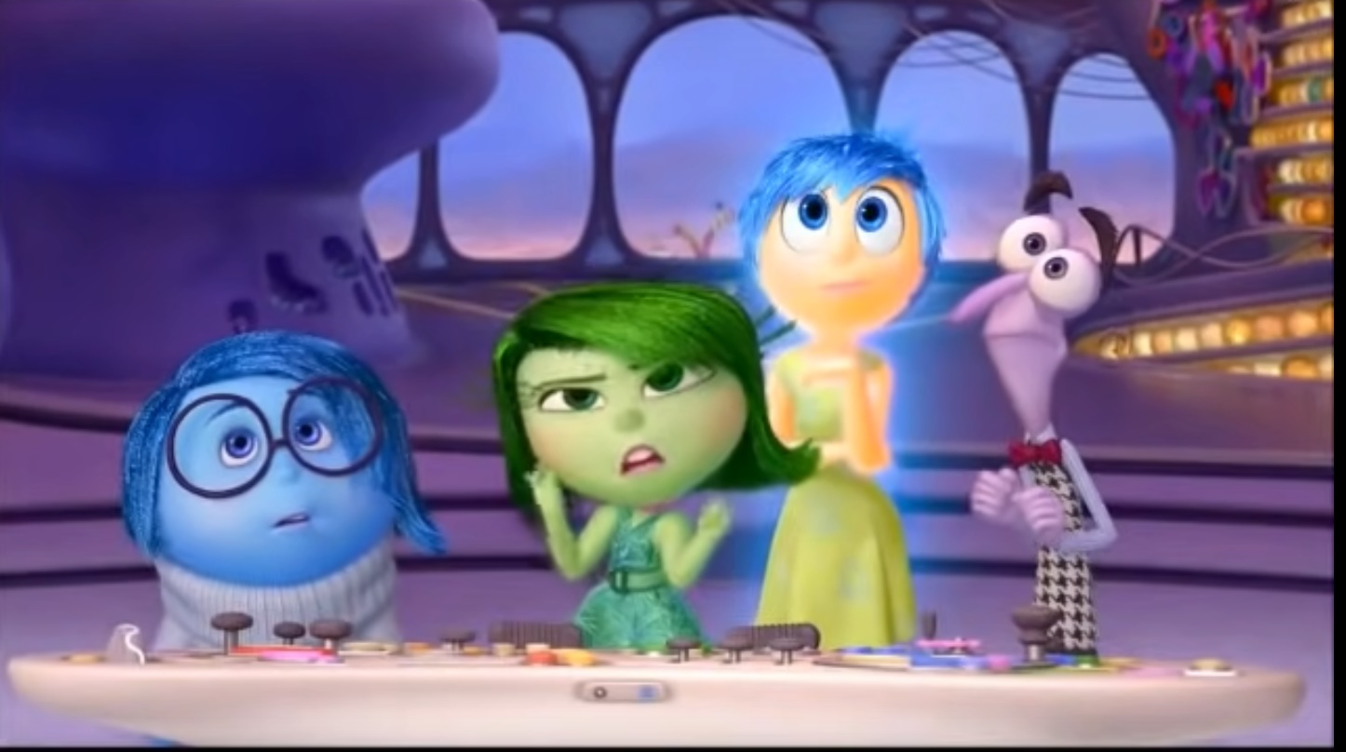
Metaphors in Movies – A first Example
Inside Out (D: Pete Docter, Ronaldo del Carmen, USA 2015)
https://www.youtube.com/watch?v=1S0RKRRyqhQ

Slide 4
I.1. Short General Introduction into Metaphors & Image Schemata

Slide 5
Classic Understanding of Metaphors
A metaphor is "...a figure by which the actual meaning of a word is transferred to another meaning which belongs to it only by the force of a comparison."
(Du Marsais, quoted in Winfried Nöth. Handbuch der Semiotik, 2000, p. 342).
A metaphor is based on a relationship of similarity:
two signs (e.g. words or pictorial motifs) are linked by a common signifying feature (e.g. 'The world is a stage', 'Boiling with rage’)
Basic metaphorical principle: analogy/comparison between different concepts

Slide 6
Classic Understanding of Metaphors
Metaphors are considered as tropes of figural speech: they act as stylistic devices of emphasis and figurative illustration of abstract thoughts, ideas, arguments
"Something said refers to something that is not said, is absent in the concrete utterance, but is actually meant, whereby what is actually meant must become clear from the structure of what is said."
(Dennis Gräf et al. (2011). Filmsemiotik. Eine Einführung in die Analyse audiovisueller Formate. Marburg, P. 53)

Slide 7

Founders of Cognitive Metaphor Theory
George Lakoff (1941)
Linguist, USA (Berkely)
Early Works, e.g. :
(1980): “Metaphors we Live by“ (with Mark Johnson
(1987): „Woman, Fire, and Dangerous Things. What Categories Reveal about the Mind“

Slide 8

Founders of Cognitive Metaphor Theory
Mark Johnson (1949)
Philosopher, USA (Oregon)
Early Works, e.g.:
(1981) Philosophical Perspectives on Metaphor.
(1987) The Body in the Mind. The Bodily Basis of Meaning, Imagination and Reason.

Slide 9
Cognitive Understanding of Metaphors
Metaphors do not only establish a comparison between conventional meanings of e.g. words, pictures and sounds (=symbolic metaphors).
Metaphors are a basic principle of human thinking
  We conceptualize abstract and complex terms/concepts etc. with the help of simple gestalt patterns
Metaphors are based on cognitive transfer between a (mostly abstract) target domain and a (sensual-concrete, body-based) source area (= conceptual metaphors)
also Symbolic metaphors are based on conceptual metaphors of thinking!
  e.g. “time flies” (symbolic metaphor) -> ‘time is a natural force’ (conceptual metaphor)

Slide 10

Conceptual / Cognitive Metaphors
Metaphors as cognitive concepts transfer the gestalt of body-based schemas (such as 'way', 'force', 'balance', 'container') to an abstract target domain (e.g. life, time, society):
  'life is a path’,
  'time is a natural force/ a flying force' (e.g. time flies),
  'society is a building' (e.g. 'upper level of society’)
Conceptual metaphors are realized in different sign systems, e.g.:
  in language
  in body language
  in visual and in audiovisual media

Slide 11
Cognitive Schemata & Concepts
Schemas & concepts are general knowledge structures that reflect the most important features of the subject area to which they refer and, at the same time, indicate what relationships exist between these features
  e.g. ‘building’: a fix space with single entries & windows, often several levels
Why do we need Schemas? Central functions, e.g.:
  Reduction of complexity of sensorial data
  Organization & representation of knowledge (top-down-bottom-up-process of cognitive information processing)
  (Anderson, John R. 2005: Cognitive Psychology.)

Slide 12
Body-Based Image Schemata
Gestalt: The stimuli received by the senses (e.g. light, shadow) are recognized by the cognitive system in their elementary gestalt forms and grouped according to patterns that belong together:
  lines, dots etc.
  circular, angular, soft, sharp etc. shape patterns
  more complex shape patterns
Image schemata: gestalt-based cognitive concepts:
  E.g., path-, container-, force-, balance-schema.
  they have gestalt elements, connected with a knowledge schema (e.g. ‚building‘)
  Gestalt perception is crucial for 'body-based meaning attribution' (embodiment)

Slide 13
Image Schemata
“An image schema is a recurring dynamic pattern of our perceptual interactions and motor programs that gives coherence and structure to our experience. […]
Experience is to be understood in a very rich, broad sense as including basic perceptual, motorprogram, emotional, historical, social and linguistic dimensions.”
Mark Johnson 1987, The Body in the Mind: The Bodily Basis of Meaning, Imagination, and Reason. Chicago: The University of Chicago Press. (xic, xvi)

Slide 14
Container-Schema:
Gestalt-Elements: In-Out
Out
In

Slide 15
Source-Path-Goal-Schema (SPG):
Gestalt-Elements: Here – There - Path
Path
Here
There

Slide 16
Balance-Schema
Gestalt-Elements: even vs. uneven (in relation to a horizontal axis)

Slide 17
Example: Image Schemata in Comics
Asterix: La Zizanie (Goscinny and Uderzo, 1970)

Slide 18

The Source-Path-Goal-Schema (SPG) in Movies – An Example:
‚Life is a Journey‘-Metapher in animation movies (Charles Forceville)
https://www.youtube.com/watch?v=MvocTKD5o5A

Slide 19
I.2. Group Work: Analysis of Image Schemata in a Movie Scene

Slide 20
Metaphoric use of image schemata by film style
Example: Inside Out (2015) – The Family-Dispute-Scene

Slide 21
Metaphoric use of image schemata by film style
An Example Inside Out (2015) – The Family-Dispute-Scene
Group-Task:
Link to the scene: https://www.youtube.com/watch?v=ZAL0nwCo0h8
what image schemata can you identify in the use of camera; in the way, images are composed; the way, the movement of characters and objects are displayed, but also by the use of sounds?
More specifically, please look especially for the following image schemata:
  Container (in/out)
  Paths (here-there)
  Force (strong/intense – weak/low)

Slide 22
Part II: Part II Audiovisual Metaphors in Movies: Space Metaphors
2:00-3:30 pm

Slide 23
II.1: Introduction into Audiovisual Metaphors

Slide 24
Conceptual Metaphors – Symbolic Metaphors
Source Domains
Target Domains
Image Schemata
Cognitive Concepts
Force
Path
Container
…
e.g. Fire
e.g. Journey
e.g. House
…
Emotions
Processes
States
…
e.g. Love
e.g. Life
e.g. Society
…
Conceptual Metaphors
Symbolic Metaphors
e.g. LOVE IS FIRE e.g. linguistic: ‚Burning with Love‘
e.g. LIFE IS A JOURNEY e.g. linguistic: ‚Goal in Life‘
e.g. A SOCIETY IS A BODY e.g. linguistic: ‚Health of a society‘

Slide 25
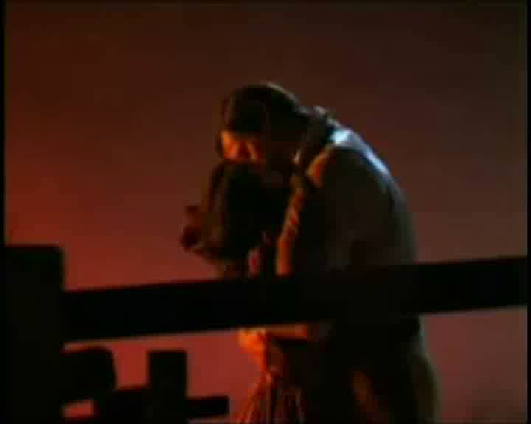
Audiovisual Metaphors in Moving Images
Conceptual Metaphor: ‚Love is Fire‘
Source Domains
Target Domains
Image Schema
Gestalt of Fire
Emotional
Experience
Dynamic,Intensity
e.g. Heat Haze
e.g. Cracking Noise
e.g. Music
e.g. Red Colours
…
Love
Synaesthetic
Gestalt
Force

Slide 26
Audiovisual Metaphors
“(…) movies, television shows, video games, or other moving images recurrently generate audiovisual metaphors in their motifs and in their audiovisual compositions
by manifesting conceptual metaphors already established in our minds and in (media-)culture; and
by creating original mappings in the metaphoric use of embodied source domains, which are elements of the very audiovisual composition and abstract or complex target domains in the genre-typical semantic framework of a piece.
  (Fahlenbrach 2016, p. 34)

Slide 27
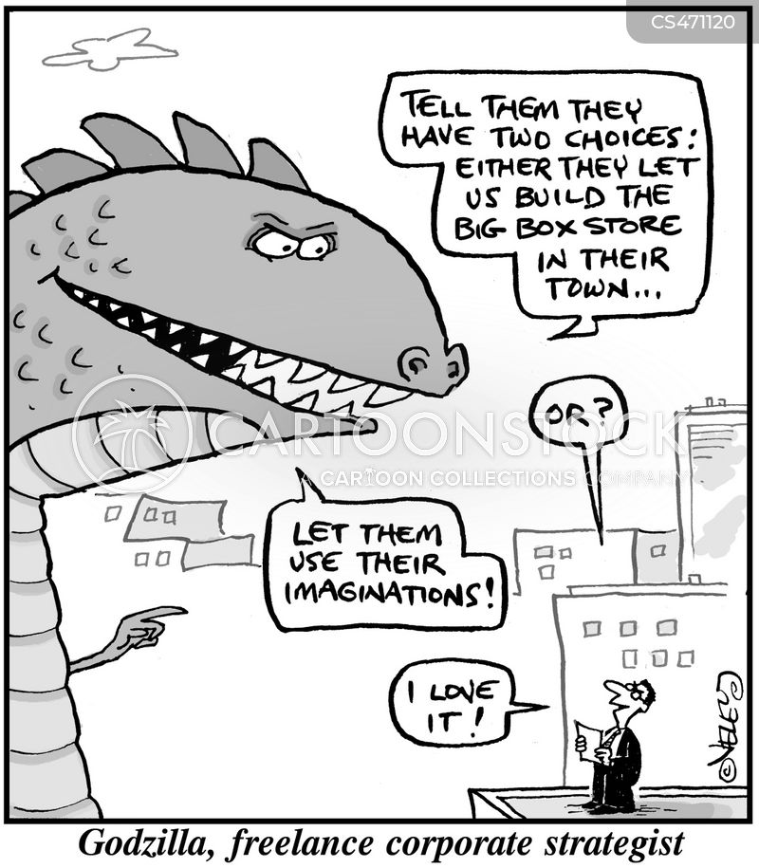
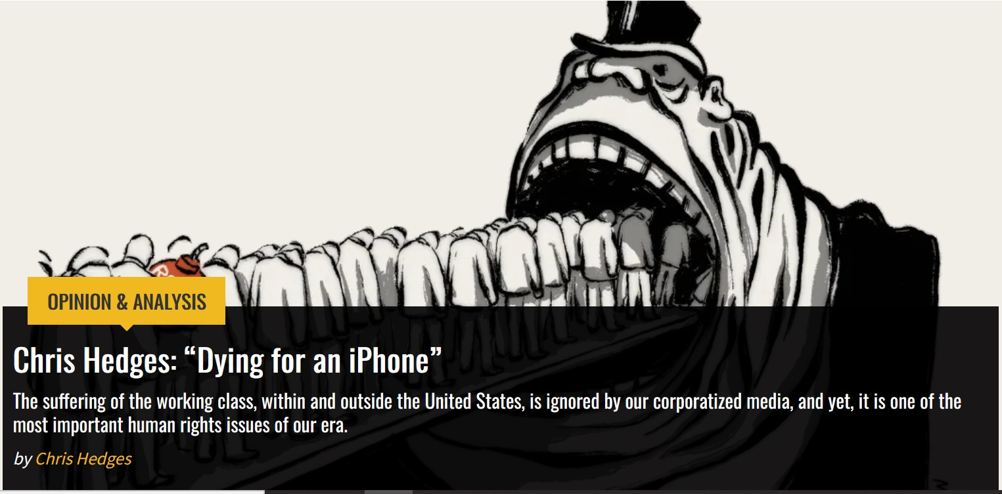
Example for Metaphors in Visual & Audiovisual Media:
„Predatory Capitalism“
Conceptual Metaphors:
‚Capitalism is a natural force‘ ->‘capitalism is a living being‘ ->‘capitalism is a predator‘

Slide 28
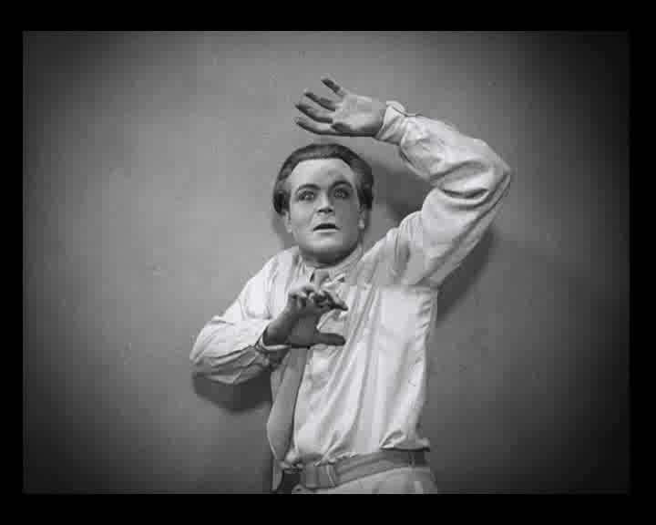
‚Predatory Capitalism‘ as an Audiovisual Metaphor
Source Domain
Target Domain
Image Schema
Collective Anxiety of uncontrolled Capitalism
deregulated power
threat for individuals
destruction of commonwealth
Gestalt of Predator
Force
physical superiority
physical threat
agressiveness
Metropolis (Fritz Lang, D 1927)

Slide 29
Two Types of Conceptual Metaphors
System
Metaphors
Event Structure
Metaphors
Referring to
states, systems etc.:
Referring to
relations, events etc.:
‘The mind is a machine’
‘Social organizations are plants’
‘Careers are buildings’
‘Society is a machine’ etc.
(Kövecses 2002, 127)
‘Progress is motion forward’
‘Action is self-propelled motion’
‘Means are paths’
‘Changes are movements’
(Kövecses 2002, 134)

Slide 30
Two Types of Conceptual Metaphors in Audiovisual Metaphors
System Metaphors for
Designing audiovisual Motifs
Event Structure Metaphors for
Designing Audiovisual Style
Audiovisual
Processes and relations via motion
Audiovisual characters and objects
as complex systems
‘lack of control over change is lack of
control over movement’
‚Complex systems are buildings‘
Referring to the container-schema
‘action is self-propelled movement’
Metaphoric Design of spatial Motifs etc.
Metaphoric use of camera movement,
movement of characters / objects…

Slide 31
II.2. Audiovisual Spaces as Audiovisual Metaphors

Slide 32
Cinematic role of Audiovisual Metaphors
Main function of audiovisual metaphors in movies and cinematic TV series: giving narrative meanings a bodily and affectively appealing aesthetic gestalt
Key bodies and key action spaces of a cinematic narrative stand at the centre of its metaphoric embodiment
  key bodies and action spaces can act as audiovisual key metaphors
  metaphoric networks of submetaphors are often created around bodies and spaces as audiovisual key metaphors

Slide 33
Primary Audiovisual Metaphors in Cinematic Spaces
Audiovisual Spaces always imply embodied image schemata:
  e.g. the container-schemata (in–out) between the frame and the pictorial field, as well as within the depicted spaces (e.g. in the display of limited spaces with doors, walls etc.);
  e.g. path-schema: movements of the camera and of moving objects along paths (here­-there), and across the limits of the depicted spaces (e.g. interior rooms)
further embodied elements in audiovisual spaces:
  gestalt patterns: e.g. up-down, size (big­ - small), or dark–bright;
  cross-modal qualities: duration (long-short), intensity (strong-weak), and position (above-below, central-peripheral, close-distant)

Slide 34
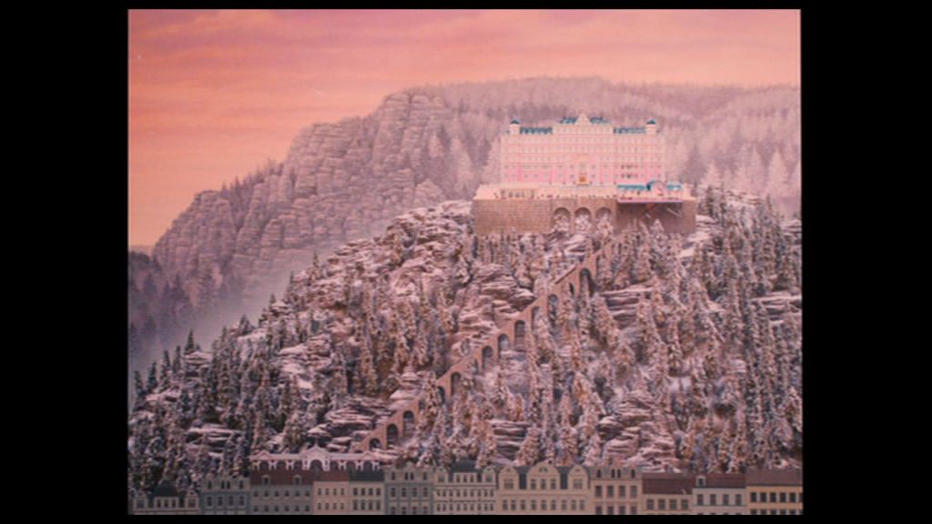
The Hotel as an audiovisual Key Metaphor
Example: The Grand Budapest Hotel (Wes Anderson, USA/G/UK 2014)

Slide 35
The Grand Budapest Hotel (Wes Anderson, USA/G/UK 2014) - Trailer
Notes:
https://www.youtube.com/watch?v=1Fg5iWmQjwk

Slide 36
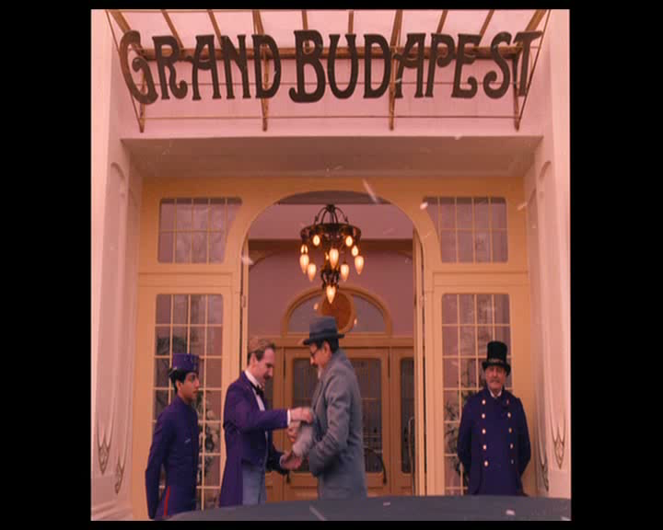
Gustave‘s Movements in the Hotel

Slide 37
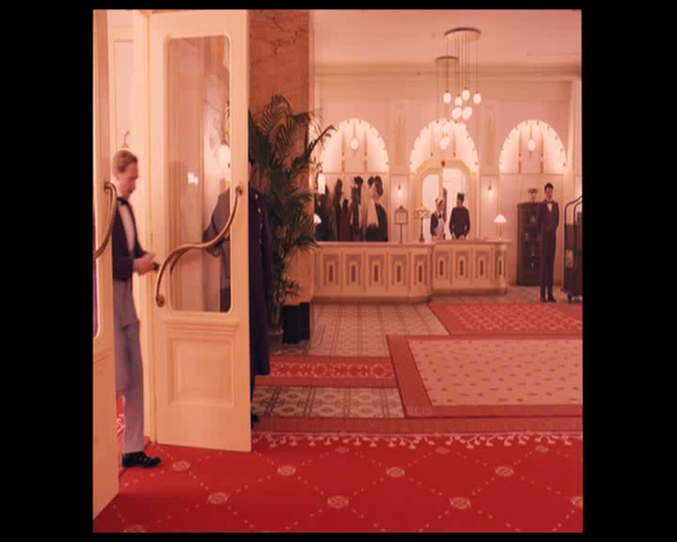
Gustave‘s Movements in the Hotel

Slide 38
Gustave‘s Movements in the Hotel
https://www.youtube.com/watch?v=JN5sqSEXxm4

Slide 39
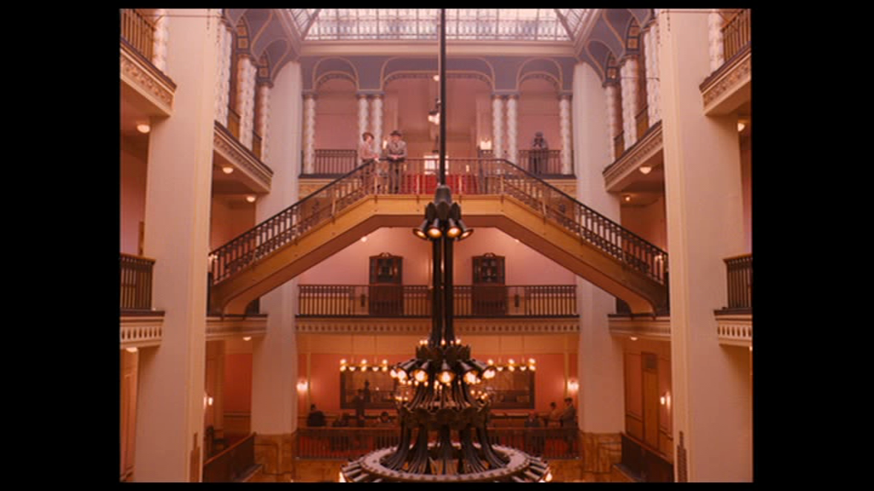
Motiv of Hotel as Key Audiovisual Metaphor:
‚social life is a hotel‘
Key Audiovisual Metaphor:
‘society is a building’ – ‘social life is an hotel’
‘social hierarchies are levels of a building’
Container-schema as source domain
hierarchic structure of levels as source domain

Slide 40
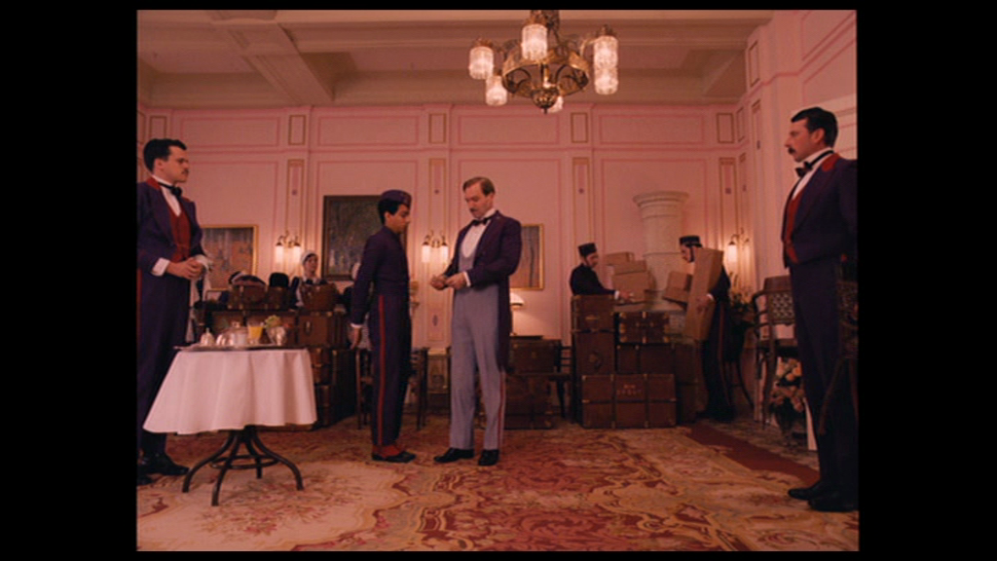
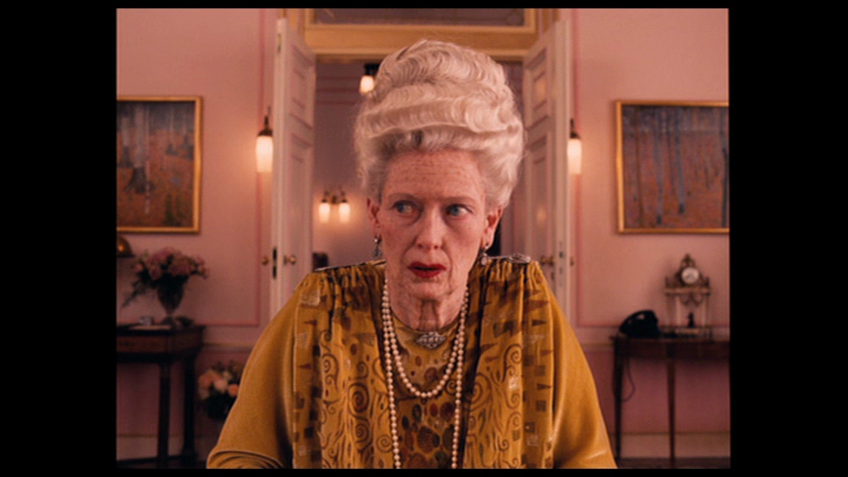
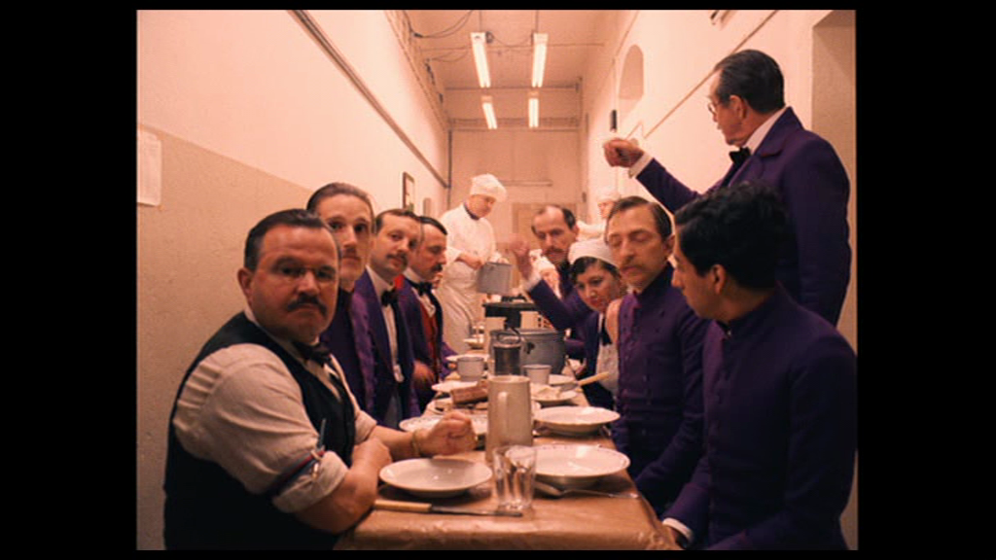
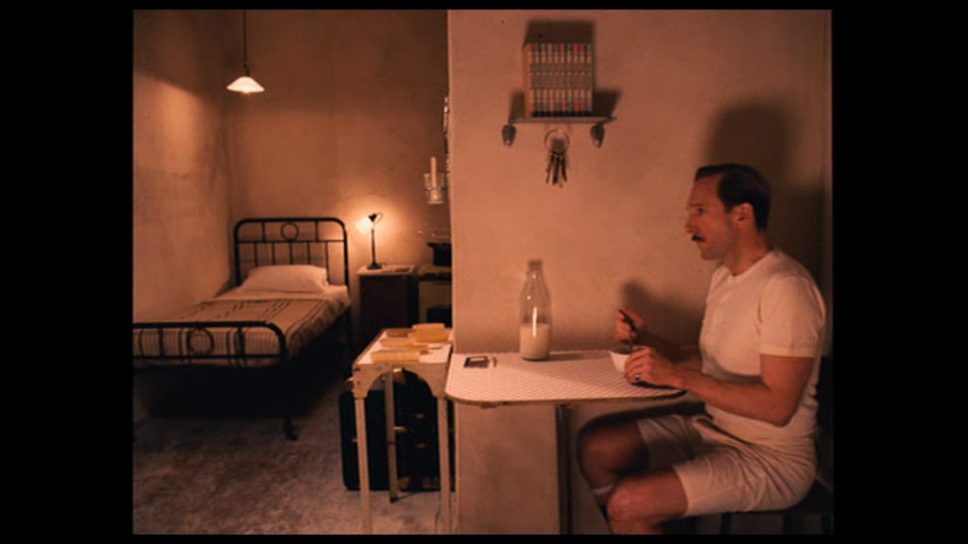
‚social life is a hotel‘: The Grand Budapest Hotel in the early 1930s
Audiovisual Submetaphors: ‚wealth is a big, bright room‘ - ‘poverty is a small, dark room‘

Slide 41
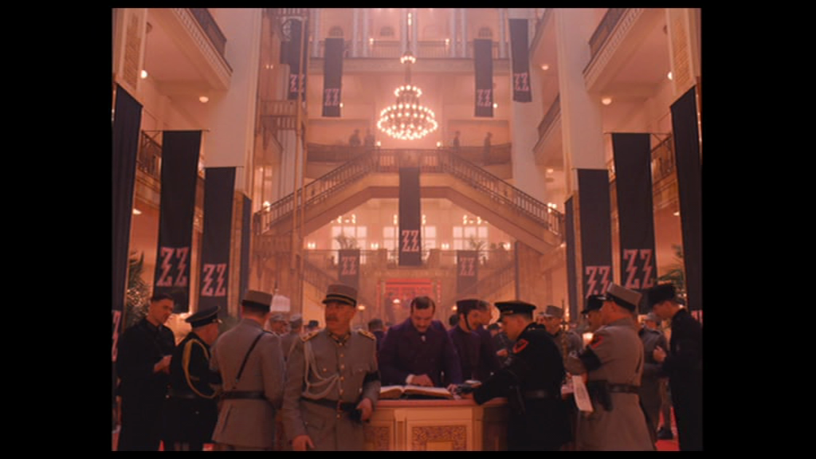
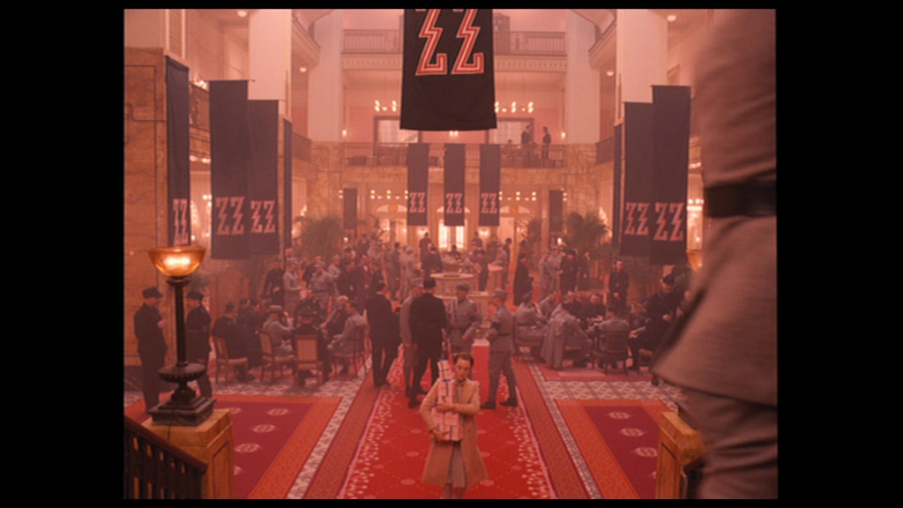
‚social life is a hotel‘: The Grand Budapest Hotel during fashist Dictatorship in 1930s
Audiovisual Submetaphor:
‚Political Repression is mass occupation of a building‘

Slide 42
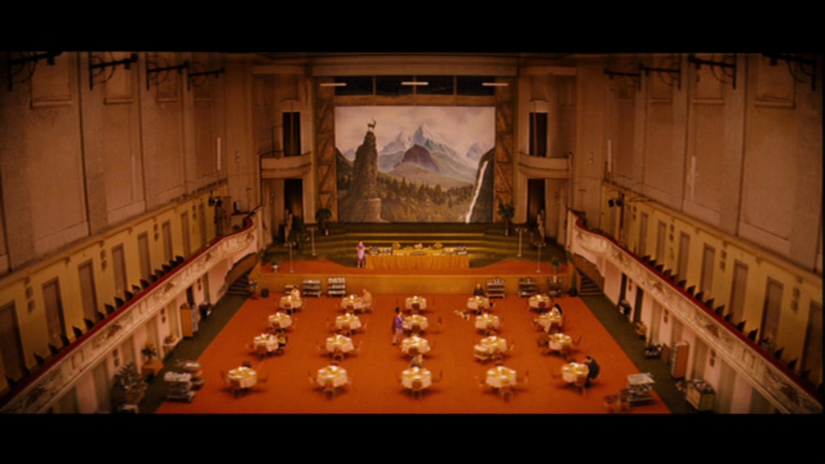
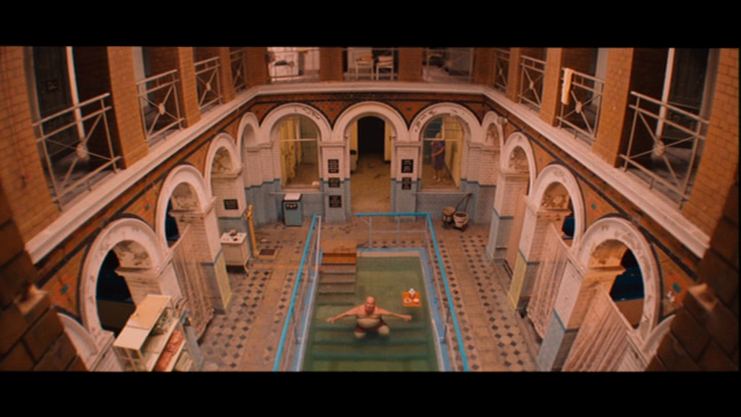
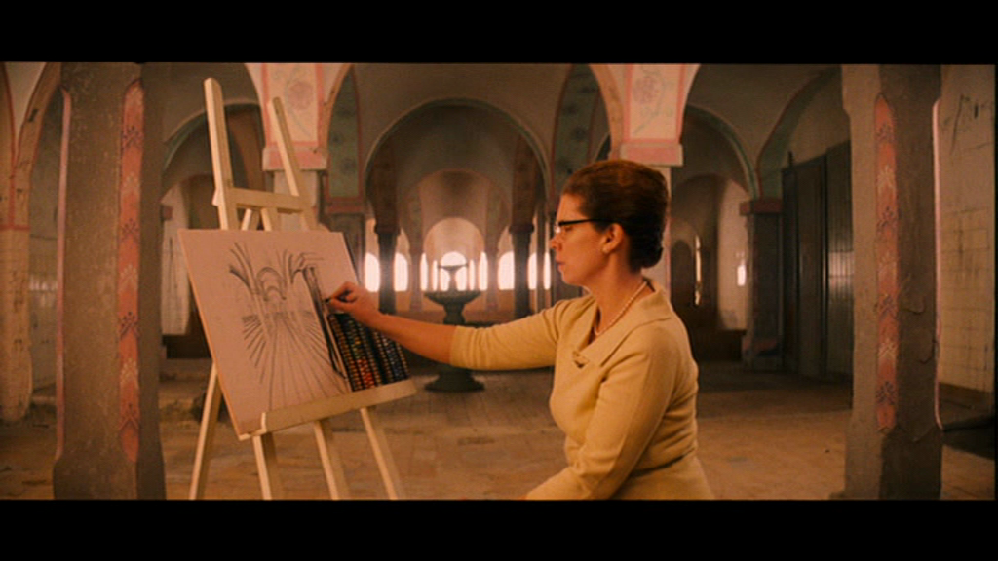
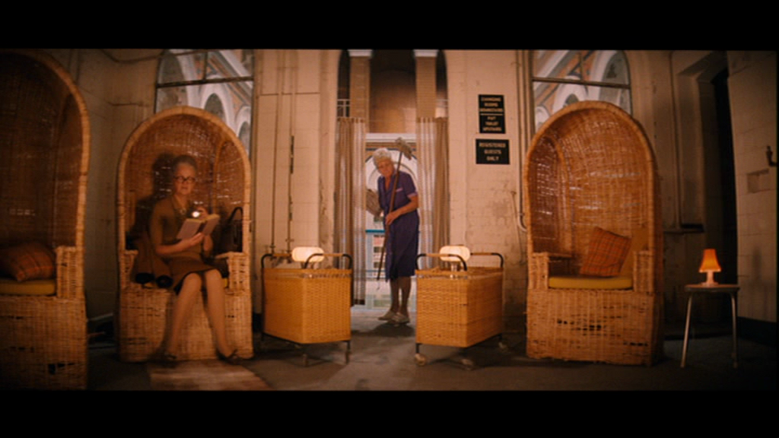
‚social life is a hotel‘: The Grand Budapest Hotel in 1968
Audiovisual Submetaphor: ‚an individualistic society is a small human group in a huge empty building‘

Slide 43
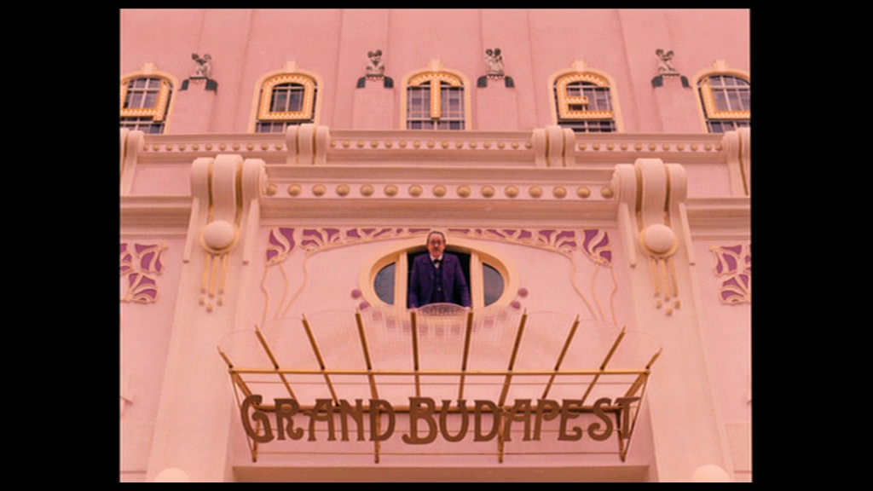
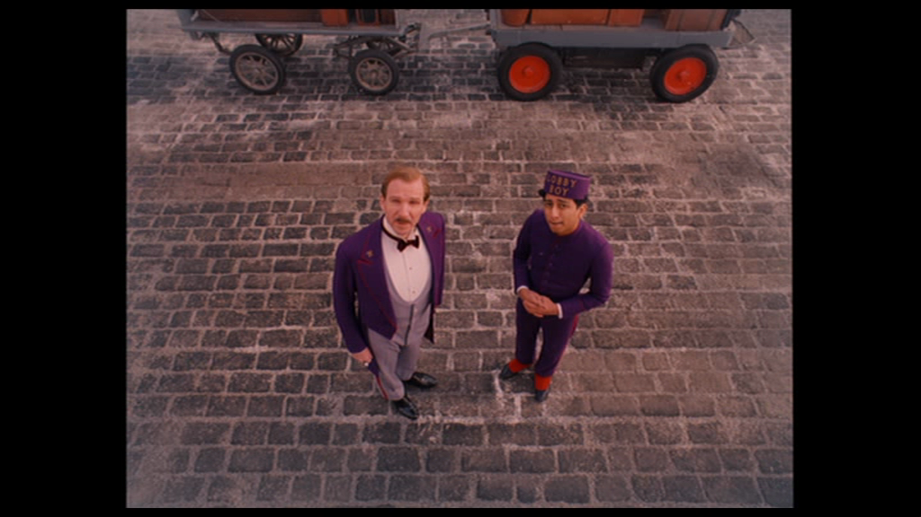
Bodily Performances of Gustave as Key audiovisual Metaphor
‚Trespassing of social limits is passing levels of a building‘
Example: One of Gustaves Gazes, performed by camera & editing as transgressing the levels of the hotel

Slide 44
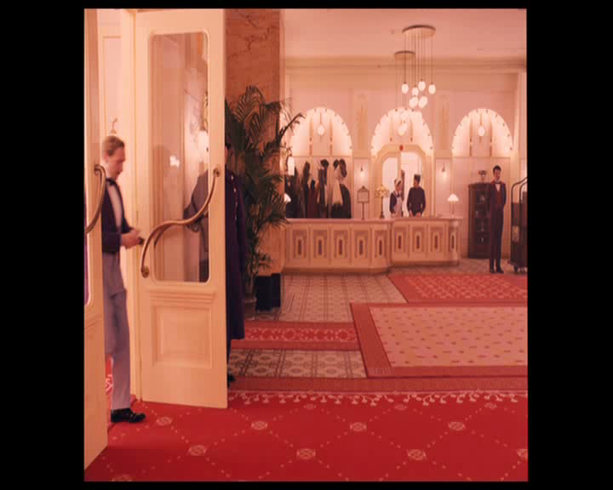
‚mastery of social order is fluid/self-controlled motion thoughout in a building‘

