Slide 1
Image, Object Text: Essay Task
20 April 2022

Slide 2
Choose one or two works of art / architecture and identify the issues raised by the task of undertaking an art historical interpretation of them.
You will be expected to discuss relevant academic publications on it / them (or on the artist / architect) – recent, historical, or a combination of the two - and analyse the methodological debates that your chosen work/s generates.
Consider the ways in which the debates relate to the topics we have discussed in the course.
Are there any alternative interpretations and methods you think might be valuable and why?

Slide 3
What is an essay?
“A short piece of writing on a particular subject.”
It is a formal, original text
With a clear sense of argument
Supported by evidence, facts
Expressed logically

Slide 4
General structure/outline of an essay
Introduction
Main Argument – divided into clear distinct sections
Conclusion
Bibliography
Illustrations

Slide 5
Introduction
The most difficult part of the essay. What is it for?
Think of the reader. The Introduction is way of letting the reader know what to expect.
Let the reader know: what is the topic of the essay?
What will be the main ideas you will be discussing?
Let the reader know what the essay is trying to do. What is the aim? (In other words: where is heading?)
Make sure there is a clear break between the Introduction and the main part of the essay – i.e. where the actual argument begins.

Slide 6
What is an argument?
A flow of reasons. It is a case presented in a logical stream, where ideas run together to support one another
Ideas that begin with a proposition, gather reinforcement and head toward a conclusion
Think of it as an exercise in persuasion – your task is to persuade the reader that your point of view is reasonable

Slide 7
What an argument isn’t
A simple presentation of facts / images

Slide 8
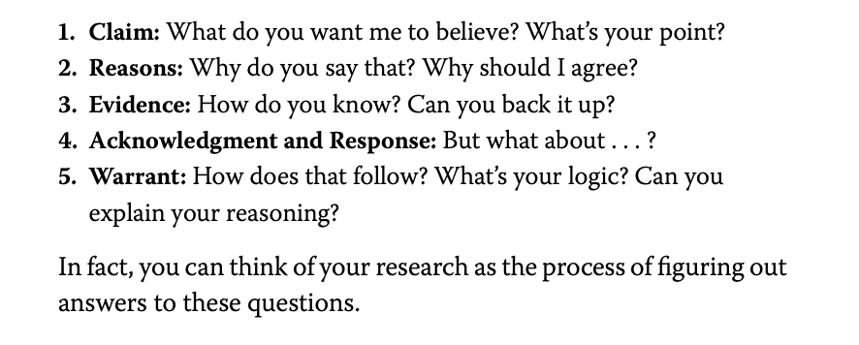
From: Wayne Booth, The Craft of Research (Chicago, 2016) p. 111.

Slide 9
Forming an argument
Do not merely describe one work, then the next work. This style—known as “block-by-block”—often leads to a lot of description but not much analysis.
Instead: structure your paper in what is known as the “point-by-point” method. In this method, identify points of comparison and contrast and allow those points to be the main ideas.
Only include information that will help your argument seem more persuasive. Do not just present all the information about an artist / author / work of art you have found.

Slide 10
Writing a conclusion
Do not simply repeat what you said in the main argument
Instead: the conclusion is where you: (a) remind the reader of the main points of your argument but, crucially, also (b) offer some kind of reflection on what you have argued.
It may be useful, when planning your essay, to start by thinking what conclusion you would like to reach, and then work out how you are going to get there
There of an essay as a journey on which you take the reader with you

Slide 11
Illustrations
Please use illustrations, but …..
Please use illustrations. In other words, they should be there for a reason, and not just for decoration
If you find you have an illustration, but you have not talked about it, then maybe it is not needed
Please make sure it is of good quality and size

Slide 12
Sources
You will be expected to support your claims with sources. This is so that: (a) you can show your claim is reliable (b) you can show that you have researched the topic of the essay and are suitably informed
Please ensure your sources are credited in footnotes or endnotes (either is fine – just be consistent) – to:
avoid suspicion of plagiarism
enable the reader to check your source themselves

Slide 13
What kinds of sources?
Books
Articles, reviews in academic journals
The Internet:
Can be a perfectly good source of academic articles (there are many online journals), but
Equally, because anyone can upload material onto the internet, it is not reliable. The classic case: Wikipedia
Check the source. Where is it from?
Principle of peer review. Has it been peer reviewed, or is it just the views of some individual?
Primary or Secondary source?

Slide 14
Bibliography
Please make sure the essay has a bibliography of sources consulted.
Only list those items that you have discussed in a footnote / endnote.
In other words, don’t list books and articles just to make an impressive-looking bibliography
Only include items where there is evidence that you have drawn on them to support your argument
Think of it like this: if you follow these rules, and you end up with a short bibliography, it suggests you have not used enough sources

Slide 15
Bibliography 2
Please make sure the bibliography makes a distinction between primary and secondary sources
Please include a list of images used, with the name of the artist / architect, title of the work, date (you can also add where the work is, the medium it has been from, the dimensions)
Please follow the Chicago Manual of Style for the format of citations and bibliography

Slide 16
Useful Guides
There are many useful guides on writing and researching. These are two of the most useful in English:
Sylvan Barnet, A Short Guide to Writing about Art (Boston, 1981)
Wayne Booth, The Craft of Research (Chicago, 2016)
If in doubt – just ask me!!

