Slide 1
Art history in a global context: decolonizing the discipline?

Slide 2
The Decolonizing Impulse

Slide 3
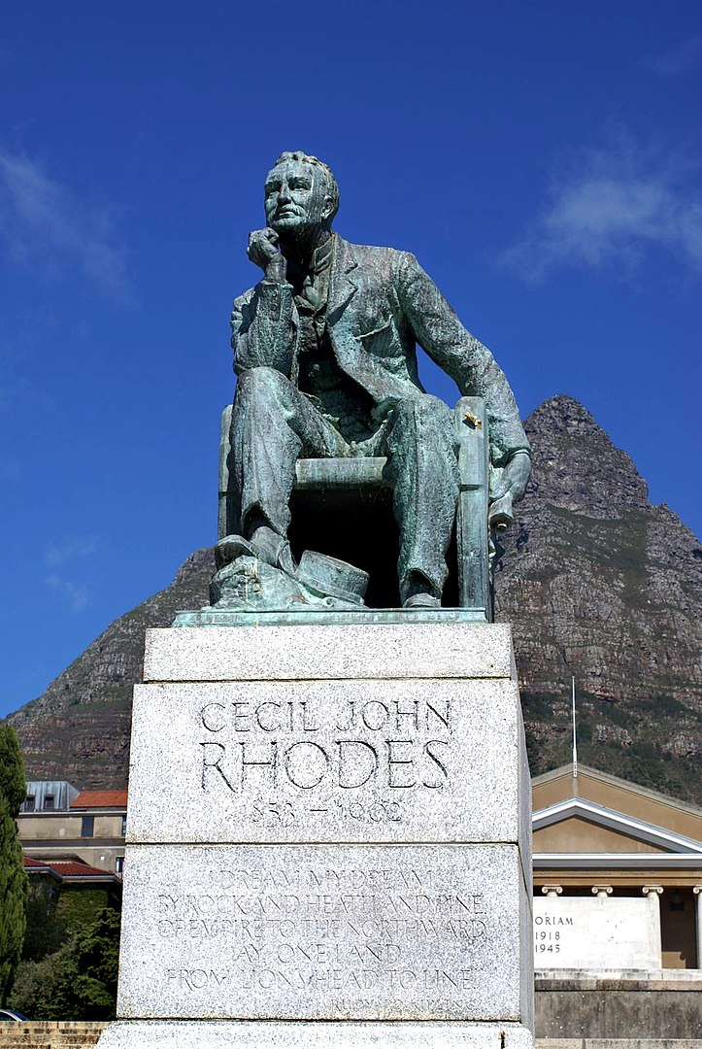
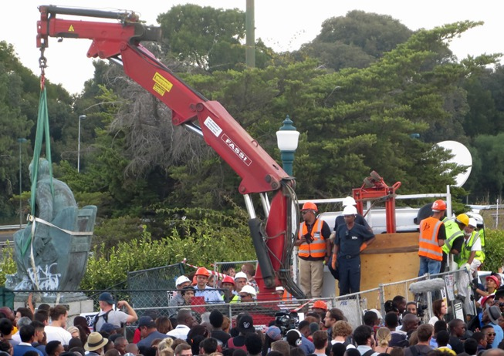
Marion Walgate
Statue of Sir Cecil Rhodes (1853-1902), University of Cape Town (1934)
Removal of the statue, 9 April 2015

Slide 4
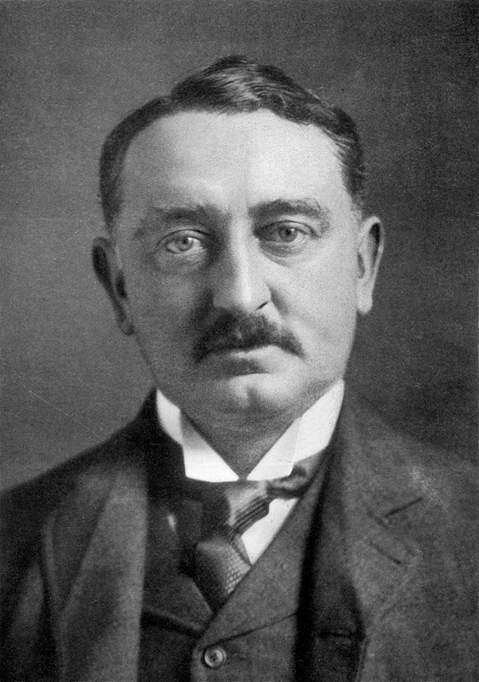
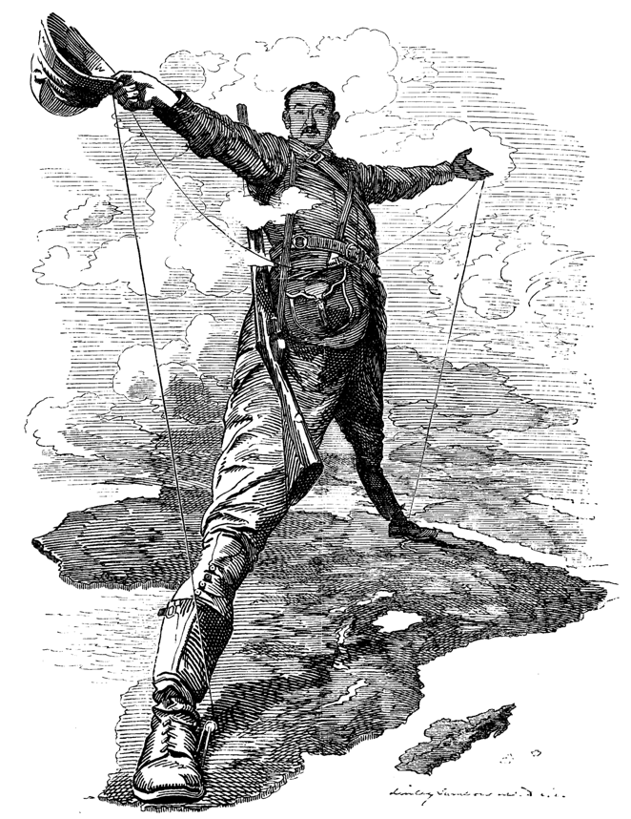
Sir Cecil Rhodes (1853 – 1902)
The Rhodes Colossus in Punch (1892)

Slide 5
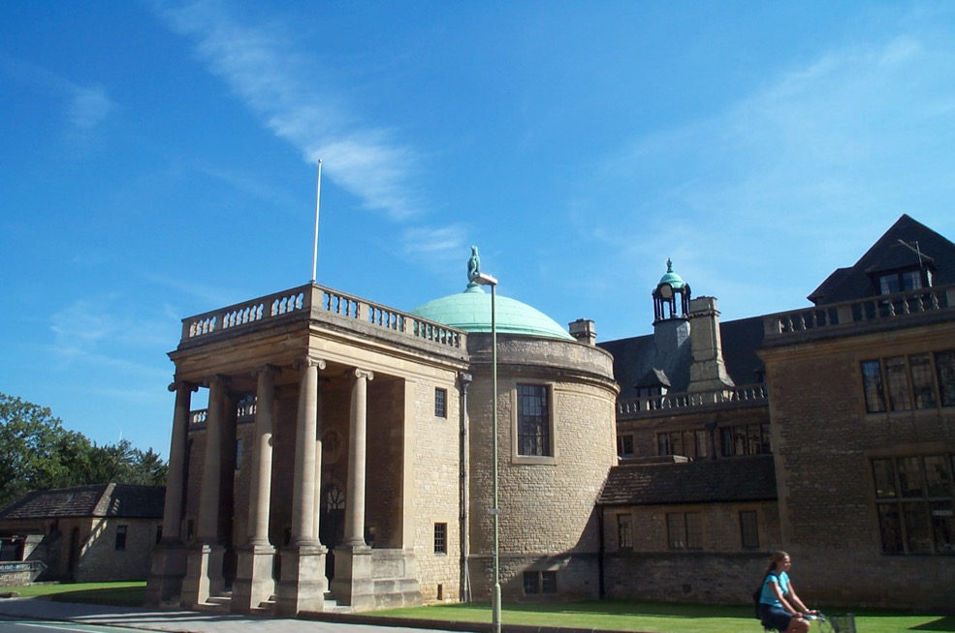
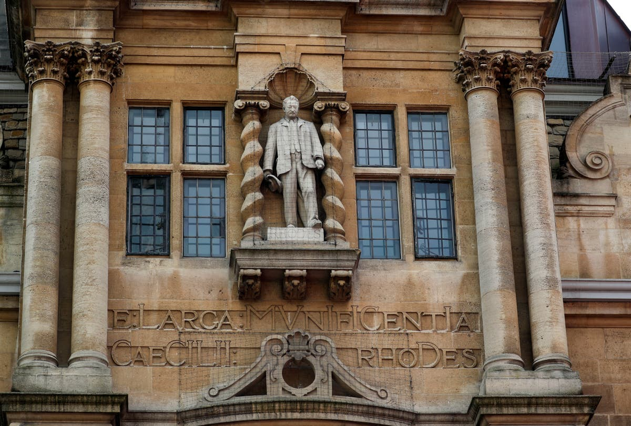
L: Rhodes House, University of Oxford
R: Statue of Rhodes, Oriel College, Oxford (1911)

Slide 6
What does ‘decolonizing’ mean? Questionnaire from Art History 43.1 (2020)
Tim Barringer, Yale University
Tim Barringer
Priyanka Basu, University of Minnesota

Slide 7
What does ‘decolonizing’ mean? Questionnaire from Art History 43.1 (2020)
David Bindman, University College London
James D’Emilio, University of South Florida

Slide 8
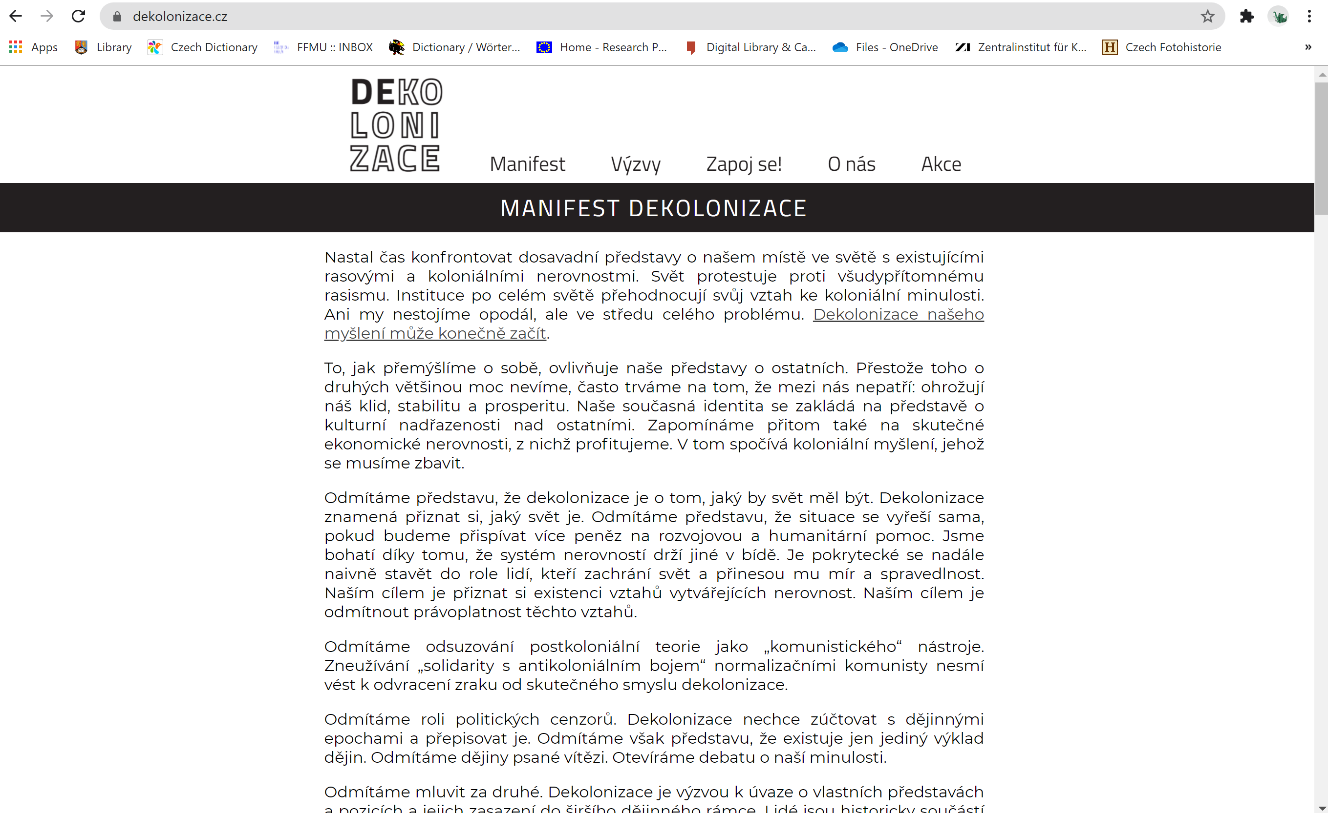

Slide 10
Orient and Blackness
Two Critical Studies

Slide 11
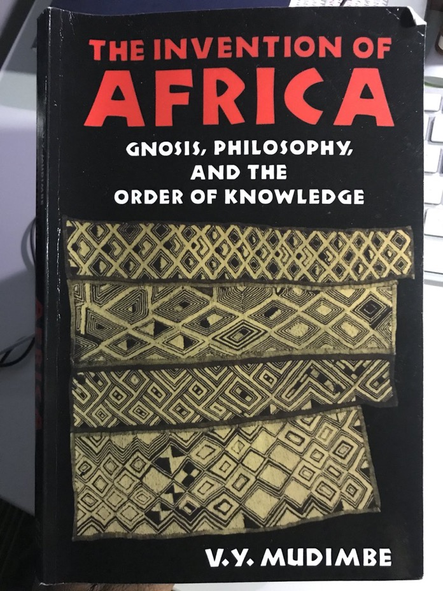
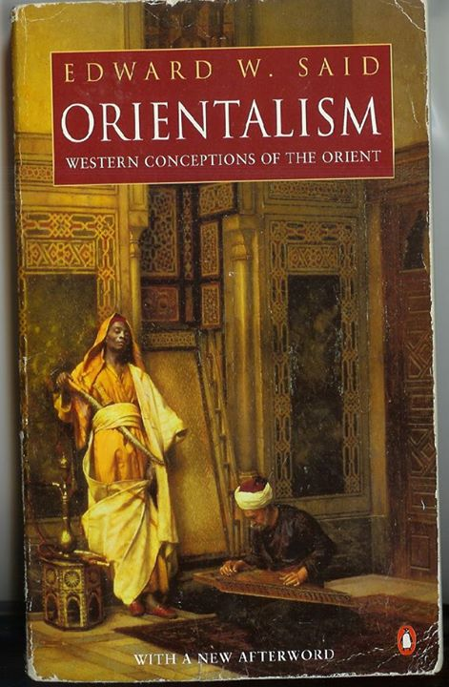

Slide 12
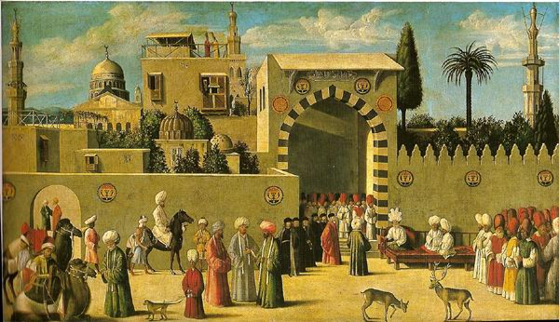
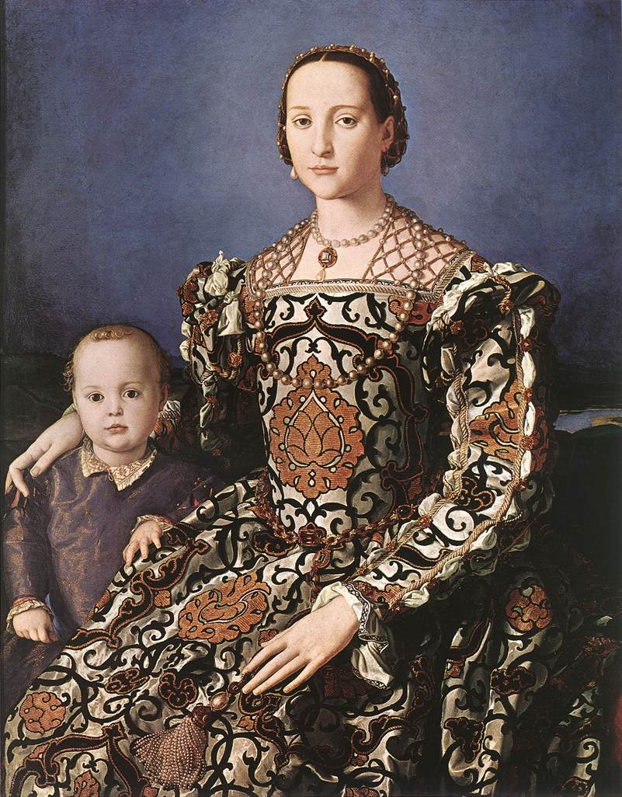
Anonymous Venetian painter – Reception of the Ambassadors in Damascus (1511)
Bronzino – Eleanor of Toledo (15444-45)

Slide 13
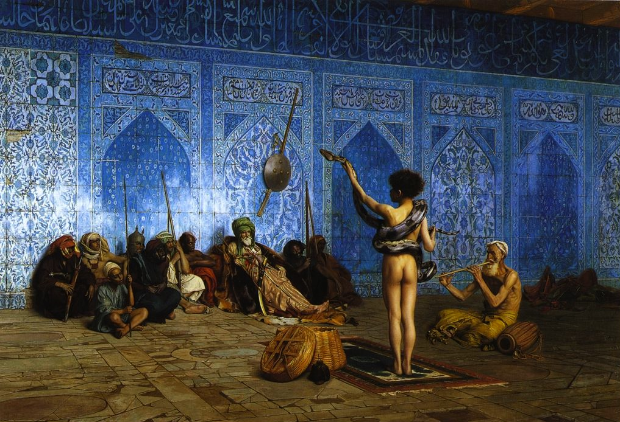
Jean-Léon Gérôme – The Snake Chamer (1870)
Sterling and Francine Clark Art Institute

Slide 14
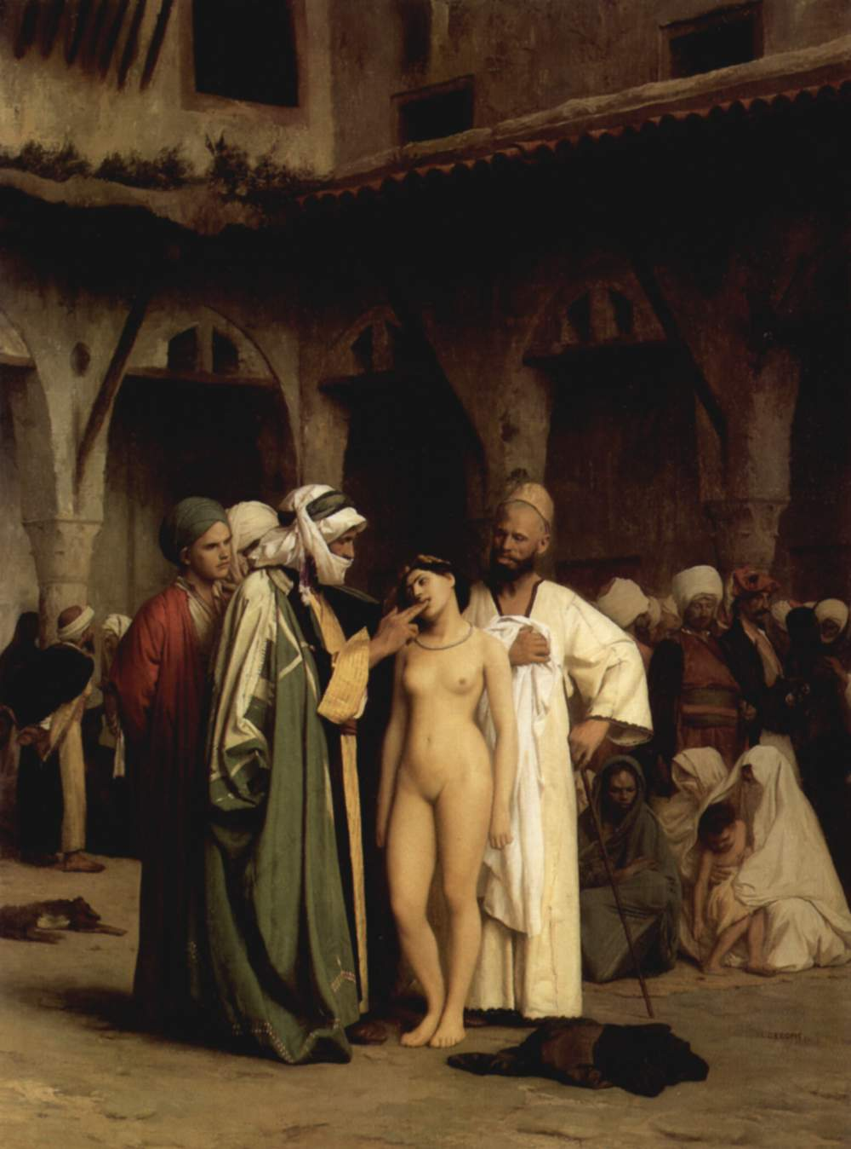
Jean-Léon Gérôme
The Slave Market (1867)

Slide 15
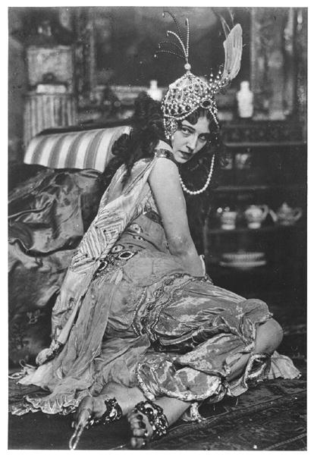
Ida Rubinstein in costume for Zubeide in Sheherazade designed by Leon Bakst (1910)
Source: Bridgeman Education

Slide 16
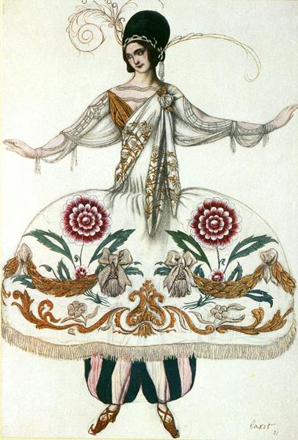
Leon Bakst
Costume Design for Sheherazade from Sleeping Beauty (1921)
Private Collection
Source: Bridgeman Education

Slide 17
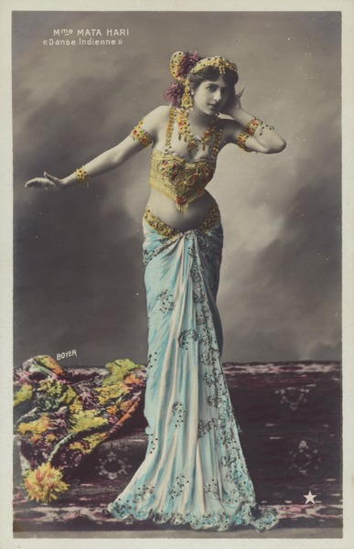
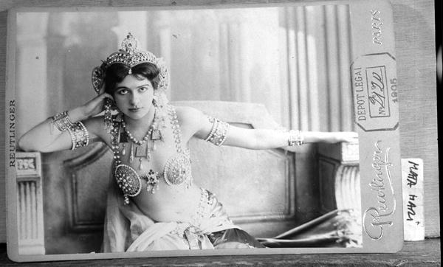
Dutch exotic dancer ‘Mata Hari’ (1876-1917)
Image Source: Bridgeman

Slide 18
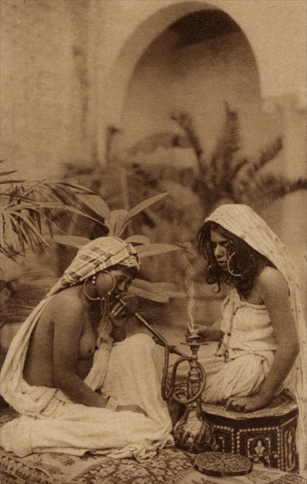
Anonymous postcard of harem girls smoking a hookah, Algeria
Ca. 1900
Source: Bridgeman Education

Slide 19
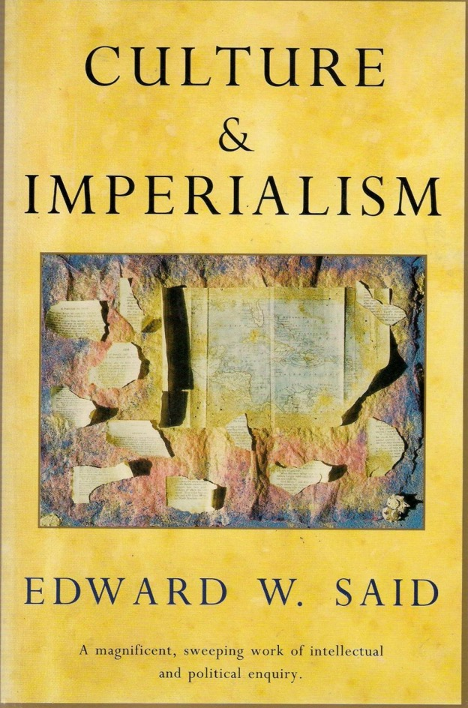
‘Both [imperialism and colonialism] are supported by and perhaps even impelled by …. notions that certain territories and people require and beseech domination, as well as forms of knowledge affiliated with domination: the vocabulary of classic nineteenth-century imperial culture is plentiful with such words as “inferior” or “subject races”, “subordinate peoples”, “dependency”, “expansion” and “authority”.
Edward Said, Culture and Imperialism (1993) p. 8

Slide 20
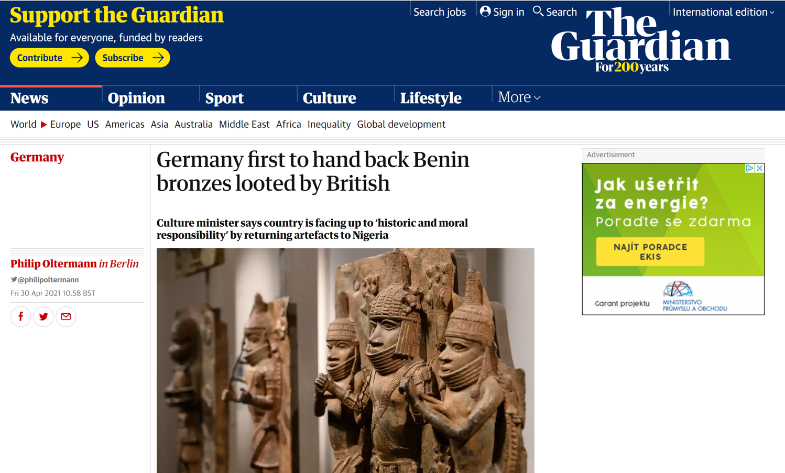

Slide 21
‘We penetrated deeper and deeper into the heart of darkness. It was very quiet there. At night sometimes the roll of drums behind the curtain of trees would run up the river and remain sustained faintly, as if hovering in the air high over our heads, till the first break of day. Whether it meant war, peace, or prayer we could not tell. The dawns were heralded by the descent of a chill stillness; the wood-cutters slept, their fires burned low; the snapping of a twig would make you start. We were wanderers on a prehistoric earth, on an earth that wore the aspect of an unknown planet. We could have fancied ourselves the first of men taking possession of an accursed inheritance…’
Joseph Conrad, Heart of Darkness (1901)
‘Although little authentic knowledge of the Benin people is current, the main characteristics of the surrounding tribes are thought to be theirs also in an intensified degree. Finding expression in habits of disgusting brutality and scenes of hideous cruelty and bloodshed, ordained by the superstitions of a degraded race of savages.’
Illustrated London News, 1897

Slide 22
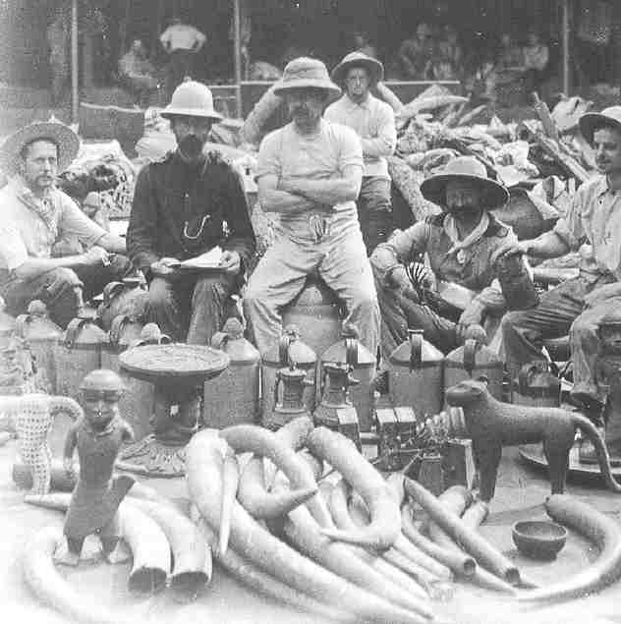
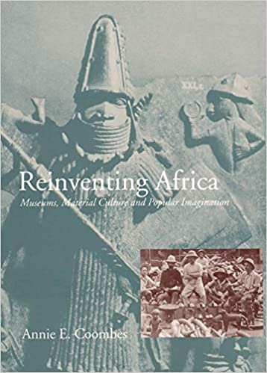
The British Punitive expedition to Benin (1897)

Slide 23
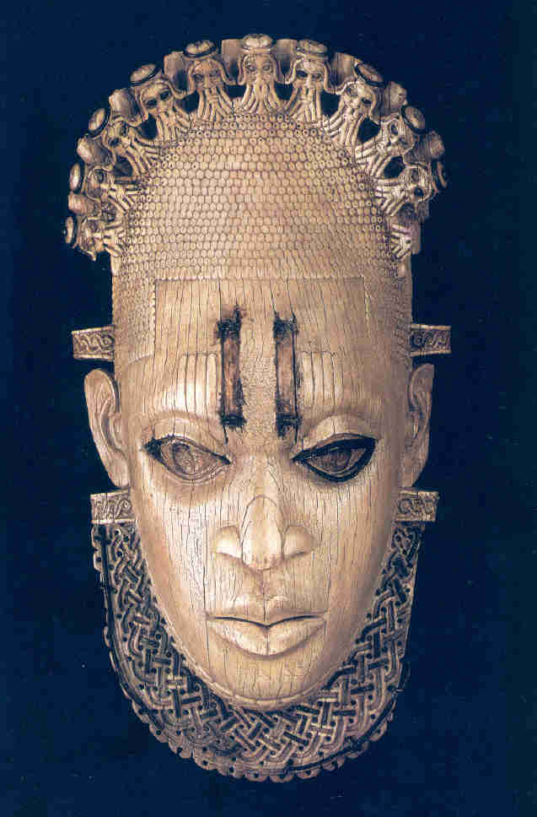
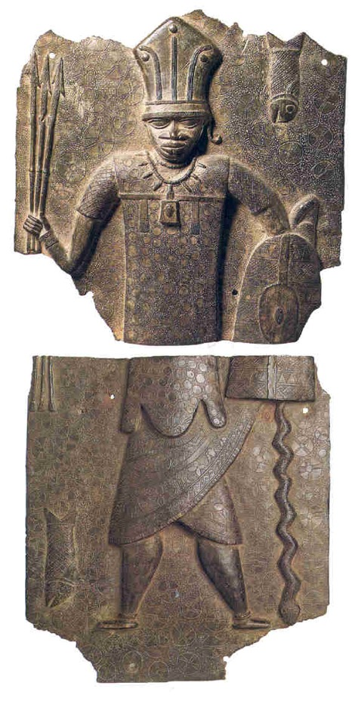
Royal Ivory Mask, ca. 1520, Benin
Brass Warrior Plaque, ca. late 16th century, Benin

Slide 24
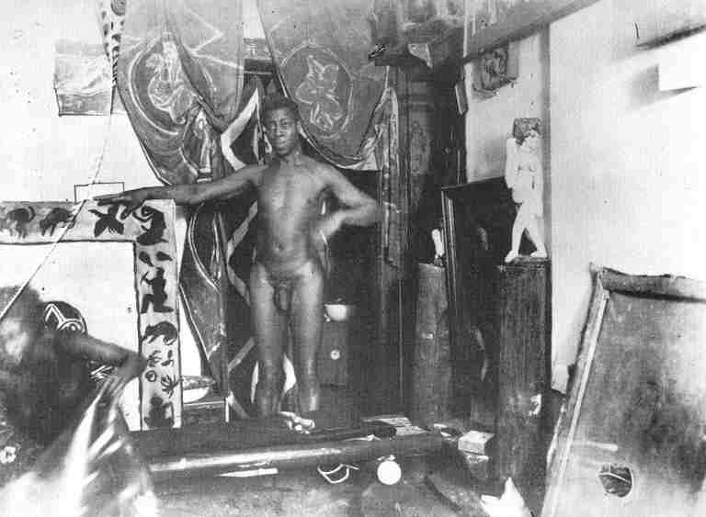
Sam and Milli from the Zirkus Schumann in Ernst Kirchner’s studio (1910)

Slide 25
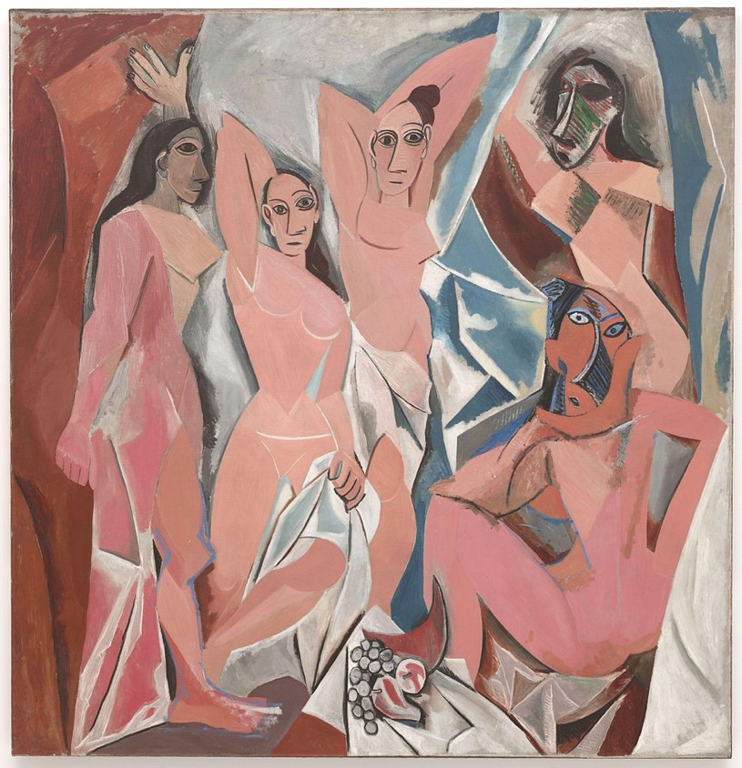
Brancusi, King of Kings (Early 1930s)
Picasso, Les Demoiselles d’Avignon (1907)

Slide 26
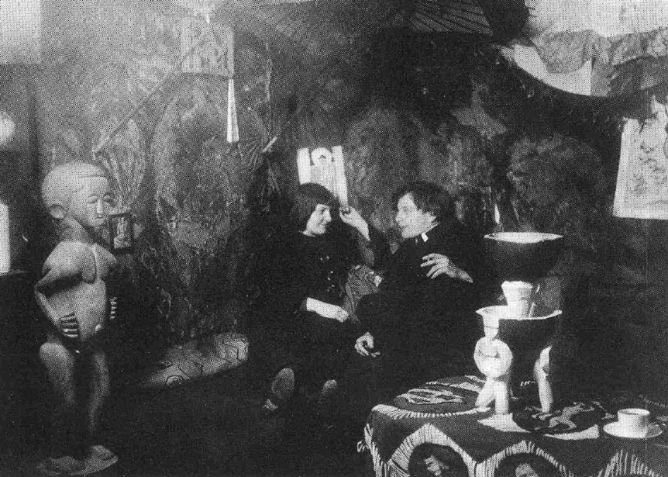
Ernst Ludwig Kirchner, 1912

Slide 27
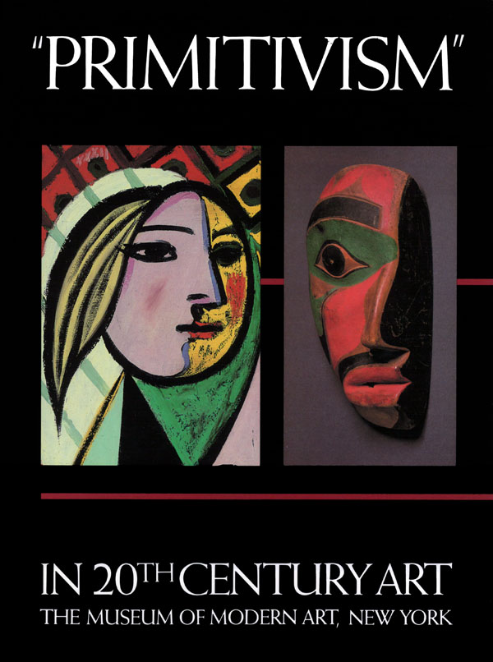
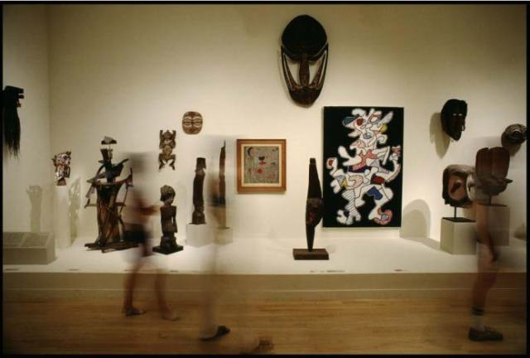
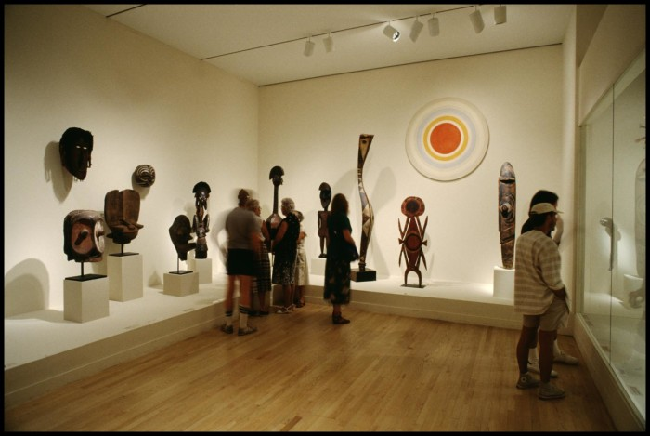

Slide 28
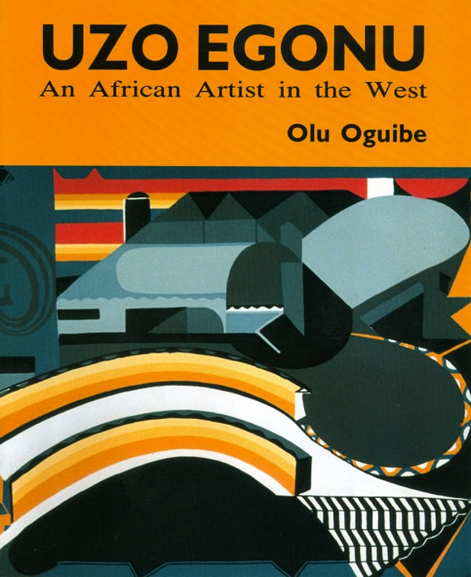
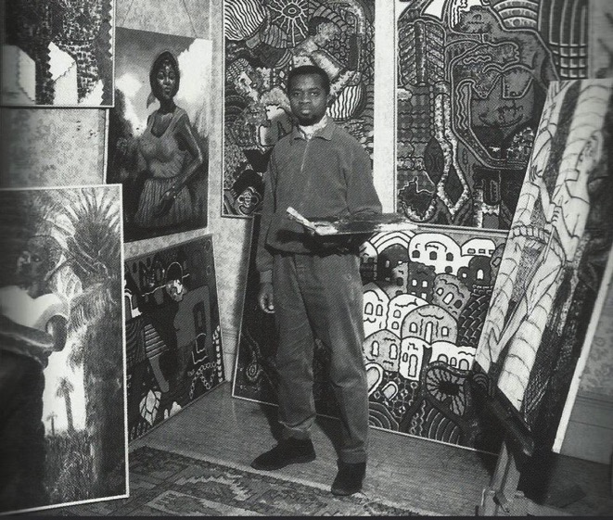
‘To reject the exoticisation of Africa is to destroy an entire world view, carefully and painstakingly fabricated over several centuries. This is the imperative for any meaningful appreciation of culture in Africa today, and it would be unrealistic to expect it easily from those who invented the old Africa today.’
Oguibe, ‘The Heart of Darkness’ p. 324.
L: Oguibe – Front cover of Uzo Egonu (1995)
R: Uzo Egonu (1931- 96) in London, ca. 1964

Slide 29
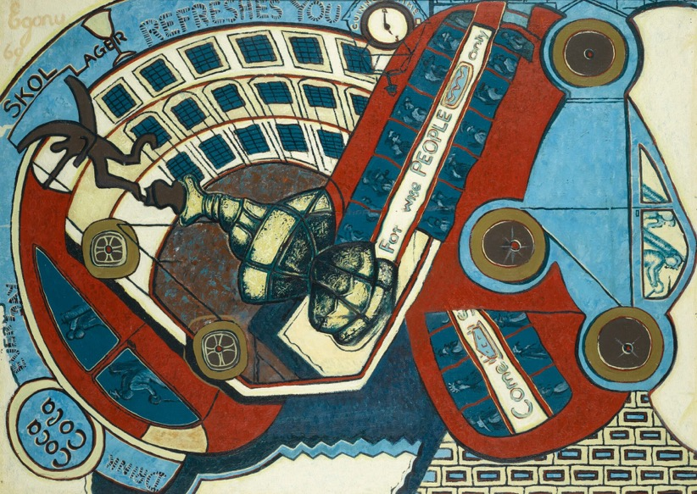
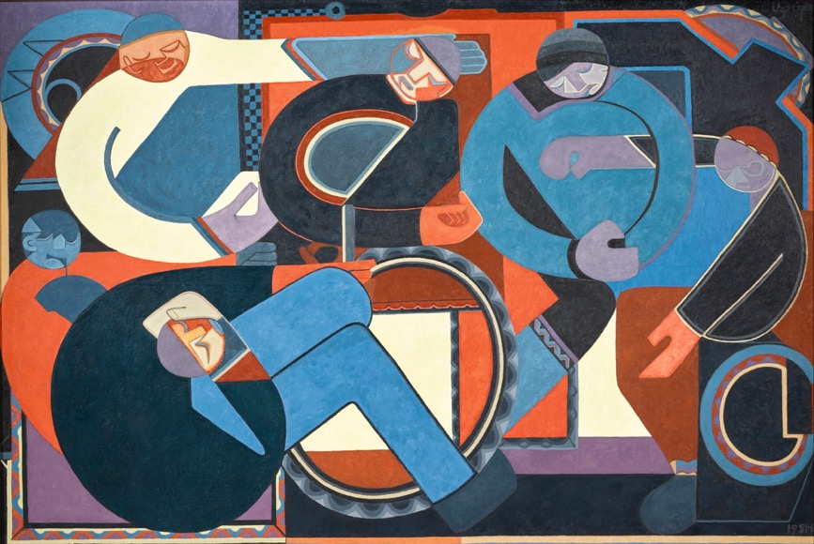
Uzo Egonu:
L: Nigerian Picadilly Circus (1969)
R: An Assembly (1982)

Slide 30
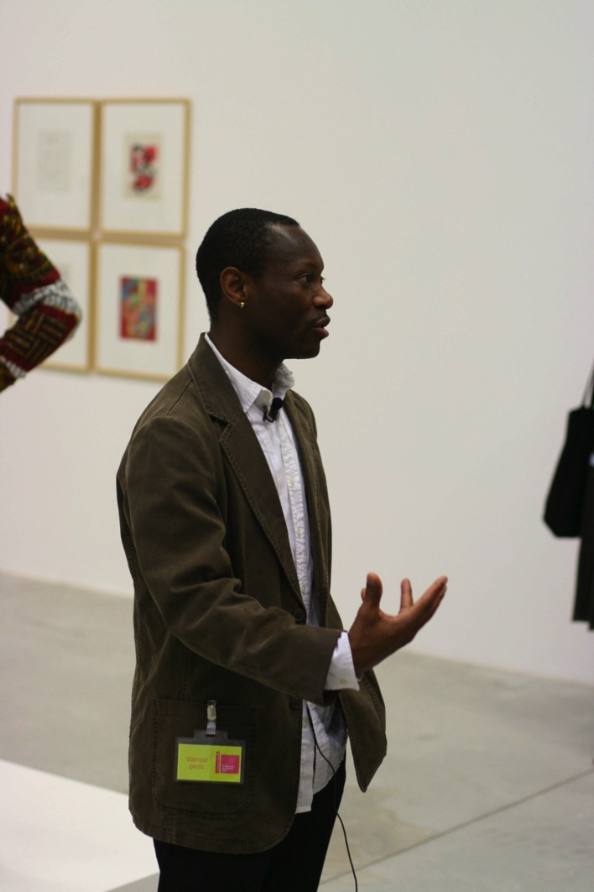
‘It is evidence of the arrogance of Occidental culture that even the concept of history should be turned into a colony …history is granted as a validating privilege, which it is the West’s to grant, like United Nations recognition …’
Oguibe, ‘In the Heart of Darkness’ in Oguibe, ed, Reading the Contemporary (London, 1999) p. 321
Olu Oguibe (1964 - )

Slide 31
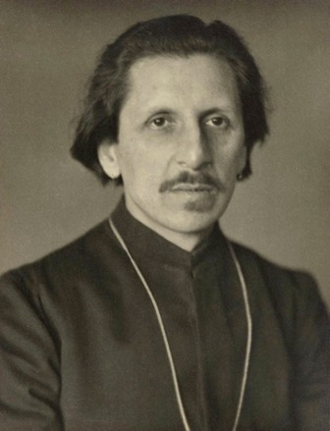
An Early Attempt at Decolonizing
Ananda Coomaraswamy (1877-1947)

Slide 32
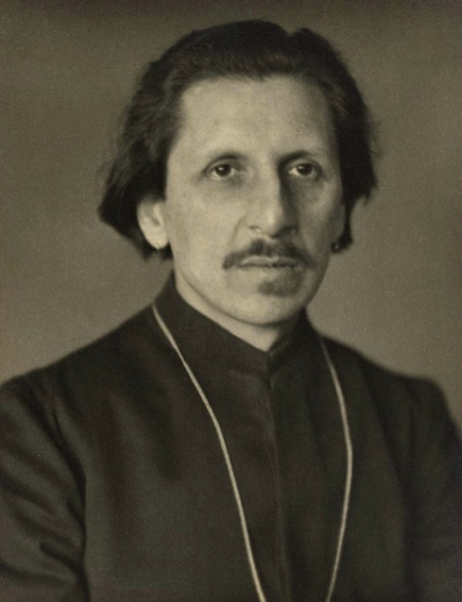
Ananda Coomaraswamy (1877-1947)
1884 – 1897: Schooled in Britain
1897-1900: Studied in University College London
1917 – 1947: Keeper of Indian Art, Boston Museum of Fine Arts

Slide 33
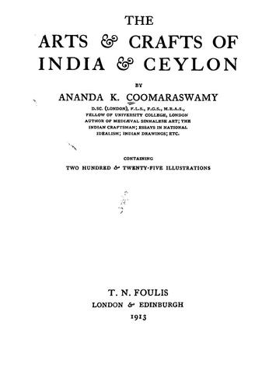
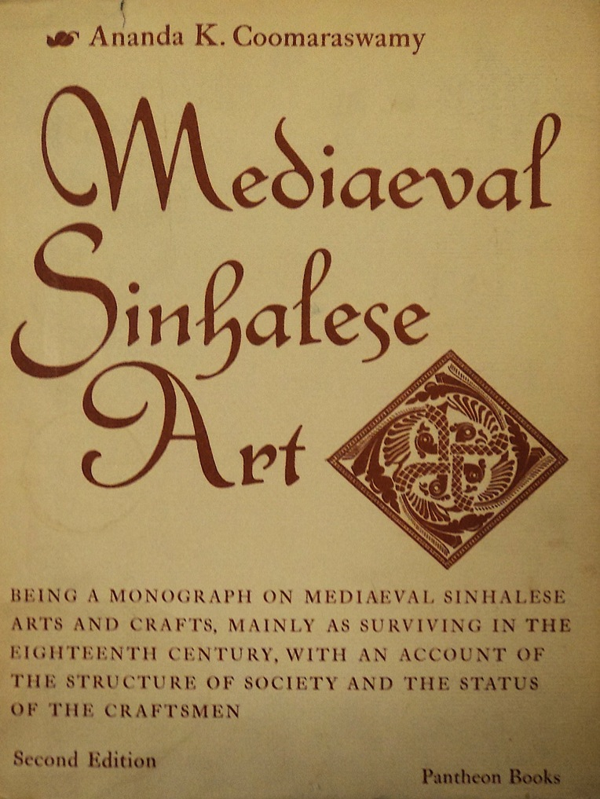

Slide 34
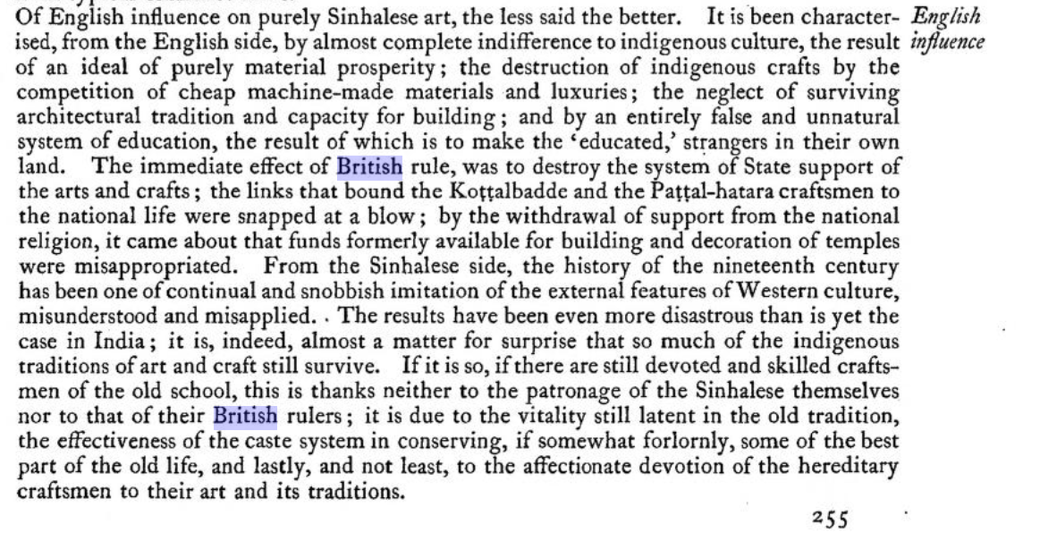

Slide 35
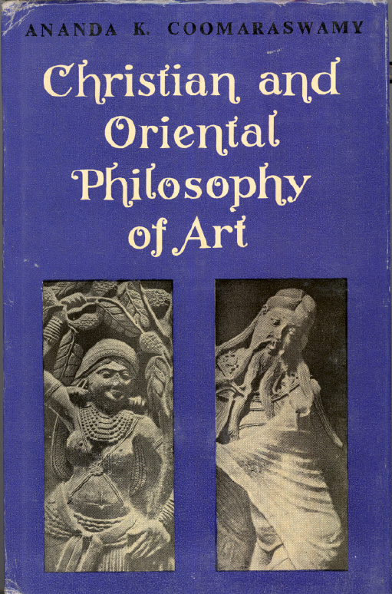
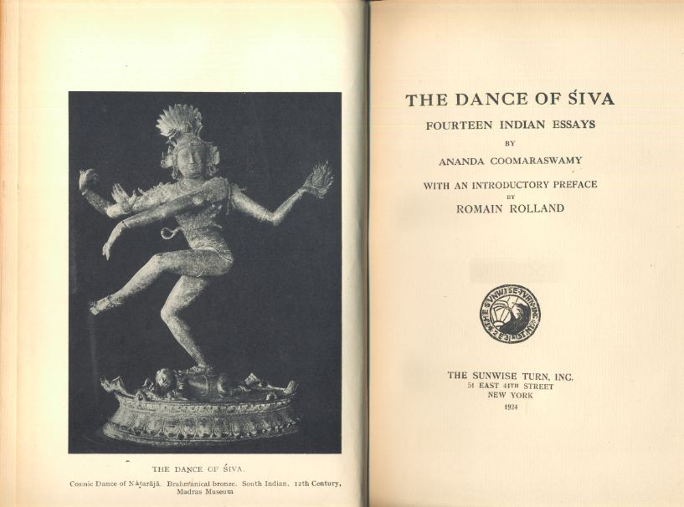
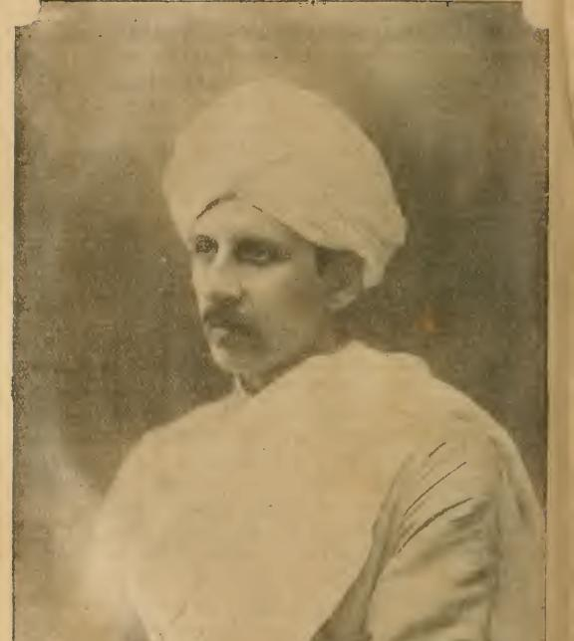
L: Christian and Oriental Philosophy of Art (1944)
R: The Dance of Śiva (first published 1918)

Slide 36
Decolonizing in Central Europe

Slide 37
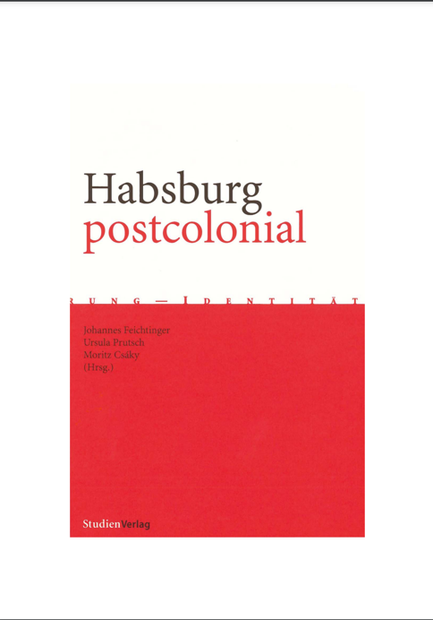
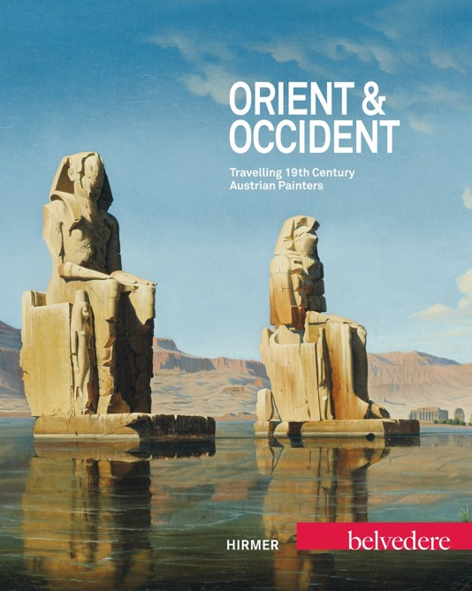
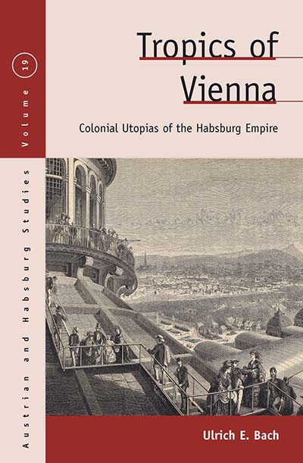

Slide 38
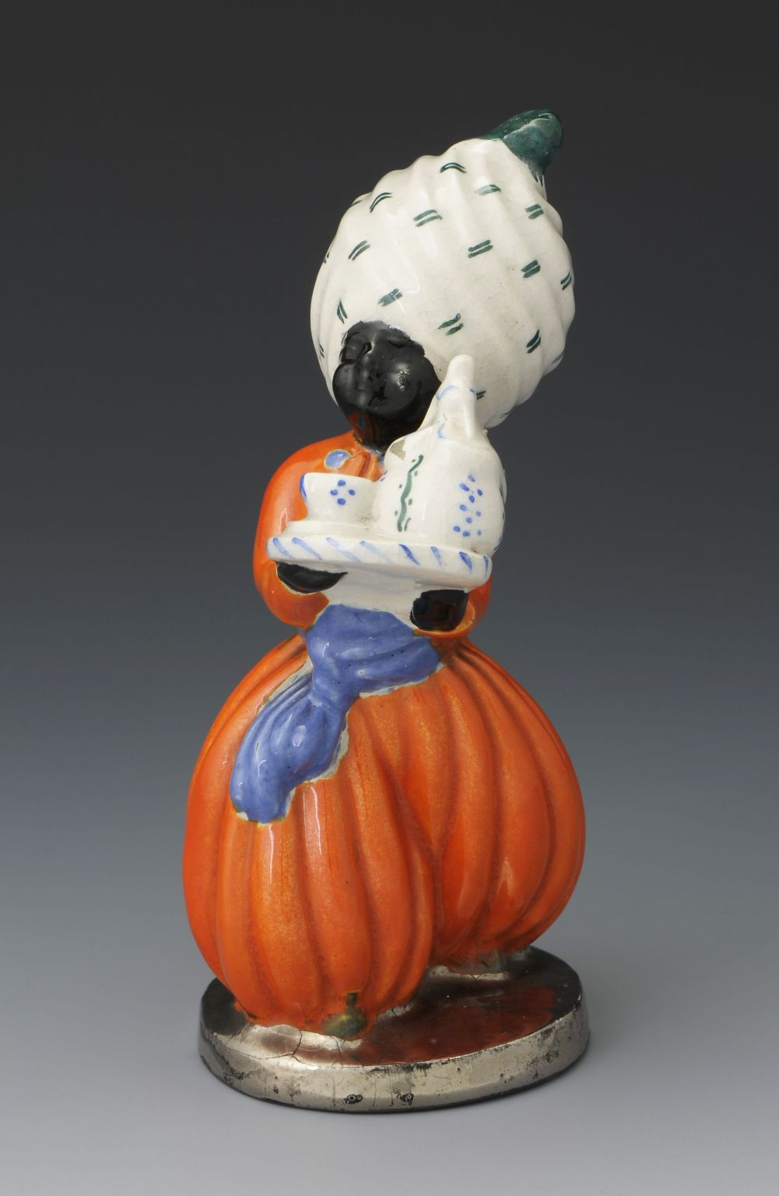
Helena Johnová
Black Boy (1912-39)

Slide 39
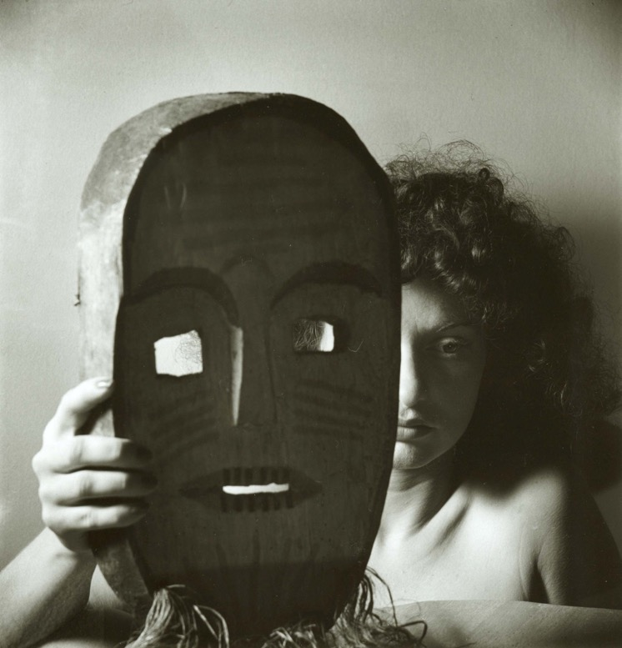
Alexander Hackenschmied, Untitled (1942)

Slide 40
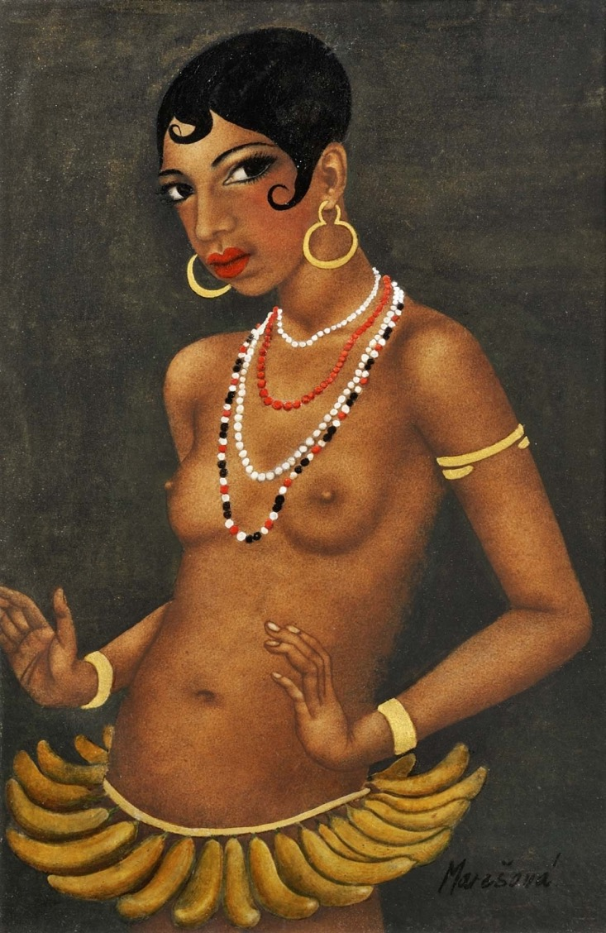
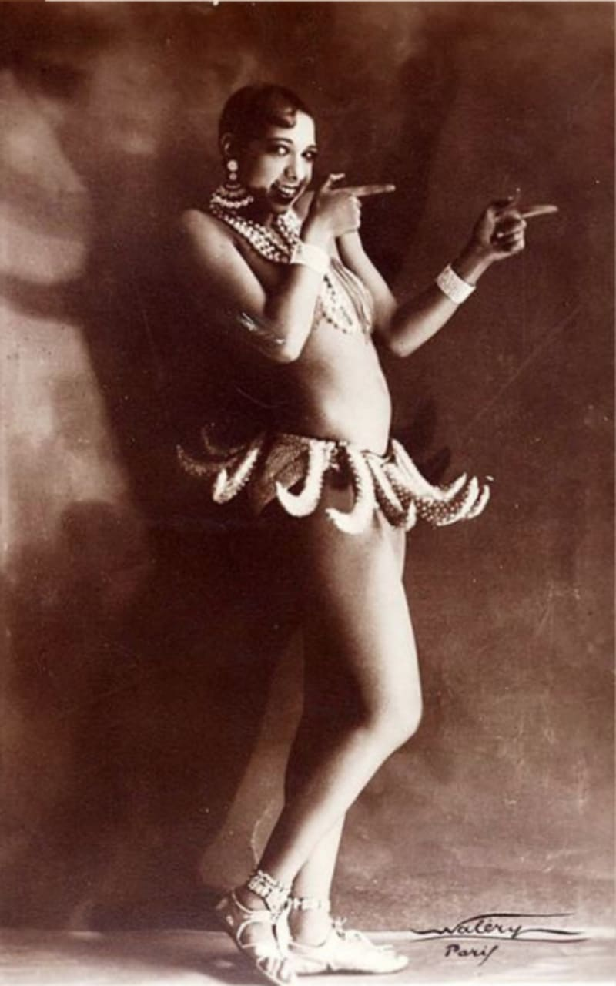
Milada Marešová
Josephine Baker (early 1930s)

Slide 41
Josef Sudek
Black Mask (1932)

Slide 42
Josef Čapek, The Art of Primitive Nations (Prague, 1938)

Slide 43
Josef Capek
Black King (1920)

Slide 44
Toyen, Black Paradise (1925)

Slide 46
Emil Filla, Heracles and the Lion (1936)

Slide 47
Vojtěch Náprstek (1826-1894)

Slide 50
(1857-1858) Ship surgeon on the Carolin, escort to SMS Novara
(1859-60) Ship surgeon on Elisabeth accompanying Maximilian to Brazil
(1864-65) Ship surgeon escorting Emperor Maximilian of Mexico
(1868-71) Ship surgeon on Friedrich on diplomatic tour around the world

Slide 51
Alois Musil (1868-1944)
Qusayr Amra, Jordan (8th cent CE)

Slide 52
1902: professor of theology, University of Olomouc
1909: professor of biblical studies and Arabic, University of Vienna
1914 – 1918: military service for the Habsburg Empire countering British influence in the Middle East
1920: professor of Arabic / Head of Institute of Oriental Studies, University of Prague

Slide 53
Museum of Aleš Hrdlička, Humpolec

Slide 54
Aleš Hrdlička (1869 – 1943). Photo from around 1930. Founder of the Anthropology Department of the Smithsonian Museum, Washington

