Slide 1
Horizontal Art History

Slide 2
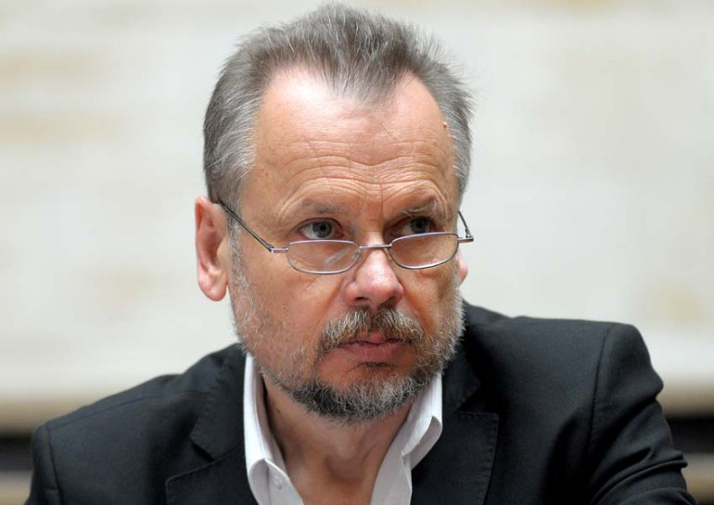
Piotr Piotrowski (1952-2015)

Slide 3
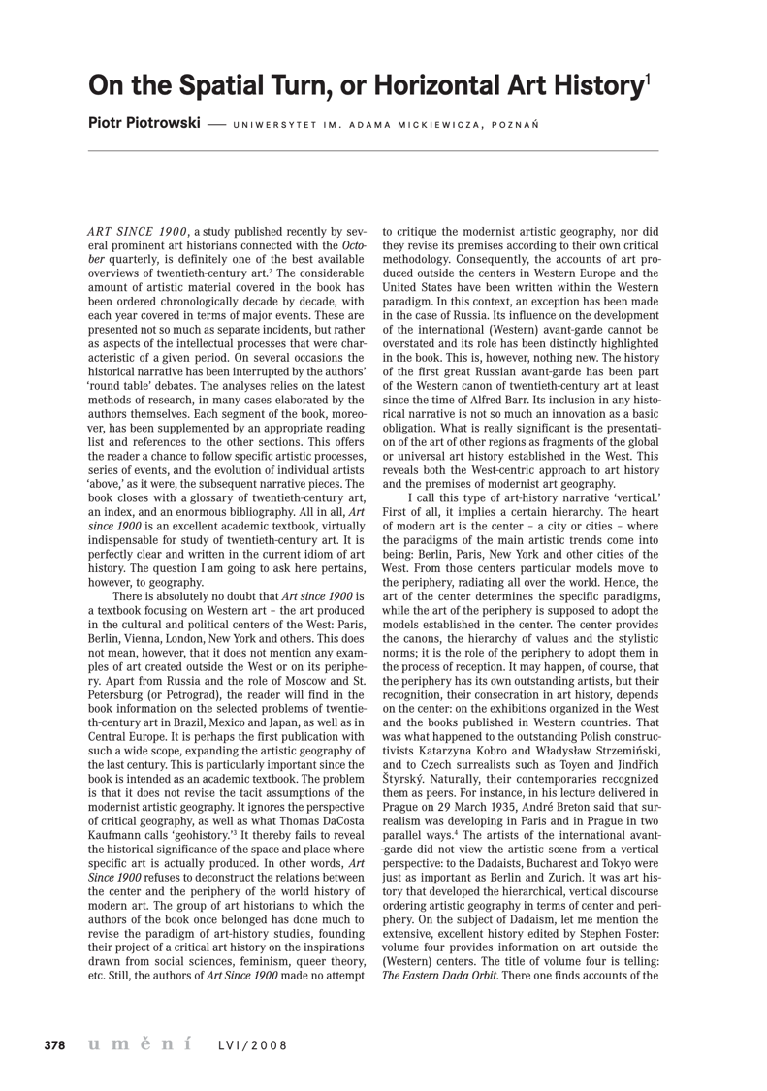

Slide 4
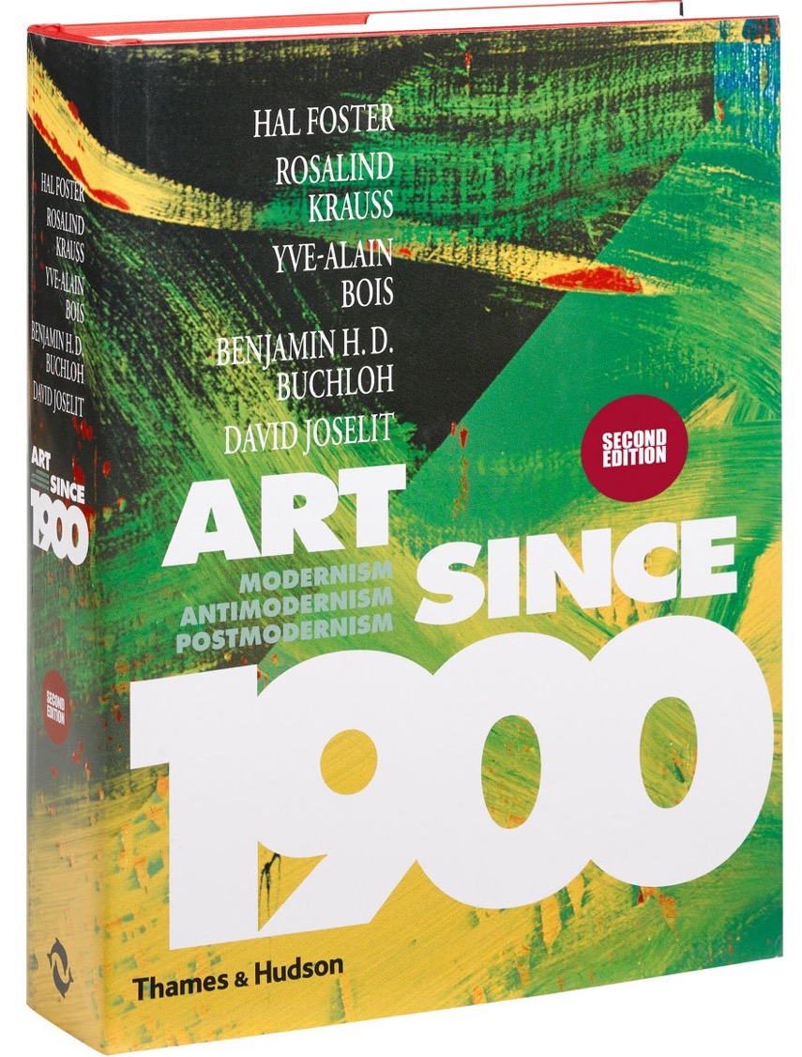

Slide 5
Centres and Peripheries

Slide 6
‘The history of European art has been largely the history of a number of centers, from each of which a style has spread out. For a time, whether short or long, this style dominates the art of the period, turning in effect into an international style, while remaining metropolitan at the center and becoming more and more provincial as it reaches the periphery. A style docs not develop spontaneously over a large area . It is the creation of a center, a single unit that provides the impulse. The center may be small, like fifteenth century Florence, or large, like Paris before the war, but it has the self-confidence and coherence of a metropolis.’
Sir Kenneth Clark, Provincialism (London, 1962) p. 3

Slide 7
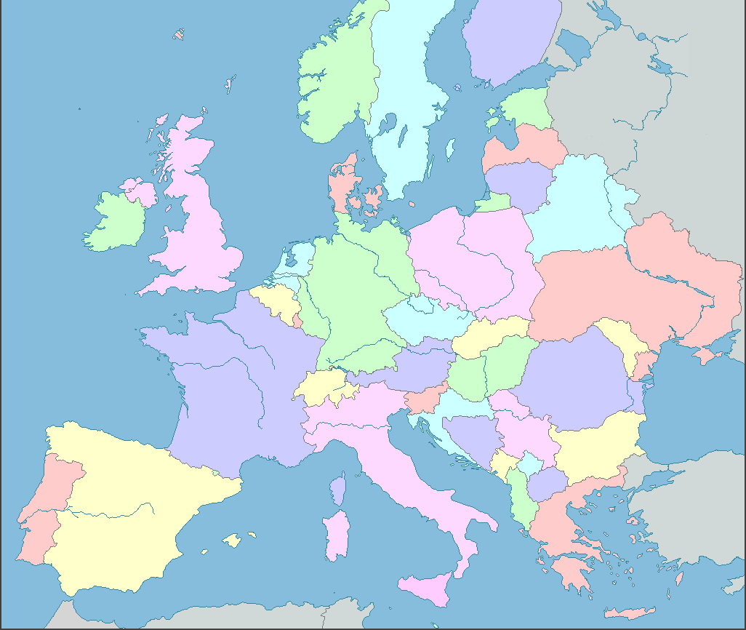
Art Centres in Europe,
1400 - 1900
Amsterdam
London
Berlin
Paris
Vienna
Venice
Florence
Madrid
Rome

Slide 8
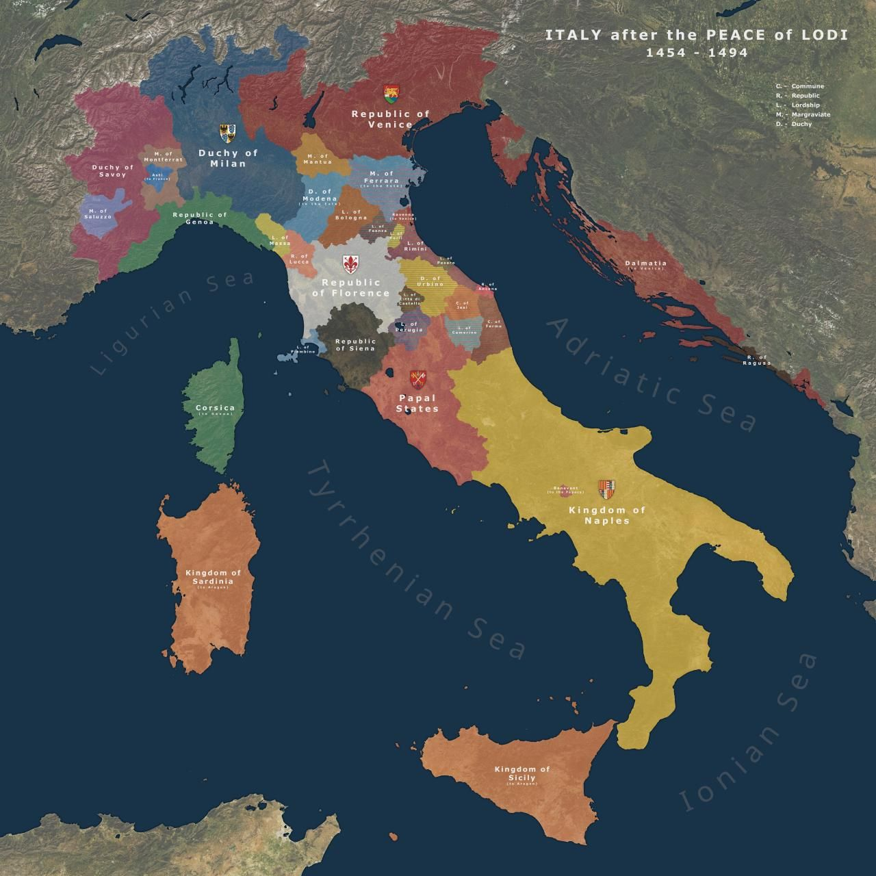
Renaissance Italy
The major centres:
Florence
Rome
Venice
Naples
Milan
Giotto (Florence)
Donatello (Florence)
Botticelli (Florence)
Masaccio (Florence)
Raphael (Rome)
Leonardo (Milan)
Bramante (Milan / Rome)
Michelangelo (Florence / Rome)
Bellini (Venice)
Titian (Venice)
Vasari (Florence)

Slide 9
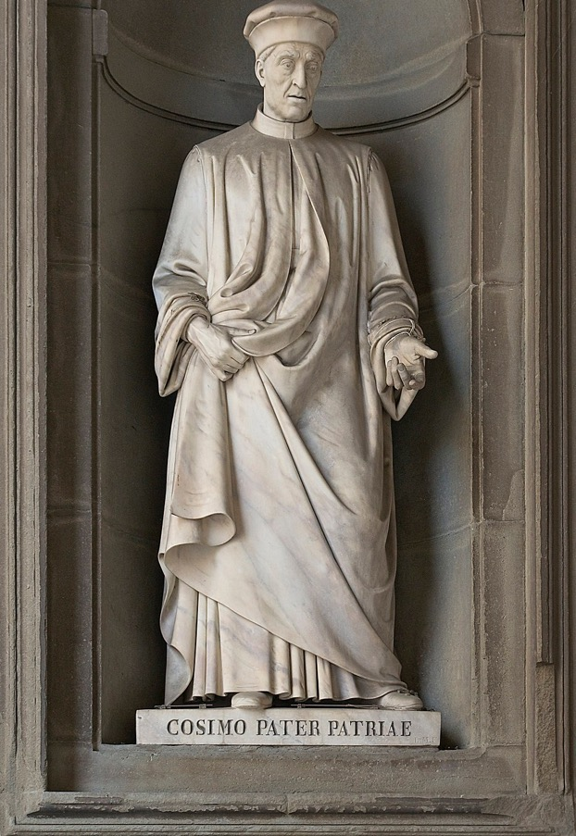
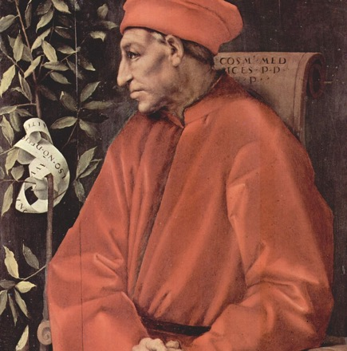
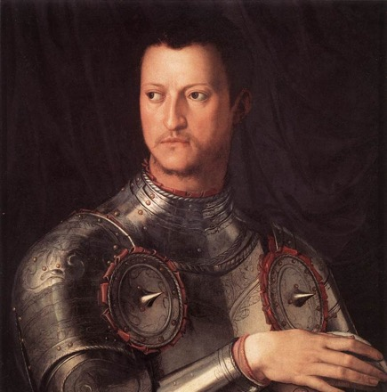
Defining Centres
‘One could indeed define the artistic center as a place characterized by the presence of a large number of artists and important groups of patrons who, moved by various motivations – be it their family or self pride, their wish for hegemony, or their quest for eternal salvation – are ready to invest part of their wealth in works of art. This latter point implies evidently that the center must be a place where considerable surplus wealth flows in, which can be directed toward artistic production.’
Enrico Castelnuovo and Carlo Ginzburg, ‘Symbolic Domination and Artistic Geography in Italian Art History, ‘ Art in Translation 1.1 (2009) p. 9.’

Slide 10
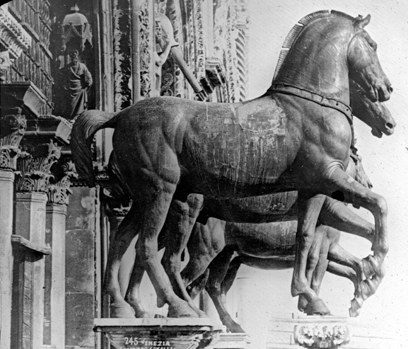
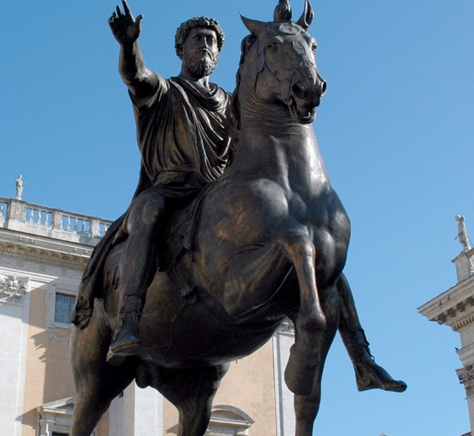
Symbolic Domination ….
‘ … the forced adoption of stylistic and iconographical models from the center; the elaboration by the latter of differentiated style codes, some aimed at the center, and the others at the periphery; the pillaging of the symbolic goods of subjected lands; the exodus of the best talents from the periphery toward the center, and the drift toward the latter of works carrying a high symbolic potential.’
Castelnuovo and Carlo Ginzburg, ‘Symbolic Domination and Artistic Geography,’ p. 26

Slide 11
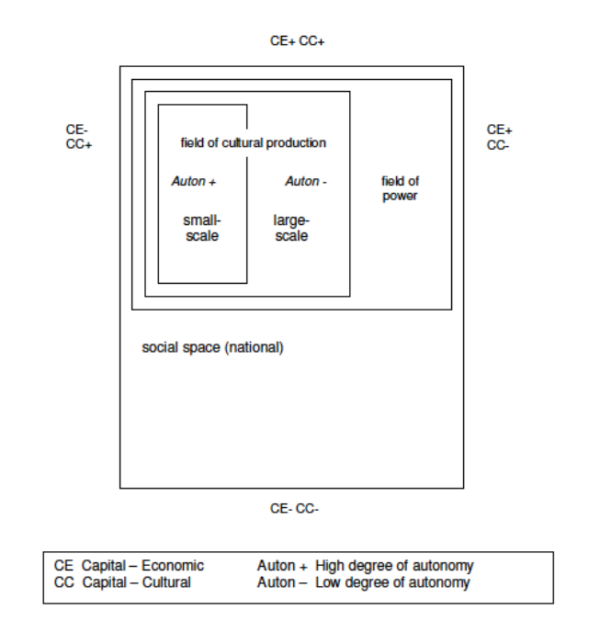
Pierre Bourdieu
Cultural Production and Cultural Capital
From:
Bourdieu, The Field of Cultural Production (New York, 1993)

Slide 12
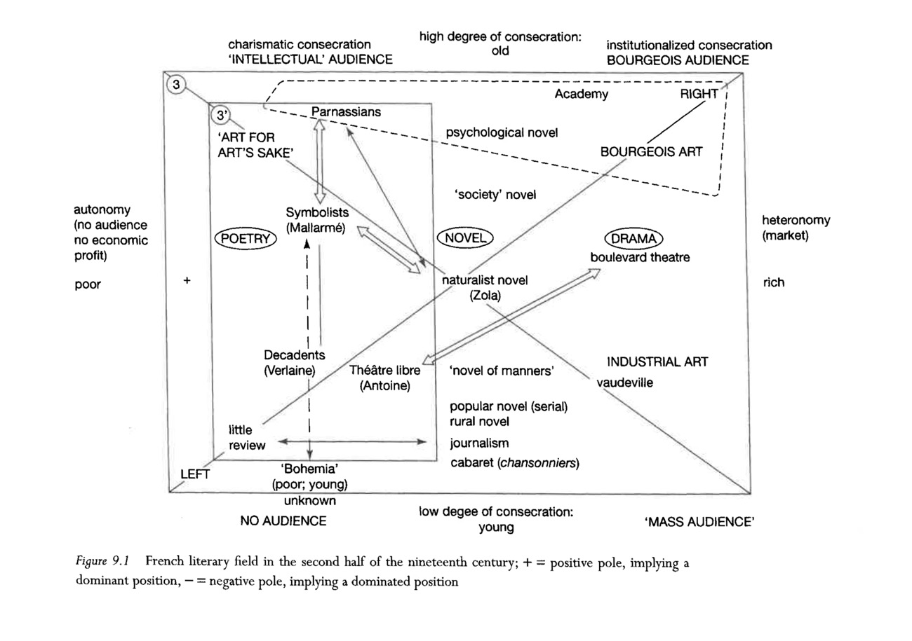

Slide 13
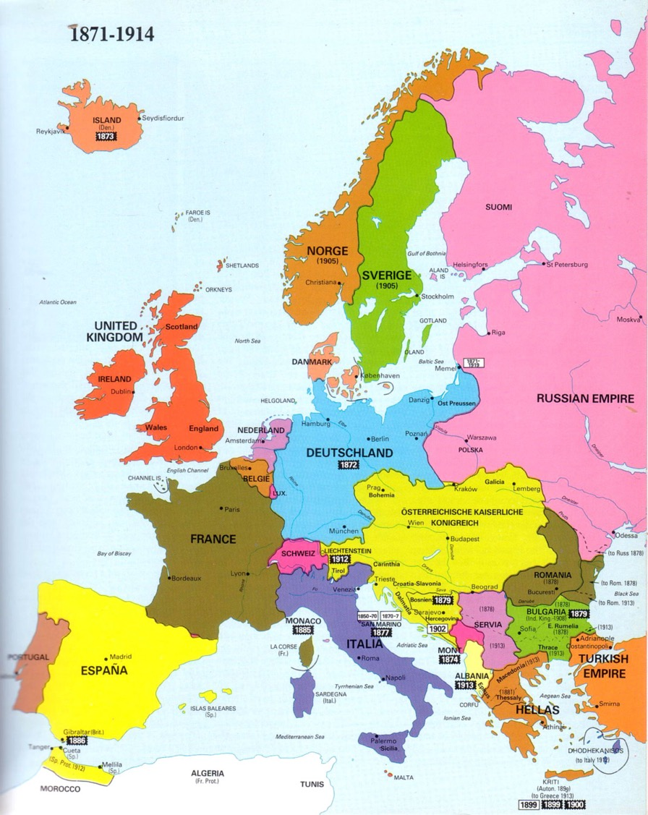
The centres of modernism, 1870 – 1939:
Paris
Berlin
Moscow
Vienna
Munich
Rome
London
The ‘peripheries’ of modernism:
Prague
Budapest
Warsaw
Madrid
Bucharest
Helsinki
Athens
etc etc

Slide 14
Symbolic Domination
Hungarian Fauvism

Slide 15
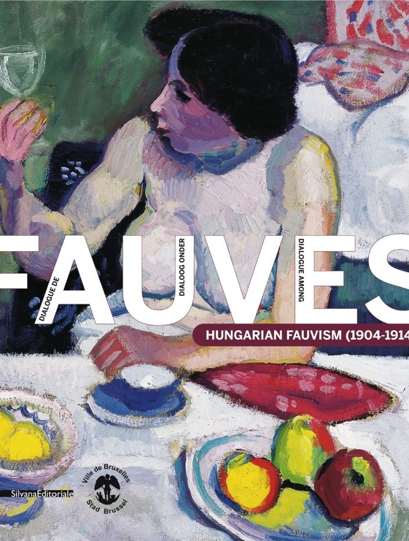
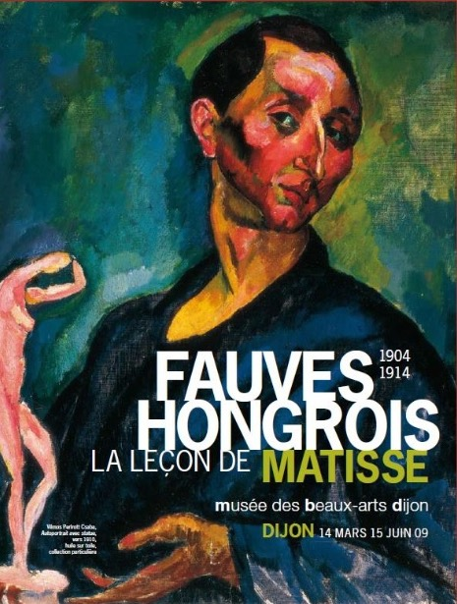
Exhibitions at Museum of Fine Art, Dijon (2009)
City Hall of Brussels (2010-11)

Slide 16
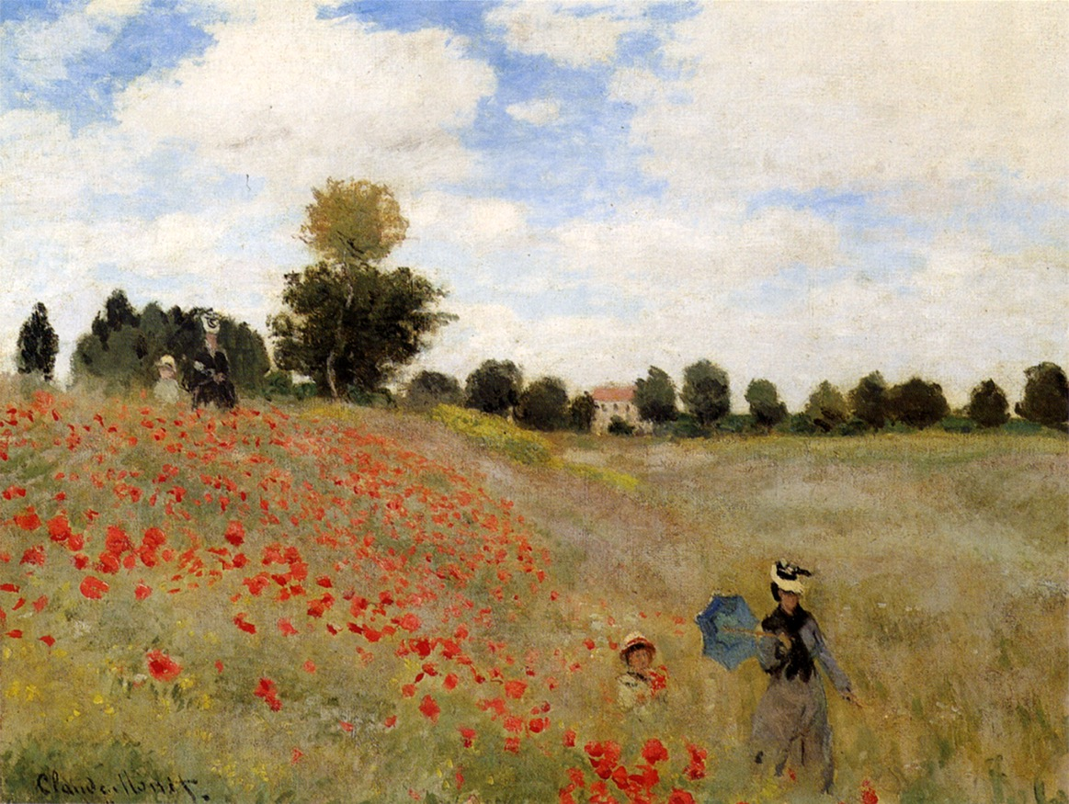
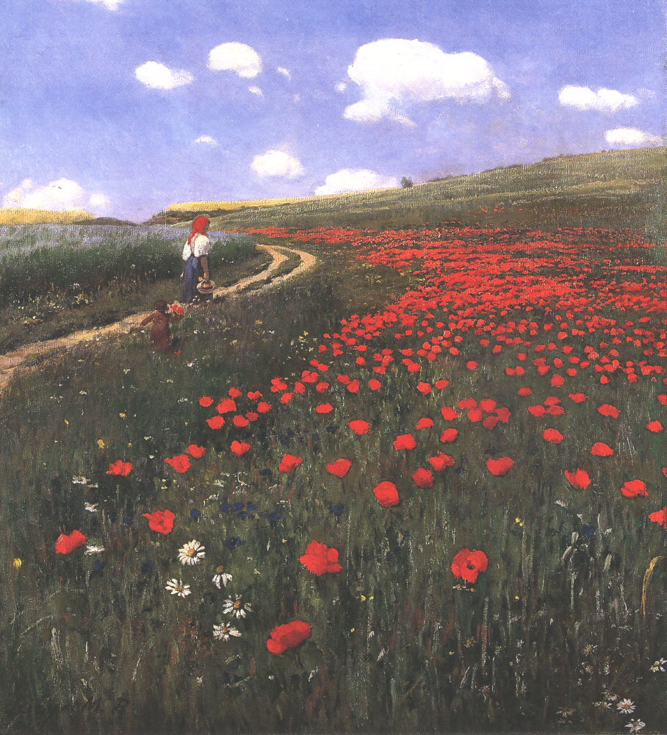
L: Claude Monet, Poppies at Argenteuil (1873)
R: Pál Szinyei Merse, Poppies in the Field (1902)

Slide 17
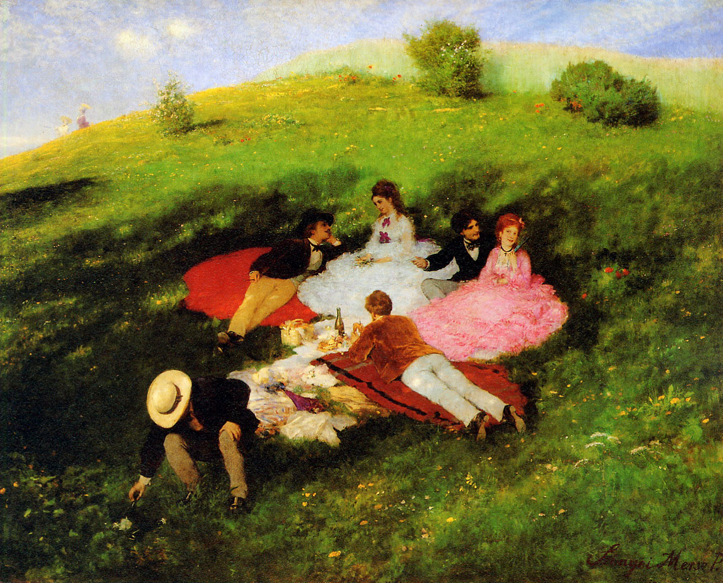
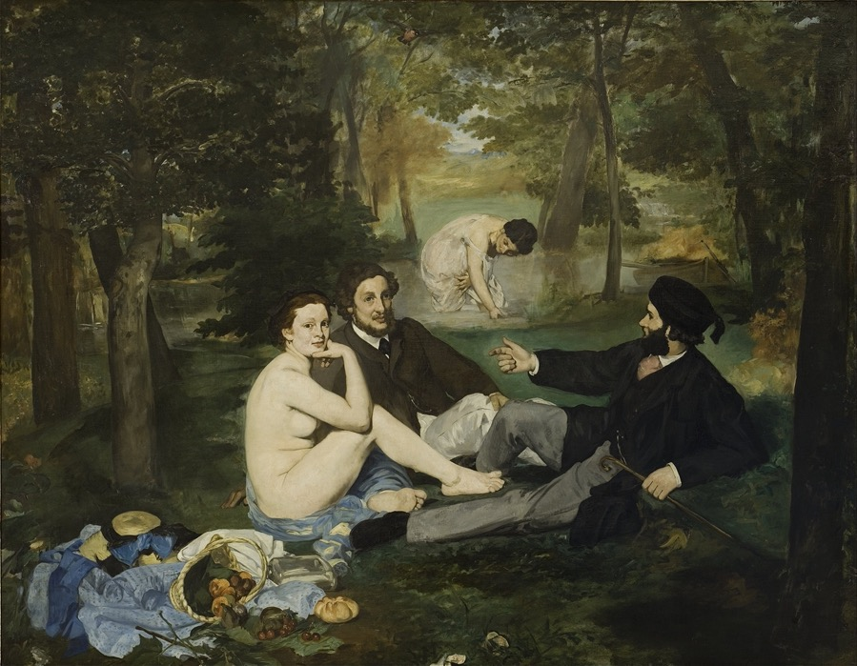
L: Pál Szinyei Merse, Luncheon in May (1873)
R: Edouard Manet, Déjeuner sur l’herbe (1863)

Slide 18
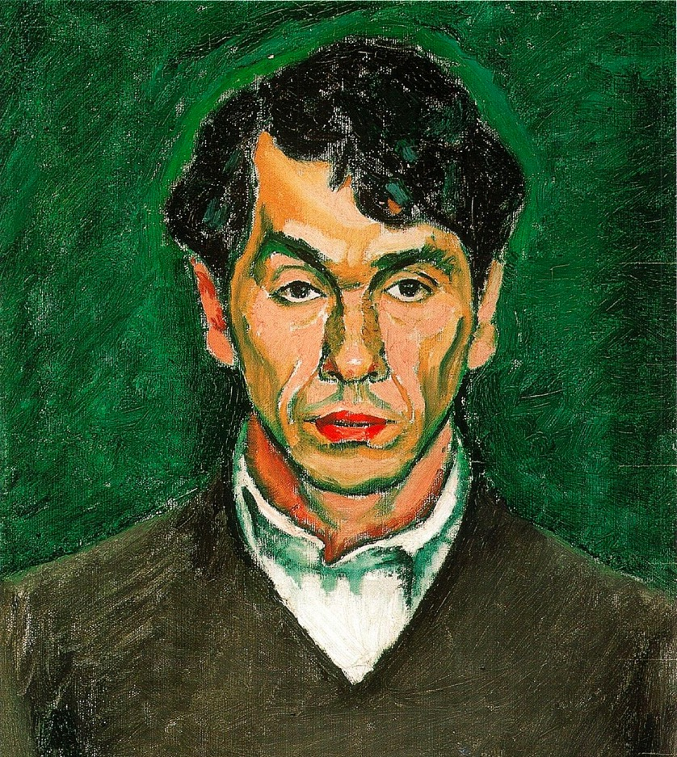
Attendance at Académie Julian (1901-7) in Paris by young Hungarian artists, such as:
Dezső Czigány
Béla Czóbel
Csaba Vilmos Perlrott
Róbert Berény
Some also study at the Académie Matisse (1908)
Exhibit in Paris at the Salon d’automne and the Salon des indépendants.
Frequent visitors at the Salon of Gertrude Stein in Paris
Dezső Czigány, Self Portrait (1909)

Slide 19
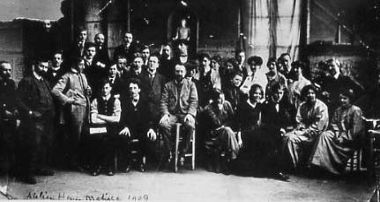
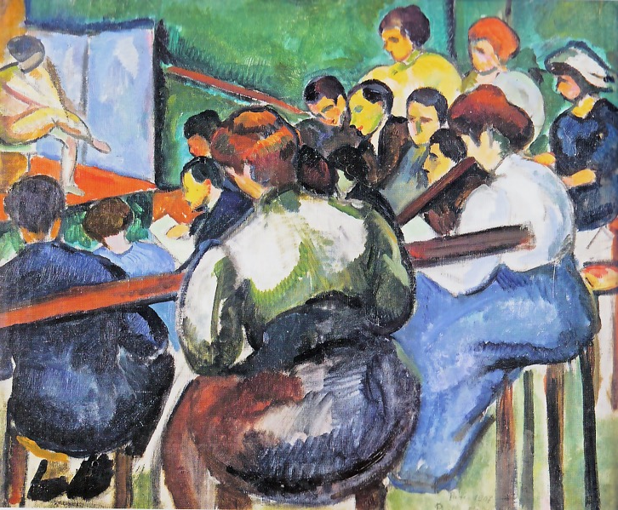
Académie Matisse
1907 – 1911
Hungarian students included:
Géza Bornemisza
Vilmos Perlrott-Csaba
Vilmos Perlrott-Csaba
School of Painters (1907)

Slide 20
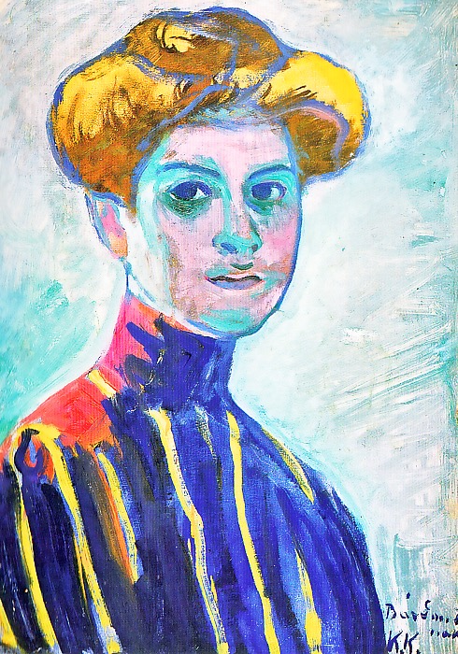
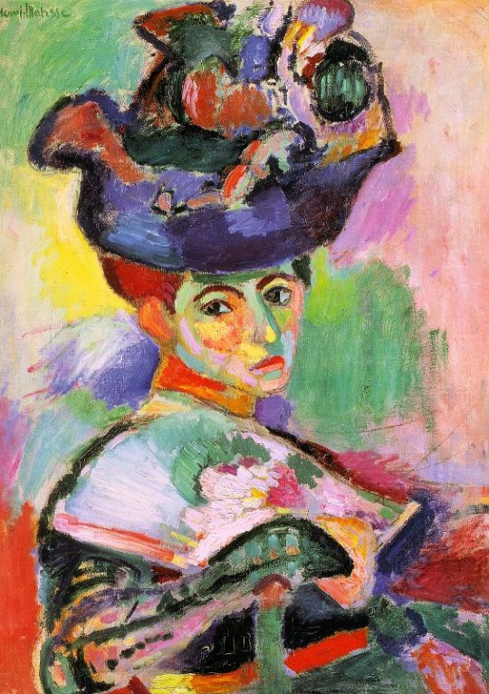
Henri Matisse
Women with Hat (1905)
Károly Kernstock – Portrait of a Young Girl (1909)
Desző Cigány – Actress with Yellow Hat (1907)

Slide 21
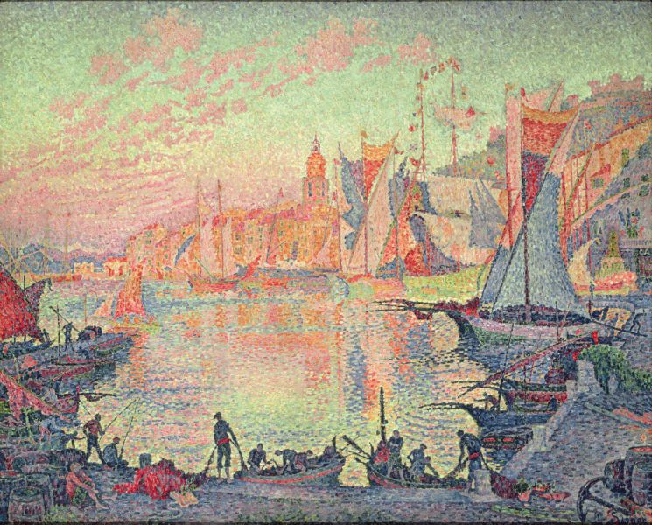
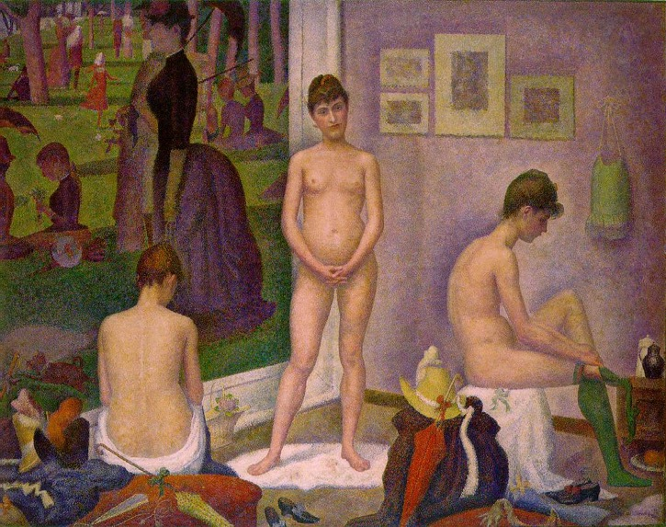
L: Paul Signac
The Port of Saint Tropez (1901)
R: Georges Seurat
Les Poseuses (1888)

Slide 22
Béla Czóbel – Street in Paris (1905)

Slide 23
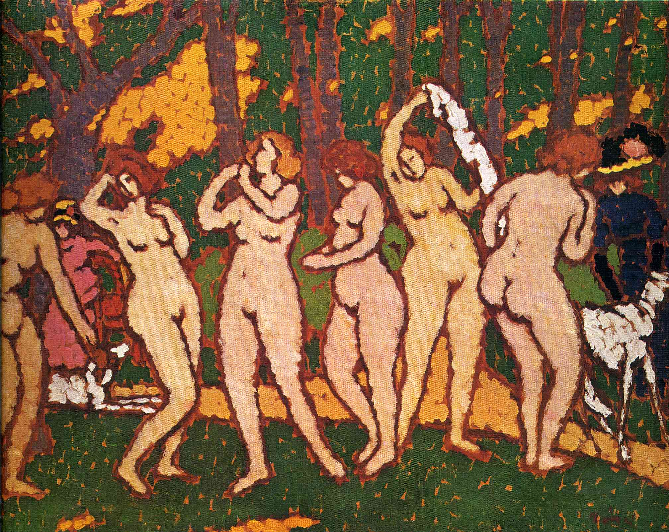
József Rippl-Ronai – Park with Nudes (1910)

Slide 24
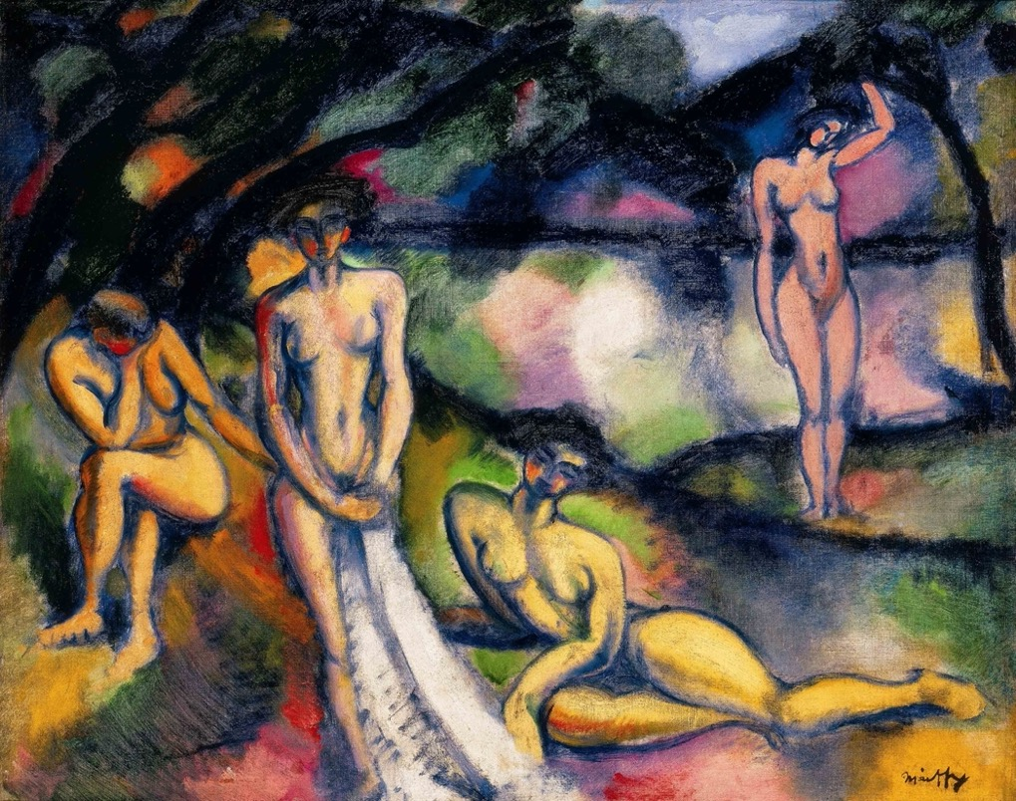
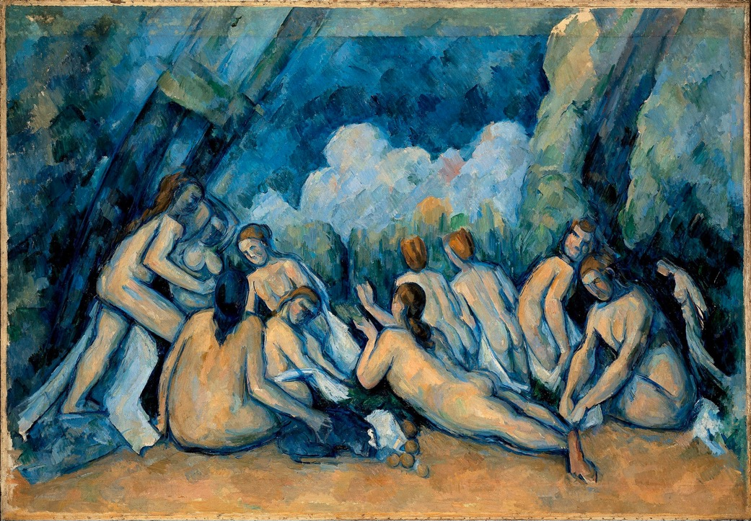
Paul Cézanne, Les Grandes Baigneuses (1894-1905)
Ödön Márffy
Composition with Nudes (1909)

Slide 25
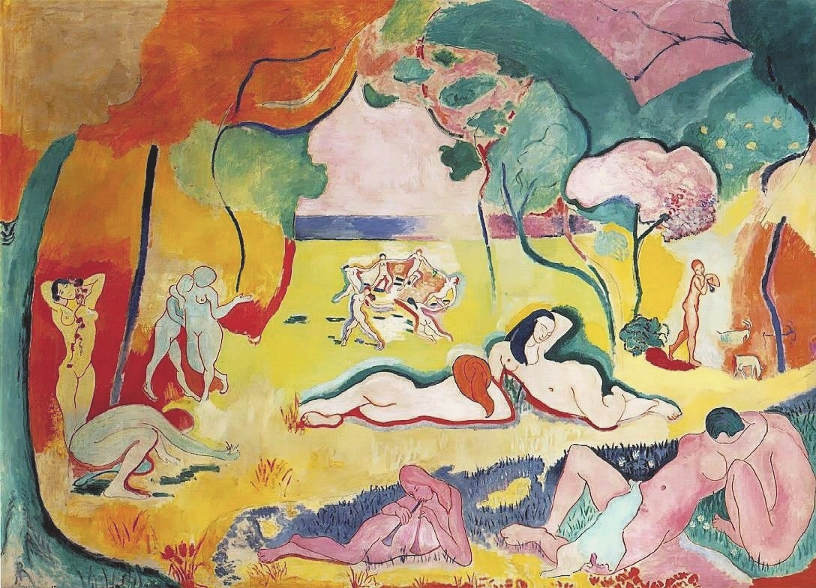
Vilmos Perlrott-Csaba, Nudes in the Open Air (Eden) (1909)
Henri Matisse, Bonheur de vivre (1905)

Slide 26
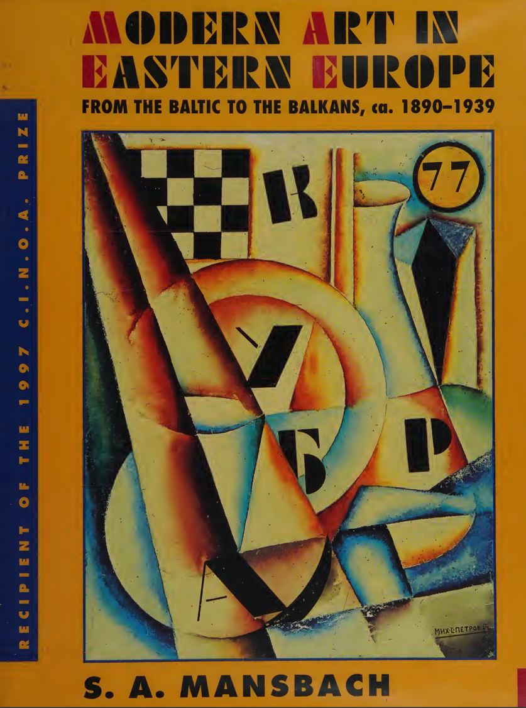
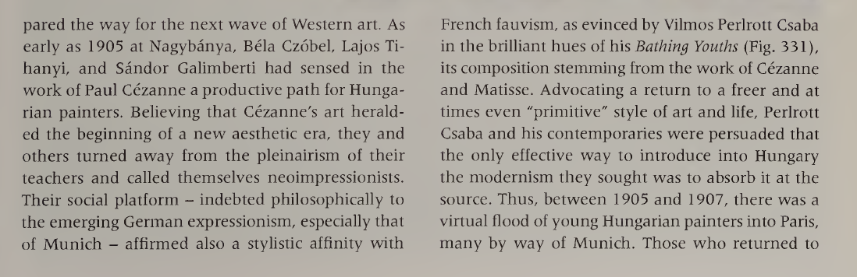

Slide 27
Symbolic Domination
Czech Cubism

Slide 28
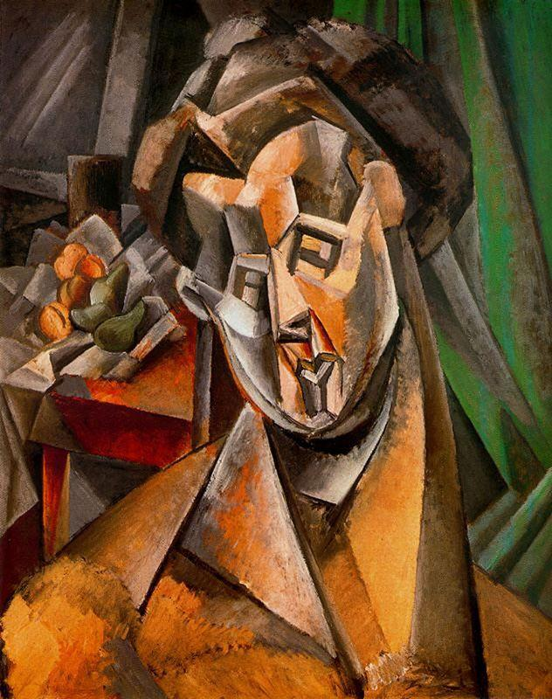
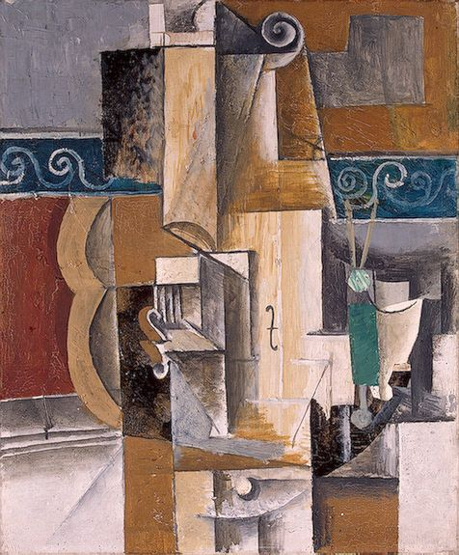
L: Pablo Picasso, Guitar and Violin (1912)
R: Picaoo, Woman and Pears (Fernande) (1909)

Slide 29
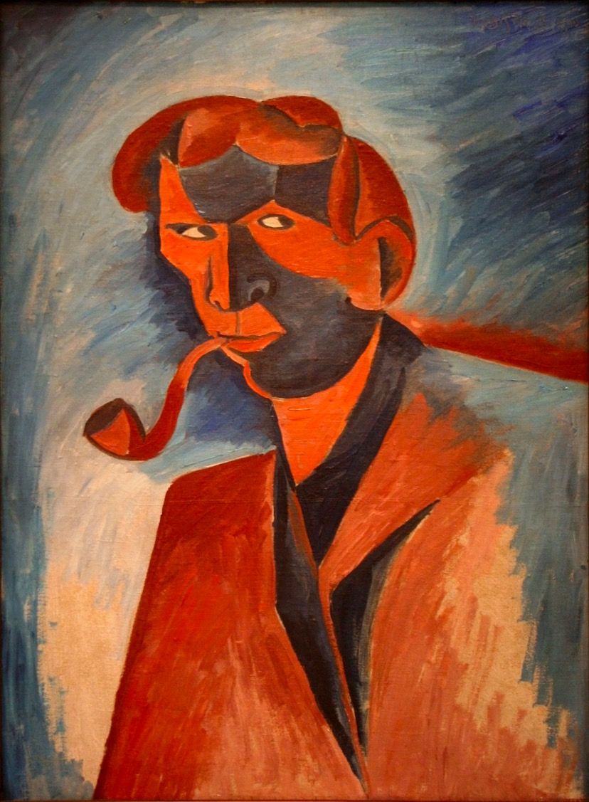
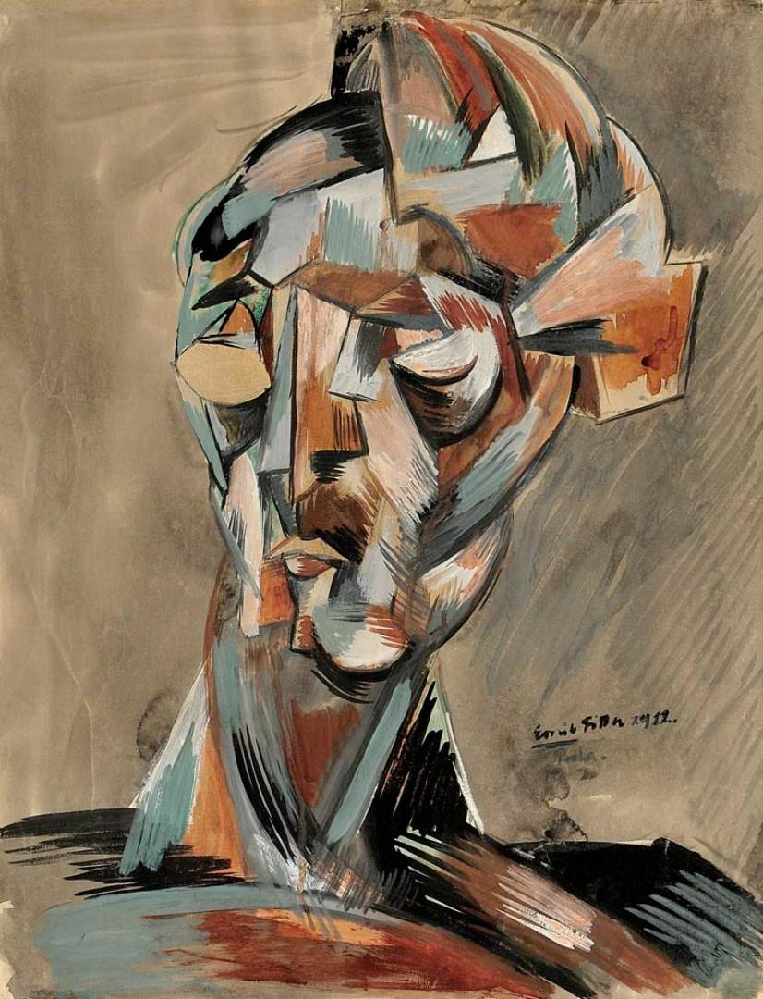
Emil Filla, Head (1912)
Bohumil Kubišta, Smoker (Self-Portrait) (1910)

Slide 30
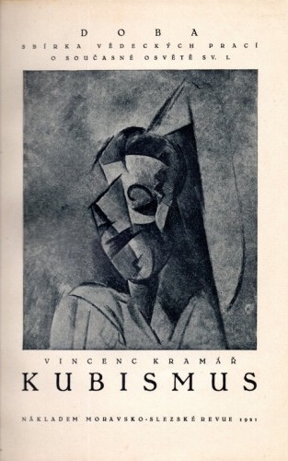
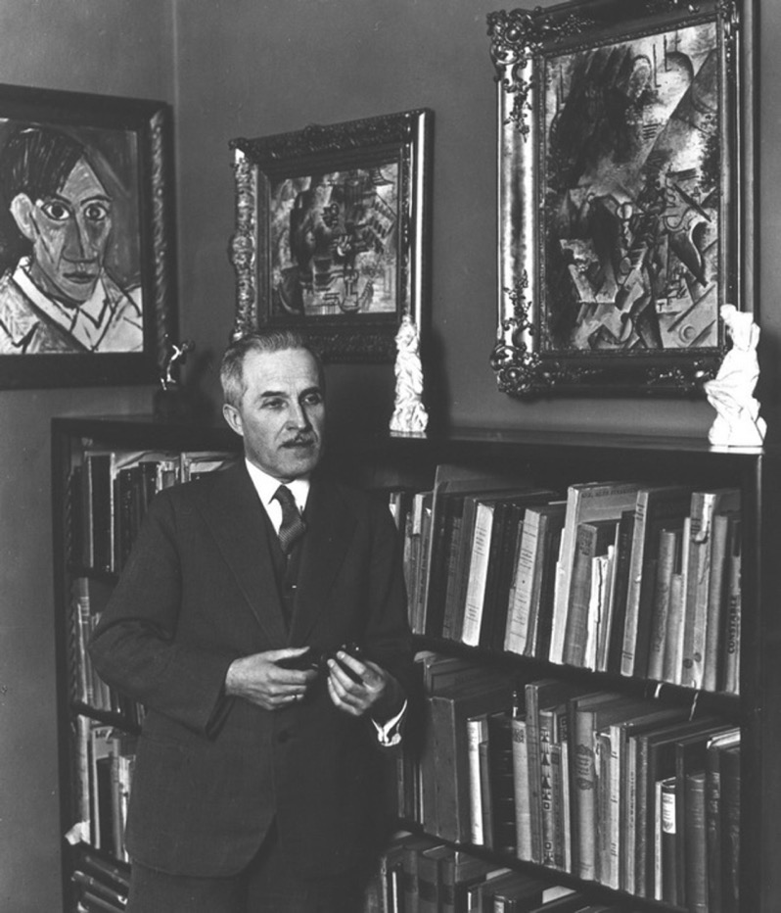
Vincenc Kramář, Cubism (Brno, 1921)
Vincenc Kramář (1877-1960)

Slide 31
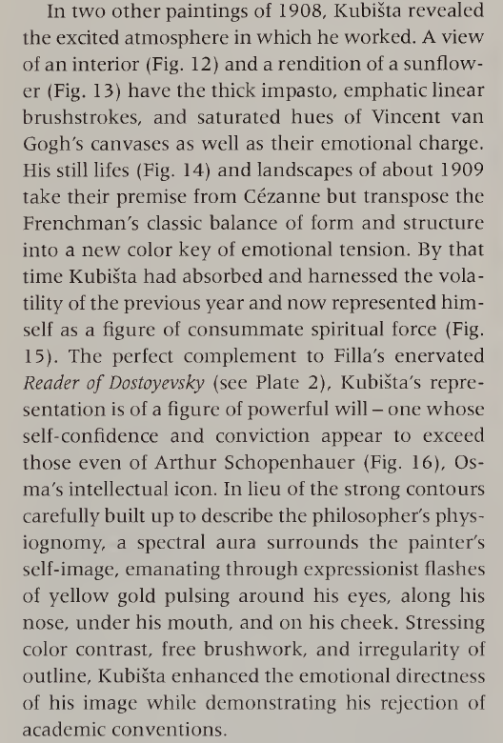

Slide 32
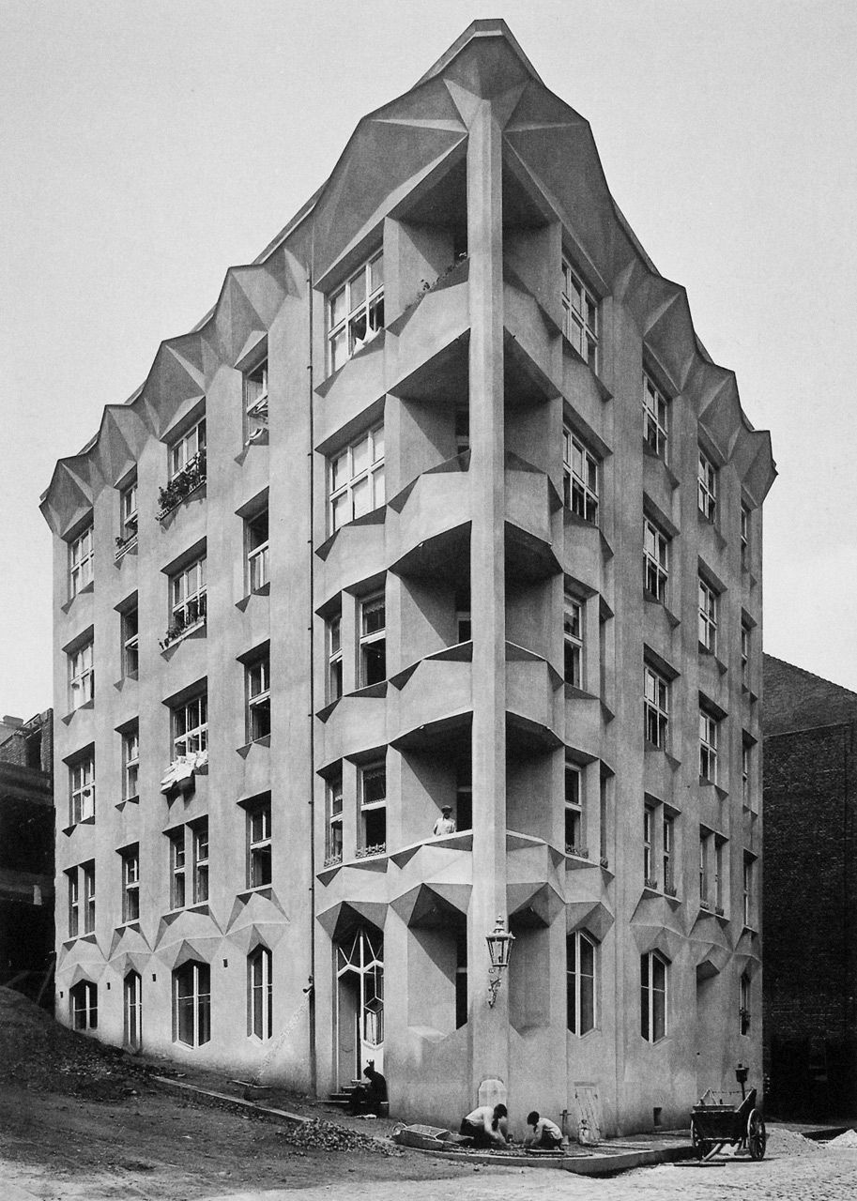
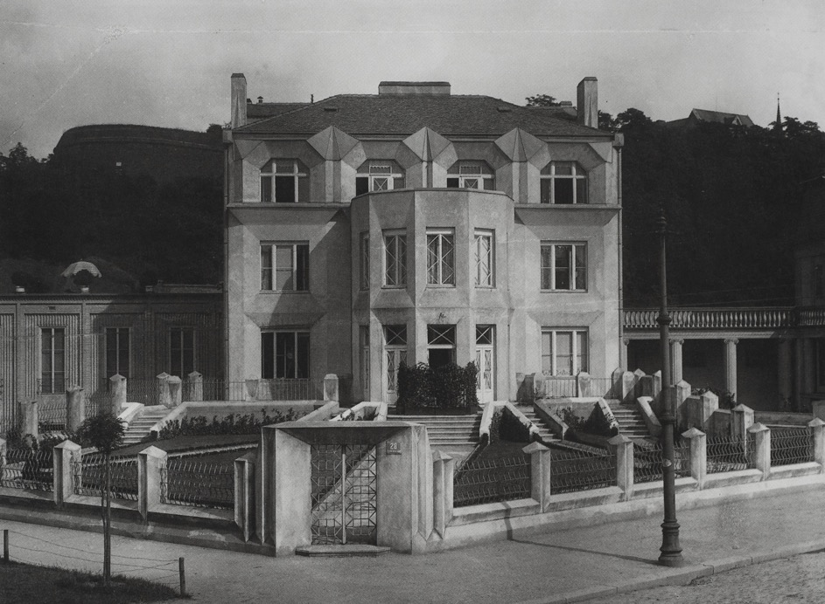
Josef Chochol
Apartment block, Vyšehrad, Prague (1914)
Josef Chochol, Vila Kovařovicova, Prague (1912-13)

Slide 33
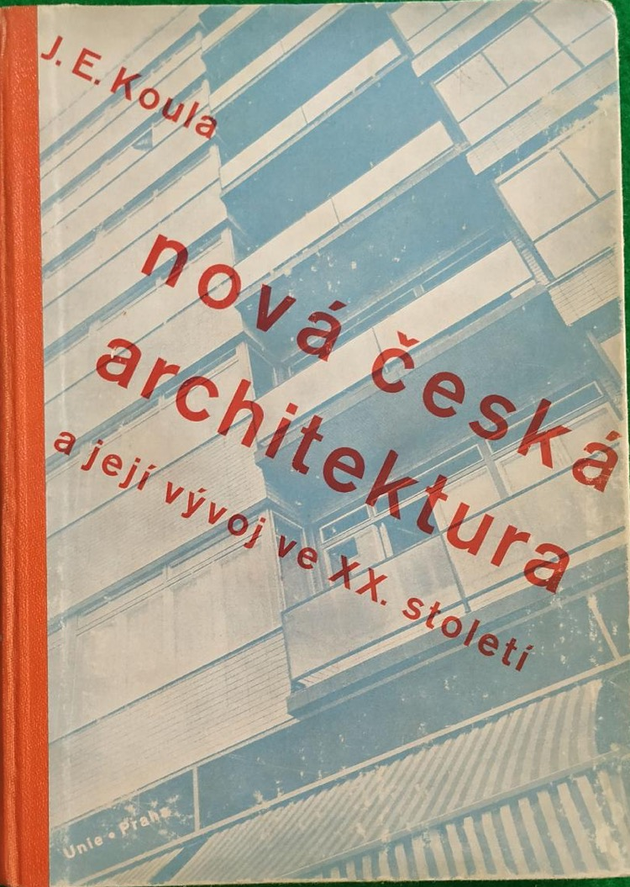
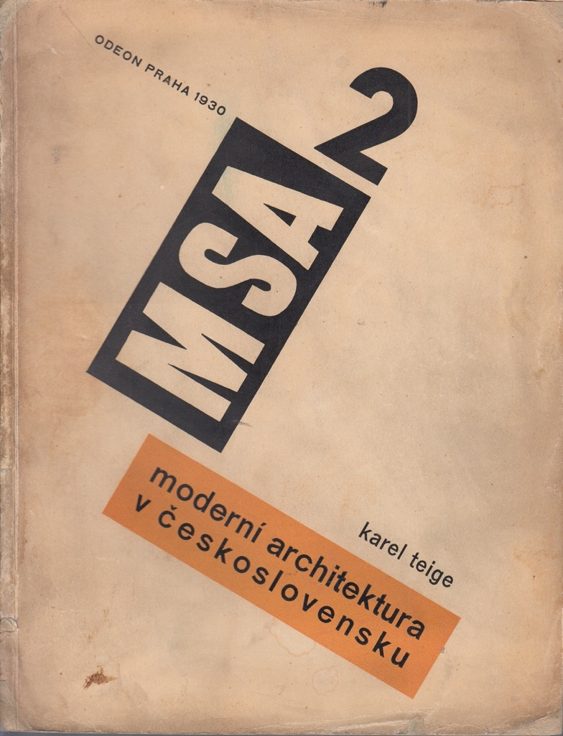
Jan Koula, Modern Czech Architecture and its Development in the 20th Century (Prague, 1940)
Karel Teige, Modern Architecture in Czechoslovakia (Prague, 1930)

Slide 34
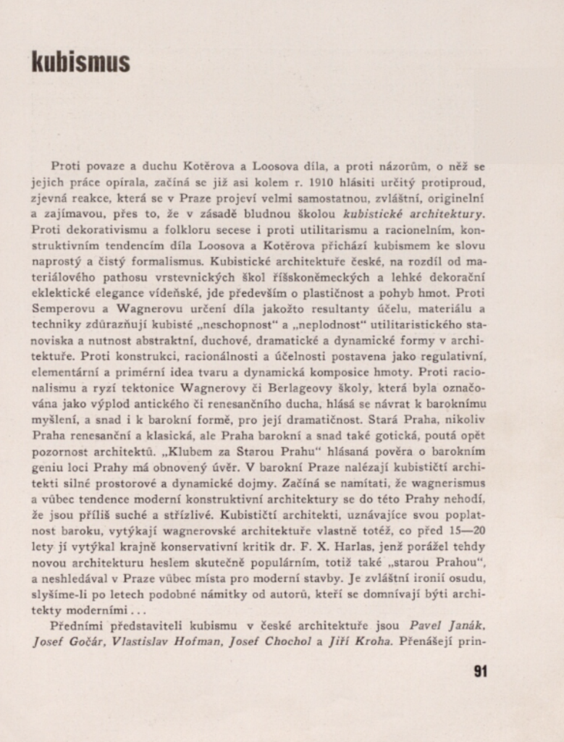
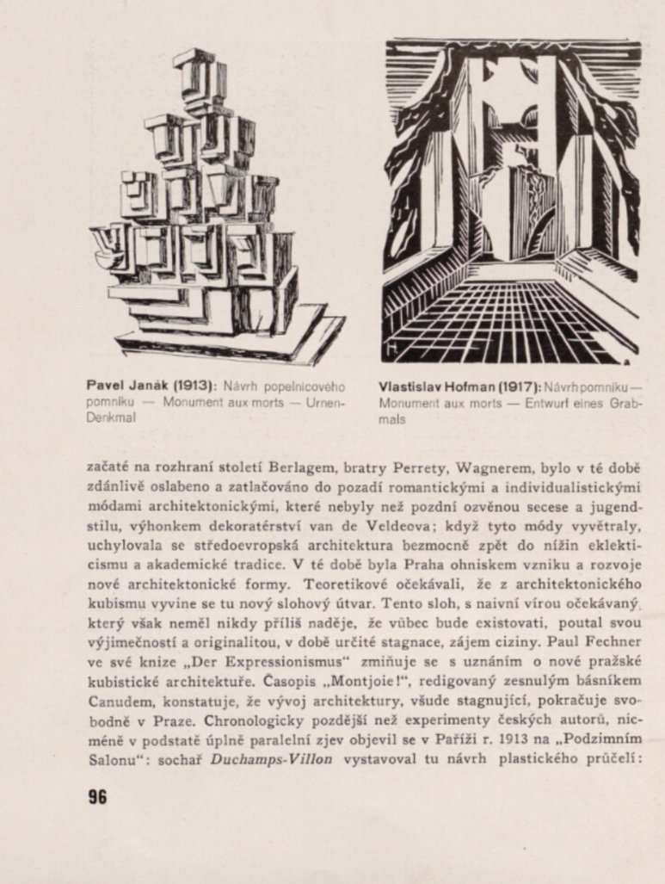

Slide 35
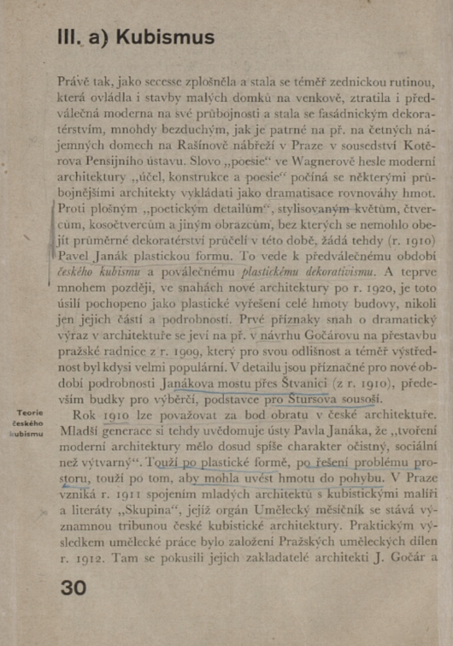
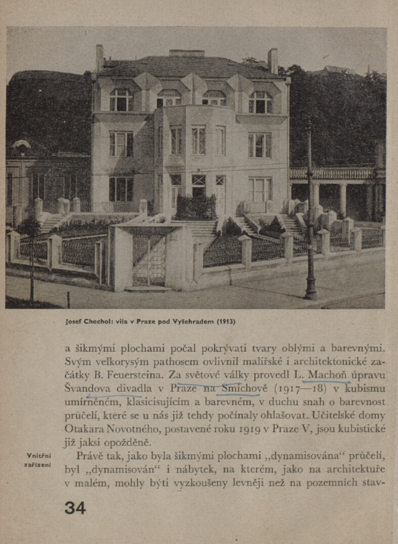
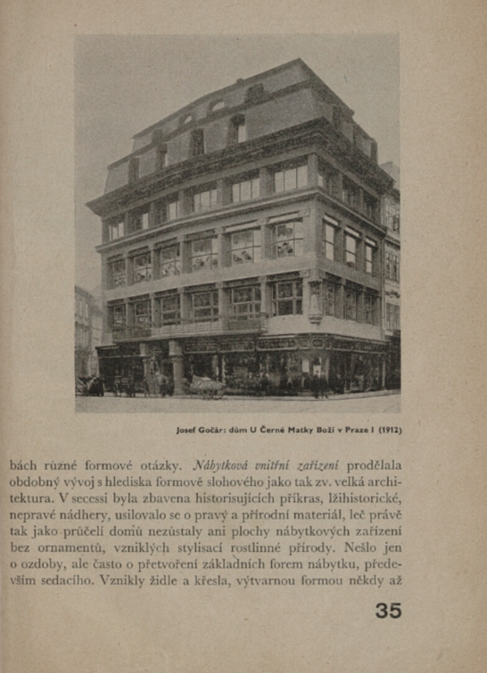

Slide 36
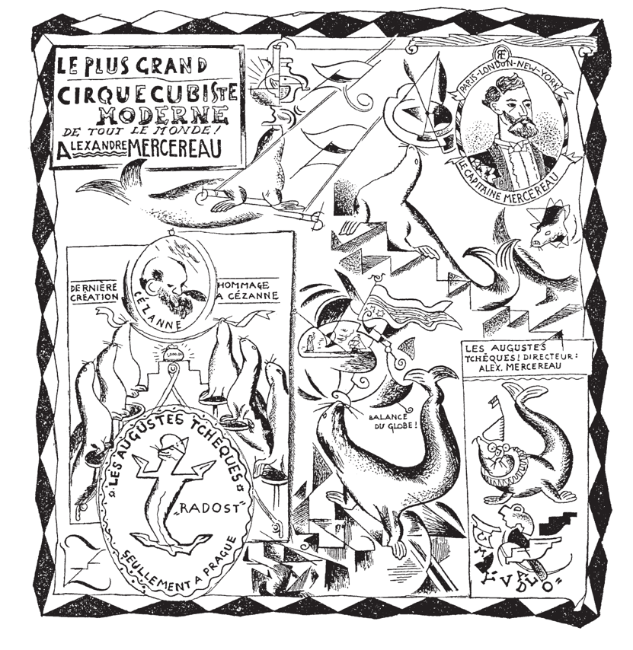
‘Only the institutional entanglement of the creative work of the four architects with the activities of the artists involved in the Prague Skupina speaks in favour of using the term ‘Cubism’ in connection with Czech architecture from the period after 1912.
… it has a paradoxical consequence: it devalues the originality and conceptual depth of Czech ‘modern art’ and reduces it merely to being a marginal articulation of the convergence of the Prague periphery and the Parisian centre.’
Jindřich Vybíral, Český kubismus na trhu symbolických statků in Michal Novotný , ed., Kubismus v české architektuře. Sto let poté
(Prague, 2013) p. 18 and 19
Zdeněk Kratochvíl, Le plus grand cirque cubist, Umělecký měsíčník (1914)

Slide 37
Horizontal Art History

Slide 38

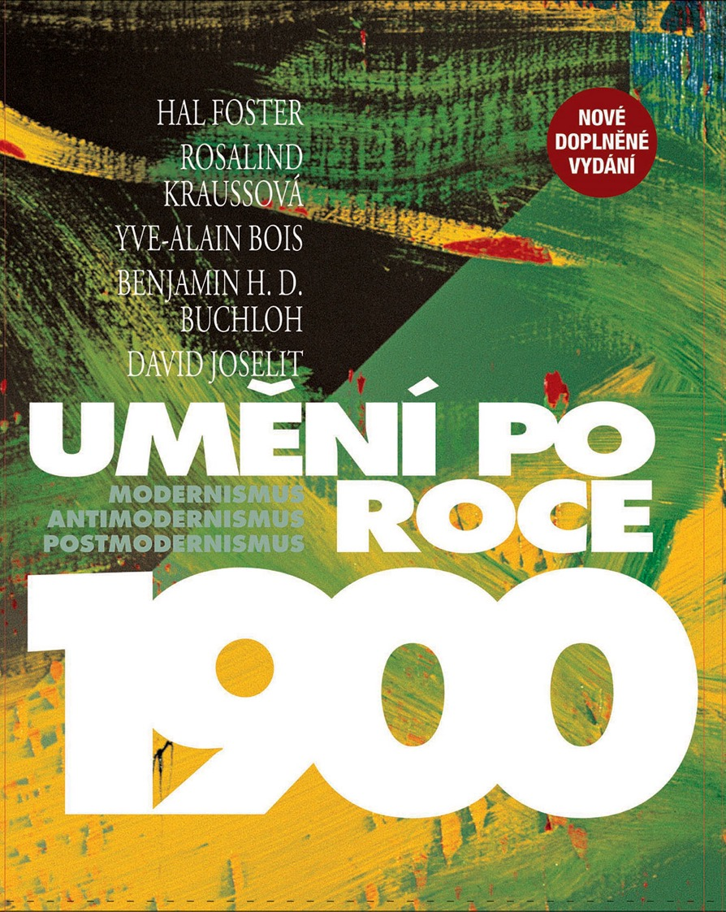

Slide 39

Piotrowski, ‘Towards a Horizontal Art History’ p. 54

Slide 40
Some principles:
Approach the ‘center’ from the viewpoint of the periphery ‘the marginal observer sees that the center is cracked’
Critique the ‘canon’ and ‘style’: both of these are not as uniform as the ‘center’ imagines
‘A canon is always an effect of an analytical and historical construction’ (p. 55)
The art of the margins ‘never accepted the western “purity” of style’ (p. 55)
Dismantle the opposition between ‘universal’ (i.e. French / German / US) modernism and ‘national / local’ (i.e. Czech / Polish / Hungarian / Slovak) modernism
Relativize the center – ‘French’ modernism is also a ‘local’ modernism
‘Transnational’ art history - ‘negotiating values and concepts along other lines than the opposition of the national versus the international’ (p. 58)

Slide 41

Alfred Barr
Cubism and Abstract Art (New York, 1936)

Slide 42


Slide 43


IRWIN, Eastern European Art Map

