Slide 1
Queering Art History

Slide 2
‘As a category of identity, “queer” is used to denote non-normative sexualities. It sometimes includes or is aligned with nonnormative genders, but it should not be conflated with transgender or other trans-identities.
[ … ]
Queer studies as an academic discipline also emerged in the 1990s, in conversation with post-colonial theory, feminist theory, critical race theory, and other schools of thought that center on ideas and experiences of difference. The ways in which multiple marginalized subjectivities intersect and interact is essential to the methodology of queer studies.
Queer studies also introduced the use of “queer” as a verb. To “queer” something or to do something “queerly” is not only to resist normativity but to point out and articulate the conventions that sustain and perpetuate normativity.’
Sylvia Page, ‘ “Making Visible the Otherwise.” Queering the Art Library,’ Art Documentation 37 (2018) p. 21

Slide 3
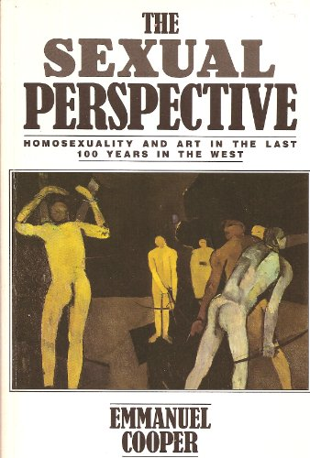
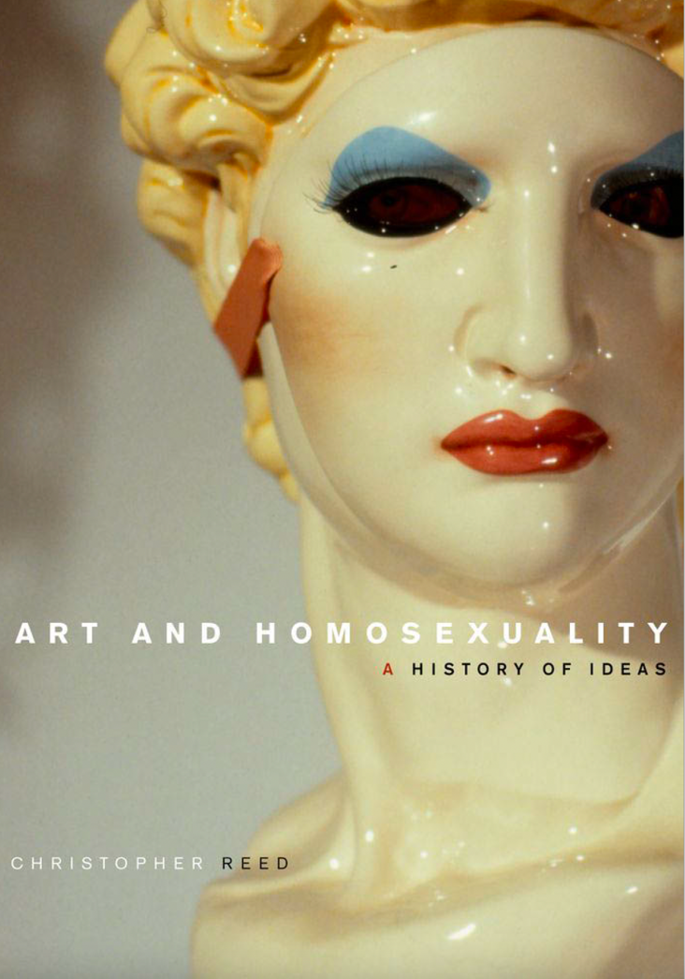
L: Emmanuel Cooper, The Sexual Perspective (London, 1986)
R: Christopher Reed, Art and Homosexuality (Oxford, 2011)

Slide 4
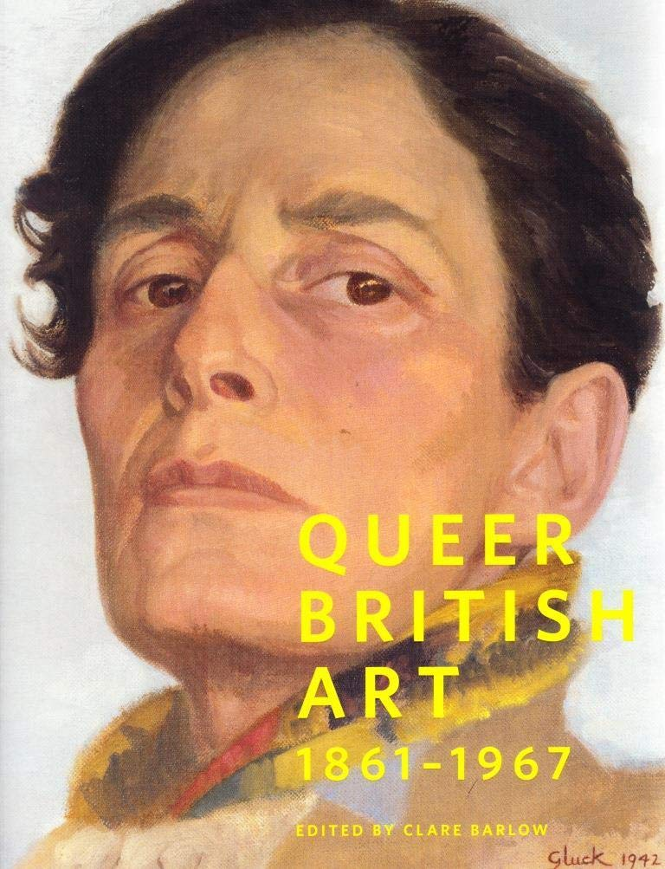
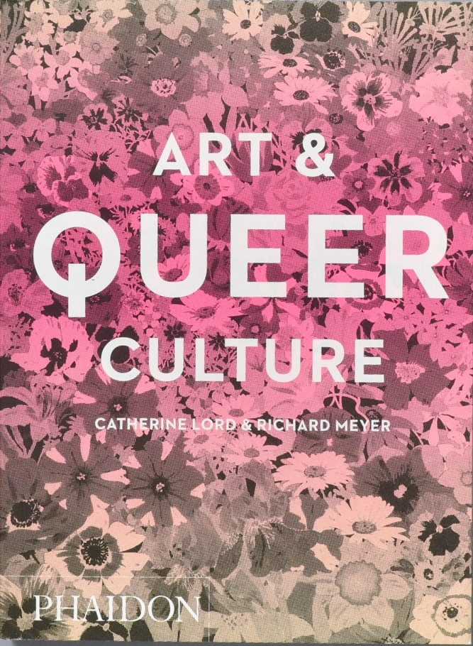
Catalogue cover of the Queer British Art exhibition, Tate Britain, London 2017
Catherine Lord and Richard Meyer, Art and Queer Culture (London, 2019)

Slide 5
Piotr Piotrowski
Ars Homo Erotica (National Museum, Warsaw, 2010)
Themes:
Homoerotic Classicism
Male Nudes
Ganymede
Saint Sebastian
Lesbian Imaginarium
Transgender / Androgyny

Slide 6
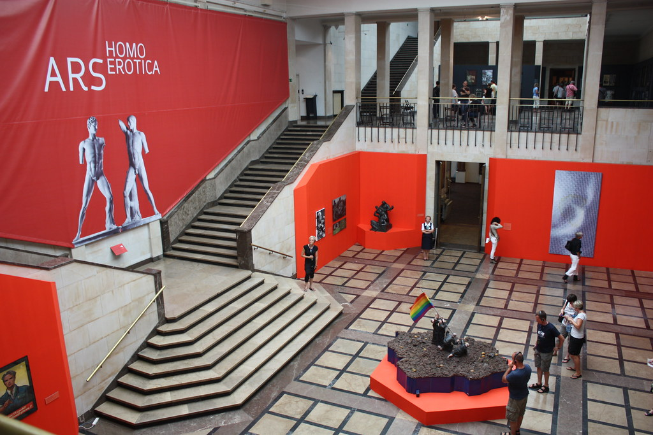
Installation short of Ars Homo Erotic with (l) Harmodius & Aristogeiton and
(r) David Černý, Poland (from Entropa, 2008)

Slide 7
David Hockney
Peter Getting out of Nick’s Pool (1966)

Slide 8
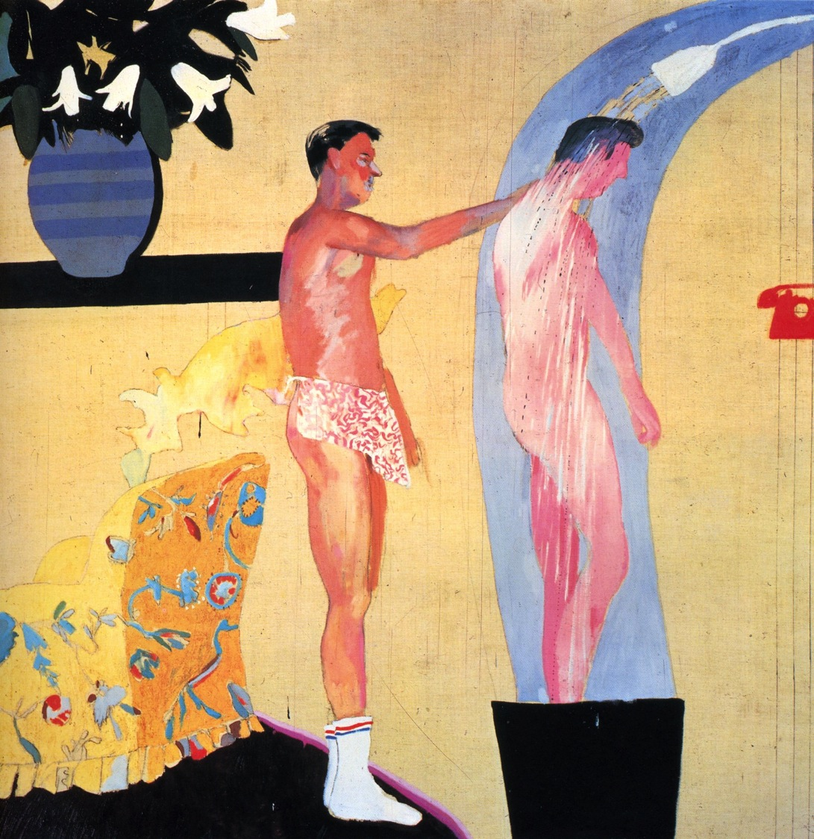
David Hockney
Domestic Scene, Los Angeles (1963)

Slide 9
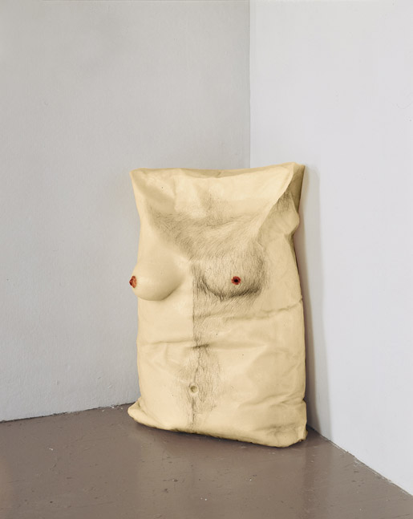
Robert Gober
L:
R: X Playpen (1987)

Slide 10
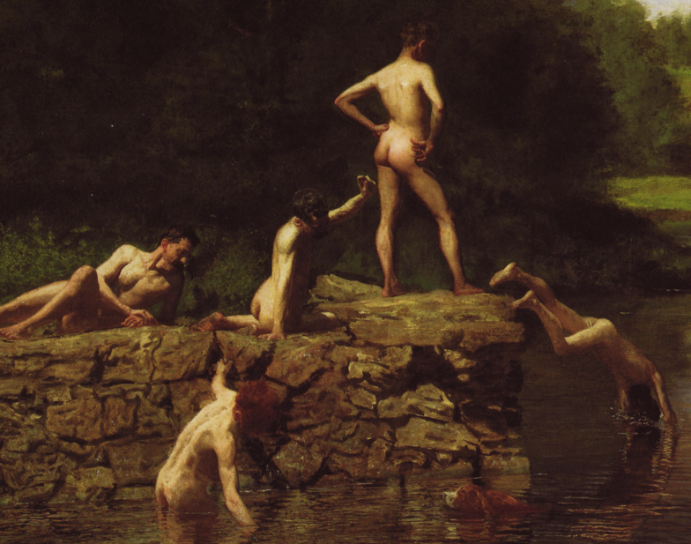
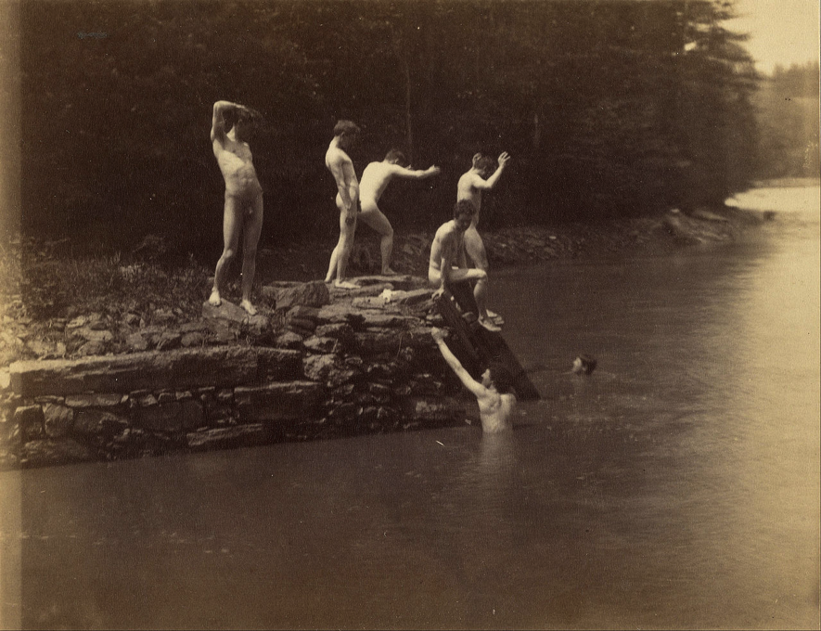
Thomas Eakins
The Swimming Hole (1885)
Homosocial or ‘Homosexual’?

Slide 11
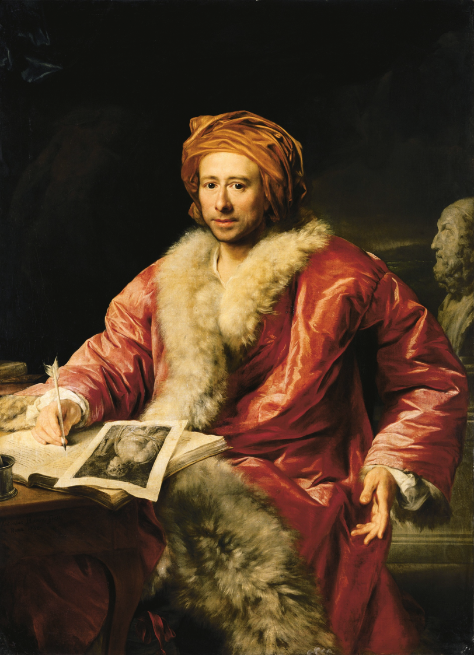
Anton von Maron
Portrait of Johann Winckelmann (1768)

Slide 12
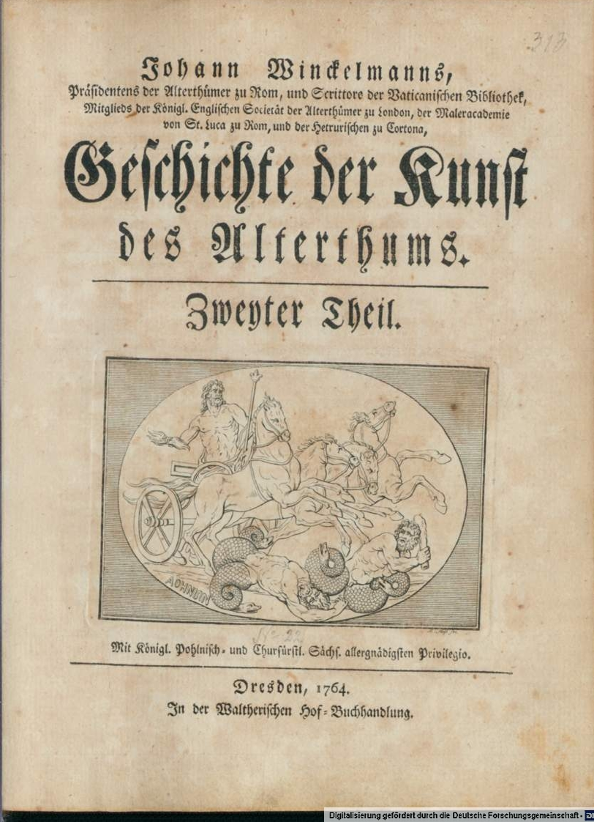

Slide 13
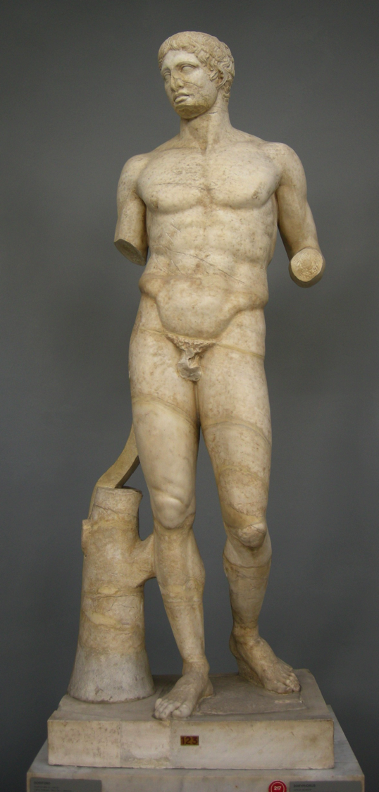
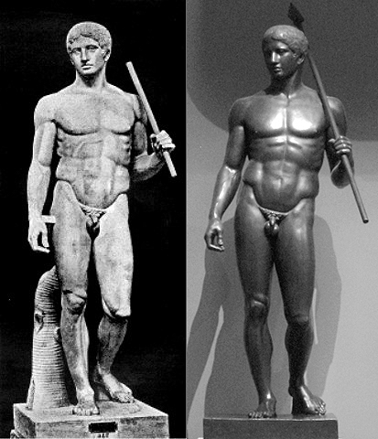
Roman copies of the lost Greek original sculpture the Doryphoros (“Spear carrier”)

Slide 14
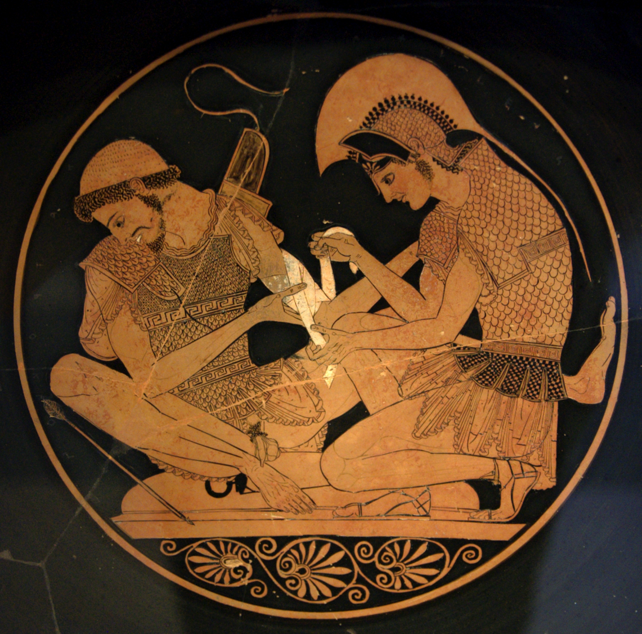
Achilles and Patroclus
Red figure vase, ca. 440 BC

Slide 15
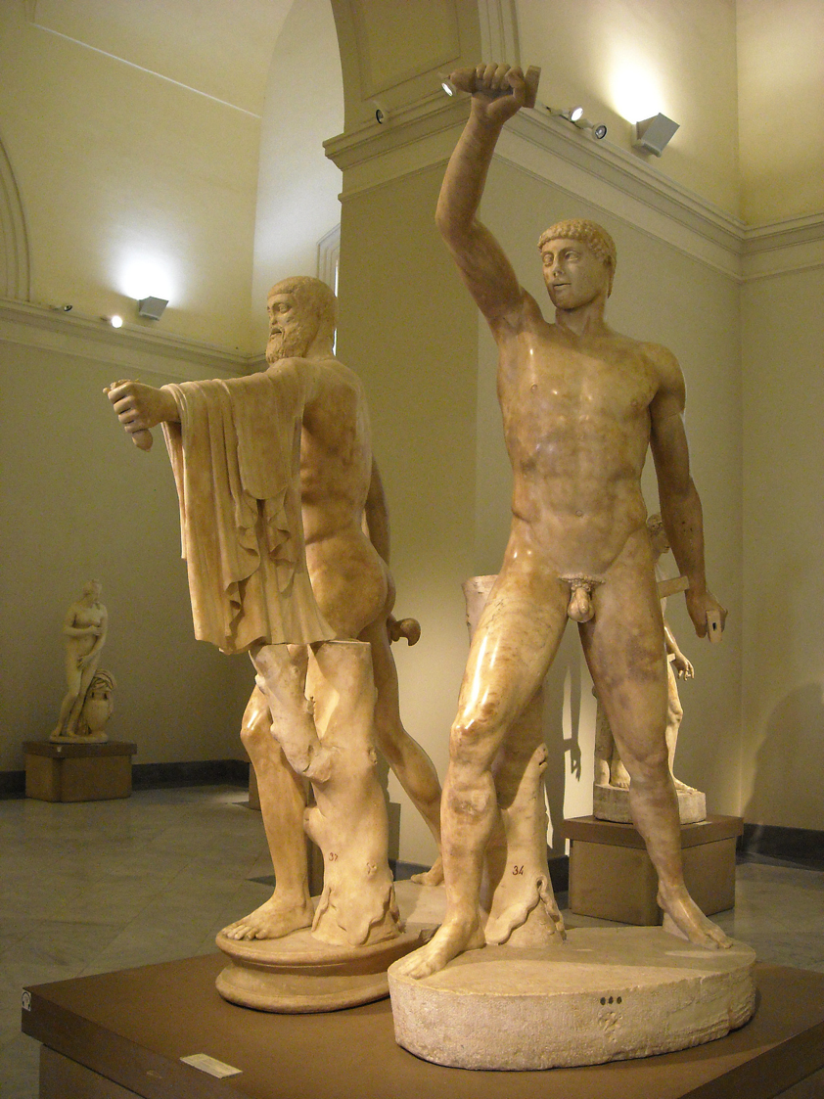
Roman 2nd century copy of a Greek sculptural pair of Harmodius and Aristogeiton

Slide 16
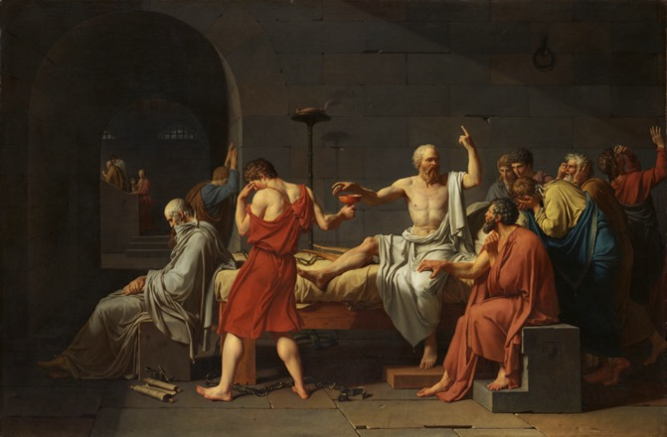
Jacques –Louis David, The Death of Socrates (1787)
‘I was interested in having my students challenge the rather sanitized, if not down right inaccurate, accounts propounded by various proponents of "our Western heritage." Lynne Cheney wants students to study Socrates; and why not? I thought. Socrates was surrounded with pretty boys; the dialogues, as narrated by Plato and others, are partly just fancy versions of the intellectual cultivation, the osten tation, contest, and romance, and the idealization of the merely sexual into the broadly ethical that characterized Greek male courtships. Certainly most of the standard textbooks of the his tory of art do not address the issue, despite the great importance that studies of gender and sexuality have come to have in art history generally and the obvious presence of an erotically meaningful representation of the male body in classical art.’
Whitney Davis, ‘Founding the Closet: Sexuality and the Creation of Art History,’ Art Documentation 11.4 (1992) p. 172

Slide 17
Limits of concept: Classical and Renaissance sexuality

Slide 18
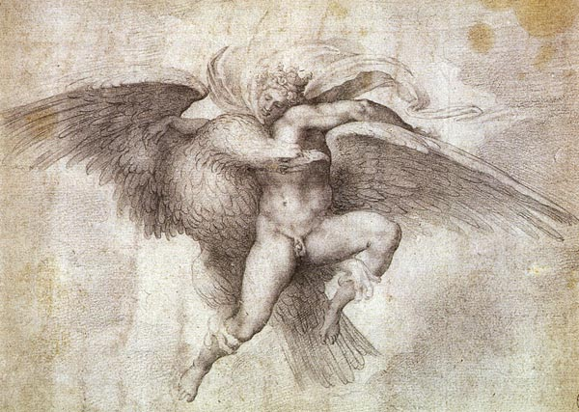
Copy of Michelangelo Ganymede (1532). Original now lost.

Slide 19
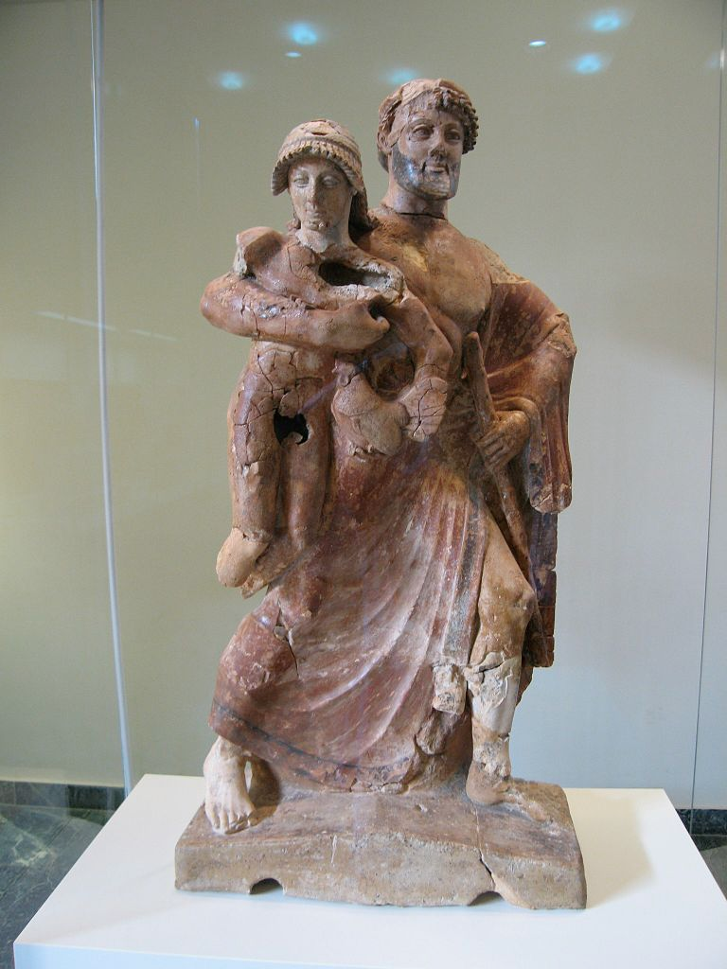
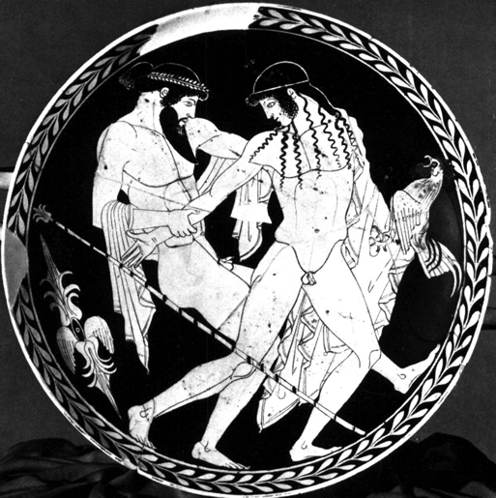
L: Zeus abucting Ganymede
6th century BCE
R: Zeus and Ganymede mid-5th century BCE

Slide 20
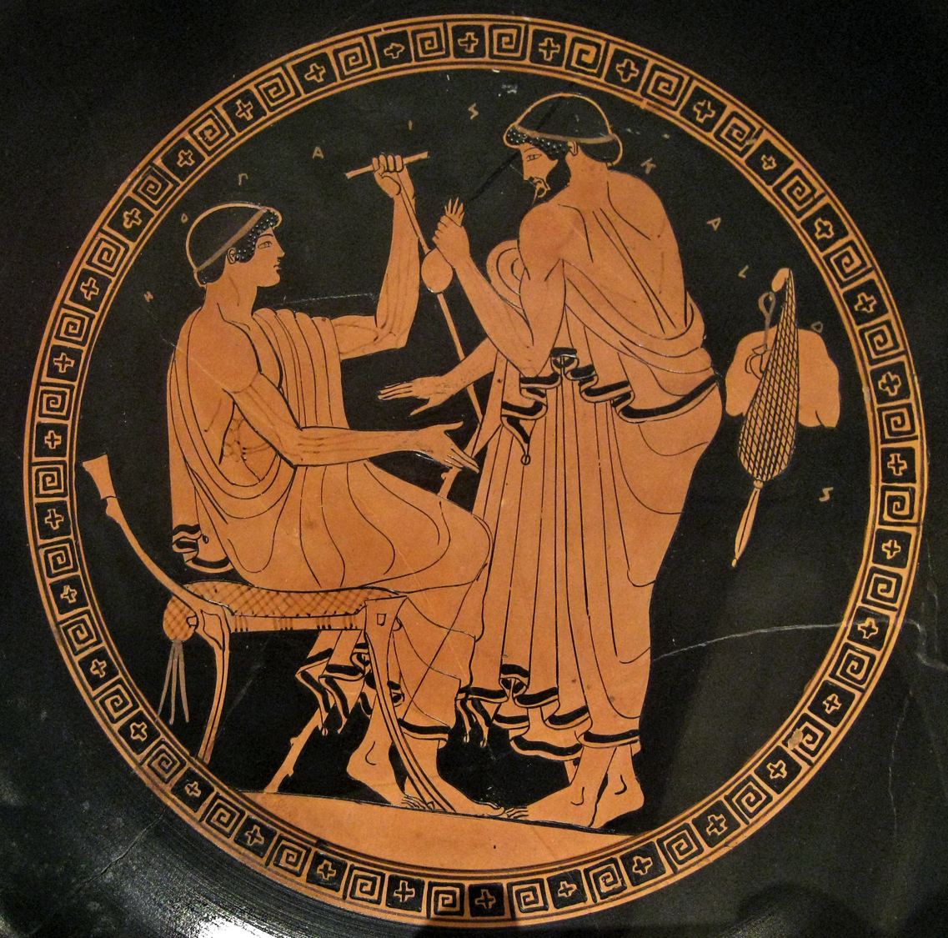
Red figure vase depicting an older man bargaining for sex with a younger man (mid 5th century BCE)

Slide 21
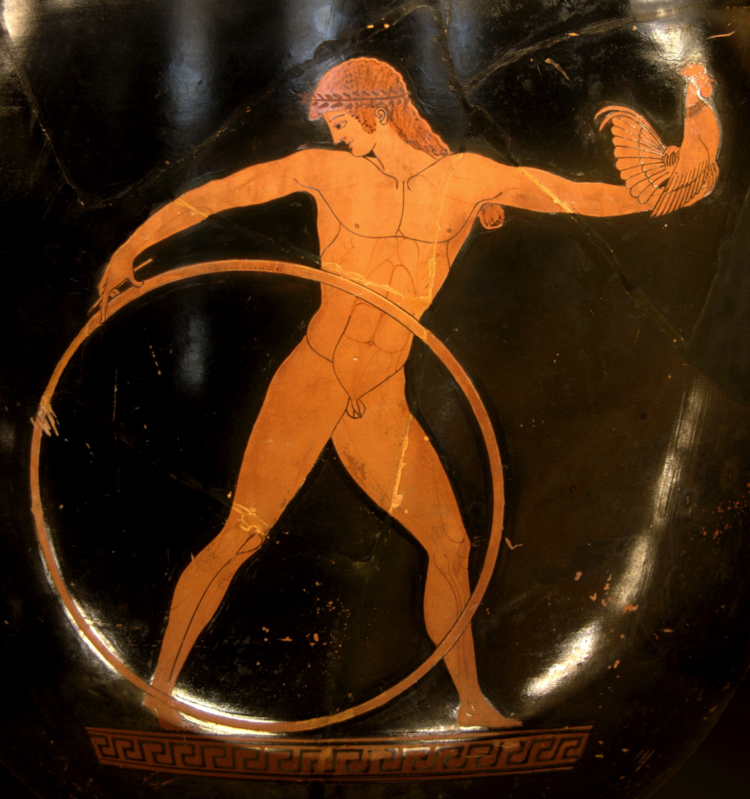
Ganymede on a crater by the so-called Berlin Painter (ca. 500-490 BCE)

Slide 22
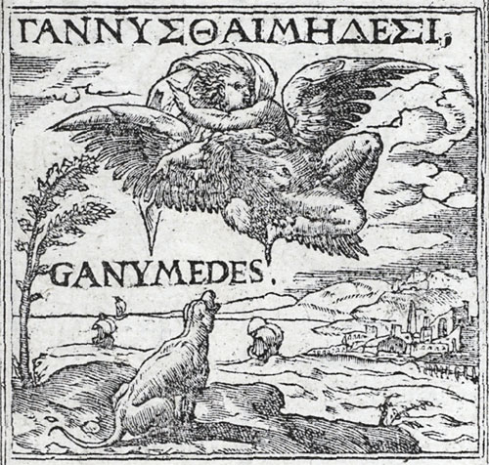
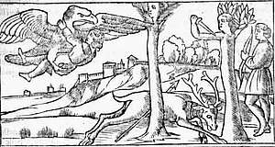
Nicolò degli Agostini – Zeus and Ganymede from Ovid, Metamorphosi (Venice, 1522)
Andrea Alciati
The Rape of Ganymede in Emblemata (1531)

Slide 23
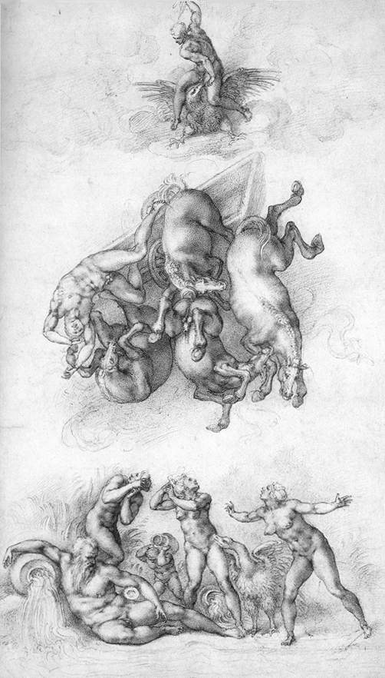
Michelangelo
The Fall of Phaethon (1533)
Given to Tommaso dei Cavalieri

Slide 24
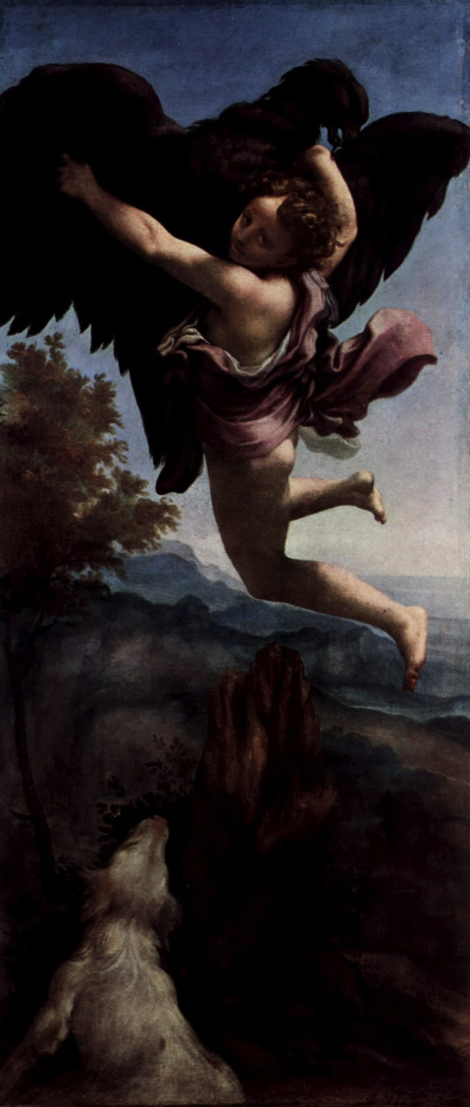
Correggio
The Rape of Ganymede (1530)

Slide 25
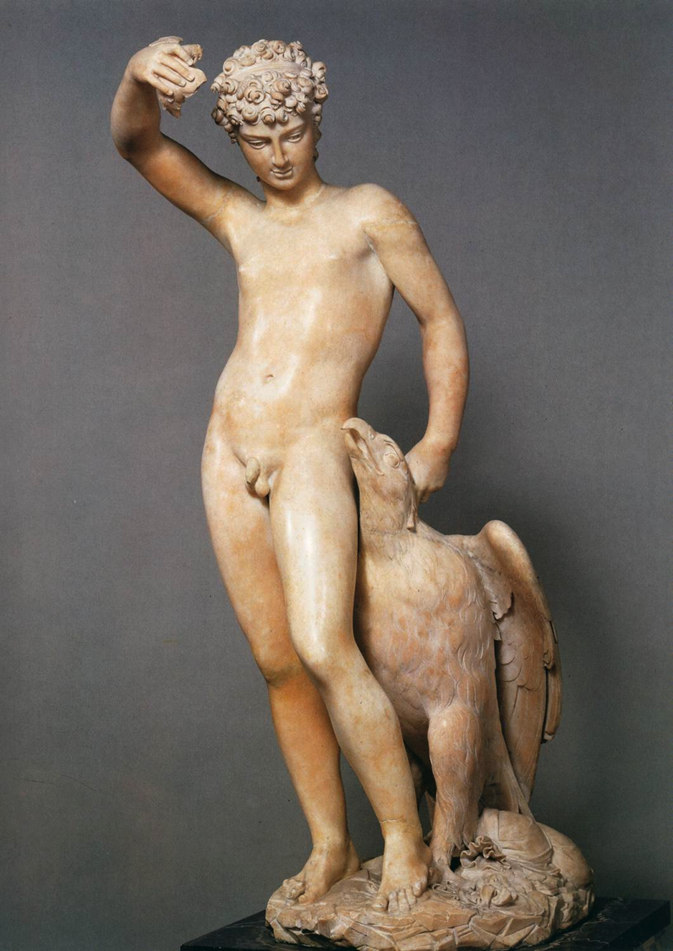
‘If you would share in my society
Do not discourse on female love to me
How pitiful the man who changes his mind
For woman, or for her feels joy or dismay
Or who permits her his liberty to bind
Or trusts her words or glances that betray’
Angelo Poliziano, Orfeo (1480)
Benvenuto Cellini
Ganymede and the Eagle (1545-46)

Slide 26
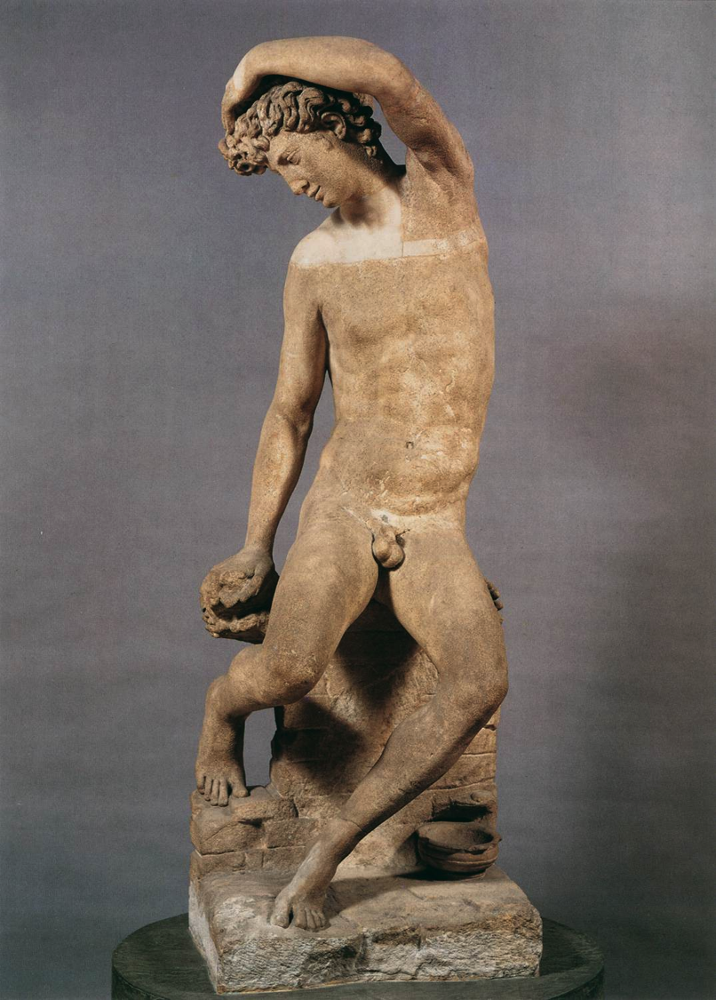
Benvenuto Cellini
Narcissus (1545)

Slide 27
Parmigianino
Amor (1532-33)

Slide 28
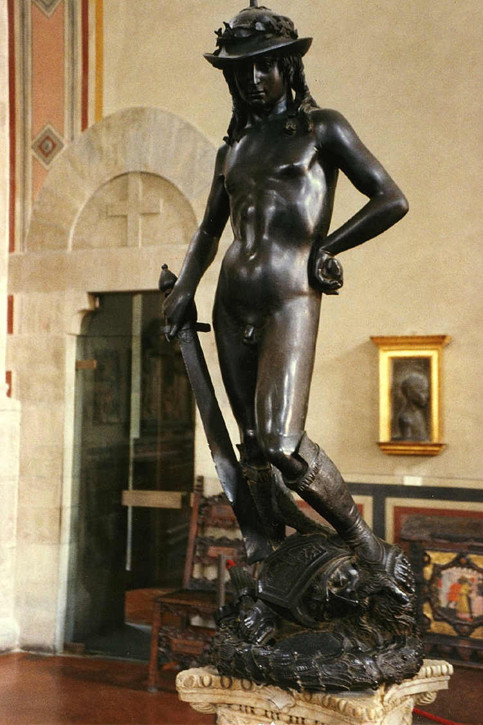
‘In Florence, Donato di Niccolò di Betto Bardi, known as Donatello (1386–1466), never married
and the records from his patron Cosimo de Medici repeatedly refute rumors that the artist’s erotic
interests led him to choose apprentices more for their beauty than for their talent. This has led
some scholars to interpret his winsome statue of David, the boy warrior of the Bible as a record of the artist’s erotic desires.’
Reed, Art and Homosexuality, p. 44
Donatello
David (1440s)

Slide 29
‘The argument for civic iconology would alleviate both Janson's and Schneider Adams' assertions of intentional homoeroticism from problems inherent in a presumed contem rary Florentine religious reaction. In other words, had the s ue been consciously commissioned as both religious symbol and homoerotic emblem, one could plausibly argue that the Church and contemporary Catholic sensibilities would have unconditionally condemned a blatant eroticizing of so potent a connection to Christ, particularly one conspicuously visible in the palace cortile of an eminent Florentine patrician.’
Peter Weller, ‘A Reassessment in Historiography and Gender,’ Artibus et Historiae, 33.65 (2012) pp. 52-53

Slide 30
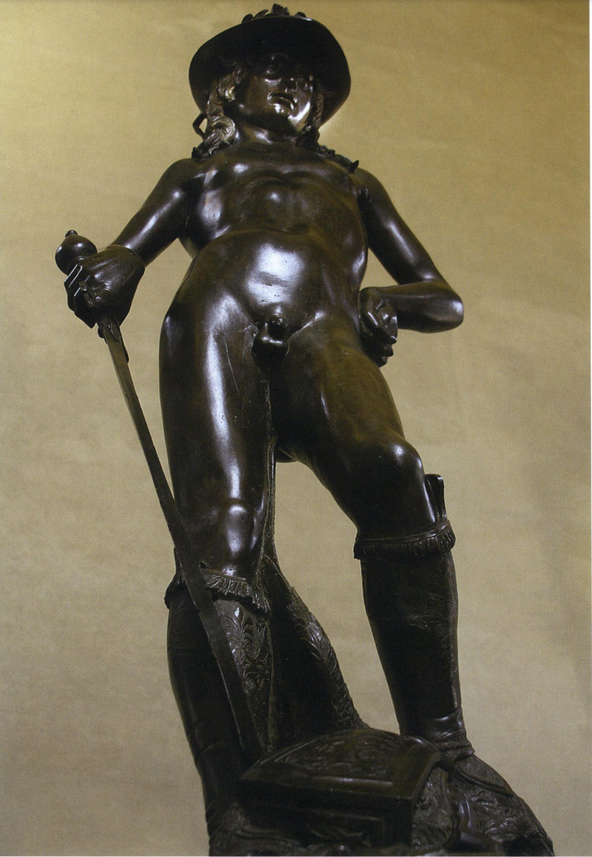
‘When one looks upward at the statue from this more severe angle and distance below the base, di sotto in sù, the elongated lower abdomen visually col lapses by means of Donatello's gift of intentional foreshortening and the viewing angle now emphasizes an adolescent chest that may be gendered with a hetero-prowess and self-confidence. As Munman opines, the statue's legs become stronger and the countenance more defiant, the entire body evokes torsion and dynamism that overpowers the modern eye's notion of effeminacy endowed by the current view displayed from the shallower angle and shorter height.’
Weller, p. 54

Slide 31
Furthermore ….
’ … records suggest that sexual behavior in Renaissance Italy was
not seen as a basis for individual identity. When preachers fulminated
against sodomites as a group, their hyperbolic claims about the seriousness of the problem cast sodomy as a ubiquitous form of youthful
delinquency, rather than a characteristic of an identifiable minority.
Their ongoing recourse to such rhetoric also suggests that sermons did
little to change behavior. The absence of modern notions of homosexual
identity in the fi fteenth century should not be surprising, however, for
modern ideas of individual identity in general postdate the Renaissance.’
Reed, Art and Homosexuality, p. 43.

Slide 32
Modernist readings

Slide 33
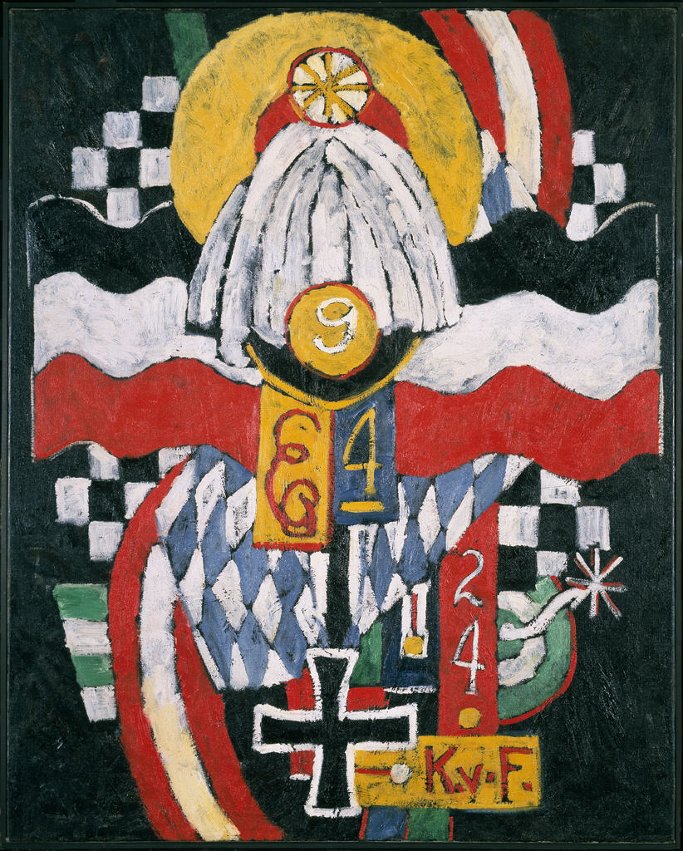
Marsden Hartley
Portrait of a German Officer (1914-15)

Slide 34
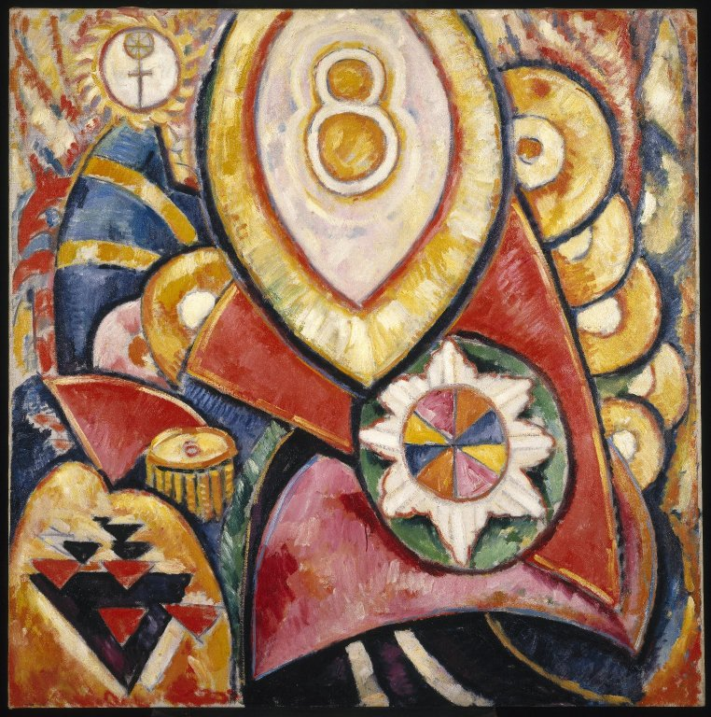
Marsden Hartley
Painting No. 48 (1913)

Slide 35
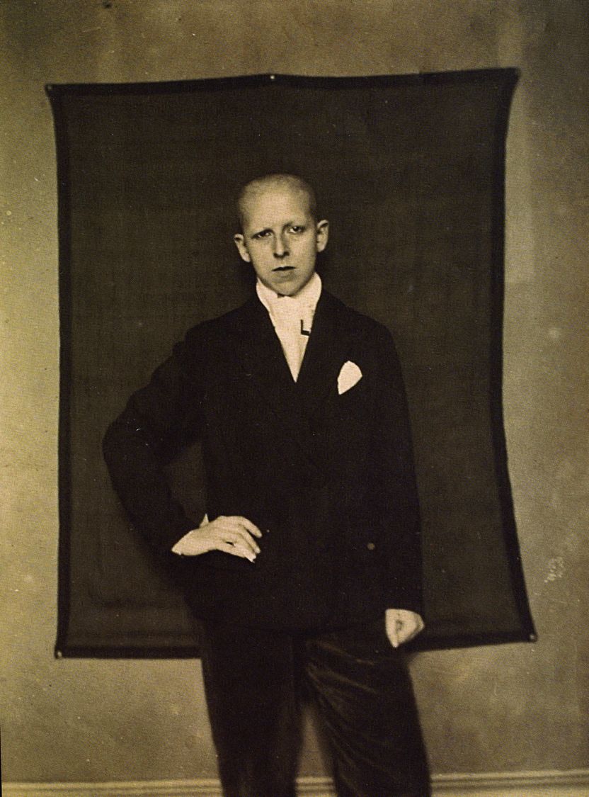
Claude Cahun
Self-Portrait (1920)

Slide 36
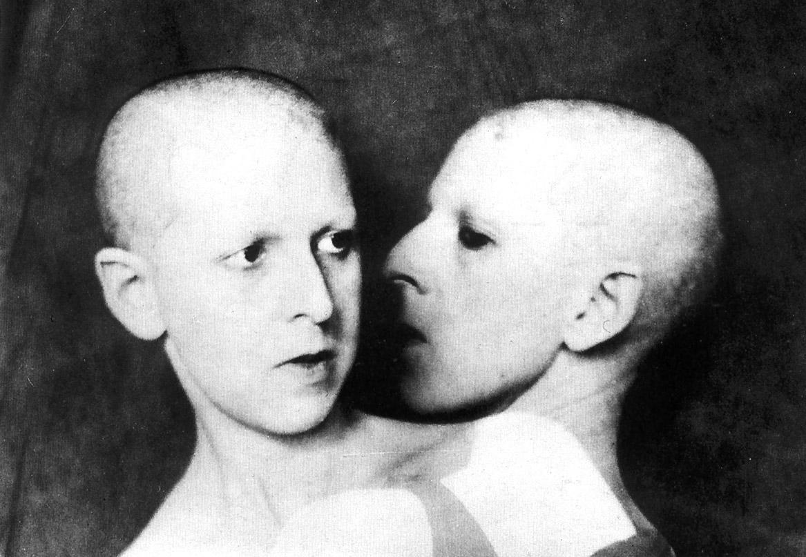
Claude Cahun – What Do You Want? (1929)

Slide 37
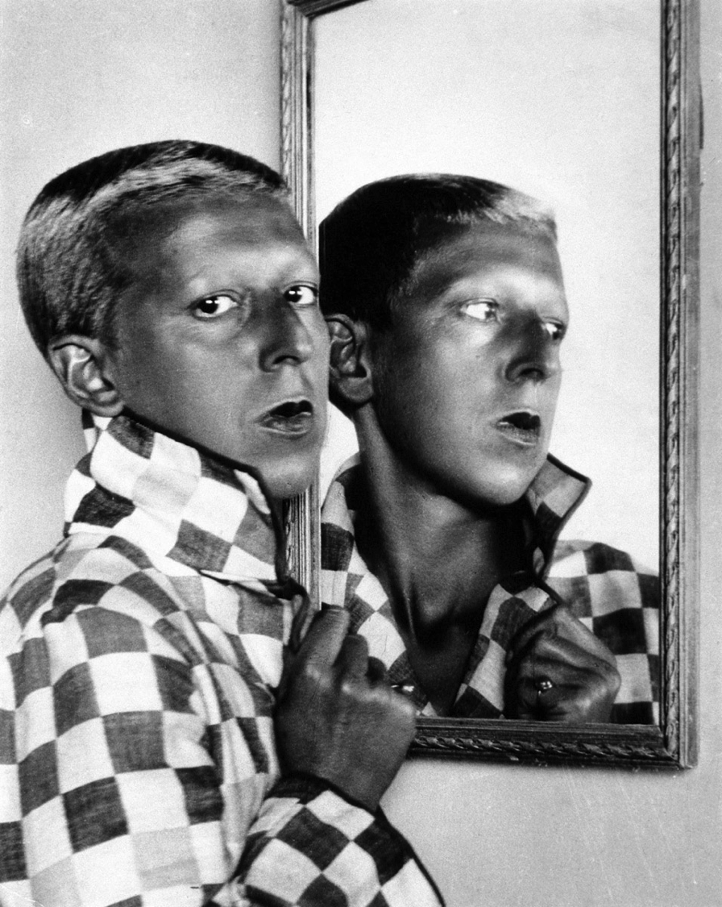
Claude Cahun
Self Portrait (1929)

Slide 38
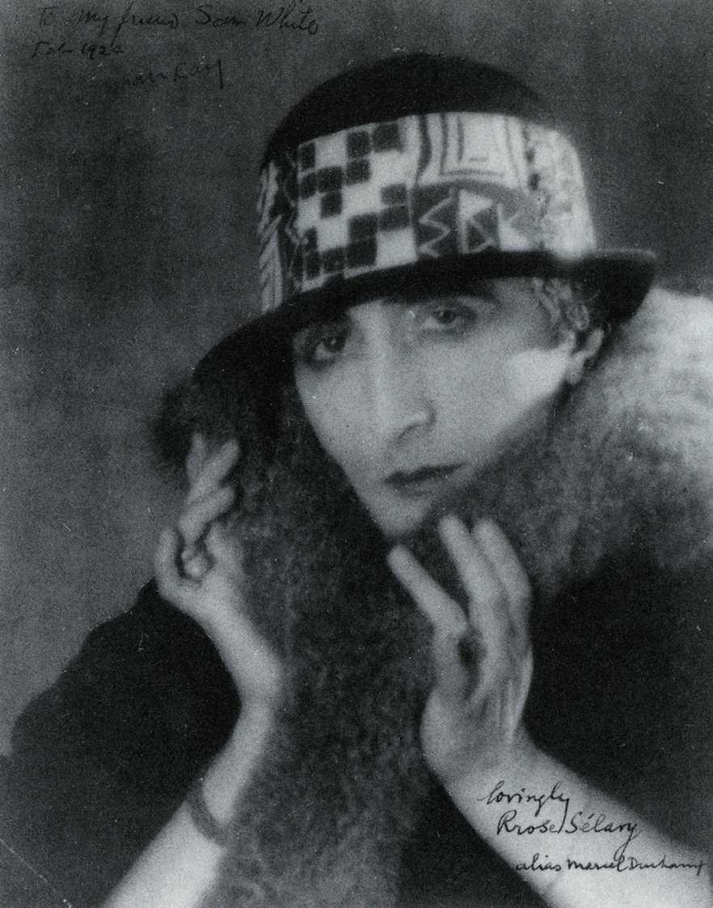
Man Ray
Photograph of Marcel Duchamp as Rrose Selavy (1921)

Slide 39
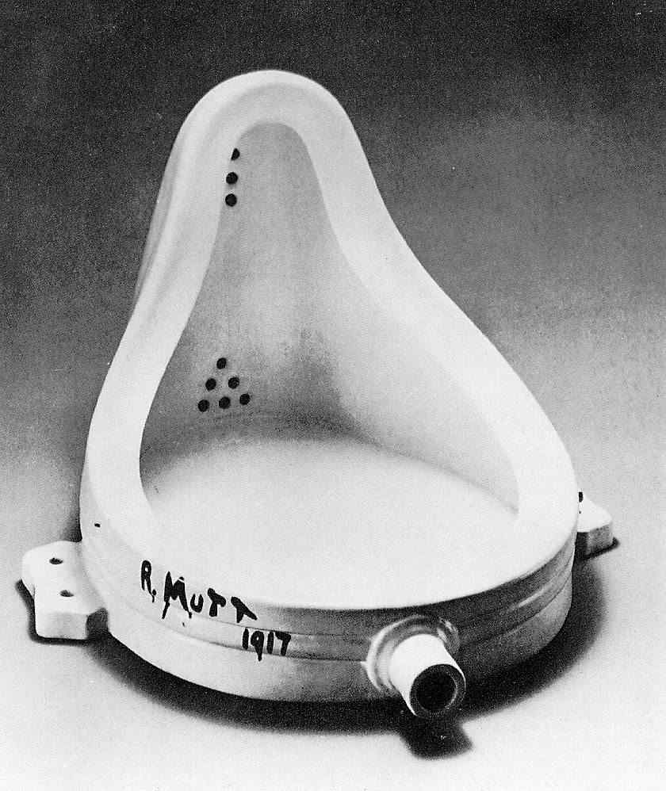
Marcel Duchamp
Fountain (1917)

Slide 40
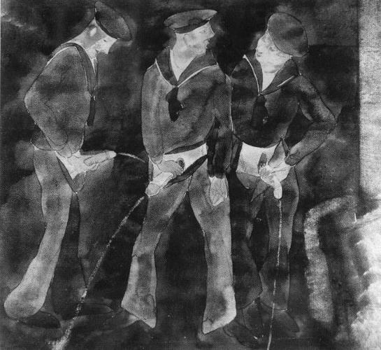
Charles Demuth – Three Sailors Urinating (1930)

Slide 41
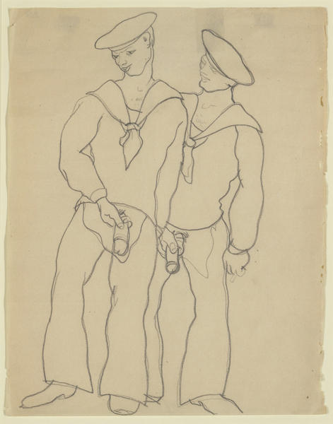
Charles Demuth
Sailors urinating (1930)

Slide 42
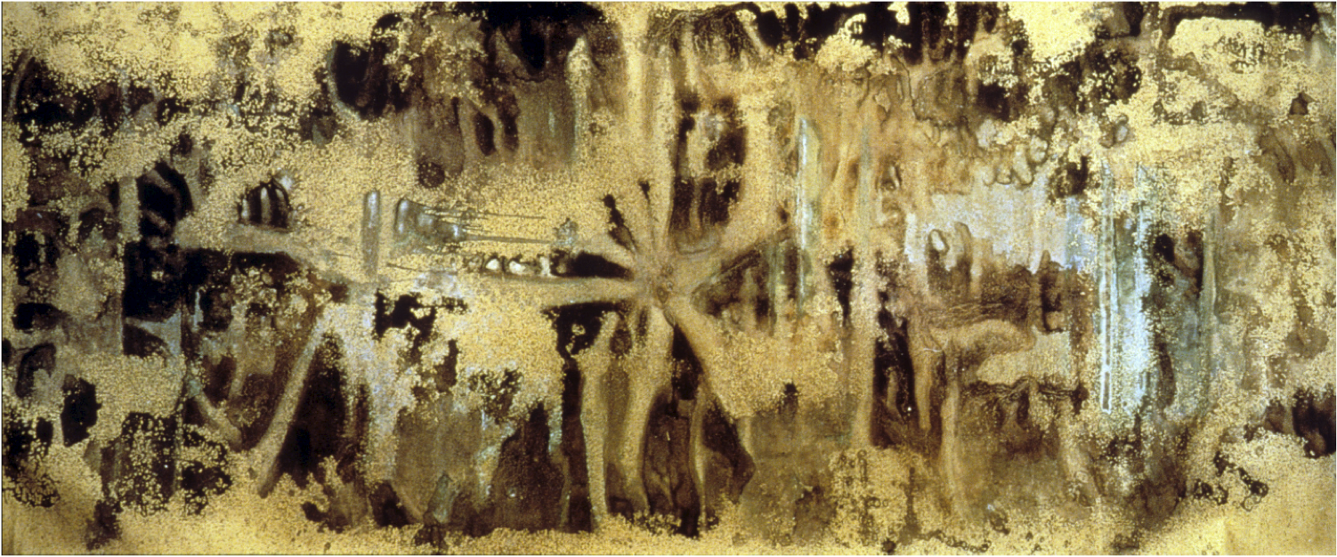
Andy Warhol – Oxidation Painting (1978)
(Copper metallic pigment mixed with acrylic and urine)

Slide 43
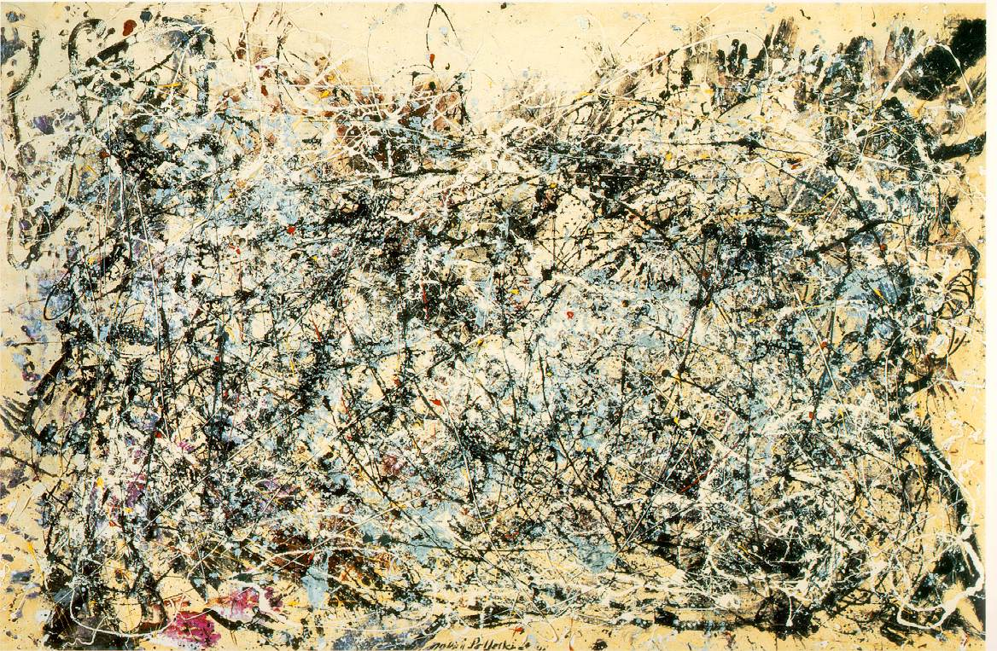
Jackson Pollock – Number 1 (1948)

Slide 44
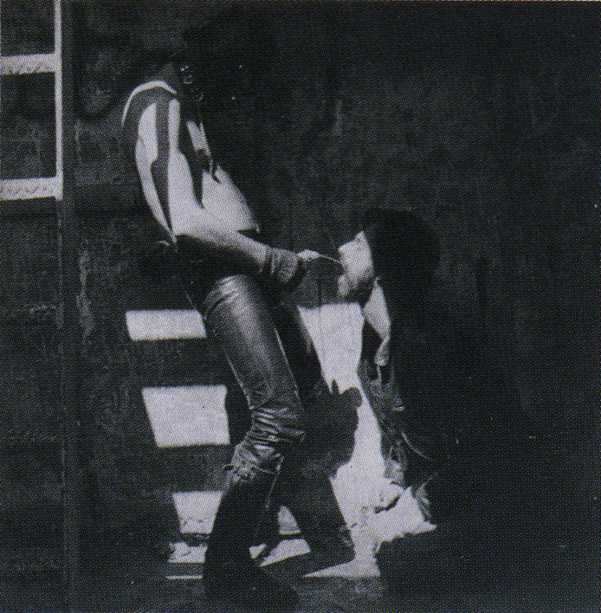
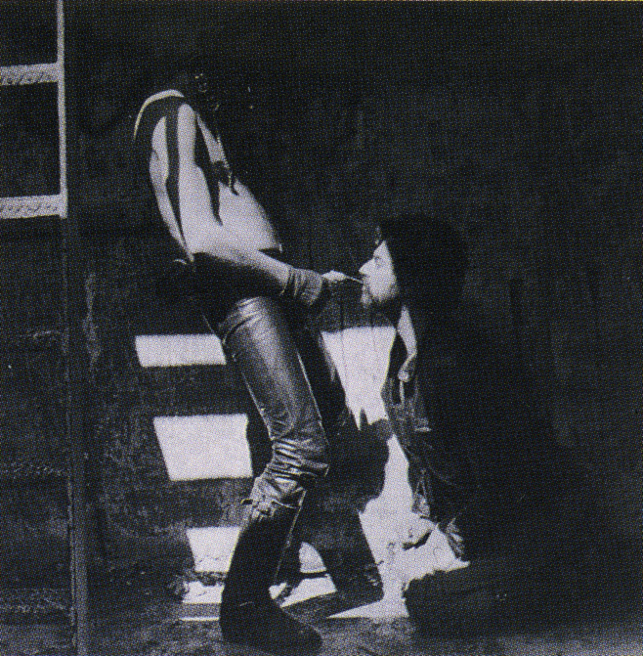
Robert Mapplethorpe
Jim and Tom, Sausolito (1977)

Slide 45
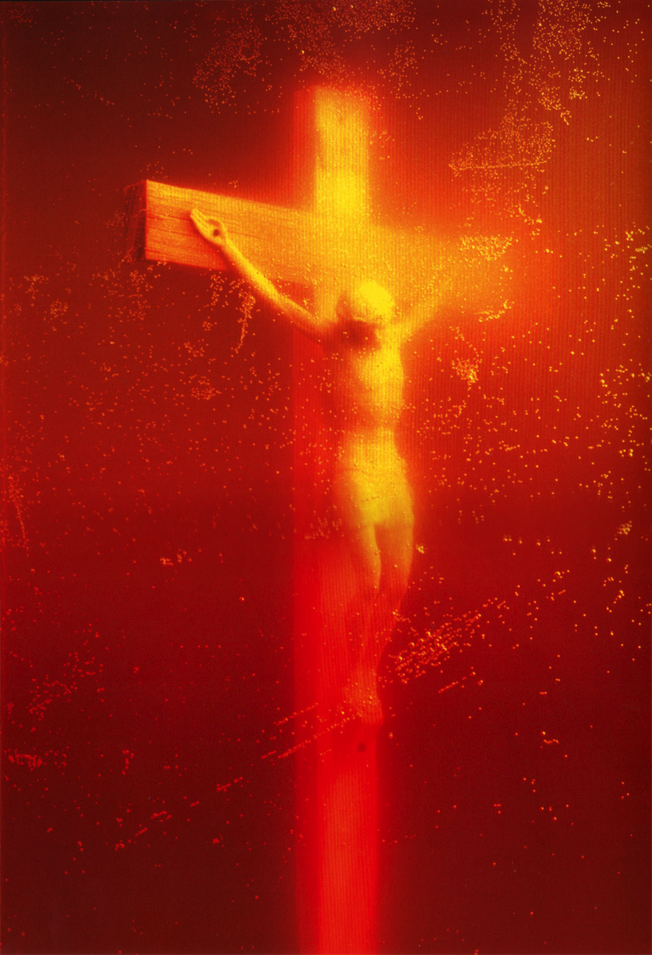
Andres Serrano
Piss Christ (1987)

Slide 46
‘These bad boys of modern art – metaphorical bed-wetters all – Duchamp, Demuth, Mapplethorpe, Warhol, Serrano and perhaps even Pollock … void the civilized boundaries placed on our concept of the body’s beauty, on what is clean and dirty, and finally on what is sexually permissible.’
Jonathan Weinberg, ‘Urination and its Discontents’ in Davis, ed, Gay and Lesbian Studies in Art History, p. 242

