Slide 1
The meanings of ‘style’
Formalism and the
Social History of Art

Slide 2
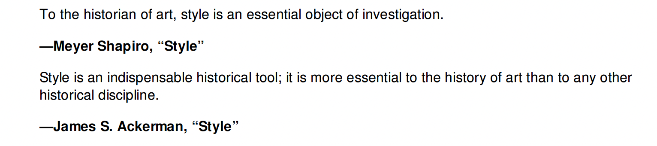

Slide 3
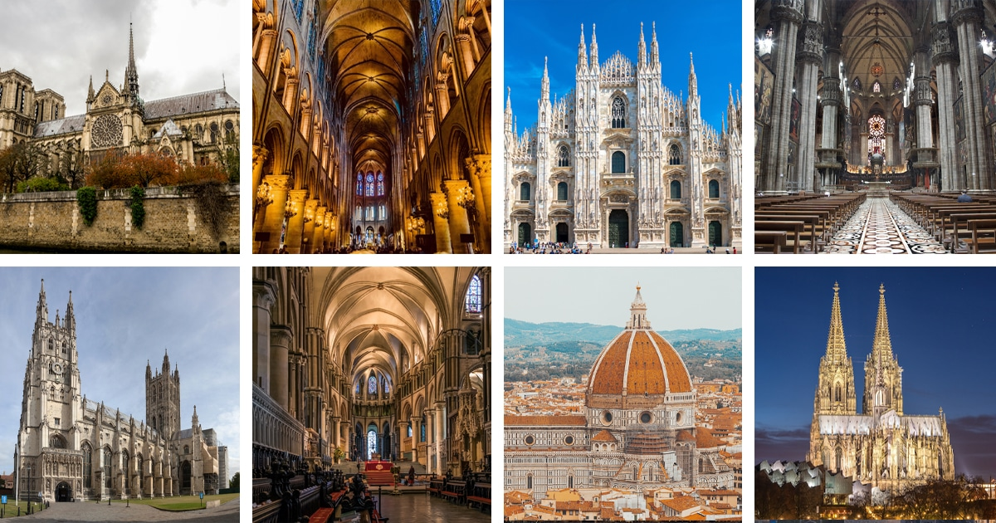

Slide 4
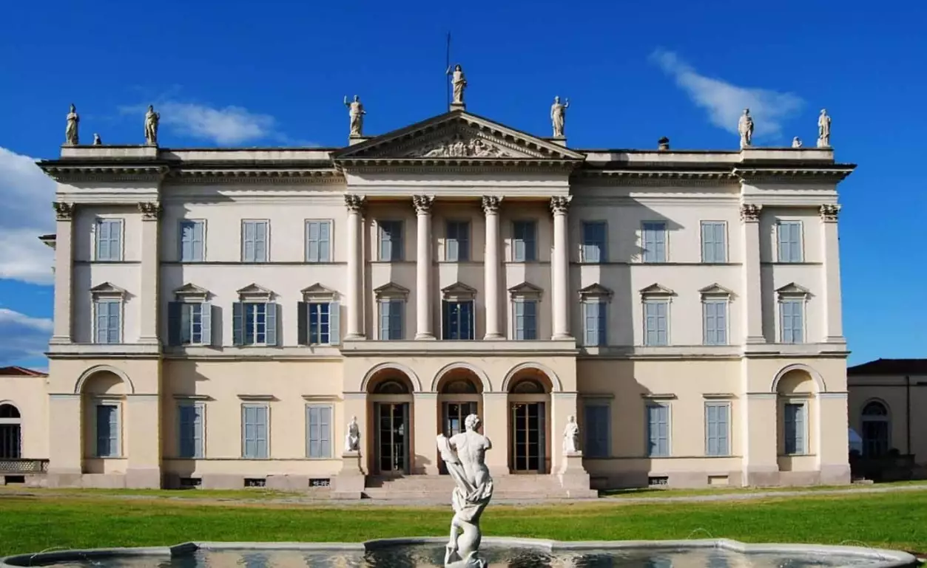
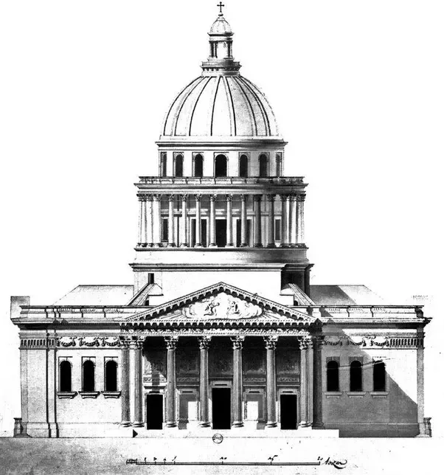
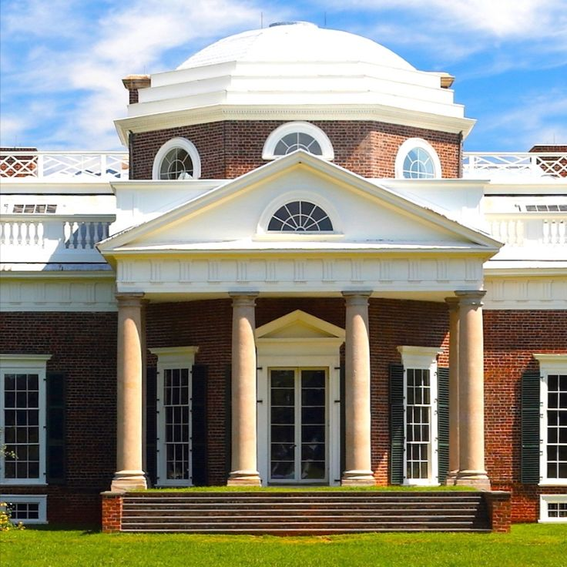
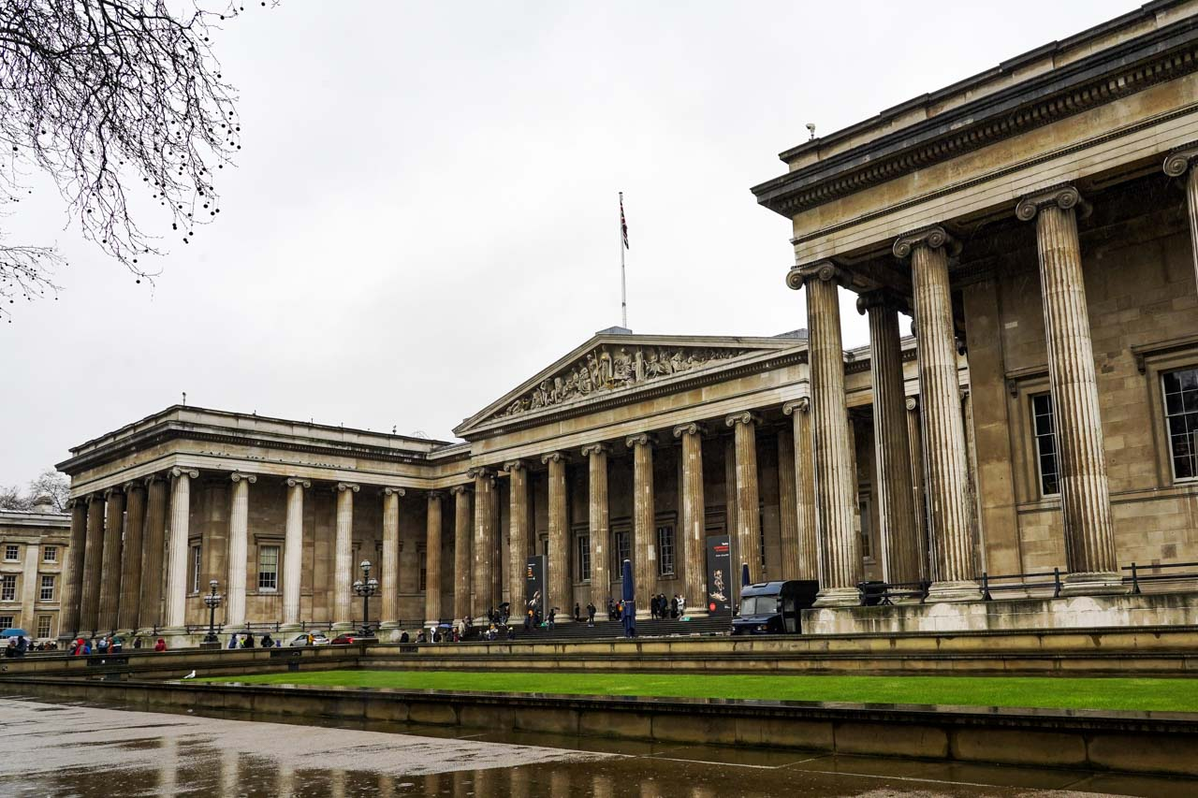

Slide 5
‘ … style is any distinctive, and therefore recognizable, way in which an act is performed or an artefact made or ought to be performed and made.’
E H Gombrich, ‘Style’ in Preziosi, The Art of Art History (2003) p. 150
‘By style is usually meant the constant form – and sometimes the constant elements, qualities, and expression – in the art of an individual or a group. The term is also applied to the whole activity of an individual or society, as in speaking of a “life-style” or the “style of a civilization”.’
Meyer Schapiro, ‘Style’ in Alfred Kroeber,
Anthropology Today (Chicago, 1953) p. 287

Slide 6
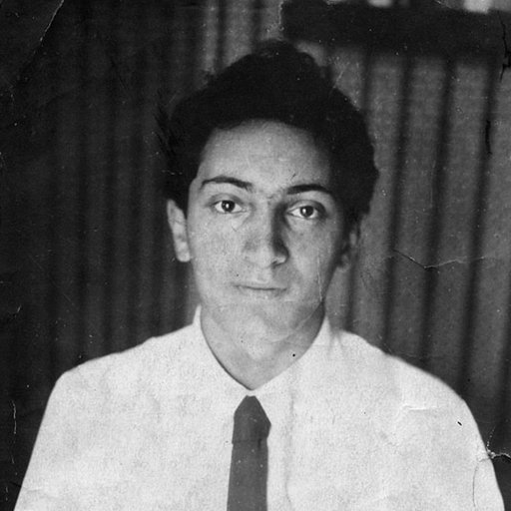
‘ … style is above all a systems of forms with a quality and a meaningful expression through which the personality of the artist and the broad outlook of a group are visible … It is, besides, a common ground against which innovations and the individuality of particular works may be measured.’
Meyer Schapiro, ‘Style’ in Alfred Kroeber,
Anthropology Today (Chicago, 1953) p. 287
Meyer Schapiro (1904-1996)

Slide 7
3 ideas of style
Johann Winckelmann (1717-1768)
Gottfried Semper (1803-1879)
Alois Riegl (1858-1905)

Slide 8
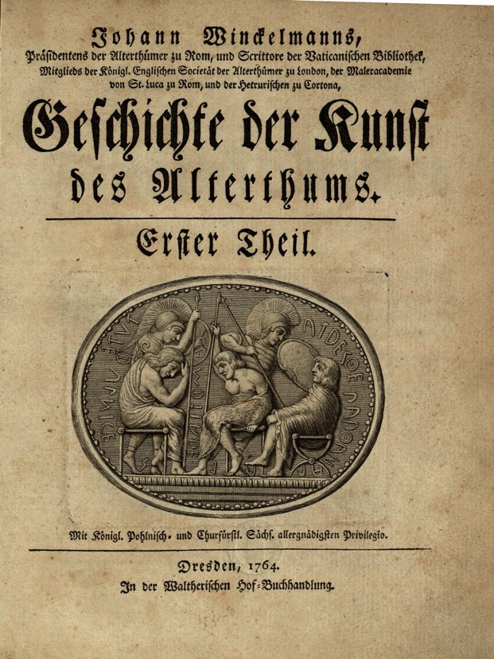
Johann Winckelmann, History of the Art of Antiquity (1764)
‘Greek art has …. four main periods, and we can even distinguish five. For just as each action and event has five parts or stages - beginning, development, plateau, waning and end, which is the reason for the five scenes or acts in theatrical pieces – so it is with the chronological succession of Greek art … The more ancient style lasted until the time of Pheidias. Through him, and through the artists of his time, art achieved its greatness, and we can call this style the grand or high style. From the time of Praxiteles to that of Lysippos and Apelles, art acquired more grace and complaisance, and this style can be called the beautiful style.’
Johann Winckelmann, History of the Art of Antiquity (Los Angeles, 2006) p. 227.

Slide 9
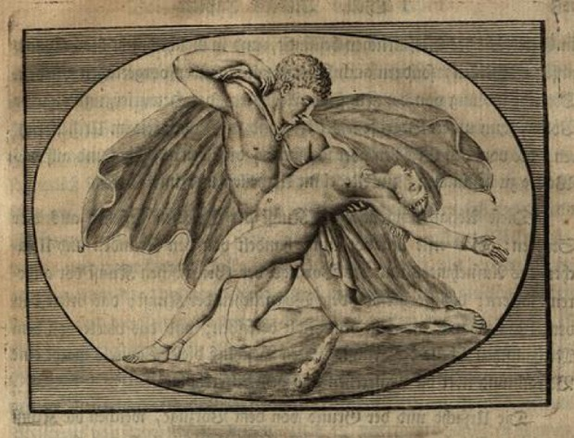
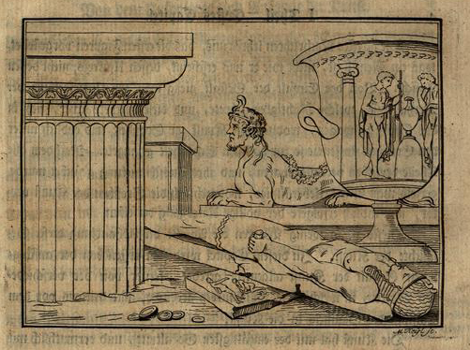
‘The more ancient style was built on a system of rules that were taken from nature and subsequently departed from it and became ideal.
The style can itself be called the grand style because – aside from beauty – the most notable aim of these artists seems to have been grandeur. Here we should distinguish hardness from sharpness in drawing, so that no one will mistake, for example, the sharply drawn indication of the eyebrows that one always sees in appearances of the highest beauty for an unnatural hardness left over from the more ancient style.’
Winckelmann, History of the Art of Antiquity, p. 232

Slide 10
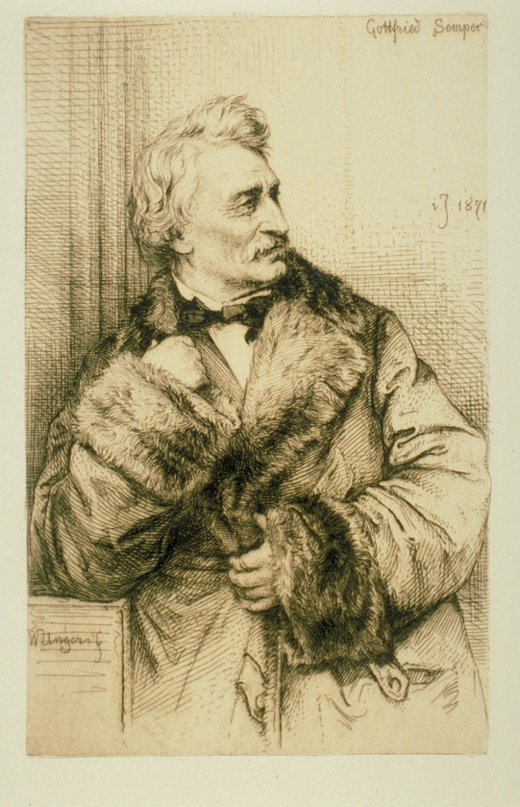
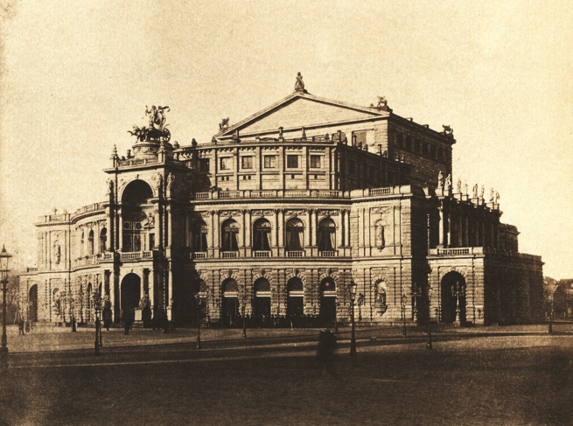
The Dresden Opera House designed by Semper (1871-79)
Photo: after 1880
Wilhelm Unger, Gottfried Semper (1871)

Slide 11
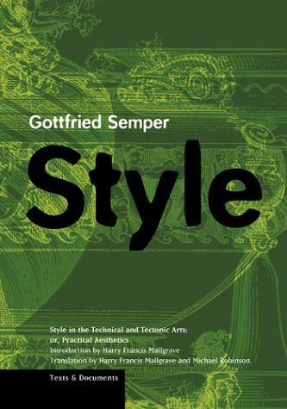
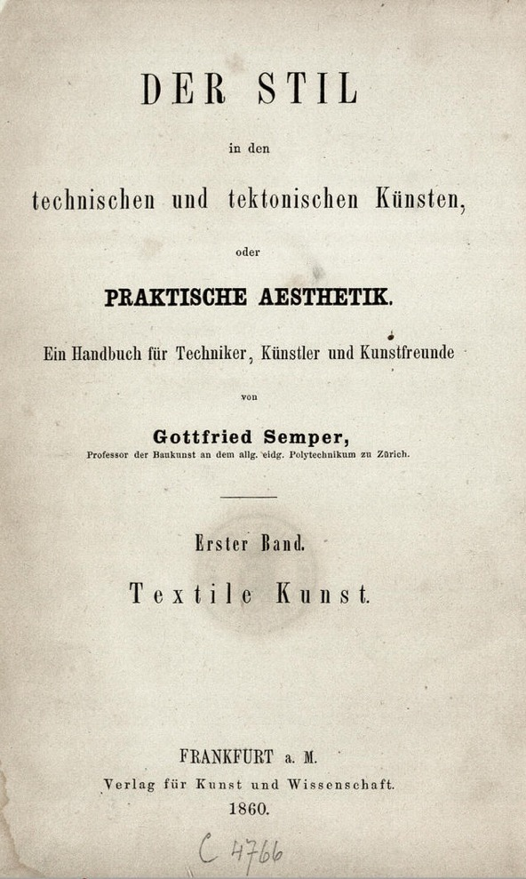
Semper’s Style in the Technical and Tectonic Arts (1860-1863)
(Front cover of the Getty translation of 2004)

Slide 12
‘ … the fundamental principles of style in the technical arts are identical with those governing architecture … They will be … examined from the following two points of view:
1. The work as a result of the material service or use that is intended, whether actual or only presumed, and taken in a higher symbolic sense.
2. The work as a result of the material used to produce it, as well as of the tool and procedures applied.’
Semper, Style (Los Angeles, 2004) p. 107

Slide 13
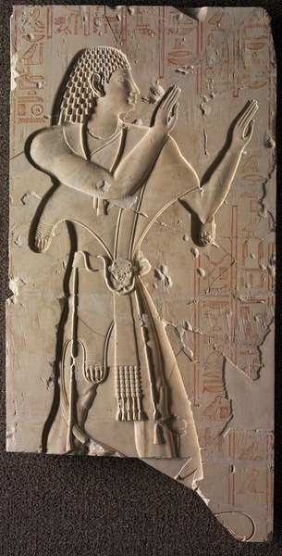
‘The peculiar style of Egyptian sculpture … can be explained at least in part by the technical demands imposed by the hard materials employed and by the simple means used to overcome them. Those granite colossi with their compact extremities and accessories, their sharpy accented, refined and yet restrained contours amount to a conventional compromise as it were between a hard and resistant material and the soft human hand with its simple tools …’
Semper, Style (Los Angeles, 2004) p. 176
Late Egyptian Sculptural Frieze, 7th Century BCE. Cleveland Museum of Art. Source: Bridgeman

Slide 14
‘Every technical product is a result of purpose and material.
The use of any technical product remains essentially the same at all times. It is based on universal human needs and on natural principles seeking formal expression that are valid everywhere and at all times.
It is thus more appropriate to link more general formal-aesthetic considerations to the question of purpose and to link considerations of the history of style to materials.’
Gottfried Semper, Style (Los Angeles, Getty, 2004) p. 107.
‘… textiles should undoubtedly take precedence because they can be seen, as it were, as the primeval art from which all other arts – not excepting ceramics – borrowed their types and symbols …. Textile types evolved within the art itself or were borrowed directly from nature. There can be no doubt that the first principles of style are bound up with this earliest of artistic techniques.’
Semper, Style, p. 113.

Slide 15
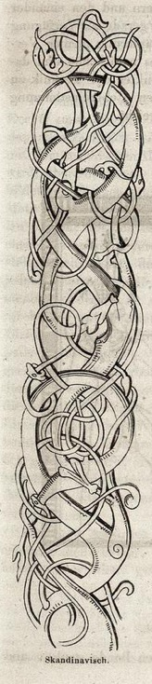
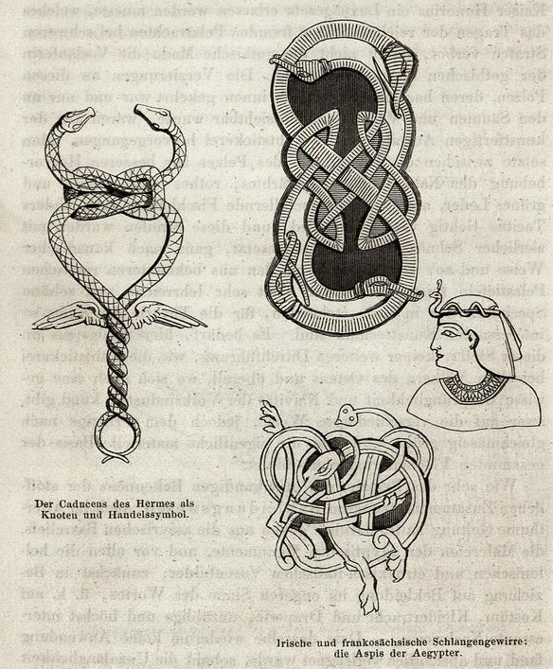



Slide 16
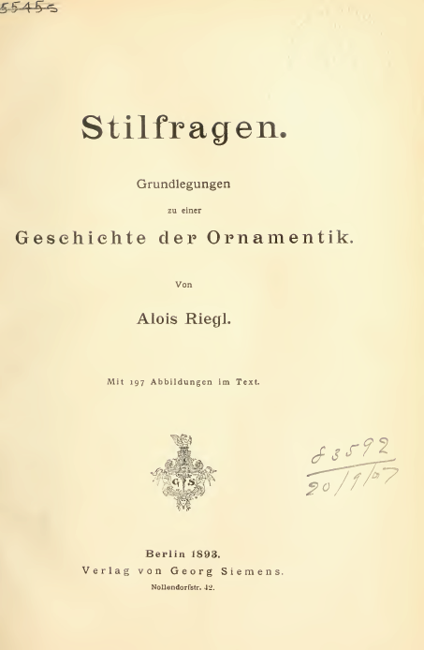
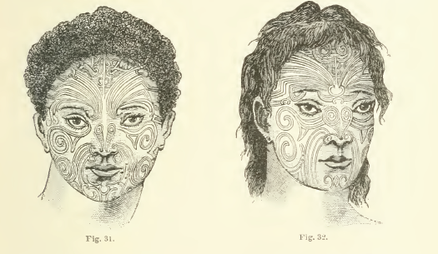
Alois Riegl, Questions of Style (1893)
Concerned with internal development of floral motifs from ancient Egypt to early Islamic art.
In contrast to Semper’s materialism, style is a function of the ‘artistic idea’ (‘Kunstschaffende Gedanke’) or ‘artistic volition’ (‘Kunstwollen’).

Slide 17
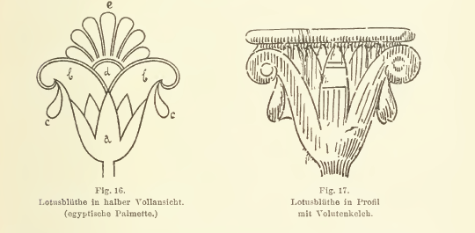
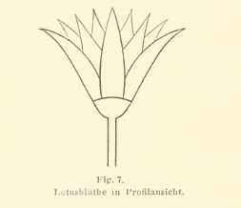
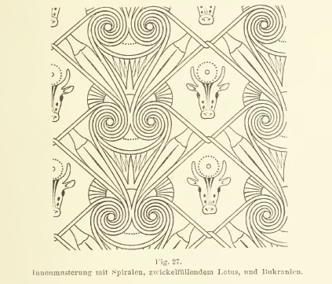
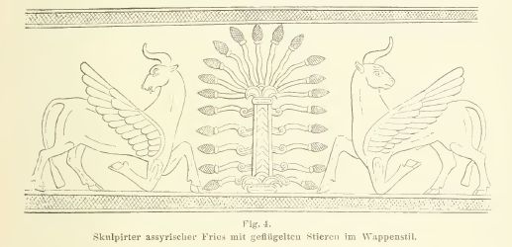

Slide 18
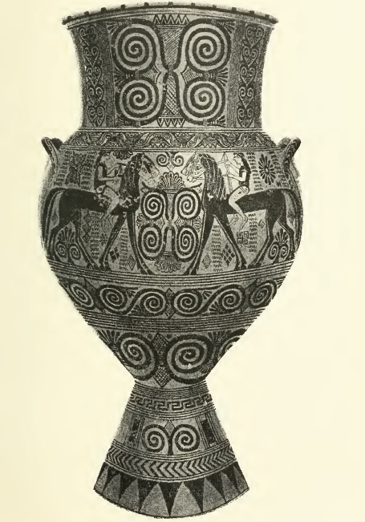
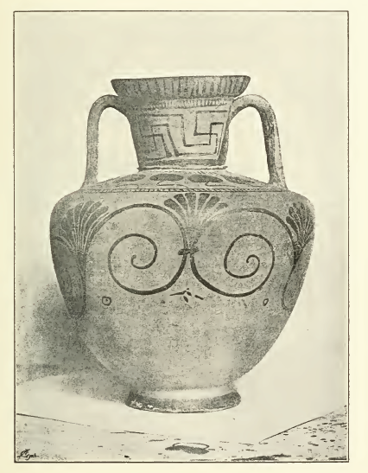
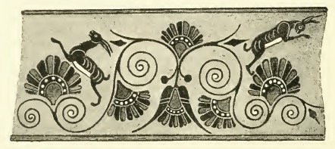

Slide 19
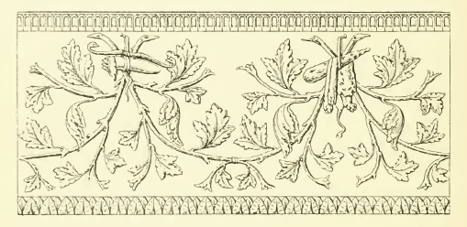
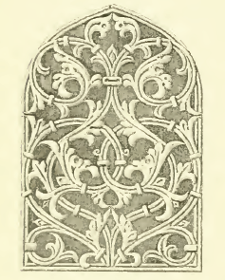
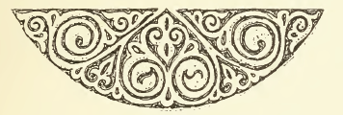
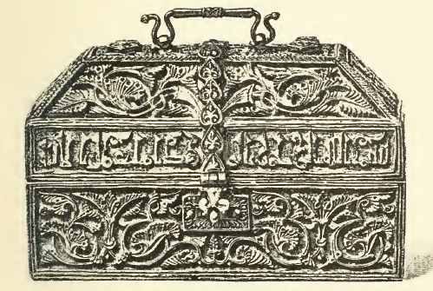
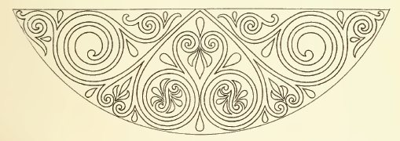

Slide 20
So …..
Style is either:
a function of climate and environment (Winckelmann)
or practical techniques and the limitations of material (Semper)
or … aesthetic impulse (Riegl)

Slide 21
Style as a scientific method

Slide 22
The driver behind the renewed interest in ‘style’ (or its equivalents)
Debate (from the 1870s onwards) over the ‘scientific’ (‘wissenschaftlich’) status of the humanities (and art history ).
What prevents art history from being a dilettantish reflection of mere ‘taste’?
How does one overcome the limits of the positivistic attention to historical / art historical facts?
Can the humanities demonstrate that they are ‘nomothetic’ are they like the natural sciences in identifying lawlike, predictable patterns in history?

Slide 23
‘The object of these considerations is the question, which always seemed to me to be a quite remarkable one: How is it possible for architectural forms to express something mental , a mood?’
Wölfflin, ‘Prolegomena’ in Harry Francis Mallgrave, ed., Empathy Form and Space (Los Angeles, 1994) p. 150

Slide 24
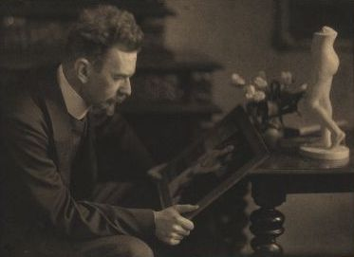
Heinrich Wölfflin
‘Prolegomena to a Psychology of Architecture’ (1886)
Rudolf Dührkoop, Photo of Heinrich Wölfflin (n.d.)
‘Physical forms possess a character only because we ourselves possess a body. If we were purely visual beings, we would be denied an aesthetic judgement of the physical world. But as human beings with a body that teaches us the nature of gravity, contraction, strength and so on we gather the experience that enables us to identify with the conditions of other forms.’
Wölfflin, ‘Prolegomena’ in Harry Francis Mallgrave, ed., Empathy Form and Space (Los Angeles, 1994) p. 151

Slide 25
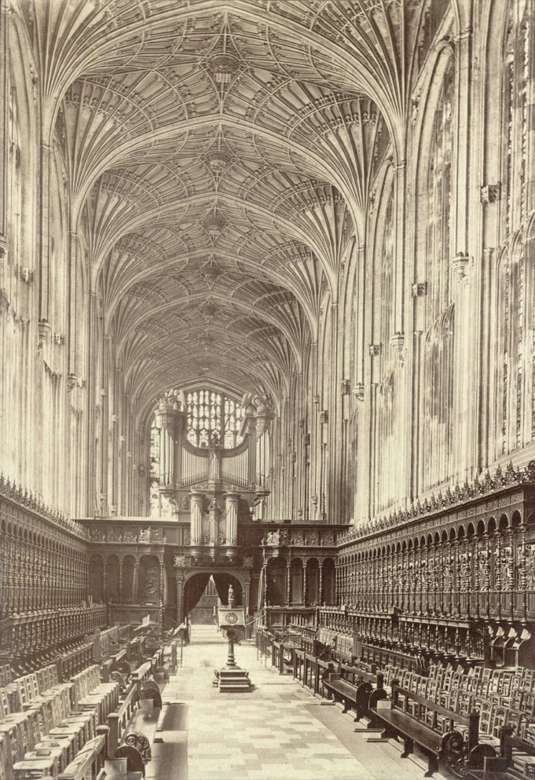
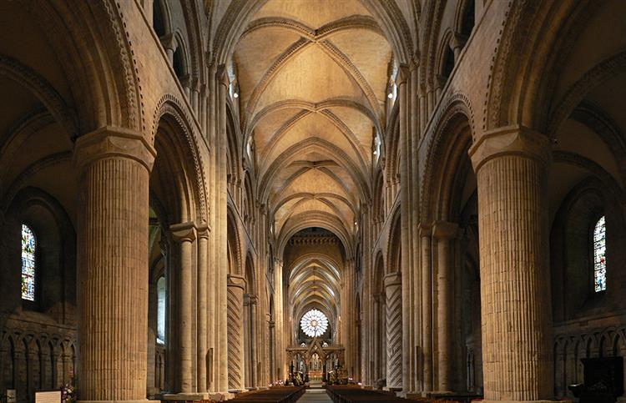
L: King’s College Chapel, Cambridge (1446)
R: Durham Cathedral (1093-ca. 1200)

Slide 26
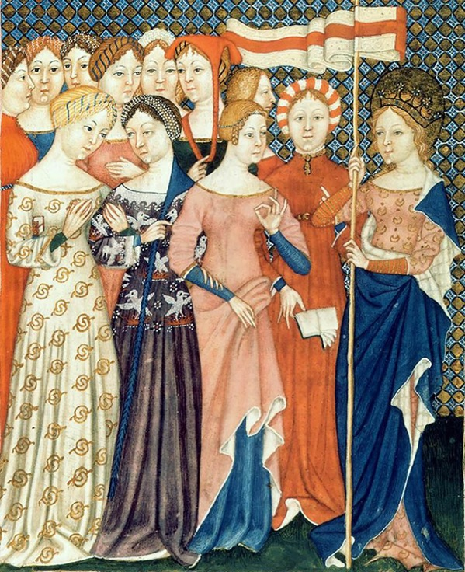
‘ … any architectural style reflects the attitude and movement of people in the period concerned. How people like to move and carry themselves in expressed above all in their costume, and it is not difficult to show that architecture corresponds to the costume of its period.
[ … ]
Scholasticism and spiritualism can be considered the expression of the Gothic period only if one keeps in mind this intermediate stage, during which a psychological feeling is directly transformed into a bodily form. The sophisticated subtlety of the scholastic centuries and the spiritualism that tolerated no matter divested of will can have shaped architectural form only through their bodily expression.’
Wölfflin, ‘Prolegomena,’ pp. 182 and 183

Slide 27
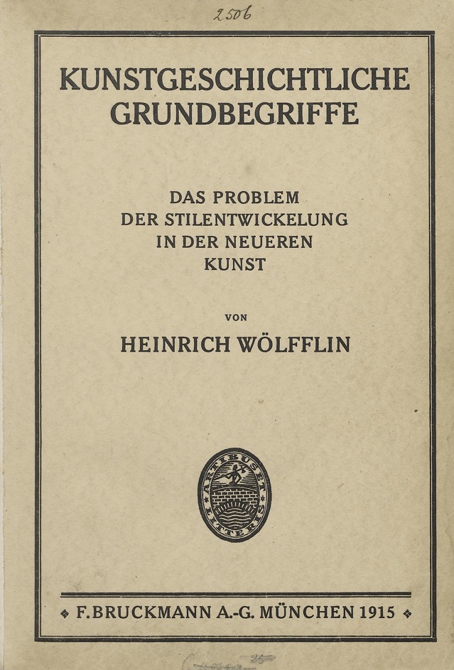
‘Every artist finds certain visual possibilities before him, to which he is bound. Not everything is possible at all times. Vision has its history, and the relevation of these visual strata must be regarded as the primary task of art history.
[ … ]
In other words there can be discovered in the history of style a substratum of concepts referring to representation as such and one could envisage a history of the development of occidental seeing for which the variations in individual and national characteristics would cease to have any importance.’
Wölfflin, Principles of Art History (1915)
(New York: Dover, 1950) p. 11 and 12.

Slide 28
Five binary oppositions:
Linear vs. Painterly
Planar vs. Recessive
Closed vs. Open
Unity vs. Multiplicity
Absolute clarity vs. Relative clarity

Slide 29
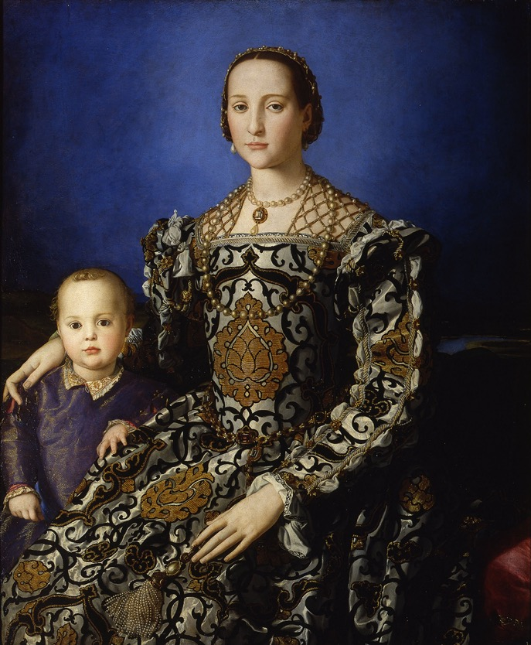
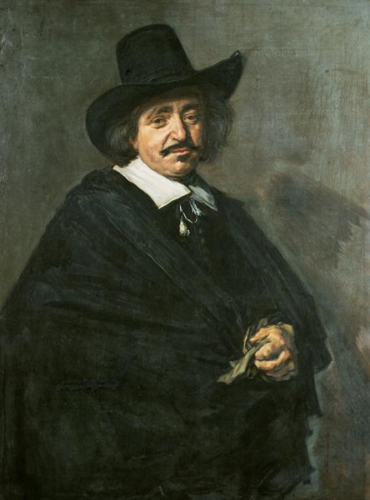
Linear vs. Painterly
Bronzino – Eleanor of Toledo (before 1544-45)
Frans Hals – Portrait of a Man (1654-5). KHM Vienna

Slide 30
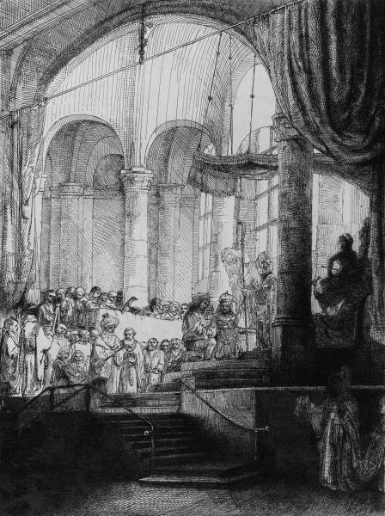
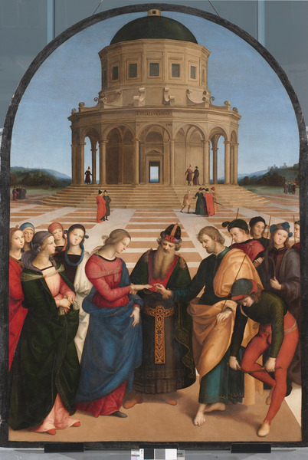
Planar vs. Recessional
L: Raphael, Marriage of the Virgin (1504)
R: Rembrandt, Medea or the Marriage of Jason and Creusa (1648)

Slide 31
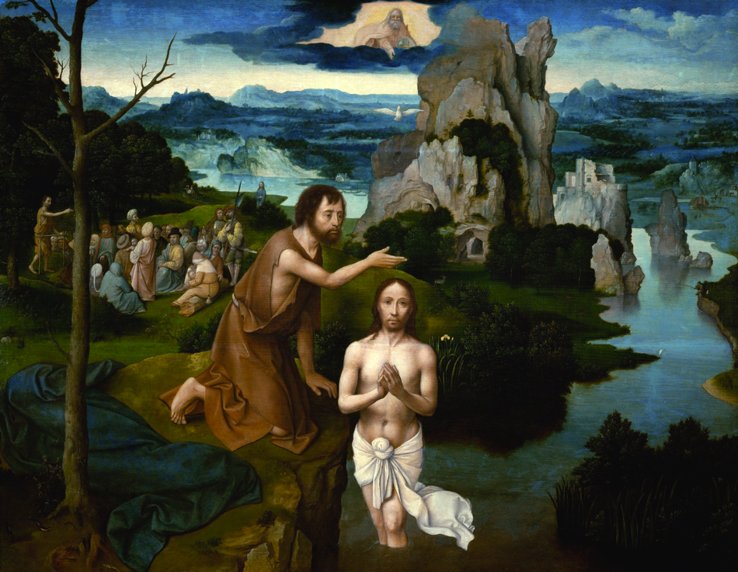
Closed vs. Open
‘The tree is thoroughly felt in its relation to the picture edge, from which it draws strength …
The horizontality of the landscape zone conforms to the base line’
Wölfflin, Principles, p. 145
Joachim Patenir
Baptism of Christ (1510-20)
Vienna, Kunsthistorisches Museum

Slide 32
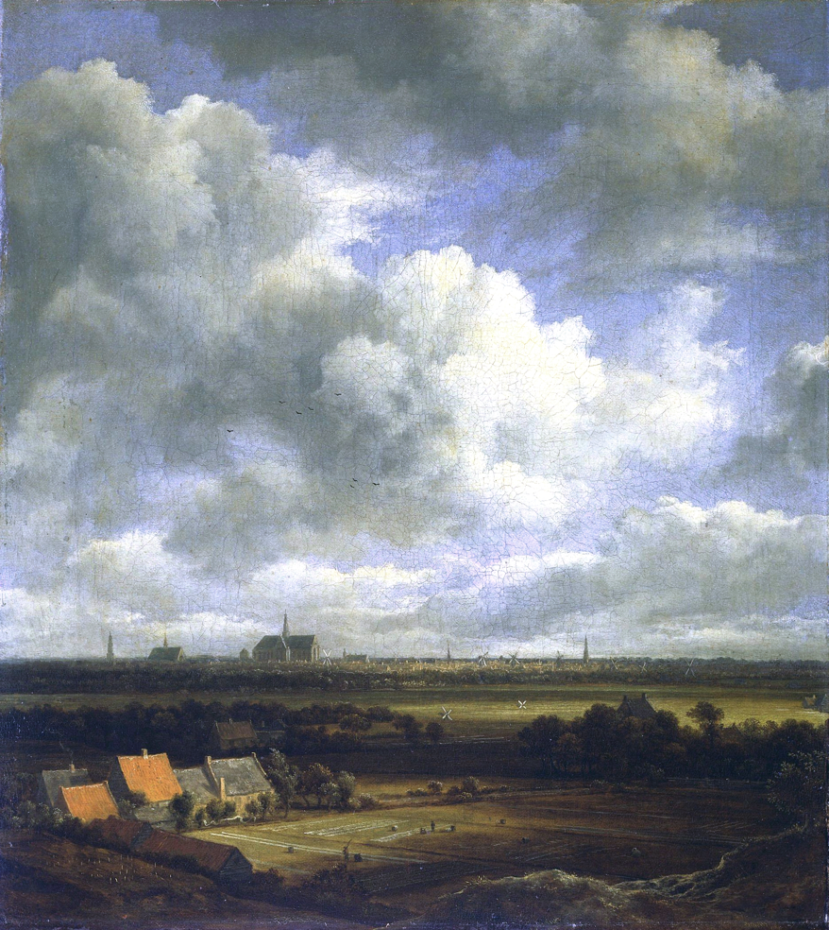
Jakob Ruysdael
View of Haarlem with Bleaching Fields (1670)
‘We feel only the limitless extent of space and the picture is the characteristic model for that beauty of the infinite …’
Wölfflin, Principles, p. 145

Slide 33
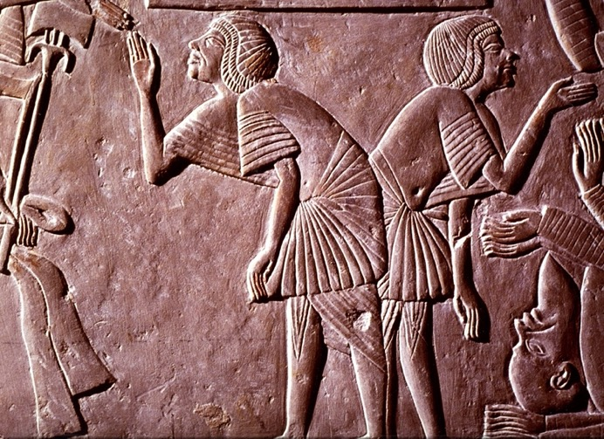
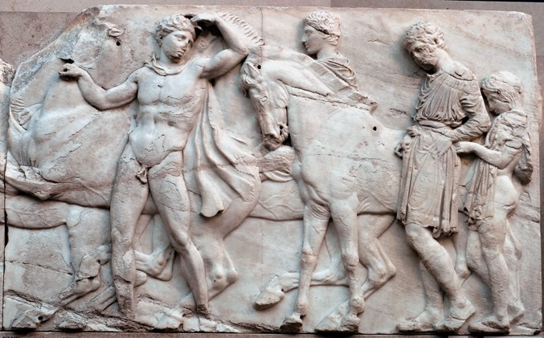
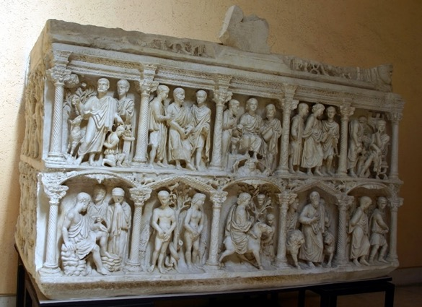
In Late Roman Art Industry (1901) Riegl provides ‘Kunstwollen’ with a theoretical basis, namely, psychology of perception.
Stylistic shifts reflect shifts in the development of vision
‘Nahsicht’ (‘Proximate seeing’) – also ‘haptic vision’
‘Normalsicht’ (‘Normal seeing’)
‘Fernsicht’ (‘Distantiated seeing’) – also ‘optical vision’

Slide 34
‘Late Roman Kunstwollen differs from previous art periods in antiquity … in that it was not satisfied with looking at the individual shape in its two-dimensional expansion, but it wanted to see it in its three-dimensional, fully spatial boundaries.
[ … ]
Not only was the classic attempt to erect a mechanistic system of causality between individual phenomena no longer valued, but one went so far as to bring externally, individual shapes in reciprocal isolation from each other … a mechanistic theory of connection between individual shapes … was replaced with a different kind of connection – magic. The latter found expression in the entire late-pagan early Christian world in neoplatonism and in syncretic cults as well as in the beliefs of the early Christian church.’
Riegl, ‘The Characteristics of Late Roman Kunstwollen,’ in Preziosi, The Art of Art History, pp. 170 and 175

Slide 35
The problem with style

Slide 36
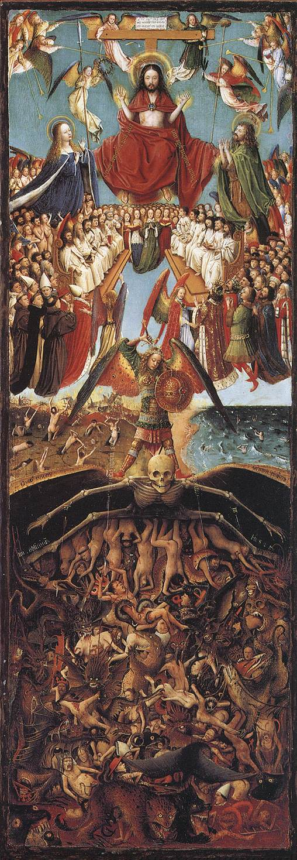
‘… it must never be forgotten that terms such as “complexity” and “elements” do not here refer to measurable entities … What may appear to one critic as the classic moment of an art may carry, for another, the seeds of corruption … the naturalism of Jan van Eyck can be seen as the climax of late Gothic tendencies … or as the primitive start of a new era.
It is evident, moreover, that the units, or styles, by which the evolution [of art] will be traced will always be rather arbitrarily chosen … we may find, for instance, that what was a late phase for portrait painting (e.g. mannerism) was an early one for landscape painting.’
E H Gombrich, ‘Style’ in Preziosi, ed, The Art of Art History (2003) p. 157

Slide 37
Style as a Comparative Construction
‘I suggested that the concept of style is a means of establishing relationships among individual works of art …. There is no objective correlative for our image of a style; we may observe and define certain traits or characteristics in a single work of art, but we cannot call them traits of Rembrandt's style, Gothic style, or Tuscan style without summoning our experience of other works by Rembrandt, or the "Gothic period" (which is itself a historian's invention), or from Tuscany. A particular work of art therefore may represent or exemplify characteristics of a style in the way that a person may be representative of a society, but to say that it "has a style," as we often do, is not illuminating.’
James S. Ackerman, ‘A Theory of Style,’
The Journal of Aesthetics and Art Criticism 20.3 (1962) p. 227

Slide 38
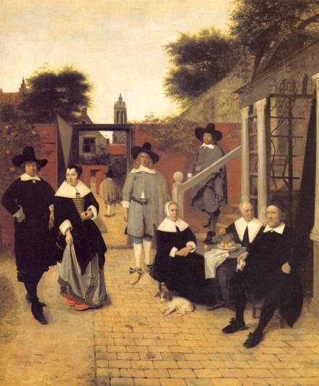
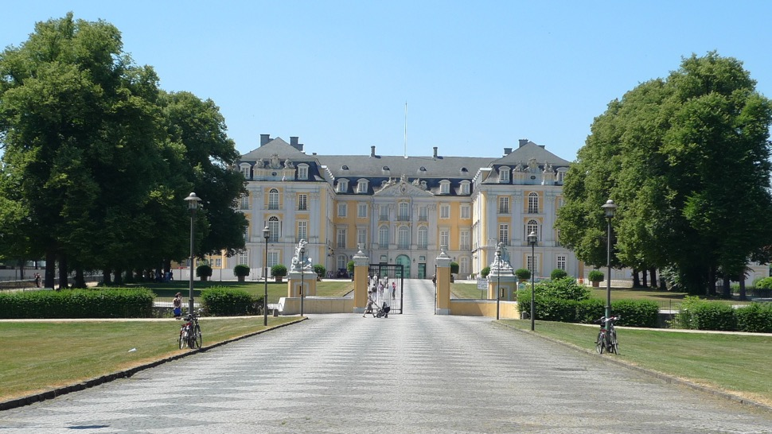
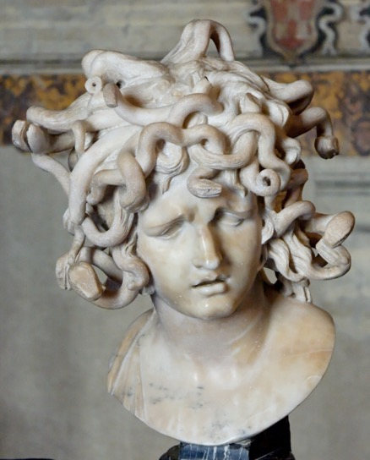
‘ … since the selection of a style as the object of study inevitably involves a presumption of cohesiveness, it should follow and not precede the hypothesis that a certain group of works is closely integrated and clearly distinguished from other groups. If we assume the existence of a style at the start (a danger with pat concepts such as "Classic" and "Romantic" periods, etc.), we shall delude ourselves into crowding into it what does not belong.’
James S. Ackerman, ‘A Theory of Style,’
The Journal of Aesthetics and Art Criticism 20.3 (1962) p. 237

Slide 39
‘The basic stylistic reflex, then, is the grouping of like with like and the disjunction of unlikes, on the basis of morphological or formal analysis … There are plenty of similarities among objects that may or may not need to be excluded (weight, color, kind of stone, and so forth, depending on the particular comparison in hand), and the decision of relevance as to what one must take account of is one of the great critical judgments inherent in the function of the art-historical eye. For all the jargon of objectivity, stylistic analysis is subjective and judgmental … ‘
Jaś Elsner, ‘Style’ from Nelson and Schiff, eds, Critical Terms for Art History (Chicago, 2003)

Slide 40
Social history of art

Slide 41
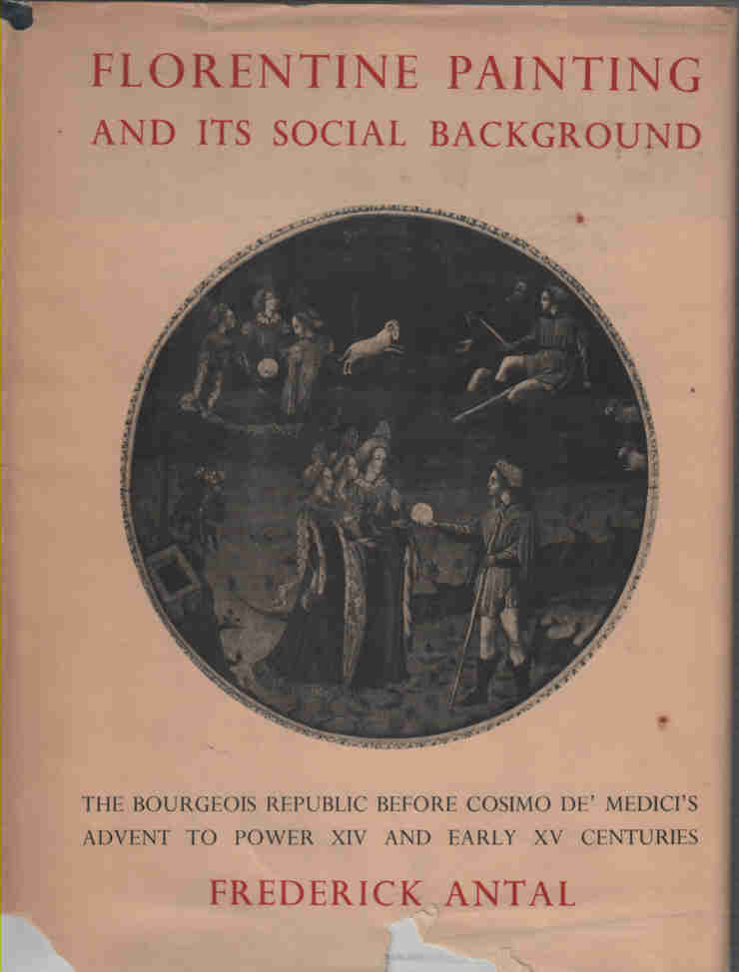
Frederick / Frigyes Antal
(1887-1954)
Front cover of first edition of Florentine Painting and its Social Background (London, 1948)

Slide 42
‘In the pre-bourgeois era the Church … was still in general very unsympathetic towards the things of this world, and placed little value on art considered as observation of nature … art could never give anything more than a pale reflection of absolute beauty, the transcendental beauty of God.’
Antal, Florentine Painting and its Social Background, p. 274

Slide 43

Cimabue – Crucifixion (ca. 1270). San Francesco, Assisi.

Slide 44

Giotto
The Lamentation of Christ (1305)
Arena Chapel, Padua
Source: Bridgeman

Slide 45
‘ … as the urban bourgeoisie became pre-eminent, the purpose of art tended to gravitate towards a humanisation of the Divine …. Obviously, a class which, despite its religious sentiment, was so sober-minded and so close to reality as was this could find satisfaction only in a religious are which already showed a considerable degree of fidelity to nature’
Antal, Florentine Painting and its Social Background, pp. 120-1
‘… the old formulas of composition – memory images, they might be called – no longer played their decisive part … [there was] a new criterion for judging truth to nature, and a new and independent way of looking at nature itself. Figures were now portrayed in quite a new manner, as the result of this independent and individual observation of nature, and the old traditional types of figure presentation were more or less abandoned.’
Antal, Florentine Painting and its Social Background, p. 138

Slide 46

Masaccio – Adoration of the Magi (1426). Staatliche Museen zu Berlin.

Slide 47

Gentile da Fabriano – Adoration of the Magi (1423). Uffizi

Slide 48

Front cover of 1988 edition of Baxandall, Painting and Experience in Fifteenth-century Italy (Oxford, 1972)

Slide 49

The Head of Niccolo da Tolentino, detail from Paolo Uccello – The Battle of San Romano
Source: Bridgeman Education

Slide 50

Baxandall, Painting and Experience, p. 40

Slide 51

Paolo Uccello – Battle of San Romano (1456). Louvre.
Source: Bridgeman

Slide 52



Slide 53


From: Painting and Experience, p. 101-102.

Slide 54

Paolo Uccello – The Hunt in the Forest (1465-70). Ashmolean Museum, Oxford. Source: Bridgeman Education

Slide 55

Crow’s Painters and Public Life (London, 1985). Major themes:
a) The Spaces of Exhibition and the Audiences for Art, including;
- The Academy and Royal Patronage
- The Fairs
- The Public Salon (from 1737)
b) Art Criticism and the Rise of the Art Public

Slide 56
Main critical concern: the rise of the Salon as the occasion of a conflict between the Aristocratic patrons of traditional culture, and the new bourgeoisie.
At stake: control of the domain of culture.
Salon was a crucial moment in the process of the embourgeoisement of culture.
It provided for:
The idea of the public sphere as an arena of critical debate, and
2) The idea of the work of art as a discrete object of attention

Slide 57

Hence the hostility of the supporters of the traditional culture towards …

Slide 58

Thomas Rowlandson
Exhibition ‘stare’ case / staircase (1811)

Slide 59

… art critics, who presumed to submit the output of the academicians to open debate.

