Slide 1
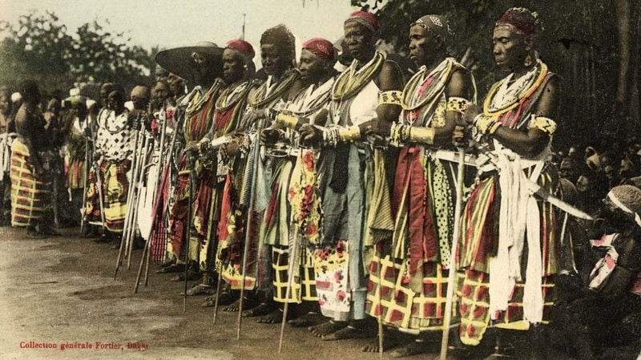
DOMINIKA CZARNECKA: BLACK FEMALE BODIES AND THE „WHITE“ VIEW
Karolína Králiková

Slide 2
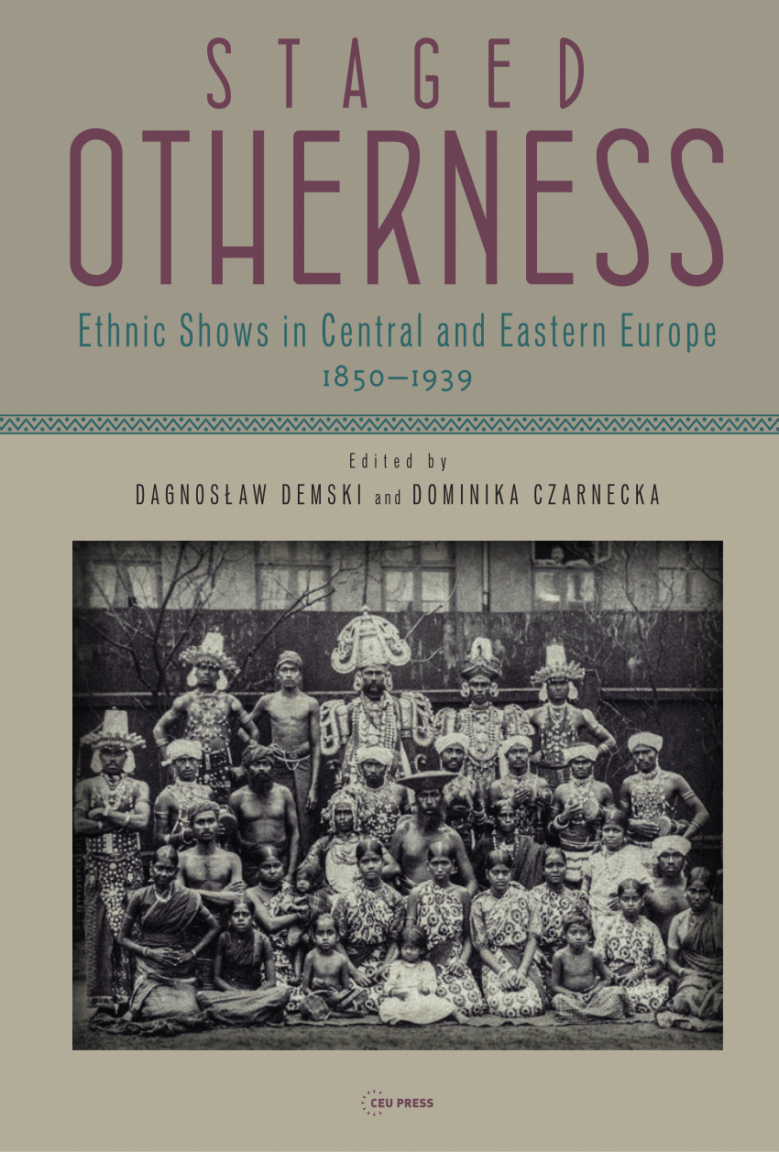
Notes:
Polish Academy of Sciences - Centre for Ethnology and Modern Anthropology (cultural anthropologist)

Slide 3
BLACK FEMALE BODIES AND THE „WHITE“ VIEW
-Anthropological article
-Studies of human exhibitions from the end of the 19th century
-Focus on the Polish territory in the late partition period
-Presenting black women in Warsaw, Cracow and Poznan
-Topics of savagery, sexualization and racialization of the Others´ female bodies
-The idea of construing of the view
Notes:
Aim to examine strategies of presenting Black African women to the Polish audiences

Slide 4
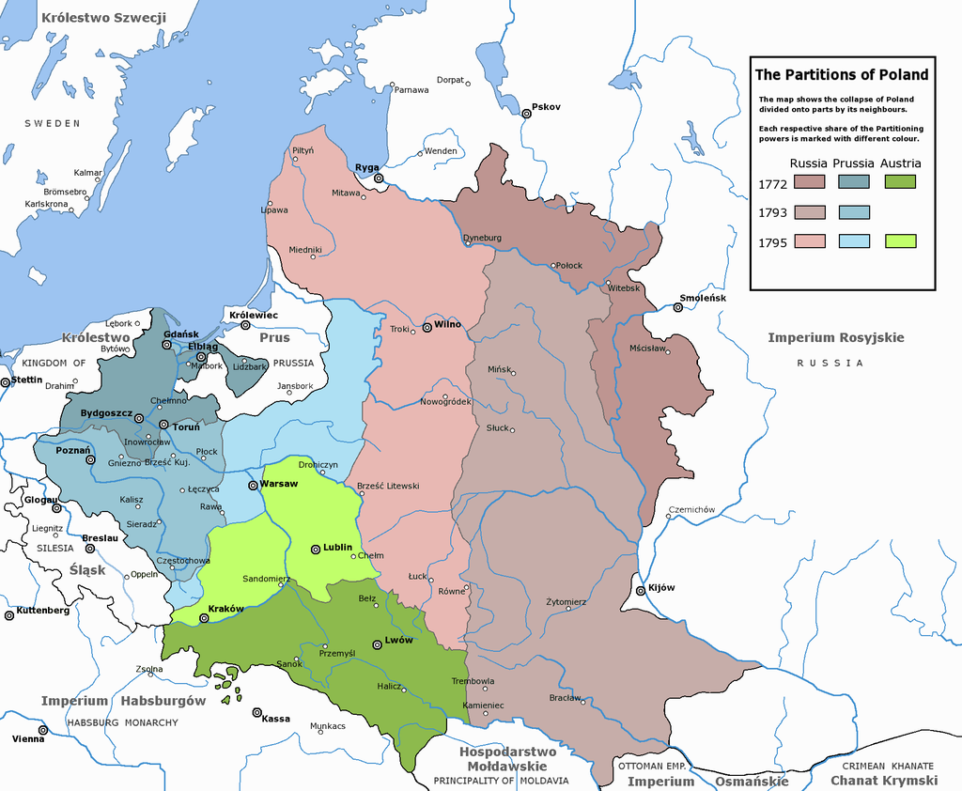
Notes:
The Partitions of Poland^{[a]} were three partitions of the Polish–Lithuanian Commonwealth that took place toward the end of the 18th century and ended the existence of the state, resulting in the elimination of sovereign Poland and Lithuania for 123 years. The partitions were conducted by the Habsburg monarchy, the Kingdom of Prussia, and the Russian Empire, which divided up the Commonwealth lands among themselves progressively in the process of territorial seizures and annexations.

Slide 5
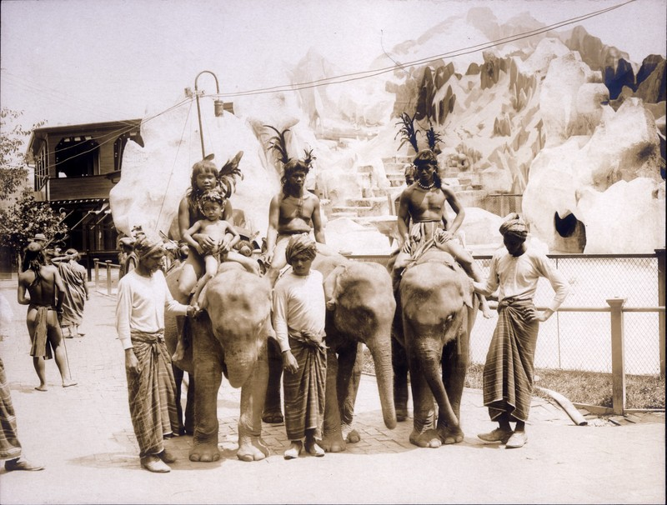
ETHNOGRAPHIC SHOWS
Living ethnological exhibitions, very popular in late 19th century
1880s and 1890s
Phenomenon of Otherness (the spectacle of Otherness)
Part of the overall boom of multiform varieties of public shows based on live presence of people of non-European origin occurring in late 19th and early 20th century in Europe and US
New medium of popular culture related to the development of entertainment business
Ethnographic shows as a way of entrepreneurship and competition between their organizers – “ethnographic enterprise”
Construction of distant “words” in European cities as objects for visual consumption of the masses
Emphasize on unusuality and bizarreness as an answer to the public´s desire to be entertained
Notes:
Vienna 1873 (400 000+ spectators), Moscow, Riga, Prague, German cities
Otherness was a part of the then mass culture
Unprecedented mobility and exchangeability affecting the act of viewing and seeing
In 18th such show of otherness were exclusive (royal families, aristocracy), in 19th century the phenomenon became much more widespread
Changed demand for public entertainment
Live encounter between masses and nnon-Westerners

Slide 6
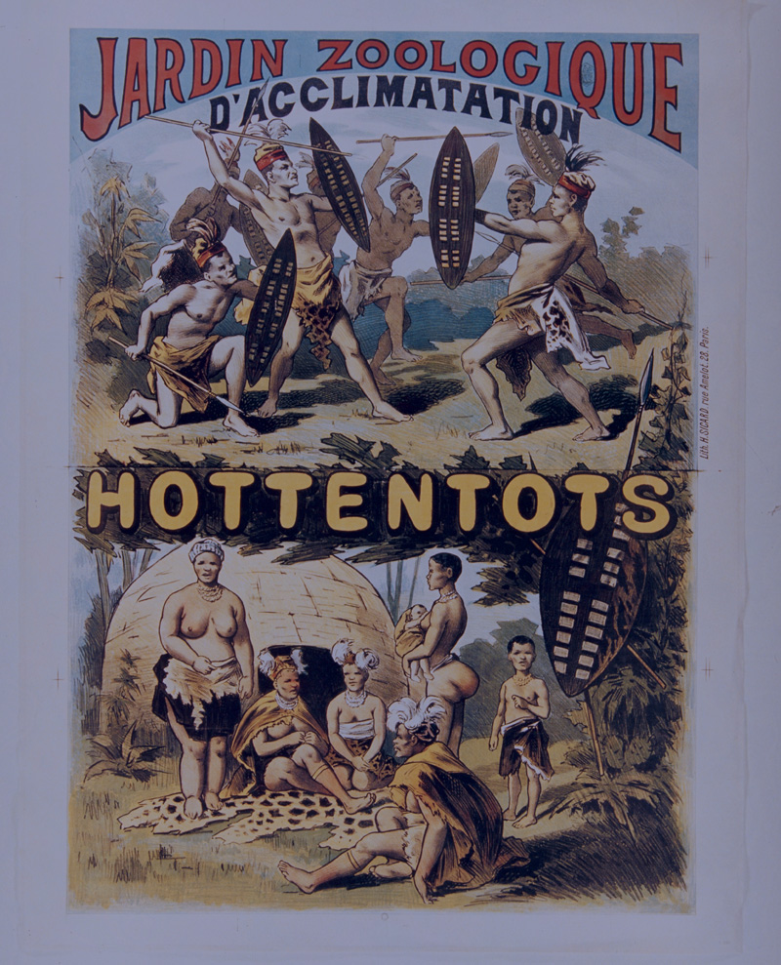
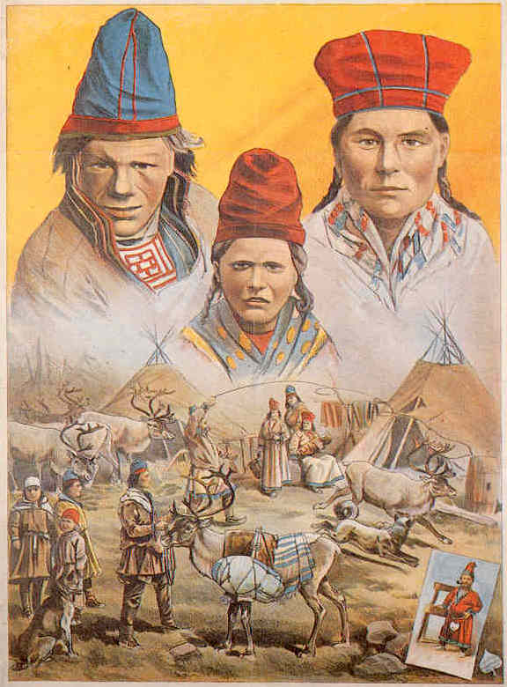

Slide 7
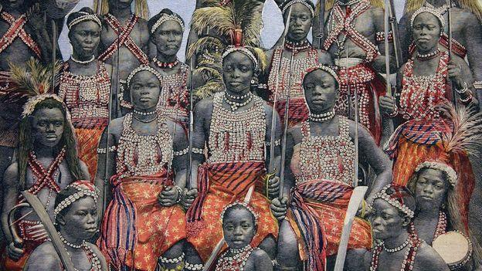
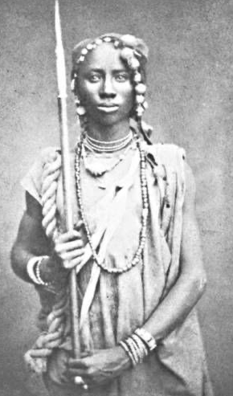
DAHOMEY SHOWS
Popular in 1890s
Related to the myth of Amazons of Dahomey, created by the French colonial troops
Connected to the Franco-Dahomean Wars (1890, 1892-1894)
Dahomey people exhibited in European (and American) cities during these wars
African women warriors as a key image of the shows
Performances including singing, dancing, drum playing, gymnastics, rifle shooting, fencing or fighting
Women equipped with weapons, wearing leather diadems, snug bodices, adorned with cowries
Education and informative value emphasized as a justification of such shows
Entertainment remained a fundamental function
Notes:
Connection to colonialism – “symbol of defeat of Darkest Africa by colonizing West”
Appearance of the women bore little resemblance to actual Amazons – the emphasis was on exposing a black female body in order to make show more attractive
There were no actual Amazons in the troupes
although men were also present in the Dahomean groups

Slide 8
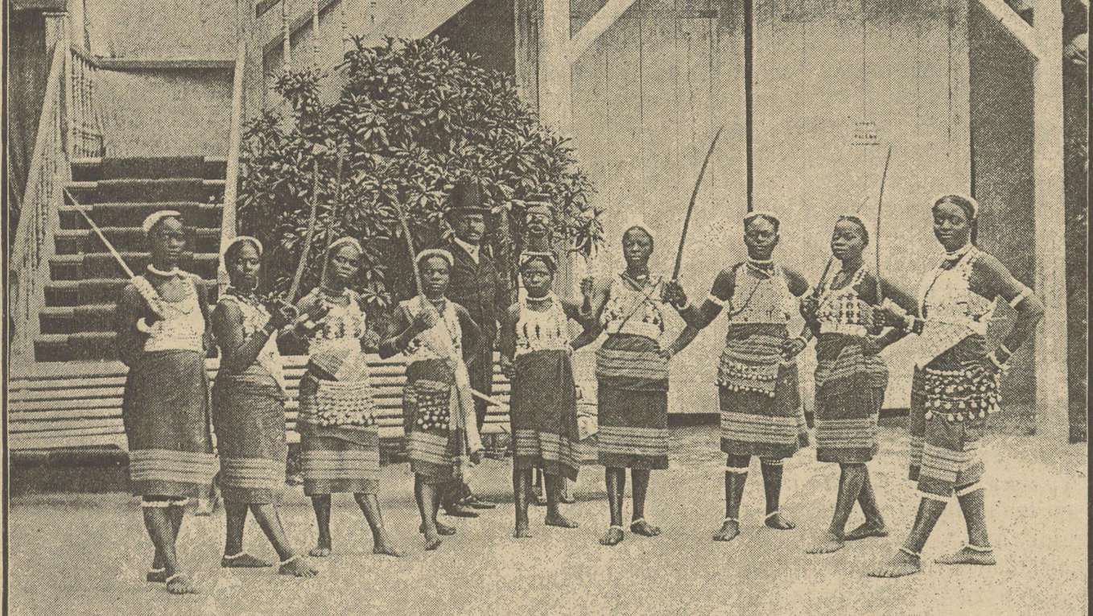
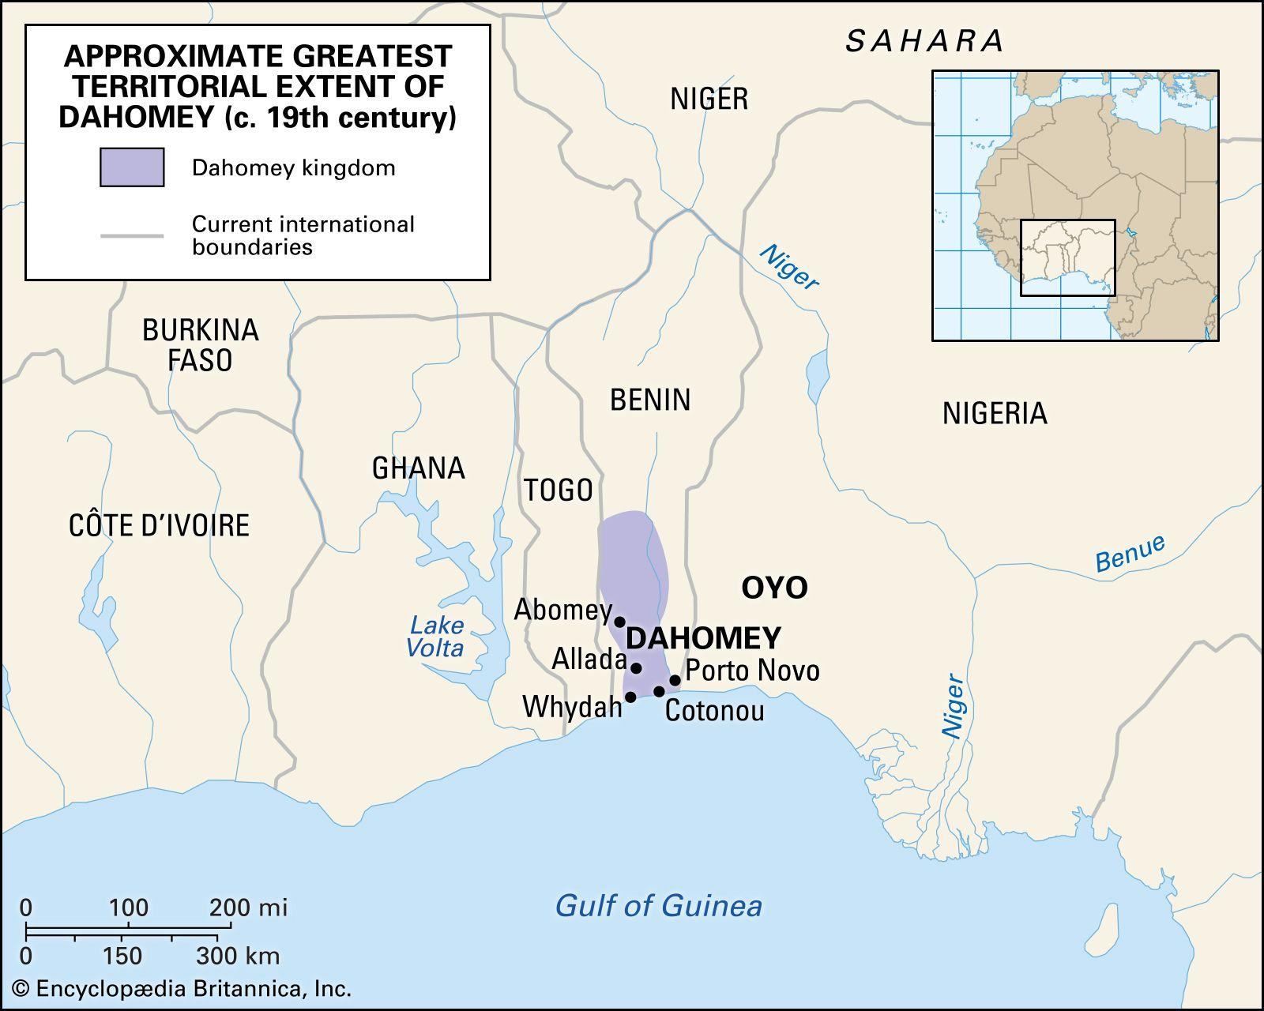
DAHOMEY SHOWS IN EUROPE
Riga June1889
Warsaw June-July1889 (Russian Poland)
Lublin July 1889
Poznań June-July1892 (Austrian Poland)
Cracow July 1892 (Prussian Poland)
Budapest August 1892
Vienna August 1892, February 1897
Prague September 1892, August 1898
Brno July 1898
Breslau 1898/1899
Moscow April 1901

Slide 9
POLISH SHOWS
Warsaw (Russia), Cracow (Austria), Poznań (Prussia)
Research on press commenting the shows (main source of information)
Dahomey shows reflected in local press through satirical poems (Amazonki, Konferencja z Dohomejczykiem)
Prevailing ideas of “savage Africa”, but also sexual undertones with plenty of racial gender stereotypes presented in the press commentaries
Cracow and Poznań shows were part of a two-year European tour
Notes:
The author considers press a way how people were educated about non-Europeans before meeting them
Press as a primarily political tool (because of the partitions)
Tours organized by enterpreneurs!

Slide 10
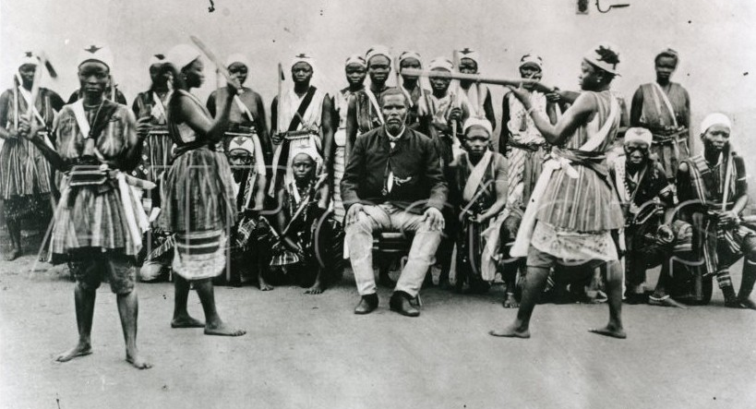
WARSAW (RUSSIAN POLAND)
June-July1889
Area of the summer Circus in the Swiss Valley (Dolina Szwajcarska)
The city hosted several exotic Others from different parts of the world (Ashanti people, Arabs, Native Americans, the Sinhalese from Ceylon etc.)
Street parades preceding the shows - a self-advertising strategy
Notes:
A funeral of one of the member of the troupe – taken as another unusual attraction – an extreme number of spectators followed a carriage with the coffin

Slide 11
BLACK FEMALE BODIES AND THE “WHITE GAZE”
Numerous taboos of 19th century concerning nudity, body exposure, touching and controlling one´s body
Contradiction between the official “chaste and prude” official sphere and an unofficial one, where “debauchery overpowered prudery”
African women often reduced to the role of mere sexual objects – sexuality was at least a crucial component of the displays of the Others
African women from Dahomey were not considered beautiful, as they belonged to a “degenerated race”
Gaze of the black female body was extremely “white” and male centric
Notes:
Black female bodies were exposed to the white audience
European beauty norms reaffirming the racial hierarchy with ideal Nordic whiteness on the top – Asians were higher than Africans
Paradoxically high interest in the naked and semi-naked bodies
Advertisements and posters focused solely on presentation of female bodies
It was acceptable, since it assumed inferiority of “uncivilized and primitive” cultures, which conformed to some other moral norms from the European ones
Dahomey shows as a possible way of displaying naked bodies in a legitimized manner - Semi-nudity of “savages” based on “scientific and informational reasons”
Literal sexual and physical contact was a common practice behind the Scenes (Dahomeans with white men) - On the other hand, African women allowed audiences to touch them in exchange for gifts

Slide 12
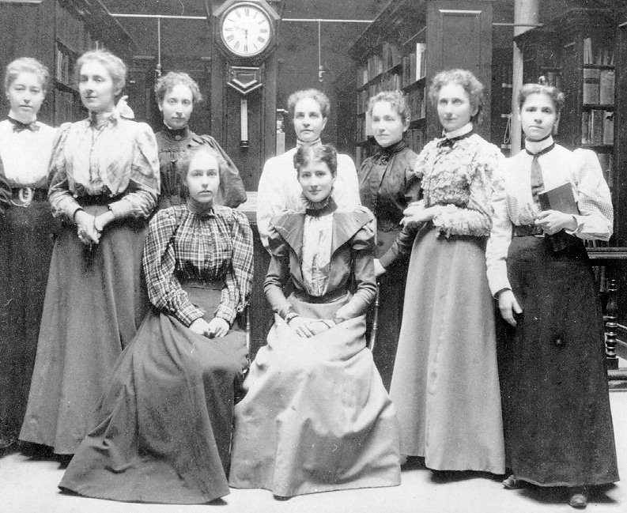

Slide 13
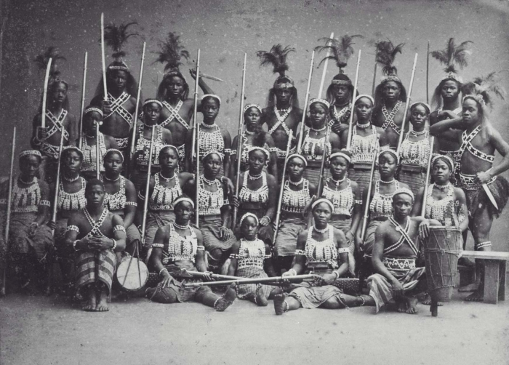
IDEA OF “SAVAGE AFRICA”
African people considered to be extremely sensual, sexual, primitive and savage beings in 1890s Europe
Connection to the contemporary moral hierarchy – self-disciplined Europeans were “on the top of civilization and the sensual-sexual primitives at the bottom”
Even among “the Others” was a hierarchy: some exotic groups were considered more “civilized” than others
Amazons were exhibited to the European audience in manners that evoked fear and fascination via the concept of savage
Aim to demonstrate achievements of civilizing mission
Notes:
Research papers of the time represent and confirms this convictions
Mid 19th century was associated with pornography quickly becoming a pillar of modern visual imagination
Those races, who did not fit into contemporary view of civilized people were deliberately portrayed as savages

Slide 14
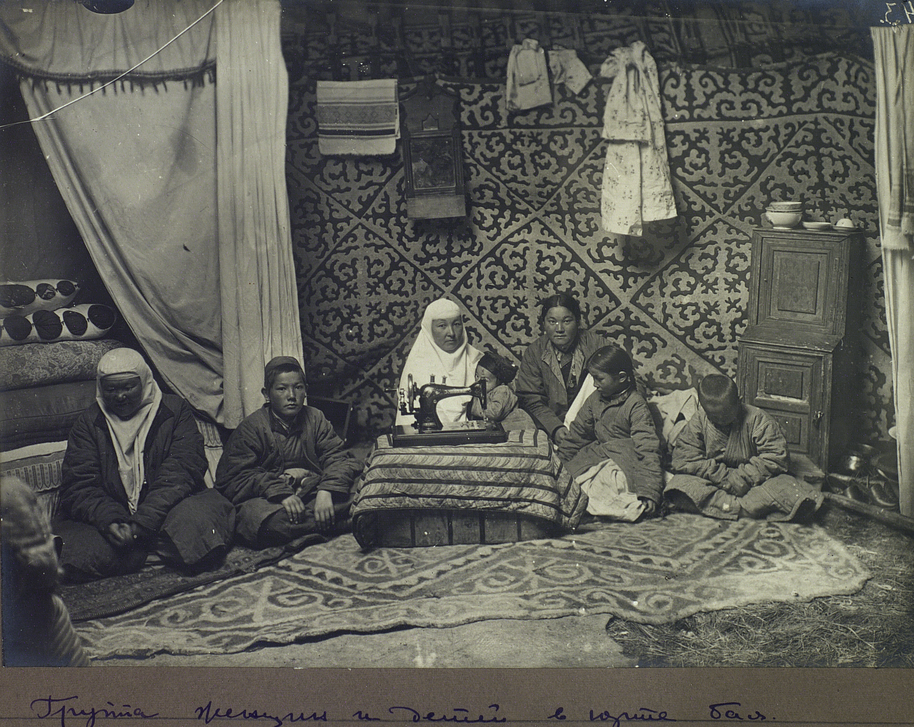
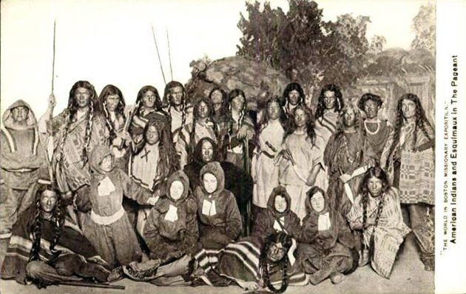

Slide 15
Noble savage - impersonating positive qualities of the wild men
Ignoble savage - all negative qualities - bestiality, inability to control desire and sexual drive, inclination towards unjustified violence, stupidity, moral inferiority
In the contemporary Polish press Dahomeans were presented as an example of African tribe who, despite all the efforts undertaken by Europeans, resisted civilizing practices:
“Their savage nature has not yet been mitigated by the influence of civilization, which is rather unsuitable for this Negro country located on the Slave coast” (Dahomejczycy, Tygodnik Ilustrowany 13 July 19, no. 341, p. 27)
Notes:
Dahomeans perceived as living signs of savagery

Slide 16
Dahomey women portrayed as armed, brave belligerent warriors became icons of “savage Africa” in the local imagination
Presented in military uniforms and armed with rifles or long swords or sabers in their hands, standing in militaristic poses prepared for a battle or holding a loot proving their victory, casting fierce gazes towards their observers
“...The archers are most slender and youngest, apart from archery they are skilled in dancing. Their legs are tattooed up to their knees, their backs are also covered with tattoos. … Not only can this female army be called belligerent, but they are also extremely ferocious - committed to their king in body and soul” (Wędrowiec 5 July 1889, no. 27, p. 315)
Notes:
“They are a savage bloodthirsty nation who, if their king was not afraid of English, would gladly proceed with an excruciating slaughter, many of the sort of which took place in the Dahomey state”.

Slide 17
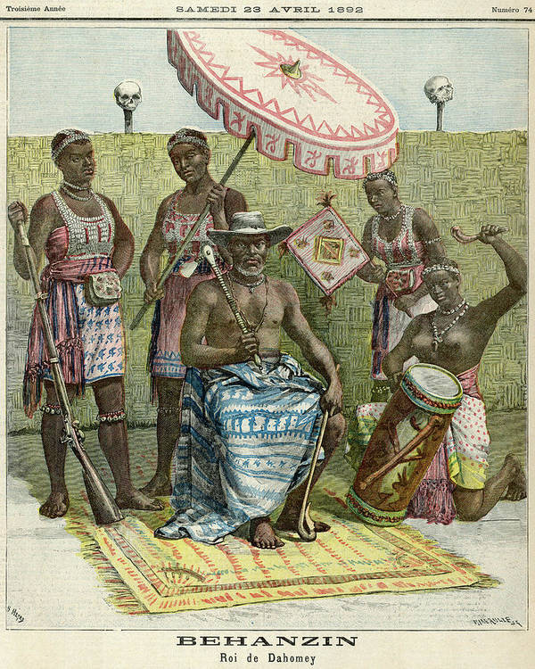
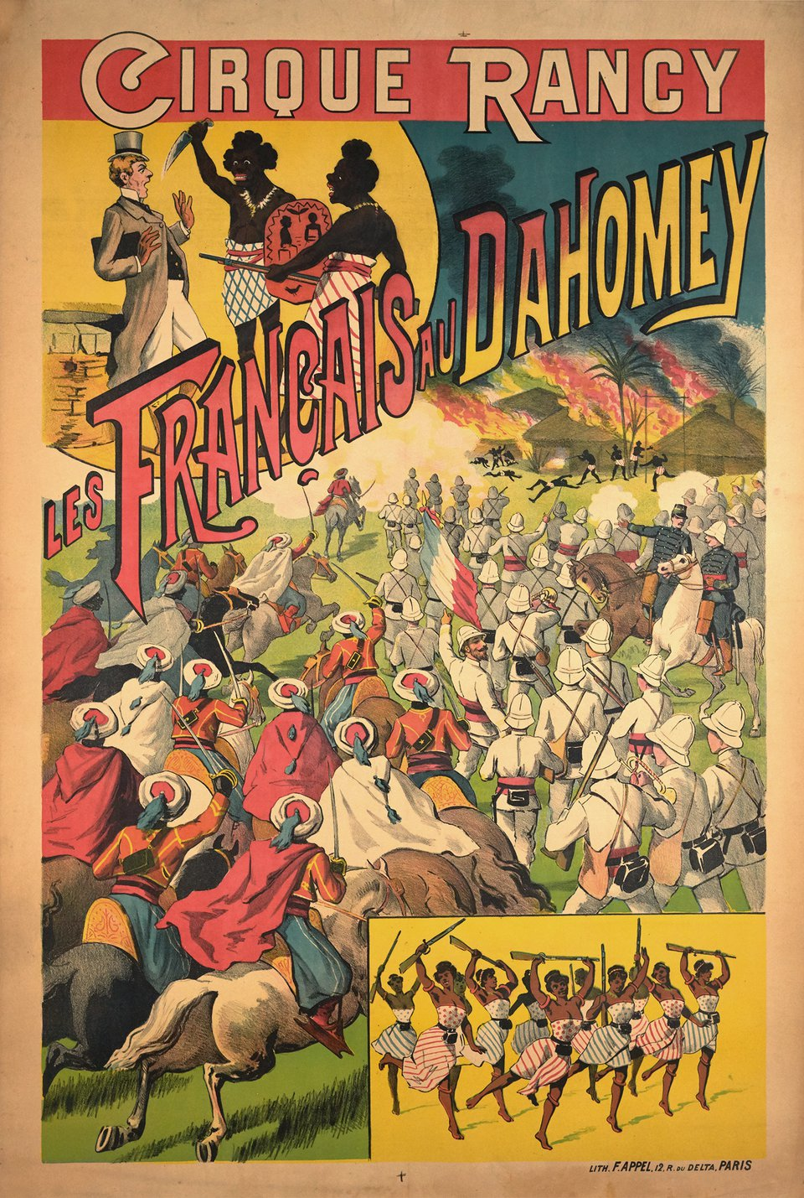

Slide 18
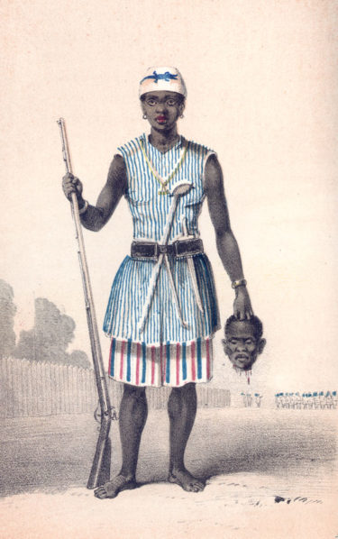
“Apart from the regular army the king possesses five thousand national guards, consisting of female soldiers. They are recruited among those in the obligatory, two-year military service, which in this strange nation involves 20-year-old girls. … They are also commanded by women. … Their uniform consists of a piece of fabric worn like a short skirt, accompanied by a leather armor covering their breasts and trimmed with seashells, which are used as circulating coins in the Dahomey state, and a white cap. Their banners show skulls. One can be impressed by their finely styled curly hair.” (Czas 7 July 1892, p. 3)
The sexual appeal of Black female bodies was associated not only with exoticism and eroticism, but also with strength, musculature and warcraft
Such elements were undesirable in the context of viewing white female bodies
Notes:
Amazon with decapitated man head with expressive gaze, firm and dominant standing pose
-aim to depict bravery of African woman warrior who defeated a man – reversal of gender roles –female body taking place of the male body

Slide 19
PROCESS OF CONSTRUING VIEWS
Linked with the contemporary beauty norms behind the physical act of looking
Racial, gender and sexual inequalities
Importance of live presence of non-European people – live encounter between the viewers and the Others being exhibited
Visual appeal of the ethnographic included wide range of devices – posters, postcards, leaflets, articles or reports
Specific act of seeing
Exhibited body becoming objectified
Press offering a peculiar instruction for how to look, what to feel and experience while watching the live shows
Act of touching through viewing based on transposing touch to the sphere of vision
Notes:
Strong racial discourse of the time well established and rooted in then academic circles reflected through the views of expanding mass culture
People of non-European were exposed to the gaze of Europeans and were not treated as subjects, but always as objects of information or desire on a basis of their physical appearance
Both of the bodies are affected –this of the viewed and this of the viewer as well

Slide 20
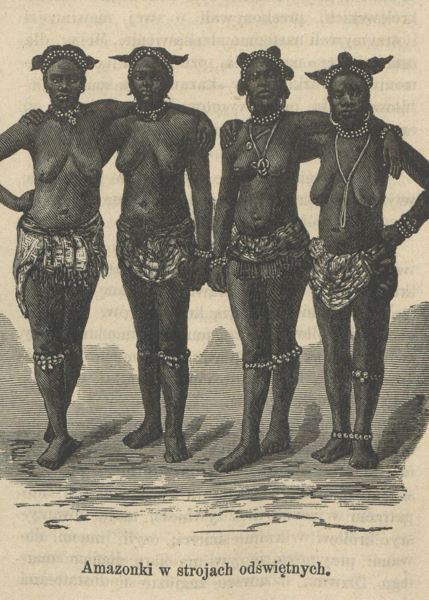
“The Dahomey marriage is based on trading; they have no idea of love, even maternal love does not exist among them. Thus, the life of Dahomey women is miserable. An average Dahomey man has between two and ten wives, based on wealth, with the king married to between three and four thousand wives!” (Wędrowiec i5 July 1889, p. 315)
Notes:
Discursive shift between thee educational and informative sphere and ethical and moral judgements
Such images aimed? Helped to arouse desires and fantasies of the white male viewers

Slide 21
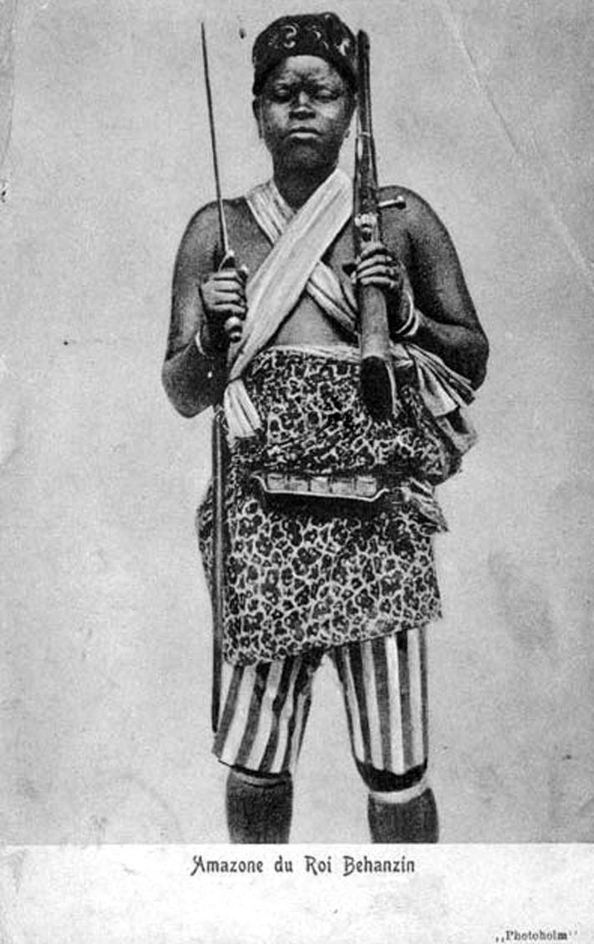
The presentation of Dahomey black bodies was aimed to affect the audience not only through emotions, sensual arousal and racial dynamics, but also by questioning stereotypical female social roles and sexual transgression
Observed object becomes entirely submissive to the viewer´s gaze – certain power relation is established and reinforced
Spectacle of foreign corporeality which was impossible to meet the beauty norms of the white gaze
Project of modern era based on the supremacy of sight over other senses
Notes:
Challenging established boundaries and destabilizing normative concepts of sexuality, gender and power
Ethnographic shows appropriated the bodies of the Others as it was solely corporeality – body surface became the object of experience placed in the sphere of public visibility
Author emphasizes, that ethnographic shows should be analyzed in context of transformations of the modern era happening at the end of the 19th century
Including transformations of the visual culture
These views were very expressive
Analysis of this phenomenon provides much more information about the spectactors´view than about the peoples being displayed in the shows
Participants of women´s emancipation movement era were often referred to as Amazons

Slide 22
