Slide 1
Laura Mulvey «Visual Pleasure and Narrative Cinema» and how it is related to art history
Arina Muravjova
UČO:530268

Slide 2
Psychoanalitic theory as political weapon
Phallocentrism – a doctrine or belief centered on the phallus, especially a belief in the superiority of the male sex.
Zigmund Freud psychoanalitical teories
"Girls hold their mother responsible for their lack of a penis and do not forgive her for their being thus put at a disadvantage," Freud suggested (1933).
In symbollic order women in cinematography

Slide 3
Visual pleasure in cinema
Scopophilia - the obtaining of sexual pleasure by looking at nude bodies, erotic photographs, etc. (and also being looked at)
Cinematography makes auditory seperate from the world which is seen in the screen that makes them play in voyeuristic fantasy

Slide 4
Scopophilia in its narcissistic aspect -> human form is in the center of mainstream cinema
The moment when children recognizes themselves in a mirror – crucial aspect in developing ego
Cinema gives a loss of ego and at the same time reinforces the ego
In mirror phase child recognizes reflection in mirror as an ideal ego

Slide 5
The first one implies seperation with sexualized object, the other aspect requires identification with the image
First is sexual instinct sedond ego libido
Cinematogrpahy has developed fantasy where this two aspects occures in one fantasy world where they have a meaning within symbols and language.

Slide 6
Male gaze
Women -> passive sexual object
Men -> active, the one who objectifies women
Women always displayed as desirable for men, female character is an element of narrative but it tends to work against the story line, it pauses it in erotic contemplation
Women character displays fears and desires of a hero

Slide 7
Women character functions as:
erotic object for characters within story line,
erotic object for auditorium.
It is emphasied by a work of camera (that is focused on body parts or face)

Slide 8
Male as a creator of fantasy
Male characters are not objectified, they are creators of fantazies.
Spectators are identifing themselves with male characters
Male pratagonists controls the sceen, the story and the way how women are percieved
Their characteristics are differant than the erotic object has, they are more idealized, complete
Ideal ego

Slide 9
Symbolicly male protoganist always gains power over female character and then posess her.
The presence of women evoke castration anxiety that can be escaped by:
Solving womens mystery,
Devaluation (saving or punishing)
Or over-valuation (turning into fetish)

Slide 10
Hitchcock and Sternberg examples
Voyarism (associated with sadism) – fits in the story line (victory/defeat, implies development of characters)
In Hitchcock movies male protagonists sees the same as spectators.
His characters work in story line in symbolic order and the law (Voyarism is hidden by ideaological corectness and morals)
Objectifies women and then takes back power by establishing legal rights and establishing guilt of women (fear of castration)
Camera works as protagonist point of view
Fetishised socophilia - exists outside the story line because it is focused only on the looks
In Sternberg movies male protagonist is broken in favor of the image in direct erotic rapport with spectator.

Slide 11
How Laura Mulvey essay relates to art history?
High culture as a creator of values and ideology
Visual representation of genders: social practices, iconography, language codes.
Women as visual sign but not signifier
Phallocentrism and male gaze
Ideology – systemati heararchy of meanings

Slide 12
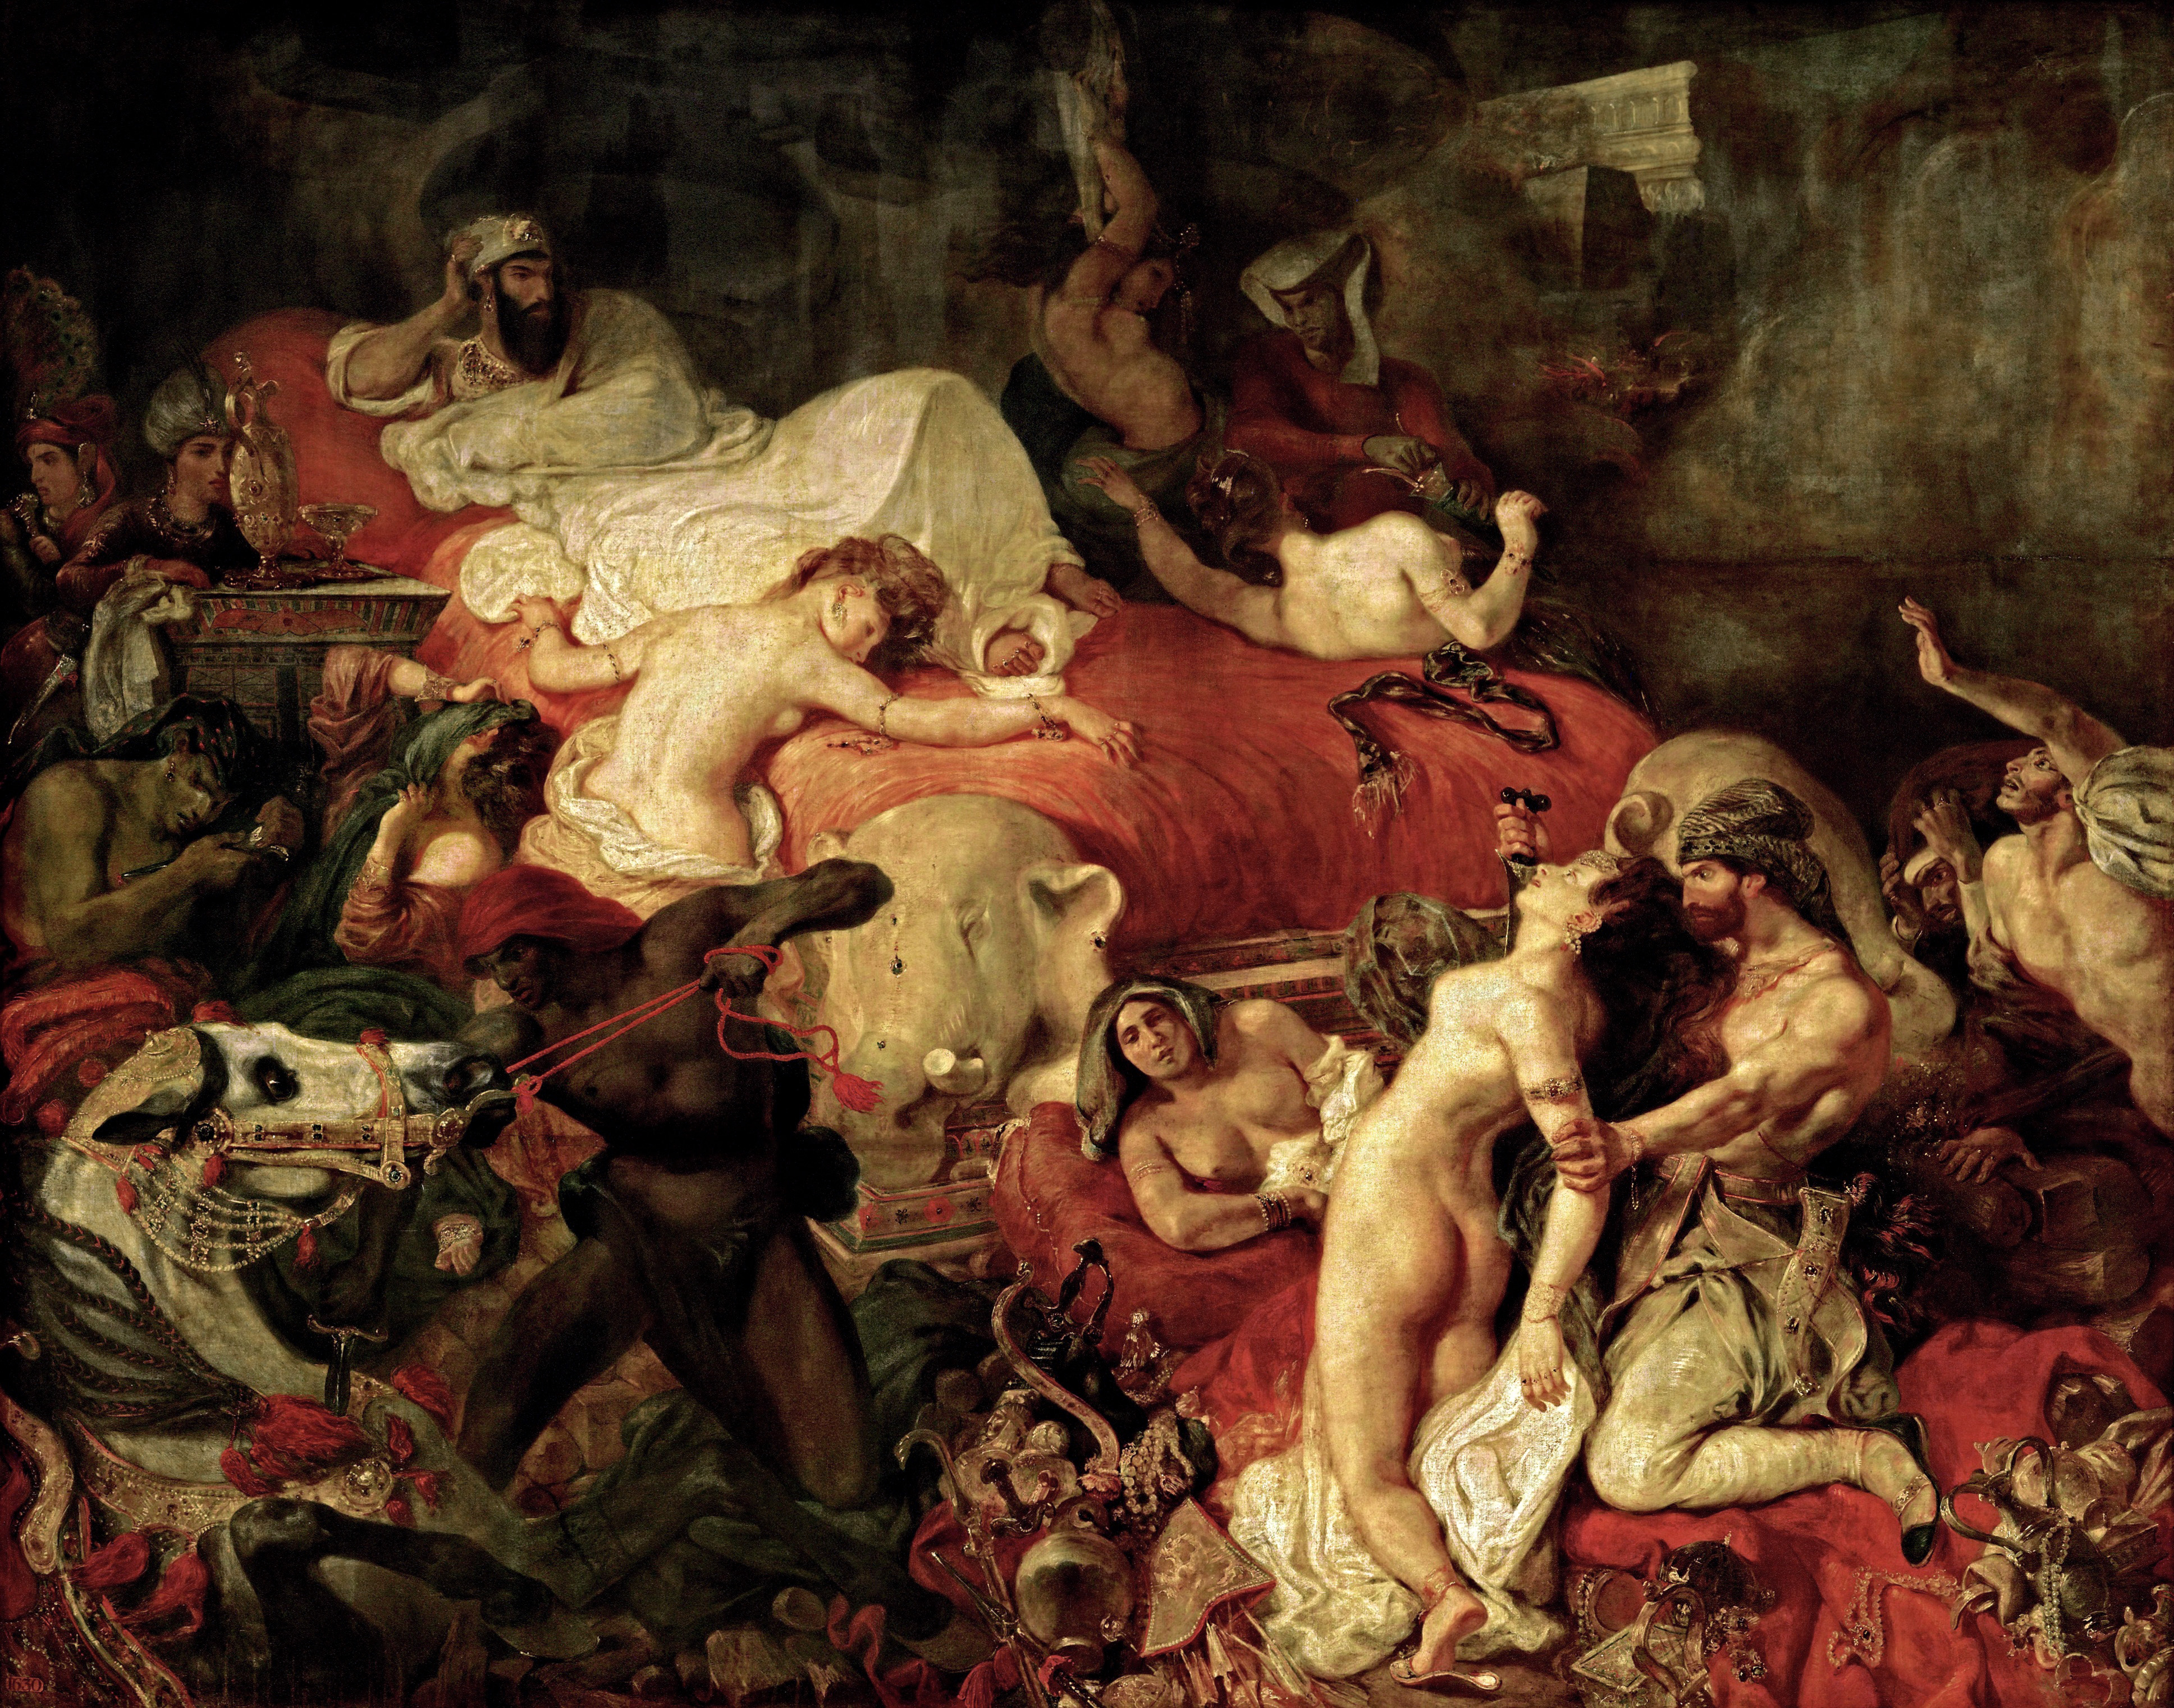
Sadism and Castration anxiety
Delacroix’s «Death of Sardanapalus» - the sadistic desire to have limitless power over women body
Assumption that men are naturally “ entitled” to desire, to possess, and to control the bodies of women are not fantasies of Delacroix but this concept lives in social context

Slide 13
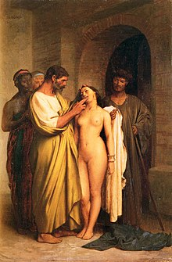
Near Eastern or Women, Art, and Power II Classical themes, such as Jean-Léon Gérôme’s «Oriental Slave Market»
Artists had availability of studio models not only for professional but also sexual needs

Slide 14
Male gaze in art histroy
Diego Velazquez «The toilet of Venus» - triggering the desire of posession

Slide 15
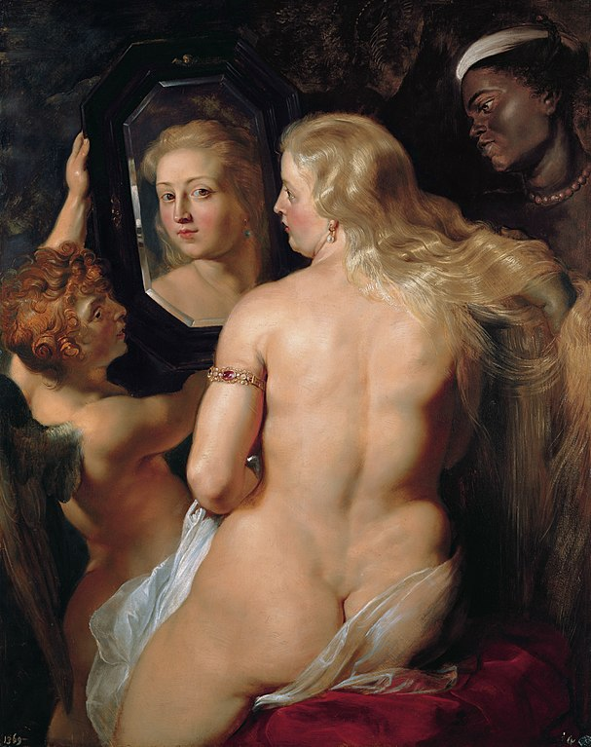
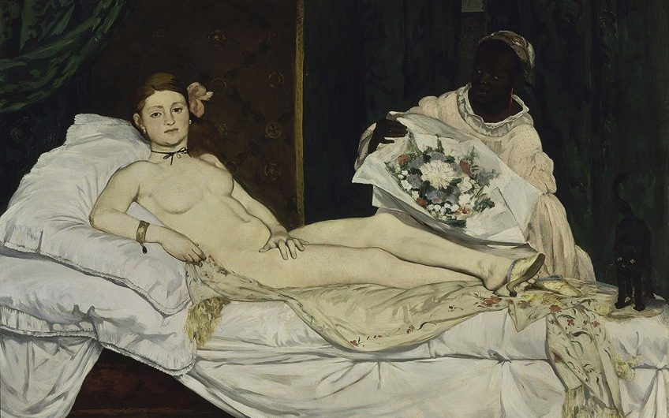
Sexual women as a prostitue in Edouard Manet «Olympia» - makes spectator uncomfortable
Male gaze in Rubens «Venus Looking in a Mirror» - spectators envolvment

Slide 16
Sources
Edward Snow (1989). Theorizing the Male Gaze: Some Problems. Accessible: : http://www.jstor.org/stable/2928465
Laura Mulvey (1975). Visual Pleasure and Narrative Cinema.
Gisselda Pollock (1988). Vision and Difference Feminism, femininity and the histories of art.

