Slide 1
THE MEANINGS OF ‘STYLE’ Robert Bagley ‘Style’

Slide 2
Style of the object is a certain ensemble of its physical properties

Slide 3
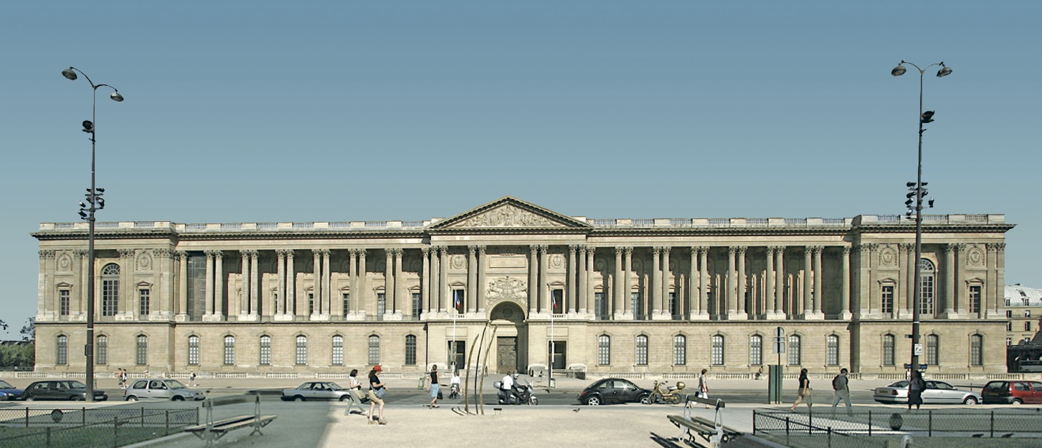
East Front of the Louvre

Slide 4
It belongs to the classical style

Slide 5
Its style is French

Slide 6
The East front is Baroque

Slide 7
It is the style of Perrault

Slide 8
History of bronzes

Slide 9
“It is a widely held belief that art expresses its time, and that meaningful parallels of the same period can be found between the art and the culture of the same period can be found.” In fact, he says, the style of a work “corresponds to no given objective reality supplied by the time or its character or spirit.”

Slide 10
Thank you for the attention

