Slide 1
Umění videa
  VT ≠ TV
Tři začátky umění videa
1963: Nam June Paik: Exposition of Music – Electronic Television, Galerie Parnas, Wuppertal, Německo.
1965: Andy Warhol: Outer and Inner Space. /videokamera Norelco /- umělecké nahrávky na party v NY, 29. září.
1965: Nam June Paik: Electronic Video Recorder, Cafe Au Go Go, New York.

Slide 2
Umění videa
  VT ≠ TV
TV estetika vs. video estetika
Peter Weibel a jeho atributy videoartu a „videologie“ in: R. Frieling: VT ≠ TV – The Beginnings of Video Art
http://mediaartnet.org/source-text/63/

Slide 3
Umění videa
  VT ≠ TV
«On the Philosophy of VT and VTR» he listed these attributes as follows: 1. Synthetics – the entire range of electronic image manipulation, 2. Transformation – the «psychedelic» shift from concrete, interpretable images to abstract shapes, 3. Self-reference, 4. Instant time – the components of a two-way communications system (closed-circuit, video feedback), and 5. Box – the monitor deployed by TV and VTR and representing for Weibel the switch to a machine system as opposed to the projection system used by cinema. This initial view of the monitor as a media-specific essential of video art has not unconditionally survived up to the present day. While Paik enthusiastically saw his dream of an electronic Sistine Chapel approaching realization when the first video projectors were launched, both Wulf Herzogenrath and Peter Weibel emphatically assigned the «box» (the TV set or monitor) to the grammar of video, or «videology».(5)
By way of generalization, however, Weibel etymologically revealed the inherent notion of art in video technology: «video art is always epistemic, the Greek «techne» means «artefact, art». from ‹eidos› (image) to ‹idos› (idea), even to ‹idein›. from eidology to idology and to ideology. idotechne (the art of the image) is video technique is video art, that is the art of seeing and knowing.»(6)
Cit.z: Rudolf Frieling: «VT ≠ TV – The Beginnings of Video Art»
http://www.mediaartnet.org/source-text/63/

Slide 4
Umění videa
  VT ≠ TV
video-instalace:
Peter Weibel:
  Audience Exhibited: http://www.mediaartnet.org/works/audience-exhibited/
  Crucification of Identity:
  http://www.mediaartnet.org/works/krucifikation/
  http://www.mediaartnet.org/works/beobachtung/
Valie Export:
  Autohypnosis:
  http://www.mediaartnet.org/works/autohypnose/
  Ulrike Rosenbach: http://www.mediaartnet.org/works/glauben-sie-nicht/
  Nan Hoover: http://www.mediaartnet.org/works/impressions/

Slide 5
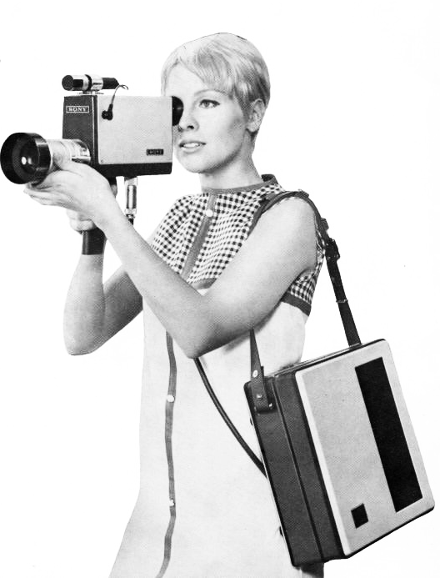
Umění videa
  VT ≠ TV
Klíčové nástroje umění videa
Zpětná vazba (feedback)
Vasulkas: Calligram, 1970.
http://www.ubu.com/film/vasulka_calligrams.html
Elektronický syntezátor: Paik/Abe, 1969-1971
http://www.medienkunstnetz.de/works/paik-abe-synthesizer/
Andy Warhol: Outer and Inner Space, 1965
http://www.mediaartnet.org/works/outer-and-inner-space/video/1/
http://www.youtube.com/watch?v=os9yoPyrtFs&feature=related
http://www.youtube.com/watch?v=Xo2RItFeXcM
SONY CV PORTAPACK, 1969

Slide 6
Umění videa
Gary Hill: Happenstance, 1983
http://www.youtube.com/watch?v=AFXLkPAT6dg&feature=related
70s
Témata umění videa:
konceptuální promýšlení kategorií času a prostoru.
užívání těla jako uměleckého materiálu.
ČAS:
Dan Graham: Present Continuous Past, 1974 http://www.youtube.com/watch?v=aLNfUB7JtA4
Dan Graham: Time Delay Room, 1974. http://www.mediaartnet.org/works/time-delay-room/
Valie Export: Time and Countertime, 1973. http://www.mediaartnet.org/works/zeit-und-gegenzeit/
TĚLO:
Bruce Nauman: Walking in an Exaggerated Manner, 1967 – 68 https://www.youtube.com/watch?v=x7DWz_jMtR4
Chris Burden: Shoot, 1971 http://www.ubu.com/film/burden_selected.html
Bruce Neumann: Video Corridor:
http://www.youtube.com/watch?v=VUfwg0bz-Yo&feature=related

