Slide 1
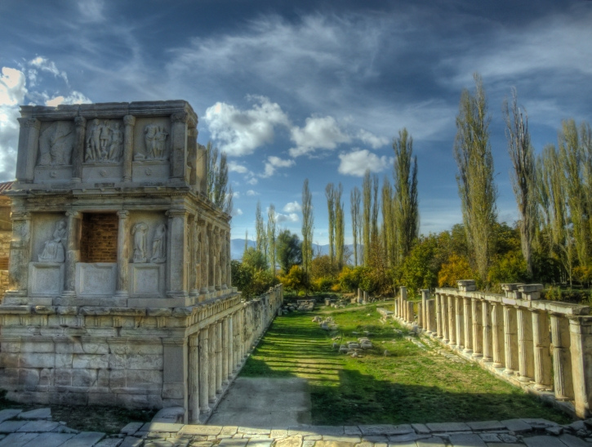
The Buildings and the Images of the Imperial Cult
V Aphrodisias – Sebasteion

Slide 2
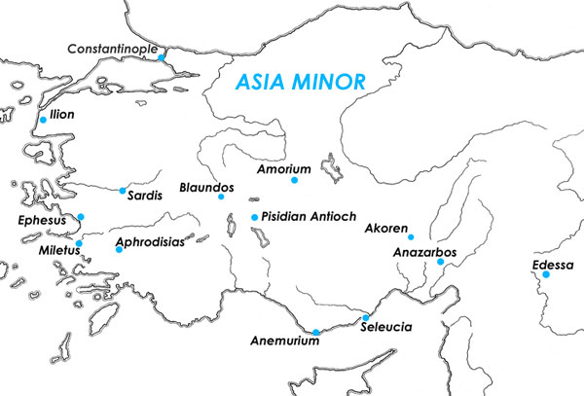
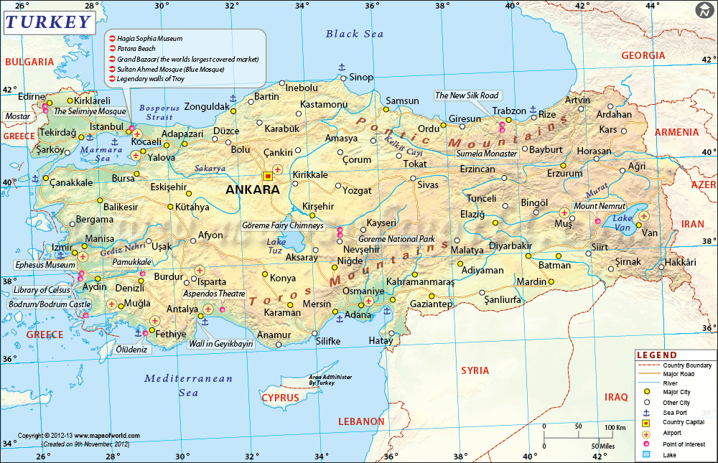
Aphrodisias
south-western Asia Minor, the Maeander river basin, province Caria, 150 kilometers from the Aegean Sea
it is situated at the center of the valley, 35 km up the river Morsynus from its confluence with the Maeander at an elevation 500 m
dominant feature – Kadmos – the source of water
the principal natural resources of the valley are springs, fertile soils, potter´s earth and marble coming from several different quarries
the site has been known since the 18th century – several expeditions – inscriptions documentation (French, Italian, Istanbul Archaeological Museum, Ismir Archaeological Museum)
free and autonomous city within the Roman province of Asia, best known for the Sanctuary of Aphrodite and marble sculptors
relative isolation from the main roads (medieval and modern) – well-preserved
Aphrodisias

Slide 3
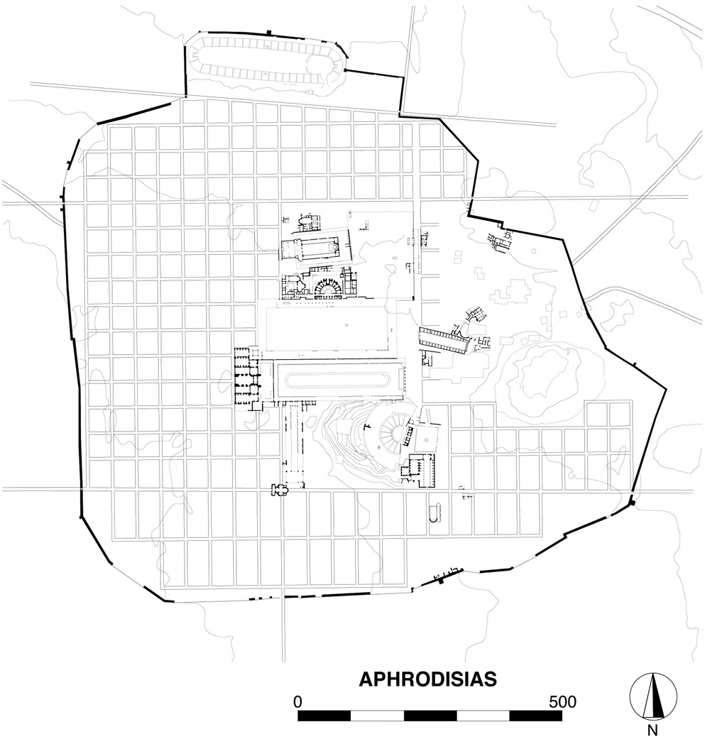
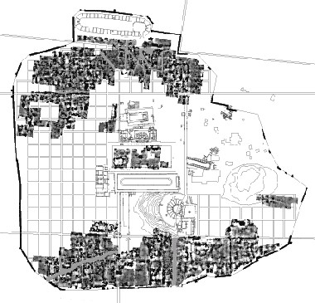
- orthogonal planning – found by geophysics (1995-1998), 800 000 square kilometers, the grid 120x162 Roman feet, streets were 12 feet wide
- medium-sized city, monuments documented in great detail – inscriptions who paid the function, what the honored had done for the community
Greek features: central organization of the public buildings and places (the Agora and its surrounding)
Roman features: rectangular shape of the basic city block
- some of the buildings do not fit the regular grid – four streets, stadium, Sebasteion and the theatre

Slide 4
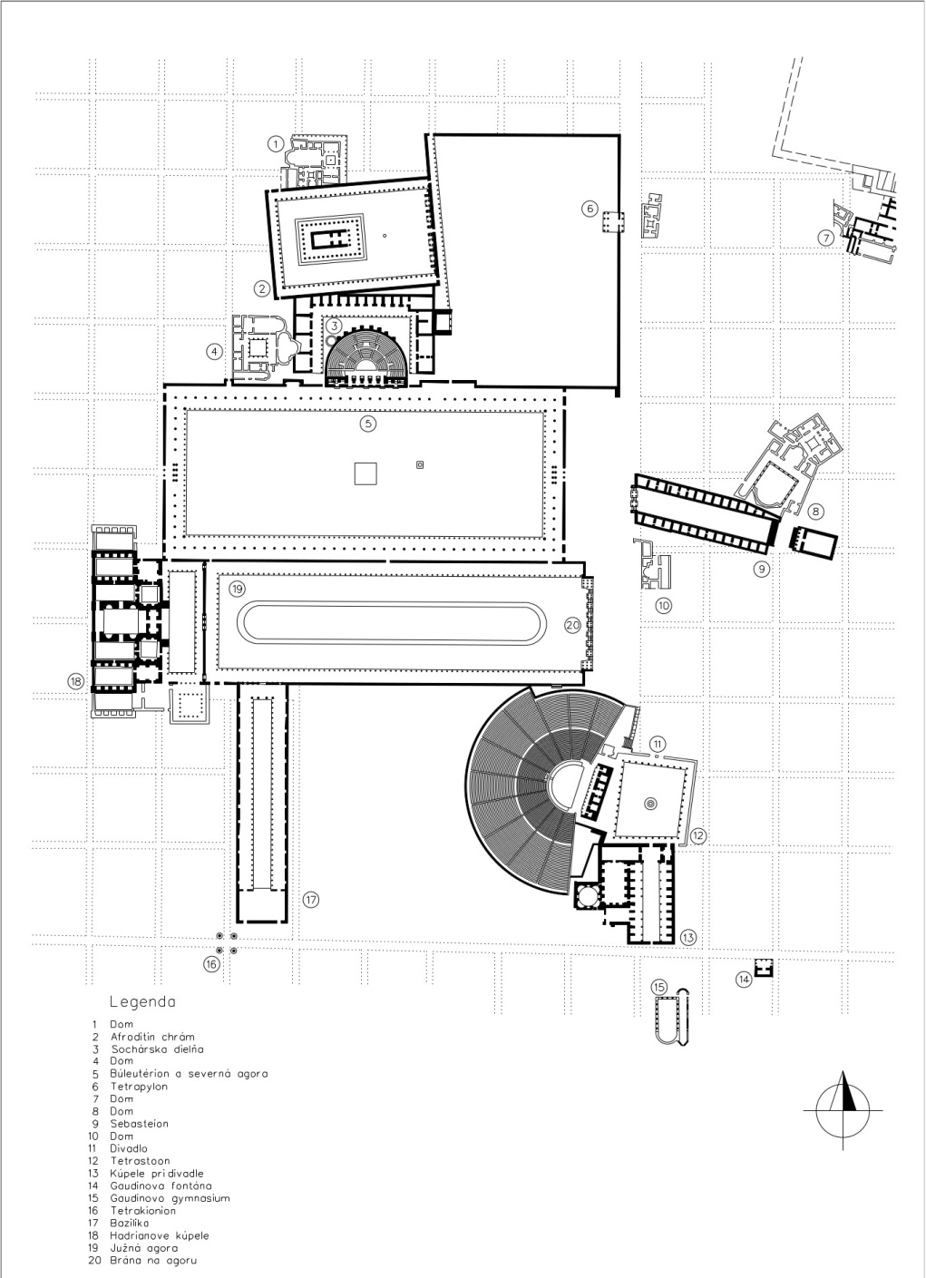
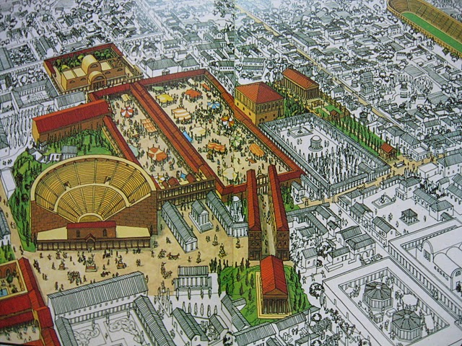

Slide 5
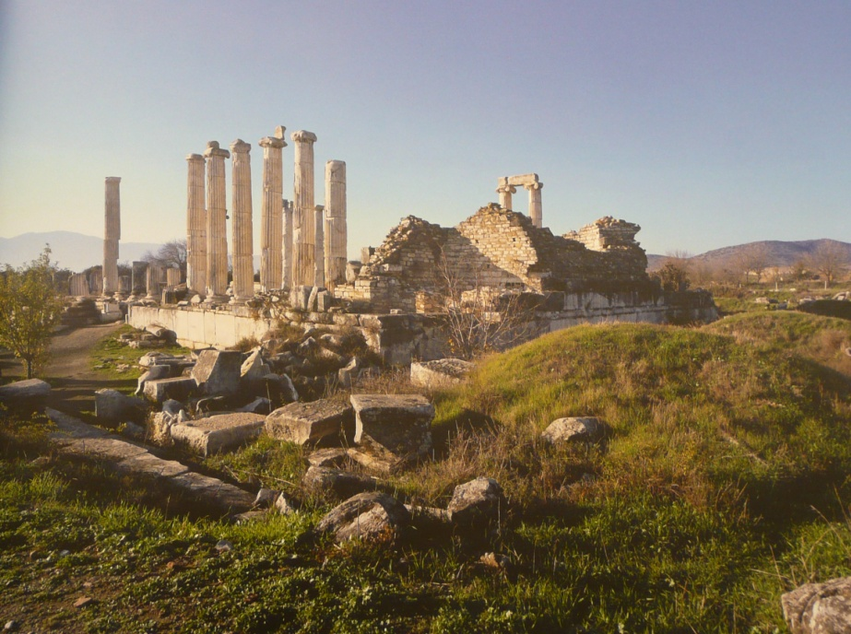
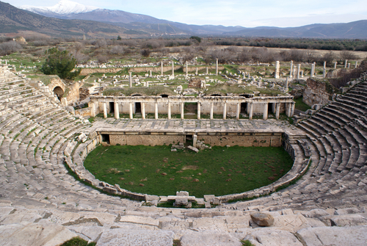
Chronology of the city’s evolution:
a)Earliest occupation: Late Chalcolithic and Early Bronze Age (mid. 5th – 3rd millennium BC), small
agricultural settlement, pottery – fills the gap in Anatolia
b) Small settlement (1200 BC – 2nd century BC) – founding of the city – on the Theatre hill, stray finds, 6th century BC – earliest evidence of the Sanctuary of Aphrodite
c) Hellenistic and Augustan (2nd century BC – late 1st century BC) – founding of the city, intensive urbanization – Seleucid kings
- rectangular grid – equitable distribution of land to new settlers
- late 1st century BC – earliest buildings – houses of the residents
at the conclusion of Roman Civil Wars – extensive building activity, public life: the sanctuary, the Agora, the Theatre, the tomb of Julius Zoiolos

Slide 6
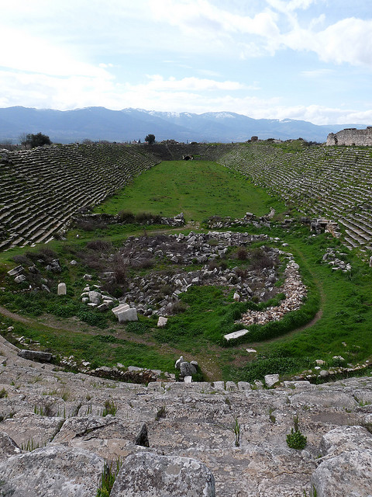
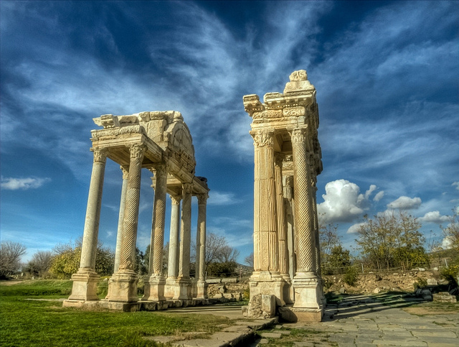
d) Early imperial (1st century AD)
- privileged relations with the Julio-Claudian family, massive urban building – Hellenistic plan, local families – some with the Roman citizenship
New buildings: the Stadium, public square between the Agora and the Theatre, Sebasteion, Civil basilica (Flavian emperors – finished mid. 90s AD)
e) High imperial (100 - 300 AD)
Tetrapylon, W end of S Agora – redesigned – new stoa,
Hadrianic Baths, Agora Gate, Bouleuterion,
the Theatre Baths
Caracalla 212 AD – Roman citizenship to all freeborn
inhabitants, civic activity – inscribed marble sarcophagi

Slide 7
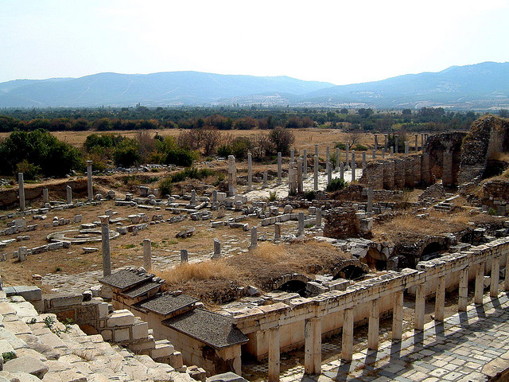
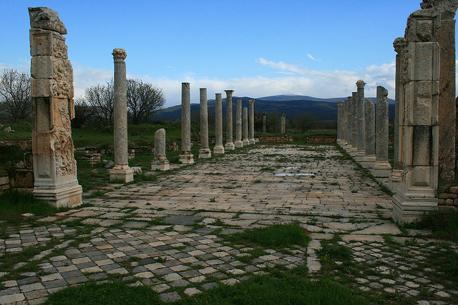
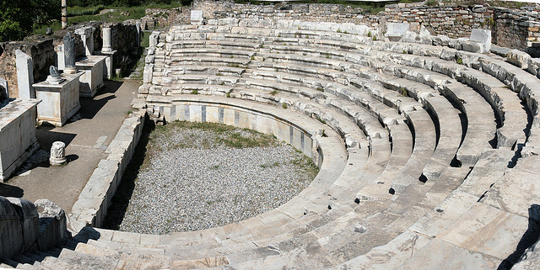

Slide 8
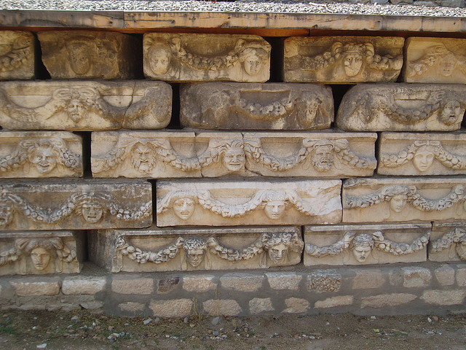
f) Late Antiquity (300 – 600 AD)
Long and prosperous second life, 7th century – urban collapse, abandoned
- reasons: Persian and Arab invasions, failure of the imperial government in Constantinopole
Small settlement around cathedral of St. Michael (the Theatre Hill)
- local notables – spend more on their houses - Atrium house, The North Temenos House, The Bishop’s Palace
- 250 AD – stop to civic buildings, emphasis on maintenance, remodelling for new functions, new building project – City Walls (spolia)
- adaptation of buildings (Stadium – Amphitheatre, The Temple of Aphrodite – Christian Church, Sebasteion – defacing)

Slide 9
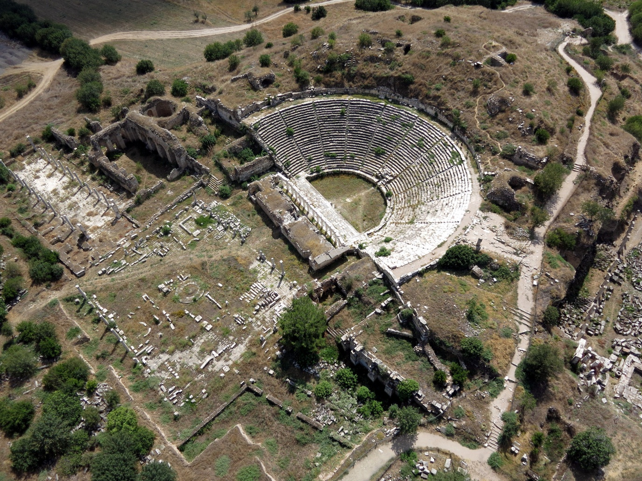
Excavations:
- the site has been know since the 18th century – several expeditions – documentation of its inscriptions
- systematic research: New York University – Kenan Erim, 1961 - 1990
- 60s – high-quality mapping, excavations on the Sanctuary of Aphrodite, theatre, baths, bouleuterion, Christian basilica, odeion, porticus
- 70s – structures in the centre of the city – Sebasteion (1979), basilica, theatre, excavations at the theatre, portico, basilica continued
- 80s - two main projects: Sebasteion, tetrapylon
- 90s – documentation and publication – sculptural decoration, archaeological works of minor extent – the church with three apses
the beginning of the 21st century
– mapping, documentation,
expositions in the museum,
excavations – overall characteristics
of the city plan, city wall and
the agora, conservation of
excavated structures and statuary
decoration

Slide 10
Sebasteion
- east of the city centre, out of the main street running north-south, orientation east-west
(45 meters east of the Northern Agora, 200 meters south-east of Tetrapylon, 200 meters north-east of the Theatre)
- clearly younger than the original town planning (doesn’t fit the grid)
a) The complex was built around an existing house, which is in the maps showed by its late-roman plan, which interfere with the temple
b) The propylon was intentionally planned opposite the entrance to the Agora and the direction was given by the slope, where the temple should have been placed
- the complex was paid for by two important families:
a) Propylon and the northern portico – Menander and Eusebeos (brothers)
b)Temple, southern portico – Diogenes and Attalos (more probably his wife Attalis, he was already dead)

Slide 11
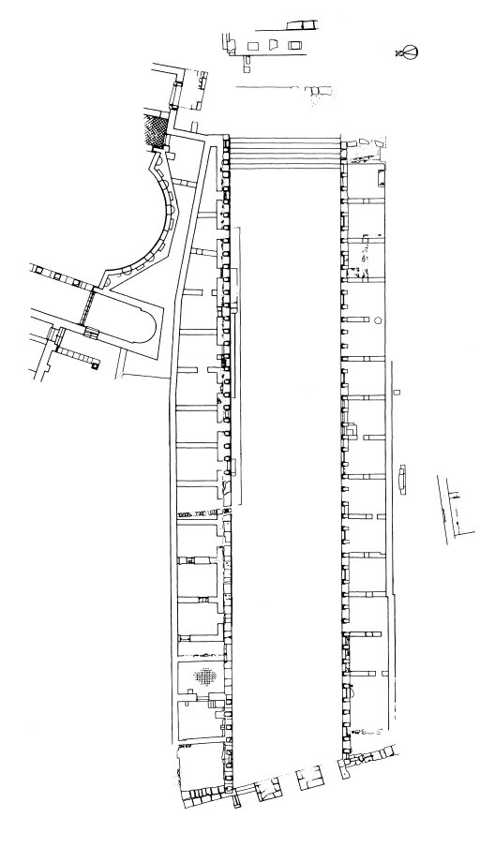
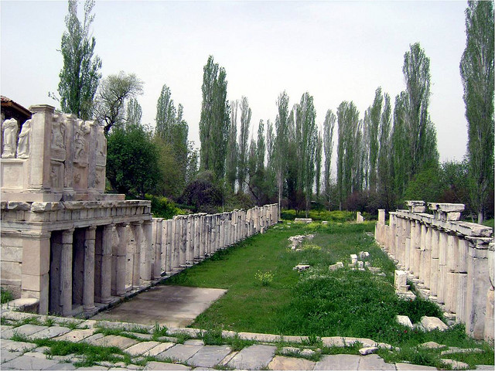
dedicated to the emperor, Livia, Theoi Sebastoi and Demos (worship of Aphrodite and the emperors of the Julio-Claudian dynasty)
20 – 60 AD conceived by Tiberius (earthquake destroyed part of the building), second building phase during the reign of Nero (absolute chronology – inscriptions and portraits)
- concrete representation of the special relationship with the Julio-Claudians

Slide 12
Excavations:
1979 - a surprising discovery of an architectural feature with a substantial amount of sculptural decoration
a) Series of rooms – east-western orientation, form two porticoes, at least two storeys high – Doric and Corinthian capitals
b) Panel reliefs – above each entrance to the room – mythological (meander on the bottom of these panels), imperial, allegorical
c) Paved courtyard
1980 - further excavations – southern portico, attempts to reconstruct the façade, 3 storeys – different columns in each of them – Doric, Ionic, Corinthian, length 100 meters
1981 - a full length documented, monumental entrance
- 4th century AD – market, 7th century AD some kind of a natural disaster ending the life of
the building
- a circular structure found with images clipeatae (rotunda?)
1982 - the most intense and richest for findings
- a close study of the propylon – three staircases, 2 storeys, Ionic and Corinthian capitals
- rotunda closely searched – a room with an apsidal ending – busts, fragments of
statues, images clipeatae, at the end – smaller temple, close to the northern portico
(a residence of a rich family - marbles used in the decoration were expensive - used from
the 3rd to the 7th century AD – a residence of a priest) – bishop’s house
Following 10 years – not such a dynamic research, but systematic excavating and evaluating
- a complex analysis and detailed mapping, four bases with inscriptions and many pieces of sculptural decoration,

Slide 13
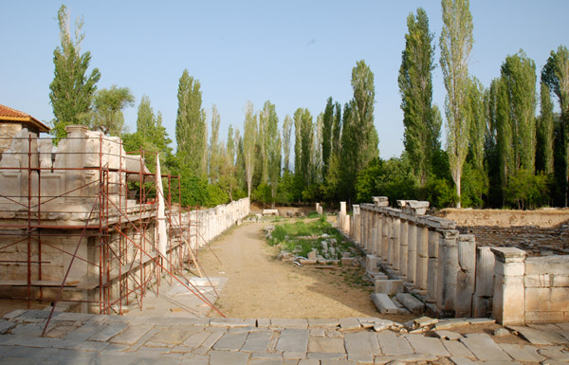
90s - publication and minor field work, restoration, re-building of the porticoes
- understanding the situation in the Byzantine period – the first room of the southern
portico – a kiln for glass production, a staircase to the second floor and a low wall running
in the middle of the room – evidence of the occupation of the site in the late antiquity, a
hoard of coins from the 3-6th century AD
Early 21st century
- overall understanding of the situation in the site and its function, excavations in the area of the temple (podium, fragments of two acroteria)

Slide 14
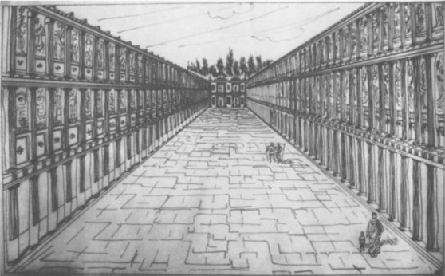
Characteristics:
- consists of 4 buildings: the propylon, the temple, two porticoes surrounding a narrow sanctuary
- a combination of Greek and Roman elements in architecture
a) Greek: axial placement of a temple in a complex, axial symmetry, BUT not a wide place so that the temple could be visible from all sides
b) Roman: narrow courtyard – processional way, the attention of the visitor should have been attracted by the temple in the eastern part, very similar to the roman forum (Caesar’s and Augustus’ existing at that time)
c) Novum: 12 m height - local innovation, porticoes look like a combination of stoa and
a façade of a theatre building
unique sculptural decoration, more than 90 panel reliefs documented (assumed number is
about 190)
- a combination of buildings, sculptural decoration and inscriptions showing a picture of the roman imperial cult set in the Greek city

Slide 15
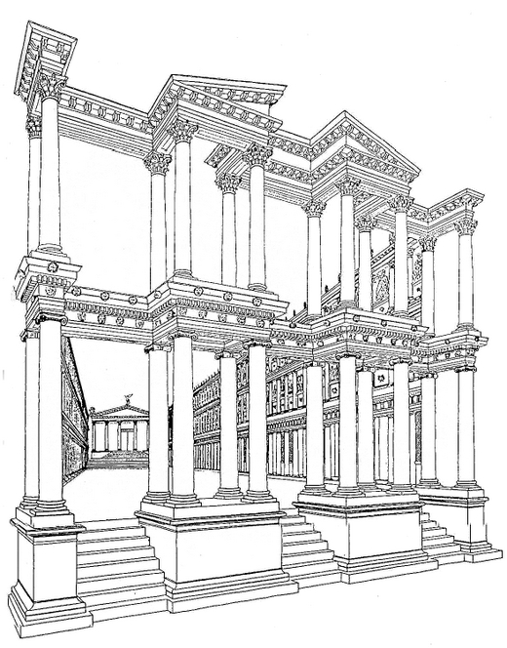
Propylon
a monumental, two-storey column entrance gate, aediculated façade
behind the entrance – long, paved courtyard (14 x 90 m)
built during the reign of Tiberius, it was open to space in both floors
every aedicule could hold two statues, one facing outside, the other inside the complex,
lower floor – Ionic columns
upper floor – Corinthian
divided by two pillars into three entrances with three staircases
Statues of an imperial family and their ancestors (also mythical to claim their powers)
10 bases with inscriptions
4 bases with inscriptions and fragments of statues
1 statue and its base

Slide 16
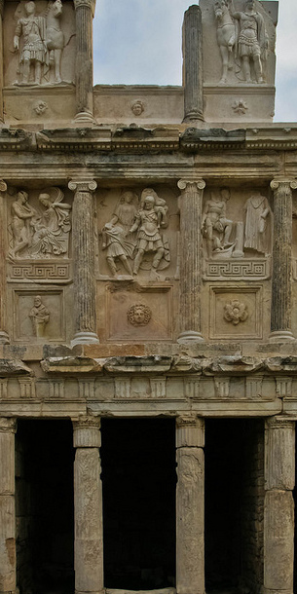
Porticoes
- southern and northern porticoes
divided to rooms with the width of 3 intercolumnari
- the rooms not visible at the first sight, the main stress on the aesthetics of the second and third floors, eastern part of the northern portico – asymmetry in the plan (because of reconstructions or earlier structure)
- Doric, Ionic, Corinthian style
- 190 sculptural reliefs (90 preserved and documented)
the ground floor rooms – shops and workshops, only in the 4th and 5th century, earlier no evidence of usage
upper floors not even an evidence of a floor or pavement
- originally no practical function, only decorative

Slide 17
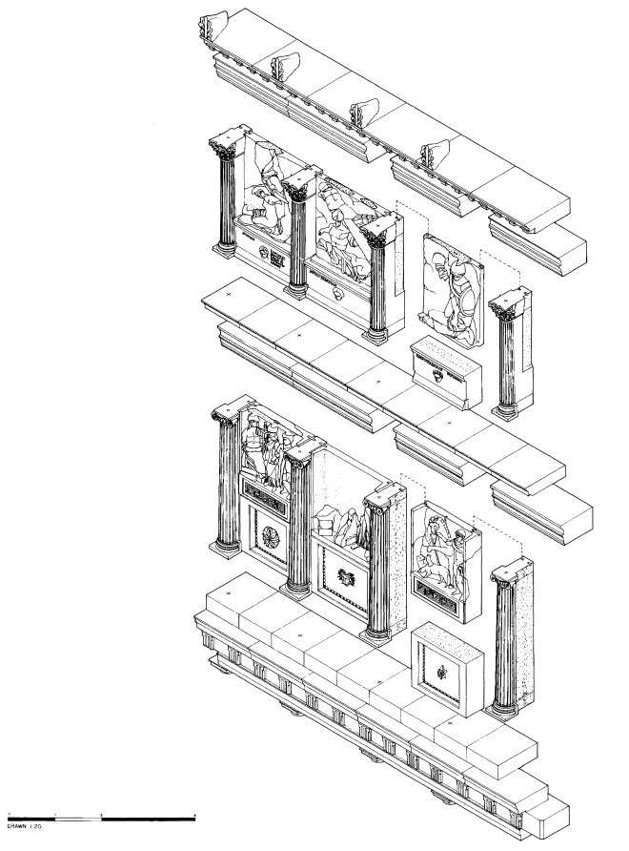
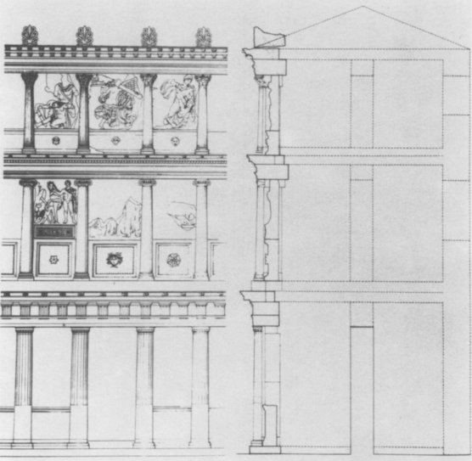
The relief panel have been carved from single blocks of Aphrodisias sculputral marble (white and medium-grained). They have been set with their sides overlapping the back of the half-columns and the relief figures projecting forward between them. They are slightly broader towards the top to match the inward tapering of the columns
Northern portico
less preserved than the southern portico
pieces come from its both ends (more from the eastern end), - the middle part collapsed after one of the earthquakes, the debris used for the theatre reconstruction
Southern portico
- collapsed in late antiquity – a lot of material found in the debris, it wasn’t used again, so the most of the sculptural decoration could be collected
- panels: not evenly wide, wider is flanked by two narrower relief panels

Slide 18
Eastern part of the complex
the worst preserved part
only a ground plan documented
a roman style temple – podium with an entrance to the temple only from the front side, Corinthian style, prostyle, hexastyle porch
dedicated to Aphrodite and to the imperial family
- sacrifices in front of the temple
Panels: mythological, allegorical, imperial context

Slide 19
Sculptural Decoration in Sebasteion
There are two different kinds of sculptural decoration in Sebasteion:
Panel Reliefs:
Mythological reliefs – south portico (S), 2nd storey, (36)
Imperial reliefs – south portico, 3rd storey, (12), north portico, 3rd storey, (1)
Traditional gods – south portico, 3rd storey, (14)
Series of personified nations (Ethné)– north portico (N), 2nd storey, (6), bases (16)
Universal allegories – north portico, 3rd storey, (2)
two or three central elements in the panels,
according to the width
Individual Statues:
members of the julio-claudian dynasty, found in
front of the propylon (P) or in the Byzantine wall
near the theatre:
Statues (or fragments) and bases - 5
Bases (only) – 10
N
S
P

Slide 20
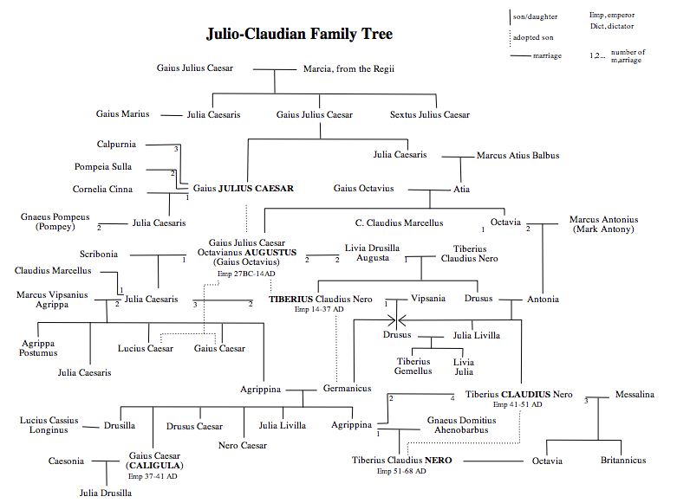
Aemilia Lepida

Slide 21
Statues
Bases and statue (fragments):
Livia
Lucius Caesar
Drusus Caesar
Aemilia Lepida
Agrippina Maior
Bases:
Gaius Caesar
Aeneas
Aphrodite
Germanicus Caesar
Marcus Lepidus
Antonia Augusta
Tiberius Claudius Drusus
Agrippina Minor
Julia
Atia (Augustus’ mother)

Slide 22
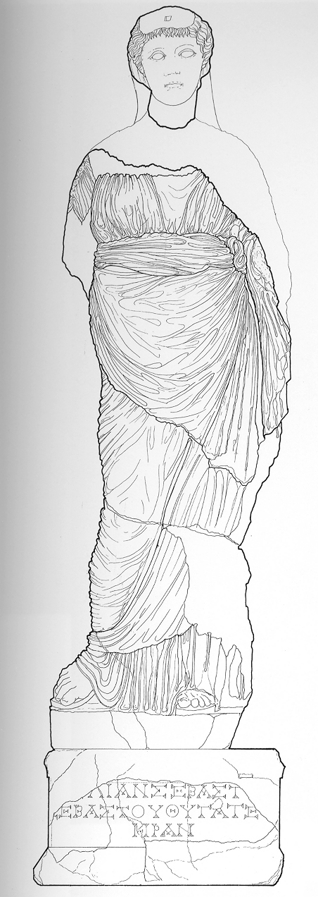
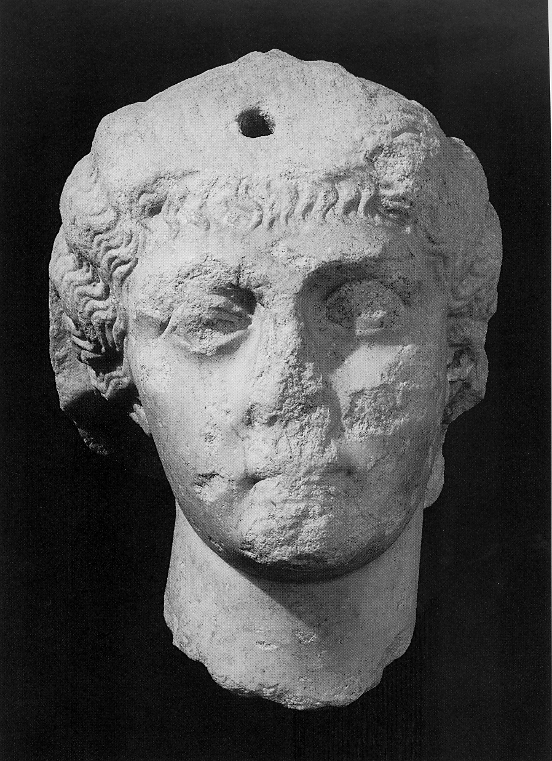
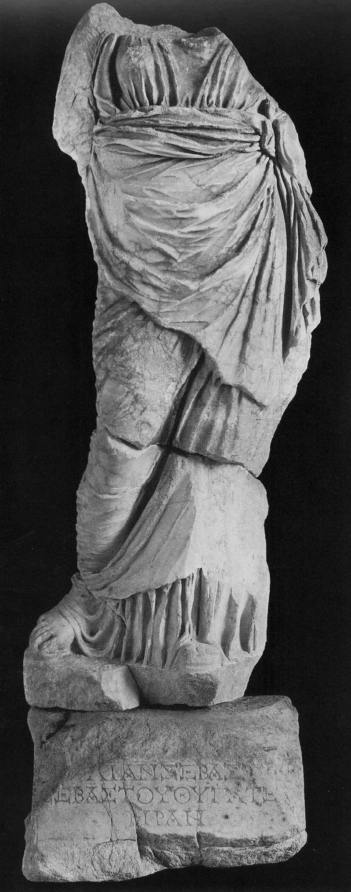
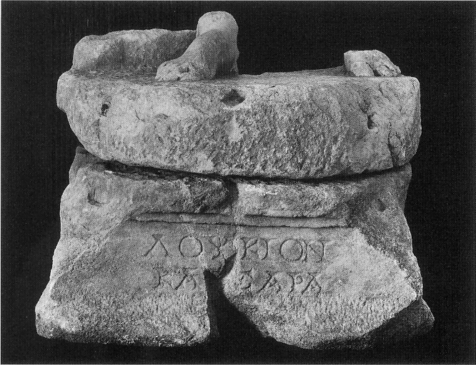
Bases and statue (fragments):
Livia
found in city wall near the theatre
the head was originally carved in one piece with the body, the Byzantine builders of the wall selected only the blocks best-fitting the incorporation into the wall, e.g. legs, bases
bodies were left on the spot
arms were separately worked – holding patera in her right hand, the left one supporting the palla
Lucius Caesar
found in the north-western part of Sebasteion
heroic nudity

Slide 23
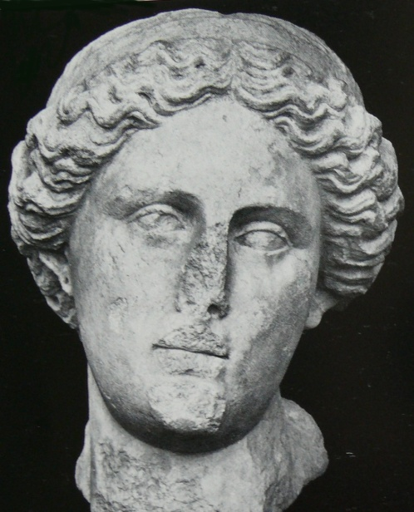
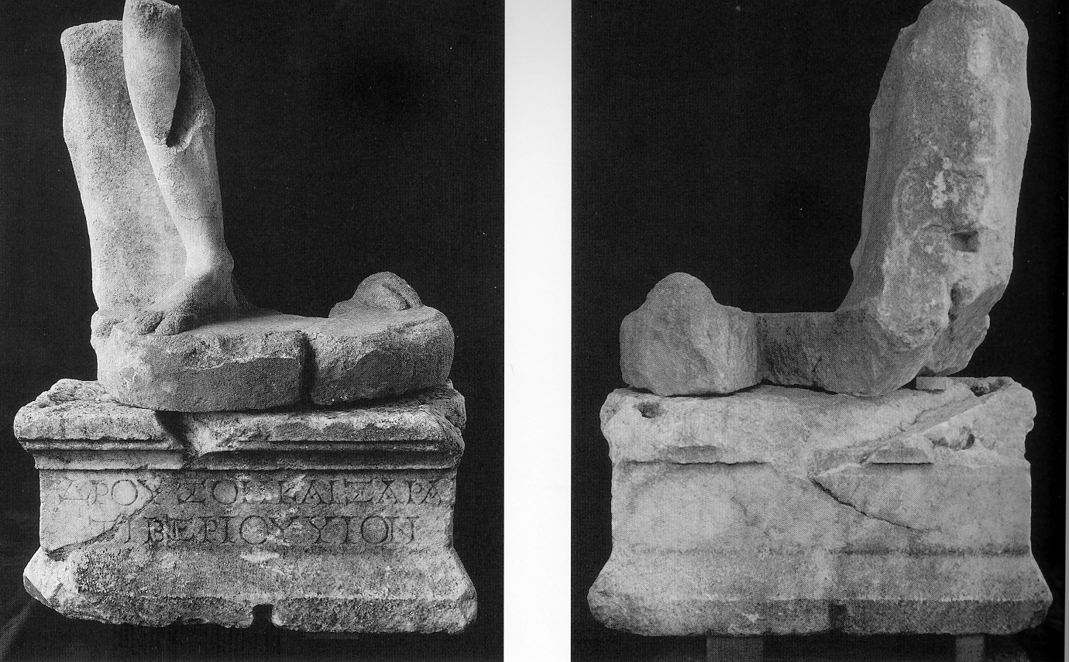
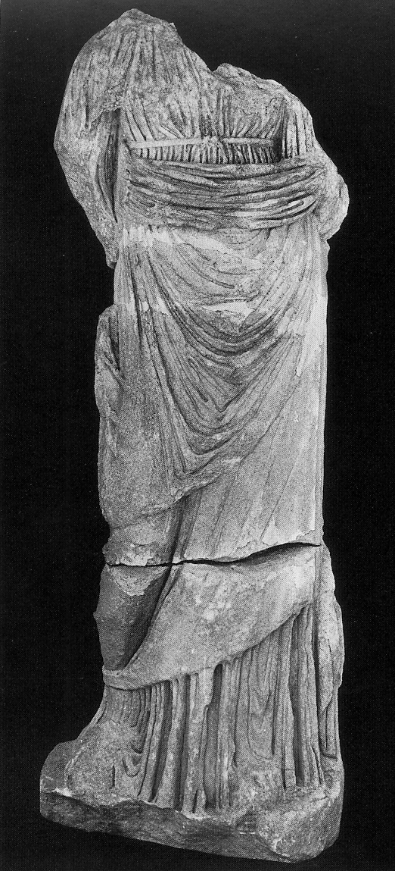
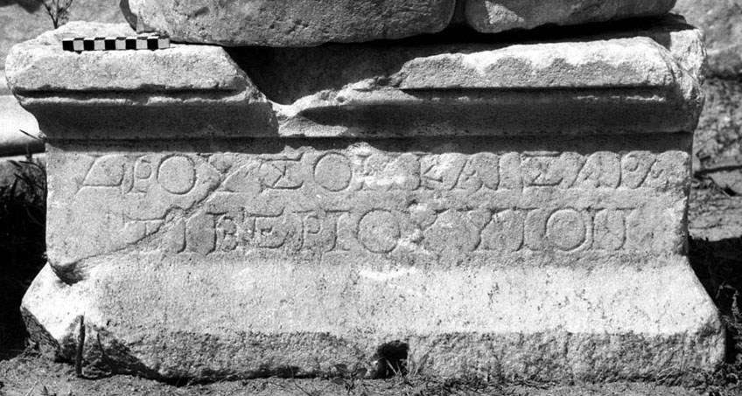
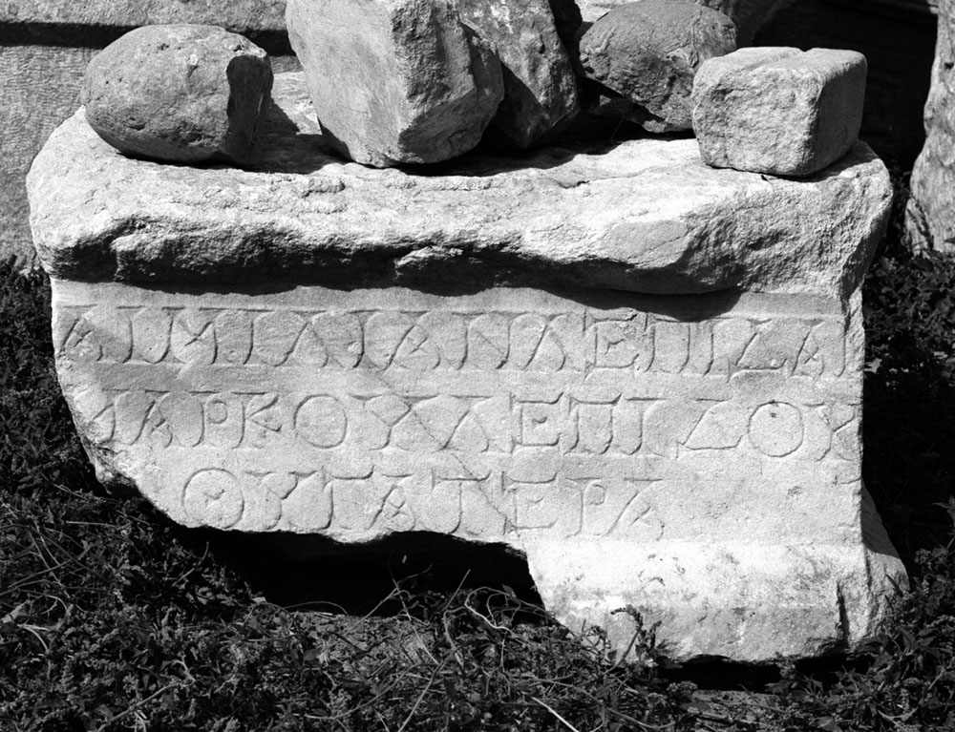
Drusus Caesar Aemilia Lepida Agrippina Maior
found near the propylon - near the Tetrastoon - east of the theatre
heroic nudity - base in the entrance - base and head
- put together according to
the fitting holes

Slide 24
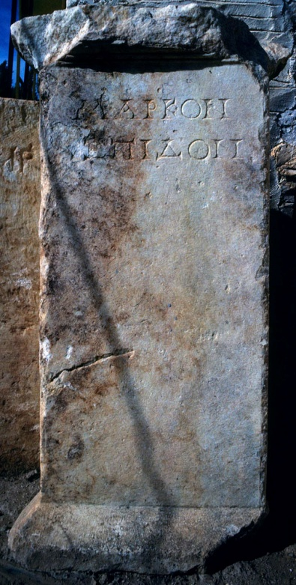
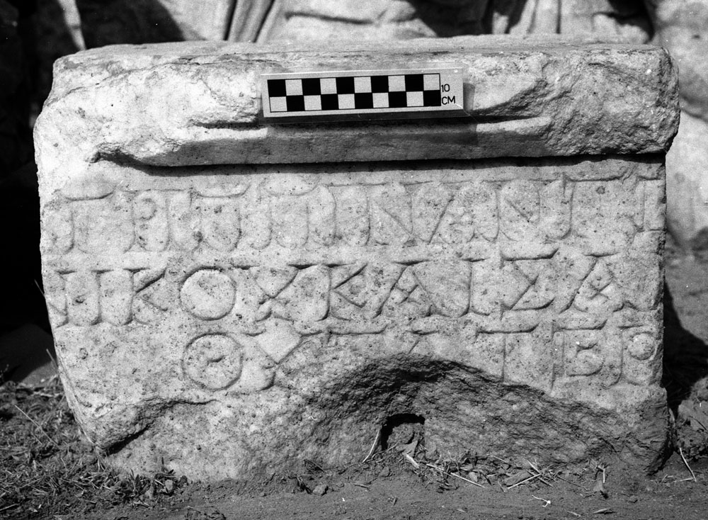
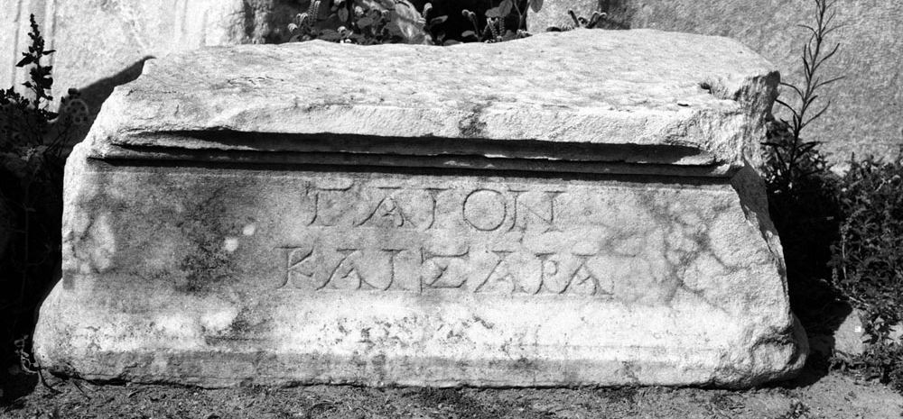
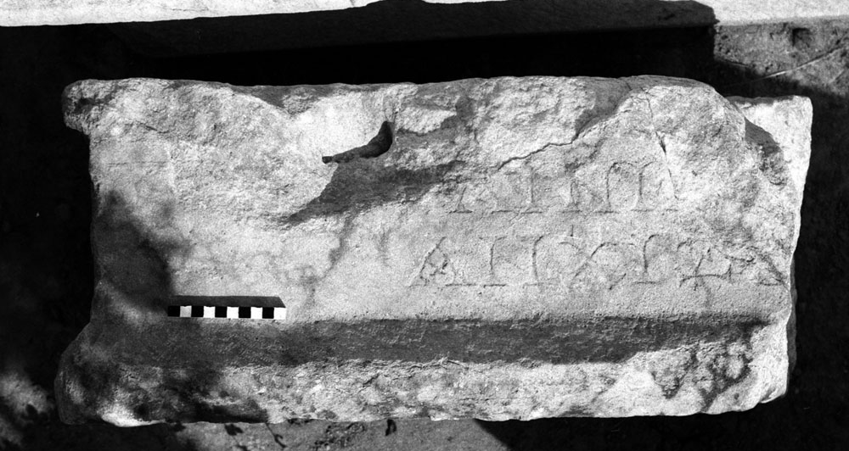
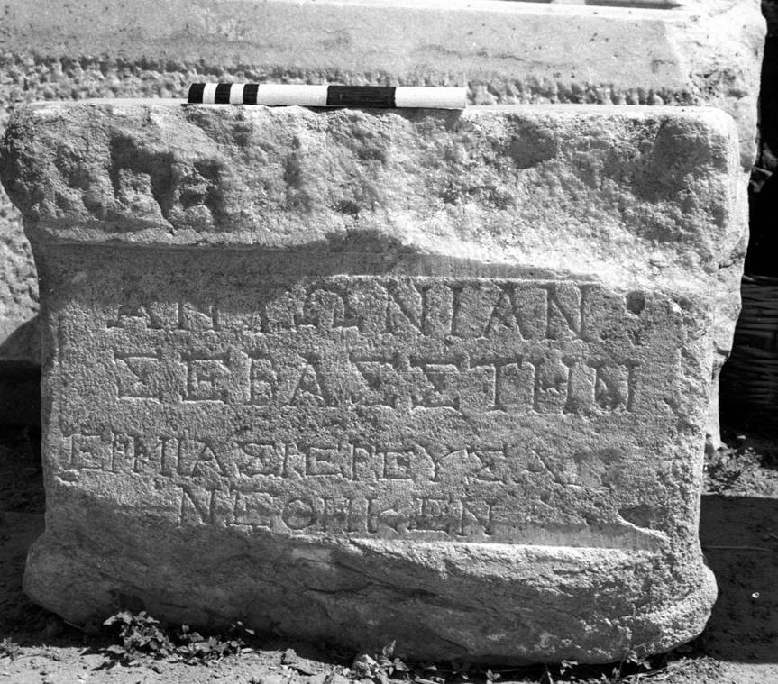
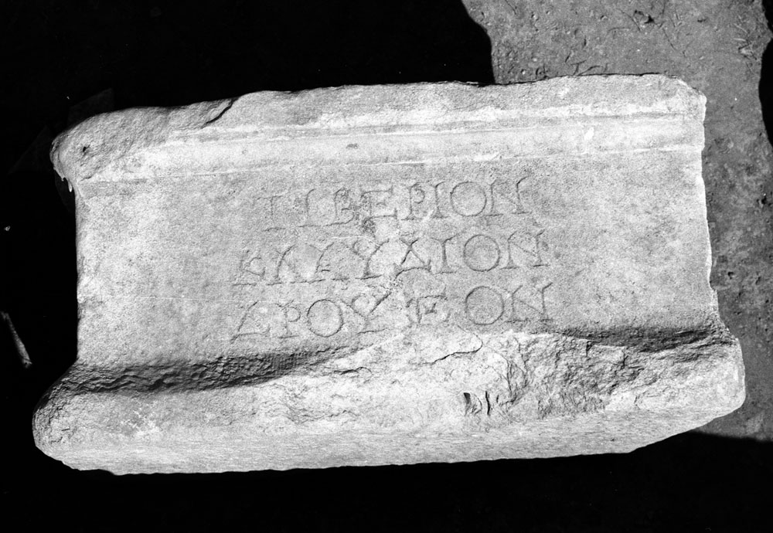
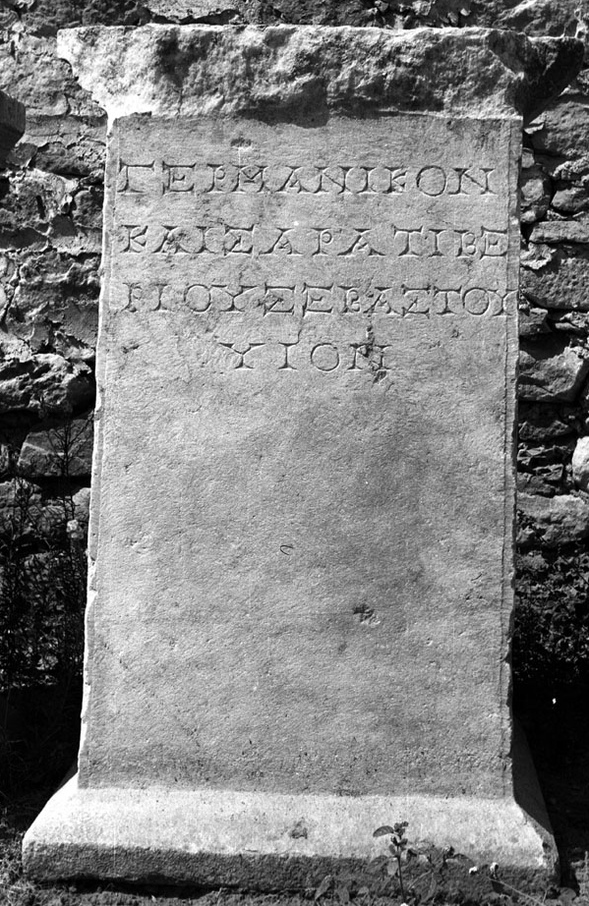
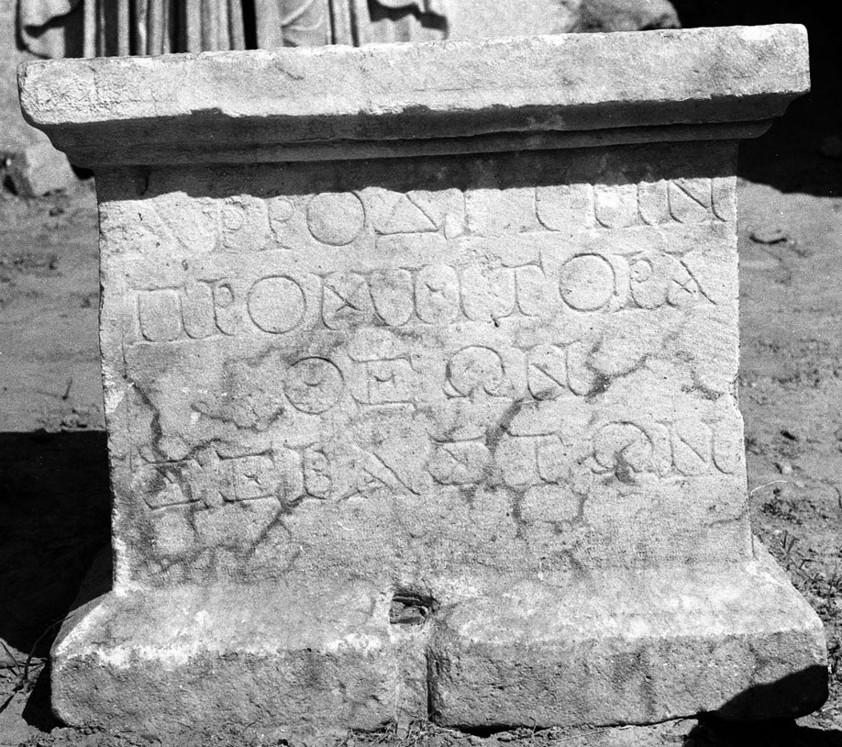
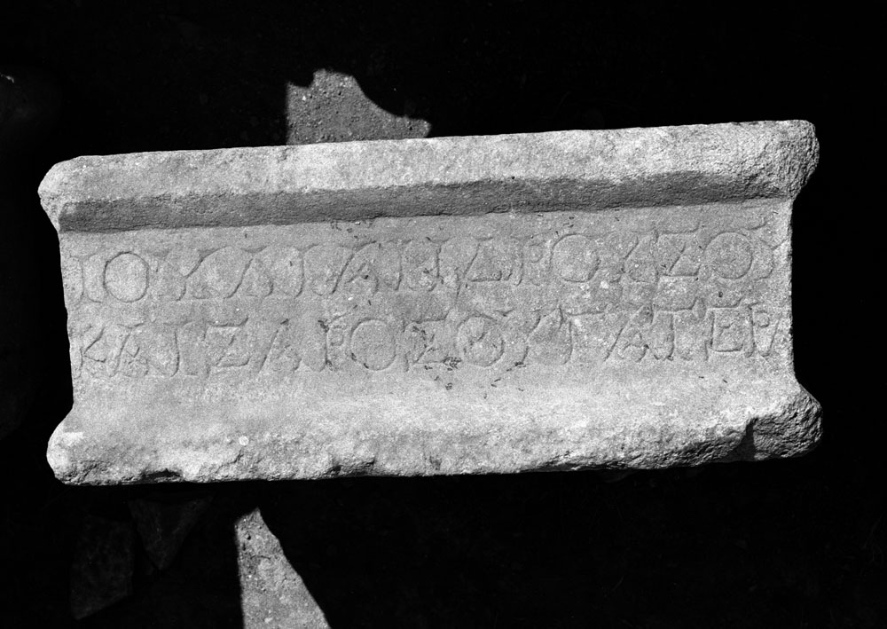
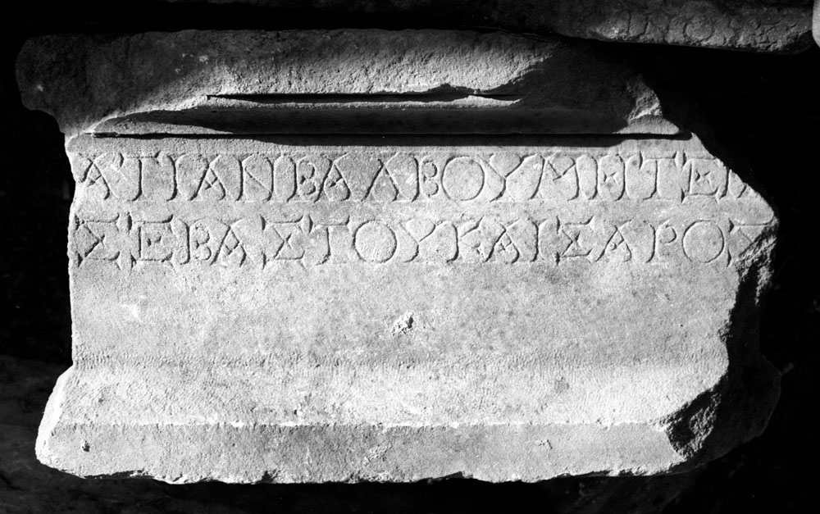
Bases:
Marcus Lepidus
Gaius Caesar
Agrippina Minor
Aeneas
Marcus Lepidus
Antonia Augusta
Tiberius Claudius Drusus
Julia
Aphrodite
Germanicus Caesar
Atia

Slide 25
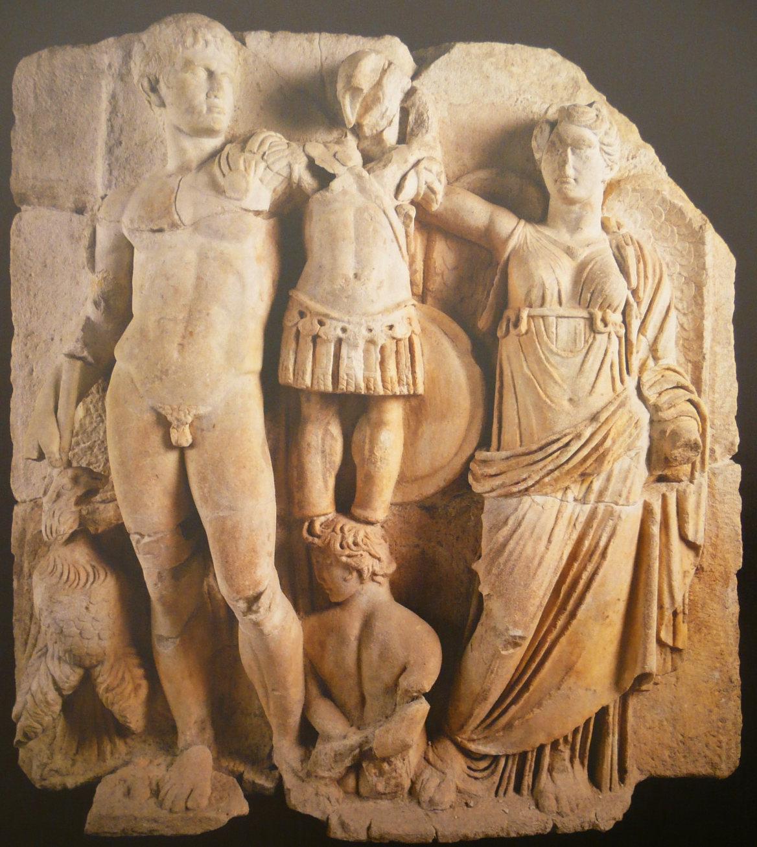
Augustus, Nike and trophy
the emperor carried a spear and has an eagle at his feet
winged Victory is crowning a military trophy
a barbarian captive with his hands tied behind his back is sunk into the plinth
Prima Porta portrait type but wrongly copied coiffure
Mistakes: hand, spear, naked emperor, the shield on the trophy
Imperial and Hellenistic royal iconography, adapting elements of both

Slide 26
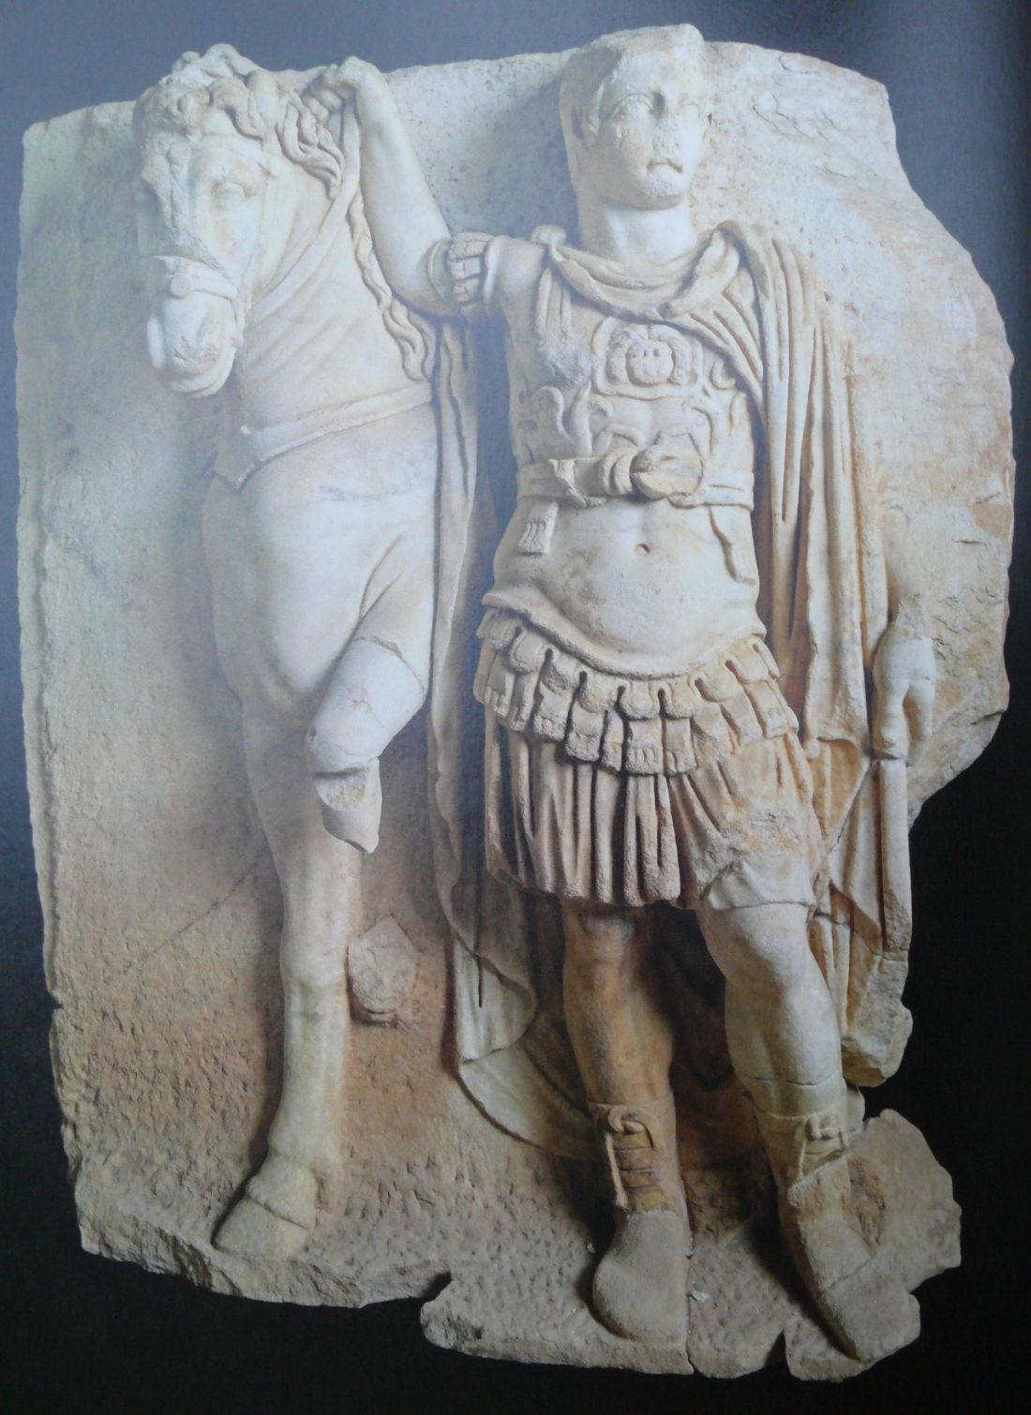
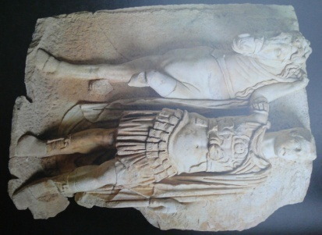
Imperial prince as Dioskouros
the relief is one of a pair that represented two armored princes framing the Augustus relief
the princes have short-haired portrait heads and Roman armour, while their symmetrical poses, each with a horse, likens them to the Dioskouroi, sons of Zeus
probably Gaius and Lucius Caesar
the three reliefs represented Augustus as Zeus with his sons as the Dioskouroi

Slide 27
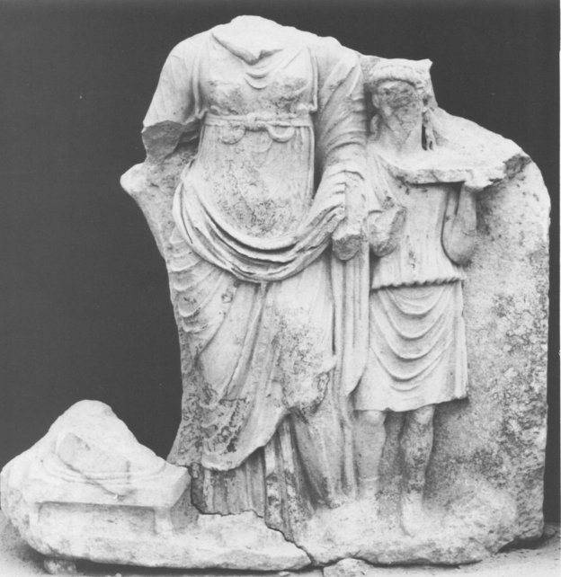
Empress sacrificing (Livia?)
a draped imperial woman stands in the centre (probably pouring a libation), a sacrificial attendant stands at her side with an offering tray
the attendant is a real figure with a contemporary hairstyle, guarantees that this is an imperial sacrifice, not an Olympian or mythological (in the south portico reliefs)

Slide 28
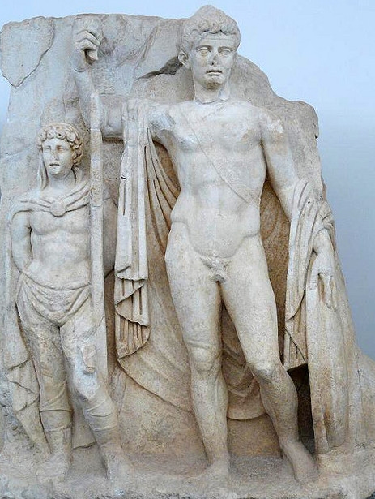
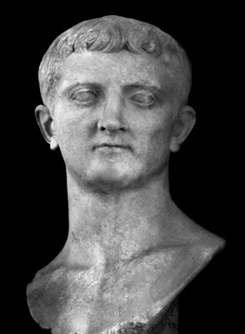
Unfinished Imperator (Tiberius)
the naked emperor, Tiberius, recognizable from his portrait, occupies the centre of the relief. He stands frontally, holding a spear and a shield and wearing a cloak and baldric
the prisoner wears a cloak and trousers and has his hands tied behind his back
portrait type: Basel

Slide 29
Germanicus with a captive
an imperial prince holding an orb in one hand and crowning the trophy to his right with the other
a small boy-captive in profile standing between the prince and the trophy
portrait is a combination of all three Germanicus’ portrait types: a) adoption, b) Beziers, c) Gabii
the scene also helps the identification: the globe in the hand means that the person is the heir, the captive wears clothes typical for the north (Germania)

Slide 30
Claudius with allegories of Land and Sea
the emperor strides across the panel, framed by a drapery indicating floating, flying – here it indicates divine epiphany
receives a cornucopia in his right hand, and a steering oar in his left hand (both mean prosperity of land and sea under the emperor’s rule
the Roman emperor is showed as a powerful hellenistic-style divinity
the portrait type: Kassel

Slide 31
Claudius and Agrippina
the emperor Claudius stands in the centre of the relief, shaking hands with Agrippina
Agrippina holds a bunch of wheat ears in her left hand (assimilation to Demeter)
both of them recognizable by their portraits and distinctive hairstyles – official portrait types (Hauptypus, Ancona – both from Copenhagen)
on the right – figure wearing a Roman toga who crowns the emperor with a wreath of oak leaves – a personification of the People or the Senate

Slide 32
Nero and Agrippina
Agrippina crowns her son Nero with a laurel wreath, she carries a cornucopia
Nero wears the armor and cloak of a Roman commander, he held a spear in his right hand and probably an orb in his left
helmet lies on the ground
both figures identifiable by their portraits
the scene refers to Nero’s accession in 54 AD and before 59 AD, when Nero had Agrippina murdered
a) Parma b) Cagliari c) Thermen museum
Stuttgart type

Slide 33
Two princes
two princes stand like statues, naked, wearing cloaks
the left figure is slightly taller and clearly the senior, holds the orb of the world in his left hand (a symbol of world rule) indicating that he is the imperial heir, in the right hand – aphlaston (ship’s stern ornament) a symbol of naval victory
the right figure is younger, doesn’t hold any attributes
clearly individual facial features and hairstyle
several possibilities of identification:
a) Gaius and Lucius Caesar
b) Drusus Younger’s sons (twins)
c) Nero Caesar and Drusus Caesar
d) Nero and Britannicus

Slide 34
Sometimes two members of the Imperial house appear together in the same relief. According to the surviving panels, it seems that this happens only for the family of Claudius: the marriage between Claudius and Agrippina, Nero and Britannicus, Agrippina crowning Nero.
Another arguments supporting the theory, that the two princes are Nero and Britannicus

Slide 35
Claudius and Britannia
Claudius is about to deliver a death blow to a slumped figure of Britannia
Claudius wears helmet, cloak and a sword belt with scabbard
Britannia wears a tunic with one breast bare – like the Amazon figures on which she was modeled
the subject is identified by the inscribed base and the imperial portrait (Hauptypus)
Tiberios Klaudios Kaisar – Bretannia
the invasion of Britain in 43 AD

Slide 36
Nero and Armenia
the heroic, naked figure of Nero wearing cloak and baldric supports slumped figure of Armenia by her upper arms
Armenia wears a soft, pointed oriental hat, and her bow and quiver can be seen in low relief behind her to the left
composition: a heroic group of Achilles and Penthesilea
the subject is identified by its inscribed base and eastern iconography of the conquered personification
Nero’s name was erased after his fall in 68 AD (damnatio memoriae)

Slide 37
One of the main themes – military triumph of the Julio-Claudian emperors – embodied by the flying Victory, with a trophy on her left shoulder labeled Nike Sebaston (Victoria Augustorum)
the reconstruction of position (between the panels with Claudius and Britannia and Nero and Armenia) has two reasons:
a) they represent the farthest west and east of the Roman empire
b) they suggest that the Roman conquest involved not only submission but also assistance to the conquered
Peter Scherrer suggested: panels are contradictions representing the politics – old, cruel Claudius and his severitas, young, unspoiled Nero and his clementia.

Slide 38
Composition
the two reliefs complementing each other
they show crowning of male and female figure
the portraits are highly idealized, but it is very likely that the couple represents Augustus and Livia, even though the position is not so close
Emperor and Roman people
the emperor is crowned by a personification of Roman People wearing toga
corona civica – saving citizens’ lives
the emperor is setting up a battlefield trophy beneath which kneels a female barbarian captive
Aphrodite and Roma
a draped goddess (Aphrodite) is crowned with a wreath by a female warrior figure (Roma)
the wreath – double tier of laurel or bay leaves with a central medallion

