Slide 1
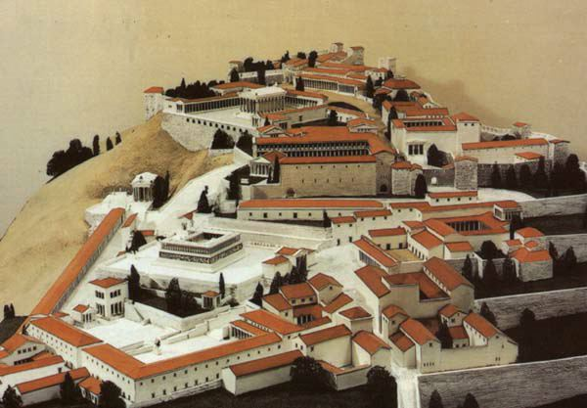
The Buildings and the Images of the Imperial Cult
IX Trajan and Hadrian

Slide 2
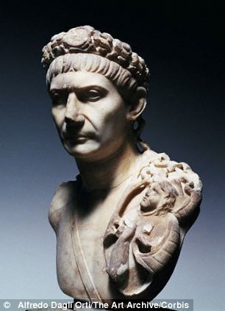
Trajan
Marcus Ulpius Traianus (98 – 117), wife Plotina
adopted by Nerva in 97
used his military skill to expand
the first emperor born in a province – Hispania
his art reflects his military exploits and their consequences for Rome
fought in Spain, against Dacians and Parthians
awarded title Dacicus, Germanicus, Parthicus
preferred the title princeps (not dominus et deus as Domitian)
founding colonies around the world
in Rome – repairs and building of roads, Trajan forum
died at Selinus, in Cilicia in 117, on his return to Rome
divinized, ashes in a golden urn deposited in the base of his column
special title optimus (informally from 100, officially from 114)
3rd and 4th c. AD – emperors – felicior Augusto, melior Traiano

Slide 3
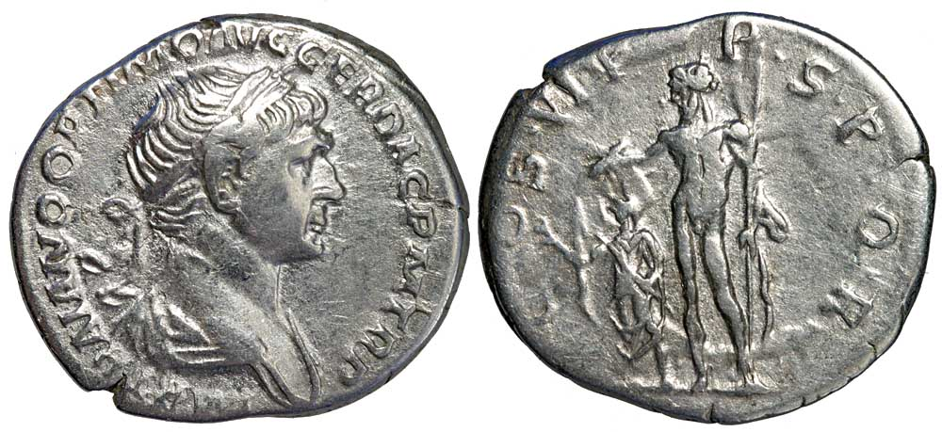
Cult
Pliny, Dio Cassius
Nerva – providentia deorum - a good heir to the throne, made gods his advisors
adoption of Trajan – the temple of Jupiter Optimus Maximus
Trajan elected by the gods, through Nerva it was implemented and maintained its legitimacy, the same with Hadrian
assimilation – transformed from a mortal into a leader destined by providence
captured the land of Armenians – senate – honors and title optimus (restricted for Jupiter)
careful not to incorporate it to his official titulature
Trajan – assimilation to Jupiter, in the West
During his life – worshipped as Zeus only in Pergamon – 2nd neokarate – 1st city with two imperial temples – Traianeum and Augustus
Trajan honored as Zeus – after death - East – Zeus Eleutherios, Zeus Embaterios
IMP TRAIANO OPTIMO AVG GER DAC PM TR P

Slide 4
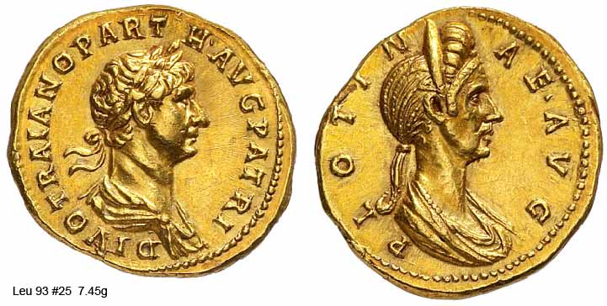
DIVO TRAIANO PARTH AVG PATRI

Slide 5
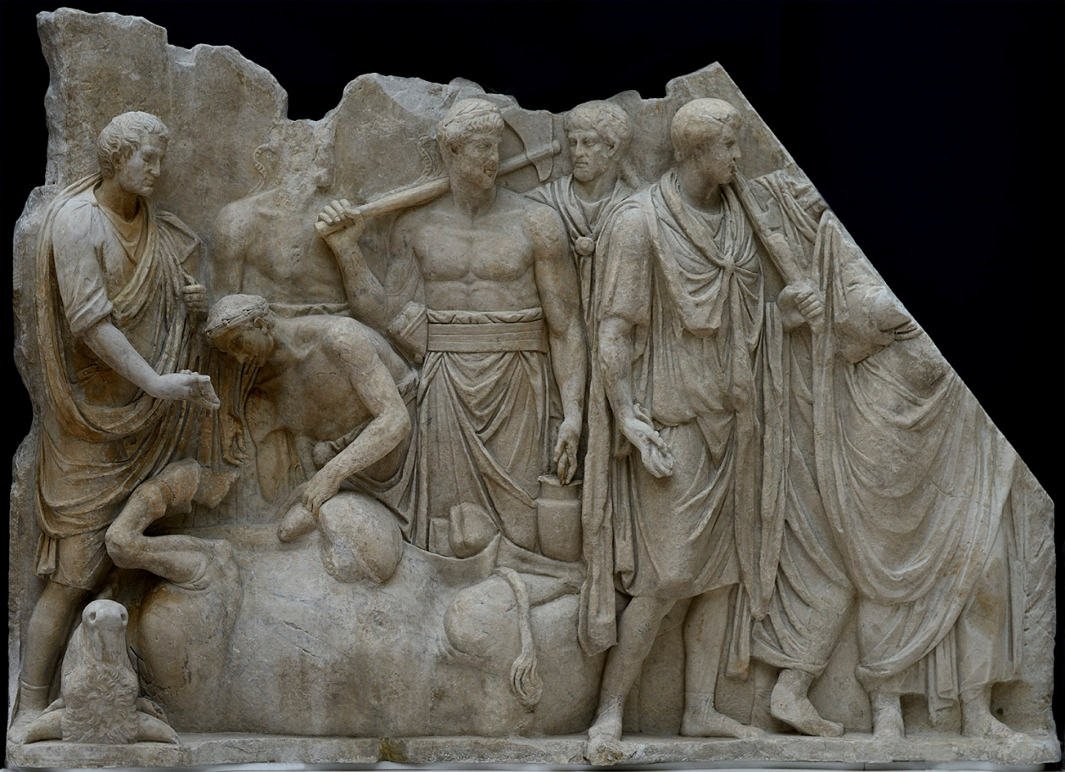
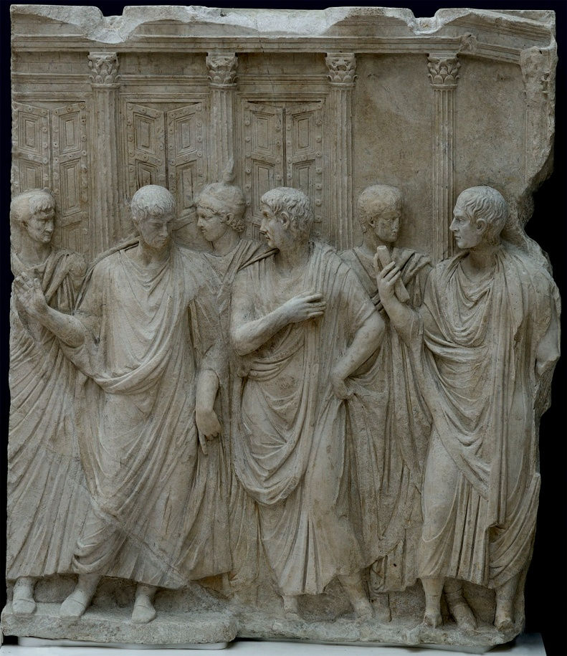
Rome and Italy
The Temple of Divus Traianus
The Extispicium Relief
The Arch of Trajan in Benevento
Provinces
a) The Temple of Trajan at Pergamon

Slide 6
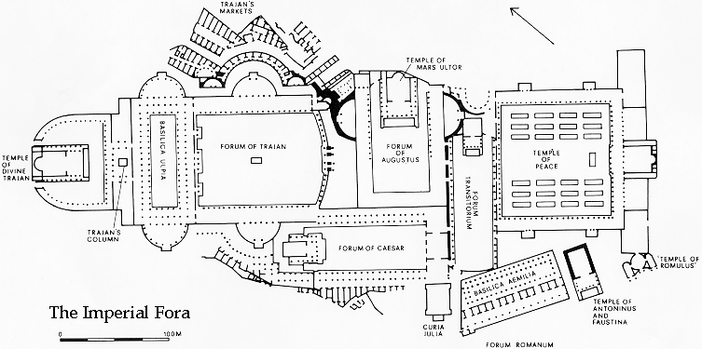
The Temple of Divus Traianus
- planned by Apollodorus of Damascus (?)
- construction: responsibility of Hadrian
- inscriptions – a family shrine dedicated jointly to Trajan and Plotina (died 123 AD, given divine honors)
Historia Augusta – the only temple with Hadrian’s name
Location: northwest of Trajan’s Column, the remains are buried beneath the 16th – 18th c. churches – S. Maria di Loreto a SS. Nome di Maria

Slide 7
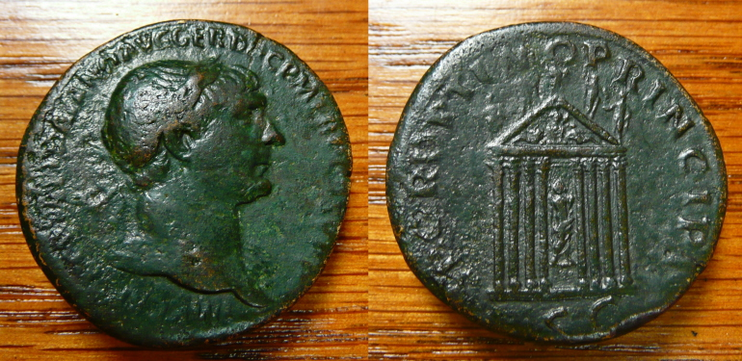
The temple of Divus Traianus
- coin images: tall podium, archaeological evidence 4.37 m high
- cella: two rows of columns, divided space into a nave and two side isles
- walls faced with exotic marbles
- an apse holding a cult statue of Trajan (coins depict the statue between the two center
façade columns) – his right hand raised, left rests on his lap, upper torso is bare, waist and
legs draped, right hand – a sceptre, left a winged Victory statue
- architrave: three fasciae, frieze – carved figures
- pediment: seated central figure flanked by two reclining river gods (Danube, Tirgris), apex –
standing figures

Slide 8
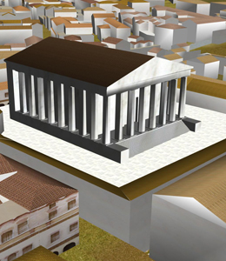
The temple of Divus Traianus
- fragments of temple’s granite column
shafts, one shaft (14.8 m) and capital
(Corinthian, 2.90 m) found close to the
column – close to the presumed
position
- dimensions correspond to those of
Mars Ultor and the final version of the
Temple of Jupiter Capitolinus
plan: eight columns, pseudodipteral,
width of the façade 36 metres, very
similar to Mars Ultor

Slide 9
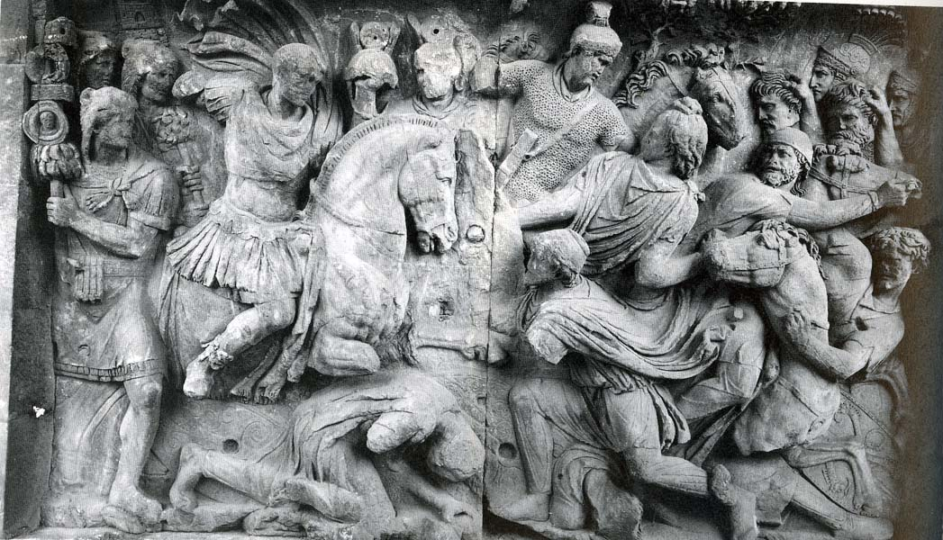
The temple of Divus Traianus – The Great Trajanic Frieze
short side of the Constantinian arch – four slabs, two scenes
Scene 1
Trajan depicted on a horseback, Dacian kneeling in front of the emperor begging for mercy
the emperor is a conqueror and merciful man at the same time

Slide 10
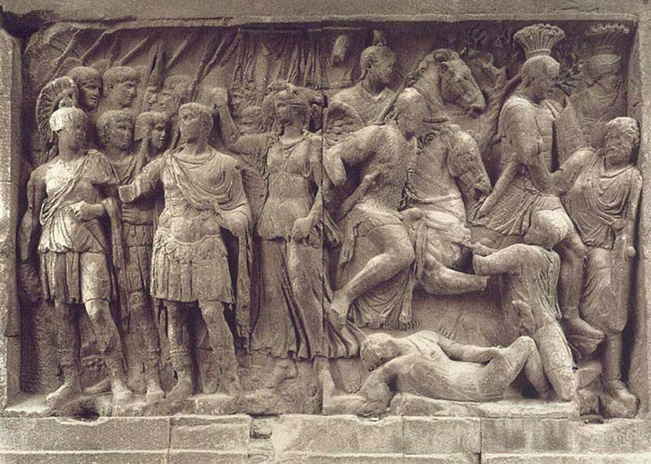
The temple of Divus Traianus – The Great Trajanic Frieze
Scene 2
adventus of Trajan
Trajan is being crowned by Victory and is welcomed by Virtus and Honos

Slide 11
The temple of Divus Traianus (?) – The Extispicium Relief
discovered in the east hemicycle of the Forum of Trajan
associated with the Great Trajanic Frieze – findspot, comparable height
Scene (not sure!)
in front of the Temple of Jupiter Optimus Maximus Capitolinus, the pediment (with the Capitoline triad) is now missing, but there are drawings recording its original form
in front of the temple – eight togati men – the central one - Trajan
the left side of the temple: extispicium rite – a victimarius examines the bull while a haruspex in a toga interprets the sings
this rite usually appeared at the beginning of a military campaign
a Victory with a vexillum flies above the extispicium

Slide 12
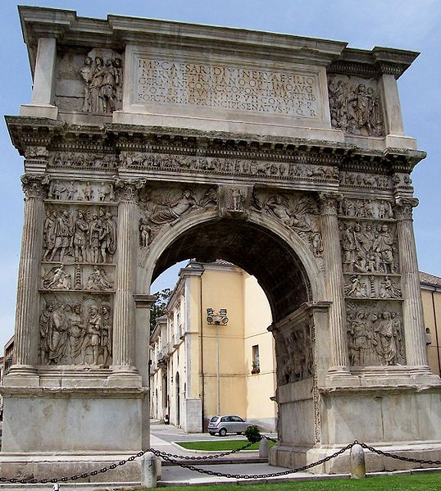
The Arch of Trajan at Benevento
advertised Trajan’s program – donations, taking care of poor, increase of a birthrate, alimenta
central bay: alimenta, Trajan sacrificing to commemorate the opening of the Via Traiana
eight panels on the main body of the arch – major event from the principate of Trajan: the emperor’s military campaigns in Dacia and Germania, the subsequent founding of military colonies, the building of a new port in Ostia, Trajan’s triumphal entry into Rome, the establishment of the alimenta
not intended to be a precise historical reportage, only an illustration of the emperor’s policies in Italy and abroad
significance: the panels continue a Flavian tradition to depict interaction of human beings and divinities, Trajan usually depicted taller than other humans
the vault – coffers with rosettes, in the centre Trajan in military breastplate crowned with a laurel wreath by Victory

Slide 13
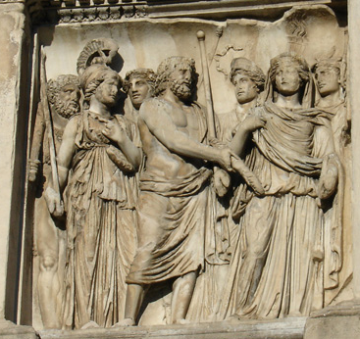
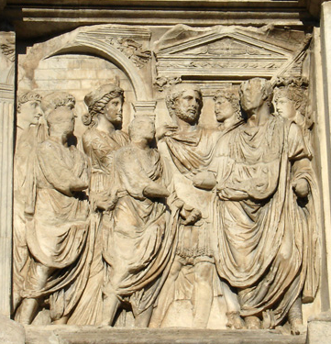
The Arch of Trajan at Benevento – four attic panels
one panel at each side of the inscription plaque
the country side: the left - the reception of the Dacian gods, the right – Dacia kneeling at Trajan’s feet
the city side: adventus – Trajan is welcomed in Rome by two togate consuls, Roma and the Capitoline Triad. Jupiter holds his scepter in his left hand and offers his thunderbolt to a togate Trajan, who stands in the other panel
the inscription informs, that Trajan is already divus and also shares the title optimus with Jupiter
Trajan receives his power from Jupiter, stands in front of the Capitolium, Hadrian present

Slide 14
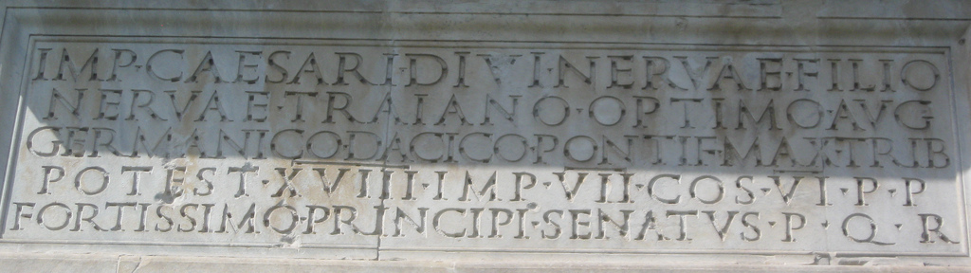

Slide 15
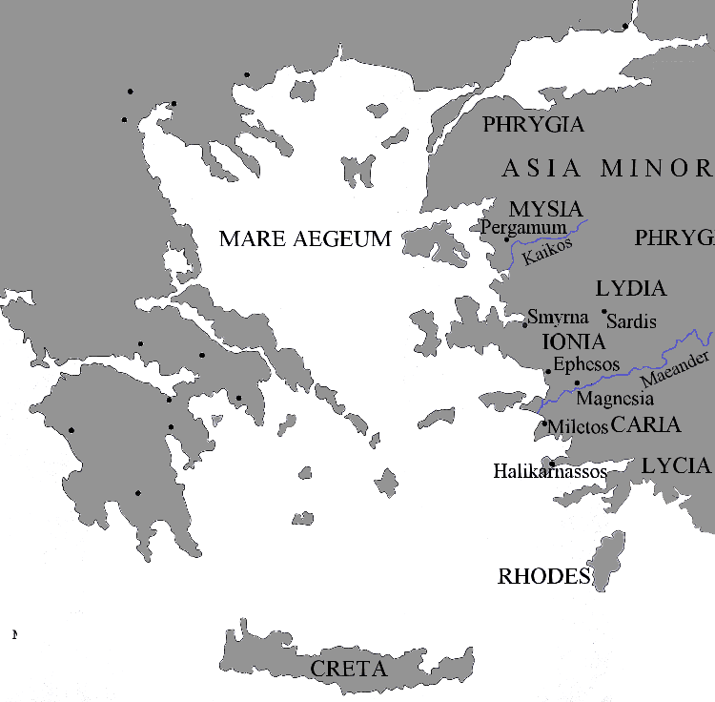
PERGAMON
- an elevation of 392 meters from the sea level
the area of the Acropolis was formed with several terraces enabling the construction of palaces, temples, altars, and many other structures
no proof of a settlement belonging to the earlier period (12th – 10th centuries)
inland, not a favorable position for settlement
560 BC – Lydian king Kroisos, defeated by Persians, but the city stayed independent, had to pay taxes
334 BC the King of Macedonia, Alexander the Great defeated the Persian King Darius III
323 BC Lysimachus got to the throne – military base and treasury, betrayed by Philetairos (his general) – enlarged borders

Slide 16
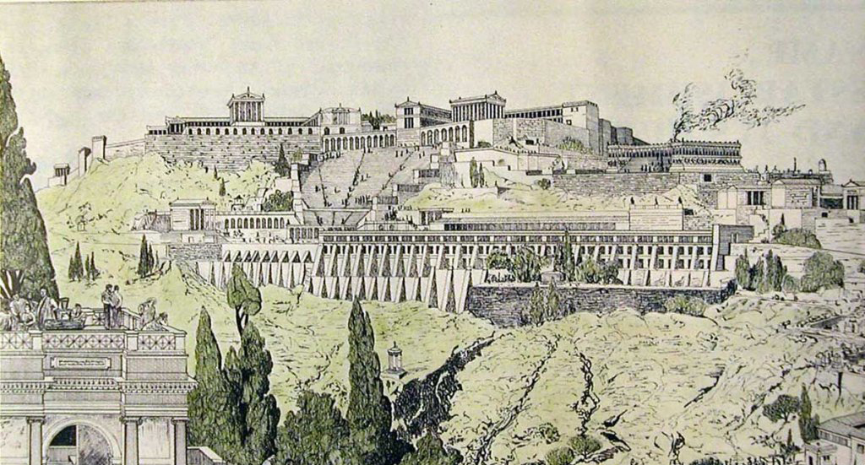
263 BC Eumenes I – the kingdom expanded, the city was a centre of arts and science
Attalos I – continued to rule with the same politics, gained large territories, the Altar of Zeus was built
Eumenes II – friendly relationship with Rome – Pergamon the most powerful and richest of all the times, most of the still visible monuments were built
Attalos III – bequeathed the kingdom to Rome
- continued to be an important center during the Roman period.
- the Byzantine period - an important episcopal seat and after the adoption of Christianity it became an important missionary center
the attacks of the Arabs, and sacked by them in 717 AD
finally fell to Ottoman Sultan Orhan in 1336.

Slide 17
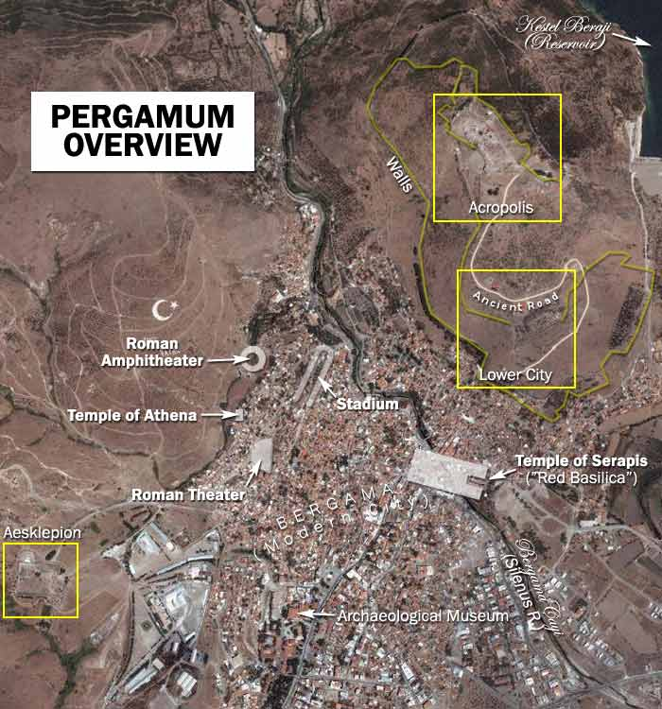
Lower City
the Upper Gymnasium
the Middle Gymnasium
the Lower Gymnasium
the Temple of Demeter
the Sanctuary of Hera
the House of Attalus
the Lower Agora and
the Gate of Eumenes
Sanctuary of Asclepius
the Roman theater
the North Stoa
the South Stoa
the Temple of Asclepius
a circular treatment center (sometimes known as the Temple of Telesphorus)
a healing spring
an underground passageway
a library
the Via Tecta (or the Sacred Way, which is a colonnaded street leading to the sanctuary) and
a propylon

Slide 18
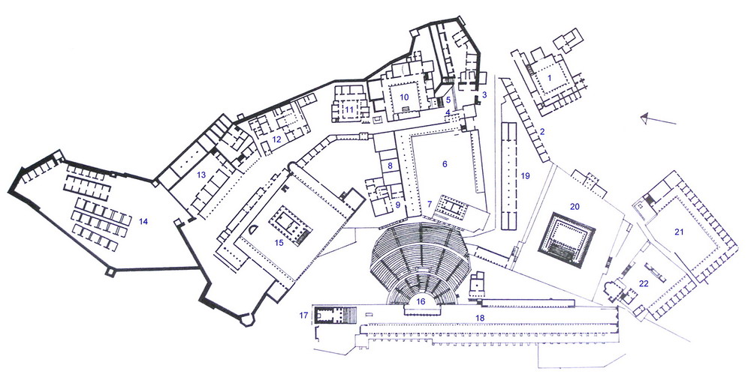
1 the Heroon – a shrine where the kings of Pergamon, particularly Attalus I and Eumenes II, were worshipped
6 -7 the Sanctuary of Athena
10 – 13 the Royal palaces
15 the Sanctuary of Trajan (also known as the Trajaneum)
16 the Hellenistic Theater with a seating capacity of 10,000. This had the steepest seating of any known theater in the ancient world
17 the Temple of Dionysus

Slide 19
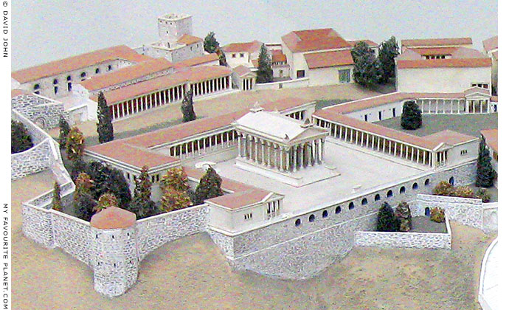
TRAJANEUM
the Temple of Trajan (Trajaneum)
Pergamon's Upper Acropolis area
- the only Roman monument in this location
- construction initialized under Trajan in 114 AD and completed by his successor Hadrian
purpose: to provide a venue for the religious cult of both rulers as well as Zeus to strengthen the bonds of Pergamon with Rome and with the Imperial family
the fourth imperial cult temple in the province of Asia: 1st in Pergamon, Augustus, 2nd Smyrna, 3rd Sebastoi, now the temple of Domitian in Ephesos

Slide 20
The sacred precinct
- originally dedicated to Zeus Philios (Latin, Jupiter Amicalis) and Roman Emperor Trajan
- The epiphet "Philios" (friendly), previously not known at Pergamon, may signify the patronage of Zeus over the bond of friendship between Rome and the Greek cities of Asia
Hadrian worshipped at the Trajaneum
An inscription found at Pergamon is the copy of a letter written by Hadrian in 137 AD, in which he turns down the request of the Pergamese to build him a temple, but consents to the placing of a statue of him in the temple of his father, the Trajaneum.
Acrolithic statues from the Trajaneum
- acrolithic statues: the head of Trajan is one of a pair now in Berlin's Pergamon Museum, the other is Hadrian (severly damaged, much of the jaw missing)
Pergamon's three neokoroi
- Pergamon's first neokoros, or "provincial temple" was the Temple of Augustus and Roma, the third neokoros was the Temple of Aesclepieios at the Asclepieion also dedicated to the Emperor Caracalla

Slide 21
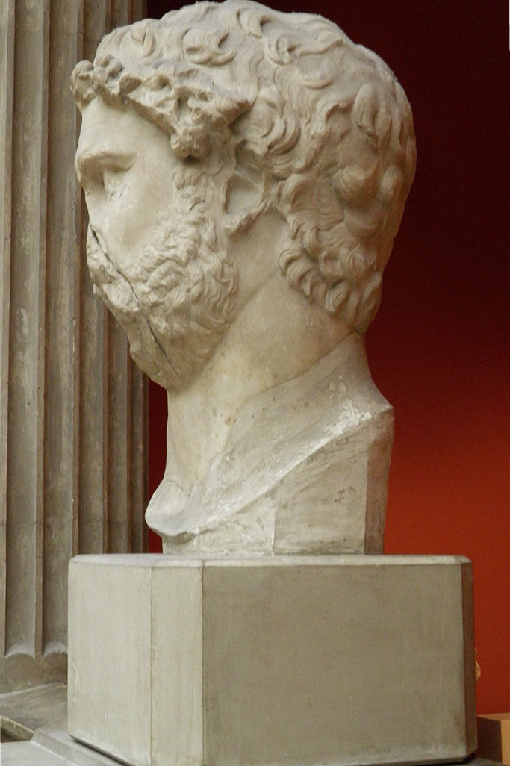
TRAJANEUM
Archaeological research
uncovered and examined in the years 1879-1880 and 1885 by an architect H. Stiller, but for decades the ruins were left
- 1960's the Turkish Administration initialized the process of its restoration - German Archaeological Institute (DAI)
- preparations started in 1965 and in 1976 the restoration program was approved by the Turkish Directorate of Antiquity, finished in 1994
- the reconstruction started with the halls
- method: anastylosis – the reassembly of existing, but loose parts
- statues of Trajan, Zeus Philios and Hadrian were found during the reconstruction process which are now in the Pergamon Museum in Berlin.

Slide 22
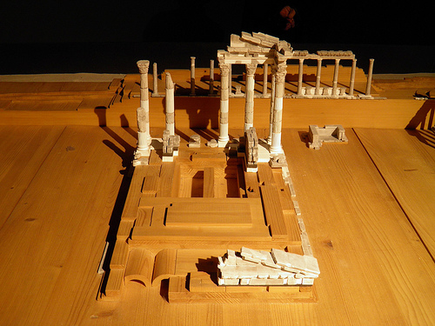
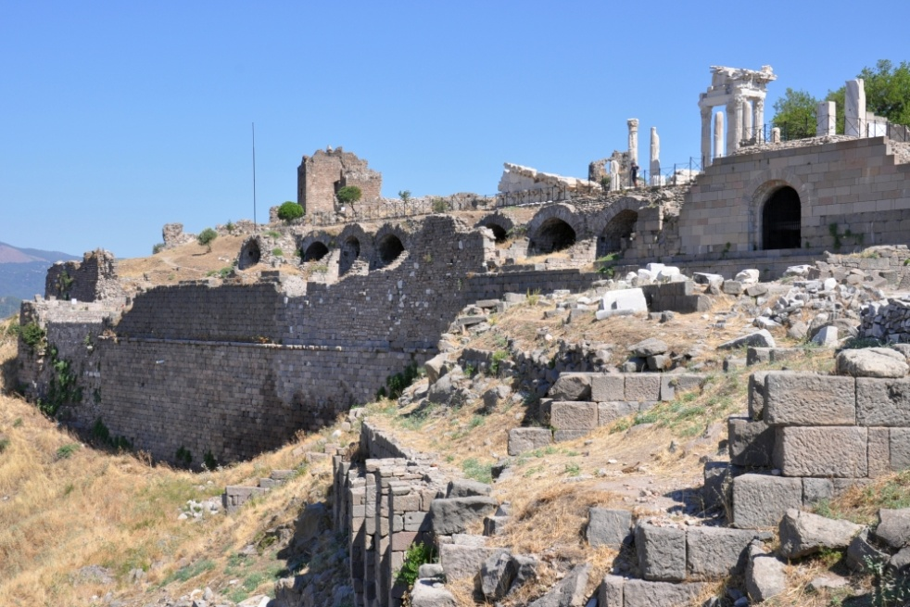
TRAJANEUM
Construction
-high podium covered with marble, in the middle of the site, the top of the acropolis hill
- the large space - obtained by leveling the rock in the side of the mountain, a platform supported by arches was built
- the structure: strong parallel supporting walls which were covered with barrel vaults
- the substructure towards the valley finishes with an ashlar stone wall 23 meters high and consisted of 11 parallel rows of arched tunnels
- the upper part of this wall, with a large arch in front of each vault
- the lower part - the vaults form a passageway
- in late antiquity - increasing value of metals inspired the plundering of ancient buildings.
- in Byzantine period the temple wall facing the valley included in the acropolis fortifications and restored several times
- some parts of the substructure were used as cisterns and warehouses.
- until the end of the 19th c. - the marble components of the building served as material for lime burning.

Slide 23
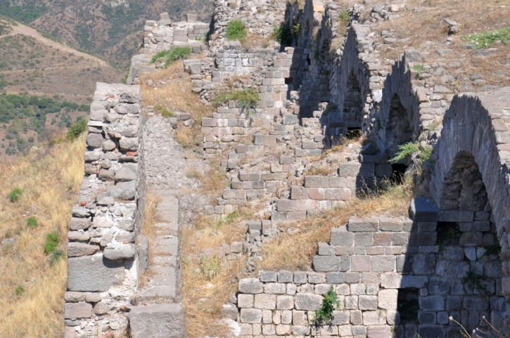
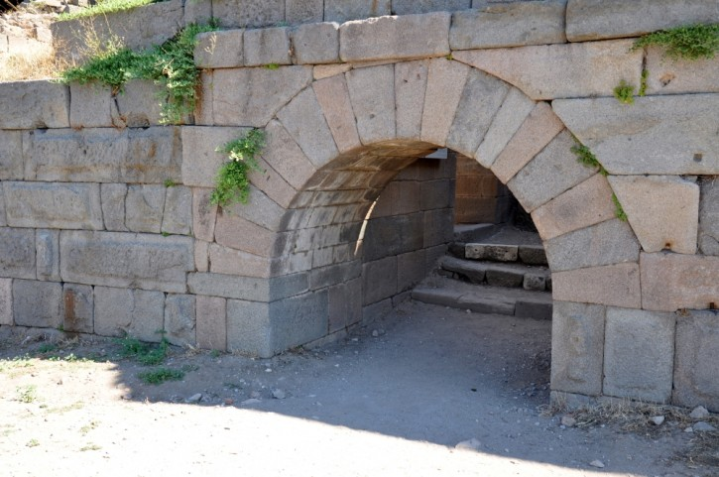
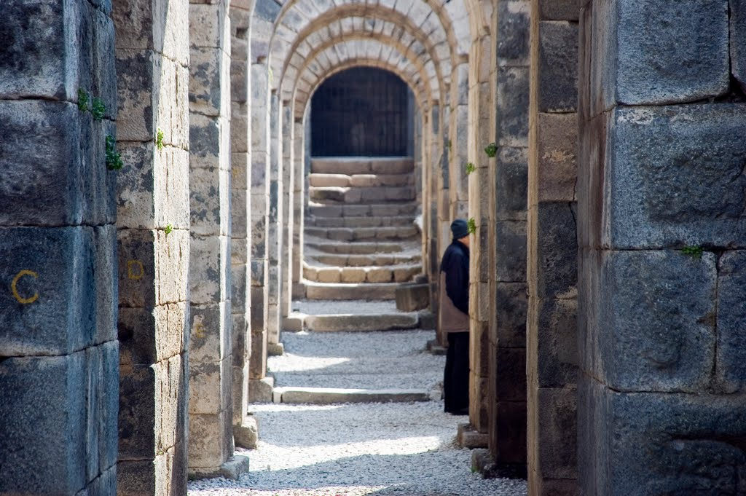

Slide 24
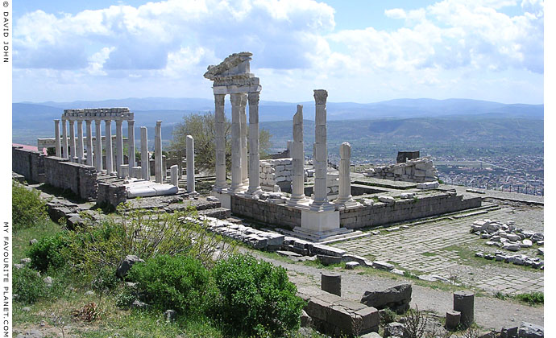
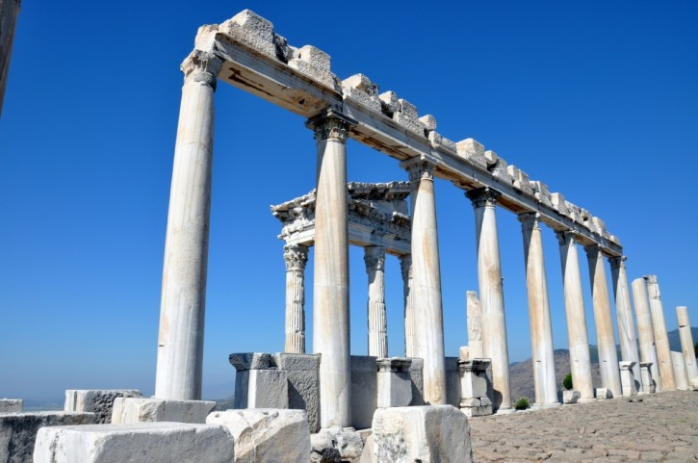
TRAJANEUM
Typology
rectangular podium 68 x 58 meters.
the temple stands on the highest point of the previous constructions of terraced residential and trade buildings from the Hellenistic period found underneath
Greek traditions - the main part of the building - free-standing.
- three sides (north,east and south)- surrounded by stoas with monolithic columns and a special form of Corinthian capitals
the west side was left open so that the temple could be seen and admired from below the Acropolis and the surrounding countryside.
- the stoa on the back of the temple is higher than others by 5 meters, because of the terrain unevenness.

Slide 25
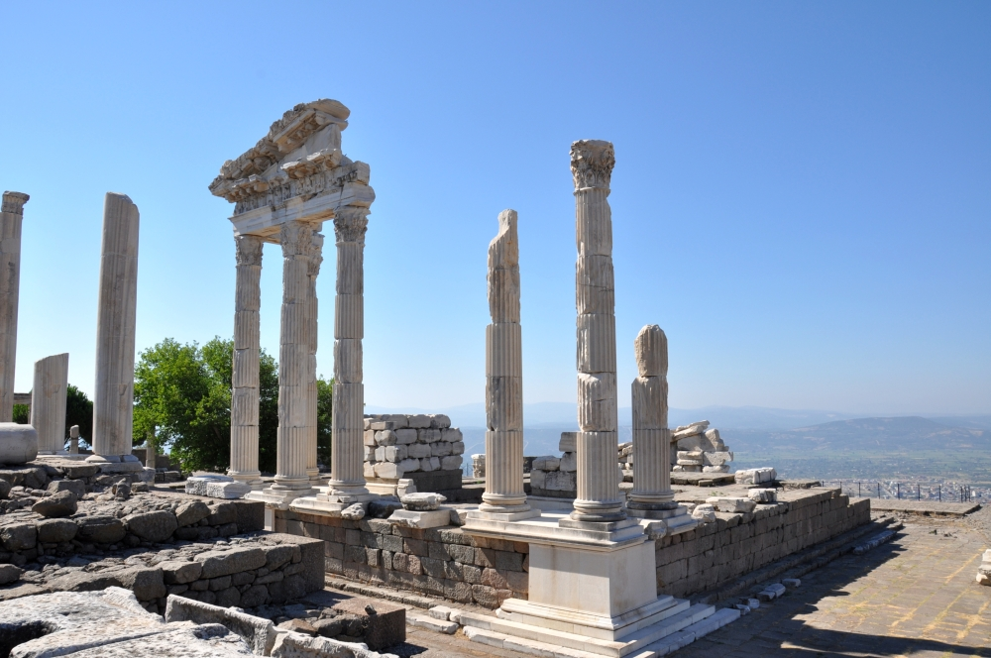
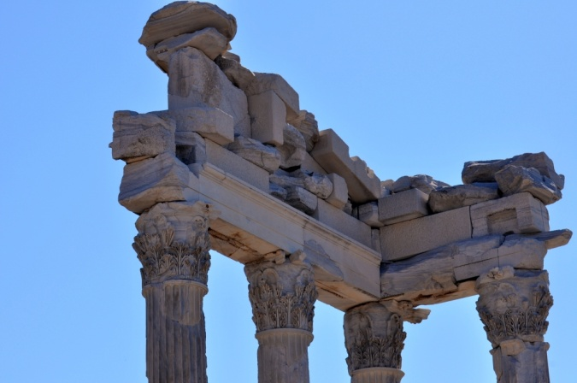
TRAJANEUM
Temple
a peripteros type, hexastyle, with 9 columns on both longer sides, Corinthian order
- next to the temple - an altar where the statues of the emperors once stood
- near the entrance to the Trajaneum two inscriptions:
from the city of Thyatira and it congratulates Pergamon for becoming neokoros for two imperial cult temples.
from the time of Trajan and it declares him the lord of the land and the sea.

Slide 26
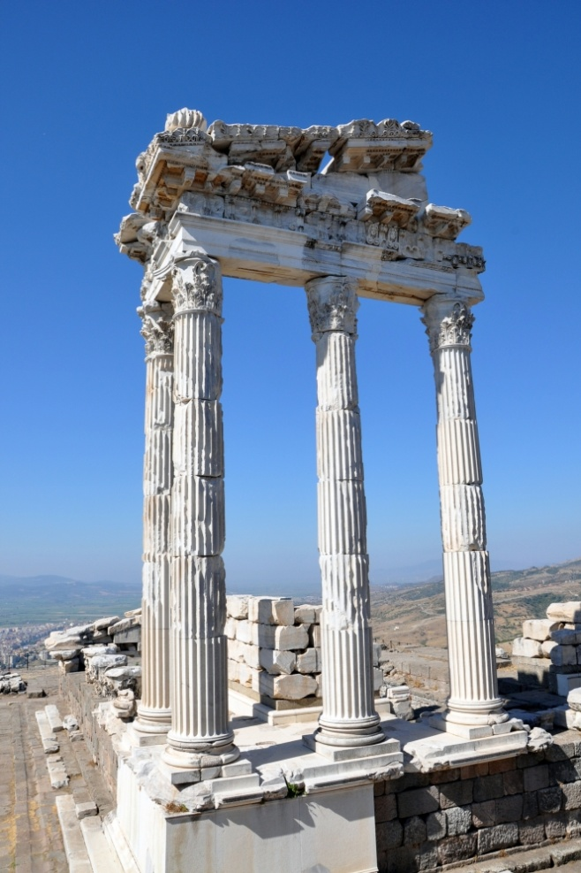

Slide 27
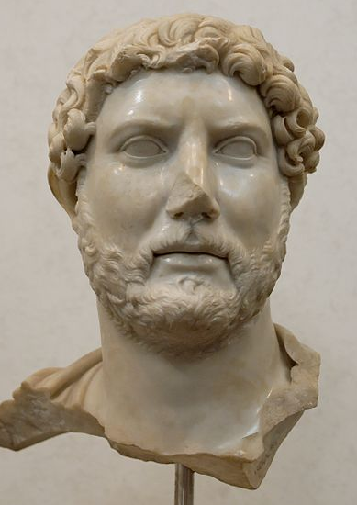
Publius Aelius Hadrianus (76 – 139)
- imperium in 117 AD
- born in Hispania, a ward of Trajan (family connection)
- educated in music, arts, loved Greece and Greek culture
- most of his principate – traveling everywhere – statues, monuments, erected in his name
- no military ambitions – consolidating and protecting (Hadrian’s Wall)
- the adoption – suspicious (supported by Plotina)
- patron of architecture – amateur architect, designed the Temple of Venus and Roma
- Apollodorus of Damascus – Hadrian designed and “drew pumpkins”
- Villa in Tivoli – pumpkin-vaulted structures
112 archon eponymous
Athens – Roman Agora – Arch of Hadrian, Olympieon, Library, the Theatre of Dionysius
- died at Baiae, divinized by Senate

Slide 28
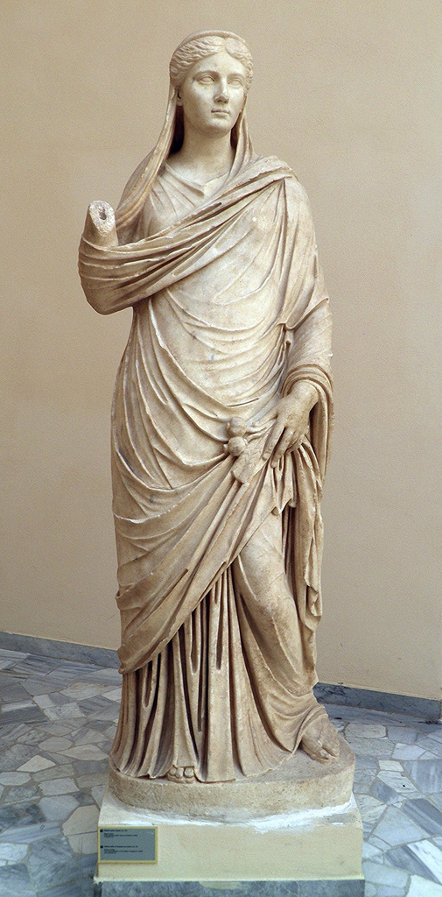
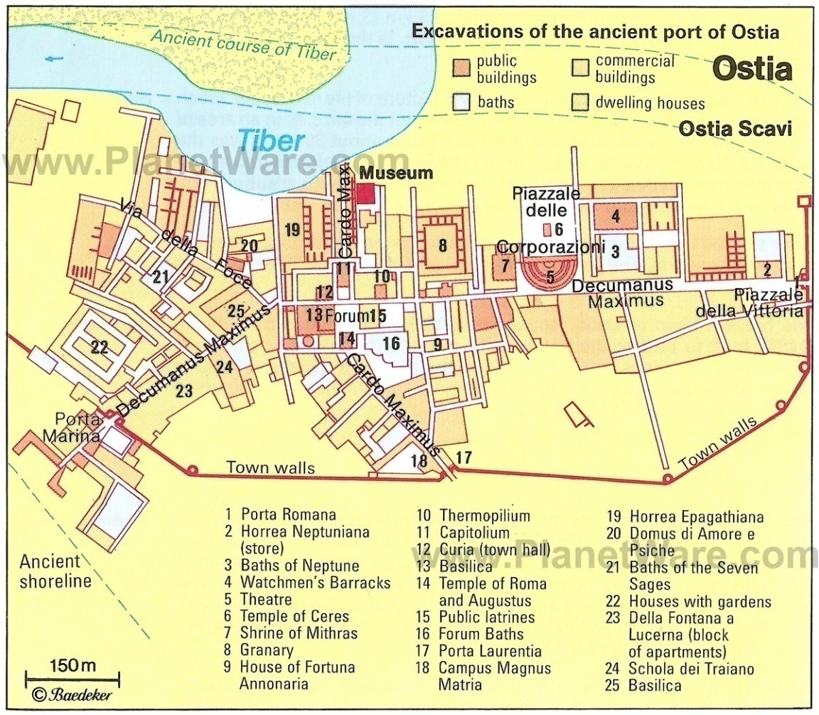
Sabina
100 – Hadrian married Sabina
Sabina died 136/137, divinized by Hadrian and honored jointly with him after death
Ostia – Sabina as Ceres – poppy and an ear of corn (posthumous version)
found in the palaestra of the Terme di Nettuno, Ostia

Slide 29
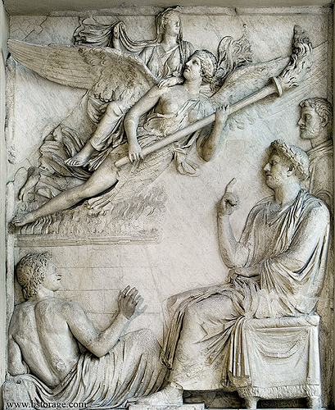
Arco di Portogallo (136 – death of Hadrian)
- 2 reliefs – Palazzo dei Conservatori – Sabina’s apotheosis, Hadrian’s alimentaria
- the form is unknown (maybe arch or altar)
- found close to Portuguese ambassy
Apotheosis of Sabina
- the first depiction of the apotheosis of an empress in monumental sculpture
also coins
characteristic Greek-style coiffure covered with diadem and veil
- seated on winged female personification – Aeternitas(?), who carries a torch
- Aeternitas seems to rise from flaming ustrinum (modern addition?)
- the young figure – watching – Campus Martius
Hadrian sitting on the right (figure behind, impossible to identify)
all figures in profile
- the style of reliefs – classicizing – elegant figures on a blank background

Slide 30
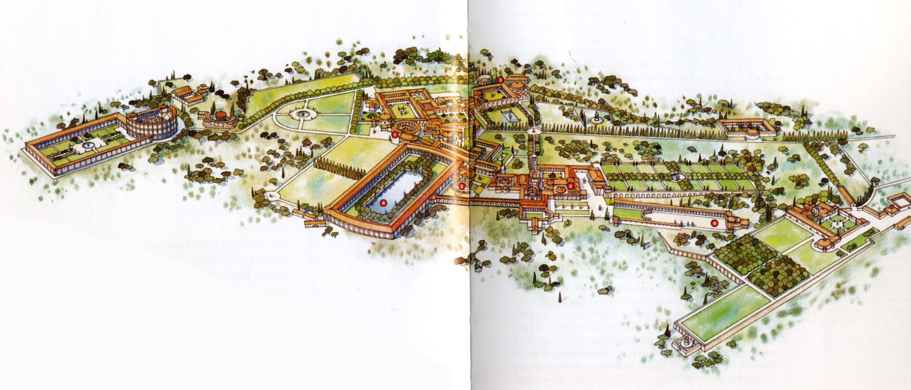
Antinous
a Bithyan Greek
born in Claudiopolis, Turkey
introduced to Hadrian in 123 AD
- 128 AD – a tour of the Empire as a member of Hadrian’s retinue
died in October 130 AD, while going along the Nile – mysterious circumstances
Cult of Antinous
Hadrian deified Antinous by identifying him with Osiris, without the permission of the Senate
the decision unusual – divinization reserved for the emperor and members of the imp. family
body was probably embalmed and mummified, taken back to Rome to the villa in Tivoli
on the site of his death – the city of Antinoopolis
in Athens, October – Antinoeia (games)
worshipped as a divine hero, a god, or both

Slide 31
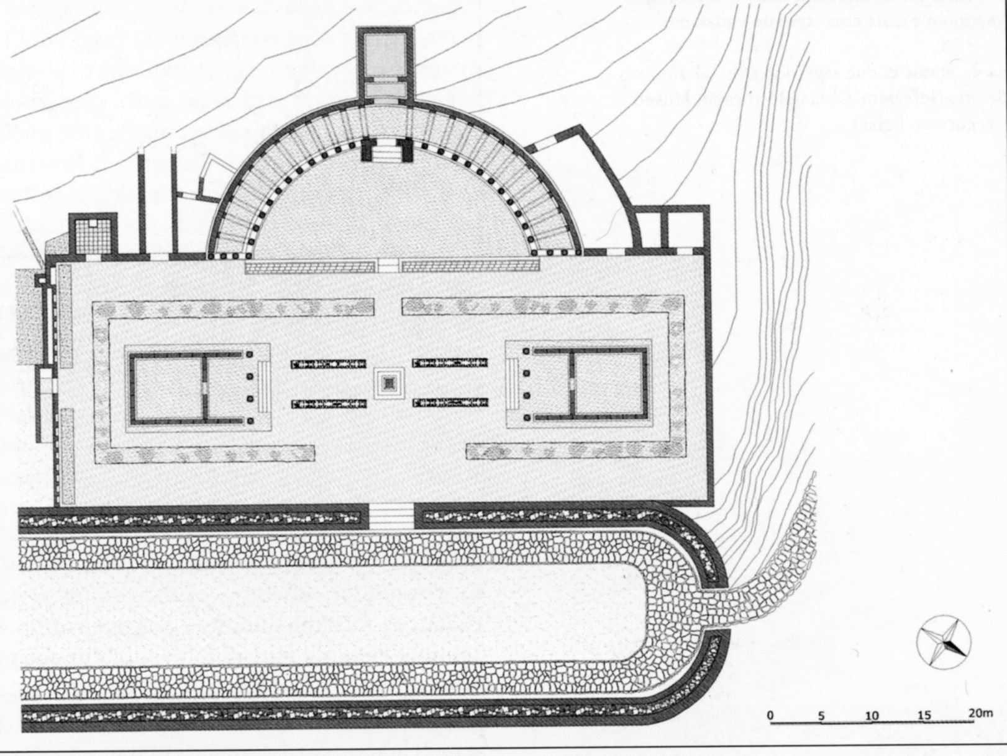
- three excavation campaigns (2002-2004) - - a rectangular temenos (63 x 23 m), opening in the west side into a wide hexedra.
inside the temenos - two facing temples (A: 15 x 9 m each) in antis (4 columns on the front), with a deep pronaos and a podium with central staircase
entirely in marble, until the top of the roof
destroyed because of the intensive cultivation of the area since the 17th century
B
C
C
F
D
D
A
E
E
A
F
inner foundation wall of the hexedra - slim columns in giallo antico, forming porch (B)
in front of the hexedra - two long and narrow basins (C: 13 x 1 m), covered in white marble slabs
the pavement of the temenos was in mosaic.
the area was organized as a garden:
the two temples were enclosed inside a deep trench in the tufa (D), into which trees must have been (possibly palm-trees, evocating the Egypt and, thanks to their high stem, not hiding the temples with their foliage)
four parallel trenches - flowers (E).
- the hydraulic system was very well conceived and on the south wall of the temenos there
were fountains (F).

Slide 32
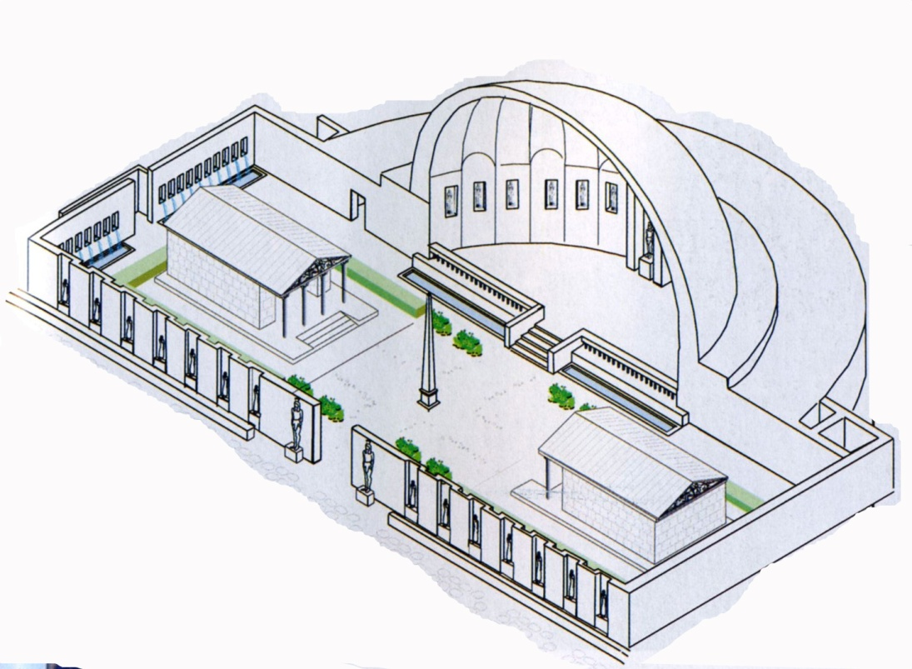
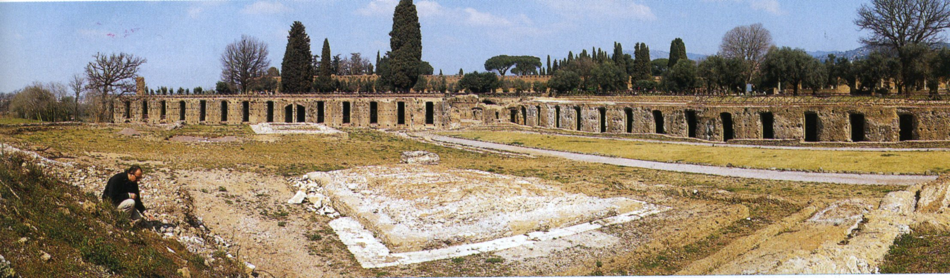

Slide 33
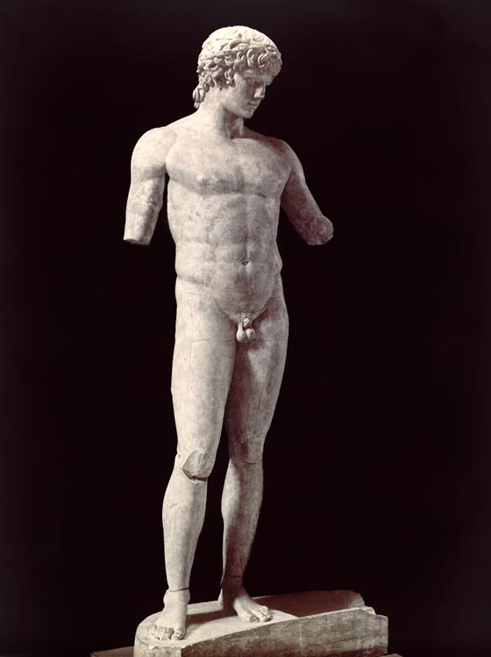
Hadrian focused on the spread of the cult in the Greek lands
Antinous syncretized with Hermes, Dionysus, Bacchus, Silvanus, Apollo, Osiris
altars and temples to the god erected in Hermopolis, Alexandria, Oxyrhynchus, Tebytnis, Lykopolis, Luxor
a small cult (comparing to traditional deities or emperors) – found in 70 cities, at least 28 temples, about 2000 sculptures (115 survive – 44 found in Italy, 12 in Greece and Asia Minor, 6 in Egypt)
votive offerings, gifts of food and drink in Egypt, with libations and sacrifices
Antinous as Apollo (Delphi)

Slide 34
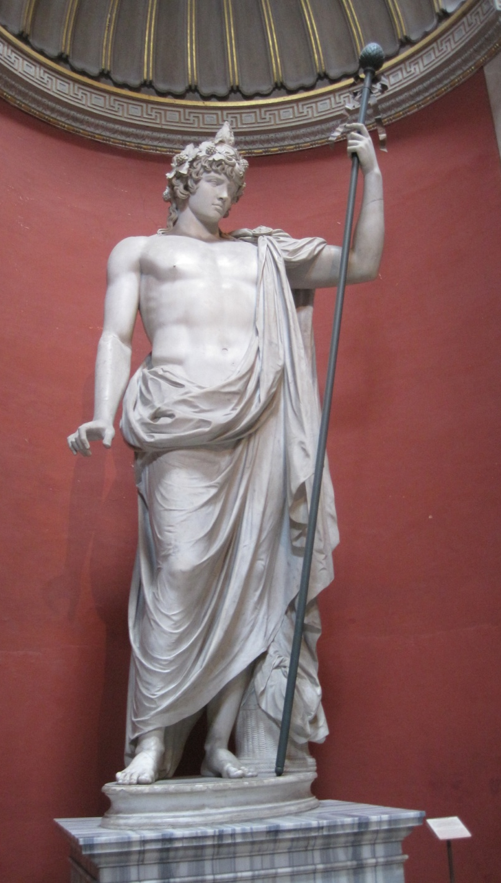
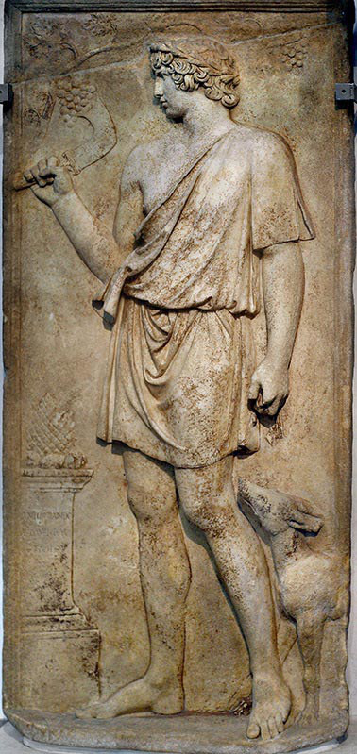
Antinous as Bacchus (Vatican)
- Antinous as Silvanus (Lanuvium) – from Aphrodisias
a pinecone on the altar, and Antinous appears to be cutting a grape vine (both of which suggest Dionysos)
but he is holding a falx (the curved vineyard knife), which was one of Silvanus’ attributes
accompanied by a hunting dog
about 90% of the extant images of Silvanus

Slide 35
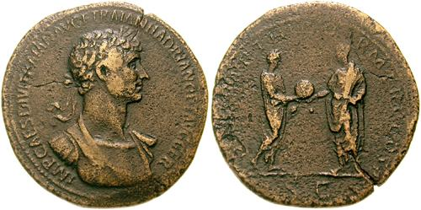
Hadrian and the Imperial cult
- centre of his religious program – focused on the emperor and imperial house – Sabina and Antinuos
- early in his reign – silenced rumors regarding his adoption – adoption planned by the gods (coins) – Jupiter´s providence, Trajan only implemented the divine will
- Hadrian – invoking both earthly and divine commands
religious language – Greeks – public monuments, private dedications, received more divine =
honors than any of his predecessors – statues, shrines, association with Greek divinities – Zeus, Apollo
– a bronze sestertius – reverse Hadrian bust, obverse Hadrian and Trajan – standing close to each other, Trajan delivers globe to Hadrian

Slide 36
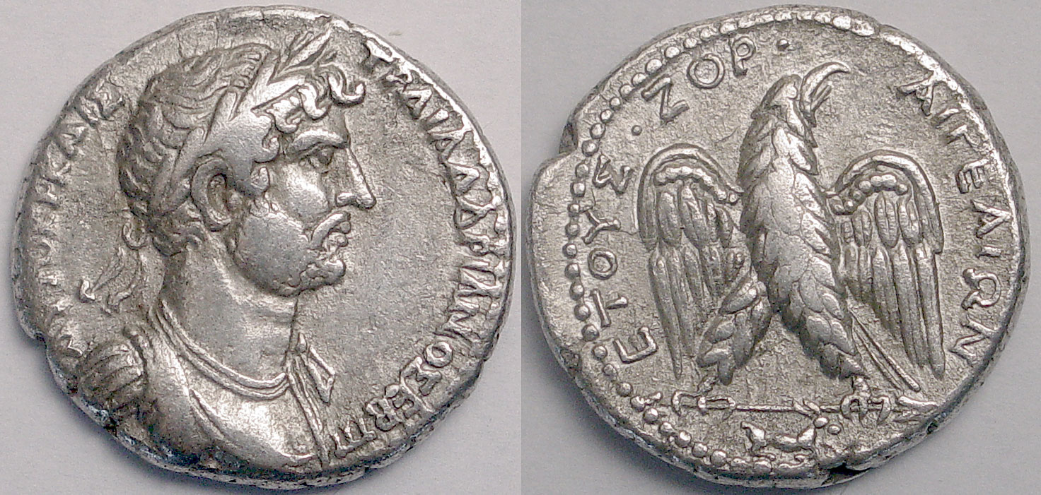
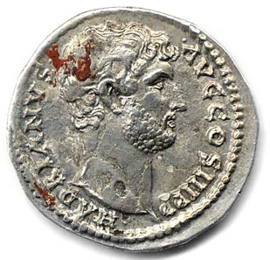
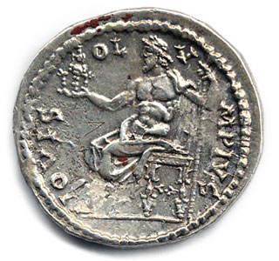
- Hadrian – importance of the cult – unifier of the empire, promotion of the cult of Zeus and his own assimilation with this god
- religion in the service of politics

Slide 37
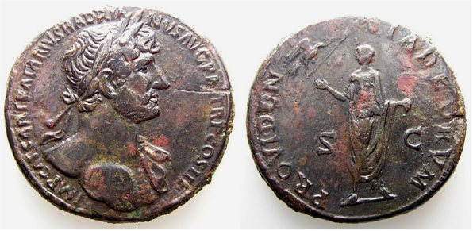
Hadrian and Divine election
- Giessen papyrus – 2nd c. AD – Egypt – dramatic performance in honor of Hadrian´s accession, people participating: Apollo, Demos of the city – Apollo brings a divine message, rides on the chariot, rises as Helios to the sky with Trajan and introduces the new king Hadrian to the audience
- Apollo as a messenger – not a coincidence – Apollo as Helios is Egyptian Ra, protector of pharaohs
- poem - composed on account of Hadrian´s accession, Trajan already deified here
- coins – bronze sestercius – 119 – 121 AD – obverse- rises hand towards an eagle – Jupiter, which bears a scepter in his claws, Hadrian – a roll in the other hand, the legend – providentia divorum – a providence of the gods and a good emperor

Slide 38
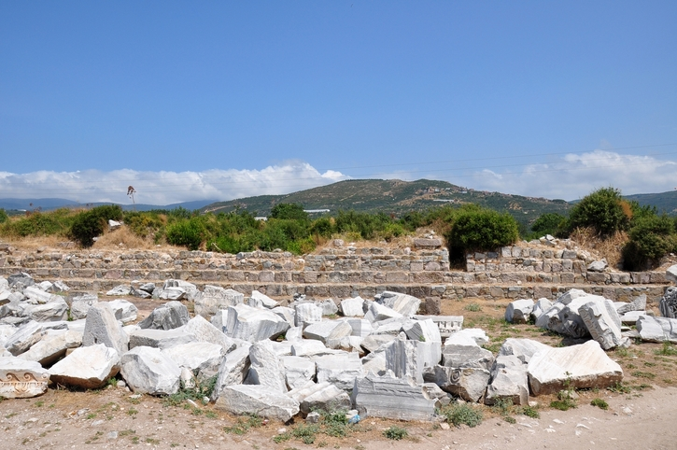
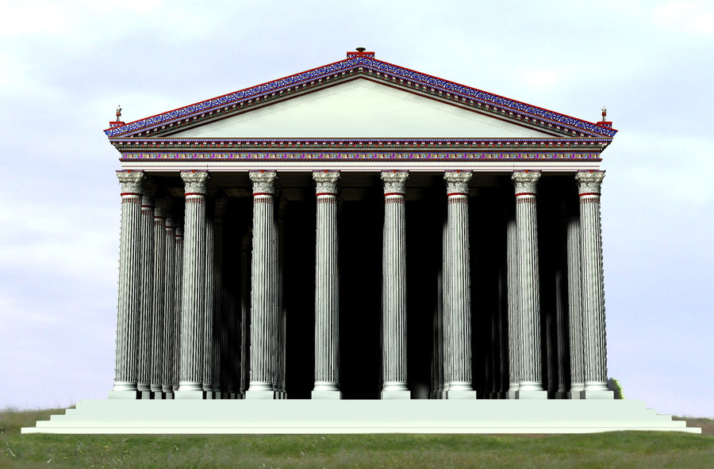
- golden aureus – laureate bust on the obverse, reverse – Hadrian standing, receives the globe from Jupiter, between them – an eagle
- wanted to state his divine election publically
- city Cyzicus – declared Hadrian the 13th god, and the city became a neokoros of his cult – temple – worshipped alone or as synnaos of Zeus, or all the gods
- Hadrian became the new Zeus

Slide 39
Hadrian and Divine
interested in divination and mystic cults, magic, was superstitious
skilled in astrology and every science and art, credited with healing powers (divine, superhuman – predestinated)
desire to know past and future – generous to Delphi and its oracle
125 AD – Delphi – elected him an archon 2nd time
a frequent visitor to the oracle – 2 visits before gaining imperium, excellence in the art of astrology – created his own horoscope
The art of the occult
Aurelius Victor – Antinous offered himself – Hadrian believed that he´ll prolong his life

Slide 40
Promotion of the cult of Rome
- consolidating traditions
problems in Rome - instability and revolts
strong in the east – more accepted there, because he didn´t want assimilation of different nations, but their acceptation
Trajan – accepted as and assimilated to Jupiter, in the West
Hadrian – Zeus – helped him to promote his program among the Greek people
But what about the West?
Two main cults – Zeus – Greek mainland and Asia Minor
Roma – Latin West
Roma and Augustus (Venus)
Hadrian - temple of Venus and Rome in Rome
- dedicted because pietas towards the Julio-Claudian dynasty, especially Augustus
- inclusion Rome and Venus – inclusion of Augustus line in the monument – legitimacy to his rule
- rebirth of Roma´s cult – restoration and revitalization

Slide 41
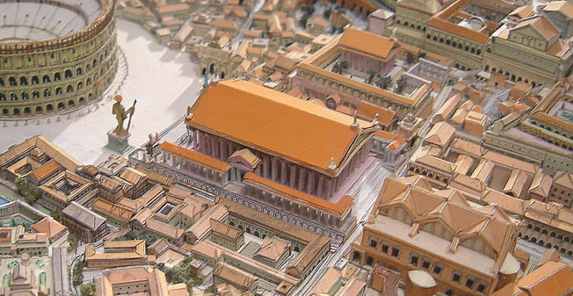

“‘For now,'” he said, ‘if the goddesses wish to get up and go out, they will be unable to do so'”, Apollodorus Damascus
(Dio, LXIX.4.1-5).

Slide 42


Hadrianeum
145 AD, coins, inscriptions - Antoninus Pius – commemorated Hadrian
location: close to Pantheon, Piazza della Pietra
1696 - pontificate of Pope Innocent XII – incorporated into a large building designed by Carlo Fontana to house the central Custom office
1879 – 1882 – building modified, baroque decoration replaced by a simpler one
1928 – wall of the cella freed
today – Rome’s stock exchange

Slide 43

The precinct
consisted of: the Temple of Divus Hadrianus (later also Diva Sabina), enclosed by a rectangular porticoes with an internal colonnade, 2 columns still in situ (northern peristyle) and an arch of Hadrian nearby
entrance gates – main axis – east and west side
monumental wall in peperino tufa, 4 m below the pavement level

Slide 44


The temple
peripteral (similar to Venus and Rome), 8 x 13 columns, podium 27 x 45 m, shafts on columns, not monolithic, Greek fashion
cella and columns – stand upon a stylobate and large podium – excavations - 5 m below the present floor level
poorly preserved – 11 Corinthian columns – peperino blocks from the north wall of the cella, part of the vaulting, remains of the staircase, 15 metres high, 1.44 m diameter
interior – vaulted, lined with columns on each sides, west – apses
architrave – 2 fasciae and 3 moldings - cavetto, ovolo, astragal, frieze
richly decorated entablature

Slide 45




Slide 46

The sculputral program
- portraying the provinces united under the emperor and under Pax Romana
- Hadrian’s politics – pacification, unification
- 21 panels of provinces, 9 trophies – Palazzo dei Conservatori (7+3), Naples (3+2) and private collections (some panels known only from the drawings from the 18th century)
- no inscriptions, attributes identify the provinces
location of the panels: many theories – inside or outside the temple – architectural support, provinces alternated trophies
3 different theories:
a) decoration of balustrade of the temple’s podium – province under a column, trophy in intercolumnarium
b) attic of the temple – now, the most preferable
c) external frieze
d) fine preservation – must have been inside the cella – flanking the statue of Hadrian – colossal statue base found

Slide 47



style: classicizing (continuation of the style)
figures: frontally positioned, blank background, stationary figures, high relief, projecting in front, with their feet resting on a molded base
techniques: incised on the stone – outlining of the figures and the drawing in stone – artist’s attempt to highlight figures seen from a distance and from below

Slide 48




Slide 49




Slide 50




Slide 52




Slide 53



Slide 54



HADRIAN´S ATHENS
The library of Hadrian
Pantheon
The Roman market
Vespasianai
The tower of winds
Agoranomeion (Sebasteion?)

Slide 55



Vespasianai (1st c. AD)
a square building built in the 1st century AD
used as a public toilet of the Roman Market
took its name after the emperor Vespasian (built many similar buildings around the Roman empire)
The "Agoranomeion" (circa AD 50)
unknown use
facade includes three arches made from grey Hymettus marble
access to it was made via a big staircase
the older hypothesis - the ‘Agoranomeion’ (invalid)
most likely - dedicated to the imperial family (Sebasteion)
the newest research - the arches - the monumental entry to a street with stoas.
The Pantheon (AD 130)
philological sources
a temple dedicated to the gods and was built by Hadrian around AD 130
the location not known precisely
the foundations of a big building east of the Library of Hadrian, likely belong to the Pantheon.

Slide 56


Library
132 AD – pattern of the Temple of Peace – 122 x 82 m, 30 x 22 columns around, marble from Phrygia
267 AD badly damaged by the Herulians
- restored in 408 – 412 (Herculius), in the courtyard - church
- other churches in the Byzantine period
entrance – propylon – 4 Corinthian columns
western wall – Penthelic marble, 14 Corinthian, green cipollino, similar to the forum of Nerva
- internal courtyard with a garden and a pool in the middle
- eastern part – rooms with papyruses (two big rooms), wings – lecture rooms, smaller rooms – reading rooms, a cult room (?)

Slide 57




Slide 58





Slide 59

The theatre of Dionysus
- 2nd visit of Athens - reconstruction
- a bronze statue of Hadrian

Slide 60


12 statues of Hadrian – in the theatre – 12 attic tribes, 4 bases found

Slide 61

- reconstructed the theatre – built a monumental scaenae frons with reliefs depicting the life of Dionysus
association with Dionysus – scaenae frons – the new Dionysus, the new founder of Athens

Slide 62


The temple of Olympian Zeus – “Olympeion”
- 3rd visit of Athens, 110 x 44 m, 104 columns, no altar in front of the temple, Corinthian order
- many statues of Hadrian – by the cities (bases still visible)
- project had started 600 years before by Peisistratos (platform and some elements of columns)
174 BC – Antiochus IV with Cossutius – Corinthian order
164 BC, abandoned when Antiochus died, half finished
86 BC – Sulla – serious damage – columns re-used in Rome – temple of Jupiter
131 AD – intended a dedication ceremony, winter
today: 15 columns remain (total 104) - 1852 the 16th fell down
Pausanias – colossal chryselephantine statue, behind the temple – colossal statue of Hadrian
Hadrian associated with Zeus and received the epithet “Olympios” also called “Hadrianos Zeus Olympios”
- originally dedicated to Zeus – became a centre of the imperial cult

Slide 63




Slide 64

The Arch of Hadrian
- Athenians erected in honor of Hadrian’s benefactions
- purpose: divide old and new part of the city
“This is Athens, the ancient city of Theseus.” – western side
“This is the city of Hadrian and not of Theseus.” – eastern side, facing Olympieon
- the 3rd visit to the Athens, 131 AD - on the occasion of dedication the Temple of Olympian Zeus
- strategic position – people coming from the Agora went through the arch and could read the text, or returning from the Olympieon
- boundaries of old and new Athens of Hadrianoupolis, no statuary decoration

Slide 65



