Slide 1
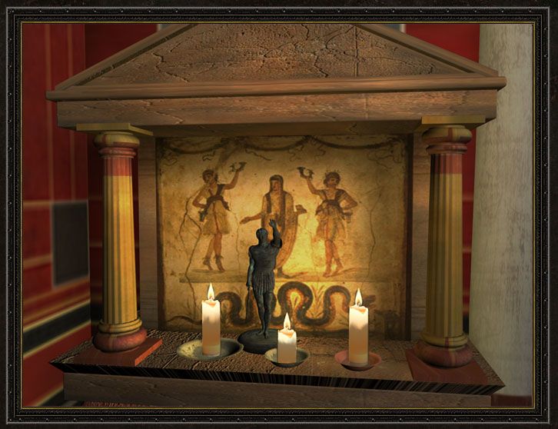
The Buildings and the Images of the Imperial Cult
I. Beginnings

Slide 2
What is the imperial cult?
- assimilating an emperor and deity
The beginnings:
Later unitary concept, but also:
Initial phase of heterogenity
Regional differences and peculiarities
5 points to remember:
Rome and the East – great military leaders (a complex system of interrelations) but also traditional Greek cities to the Hellenistic rulers relationship
A ruler needs – the consent of some people, the support of the army
Greeks and Jewish/Christians – different concept of deity
„human“ and „divine“ not strictly divided
Servius , Ad Aeneida:
„deos perpetuos [dicimus], divos ex hominibus factos […], unde divos etiam imperatores vocamus“ („we call deos those who are eternal, divos those who, once men, became [gods] […], so we call divos also the emperors“).
5. Today´s idea of separating cultural-religious sphere and political sphere wasn´t familiar to the ancient people

Slide 3
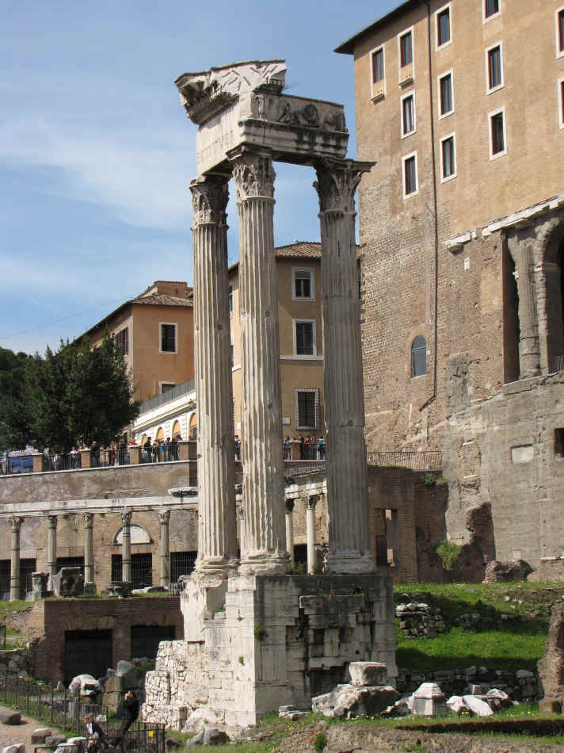
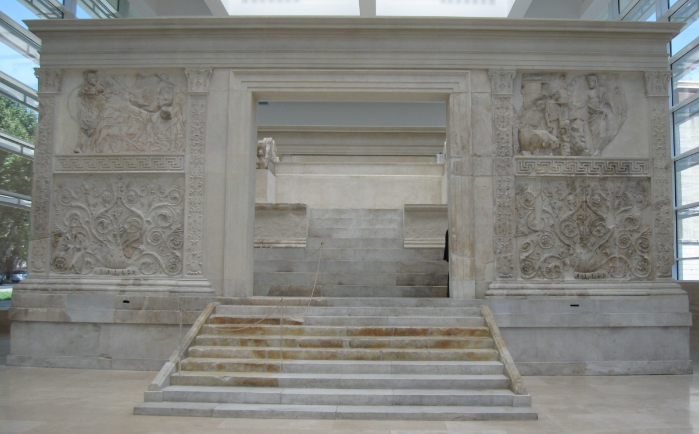
-the most important change of the roman religious system – the end of republic and beginning of the principate
-uniformity
Phenomena:
Building and consecrating altars and temples to emperors and members of their family
Ara Pacis, Rome
The temple of Vespasian and Titus, Forum Romanum

Slide 4
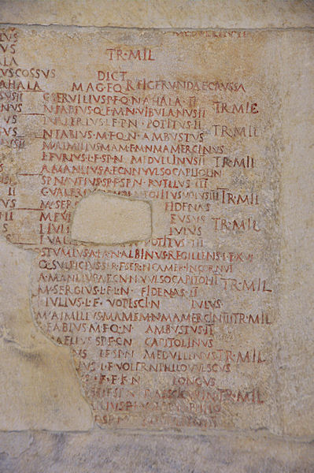
2. Establishing of priests – administer cultic activity,
e.g. Marc Anthony – a flamen of Julius Caesar
3. Emphassising the characteristic features and achievements – using religious terminology, e.g. aeternus (perpetuus), invictus, providus, operosus, omnipresens, decorus, divinus, using astral connotations to Sol etc.
4. Setting public holidays – concerning living or dead emperors and their inclusion to the
calendar, regular rituals: fasti capitolini, fasti triumphales, fasti sacerdotales, …
5. Rituals and traditions previously reserved for deities – e.g. games on behalf of the emperor, increasing importance of emperal portraits in public life and including them to processions: Ludi Augustales, October 3rd – 12th , games were held in Augustus' honor starting in 11 BC. It became a ten-day event under Tiberius.
Fasti capitolini, The Capitoline Museum, Rome

Slide 5
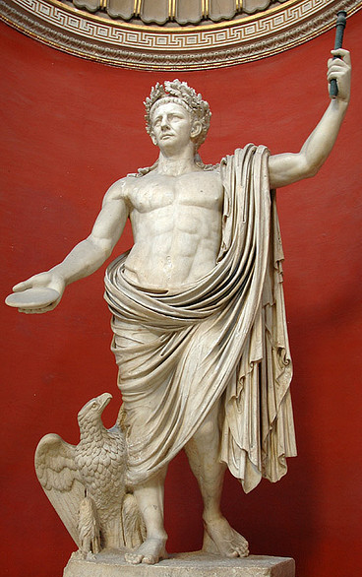
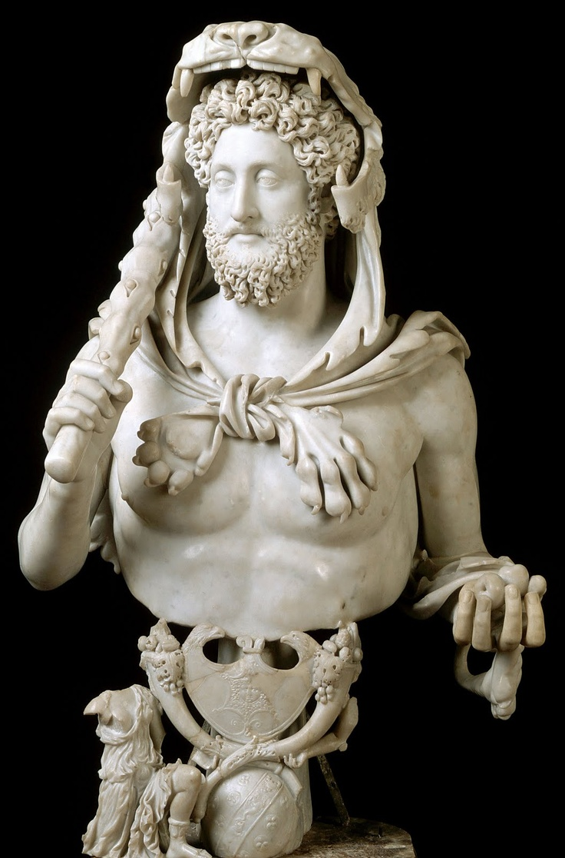
6. Likening emperors to dieties – e.g. statues with characteristic atributes
Claudius as Jupiter, marble, Vatican Museums, Rome
Commodus as Hercules, marble, The Capitoline Museum, Rome

Slide 6
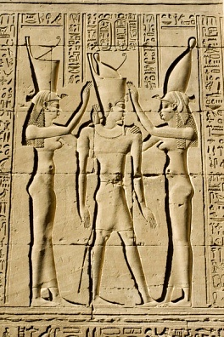
Preliminary steps to the imperial cult:
1. Egypt – ancient Egyptian cults: Divine cults, Royal cults, Private cults, Animal cults and Funerary cults
- Egyptian ruler received cult both during his life and after his death
- during coronation – deified
2. Hellenistic world – cults dedicated to the rulers of the Hellenistic kingdoms
3. Greek cities – divine cults of the individuals
4. Roman republic – standardization of rituals, beginnings of the system and rules for deification
Some scholars (Price) suppose that the ruler cult speeded up the decline of the traditional cults.
Coronation of King Ptolemy VIII conducted by the goddess Nechbet,right,and the goddess Uto or Wadjet,left,Temple of Horus,Edfu,Luxor,Nile Valley,Egypt

Slide 7
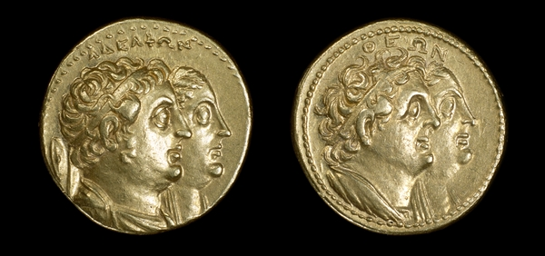
EGYPT
the ruler cult is the strongest
the „divine essence“ of the ruler spreads to the south and west coasts of Asia Minor and Aegean - conquests
e.g. : Telmessus (Turkey) – an altar in the middle, Ptolemaic style
difference: divinity was a public matter for centuries
Starting point – a close relationship between Ptolemaic monarchy and Egyptian cults
From the cult of the deceased ancestors - to the veneration of living men: 17th year of the reign of Ptolemy II Philadelphus – proclaimed his father god and made himself and his sister/wife Arsinoe II living gods
Gold octodrachm – reverse capita iugata of Ptolemy II and Arsinoe – legend “of the siblings – άδελφῶν”, obverse – capita iugata of Ptolemy I Soter and his wife Berenice I – “of the gods - θεῶν”

Slide 8
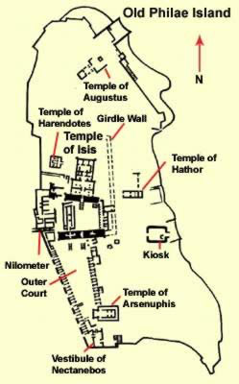
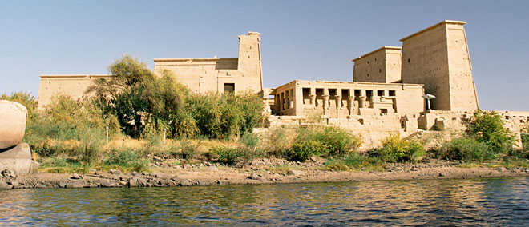
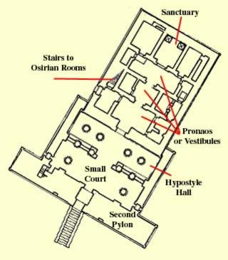
Temple of Isis on the isle of Philae
the cult centre of Isis during the Ptolemaic Period
- dedicated to Isis and Osiris
a court, vestibule, several antechambers and the inner sanctum, where the sacred image of Isis was kept
reliefs and inscriptions: various Ptolemies (Philadelphus, Euergetes II) and Roman Emperors (Augustus, Tiberius, Antonius Pius) – making offerings and rituals
Temple of Isis, the island of Philae

Slide 9
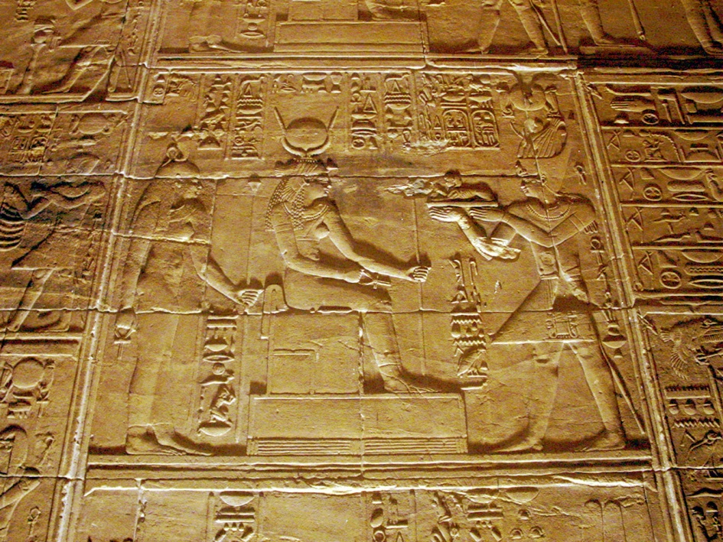
Ptolemy II in Pharaonic costume
offering to Isis (also Augustus depicted in the Pharaonic costume in front of Isis and Harpocrates).
No difference between the ways in which Octavian-Augustus and Ptolemic predecessors are
named and depicted:
“Welcome! Welcome, son of Ra, Caesar, who lives forever. Until the sky lasts, your kingdom
will last. Your mother Isis is pleased with that you have done and directs you the hearts of
the inhabitants of the Earth.”
Augustus is named:
“Ra of Upper and Lower Egypt, lord of the two kingdoms, emperor son of Ra, lord of the
crowns, Ceasar, who lives forever, the beloved of Ptah and Isis.”

Slide 10
2. HELLENISTIC WORLD
hellenistic cults - considered preliminary to the imperial cult
religion: belief in cults, a set of rules of rituals
politics: about actions, diplomacy and wars
ruler cult: honours granted in gratitude for political benefactions
Hellenistic rulers – cults - mostly meant as cults of benefactors, saviours from dangers and
founders of cities
Such devotion is explained with the increasing number of people depending on the will of a
single man, the greater merits, the deeper devotion towards him
first – heroic honours
then – switch to divine honours
Imperial cult – continuation
Crucial conditions: AUTOCRATIC RULE
EXTERNAL TO THE POLIS
AT LEAST A BIT GREEK
Why not earlier? Tyrants – didn´t fit, no monarchical institutions, not external to the polis
Pindar – no special language praising tyrants – the same as other aristocrats
Persian kings – monarchy highly developed, but Persian rule was rejected, not at least a bit
Greek

Slide 11
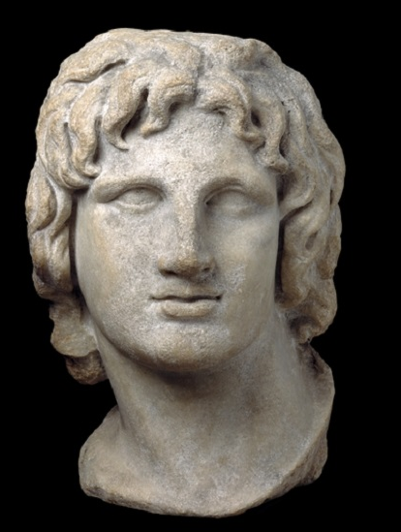
Examples of cult:
Macedonia – cults of Macedonians before and after Alexander – rare
Macedonian towns – less important role in the organization of kingdom than
the Old Greek cities
Philip – cult in Philippi (particular case, because the city was founded by him)
Alexander the Great – divine cult was offered to him in his lifetime
Absence of the cult in Macedonia – lack of independent civic traditions, unproblematic nature of the traditional monarchy
Alexander the Great, Alexandria, Egypt, 2nd / 1st century BC

Slide 12
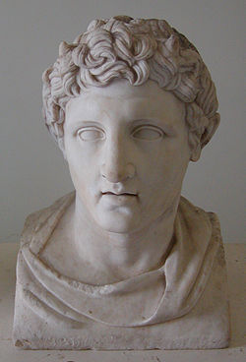
Antigonus I Monophtalmus (Antigonus the One-eyed) and his son Demetrius Poliorcetes (the Besieger)
The end of the 4th century BC , by Athens – the democracy was restored
celebrated as „saviours“ and „benefactors“
the hymn sung in honour of Demetrius:
„For the other gods are far apart, or have no ears, or no existence and they do not care of us. But you are present, not made of wood or stone, a real god, we pray to you.“ (Athenaeus of Naucratis, The Banquet of the Learned VI 253e)
what makes him divine:
a) power to offer protection to Athens
b) vengeance against those who had attacked them
Essential feature of divinity for Greeks – not immortality but the willingness to hear the prayers of men and offer them help in need (Asklepios, Herakles – once men, helping, then entered the sphere of gods)
The hellenistic ruler never declared himself divine, but the recipients of benefactions did
Marble bust of Demetrius I Poliorcetes. Roman copy from 1st century AD of a Greek original from 3rd century BC

Slide 13
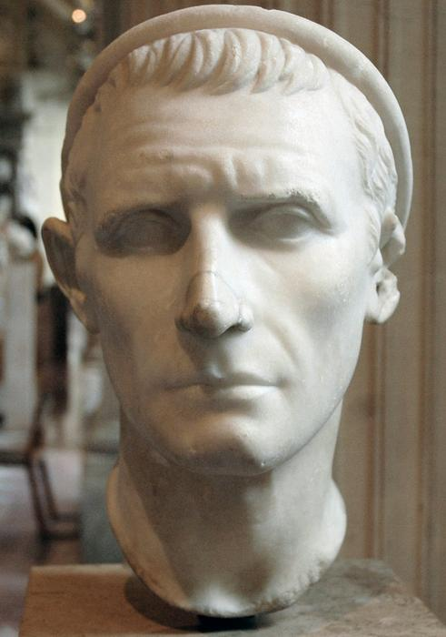
Antiochus III, Syria
- liberation of Iasos 197 BC – altar, later further honours
- Laodice III – wife, shelters for the daughters of poor citizens, new cult – priestess, procession, sacrifice
Teos – Antiochus III and Laodice received cult
– feast (marked in the civic calendar), sacrifices, cult statues next to the statue of Dionysus in his temple
Kings are gods not heroes
Distinction: funeral – depends on sacrifices
thysia – in the cult of gods – a part was eaten
enhagisma – heroic sacrifice – non-consumable, didn´t deify the deceased, were not directed to them either
„heroic honours“ – Alexander the Great
Heroes – limited space and couldn´t intimate relations with the power of heaven
Ruler cult – the universal power of a god lying outside the city and that of the king
Antiochus III, Louvre

Slide 14
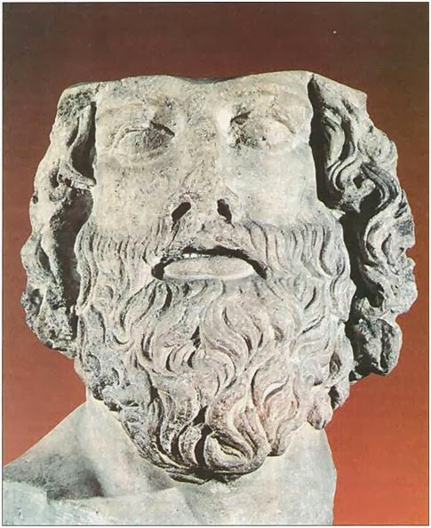
3. GREEK CITIES
Lysander – Spartan general, 5th /4th century BC
not of a noble origin
recieved a cult on Samos as the first mortal during his lifetime
  Samians erected an altar
  Offered him sacrifices
  Sang cultic songs
  Renamed the festival of Hera the Lysandreaia
Still a substantial difference between worship of the gods and the honours for the mortal: no reference to a cult statue or to a shrine.
Lysander

Slide 15
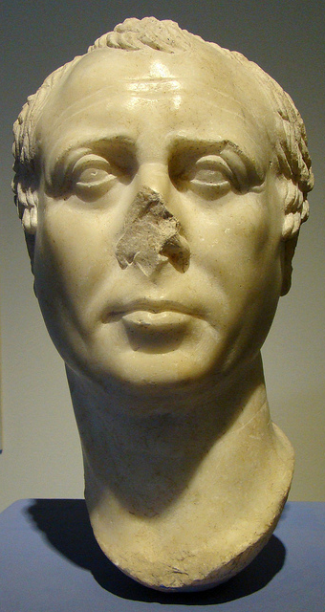
Divine cult of individual citizens – the end of the 2nd century BC
Diodorus Pasparos at Pergamum
city lost its freedom – Mithridatic War against Rome (88-85 BC)
Diodorus – went to Rome – reduced the rate of tribute to Rome
series of divine honours:
    1st: a tribe was named after him
    recieved a priest
    the day of his return – commemorated
    by a festival
    a sanctuary containing his cult statue
    was built
    2nd: in the gymnasium – a cult statue in a
    separate room sharing the throne with
    the gods of the palaestra
    This kind of honours – isotheoi timai (god-like honours)
Diodoros Pasparos – the cult statue from his sanctuary

Slide 16
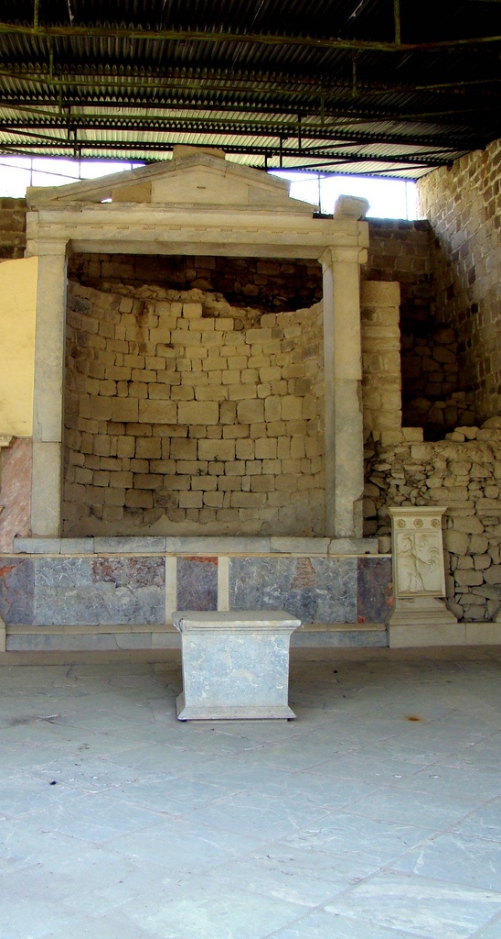
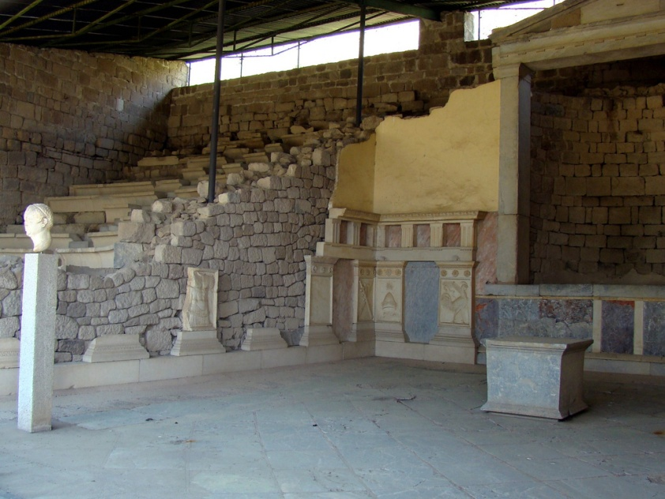
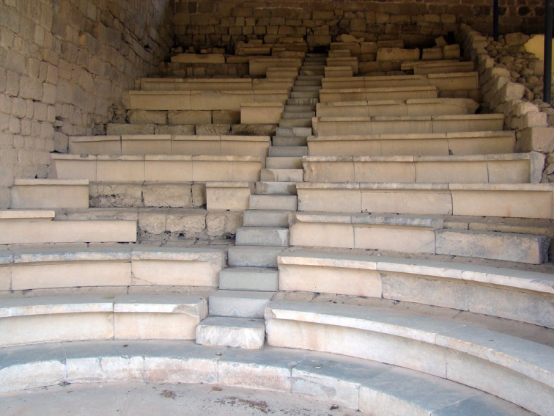
Heroon of Diadoros Pasparos – the cult room and odeon, Pergamon

Slide 17
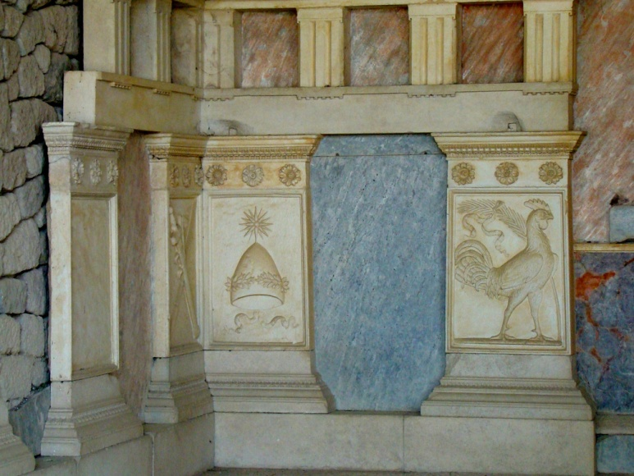
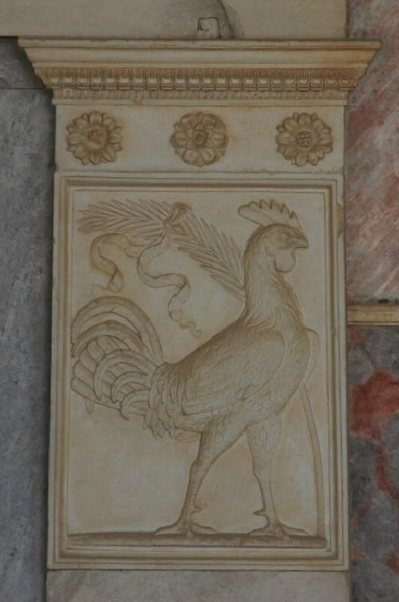
Heroon of Diadoros Pasparos – the cult room and odeon, Pergamon – marble panels

Slide 18
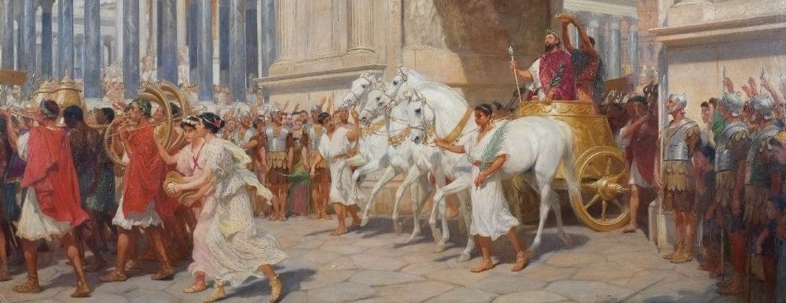
4. ROME
I Public sphere
The regal period – kings put to the position much closer to the gods than other people
e.g. Romulus – after his death (or disappearance) – worshipped as Quirinus
Servius Tullius – a friendly relationship with goddess Fortuna, chosen to reign by a prophecy in his early childhood
Army leaders – on the day of their triumph – more or less worshipped as a deity
(Tertullian (160 AD – 225 AD):Respice post te, hominem memento te)
A triumph – in the regal pariod awarded to: Romulus (?), Ancus Marcius, Tarquinius Priscus, Servius Tullius, Tarquinius Superbus and some generals (Fasti triumphales)

Slide 19
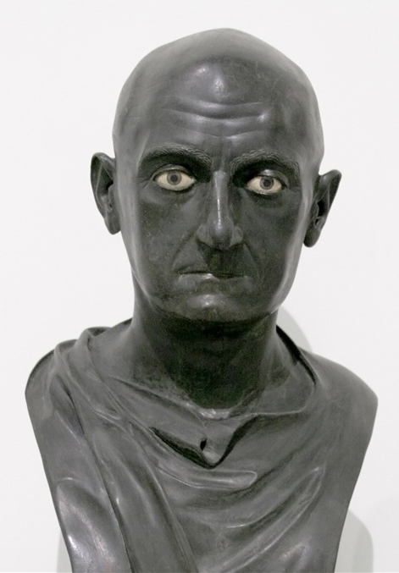
The republican period – several historical moments – inspiration to the imperial cult
the cult of important individuals (imperatores):
Publius Cornelius Scipio Africanus
– the first member of aristocracy, who during the battle with Hannibal, gained the status highly exceeding the other aristocrats
- close relationship with Jupiter Capitoline
- in favour of gods
- legends about his divine origin – similar to those of Alexander the Great
- divine origin – will appear in unchanged
form with the birth of Augustus
- Apotheosis – 50 BC – Cicero – describing
Scipio Africanus – became a star – a symbol of
apotheosis
b) Tiberius and Gaius Gracchus
- statues placed in public places –compita,
- sacrifices of the first crops in all seasons, worship
c) Marius Gratidianus
- for a currency reform, 85 BC, statues displayed in compita
Publius Cornelius Scipio Africanus, bronze, Naples, National Archaeological Museum

Slide 20
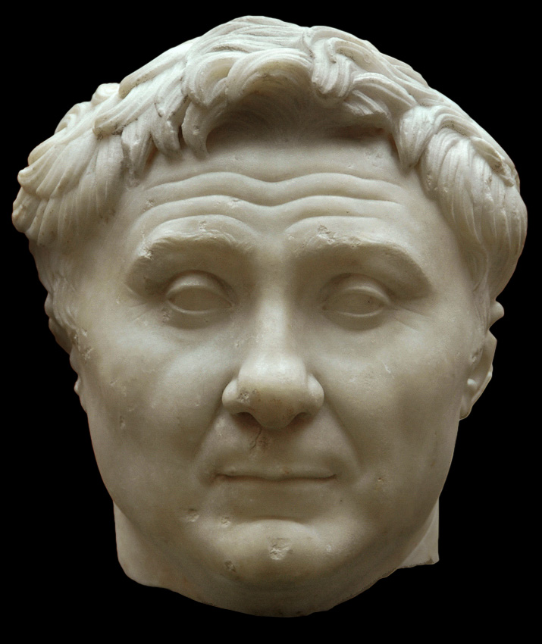
d) Pompey
honours rendered to him by the Greek cities in Asia Minor
Miletopolis (Pompey defeated Mithriades, 63/62 BC) – σωτήρ (soter/saviour), εύεργέτης (euergetes/benefactor), and έπόπτης γῆς καί θαλάσσης (epoptes ges kai thalasses/an overseer on the sea)
his dominion is „universal“ – control over land and sea is a warranty of a universal peace
Ilion (inscription) – Pompey „has freed men from the wars against Barbarians and from the dangers of the pirates, giving peace and safety on land and sea“
in the East – Pompey regarded as the heir of Alexander the Great and taken as Neos Dionysos (evidence: coins from Amisos, Nicea, Nicomedia, Prusa ad Olympium)
Pompey the Great, marble bust, Carlsberg Glyptotek, Copenhagen

Slide 21
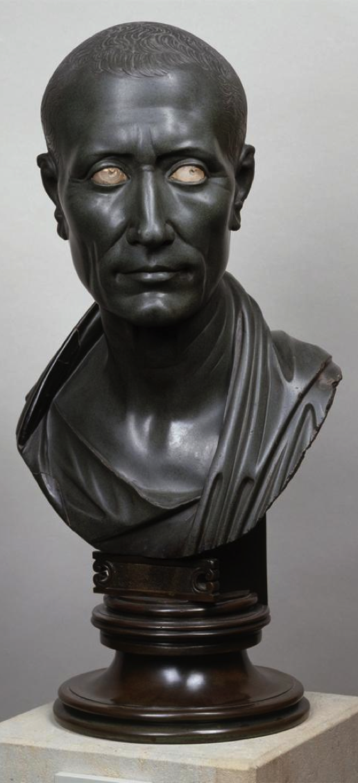
e) Julius Caesar
the only living man in Rome receiving divine honours
three main phases of the Senate´s honours:
1. after the battle of Thapsus – April 6th,46 BC – senators decreed him a chariot (facing Jupiter temple or another statue?), a statue (his foot on the globe) to be placed on the Capitol – inscription hemitheos (the first time the term applied to a ruler in Rome)
2. the battle of Munda – March 17th, 45 BC – a statue in the temple of Quirinus with an inscription „unconquered god“ „deus invictus“
- the news about the victory got to Rome on April 20th – the Senate announced the Parilia (anniversary of the foundation of Rome) to be dedicated to celebrations of the victory
- a procession – Caesar´s image carried in the company of gods, Cicero says „next to Quirinus“
3. the last months of Caesar´s life – decreed a divinity with a cult name Divus Iulius, a state flamen, a state temple, a pulvinar for his image
Julius Caesar, bronze, Altes Museum, Berlin

Slide 22
Cassius Dio, Roman History, book XLIV (the list of honours granted to Julius Caesar by the Senate)
The privileges that were granted him, in addition to all those mentioned, were as follows in number and nature; for I shall name them all together, even if they were not all proposed or passed at one time. 2 First, then, they voted that he should always ride, even in the city itself, wearing the triumphal dress, and should sit in his chair of state everywhere except at the games; for at those he received the privilege of watching the contests from the tribunes' benches in company with those who were tribunes at the time. 3 And they gave him the right to offer spolia opima, as they are called, at the temple of Jupiter Feretrius, as if he had slain some hostile general with his own hand, and to have lictors who always carried laurel, and after the Feriae Latinae to ride from the Alban Mount into the city on horseback. 4 In addition to these remarkable privileges they named him father of his country, stamped this title on the coinage, voted to celebrate his birthday by public sacrifice, ordered that he should have a statue in the cities and in all the temples of Rome, 5 and they set up two also on the rostra, one representing him as the saviour of the citizens and the other as the deliverer of the city from siege, and wearing the crowns customary for such achievements. They also resolved to build a temple of Concordia Nova, on the ground that it was through his efforts that they enjoyed peace, and to celebrate an annual festival in her honour. 5 When he had accepted these, they assigned to him the charge of filling the Pontine marshes, cutting a canal through the Peloponnesian isthmus, and constructing a new senate-house, since that of Hostilius, although repaired, had been demolished. 2 The reason assigned for its destruction was that a temple of Felicitas was to be built there, which Lepidus, indeed, brought to completion while master of the horse; but their real purpose was that the name of Sulla should not be preserved on it, and that another senate-house, newly constructed, might be named the Julian, even as they had called the month in which he was born July, and one of the tribes, selected by lot, the Julian. 3 And they voted that Caesar should be sole censor for life and should enjoy the immunities granted to the tribunes, so that if any one insulted him by deed or word, that man should be an outlaw and accursed, and further that Caesar's son, should he beget or even adopt one, should be appointed high priest. 61 As he seemed to like all this, a gilded chair was granted him, and a garb that the kings had once used, and body-guard of knights and senators; furthermore they decided that prayers should be offered for him publicly every year, that they should swear by Caesar's Fortune, and should regard as valid all his future acts. 2 Next they bestowed upon him a quadrennial festival, as to a hero, and a third priestly college, which they called the Julian, as overseers of the Lupercalia, and one special day of his own each time in connection with all gladiatorial combats both in Rome and the rest of Italy. 3 When he showed himself pleased with these honours also, they accordingly voted that his golden chair and his crown set with precious gems and overlaid with gold should be carried into the theatres in the same manner as those of the gods, and that on the occasion of the games in the Circus his chariot should be brought in. And finally they addressed him outright as Jupiter Julius and ordered a temple to be consecrated to him and to his Clemency, electing Antony as their priest like some flamen Dialis.

Slide 23
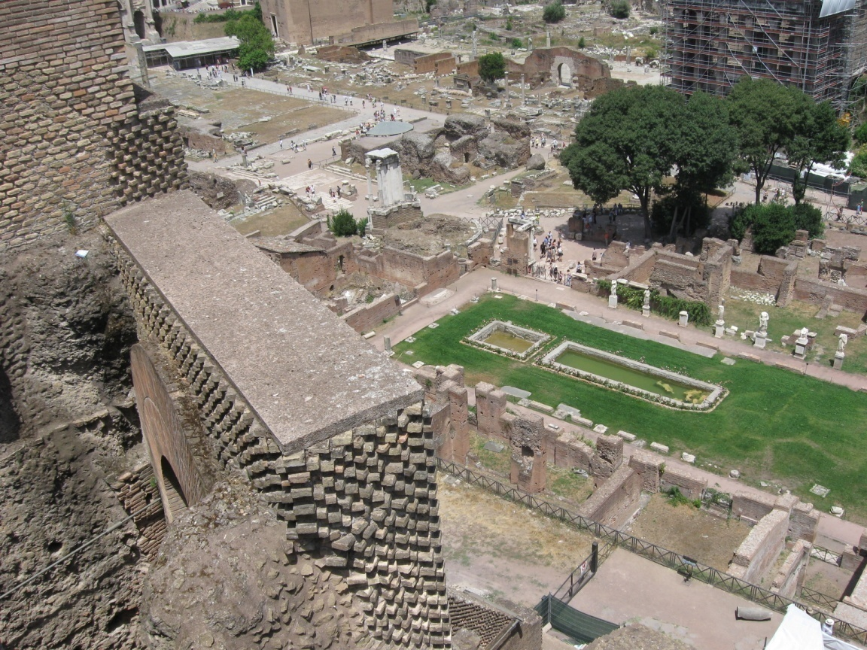
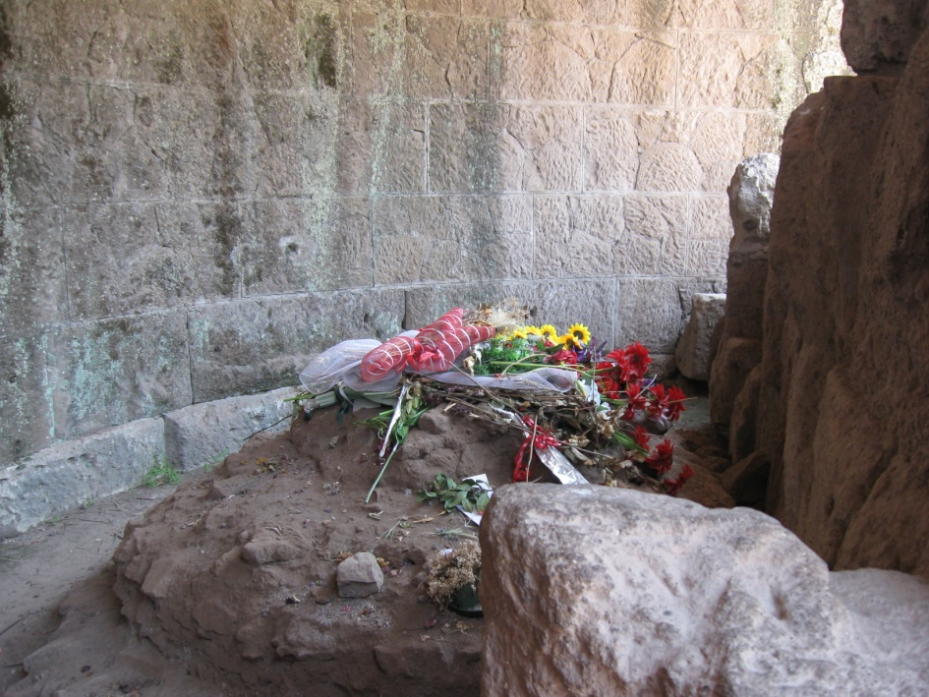
The death of Julius Caesar and the process of his deification:
March 44 BC – a grand public funeral on the traditional lines, but some extraordinary features:
a) The corpse – hidden by an image of wax which lay inside a gilded shrine modelled on the temple of Venus Genetrix.
b) Marc Anthony – funeral speech (reciting earlier decrees which passed divine honours and praising him as a god)
c) Caesar’s wounds displayed – perhaps by rotating the wax image
d) Cremated – also the wax image

Slide 24
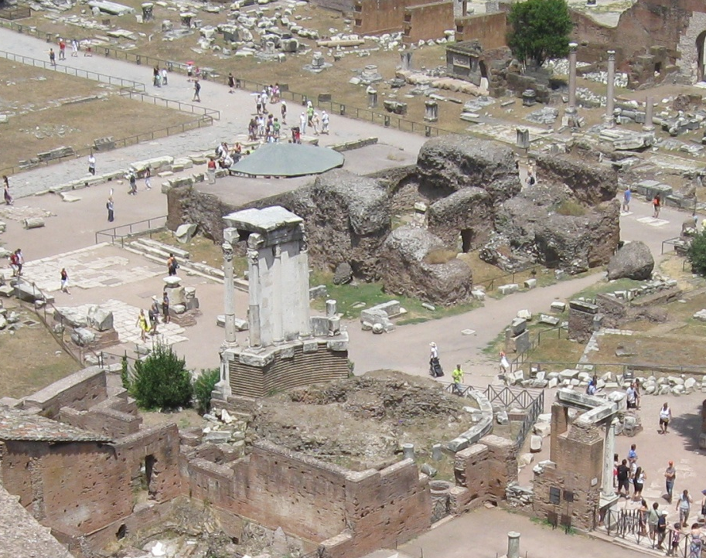
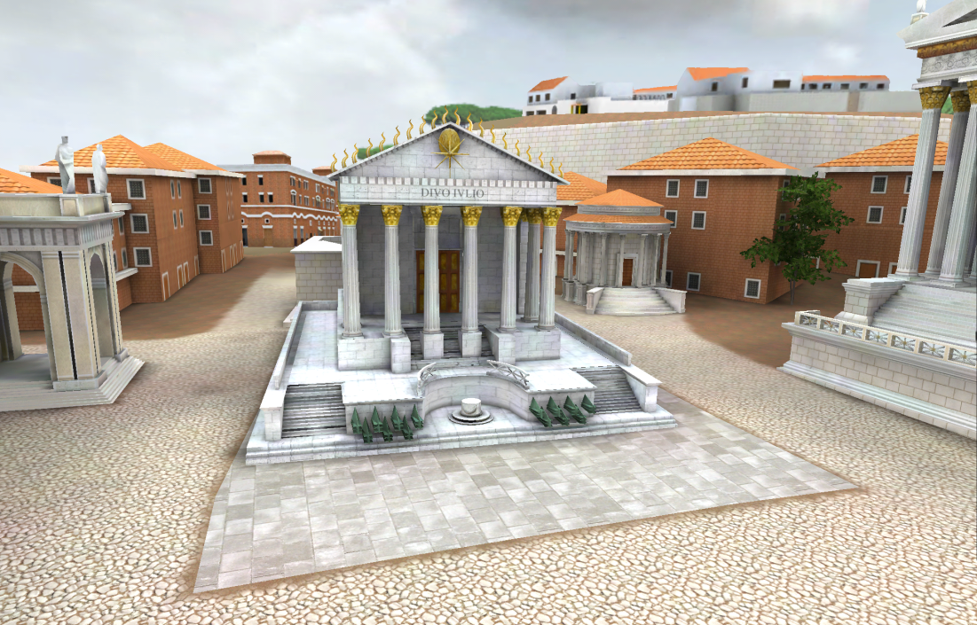
The Temple of Divus Iulius
Caesar’s body was cremated in this area – a marble column with the inscription: parenti patriae (to the father of the fatherland) – later removed
dedicated: August 18th , 29 BC - erected by Augustus
podium (opus cementicum) has survived, the front part – hemicycle (altar)
later: hemicycle with the altar closed off by a straight wall
ionic, composite (coin representations) or corinthian style (archeaological evidence)
destroyed during the reign of Septimius Severus and then restored

Slide 25
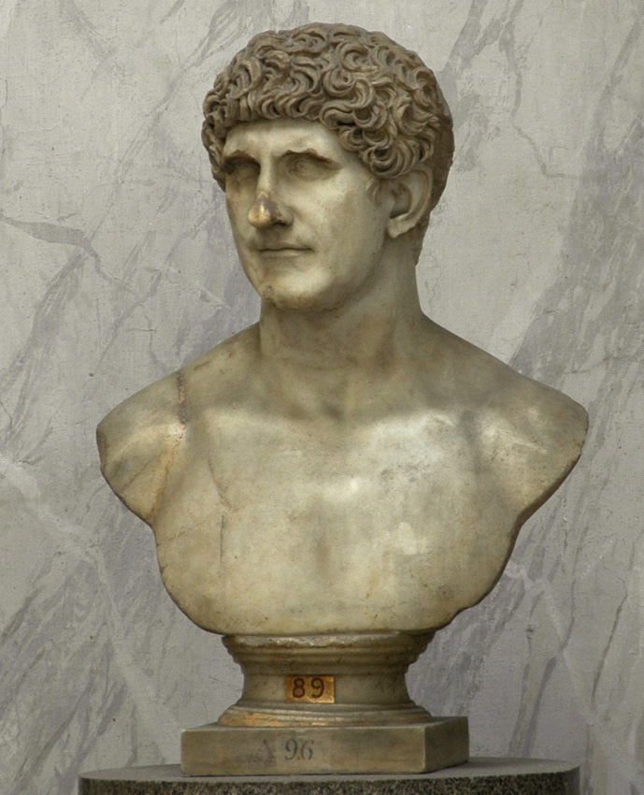
The events after Caesar’s death:
July 44 BC – the games held in memory of Caesar – comet appeared (believed to be Caesar’ s soul in heaven)
September 44 BC - Antonius forced the Senate to add a day to the of each official supplication of the gods, on which prayers made to Caesar
Beginning 42 BC – the Senate passed the official consecration of Caesar, including building the temple to Divus Julius.
40 BC Marcus Antonius inaugurated a flamen of Divus Iulius
Marcus Antonius, marble, Vatican Museums, Rome

Slide 26
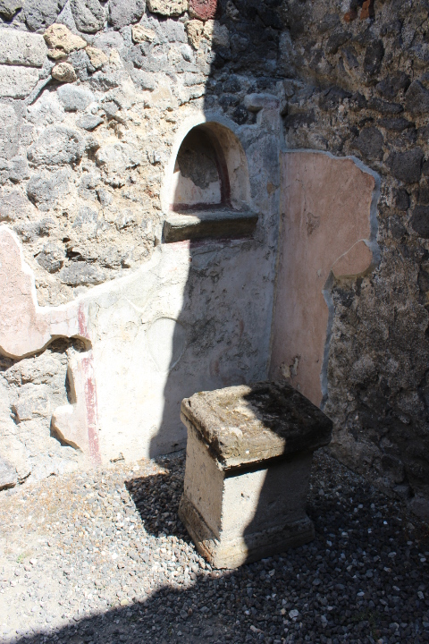
II Private sphere
Divine honours – before Caesar – confirmed in the private sphere (more cases than a public sphere) – the master of the house – „paterfamilias“
„paterfamilias“ – unlimited power
- house cult – slaves, freedmen – in the individual household for its welfare
- monarchic position – permanent, institutionalized, hereditary
Sources: comedies, inscriptions, archaeological sources (few, damaged, only poor had benefactors) – mainly Pompeii
Lararium, Pompeii

Slide 27
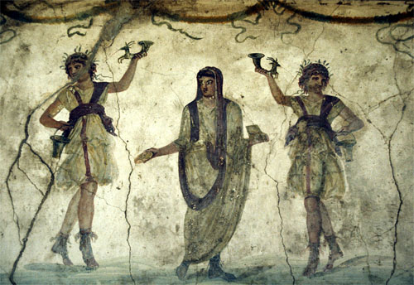
The object of worship: Genius (paterfamilias), Juno (the life force of women)
Genius – the life force of a man – external to a man – spiritual companion under whose protection he lived
earliest sources: Genius worshipped along with other gods such as Lares, Penates, Manes, Olympian Gods.
rituals: prays, offerings – on birthdays
not only humans had Genius, also places (Genius loci), buildings, towns, groups of men (Genius collegii) or things
representation: Genius of a man - corporeal form, a Roman youth in toga with the rim drawn over his head, with a cornucopia and sacrificial vessel, often in the act of sacrificing – pouring a libation
the facial features of Genii are irrespective of the physical appearance of their owners
Genius of a place - snake
House of the Vetii: decoration

Slide 28
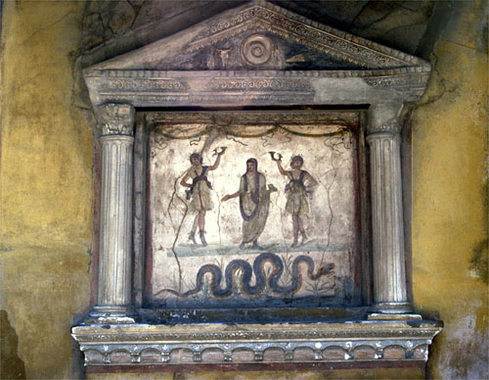
Lararium – the place where Genius was worshipped
In the house – a modest niche in the wall, in Pompeii usually embellished with the main gods of the cult – Lares – and Genius
Lares – unclear origin
intepratation – collective personifications of dead ancestors of the paterfamilias, dancing youths in short tunics, pouring wine from drinking vessels
All these gods had their public equivalents with state temples in Rome, reflecting a view of the Roman state as a large domus. The one clear difference is revealing: during the republic, the Genius worshipped in state cult was not of a man, but of the populus Romanus.
Only in 14-12 BC was the worship of the Genius formally declared a state cult and the emperor´s Genius was officially honoured along with the Lares Augusti, set up at the crossroads of Rome and eventually in many towns and country districts throughout Italy

Slide 29
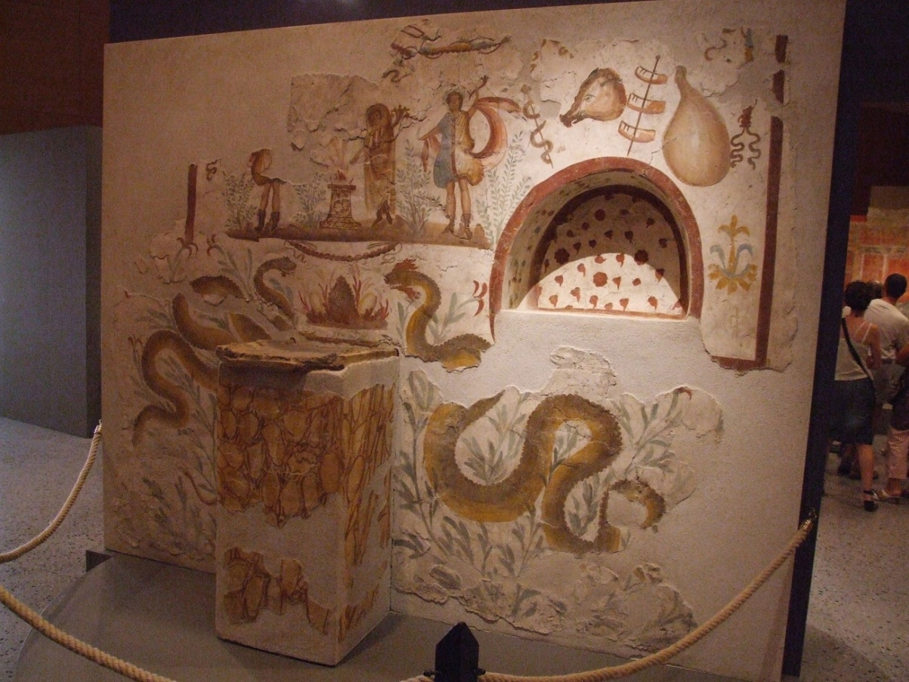
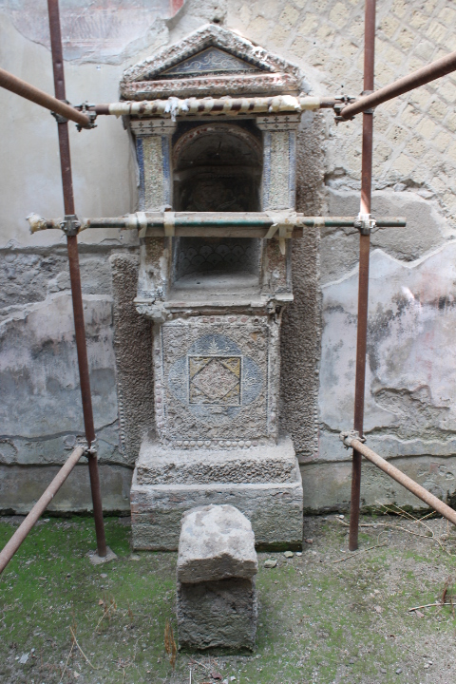
Lararia, Pompeii

Slide 30
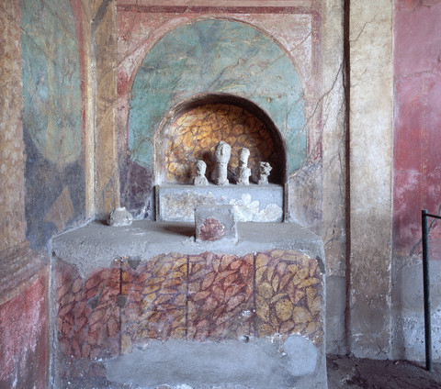
Lararium of the House of Menander, Pompeii

Slide 31
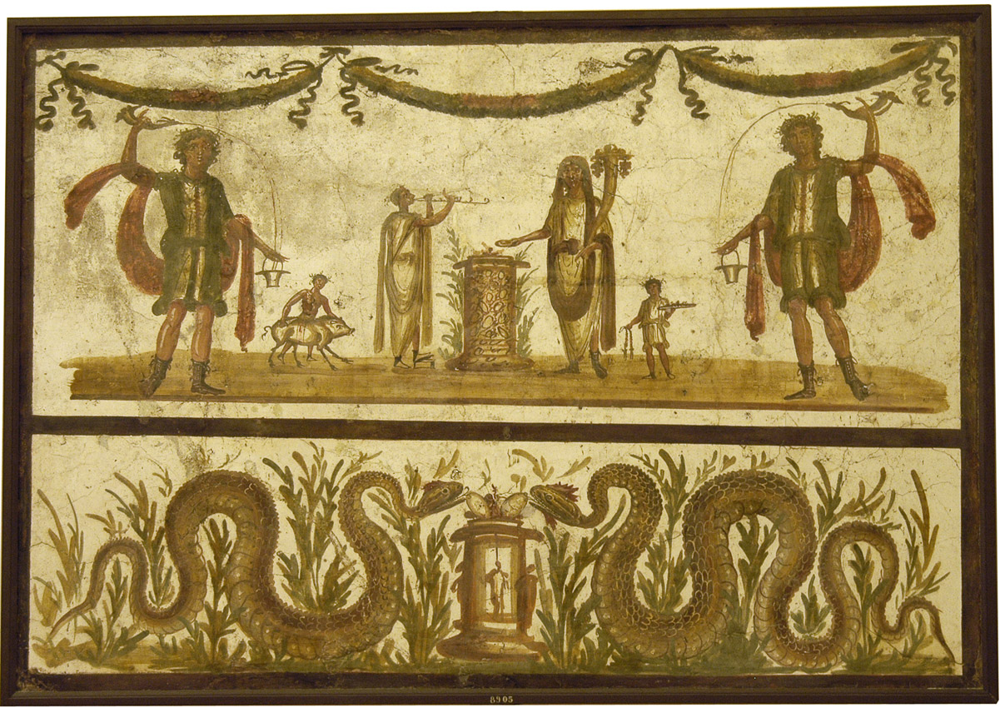
Lararium from Pompeii, National Archaeological Museum, Naples
Above: The Genius is flanked by the Lares. The Genius is pouring a libation to himself. The sacrifice is attended by a flute player and a small boy carrying the tray with mola salsa. Another attendant, a victimarius, leads a pig to be sacrificed to the Lares.
Below: two snakes (for symmetry if to be meant as a doubled Genius loci, or perhaps representing the Genius and Juno of the master and mistress respectively) partake of eggs placed on an altar.

Slide 32
The emperor cult is the practice of assimilating emperor and deity
In the Hellenistic world in 307 BC the hymn sung in honour of Demetrius Poliroctes is the earliest attestation of the rules as a “present god”.
The great leap from the cult of the deceased ancestors to the veneration of living men takes place in Egypt, where the ruler cult is the strongest in the 14th year of the reign of Ptolemy II Philadelphus, when the living siblings Ptolemy II and his sister/wife Arsinoe II were deified.
In the Greek cities the divine cult of individual citizens can be found towards the end of the 2nd century BC, one of the earliest cases is the cult of Diodorus Pasparos at Pergamon.
Also in the Roman world, in private/public relations, it had been usual for a long time to address a man with emphatic epithets and to honour him: this is the case of the relation patronus/cliens, the patron is the benefactor of his clients
The object of worship in the household was the Genius of the paterfamilias. The worshippers were freedmen and slaves.
The development of intersections between the ideology of patronage and of Hellenistic kingship.

