Slide 1
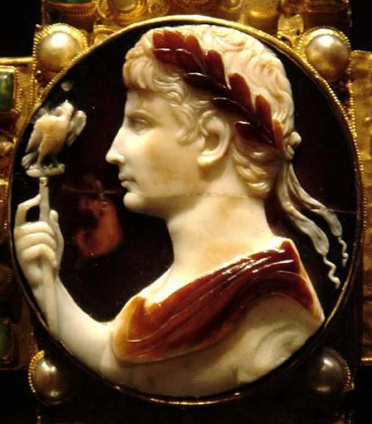
The Buildings and the Images of the Imperial Cult
2. The birth of imperial cult under Augustus

Slide 2
The emperor cult is the practice of assimilating emperor and deity
In the Hellenistic world in 307 BC the hymn sung in honour of Demetrius Polirocetes is the earliest attestation of the rules as a “present god”.
The great leap from the cult of the deceased ancestors to the veneration of living men takes place in Egypt, where the ruler cult is the strongest in the 14th year of the reign of Ptolemy II Philadelphus, when the living siblings Ptolemy II and his sister/wife Arsinoe II were deified.
In the Greek cities the divine cult of individual citizens can be found towards the end of the 2nd century BC, one of the earliest cases is the cult of Diodorus Pasparos at Pergamon.
Also in the Roman world, in private/public relations, it had been usual for a long time to address a man with emphatic epithets and to honour him: this is the case of the relation patronus/cliens, the patron is the benefactor of his clients
The object of worship in the household was the Genius of the paterfamilias. The worshippers were freedmen and slaves.
The development of intersections between the ideology of patronage and of Hellenistic kingship.

Slide 3
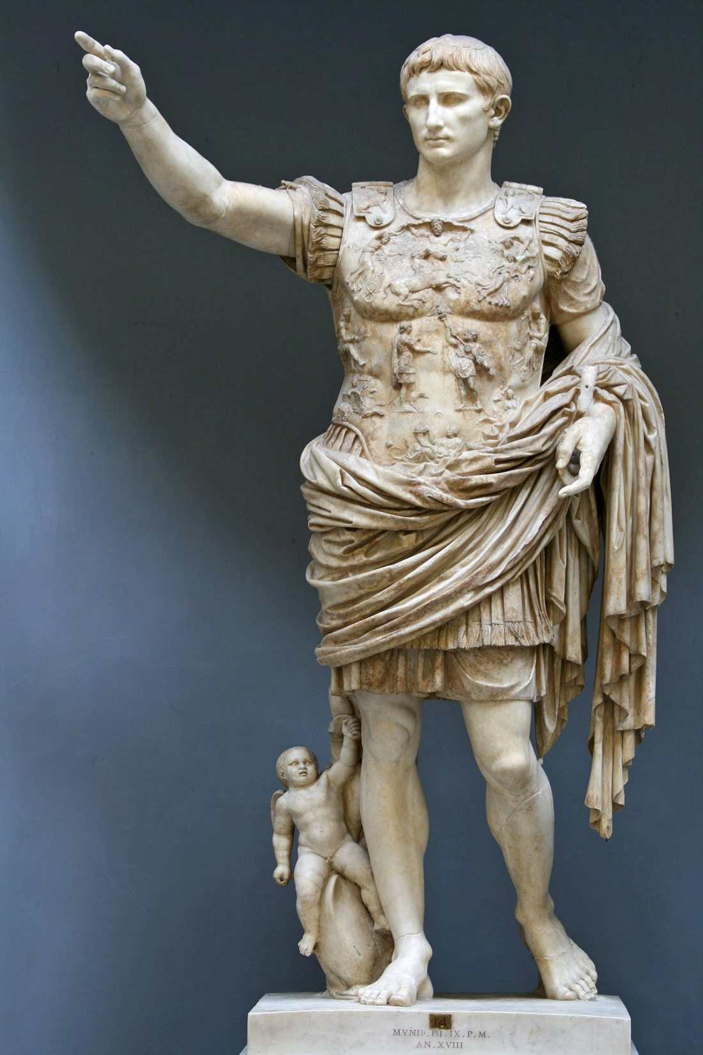
Biography
2. Apotheosis
3. The cult settlement – state, private,
provincial level
4. The images
Terminology:
Apotheosis – the actual event of ascending to the divine sphere
Divinization – the Senate claims the divine principle of the emperor
Consecration – consecratio – practical implementation to the divine sphere

Slide 4
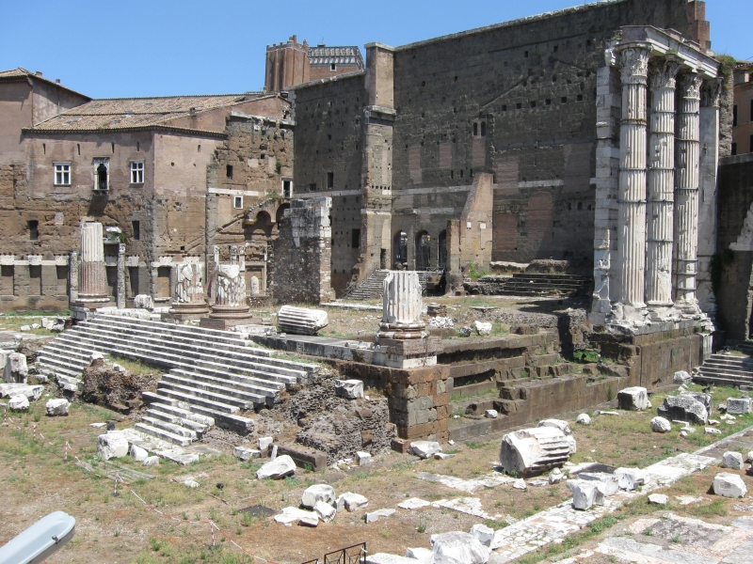
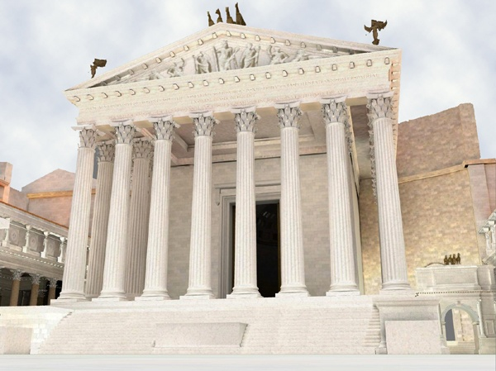
BIOGRAPHY
Born: Gaius Octavius, Rome, September 23rd , 63 BC
Parents: Gaius Octavius and Atia (Julius Ceasar’s niece)
Early training in public life: at the age of 12 - recited his grandmother’s laudatio
46 BC – accompanied his great uncle in his triumphal procession
44BC – adopted by Julius Caesar (19 years old)
43BC – propraetor and consul - name Gaius Julius Caesar Octavianus
2nd triumvirate – with Marcus Antonius, Marcus Lepidus
42BC – battle at Philippi – vowed to construct a temple to Mars Ultor if he won

Slide 5
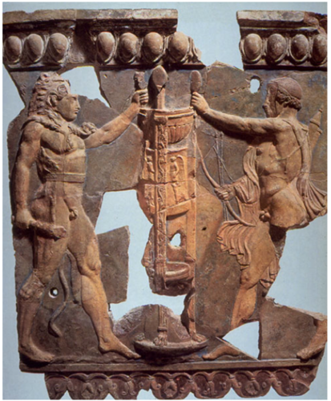
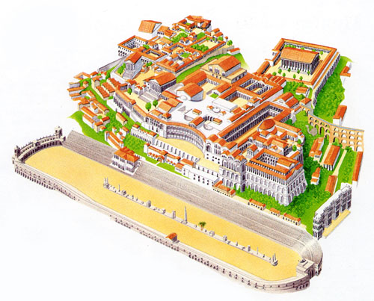
42BC, January – divi filius
During the 30’s – protection of Apollo
31BC – Actium – defeated Marcus Antonius and Cleopatra
28BC – the temple of Apollo on the Palatine hill – personal patron
27BC, January 16th – title Augustus (by Plancus)- the word used of votive offerings, temples and sites dedicated to the gods (original idea – Romulus)
sacred places too, and those in which anything is consecrated by augural rites are called "august" (augusta), from the increase (auctus) in dignity
Augustus - before used in ritual, formulaic language (obscure synonym to “divinus”), but it was regarded as a title only - any formal powers, after Augustus - the institution – emperor

Slide 6
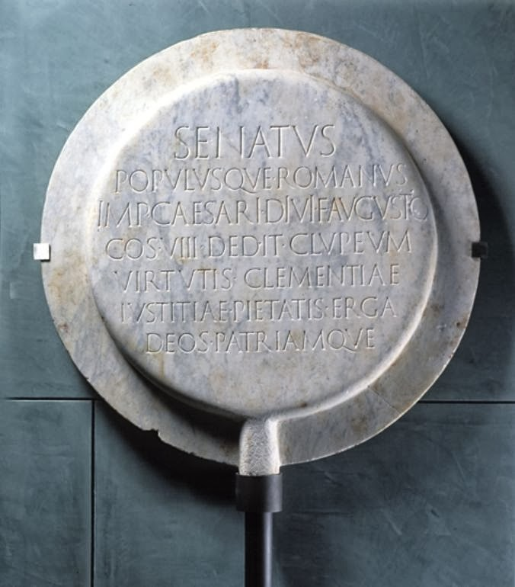
23 BC – imperium
18 – 12 BC – Lex Iulia de adulteriis, Lex Iulia de maritandis ordinibus, Lex Papia Poppaea
12BC – pontifex maximus
2BC – pater patriae
Last will, testament and a list of accomplishments: Res Gestae Divi Augusti – two bronze pillars in front of Augustus’s mausoleum in Rome (now only copies)
Died: Nola, 19th August, 14 AD
Succession – daughter Julia, 2nd marriage to Agrippa – two sons Gaius and Lucius Caesar, died
Forced to adopt Tiberius – Livia’s son from the first marriage
Cliepeus virtutis – for Augustus from the Senate to acknowledge his virtus, clementia, iustitia, pietas, Curia Iulia, originally gold, marble copy preserved in Arles
Apart from the title, he received: a) the right to adorn the entrance of his house with laurel
b) the corona civica
c) clipeus virtutis (hung in the Curia Iulia)

Slide 7
2. APOTHEOSIS
Augustus died 19th 14 AD, Nola and was cremated at Campus Marcius, buried in his family tomb
September 17th - officially deified and subsequently consecrated by his adoptive son Tiberius
Shortly after his funeral – apotheosis – attested by an eyewitness (very doubtful) – Roman Senate - authority in religion.
The testimony – spontaneously or with an intention?
The death of Augustus in Nola, August 19th, 14 AD
.
His public funeral at the Campus Martius, exact date unknown
The testimony of his apotheosis
The senate awarded divine honours to Augustus September 17th , 14 AD
Official consecration performed by Tiberius, Augustus became a state god

Slide 8
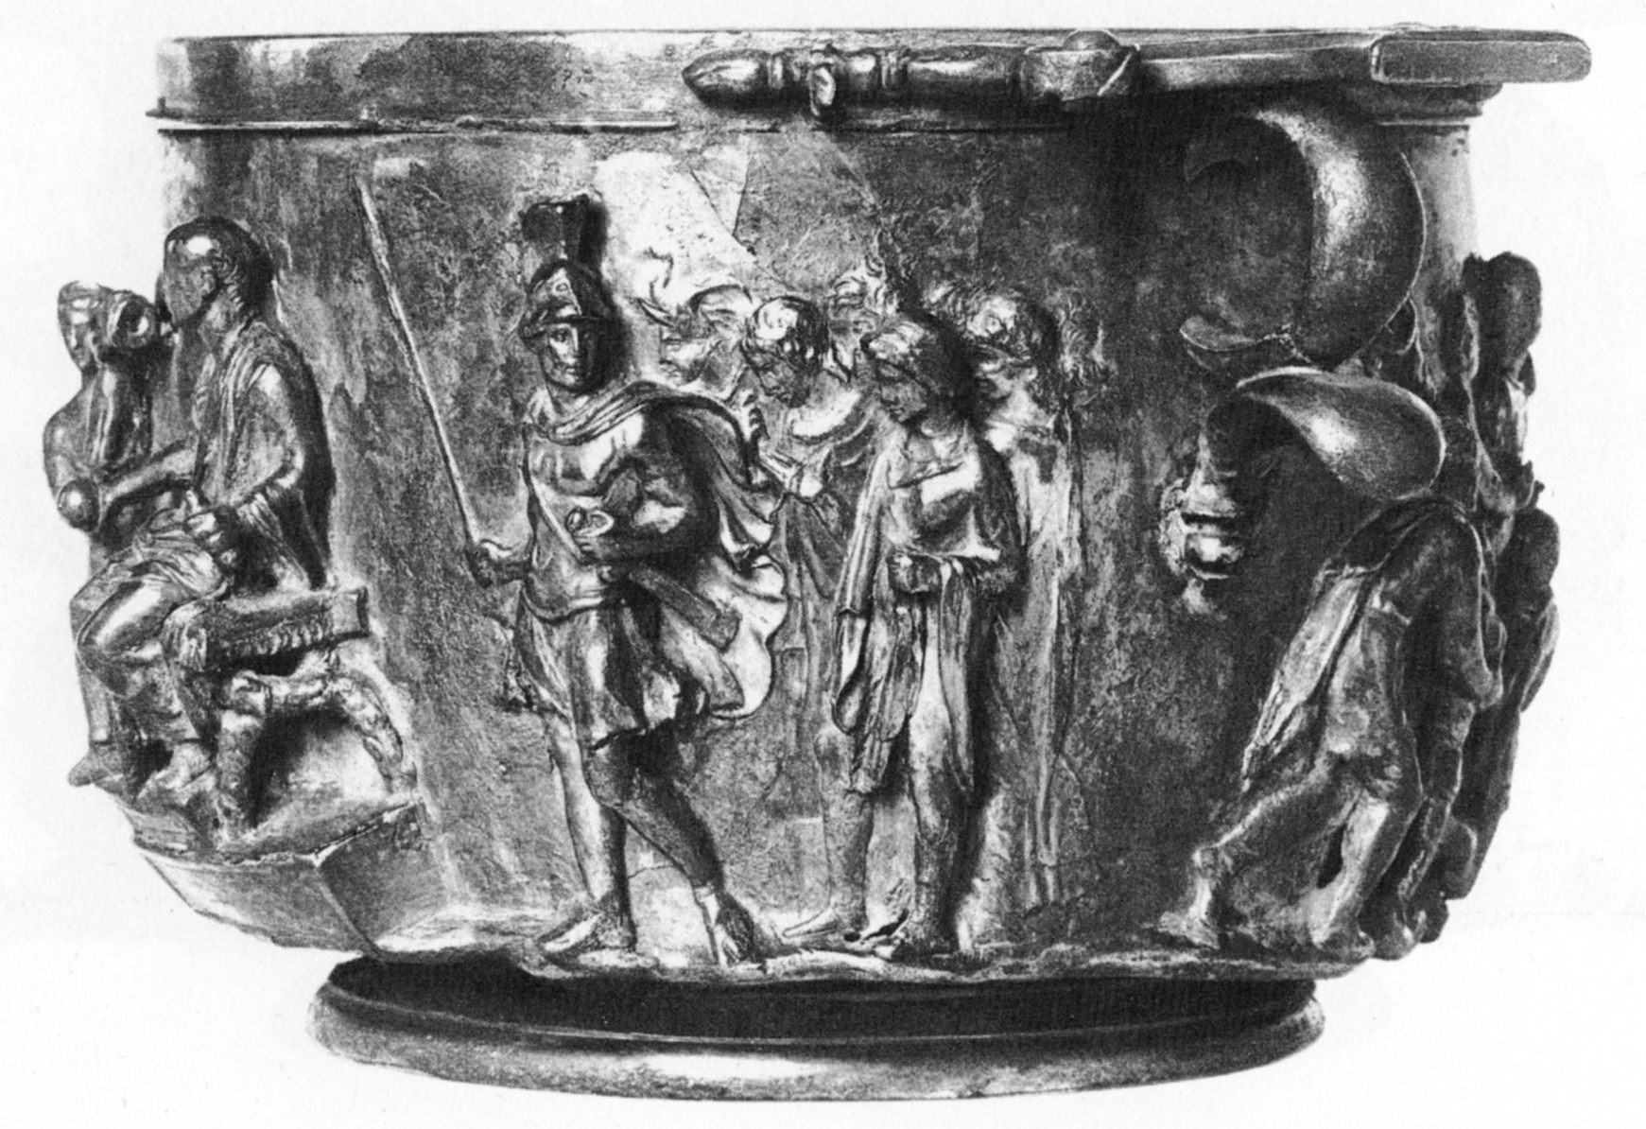
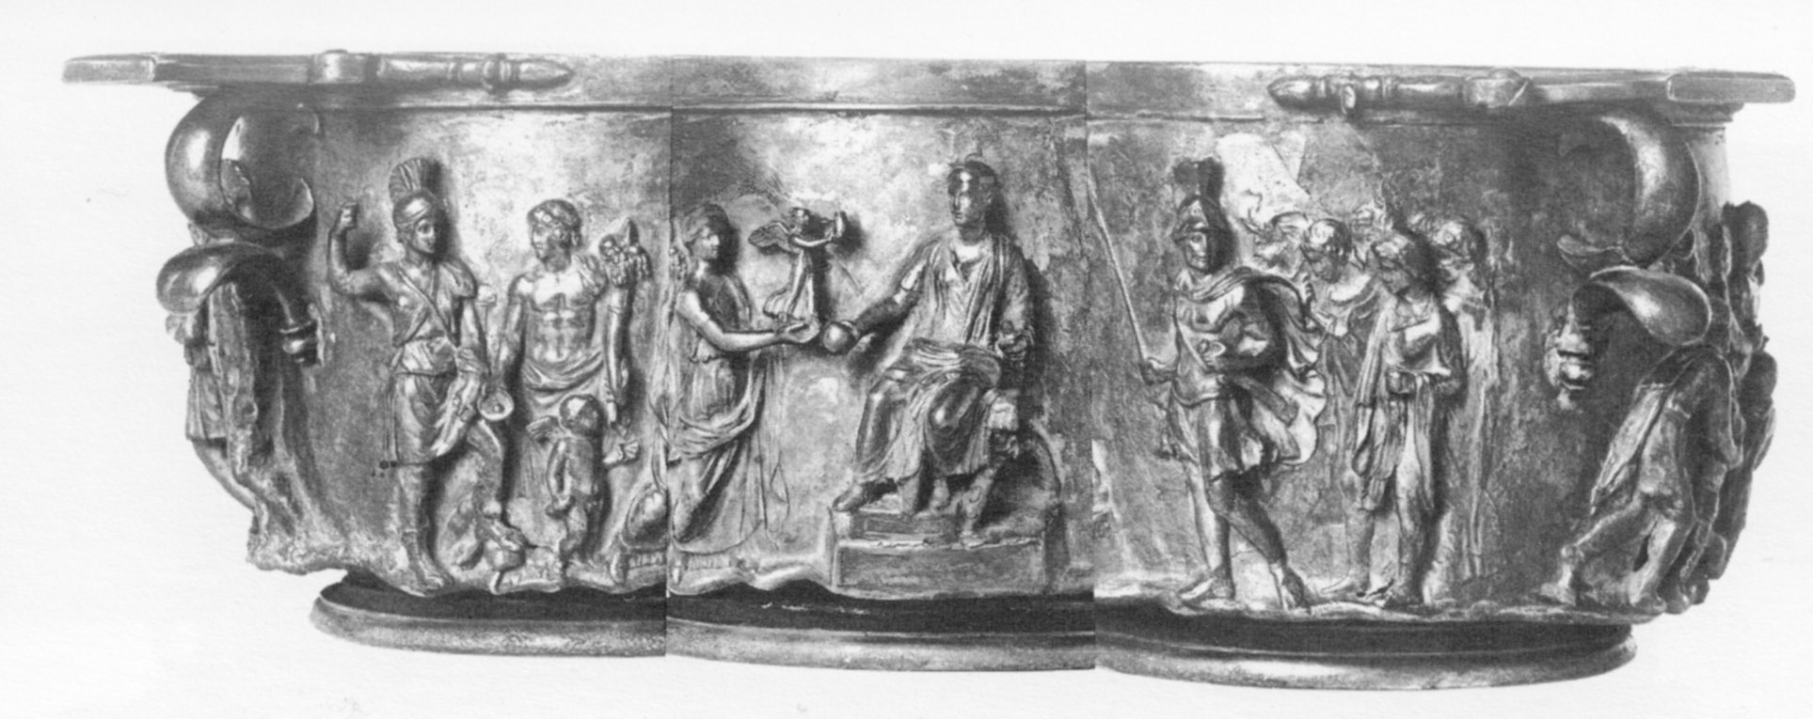
Ruling strategy:
Reputation: a military victor, a bringer of peace and a supporter of Roman traditions
His genius: combined history, law, social policy, religion, literature, art and architecture
Ideology: images by historians, poets, gem cutters, painters, sculptors and architects – state relief
- portraits, large scale monuments erected in new provinces
Consolidating power
Expanding borders

Slide 9
2. THE CULT SETTLEMENT
Caesar – was appointed god – monarchical position – resulted in his murder
demonstration - how not to go about reforming the Roman constitution
Augustus – the first among equals – defining this imagery (very cautious!)
Artists: free to declare anything:
Tacitus, Annals I 10.6 – a bit exaggerated, but gives a picture of his politics:
“No honour was left for the gods, when Augustus chose to be himself worshipped with temples and statues, like those of the deities, and with flamines and priests.”
Vergil, Aeneid VI 789-794
“Here Caesar [=Augustus], of Iulus’ glorious seed, look at him ascending to the world of light! Watch, at last, that man, whose coming so often you listened foretold, Augustus Caesar, son of a god [=Divus Julius]. He brings a golden age, he shall restore old Satrun’s scepte to our Latin land”.
Horace, Odes III 5. 2-3
“praesens divu habebitur Augustus”
Letters II 1, 15-17
Praesenti tibi maturos largimur honores

Slide 10
Historians:
Suetonius
“Although well aware that it was usual to vote temples even to proconsuls, yet in no province would he accept one save jointly in his own name and that of Rome, and in the city itself he refused this honour most emphatically.”
- doesn’t claim that there wasn’t a divine worship of the emperor in Rome – only that he never received a state temple in the city
Suetonius, Dio and other historians – ignored private cults – not important for them
In the imperial cult, the political and social cohesion had to be safeguarded. The sacrifices and the public rituals had the aim to define relationship of powers and their hierarchy.
Continuous measures – to secure the position of the emperor:
Roman magistrates ceased to be autonomous as they had been during the republic
The emperor only may celebrate the triumph
The title imperator was granted 11 AD
11 AD – banned honours for governors in their provinces during term of office and for 60 days thereafter

Slide 11
Different levels of the cult:
State cult level -Augustus constantly avoided direct deification – remembering Julius Caesar
Accepted measures to the very limit, but never beyond – thus he
accepted the title Augustus
Other levels – provincial, municipal, private cults – no evidence
that he was averse
Municipal cults – no restrictions
Provincial cults – insisted that Roma was worshipped with him
in the same temple
Private cults – no restrictions
STATE CULT
Augustus became a god of the Roman state only after his death
Generally believed – public worship of his genius – linked to
gaining the function pontifex maximus in 12 BC
Holder of this office – villa publica in the Forum Romanum – handed
it to Vestal Virgins and opened part of his house for the public
His house public – his household cult public – worship of his Lares
and his Genius public.

Slide 12
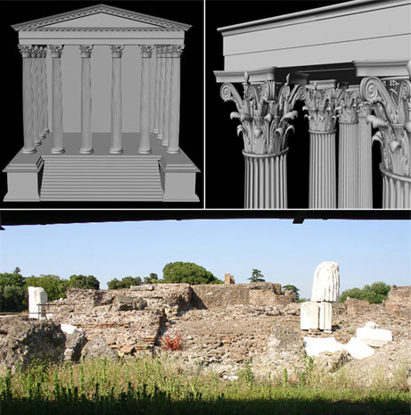
Acknowledging Genius into a state cult, implied that the emperor was paterfamilias of the Roman state household and senators performing the cult would be taken as his clientes (humiliating for high-ranking senators)
Emperor – unlimited formal powers – the Roman state –a monarchy (again)
Arguments against:
Literary sources
a) Ovidius:
Not that Augustus’ house cult became public, but that the grandiose temple of Apollo and the new cult of Vesta were part of Augustus’ domestic cults, which became public. Apollo was Augustus’ personal tutelary god. [Gradel]
b) Calendar from Praeneste: mentions only Vesta, the new cult on Palatine, no Genius or Lares or Penates Augusti

Slide 13
c) Birthday
man’s birthday - the main feast of his Genius
Augustus’ birthday - sacrifice to Mars and Neptune (Campus Martius) and to Apollo (the theatre of Marcellus) – Augustan tutelary divinities
“F(eriae) ex s(enatus) c(onsulto), q(uod) e(o) d(ie) Imp(erator) Caesar Aug(ustus) pont(ifex) ma[x(imus)] natus est: Marti, Neptuno in Campo, Apo[l]lini ad theatrium Marcelli”
d) Sacrifices
Augustus’ unique position was formulated only by sacrifices to the traditional gods on Augustus’ behalf, for the welfare of the emperor (pro salute Augusti)

Slide 14
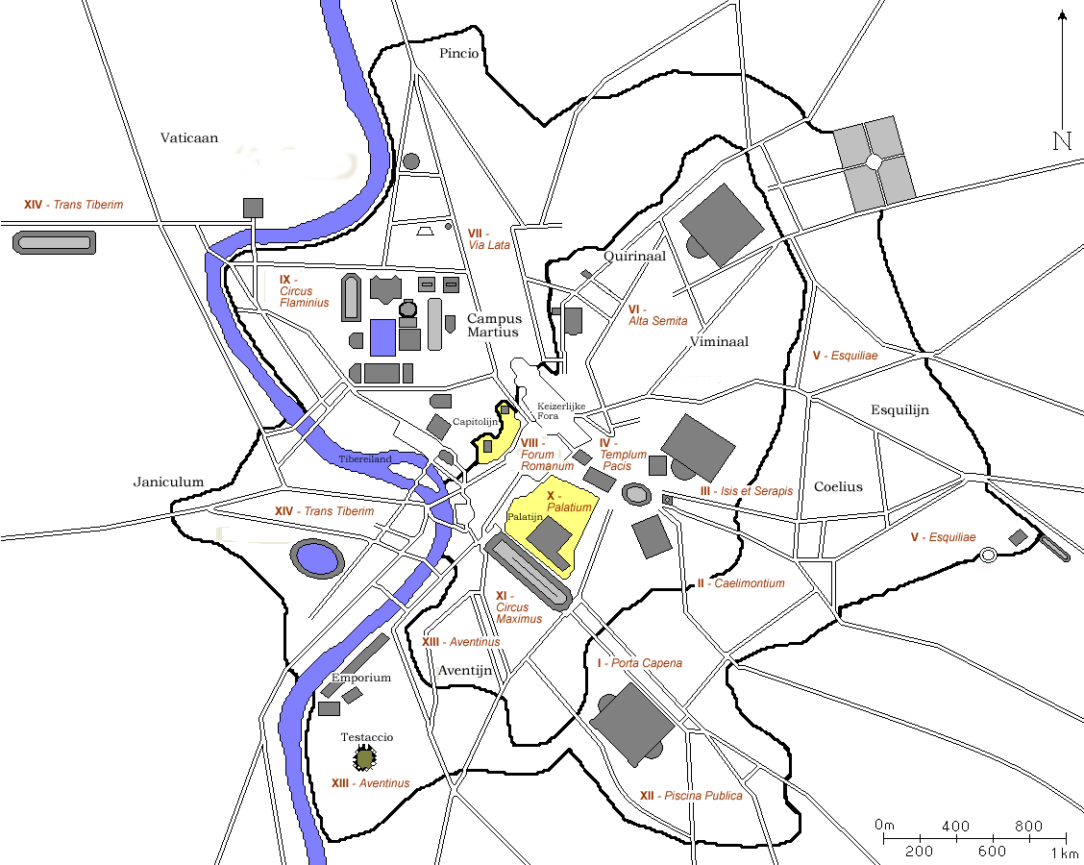
PRIVATE CULT
7 BC – Augustus reorganized the administrative system of the city of Rome
- 14 regiones and 265 vici
Augustus intention – restore age-old cults and traditions
- strongly involved in the reform – presented the shrines with their new cult images
- enthusiastic reception all over Italy (e.g. Pompeii – not the crossroads, but pavements at the side of main streets)

Slide 15
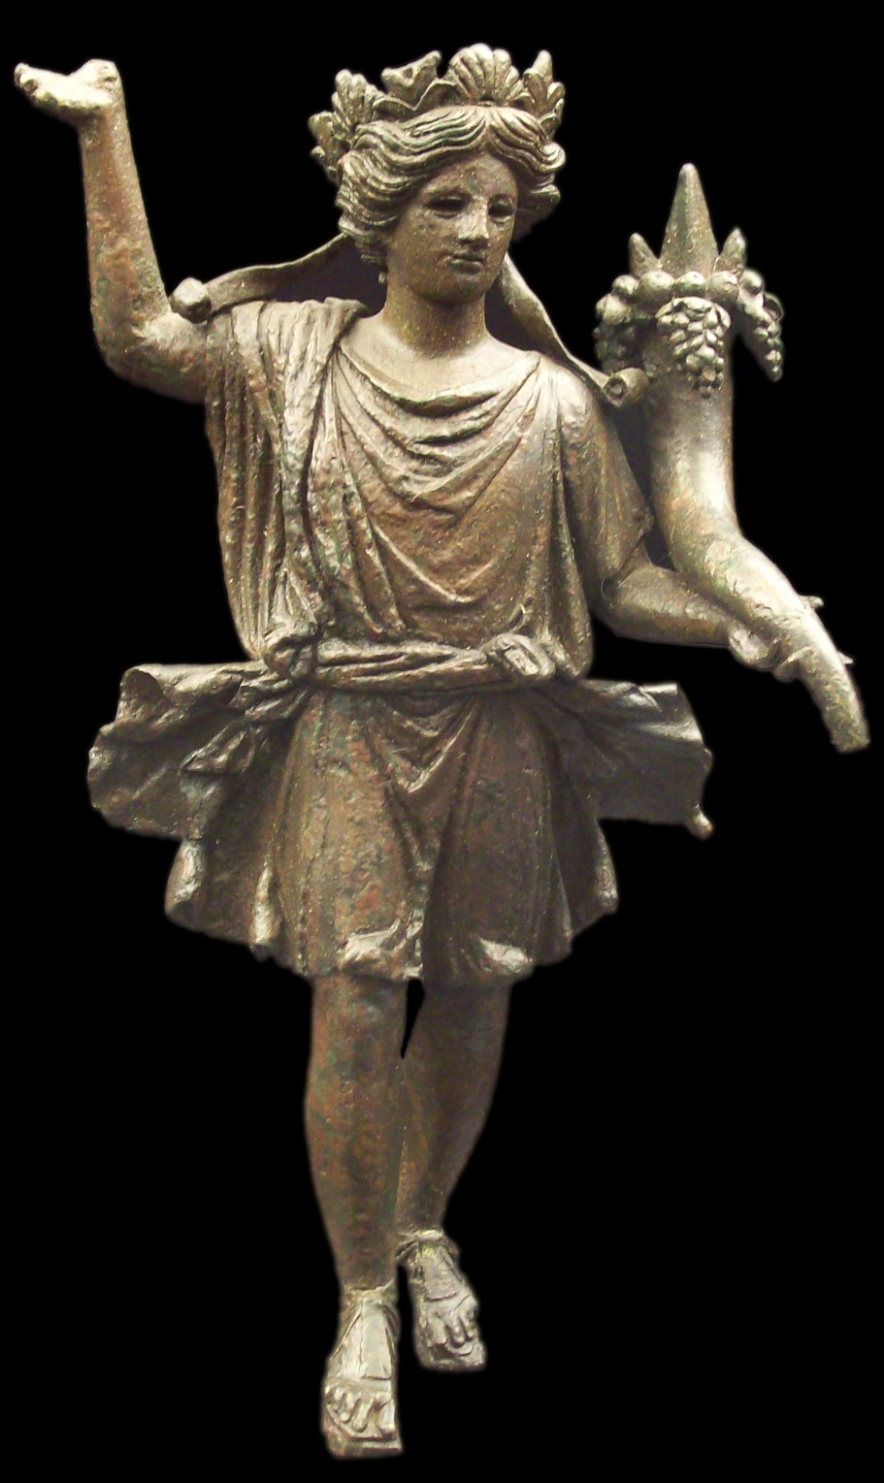
Vicus – own cult
worshipped: Lares of the crossroads (Lares compitales)
run by: magistri of the vicus plus four ministri (slaves)
public events: the festival of Compitalia, games celebrated at the shrines (compita)
Magistri vici
inhabitants of the vicus, freedman
allowed to wear the magistrates’ purple-bordered toga
accompanied by a lictor
Augustus reform – new function
- administrative tasks
organizing firefighting
conducting censuses for the grain dole
Cults were financed by magistri (inscriptions as dedicators), so that Augustus had to make the position attractive

Slide 16
After the reform:
Two lares compitales turned to Lares Augusti and Genius Augusti enetered the worship - several relief-decorated and inscribed altars from the Augustan cults
Sacrifice:
Lares - blood offering (pig), genius - bloodless
Aspect imposed from above – sacrifice to the Genius Augusti of a bull (implication of the importance of this figure, maybe a main divinity of the cult)
Compital cults cannot be termed state cults – not a part of sacra publica, thus only sacra privata
Sacra publica
rites performed by state officials
paid for by public funds
on behalf of the whole populus Romanus
But Augustus stays conservative also in the compital cults:
4BC – inscribed base, dedicated by Augustus – clearly after the reform – Laribus publicis, not Laribus augustis, any indication that Augustus’ Genius was included in this cult

Slide 17
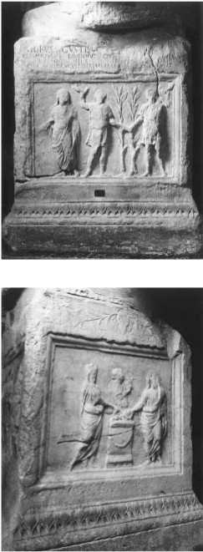
Inscribed relief-decorated altars
7 BC – Augustan compital altar
front side – togate Genius Augusti and the two Lares Augusti, in the background two laurel trees short side – two magistri vici while pouring libations accompanied by a flute player, the other short side - identical, so that all four magistri are shown

Slide 18
2. 2-3 AD Augustan compital altar
front side – a scene of sacrifice – magistri vici are pouring the libations while the victims (a pig for Lares and a bull for Genius) are being led by two victimarii, there is also the lictor and the flute player
back: three ministri are receiving stauettes of the Lares from a man in toga, taller than them, velato capite. He must be Augustus himself, accompanied by the princes Gaius Caesar and Lucius Caesar.
Identification: the person offers the statuettes of the Lares only, and not the one of his own Genius.

Slide 19
The Sorrento base, late Augustan, after 12 BC
Reference: the state religion, divine ancestors of the Julian family and Augustus’ personal protector - Apollo
The primary side: the Vestal Virgins in procession towards a seated Vesta. In the background – a Ionic portico and a round shrine, continues to the short side
The short side: Augustus’ house identified by the corona civica – Mars Ultor, Amor, Venus (?), Genius
The other short side: Diana, Apollo and Leto
The back side: Cybele with her lion and a dancing male figure (traditional in her cult)

Slide 20
The seated figure holding cornucopia in the middle – Genius (only divinity with this attribute), heroically semi-nude and youthful, probably Genius populi Romani (problem – usually grouped with Dea Roma or Genius senatus, not Mars or Venus)
Result: these two Genius populi Romani and Genius Augusti started being mixed up, indistinguishable without an inscription
Augustus and later emperors took over and exploited this figure.
A preparatory step by Augustus or by his supporters towards his Genius worship.
Continuity in iconography - innovation easier to accept – a good strategy.
Other preparatory step – Genius received a bull as a sacrifice, previously bloodless.

Slide 21
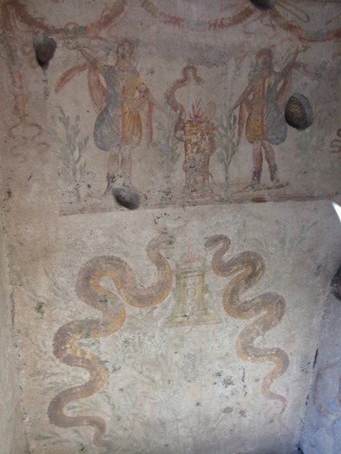
Lararia in Pompeii
– decoration influenced by iconography of the Augustan compital cults
Lares – depicted with flanking laurels (reflecting laurel trees planted outside Augustus’ house)
laurels taken after mechanically – without clear knowledge (four laurels)
presumably this is the typical way how imperial imagery entered the iconography of domestic cults
The basic meaning of the imperial cult in the private sphere – integration of all citizens of the Roman empire, who, through the cult of the emperor, shared the same identity.

Slide 22
PROVINCIAL AND MUNICIPAL LEVEL
– no evidence that he was averse
Municipal cults – no prohibiton
Provincial cults – insisted that Roma was worshipped with him in the same temple
Epigraphic documentation – the cult of the Genius of Augustus already existed during his lifetime (in provinces, no question, in Rome – more conservative approach)
Daily text on papyrus from Oxyrhynchus
The Oxyrhynchus Papyri – a numerous group of manucsripts discovered by archaeologists at an ancient rubbish dump near Oxyrhynchus in Upper Egypt.
date: from the 1st to the 6th century AD.
thousands of Greek and Latin documents, letters and literary works
Poxy 12, 1245
The text is an old document, brought to light as waste paper, bearing an oath
“in the name of Caesar [=Augustus], son of a god”.

Slide 23
Official epigraphic document
a decree issued in 9 BC by Paullus Fabius Maximus, proconsul of Province Asia
found at Priene
important innovation: a new year calendar for the province, starting on the day of Augustus’ birthday (September 23rd )
OGIS [Orientis Graeci inscriptiones selectae] 458
a) Augustus’ birth is a sign of divine providence: for this reason all the virtues are in him at the highest degree
b) Augustus is the saviour of humanity, who put an end to war and restored peace, excelling all the preceding benefactors and leaving no possibility to the future ones to excel him
c) As the day of Augustus’ birth marked for the world the beginning of the benefits that Augustus would have brought, Paullus Fabius Maximus decides such an extraordinary innovation: the change in the starting of the new year.

Slide 24
The temples of the veneratio Augusti:
56 dedicated to the first emperor Augustus
of them, 37 were built during his lifetime
in Italy – 16, 7 surely built in his lifetime, only one is surely posthumous (Nola).
The municipal cults in Italy: the living emperor rather than on the Divi
in the city of Rome – no temple dedicated to Augustus during his lifetime
civic priests all over Italy – flamen (sacerdos)
the temples are designed in the same way as the temples of the traditional gods, so that it is impossible to distinguish them if lacking in iconographic apparatus (statues, relieves) or in epigraphic texts
The emperor as an object of cult had a great importance for the political cohesion of the Empire.

Slide 25
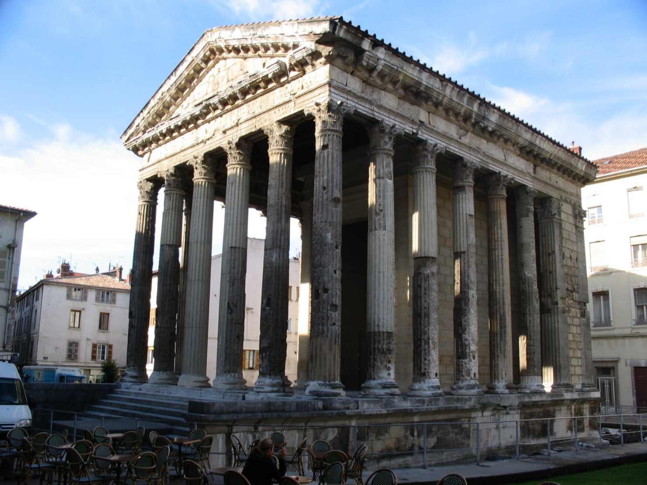
The Temple of Augustus and Livia (Temple d'Auguste et de Livie), Roman temple, Vienne, France Built: 20 BC – 10 BC, restored in the 1st c. AD, rededicated to Livia by Claudius
description: a hexastyle, prostyle porch, 14.25 x 23.85 m
- well-preserved: incorporated into a church in about the 5th c. AD, restored in 19th c.

Slide 26
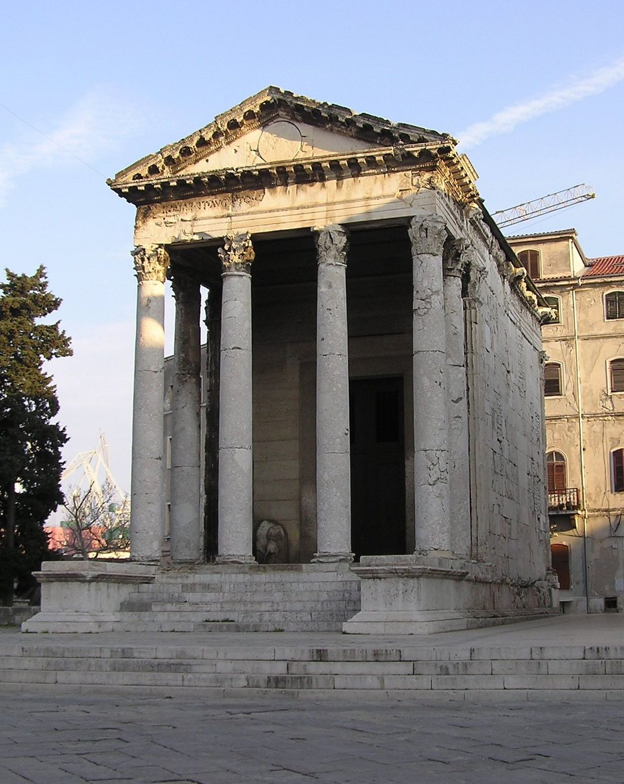
The Temple of Augustus, Pula, Croatia
Built: between 2 BC and his death in 14 AD
under Byzantine rule – converted into a church, later used as a granary, hit by a bomb in WWII, much of the structure rebuilt
- description: tetrastyle prostyle porch, Corinthian columns, 8 x 17.3 m, decorated frieze
- Part of a triad – the Temple of Augustus, larger central temple (not preserved), the Temple of Diana (only the back side of the temple has survived – incorporated into the Communal Palace)
- dedication:
ROMAE · ET · AUGUSTO · CAESARI · DIVI · F · PATRI · PATRIAE
Roma and Augustus Caesar, son of the deity, father of the fatherland

Slide 27
4. THE IMAGES
Used art in the service of his political and social ideology
The emperor and his family – immortalized in individual portraits and in family groups
Standardization of the image of the living ruler
Four themes in augustan art and architecture – victory, peace, prosperity and divine descent
To tell such a complex course, Augustus chose two different communication strategies:
Visual language:
e.g.:
The Forum of Augustus
Ara Pacis
The Belvedere Altar
Gemma Augustea
Textual language:
Res gestae – written in the first person, narrating his own life at the service of the Senate and the Populus Romanus, known fragmentary epigraphic texts:
Original - bronze plates - Mausoleum Augusti
fragmentary copies in greek and latin - The Temple of Augustus and Rome at Ancyra in Galatia
fragments of the greek version - large podium of a sculptural group representing Augustus and his family, near Apollonia (Uluborlu)
fragments of the Latin text - propylaeum erected at Psidian Antiochia

Slide 28
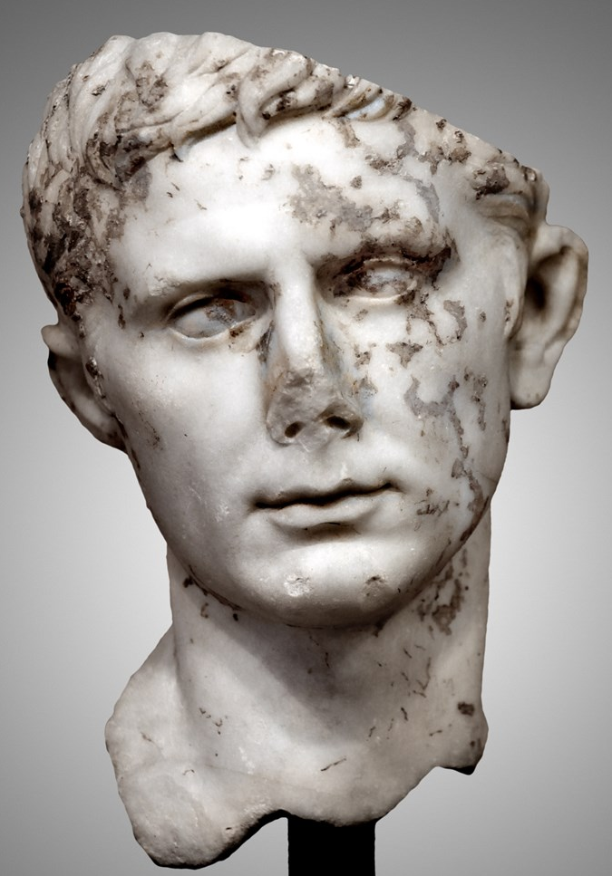
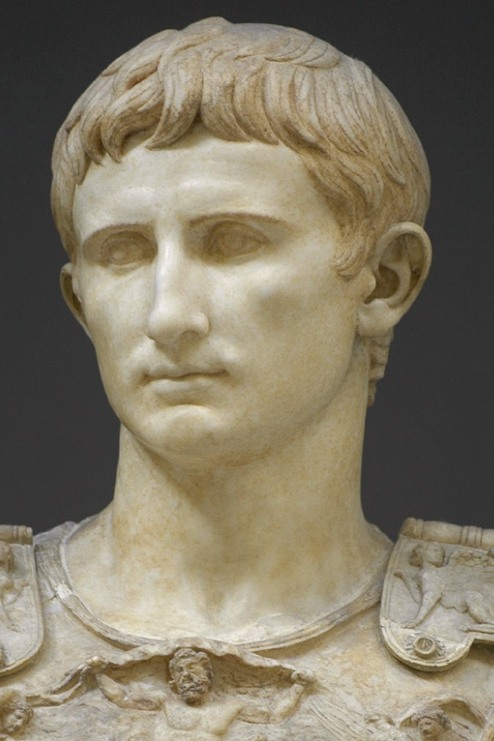
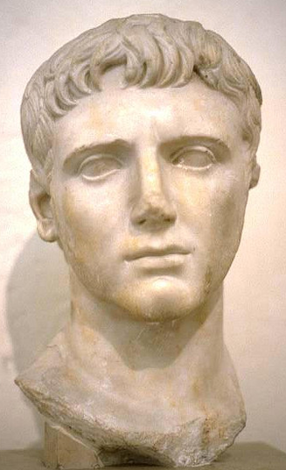
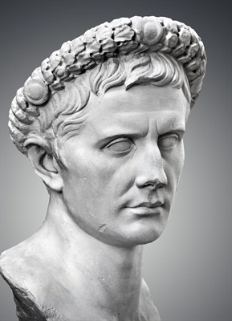
Portraits
Always youthful – Apolline image of youthful radiance – Apollo, personal god, the portraits are products of centrally chosen types
Arles type – mourning, 37 BC, bearded
The Actium type – determined military man, two deep vertical lines, full head of curls set in relative disorder (Musei Capitolini)
The Primaporta type – Primaporta, Via Labicana – capite velato – no deep vertical lines, also for Corinth and Samos – stressing his aspect of a pious Roman
The Forbes type – or the Ara Pacis type – hair brushed to one side

Slide 29
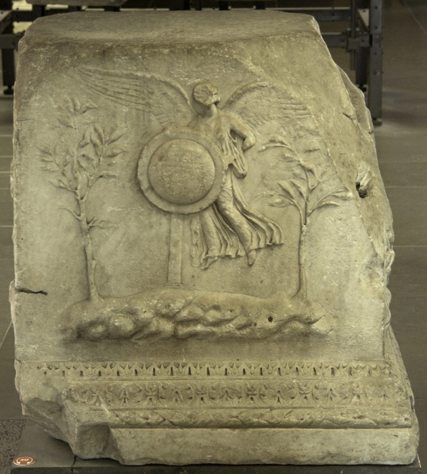
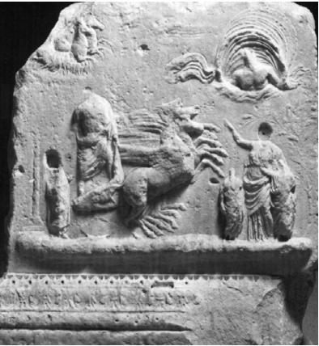
THE BELVEDERE ALTAR
Summarizes Augustus’ political ideology, social laws and religious beliefs
The front side: a rocky (Palatine) setting with a pair of laurel trees (Augustus’ house) flanking a flying Victory who is setting an inscribed shield on a pillar.
Inscription: refers to Augustus as pontifex maximus
The back side: a chariot scene with the chariot drawn by four houses that rise from the horizontal groundline, the chariot holds a seminude male figure with a mantle, a woman with two small boys are in front of the chariot. In the sky there are Caelus and the horses of the sun god. The scene is the apotheosis – Julius Caesar, Augustus or Romulus. The male to the left – Tiberius or the senator Julius Proculus. The woman on the right is Livia, Julia or Venus. The two boys are Gaius and Lucius Caesar (or two children of Romulus and his wife Hersilia).

Slide 30
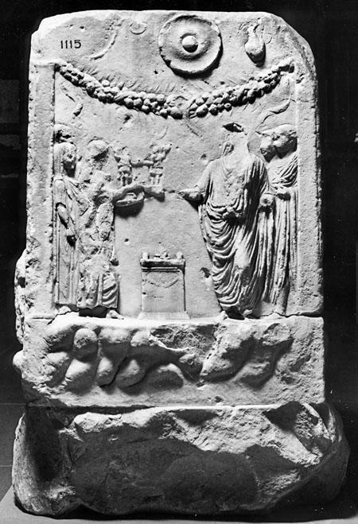
Another side: Helenus and Aeneas’ discovery of the sow of Lavinium
The last side: Augustus’ presentation of lares statuettes to the attendats of the street superintendents or vicomagistri and this altar
meaning: Augustus is Aeneas’ successor, he guided Rome under the protection of his divine father and protector, Apollo. Augustus’ hopes for the future which lies in his two young heirs. Julius Caesar apotheosis is an early articulation of the divine claims of Augustus' household to monopolize Rome’s military responsibilities.
- the assimilation of divine and human households

Slide 31
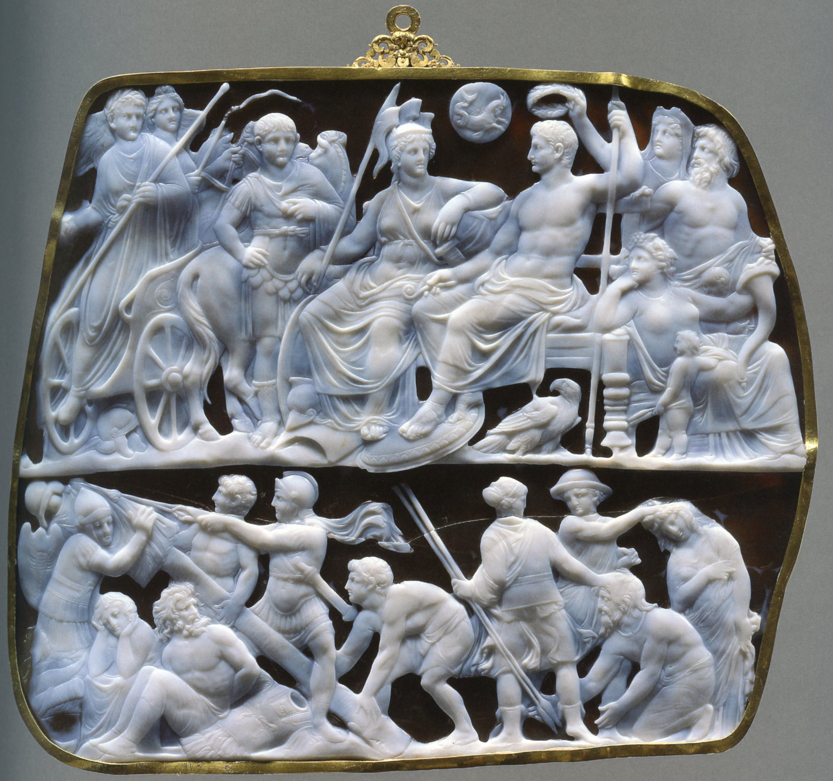
GEMMA AUGUSTEA
Two-layer sardonyx: white the upper, brown the lower.
Wien, KHM, Antikensammlung, Inv. No. IXa 79.
Subject: Augustus receives Tiberius and Germanicus after the victory upon Pannonia and Dalmatia.
AD 9/10-12.

Slide 32
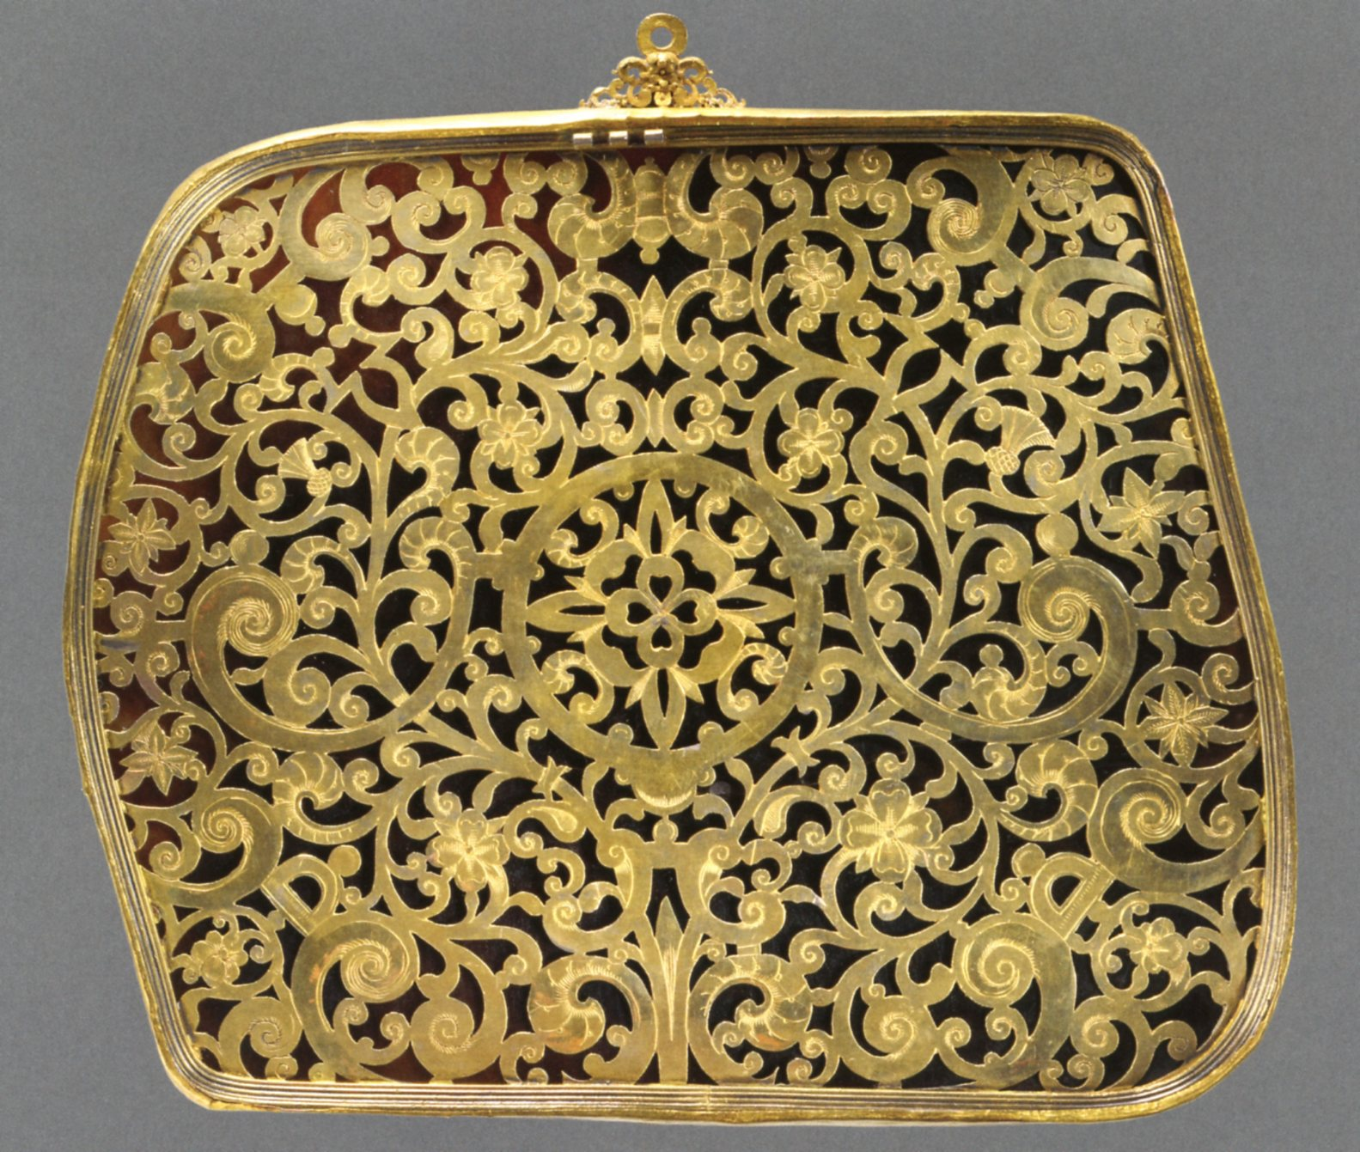
Gemma Augustea
backside
gold and silver
manufactured in the court ateliers of Rudolph II in Prague, beg. 17th century
known since 1264
until 1533 – Toulouse
after 1591 – Venice
1619 Vienna

Slide 33
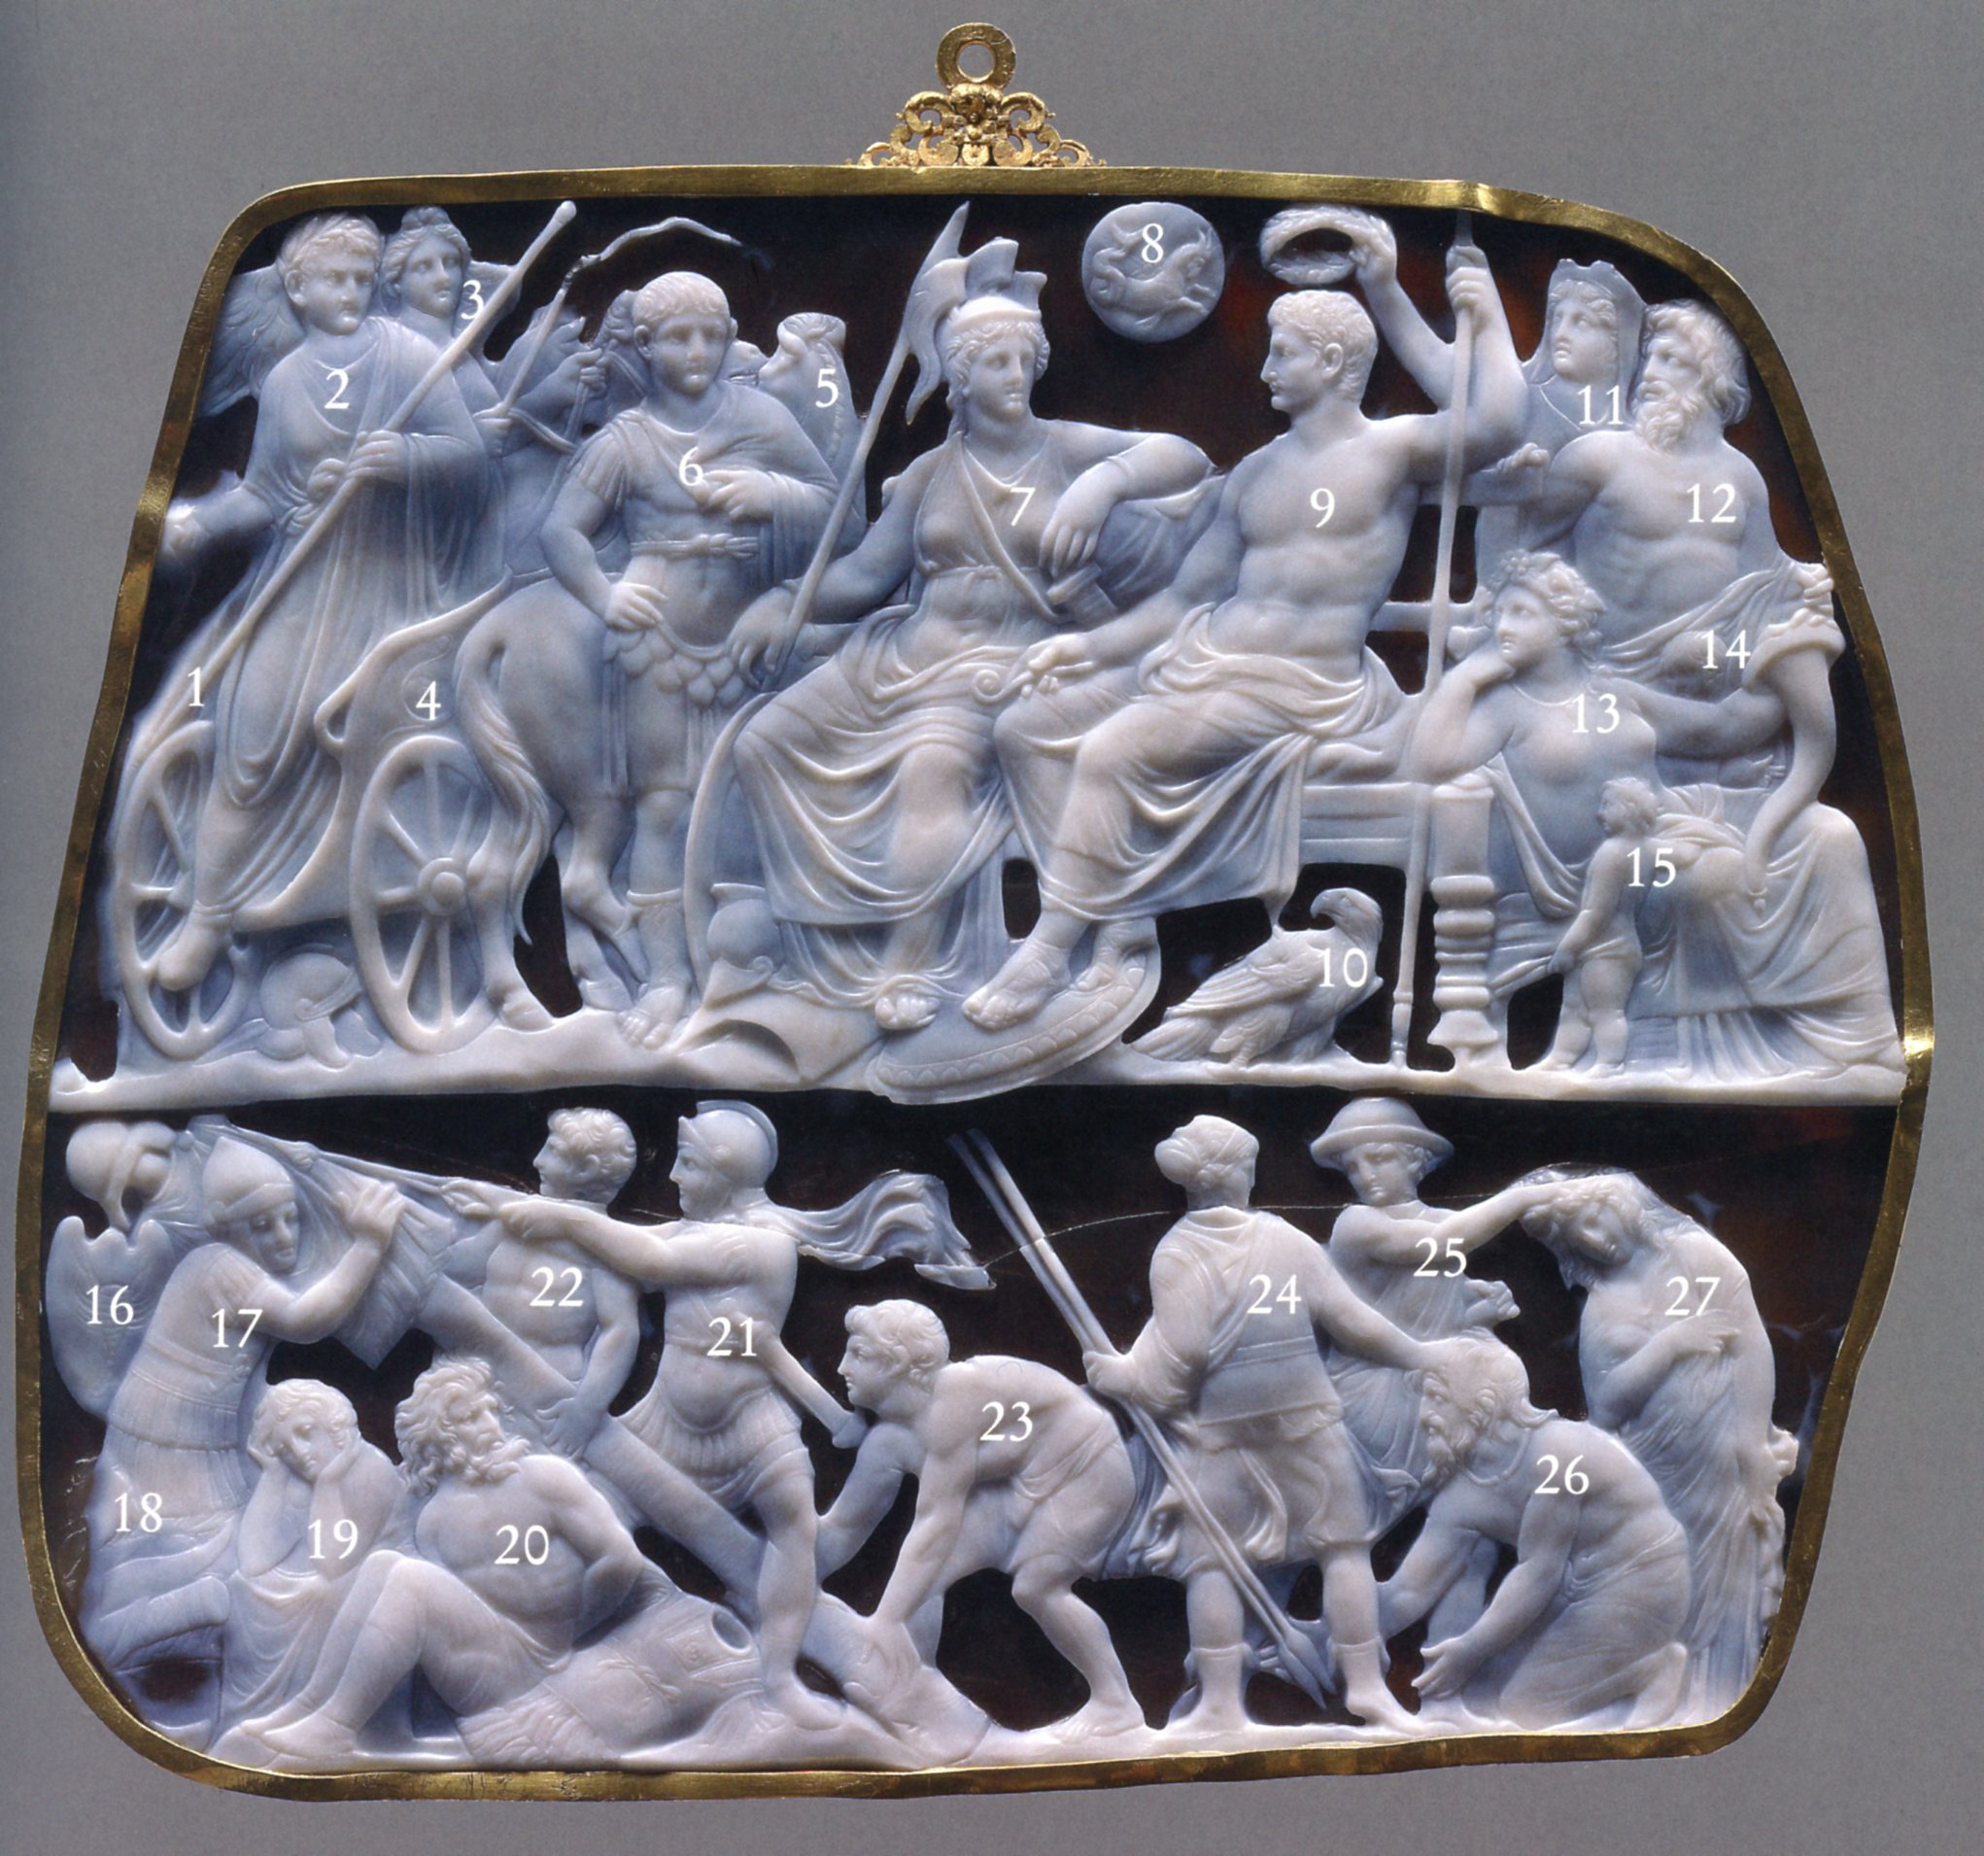
6 AD – Tiberius led war against uprised Pannonians, which ended with the participation of Germanicus in 9 AD. Reditus is depicted – victorious return.
1 – missing togatus, 2 – Tiberius, 3 – Victory, 4 – biga, 5 – horse, 6 – Germanicus, 7- goddess Roma, 8 – astrological device, 9 – Augustus as Jupiter, 10 – eagle, 11 – Oikoumene, 12 – Saturnus, 13 – Tellus, 14 and 15 - children

Slide 34
A scene of victory – the erection of a trophy
16 – a shield with a scorpion, 17 – Romulus=Quirinus, 18 – horseman, 19 – sitting barbarian woman, 20 – chained barbarian, 21 – Mars, 22 and 23 Castor and Polux, 24 - Diana, 25 – Mercury, 26 – kneeling barbarian, 27 – barbarian woman

Slide 35
Augustus and the imperial cult
State cult
avoided direct deification
became god after death
Municipal and Provincial cult
insisted Roma was worshipped
with him
- political cohesion of the Empire - Vienne, Pula
Private cult
- no restrictions
- reorganized the administrative system – vicus
relief decorated altars
Genius
- integration of all citizens of the Roman empire – shared the same identity
Communication strategies
Visual language – The Forum of Augustus, Ara Pacis, the Belvedere Altar, Gemma Augustea
Textual language – Res Gestae

