Slide 1
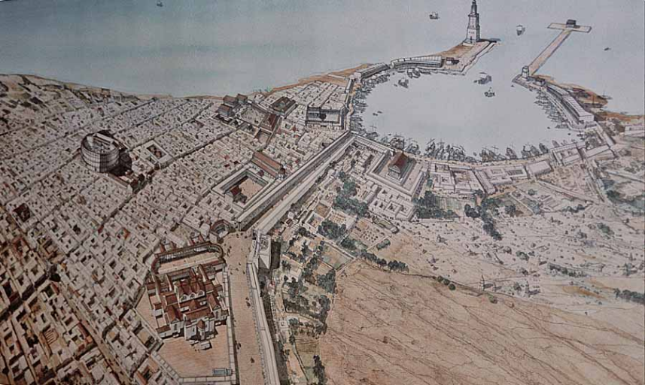
The Buildings and the Images of the Imperial Cult
VI Leptis Magna

Slide 2
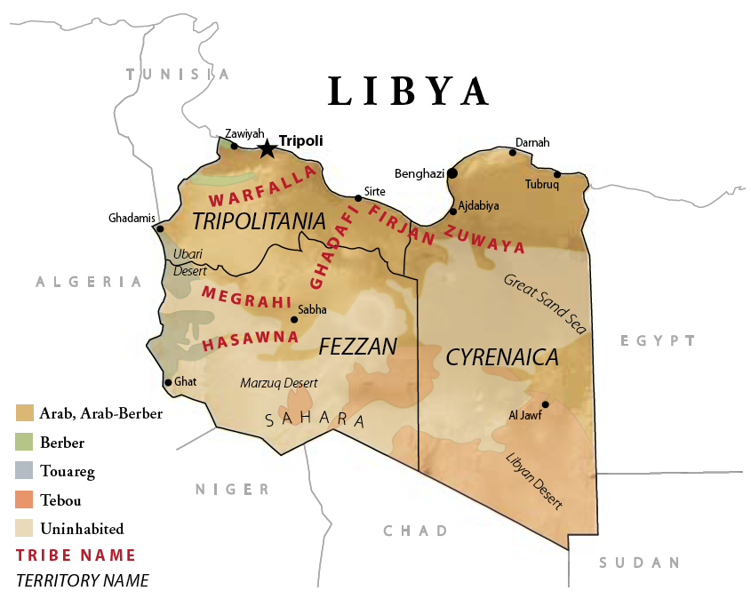
North Africa – most of the country in the Sahara desert
population: along the coast and its immediate hinterland
Tripoli – the capital
3 historical regions:
a) Tripolitania
b) Cyrenaica
c) Fezzan
Two languages: Greek and Punic
History:
trading post – Phoenicians
Cyrenaica
630 BC – Greek colonization – city Cyrene – Persians – Alexander the Great – Ptolemaic kingdom
Tripolitania
5th c. BC – Carthage – hegemony across most of the North Africa – fall of Carthage – Numidian kings – Roman empire as a province Africa Nova with Crete –golden age 2nd and 3rd c. AD
Fezzan
5th c. BC – 5th c. AD – Garamantiam Empire – operated trans-saharan trade routes between Carthage and the Roman Empire and Sahelian states of west and central Africa

Slide 3
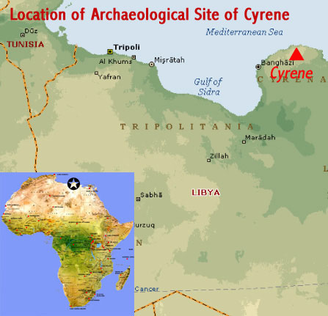
Carthage
Sallust
The War with Jugurtha

Slide 4
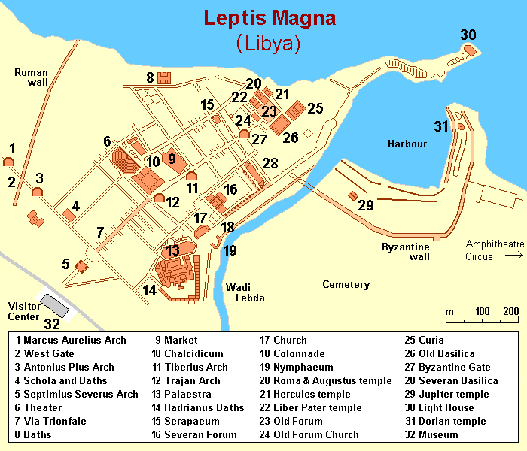
130 km east of Tripoli, near Khom, on the coast
founded by Phoenicians – 12th c. BC
prominence when Carthage a major power in the Mediterranean – 4th c. BC
after the 3rd Punic War – part of the Roman Republic
Septimius Severus – independent city
high degree of preservation (earthquakes, abandoned – Arab conquest)

Slide 5
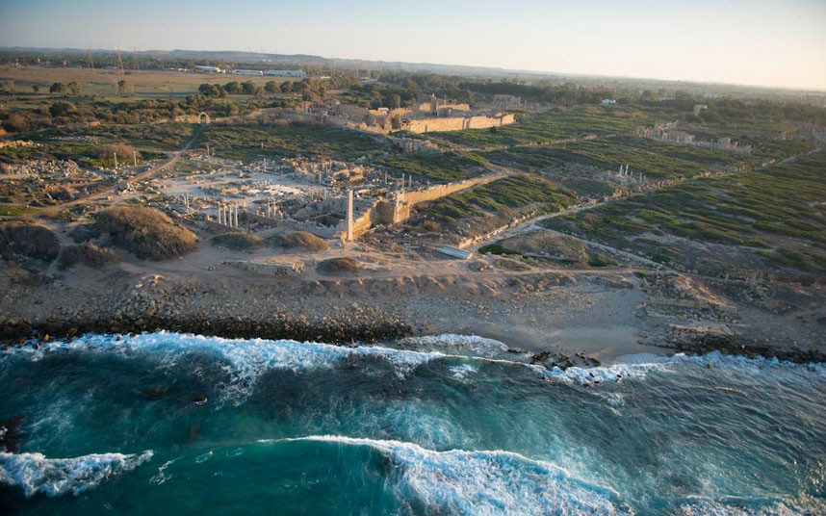

Slide 6
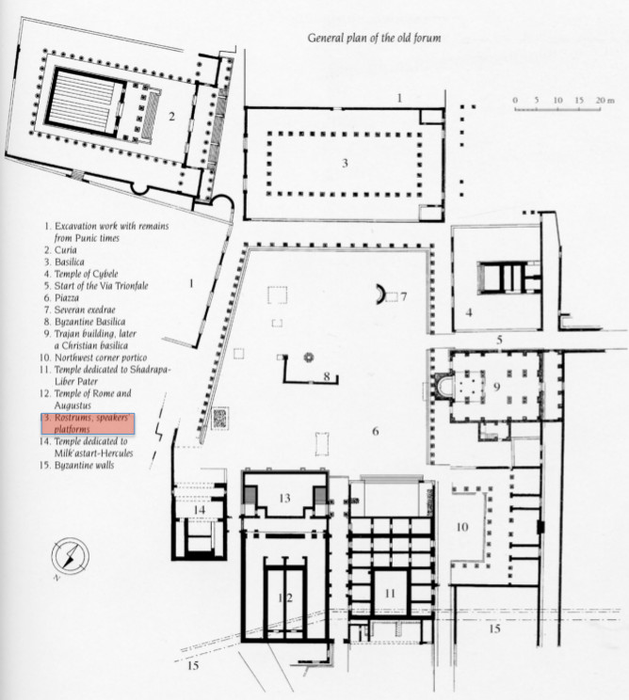
The Old Forum
Augustan age
reconstructions: Claudius (53/54 AD), the Antonines (mid. 2nd c. AD)
3 temples N side:
Liber Pater
Hercules
Rome and Augustus
typical Leptitan temples: very high podium housing rooms in its inside
Augustan period: theatre, market, The Old Forum,

Slide 7
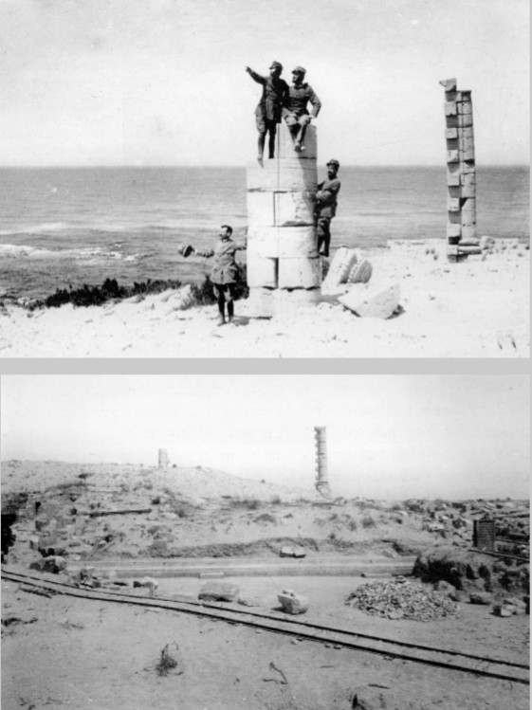
Excavations
The temple excavated in 1922, 1925 – 27, 1932, published only partly
J.B. Ward Perkins – after the war, only basic research
Systematic research – 2001 – 2003
2001 – the first recognition of the structures and the size of the temple
2002 – cleaning the structures, detailed survey, fragments documentation, a small trench to study foundations
2003 – historical research and documentation – based on photos, drawings and aerial photos from 1965
architectural fragments determine different phases of the temple
The two semi-columns in the rear side of the temple have been always visible

Slide 8
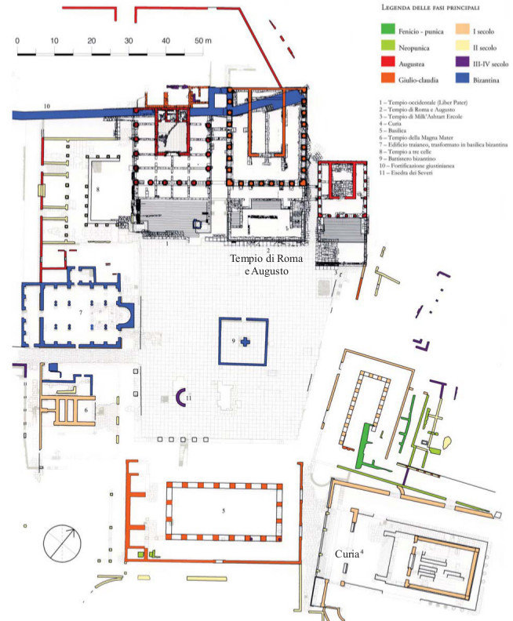
The Old Forum
South-west, north-east: two streets linking the Old Forum with the residential quarters at north-west
7 phases
The Temple of Rome and Augustus
Phase I – Tiberian period
construction of the building, first figurative cycle (Tiberian)
Phase II – Claudian period
Remake of the square pavement and bilingual inscription, other two figurative cycles (Claudian)
Phase III – Antonine period
Works on the peristasis and the top order of the cella
Phase IV – Destruction and later re-occupations
310 and 365 AD

Slide 9
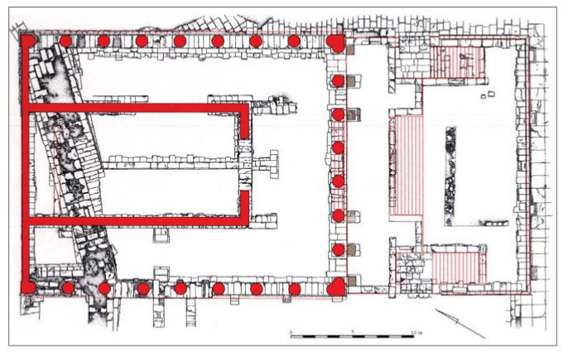
The Temple of Roma and Augustus
Date: 14 – 23 AD
Position: the centre of the north-east part of the Old Forum
south-east the Temple of Liber Pater, opposite side the Temple of Hercules
Dimensions: 41,41 x 21,05 m
Type: ionic, peripteros sine postico on a high podium, octastyle porch, 8 columns on its sides too
corners: heart-shaped half-columns
Podium: 5.09 m high above the surface level of the forum, in front a lower part – rostra (2.77 m height), 3 staircases, Ras el-Hammam limestone (rear wall in sandstone covered with plaster)
Cella: 10.30 x 18.55 m, podium covered with marble slabs in the back supported the cult statues

Slide 10
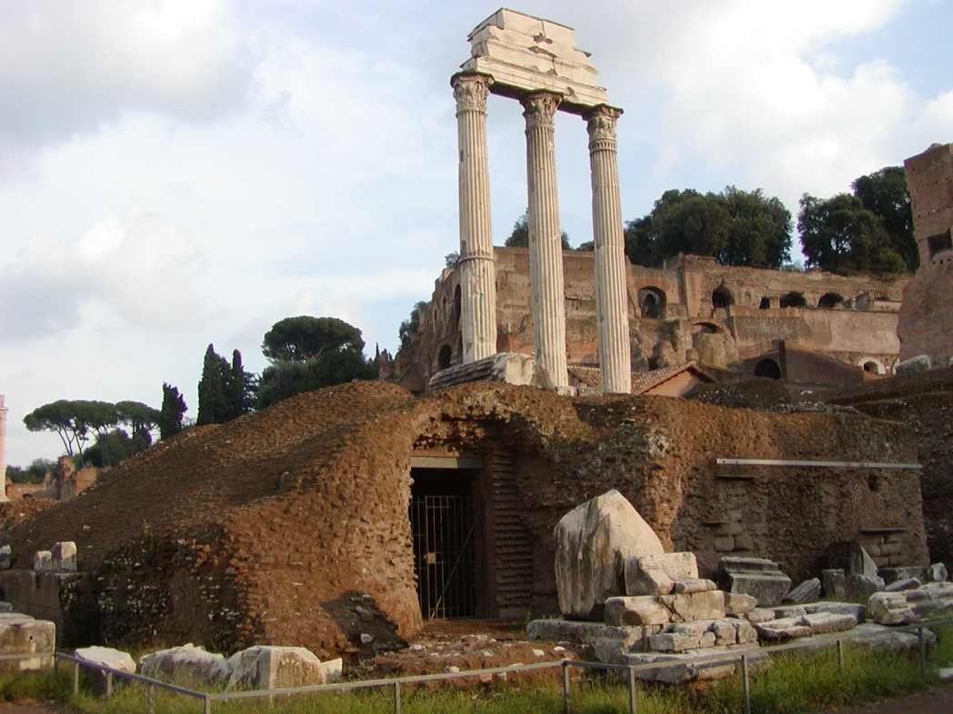
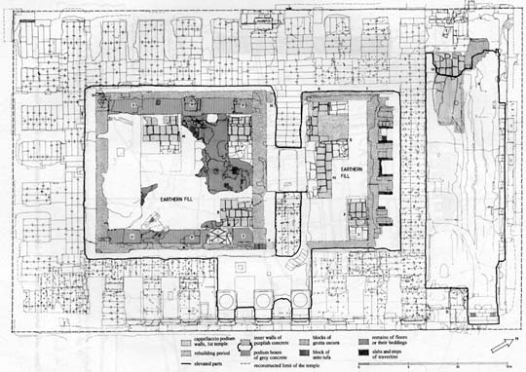
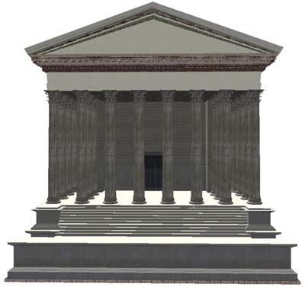
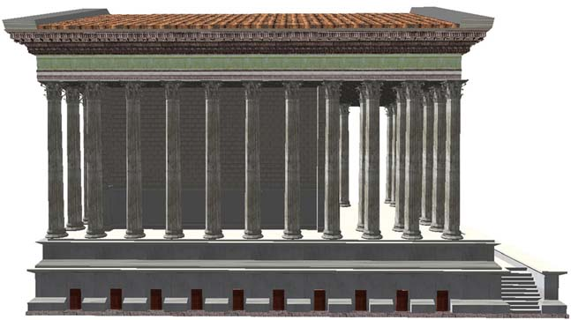
Some urban models of the temple:

Slide 11
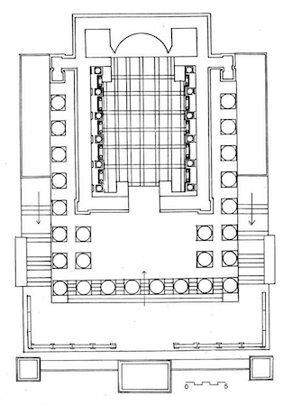
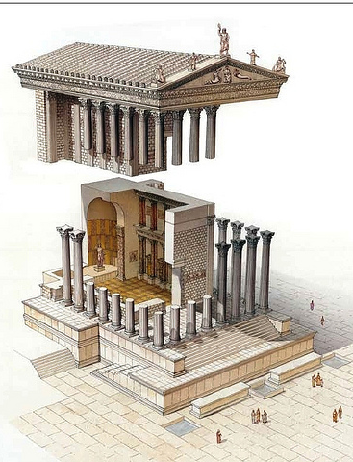
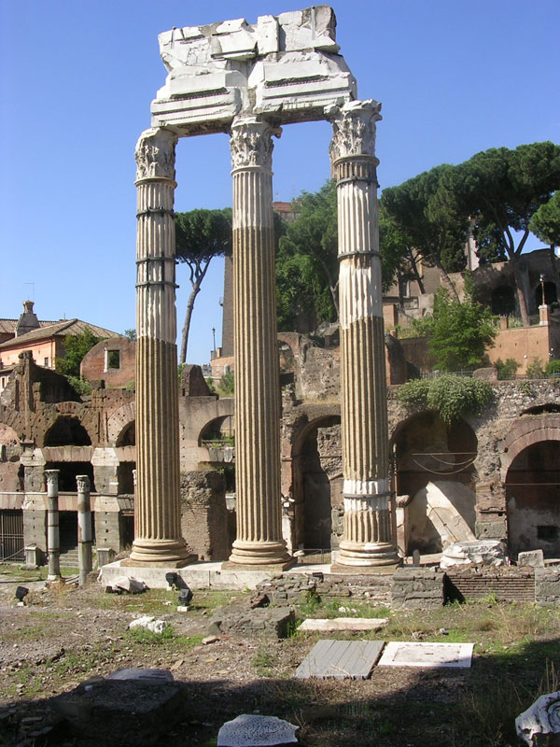

Slide 12
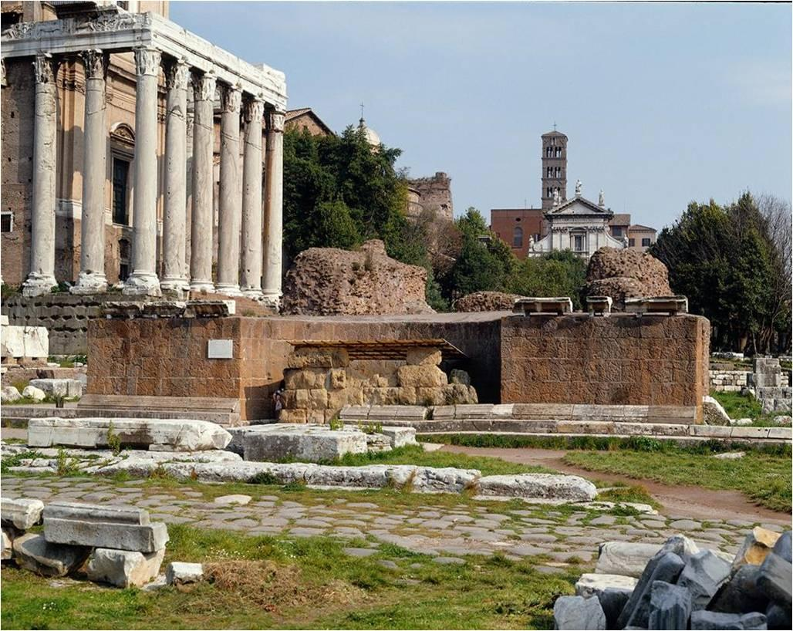
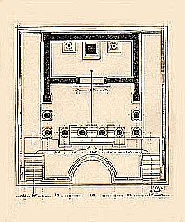
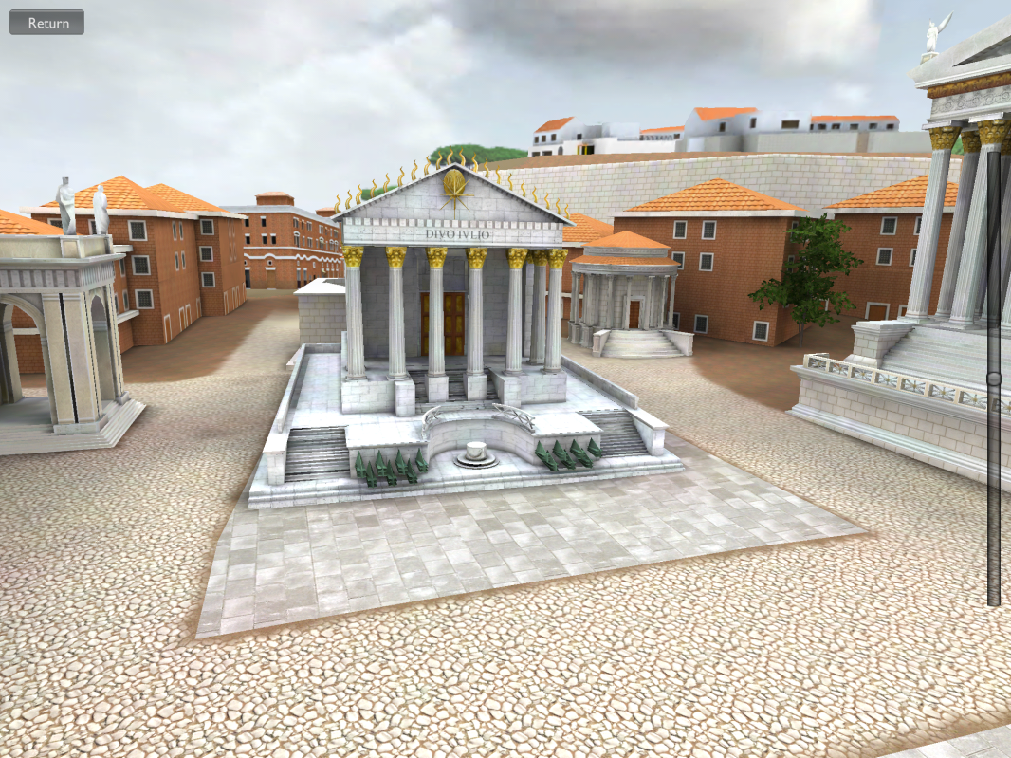

Slide 13
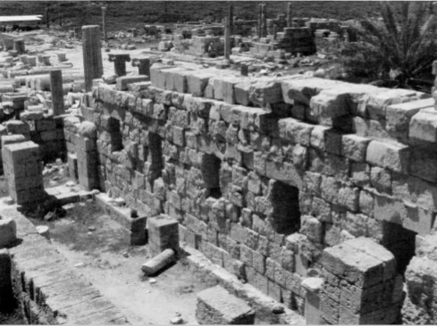
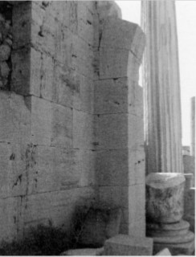
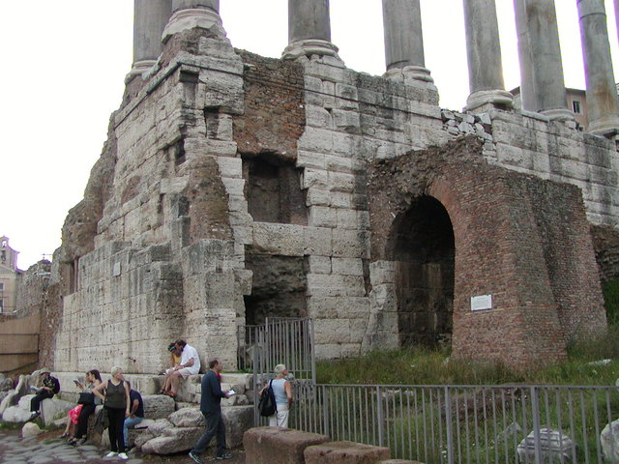
Special features
podium:
inner rooms in the podium closed and enlightened by narrow windows – probably contained a valuable objects (aerarium of the city?)
arches on imposts – structures between podiums, supported elevated passage – linked the temples at the level of the intermediate terrace

Slide 14
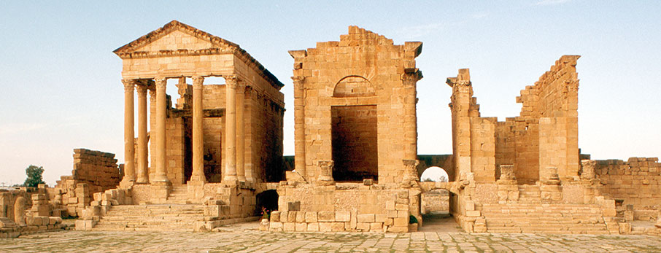
Tunisia, Sufetula
Leptis Magna, Libya

Slide 15
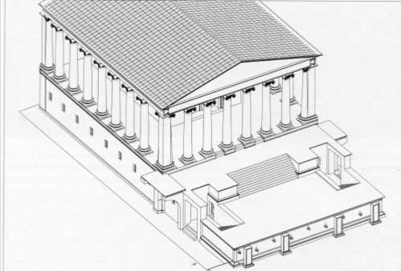
- The three temples aligned on the front line (evidence of a Punic tradition) – a sanctuary with three cells, visual unity
later phase – other arches built
passageways – widened the fruition of the internal paths of the sacred space (the temple accessible through two stairways, pronaoi of the other two temples)
built at the moment of the erection of the Temple of Rome and Augustus
A front terrace
B intermediate terrace
C temple
D side passageways
C
B
D
A
D
in the sides of the tribune – two passageways preceded by three steps, one passed into a square chamber of disengagement, from which the tribune was reachable or the spaces under the intermediate terrace (favissae)
design comes from the need to create a terrace facing directly the forum with no loose of spaces (frontal stairway)

Slide 16
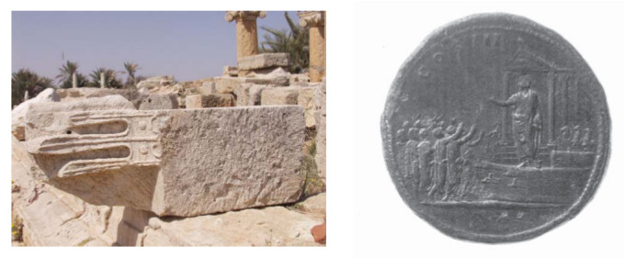
front side of the tribune – a series of rostra sculptured in limestone, one preserved in situ
the comparison – the Temple of Divus Julius (Hadrianic sestertius)

Slide 17
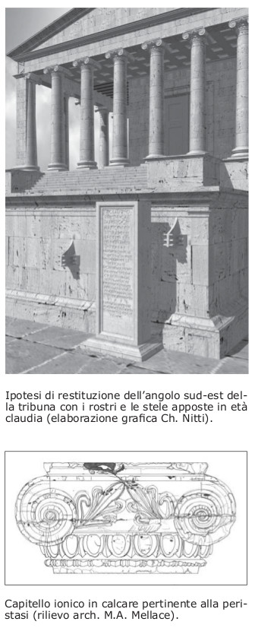
8 x 8 columns, semi – columns in the corners, attic bases, smooth and tapered shaft, made by drums with a ionic capital
the architrave was made of single blocks, not monolithic (limestone and sandstone are not suitable for monolithic trabeations)
Only one block preserved with the upper half of a tabula ansata (a tablet with dovetail handles, very popular in Rome for votive reliefs)

Slide 18
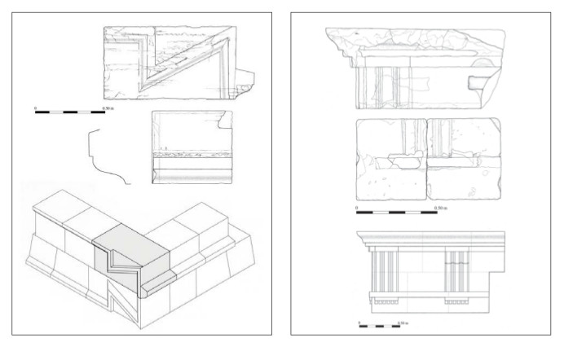
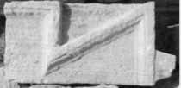

Slide 19
the cella measures 10.30 x 18.55 m with a large podium in the rear as wide as the cella itself, against the rear wall
the podium covered with marble slabs (pavonazzetto, giallo antico, green serpentine)
the cella contains a single room (the three partition walls must have been a further support of the floor)

Slide 20
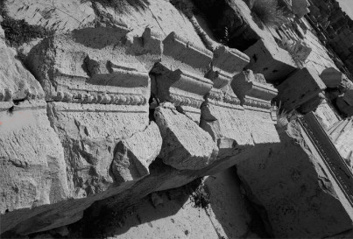
Phase I – Tiberian period
large description above the doorway in limestone, found during excavations
neo-punic inscription
…the statues of the god Augus]tus and of Rome and of Tiberius Augustus and of Julia Augusta and of Germanicus and of Drusus Caesar and of Agrippin[a, the wife of] Germanicus and [of Livia the wife of Dru]us and of Antonia the [mother of Ger]manicus and of Agrippin[a the mother of ] Drusus and the collection of statues of the god Augustus and the throne of the statue of the god Augustus
…of the statue of the god] Augustus and the vestments of the statues of Germanicus and of Drusus Caes[ar]… for Tiberius Caesar and the quadriga of [Germani]cus and of Drusus C[aesar] and the bronze doors and the ceiling of the portic[o and the] forecourt of the sancturary and the porticos, they were taken up at the expanse ..., the sufets being Baliton, the son of Hanno G… Saturninus and Bodmelqart, the son of Bodmelqart Tapapi …riculus.

Slide 21
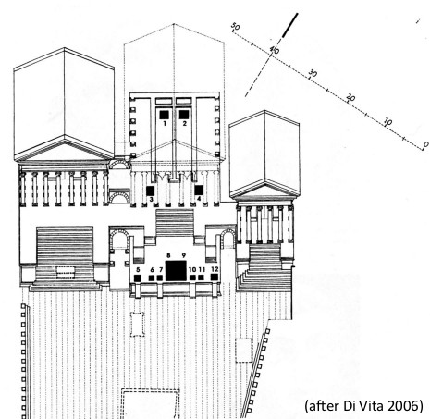
The statues listed in the inscription:
Divus Augustus (head)
Rome (head)
Tiberius Augustus (head)
Julia Augusta [Livia] (head)
Germanicus’ mother Antonia (complete standing statue)
Germanicus’wife Agrippina [Maior] (complete standing statue)
Germanicus (head in the round)
Quadriga
Quadriga
Drusus [Minor] Caesar (head in the round)
Drusus [Minor] Caesar’s wife Livia [Livilla]
Drusus [Minor] Caesar’s mother Vipsania Agrippina (head in the round)
quadriga: for Germanicus and Drusus Caesar, only several blocks of the base found, some of them inscribed, the quadriga must have been in bronze, 1.5 times larger than life-size, total width 5.30 m, coherent width the space between the two rostra in the middle
all statues are in the Museum of Tripoli, they were studied in the 40’s on the base of the list of the dedicatory inscription
The heads of the acroliths 1-4 are all partially empty inside (the same technique of assembling the statue of Genius Augusti in the Hall of the Colossus)

Slide 22
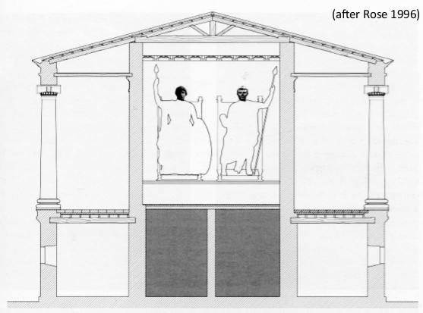
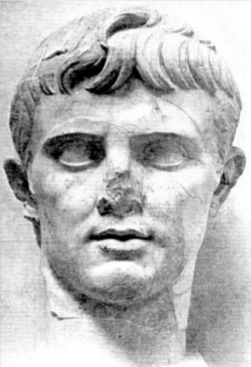
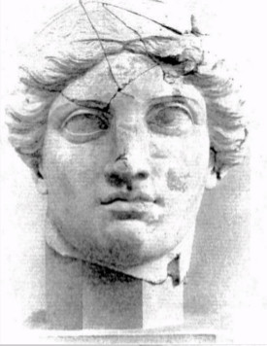
- internal dimensions of the cella are 17.25 x 8.70 m, the base against the rear wall was 2.06 m deep, housed the acroliths of Augustus and Rome only (4:1), Tiberius and Livia outside (not enough room)
- dimensions of Augustus 3.50 m wide, 7.60 m high

Slide 23
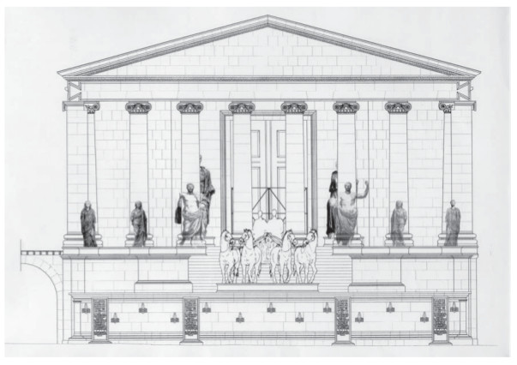
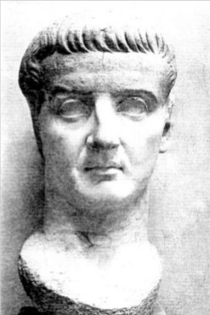
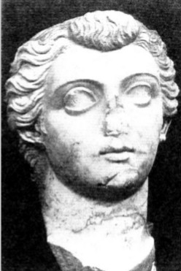
- the statues of Tiberius and Livia were placed outside the cella (both were still alive at the time of construction), the best place is the pronaos at each side of the doorway (Pantheon of Agrippa – Augustus and Agrippa during their lifetime)
- inside the podium - remains of a structure similar to that under the base inside the cella – it could have supported two segments of the base 2.20 m deep, on which the two acroliths of Tiberius and Livia were places (3:1)

Slide 24
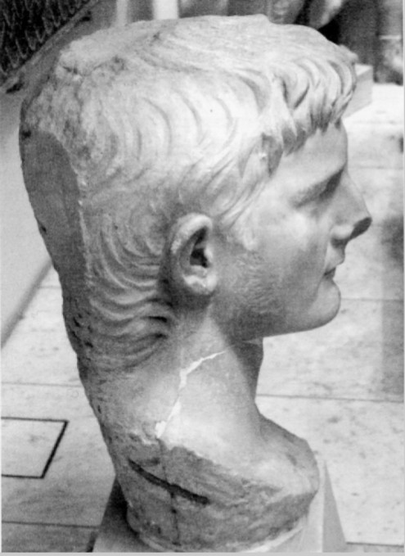
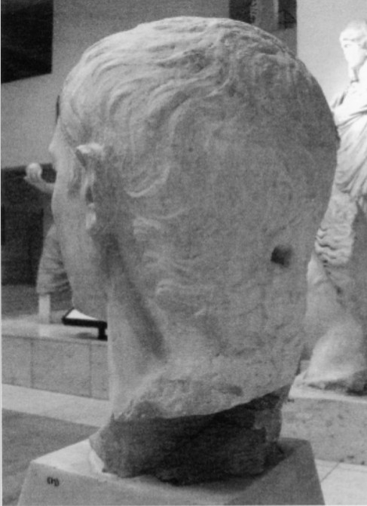
- the number of remaining statues is the subject of discussion – the main problem: were Germanicus and Drusus Minor shown twice? (standing and in the quadriga) or only once?
Reasons for the first hypotesis:
The quadriga was in bronze, the two heads are in marble
The ratio of the quadriga 1.5:1, the heads are 2:1
The marble heads are unfinished in the back (Germanicus) and show the hole for a tenon (Drusus Minor) – not in the sight, must have been secured on its back
Germanicus
Drusus Minor

Slide 25
The result – several sculptural groups:
In the cella – Augustus and Rome
Under the pronaos – Tiberius and Livia
Under the intermediate terrace, in alignment with the outer three columns on both sides of the temple: Antonia Maior (A), Agrippina Maior (B), Livilla (C), Vipsania Agrippina (D) and the other two, who cannot be but Germanicus (E) and Drusus Minor (F) depicted standing. (Germanicus and Drusus Minor 2:1, wives and mothers 1.5:1)
The quadriga on the tribune, inside filled with soil according to the building tradition for North-Africa
E
F
A
B
C
D

Slide 26
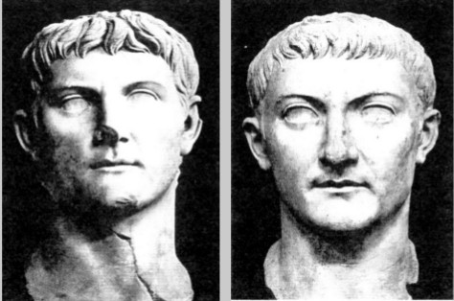
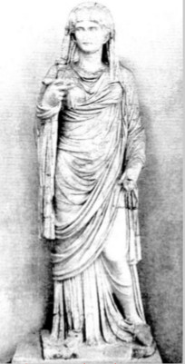
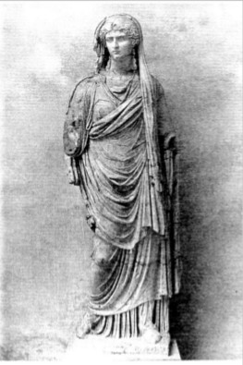
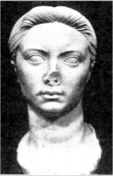
Germanicus
Drusus Minor
Vipsania Agrippina
Antonia Minor
Agrippina Maior
Livilla

Slide 27
The chronology of the Temple of Rome and Augustus
deduced by
the relationship of the temple with the pavement of the square
the adjacent temples
the inscription above the doorway
Results:
Relative chronology: the temple is later than both the other two temples (the arches were additionally added), but earlier than the pavement of the square (dated to 53 AD by an inscription)
The absolute chronology is possible due to the inscription. The temple itself was built in function of the sculptural cycle
The presence of the acrolith of Augustus inside the temple and Livia and Tiberius at each side of the doorway, the term divus related to the name of Augustus and the attribute Augustus to the name of Tiberius in the inscription suggest a date post 14 AD
End of the works – after 32 AD (damnatio memoriae of Livilla, wife of Drusus, whose statue was on the terrace of the temple) or even before 29 AD, the year of Agrippina’s exile to Pandataria (today Ventotene)
The Quadriga with Germanicus and Drusus Minor – its base partly preserved, the titles indicate a date after the death of the two princes, already heroized there. The monument must have been ready at the moment in which the inscription above the doorway was made. Then, the end of the works ranges from 23 AD (Drusus’s death) to 29 AD (Agrippina’s exile)

Slide 28
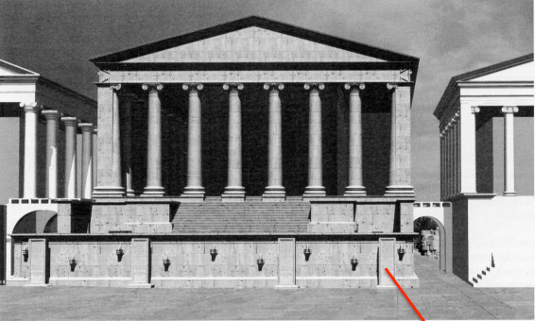
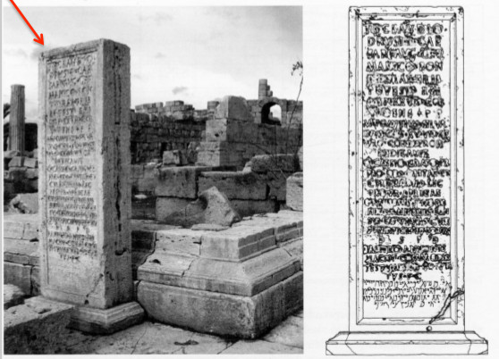
Phase II – Claudian period
4 bilingual stelae (Latin and Neo-Punic) attest that in 53 AD a rich citizen of Leptis offered de pecunia sua columnas cum superficie et forum
new pavement, a three-side portico, three connected temples and a basilica at the opposite side of the temples – the Roman-Italic trend
- the new pavement – large slabs of limestone of Ras el-Hammam (the level of the square raised by 32 cm)
- in front of the tribune, against the front side, the bases of four inscribed stelae were put (three of them are still in situ), they are not evenly spaced, but are placed in two pairs slightly closer to the corners
the stelae also indicate a position of the statues on the tribune of a later date – did not clutter the area of the central quadriga

Slide 29
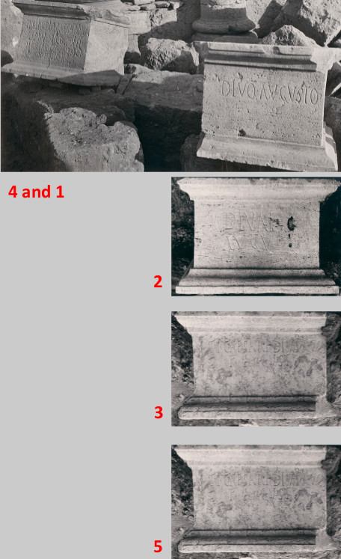
two sculptural cycles in this period:
only the bases survive – found close to the Temple of Rome and Augustus
5 identical bases: 1) DIVO AVGVSTO (Augustus)
2) DIVAE AVGV (Livia)
3) TI. CAESARI DIVI AVG F AVGVSTO (Tiberius)
4) TI CLAUDIO CAESARI AVG GERMANICO PONT MAX TRIB POT V IMP XI P P COS DESIG IIII (Claudius) – 45 – 46 AD
5) (eraded) MESSALINAE C[…] (Messalina)
none of the survived statues can be ascribed to such bases
the dimensions suggest statues with the ratio 1:1, they must have been placed against a wall (the back side is rough)

Slide 30
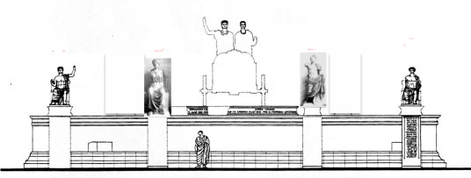
b) Three seated statues and one standing
the ratio is 1.5:1
probably a fourth seated statue was part of the cycle, so four enthroned statues located on the level of the tribune, at the sides of the quadriga, in correspondence with the stelae below
the standing statues on the pavement below
but, the seated statue of Claudius shows a hole for a tenon – must have been placed at the wall, the same with the Tiberius statue
the standing Tiberius statue was found in the cella, so some of the Julio-Claudian portraits must have been located inside the cella

Slide 31
the preserved statues portray:
Seated Augustus
Seated Livia (reconstructed from two large fragments, the lower could also belong to a fourth (female) seated statue
Seated Claudius
Standing Tiberius

Slide 32
