Slide 1
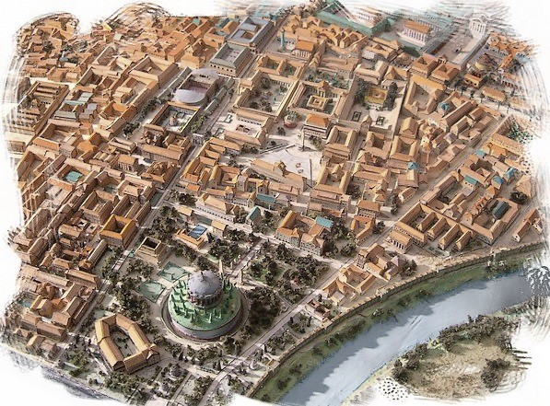
The Buildings and the Images of the Imperial Cult
VII The Flavian cult

Slide 2
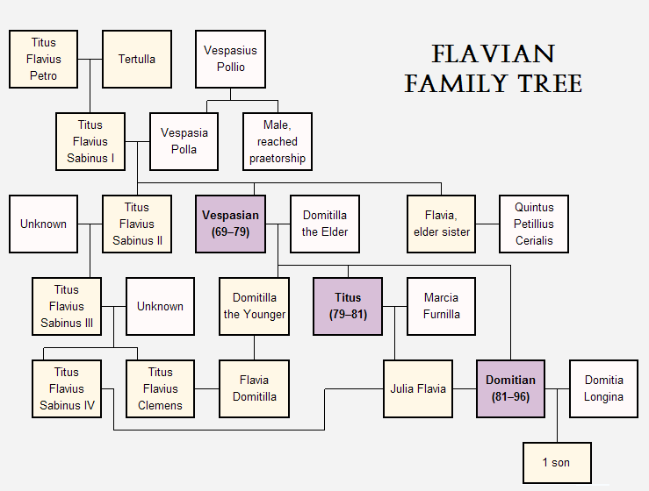

Slide 3
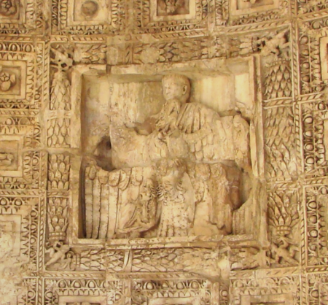
The Flavian Cult
changes:
a) Arval rituals
b) Genius of the princeps
c) Divi

Slide 4
Arval rituals
- the calendar of events marked with the imperial cult and the pantheon of deities - differed under the Julio - Claudians and Domitian
Julio-Claudians
- anniversaries of the days on which the princeps received important powers: imperium, Pater Patriae, Pontifex Maximus
- imperial birthdays, first entering the city as princeps,…
Flavians
almost all these occasions ceased: birthdays, assumption of power (the imeprium and tribunicia potestas), the only annual imperial cult from the Julio-Claudian which continued was Januray 3rd vota
Votum: the people assembled on January 3rd to offer collective vows for the salus ("health, safety, wellbeing") of the emperor
Pantheon
Julio-Claudians
- Capitoline Triad, Salus, divi, Genius of the princeps (responsible for the prosperity and continuation of the Julio-Claudian household, emphasized the dynastic source of imperial power
Domitian
- divi and Genius absent, new imperial cult ritual – January 22nd vota, focused on the importance of the Principate as an institution in the state rather than on the individual incumbent princeps

Slide 5
Sources:
Galba, Otho, Vitellius – quite complete records - the same cultic calendar as under Nero
Vespasian - no evidence from Arvals celebrating anniversaries (also Titus), only 70 AD adventus
- only 12 entries of Arval Brothers from his ten-year-long reign, 4 related to the imperial cult (the rest Dea Dia)
Titus – a clear decrease of annual rites in the imperial cult and pantheon reduction
Domitian - 91 AD – Salus Augusta introduced for the first time, changes official
- but it is hard to say for sure that Genius of the princeps was removed - only with Arval Acta

Slide 6
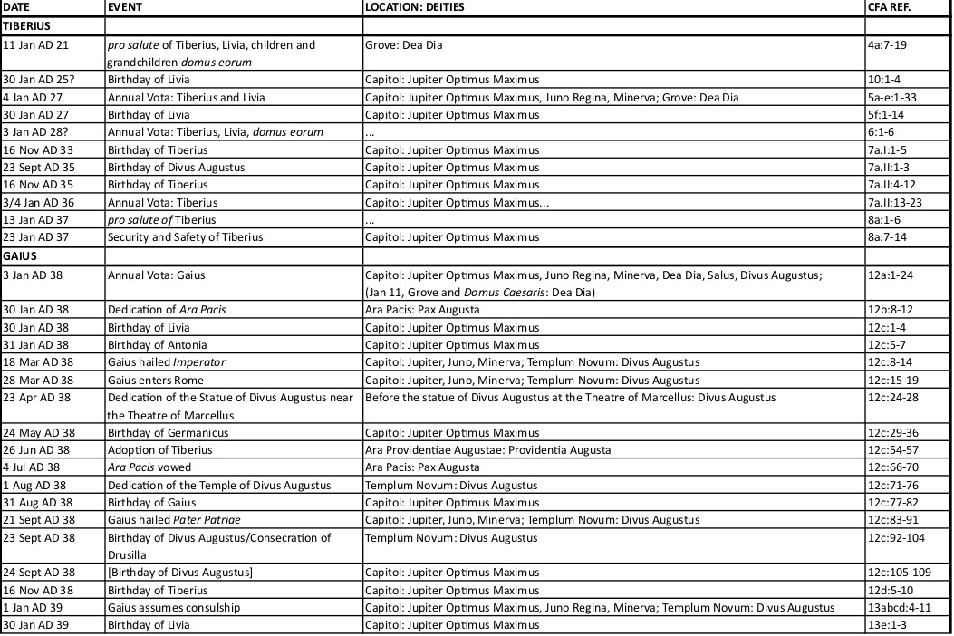

Slide 7
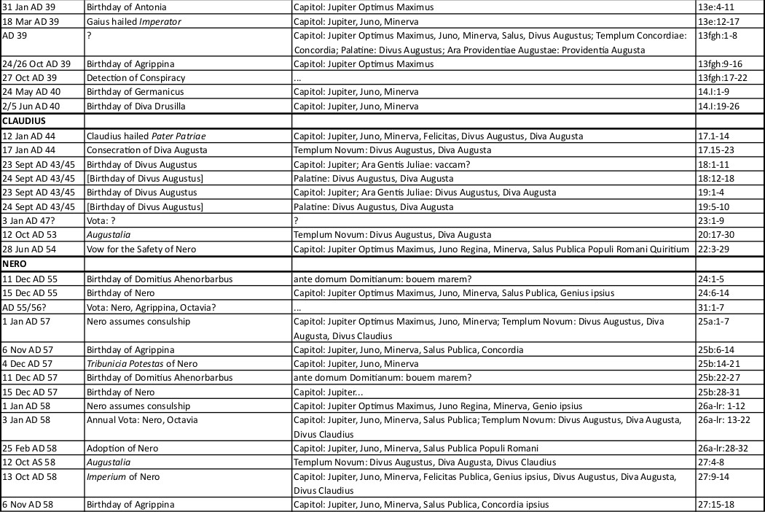

Slide 8
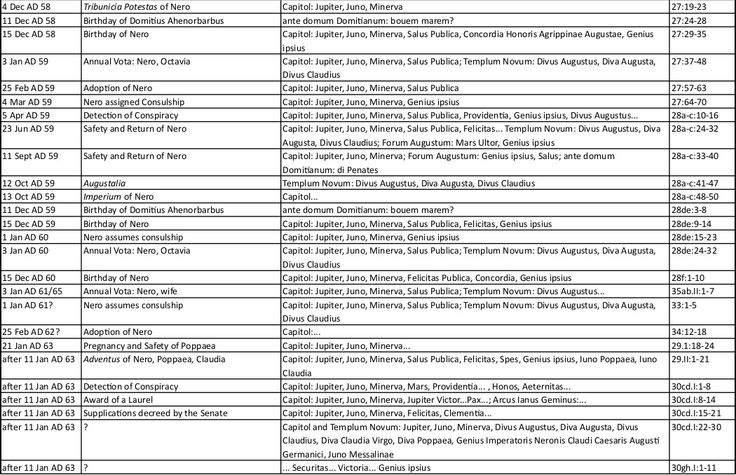

Slide 9
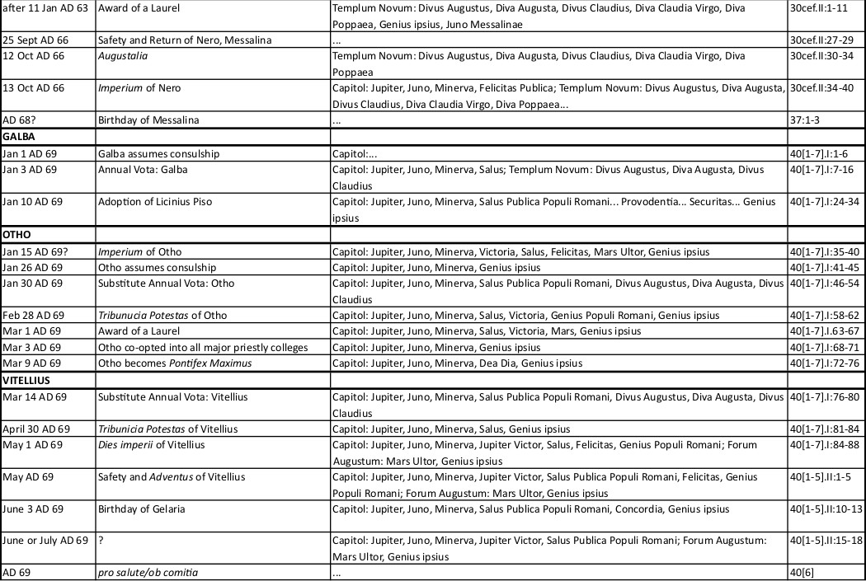

Slide 10
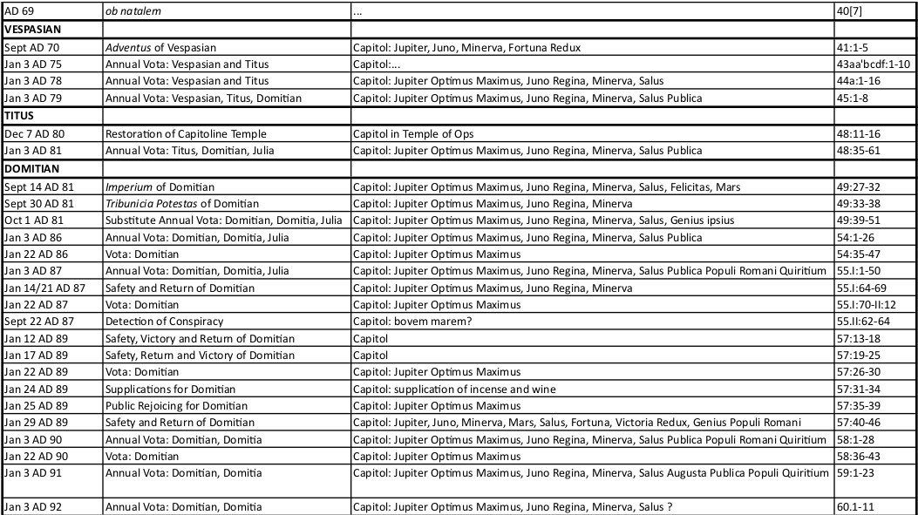

Slide 11
Genius
Censorinus (grammarian): “A genius is a god under whose protection each person lives from birth”
Modern scholars: “Life force or guardian spirit”
Julio-Claudians
gradually incorporated into the state imperial cult
Augustus
introduced into the state imperial cult – street guardians – then identified with the guardians of Augustus’ domus – became known as the Lares Augusti (at this time Genius of the princeps was included in the compita alongside Lares Augusti mimicking Augustus’ domestic cult)
oaths taken by the Genius (Tiberius refused it)
Nero
Arval Brothers sacrificed to his Genius in 55 AD, throughout his reign important part of pantheon
receiving sacrifices on emperor’s birthday, dies imperii, Pontifex Maximus
the earliest written note, but probably incorporated during Caligula’s reign
genius Augusti on the coinage with the same iconography as Genius of the Roman People

Slide 12
Galba, Otho, Vitellus
Genii important
Vespasian
- change in the role of Genius
Domitian
Genius completely absent
instead to represent the state: People, Senate, Rome
- an autocratic ruler, Genius was largely suppressed – not included into pantheon (dramatic decrease)
- Pliny – Panegyricus – praises Trajan for not allowing gratitude for his benefactions to be delivered to his Genius (implying that Domitian had done the opposite)
- Domitian’s genius present in compita – inscriptions from compital altars

Slide 13
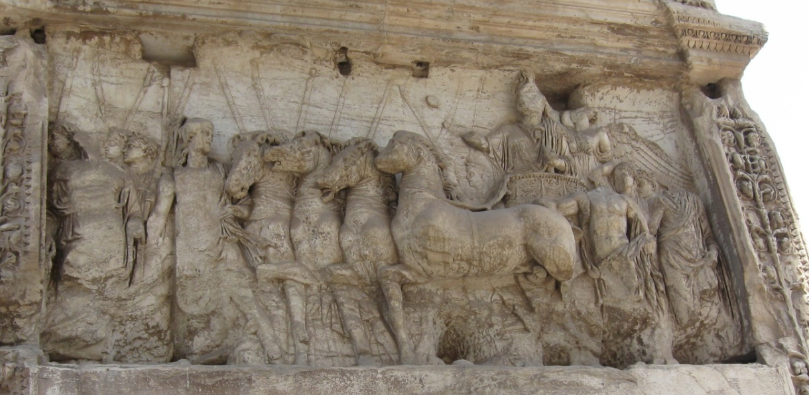
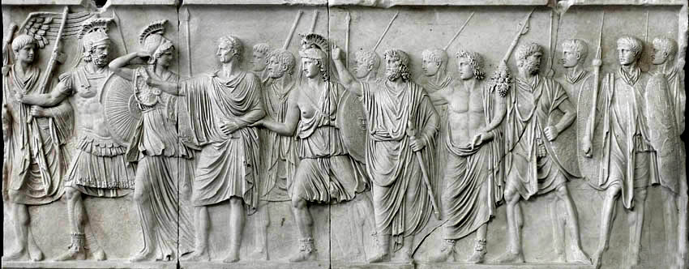
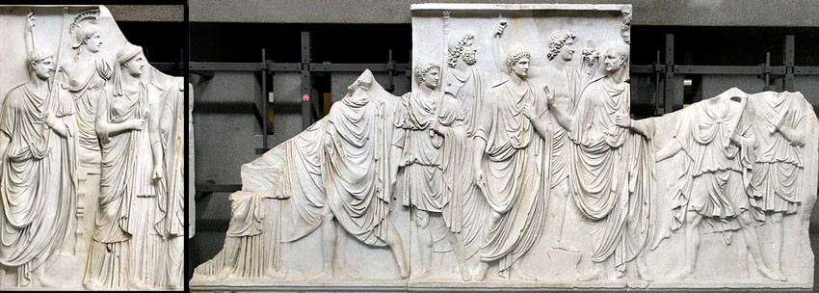
Iconographic evidence:
a) The Arch of Titus
b) Cancelleria A and B
c) The Temple of Domus Flaviae
Genius absent - each relief includes Genius Populi Romani and Senatus, together with Roma - personification of the Roman state
- all these reliefs – princeps alongside 3 deities

Slide 14
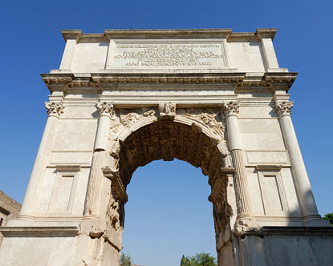
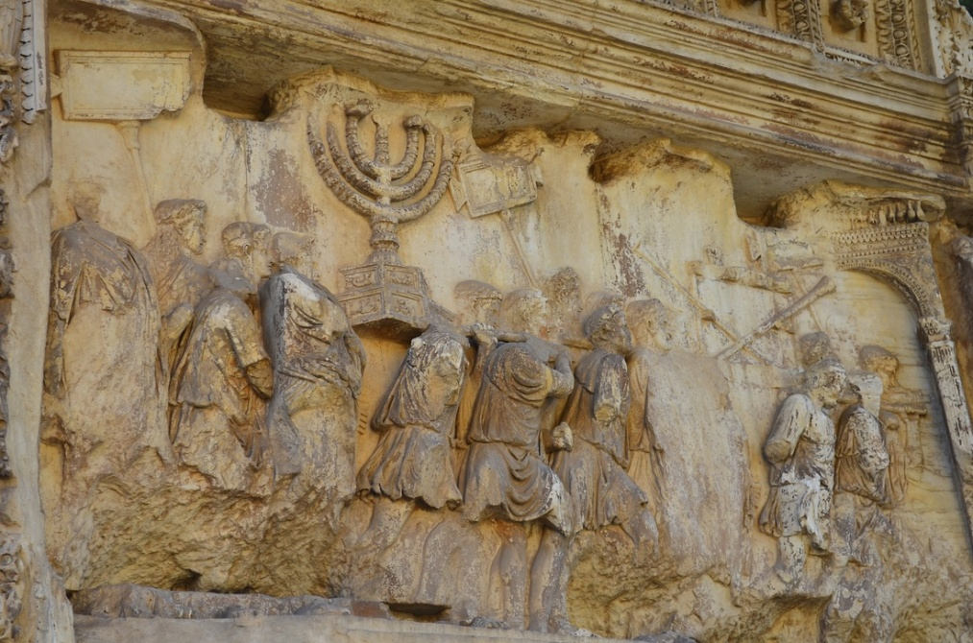
The Arch of Titus
- the arch dedicated to Divus Titus by the Senate and Roman People, inscription and apotheosis of Titus – after death
dedicated by Domitian or Trajan
1st theory: Domitian hated his brother - Trajan
2nd theory: the Booty relief (opposite the Triumphator relief) – men carrying spoils taken from Judea in the triumphal procession of 71 AD passing under a triumphal arch
the arch at the far right: two men in quadrigae flanking a man on horseback and a larger than life female figure
the arch: a temporary structure erected for the day of the Judean triumph, later replaced with a permanent structure
the two men – triumphatores Vespasian and Titus, the equestrian Domitian, unidentified goddess
because Domitian appears on the arch supports the suggestion that the relief image completed during his reign
Trajan – damnation memoriae on Domitian

Slide 15
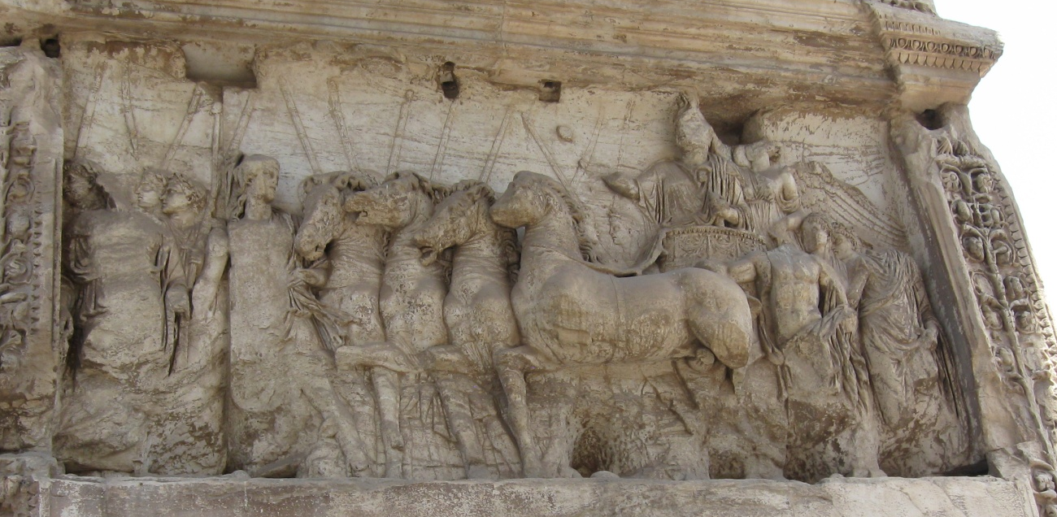
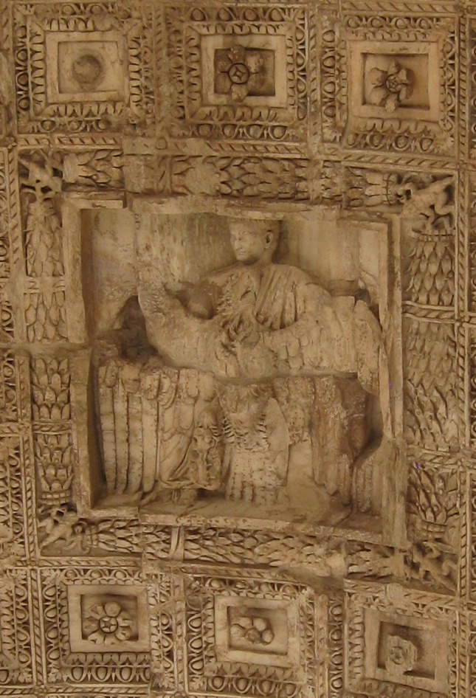
The Arch of Titus – the Triumphator relief
the protagonists: both human and divine – the first monumental state relief in which the two coexist
the scene not a specific historical event:
the triumph was voted for Titus and Vespasian
Domitian was an active participant in the triumph too
The vault
coffers with central rosettes
A square panel: framed with garlands held in the corners by four Erotes, Titus wears a tunic and toga, he is being carried to heaven by an eagle (apotheosis)
Apotheosis scene – the first in the monumental Roman art (previously only gem)

Slide 16
The Cancelleria Reliefs
- discovered in 1937 and 1939, under the Palazzo della Cancelleria in Rome
- controversy: date, identity of the protagonists, appearance of the building for which they were fashioned
- style: classicizing, high relief and relatively low, no background, heads always in profile or three quarters

Slide 17
Panel B
- Vespasian’s return to Rome (adventus) – 70 AD after his victory in the Civil War, Domitian is greeting him with Roma, Genius Senatus and Genius Populi Romani.
Roma – seated on a throne raised on a pedestral (maybe one of the Rome’s seven hills?), around Roma – Vestal Virgins, virgins followed by lictors, Domitian, Vespasian
Domitian – identification – protruding upper lip, hairstyle, slight beard on the cheeks and chin – a young man before the first shave at the age of 20
Vespasian – short, receding hair at the temples, lined forehead, cheeks and chin, remains of laurel wreath about his head, probably flying Victory (latest theories – Domitian reworked to Vespasian)
Genius Senatus, Genius Populi Romani

Slide 18
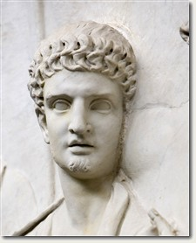
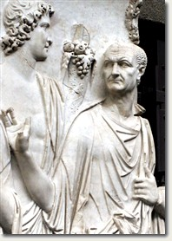
Domitian – protruding upper lip, hairstyle, slight beard on the cheeks and chin – a young man before the first shave at the age of 20
Vespasian – short, receding hair at the temples, lined forehead, cheeks and chin, remains of laurel wreath about his head, probably flying Victory

Slide 19
Panel A
- 23 years later, Domitian an emperor
- Domitian’s departure (profectio) for his Sarmatian War in 92 – 93 AD
- he is lead by Victory, lictor, Mars, Minerva (Domitian’s divine patroness), Roma (or Virtus), Genius Senatus, Genius Populi Romani, roman soldiers
Domitian – reworked to Nerva
Placement: the Temple of Fortuna Redux, Porticus Divorum, Porta Triumphalis…

Slide 20
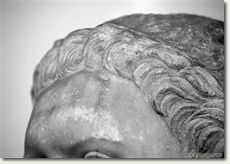
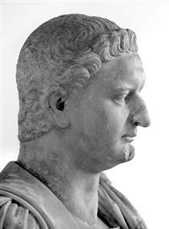
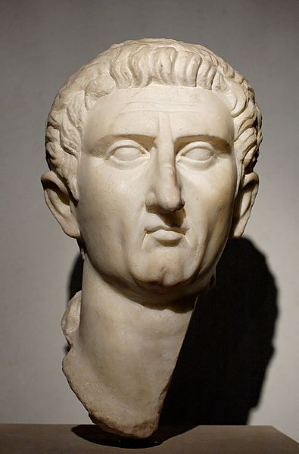
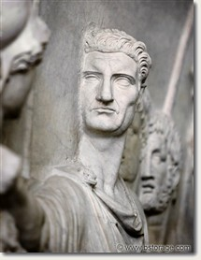
the hairstyle – clearly Neronian coma in gradus formata that he favoured, but the head is too small
facial characteristics: slanting forehead, thin lips, hooked nose - Nerva

Slide 21
Divus
more similarities between the Julio - Claudians and Domitian
The Julio-Claudians
- used divi to bolster their own position on the basis of their dynastic connections
central role in the Arval pantheon of deities to receive sacrifices
guardians of the princeps, emphasized the dynastic source of imperial power
Beginning of Vespasian’s rule
divi removed from the pantheon (both Julio-Claudian and Flavian)
no need in deifying ancestors (divi were not his ancestors)
Titus
- deified Vespasian – Divus Vespasianus
Domitian
used Flavian divi to bolster his claim to power through dynasty – promoting all Flavian divi as a collective – shared temples and priests
idea of a distinctive Flavian heaven from which princeps drew power (not only in Rome but also in all provinces)
Ephesos – provincial cult of the Flavians – cult dedicated to Sebastoi (divi, the princeps and the members of the imperial family),
deified many members of his family
Flavians – two groups of divi: divi principles and divi minors, Hadrian canceled this division

Slide 22
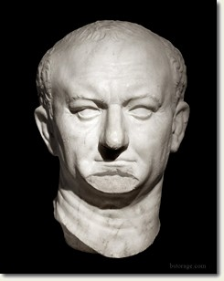
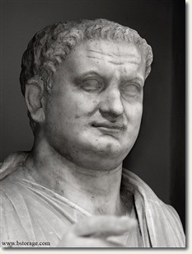
Flavian deification
5 members deified: Vespasian, Titus, Julia Titi, Caesar Domitiani filius, Domitilla (4 deified under Domitianus)
Vespasian
- died 24th June, 79 AD, divus in September 79 AD (delay) – 2 military diplomas dating to the summer of 79 AD – referring to Titus as Augusti filius rather than divi filius – indicating that Vespasian hadn’t been yet deified
- but an inscription from 79 AD – Phrygia, Aqua Marcia – Titus as divi filius – must have been deified before the end of 79 AD
Coins – title officially changed in 80 AD, deification in 79 or early 80 AD
Titus
even more difficult to determine, phrase “brother of the God” not normally included in Domitian’s title
died 13th September 81 AD and his daughter Julia Titi still “filia Augusta”on 1st October (not deified yet)
but later only as Julia Augusta (no titles) – hard to determine
divi filia on coins and other inscriptions – can’t be dated precisely

Slide 23
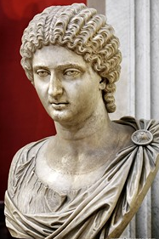
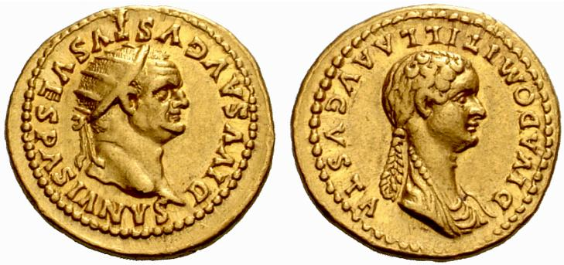
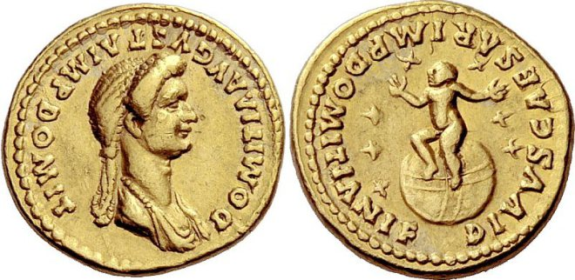
Julia Titi
- died 89 AD – must have been deified within a few months of her death
appears as diva on coins between 90 – 94 AD, - also titled diva in 90 AD in a book Epigrammata
Others – must have been deified much longer after their deaths
Diva Domitilla
- wife or daughter of Vespasian
Deification under the reign of Titus (numismatic evidence)
Domitian’s son
deified early in Domitian’s reign – on the coins 82 - 84 AD

Slide 24
Cult Apparatus
shared temples and shared priests
Divae – shared a temple with the Divi – coin – installment of the image in the temple of Gentis Flaviae (all 5 divi had a place there)
3 temples:
Divus Vespasianus and Divus Titus (Forum Romanum)
Porticus Divorum (Campus Martius)
Templum Gentis Flaviae (to all the divi as well as important family deities – penates) (Quirinal hill)

Slide 25
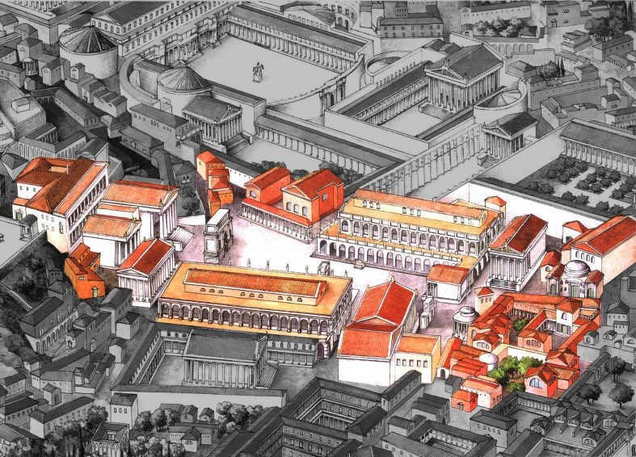
The temple of Divus Vespasianus and Divus Titus
Forum Romanum
- North of the Porticus Dei Consonentes and south of the Temple of Concord
- The temple closed off the entrance to the Tabularium
Identification: the inscription on the architrave visible in the 8th century AD
Dedicated to: Vespasian and Titus (started during Titus’ reign, completed by Domitian)

Slide 26
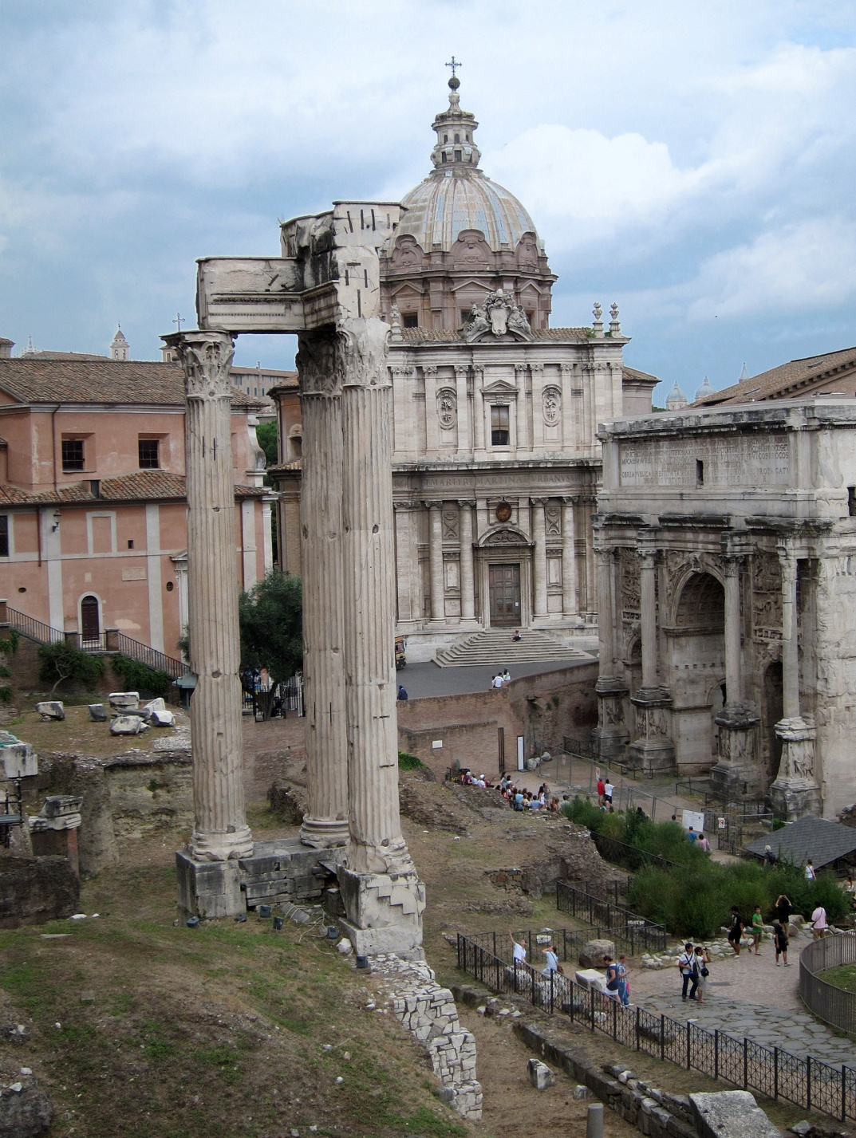
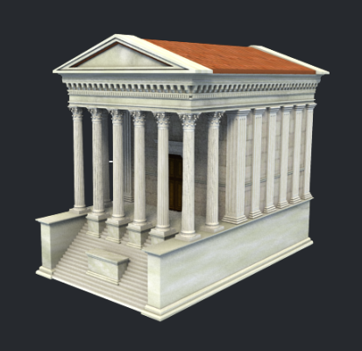
- 33 x 22 m, prostyle, hexastyle porticus with a spacious cella (two story, vaulted room)
- statues of the two deified emperors
- only the 3 columns survive, supporting a fragment of the architrave – a frieze with sacrificial implements
- Severan restoration

Slide 27
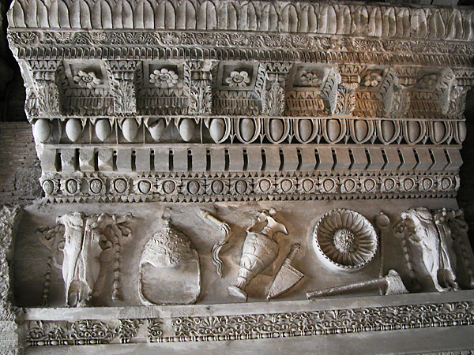

Slide 28
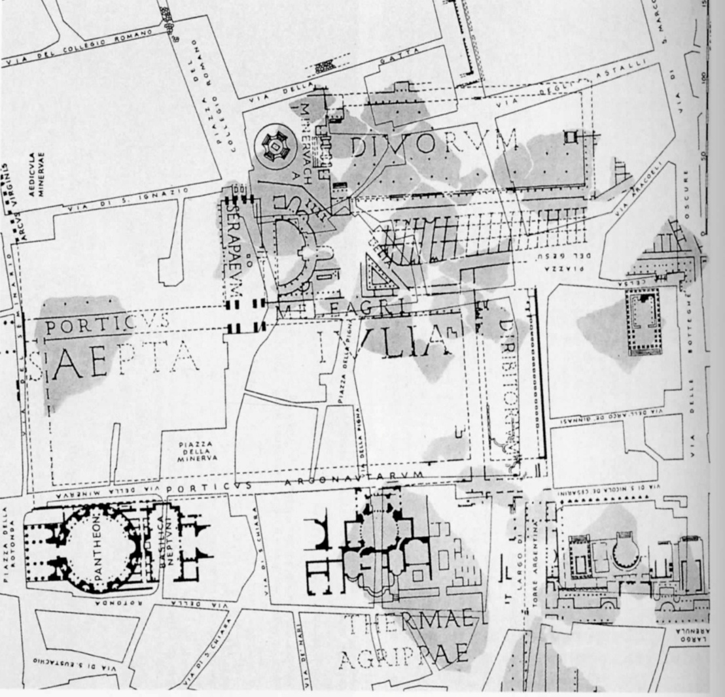
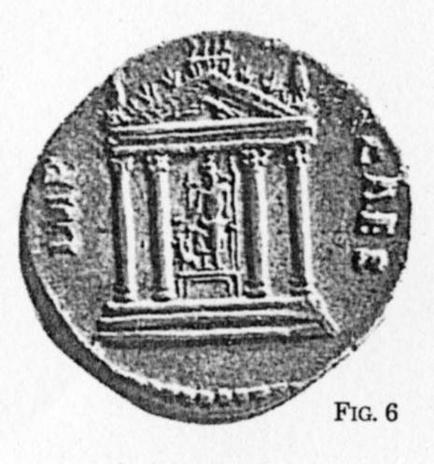
Poticus Divorum, Divorum, Temlum Divorum
Campus Martius
coins of Domitian (94-96 AD) - the image of a tetrastyle temple
a stairway, a triangular pediment with an eagle holding a wreath in its beak, a sitting statue identified with a copy of the Bryaxis’ statue for the Serapeum in Alexandria
Identification:
the Temple of Sarapis flanking that of Isis inside the temenos, where yet it never was
Domitianic building in the central Campus Martius: the Porticus Divorum, built in honour of father Vespasian and brother Titus,
both deified.

Slide 29
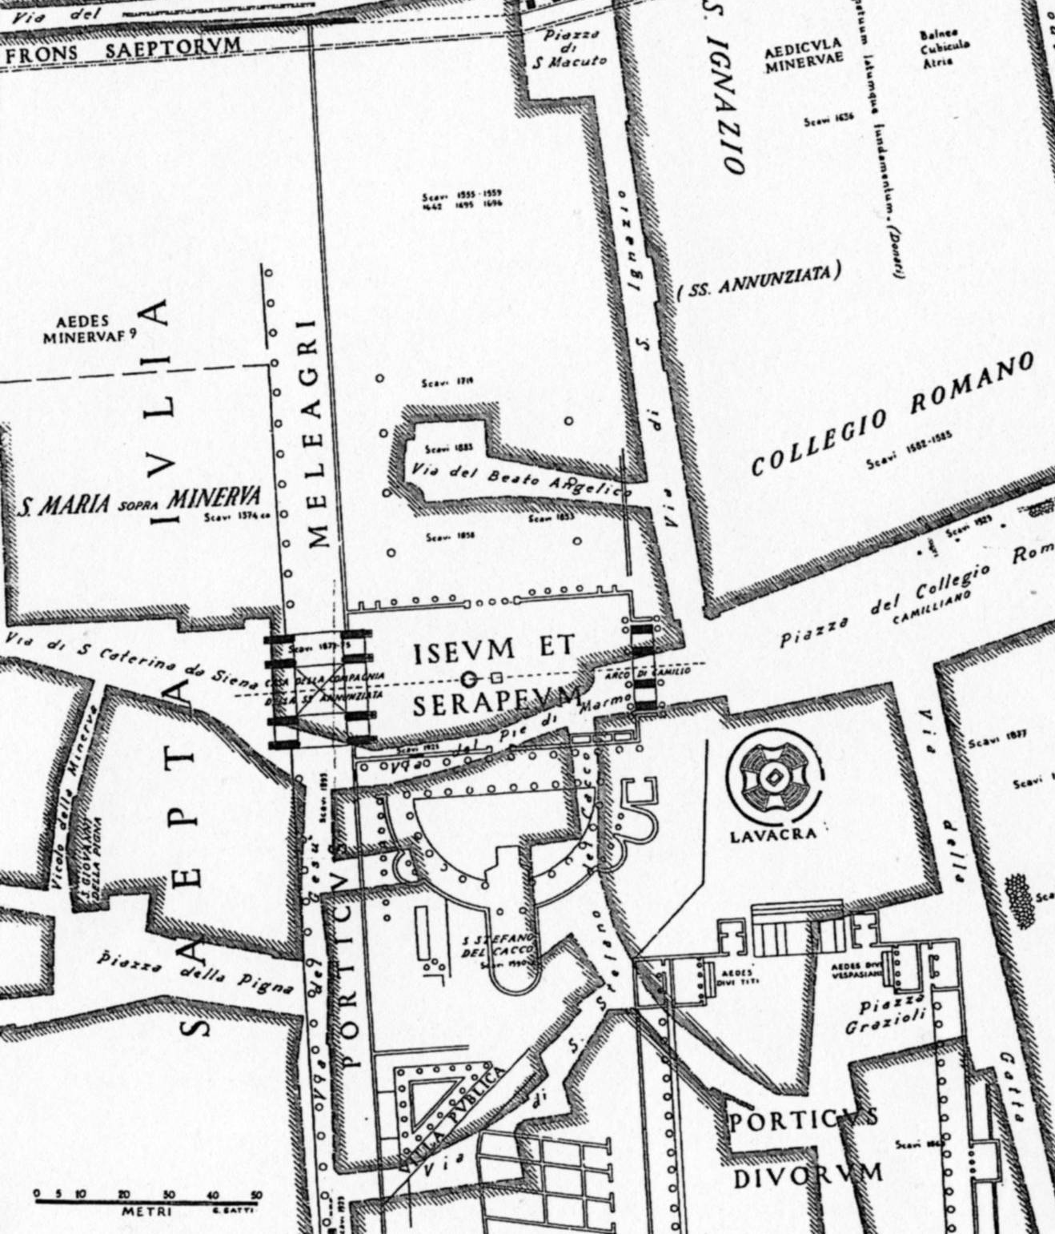
The building had a great importance in the religious policy of Domitian, having as final goal the legitimization of the princeps’ power.
well known from the Forma Urbis Marmorea (eleven fragments represent the porticus) : it is a great temenos in the open air (200 x 77 m ca.), porches on three sides and a magnificent propylaeum on the northern side as an entrance.
between the Saepta and the baths of Agrippa
The porticus
rectangular, about 200 metres long and 55 wide
over thirty columns on the long sides and sixteen on the short side.
extended: from the present Piazza Grazioli nearly to the Via di San Marco

Slide 30
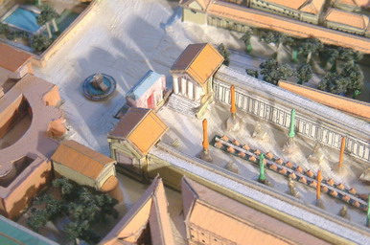
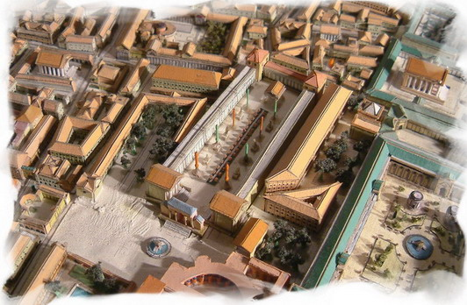
The Propylaeum
- a triple arch on the north side
flanked by two rooms, oriented toward the inside of the complex, toward the two temples (A and B)
The Temples
both prostyle tetrastyle with stairway on the front, built in the inside corners of the front side of the temenos
facing each other, and dedicated to Vespasian and Titus (aedes divi Vespasiani and aedes divi Titi).
- the coin represents one of them:
the eagle with the wreath is a symbol of divinization, while the quadriga on the top of the pediment refers to the triumph and Sarapis is a deity linked to the Judaic victory.
A
B

Slide 31
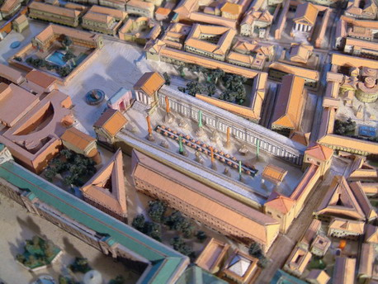

after the fourth century there is no mention of the structure, but its name is preserved in the Diburi or Diburo of several mediaeval documents in connection with the monastery of S. Ciriaco in Camiliano
many architectural remains have been found on the site of the building, but not such as to permit of a reconstruction.
Porticus Divorum belongs to the sanctuary in Rome dedicated to the Egyptian gods, which consist of three complexes:
the Temple of Minerva Chalcidica
the Iseum Campense/Serapeum
the Porticus Divorum
- the two temples inside - dedicated to Egyptian gods, in an ideological frame in which the deceased Vespasian and Titus were assimilated to gods.
- one of the Egyptian gods was Sarapis, the second must have been Anubis.

