Slide 1
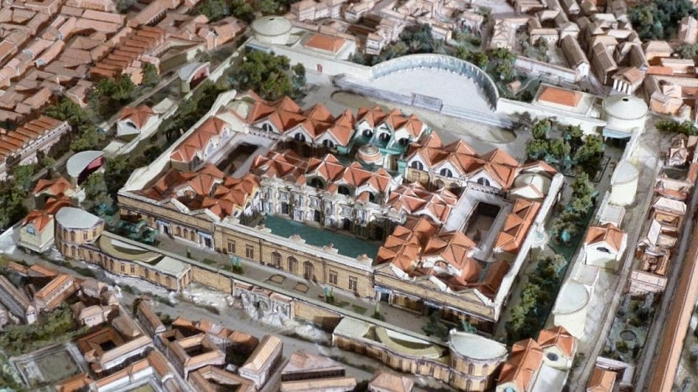
The Buildings and the Images of the Imperial Cult
VIII Templum Gentis Flaviae, Domitian temple (Ephesos)

Slide 2
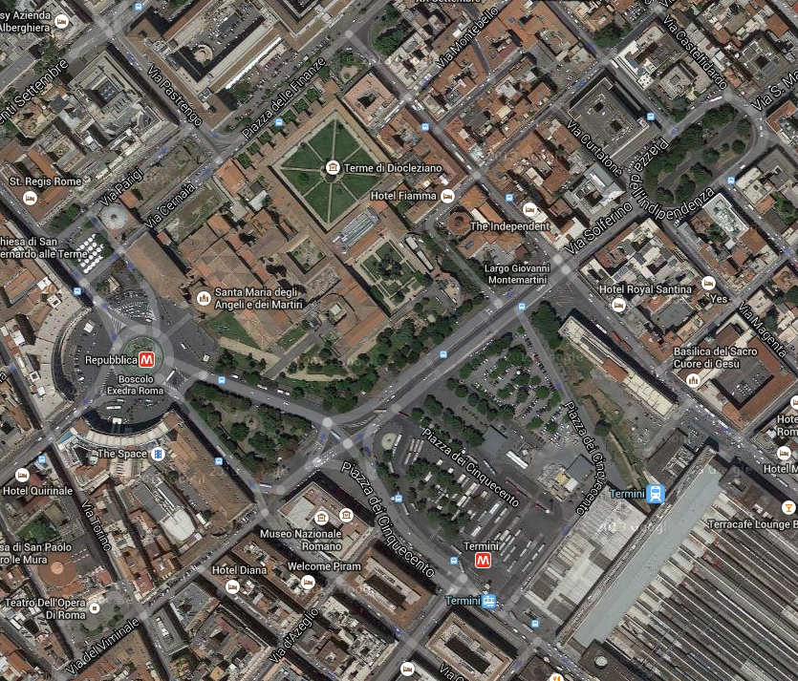
Templum Gentis Flaviae
Suetonius:
“Domitian was born on the ninth day before the Calendes of November, when his father was a consul… in Pomegranate Street in the 6th district of the city, in a house that he later converted into the Temple of the Flavian Gens.”
- 12 references to the temple in the sources
the house was on the Quirinal hill, Vespasian moved here his house, 6th Roman region
Fragments:
a) Piazza della republica (north side) – the relief with flamen
b) Ministero delle Finanze e dell’Economia – a colossal head of Titus , found in 1872 – known facial features of Titus, but not an official portrait type
contrast: smooth surface of the face, strong contourism of the hair (drilled), possibly a cult statue inside the temple, an acrolith
now in Naples – exchange for some fragments of the Acta Fratrum Arvalium

Slide 3
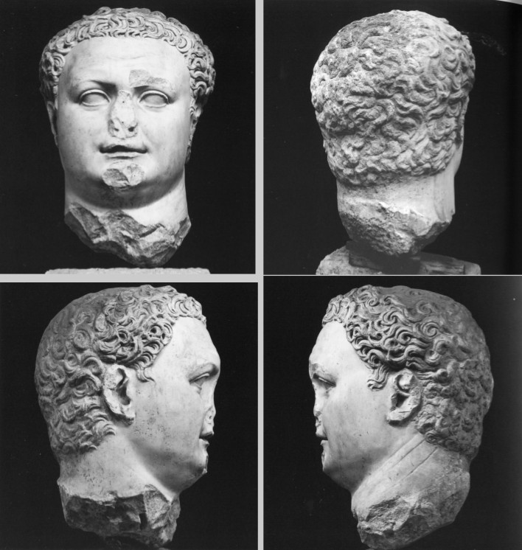
found in 1871/1872
known facial features of Titus, but not exactly comparable to any official portrait type
remarkable: the contrast between the smooth surface of the face and the strong contours of the hair
deeply influenced by Domitian’s portrait (could be his posthumous portrait)
possible a cult statue of Titus inside the Templum Gentis Flaviae

Slide 4
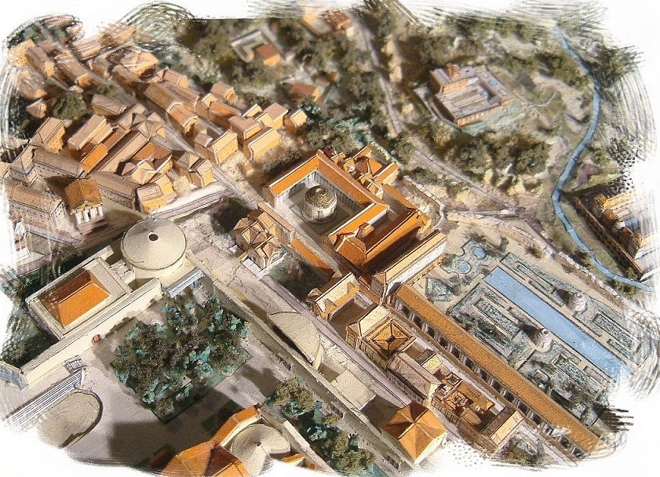
Vicinity
the Temple of Quirinus, Horti Sallustiani, Bath of Diocletian, a republican house
- Romulus – Domitian’s legendary counterpart, Quirinal – the temple of Quirinus (Iulius Proculus 325 BC the first temple)
- the temple of the Flavians and Romulus - very close (Domitian deliberately emphasized the proximity)
- republican walls in opus reticulatum, some of which were decorated with glass paste polychrome mosaics of fantastic architectural and human figures (similar to 4th style wall painting)
- dating to Neronian or Flavian period
- water pipe – identification – nympheum
Inscriptions: owner – Flavius Sabinus (Vespasian’s brother), Domitian was born in neighbouring residence belonging to Vespasian or this one (Flavius Sabinus), so the podium might be a site of the Templum Gentis Flaviae

Slide 5
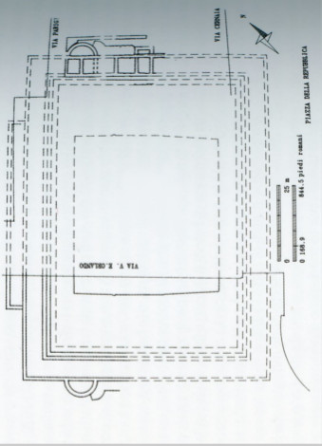
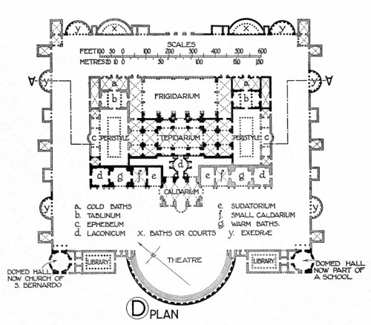
The Baths of Diocletian
between the Aula Ottagona and the church of San Bernardo – remains of a huge building
dating: the age of Domitian, demolished when the baths were built (based on the brickmarks and the technique of the walls)
a wide porticoed precinct – pillars in travertine, walls in opus latericium
dimensions: quadriporticus 123x83 m, the porticoes 5.80 m deep, the walls always 1.20 m thick
on the outside – semi-circular and rectangular exedrae
a monumental entrance probably on the NW side

Slide 6
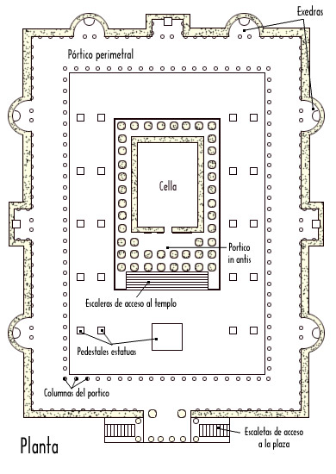
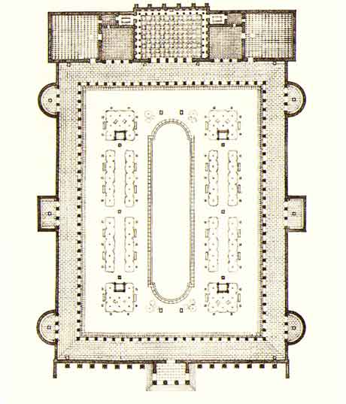
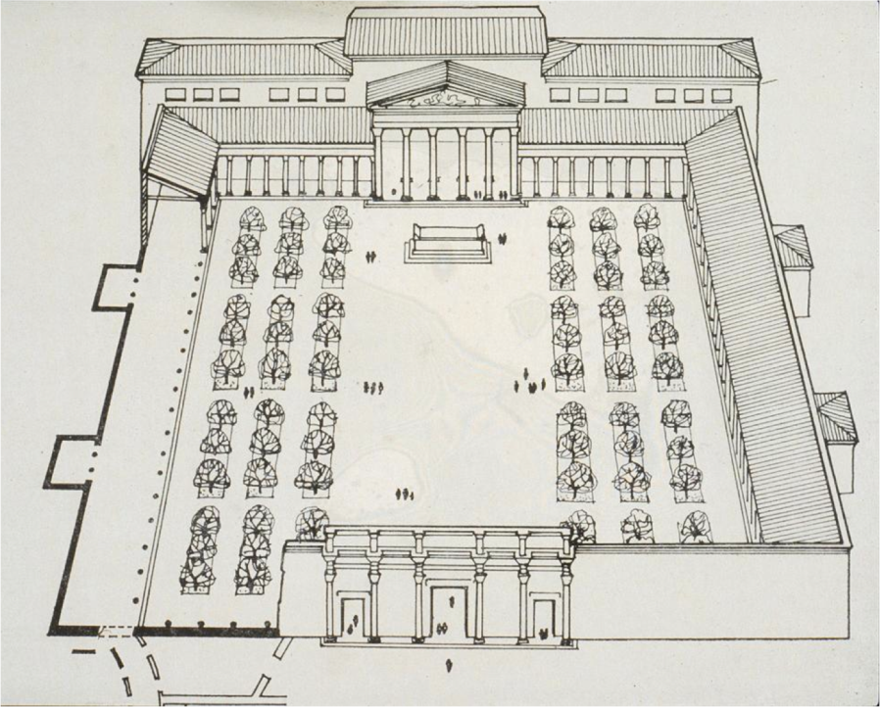
the centre of the site:
- difficult to state dimensions – a podium 70x47 m
on the podium – a giant temple or smaller one with altar (similar to Traiaeneum at Italica)
Hadrian’s library, Templum Pacis – exedrae, regular distance
- the scheme of the porticoed square with exedrae comes from Hellenistic models – imitated in Rome and Italy and then later used in provinces (Trajan, Hadrian)

Slide 7
Chronology of the area of Quirinal:
64 AD republican Macellum destroyed by “Nero’s fire”
71-75 AD – Vespasian financed the construction on the Quirinal hill with the spoils of the Judaic War
Domitian: huge reconstruction and building campaign (after Nero’s fire)
Temple construction
after some time of Domitian’s assumption in 81 AD, completion between 89 – 94 AD (not known precisely)
before Domitian’s death September 18th 96 AD – quoted in several sources (e.g. Epirgrammata) - regularly referred to in contemporary literature, but not identified on the coinage
96AD - lightning struck it
192 AD - another fire, rebuilt by Septimius Severus
354 AD - Chronographer took a note of it
408 AD - earthquake, restoration
The mausoleum for:
Flavia Domitilla (69 AD)
Flavius Sabinus (69 AD)
Vespasian (79 AD)
Titus (81 AD)
Julia Titi (89 AD)
the son of Domitian (73 AD)
Domitian (96 AD)
Use: imperial mausoleum until the death of Domitian, Nerva (96 AD died) – buried in Augustus Mausoleum
Combination of a sanctuary of the familiar cult and a dynastic mausoleum, within the pomerium – special permission by the Senate

Slide 8
Several different theories of reconstruction:
- Statius “Flavian heaven” – many scholars meaning that it was round or oval, topped with a dome to complete the impression of the skies
- Martial and Statius – a rectangular, peripteral building with cryptoporticoes and nymphea, along the line of the Claudian on the Caelian hill
La Rocca - on the podium a medium-sized temple, altar in front with Hartwig reliefs
Coarelli - centralized circular building covered by a dome
Paris – an arch similar to Titus, or an altar similar to Ara Pacis , enclosure with caryatids leaning against palm trees
Torelli - a giant temple occupying the whole podium, historical relief in the Vatican Museums and Terme di Diocleziano

Slide 9
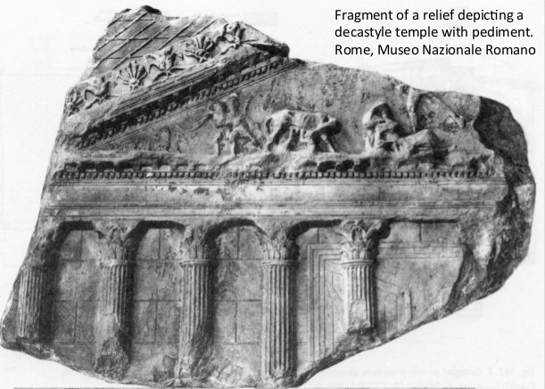
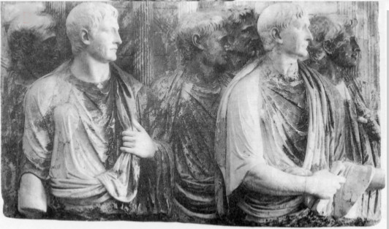
a) on the basis of sestertius – decastyle porch within a double precinct, complete porticoes and a façade marked by an arch and 2 lateral entrances
the coin minted in 95/96 AD (Domitian)
b) Two reliefs depicting a temple (Museo Nazionale Romano, Terme di Diocleziano
the pediment decoration suggests the decoration of the temple – Lupercal - the birth of Romulus and Remus, sleeping Vestal Virgin, Rhea Silvia, in the heaven Mars (only legs and spear), she-wolf suckles twins, two shepherds standing nearby with their flock
cycle of birth, death, apotheosis in the pediment and nearby temple
- 1980’s – excavations – a concrete core for a huge podium facing south
Only a little evidence of the temple -monumental, very decorated
- family tomb and cult place (mausoleum and sacrarium)

Slide 10
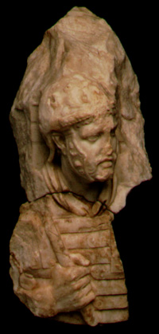
Sculptural decoration
- symbol of the whole cycle of life: birth, death, apotheosis
1901 – Paul Hartwig – purchased a group of sculptural fragments – art market – donated to the Museo Nazionale delle Terme, there is a record: discovered while construction of the large semicircular palazzo on the northern side of the exedra – not organized excavation
1901 – Francis W. Kelsey – a set of relief fragments – record: from the bath of Diocletian, similar style – penthelic marble, figure proportions similar
- Hartwig-Kelsey Reliefs – Museo Nazionale Romano, University of Michigan – they didn’t know about the connection, Hartwig identified them immediately, Kelsey 70 years later – head and a breastplate fit perfectly
stylistically late first or early 2nd century
palm tree columns – subjugation of Judea
Vespasian’s head – a high quality of the sculpture
suggest they belong to a monument of a major importance at the time of the Flavians

Slide 11
Hartwig:
1. Corner Entablature Fragment with Part of a Capital
2. Projecting Corner Entablature Fragment with Part of a Capital
3. Male Torso Draped in a Mantle and Leaning against a Palm Tree
4. Nude Male Torso
5. Relief Fragment with Representation of the Temple of Quirinus
6. Relief Fragment with Head of a Bull
7. Relief Fragment with the Head of a Soldier
8. Relief Fragment with Female Head
9. Relief Fragment with the Profile of a Male Head
Kelsey:
10. Profile Head of a Soldier in Relief
11. Fragment of a Lorica Segmentata and Right Hand in Relief
12. Head in Relief of Vespasian Wearing the Corona Civica
13. Fragment of an Entablature
14. Fragment of an Entablature
15. Fragment of an Ionic or Composite Capital
3 groups:
Architectural features: entablature crowning a wall, free standing columns shaped and stylized palm trees, male figures leaning against them
Panel 1Triumph (adventus) of Vespasian: the head of Vespasian, the torso of armored soldier, idealized youthful head of Genius Populi Romani, head of Victoria
Panel 2 Sacrifice of a bull: Head of a sacrificial bull, head of a flamen, a temple façade – temple of Quirinus – ceremony of founding of the Temple Gentis Flaviae

Slide 12
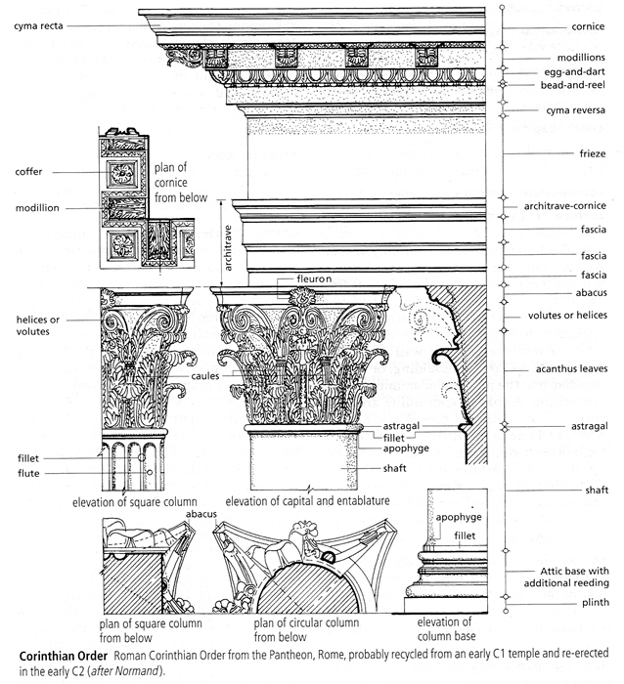

Slide 13
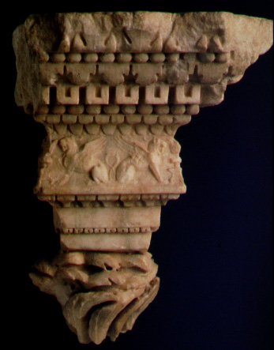
Corner Entablature Fragment with Part of a Capital
-the corner entablature, decorated on all sides, respects all the elements of the Corinthian order aside from the absence of a corona.
- the cornice composed of a molding, a cyma decorated with upturned leaves, the astragal, the echinus decorated with down-turned leaves, and dentils with hollowed centers.
the subcornice is composed of an astragal and cyma reversa decorated with a double row of down-turned leaves
the frieze is a continuous relief of crouching griffins
there follows a molding, a cyma reversa decorated with a row of lotus flowers, the first fascia of the architrave, an echinus decorated with a vegetal motif, and the second fascia of the architrave.
the capital is composed of palm fronds articulated by deep drill channels that create a sense of movement
The griffins - a recurrent motif in Roman decorative art
- their symbolic meaning is connected with the apotheosis of the deceased and was ultimately coopted as a symbol of imperial apotheosis (Ara Pacis, Basilica Ulpia in the Forum of Trajan, the frieze of the Temple of Antoninus and Faustina)
Dentils - with hollowed centers are rare and specific to the Domitianic period

Slide 14
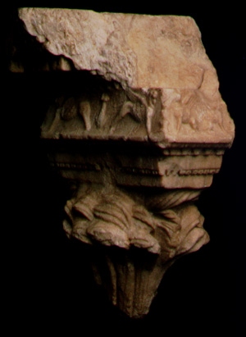
2. Projecting Corner Entablature Fragment with Part of a Capital
the moldings are the same as previous
this piece belonged to a projecting part of the structure and was associated with the male torso that leans against a palm tree

Slide 15
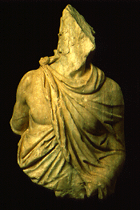
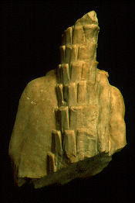
3. Male Torso Draped in a Mantle and Leaning against a Palm Tree
the figure depicts a male personage of mature age, in a standing position and dressed in a mantle fastened by a bulla on the right shoulder
the left hand probably held an attribute
the back of the figure is not finished, leans against the trunk of a palm tree, which continued upward to form a palm-frond capital
constituted the colonnaded part of the structure
- the use of male and female figures as supports for the entablature of buildings - long tradition - two typologies: telamones (support the overlaying architecture) and caryatids (in no way emphasize their weight-bearing, often female - the Forum of Augustus)
probably represents a personification
given the association with a palm tree, the conquest of Judaea, an event of the highest importance in the history of the Flavians, immediately comes to mind.

Slide 16
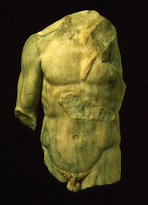
4. Nude Male Torso
a nude male at the height of his physical powers
the hand probably held an attribute, of which a small part remains under the left breast
served as one of the columns of the structure
this figure was directly attached to the wall Its dimensions are the same as those of the preceding.

Slide 17
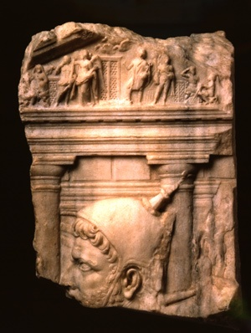
5. Relief Fragment with Representation of the Temple of Quirinus
the head of a flamen, who wears the characteristic headgear, the spiked galerus, in front of
the central part of a temple identified as the Temple of Quirinus on the Quirinal - two columns of the Tuscan order, part of the isodomic masonry of the wall of the cella, part of the cornice of the doorway, and almost all of the pediment decorated with a complex figural scene
- scholars have advanced many interpretations of the scene represented on the pediment all involve the theme of the foundation of Rome:
a) augurium augustum – taking of auspices at the foundation of Rome watched by Romulus and Remus
b) the apotheosis of Romulus – Victory crowning him, witnesses: Aeneas, Mercury, Hercules, Faustulus, Alea Larentia
- the appearance of the temple is that of the Augustan restoration of AD 16.

Slide 18
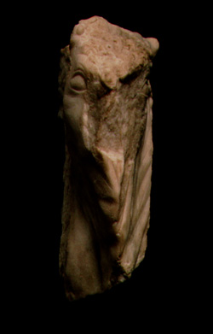
6. Relief Fragment with Head of Bull
the head with its join to the neck
the animal depicted in an erect position, walking toward the left, with its head slightly inclined to the rear.
the infula, a typical ornament for a bull destined for sacrifice, is wound between the horns and then hangs down along the body
the victim is shown at a moment before the blood sacrifice.

Slide 19
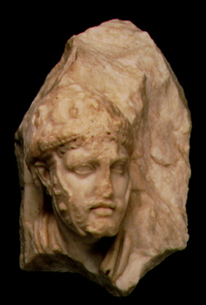
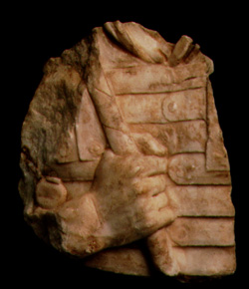
7. Relief Fragment with the Head of a Soldier
the head, in high relief, of a soldier depicted against the background of a building
the figure has a beard and moustache and wears a helmet decorated with a very delicate vegetal design. The right cheek guard is decorated; the other has been left plain because it would not have been visible.
- belonged to a scene of military character, probably involving the presence of the emperor Vespasian (close to certain individuals on Relief A from the Palazzo della Cancelleria – much more formal and academic)
face appears to have been carved with a greater degree of refinement, different parts of the figure worked by different artists
11. Fragment of a Lorica Segmentata and Right Hand in Relief
the upper chest, right hand, wrist, shoulder, and upper arm of a soldier
eight low relief bands of his lorica segmentata fasten along the center of his chest in an alternating pattern.
the soldier's right hand grasps a lance marked with a spiraling groove
the pommel of his gladius is visible near the wrist

Slide 20
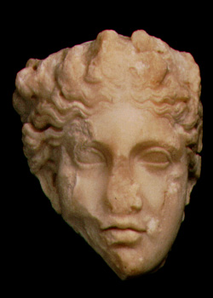
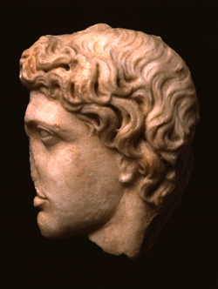
8. Relief Fragment with Female Head
this little head is worked almost in the round and is shown in three-quarter view
The hairstyle, with center part and soft curls gathered at the nape of the neck, is completed by a garland.
- in this head one can recognize a representation of Victory, who frequently appears in scenes of a military-commemorative character (the Arch of Titus, the Palazzo della Cancelleria, and the Arch of Trajan at Beneventum)
9. Relief Fragment with the Profile of a Male Head
left profile of a young man with idealized features
the very close comparison with the figure who represents the Genius Populi Romani on one of the Cancelleria relief panels - - - ought to be recognized as the same personification

Slide 21
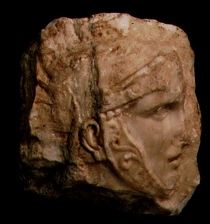
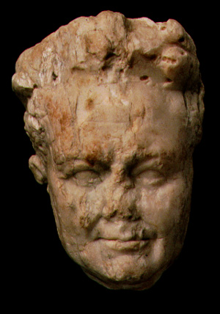
10. Profile Head of a Soldier in Relief
the soldier's head, in low relief, is shown in right profile wearing a helmet with cheek guards, brow-plate, and crest
the cheek guard bears a decorative scroll in low relief
12. Head in Relief of Vespasian Wearing the Corona Civica
Vespasian appears as an idealized aging man with furrowed cheeks, sagging flesh, and crow's feet at the corners of his eyes. - - his lips curve into a slight smile
an expression of remote benevolence
he wears corona civica

Slide 22
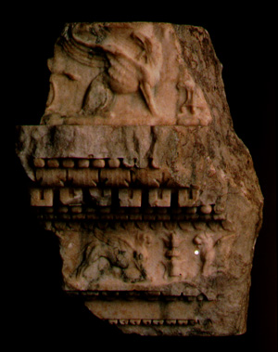
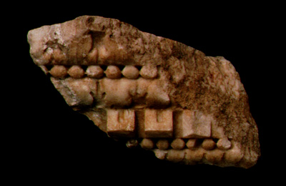
13. Fragment of an Entablature
the somewhat concave sima at the top of the piece bears the profile of a seated griffin in low relief
beneath the sima are the broken remains of a projecting cornice, followed by a beaded astragal, an ovolo with broad pendant leaves, dentils with indented centers, another beaded astragal, a smaller ovolo with pendant leaves, and a fillet covered with broader pendant leaves
below these is a frieze with opposed lion griffins
- parallels for individual elements of the unusual decorative forms of these pieces can be found in structures datable to the late Flavian and early Trajanic periods.
14. Fragment of an Entablature
the same sequence of decorative elements as the previous piece except for the cyma recta of leaves pointed upward above the upper beaded astragal
- below this astragal are preserved only an ovolo with broad pendant leaves, a row of dentils with central indentations, another beaded astragal, and a smaller ovolo with pendant leaves.

Slide 23
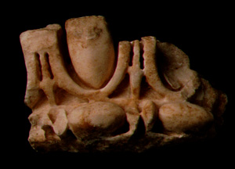
15. Fragment of an Ionic or Composite Capital
- the fragment consists of an egg-and-dart band over a bead-and-reel band.
- approximately the upper part of an Ionic columm

Slide 24
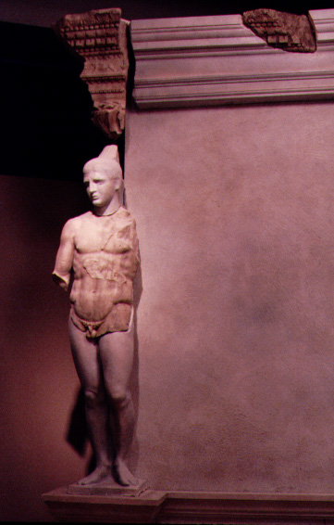
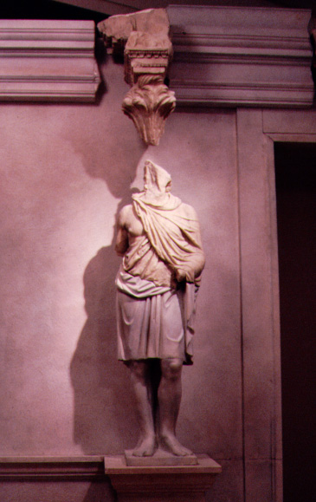

Slide 25
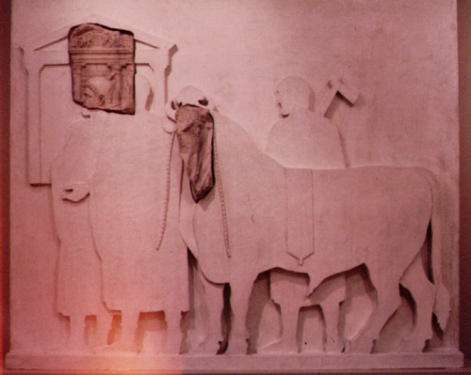

Slide 26
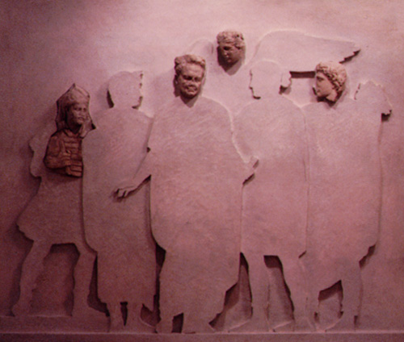

Slide 27
Function:
Political manifesto addressed to the citizens (problems justifying position – dedicated temples)
Torelli: competition – nomen Flavian as popular as nomen Julium
To legitimate adoptive sons (children of his cousin, his own son died very young, no other children)
d) Male caryatids against palm trees – symbol of Judae conquered by the Flavians, gained a +
triumph and Vespasian return home
Collective priests:
flamines and sodales
Flamines – none, specific for the Flavians
Sodales – a college of priests created by Tiberius to serve Divus Augustus and the Julian gens, originally 21 members, continued to be important for 3 Flavians, they were important – 30 inscriptions (other adjectives – Flaviales, Titiales, Flaviales Titiales)

Slide 28
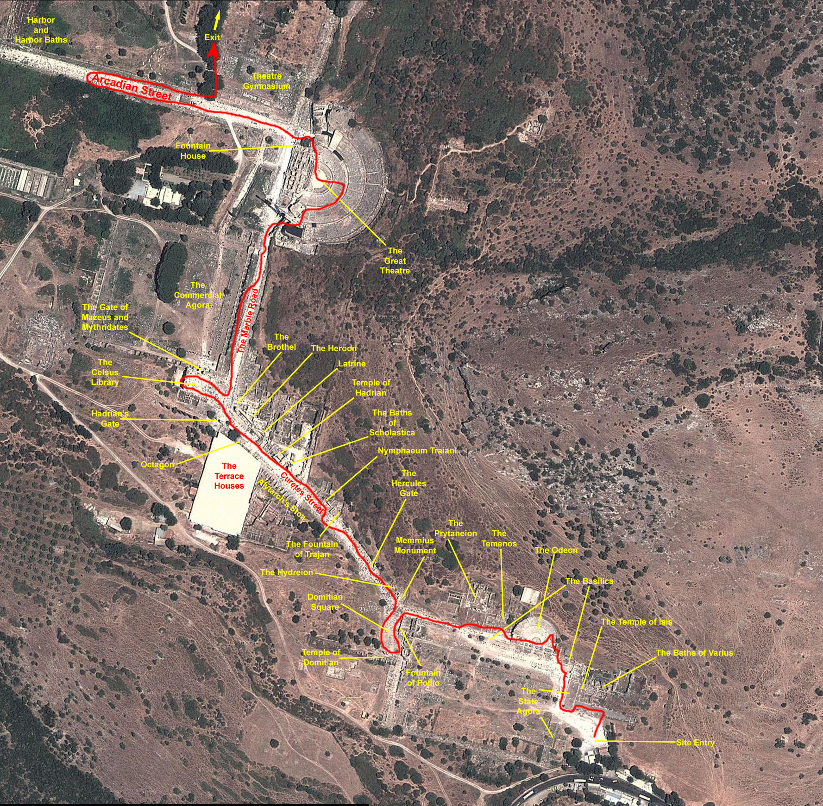
EPHESUS

Slide 29
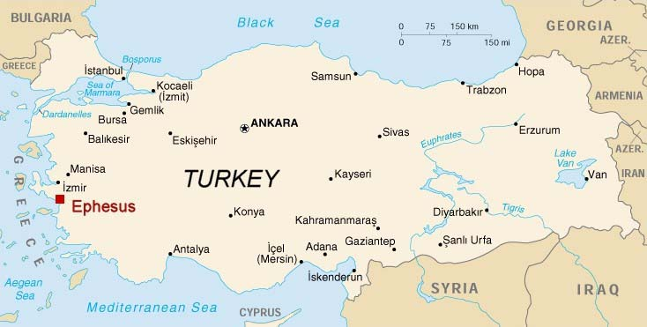
Strabo, Pausanias:
10th century B.C the story of the settlement: Androklos, son of Kodros (the King of Athens), and his friends who were about to migrate to Anatolia, could not decide on the location of the new city they were going to establish. They consulted the oracle of Apollo, which told them to establish their new city at the location which would be indicated by fish and a boar. Androklos and his friends who came to the region wanted to cook fish, but the fish they were frying jumped off the pan, scattering flames that set the dry bushes on fire. A boar ran out of the burning bushes and Androklos started to chase the boar, caught it and killed it. Convinced that the prophesy of the oracle had come true, Androklos and his friends established their new city in this location.

Slide 30
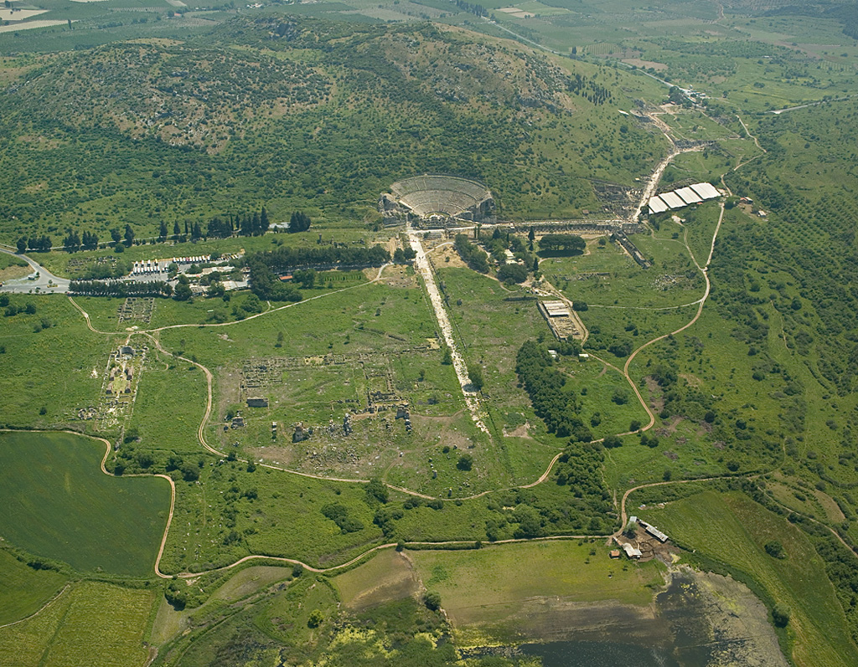
the town of Apasas under the rule of Ahhiyava Kingdom mentioned in the written records of the Hittites of the 14th and 13th centuries B.C
a number of the findings on southern slopes of Ayasuluk (Selcuk) by the Ephesus Museum are dated to second millennium
after the fall of Troy, the Thracians started migrating south and settled in Western Anatolia, forming colonies
to ensure security, the immigrants preferred to settle on islands near the coast and on peninsulas
the colonization of Ephesus was completed in the 10th century B.C.
Ephesus was attacked by the Cimmerians in the 7th century BC but the 6th century BC brought a prosperous period
later under the rule of the Lydians and then under the Persians, in 334 BC, Alexander the Great captured Ephesus
after the death of Alexander - dark days, ruled in 287 BC by Lysimachos.
later on Ephesus came under the sovereignty of Rome, and Emperor Augustus declared Ephesus a metropolis
in the year 262 AD Ephesus was attacked and destroyed by the Goths and after this, it never regained its previous importance.

Slide 31
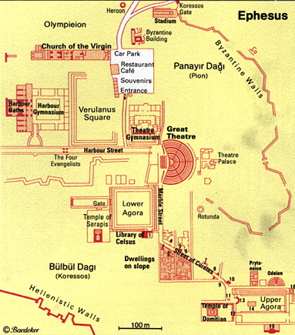
The cult in Ephesos:
4 imperial temples
a monumental Antonine altar
an imperial portico
4 gymnasia associated with the emperor
3 monumental gates – statues of members of Augustus, Trajan, Severus’ family
- number of imperial statues – in buildings, theatre, council house, streets…
monumental nympheum – life-sized statue of Trajan
- the city had two dominant, equivalent cults – Ephesian Artemis, the Emperors
Porticoes – not only used for trade, started a cultic function (not only Ephesos, also Thera (north end – imperial statues), Italy, North Africa) - porticoes regulated boundaries
Creation of special rooms for the imperial cult in gymnasia – Hellenistic period – cults of kings and benefactors (Pergamon – king, Diadorus Pasparos), about 10 gymnasia in Asia Minor
Small altars
imperial statues in various locations
- the imperial cult – attempts to find a position – it should be within the civic space rather than separate area outside the city

Slide 32
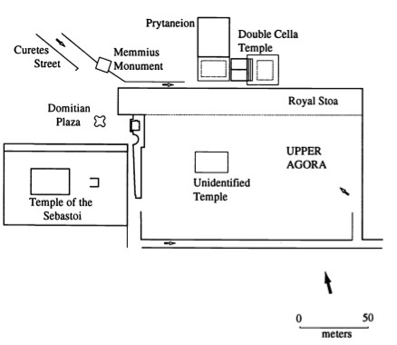
Upper agora
redesigned during Augustus:
prytaneum, magistrate building – the sacred hearth of the city, council house,
Double temple Roma and Julius Caesar
Royal portico – dedicated to Artemis, Augustus, Tiberius – one end – over life-sized statues of Augustus and Livia
The centre of the square – a temple of Augustus – 27 BC
Domitian – a precinct next to the main square – construction of a high platform and fine façade to the main street
e.g.: Ephesos – imperial cult buildings – double temple, royal portico, free-standing temple, later further addition of Domitian – transformed central civic space of Ephesus, permanent position of the emperor in the heart of the city
- imperial architecture – relationship of the city and the emperor, the emperor and traditional deities
traditional sanctuaries included emperor in 2 main ways:
separate buildings in the sanctuary
in the temple – several ways: statues, inscriptions, colossal statues in the separate part of the temple

Slide 33
Neokoros of the cult (Ephesos)
- a term is standard part of modern interpretation of provincial cults
Neokoros – a title for certain officials associated with many different cults, the officials always associated with the temple cult, the office lasted for a year, sometimes granted for life
Responsibilities (not the same in all regions, depended on the size of the cult):
the same as priests (priestesses)
assist the priests (Socrates said: “the temple cults – ideal state – priests and neokoroi)
In some occasions – a guard for a precinct or the possessions of the deity
Care of sacred facilities, equipment and funds
at some point, cities started to call themselves “neokoroi”
no trace of it before the 1st century AD
In the 1st century/2nd century AD – 3 mentions:
Kyzikos inscription 38 AD – honoring Antonia Tryphania – the first known usage of “neokoros” – not yet an official city title, only emphasizes benefits
Nero coin– obverse Nero, reverse proconsul of Asia Marcilius Acilius Aviola – 65/66 AD and a temple depiction with 4x6 columns, the town called “neokoros” of Artemis
The book Acts – later than Nero – city of the Ephesians was known throughout the world as the neokoros of Artemis
- the latter two – emphasize responsibilities, which come from the title
Evidence: coins – twice neokoros (Domitian + Artemis, Domitia + Artemis)
- the use of the city titles constituted a fundamental development in the political and religious propaganda of the Empire

Slide 34
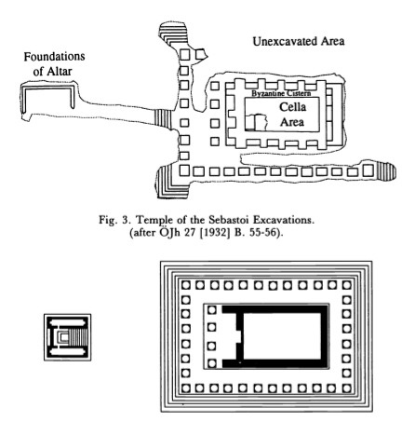
EXCAVATIONS
- Austrian Archaeological Institute – began excavating in the late 19th century
1930
- Josef Keil – excavation on the top of an artificial terrace
- Roman imperial period (south-west corner of the Upper agora)
- large marble friezes – existence of the Parthian Monument – earlier discoveries, excavations to uncover the monument there, but foundations supported a temple
- identification unclear until a colossal acrolithic male was found
- the temple floor plan – 34x24 m (under a Byzantine cistern), cella 7.5x13m
how many statues? - the statue of Titus - a base at least 3.5x2 m, 5
- tetraprostyle temple surrounded by a pseudodipteral colonnade (8x13 columns), crepidomia – 6 steps on all sides
Later excavation – north- east corner of the precinct – confirmed datation to the late 1st century AD, during Domitian’s reign

Slide 35
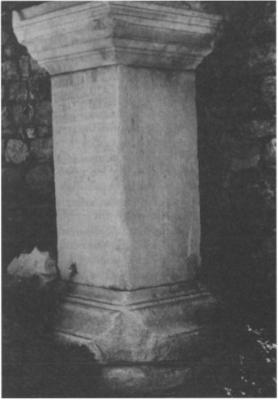
- 13 inscriptions found in different places – mostly bases for statues
- the temple dedicated in 89/90 AD
- the right to establish the cult - granted by Domitian – early or mid-eighties
Nature of the cult:
- Domitian – a predominant figure in the cult, but he was not the only recipient of the worship in the temple
Inscriptions:
- Sebastoi – it means Domitian was only one of them
- all three Flavians: Vespasian, Titus and Domitian + maybe Domitia
- the group dedication - allowed the cult to survive “damnatio memoriae” – the cult shifted its focus to Vespasian and flourished for at least another century (Domitian was erased)

Slide 36
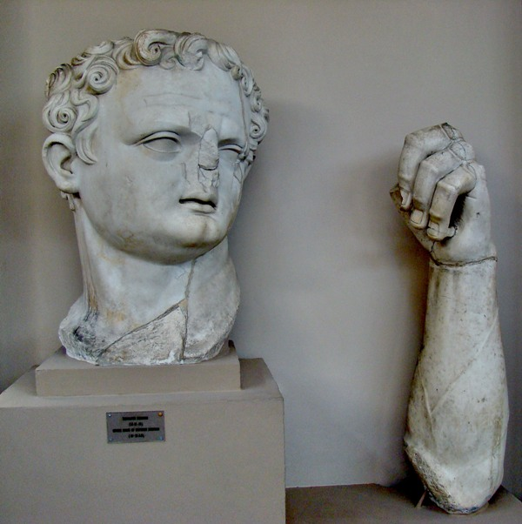
- a colossal statue found close to the sanctuary
- immediately identified as Domitian, but other scholars argued that the facial features belong to Titus (it must have been one of the statues in the cella)
- the portrait is a bit unusual – not an official portrait known in Rome
- Wegner: this is an example of Asian workmanship “das asianische Barock”
- the left forearm is as tall as an adult, a spear was held (agrees with the coins depicting a statue in a standing position and holding a spear)

Slide 37
1960 – 1961
- eastern side terrace – trenches:
shops - under pre-Roman wall, unidentified building
Street - an earlier street from Augustan period
north-western corner – early imperial pottery – in the fill that supports the terrace - bellow: Hellenistic period
Occupation:
- part of the terrace – residential area in Hellenistic times – larger building
the street – Augustan period – shops on the agora, repaved when the terrace was built – redefining an existing district
- north-east corner – large square in relation to the temple - apsidal monument raised in the middle, terrace opened to the square in the north (not the 4th stoa built)
Square function: free space from which the viewer could watch north side of the terrace and the temple

Slide 38
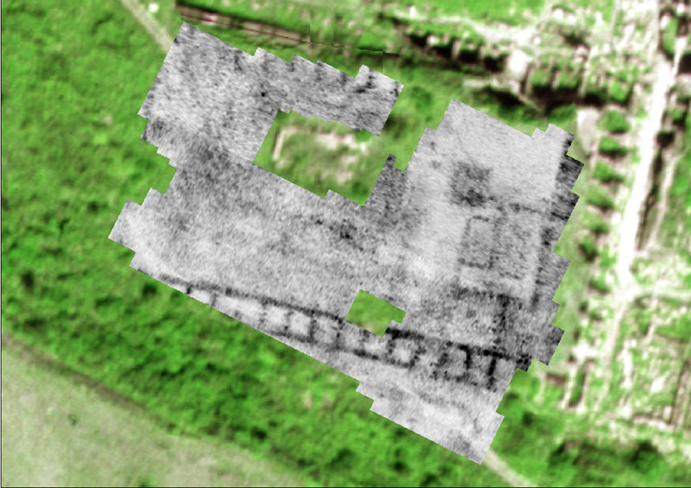
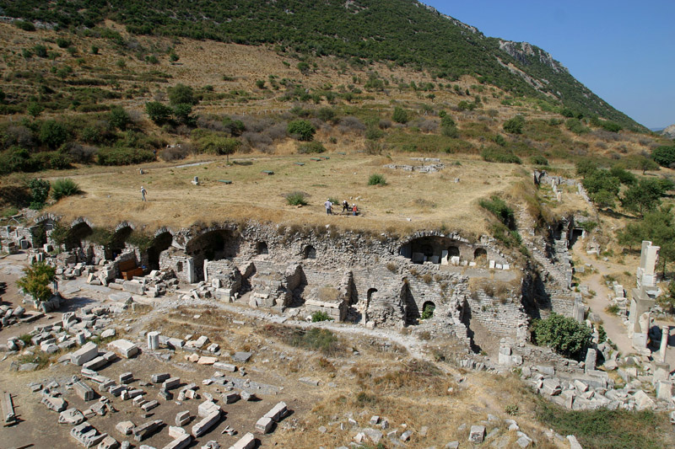
2009 - 2011
the project Cult and Ruler - the absolute chronological classification of the building phases
the excavations in the area of the imperial cult temple 2009, a geophysical survey in 2010
the focus of the excavations was on the period of destruction and the later usage of the site
- an initial chronological evaluation indicated that the temple was destroyed in the 5th century AD
- Almost immediately a building was erected in the 5th century AD
- the period of usage extended probably into the 6th century A.D., as it has not been possible to document more recent finds.

Slide 39
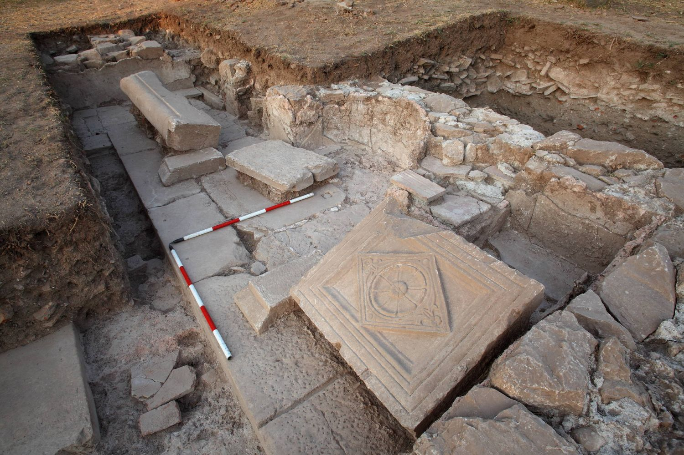
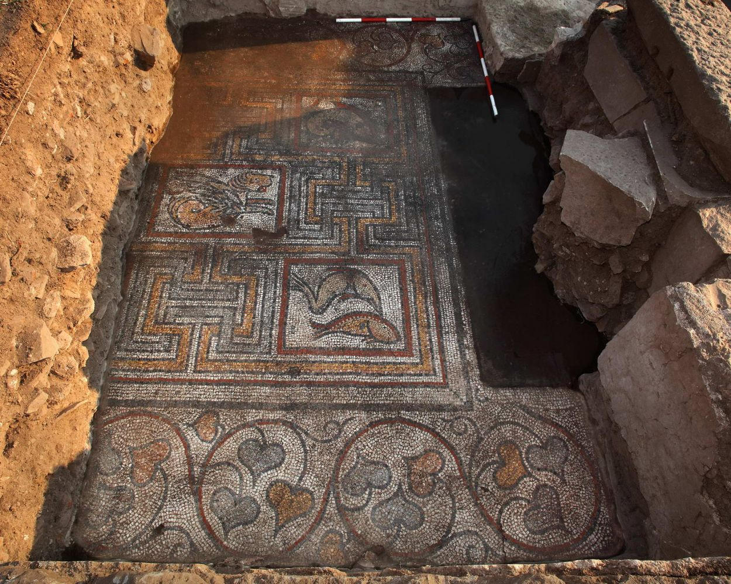
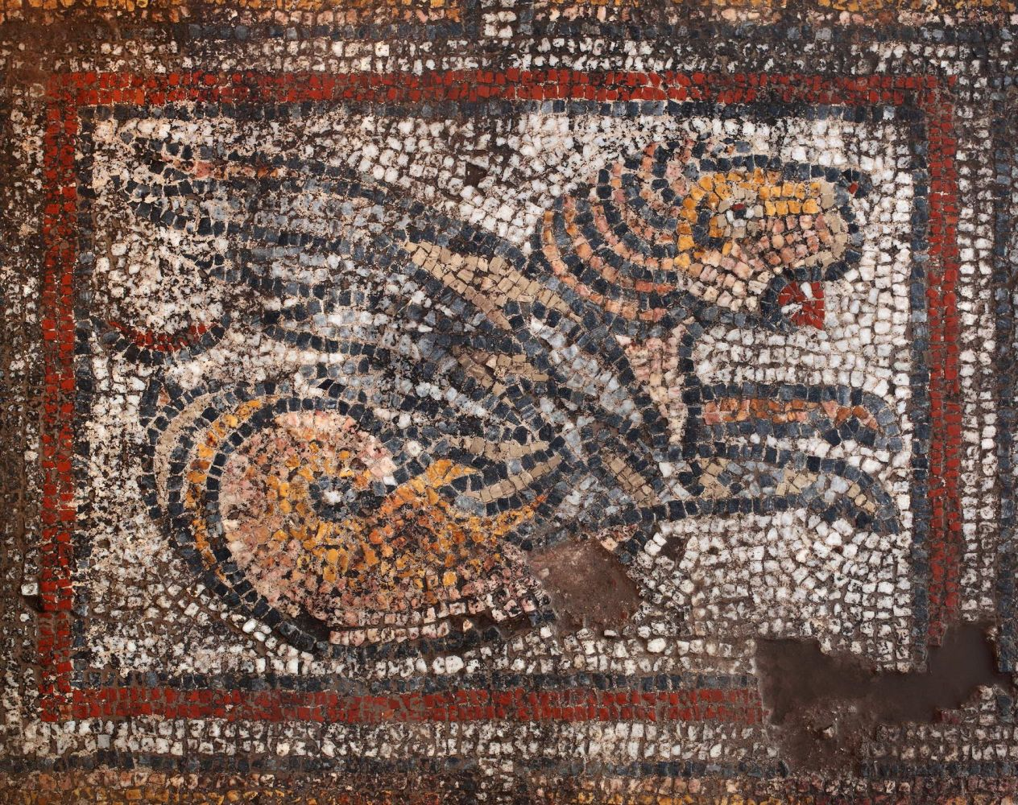
- the east of the Imperial cult area
- excavations in 2011- an impressive building complex consisting of a courtyard, an elongated room with mosaic floor, a fountain and a tract for commercial use
- bases, columns and capitals of marble are preserved, and the courtyard was also paved with marble slabs.
- a four-colored mosaic floor in one of the rooms – marine motive
- to the south of the mosaic room - a three-part nymphaeum

Slide 40
TYPOLOGY
Terrace
- near the upper agora – close to large dwellings of wealthy inhabitants – valuable land in the city centre
- function: to create a level area above the descending slope of Mr. Koressos
- the greatest height – in the north - square - 10.4 m - vaulted shops behind a colonnaded hall cca 5 m wide
- in front of the hall – 3-story façade reaching to the top of the terrace, 4.3 m wide monumental stairway – close to north-eastern corner – main access to the top of the terrace, at least one other entrance is known

Slide 41
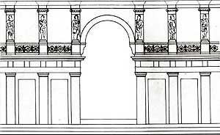
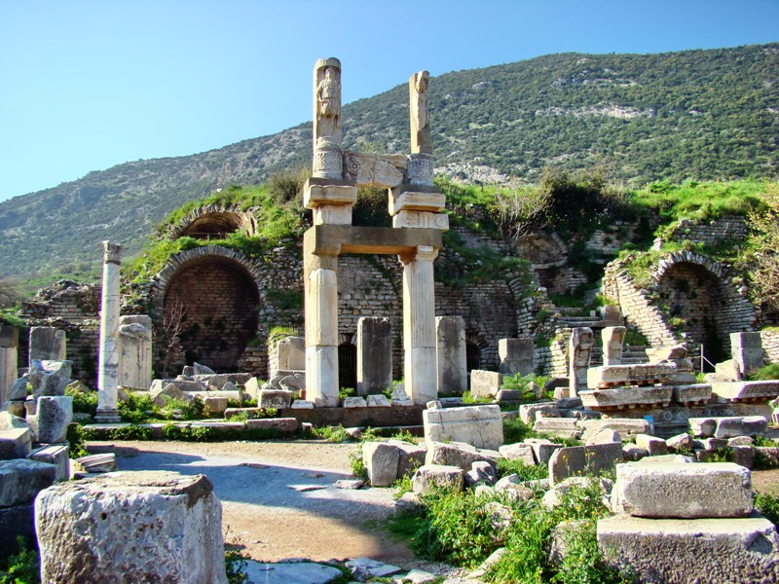
1st story - Doric - architrave (palmette, lotus, rosette designs)
2nd story - columns with engaged deities (Attis and Isis) along the length of the façade
Banner – the colonnade contained eastern deities
Price - way of depicting the relationship of the emperors and the gods, deliberate attempt to classify the emperors in the divine category without equating them with the gods
3rd story - Corinthian order

Slide 42
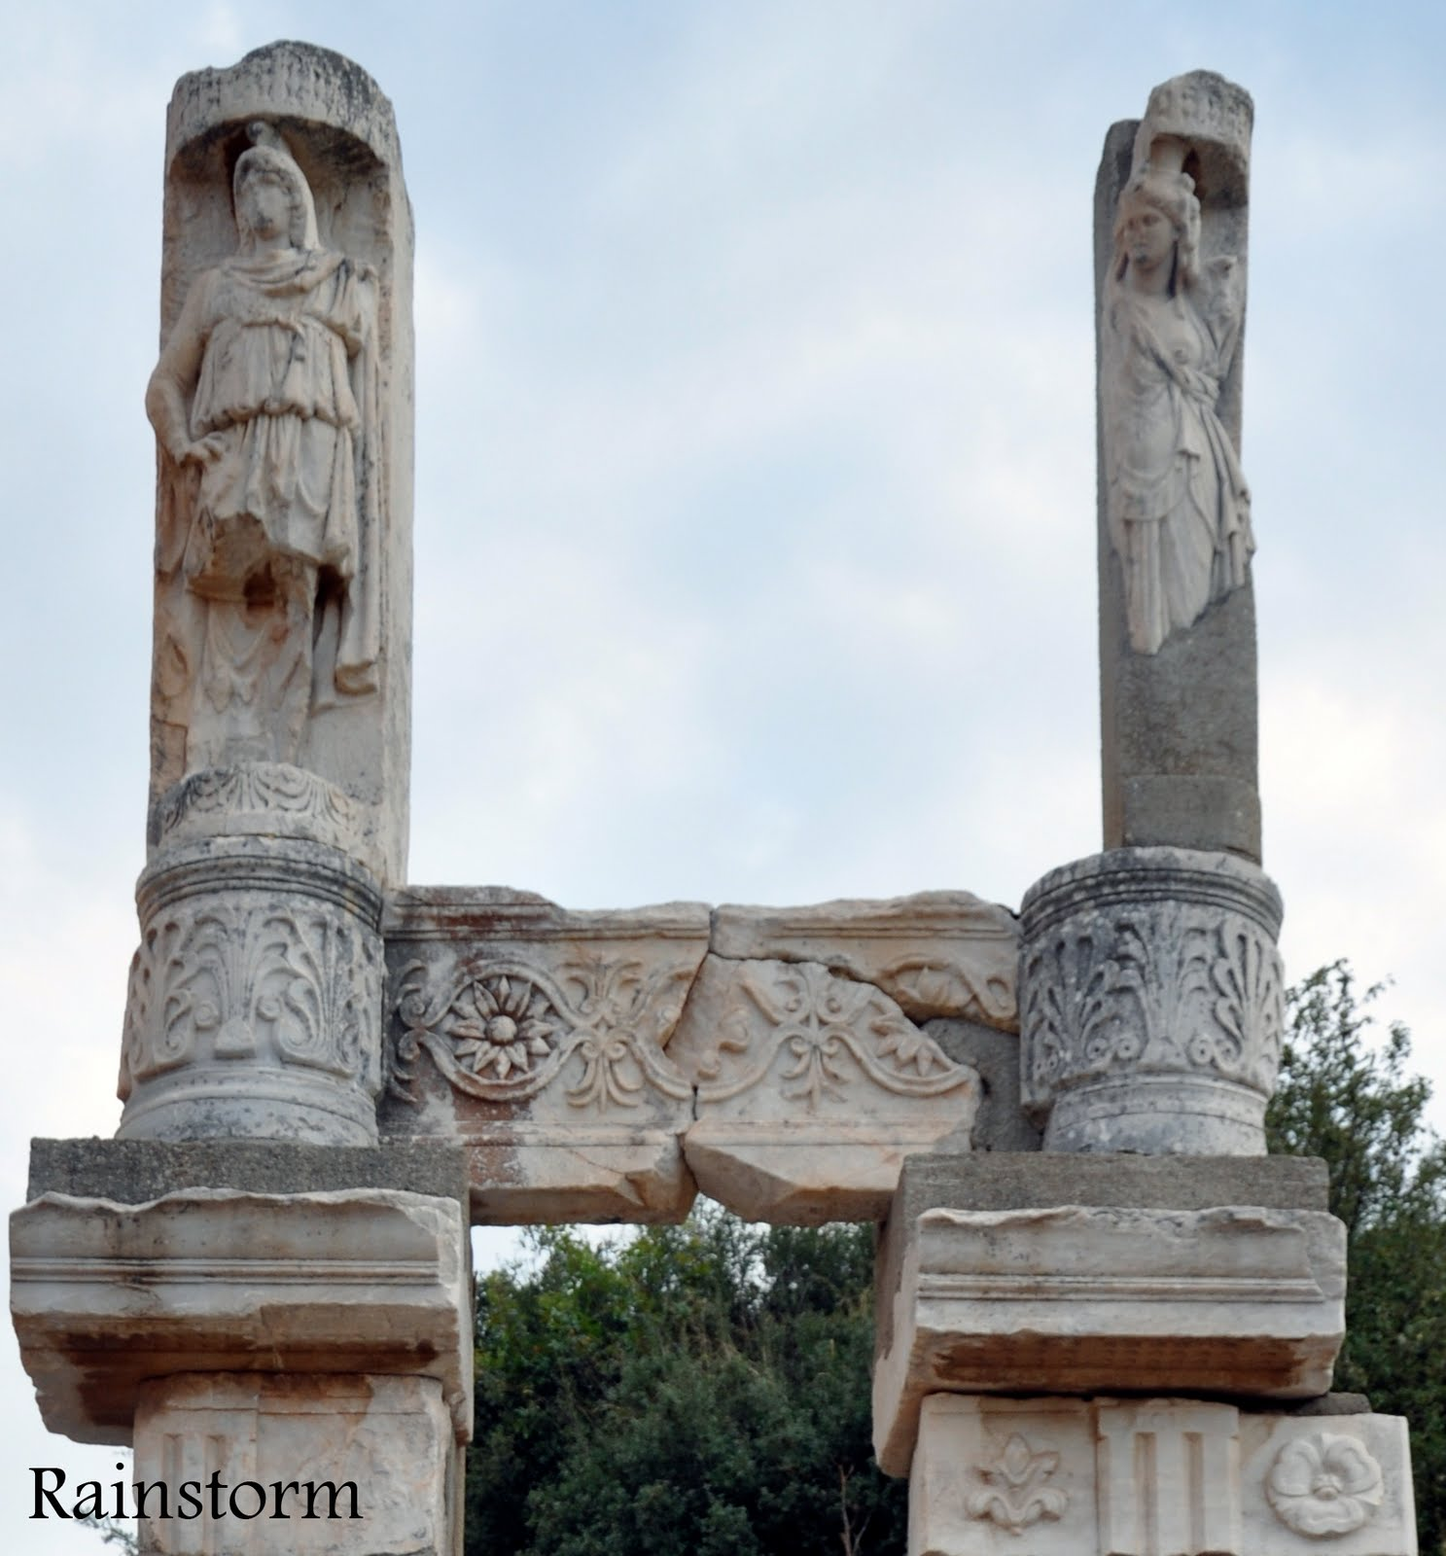
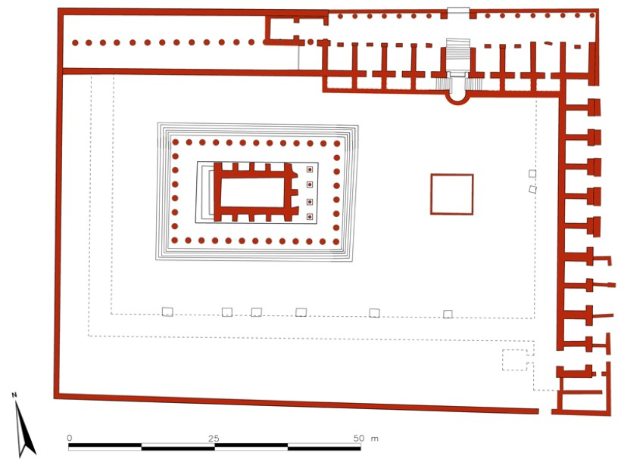

Slide 43
TYPOLOGY
Temple
- reconstruction: not possible, but it appears on the reverses of several coins – alongside the temple of Artemis, sometimes with other (later) provincial temples (Hadrian)
- order: Corinthian – typical for imperial temple buildings (even though that depicted as Ionic on the coins – just the way how temples depicted, inspired by Artemision)
- the temple set within a precinct – occupied the area on top of the artificial terrace (85.6x64.6m) - lined by stoas (3 sides), north side open to a square and an intersection of streets below
The layout is typically Hellenistic:
- temple – a Greek style (Italian temples – not unknown – the cult of Rome and Divus Iulius – north side of Ephesian upper agora), but the Greek design – more appropriate for Sebastoi
- Floor plan – modeled on traditional forms from Asia – tetraprostyle temple surrounded by a pseudodipteral colonnade (8x13 columns), crepidomia – 6 steps on all sides

Slide 44
Altar
- U-shaped altar – a common feature associated with major temples in Asia – Artemision, Athena in Priene, Pergamon…
- imperial altars – appropriate location for elaborate relief sculpture
- Ephesus – 2nd century AD – U-shaped altar (9 m2, only half of the foundations survived)
- Steps – western side (faced the temple), raised platform, three friezes found – mid. 2nd c. AD
- reliefs – military motifs, shields, spears, armour, trophies, a band captive – ideology of imperial victory

