Slide 1
Cantonese II
Week 10

Slide 2
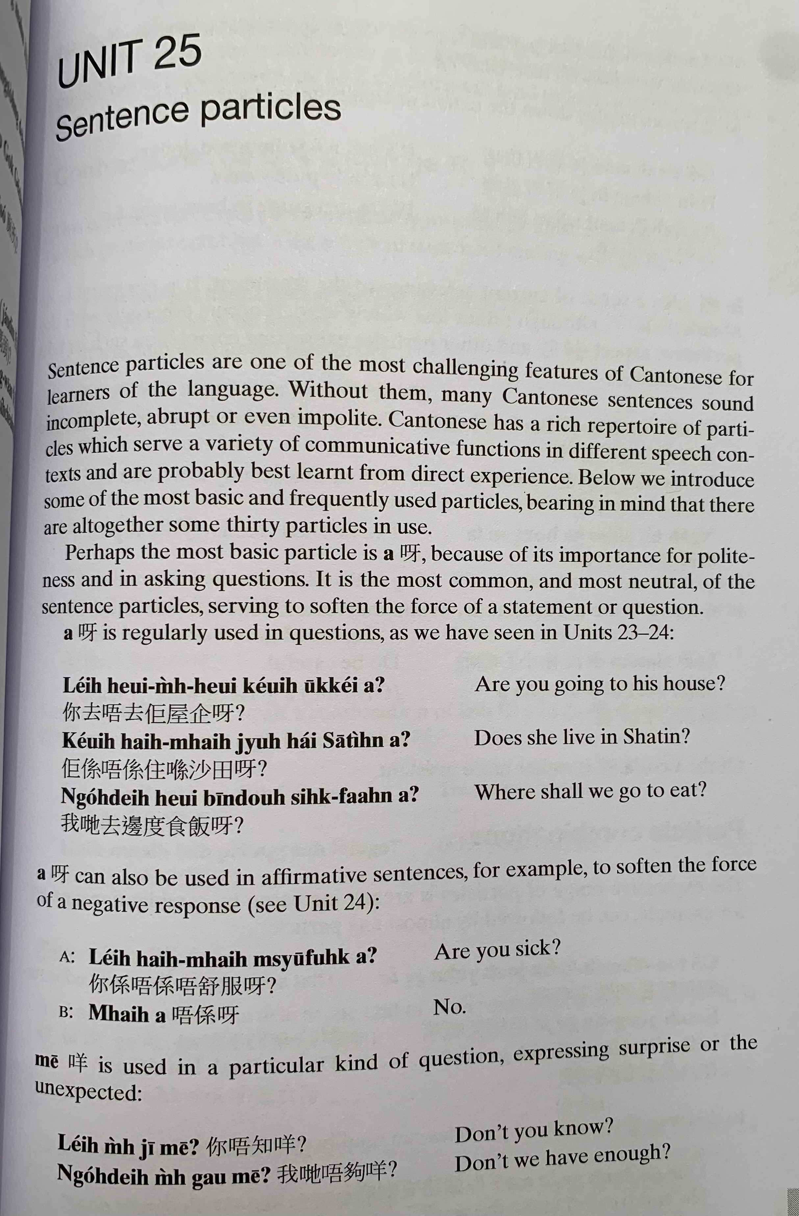
aa3
aa3
nei5 heoi3 m4 heoi3 keoi5 uk1 kei2 aa3 ?
keoi5 hai6 m4 hai6 zyu6 hai2 saa1 tin4 aa3 ?
ngo5 dei6 heoi3 bin1 dou6 sik6 faan6 aa3 ?
aa3
nei5 hai6 m4 hai6 m4 syu1 fuk6 aa3？
m4 hai6 aa3

Slide 3
me1
nei5 m4 zi1 me1 ?
ngo5 dei6 m4 gau3 me1?

Slide 4
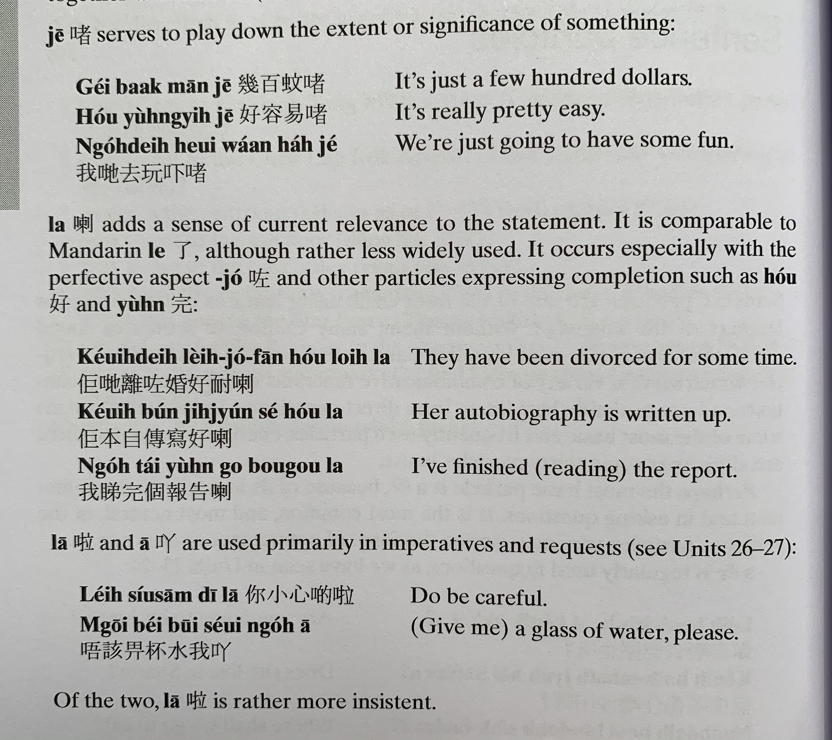
ze1
gei2 baak3 man1 ze1
hou2 jung4 ji6 ze1
講笑啫
Gong2 siu3 ze1
ngo5 dei6 heoi3 waan2 haa5 ze1
laa3
zo2
hou2
Jyun4 完
keoi5 dei6 lei4 zo2 fan1 hou2 noi6 laa3
keoi5 bun2 zi6 cyun4 se2 hou2 laa3
ngo5 tai2 jyun4 go3 bou3 gou3 laa3
laa1
aa1
nei5 siu2 sam1 di1 laa1
m4 goi1 bei2 bui1 seoi2 ngo5 aa1

Slide 5
go2 tou3 din6 si6 kek6 zou6 jyun4 ge3 laa3
keoi5 gong2 siu3 ge3 ze1
nei5 ji5 wai6 ngo5 so4 ge3 me1 ?
nei5 sik1 lou6 ge3 laa3 me1 ?
keoi5 hai6 siu2 hok6 saang1 lai4 ge3 zaa3 wo3 !

Slide 6
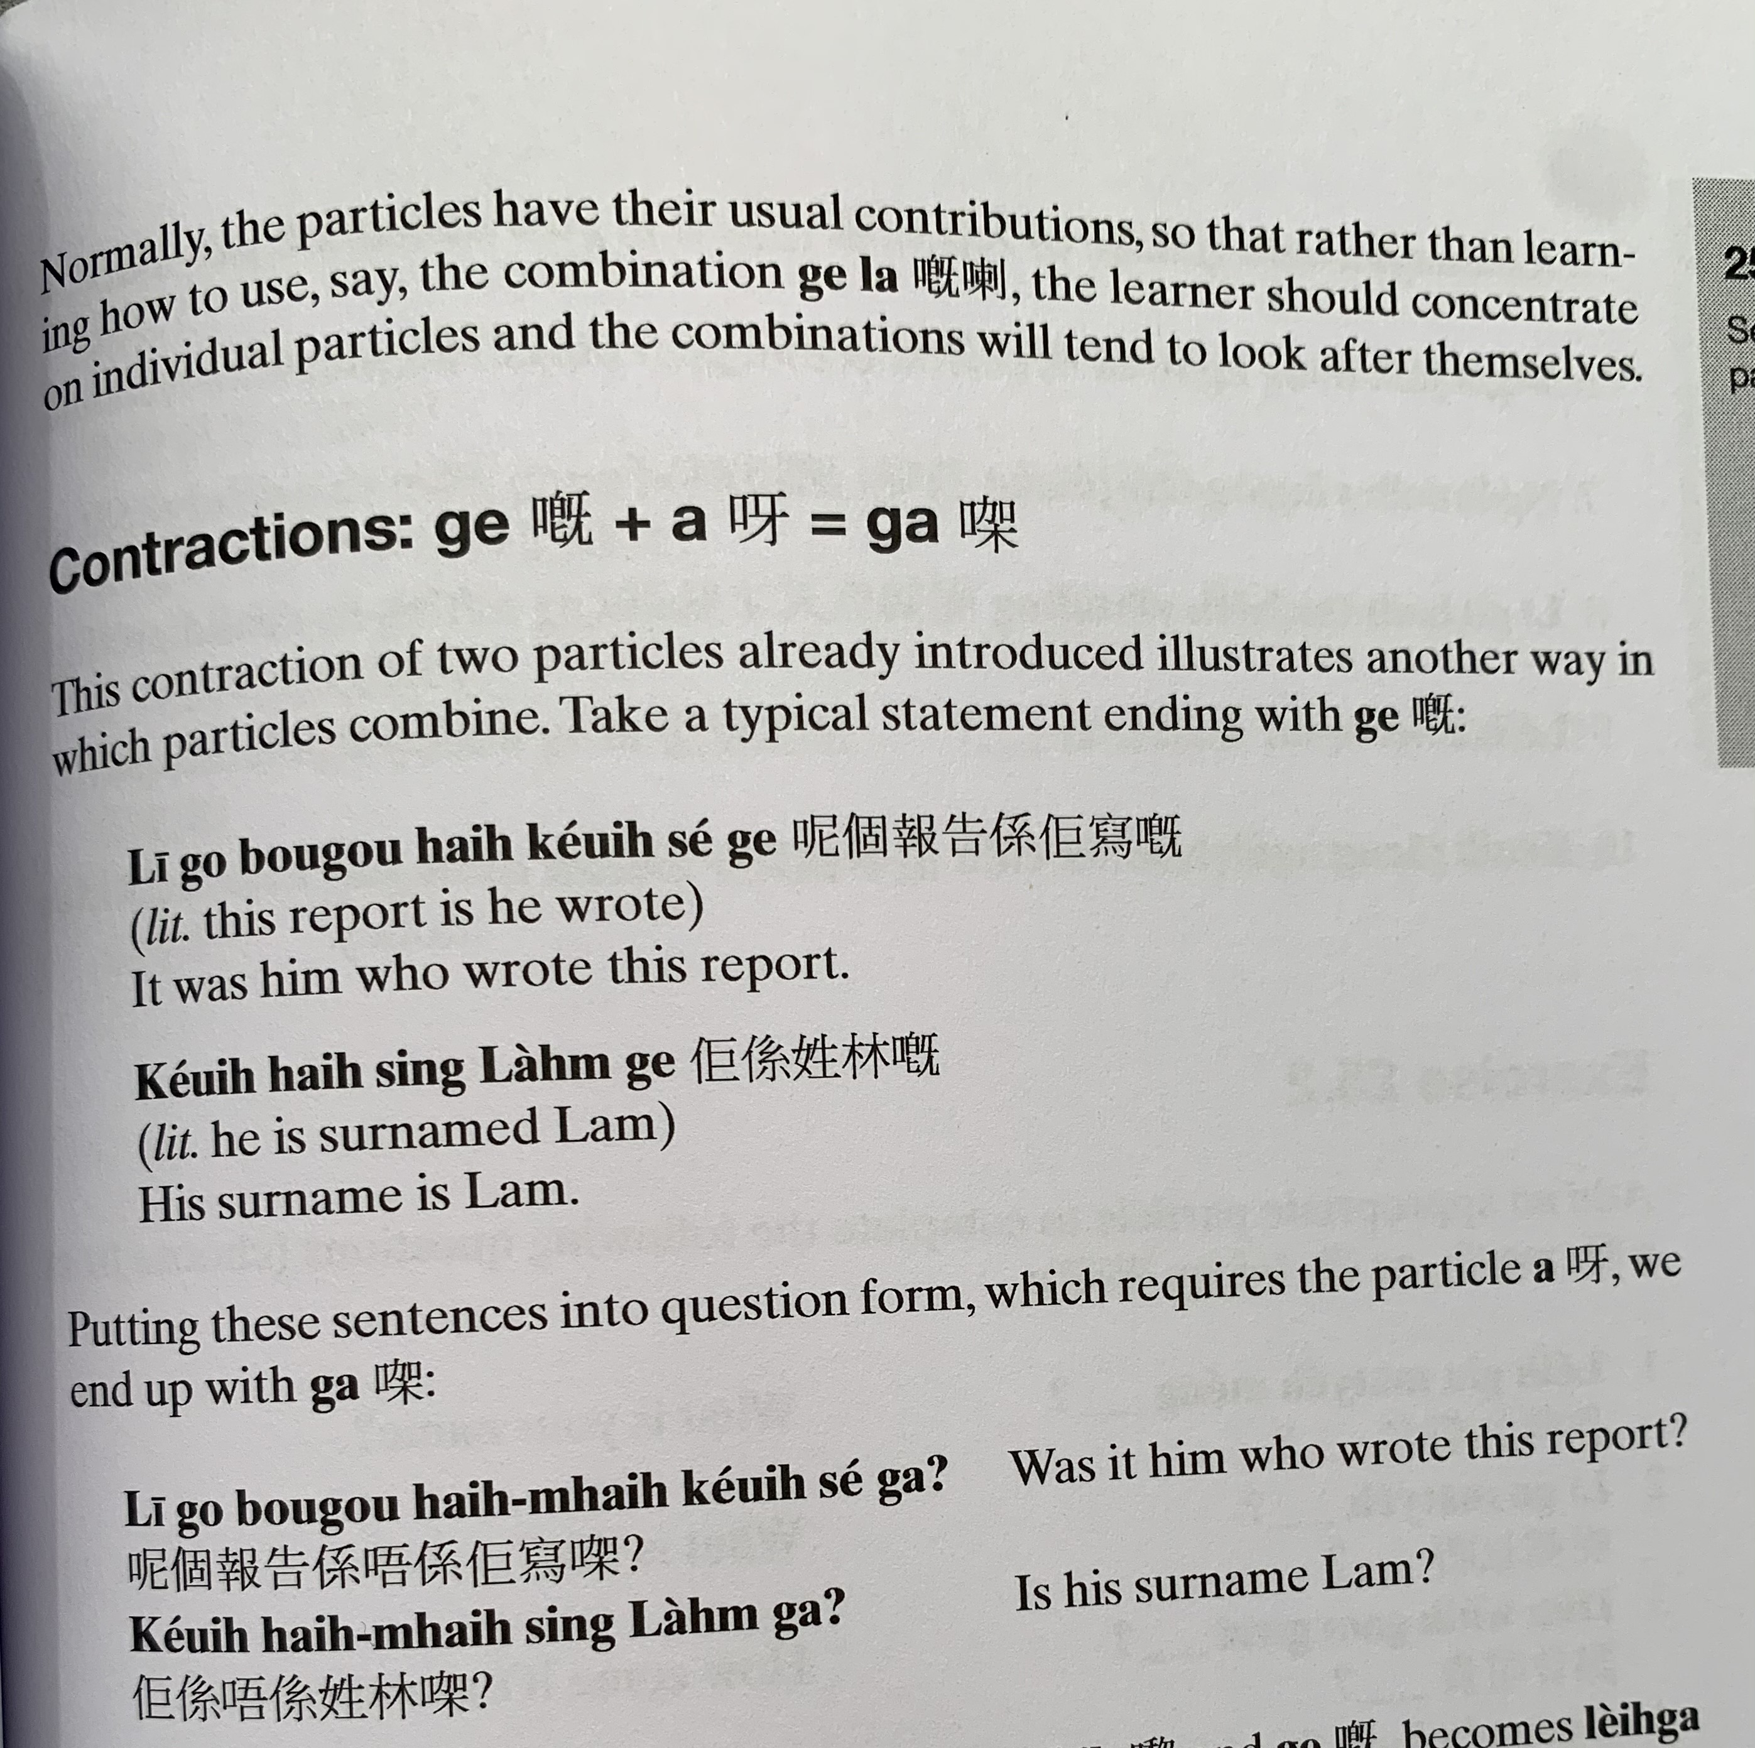
ni1 go3 bou3 gou3 hai6 keoi5 se2 ge3
keoi5 hai6 sing3 lam4 ge3
ni1 go3 bou3 gou3 hai6 m4 hai6 keoi5 se2 gaa3 ?
keoi5 hai6 m4 hai6 sing3 lam4 gaa3 ?

Slide 7
Translate into Cantonese with the appropriate final particles
Don’t you know there will be exam （haau2 si3）?
Whose book is this?
This book is mine.
How to go to the park?
He/She studies Chinese Studies.
Does he/she study Chinese studies?

Slide 8
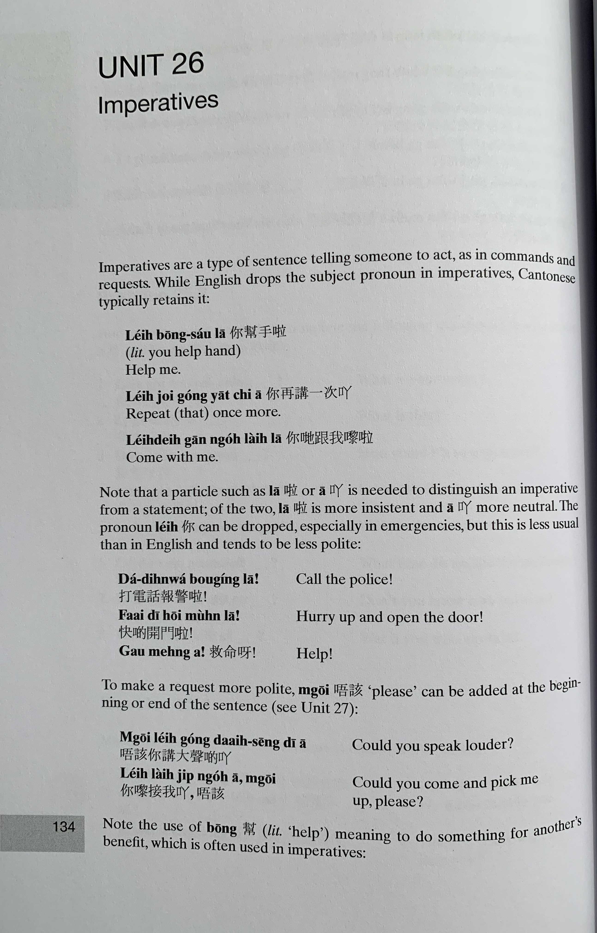
nei5 bong1 sau2 laa1
nei5 zoi3 gong2 jat1 ci3 aa1
nei5 dei6 gan1 ngo5 lai4 laa1
daa2 din6 waa2 bou3 ging2 laa1
faai3 di1 hoi1 mun4 laa1
gau3 ming6 aa3
m4 goi1 nei5 gong2 daai6 seng1 di1 aa1
nei5 lai4 zip3 ngo5 aa1, m4 goi1

Slide 9
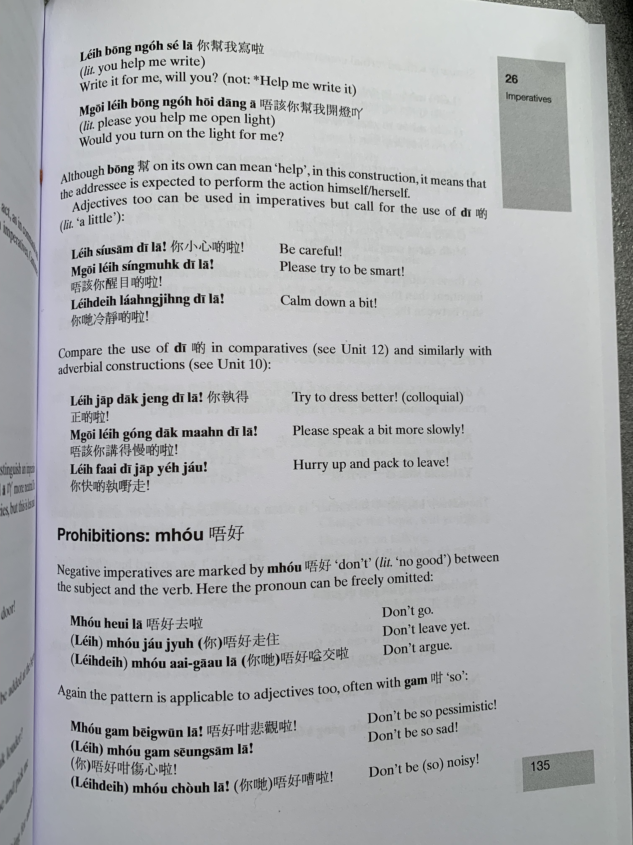
nei5 bong1 ngo5 se2 laa1
m4 goi1 nei5 bong1 ngo5 hoi1 dang1 aa1
nei5 siu2 sam1 di1 laa1
m4 goi1 nei5 sing2 muk6 di1 laa1
nei5 dei6 laang5 zing6 di1 laa1
nei5 zap1 dak1 zeng3 di1 laa1
m4 goi1 nei5 gong2 dak1 maan6 di1 laa1
nei5 faai3 di1 zap1 je5 zau2
m4 hou2
m4 hou2 heoi3 laa1
m4 hou2 zau2 zyu6
m4 hou2 aai3 gaau1 laa1
m4 hou2 gam2 bei1 gun1 laa1
m4 hou2 gam2 soeng1 sam1 laa1
m4 hou2 cou4 laa1

Slide 10
mai5 cou4 laa1
mai5 zau2 zyu6
mai5 ceot1 seng1 laa1

Slide 11
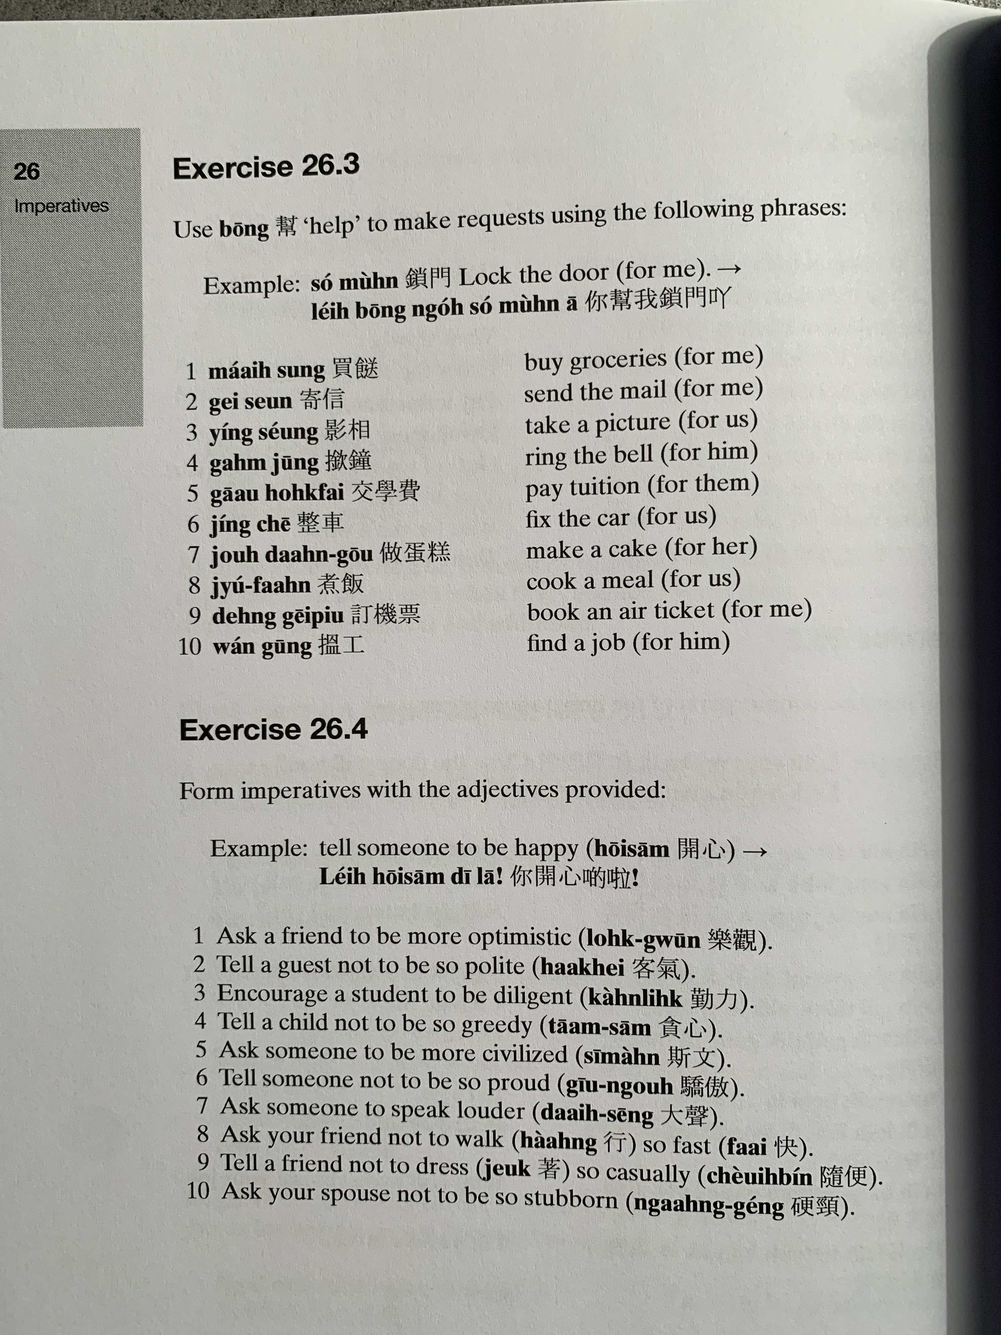
bong1
nei5 bong1 ngo5 so2 mun4 aa1
maai5 sung3
gei3 seon3
jing2 soeng2
gam6 zung1
gaau1 hok6 fai3
zing2 ce1
zou6 daan6 gou1
zyu2 faan6
deng6 gei1 piu3
wan2 gung1
唔好意思，我唔得閒，我要。。。
m4 hou2 ji3 si3, ngo5 m4 dak1 haan4, ngo5 jiu3...

Slide 12
lok6 gun1
haak3 hei3
kan4 lik6
taam1 sam1
si1 man4
giu1 ngou6
daai6 seng1
haang4
faai3
zoek3
ceoi4 bin2
ngaang6 geng2

Slide 13
頭髮 | Hair | tau4 faat3
面 | Face | min6
眼 | Eye | ngaan5
耳 | Ear | ji5
口 | Mouth | hau2
鼻 | Nose | bei6
顏色 | Colour | ngaan4 sik1
黑色 | Black | hak1 sik1
金色 | Gold/Blonde | gam1 sik1
啡色 | Brown | fe1 sik1
藍色 | Blue | laam4 sik1
綠色 | Green | luk6 sik1
高 | Tall | gou1
矮 | Short | ai2
肥 | Fat | fei4
瘦 | Thin | sau3
大 | Big | daai6
細 | Small | sai3
大隻 | Muscular | daai6 zek3

Slide 14
職業 |  | zik1 jip6
職業係乜嘢？ 做乜職業？ | What is his/her occupation? | zik1 jip6 hai6 mat1 je5? zou6 me1 zik1 jip6?
學生 | Student | hok6 saang1
醫生 | Doctor | ji1 sang1
海盜 | Pirate | hoi2 dou6
特務 | Spy | dak6 mou6
佢識啲乜嘢呀？ | What does he/she know? | keoi5 sik1 di1 mat1 je5 aa3?
魔法 | Magic | mo1 faat3
揸船 | Driving a boat | zaa1 syun4
穿梭時間 | Time travel | cyun1 so1 si4 gaan3

Slide 15
https://www.youtube.com/watch?v=191jEmyM81w
12:30

