Slide 1
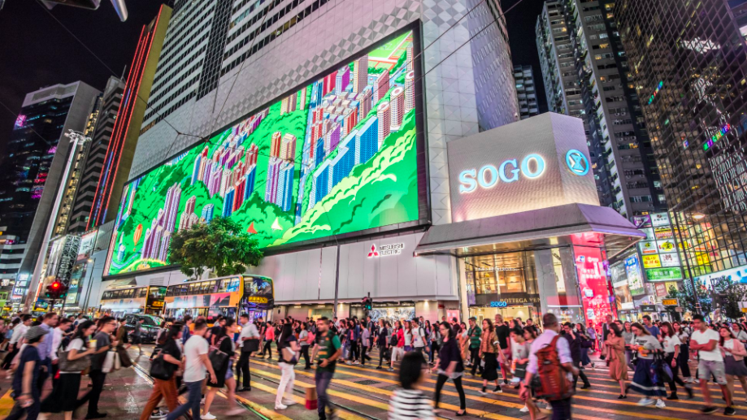
Cantonese II
Week 13

Slide 4
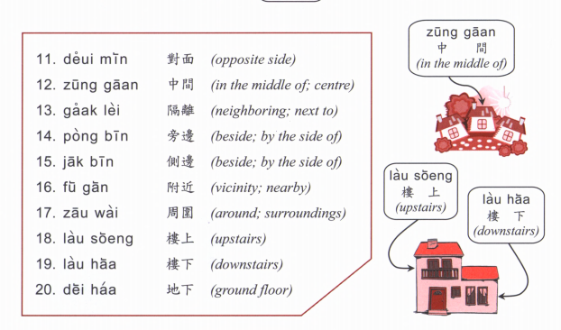

Slide 5
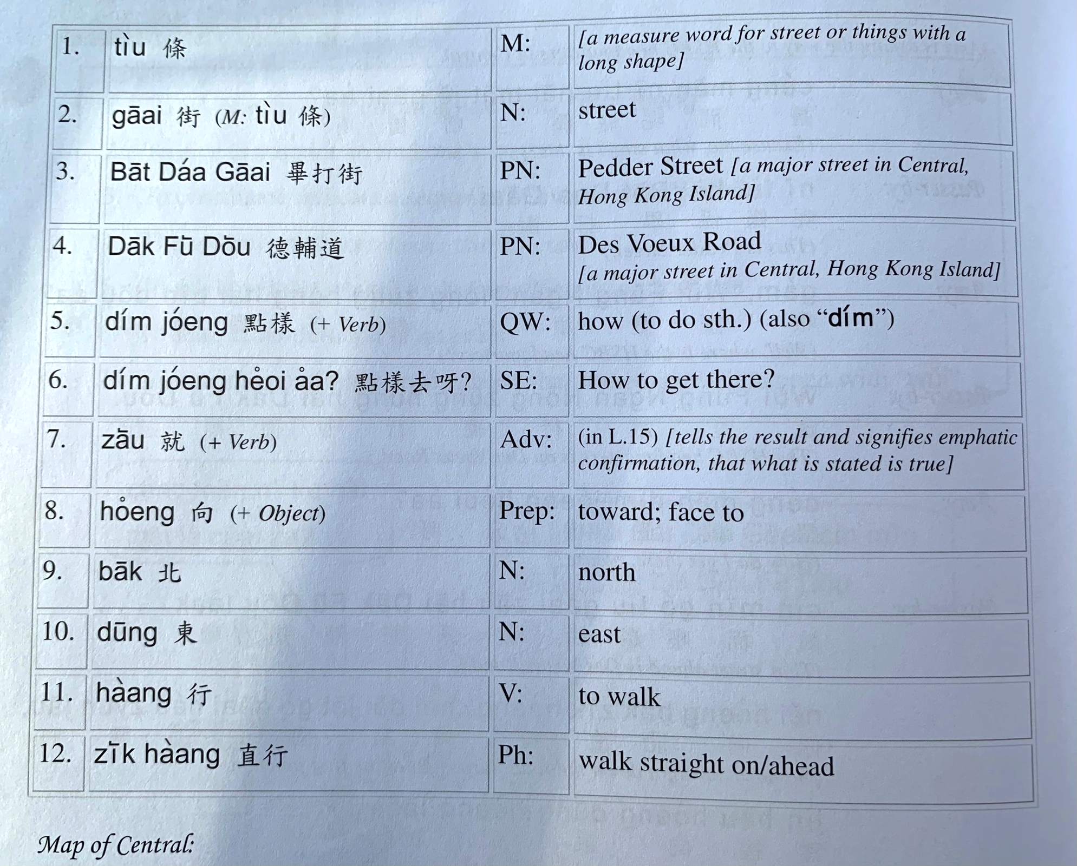

Slide 6
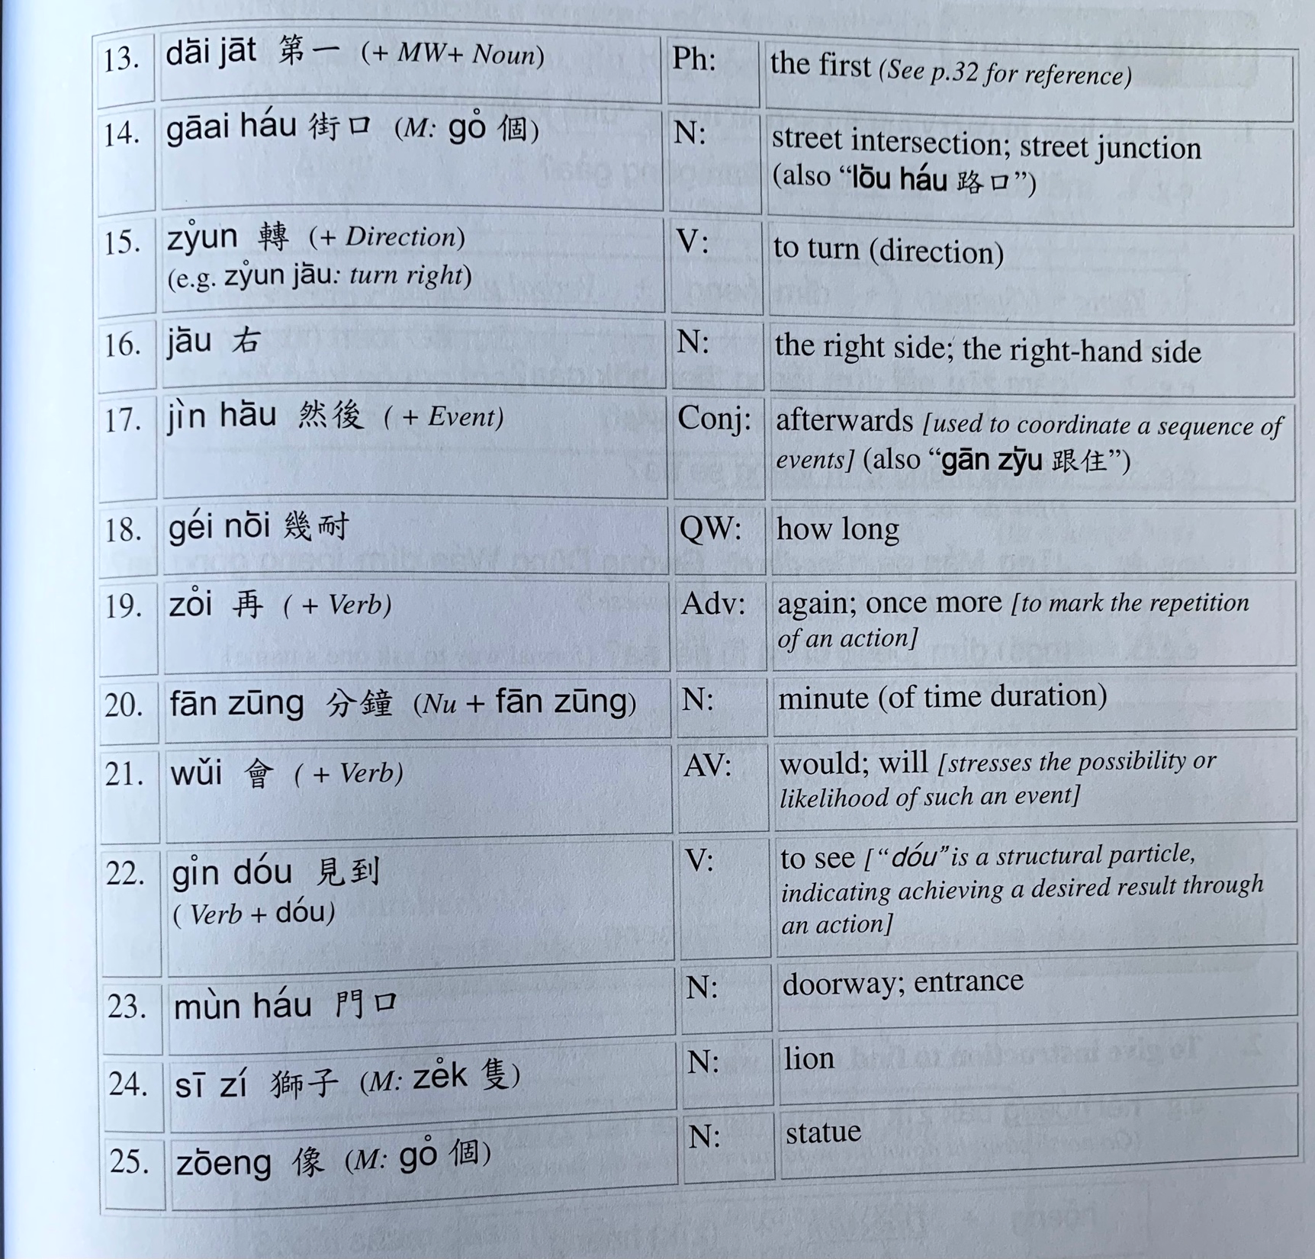

Slide 7
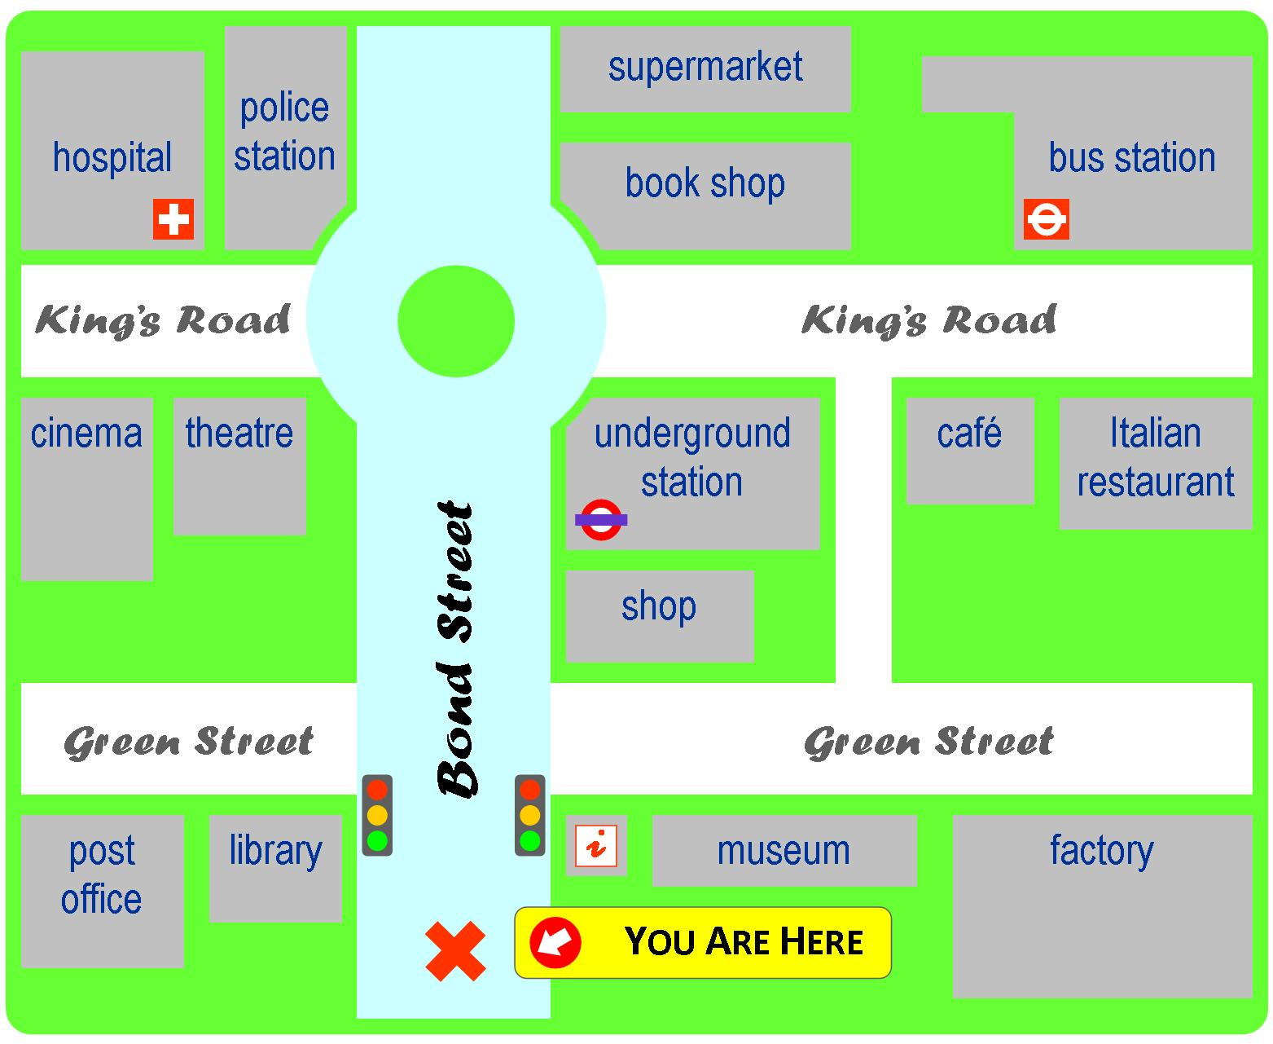
Yi1 jyun2
Ciu1 kap1 si5 coeng4
baa1 si2 zaam6
ging2 guk6
syu1 guk2
dei6 tit3 zaam6
hei3 jyun2
kek6 coeng4
gaa3 fe1 teng1
caan1 teng1
soeng1 dim3
hung4 luk6 dang1
bok3 mat6 gun2
Tou4 syu1 gun2
gung1 cong2
jau4 guk2

Slide 8
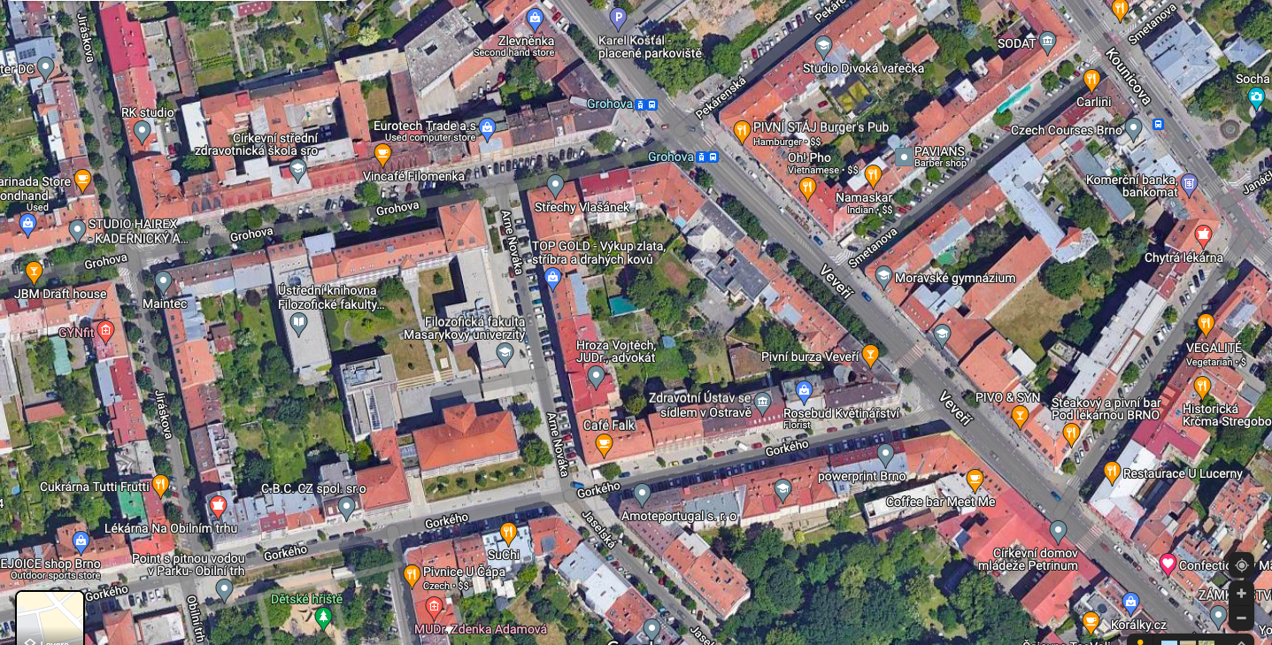

Slide 9
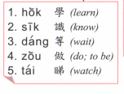
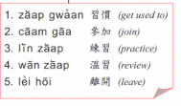
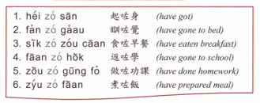
maai5 ye5 | 買嘢 | shopping
maai5 sung3 | 買餸 | Grocery shopping
haang4 gaai1 | 行街 | Window shopping
tai2 hei3 | 睇戲 | Watch movies
Coeng3 K | 唱K | Sing karaoke
daa2 gei1 | 打機 | Play video games
teng1 go1 / ting1 jam1 ngok6 | 聽歌/聽音樂 | Listen to music

Slide 10
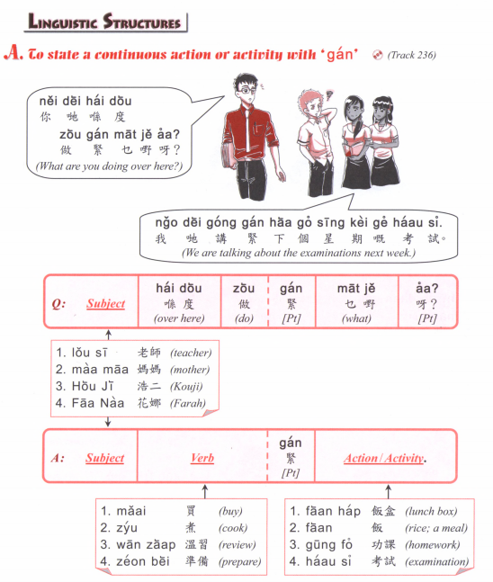

Slide 11
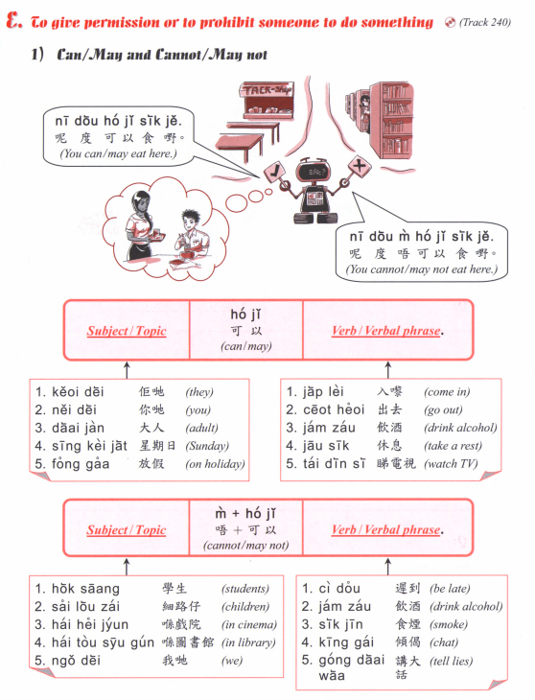

Slide 12
Translate the following into past/ future/ present/ present continuous tense.
My father goes to work every Monday to Thursday
I don’t have to go to school on Friday
I stayed at home last weekend
We will go to the cinema to watch Dr Strange
I am going to the park with my friends
I am not free, I am cooking
I am taking the tram to Namesti Svobody
I will go to celebrate （hing3 zuk1慶祝） after the exam
I will have dinner soon

Slide 13
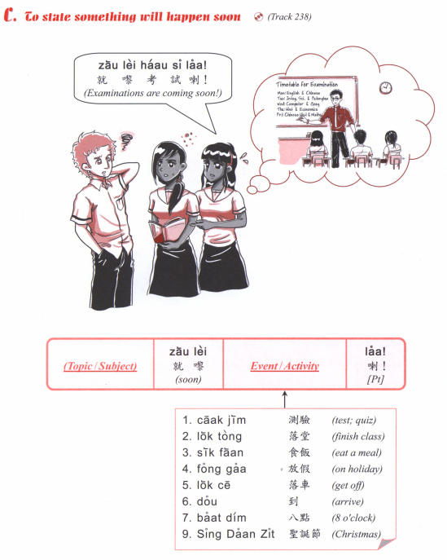
食咗飯
食緊飯
就黎食飯
會食飯

Slide 14
Translate the following into Cantonese using adverbs.
1. I didn’t go to school last week
2. I had lunch just now but I am still very hungry
3. I originally had to work but I don’t have time
4. See youn next time

Slide 15
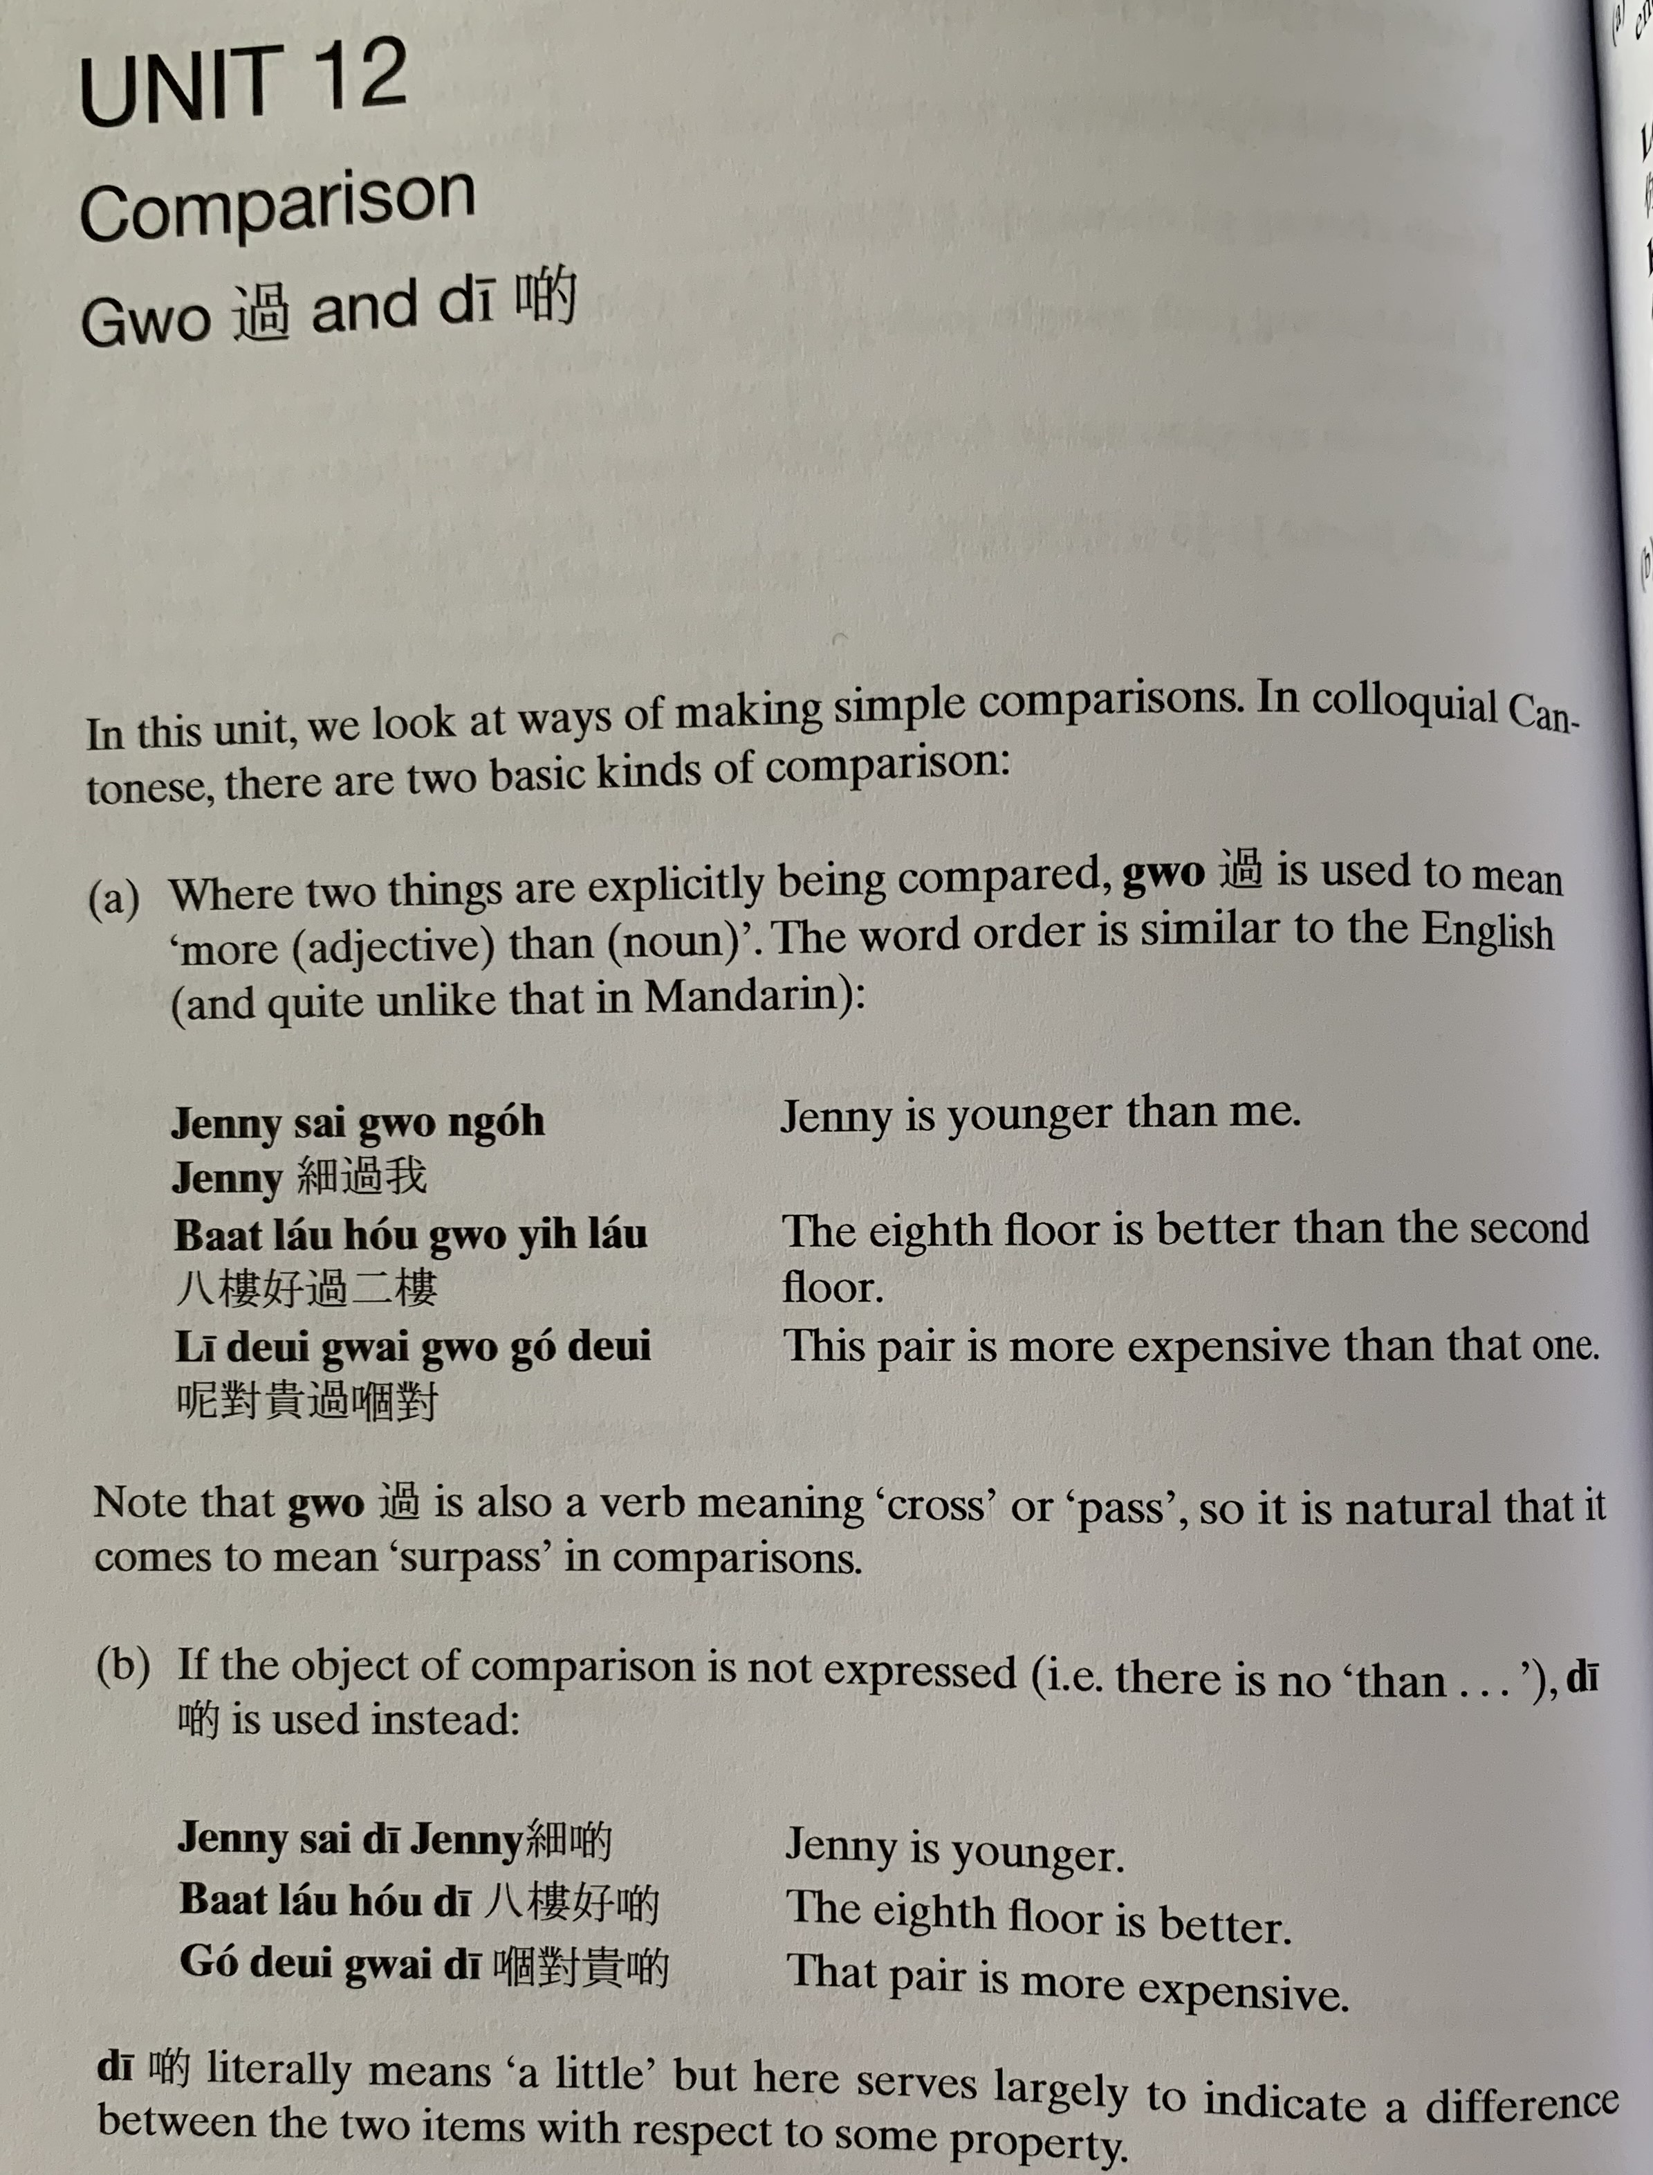
Gwo3
sai3 gwo3 ngo5
baat3 lau2 hou2 gwo3 ji6 lau2
ni1 deoi3 gwai3 gwo3 go2 deoi3
Jenny sai3 di1
baat3 lau2 hou2 di1
go2 deoi3 gwai3 di1

Slide 16
Translate the following into Cantonese
1. My friend is younger than me
2. This restaurant is more expensive
3.This cake is much cheaper than that
4. This colour is better
5. Red is better than white
6. I am busier this year than last year

Slide 17
Translate the following into Cantonese using zo2, gwo3, mei6 or mou5.
I’ve listened to this song before
I haven’t listened to this song before
He had breakfast this morning
He doesn’t eat breakfast
He hasn’t eaten breakfast
I’ve been to Brno
I went to Brno
I have never been to Brno
I didn’t go to Brno
I don’t know yet
I don’t know

Slide 18
Bei2
Translate the following into Cantonese
I have to return the book to you
I have to buy a gift (lai5 mat6 禮物) for my sister.
I made a cake for you
It is not allowed to eat in the library

Slide 19
Passive Voice
Translate the following into Cantonese and also in passive voice.
1. Someone ate my salad
2. My brother broke （zing2 waai6 整壞） the computer
3. I washed （sai2 洗） the clothes （saam1 衫）
4. Someone stole （ tau1 偷）my phone
5. He was scammed （ aak1呃）

Slide 20
Think of 2 requests (using bong1 and final particles)
Answer with:
唔好意思，我要。。。
m4 hou2 ji3 si3, ngo5 jiu3...

Slide 21
zyu6
ngo5 m4 faan1 uk1 kei2 zyu6
nei5 m4 hou2 gong2 bei2 jan4 teng1 zyu6
mai5 zau2 zyu6
gaa3 ce1 mei6 zaa1 dak1 zyu6
ngo5 dei6 zaam6 si4 m4 sai2 bun1 zyu6
How to say
I am not ready yet

Slide 22
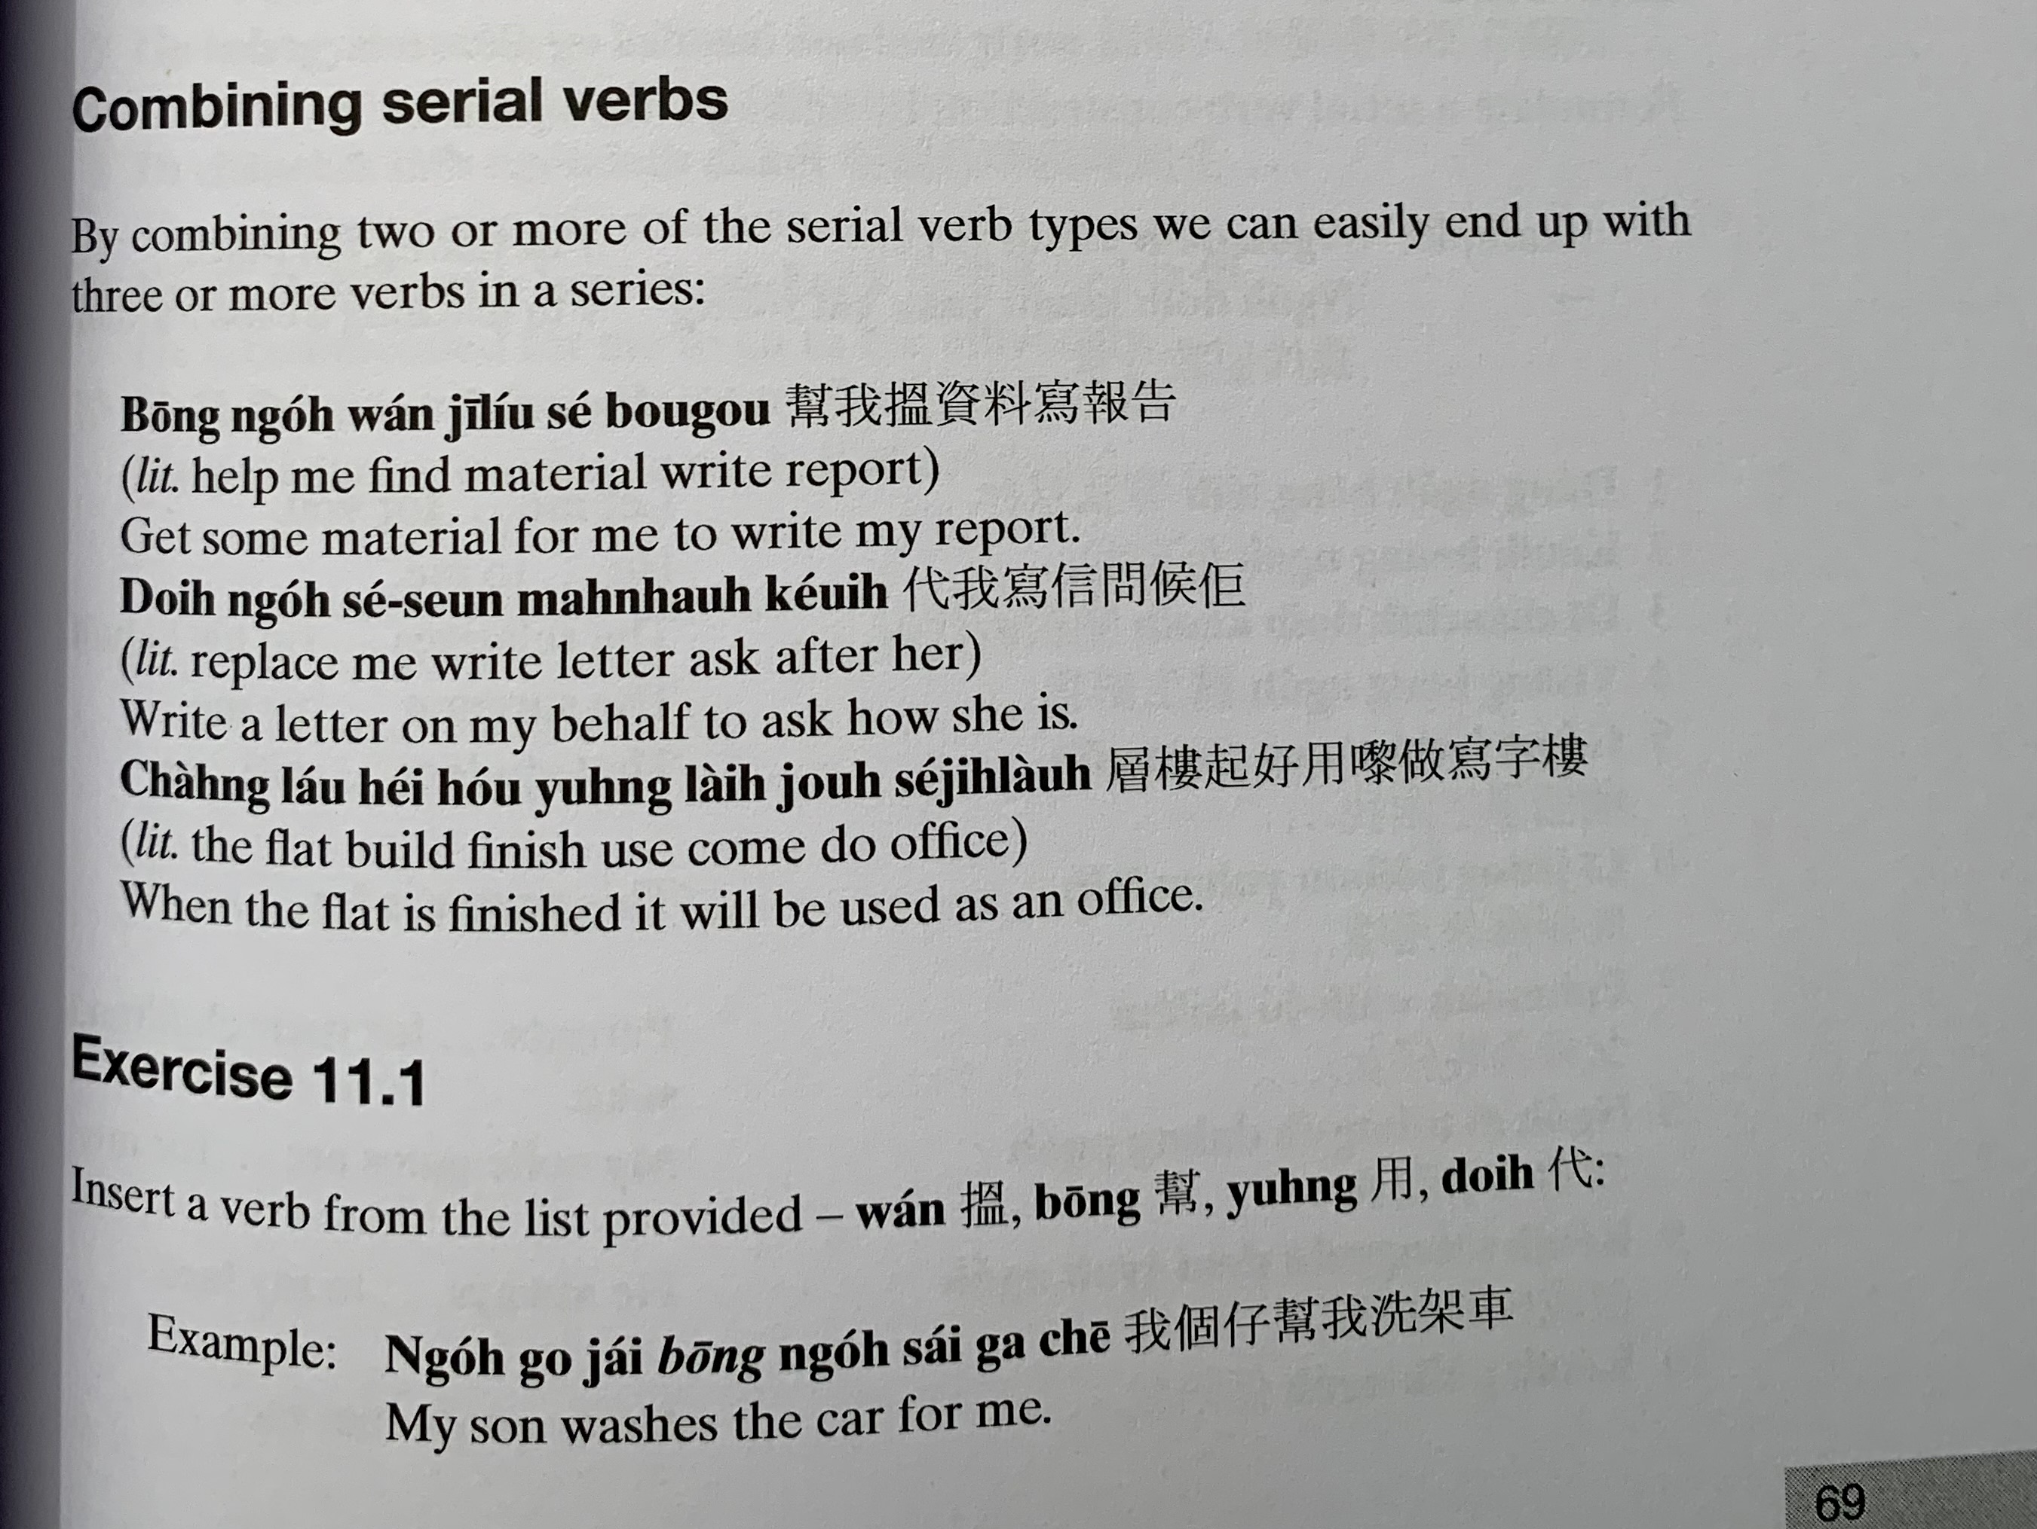
bong1 ngo5 wan2 zi1 liu2 se2 bou3 gou3
doi6 ngo5 se2 seon3 man6 hau6 keoi5
cang4 lau2 hei2 hou2 jung6 lai4 zou6 se2 zi6 lau4
wan2
bong1
jung6
doi6
ngo5 go3 zai2 bong1 ngo5 sai2 gaa3 ce1

Slide 23
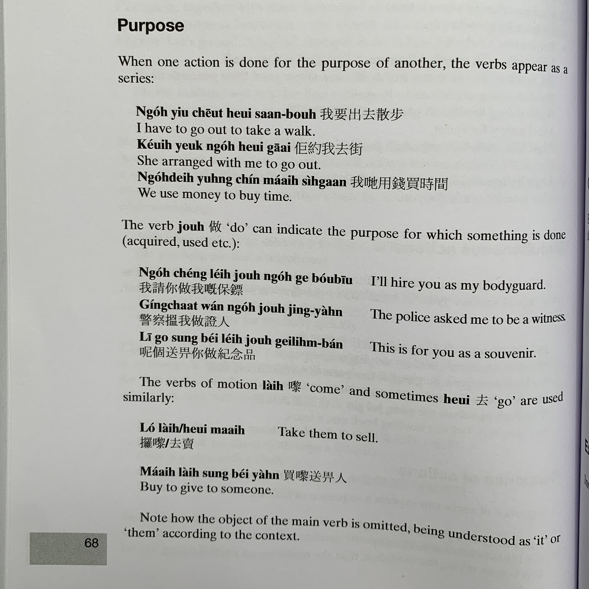
ngo5 jiu3 ceot1 heoi3 saan3 bou6
keoi5 joek3 ngo5 heoi3 gaai1
ngo5 dei6 jung6 cin2 maai5 si4 gaan3
zou6
ngo5 ceng2 nei5 zou6 ngo5 go3 bou2 biu1
ging2 caat3 wan2 ngo5 zou6 zing3 jan4
ni1 go3 sung3 bei2 nei5 zou6 gei2 nim6 ban2
lai4
heoi3
lo2 lai4/ heoi3 maai6
maai5 lai4 sung3 bei2 jan4

Slide 24
Get someone to fix （sau1 lei5修理）the computer
Flour is for making （zing2整/ zou6做） bread
The flowers is for a gift

Slide 25
邊個 | Who | Bin1 go6
咩 / 乜嘢 | what | Me1 / Mat1 je5
邊度 | Where | Bin1 dou6
點解 | Why | Dim2 gaai2
幾時 | When | Gei2 si4
點（樣） | How | Dim2 （yoeng2）
幾多 | How many/ much | Gei2 do1

