Slide 1
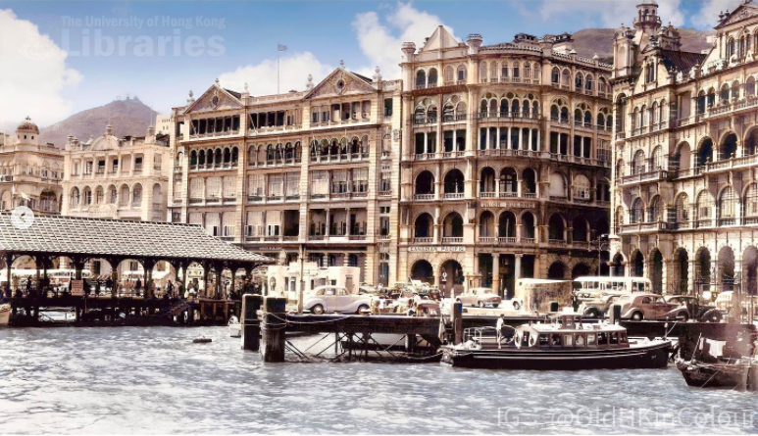
Cantonese II
Week 2

Slide 2
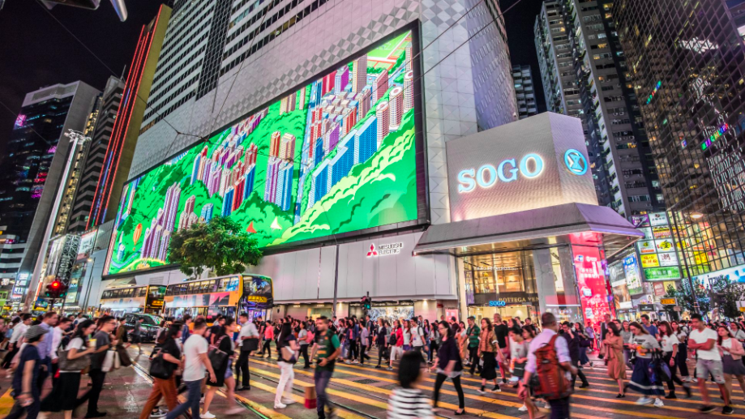
A day in Hong Kong
1. Ask how to go to the shop 2. You want to buy a new phone, ask for a discount. 3. Ask how to go to a restaurant from the shop 4. Order a meal in the restaurant 5. In the restaurant, you met a new friend, ask each other where you are from, your hobbies, what is your plan for later

Slide 3
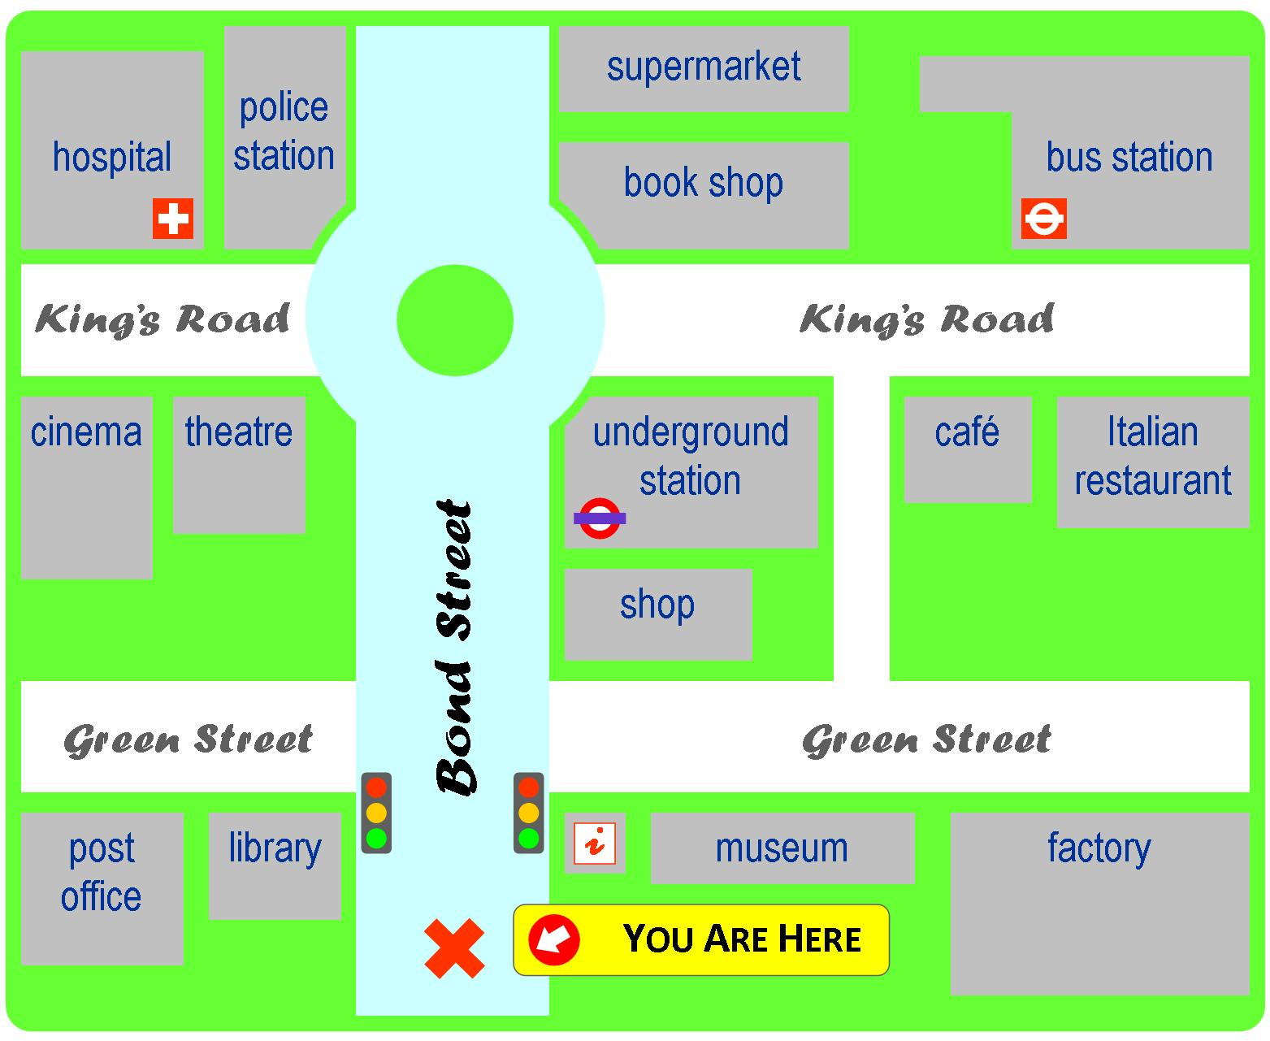
Yi1 jyun2
Ciu1 kap1 si5 coeng4
baa1 si2 zaam6
ging2 guk6
syu1 guk2
dei6 tit3 zaam6
hei3 jyun2
kek6 coeng4
gaa3 fe1 teng1
caan1 teng1
soeng1 dim3
hung4 luk6 dang1
bok3 mat6 gun2
Tou4 syu1 gun2
gung1 cong2
jau4 guk2

Slide 4
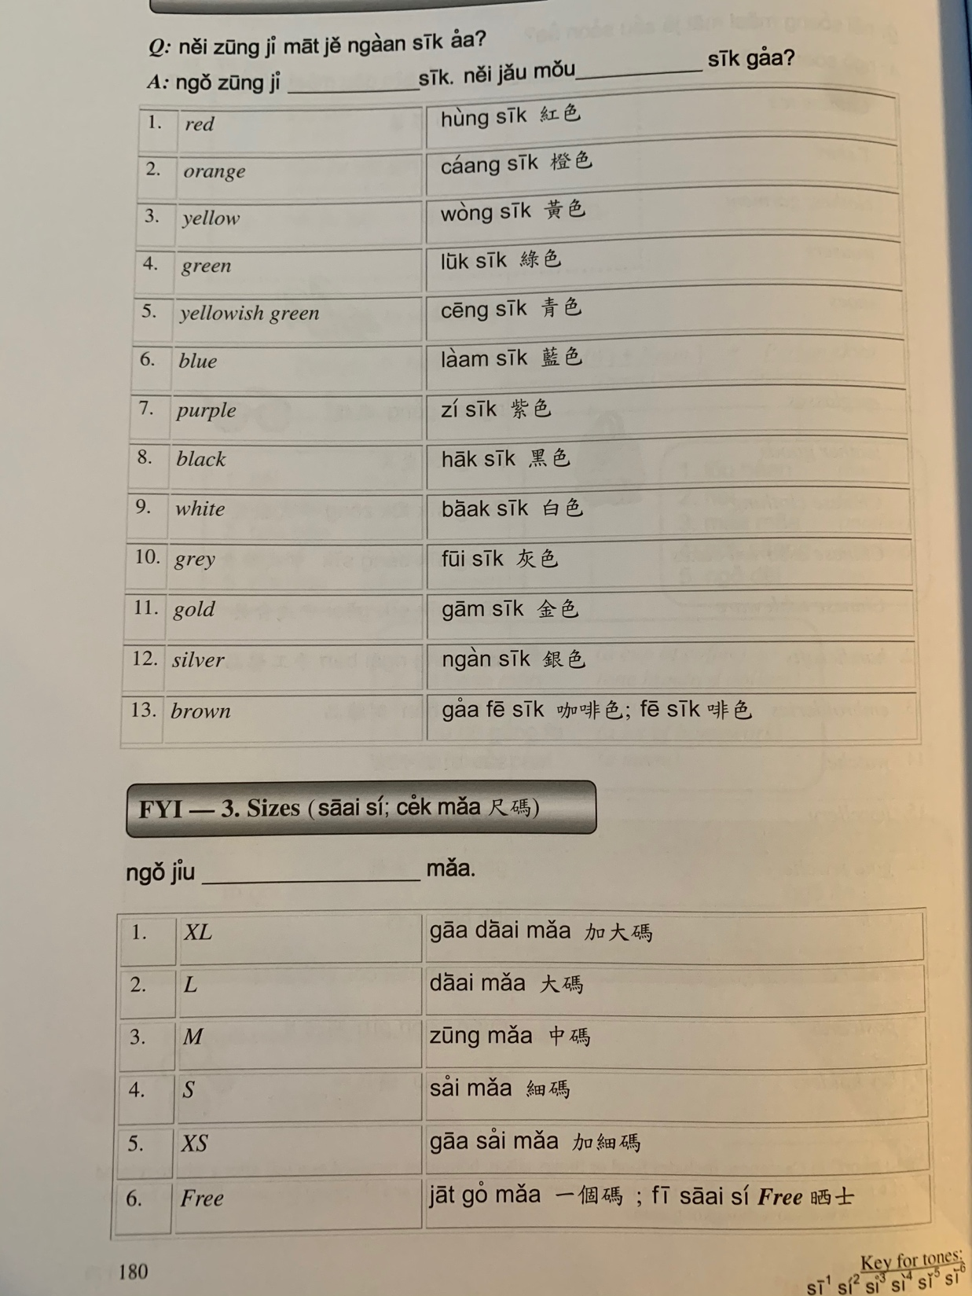

Slide 5
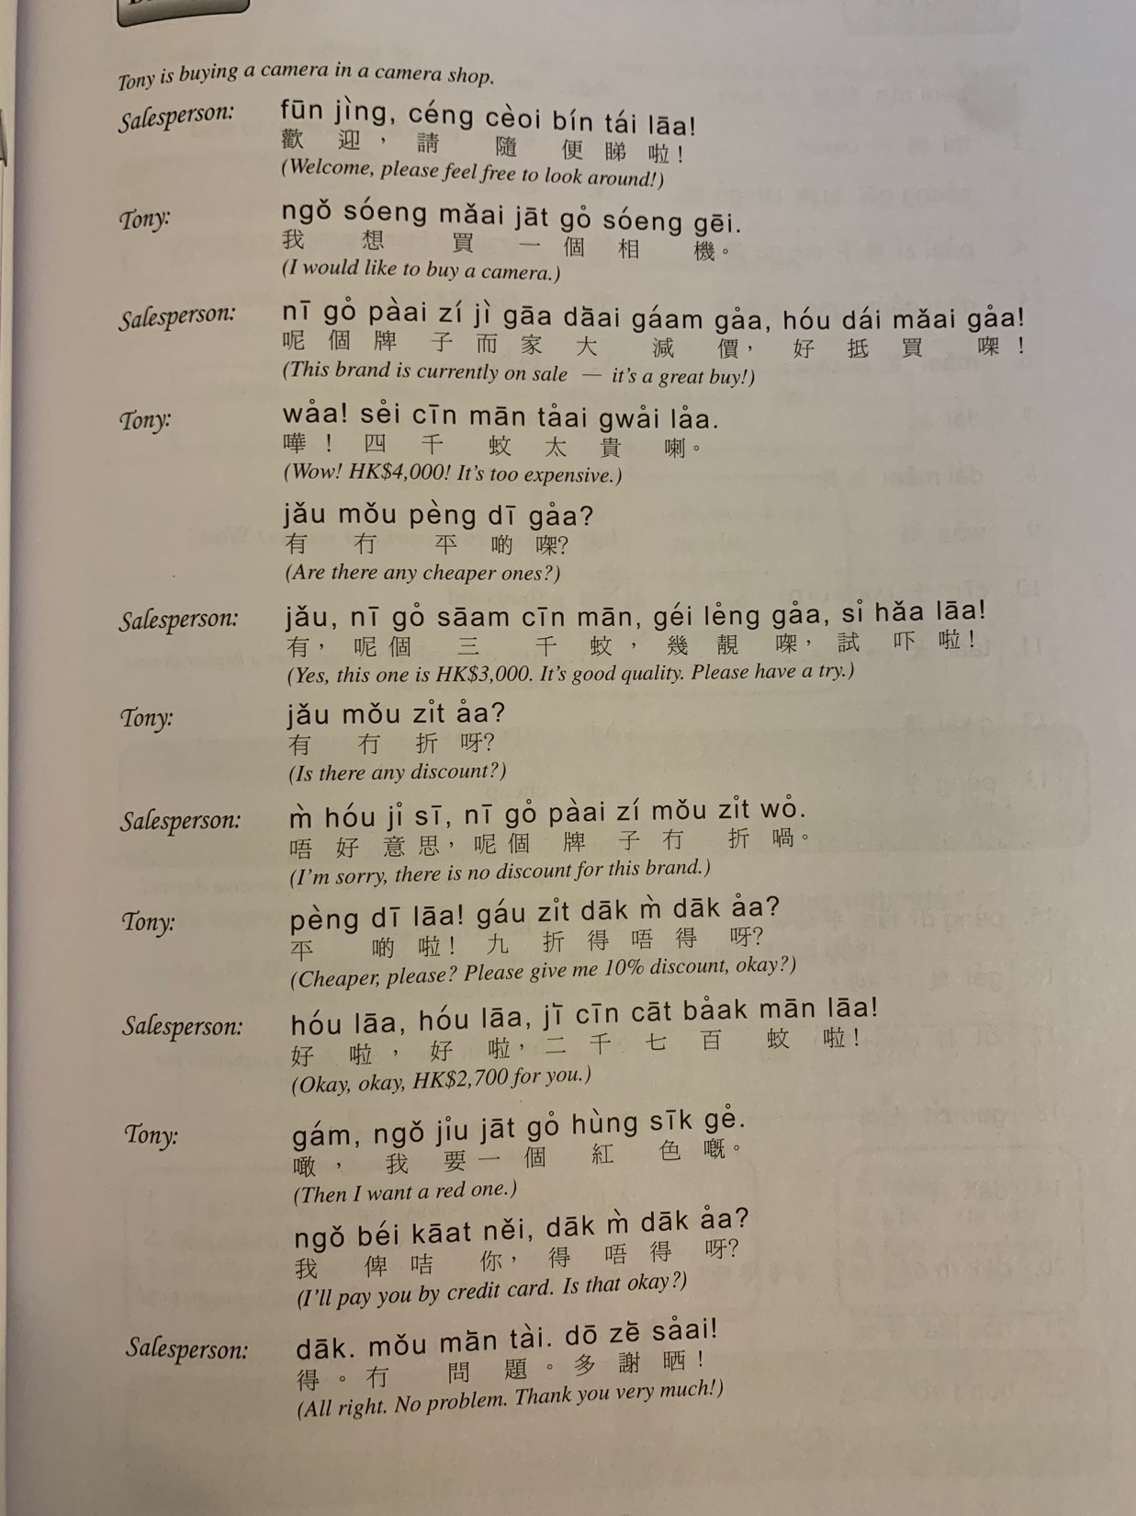

Slide 8
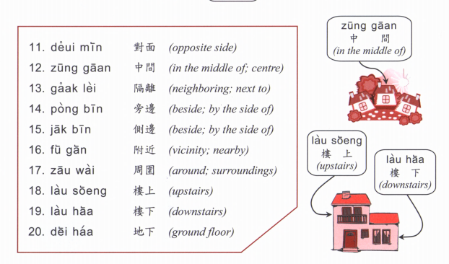

Slide 9
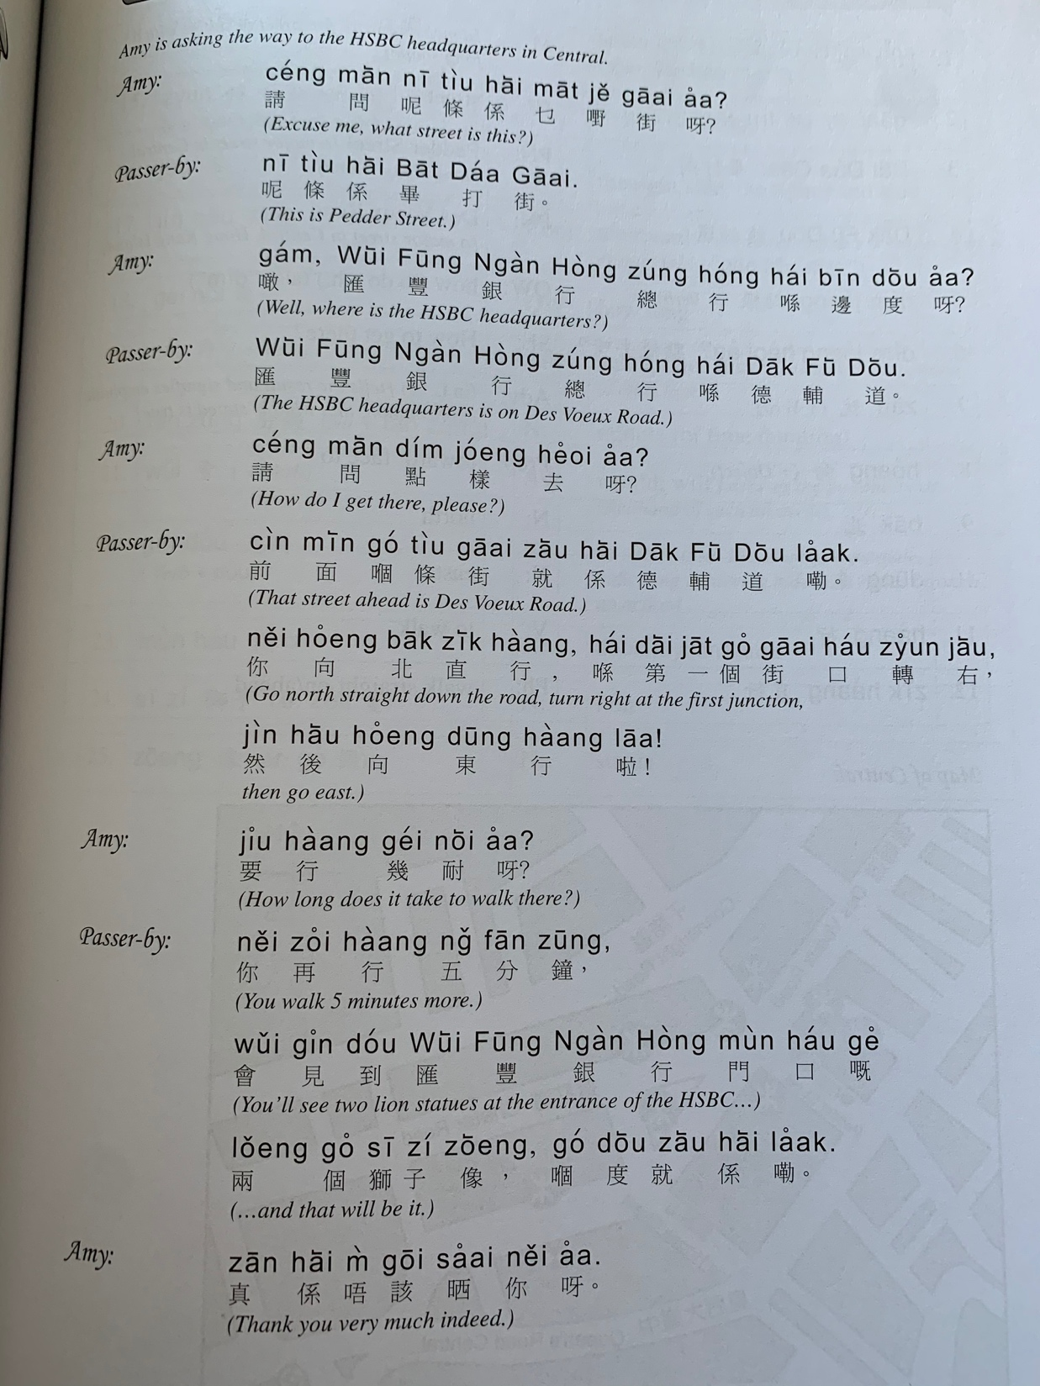

Slide 10
Translate the following into past and future tense.
My friend goes to work on Saturday
On Friday I go to school
On Sunday I stay （留喺 lau4 hai2 ）at home
We go to the cinema in the weekend
I get up at 7am
I read in the morning
He cooks dinner
She studies in the afternoon
On Friday night I watch TV （睇電視 tai2 din6 si6）
I go to buy groceries （買餸 maai5 sung3） in the supermarket
I go to have dinner with friends
I go to concerts （演唱會 jin2 coeng3 wui2 / 音樂會 jam1 ngok6 wui2）in the summer （夏天haa6 tin1）

Slide 11
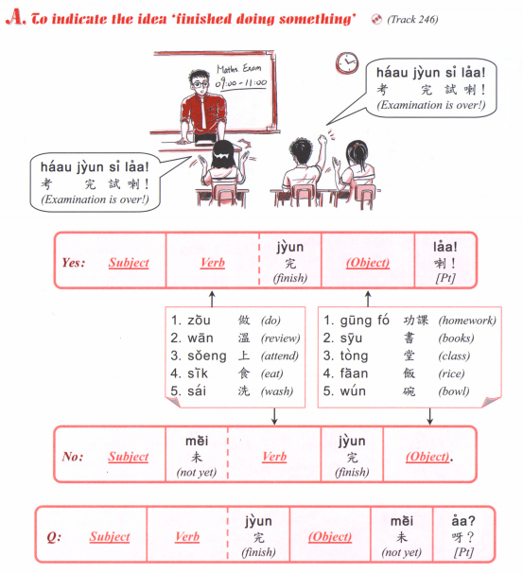

Slide 12
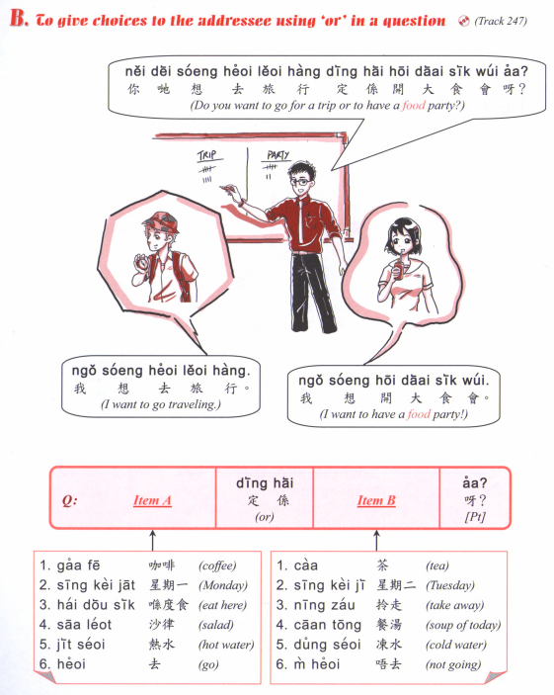

Slide 13
Think of 3 questions using ding6 hai6

Slide 14
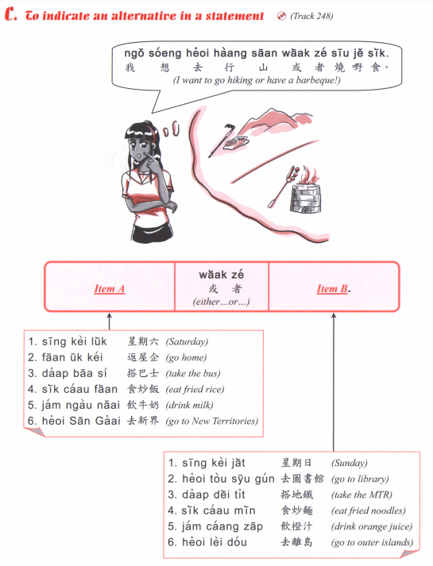

Slide 15
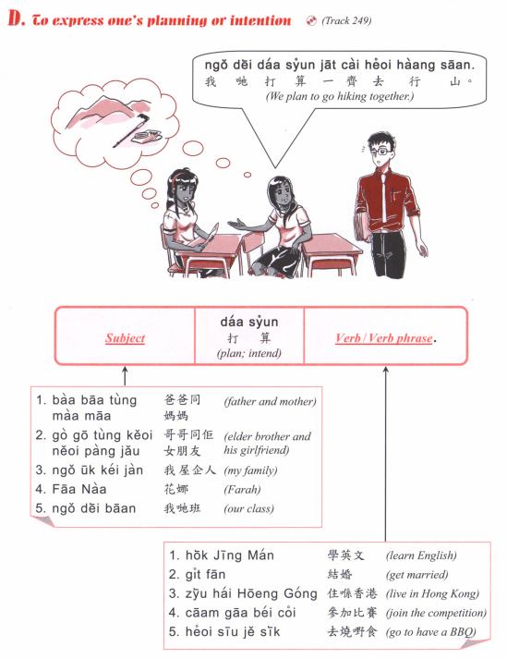

Slide 16
What do you plan to have for dinner?
What do you plan to do in the weekend?
What do you plan to do after graduation (bat1 jip6)?
Answer with waak6 ze2

Slide 17
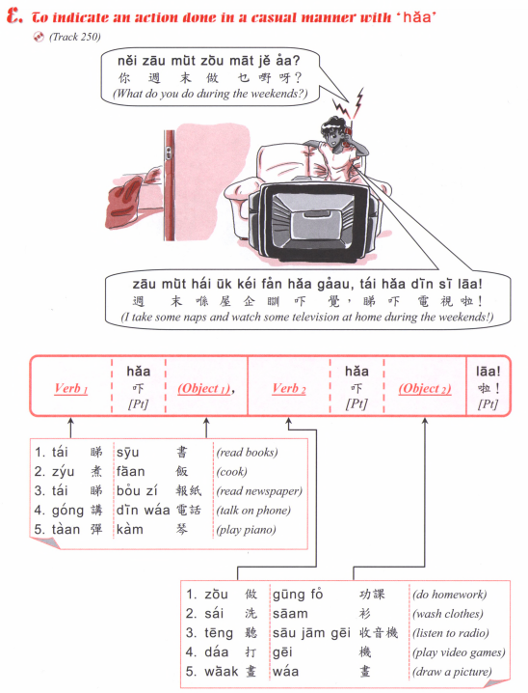

Slide 18
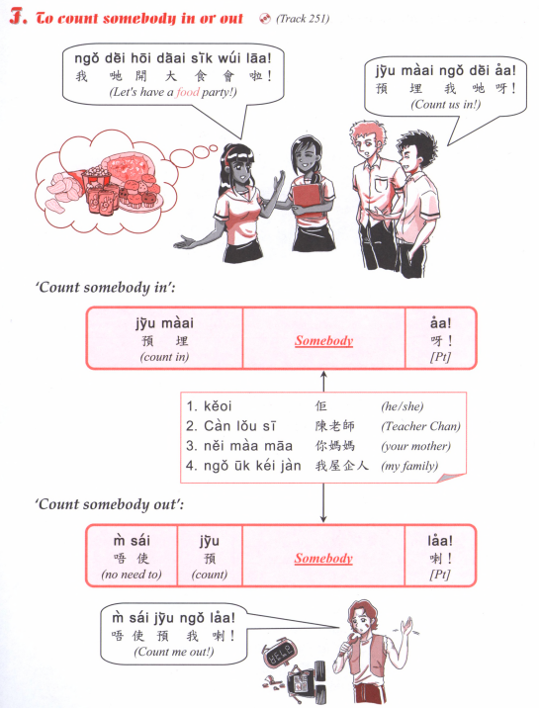

Slide 19
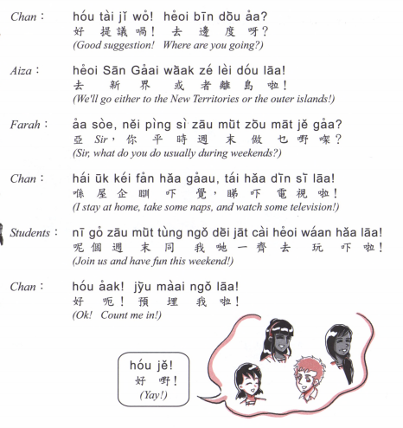
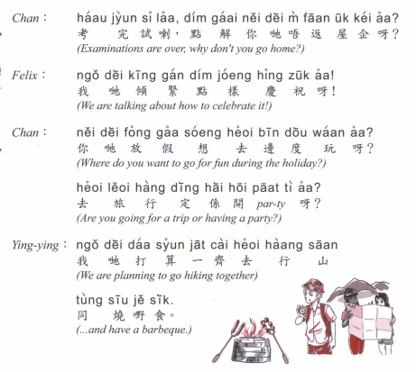
同埋 tung4 mai4

Slide 20
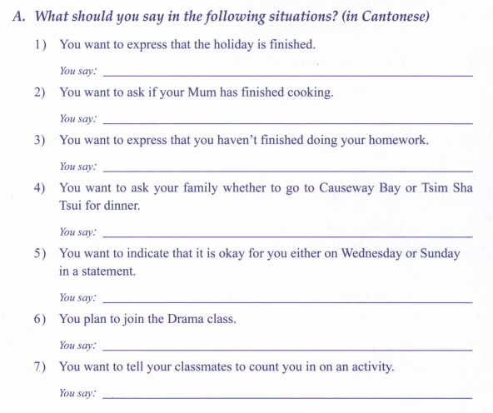
話/戲劇班 waa2/hei3 kek6 baan1

Slide 21
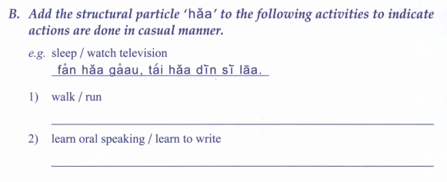
haang4 lou6 / paau2 bou6
wui6 waa2 / syu1 se2
Maai5 saam1 / tai2 hei3
coeng3 go1 / tiu3 mou5

Slide 23
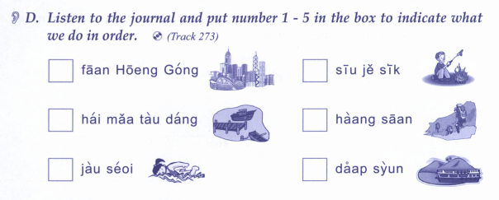

Slide 24
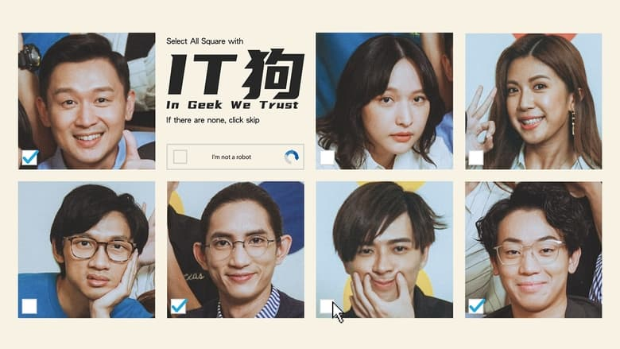
Cantonese TV series - IT gau2
https://dramacool.pk/episodes/in-geek-we-trust-2022-episode-1/

