Slide 1
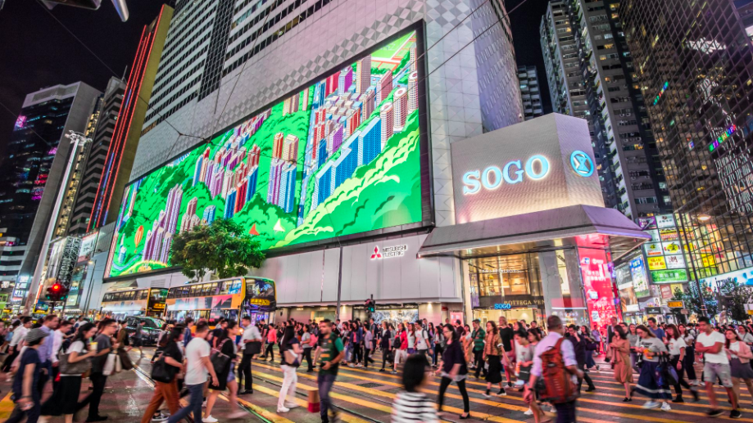
Cantonese II
Week 4

Slide 2
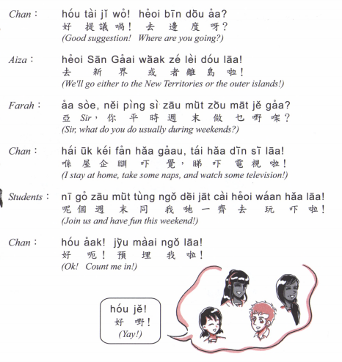
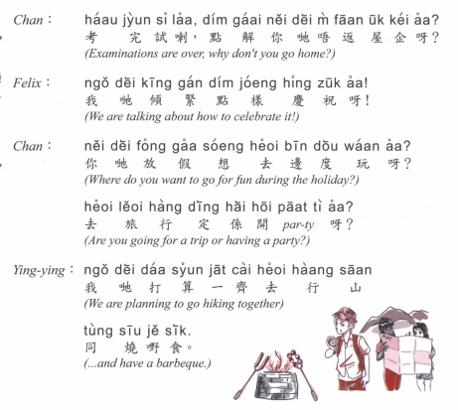

Slide 3
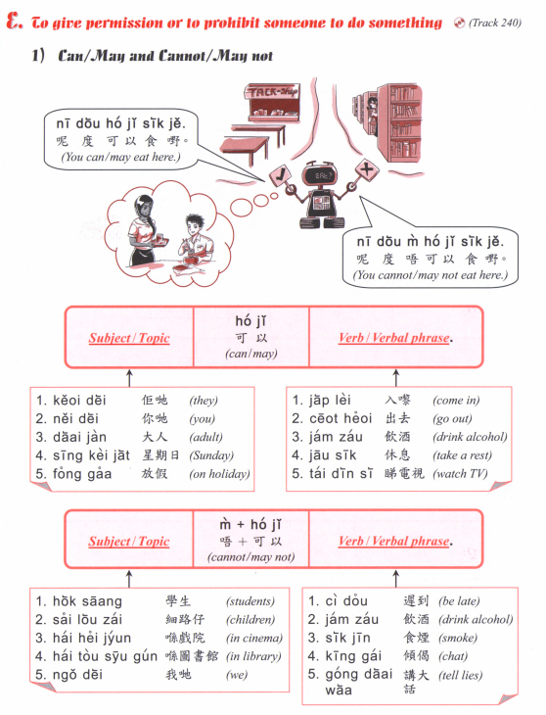

Slide 4
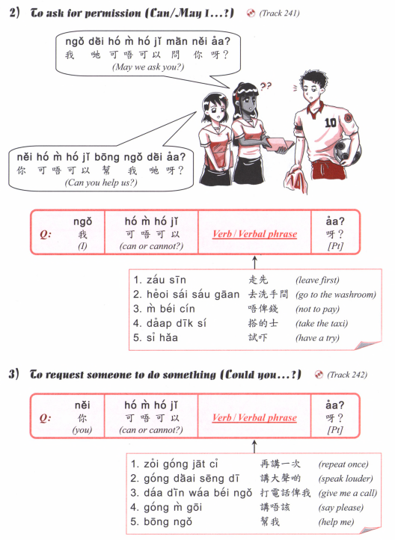

Slide 5
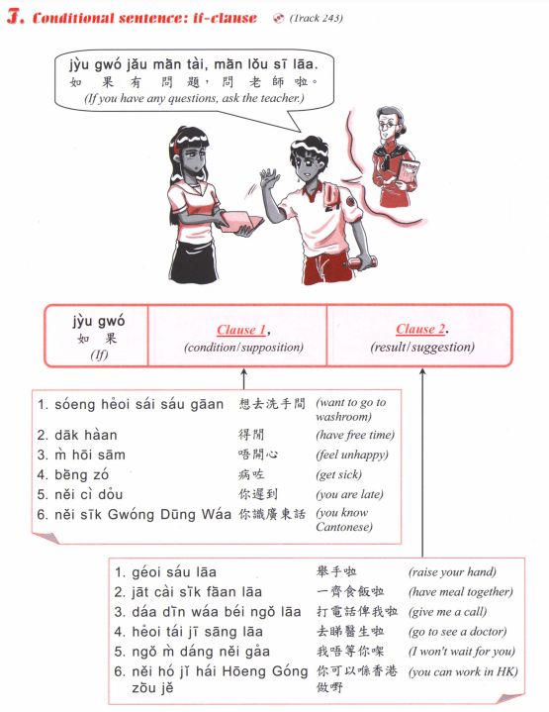

Slide 6
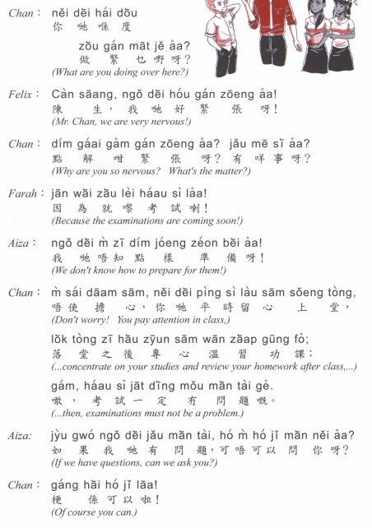

Slide 7
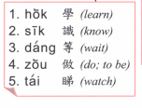
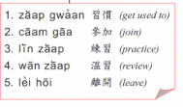
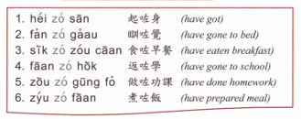
maai5 ye5 | 買嘢 | shopping
maai5 sung3 | 買餸 | Grocery shopping
haang4 gaai1 | 行街 | Window shopping
tai2 hei3 | 睇戲 | Watch movies
Coeng3 K | 唱K | Sing karaoke
daa2 gei1 | 打機 | Play video games
teng1 go1 / ting1 jam1 ngok6 | 聽歌/聽音樂 | Listen to music

Slide 8
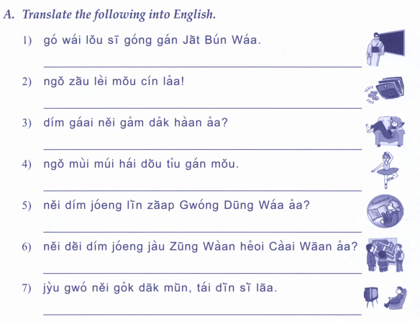

Slide 10
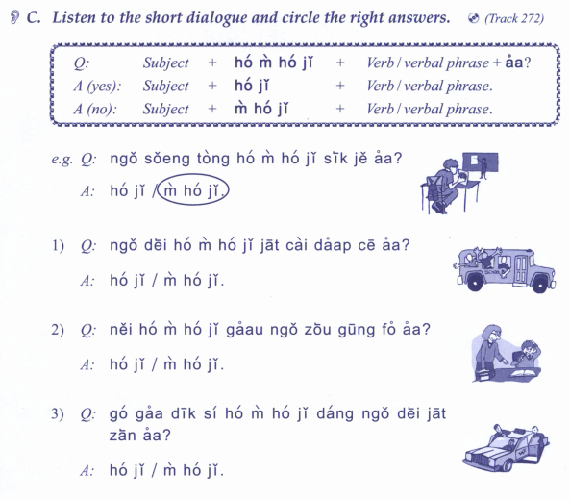
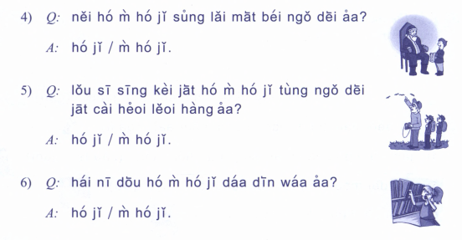

Slide 11
Express the followings in Cantonese:
If you don’t go, I won’t go either
I have to go to work soon
You can go to watch movie with me
Can I leave early （zou2 早）?
If there is traffic jam （sak1 ce1 塞車）, I can take the metro (daap3 dei6 tit3 搭地鐵）
I can help （bong1 幫）you to prepare dinner
I must get up at 6am tomorrow
She is very focused in studying for her exam
He is worried about the war （daa2 zoeng6 打仗）

Slide 12
Express the followings in Cantonese:
Ask your friend if you can eat with them
Ask the teacher if you can go to the toilet (sai2 sau2 gaan1洗手間）
Tell your friend that you are busy，don’t count you in
Tell your friend you are worried about something
Reassure your friend that everything will be alright
Ask for help

Slide 13
Discuss where to go for the weekend with your friends
Propose a time, one friend can’t make it, propose a new time
Propose what to do, ask if they like it
One friend wants to do something else (explain why

Slide 14
New textbook: Basic Cantonese A Grammar and Workbook
Yale romanization of Cantonese
Limitation: unable to describe all vowels being used in Cantonese

Slide 15
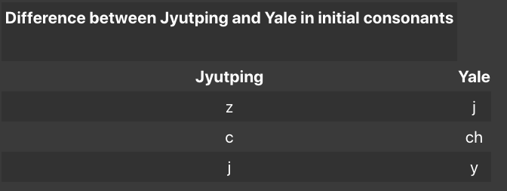
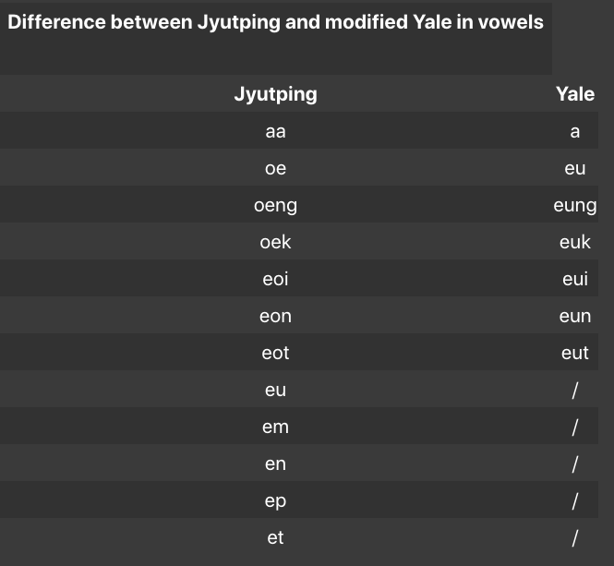
https://hongkongvision.com/tool/cc_py_conv_zh

Slide 16
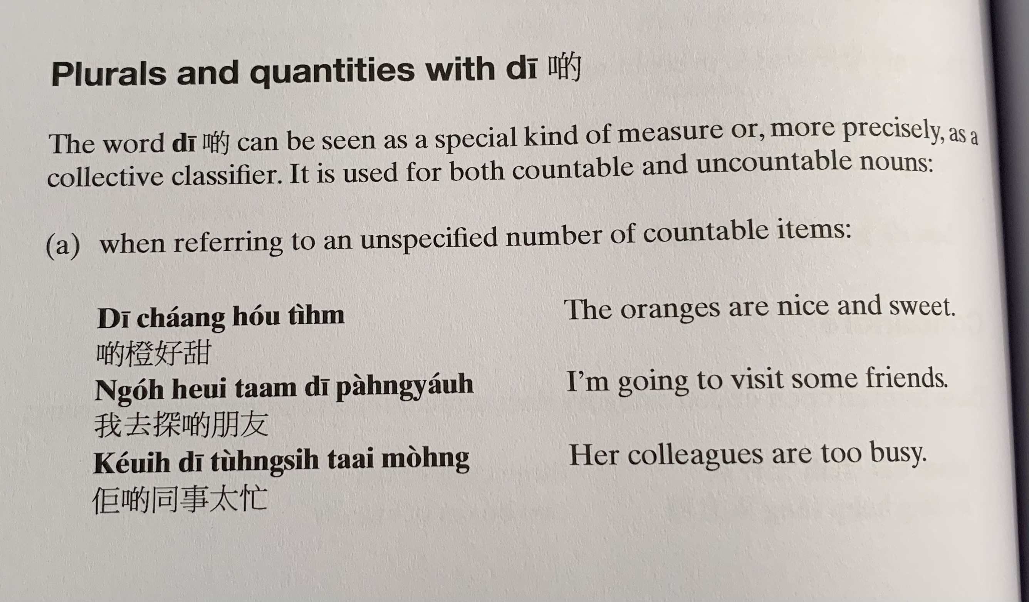
Di1 caang2 hou2 tim4
Ngo5 heoi3 taam3 di1 pang4 jau5
Keoi5 di1 tung4 si6 taai3 mong4

Slide 17
Di1 seoi2 m4 gau3 jit6
Ngo5 jiu3 maai5 di1 sin1 naai5
Nei5 di1 caa4 hou2 hoeng1

Slide 18
Gaa3
ce1
Gin6
Jat1 go3 ji1 sang1
Go3
Ni1 go3 kyut3 ding6
Jat1 go3 mung6
Zek3
Zek3 gau2
Jat1 zek3 sau2
jat1 faai3 geng3
jat1 fuk1 waa2
zoeng1
jat1 zoeng1 toi2
zi1
zi1 bat1
jat1 lap1 tong2
tiu4
tiu4 lou6

Slide 19
gin6 saam1 hou2 gwai3
gaa3 ce1 zau2 zo2
go3 wai6 hou2 tung3
keoi5 maai5 zo2 gin6 saam1
ngo5 gam1 jat6 tai2 zo2 bun2 syu1
keoi5 dei6 hoi1 zo2 go3 wu6 hau2

Slide 20
hung4 zau2
dip6
caau2 min6
wun2
faan6
deoi3
faai3 zi2
zeon1
seoi2
caan1 paai2
zau2 bui1
Zek3
wu4
jit6 seoi2
gin6
daan6 gou1
gaa3 fe1

