Slide 1
Yery Kim
Myeng wha Kim
Korean class week 2

Slide 2
Index
Grammar
Informal/polite expression
Basic grammar
Demonstrative pronouns
Postpositional Particles
2. Today’s conversation
3. Today’s word / expression
4. Korean culture

Slide 3
1. Informal/polite expression
I Informal/polite
ex) I’m drinking water
나는 물을 마시고 있어. [ Na-neun mul-eul masigo iss-eo]
저는 물을 마시고 있어요. [Jeo-neun mul-eul masigo iss-eoyo]

Slide 4
1. Informal/polite expression
My Informal/polite
ex) My hobby is jogging.
나의 취미는 조깅이야. [ Na-ui chwimineun jogging-iya ]
저의 (제) 취미는 조깅이에요. [ Jeo-ui chwimineun jogging-ieyo ]

Slide 5
1. Informal/polite expression
Me Informal/polite
ex) Please give it to me.
그것을 나에게 줘 [ Geu-geot-eul na-e-ge gwo ]
그것을 저에게 주세요 [ Geu-geot-eul jeo-e-ge ju-sae-yo ]

Slide 6
1. Informal/polite expression
You Informal/polite
ex) You are pretty
너는 예쁘다 [ Neo-neun yae-bbeu-da ]
당신은 예뻐요 [ Dang-sin-eun yae-bbeo-yo ]

Slide 7
2. Basic grammar
Be – Verb
Am , Are , Is
~다 / ~이다 [ da / I –da]
ex)
뷔는 밥을 먹는다 -V is eating a rice [V neun bab-eul meong-neun-da]
지민이는 천재이다- Jimin is a genius [Jimin-ineun cheonjae-ida]
제니는 공주이다-Jenny is a princess [Jenny neun gongju-ida]
Most Korean sentences end with '다' [da]
However, when you want to change a noun to a descriptive word, you can add ‘이다’ [I-da]

Slide 8
2. Basic grammar
Korean have a different word order from English
나는 초콜렛을 좋아한다.
I like chocolate
[ naneun chokolles-eul joh-ahanda ]

Slide 9
2. Basic grammar
Korean have a different word order from English
내 이름은 예리입니다.
My name is Yeri
[Nae ileumeun yeri ibnida]

Slide 10
2. Basic grammar
Korean have a different word order from English
나는 치킨을 먹었다.
I ate chicken
[naneun chikin-eul meog-eoss-da]

Slide 11
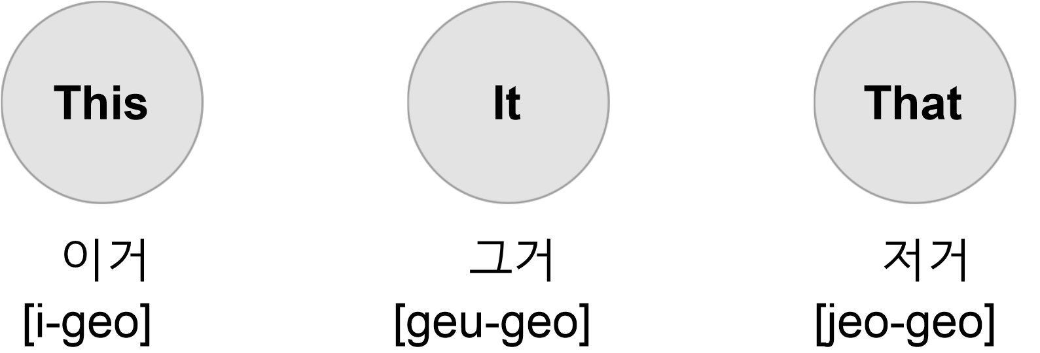
3. Demonstrative pronouns

Slide 12
3. Demonstrative pronouns
What is this?
:이거(는) 뭐예요? ( i-geo (neun)-mwo-ye-yo?)
What is it?
:그거(는) 뭐예요? (geu-geo(neun) mwo-ye-yo?)
What is that?
저거(는) 뭐예요? (jeo-geo (neun) mwo-ye-yo?)
This is ~
:이건 ~ 예요 ( i-geon ~ ye-yo)
* 이거는 [i-geo-neun] = 이건 [i-geon]
는[neun] is the postposition to make subjective

Slide 13
4. Postpositional Particles
은[eun]
는[neun]s[
이[i]
가[ga]
Topic making particle
Subject making particle
Ending in a
Consonant
Ending in a
Vowel

Slide 14
Postpositional Particles
이것은 이것이 This is
저것은 저것이 That is
Ends with consonant – 은 [eun] / 이 [i]

Slide 15
Postpositional Particles
저는 제가 I’m (Formal)
나는 내가 I’m (Informal)
Ends with vowel – 는 [neun] / 가 [ga]

Slide 16
Postpositional Particles
General fact
2. Introducing yourself
3. Show the contrast or the opposite
은 / 는 [eun/neun]

Slide 17
1. General fact

Slide 18
2. Introducing something
I’m Yeri
저는 예리에요 [jeo-neun yeri-eyo]
2. I’m a student
저는 학생이에요 [jeo-neun hak-saeng-ieyo]
3. This is my mother
이쪽은 저의(제) 어머니(엄마)예요 [ijjogeun jeoheui eomeoni-yeyo]

Slide 19
3. Show the contract or opposite
1. Do you like animals?
동물 좋아해요? [dongmul joh-ah haeyo]?
I only like cats. (= I hate animals but I like cats.)
고양이는 좋아해요[goyang-i neun joh-a haeyo]
2. Are you able to eat seafoods?
해물 먹을 수 있어요? [haemul meog-eul su iss-eo yo?]
I only eat shrimps. (=I can’t eat seafoods but shrimps.)
새우는 먹어요 [saeu neun meog-eo yo]

Slide 20
3. Show the contract or opposite
3. I want to go Itaewon today
오늘 이태원 가고 싶어. [oneul itaewon gago sip-eo]
(But) I want to go to Gangnam today
(그런데) 나는 오늘 강남에 가고 싶어. [(geuleondae) naneun oneul gangnam-e gago sip-eo]
(=Implies the meaning that I don’t want to go Itaewon today)
4. Do you like idols?
너는 아이돌 좋아해? [neo idol joh-a hae?]
I only like BTS (= I don’t like idols but I like BTS)
나는 BTS는 좋아해 [naneun BTS neun joh-a hae]

Slide 21
Postpositional Particles
subject + 이/가
1.Observe or describe something
2. Emphasize the subject
이 / 가

Slide 22
1. Observe or describe something
Observe something
1 . The apple is red
사과가 빨갛다 [sa-gwaga ppal-gah-da]
2. You have many luggage (+ I will help you)
짐이 많으시네요 [jimi maneu shineyo]
(+제가 도와드릴게요) [jega dowadeulil-geyo]

Slide 23
Postpositional Particles
Describe something
1. The bag is heavy
가방이 무겁다 [gabang-I mugeob-da]
2. The water is cold
물이 차갑다 [mul-I chagab-da]
3. The dog is cute
강아지가 귀엽다 [gang-aji-ga gwiyeob-da]

Slide 24
2. Emphasize the subject
Who ate it all?
이거 누가 다 먹었어? [igeo nuga da meogeosseo?]
I ate it all (= I’m the one who ate it all)
제가 다 먹었어요 [jega da meogeo-sseoyo]
2. Which one is pretty?
어떤 것이 예쁘니? [eotteon geos-I yeppeuni?]
This bag is pretty
이 가방이 예뻐요 [I gabang-I yeppeoyo]
1) General function (delivery of what you feel)
oh, your bag is pretty
2) Special Function Emphasizing the subject
what’s pretty is your bag (not shoes or something else)

Slide 25
2. Emphasize the subject
2. Cheetah is slow
치타가 느리네요 [chitaga neurineyo]
You’re observing cheetahs and you’re talking about that right in that moment
If you say 치타 “는“ 느리네요 [chi-ta- NEUN neu-ri-ne-yo]
-> It sounds more like a general fact or a contrast
( Cheetahs are slow or ONLY that cheetah is slow)
But, If you say 치타 “가“ 느리네요 [chi-ta-GA neu-ri-ne-yo]
-> It means the cheetah you know THE ONE you’re watching, is slow

Slide 26
Postpositional Particles
Question 1
YERI likes swimming but not other sports
수영은[eun] 좋아한다
수영이[i] 좋아한다
Question 2
The cheetah over there is slow (watching now)
치타는[neun] 느리다
치타가[ga] 느리다
Question 3
You are not an animal, you are a human
너는 동물[이/ ] 아니고 사람이야
은

Slide 27
Today’s conversation
Yeri : Hi, Did you eat something?
안녕, 너 밥은 먹었어?
[ An-nyeong, neo bab-en meog-eoss-eo?]
Jimin : No, I am hungry
아니, 나 배고파
[Ani, na bae-go-pa]

Slide 28
Today’s conversation
Yeri : Me, too. Let’s eat dinner together.
나도. 같이 저녁 먹자
[Nado. get-i jeo-nyeog meog-ja]
Jimin : What do you want to eat?
뭐 먹고 싶어?
[mwo meog-go sip-eo?]
Yeri : I want to eat ___불고기___
나는 __불고기___ 먹고싶어
[Na-neun __Bulgogi__ meog-go sip-eo]

Slide 29
Today’s expression
Thank you for the meal (=Bon appetit)
잘 먹겠습니다
[Jal meog-ges-sseub-ni-da]
I really enjoyed the meal
잘 먹었습니다
[Jal meog-eos-sseub-ni-da]
cheers
건배 / 짠
[gepnbae / jjan]

Slide 30
Today’s word
Love = 사랑 [sa-rang]
Movie = 영화 [young-hwa]
Cooking = 요리 [yo-ri]
Today = 오늘 [o-neul]
Tomorrow = 내일 [nae-il]
Yesterday = 어제 [eo-jae]
Do not know = 모른다 [mo-reun-da]
Study = 공부하다[gong-bu-ha-da]
Exercise = 운동하다 [un-dong-ha-da]
Sing = 노래하다 [no-rae-ha-da]
Laugh = 웃다 [ut-da]
Cry = 울다 [ul- da]

Slide 31
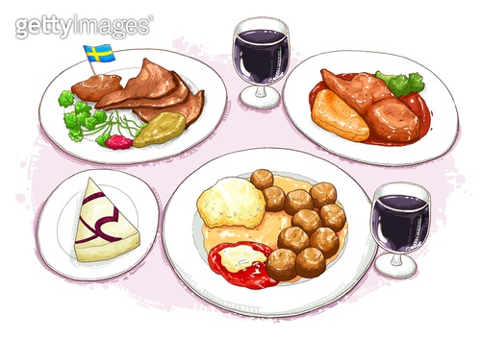
Today’s word
Food
Water - 물 [ mul ]
Rice - 밥 [ bab ]
Plate - 접시 [ jeobsi ]
Cup - 컵 [ cub ]
Spoon - 숟가락 [ sud-ga-lag ]
Chopstick - 젓가락 [ jeod-ga-lag ]
Fork - 포크 [ pokeu ]
Knife - 칼 /나이프 [ kal / nife ]

Slide 32
Korean Culture

Slide 33
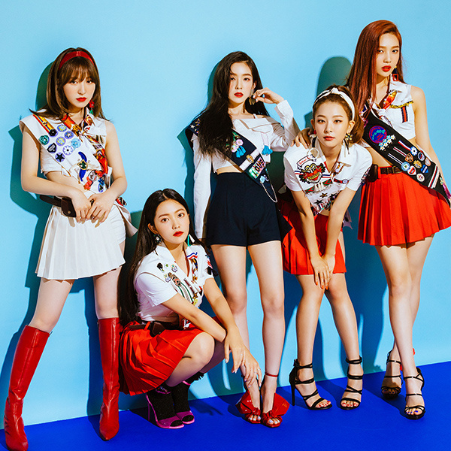
Today’s K-pop
https://www.youtube.com/watch?v=wr7UtYDG7Jo
Red Velvet – Dumb Dumb
https://www.youtube.com/watch?v=wr7UtYDG7Jo

