Slide 1

K
O
R
E
A
N
C
L
A
S
S
WEEK 2
YERI KIM & MYENG WHA KIM

Slide 2

TODAY’S INDEX
01. Review (consonants & vowels)
02. Batchim
03. Basic words / sentences
04. Informal/polite expression
05. Korean culture(food)

Slide 3

Introduction
Yeri Kim
Born in Seoul, Living in Seoul
Student of Sungshin Women’s University
Exchange student in Masaryk university
Studying in Faculty of Sports

Slide 4

Introduction
Myengwha Kim(김명화)
Living in Incheon
Student of Kangwon National
University
Exchange student in Masaryk
university
Studying in Faculty of Economics

Slide 5

01. Review

Slide 6
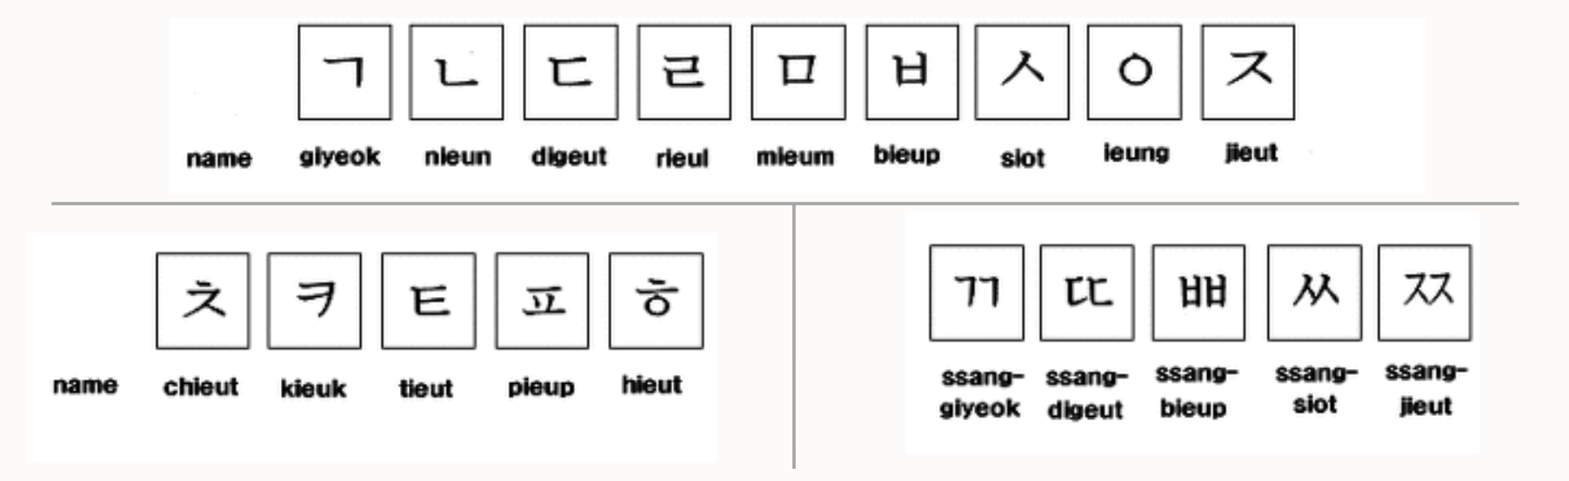
Let’s review!
Consonants [자음:ja eum] (19)

Slide 7
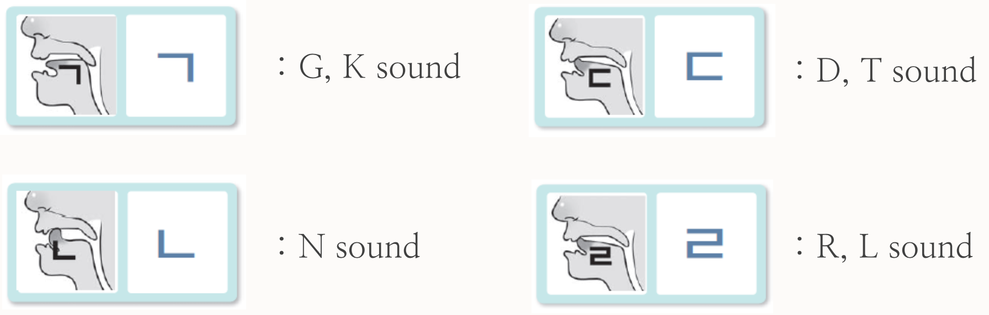
Let’s review!
Consonants

Slide 8
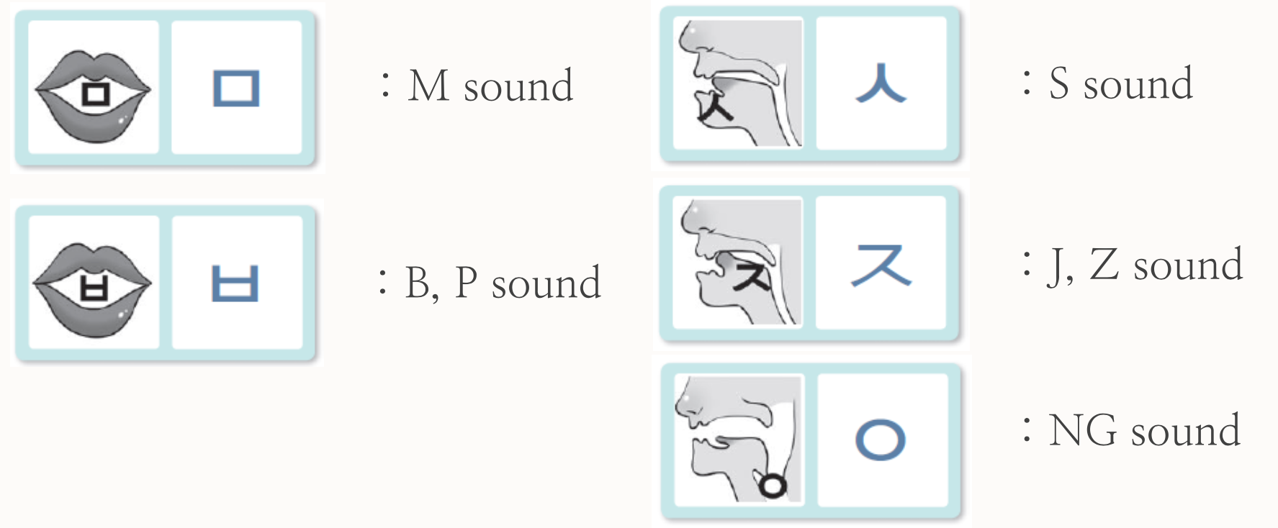
Let’s review!
Consonants

Slide 9
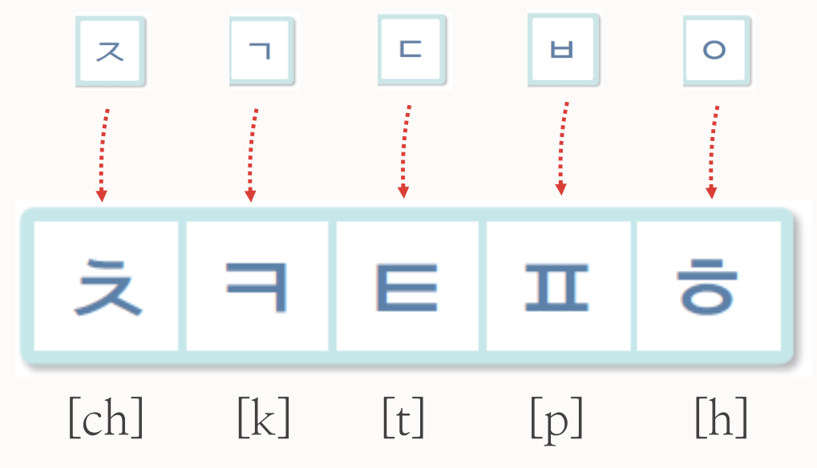
Let’s review!
Consonants
These consonants let out a lor of air when pronounced

Slide 10
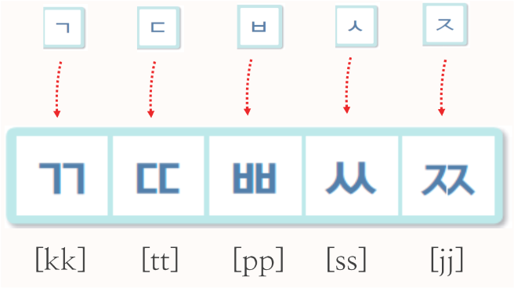
Let’s review!
Consonants
Let’s learn how to write and make sounds of 쌍자음 [ssang:jaeum]
These consonants let out no air when pronounced

Slide 11
Let’s review!
Consonants
ㄱ
ㄴ
ㄷ
ㄹ
ㅁ
Name
Sound
giyeok
[G/K]
nieun
[N]
digeut
[D/T]
rieul
[R/L]
mieum
[M]
ㅂ
ㅅ
ㅇ
ㅈ
Name
Sound
bieup
[B/P]
siot
[S]
ieung
[NG]
Jieut
[J/Z]

Slide 12
Let’s review!
Consonants
ㅊ
ㅋ
ㅌ
ㅍ
ㅎ
Name
Sound
chieut
[CH]
kieuk
[K]
tieut
[T]
pieup
[P]
hieut
[H]
ㄲ
ㄸ
ㅃ
ㅆ
ㅉ
Name
Sound
ssanag- giyeok
[KK]
ssanag- digeut
[TT]
ssanag- bieup
[PP]
ssanag- siot
[SS]
ssanag- jieut
[JJ]

Slide 13
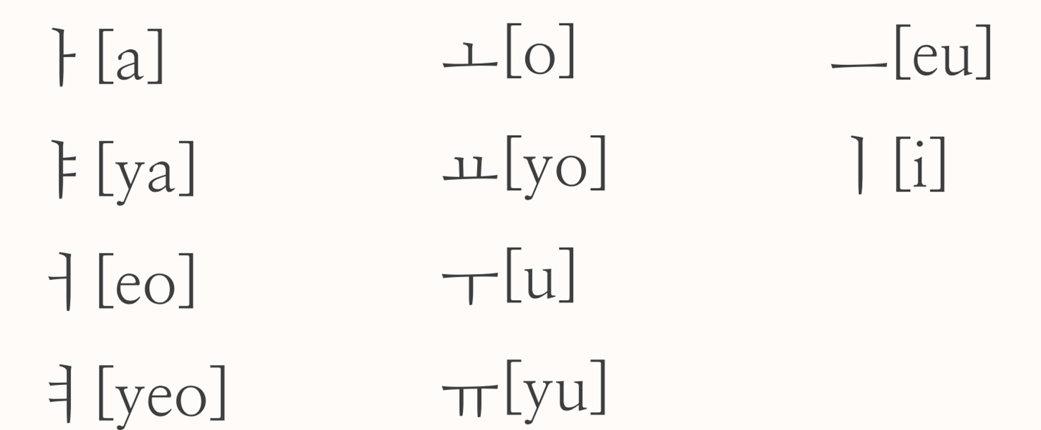
Let’s review!
Vowels [모음:mo eum] (21)
Basic Vowels

Slide 14

Let’s review!
Combined vowels

Slide 15
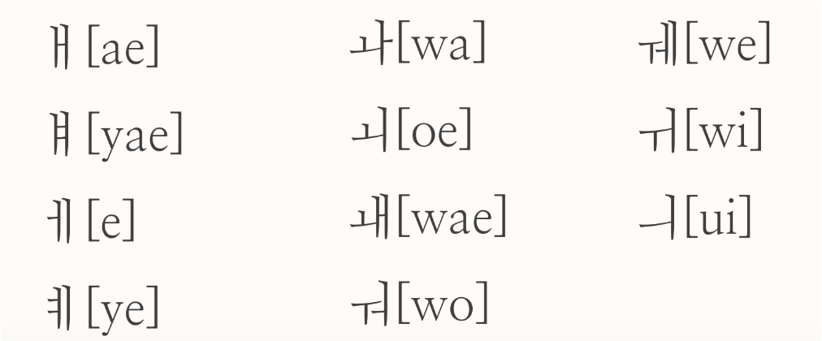
Let’s review!
Vowels [모음:mo eum] (21)

Slide 16
02. 받침 Batchim

Slide 17
About 받침(Batchim)
There are 4 ways to make Korean words
consonant
consonant
vowel
가, 너
소, 무
vowel
consonant
consonant
vowel
달, 별
꽃, 춤
vowel
consonant
Batchim
consonant

Slide 18
About 받침(Batchim)
Batchim’s pronunciation
Consonant base | Pronounciation | example
ㄱ, ㅋ, ㄲ | [ㄱ] G/K | 책[책] : Book-[Chaek], 부엌[부억] : Kitchen-[Bueok], 밖[박] : outside-[bak]
ㄴ | [ㄴ] N | 산[산] : Mountaion-{san]
ㄷ, ㅅ, ㅆ, ㅈ, ㅊ, ㅌ, ㅎ | [ㄷ] D/T | 낮[낫] : Daytime-[nat], 꽃[꼿] : Flower-[ggot],
ㄹ | [ㄹ] R/L | 길[길] : Road-[Gil], 달[달] : Moon-[dal]
ㅁ | [ㅁ] M | 몸[몸] : Body-{mom]
ㅂ, ㅍ | [ㅂ] B/P | 밥[밥] : Rice-[bap], 숲[숩] : Forest-[soop]
ㅇ | [ㅇ] NG | 강[강] : River-[gang]

Slide 19
About 받침(Batchim)
Plus
Can you see the difference between them?
ㅏ, ㅑ, ㅓ, ㅕ
ㅣ, ㅒ, ㅖ
ㅗ, ㅛ, ㅜ, ㅠ, ㅡ
consonant
consonant
vowel
On the downside of consonant
On the right side of consonant
vowel
consonant
consonant

Slide 20
03. Basic words / sentences
/ dialogue

Slide 21
Basic sentences
Hi / Hello
안녕하세요 [an-nyeong-ha-se-yo]
안녕 [an-nyeong]
Bye
안녕히 계세요 [an-nyeong-hi-gye-se-yo]
잘가 [jal-ga]

Slide 22
Basic sentences
Thank you
감사합니다 [gam-sa-hap-ni-da]
고맙습니다 [go-map-seup-ni-da]
고마워 [go-ma-wo]
Sorry
미안합니다 [mi-an-hap-ni-da]
죄송합니다 [joe-song-hap-ni-da]
미안(해) [mi-an-(hae)]

Slide 23
Basic sentences
Nice to meet you
만나서 반갑습니다/반가워
[man-na-seo
ban-gap-seup-ni-da/ ban-ga-wo]

Slide 24
Basic sentences
What’s your name
이름이 뭐예요?
[i-reum-i mwo-ye-yo?]
My name is ~
제(내) 이름은 ~ 입니다
[je-i-reum-eun ~ ip-ni-da]

Slide 25
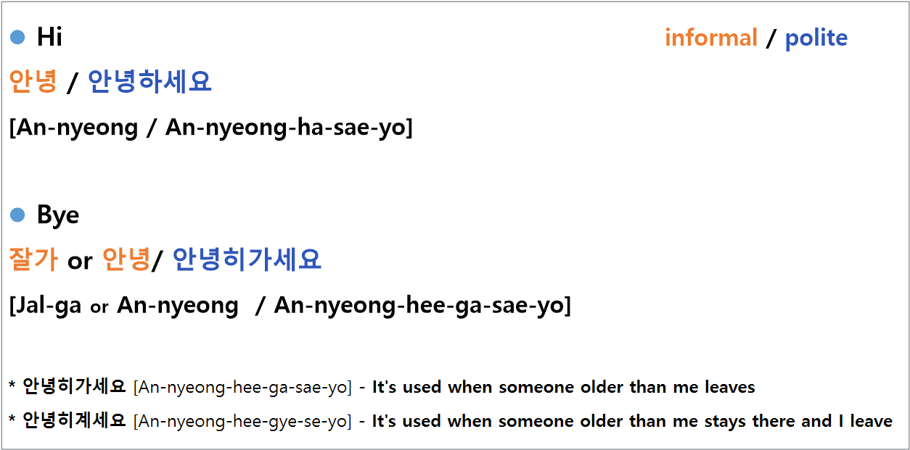
1. Informal/polite expression

Slide 26
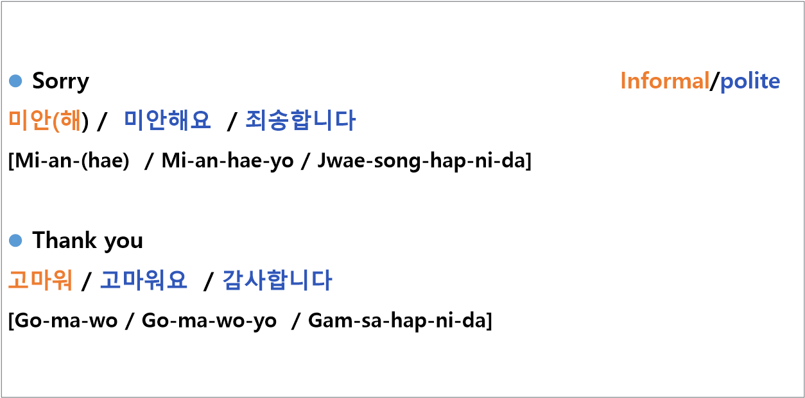
1. Informal/polite expression

Slide 27
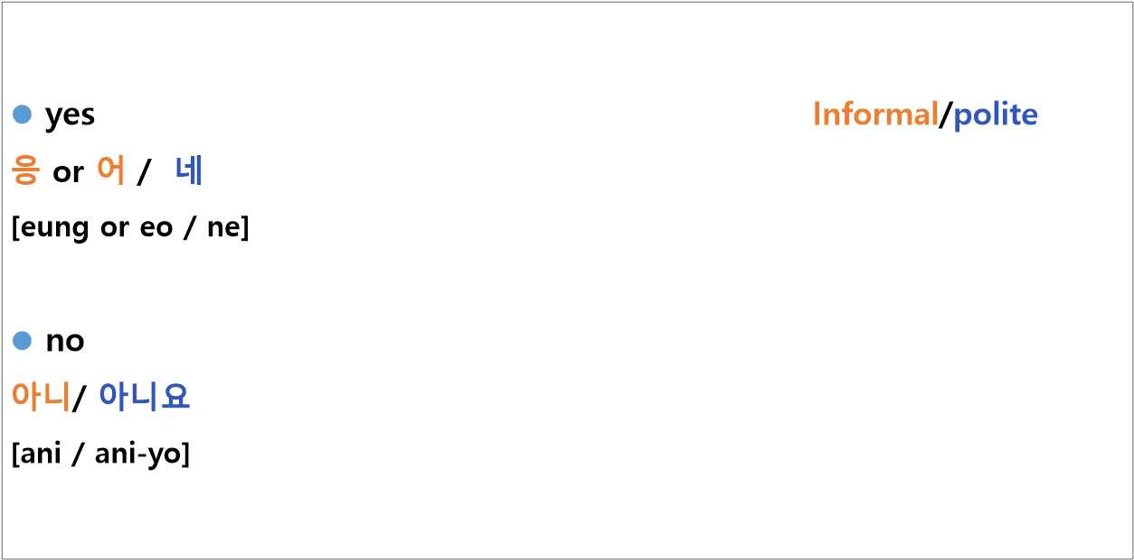
1. Informal/polite expression

Slide 28
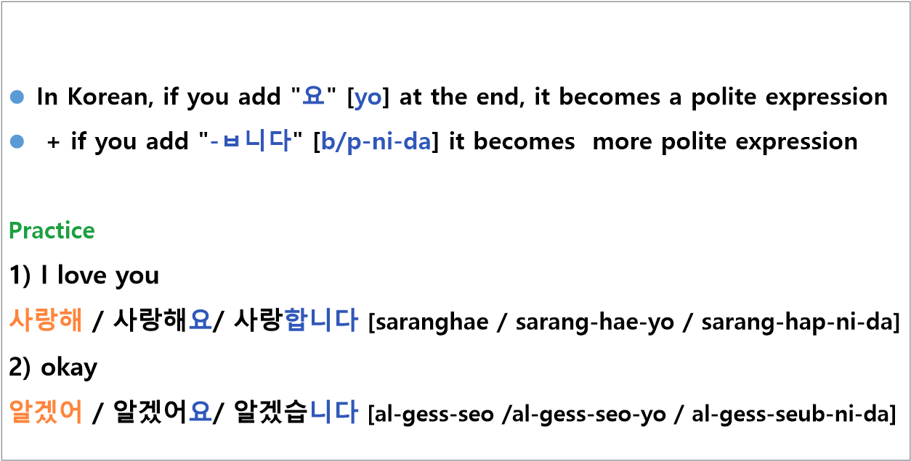
1. Informal/polite expression

Slide 29
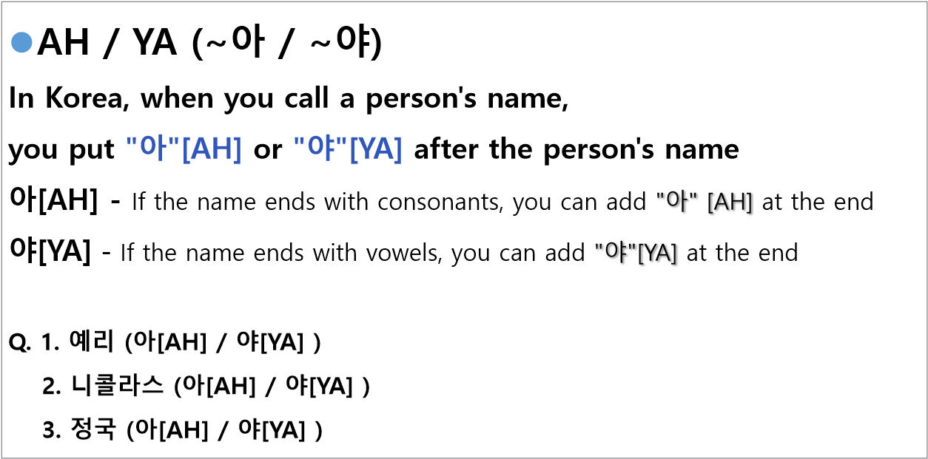
1. Informal/polite expression

Slide 30


Basic words - family
Mom - 엄마 [eom-ma]
Dad - 아빠 [a-ppa]
Parents – 부모님 [bu-mo-nim]
Older sister - 누나/언니 [nu-na / eon-ni]
Older brother - 형/오빠 [hyeong /o-ppa ]
Family - 가족 [ga-jok]

Slide 31


Basic words - school
Class - 수업 [su-eop]
Classroom - 교실 [gyo-sil]
Assignment - 과제 [gwa-je]
Professor - 교수님 [gyo-su-nim]
Friend - 친구 [chin-gu]
Study - 공부 [gong-bu]

Slide 32
04. Korean culture
(Delivery food)

Slide 33
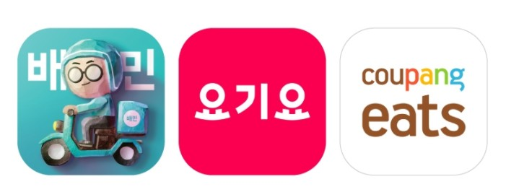
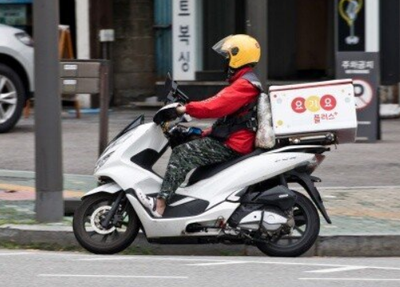
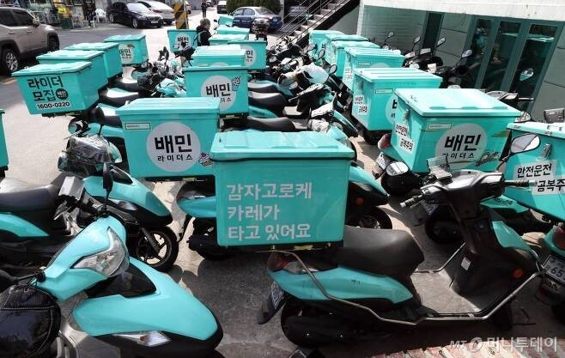
K-food
Introduction of Food Delivery in Korea
The meal I ate in the Korea
Notes:
Similar to Czech republics delivery food for example uber eats, wolt and etc Korea has its own delivery service. The three most famous is 배달의 민족, 요기요, 쿠팡 잇츠
The most basic way for them to deliver is by a motorcycle. Which in cezch, a lot of delivery is made by bikes.

Slide 34
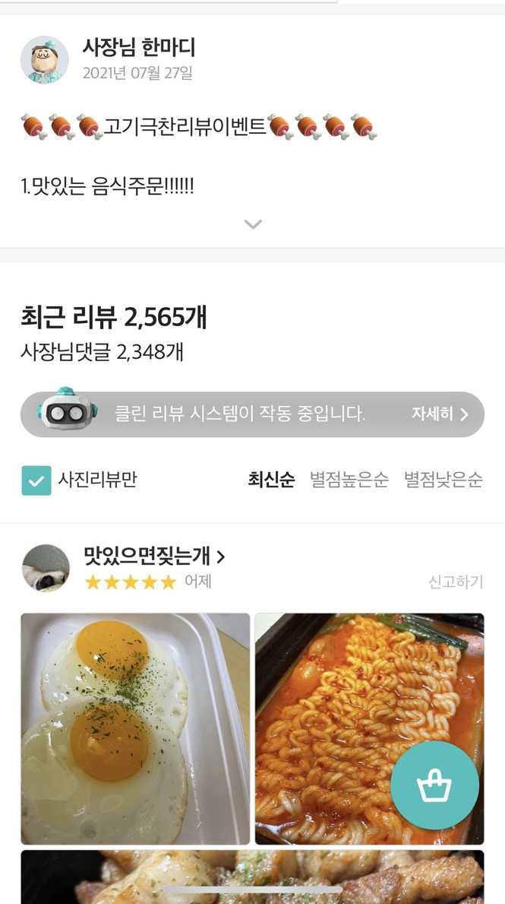
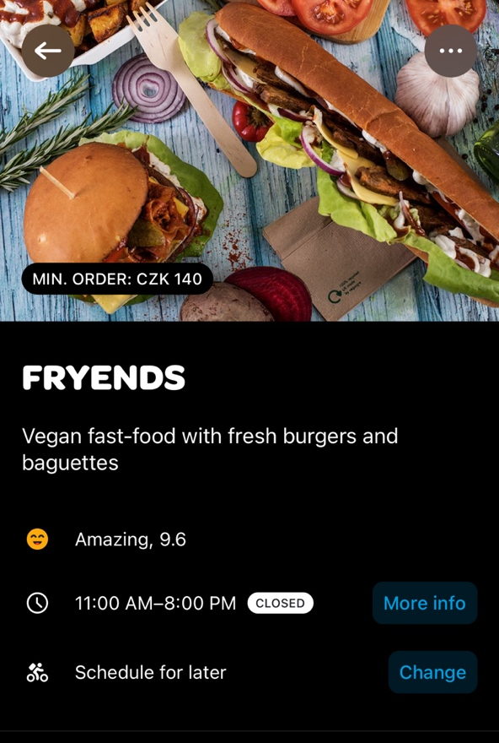
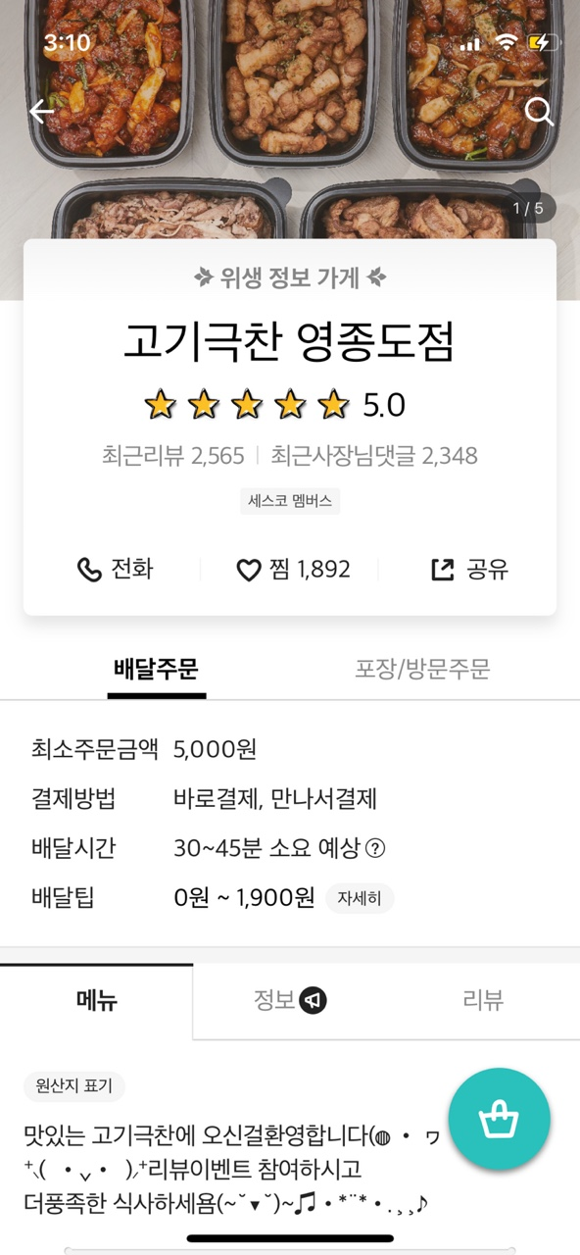
K-food
Introduction of Food Delivery in Korea
Notes:
We can check how the delivery sites differ in Korea and czech.
In the wolt app we can check the rates and see if the restaurant is good or bad. But In Korea, the reviews of previous orders are one of the most important things we look at before ordering some food.
So, if a restaurant has a lot of reviews you can tell that the place is popular. to get more reviews and to get a nicer review, the restaurant owners often puts on a review event. The review event is something that the restaurant gives out for free, something like a side dish such as fries or cheese sticks etc if the customers promises to write a review. But, sometimes few people lie about the participation and take the advantage of it without keeping the promise. But those are only few people and most of the participaters take nice photos of the food and posts it so other people can take a look at the actual image of the food and make dicisions.

Slide 35
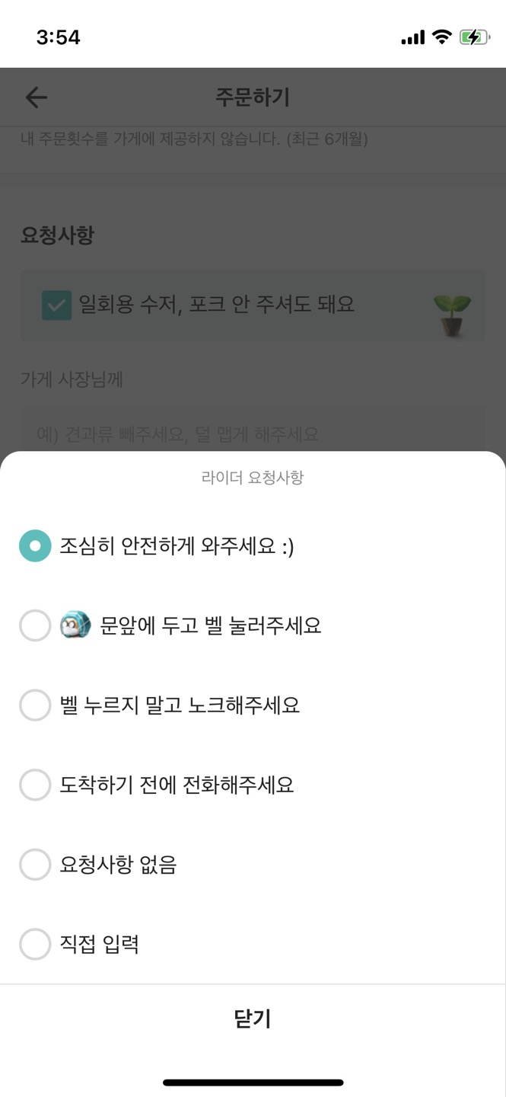
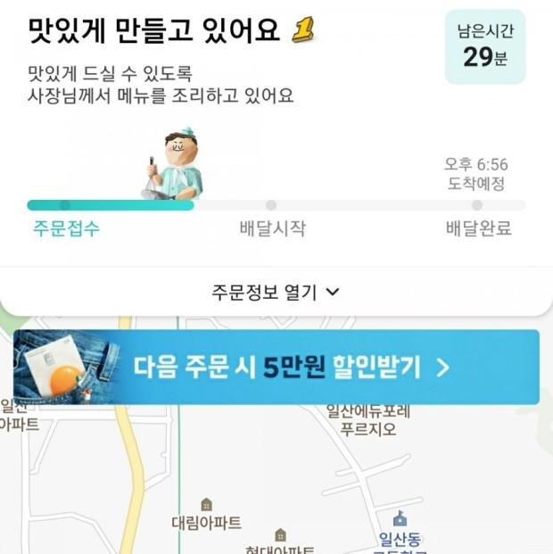
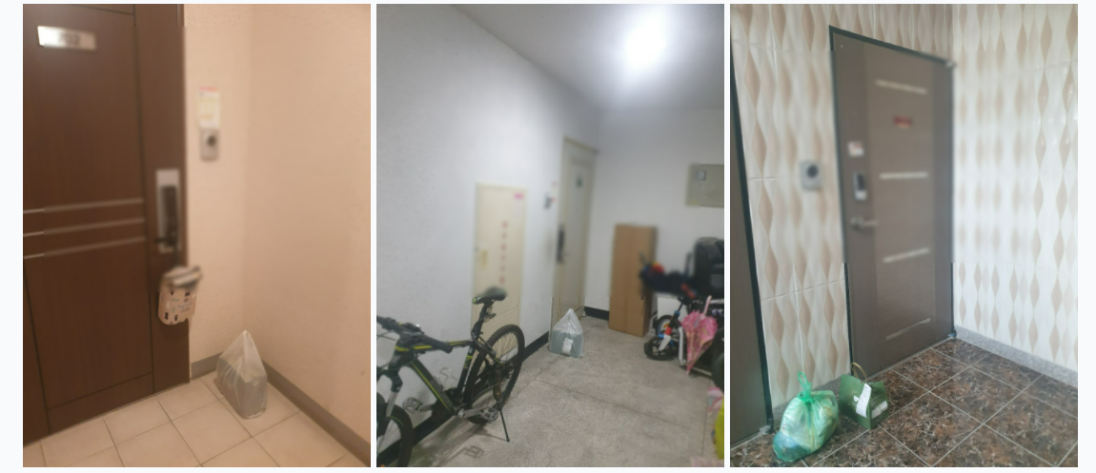
K-food
Covid-19 and Food Delivery in Korea
= Be safe ☺
= please leave it
in front of the door
and ring the bell
=receiving an order
=being delivered
=completed
delivery
= do not use the bell. Please knock
= give me a call before arriving
=no requires
Notes:
Next is how covid influenced koreas food delivery service.
Because of covid-19, to reduce the contact with random people a lot of us asks for the untact delivery service.
When we order, we can choose the way we want it to be delivered. If you can see on the screen there is a little drawing of a character with a mask and it saids to ‘ leave it in front of the door and ring a bell’. We can check the delivery time and check when the food is about to come, so we don’t have to get worried about the food getting cold if it is left outside.
And this is a photo of how the food is left in front of the door.

Slide 36
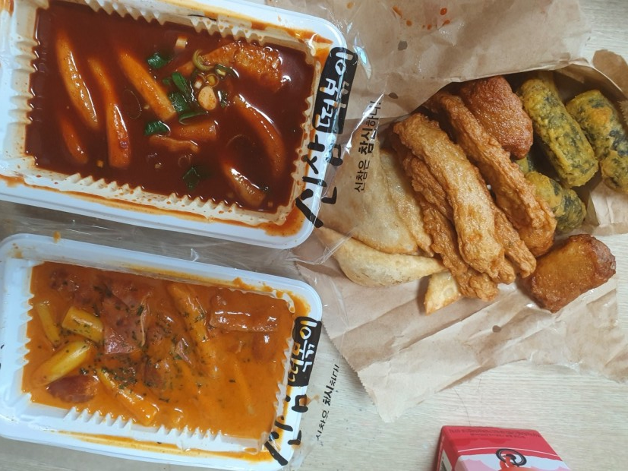
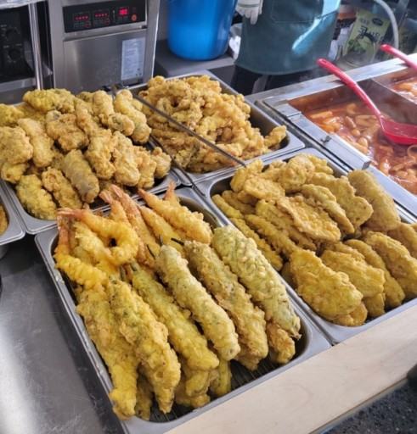
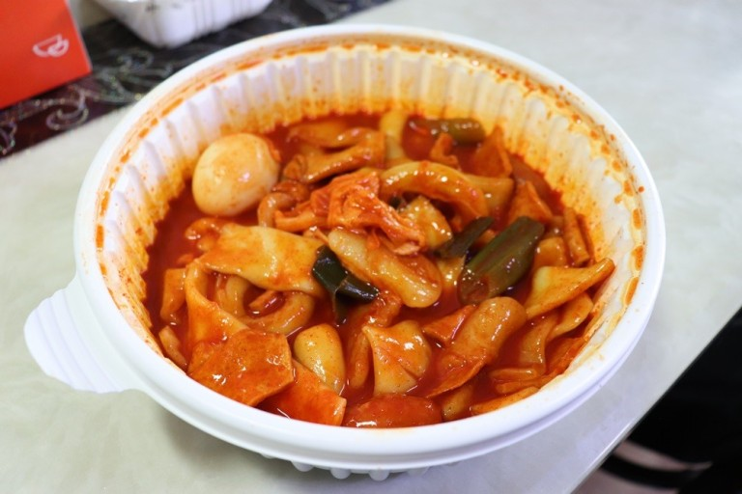
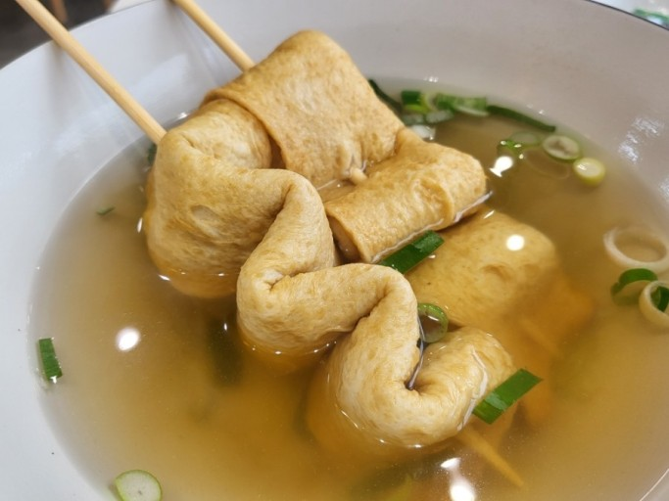
K-food
Most Popular Delivery Food in Korea
Top 5 - Tteokbokki
튀김
Tteokbokki
(떡볶이)
Eomuk(어묵)
Notes:
Next, I will be introducing the most popular delivery food. In korea. It is an official ranking made by the Korea agro-fisheries & food trade corporation. And I will be introducing the top 5 food. That Koreans deliver the most
The first food, which is ranked 5 is 떡볶이. If you are familiar with Korean food you might have heard about 떡볶이. It is a spicy food made with pepper paste. It is a food made with the rice cake which is a chewy ingredient.
We often match it with some other foods, for example ‘튀김’. It is a assorted type of deep fried food such as sweet potatos, shirmps and more. It goes well with the 떡볶이 because, it goes so well together when you dip the 튀김 in the 떡볶이 sauce.
The other match is 어묵 which is a fish cake and soup. Fish cake is a food which we make by battering the fish with some wheat and make it shape what we can see on the screen. We enjoy eating it together with the 떡볶이 because it eases the spiciness.

Slide 37
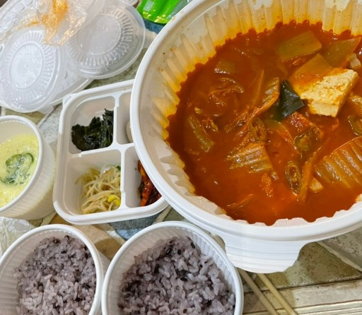
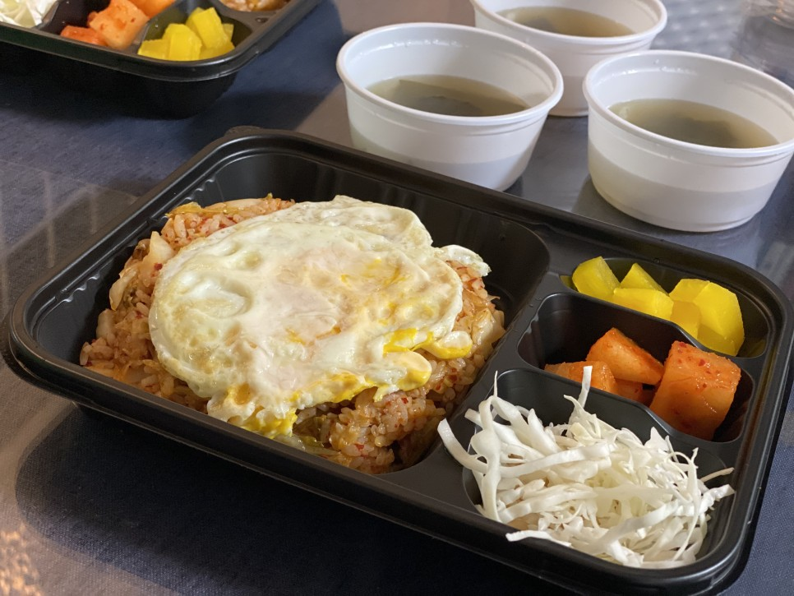
K-food
Most Popular Delivery Food in Korea
Top 4 – Typical Korean Food
Fried rice(볶음밥)
Gimchijjigae(김치찌개)
Notes:
The fourth ranking delivery food are typical Korean foods. The best ordered two food of all is called 볶음밥 and 김치찌개. 볶음밥 means fried rice in korea and the most basic kind is the kimchi 볶음밥. We fry rice with 김치 and ham and more ingredients. And if you want to make it a bit fancier you can put fried eggs on top and enjoy it.
The other food is called 김치찌개. This is also made out of 김치. And it is a stew type of dish. You boil the 김치 with other ingredients like pork meat, tofu and more and mostly eat it with rice.

Slide 38
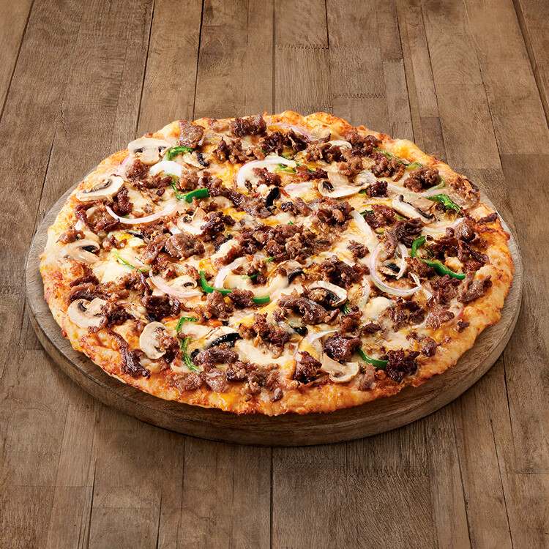
K-food
Most Popular Delivery Food in Korea
Top 3 – Pizza
Bulgogi Pizza
( 불고기 피자)
Notes:
The third ranking food is the pizza. Since pizza is an international food, I would like to introduce one type of Korean styled pizza. And it is called the 불고기 피자. 불고기 is a beef barbecue marinated with soysauce and other few ingredient. It is a sweet and flavorful food. (And in korea, we like pizza with a lot of toppings.)

Slide 39
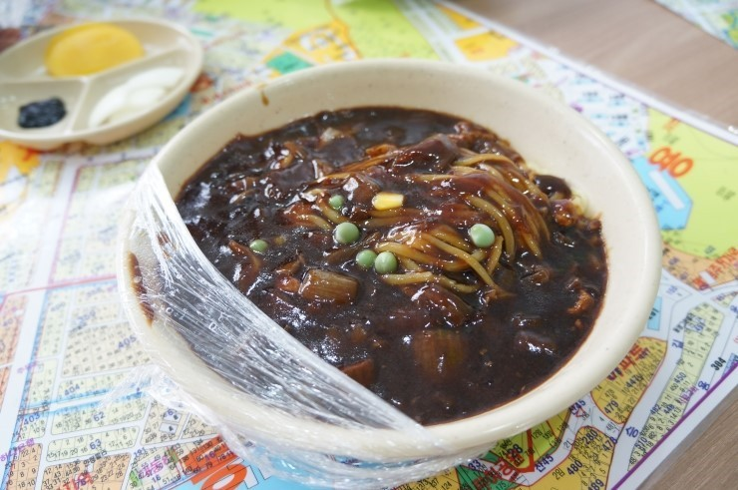
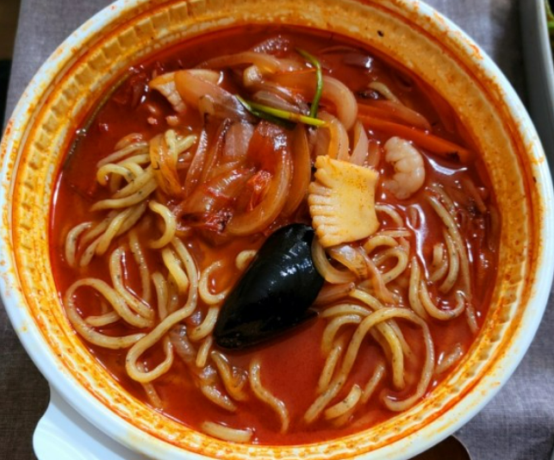
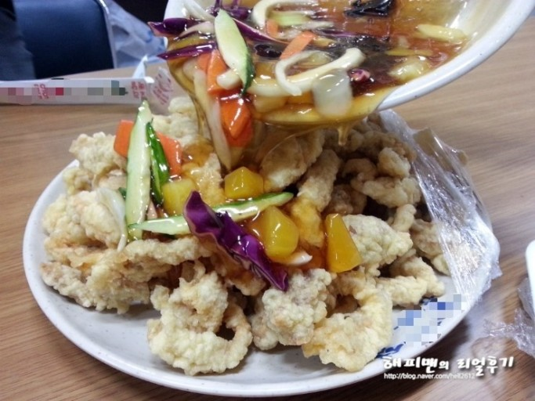
K-food
Most Popular Delivery Food in Korea
Top 2 – Chinese food
Jajangmyeon(짜장면)
Jjamppong(짬뽕)
Tangsuyuk(탕수육)
Notes:
The second ranking delivery food is the Chinese food. It is not a typical Chinese food but a Korean styled Chinese food.
The most popular food among all is 짜장면. It is also known as black bean sauce noodles. The next popular food is 짬뽕. It is a Chinese style spicy noodles with vegetables and seafood.
The last chinese styled food to introduce is the 탕수육. It’s a deep-fried pork with a sweet and sour sauce. We eat 탕수육 together with the 짜장면 and the 짬뽕 and mostly share it with the whole people who are enjoying the meal together because it normally comes in big sizes.

Slide 40
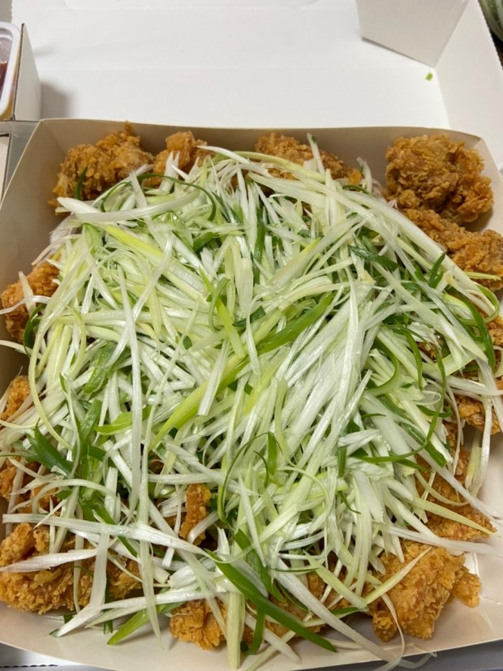
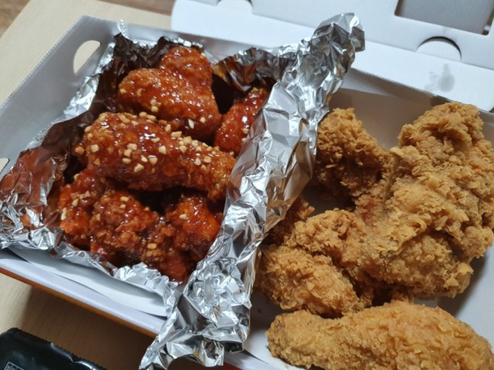
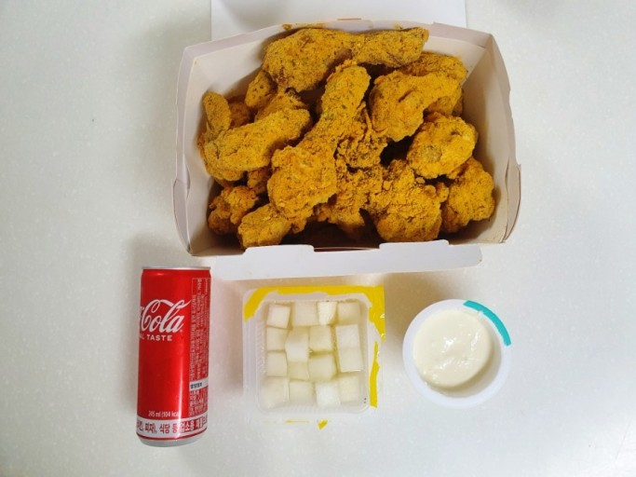
K-food
Most Popular Delivery Food in Korea
Top 1 – Chicken
Jajangmyeon(짜장면)
Notes:
The most popular delivery food of all is the chicken. Have you ever heard of the Korean styled fried chicken? It got famous at first for the sweet and a bit spicy sauced chicken. And after that appeared a lot of different kind of chickens as for example chicken with green onions, and cheese powdered chicken.
There are lots of different types of chicken in korea like sweet soy sauced chicken and more so I think it would be fun if you try some different types of Korean chicken.

Slide 41

Today’s k-pop
BlackPink – How you like that
https://youtu.be/IZnUWDugxnQ

Slide 42
T
H
A
N
K
Y
O
U
감사합니다 ☺

