Slide 1
Yery Kim
Myeng wha Kim
Korean class week 3

Slide 2
Index
Review
1) Postpositional Particles
Korean sentence form
1) Combination of consonant and vowel
2) Basic sentence
3) Grammatical category of number
4) Stems of verbs and adjectives
3. Today’s word / expression
4. Korean culture
Notes:
Quick look back on the previous class. The postpositional particles(입자=부분을 말하나보다.)
And then we would learn how to form a sentence using words and learning the right combination of words.

Slide 3
Review - Postpositional Particles
은 / 는 [eun/neun]
General fact ex) 사과는 빨갛다.
2. Introducing yourself ex) 제 이름은 김명화에요.
3. Show the contrast or the opposite ex) 사과는 좋아해
Notes:
다 훑고 가는 거 힘들면 줄이자. 예시 문장 하나씩이라던지. 아니면 아예 문제로 가서 간단 설명이 낮겠다.
예시 문장 없이 이렇게 설명하고 질문으로 예시문장 하자.

Slide 4
Review - Postpositional Particles
subject + 이/가
1.Observe or describe something
ex) 영화가 재밌다.
2. Emphasize the subject
ex) 사과가 맛있다.
이 / 가
이 / 가
Notes:
다 훑고 가는 거 힘들면 줄이자. 예시 문장 하나씩이라던지. 아니면 아예 문제로 가서 간단 설명이 낮겠다.
예시 문장 없이 이렇게 설명하고 질문으로 예시문장 하자.

Slide 5
Review - Postpositional Particles
Question 1
YERI likes swimming but not other sports
수영은[eun] 좋아한다
수영이[i] 좋아한다
Question 2
The cheetah over there is slow (watching now)
치타는[neun] 느리다
치타가[ga] 느리다
Question 3
You are not an animal, you are a human
너는 동물[이/ ] 아니고 사람이야
은
Notes:
But은 contrast 니까 은는이 필요하겠죠. 근데 수영이라는 단어가 consonant로 끝나니까 은이 되어야 겠죠.
Watching now에서 힌트를 얻을 수 있는데, it means that you are describing what you are describing what you see so you can choose 가. 그리고 vowel로 끝나니까 이가 아닌 가를 사용해야 한다.
마지막은 강조하는 거니까, 이. 자음이니까 가가 아니라 이

Slide 6
1. Combination of consonant and vowel
Vowel and consonant
The position of the vowel symbol is either to the right of or below the initial consonant symbol
ㄱ
ㄱ
X
Con-sonant
vowel
ㄱㄴ
X
vowel
Notes:
So if we want to write a sentence, we have to start with how to form a word. And in korea the words are a combination of vowels and consonants. So today we are going to start with the combination of consonany and vowel

Slide 7
1. Combination of consonant and vowel
Vowel and consonant
The position of the vowel symbol is either to the right of or below the initial consonant symbol
가 노 돠
The right of the consonant
Below of the consonant
The right and below of the consonant
Notes:
1) Korean syllable dose not start with two consonants. E.g. unlike the English word “clip”.
2) Each syllable should look about the same size, no matter how many symbols it nay contains. E.g. 나[Na] and 흙[Heuk]
3) Hangul follows the spelling convention, so Korean spellings do not change just because it reads a little differently from its symbol combination. This is the same for English, where you cannot write just as you hear or speak.

Slide 8
1. Combination of consonant and vowel
3 rules of vowel and consonant
Korean syllable does not start with two consonants.
E.g. unlike the English word “clip”.
2) Each syllable should look about the same size, no matter how many symbols it may contain.
E.g. 나[Na] and 흙[Heuk]
3) Hangul follows the spelling convention, so Korean spellings do not change just because it reads a little differently from its symbol combination. This is the same for English, where you cannot write just as you hear or speak.

Slide 9
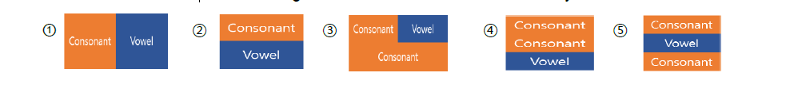
1. Combination of consonant and vowel
Question
Which of the following combination of consonant and vowel symbol is NOT true?
ㅇ
오
아
우
앙
웅

Slide 10
2. Basic sentence form
Korean is a subject-object-verb (SOV) language
noun
adverb/ number
verb/
adjective
Clarify the meaning
of the noun
Explanation
for the noun
Subject and(or) object
Notes:
2. Korean is a subject-object-verb (SOV) language. Nouns (e.g., subject and/or object), adverbs, and numbers, appear before verbs and/or adjectives. However, the word order of Korean would be change because of the particles that always come after the noun. Because of particles, Korean sentences do not always follow the SOV pattern. Korean nouns (as subjects or objects) can be freely arranged in a sentence.
Exercise 2. Which of the following sentence of word order is NOT true?
① 점심을앤드류가집에서먹어요[Jeom·si·mul aen·deu·ryu·ga ji·be·seo meo·geo·yo] “Lunch Andrew home-at eats”
② 점심을집에서앤드류가먹어요[Jeom·si·mul ji·be·seo aen·deu·ryu·ga meo·geo·yo] “Lunch home-at Andrew eats”
③ 앤드류가먹어요점심을집에서[Aen·deu·ryu·ga meo·geo·yo jeom·si·mul ji·be·seo] “Andrew eat lunch at home”
④ 앤드류가집에서점심을먹어요[Aen·deu·ryu·ga ji·be·seo jeom·si·mul meo·geo·yo] “Andrew home-at lunch eats”
⑤ 앤드류가점심을집에서먹어요[Aen·deu·ryu·ga jeom·si·mul ji·be·seo meo·geo·yo] “Andrew lunch home-at eats”

Slide 11
2. Basic sentence form
Korean is a subject-object-verb (SOV) language
Ex) He ate a banana.
그가 바나나를 먹었다. [geuga bananaleul meog-eossda]
>He: S / ate: V / a banana: O
바나나를 그가 먹었다. [bananaleul geuga meog-eossda]
Korean nouns (as subjects or objects) can be freely arranged in a sentence.
Notes:
This is just the basic form of a sentence. It is not always like this. Especially
2. Korean is a subject-object-verb (SOV) language. Nouns (e.g., subject and/or object), adverbs, and numbers, appear before verbs and/or adjectives. However, the word order of Korean would be change because of the particles that always come after the noun. Because of particles, Korean sentences do not always follow the SOV pattern. Korean nouns (as subjects or objects) can be freely arranged in a sentence.

Slide 12
2. Basic sentence form
Question
Which of the following sentence of word order is NOT true?
① 점심을 앤드류가 집에서 먹어요 [Jeom·si·mul aen·deu·ryu·ga ji·be·seo meo·geo·yo]
② 점심을 집에서 앤드류가 먹어요 [Jeom·si·mul ji·be·seo aen·deu·ryu·ga meo·geo·yo]
③ 앤드류가 먹어요 점심을 집에서 [Aen·deu·ryu·ga meo·geo·yo jeom·si·mul ji·be·seo]
④ 앤드류가 집에서 점심을 먹어요 [Aen·deu·ryu·ga ji·be·seo jeom·si·mul meo·geo·yo]
⑤ 앤드류가 점심을 집에서 먹어요 [Aen·deu·ryu·ga jeom·si·mul ji·be·seo meo·geo·yo]

Slide 13
2. Basic sentence form
Question
Andrew eats lunch at home
① 점심을 앤드류가 집에서 먹어요 [Jeom·si·mul aen·deu·ryu·ga ji·be·seo meo·geo·yo]
② 점심을 집에서 앤드류가 먹어요 [Jeom·si·mul ji·be·seo aen·deu·ryu·ga meo·geo·yo]
③ 앤드류가 먹어요 점심을 집에서 [Aen·deu·ryu·ga meo·geo·yo jeom·si·mul ji·be·seo]
④ 앤드류가 집에서 점심을 먹어요 [Aen·deu·ryu·ga ji·be·seo jeom·si·mul meo·geo·yo]
⑤ 앤드류가 점심을 집에서 먹어요 [Aen·deu·ryu·ga jeom·si·mul ji·be·seo meo·geo·yo]
Basic sentence : S / O / V
S- Andrew
O- lunch, at home
V- eats
Andrew lunch home-at eats
Andrew home-at lunch eats
/
/
Notes:
주어 동사를 먼저 찾아보세요. 그리고 주어의 경우에는 은는이가. 아까 복습한 postpositional particles랑 같이 자주 나오니 참고

Slide 14
2. Basic sentence form
Question
Andrew eats lunch at home
① 점심을 앤드류가 집에서 먹어요 [Jeom·si·mul aen·deu·ryu·ga ji·be·seo meo·geo·yo]
② 점심을 집에서 앤드류가 먹어요 [Jeom·si·mul ji·be·seo aen·deu·ryu·ga meo·geo·yo]
③ 앤드류가 먹어요 점심을 집에서 [Aen·deu·ryu·ga meo·geo·yo jeom·si·mul ji·be·seo]
④ 앤드류가 집에서 점심을 먹어요 [Aen·deu·ryu·ga ji·be·seo jeom·si·mul meo·geo·yo]
⑤ 앤드류가 점심을 집에서 먹어요 [Aen·deu·ryu·ga jeom·si·mul ji·be·seo meo·geo·yo]
Korean nouns (as subjects or objects) can be freely arranged in a sentence.
/
/
/
/
Notes:
So as we said before and of what you can see on the blue box, Korean nouns can be freely arranged. In nuber1&2 you could see that the noun 앤드류 moved. But, in number 3 instead of the noun,

Slide 15
2. Basic sentence form
But why do Koreans switch the sentence of word order?
Notes:
*cluster: 무리를 이루다 *omission: 생략
The further the word is from the end of the sentence, the less important the element is and more likely it is to be dropped. What determines the omission is the context. The Korean language is a context-oriented language in that any contextually understood elements may be omitted unless they are indispensable. => 문맥지향적 언어
Exercise 3. Circle whether the following statement is True or False.
Korean sentences that have no verb or adjective but just a subject or an object are grammatically correct and natural in conversation. (T / F)

Slide 16
2. Basic sentence form
In Korean the most important elements tend to cluster to the end of the sentence
The further the word is from the end of the sentence, the less important the element is and more likely it is to be dropped.
What determines the omission is the context. The Korean language is a context-oriented language, elements may be omitted unless they are indispensable
Notes:
*cluster: 무리를 이루다 *omission: 생략
The further the word is from the end of the sentence, the less important the element is and more likely it is to be dropped. What determines the omission is the context. The Korean language is a context-oriented language in that any contextually understood elements may be omitted unless they are indispensable. => 문맥지향적 언어
Exercise 3. Circle whether the following statement is True or False.
Korean sentences that have no verb or adjective but just a subject or an object are grammatically correct and natural in conversation. (T / F)

Slide 17
2. Basic sentence form
Ex) Andrew eats lunch at home.
Emphasize that he is eating at home:
앤드류는 점심을 집에서 먹어요.
[aendeulyuneun jeomsim-eul jib-eseo meog-eoyo.]
“Andrew lunch home-at eats”
Emphasize that he is eating lunch:
앤드류는 집에서 점심을 먹어요.
[Aendeulyu-neun jib-eseo jeomsim-eul meog-eoyo.]
“Andrew home-at lunch eats”
Notes:
생략되는 거 설명하기 어렵다면, 앤드류는 집에서 점심으로 피자를 먹어요.를 예문으로 또 적고, 이 경우
집에서 점심으로를 뺄 수 있는 경우, 집에서와 피자를을 빼고 문장을 구성하는 경우 등을 설명할 수 있을 것이다.
By dispensible we mean that you can still form a sentence without the words you eliminated. But for example if you eliminate 먹어요, the sentence couldn’t be formed so you could tell that 먹어요 is indispensable.

Slide 18
2. Basic sentence form
Question
Korean sentences that have no verb or adjective but just a subject or an object are grammatically correct and natural in conversation.
( T / F )

Slide 19
3. Grammatical category of number
Korean has the suffix 들[Deul] (that can be attached after a countable noun) for indicating the plurality of the noun. However, its usage is not mandatory for marking plurality, thus its purpose is rather for highlighting the plurality of the noun.
Korean nouns are not specific about the number in that it does not have the grammatical category of number.
Notes:
4. Korean nouns are not specific about the number in that it does not have the grammatical category of number. Korean has the suffix 들[Deul] (that can be attached after a countable noun) for indicating the plurality of the noun. However, its usage is not mandatory for marking plurality, thus its purpose is rather for highlighting the plurality of the noun.
Exercise 4. Circle whether the following statement is True or False.
The noun 연필[Yeon·pil] “pencil” can be translated into at least the following: pencil, a pencil, the pencil, some pencils, the pencils, pencils. (T / F)
5.

Slide 20
3. Grammatical category of number
Question
The noun 연필[Yeon·pil] “pencil” can be translated into at least the following: pencil, a pencil, the pencil, some pencils, the pencils, pencils.
( T / F )

Slide 21
4. Stems of verbs and adjectives
The stems of verbs and adjectives do not stand alone, and they are always conjugated by various or inflectional endings.
Stem of verbs and adjectives
(descriptive verbs)
+ -다
anything being left out after you take ‘-다’ out from the verbs and adjectives is the stem
*Verbs and adjectives resemble one another in how they inflect and how they function in the sentence.
There is no obvious structural difference between verbs and adjectives.
Notes:
The stems of verbs and adjectives do not stand alone, and they are always conjugated by various or inflectional(활용, 어미 변화의) endings. Generally, Korean verbs and adjectives take a special dictionary form ending -다[Da]. Consequently, finding the stem of a verb and/or an adjective is simple in that anything being left out after you take 다out from the verbs and adjectives is the stem.
Verbs and adjectives resemble one another in how they inflect and how they function in the sentence. There is no obvious structural difference between verbs and adjectives. In addition, there is no obvious structural difference between verbs and adjectives. In fact, adjectives behave like verbs so much that Korean grammarians categorize adjectives as “descriptive verbs.”
Exercise 5. Write the stem of each word and circle whether it is a verb or an adjective.
① 잠자다[Jam·ja·da

Slide 22
4. Stems of verbs and adjectives
① 잠자다[Jam·ja·da] stem: ___________ Verb / Adjective
② 작다[Jak·tta] stem: ___________ Verb / Adjective
③ 먹다[Meok·tta] stem: ___________ Verb / Adjective
④ 입다[Ip·tta] stem: ___________ Verb / Adjective
⑤ 걷다[Geot·tta] stem: ___________ Verb / Adjective
⑥ 기쁘다[Gi·ppeu·da] stem: ___________ Verb / Adjective
잠자
작
먹
입
걷
기쁘

Slide 23
Today’s conversation
Yeri : Hi, Did you eat something?
안녕, 너 밥은 먹었어?
[ An-nyeong, neo bab-en meog-eoss-eo?]
Jimin : No, I am hungry
아니, 나 배고파
[Ani, na bae-go-pa]

Slide 24
Today’s conversation
Yeri : Me, too. Let’s eat dinner together.
나도. 같이 저녁 먹자
[Nado. get-i jeo-nyeog meog-ja]
Jimin : What do you want to eat?
뭐 먹고 싶어?
[mwo meog-go sip-eo?]
Yeri : I want to eat ___불고기___
나는 __불고기___ 먹고싶어
[Na-neun __Bulgogi__ meog-go sip-eo]

Slide 25
Today’s expression
Thank you for the meal (=Bon appetit)
잘 먹겠습니다
[Jal meog-ges-sseub-ni-da]
I really enjoyed the meal
잘 먹었습니다
[Jal meog-eos-sseub-ni-da]
cheers
건배 / 짠
[gepnbae / jjan]

Slide 26
Today’s word
Love = 사랑 [sa-rang]
Movie = 영화 [young-hwa]
Cooking = 요리 [yo-ri]
Today = 오늘 [o-neul]
Tomorrow = 내일 [nae-il]
Yesterday = 어제 [eo-jae]
Do not know = 모른다 [mo-reun-da]
Study = 공부하다[gong-bu-ha-da]
Exercise = 운동하다 [un-dong-ha-da]
Sing = 노래하다 [no-rae-ha-da]
Laugh = 웃다 [ut-da]
Cry = 울다 [ul- da]

Slide 27
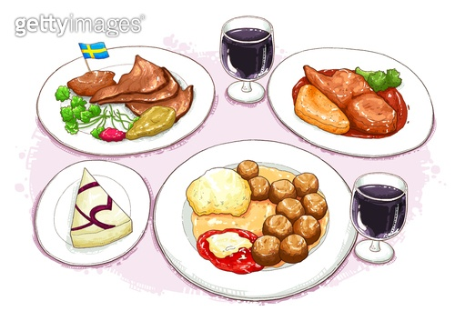
Today’s word
Food
Water - 물 [ mul ]
Rice - 밥 [ bab ]
Plate - 접시 [ jeobsi ]
Cup - 컵 [ cub ]
Spoon - 숟가락 [ sud-ga-lag ]
Chopstick - 젓가락 [ jeod-ga-lag ]
Fork - 포크 [ pokeu ]
Knife - 칼 /나이프 [ kal / nife ]

Slide 28
Korean Culture

Slide 29
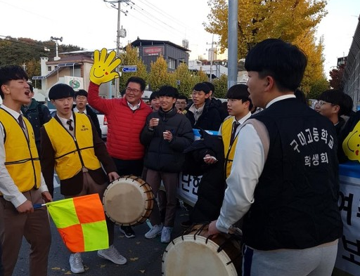
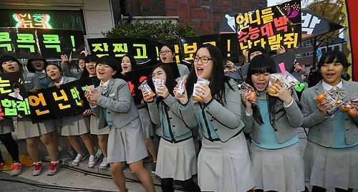
1. Relative evaluation
https://www.youtube.com/watch?v=l5SqUAkxxQo
To enter University
https://www.youtube.com/watch?v=XLDqRRp_ERQ
https://www.youtube.com/watch?v=l5SqUAkxxQo
수능(su-neung) : university entrance examination system in Korea
Every November 3rd week’s Thursday is the 수능 day.
In Korea, University level is very important to get job, meet and judge people.
Universities in Seoul are regarded as high level.
Every students study hard to enter the “in Seoul” university.

Slide 30
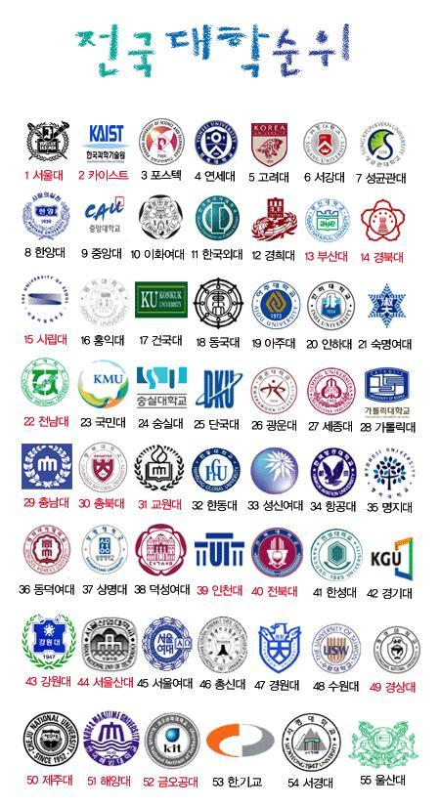
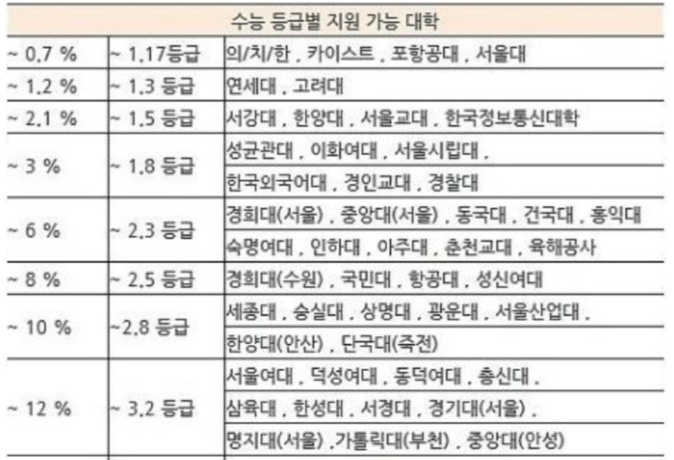
National university ranking
Only top 12 percent of 600,000 students can enter ‘In Seoul’ University
We take a total of seven subjects in the ‘수능’ day
Korean, math, English, two subjects from social studies or science, and Korean history must be taken. In the case of liberal arts, a second language can be replaced with a social studies course
second language :
French, Spanish, German, Japanese, Chinese, Korean Chinese, Russian, Arabic and Vietnamese

Slide 31
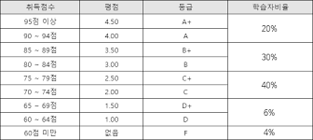
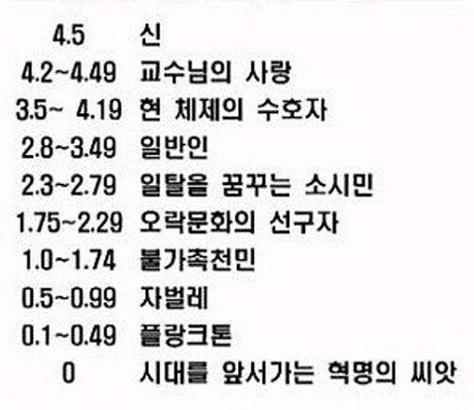

1. Relative evaluation
Unlike other overseas univ. which are absolute evaluations, Korea is a relative evaluation, so there is a considerable checks among friend to get good grades in the subjects
God
Professor’s love
Ordinary person
Guardian of present system
A small citizen dreaming of escape from daily life
Untouchable person
Bug
Pioneer of entertainment culture
Plankton
Seeds of revolution ahead of time

Slide 32
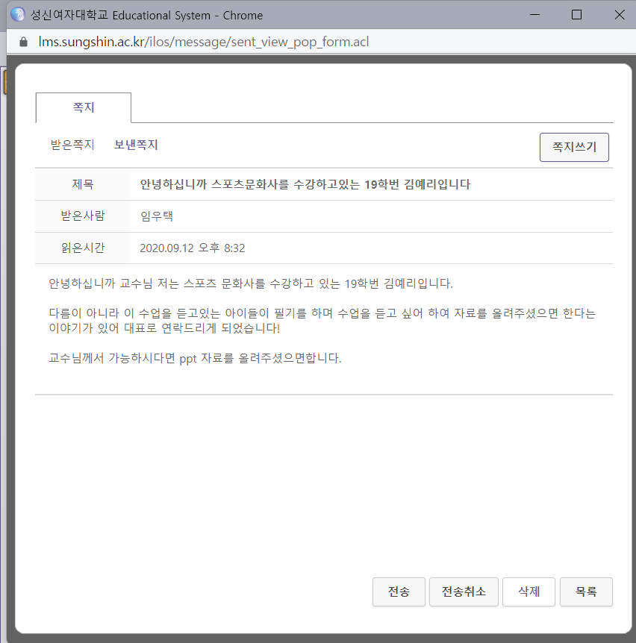
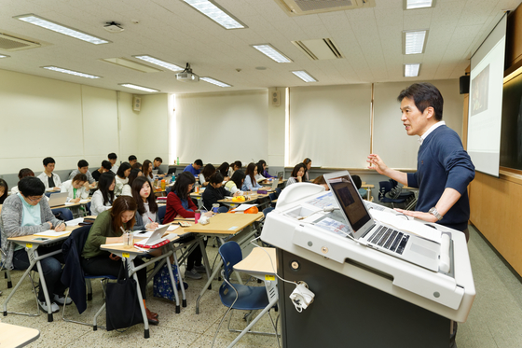
2. Cultural differences - 1)Politness
Hello professor, I'm Kim Yeri, class of 19, who is taking the 'Sports Culture History' course
I contacted you as a representative because there were some opinions that the students who are taking this class wanted to take notes and take classes, so I wanted professor to upload materials!
Professor, if possible, I would like you to upload the ppt data
Sorry for emailing at the late night

Slide 33
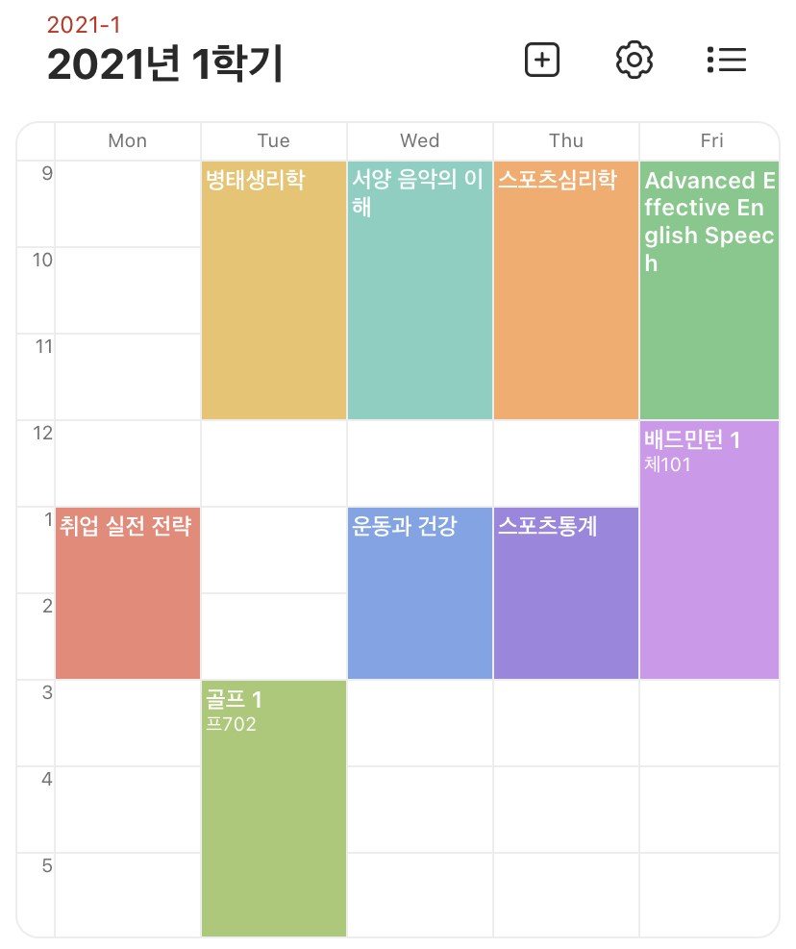
2. Cultural differences - 2) Semester & Credits
Unlike here, spring semester is the first semester in Korea, and winter semester is the second semester
Also, there is little difference between winter vacation and summer vacation (the day)
pathophysiology
The earliest class starts at 9 o'clock, and professors usually finish the class earlier than scheduled ^_^
For most students, 19 credits are the maximum, and students with more than 4.00 grades can take up to 22 credits
Normally graduate at 130 credits
3 credits per subject is the highest credit

Slide 34
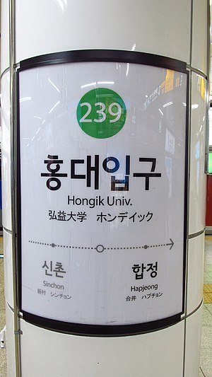
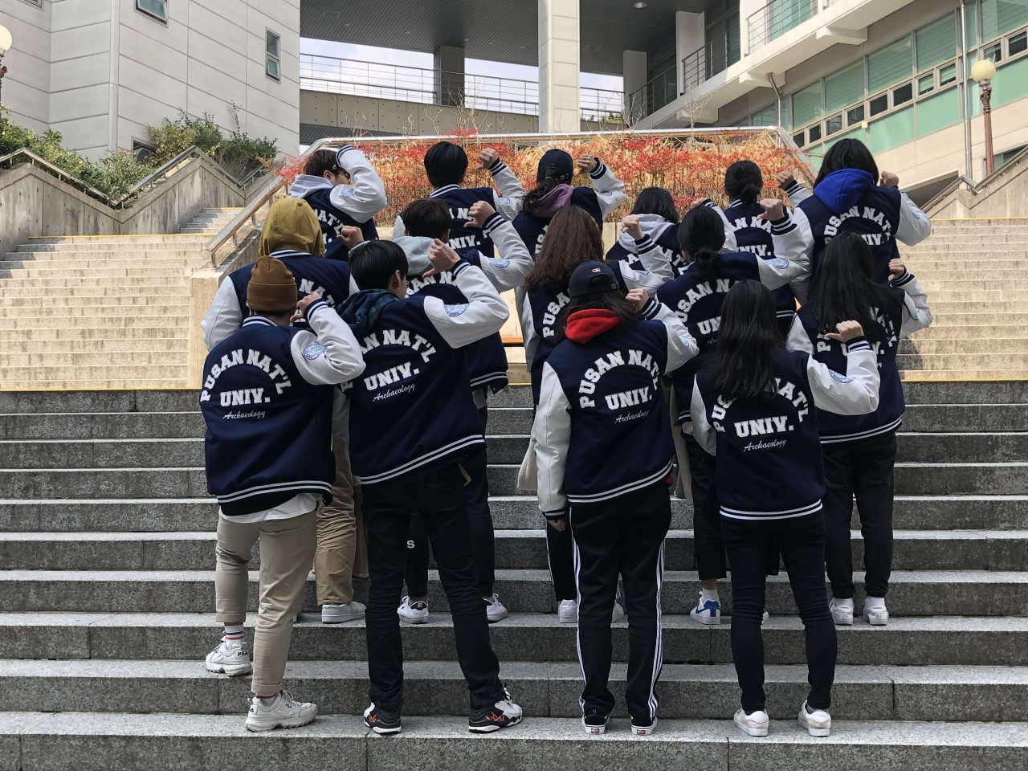
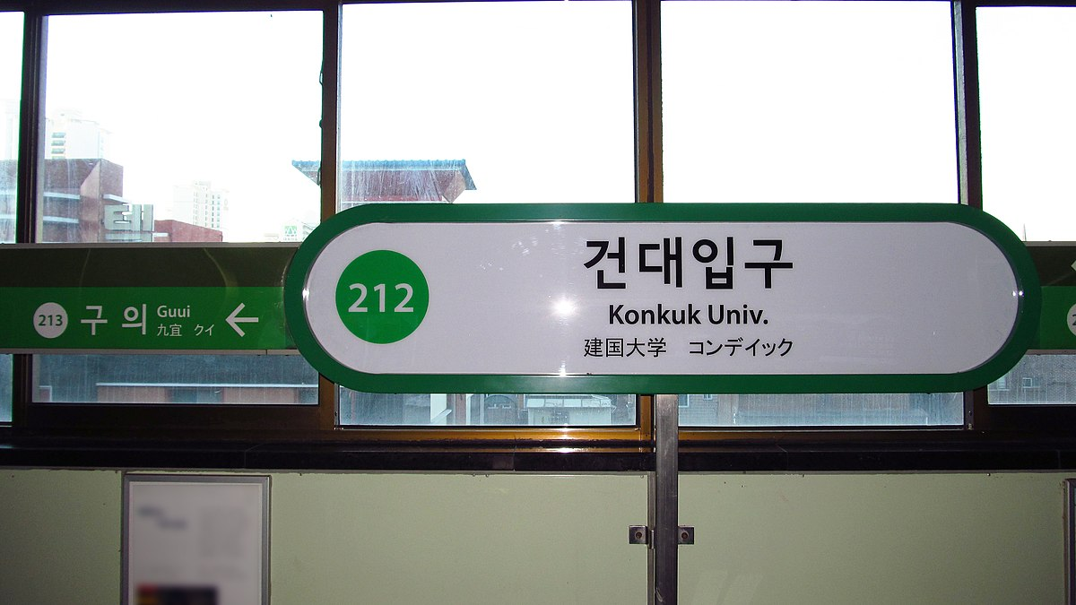
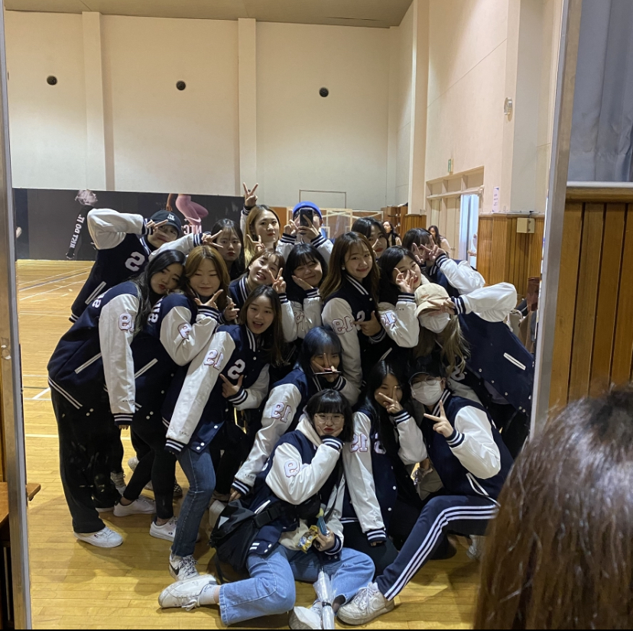
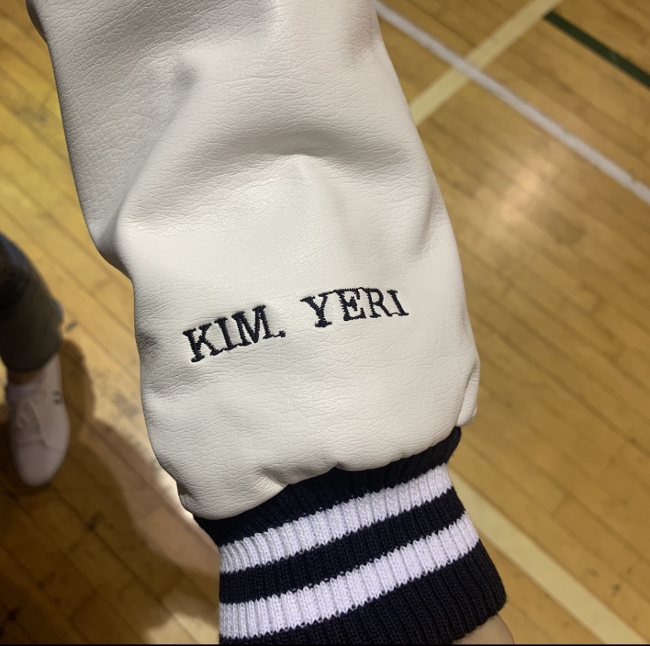
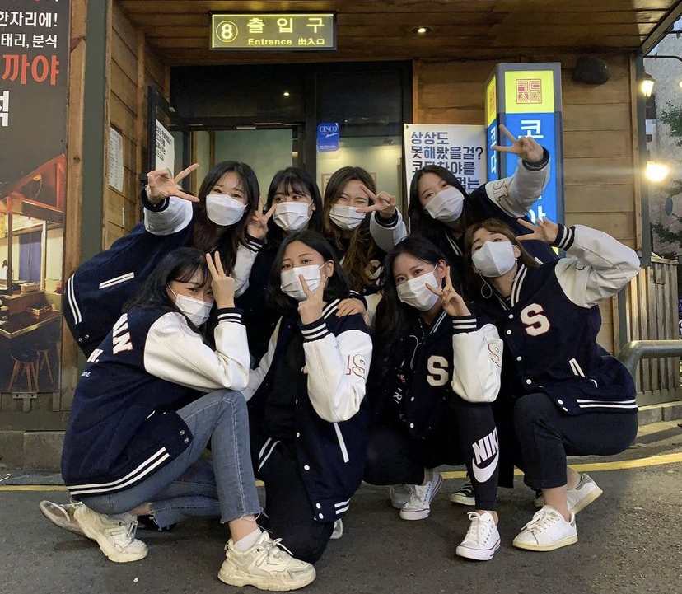
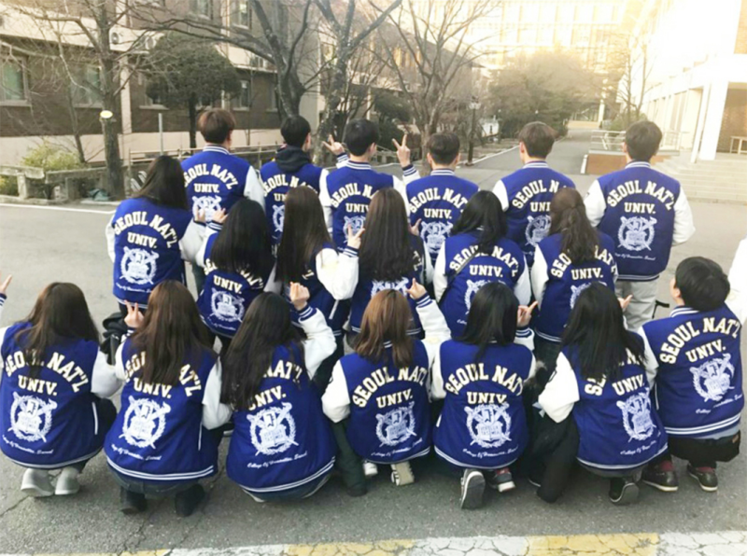
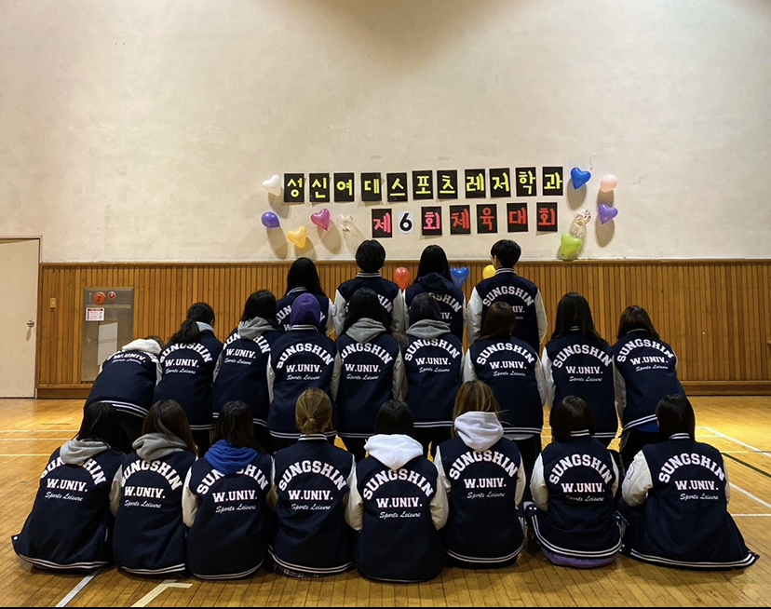
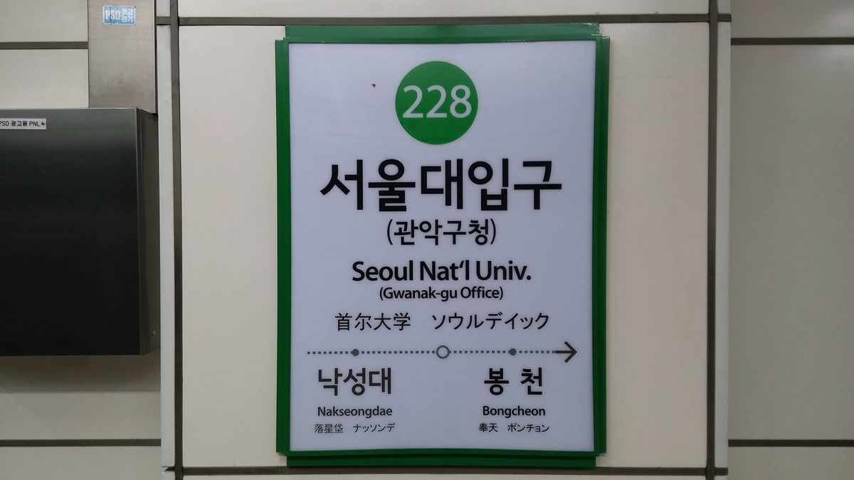
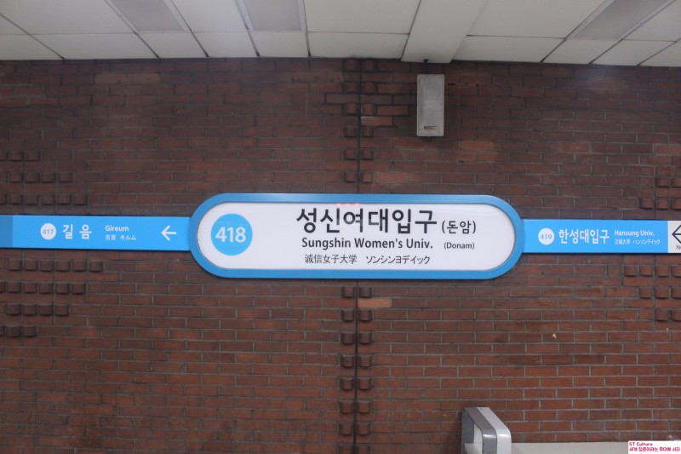
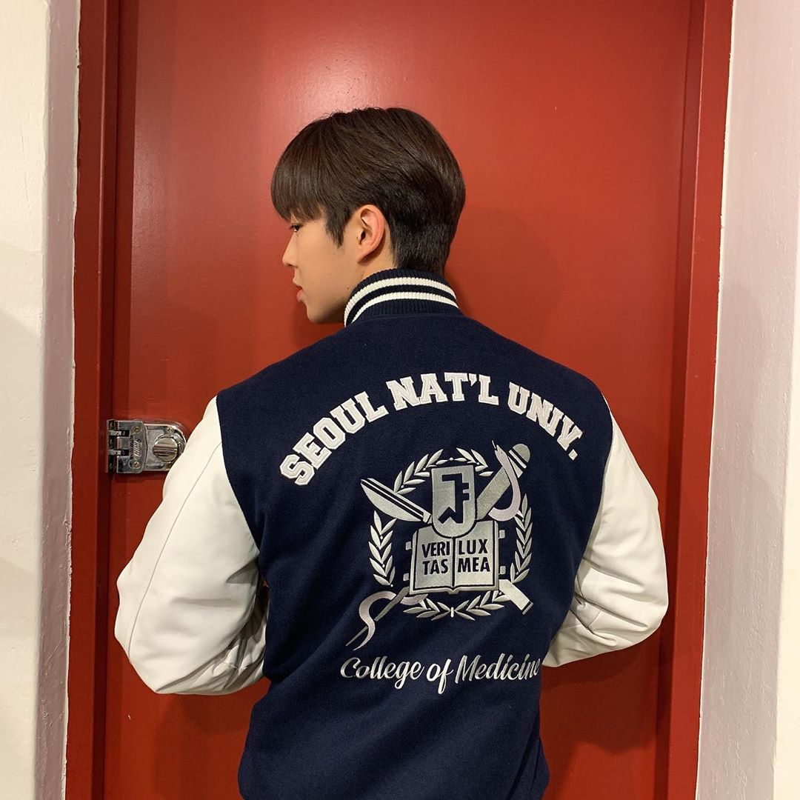
2. Cultural differences – 3) department coat

Slide 35
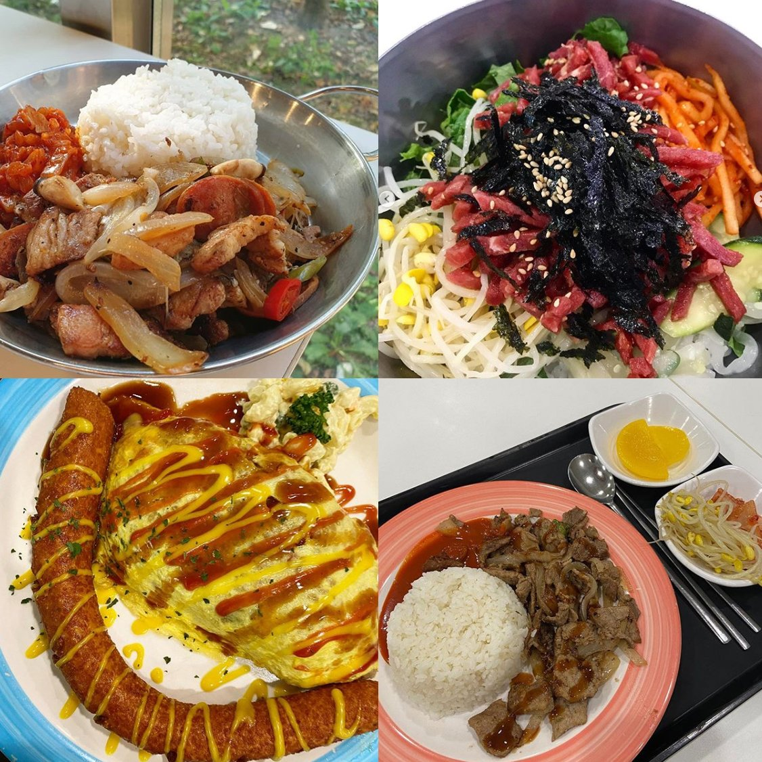
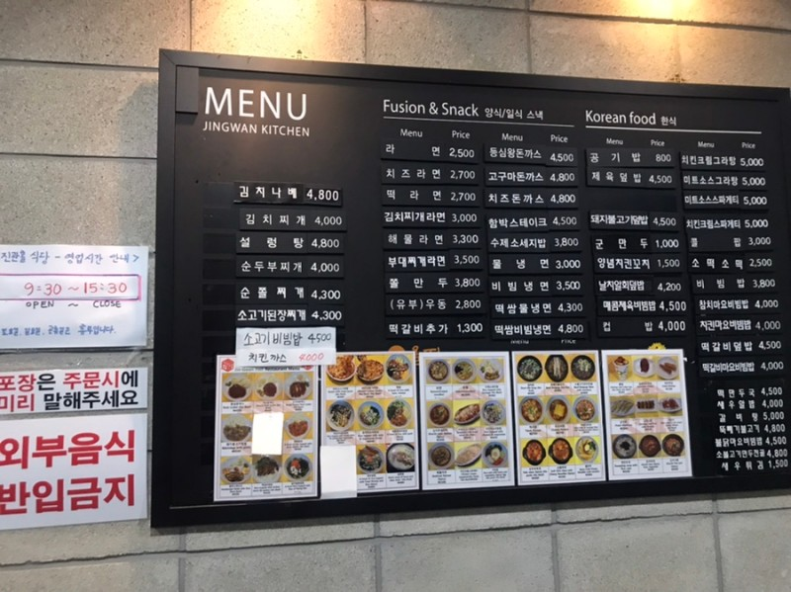
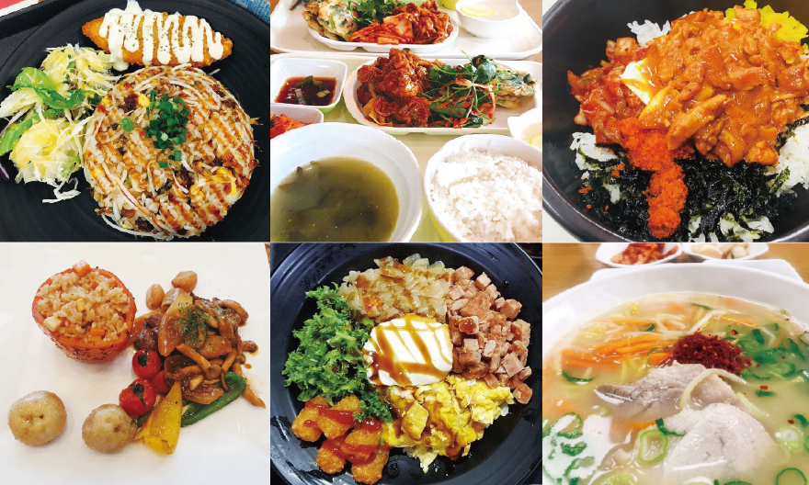
2. Cultural differences – 4) University cafeteria and playing
You can enjoy about 50 different menus for less than 5,000 won (90czk, 3.5 euro)

Slide 36
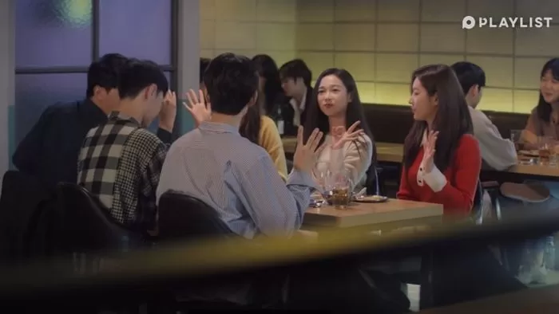
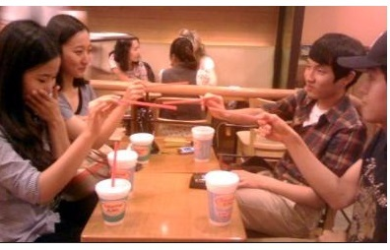
2. Cultural differences
4) University cafeteria and playing
Meeting (미팅)
Students from different universities are mainly composed of (three men, three women) or (four men, four women) and play games and drink together in bars,
Of course, they go out to make boyfriends or girlfriends, but they also go out simply because they want to meet new friends

Slide 37
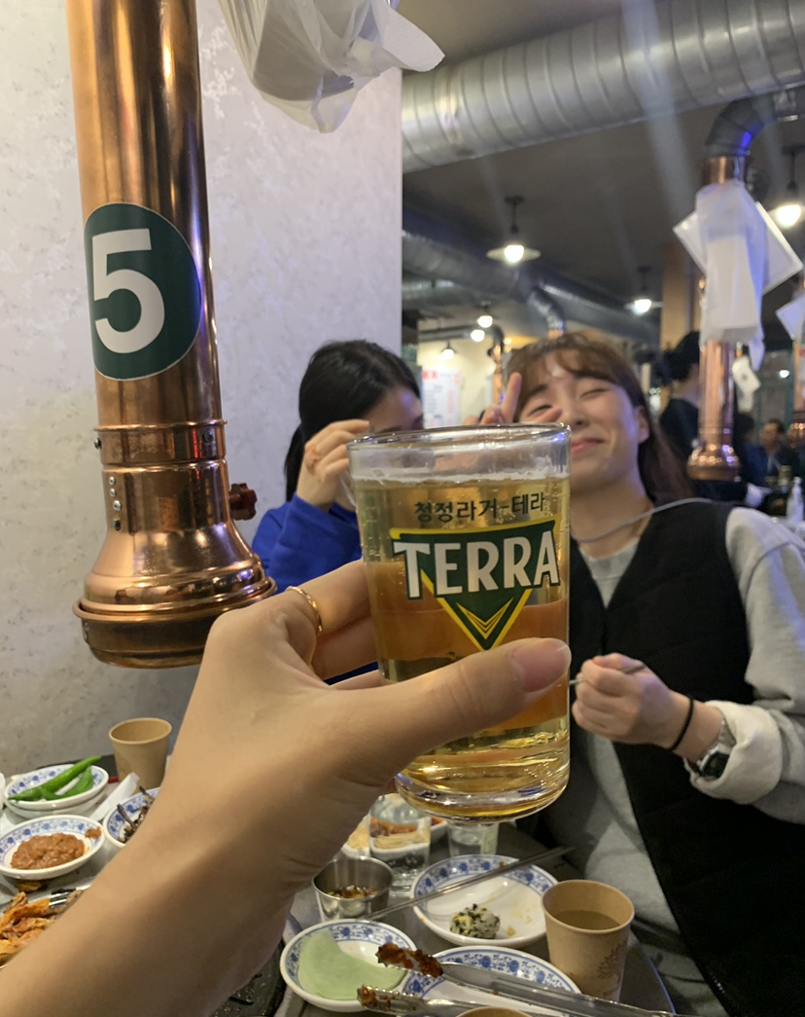
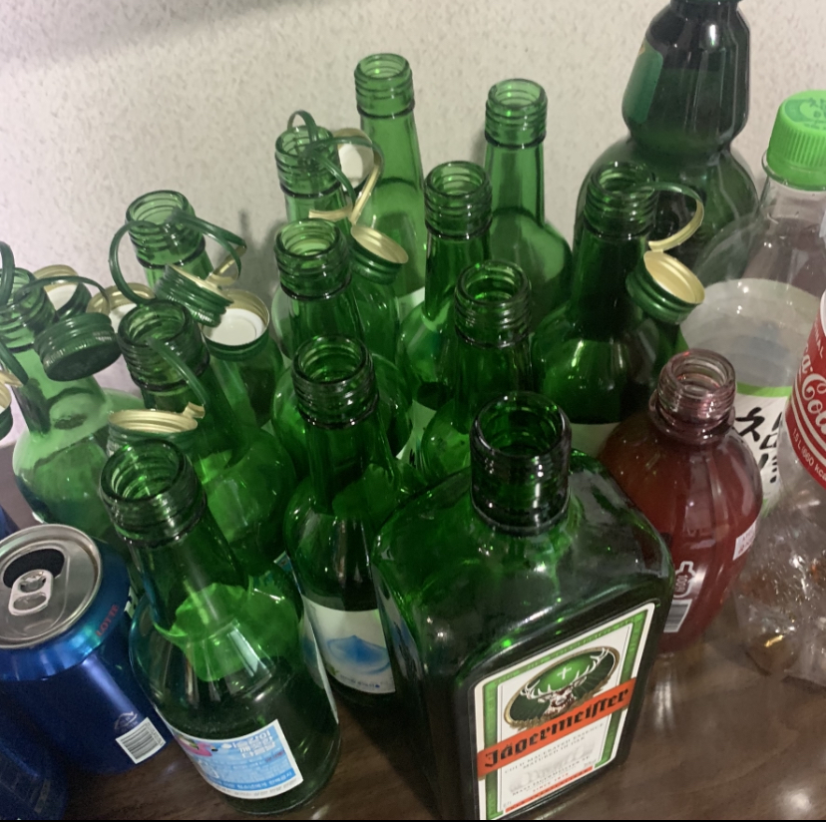
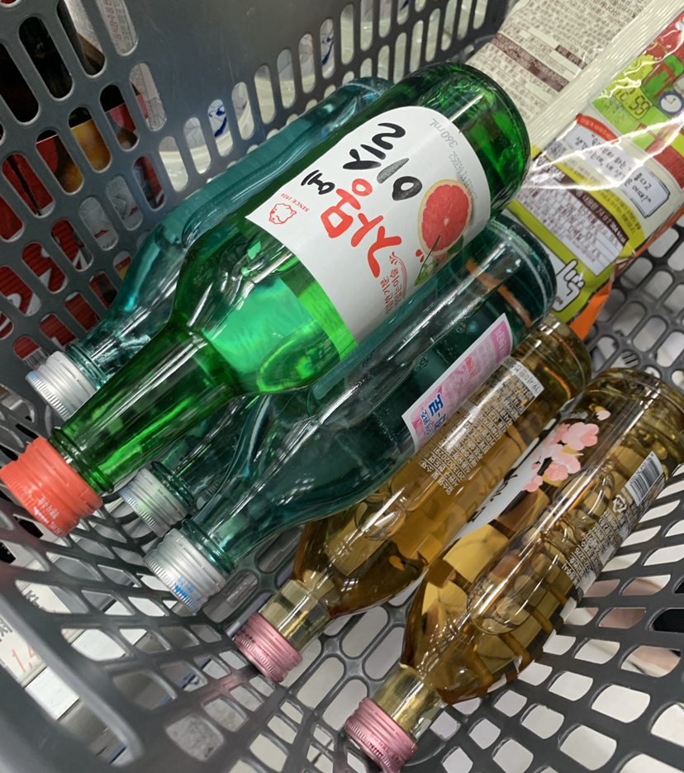
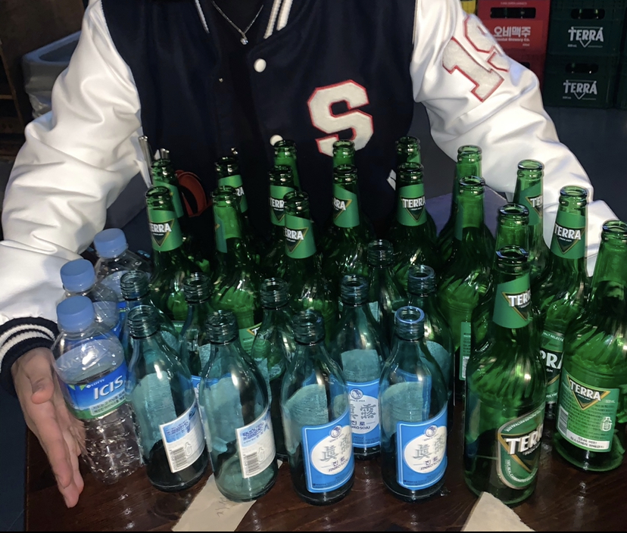
2. Cultural differences -4) playing

Slide 38
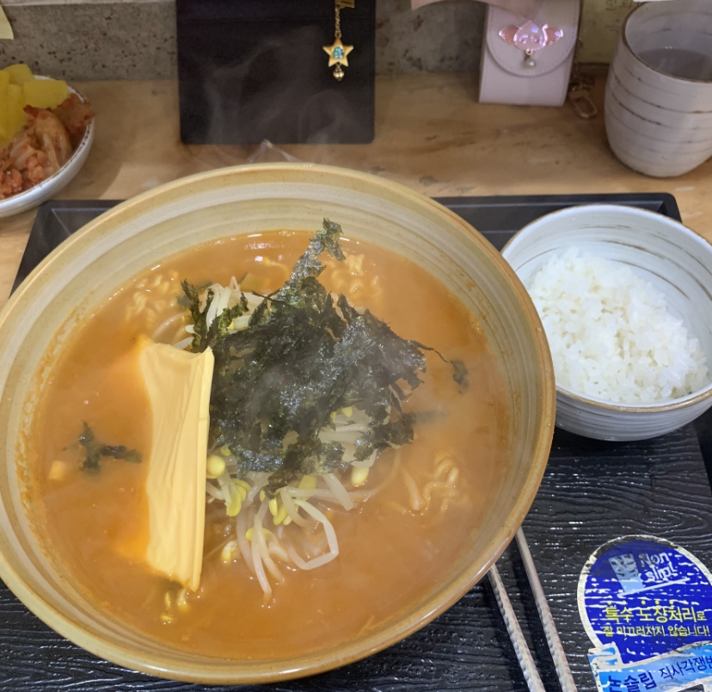
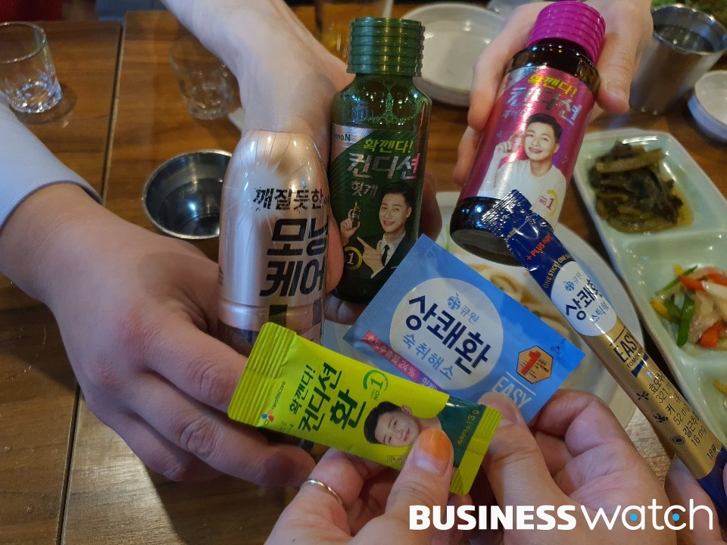
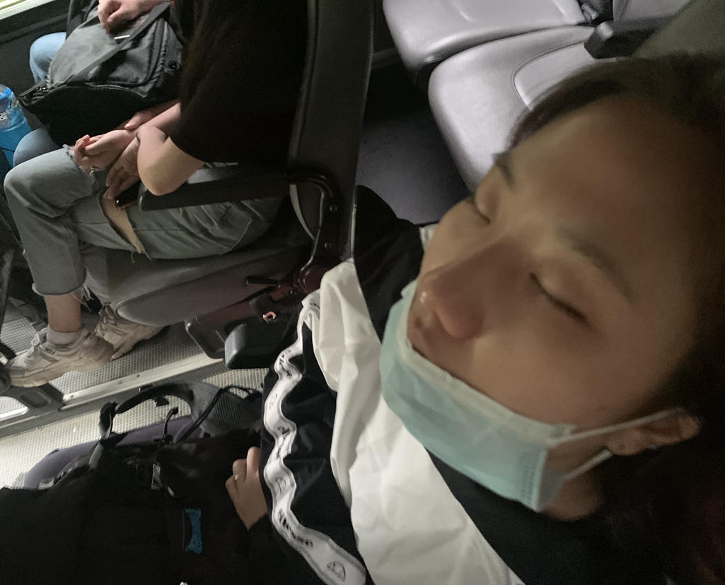
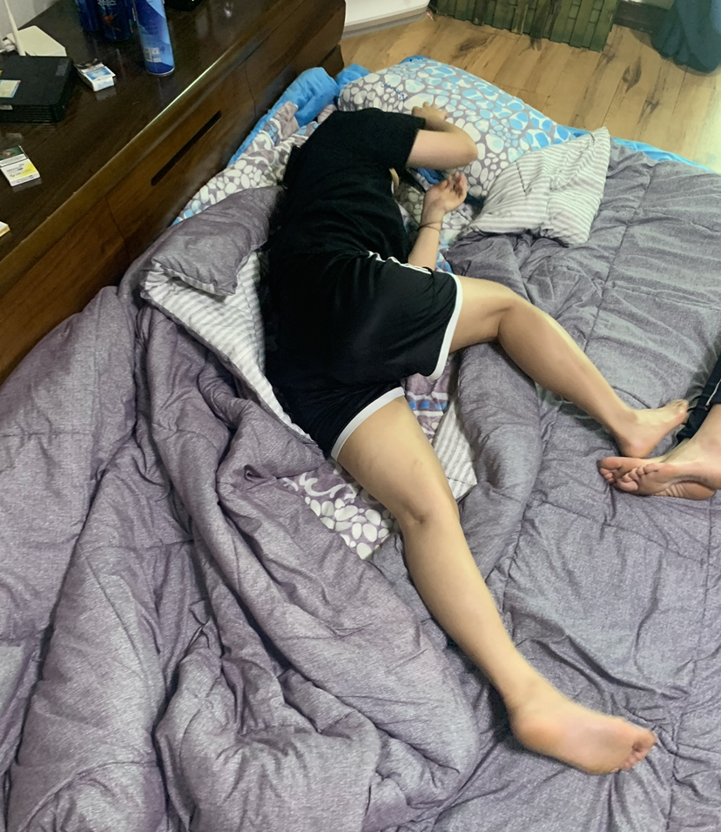

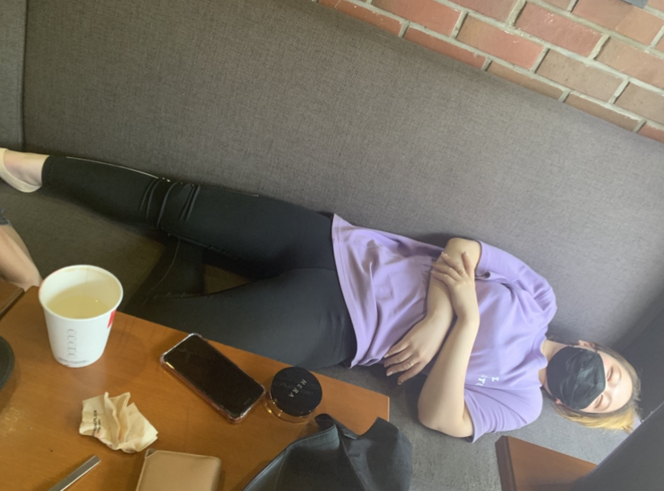
2. Cultural differences -4) playing
hangover reliever

Slide 39
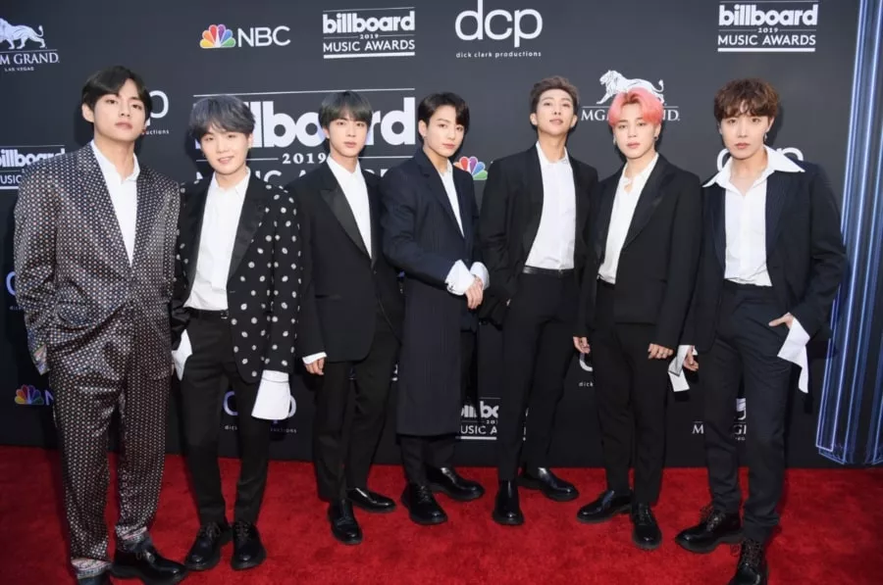
Today’s K-pop
https://www.youtube.com/watch?v=wr7UtYDG7Jo
BTS - DYNAMITE
https://www.youtube.com/watch?v=nF1zZIETE5k

