Slide 1
Yery Kim
Myeng wha Kim
Korean class week 4

Slide 2
Index
Endings
  Pre-final endings
  Final endings
  Postpositional Particles
2. Today’s word
3. Today’s conversation
4. Korean culture

Slide 3
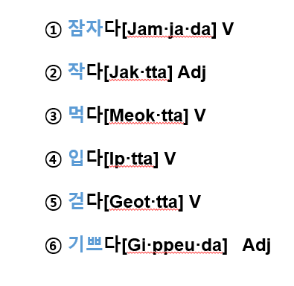
Stems of verbs and adjectives
The stems of verbs and adjectives do not stand alone, and they are always conjugated by various or inflectional endings.
Stem of verbs and adjectives
(descriptive verbs)
+ -다
anything being left out after you take ‘-다’ out from the verbs and adjectives is the stem
Notes:
예시 추가. Done!

Slide 4
1. Endings
STEM WORD + PRE-FINAL ENDING + FINAL ENDING
tense, aspect, speech levels, and so forth
밥을 먹다 -> 밥을 먹/었/다
[bab-eul meogda] -> [bab-eul meogda]
~무대가 기억에 남다 -> ~무대가 기억에 남/았/다.
[mudaega gieog-e namda] -> [mudaega gieog-e nam-assda]
Notes:
배웠었
Bright vowel. 퐁당퐁당 엇
Heavy. 풍덩풍덩 아

Slide 5

1. Endings
STEM WORD + PRE-FINAL ENDING + FINAL ENDING
tense, aspect, speech levels, and so forth
식사를 합시다
: 하다 > Stem : 하
하+ -ㅂ시다

Slide 6
1. Endings -1) pre-final endings
Pre-final endings are inflectional elements that come between the stem and the final ending. They include the honorific suffix -(으)시[(eu)si], past tense marker 었/았[eot/at] (*we will learn next time), and so on.
The honorific suffix
찾으시다(찾+으시+다)[cha·jeu·si·da]“look for,” 가시다(가+시+다)[ga·si·da]“go”.
-(으)시
-시
Consonant +
Vowel +
Notes:
Inflectional: 활용, 어미 변화가 있는
predicate: 문장 속에서 주어에 대해 진술하는 동사 이하 부분. 서술 용법
찾으시다(찾+으시+다)

Slide 7
1. Endings -1) pre-final endings
The honorific suffix
-(으)시
-시
Consonant +
Vowel +
오늘 너무 예쁘시네요~ = You look so pretty today.
[o·neul neo·mu ye·ppeu·si·neyo]
언제나 너무 아름다우시네요~ = You always look so lovely.
[eon·je·na neo·mu a·leum·da·u·si·neyo]
수고 많으셨습니다(많/-으시/ 었/습니다) = Thank you for your hard work.
[su·go manh-eu·syeoss·seub·nida]

Slide 8
1. Endings -1) pre-final endings
The suffix 겠[get]
‘겟[get]’ expresses the speaker’s intention or asks the listener’s intention, and it corresponds to “will” in English
열심히 공부하겠습니다[yeol·ssim·hi gong·bu·ha·get·sseum·ni·da] “(I) will study hard”
어디로 가시겠습니까?[eo·di·ro ga·si·get·sseum·ni·gga]“Where will (you) go?”

Slide 9
1. Endings -1) pre-final endings
The suffix 겠[get]
Second, the suffix 겠 indicates the speaker’s conjecture or asks the listener’s idea regarding the topic in question. It is corresponding to “I guess/think” or “do you think that . . .” in English.
내일 시험이 어렵겠어요. [nae·il si·heo·mi eo·ryeop·gge·sseo·yo]“(I guess that) tomorrow’s test will be difficult”
내일 시험이 어렵겠어요?[nae·il si·heo·mi eo·ryeop·gge·sseo·yo] “(Do you think that) tomorrow’s test will be difficult?”

Slide 10
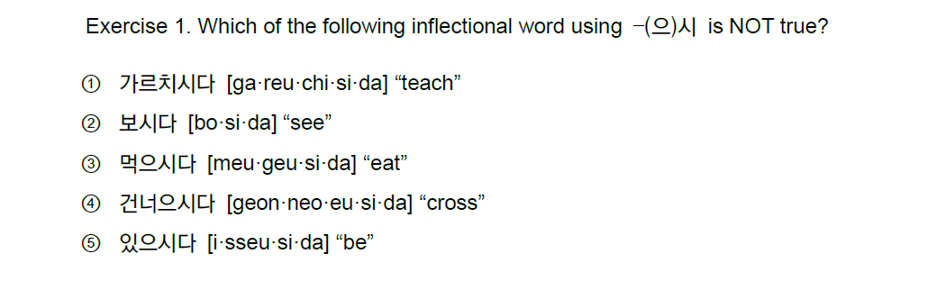
1. Endings -1) pre-final endings
X

Slide 11
1. Endings -1) pre-final endings
Exercise 2. Which of the following translation of the Korean sentences is NOT true?
① 음식이 맛있겠습니까? [eum·si·gi ma·sit·kket·sseum·ni·kka] “(Do you think that) the food will delicious?”
② 영화를 보시겠습니까? [yeong·hwa·reul bo·si·get·sseum·ni·kka] “(Do you think that) the movie will be fun?”
③ 길이 좁겠어요? [gi·ri jop·kke·sseo·yo] “(Do you think that) the road will be narrow?”
④ 꼭 담배를 끊겠습니다. [kkok dam·be·reul kkeun·ket·sseum·ni·da] “Surely, (I) will quit smoking.”
⑤ 매일 요가를 하겠습니다. [mae·il yo·ga·reul ha·get·sseum·ni·da] “(I) will do yoga everyday.”

Slide 12
1. Endings -1) pre-final endings
영화를 보시겠습니까? [yeong·hwa·reul bo·si·get·sseum·ni·kka]
Verb : 보다 / Stem : 보
Meaning of 겠 : asks the listener’s idea regarding the topic in question
Translation : Would you like to see a movie?
“(Do you think that) the movie will be fun?”
Fun = 재미있다[jae·mi·iss·da] -> 재밌다[jaemiss·da]
Translation : 영화가 재밌겠습니까? [yeong·hwa·ga jaem·iss·get·seum·ni·kka]

Slide 13
1. Endings -2) final endings
There are two types of final endings:
Non-sentence final endings = ends a verb or an adjective but not the sentence
Sentence final endings = ends both the verb and the sentence
Non-sentence final endings
: Non-sentence-final endings include various causal conjunctives
-고[go] “and then,”
-어/아서[eo/a·seo] “because,”
–(으)면서[eu·myeon·seo]“while,”
-지만[gi·man]“although,”
-도록[do·rok]“in order to,”
(그는) 잘생겼지만 내 스타일이 아니야[jal·saeng-gyeoss·ji·man nae seutail-i a·niya]
He is handsome, although he is not my style.
성적이 잘 나오도록 공부를 열심히 해야 해.
[seong·jeog-i jal na·o·do·log gong·bu·leul yeol·sim·hi hae·ya hae.]
You should study hard in order to get good grades.
EX)
(나는) 날씨가 좋아서 기분이 좋다.
[nal·ssi·ga joh-a·seo gi·bun-i joh·da]
I feel happy because the weather is good.
Q: 오늘 뭐 했어?[o·neul mwo haess-eo ]
What did you do today?
A: ~고, ~고, ~했어. [~go ~go ~haess-eo]
I did ~ and then ~ and then ~.
쉬면서 공부해.
[swi·myeon·seo gong·bu·hae]
Take it easy while you are studying.
EX)
EX)
EX)
EX)
Notes:
·

Slide 14
1. Endings -2) final endings
Exercise 3. Translate the following into English.
밥을 먹으면서 티브이를 봐요[ba·beul meo·geu·myeon·seo ti·beu·i·reul bwa·yo]
커피를 마시고 아이스크림을 먹어요[keo·pi·reul ma·si·go a·i·seu·keu·ri·meul meo·geo·yo]
(I) Watch TV, while eating meal.
(I) Drink coffee, and then eat ice cream.
Notes:
First sentence 내가 fully 읽어주기. 한국어로 이 단어 뜻이 뭐고 스팀 워드 이거다 정확하게 설명하고. 하나하나!!! 단어 하나 씩 짚어주기. 그리고 다음에 can you repeat after me?

Slide 15
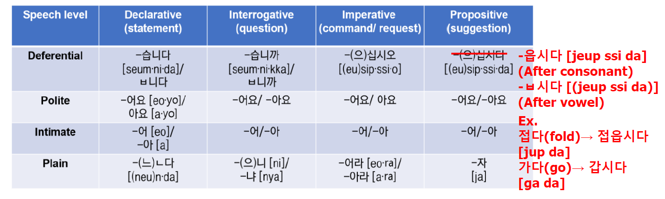
1. Endings -2) final endings
Sentence final endings
: The typical examples of sentence-final endings are various speech-level endings. These speech-level endings indicate the speaker’s interpersonal relationship with the addressees or attitude toward them (e.g., social meanings such as intimacy and formality of the situation).
Notes:
Korean has six speech levels, but in this course we will learn four speech levels as shown below.
The deferential speech level is the highest among the four, followed by the polite speech level and so on. In addition, each speech level has four endings that indicate the type of sentence: declarative (statement), interrogative (question), imperative (command/request), and propositive (suggestion).
Let us apply four of the endings above to the verb stem 먹[muk] “eat.” When saying “(someone) eats,” one needs to use one of the four interrogative endings (-습니까, -어요, -어, and -냐).
Exercise

Slide 16
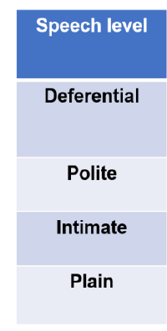
1. Endings -2) final endings
: presentation, official meeting, to customers
Situation examples
*말 놓을까요? [mal noh-eul·kka·yo]
*말 편하게 하세요. [mal pyeon·ha·gae ha·se·yo]
: presentation, official meeting, to customers
: official conversation, to someone older than you, to someone new
: to someone close, when you got permission from someone older
: to someone younger
Notes:
Korean has six speech levels, but in this course we will learn four speech levels as shown below.
The deferential speech level is the highest among the four, followed by the polite speech level and so on. In addition, each speech level has four endings that indicate the type of sentence: declarative (statement), interrogative (question), imperative (command/request), and propositive (suggestion).

Slide 17
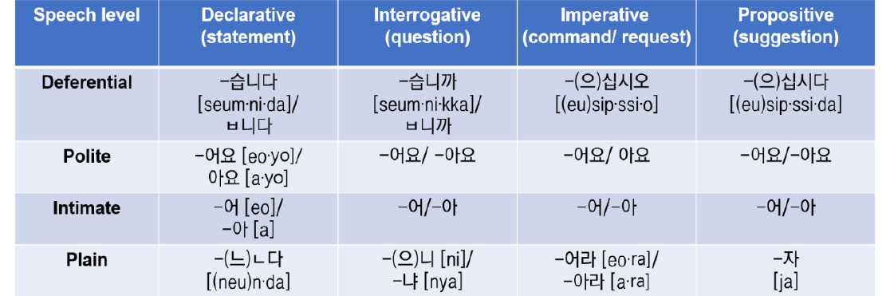
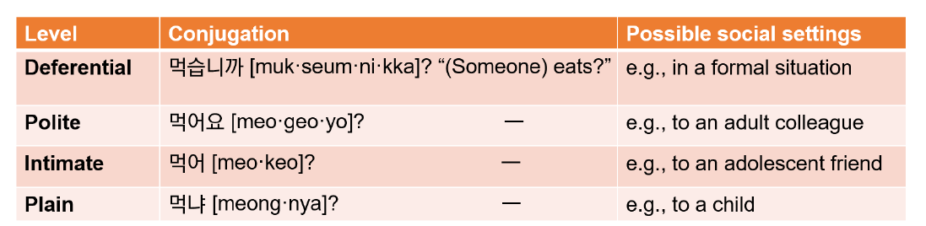
1. Endings -2) final endings
: presentation, official meeting, to customers
Applying four of the endings above to the verb stem 먹[muk] “eat”
- Interrogative(question)
Notes:
Korean has six speech levels, but in this course we will learn four speech levels as shown below.
The deferential speech level is the highest among the four, followed by the polite speech level and so on. In addition, each speech level has four endings that indicate the type of sentence: declarative (statement), interrogative (question), imperative (command/request), and propositive (suggestion).

Slide 18
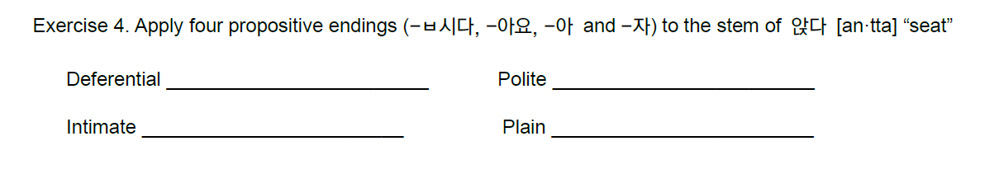
1. Endings -2) final endings
앉읍시다[an·jeup·ssi·da]
앉아요[an·ja·yo]
앉아[an·ja]
앉자[an·jja]
Notes:
Deferential: 앉읍시다[an·jeup·ssi·da]
Polite: 앉아요[an·ja·yo]
Intimate: 앉아[an·ja]
Plain: 앉자[an·jja]

Slide 19
Today’s word
점심[Jeom·sim] n. launch
잠자다[Jam·ja·da] v. sleep
작다[Jak·tta] adj. small
입다[Ip·tta] v. wear
걷다[Geot·tta] v. walk
기쁘다[Gi·ppeu·da] adj. happy
어디[Eo·di] pron. where
음식[eum·sik] n. food
맛있다[ma·sit·tta] adj. delicious
영화[yeong·hwa] n. movie
길[gil] n. road
좁다[jop·tta] adj. narrow
Notes:
우리 레벨 업 됐지? 하고

Slide 20
Today’s word
꼭[kkok] adv. surely
담배[dam·bae] n. cigarette
끊다[kkeun·ta] v. quite
매일[mae·il] adv. everyday
요가[yo·ga] n. yoga
하다[ha·da] v. do
티브이[ti·be·ui] n. television, telly
커피[keo·pi] n. coffee
마시다[ma·si·da] v. drink
아이스크림[a·i·seu·keu·rim] n. ice-cream

Slide 21
Today’s word - conversation
집[Jip] n. home, house
먹다[Muk·tta] v. eat
가다[Ga·da] v. go
말고[Mal·go] par. instead of
같이[Ga·chi] par. together
식당[Sik·ttang] n. restaurant
뭐[Mwo] pron. what, something
파스타[Pa·seu·ta]n. pasta
쿠폰[Ku·pon] n. coupon
모으다[Mo·eu·da]v. collect, gather
할인[Ha·rin] n. discount
받다[Bat·tta] v. get, take, receive
~수 있다[Su It·tta] can do
Notes:
Conversation에 나오는 단어들은 앞으로 순서 바꿔서 고치깅. 그리고 여기서 부터는 컨버세이션에 나오는 단어들이니까 이따 확인한다~ 멋드러진당…

Slide 22
Today’s word - conversation
주문하다[ju·mun·ha·da] v. order
스테이크[seu·te·i·keu] n. steak
시키다[si·ki·da] v. make, get, order
그래[geu·rae] yes, okay
버섯[beo·seot] n. mushroom
어떻다[eo·tteo·ta] adj. be how
총[chong] pren. total
개[gae] n. piece, unit
~하는김에[ha·neun gi·me] while you’re at it
새우[sae·u] n. shrimp
샐러드[sael·reo·deu] n. salad
알레르기[al·re·reu·gi] n. allergic

Slide 23
Today’s conversation
서연: 어디가?
[Eo·di ga?]
민준: 집에 밥 먹으러 가.
[Ji·be bab meo·geu·reo ga.]
서연: 밥 먹으러 집에 가지 말고 나랑같이 식당 가자.
[Bab meo·geu·reo ji·be ga·ji mal·go na·rang ga·chi sik·ttang ga ja.]
민준: 뭐 먹게?
[Mwo meok·kke?]
서연: 파스타. 나 쿠폰 모아서 할인 받을 수 있어.
[Pa·seu·ta. Na ku·pon mo·a·seo ha·rin ba·deul su i·sseo.]
민준: 그래 좋아.
[ Geu·rae jo·a. ]

Slide 24
Today’s conversation
종업원: 주문하시겠어요? [ju·mun·ha·si·ge·sseo·yo?]
서연: 네. 파스타랑 스테이크 주문할게요.
[ne. pa·seu·ta·rang seu·te·i·keu ju·mun·hal·kke·yo.]
민준: 시키는 김에 새우 샐러드도 같이 시키자.
[ si·ki·neun gi·me sae·u sael·reo·deu·do ga·chi si·ki·ja?]
서연: 나 새우 알레르기 있어서 못 먹어.
[na sae·u al·re·reu·gi i·sseo·seo mot meo·geo.]
민준: 그래? 그럼 버섯 샐러드는 어때?
[geu·rae? geu·reom beo·seot sael·reo·deu·nun eo·ttae?]
서연: 좋아. 그러면 샐러드까지 총 세 개 시킬게요.
[jo·a. geu·reo·myeon sael·reo·deu·kka·ji chong se gae si·kil·kke·yo. ]
종업원: 네 알겠습니다. [ne. al·ket·sseum·ni·da.]

Slide 25
Korean Culture

Slide 26
Korean culture-Dating culture
5. https://www.youtube.com/watch?v=wr7UtYDG7Jo
Koreans go on blind dates a lot. After a blind date, they usually in a relationship after meeting 4-5 times
If a stranger approaches you suddenly, they will be wary
It’s quite rude to date someone else when you’re meeting one person and also not good to go club when you are in a relationship
Because they prefer clear relations, they need clear words when starting a relationship
From the day they started dating, they start counting, and 100unit days are important days for couples. ( But couples who date for a long time sometimes skip them)
If they eat meal together, after it’s essential to go to a cafe or to a wine bar or pub
Couple items such as couple rings are worn a lot even if they are not serious relationship like getting marriage

Slide 27
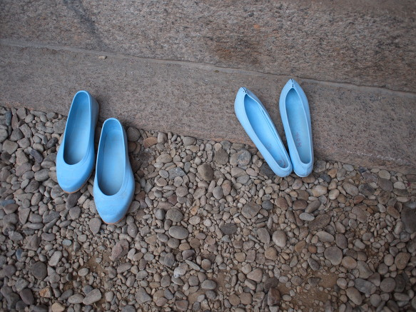
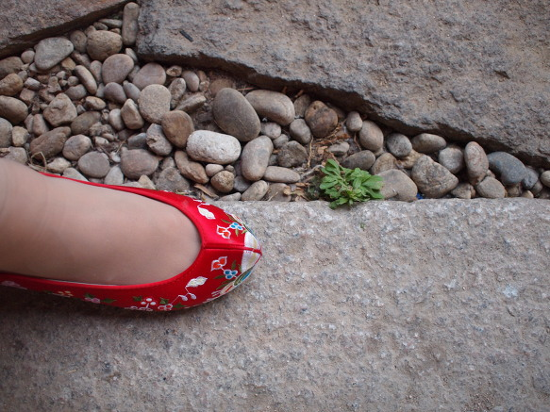
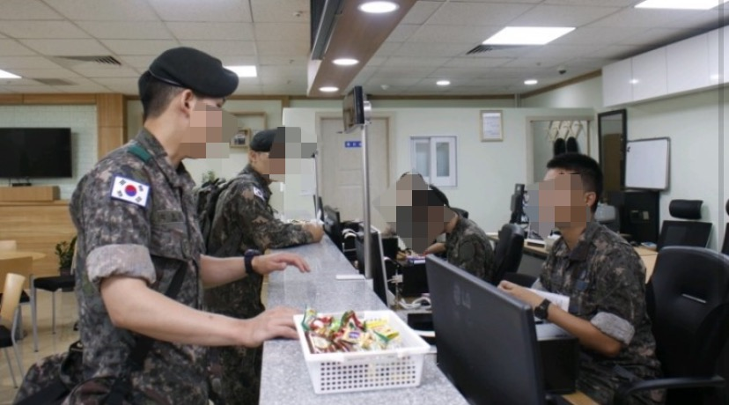
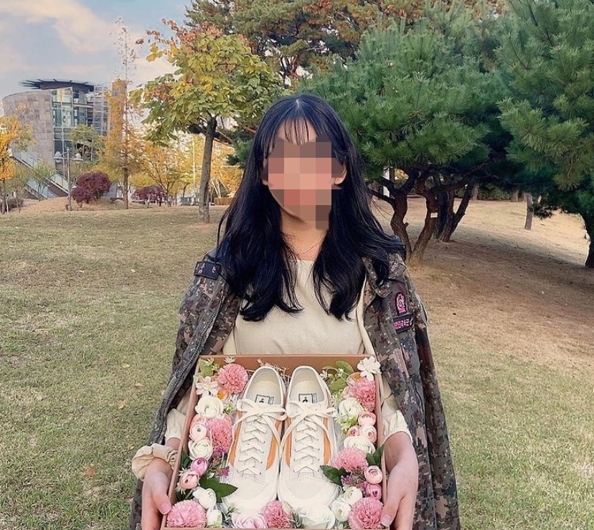
Korean culture-곰신 [gom-sin] / 꽃신 [kkot-sin]
5. https://www.youtube.com/watch?v=wr7UtYDG7Jo
3. Military
Korea is a divided country.
Most men in South Korea have to go to the military after when they turn 18. Have to spend 18 months in the military
곰신 [ gom-sin]
"Gomsin" is a popular phrase on the Internet.
It means shortening rubber shoes, a woman who sent her boyfriend to the military.
Also, “꽃신“[kkot-shin] means that a girl who has been waiting for 18 months and the boyfriend will be discharged from the military
“Wearing flower shoes."

Slide 28
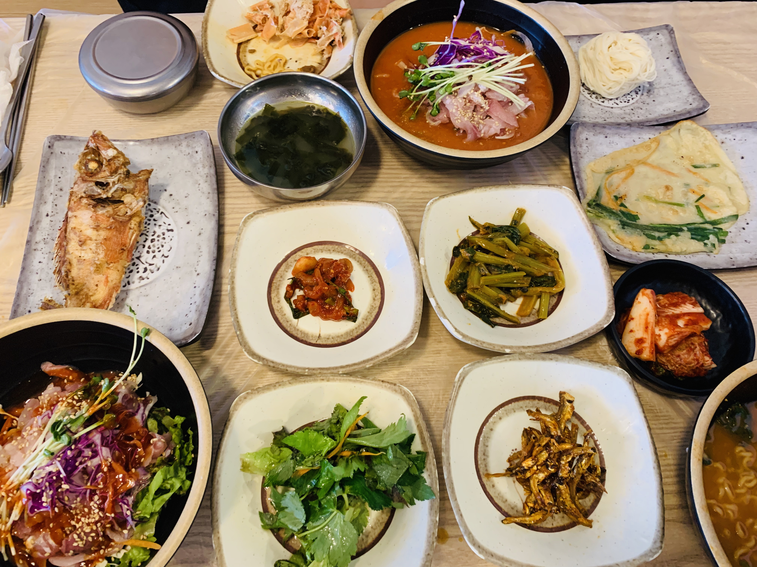
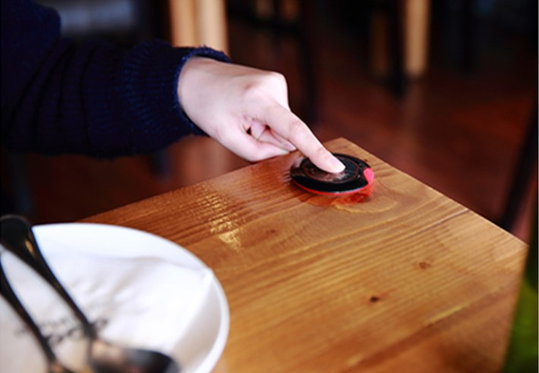
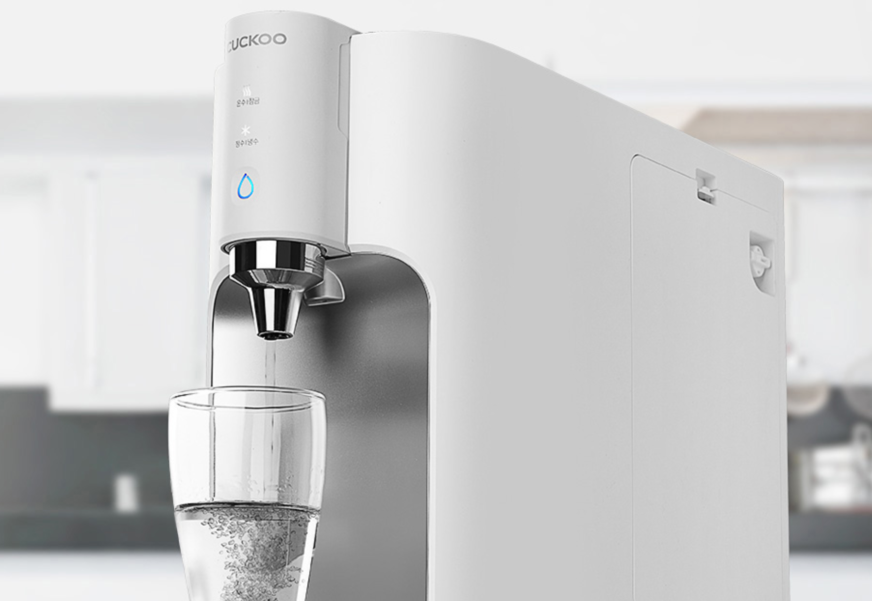
Korean culture-Restaurant
5. https://www.youtube.com/watch?v=wr7UtYDG7Jo
1. You don’t have to order the water (water is for free, also not tap water)
2. When you order, you can call the waiter (you don’t have to wait until they come to your table)
Even, the restaurant has a bell for each tables to call waiters
3. Side dishes can be refilled free of charge in most places
4. You have to go to the counter yourself to pay after eating
(The waiter won’t come to your seat)
5. They don't clean up the plates until customers finish eating and leave
6. You don’t have to pay the tip for the waiter

Slide 29
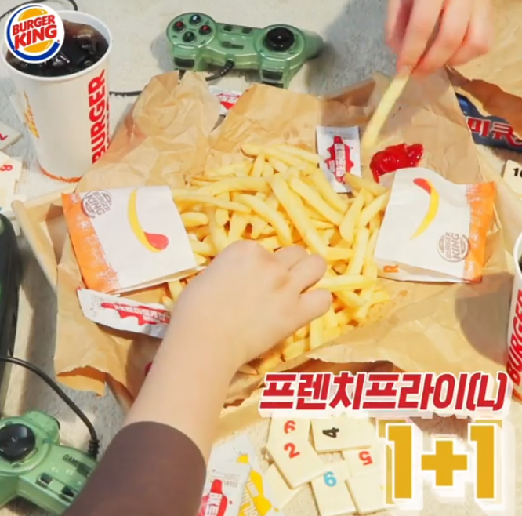
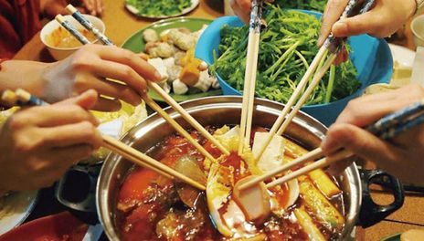
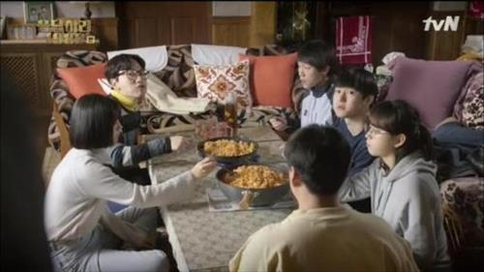
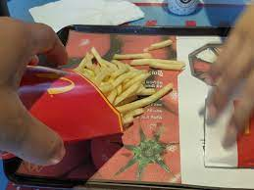
Sharing food
https://www.youtube.com/watch?v=wr7UtYDG7Jo
Most Koreans order food and share them together
So most Korean restaurants give out plates so that each person can share their foods
https://www.youtube.com/watch?v=cT6eknlHGRk

Slide 30
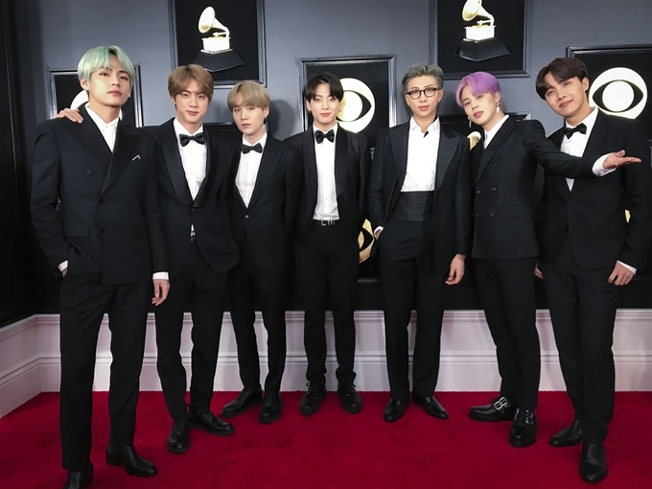
Today’s K-pop
https://www.youtube.com/watch?v=nF1zZIETE5k
BTS - Dynamite
https://www.youtube.com/watch?v=nF1zZIETE5k

