Slide 1
Korean 2 week 7
Yery Kim & Myenghwha Kim

Slide 2
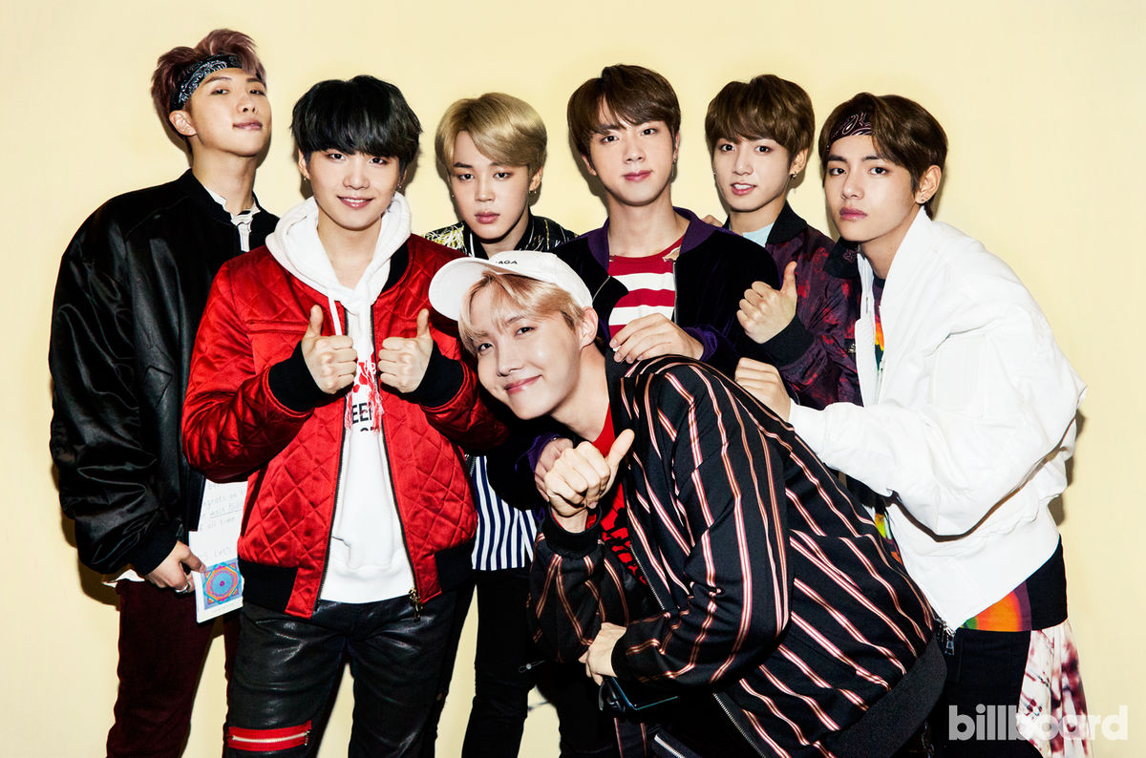
Postpositional Particles
은[eun]
는[neun]s[
이[i]
가[ga]
Topic making particle
Subject making particle
Ending in a
Consonant
Ending in a
Vowel
BTS Butter
2021. 05. 21
21/35p

Slide 3
Topic making particle
은 / 는 [eun/neun]
Introducing yourself
Emphasize predicate ( focus on action)
3. Show the contrast or the opposite
BTS Butter
2021. 05. 21
21/35p

Slide 4
1. Introducing yourself
I’m Yeri
저는 예리에요 [jeo-neun yeri-eyo]
2. I’m a student
저는 학생이에요 [jeo-neun hak-saeng-ieyo]
3. This is my mother
이쪽은 저의(제) 어머니(엄마)예요 [ijjogeun jeoheui eomeoni-yeyo]
Girl 여자 [yeoja]
Boy 남자 [namja]
+ friend 친구 [chin-gu]
BTS Butter
2021. 05. 21
21/35p

Slide 5
2. Emphasize predicate ( focus on action)
예리는 밥을 먹는다 [Yeri-neun bab-eul meog-neun-da]
Yeri eats rice
2. 오늘은 목요일이예요 [oneul-eun mog-yo-il iyeyo]
Today is Thursday
3. 지민이는 잘생겼다 [Jimin-ineun jal-saeng-gyeot-da]
Jimin is handsome
월요일 / 화요일 / 수요일/ 목요일/ 금요일 / 토요일 / 일요일
BTS Butter
2021. 05. 21
21/35p

Slide 6
3. Show the contrast or the opposite
1. Do you like animals?
동물 좋아해요? [dongmul joh-ah haeyo]?
I only like dogs. (= I hate animals but I like dogs.)
강아지는 좋아해요[gang-ah-ji neun joh-a haeyo]
2. Do you like meat?
고기 좋아해요? [go-gi joh-ah hae yo?]
I only like beef (=I hate other meats but I like beef)
소고기는 좋아해요 [ sogogi-neun joh-ah hae yo]
BTS Butter
2021. 05. 21
21/35p

Slide 7
PPT PREESNTATION
Enjoy your stylish business and campus life with BIZCAM
3. 술 좋아해요? [ sul joh-ah hae yo?]
Do you like alcohol?
소주는 좋아하지만 테낄라는 싫어해요 [soju neun joh-ah hajiman tek-kil-la neun silh-eo hae yo]
I like soju but I hate tequila
4. 동유럽 가봤어요? [dong-yuleob ga-bwat-sseo yo?]
Have you been to Eastern Europe?
체코는 가봤지만 슬로바키아는 안가봤어요
[cheko neun gabwat ji man seul-lo-bakia-neun angabwat sseo yo]
I have been to Czech but not to Slovakia
BTS Butter
2021. 05. 21
21/35p

Slide 8
Subject making particle
subject + 이/가
1.Observe or describe something
2. Emphasize the subject
(focus on subject)
이 / 가
BTS Butter
2021. 05. 21
21/35p

Slide 9
1. Observe or describe something
Observe something
1 . The apple is red
사과가 빨갛다 [sa-gwaga ppal-gah-da]
2. There is water
물이 있다 [mul-I it-da]
3. There are seven rooms
방이 일곱개 있다 [ bang-I ilgob-gae it-da]
하나 / 둘 / 셋 / 넷 / 다섯/ 여섯 / 일곱 / 여덟 / 아홉 / 열
BTS Butter
2021. 05. 21
21/35p

Slide 10
PPT PREESNTATION
Enjoy your stylish business and campus life with BIZCAM
Describe something
1. The bag is heavy
가방이 무겁다 [gabang-I mugeob-da]
2. The water is cold
물이 차갑다 [mul-I chagab-da]
3. Yeri is pretty
예리가 예쁘다 [Yeri-ga yep-peu-da]
4. Pig is fat
돼지가 뚱뚱하다 [ dwaeji-ga ttung-ttung ha da]
BTS Butter
2021. 05. 21
21/35p

Slide 11
How to distinguish 은/는 and 이/가
제가 김예리입니다
저는 김예리입니다.
In the sentence of A, the focus is on the subject.
So, the focus of the information (the MOST important information), is SUBJECT ‘제가’
On the other hand, the focus in sentence B is the information in the narrative clause
So, the MOST important information is ‘김예리입니다’
BTS Butter
2021. 05. 21
21/35p

Slide 12
How to distinguish 은/는 and 이/가
A : 야 누가 1 등이래? [ya nuga il-deung-I lae?]
B : 지민이가 1 등이래 [jimin-I ga il-deung I lae]
A : 그러면(그럼) 누가 2 등이래?
[geu-leom nuga I deung I lae?]
B : 지드래곤이 2 등이래
[G-dragon I I deung I lae]
A : 그럼 이제 제니의 등수가 궁금한데?
[geu-leom ije jenny ui deungsu-ga gung-geum-han de?]
B : 제니는 3 등이래
[jenny neun sam-deung I lae]
A: 정국이는 몇 등인데?
[jung gook I neun myeot deung-inde?]
B : 정국이는 꼴등이래
[Jung gook I neun kkol-deung-I lae]
A Hey, who is the number one?
B Jimin is number one
A Then who is second?
B G-dragon is second
A So now I’m curious about Jenny’s rank?
B Jenny is in third place
A How about the rank of Jung-gook?
B Jung gook is the last place
BTS Butter
2021. 05. 21
21/35p

Slide 13
Korean culture
BTS Butter
2021. 05. 21
21/35p

Slide 14
Today’s K-pop
BTS Butter
2021. 05. 21
21/35p

Slide 15
Thank you

