Slide 1
Korean class
Week 1

Slide 2
Index
Introduce
About Korea
About Hangeul
Vowels / Consonants
Today’s K-pop

Slide 3
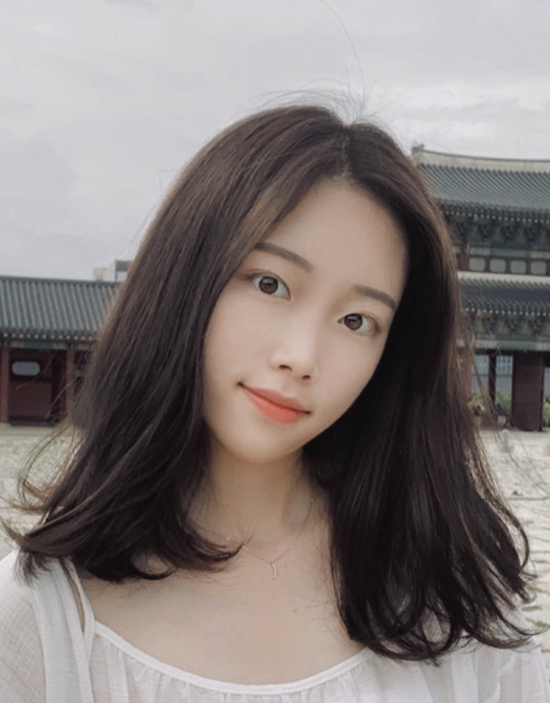
Introduction
Eun ju Chang
Born in Seoul
Student of Jeju National University
Exchange student in Masaryk university
Studying in
Faculty of Economics and Administration

Slide 4
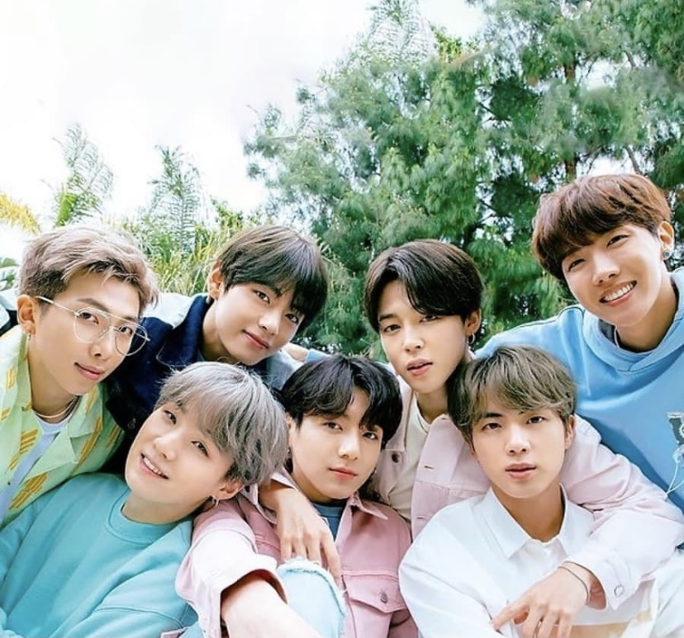
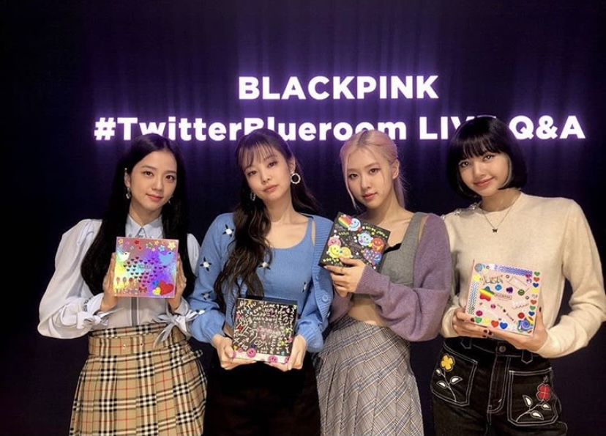
About korea

Slide 5
About korea
Watch video!
https://youtu.be/i0VJq55pIJU

Slide 6
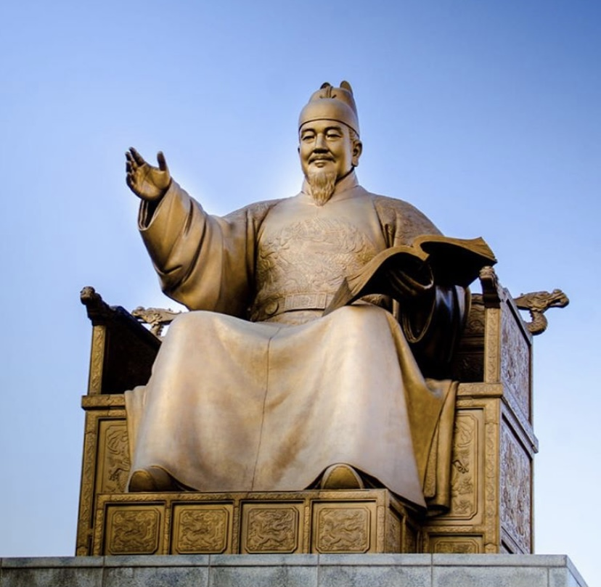
About hangeul
King Sejong created with many scholars
He made it for the whole nation
Cultural heritage

Slide 7
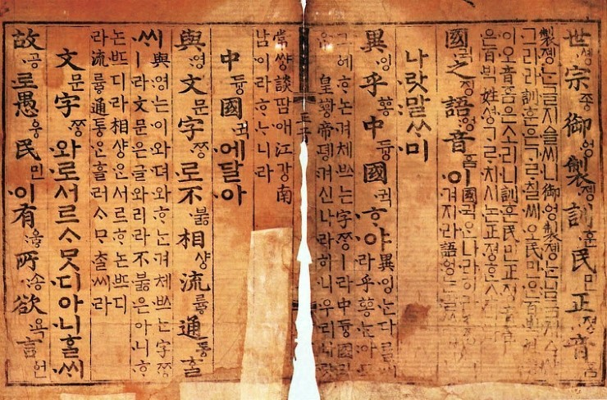
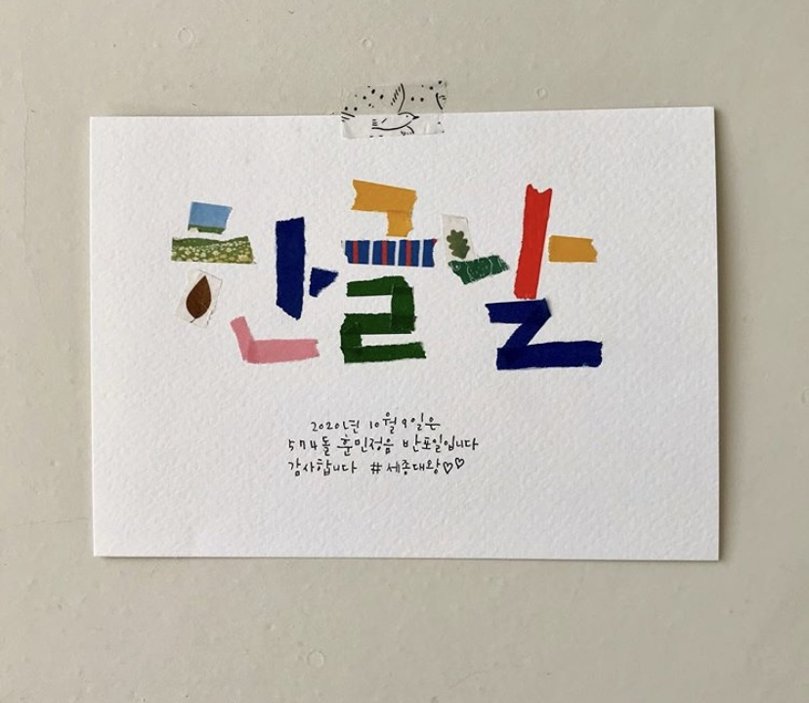
About Hangeul
훈민정음(Hunminjeongeum)
-A book containing the principles of Hangeul
한글날(Hangeul Proclamation Day)
-October 9 every year

Slide 8
About hangeul
Watch video!
https://youtu.be/2aDPpssj0h0

Slide 9
About hangeul

Slide 10
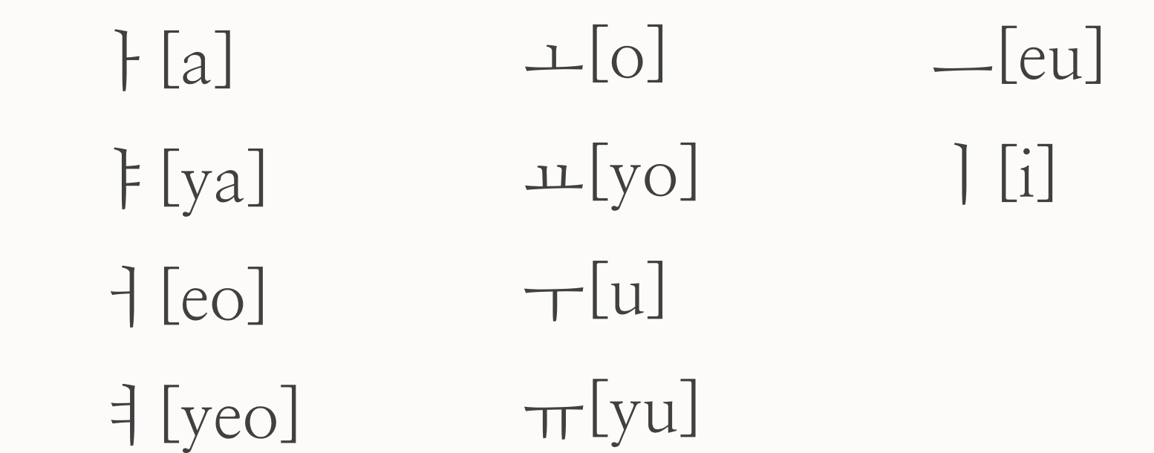
Vowels [모음:mo eum]
Basic vowels

Slide 11
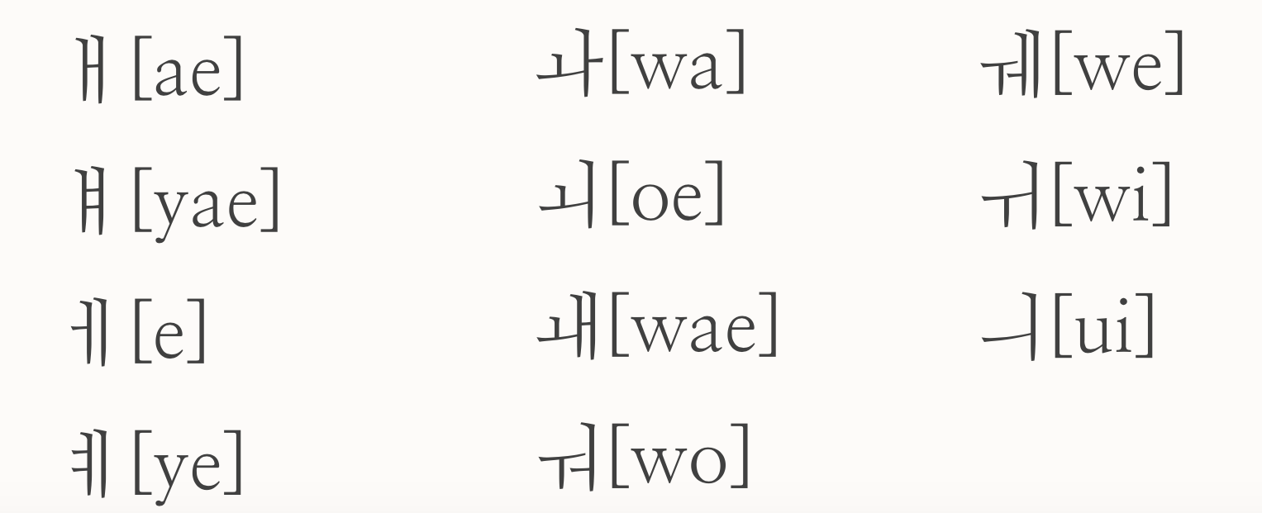
Vowels [모음:mo eum]
Combined Vowels

Slide 12
Combined vowels
ㅐ [ae] =ㅏ+ㅣ ㅘ [wa] =ㅗ+ㅏ ㅞ [we] =ㅜ+ㅔ
ㅒ [yae] =ㅑ+ㅣ ㅚ [oe] =ㅗ+ㅣ ㅟ [wi] =ㅜ+ㅣ
ㅔ [e] = ㅓ+ㅣ ㅙ [wae] =ㅗ+ㅐ ㅢ [ui] =ㅡ+ㅣ
ㅖ [ye] =ㅕ+ㅣ ㅝ [wo] =ㅜ+ㅓ

Slide 13
Consonants [자음:ja eum]

Slide 14
Consonants [자음:ja eum]
Let’s learn how to write and make sounds of consonants

Slide 15
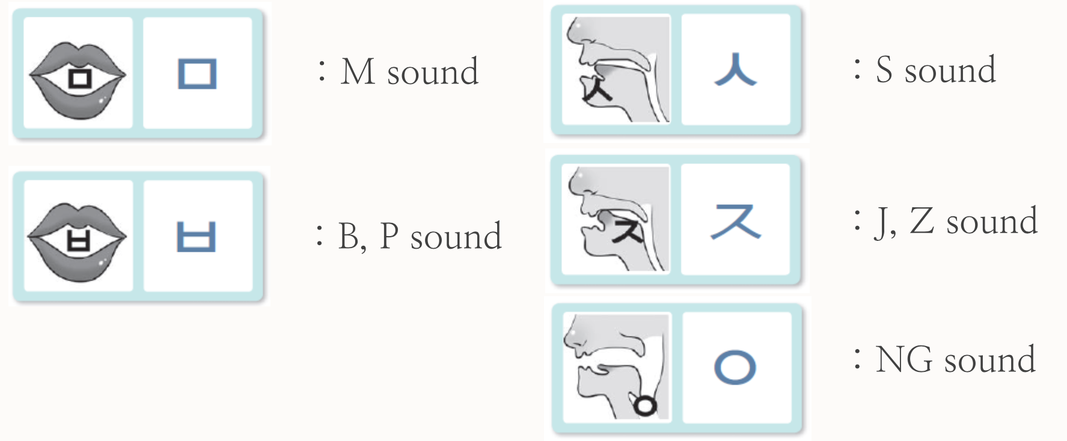
Consonants [자음:ja eum]
Let’s learn how to write and make sounds of consonants

Slide 16
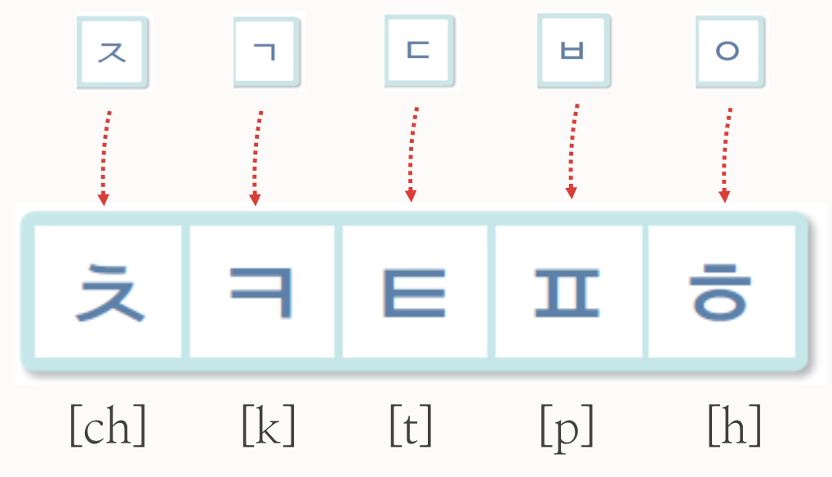
Consonants [자음:ja eum]
Let’s learn how to write and make sounds of consonants
These consonants let out a lor of air when pronounced

Slide 17
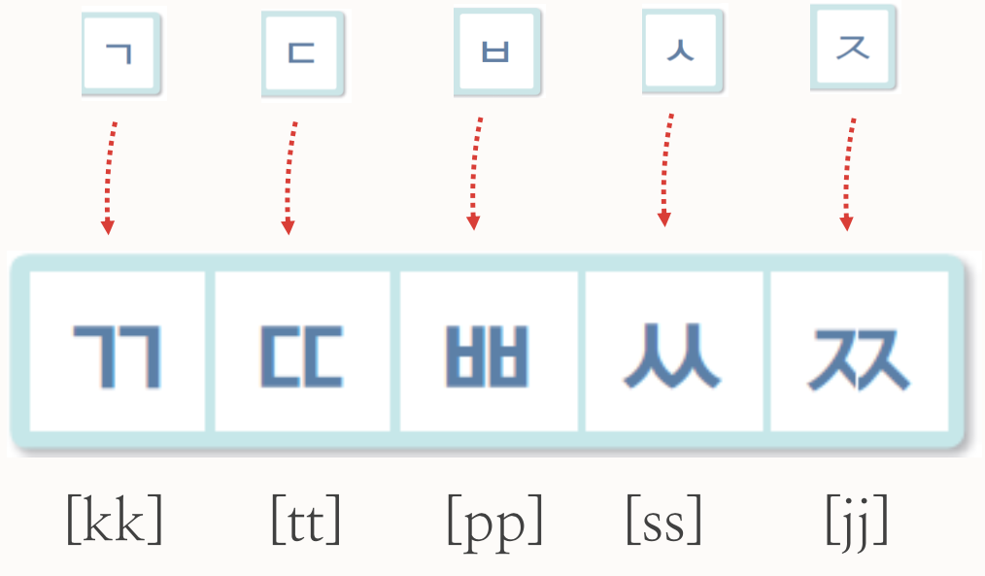
Consonants [자음:ja eum]
Let’s learn how to write and make sounds of 쌍자음 [ssang:jaeum]
These consonants let out no air when pronounced

Slide 18
Today’s k-pop
Let’s watch video!
https://youtu.be/nM0xDI5R50E
BBIBBI - IU

Slide 19
Thank you

