Slide 1
Korean 4 class
week 1
김예리 (YERY KIM)

Slide 2
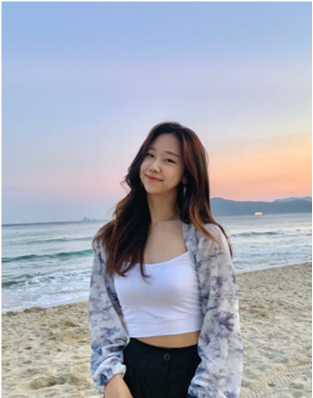
Introduction
Yeri Kim
Born in Seoul, Living in Seoul
Student of Sungshin Women’s University
Exchange student in Masaryk university
Studying in Faculty of Sports

Slide 3
TODAY’S INDEX
1. Stem word
2. Pre-final endings
3. Final endings
5. Past tense
6. Korean culture (texting)
7. Today’s K-pop
Notes:
Korean has a different sentence structure than English, so I'm going to teach you that today

Slide 4
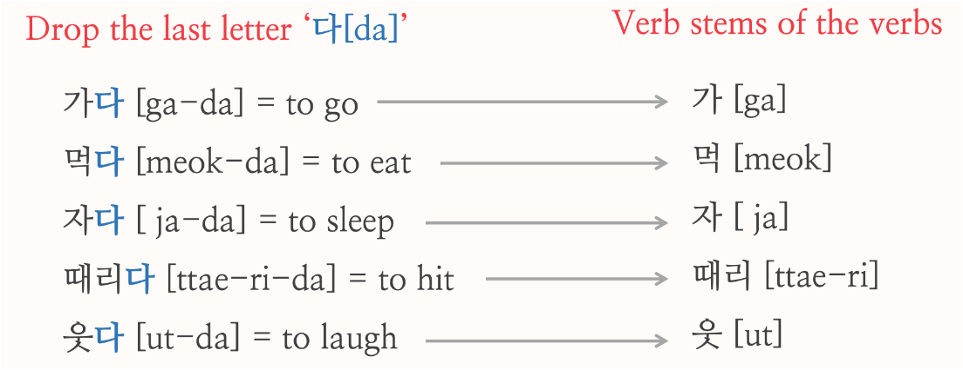
1. Stem word
The stem of verbs and adjectives do not stand alone, and they are always
conjugated by various or inflectional endings.
Generally, Korean verbs and adjectives take a special dictionary form ending ‘-다’.
Consequently, finding the stem of a verb and adjective is simple in that anything being left out after you take ‘다’ out from the verbs and adjectives is the stem

Slide 5
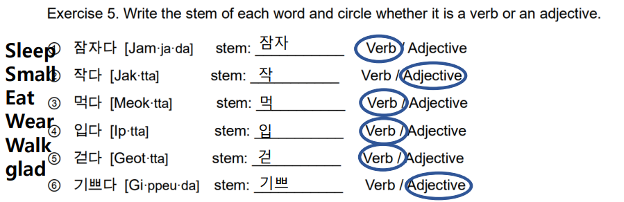
1. Stem word
Verbs and adjectives resemble one another in how they inflect and how they function in the sentence.
There is no obvious structural difference between verbs and adjectives.
In addition, there is no obvious structural difference
• 예쁜(pretty) → 예쁘다
• 큰(big) → 크다
• 작은(small) → 작다

Slide 6
2. pre-final endings
• Pre-final endings are inflectional elements that come between the stem and the final ending
• They include the honorific suffix –(으)시, past tense marker 었/았
①-(으)시 (honorifix suffix)
• It is added after the stem
• after consonant → 으시 ex.찾 으시 다 / after vowel→ 시 ex. 가 시 다
• Ex.입다[wear] → ( ), 누르다[push] → ( )
② 겠 (suffix)
1) It expresses the speaker’s intention of asks the lister’s intention = will
• Ex. 열심히 공부하겠습니다, 어디로 가시겠습니까
• Ex. 지금 가겠습니다 (I will go now), 내일 만나시겠습니까?(Would you like to see me tomorrow?)
2) It indicates the speaker’s conjecture or asks the listener’s idea = I think / guess /do you think that
• Ex. 내일 시험이 어렵겠어요, 내일 비가 오겠어요(I think it will rain.)
• Ex. 어떤 파트를 하시겠어요? (What part would you like to do?)
Notes:
It's similar to last week, but since Korea is a country that uses a lot of polite expressions, we need to learn more in detail, so we put this in class this week
There are two ways to say hi
You can use this expression among your friends
We use this expression politely to those who are older than us
You asked me last week, so I wrote the difference between the two expressions

Slide 7
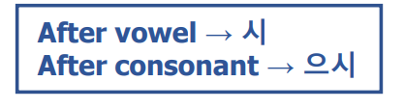
2. pre-final endings
Exercise 1. Which of the following inflectional word using –(으)시 is NOT true?
① 가르치시다 [ga·reu·chi·si·da] “teach”
② 보시다 [bo·si·da] “see”
③ 먹으시다 [meu·geu·si·da] “eat”
④ 건너으시다 [geon·neo·eu·si·da] “cross”
⑤ 있으시다 [i·sseu·si·da] “be”
Notes:
It's similar to last week, but since Korea is a country that uses a lot of polite expressions, we need to learn more in detail, so we put this in class this week
There are two ways to say hi
You can use this expression among your friends
We use this expression politely to those who are older than us
You asked me last week, so I wrote the difference between the two expressions

Slide 8
2. pre-final endings
Exercise 2. Which of the following translation of the Korean sentences is NOT true?
① 음식이 맛있겠습니까? [eum·si·gi ma·sit·kket·sseum·ni·kka] “(Do you think that) the food will delicious?”
② 영화를 보시겠습니까? [yeong·hwa·reul bo·si·get·sseum·ni·kka] “(Do you think that) the movie will be fun?”
③ 길이 좁겠어요? [gi·ri jop·kke·sseo·yo] “(Do you think that) the road will be narrow?”
④ 꼭 담배를 끊겠습니다. [kkok dam·be·reul kkeun·ket·sseum·ni·da] “Surely, (I) will quit smoking.”
⑤ 매일 요가를 하겠습니다. [mae·il yo·ga·reul ha·get·sseum·ni·da] “(I) will do yoga everyday.”
Would you like to see a movie? =영화가 재밌겠습니까?

Slide 9
3. Final endings
• There are two types of final endings
• One that ends a verb or and adjective but not the sentence (non-sentence-final endings)
• One ends both the verb and the sentence (sentence-final endings)
1) Non-sentence-final endings
• Non-sentence-final endings include various clausal conjunctives
• 고 = and then ex. 먹고 마시고 (eat and then drink)
• 어/아서 = because ex.나는 아파서 갈 수 없다. (I can't go because I'm sick.)
• (하)면서[ha myen su]= while ex. 커피를 마시면서 책을 봐요. (Reading a book while drinking coffee.)
• 비록 ~일지라도 [bi rok ~il ji ra do]= although ex. 비록 피곤할지라도 공부를 해야 돼.
(Although I’m tired, I have to study.)
• 위하여 [we ha yeu]= in order to ex. 좋은 성적을 받기 위하여 공부해야 한다. (You have to study in order to get a good grade.)

Slide 10
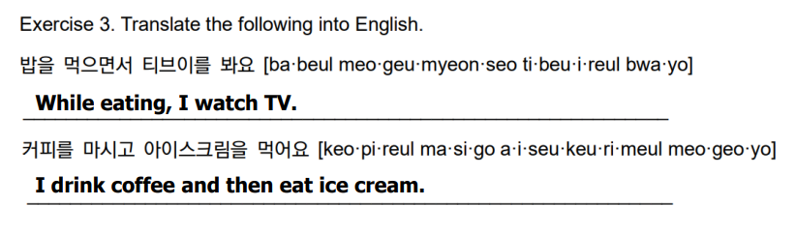

3. Final endings
좋은 대학교에 가기 위해서는 열심히 공부해야 합니다.
I have to study hard to get into a good university.
나는 부자가 되고 싶어서 열심히 일한다.
I worK hard because I want to be rich.
Notes:
It's similar to last week, but since Korea is a country that uses a lot of polite expressions, we need to learn more in detail, so we put this in class this week
There are two ways to say hi
You can use this expression among your friends
We use this expression politely to those who are older than us
You asked me last week, so I wrote the difference between the two expressions

Slide 11
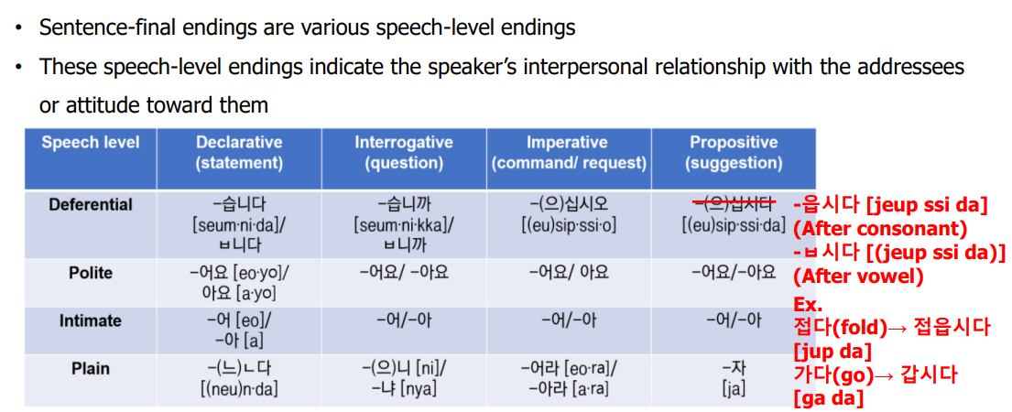
3. Final endings
2)sentence-final endings

Slide 12
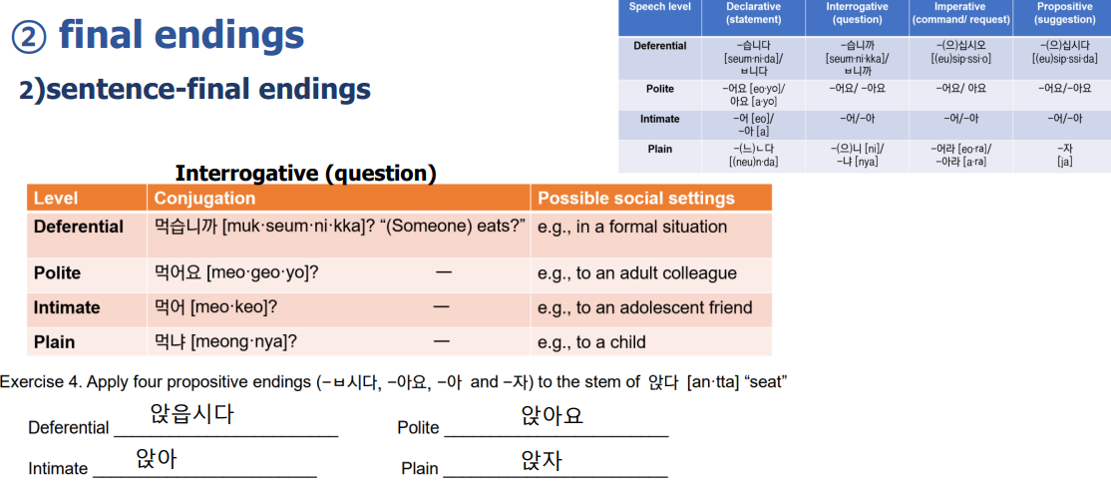
3. Final endings
Notes:
It's similar to last week, but since Korea is a country that uses a lot of polite expressions, we need to learn more in detail, so we put this in class this week
There are two ways to say hi
You can use this expression among your friends
We use this expression politely to those who are older than us
You asked me last week, so I wrote the difference between the two expressions

Slide 13
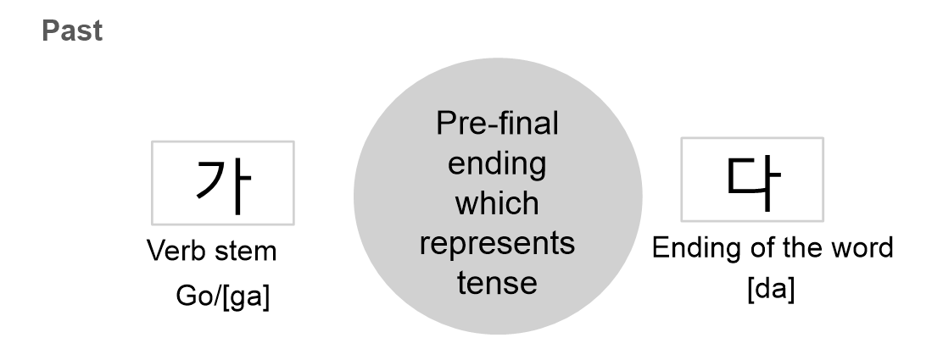
4. Past tense marker 었, 았
Notes:
It's similar to last week, but since Korea is a country that uses a lot of polite expressions, we need to learn more in detail, so we put this in class this week
There are two ways to say hi
You can use this expression among your friends
We use this expression politely to those who are older than us
You asked me last week, so I wrote the difference between the two expressions

Slide 14
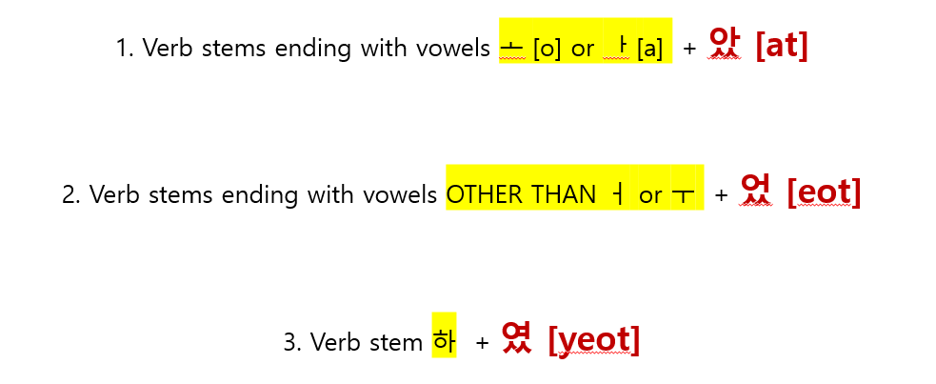
4. Past tense marker 었, 았
e.g. 선생님이 영어를 가르치셨어요
Stem : 가르치 → 치 is not bright vowel → past tense : 었
2. Honorific suffix :시
3. Speech level ending: 어요 (polite)
4. 가르치 + 시었 + 어요
5. 시었 → 셨
=가르치셨어요
-았-[at] / -었-[eot]
ends in a bright vowel
Notes:
It's similar to last week, but since Korea is a country that uses a lot of polite expressions, we need to learn more in detail, so we put this in class this week
There are two ways to say hi
You can use this expression among your friends
We use this expression politely to those who are older than us
You asked me last week, so I wrote the difference between the two expressions

Slide 15
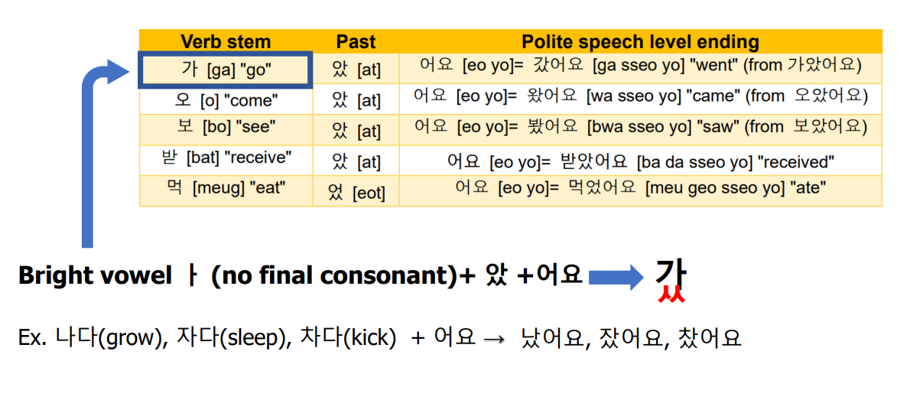
4. Past tense marker 었, 았
Notes:
It's similar to last week, but since Korea is a country that uses a lot of polite expressions, we need to learn more in detail, so we put this in class this week
There are two ways to say hi
You can use this expression among your friends
We use this expression politely to those who are older than us
You asked me last week, so I wrote the difference between the two expressions

Slide 16
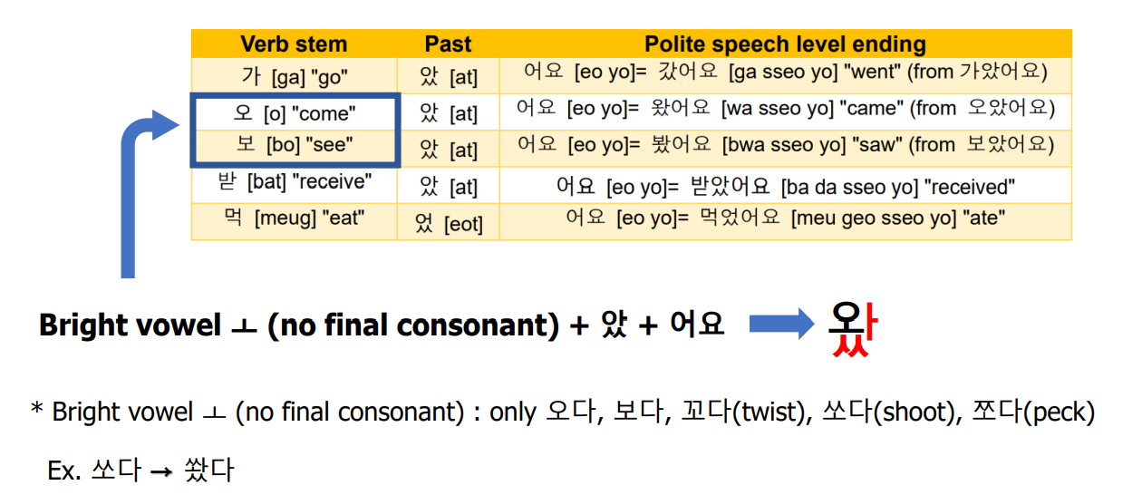
4. Past tense marker 었, 았
Notes:
It's similar to last week, but since Korea is a country that uses a lot of polite expressions, we need to learn more in detail, so we put this in class this week
There are two ways to say hi
You can use this expression among your friends
We use this expression politely to those who are older than us
You asked me last week, so I wrote the difference between the two expressions

Slide 17
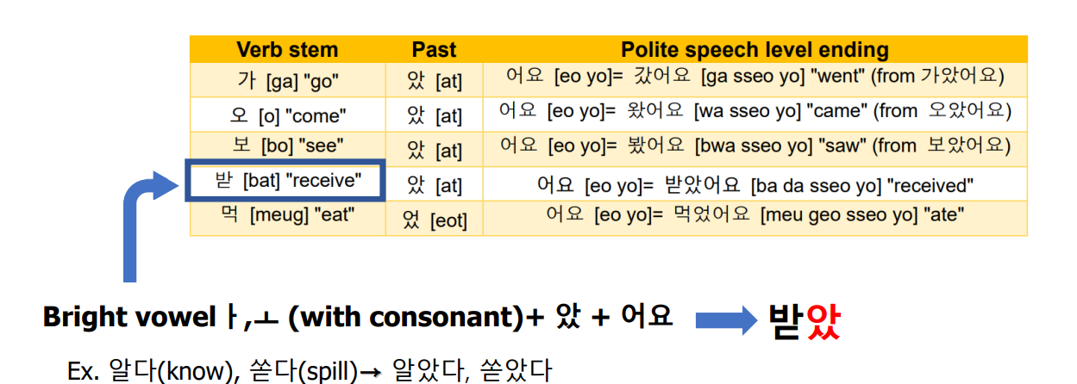
4. Past tense marker 었, 았
Notes:
It's similar to last week, but since Korea is a country that uses a lot of polite expressions, we need to learn more in detail, so we put this in class this week
There are two ways to say hi
You can use this expression among your friends
We use this expression politely to those who are older than us
You asked me last week, so I wrote the difference between the two expressions

Slide 18
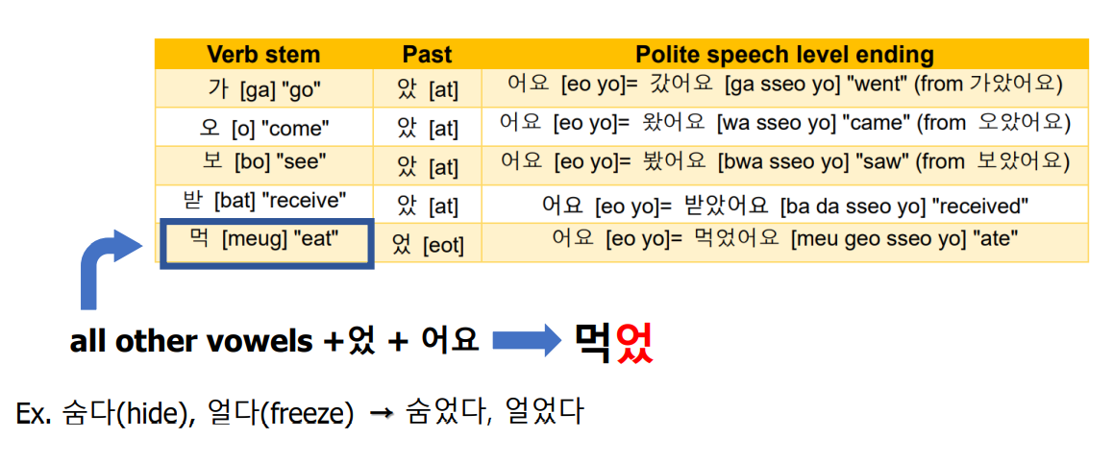
4. Past tense marker 었, 았
Notes:
It's similar to last week, but since Korea is a country that uses a lot of polite expressions, we need to learn more in detail, so we put this in class this week
There are two ways to say hi
You can use this expression among your friends
We use this expression politely to those who are older than us
You asked me last week, so I wrote the difference between the two expressions

Slide 19
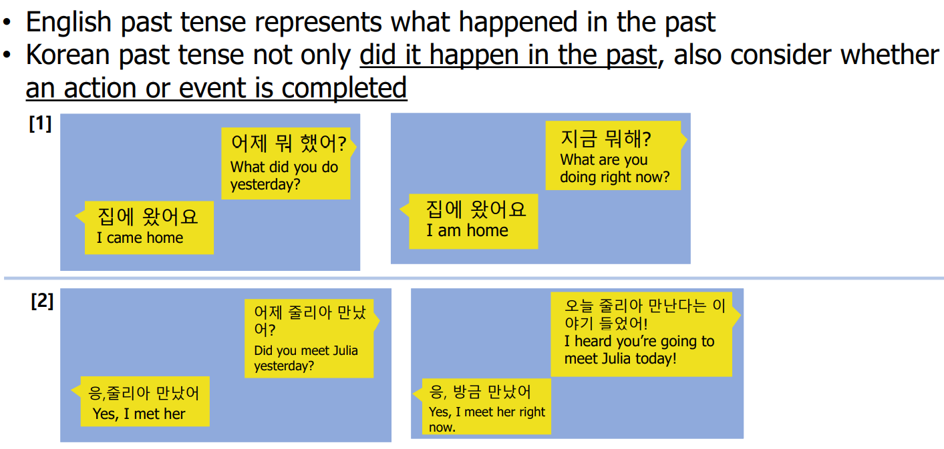
4. Past tense marker 었, 았
Caution
• The conjugation of the verb 하다 “do” is irregular
• 하 is changed to 해
• When it is combined with the past tense marker, as in 했어요 “did”

Slide 20
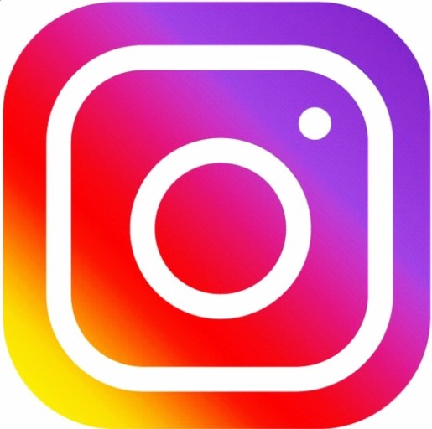




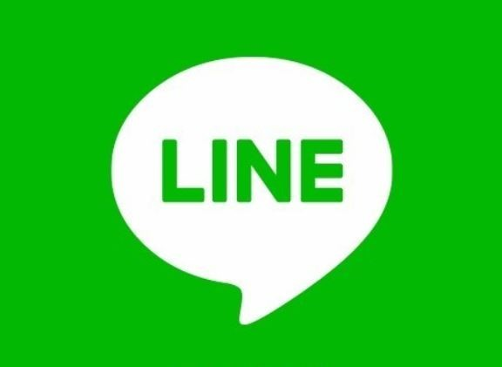
5. Korean culture (texting)
Kakao talk

Slide 21
5. Korean culture (texting)
Using initial consonants
Abbreviation/
Daily words
ㅋㅋㅋㅋㅋㅋ
ㅎㅎ
ㄱㅅ
ㅇㅇ
ㅎㅇ
ㅃㅃ
ㅊㅋㅊㅋ
ㅇㅋ
TMI
TMT
심쿵
노잼
대박
소확행
갑분싸
Notes:
현타
띵작
별다줄
사바사/케바케
JMT
어그로
인싸/아싸
이거레알
ㅇㄱㄹㅇ
안물안궁
베프
핵인싸
댕댕이
낄끼빠빠
꾸안꾸
졌잘싸

Slide 22
5. Korean culture (texting)
Using initial consonants
Describe Laughing sound
ㅋㅋ/ㅎㅎ
Number of consonants makes different nuance
1 consonant : ㅋ/ㅎ ⇒ feel like laugh at someone
2 consonants : ㅋㅋ ⇒ not really funny, mechanical and formal reactions / ㅎㅎ ⇒ more casual reaction than ㅋㅋ
3 or more consonants : ㅋㅋㅋㅋㅋㅋㅋ / ㅎㅎㅎㅎㅎㅎ ⇒ really funny and happy
Notes:
현타
띵작
별다줄
사바사/케바케
JMT
어그로
인싸/아싸
이거레알
ㅇㄱㄹㅇ
안물안궁
베프
핵인싸
댕댕이
낄끼빠빠
꾸안꾸
졌잘싸

Slide 23
5. Korean culture (texting)
Using initial consonants
Text just word’s initial consonants
ㄱㅅ : 감사 [gam-sa] (Thank you)
ㅇㅇ : 응응 [eung-eung] (Yes, Yes)
ㅎㅇ : 하이 [Ha-i] (Hi)
ㅃㅇㅃㅇ/ㅃㅃ : 빠이빠이 [bba-i-bba-i] / 빠이 [bba-i] (Bye)
ㅊㅋ : 추카 [chu-ka] (Congratulation)
ㅇㅋ : 오키 [o-ki] (Okay)
ㅇㄱㄹㅇ : 이거레알 [i-geo-re-al] (This is ture! Real!)
Notes:
현타
띵작
별다줄
사바사/케바케
JMT
어그로
인싸/아싸
이거레알
ㅇㄱㄹㅇ
안물안궁
베프
핵인싸
댕댕이
낄끼빠빠
꾸안꾸
졌잘싸

Slide 24
5. Korean culture (texting)
Abbreviation/ Daily words
대박 [dae-bak] (Great! Amazing!)
TMI : too much information
TMT : too much talker
노잼 [no-jaem] : 재미없다 (not funny, boring)
심쿵 [shim-kung] : 심장이 쿵하고 내려앉다 (surprised or excited enough to make heart drop)
맥날 [maek-nal] : 맥도날드(Mcdonald’s)
Notes:
현타
띵작
별다줄
사바사/케바케
JMT
어그로
인싸/아싸
이거레알
ㅇㄱㄹㅇ
안물안궁
베프
핵인싸
댕댕이
낄끼빠빠
꾸안꾸
졌잘싸

Slide 25
5. Korean culture (texting)
Abbreviation/ Daily words
사바사 [sa-ba-sa] : 사람 바이(by) 사람 (person by person)
케바케 [ke-ba-ke] : 케이스 바이 케이스 (case by case)
핵 [haek] (prefix means “very”, “really”)
인싸 [in-ssa] : 인싸이더 (Insider)
아싸 [a-ssa] : 아웃싸이더 (Outsider)
베프 [be-peu] : 베스트프렌드 (best friend)
현타 [hyun-ta] : 현실 자각 타임(time)
핵 [haek] + 인싸 [in-ssa]
= 핵인싸
Notes:
Insider person who actively participates in various events and gatherings and gets along well with people
Outsider A person who can't mix well with
A person who gets along really, very well with peoplethe group.
It's time to realize the real situation that you're facing after falling into vain dreams or delusions

Slide 26
5. Korean culture (texting)
Abbreviation/ Daily words
소확행 [so-hwak-haeng] : 소소하지만 확실한 행복 (Small but definite happiness)
갑분싸 [gap-bun-ssa] : 갑자기 분위기 싸해진다 (The mood is suddenly getting cold)
졌잘싸 [jyeot-jal-ssa] : 졌지만 잘 싸웠다(We lost but we fought well)
별다줄 [byeol-da-jul] : 별걸 다 줄인다(You shorten everything)

Slide 27
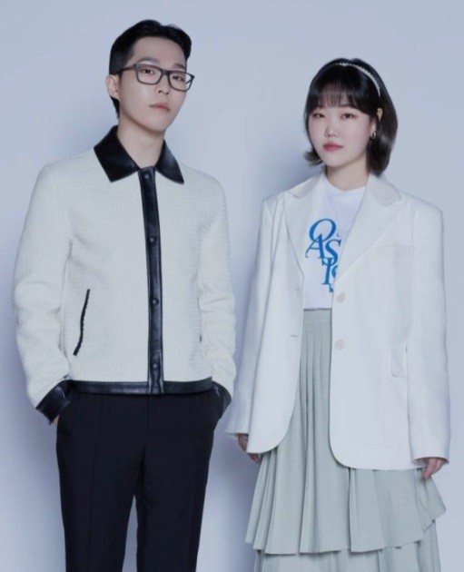

6. Today’s K-pop
AKMU(악동뮤지션)
“Dinosaur”
https://youtu.be/s_Pil-lMgZk

Slide 28
Thank you for listening
감사합니다 :)
김예리 (YERY KIM)

